Slide 1
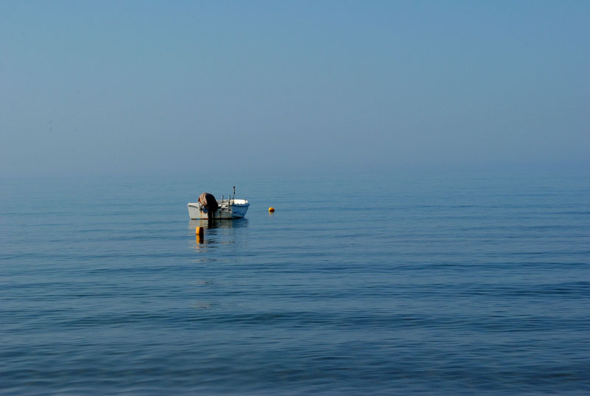


WG5 Verification and
Case studies
Overview of activities
Flora Gofa
WG5 review, 26th COSMO General Meeting, Offenbach, 04.09.2024
Notes:
Last time this name and sympilis st lrsdt two botd tom

Slide 2

SOFTWARE
NWP
Test suite
Methods - HIW
PP / PT
Collaborations
COMMON
Verification
WG5 review, 26th COSMO General Meeting, Offenbach, 04.09.2024

Slide 3

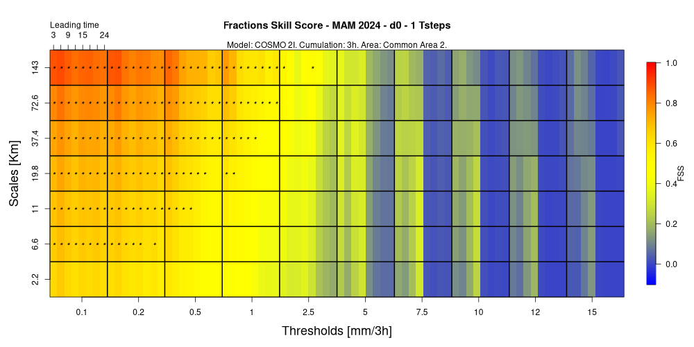
VAST 3.0 Naima Vela, Arpa Piemonte, Torino, Italy
VAST 3.0 (Versus Additional Statistical Techniques) is a software package composed by Bash, Fortran 90 and R scripts to verify the dichotomic parameters of the ICON-LAM according to a multi intensity and multi scale spatial verification approach.
Categorical scores can be calculated through different upscaling approaches (normal upscale, yes/no, minimum coverage, fuzzy logic, etc.).
Non categorical scores are also included (FSS, BSS and ETSr).
INPUT: GRIB files (forecast and observation)
OUTPUT: heatmap plots
The grib files are elaborated using CDO functions
(https://code.mpimet.mpg.de/projects/cdo/wiki/Cdo#Documentation)
The ECMWF package “grib_api” or “ecCodes” is needed by the user to elaborate the grib files
(https://www.ecmwf.int/en/elibrary/80529-grib-api , https://confluence.ecmwf.int/display/ECC )
Part of the fuzzy elaboration is run through Fortran 90 scripts compiled using the gfortran compiler
(https://gcc.gnu.org/onlinedocs/gfortran/)
The plots are created by VAST using R
(https://www.r-project.org/) A version 3.0 or higher is required.
September the 2nd 2024 - 26th COSMO General Meeting - Offenbach
Notes:
Important to have versitile, and well documented software for members and licensees

Slide 4

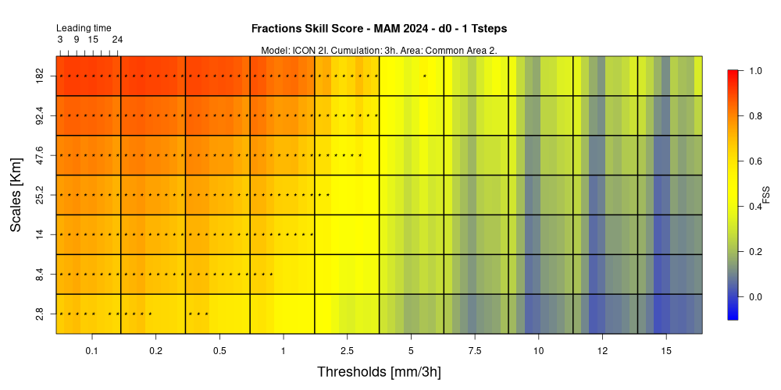

MAKE_FSS_PERIOD_VAST_3_0.SH / 3
OUTPUT:
The script produces the Fractions Skill Score heatmap plots according to the user’s selection
-l LT
September the 2nd 2024 - 26th COSMO General Meeting - Offenbach

Slide 5
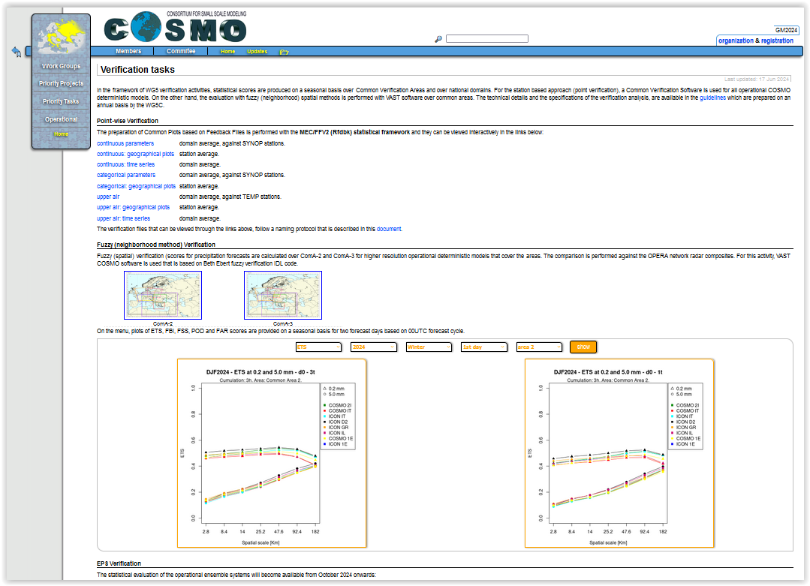

Slide 6
FFV2 Update
Felix Fundel
Avoid scp of results if Shiny-Apps and verification run on same server.
Allow upper and lower threshold in ensemble verification
  e.g. categorical and probabilistic scores for gusts between 10 and 20 m/s
Same Tmin/Tmax observation filter consistent with TD2M and T2M
  z_station – z_modsurf <=150m
  sso_stdh <= 200
Updating bitcheck function (bitcheck2)
  bitcheck allows to filter bit encoded variables (e.g. ‚flags‘ that hold reasons for obs. rejection)
  Any combination of bits can be set for an observation
  Old bitcheck function only checked if a bit is set.
  New function can check if a bit and only this bit is set or not set.
Additional filtering options
  ‚mdlsfc‘ (model surface characteristics)
  ‚level_sig‘ (type of TEMP level)
  ‘veri_model‘ (model name)
  Extension for ocean observations (ARGOS, OSTIA, SMOS)
Revised Documentation
http://www.cosmo-model.org/shiny/users/fdbk/RfdbkVeriDoku.html
Some updates relevant for EPS verification

Slide 7
MEC
Felix Fundel
AI model verification needed
DWD started developing an own AI model (AICON) and reanalysis (DREAM) for training
Verification with in house tool needed
Available AI models (Pangu, GraphCast, AIFS.. run by ECMWF) have reduced output
T, Z, U, V, RH on 13 pressure levels
T2M, U10M, V10M, TD2M, PMSL, (TOT_PREC)
0.25° ERA5 grid
MEC adaptations
Needed to cope with fewer levels (linear vertical interpolation to avoid overshooting)
Needed to works with PMSL and PS
But still uses lowest model level for FF10M, renders verification on pressure levels useless
MEC developments by Harald Anlauf
Still some MEC work coming up with AICON
MEC needs to work on model levels without HHL
For FF10M verification MEC needs to use surface wind not lowest model level
Notes:
MEC is very demanding in terms of the information that is required from model 3d felds

Slide 8
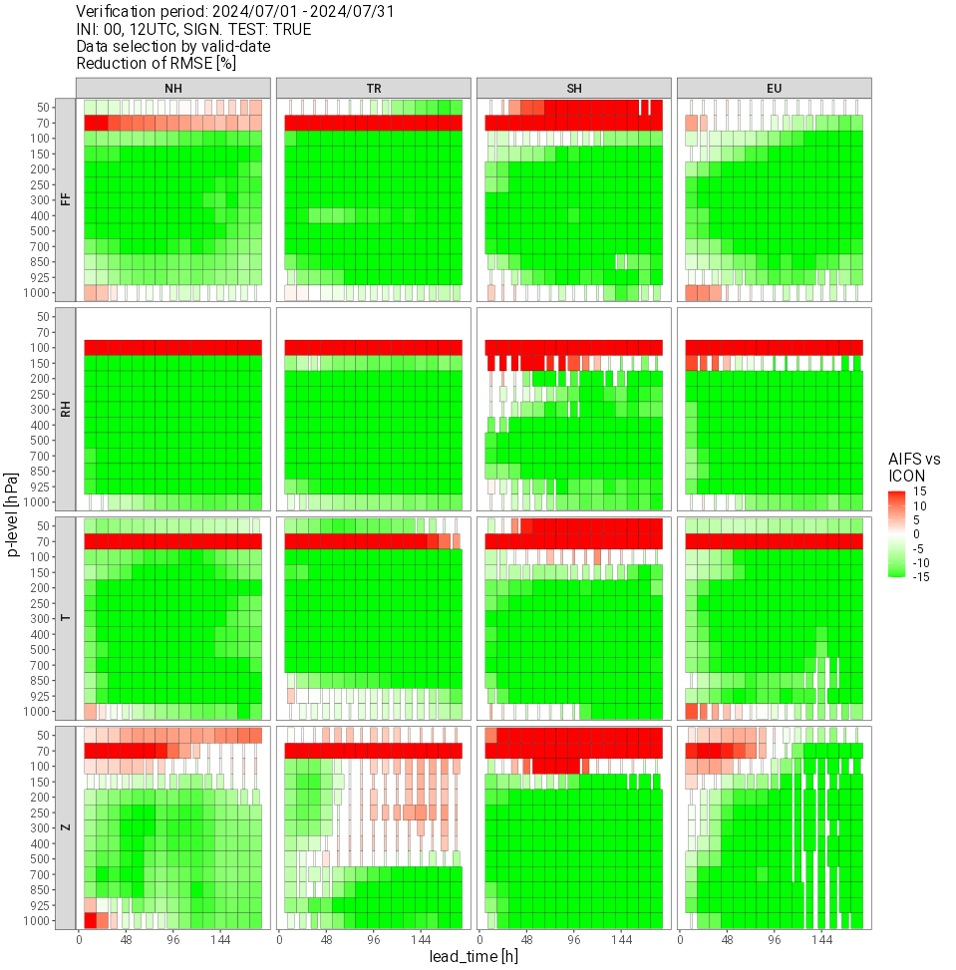
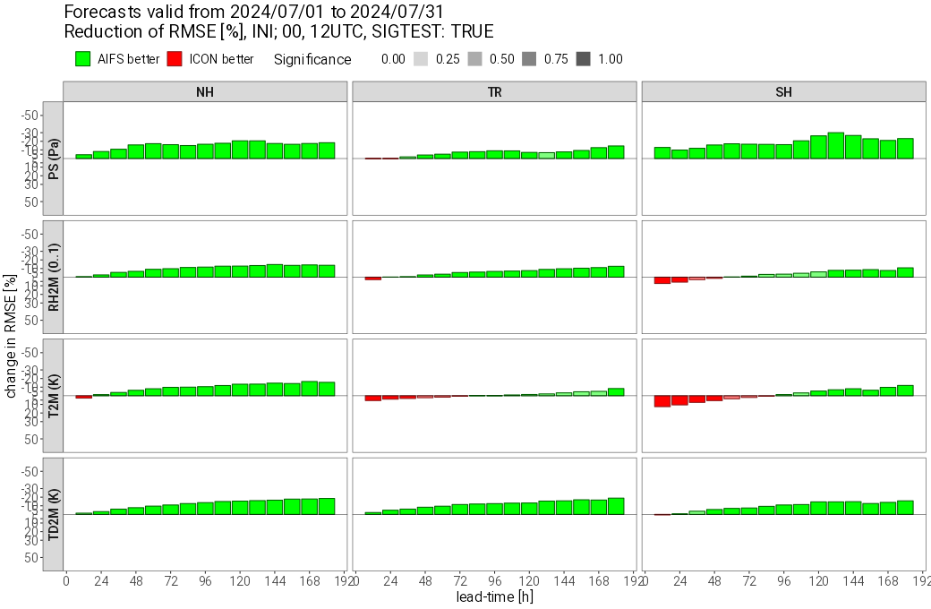
MEC
Felix Fundel
AIFS vs. ICON
AIFS much improved compared to PANGU
Even surface scores are

Slide 9
VerifMethods
HIW
WG5 review, 26th COSMO General Meeting, Offenbach, 04.09.2024

Slide 10
WW from Model Output
Verification of Weather Interpretation (WW) at DWD
Michael Hoff
Why using WW: direct connection to specific weather phenomena, comparable with observed phenomena, easier to interpret than raw model output, helpful for forecaster and warn management
WW calculated hourly at every model grid point via thresholding of relevant parameters (tuning necessary)
ICON, ICON-EU → internally, ICON-D2, RUC → post-processing
WW contains weather of last hour
Sometimes, ww-codes could differ from raw model output (e.g. ww=71 vs SNOW_GSP)
Due to temporal-, spatial-, technical- constrains, not all 99 ww-codes can be calculated
Problems: Model precipitation (e.g. showers) mostly sums of last hour but ww observations instantaneous values leads to inconsistencies and misleading interpretation
Docu (engl. follows): Wetterinterpretation für die Modelle ICON, ICON-EU, ICON-D2 und COSMO-D2 (dwd.de)
Notes:
Up to now only against SYNOP WW data (manned and automats)
Namelist-controlled
Verification of main-categories W (0-3 no significant weather, 4 fog, 5 drizzle, 6 rain, 7 snow, 8 shower, 9 thunderstorm)
Or user-oriented verification of specific WW (e.g. freezing rain, pooling 55, 56, 65 and 66)
But note that synop data, especially automats, are not suitable for some phenomena (e.g. showers or freezing rain)
Shower, Nebel e.g. intstantan

Slide 11
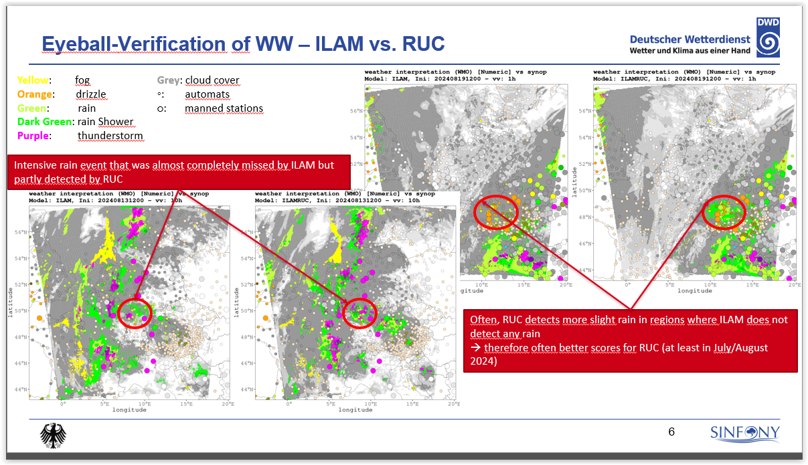
Michael Hoff

Slide 12
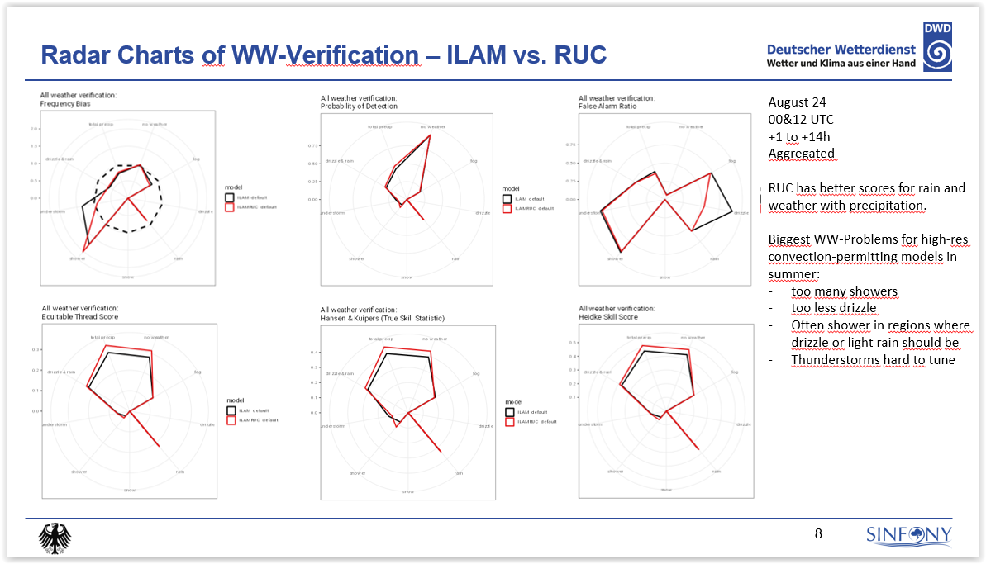
Michael Hoff

Slide 13
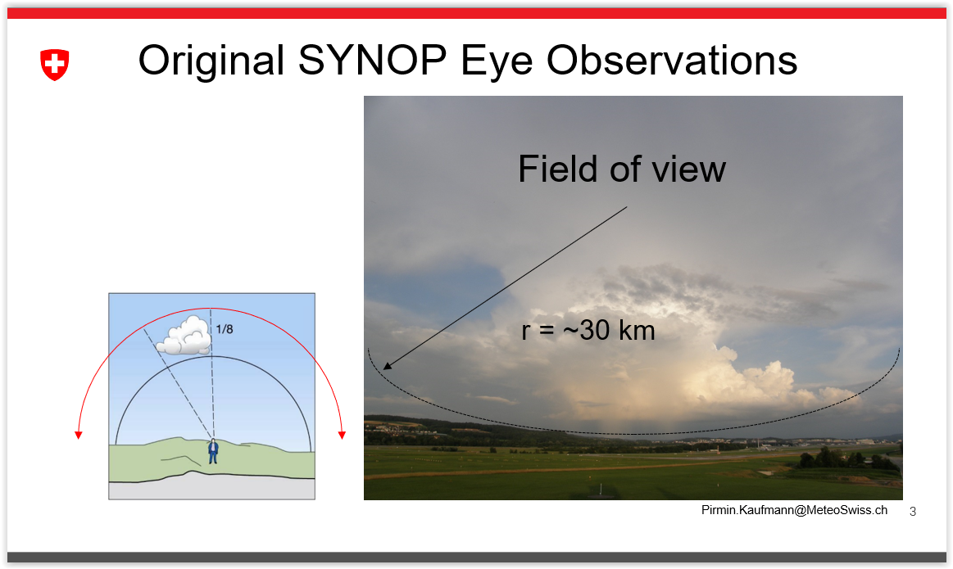
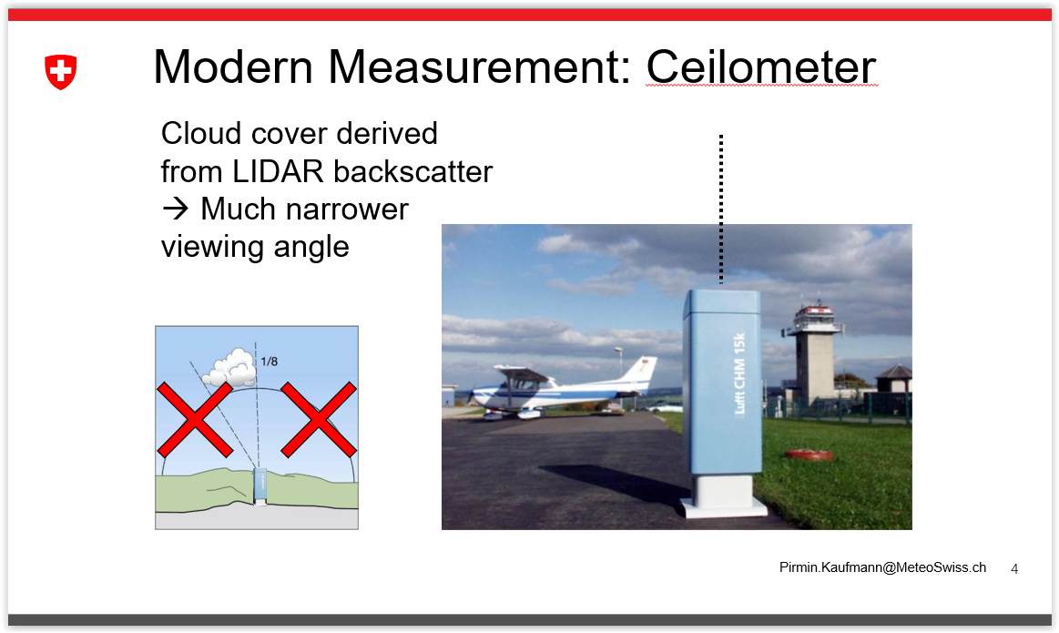
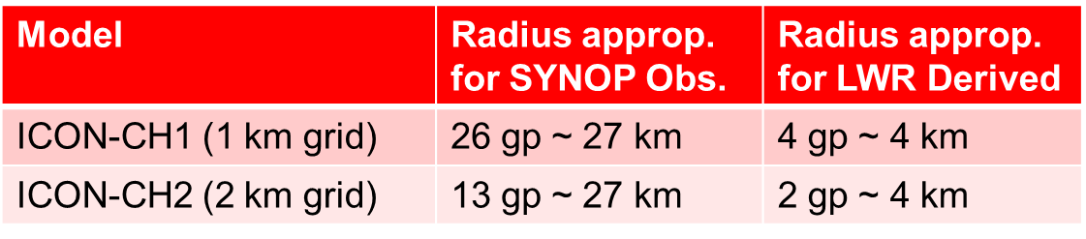
Cloud and Precipitation Verification of ICON-CH Models
Pirmin.Kaufmann@MeteoSwiss.ch

Slide 14
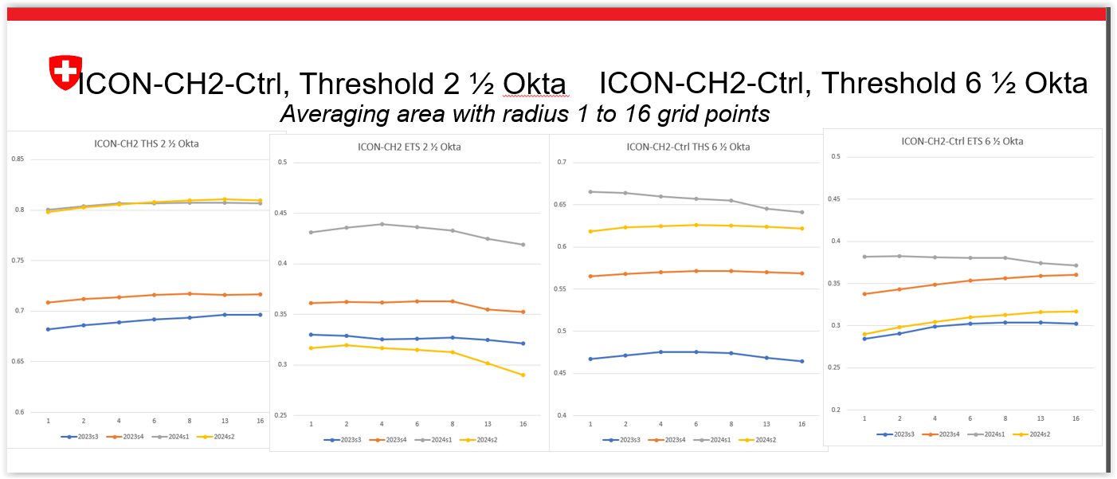
Pirmin.Kaufmann@MeteoSwiss.ch
Threat Score, depends on base frequency
Larger averaging area → higher frequencies of events → higher THS
ETS compensates frequency effect. Better for smaller averaging area (as opposed to THS)
General underestimation of frequency of event
THS depends on base frequency, so on season. Spring, Summer, Autumn, THS is independent of averaging area
ETS in winter is independent of averaging area
optimal radius depends on season

Slide 15
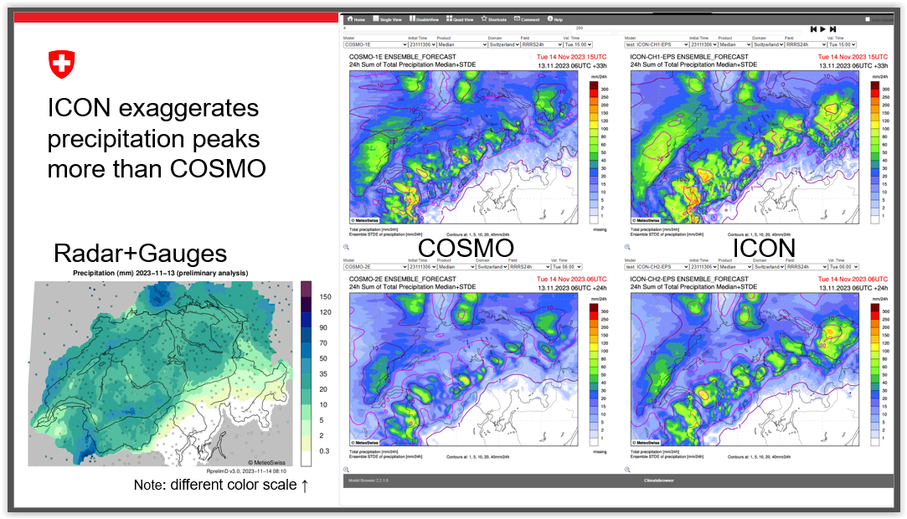

Slide 16
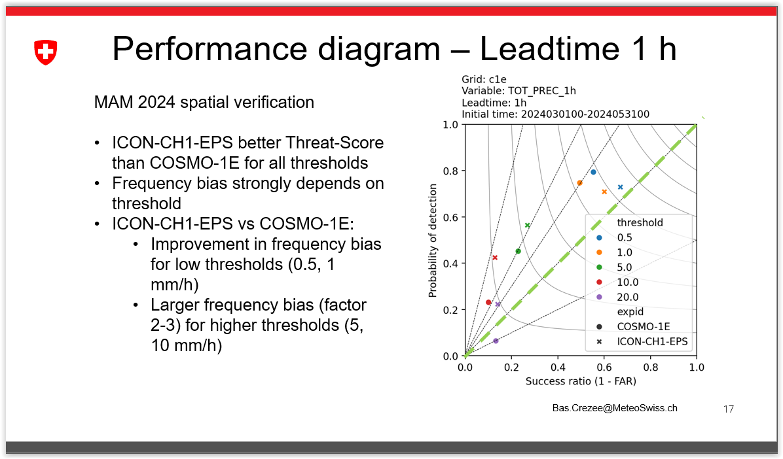

Slide 17
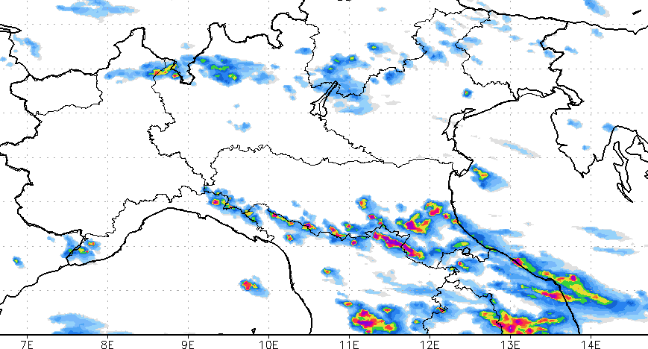
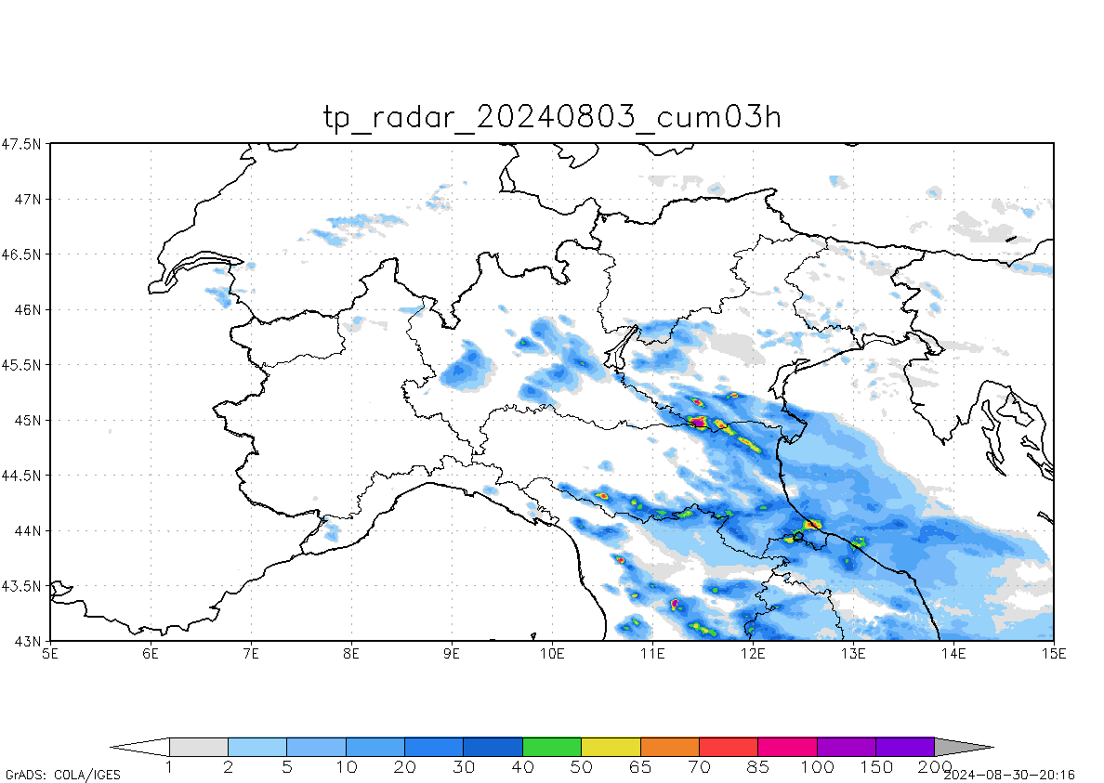

03 August 2024, max of 3h precipitation
127 mm
75 mm
222 mm
79 mm
Forecast (00Z run, d+0)
Observations (radar+rain gauges)
Forecaster complain:
“80 mm in 3 hours is a heavy storm, but 220 mm is a very extreme event.
On the whole, Icon is a very good model: the convection is realistic, and at the correct location, it’s like looking at a radar map. But this huge amount of precipitation makes it very difficult to use the model, and the hydrologists panic.”
E. Minguzzi

Slide 18
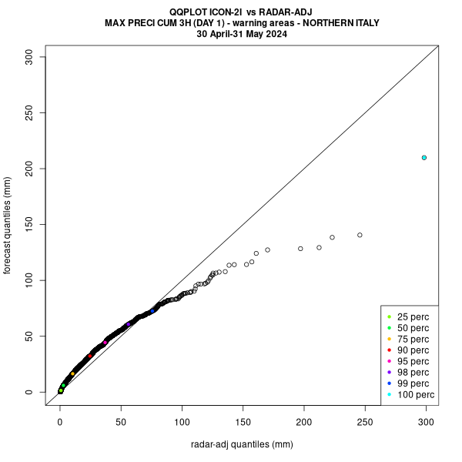
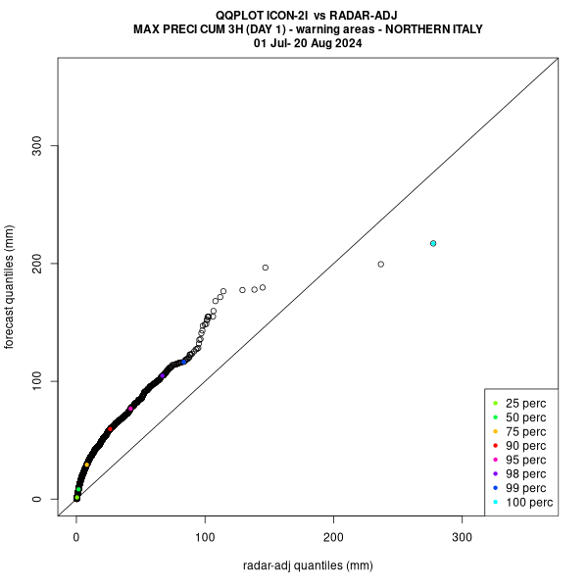
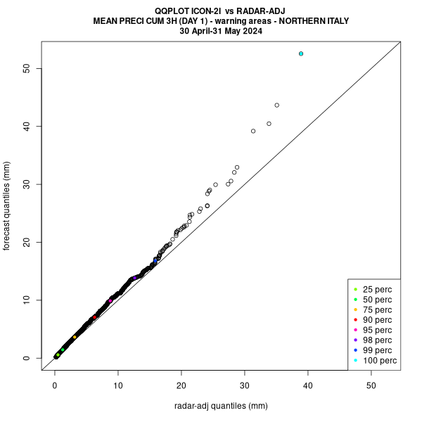
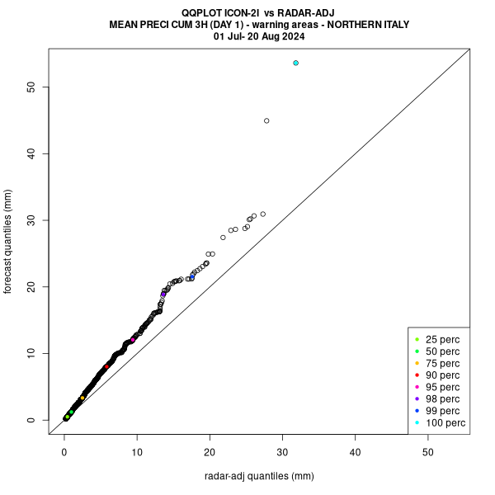
Icon-2I (operational)
In July/August 2024, precipitation was overestimated almost every day.
During Spring 2024, although convective conditions were already prevailing, Icon forecasts were not biased.
In Summer, model behavior changed abruptly.
Max
Mean
E. Minguzzi
May 2024
July-August 2024
3h precipitation in N. Italy “warning areas” (≈ 2000 km2), forecast times +00/24

Slide 19
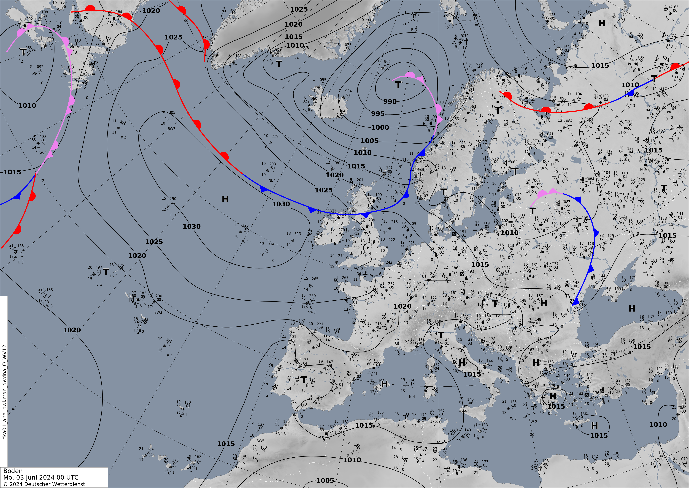
An AI front prediction system -Verification Update-
Felix Fundel
Background
Front analysis is an important product pointing to relevant weather
Front analysis maps are hand drawn for 00 and 12 UTC
Front forecasts for +36h, +60h, +84h and +108h from 00UTC
Time consuming effort involving a lot of synoptic
Since 2021 available as machine readable XML (Ninjo export)
Literature on AI for fronts
Biard and Kunkel, ASCMO, 2019
Niebler et al., WCD, 2021
Goal
  Train an AI to draw front with NWP input
  Have a front product for every model analysis and forecast step
  Use it in verification
  Offer an AI front guidance to forecasters
https://www.dwd.de/DE/leistungen/hobbymet_wk_europa/hobbyeuropakarten.html
Preprocessing Model Input
ICON global deterministic (~0.12°), vv=0
PMSL, RH2M, T2M, U10M, V10M
Re-gridded to ~0.4° (256x128 grid points)
Each variable normalized

Slide 20
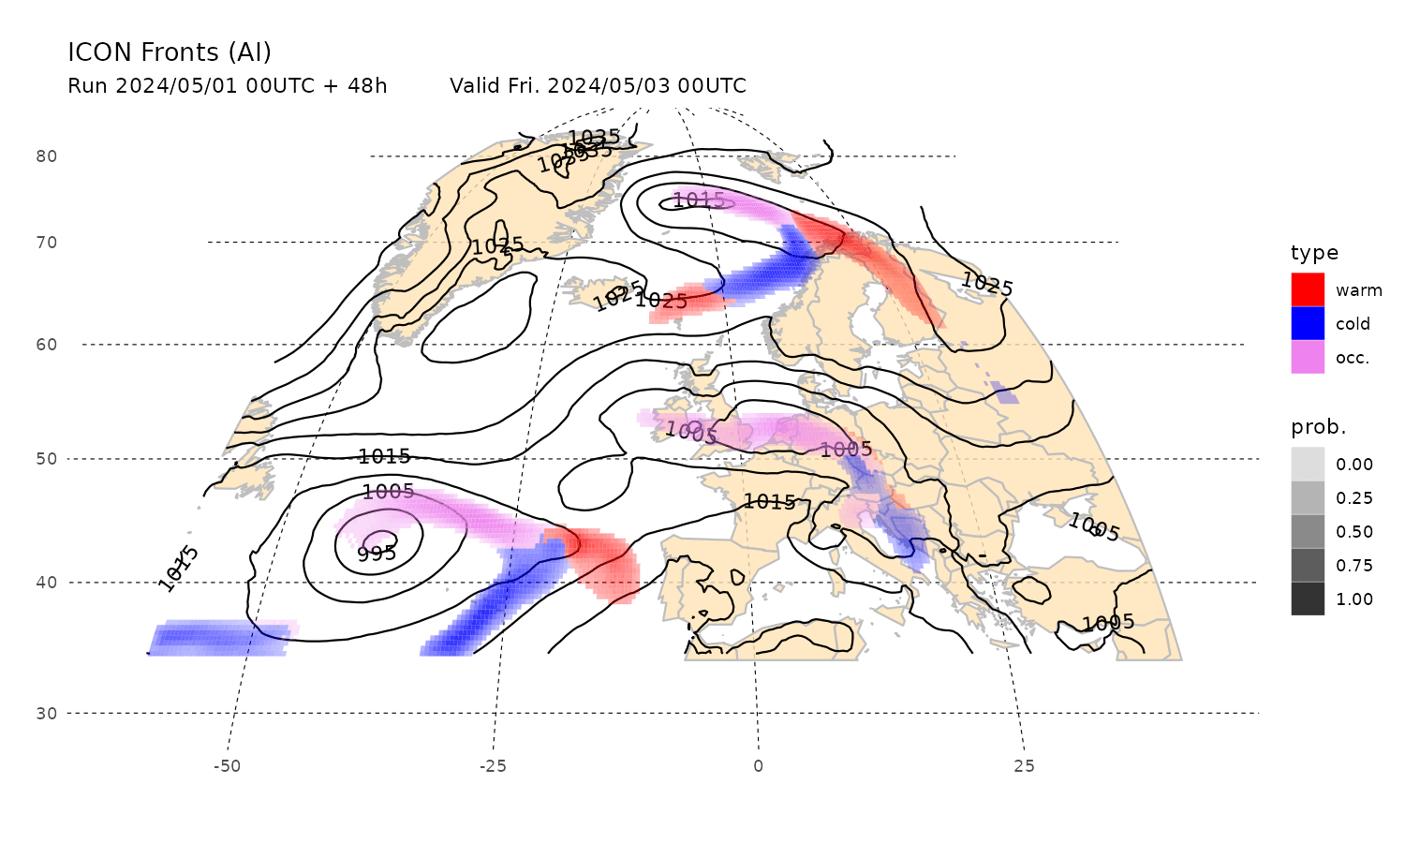
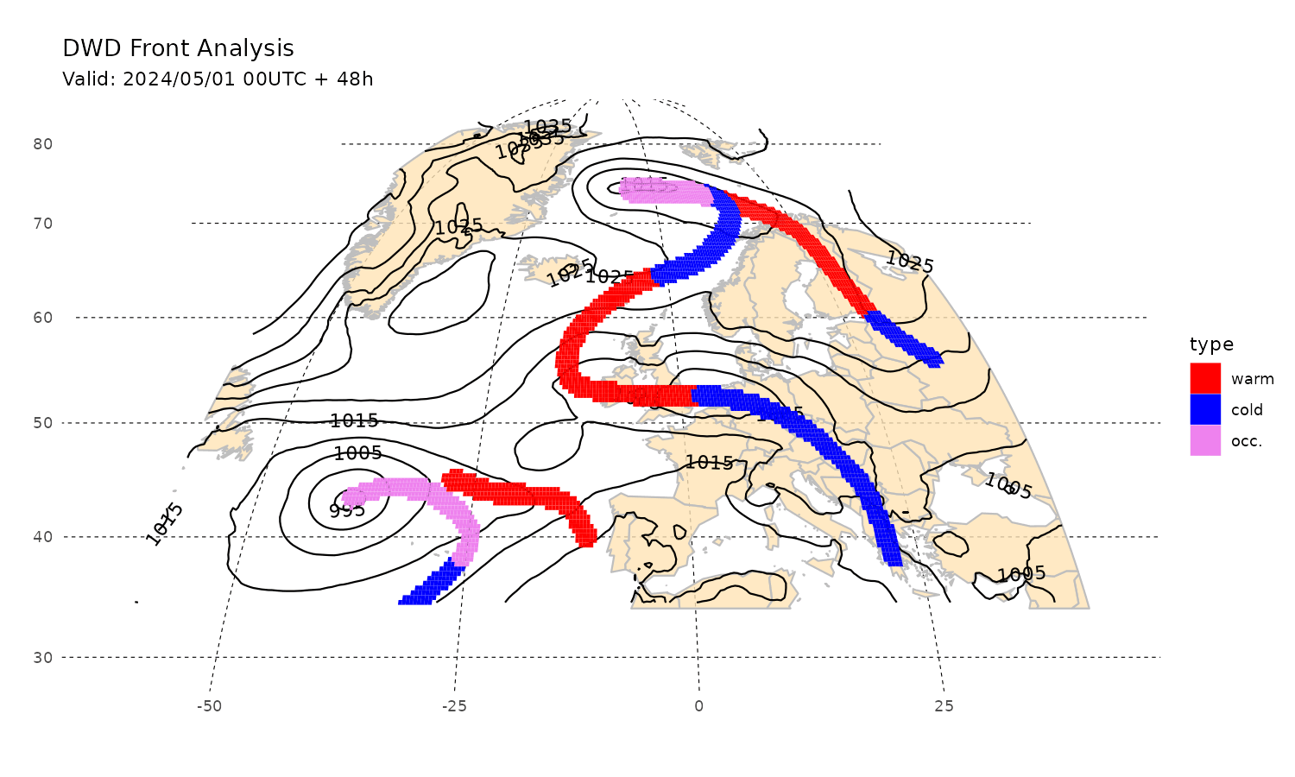
AI 48h front forecasts
Human 48h front forecasts
May 2024 AI and human front forecasts
Realistic front classification and position
AI fronts come with probability, thus broader, reflecting the model uncertainty

Slide 21
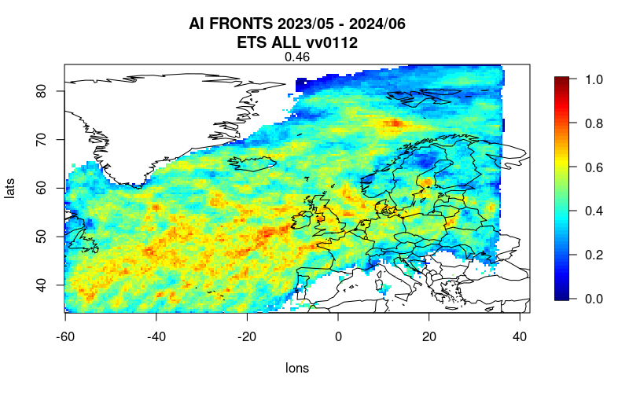
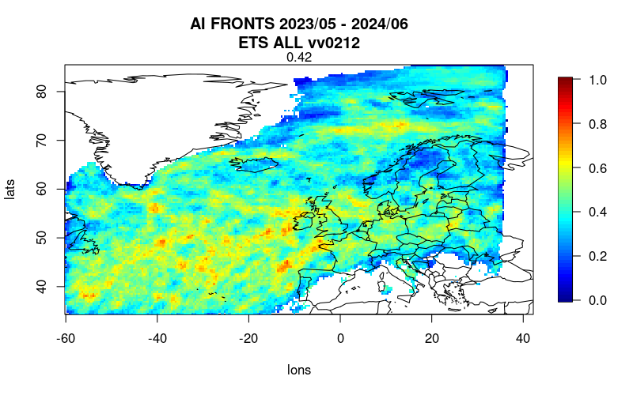
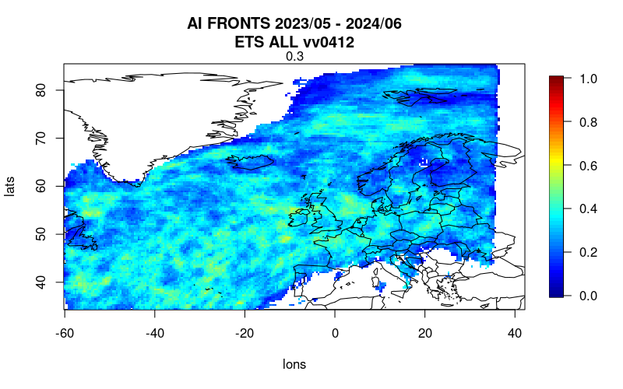
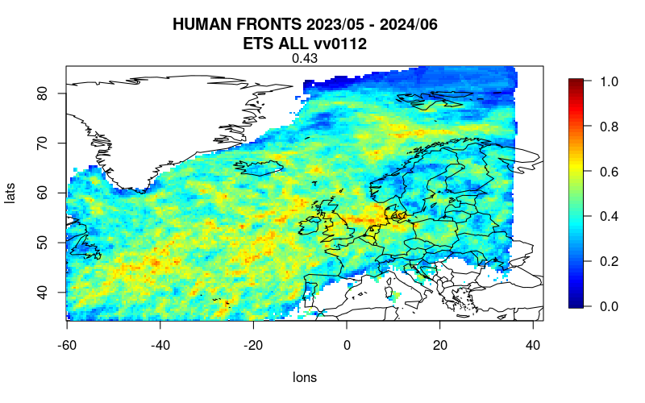
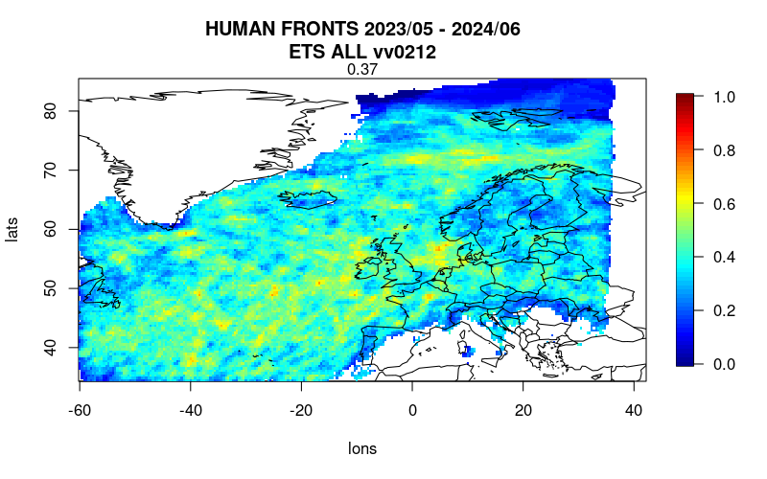
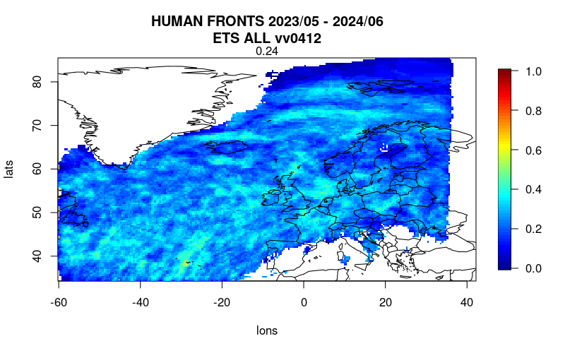
Evaluation (against human analysis)
+1.5 days
+2.5 days
+4.5 days
AI
Human
AI forecasts outperform forecaster forecasts, reasons:
  AI not subject to personal preferences, time-pressure, previously made analysis, i.e. consistency
  AI and forecaster input is the same (ICON model), no advantage for forecasters
Notes:
AI does not outperform NWP models , certainly outperforms human derived forcasts

Slide 22
PP / PT
+COLLABORATIONS
WG5 review, 26th COSMO General Meeting, Offenbach, 04.09.2024

Slide 23


PP CARMENs
Cosmo Application of Rfdbk/MEC on ENS
PL S. Gabrian
Project Objectives
Each participating service to have set up a web shiny platform where at least one season of scores based on local EPS system outputs, will have been calculated (MEC+FFV2) and uploaded.
An EPS dedicated shiny platform on COSMO web that the stats (rdata) files from each EPS system plus COSMO-LEPS will be uploaded at least for a season following all the prerequisites of CP verification.
After the completion of the PP this infrastructure will be used for COMMON PLOTS activity for following year.
WG5 review, 26th COSMO General Meeting, Offenbach, 04.09.2024

Slide 24
PP CARMENs
Cosmo Application of Rfdbk/MEC on ENS
Task 2 | MEC and Rfdbk system adaptations for EPS systems | Status | Start | End
2.1 | MEC instructions for Feedback Files based on EPS model output | Finalized: 05.2024 | 2022-09 | 2024-02
 | Issue the latest version of the guidelines available only on NMA FTP server; error uploading to COSMO repository
2.2 | MEC instructions of Rfdbk for ENS production and probabilistic scores | Finalized: 07.2024 | 2022-09 | 2024-02
2.3 | EPS evaluation guidelines as part of Common Plot activity | Ongoing | 2022-09 | 2024-02
 | First draft of the deliverable available
2.4 | Scripts to produce verification scores for EPS forecasts | Finalized: 07.2024 | 2022-09 | 2024-02
 | Script examples/templates to produce the Scorefiles from model output
COSMO PP CARMENS Task 2 Deliverables available at:
https://www.cosmo-model.org/view/repository/wg5/PP-CARMENS/Deliverables
WG5 review, 26th COSMO General Meeting, Offenbach, 04.09.2024

Slide 25
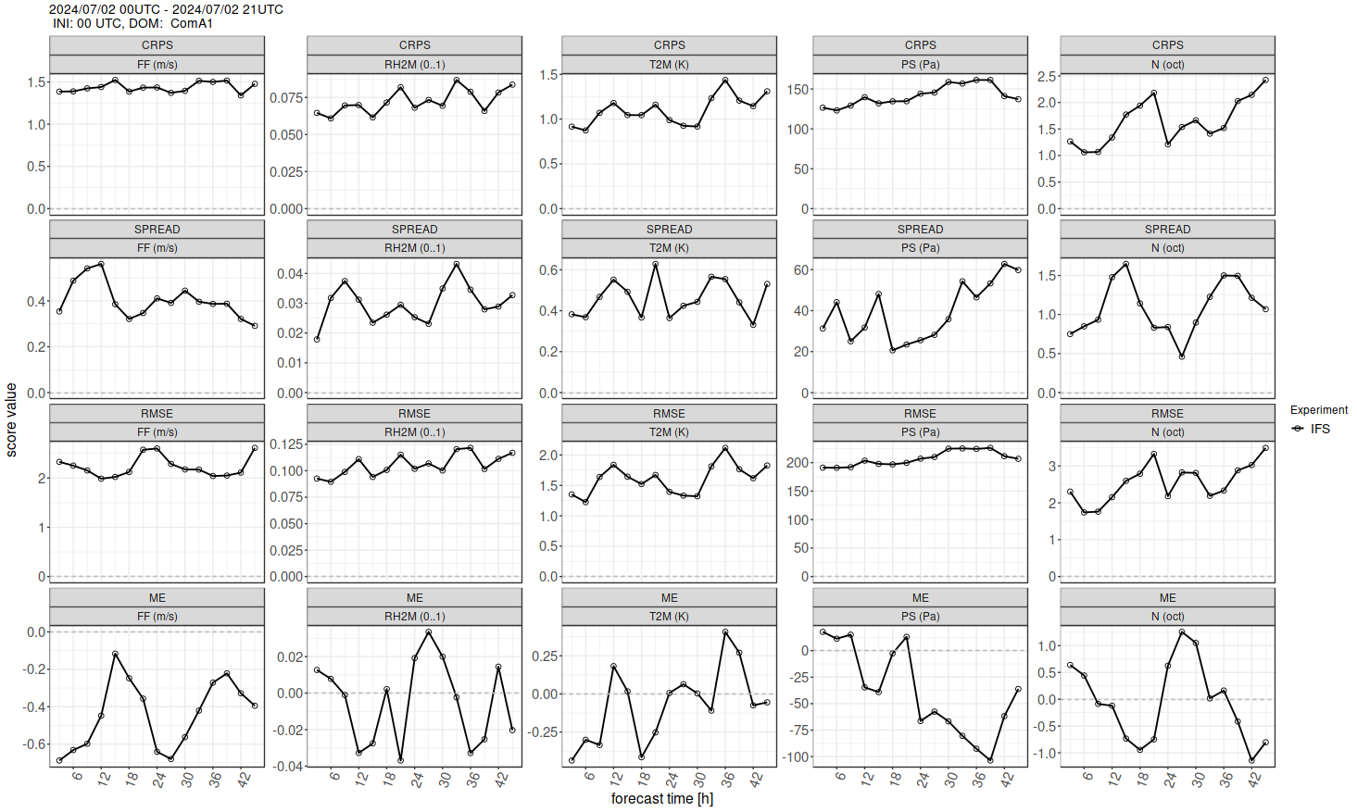
Task 2 – Running IFS-ENS
PP CARMENs
Cosmo Application of Rfdbk/MEC on ENS
According to the project proposal IFS-ENS has been tested in the in the verification system.
Extent :
Only 2 members where included
Only 1 day was validated using the forecast from the day and the previoous day.
In the guidelines for mec and in the template the
WG5 review, 26th COSMO General Meeting, Offenbach, 04.09.2024

Slide 26
PP CARMENs
Cosmo Application of Rfdbk/MEC on ENS
Task 3 | Semi-automatic use of the Rfdbk for ENS production and probabilistic scores | Status | Start | End
3.1 | Installation and adaptation of MEC-Rfdbk system for EPS | Started 06.2024 | 2022-09 | 2024-02
 | NMA and HNMS tested the verification system MEC/FFV2 succesfully. PST tested succefully the procedures on ECMWF MARS
3.2 | Preparation of Seasonal FF and test with Rfdbk | Started 06.2024 | 2022-09 | 2024-02
 | To produce 2 seasons of FF, ScoreFiles, and Score Plots
3.3 | Adaptation of Shiny visualization libraries for EPS | Started 06.2024 | 2022-09 | 2024-02
 | All the participants to the FFV2 have been given access to Shiny visualization libraries GitHub. Brief instructions available.
3.4 | Test of system features on Seasonal EPS forecasts over Common Area | Not Started | 2022-09 | 2024-02
 | Anticipated to start after one season of FF are available , and end on March 2025
WG5 review, 26th COSMO General Meeting, Offenbach, 04.09.2024

Slide 27
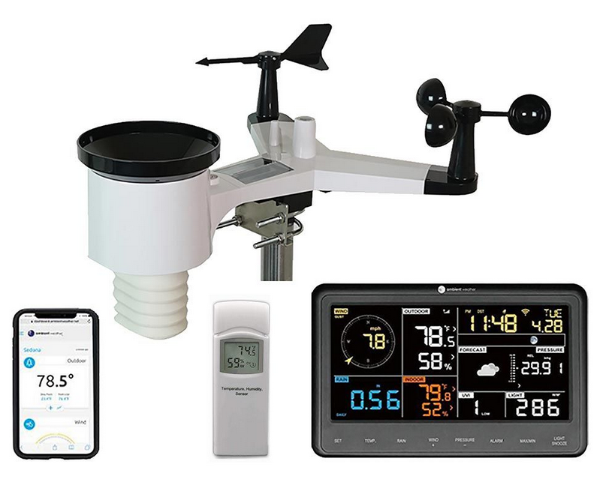


Priority Task: EPOCS (Evaluate Personal Weather Station and Opportunistic Sensor Data CrowdSourcing)
PL: Joanna Linkowska, IMGW-IB
COSMO PT EPOCS - description
The aim of PT EPOCS is to assess the use of weather data from Personal Weather Stations (PWS) and other Opportunistic Sensors (OS).
The main scientific aims of this PP are:
The development and testing of data Quality Control (QC) algorithms.
The evaluation of quality and usefulness of this data for potential applications (nowcasting, NWP and model forecast verification)
Notes:
Well documented

Slide 28
Priority Task EPOCS
Evaluate Personal Weather Station and Opportunistic Sensor Data
PL: Joanna Linkowska, IMGW-PIB
1. PWS databases survey and exploitation
1.1 Comprehensive survey of available data platforms at the European and Global level.
Marcin Grzelczyk, Francesco Sudati, Massimo Milelli
1.2 Testing the process of collection of a real-time PWS data (from IMGW-PIB employees that are using their own stations) by starting new internal database server.
Marcin Grzelczyk
1.3 Testing integrity and correctness of stored data, assess usefulness of external databases/projects (CENAGIS).
Marcin Grzelczyk
1.4 Analysis of the mobile PWS sensors: testing QC proprieties of a new mobile weather sensors from Meteotracker.
Francesco Sudati, Massimo Milelli
2. QC algorithms for precipitation
2.1 Development and testing automatic QC methods based on the RainGaugeQC algorithms developed at IMGW-PIB.
Katarzyna Ośródka, Jan Szturc, Anna Jurczyk (March 2023 - February 2024)
2.2 Testing and application of the open-source software package TITAN for a quality control of ground data.
Elena Oberto, Umberto Pellegrini (March 2023 - February 2024)
3. Analysis of PWS based gridded rainfall products
3.1 Processing different rainfall data sources (private rain gauges, commercial microwave links, sewer/water service stations, etc.)
Katarzyna Ośródka, Anna Jurczyk, Jan Szturc (March 2023 - February 2024)Combine PWS with other standard data (telemetry, radar, satellite) into new enhanced rainfall estimates (RainGRS+)
3.2 Reliability analysis of a gridded RainGRS+ high-resolution estimates of precipitation.
Joanna Linkowska (September 2023 - February 2024)
Reports available for each subtask on COSMO web
Notes:
Netatmo available upon request
Sample data of RAINGRS+ and RAINGRS (without PWS) fields will be verified against chosen independent precipitation data.

Slide 29

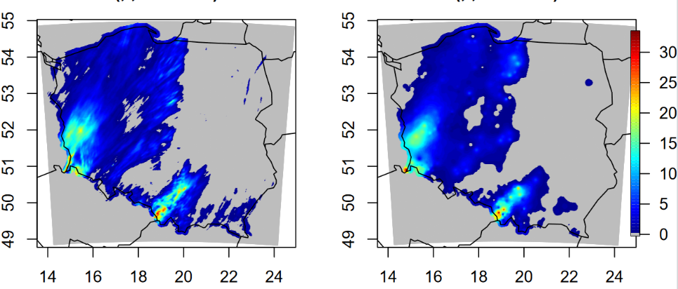
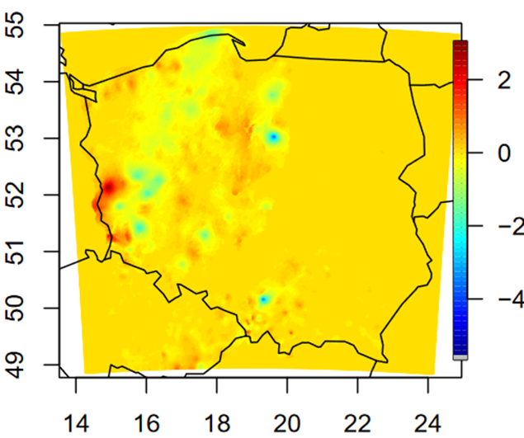
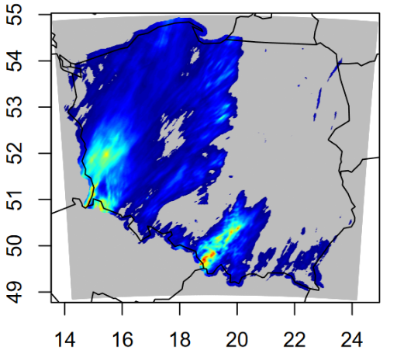
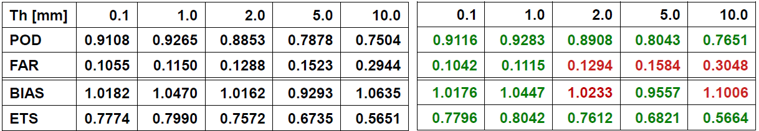
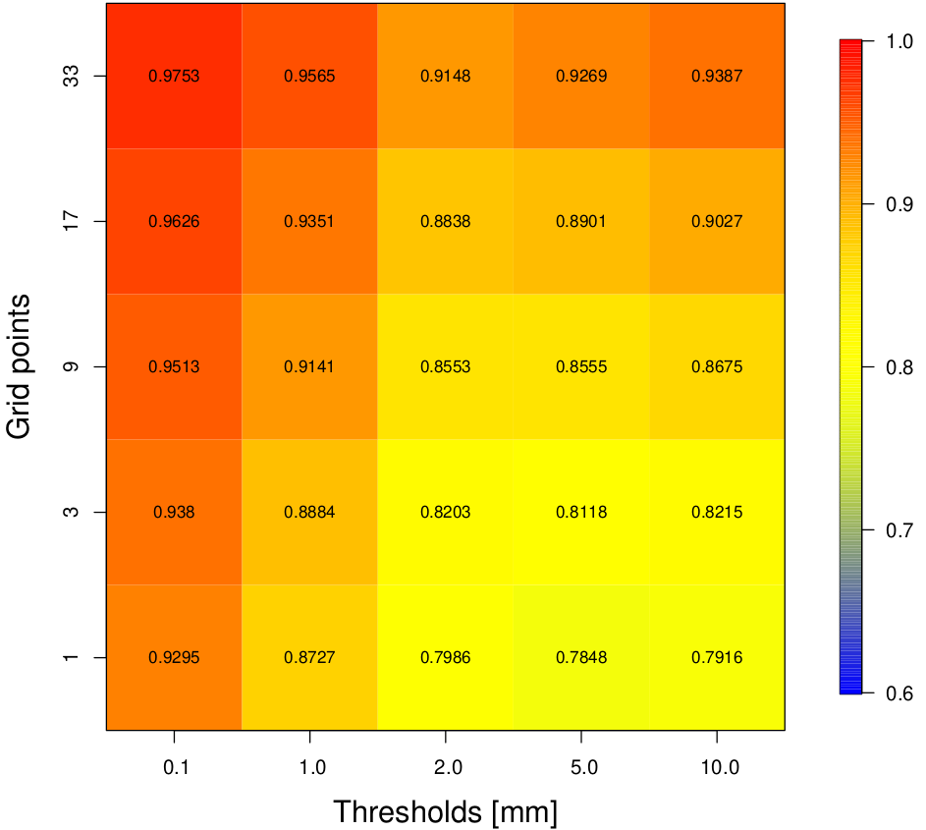
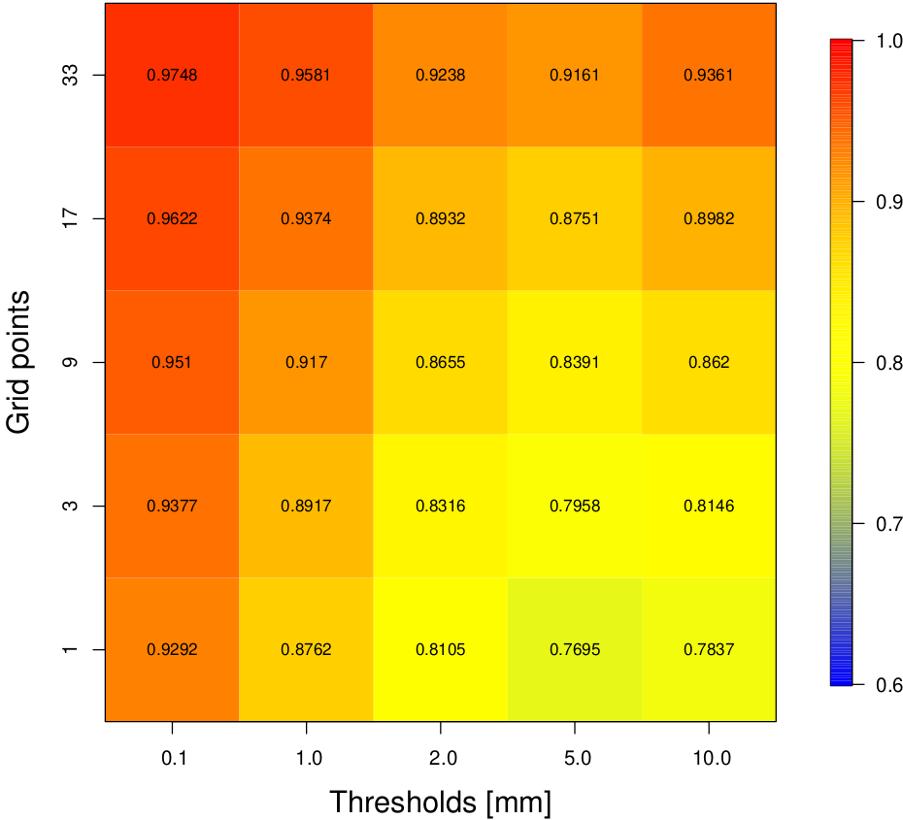
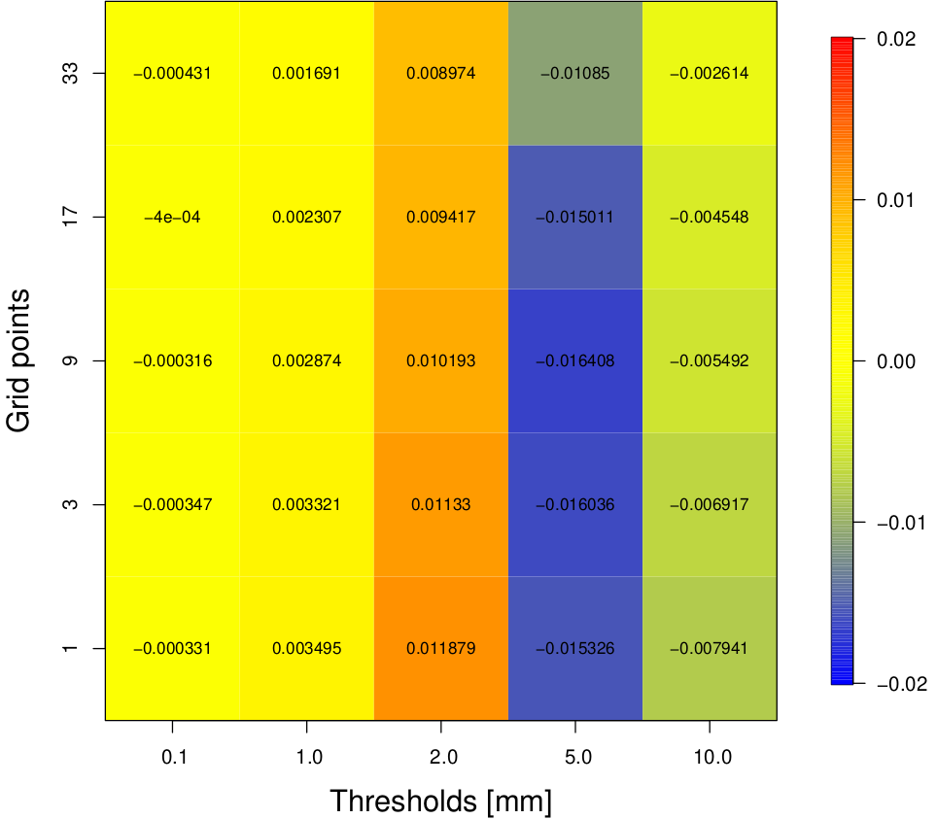
3.2 Reliability analysis of a gridded RainGRS+ high-resolution estimates of precipitation - case study 20230919-20231001- 24h precipitation (Joanna Linkowska)
Rain Gauges Hellmans
Rain GRS
Rain GRS +
Difference Rain GRS+ vs Rain GRS
Slightly better POD and ETS for RainGRS + for all the thresholds,
FAR slightly better only for small precipitation.
BIAS better for all the thresholds except 2.0mm and 10.0mm.
Rain GRS v s Hellmann Rain Gauges
Rain GRS + v s Hellmann Rain Gauges
For all thresholds & spatial scales FSS > 0.7
Very high values of FSS for smaller thresholds and smaller & larger spatial scales
Difference of FSS for Rain GRS & Rain GRS + are neglectable
Rain GRS +
Difference Rain GRS+ vs Rain GRS
Rain GRS
Notes:
commercial microwave links (CMLs) attenuation ...
Wiley
https://rmets.onlinelibrary.wiley.com › ...
· Diese Seite übersetzen
11.06.2024 — It was found that the CML-based precipitation fields are much

Slide 30
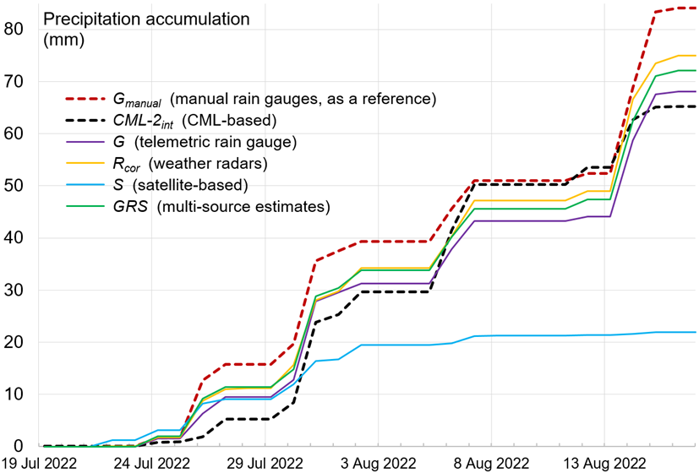
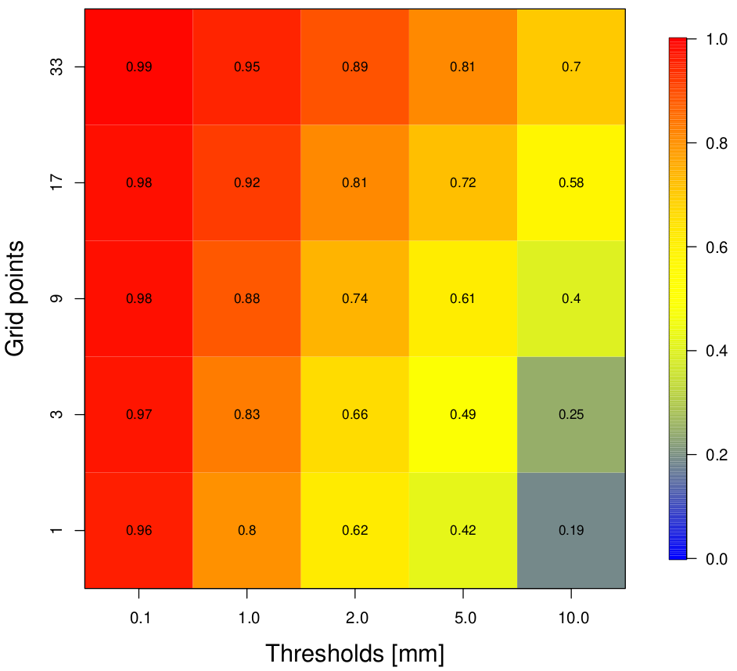
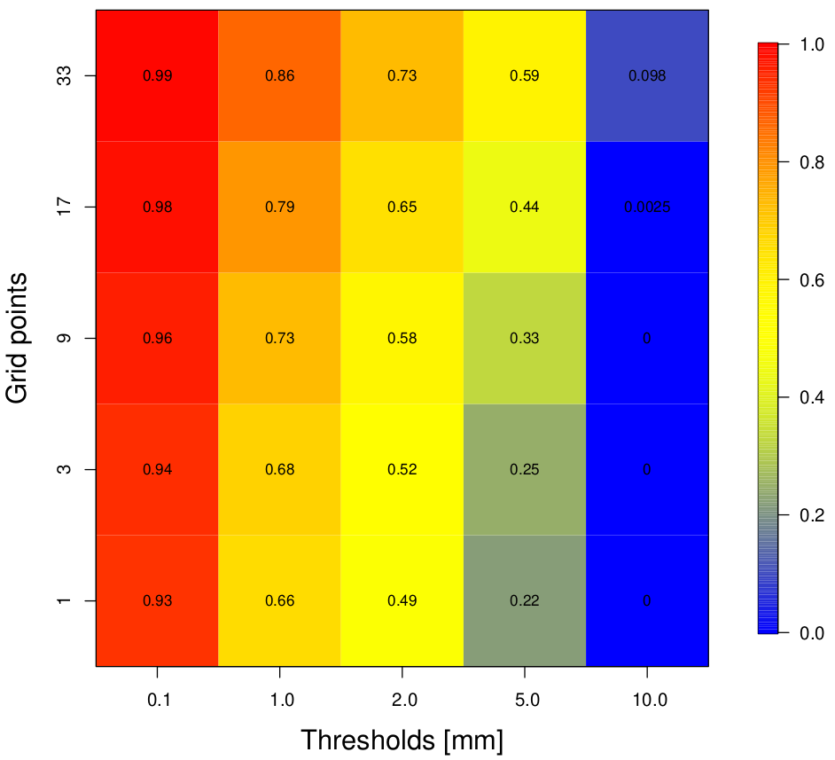
3.2 Reliability analysis of a gridded RainGRS+ high-resolution estimates of precipitation - CML based precipitation case study (Joanna Linkowska)
24h precipitation (mm) Opole station
FFS: CML vs RainGRS
CML vs Hellman Rain Gauges
Higher FSS values for CML compared to Rain GRS than against Rain Gauges.
Very high or high FSS for smaller thresholds and small and larger spatial scales.
Better scores for RainGRS than Rain Gages for higher thresholds and larger spatial scales
Correct detection of the precipitation using CML-based estimates (CML-2) with respect to the manual rain gauge, but not quite satisfactory estimation of the precipitation amount.
The spatial precipitation distribution captured relatively well

Slide 31
3.2 Reliability analysis of a gridded RainGRS+ high-resolution estimates of precipitation - case study 20230919-20231001- 24h precipitation (Joanna Linkowska)
Rain Gauges Hellmans
Rain GRS
Rain GRS +
Difference Rain GRS+ vs Rain GRS
Slightly better POD and ETS for RainGRS + for all the thresholds,
FAR slightly better only for small precipitation.
BIAS better for all the thresholds except 2.0mm and 10.0mm.
Rain GRS v s Hellmann Rain Gauges
Rain GRS + v s Hellmann Rain Gauges
For all thresholds & spatial scales FSS > 0.7
Very high values of FSS for smaller thresholds and smaller & larger spatial scales
Difference of FSS for Rain GRS & Rain GRS + are neglectable
Rain GRS +
Difference Rain GRS+ vs Rain GRS
Rain GRS
Notes:
commercial microwave links (CMLs) attenuation ...
Wiley
https://rmets.onlinelibrary.wiley.com › ...
· Diese Seite übersetzen
11.06.2024 — It was found that the CML-based precipitation fields are much

Slide 32
IMGW-PIB: Jan Szturc, Anna Jurczyk, Katarzyna Ośródka, Magdalena Pasierb, Marcin Grzelczyk, Radosław Drożdżoł, Martyna Zosicz, Bartłomiej Sobczyk, Adam Jaczewski, Joanna Linkowska (?)
HNMS: Flora Gofa, Dimitra Boucouvala
CIMA: Massimo Milelli, Elena Oberto, Francesco Uboldi
ARPA Piemonte: Valeria Garbero
Politecnico di Torino: Tanguy Houget
CNMCA: Francesco Sudati
Priority Project: EAPOCS (Evaluate Application of Personal Weather Station and Opportunistic Sensor Data CrowdSourcing)
Task 1 Development of COSMO PWS database
Subtask 1.1 Survey on available PWS from COSMO employees
Subtask 1.2 Building up passer for decoding data formats
Subtask 1.3 Adaptation or building up transfer protocols
Subtask 1.4 Development database functionalities
Task 2 Further testing of different QC to new databases and parameters
SubTask 2.1: Adaptation of the RainGaugeQC system to CML-based precipitation data
SubTask 2.2: Titan lib applied to “not conventional” raingauge datasets.
SubTask 2.3: Quality control procedure for T2m and Rh2m%
SubTask 2.4: Comparison between the “Meteonetwork” network and CML
Task 3 Adaptation of PWS to verification over Greece
SubTask 3.1: Titan lib applied to meteorological data in the Greek domain
SubTask 3.2: Climatology based Interpolation methodology of precipitation data from various sources
Task 4. Application of PWS products to model data assimilation and verification
SubTask 4.1: Improving RainGRS+ precipitation estimates
SubTask 4.2: Spatial verification techniques based on gridded precipitation obs enhanced with crowdsource data
SubTask 4.3: Application of PWS to NWP model verification in urban areas.
SubTask 4.4: Application of gridded RainGRS+ precipitation estimates for assimilation in NWP models
Sub Task 4.5: Application of Meteonetwork PWS at CNMCA: testing stability and consistency

Slide 33

Performance Trends derived from
Common Plots
WG5 review, 26th COSMO General Meeting, Offenbach, 04.09.2024

Slide 34
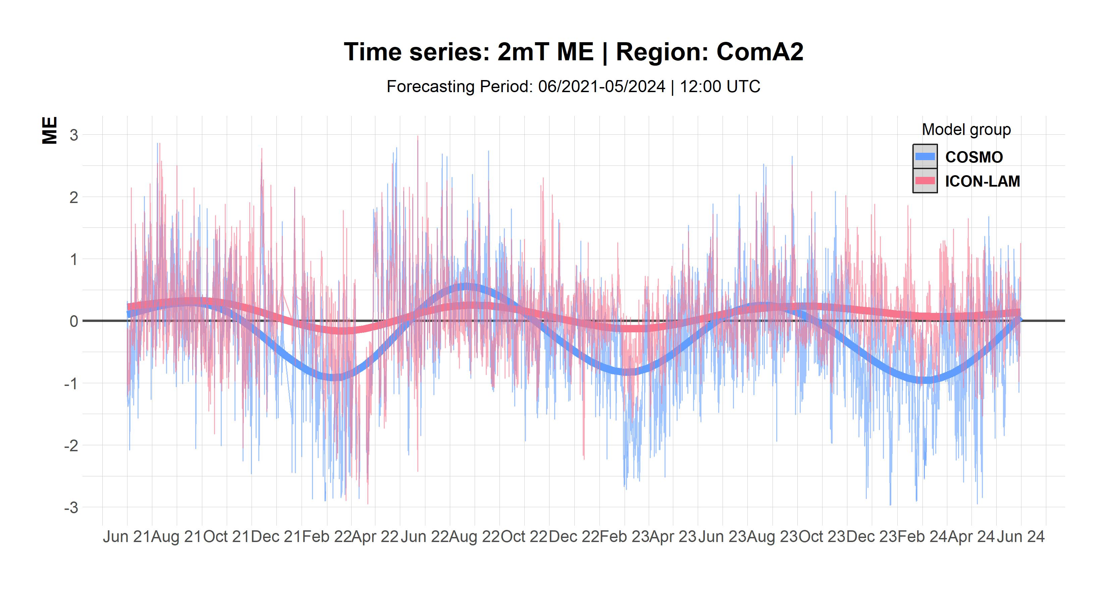
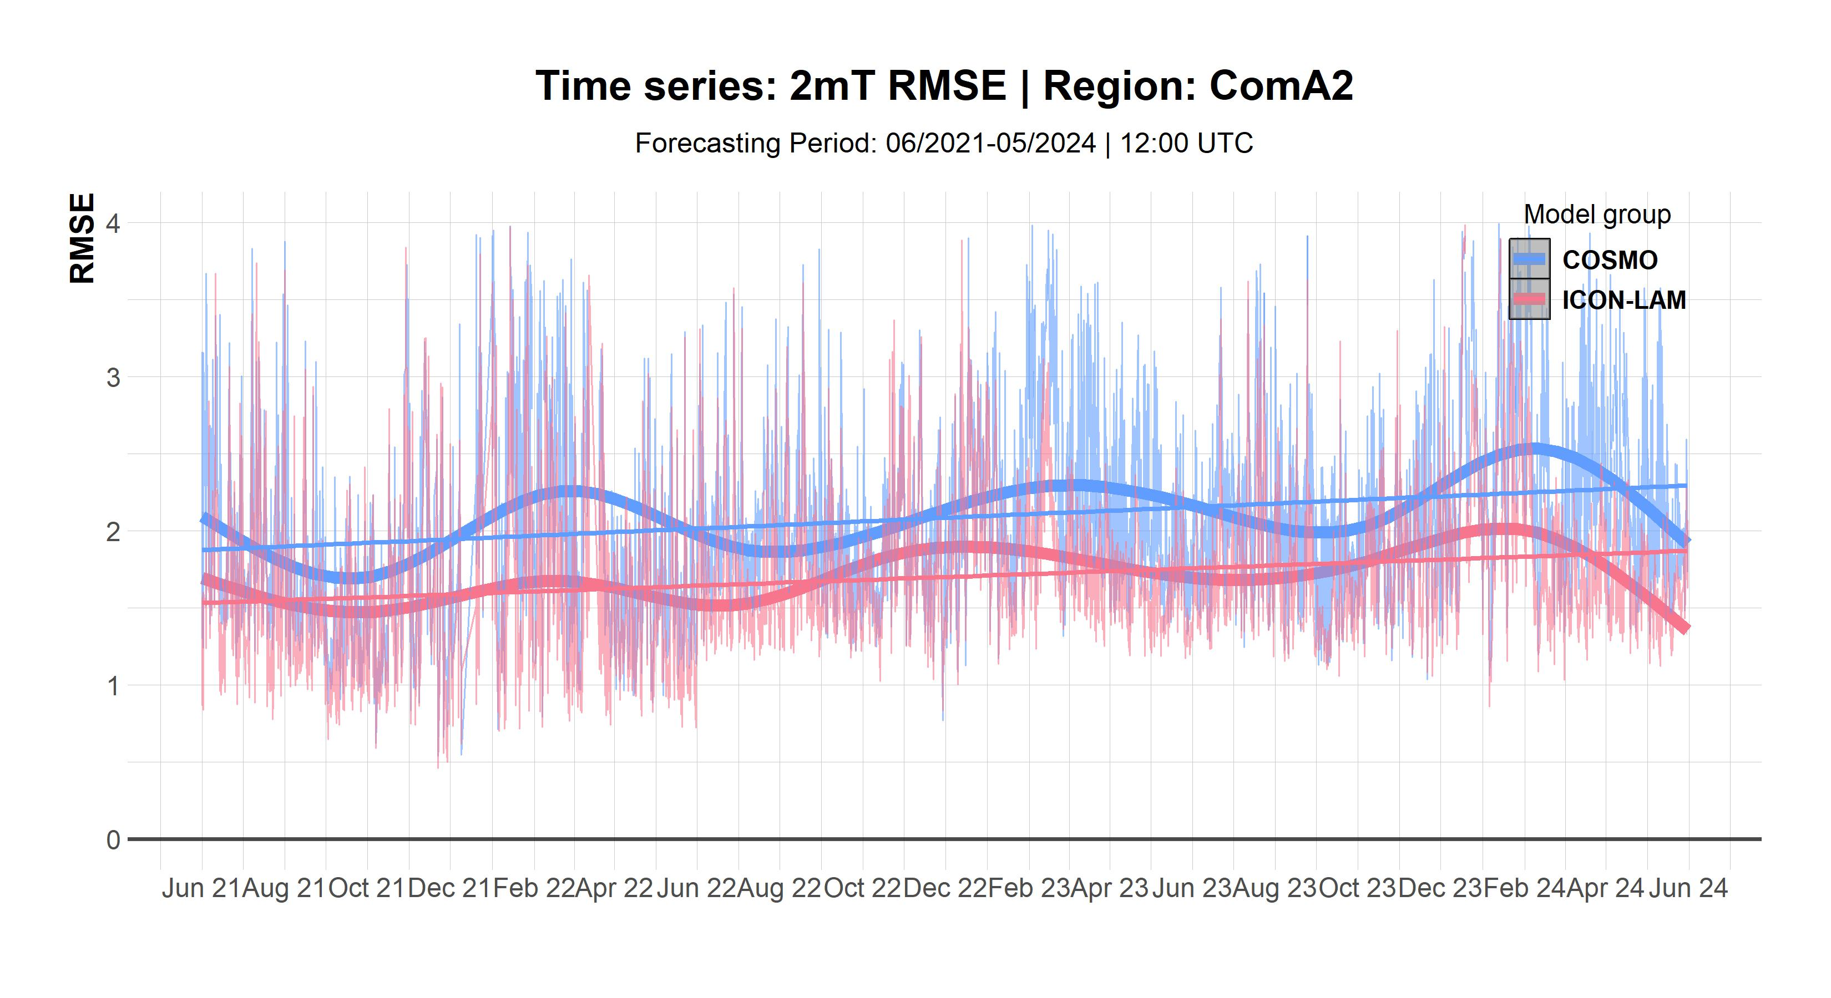
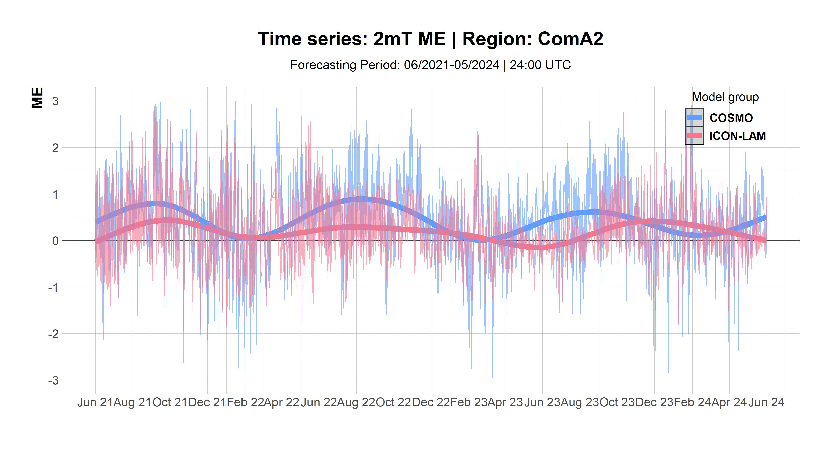
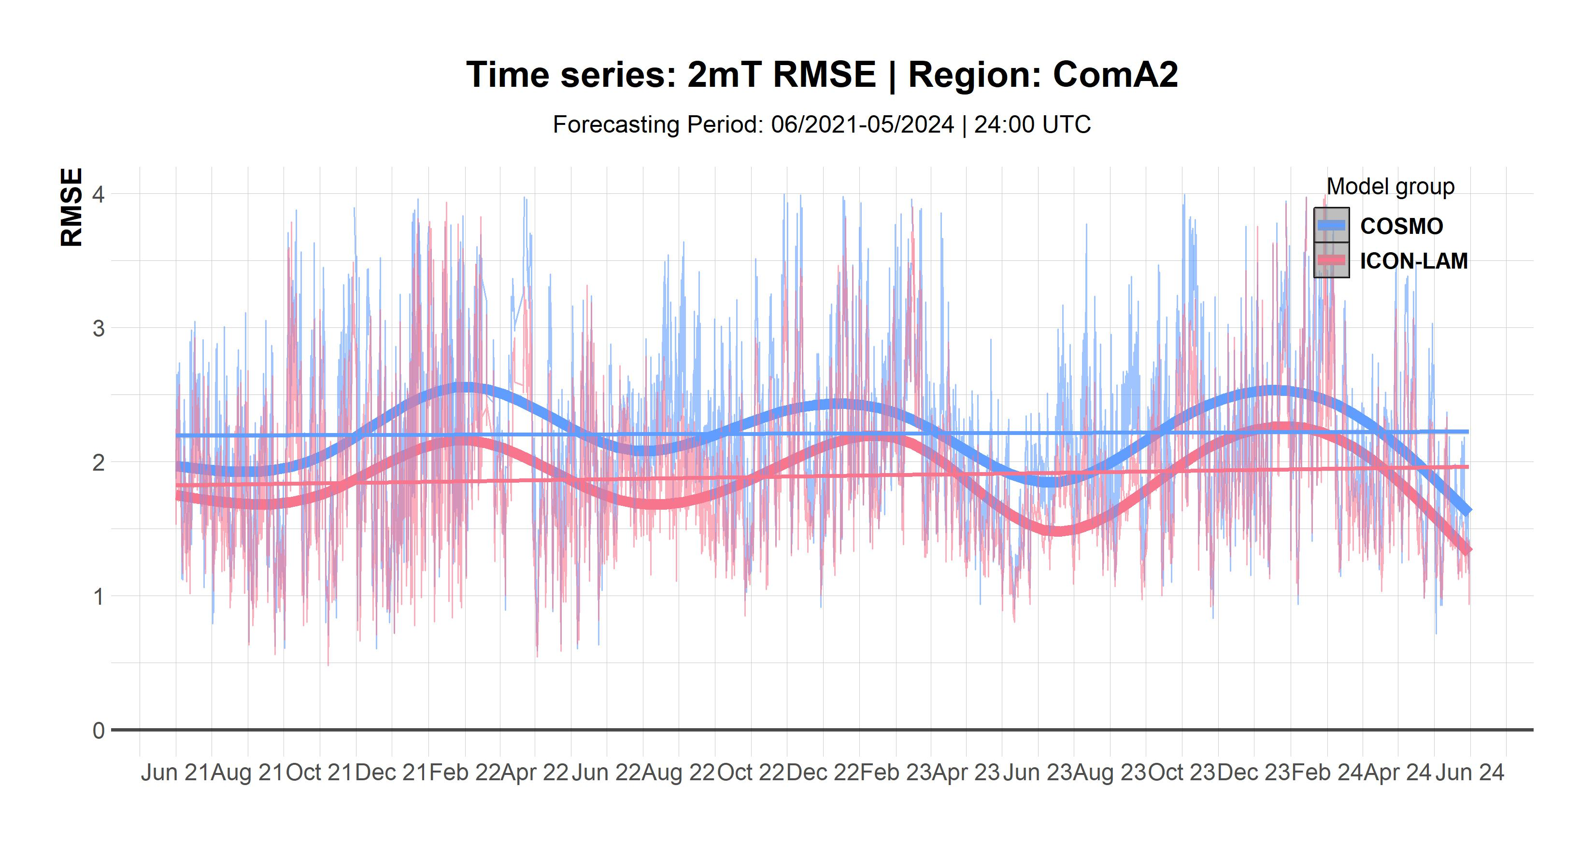
2mT @12+24UTC: all COSMO/ICON ComA2. 2021-2024
Factorial timeseries linked to ME and RMSE, thicker lines represent the smoothed average. Used: geom_smooth() that adds a regression line to a plot, and it uses a loess smooth when there are fewer than 1000 observations, and a GAM when there are more.
Mean Error
RMSE
Mean Error
RMSE
Error reduced with ICON-LAMs, as diurnal cycle, tendency to underestimate mainly in the winter night hours, but much less than COSMO that understimates at noon and overestimates at night (diurnal cycle minimized)

Slide 35
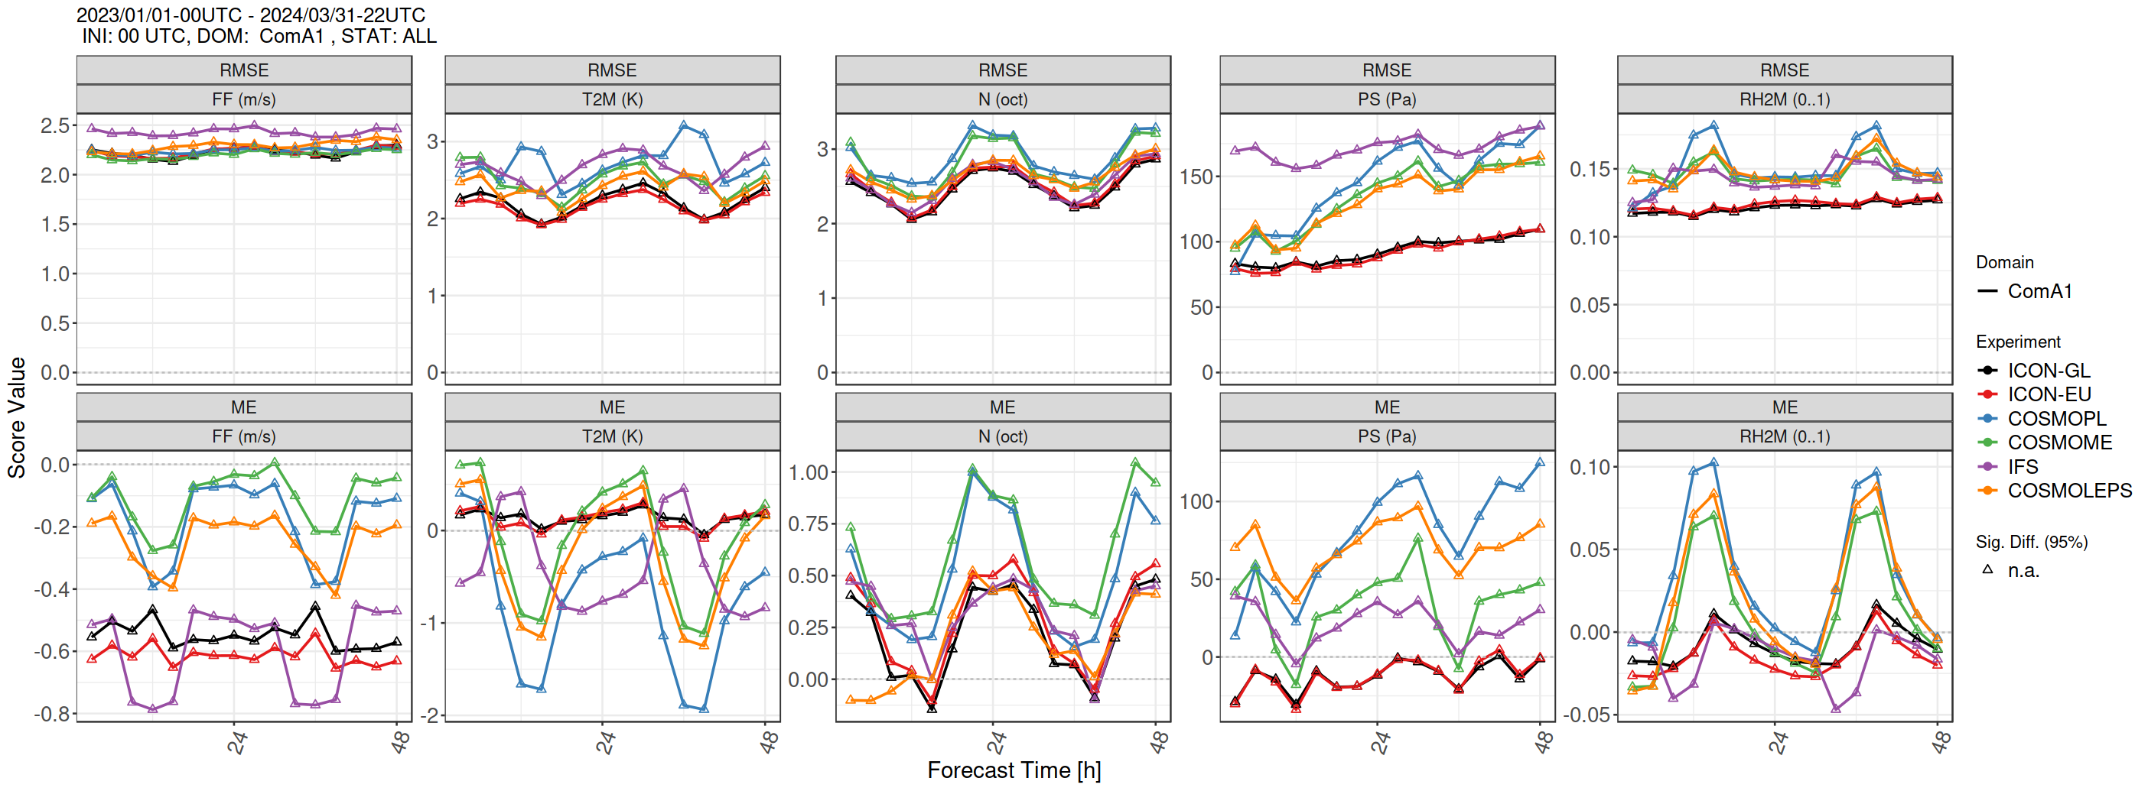
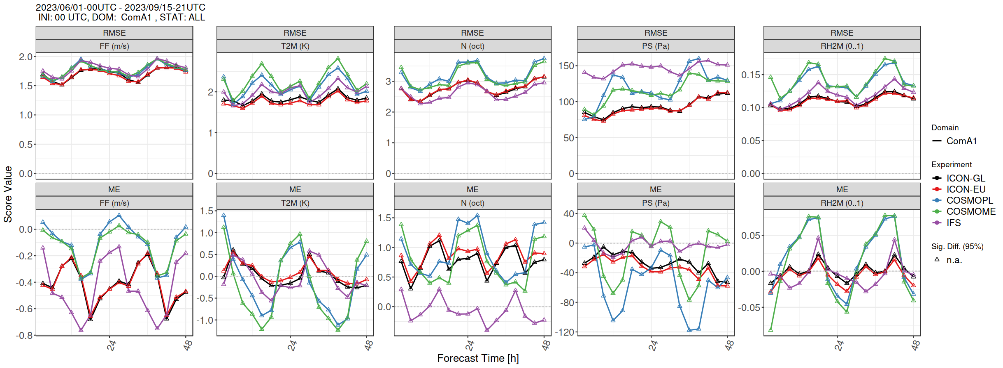
Driving Models
WINTER
SUMMER
Smaller errors in summer with ICONs
Diurnal cycle stronger in COSMO+IFS
Opposite phase
Underestimation summer mainly @night (ICON)/overestimation @summer

Slide 36
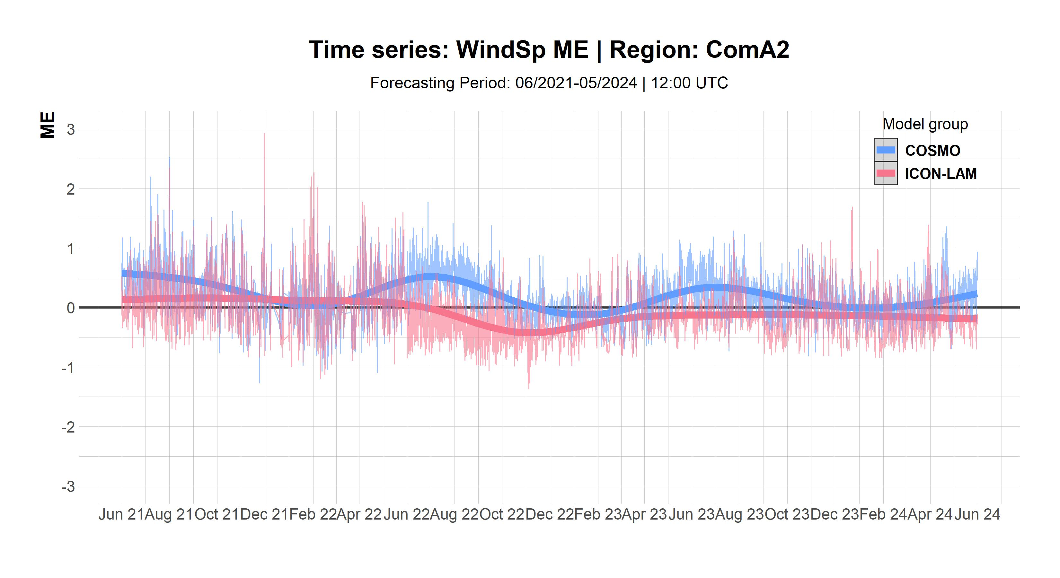
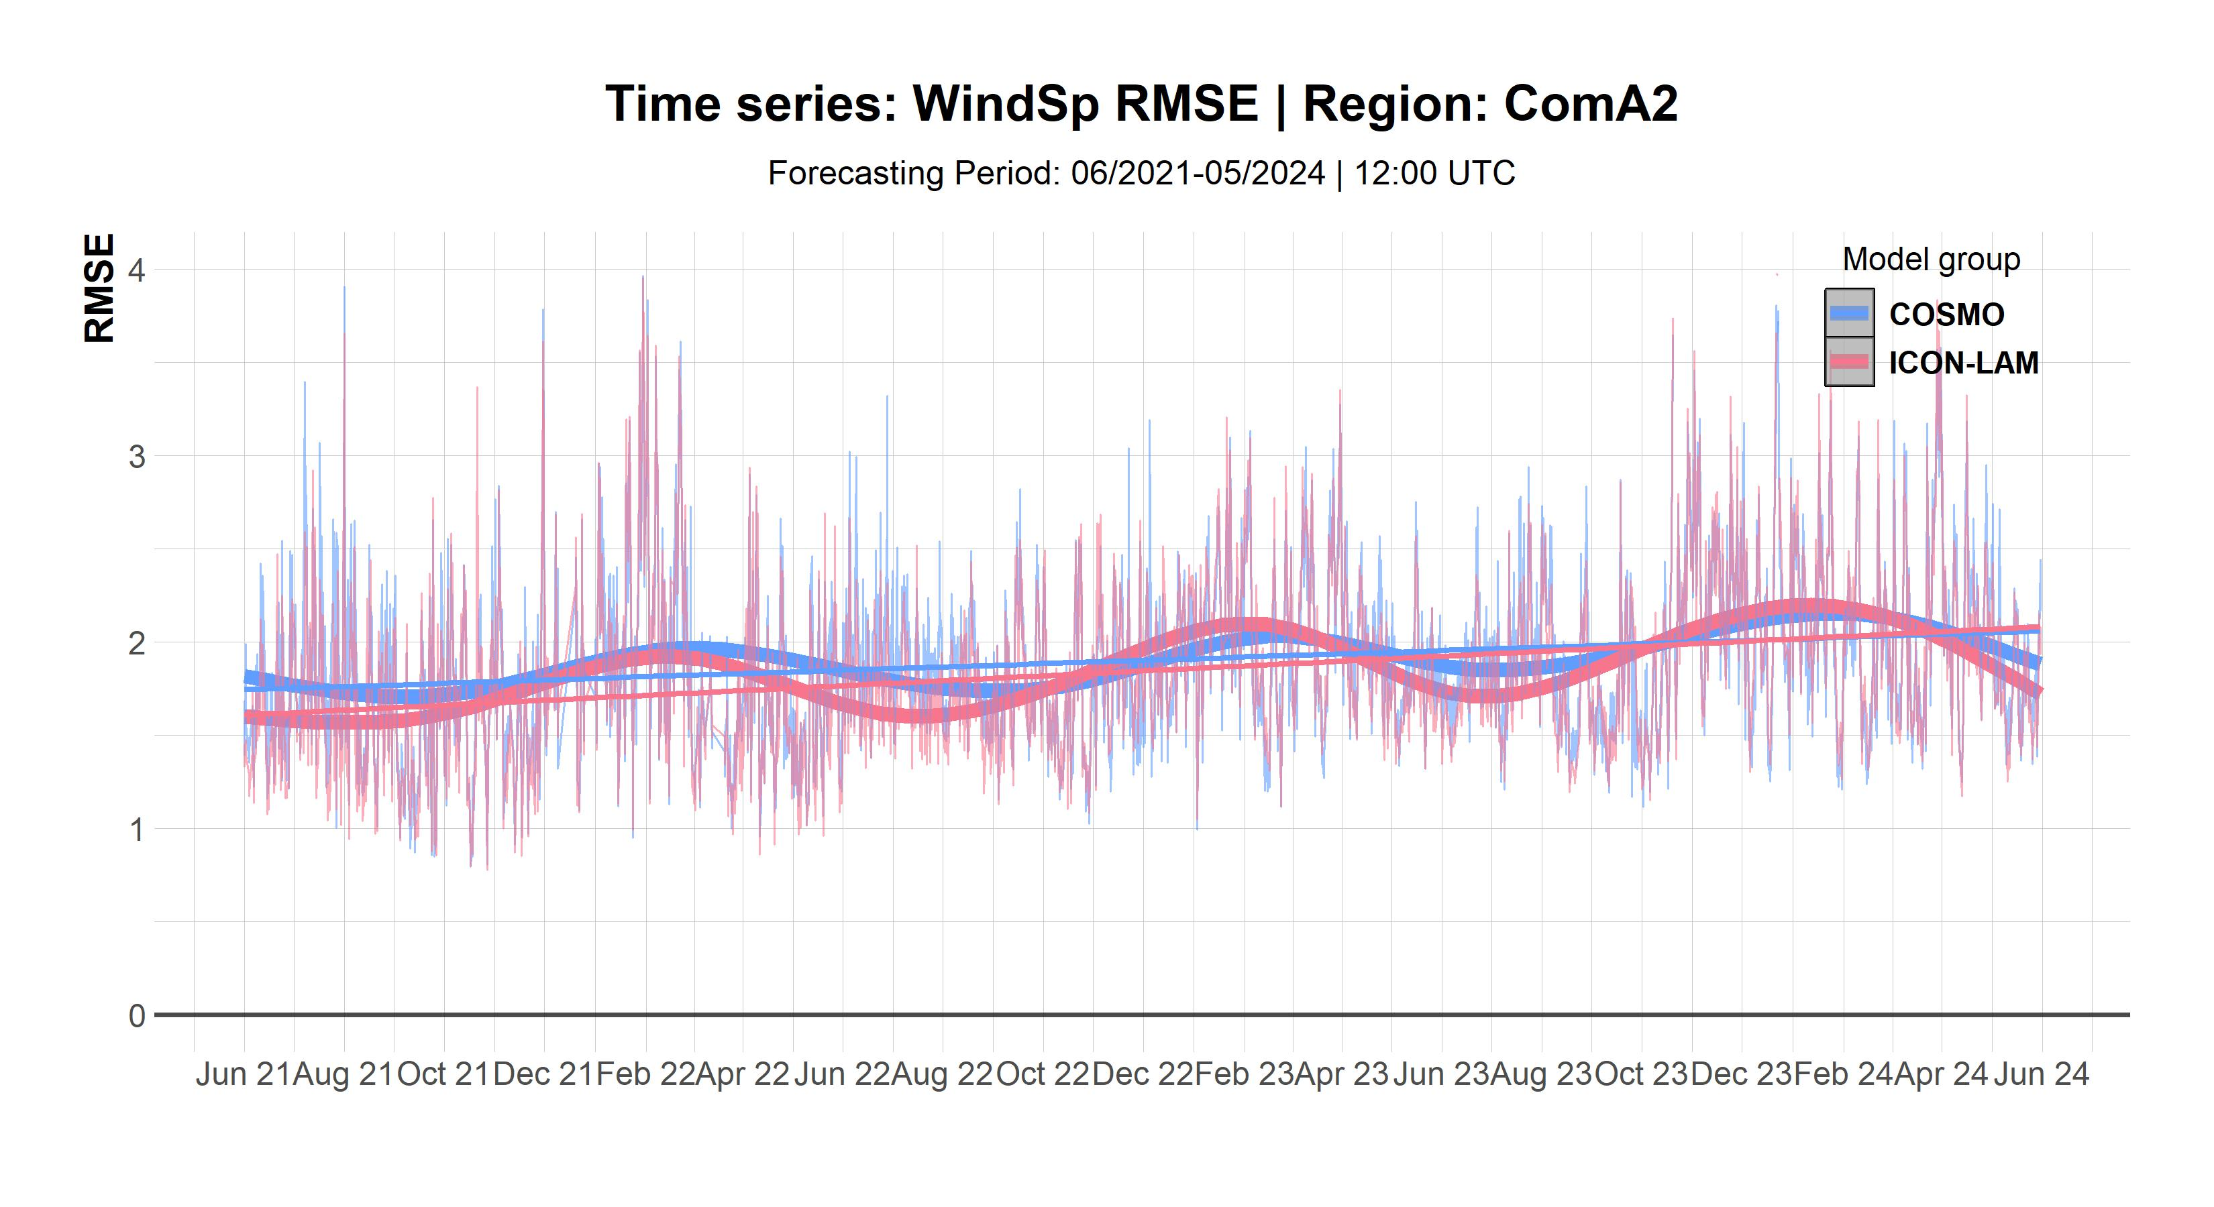
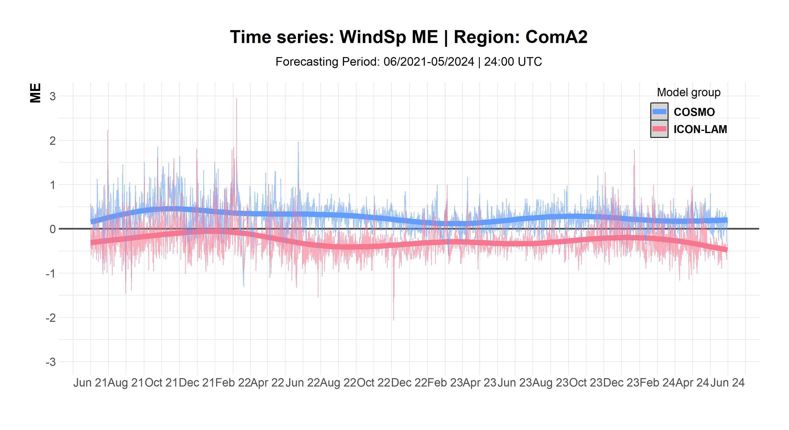

WinsSp @12+24UTC: all COSMO/ICON ComA2, 2021-2024
Factorial timeseries linked to ME and RMSE, thicker lines represent the smoothed average. Used: geom_smooth() that adds a regression line to a plot, and it uses a loess smooth when there are fewer than 1000 observations, and a GAM when there are more.
Mean Error
RMSE
Mean Error
RMSE
Smaller change in performance in Wind speed, tendency to underestimate mainly at night
26th COSMO General Meeting, Offenbach, 02 Sept 2024

Slide 37




TCC @12+24UTC: all COSMO/ICON ComA2, 2021-2024
Factorial timeseries linked to ME and RMSE, thicker lines represent the smoothed average. Used: geom_smooth() that adds a regression line to a plot, and it uses a loess smooth when there are fewer than 1000 observations, and a GAM when there are more.
Mean Error
RMSE
Mean Error
RMSE
Ambiguous performance in RMSE, both models tend to overestimate during warm months esp. @night hours (model dependant).
26th COSMO General Meeting, Offenbach, 02 Sept 2024

Slide 38




COSMO&ICON ComA2
6h Precipitation
SPRING
SysEr: For higher amounts of preci, ICON models seem drier with a tendency to underestimate mainly in summer.
Notes:
Underestimation of 2mT especially for clear sky cloudiness mainly for COSMO

Slide 39


Verification experience…
COSMO
COSMO is (was) a good model
  long term relationship based on reliability, trust, familiarity, reluctance to change…
  its evolution ceased though
ICON is a VERY good model
  younger, challenging, immature,
  susceptible of improvement
  shares some common flaws and strengths as COSMO
  reduce constant comparison with COSMO (X),
  focus on tuning its behavior
ICON
WG5 review, 26th COSMO General Meeting, Offenbach, 04.09.2024

Slide 40
Discussion on MODEL ERRORs
1st Meeting (Videoconference) 24.01.2024
Based on Common Area and National Domain verification results
Standard and Conditional Verification
Fuzzy on precipitation and TCC
Focus:
Relative performance of COSMO/ICON implementations
Reporting of systematic errors of ICON-LAMs (dependence on: season, hour, geographical location, weather, other parameters)
2nd Meeting (end November 2024)
Focus:
Relative performance of COSMO/ICON implementations
Reporting of systematic errors of ICON-LAMs (dependence on: season, hour, geographical location, weather, other parameters)
Tuning on model errors
26th COSMO General Meeting, Offenbach, 02 Sept 2024

Slide 41

WG5 activities contributors
F. Fundel, J. Linkowska, N. Vela, S. Gabrian,
S. Dinicila, M.S.Tesini, F. Sudati, F. Batignani, D. Boucouvala, P. Kaufmann, M. Zosicz, M. Grzelczyk, A. Surowiecki P. Khain, B. Maco, F.Gofa,….
WG5 review, 26th COSMO General Meeting, Offenbach, 04.09.2024

Slide 42




HeatMaps all COSMO/ICON ComA2, 2021-2024
Mean Error
RMSE
ICON
Mean Error
RMSE
COSMO

Slide 43
CLM-Community EVAL Group meeting
ICCARUS 2024
TOPICS
WG5 current activities - enable R Shiny also for global and regional climate ICON simulations (“seamless verification”), especially for testing of new ICON versions
Tuning ICON-Seamless-Atmosphere
COPAT2
Discussion on future collaboration between WG5 and WG EVAL
  focus on topics of common interest.
  prepare a list with points of common interest
  preliminary meeting in a smaller group to discuss a priority list of common interest
25th COSMO General Meeting, Gdańsk, 12 Sept 2023
Notes:
Tuning concept for ICON-NWP
Tuning on R2B4 resolution, which is not the real target resolution
ICON Seamless will use JSBACH instead of TERRA until a common land/boundary layer model is available
Starting from R2B4 and using a grid with coarser resolution for radiation (i.e. R2B3) does not really improve model performance
Results of the tuning lead to very good match in global temperatures against ERA5
Simulations with ICON NWP + ICON-O and using JSBACH or TERRA does not lead to remarkable differences: one particular bias in both models is a lack of precipitation over South Asia.
Bias in net shortwave radiation on Top of Atmosphere (TOA) near coastal areas such as ENSO zone of South America and South Africa
ICON -Seamless atmosphere particularly dry over South Asia
Tuning of microphysics in ICON Seamless-Atmosphere leads to improvements in cloud cover and net TOA radiation
Tuning related to turbulence lead to some improvements in precipitable water
Tuning parameters related to convection lead to large improvements in cloud cover
______________________
Determined optimal configuration COSMO-CLM 6.0
A report on the evaluation procedure is currently being drafted and will be distributed in the upcoming weeks
A revision of the employed metrics in the tuning process from experts of the WG5 community would be very much appreciated: ER will send a copy of the report also to FG for feedbacks
Reference ICON-CLM tuning run (Klaus Keuler) will be done with the newest ICON version 2.6.6 and SPICE2.2 (Beate Geyer)
Suggestion (Trang von Pham): Use full anthropogenic aerosol (18 instead of 15) and time dependent ozone + solar radiation.
Barbara Früh would encourage to test the developments of ICON Seamless for the regional mode. Trang has already partly suggested this with ozone and solar radiation. But JSBACH could also be interesting to be tested.
Barbara: Probably new BMBF project (UDAG), which will provide some support for some of the tasks of the ICON-CLM tuning process in line with the COPAT2 activities.
Beate Geyer: Spectral Nudging improves COPAT2 scores significantly. This information might be important for some people in the future and it will also be included in the final report, even though(Klaus Keuler/Christian Steger) spectral Nudging is forbidden in CORDEX.

Slide 44

3.1 Processing different rainfall data sources (private rain gauges, commercial microwave links, sewer/water service stations, etc.) (K. Ośródka, A. Jurczyk, J. Szturc)
The RainGRS+ system was developed to generate real-time estimates of multi-source precipitation fields.
The input data are:
  IMGW rain gauge network,
  Unprofessional networks of rain gauges (Polish Forest State data)
  IMGW POLRAD radar network completed with radars from neighbouring countries (GE, CZ, SK, LT, DK),
  EUMETNET OPERA radar precipitation,
  Meteosat (NWC-SAF) based precipitation estimates (algorithm: Jurczyk et al., 2020,
  Remote Sensing).
Algorithm: a conditional merging (Sinclair and Pegram, 2005) modified by taking into account the quality information of the individual input data.

Slide 45

COARSE
FINE
MIX
FINE
MIX
Optional

Slide 46


MEC
Pangu (ICON initialized) vs. ICON
TEMP 2024/07
SYNOP 2024/07
Good performance upper air
Not on ICON level at or near surface and in very high levels
Some issues with humidity sensitive variables at surface

Slide 47


MEC
Pangu (EC initialized) vs. ICON
TEMP 2024/07
SYNOP 2024/07
Similar pattern
Upper air prifts using EC initial conditions
Surface verification was a bit better using ICON initial conditions
Notes:
To chek how the models were run
RH2M of PANGU and GraphCast is not consisitent with observations

