Slide 1



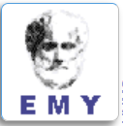
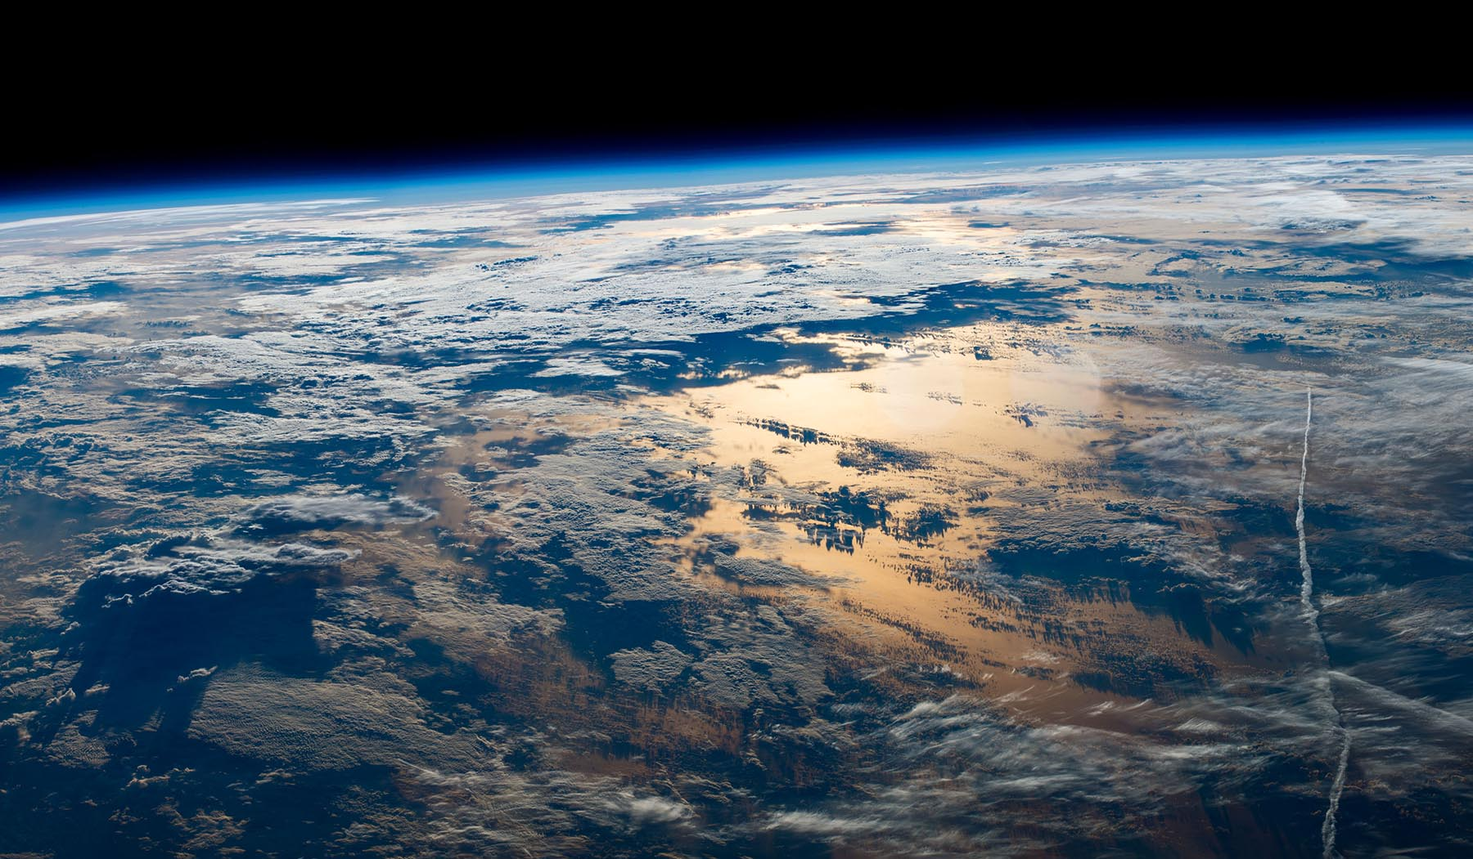
Clouds and Aerosols Improvements in ICON Radiation Scheme - CAIIR Priority Project
בס"ד
Harel Muskatel (IMS)
26th COSMO General Meeting, September 4, 2024

Slide 2
Clouds and Aerosols Improvements in ICON Radiation Scheme - CAIIR Priority Project
Project duration: March 2020 - August 2024
Participants:
Harel Muskatel (IMS)
Pavel Khain (IMS)
Alon Shtivelman (IMS)
Yoav Levi (IMS)
Daniel Rieger (DWD)
Ulrich Blahak (DWD)
Euripides Augoustoglou (HNMS)
Alexey Poliukhov (RHM)
Julia Khlestova (RHM)
Gdaly Rivin (RHM)
Natalia Chubarova (RHM)
Marina Shatunova (RHM)
Martin Kohler (DWD)
Alberto De Lozar (DWD)
Uli Shaettler (DWD)
  Cloud optics
  Aerosols inputs: CAMS forecast, CAMS climatology,
  2D AOD advection scheme
  Microphysics – new cloud nucleation schemes
  Spectral Bin Microphysics

Slide 3
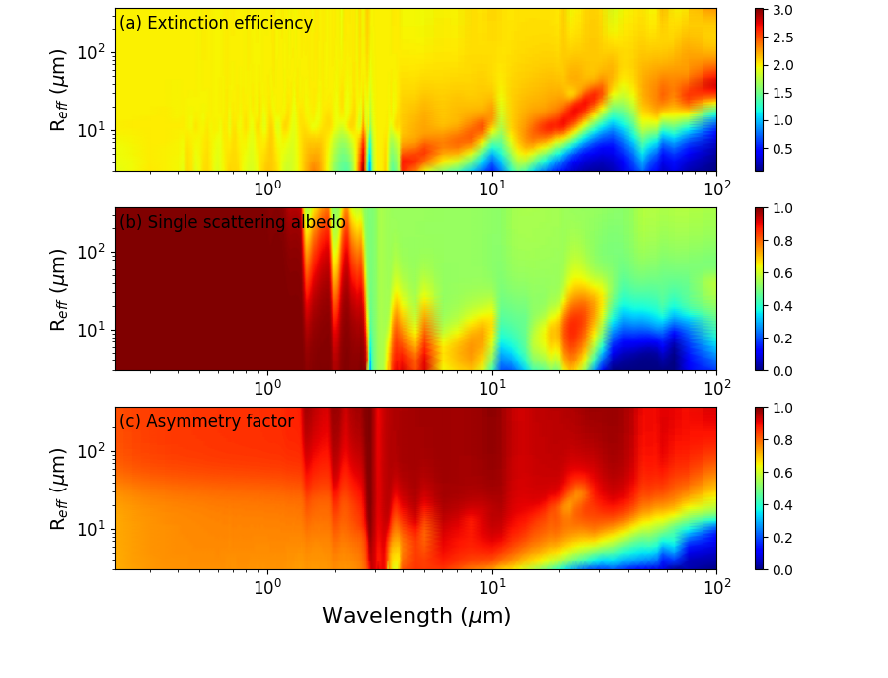
New ice optical properties for ecRAD
Muskatel, Blahak, Khain, Levi & Fu; Atmosphere 2021, 12, 89.
Extended size:
60 µm → 300 µm
Ice particles surfaces:
Rough/Smooth
High resolution:
Reff / Wavelength

Slide 4
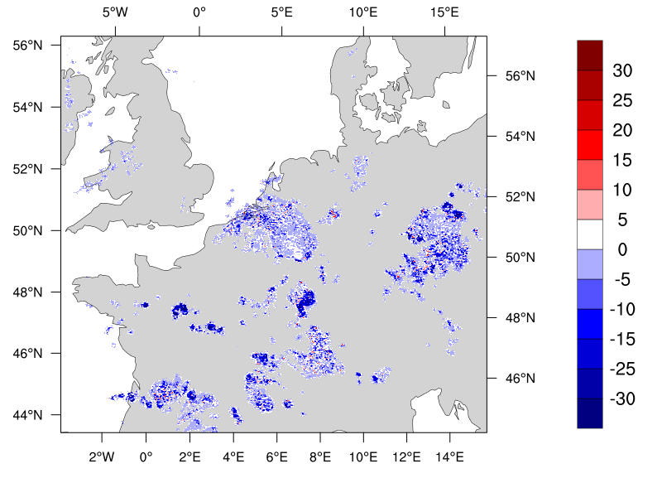
Large Hydrometeors in ecRAD
The new option ecrad_use_general_cloud_optics = .true. allows for considering each hydrometeor independently in the radiation calculations. The optical properties as function of the effective radius are provided in external files for each hydrometeor.
ecrad_iice/igraupel/isnow_scat = 0, 10, 11
0 ! Rough Muskatel et al. (2021)
10 ! Smooth Muskatel et al. (2021)
11 ! Baran (no large particles) for iice only
ecrad_ illiquid/irain_scat = 0
0 ! Mie calculations
TOA Upwelling LW (W/m²) Full – Reference
Alberto de Lozar (DWD)

Slide 5
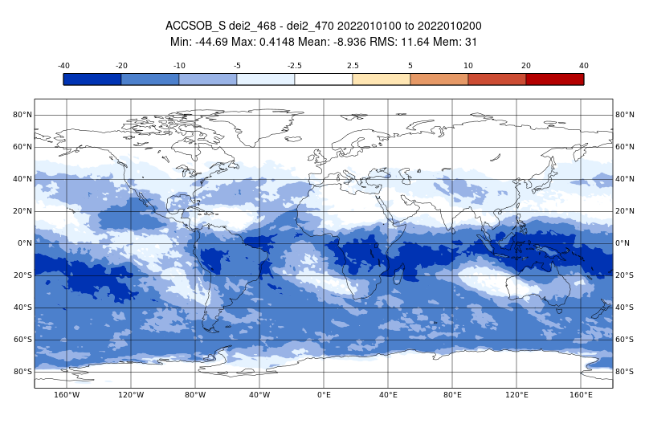
Large hydrometeors effect on radiation
Surface SW irradiance January

Slide 6
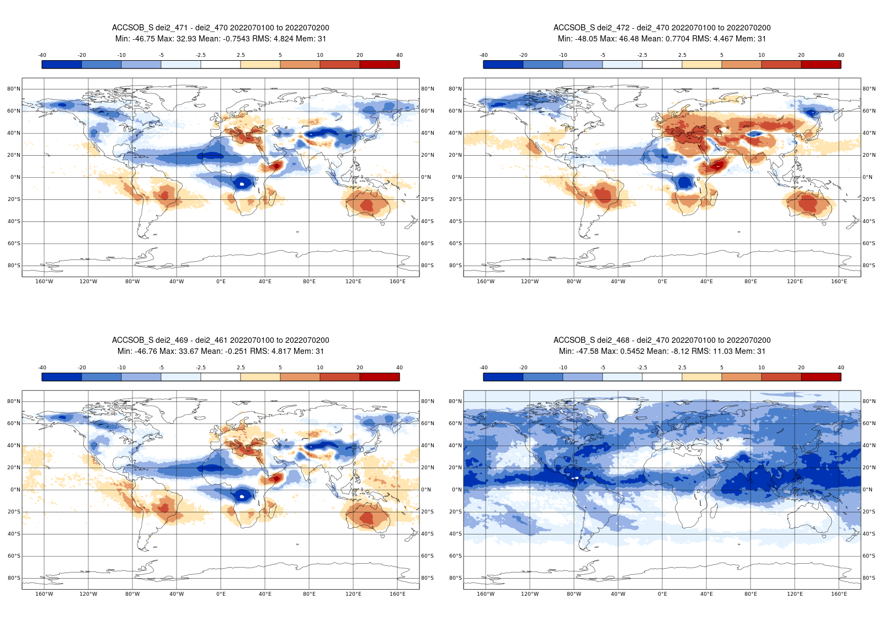
Large hydrometeors effect on radiation
Surface SW irradiance July

Slide 7
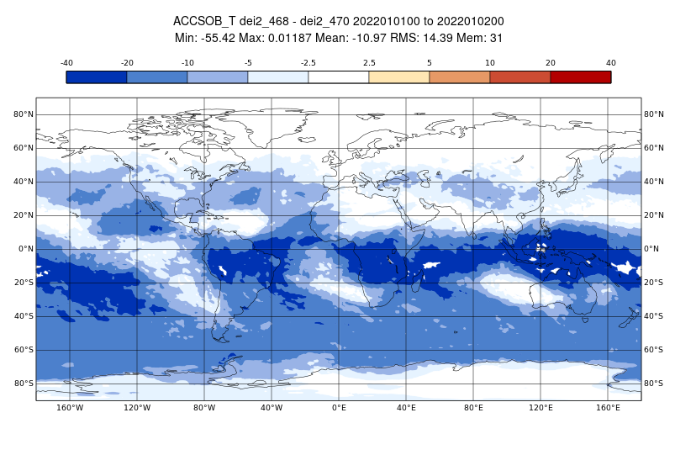
Large hydrometeors effect on radiation
TOA SW irradiance January

Slide 8
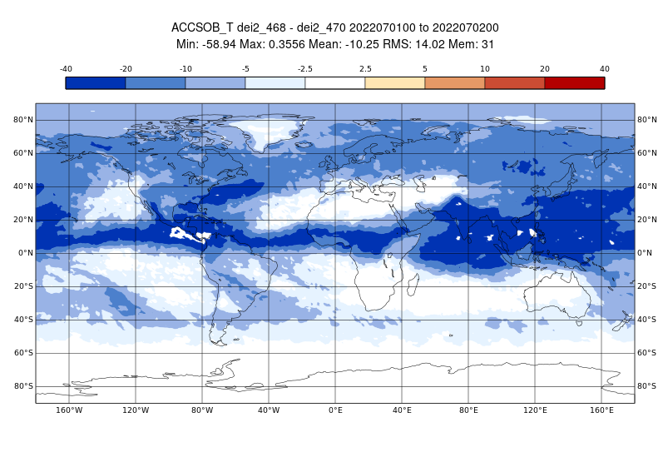
Large hydrometeors effect on radiation
TOA SW irradiance July

Slide 9
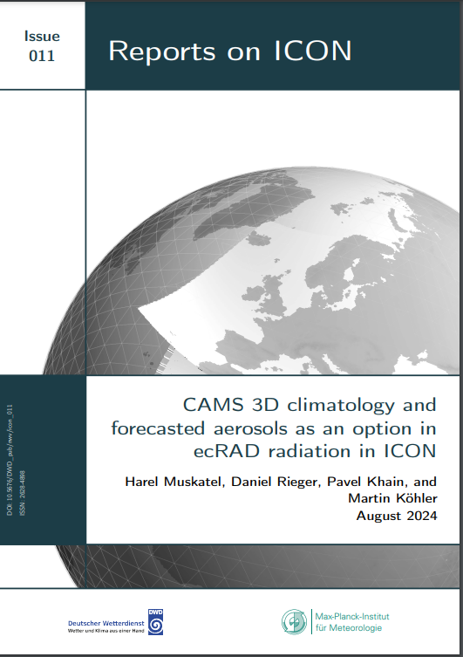
CAMS climatology and forecasted aerosols

Slide 10
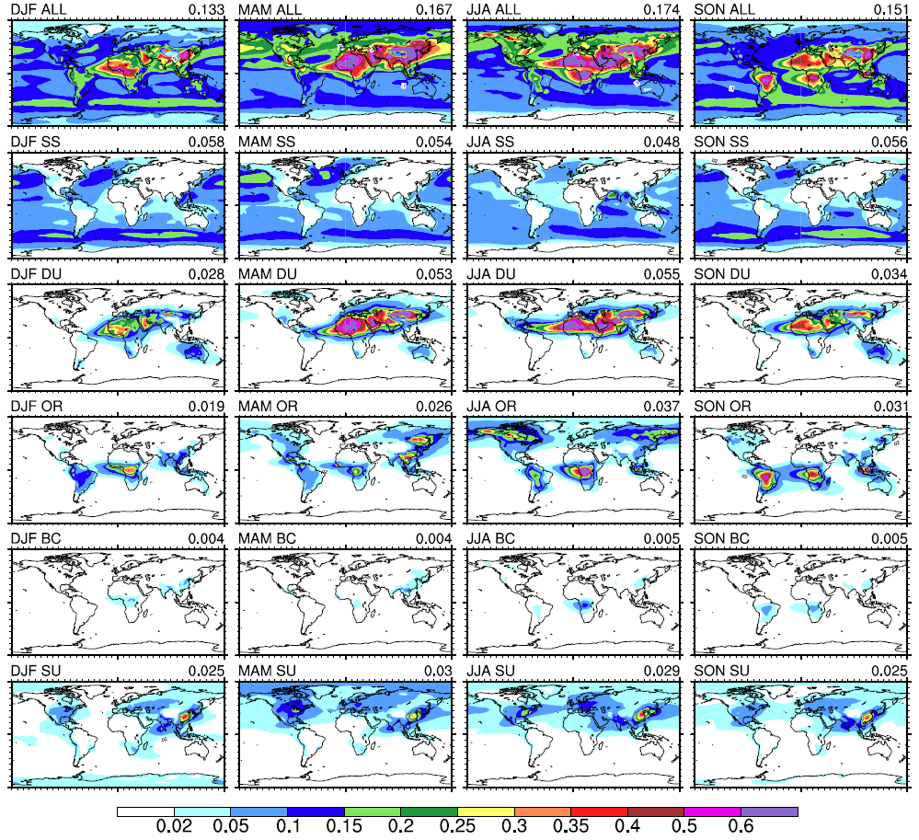
CAMS climatology - Seasonal AOD at 550nm
Bozzo et al.
2017

Slide 11
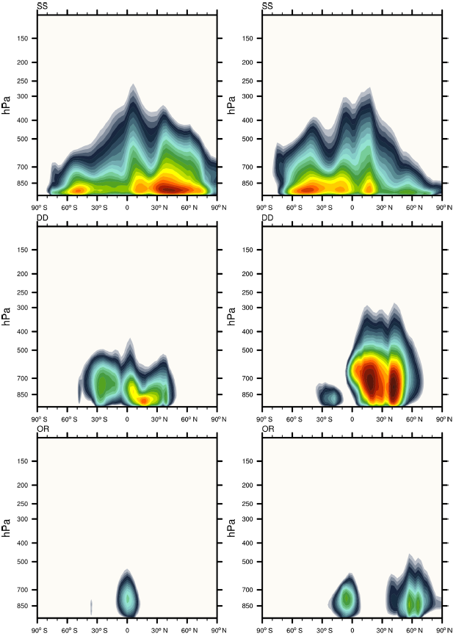
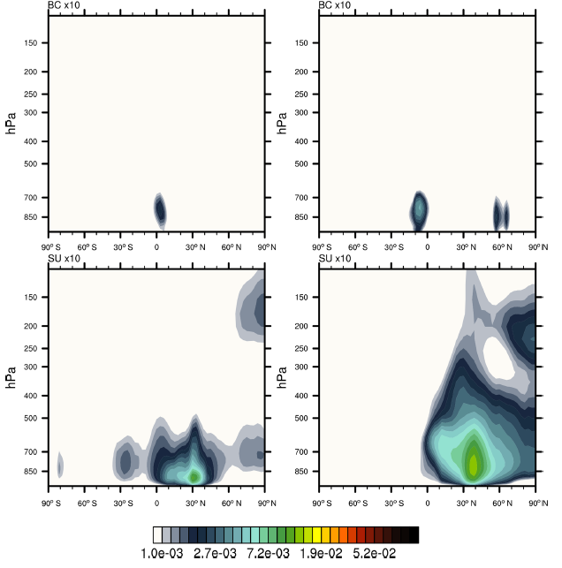
Zonal-mean layer-integrated mass profiles
Jan
Jul
SS
Jan
Jul
BC
DU
SU
OM
gr/m²
Bozzo et al. 2020

Slide 12
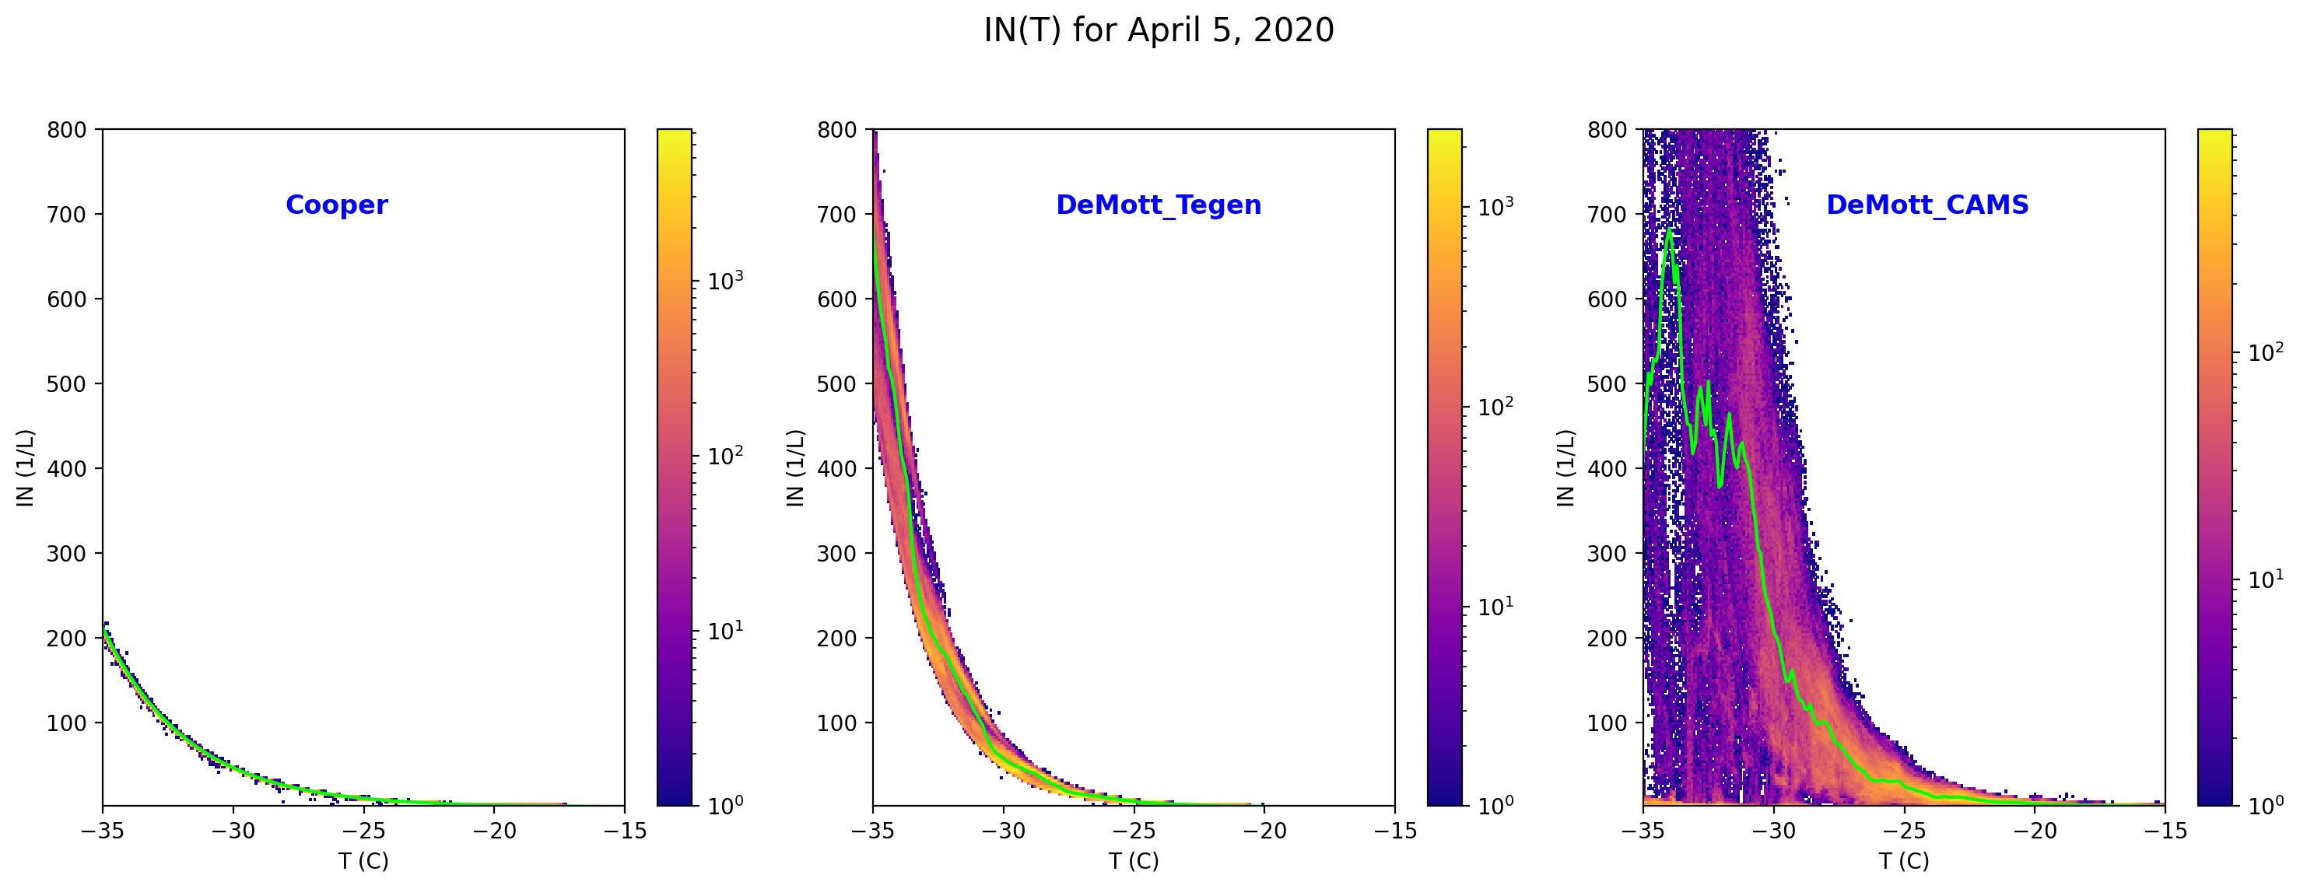
ICON Ice nucleation with DeMott (2015) scheme
$INP(T,ndust)=1000∙{n_{dust}}^{1.25}\exp^{0.46\left(T_{0}−T\right)−11.6}$
$$INP(T)=5∙\exp^{0.304(T_{0}−T)}$$
Tegen
CAMS forecast
CAMS climatology

Slide 13
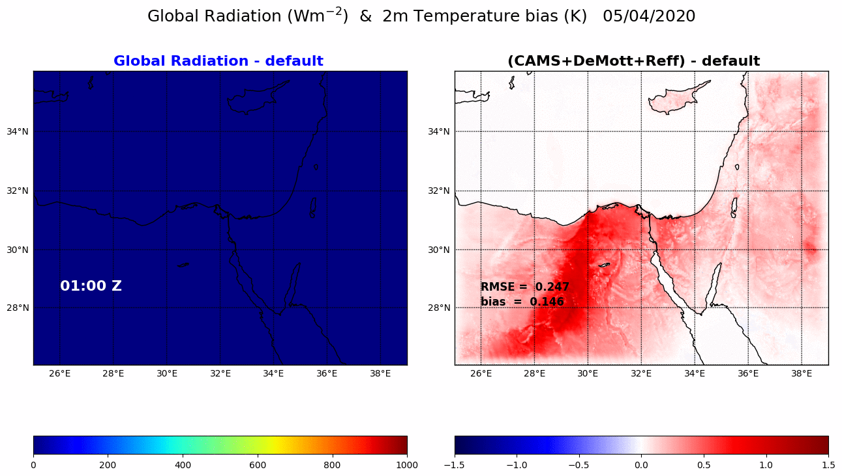
ICON Ice nucleation with DeMott (2015) scheme
direct + indirect effect

Slide 14
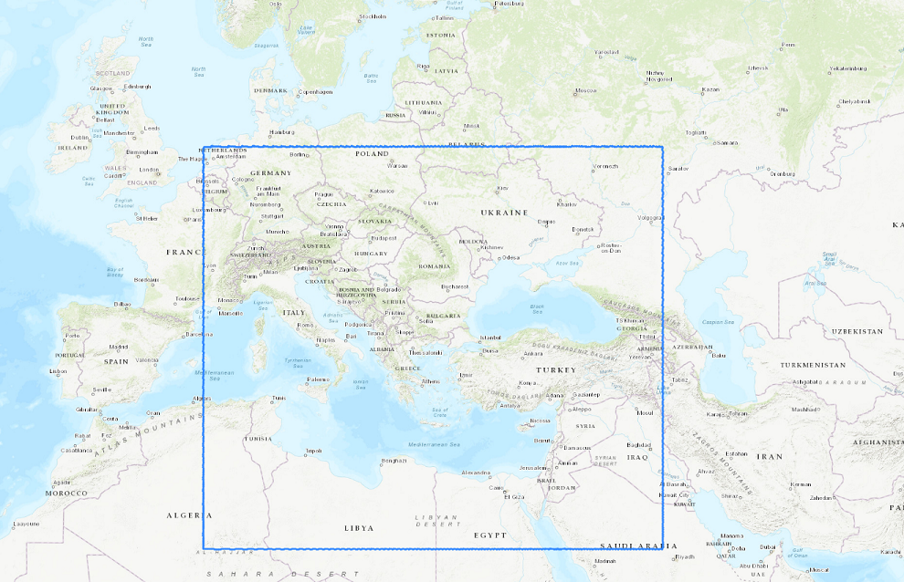
IMS verifications
Southeast Europe Domain (SEE)
IMS Domain (EM)

Slide 15
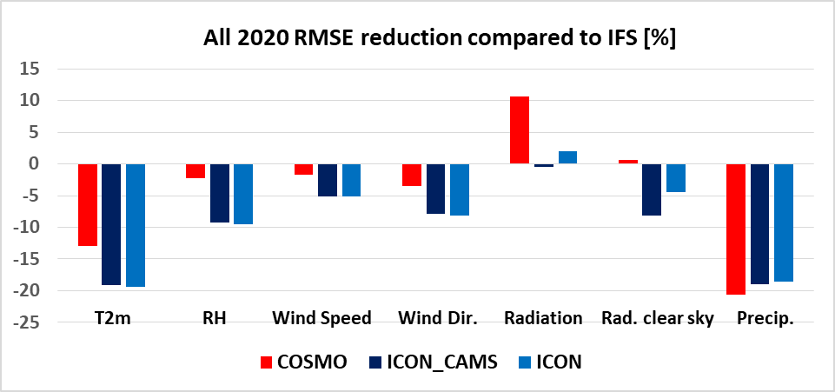
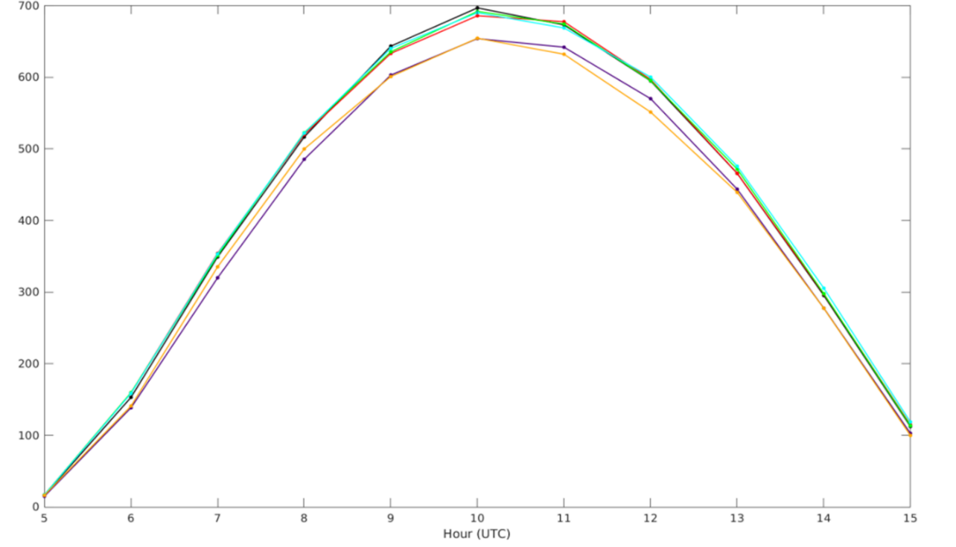

CAMS in ICON – IMS verifications
CAMS forecast
CAMS climatology
Dec-2021, Jan-Apr-Oct-2022

Slide 16
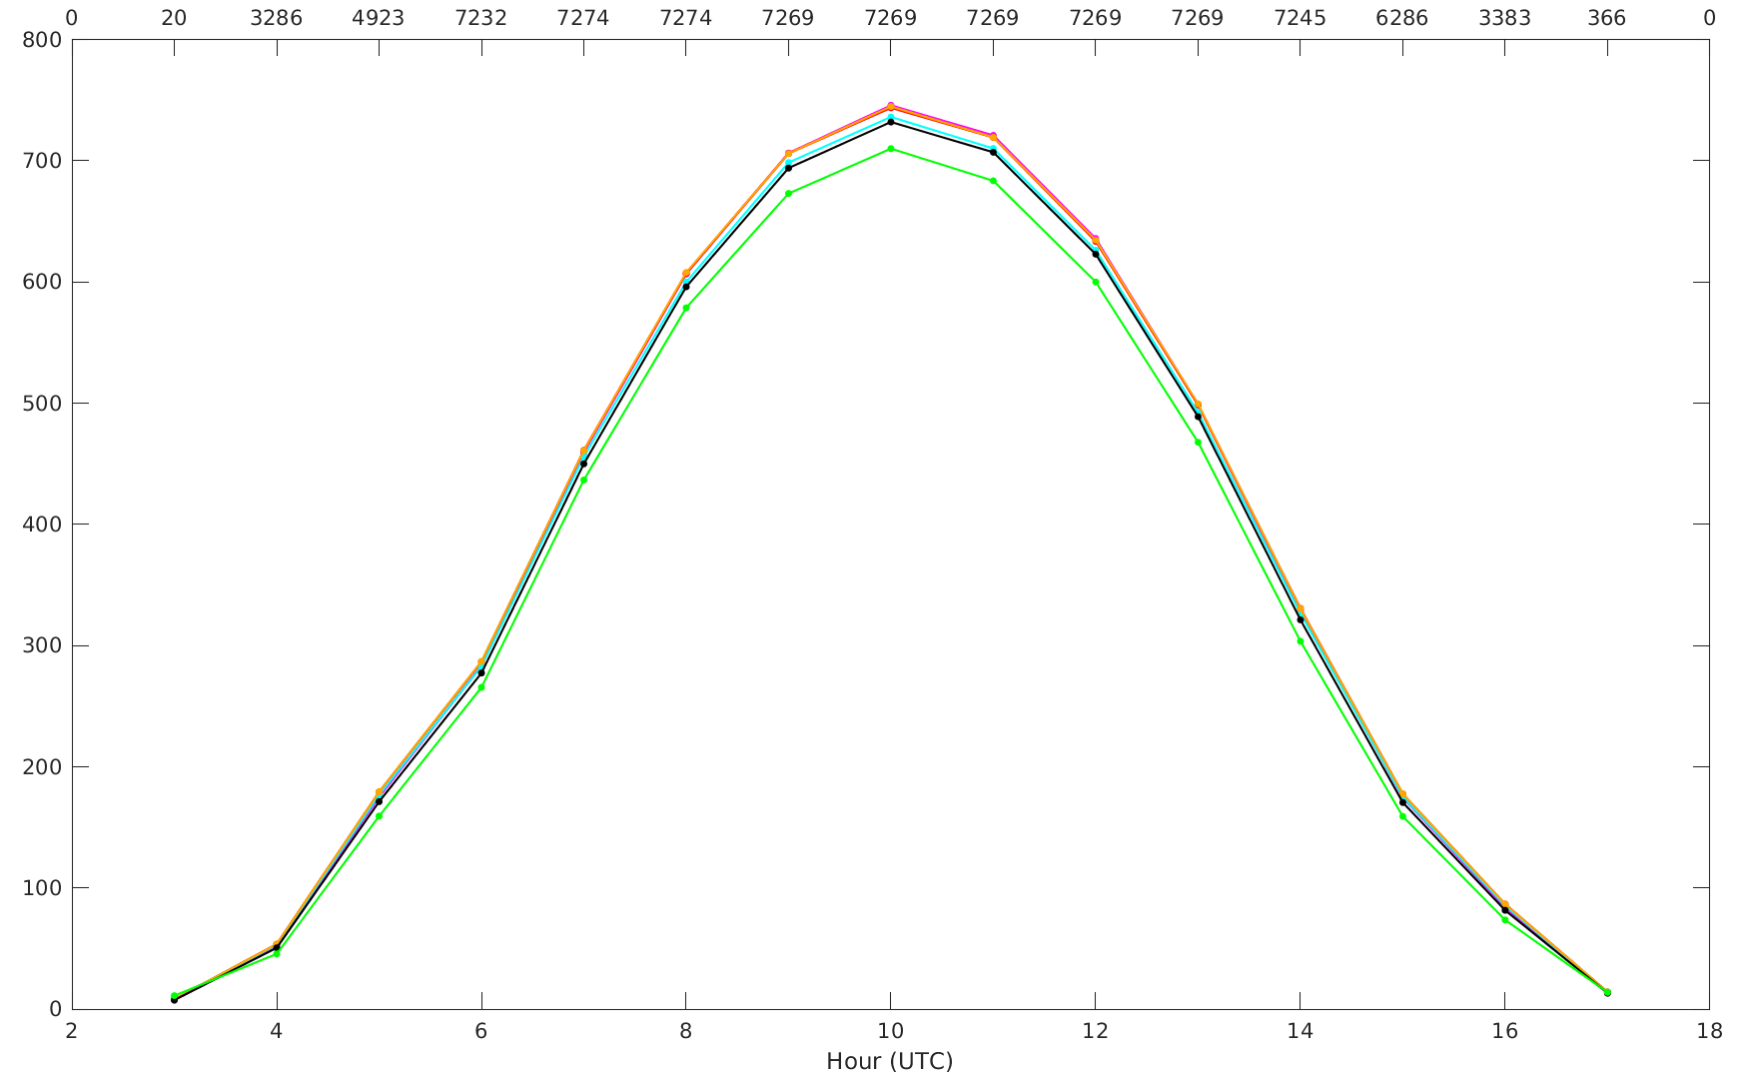
ICON Radiation Verifications
Dec2021, Jan, Apr, May, Sep, Oct 2022

Slide 17
Global simulations
Surface SW irradiance July
CAMSclim - default
CAMSforc - default

Slide 18
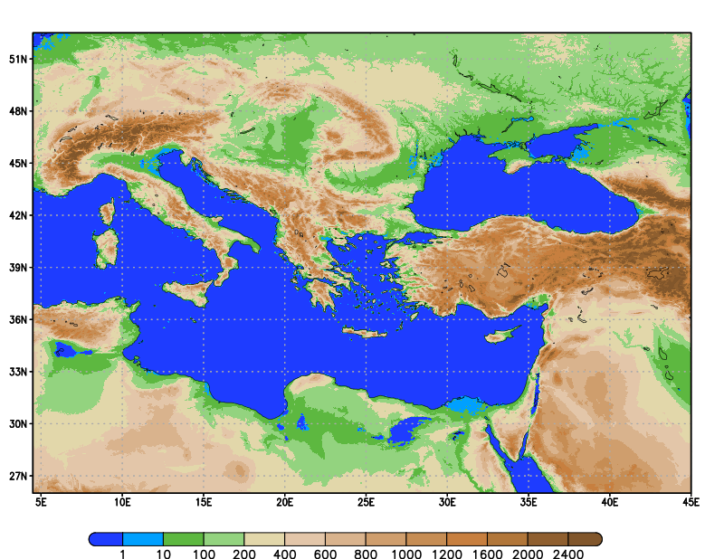
CAMS in ICON – HNMS verifications
5 model versions considered entire year 2023
~2000 runs based on ICON-IMS starting at 00 UTC daily:
Horizontal grid size: R2B10 (~2.5km).
1621x1061 grid points (wider area of Central and Eastern Mediterranean)
65 levels.
Integration time-step: 24 secs.
Integration period: 48 hs. ( An equivalent period of 10 years of model runs)
Boundary conditions : 3hr IFS Forecast.
Computational Cost of ~80 milion b.u. on ATOS Supercomputing System of ECMWF (Gratis HNMS).
Storage volume of ~20Tb at ECFS

Slide 19
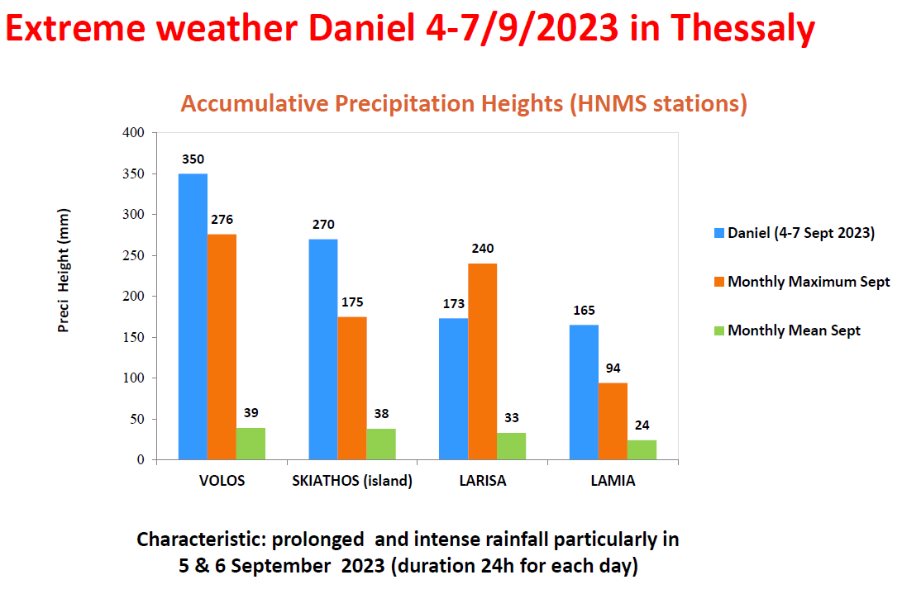
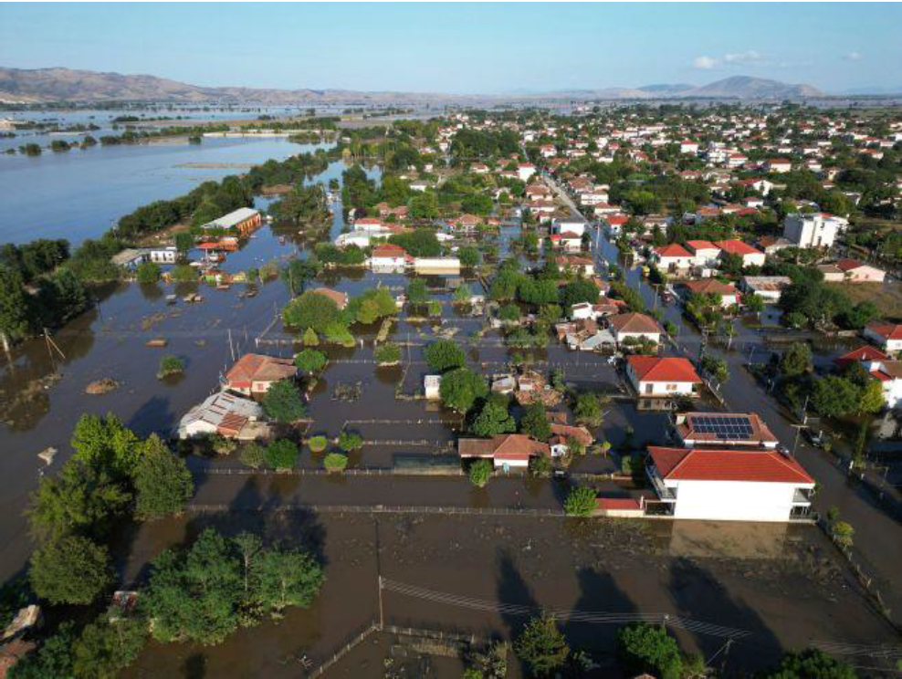
CAMS in ICON – HNMS verifications

Slide 20
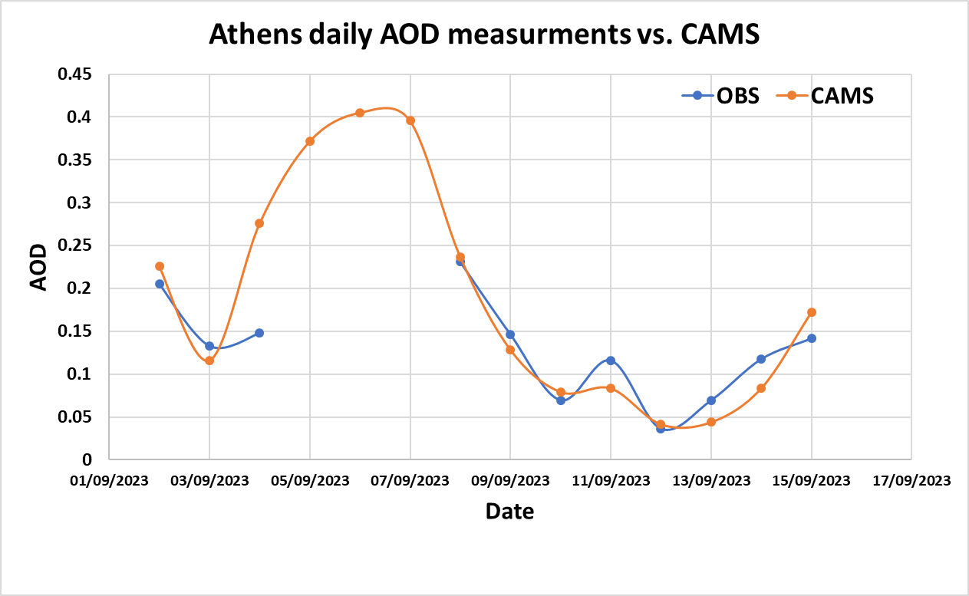
CAMS in ICON – HNMS verifications

Slide 21
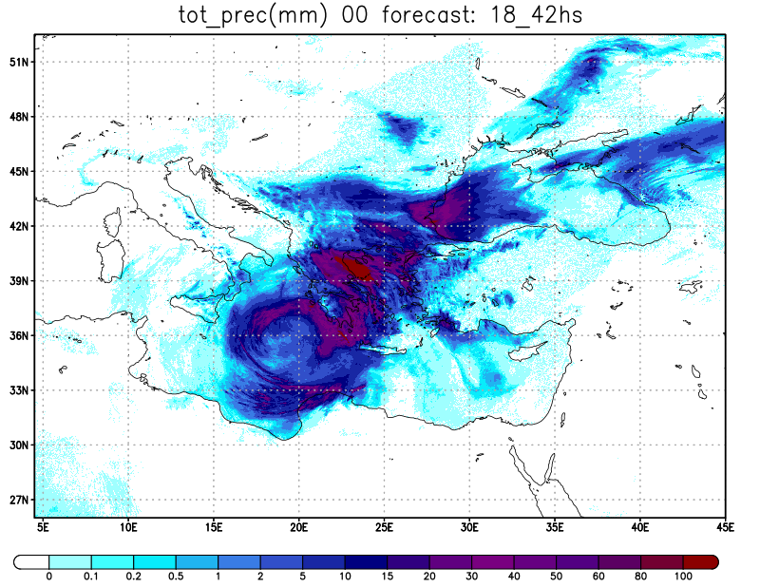
CAMS in ICON – HNMS verifications
24hr accumulated precipitation (tot_prec) [default (Tegen)] 2023090418-2023090518 UTC
mm

Slide 22
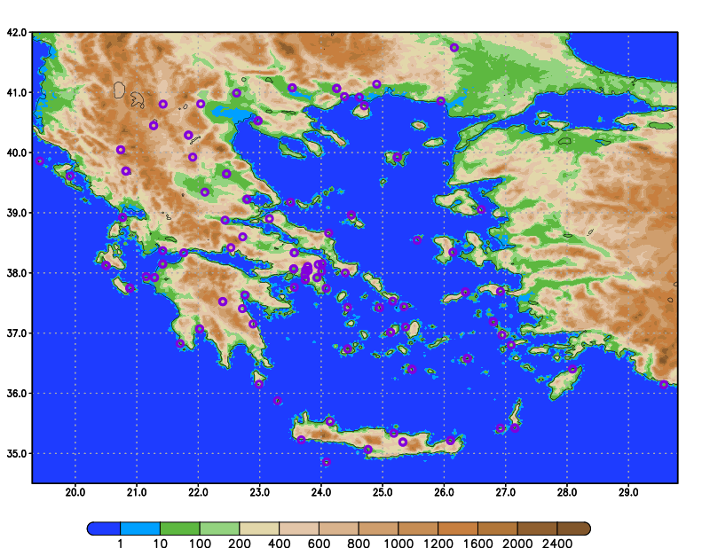
CAMS in ICON – HNMS verifications
Larisa
Volos
Lamia
Skiathos
m

Slide 23
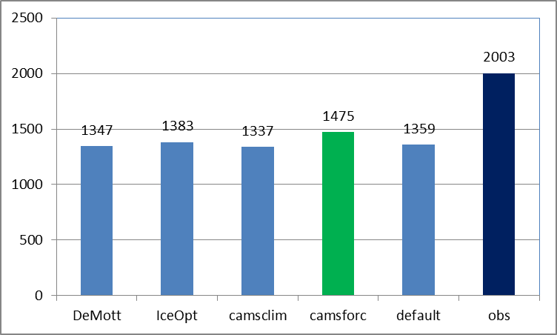
CAMS in ICON – HNMS verifications
Accumulated Precipitation 2023090318-20230718 UTC
and

Slide 24
2D AOD advection scheme (D. Rieger)

Slide 25
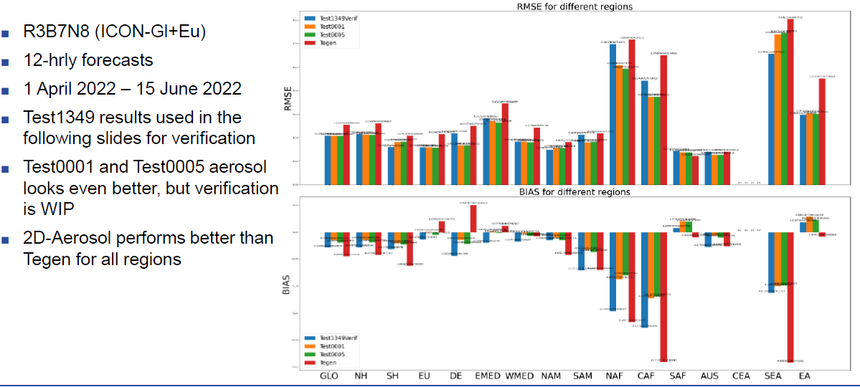
2D AOD – verifications against AERONET stations

Slide 26
CAIIR Tasks: done, removed, moved to ACLIIM
Analysis and revision of ice optical properties based on Fu (1996, 1998) in ecRAD
New liquid clouds optics based on Hu & Stamnes (better parametrisation available)
New ice nucleation parametrization (DeMott 2015) / Implementation of Segal & Khain (2006) droplets activation scheme for the effective radius calculation in ICON radiation
Implementation of CAMS forecasted aerosols 3D fields as input for ICON radiation
Implementation of CAMS climatology aerosols as input for ICON radiation scheme
Improvements/testing of the 2D aerosols advection scheme in ICON
Implementation of Kinne aerosols climatology fields as input for ICON radiation scheme (done in DWD)
Testing the radiation code using different aerosol inputs against experimental datasets for clear/cloudy sky conditions
Analysis/Revision of shallow convection scheme/SGS cloudiness in ICON radiation
Systematic tuning (CALMO methodology) of the different ICON-RRTM versions for finding the best operative setup (lack of resources)
Warm phase SBM / Mixed phase SBM

Slide 27
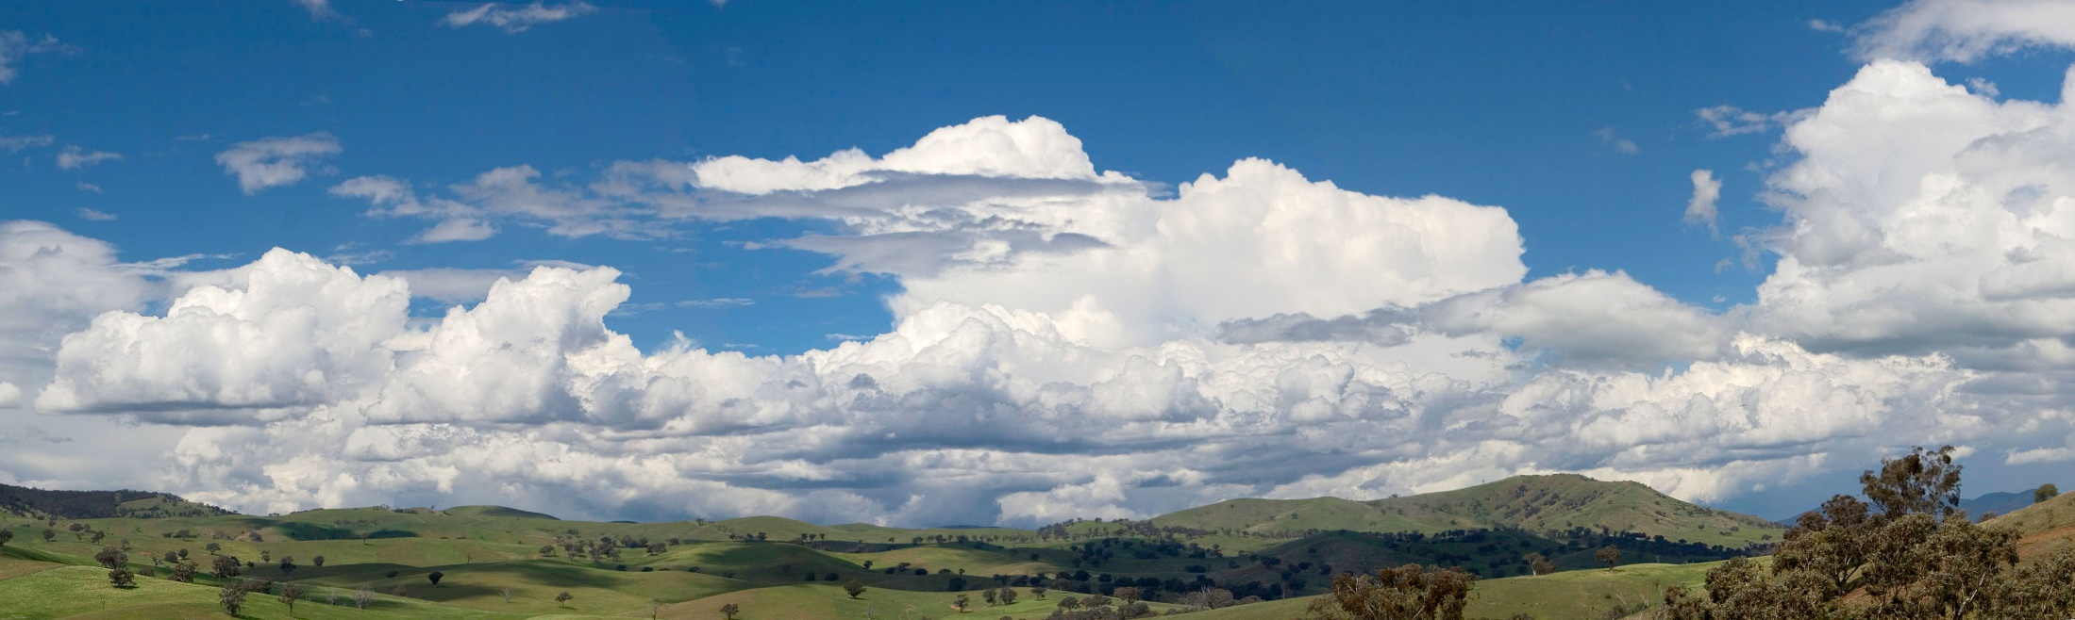
Aerosol-CLoud Interactions in ICON Model:
ACLIIM Priority Project
בס"ד

Slide 28
Aerosol-CLoud Interactions in ICON Model:
ACLIIM Priority Project
September 2024 - August 2027
Total planed FTEs : 4.8
Participants:
Harel Muskatel (IMS)
Pavel Khain (IMS)
Euripides Augoustoglou (HNMS)
Daniel Rieger (DWD)
Alberto de Lozar (DWD)

Slide 29
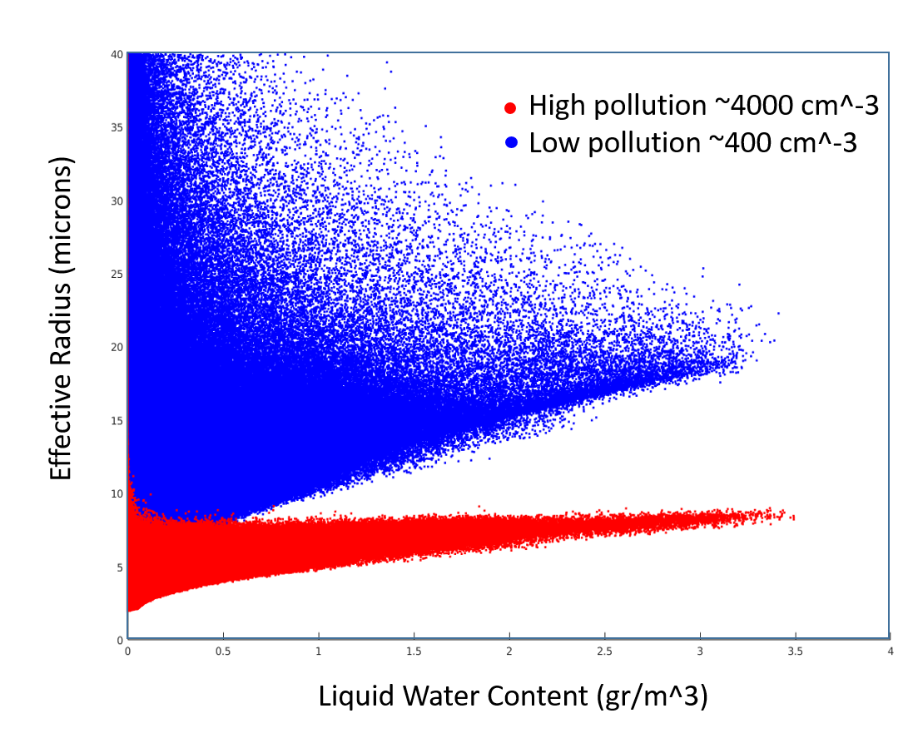
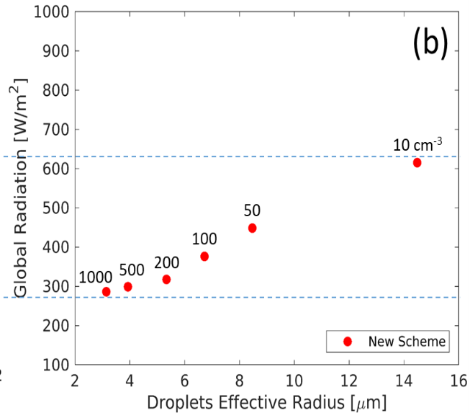
CDNC importance for radiation
SBM simulations
COSMO simulations

Slide 30
CDNC importance for microphysics
Pristine tropical clouds with low CCN concentration can rain out too quickly to mature to long lived clouds
Polluted clouds with very high CCN concentrations may evaporate before rain can occur
Rosenfeld et al., Science, 321 , 2008

Slide 31
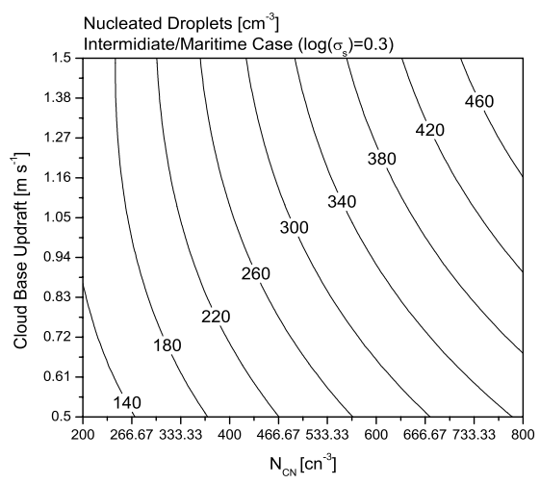
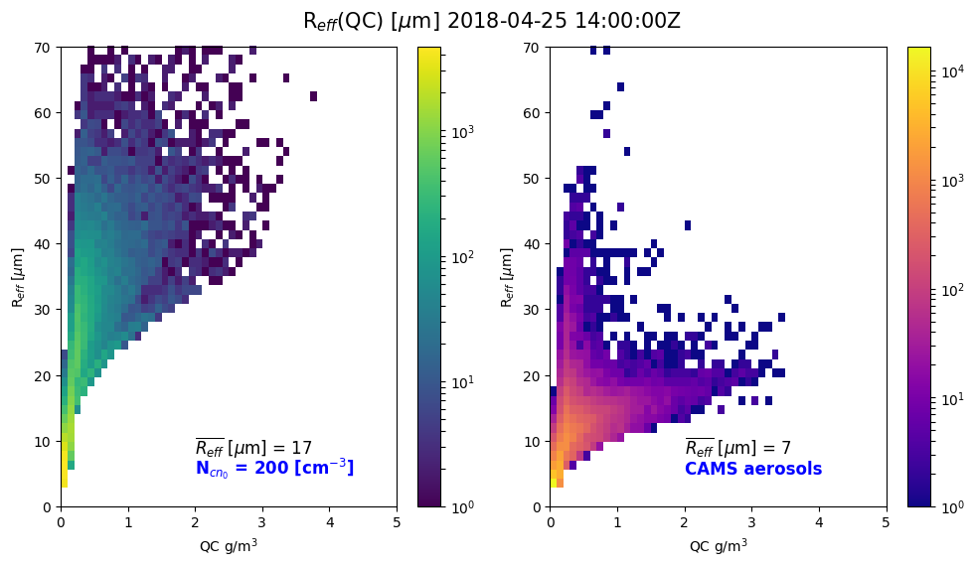

Segal & Khain cloud droplets activation scheme
  Calculation of CDNC from N_{CN} is estimated from Segal & Khain (2006)
  4D look-up table:
$$CDNC=f(n_{cn}, log(σ),r_{mod}{,w}_{CB})$$
Segal & Khain (2006)

Slide 32
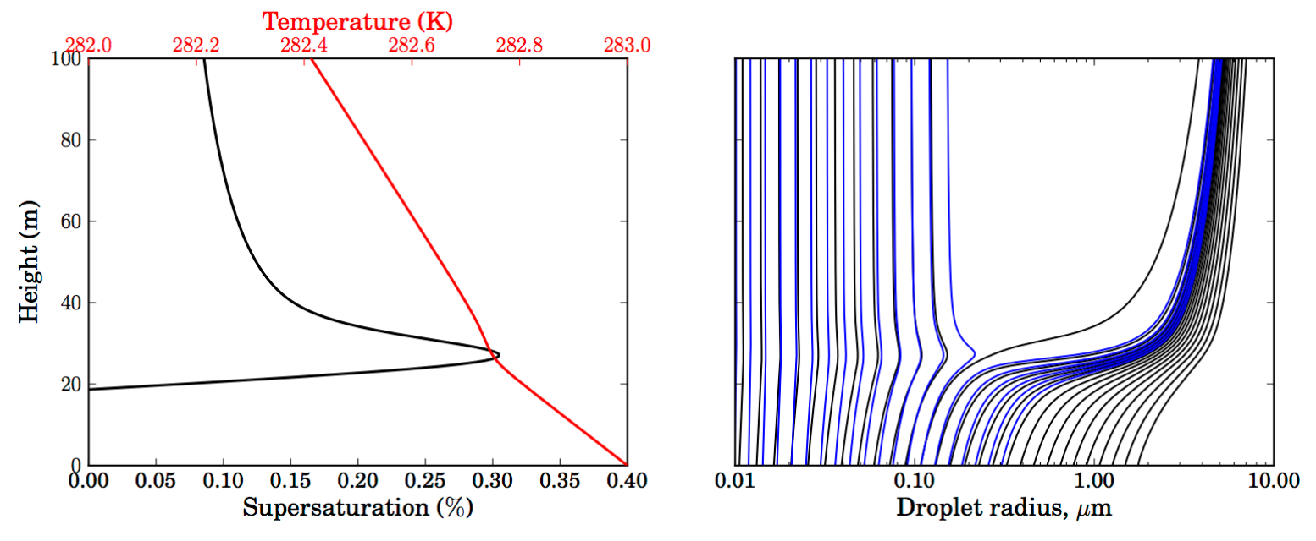

pyrcel: cloud parcel model
    Setup pyrcel
    Run pyrcel with different combinations of initial conditions:
    Train a ML model
    Plug-in of the trained ML model in ICON (Comin)
$$CDNC=f(n_{cn}, p,S,t{,w}_{CB})$$
Daniel Rothenberg and Chien Wang, 2016. J. Atmos. Sci., 73, 1255–1272.

Slide 33
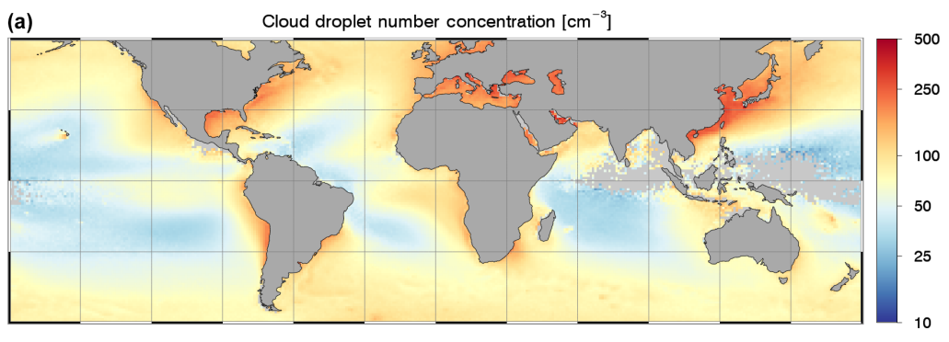
Comparisons to other datasets
1. MODIS climatology (already in ICON)
2. MODIS daily values 2000-2020 (Gryspeerdt et al., 2022)
Bennartz, R; Rausch, J (2017). ATMOSPHERIC CHEMISTRY AND PHYSICS, 17(16), 9815-9836.

Slide 34
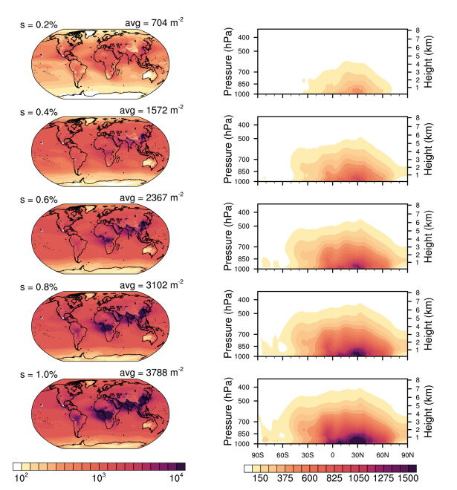
Comparisons to other datasets
3. CAMS reanalysis daily values 2003-2021 (Block et al., 2024)

Slide 35
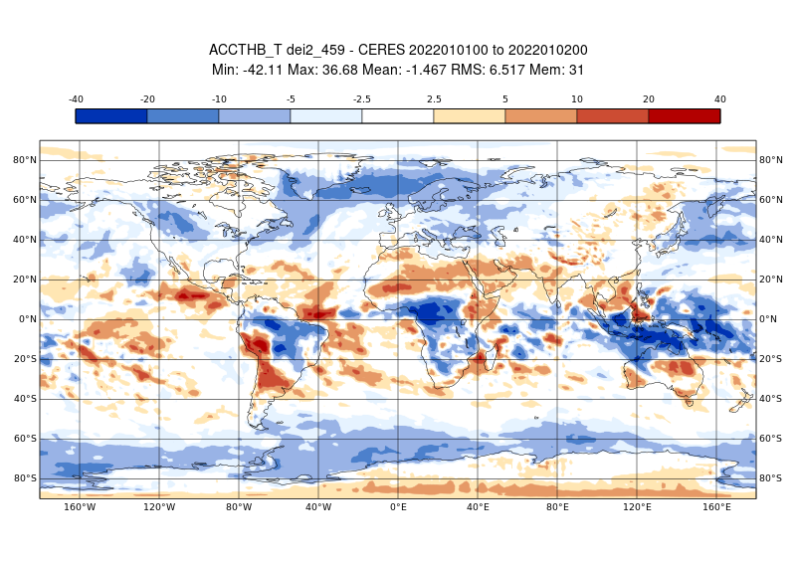
Verifications

Slide 36

Spectral Bin Microphysics in ICON
Warm-Phase Spectral-Bin Microphysics (SBM) scheme was implemented in ICON in master as part of CAIIR
66 bins: droplets + CCN tracers
Runs ~7 times slower than 1M.
SBM and 2M schemes compared: SBM shows reasonable behavior, strong sensitivity to CCN.
Example: Cumulonimbus development (Weisman-Klemp 1982)
ACLIIM: mixed-phase SBM implementation and calibration
16
12
QC+QR (g/kg)
8
4
0
50km
Khain, P., J. Shpund, Y. Levi and A.P. Khain, 2022. Atmos. Res., 279, 106388.
Acknowledgments: Axel Seifert, Daniel Reinert, Daniel Rieger

Slide 37
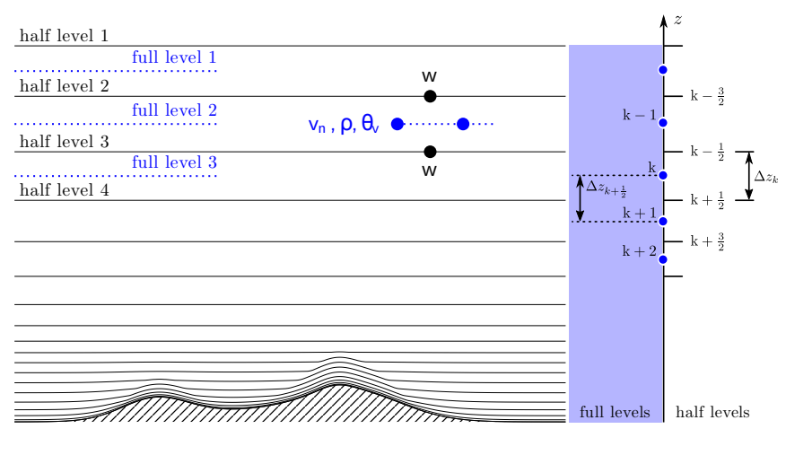
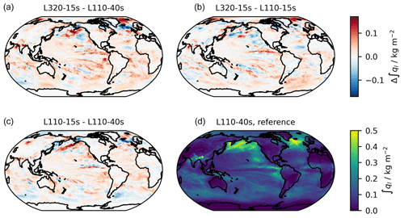
Vertical resolution impact on cloud formation, cloud cover and precipitation
Schmidt, H., et al. Geosci. Model Dev., 17, 1563–1584, 2024.

Slide 38
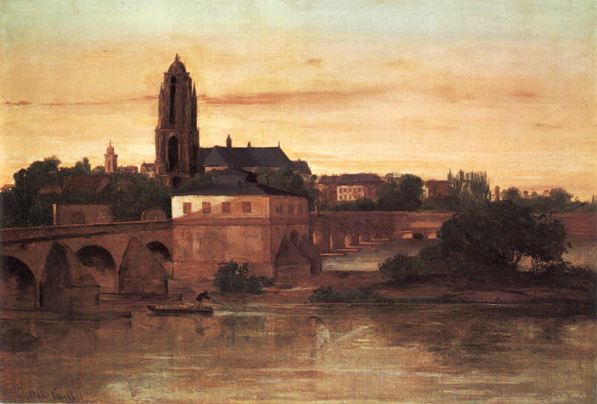
Thanks for Your Attention!

