Slide 1



WG Support and Infrastructure (former WG6)
Massimo Milelli and colleagues
4 September 2024, 26th COSMO General Meeting

Slide 2
WG outlook
PP C2I4LC (Stefan’s talk in a few minutes)
SCA Report and Open-Source Release (Uli’s talk in a few minutes)
ICON-C Update (by Xavier)
Update ICON on GPU and status of the gt4py dycore (by Christoph Müller)
SINFONY infrastructure (by Christian Welzbacher)
AICON (by Jacob/Prill)
GLORI/GLORI-A infrastructure (by Xu Xu and Alfonso Ferrone)
ICON-LEPS (by Enrico Minguzzi)
NWP Test Suite (by Enrico Minguzzi)
Staus of documentation (by me)

Slide 3
ICON-C, Consolidation Project, Status
Infrastructure project to make the ICON code more modular, i.e. encapsulate the different components with clear/defined interfaces
Allow for more scalable development workflow, in particular through an improved testing of individual components
Step-wise modernization
The final ICON-C code base should allow for all needed climate and nwp operational applications
Related project: WarmWorld, EXCLAIM
ICON-C Developers: Claudia Frauen; Joerg behrens; Ralf Mueller; P. Samanta; Daniel Reinert; Florian Prill; Roland Wirth; Sergey Kosukhin; Luis Kornblueh; Reiner Schnur; Claudius Holeksa; Yen-Chen Chen ; Terry Cojean; William Sawyer ; Andreas Jocksch; Jonas Jucker

Slide 4
Several features from ICON-C have been already merged in the main or will be soon
Need to revise soon the road map and decide what is achievable within the project
Next steps
28-30.10.2024 ICON all hands meeting – several ICON-C sessions
Decide which physical parameterization will be modularized next
Decide which part of the code will go into libraries, besides what is already done
Decide next step for communication, memory manager and grid manager

Slide 5
Update ICON on GPU and status of the gt4py dycore
C. Müller¹, D. Hupp¹, X. Lapillonne¹, V. Cherkas¹, R. Dietlicher¹, F. Gessler¹,, M. Röthlin¹,
N. Burgdorfer¹, M. Stellio¹, G. Vollenweider¹, C. Osuna¹, A. Walser¹, A. Gopal³, M. Jacob⁴,
A. Jocksch³, J. Jucker², R. Meli³, W. Sawyer³, U. Schättler⁴, D. Alexeev⁵, A. Leuthard¹,
S. Kellerhals³, N. Farabullini³, M. Luz³, C. Ong³, D. Strasmann³ , P. Kumar³
¹MeteoSwiss, ²C2SM, ³CSCS, ⁴DWD, ⁵Nvidia

Slide 6
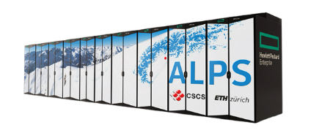
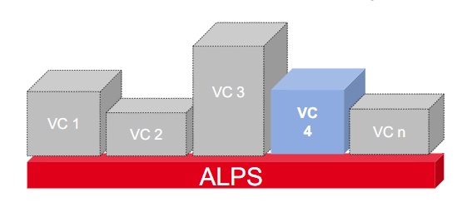
Alps infrastructure at CSCS
New MeteoSwiss system HPC Computing Services on Alps Platform
2 Virtual Clusters (VC):
Production: 42 GPU / 15 CPU Nodes
R&D: 30-50 GPU / ~15 CPU Nodes (elastic)
GPU nodes:
4 x NVIDIA A100
1 x AMD Epyc 64-cores CPU
CPU nodes:
2 x AMD Epyc 64-cores CPUs
Part of the large system (alps):
  R&D partition can be extended
  new challenges : maintenance, testing, ML, …

Slide 7
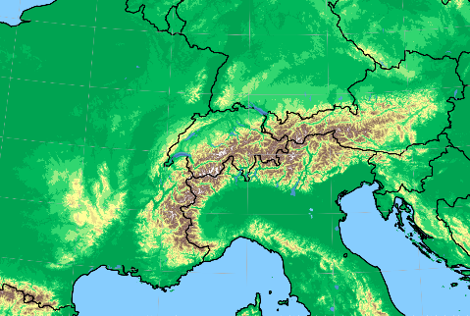
GLORI-A Configuration
ICON-CH1-EPS
Resolution: 500m
Initial Conditions:
KENDA-i1
Lateral Boundary Conditions :
IFS 9km / ICON 3.5 km
Online Nest:
Interpolation and relaxation during forward integration
ICON-Alp-05

Slide 8
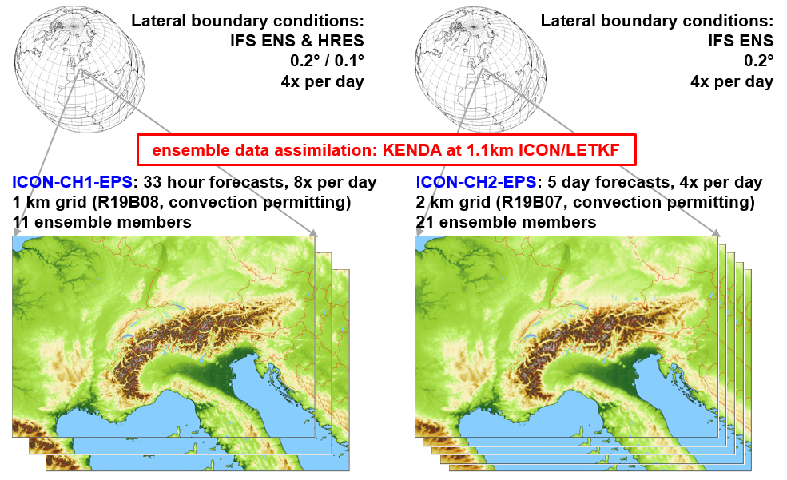
MeteoSwiss operational configuration
Operational since May 28th 2024 at CSCS
Not using all optimization yet (no cuda-graph)
Full schedule on Tasna (ALPS)
  ICON-CH1-EPS :
  3 nodes/member
  ICON-CH2-EPS :
  1 node/member
  KENDA-CH1 :
  1 node/member

Slide 9
Status of the OpenACC port to GPU
 | ported | merged
nh_solve
nh_hdiff
transport
2 way nesting
convection
microphysics (graupel)
radiation
radheat
surface (terra)
cover
turbulence
sea-ice
SSO
non-or. wave drag
2 mom. microphysics
 | ported | merged
NWP diagnostic
hailcast
DA: LHN
DA: conv. operation
DA: IAU (incr. analisys update)
SPPT
ICON-ART
pollen
EMVORADO
ICON-HAM
snow (nix)
RTTOV (synthetic sat. imag.)
 | completed
 | in progress
 | on CPU + data copy and interface ported
 | not started

Slide 10

ICON4Py Update – Overview
Granules ported (same interface as ICON-C)
  Dycore (granule verification pending)
  Diffusion (granule verifying)
In progress
  Microphysics
  Tracer advection
Performance improvements delayed
  Currently on par with OpenACC
  Define new IR called GTIR to be able to do optimization passes
Interface to ICON now on granule level
  Want to merge as soon as performance improvement is significant

Slide 11

Infrastructure
Seamless INtegrated FOrecastiNg sYstem
26th COSMO General Meeting, WG6, Offenbach am Main
2nd of September 2024
Christian A. Welzbacher on behalf of
Project-Team & Friends: Ulrich Blahak, Roland Potthast, Kathleen Helmert, Alberto De Lozar, Axel Seifert, Elisabeth Bauernschubert, Thomas Hanisch, Matthias Zacharuk, Manuel Werner, Robert Feger, Rafael Posada Navia Osorio, Lilo Bach, Michael Hoff, Martin Rempel, Lisa Neef, Kathrin Feige, Markus Schultze, Sven Ulbrich, Kobra Khosravian, Jana Mendrok, Mareike Burba, Jana Mendrok, Klaus Vobig, Leonhard Scheck, Christian Berndt, Gregor Pante, Vera Maurer, Maike Ahlgrimm, Annett Strauß, Beke Kremmling, Ulrich Friedrich, Arne Spitzer, Lukas Josipovic, Thomas Deppisch, Matthias Gottschalk, Tobias Bergmann, Cornelius Hald, Isabel Urbich, Malte Schmid, Jan Bondy, Matthias Brechtel, Michael Denhard, Marcus Paulat, Felix Fundel, Vanessa Fundel, Andreas Höfer, Markus Zeindl, Christoph Schraff, Tanja Winterrath, Ewelina Walawender, Katharina Lengfeld, Kathrin Wapler, Linda Schlemmer, Julia Bachmann, Julia Keller

Slide 12
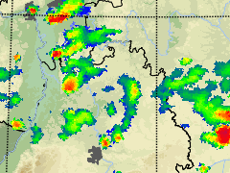
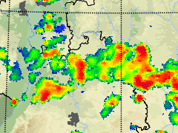
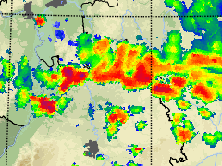
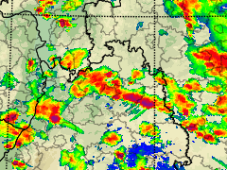
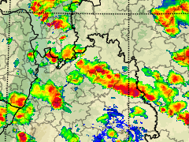
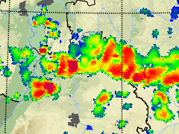
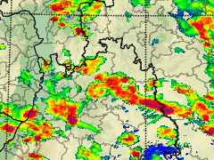
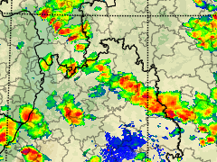
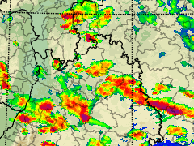
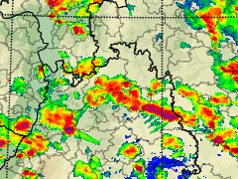
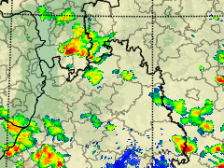
Starting point: forecast time range 0-12 h currently covered by two forecasting methods
Nowcasting
(0-2 h, update every 5 min)
Based on observations, efficient, deterministic, quickly available
Observations
DWD radar network
9.Juli 2021, Southern Germany
Numerical Weather Prediction
(0-48 h, update every 3 h)
Expensive numerical model, only available after 1-1,5 h
15:00 UTC
15:30 UTC
16:00 UTC
17:00 UTC
Started 15:00 UTC
Started 12:00 UTC
SINFONY improves both methods separately, interlocks them and produces combined forecasting products – seamless for and based on discussions with the users

Slide 13
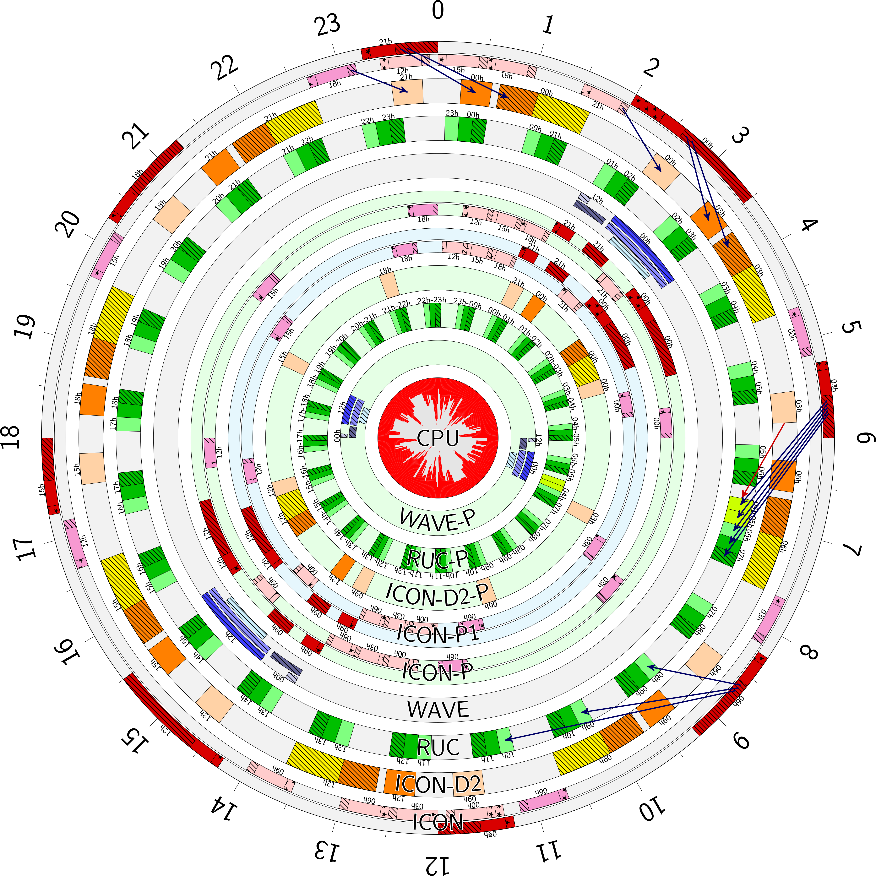

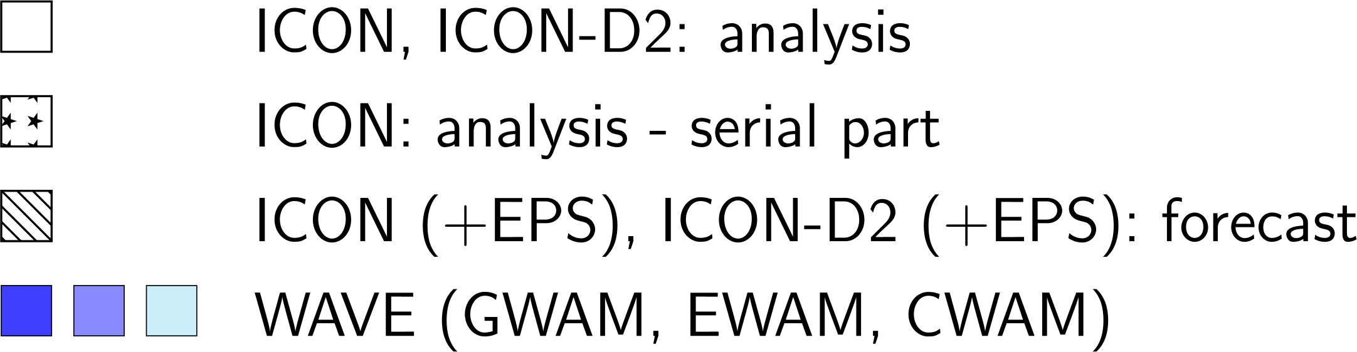
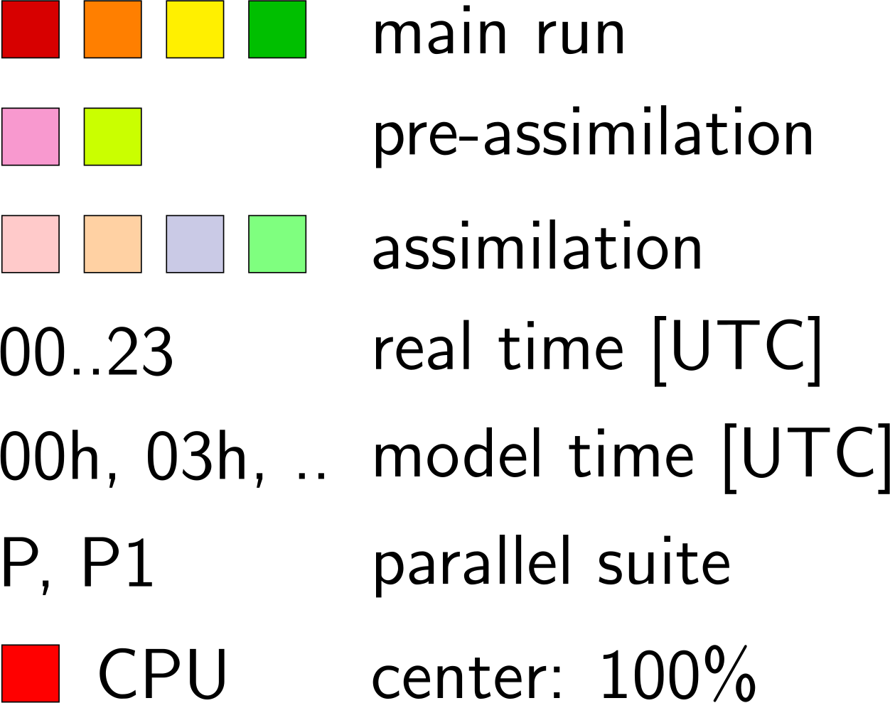
“Modell-Uhr”
Notes:
- short look to the operational timetable
- here we have a look onto the outer part
Schedule of GME, C-EU, C-DE, WAVE and RLM
- dark colors = forecast runs
- brighter colors assimilation
- the innerpart contains the schedule of our operational parallel suite
→ later

Slide 14
AI Approaches at DWD
Marek Jacob, Florian Prill & the DWD AICON team
Deutscher Wetterdienst | COSMO GM | 02 Sep 2024

Slide 15
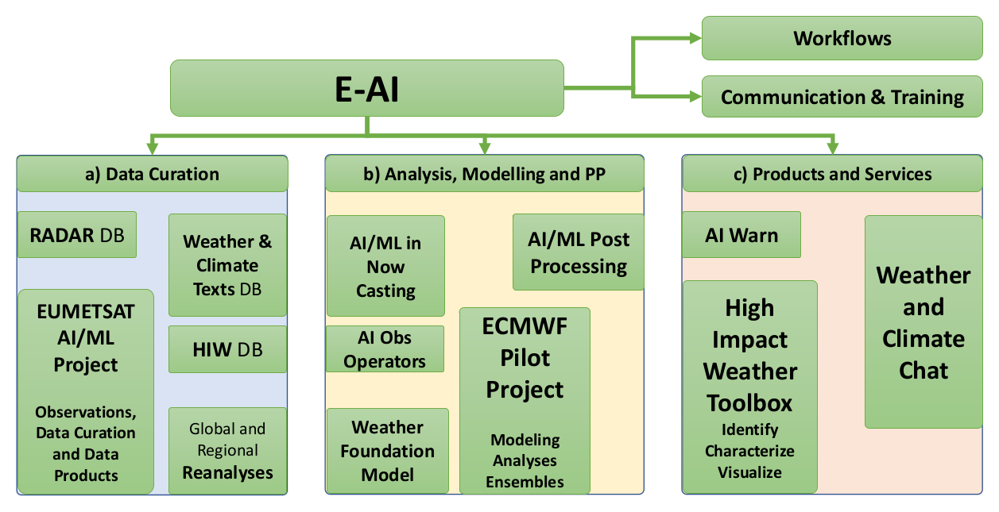
EUMETNET Programme: E-AI
Artificial Intelligence and Machine Learning in Weather, Climate and Environmental Applications
Programme Coordinator:
  Roland Potthast
Started 2024
Open Participation
  UK MetOffice
  MeteoSwiss
  Dutch KNMI
  MetNorway
  DWD
  MeteoFrance
  EUMETSAT
  ...
250 interested individuals

Slide 16
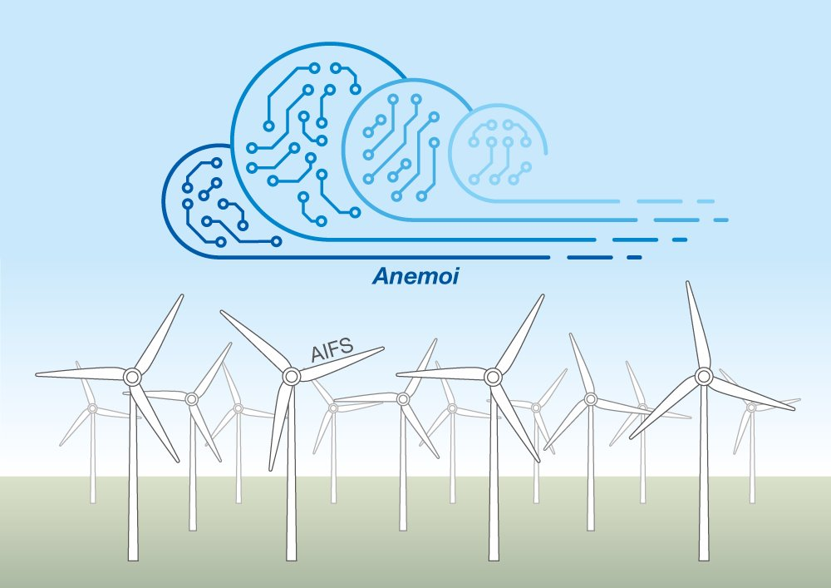
Anemoi configurations
ECMWF Artificial Intelligence
Forecasting System (AIFS)
  Initial motivation for Anemoi code base
  Trained on global ERA5
  Predicts:
  single level: z, cp, msl, 10u, 10v, 2t, 2d
  at 13 p-levels: z, t, u, v, w, q
  Lower RMSE of z_500 than IFS
AICON
  DWD's data-driven weather forecast
  Trained on ICON data and grid
  Targets global and regional
Anemoi is the driving force for models such as AIFS (ECMWF)

Slide 17
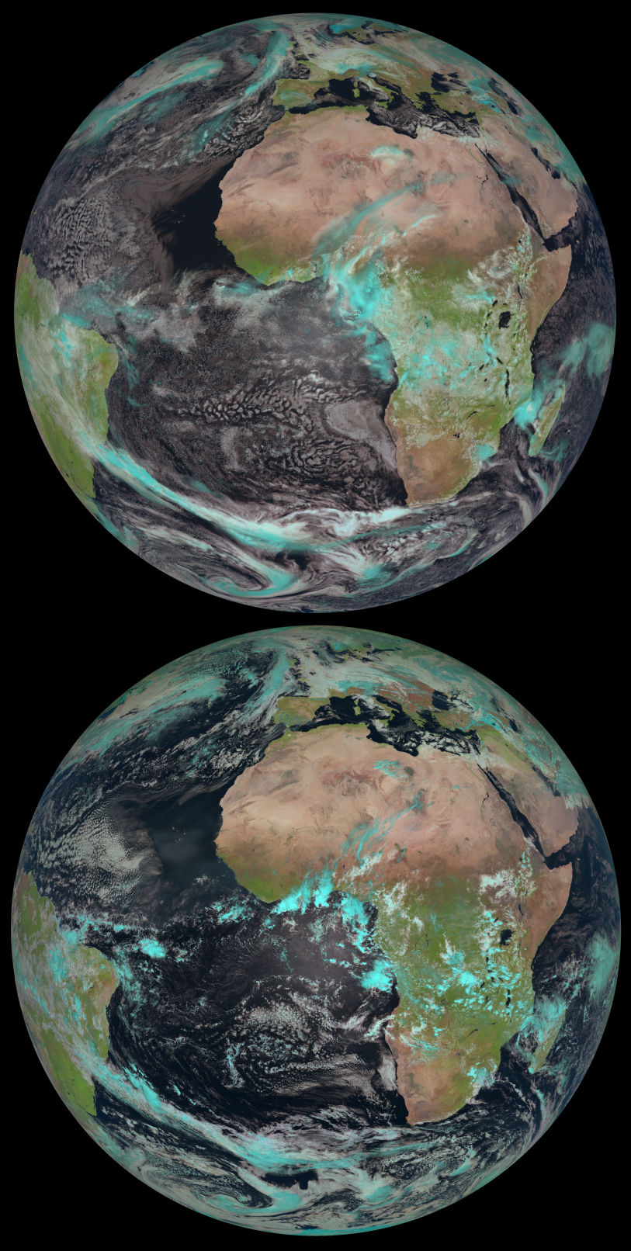
ICON-DREAM Reanalysis
Dual resolution Reanalysis for Emulators, Applications and Monitoring
Based on the operational ICON model, 3D-Var and LETKF
Conventional observations (including wind profilers),
AMVs (atmospheric motion vectors), GNNS-radio occultation,
scatterometer wind (including altimeters)
Available 2010 – 2023, probably extended to current
Global resolution: 13 km det, 40 km EPS (20 members)
  Plus Nest over EU (6.5 / 20 km)
  3hr-ly analysis, 1hr-ly reforecasts at 120 levels,
  111 variables per time step, 445 TB per year (GRIB2 compressed)
Is being evaluated internally
Will be shared among COSMO partners
ICON-DREAM and the Earth from Space
(Courtesy of L. Scheck and EUMETSAT)

Slide 18
GLORI/GLORI-A Infrastructure – Part I
GLORI Digital Twin on HoreKa
Xu Xu¹, Michael Krayer¹, Thorsten Steinert¹, Terry Cojean²
¹Deutscher Wetterdienst, Offenbach, Germany
²Karlsruher Institut für Technologie

Slide 19
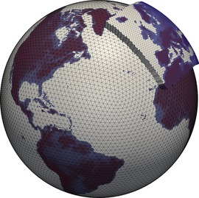
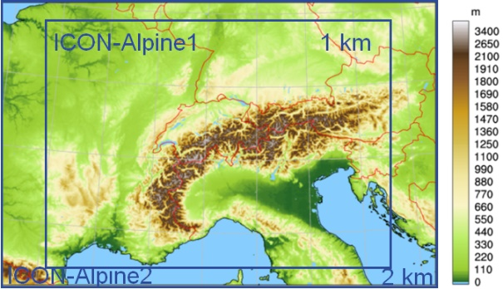
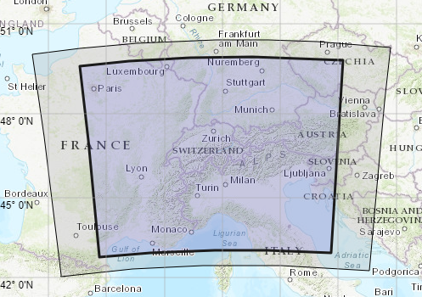

GLORI Digital Twin Configuration
Global – EU nested
GlORI-Alps
Basic Setup (CH2)
High resolution assimilation
(CH1)
Deterministic Run: 13 km 6.5km
Ensemble: 26 km
EU (two-way-nested)
Deterministic Run: 6.5 km 3.25km
Ensembles: 13 km
Ensemble members: 40
Hybrid data assimilation: 3dvar + LETKF
Deterministic Run: 2 km
Ensembles: 2 km
Nest (two-way-nested)
Deterministic Run: 1 km
Ensembles: 1 km
Ensemble members: 40
Deterministic Run: 1 km
Ensembles: 1 km
Nest (two-way-nested)
Deterministic Run: 500m
Ensembles: 500m
Ensemble members: 40
Xu Xu 19

Slide 20
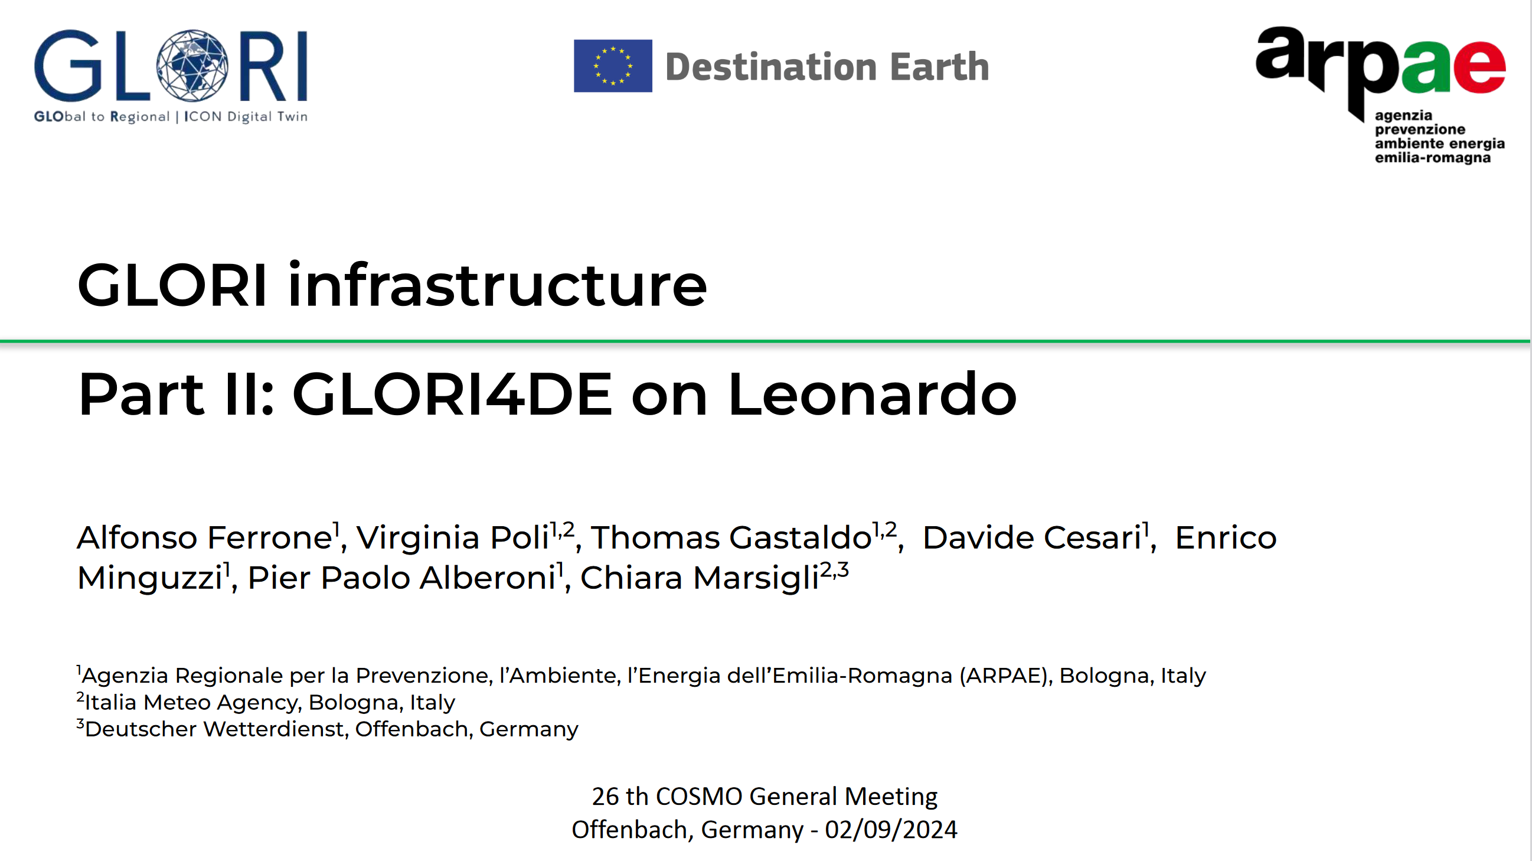

Slide 21
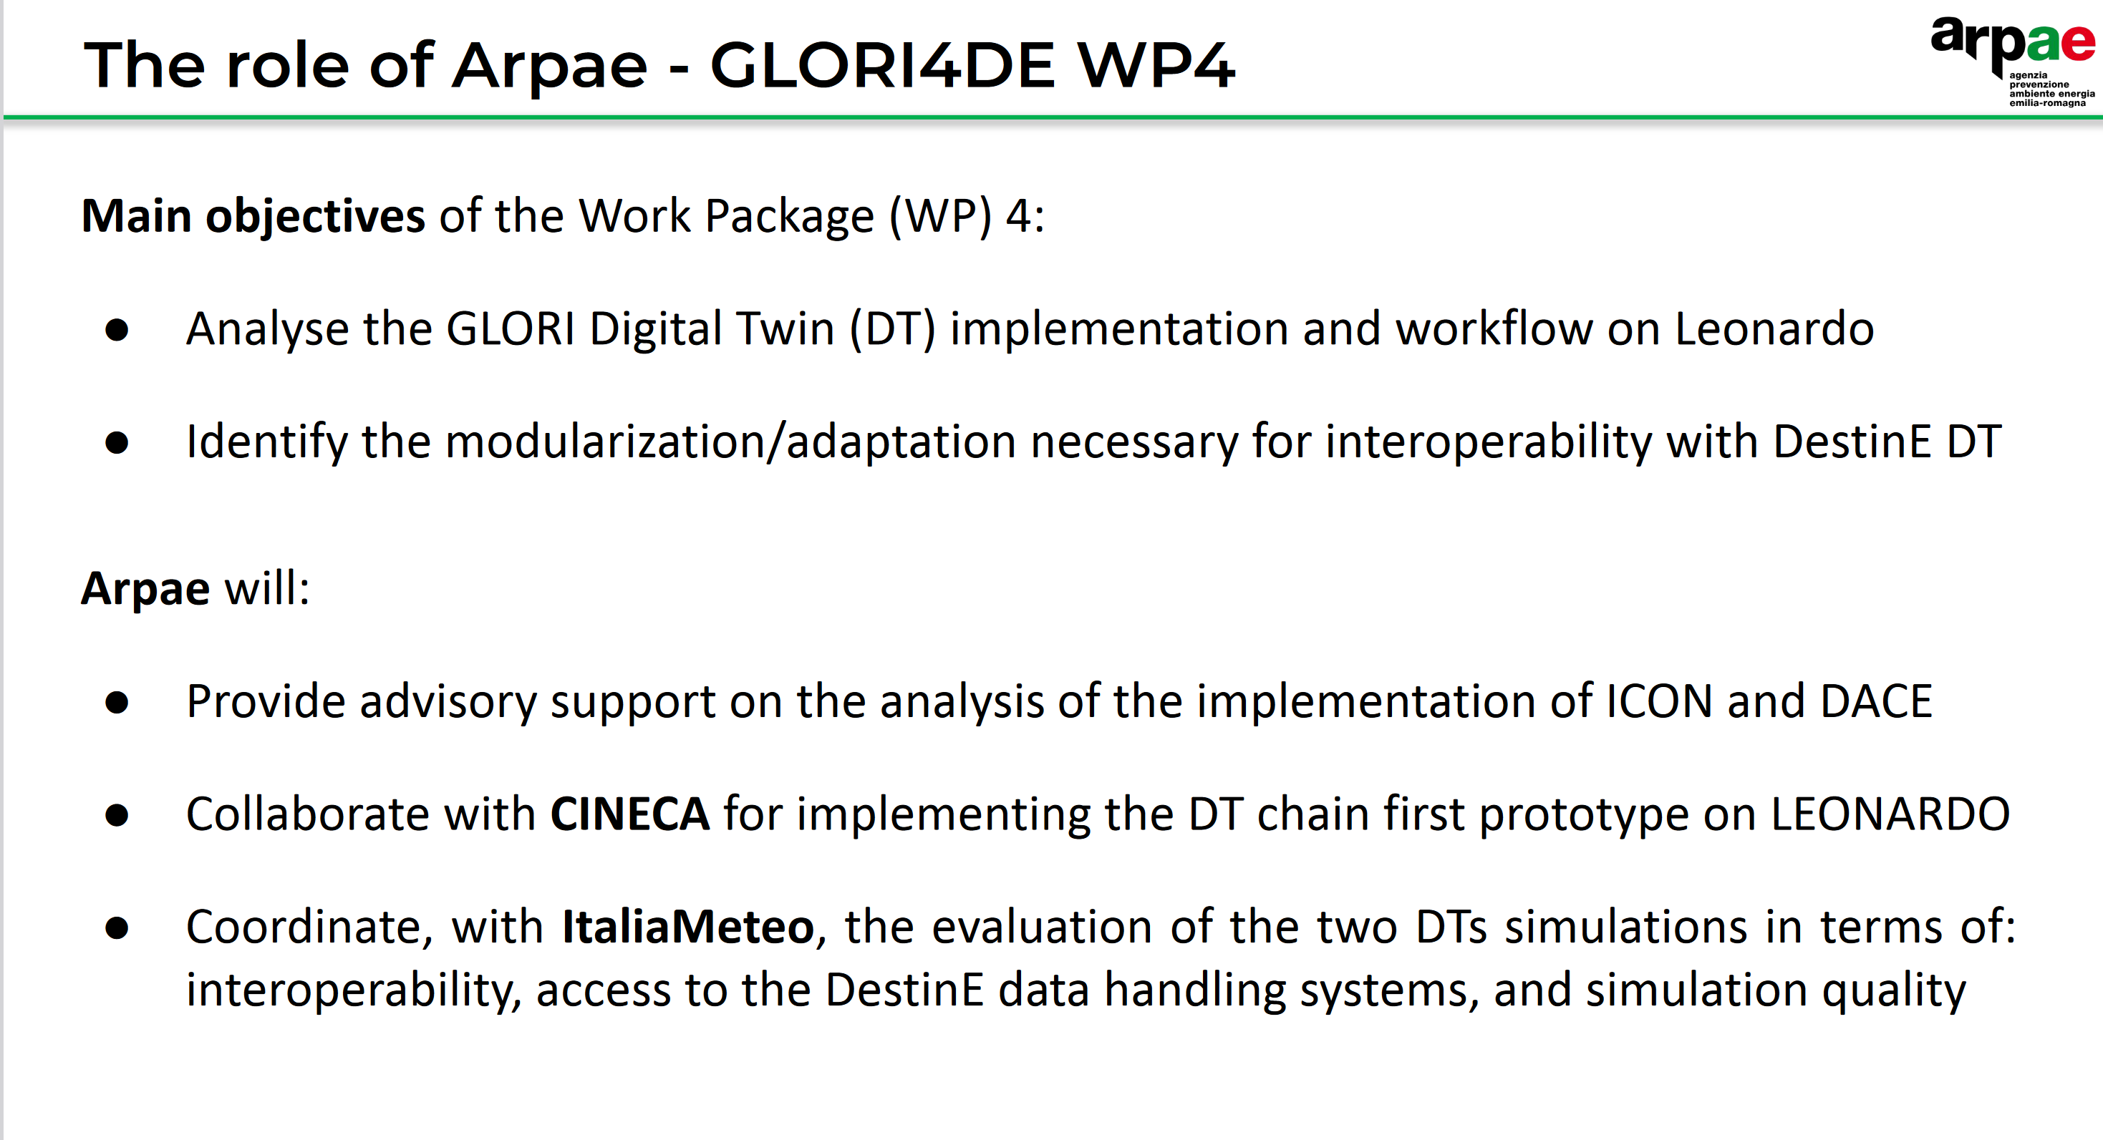

Slide 22
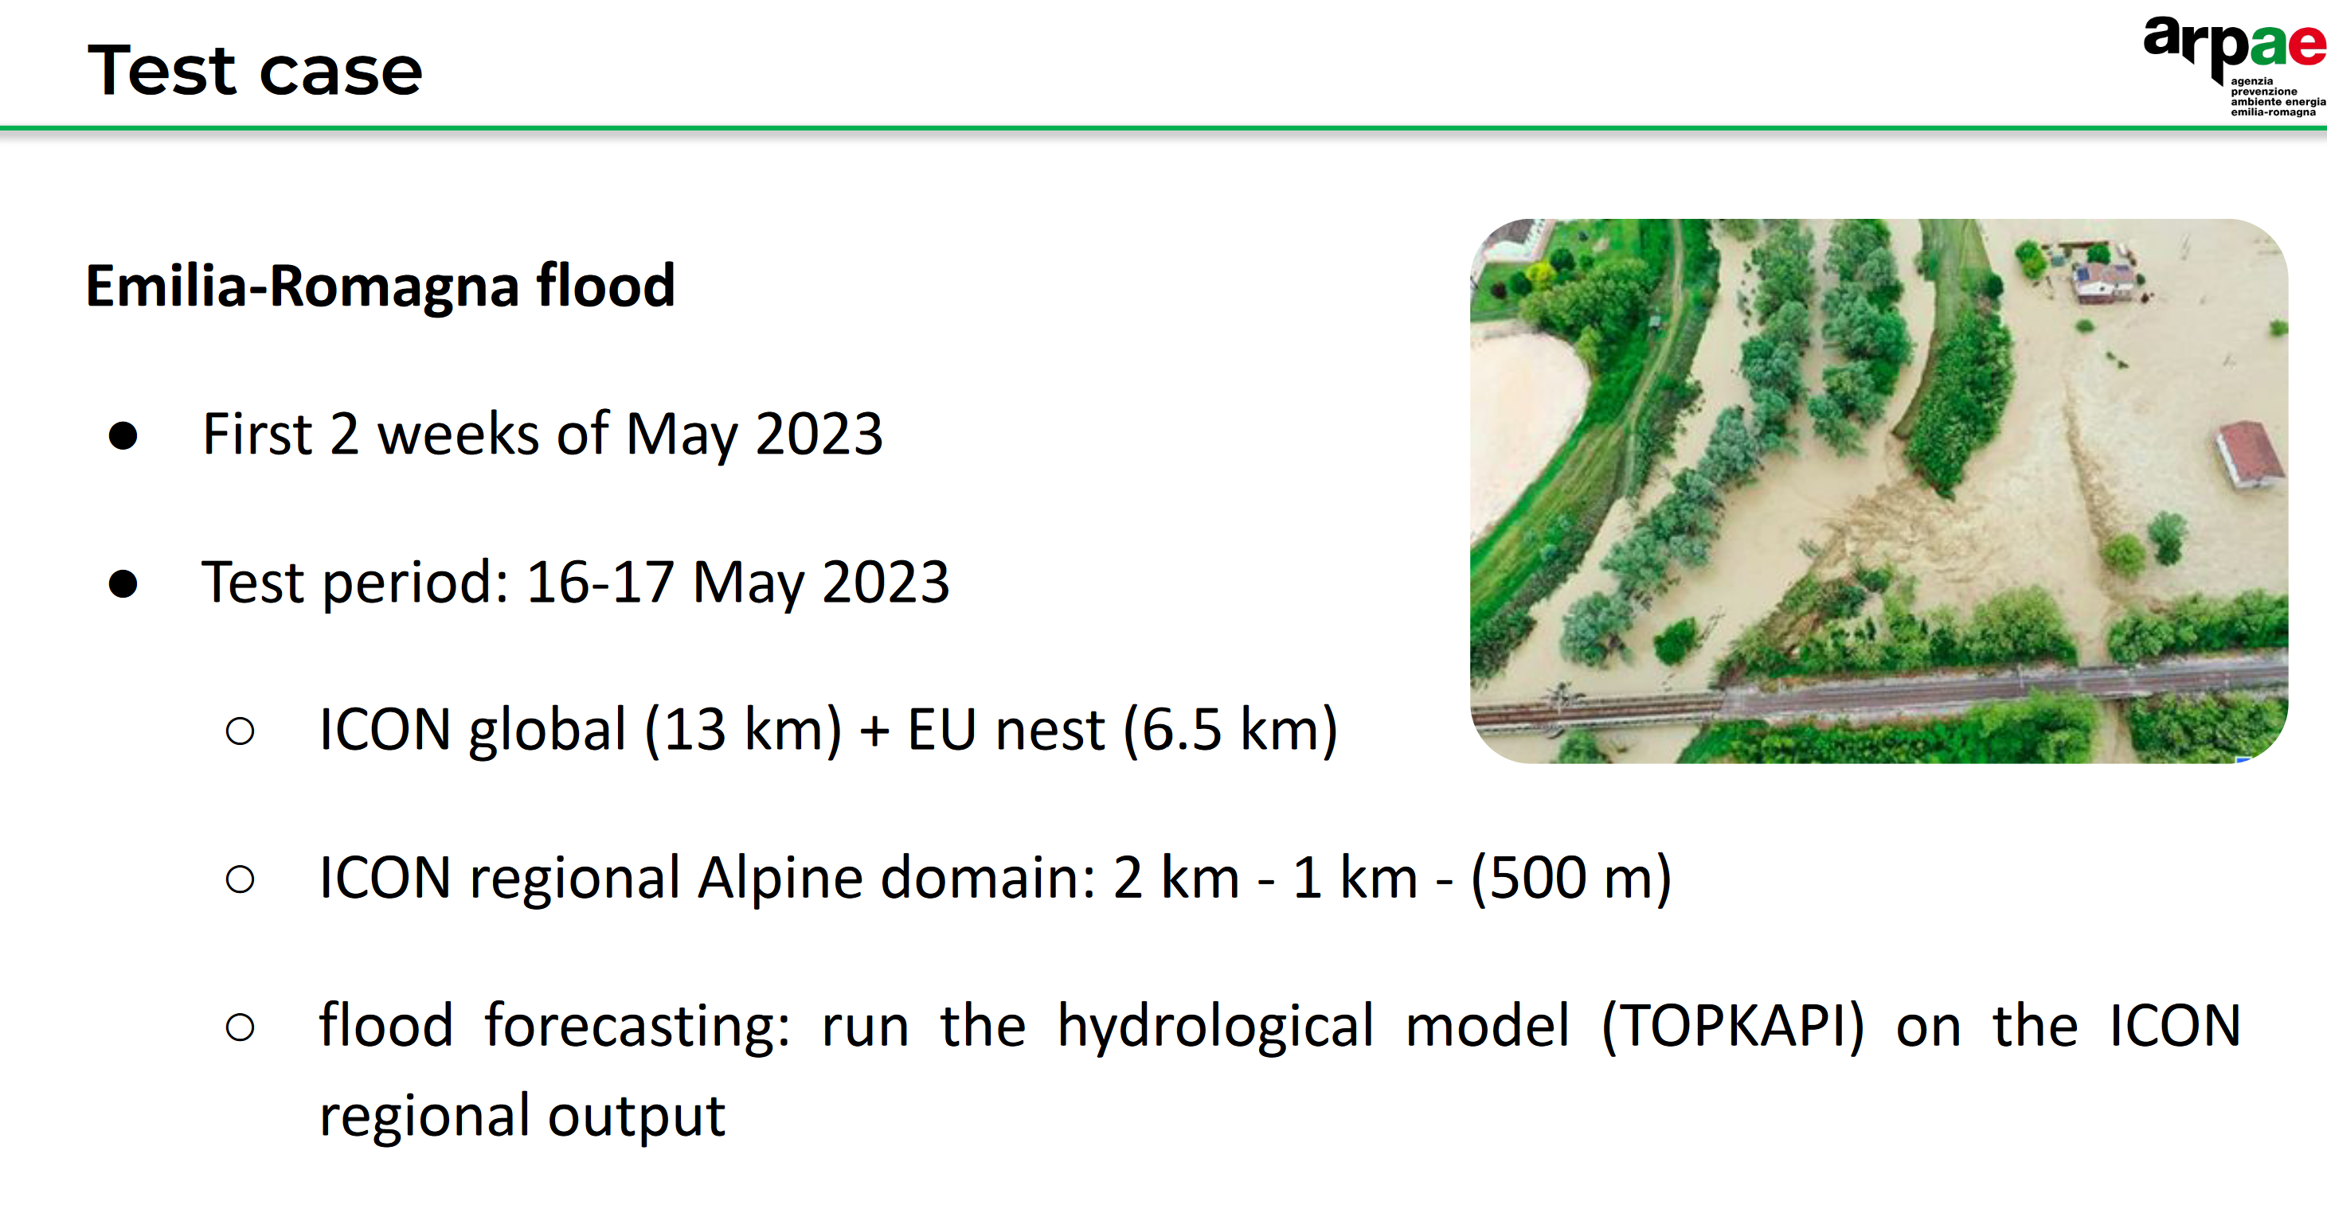

Slide 23
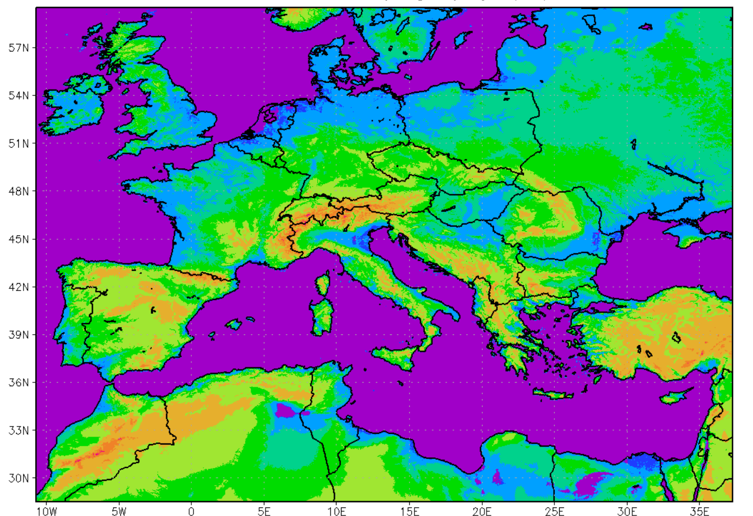
ICON-LEPS
The ICON-LEPS configuration under development foresees a grid step of 2.5 km with respect to 7 km for COSMO-LEPS, an increase of vertical levels from 40 to 65 and an enlargement of the domain. This significant configuration enhancement requires a very big increase in computational resources, more than it was initially estimated.

Slide 24
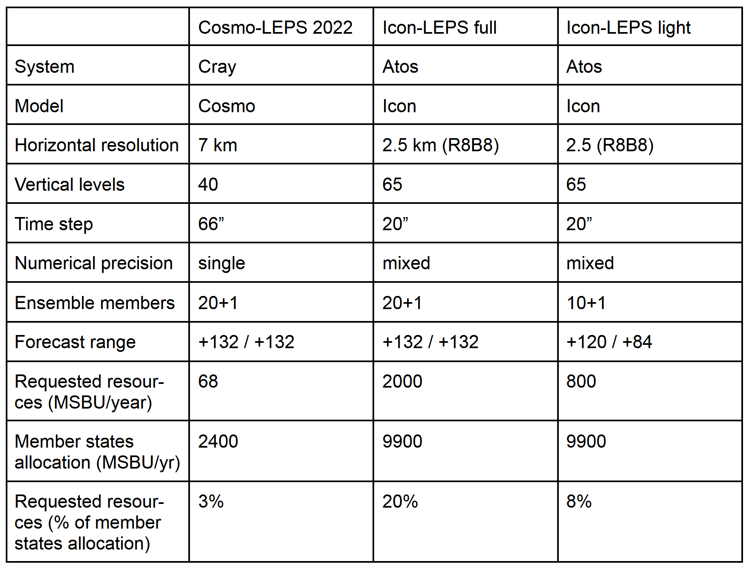
The SBU is not the only technical problem:
Human resources…
Reforecast (requested by EFAS)…
Reorganisation of postprocessing and dissemination…
Availability to have a sufficient number of nodes simultaneously…
To be discussed at SMC!

Slide 25
NWP Test Suite
Latest modification to the suite:
  1h BC
  Top boundary nudging
Proposal for the next months:
  Run the suite for ICON-2024.07 (with its new namelist)
  Compare 1) with the previous ICON release (2023)
  Run ICON-2024.07 with TBN and 1hBC
  Compare 3) with 1)

Slide 26

Documentation
TechReport N°50 (PP AWARE final report) and 51 (COordinated Parameter Testing project (COPAT2) of the working group EVAL of the CLM Community) have been published
A newer (May 2024) EMVORADO user guide was uploaded (Blahak et al.)
Report on the evaluation of DWD nowcast and warning products at the ESSL Testbed 2023
Expected TRs during the next COSMO year (09/2024-08/2025): PP ICON-COMFORT, PP PROPHECY, PP CAIIR 2, PP CARMENs
PP MILEPOST is in my hands and will be published in autumn
About PP IMPACT, a paper is in preparation

Slide 27

Thank you for the attention

