Slide 1
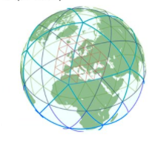
NWP status and plans for IMS 2024/2025
Yoav Levi
COSMO GM September 2024
COSMO GM 2024, Offenbach

Slide 2
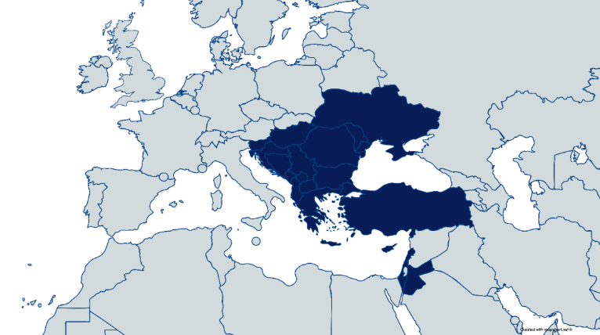
ICON at IMS
Platform: Time Critical Suite on the ECMWF HPC
Model setup: Resolution: ~2.5km horizontal, 65 levels vertical
Range: 90h, 120h
IC/BC: det. IFS + ICON
4 runs/day
Storage: ~150 T/year
Data assimilation: LHN(IMS radar + OPERA)
EPS: 20 members
ICON-RUC: 51 members, best member 8 hours forecast
4 years reforecast
WMO project SEE-MHEWS-A
Multi-Hazard Early Warning Advisory System for South-East Europe
ICON-IL-IFS domain
EPS
COSMO GM 2024, Offenbach

Slide 3
C2I Migration finished
COSMO
ICON-LAM
COSMO-IL-IFS
Operational
COSMO-IL-EPS
+control
Operational
ICON-IL-IFS-SEE-CAMS
Operational
ICON-IL-IFS-EPS
Operational
Operational
COSMO-IL-RUC
HPC dead
ICON-IL-RUC
Test suite ready
50 members
ICON-IL-ICON
COSMO-IL-CAMS
Operational
COSMO-IL-1 km
Test cases
ICON-1.25-0.6 km
Test cases
ICON-IL-ICON-EU
Test
Operational = daily runs exposed to the forecasters
COSMO GM 2024, Offenbach

Slide 4
Jan.- June 2024 skill relative to IFS
$$Skill=1 −\frac{RMSE}{{RMSE}_{IFS}}$$
80 AWS
COSMO GM 2024, Offenbach

Slide 5
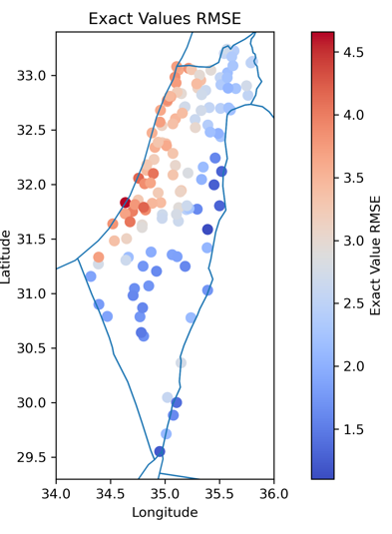
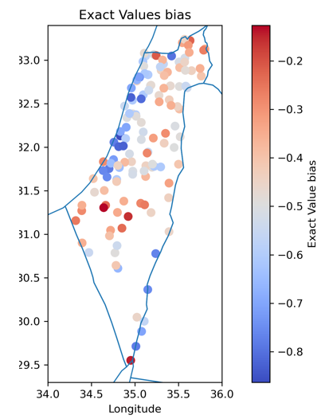
ICON precipitation verification 4 years hourly data vs. 135 rain gauges
ICON climatology on a smaller domain, 00Z runs using 6-30 hour lead time for 2019-2022
Similar results for the median and average from 27.5x27.5 km area around each rain gauge
ICON has a negative overall bias.
Near the coast larger biases and RMSE.
Nearest point RMSE
Nearest point bias
COSMO GM 2024, Offenbach

Slide 6
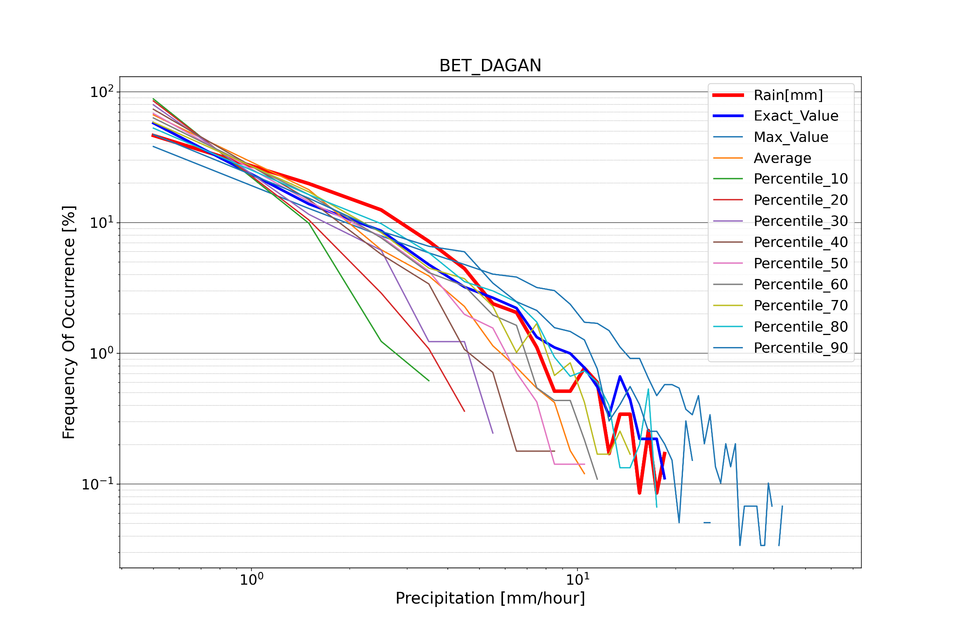
Precip. Distribution 27.5x27.5 km around Bet Dagan gauge
Obs
~ 4-5 mm/hour
Nearest point
Missing rains
max
nearest
90%
Obs
80%
COSMO GM 2024, Offenbach

Slide 7
Precip. bias 121 grid point around Bet Dagan gauge
COSMO GM 2024, Offenbach

Slide 8
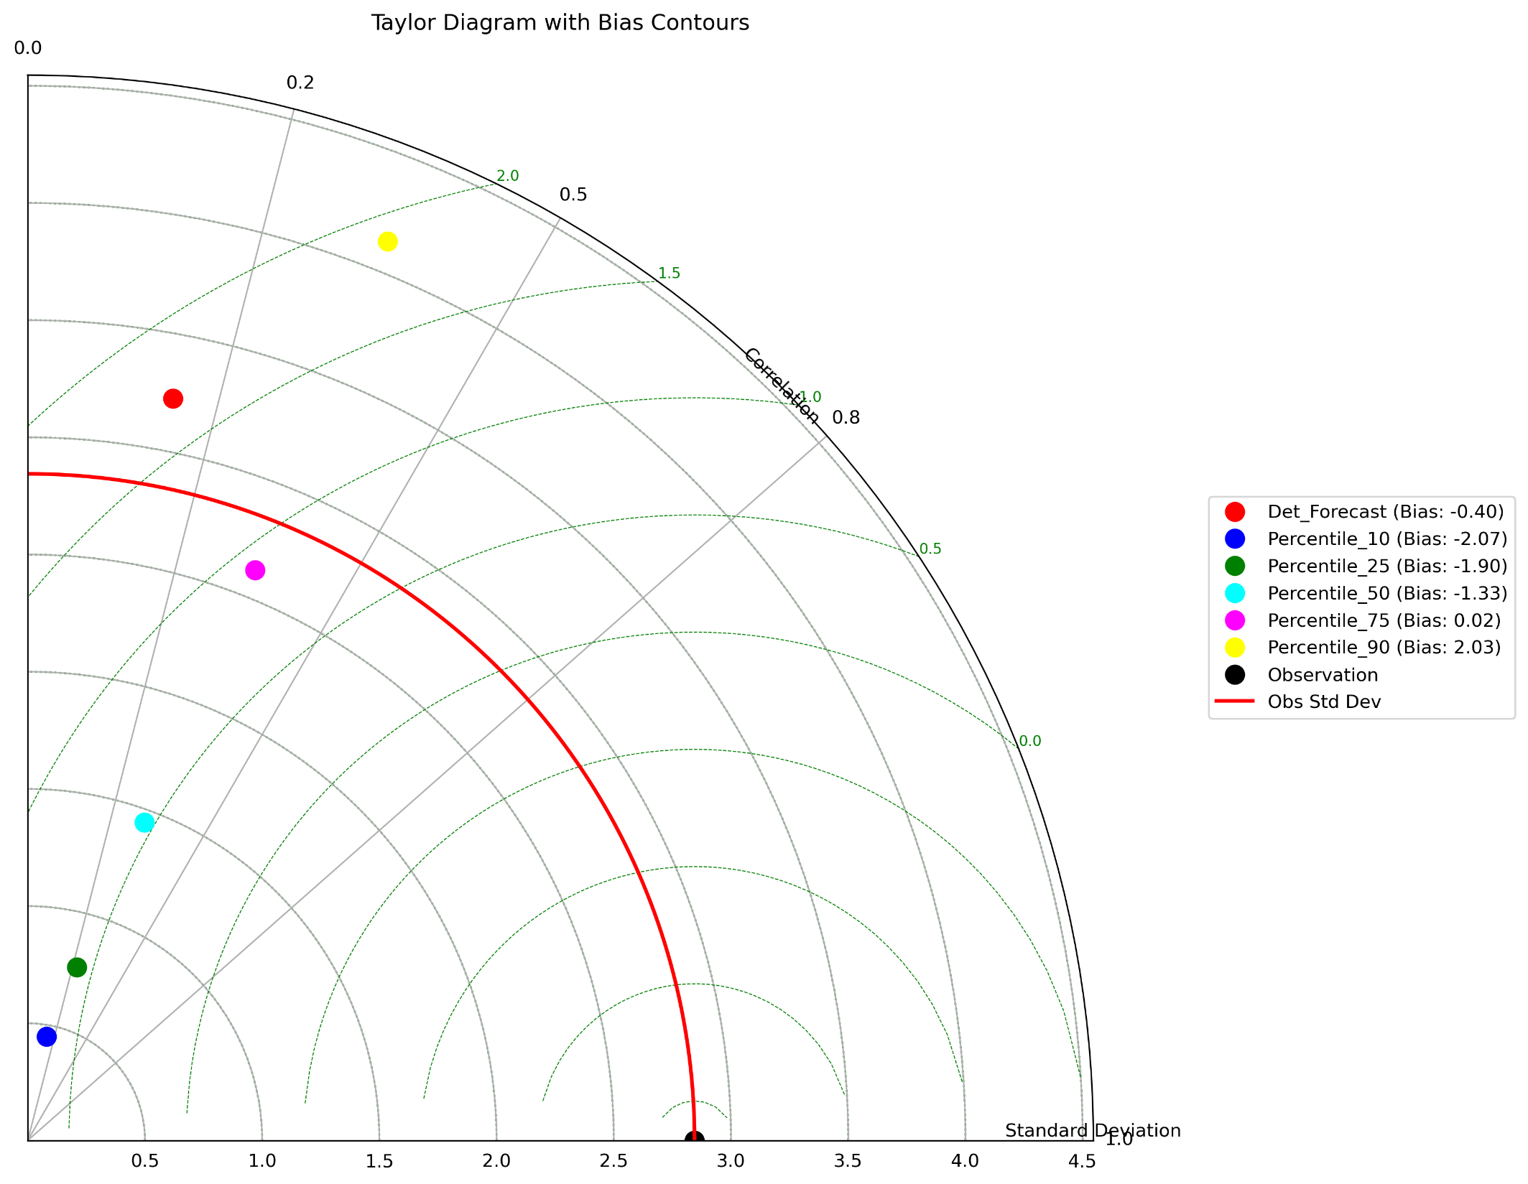
Statistics:
Observation mean: 2.1688
Observation standard deviation: 2.8445
Det_Forecast:
Standard deviation: 3.2266
RMSD: 3.8903
Correlation coefficient: 0.1921
Bias: -0.3992
Percentile_10:
Standard deviation: 0.4514
RMSD: 3.4819
Correlation coefficient: 0.1779
Bias: -2.0702
Percentile_25:
Standard deviation: 0.7684
RMSD: 3.3333
Correlation coefficient: 0.2734
Bias: -1.9037
Percentile_50:
Standard deviation: 1.4462
RMSD: 3.0208
Correlation coefficient: 0.3440
Bias: -1.3313
Percentile_75:
Standard deviation: 2.6208
RMSD: 3.0728
Correlation coefficient: 0.3701
Bias: 0.0175
Percentile_90:
Standard deviation: 4.1323
RMSD: 4.5327
Correlation coefficient: 0.3716
Bias: 2.0282
ICON EPS - 20 ICON members
Precipitation Reforecast 2023-2024 season
90%
deterministic
75%
50%
25%
10%

Slide 9
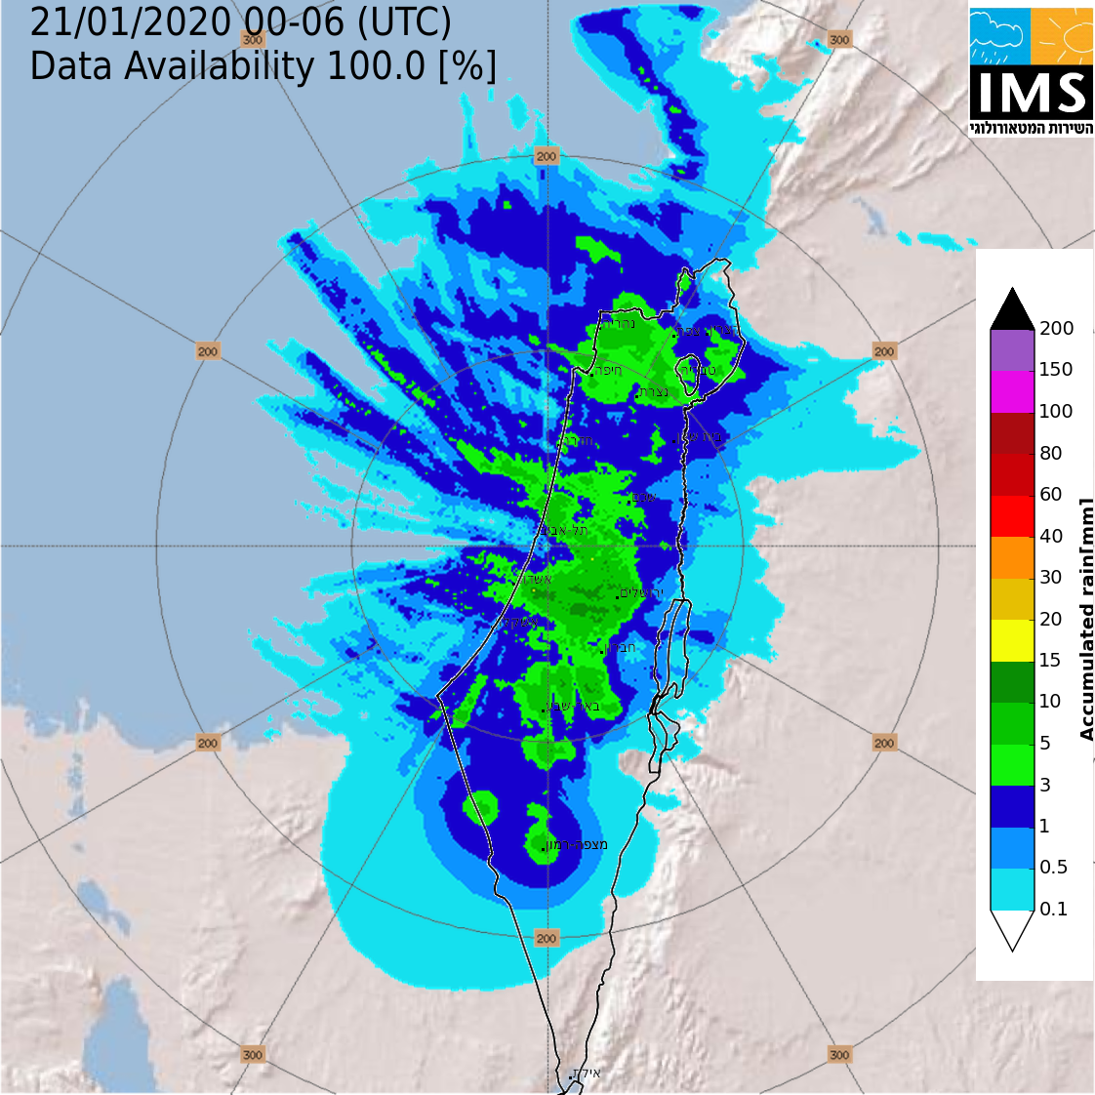
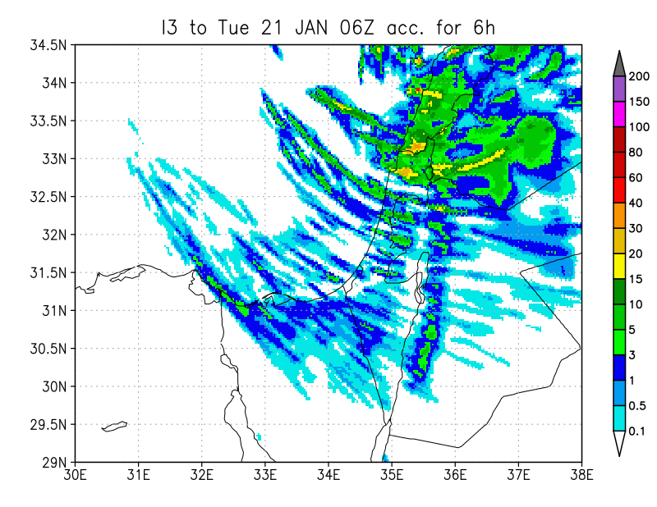
Although max values are in good agreement
there are may white areas in the ICON forecast
ICON forecast
Radar + rain gauge
COSMO GM 2024, Offenbach

Slide 10
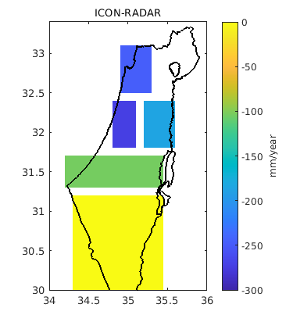
Summary
IMS migration to ICON is successfully finished ☺
COSMO will be one more model in our poor man ensemble including global models, ALADIN, WRF and ICON with both IFS and ICON-DWD as IC/BC
How to fill the precipitation gap between convective cells
and enhance the lower precipitation rates?
ICON-CLM (2.5 km) also indicates a negative bias.
COSMO GM 2024, Offenbach

Slide 11
COSMO GM 2024, Offenbach

Slide 12
COSMO GM 2024, Offenbach

