Slide 1
Andrzej Wyszogrodzki Cosmo General Meeting 2024
NWP/HPC @ IMGW-PIB
status and plans for 2024/2025

Slide 2
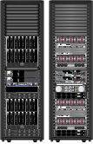
HPC status in 2024
HP Blade cluster „grad” /COSMO
139 nodes, 2780 cores,
61 Tf perf, 64TB storage,
in operation from 2015 (9.5 years)
HP Blade cluster „euros”/ ALADIN
1600 cores, 40 Tf perf,
in operation from spring 2014 (10+ years)

Slide 3
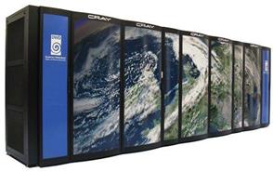
HPC plans for 2024/2025
World Bank PODPOW project (10+ mln EURO)
new system in ~September/October 2024
2 IMGW-PIB locations:
Warsaw 1Pf CPU (Dell PowerEdge R660 / Intel® Xeon® Platinum 8480+ 2.0G)
180 nodes x 2 CPU x 56 cores = 20160 cores, 512GB RAM/node
Krakow 0.75 Pf GPU (3 nodes of Dell PowerEdge XE9680)
3 x 2 x Intel® Xeon® Platinum 8468 2.1G, x 48 cores = 288 CPU corers
3 nodes x 8 cards NVIDIA HGX H100 8-GPU = 24 GPU cards
1024 Gb RAM/node
0.25 Pf CPU (Dell PowerEdge R660 , Intel Xeon Platinium 8480+ 2.0G)
45 nodes x 2 CPU x 56 cores = 5040 cores, 512GB RAM/node
Storage: 2x 4 PB datastore
GPU possible applications: COSMO/ICON, hydro models,
ALADIN/Destination Earth

Slide 4
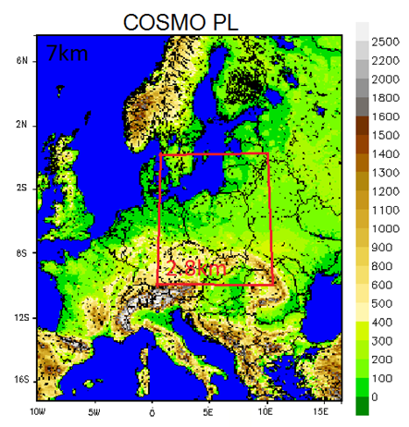
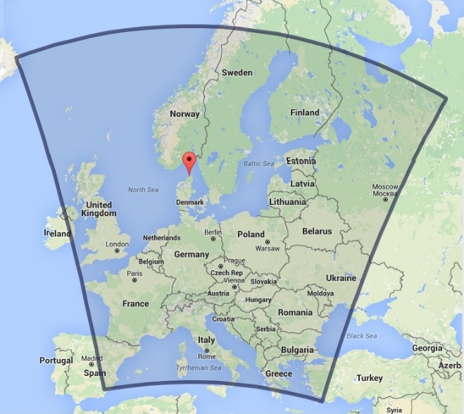
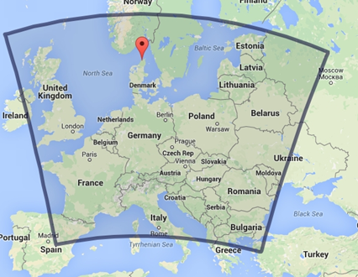
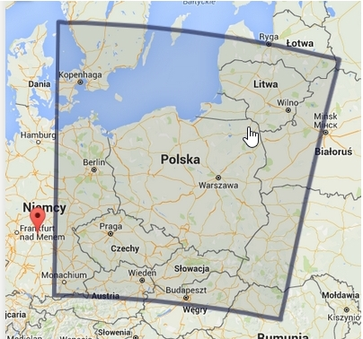
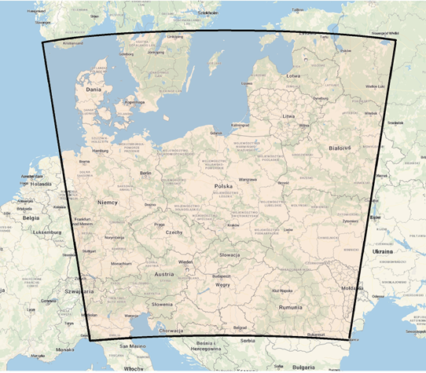
2024 NWP operational deterministic models
COSMO 7k0
COSMO 14k0
COSMO 2k8
Model version | COSMO14k0 5.05 | COSMO 7k0 V 6.01 | COSMO 2k8 V 6.01 | ICON-LAM v 2.6.2.2
Grid spacing | 14km | 7km | 2.8km | R2B10,2.5km
Grid size [NxMxL] |  | 415x445 x 51 | 380x405 x 41 | 294638 x 65
Integration time [sec] | 55 | 40 | 15 | 24
Forecast length [hours] | 78 | 96 | 60 | 48
Forcst time start [UTC] | 00,06,12,18 | 00,06,12,18 | 00,06,12,18 | 00,06,12,18
IC/BC / update time [h] | ICON / 3h | ICON / 3h | COSMO7k0/1h | ICON / 3h
ICON-LAM 2k5

Slide 5
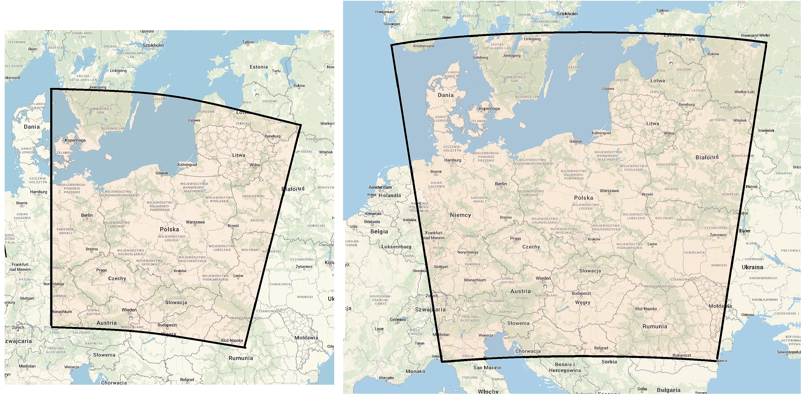
2024 NWP ICON-LAM operational setup
ICON-LAM v 2.6.2.2
R2B10, ~2.5km on COSMO2k8 grid _
Rotated north pole: -170.0,40.0
65 levels, dt=24s
48 hour forecast
4x/day (00, 06, 12, 18 UTC)
Changes in 2024
Domain extension14x14deg
294636 elements
Rotated pole: -170,0,0
planned transition to ICON v2.6.3

Slide 6
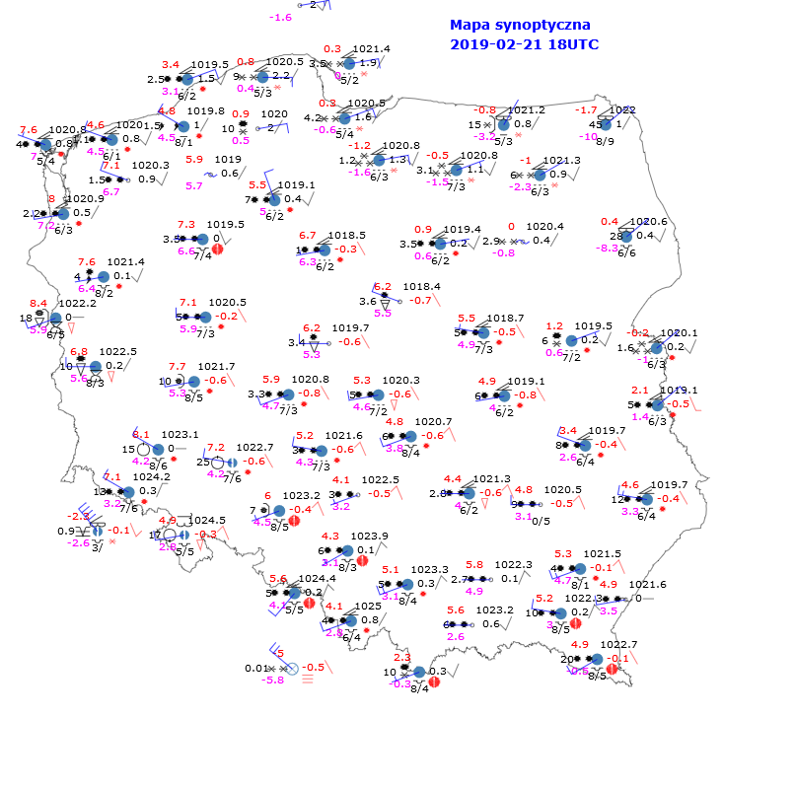
2024 ICON-LAM vs COSMO common verif.
ICON-PL 2.6.2.2 (includes cp/cv bug fix, the RRTM radiation scheme)
COSMO-CE-PL v 6.01
Verification using MEC/Rfdbk
Comparison with: the Polish SYNOP (Poland domain), TEMP stations (Poland stations)
Verification period: JJA2023-MAM2024
ICON-PL overall performs better than COSMO-CE-PL for most of surface and upper air parameters
Exceptions:
There is a systematic difference in wind speed and wind direction biases between ICON-PL and COSMO-CE-PL
COSMO-CE-PL has slightly reduced biases of cloud cover in the convective cases (daytime of MAM, JJA, SON)
ICON-PL produces more rain (higher FBI) than COSMO-CE-PL during convective seasons MAM, JJA
ICON-PL is generally less accurate than COSMO-CE-PL at the top of the atmosphere for all analyzed parameters and in the mid troposphere for temperaturę in Autumn 2023
Notes:
6

Slide 7
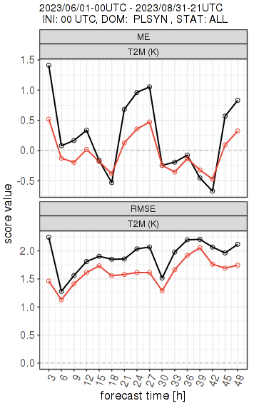
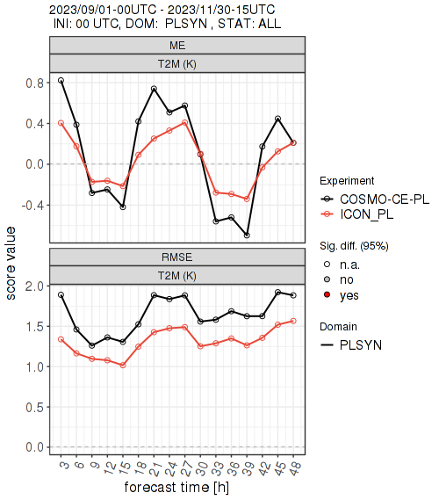
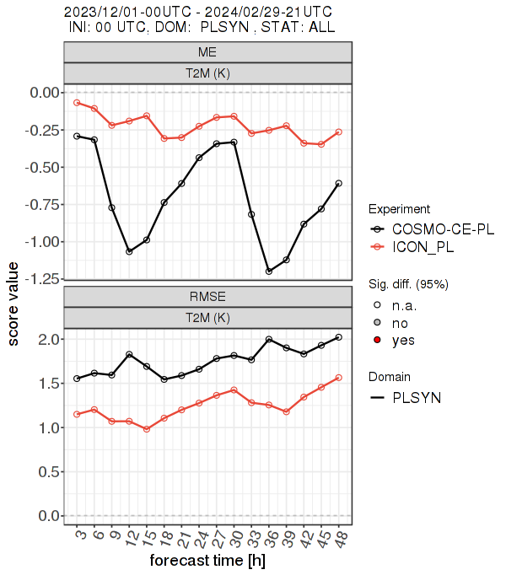
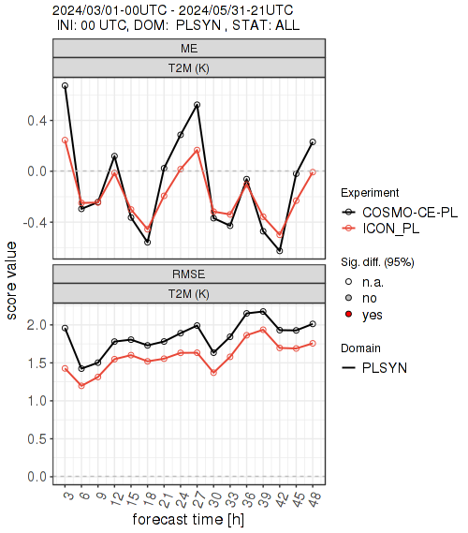
Temperature 2m, JJA 2023 - MAM 2024
2024 ICON-LAM vs COSMO common verif.
ICON-PL has a much reduced RMSE compared to COSMO-CE-PL for the all seasons.
ICON-PL is cooler than COSMO-CE PL in Summer and Spring and reduces the warm bias, particularly at nighttime.
ICON-PL is warmer than COSMO-CE-PL in Winter and reduces the cold bias, particularly during daytime.
ICON-PL has a reduced bias in the diurnal cycle compared to COSMO-CE PL in Autumn with a reduced warm bias at nighttime and a reduced cold bias during daytime.
Notes:
7

Slide 8
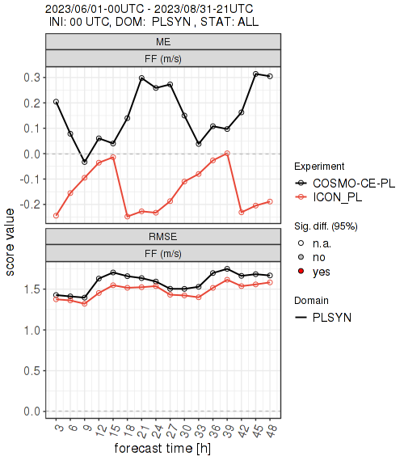
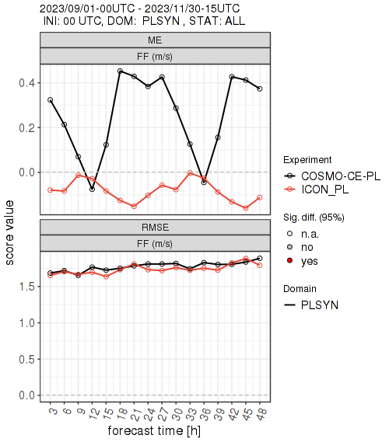
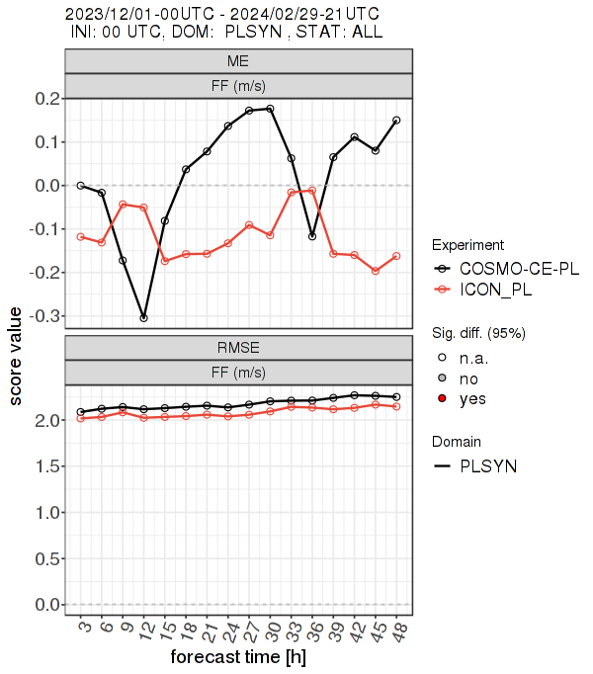
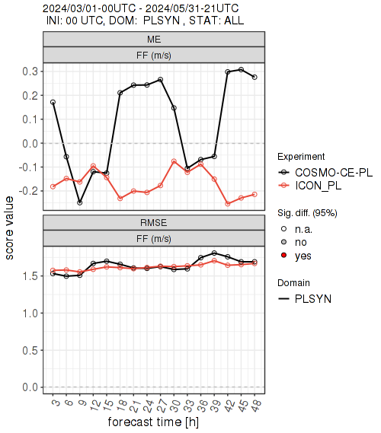
Wind speed, JJA 2023 - MAM 2024
2024 ICON-LAM vs COSMO common verif.
ICON-PL has a reduced RMSE compared to COSMO-CE-PL for Summer, Autumn and Winter seasons.
This is often associated with a reduced nighttime negative (strong) bias. In contrast the winds during the morning and early afternoon are stronger in COSMO-CE-PL compared to ICON-PL.
ICON-PL has stronger winds than COSMO-CE-PL throughout the day in Winter and has a greater positive bias.
Notes:
8

Slide 9
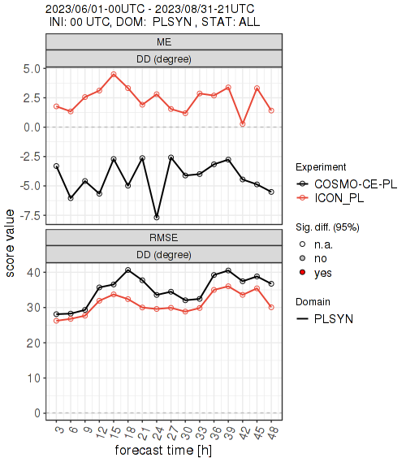
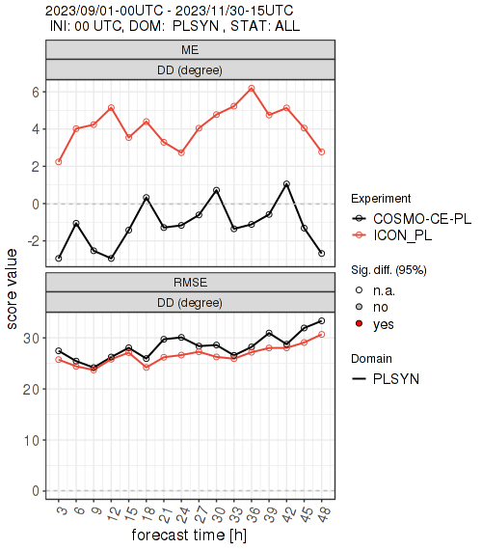
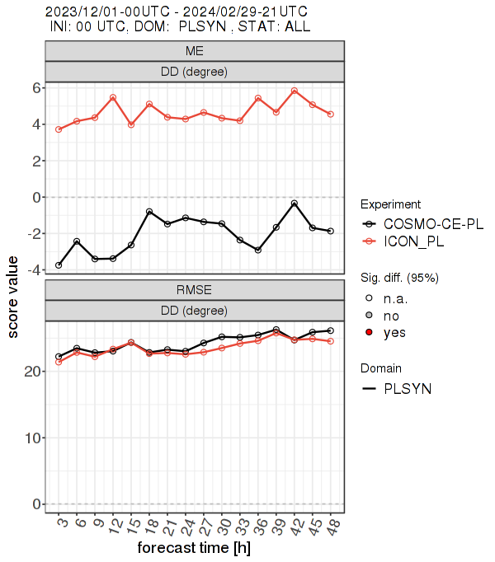
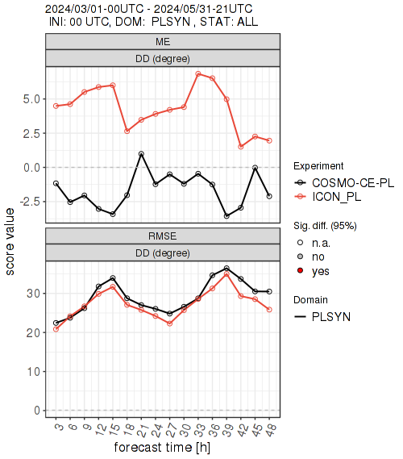
Wind direction, JJA 2023 - MAM 2024
2024 ICON-LAM vs COSMO common verif.
ICON-PL veers the wind direction (positive bias) by about 2-6 degrees compared to observations.
COSMO-CE-PL backs the wind direction (negative bias) by about 0-7,5 degrees compared to observations.
Despite the slightly larger bias, ICON-PL has RMSE values which are the same or even lower than COSMO-CE-PL.
Notes:
9

Slide 10
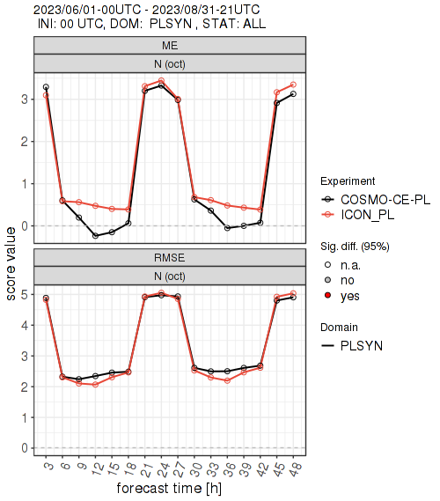
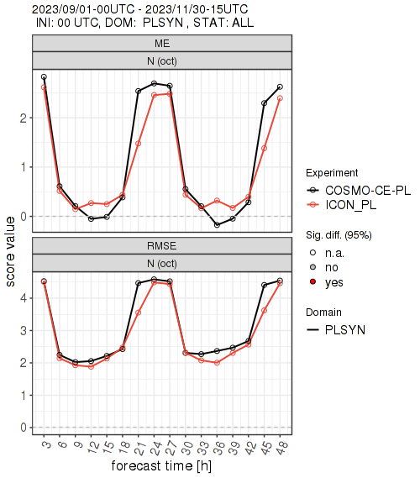
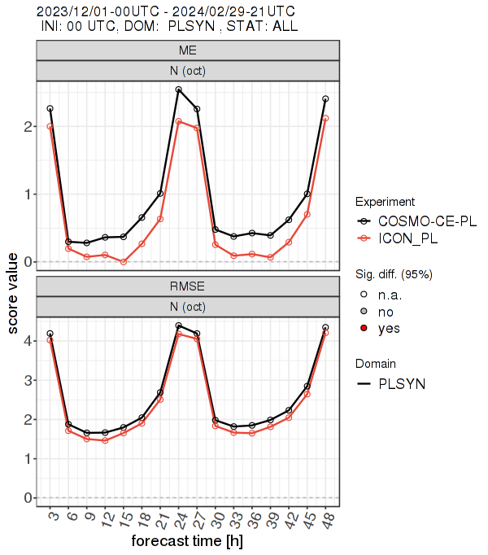
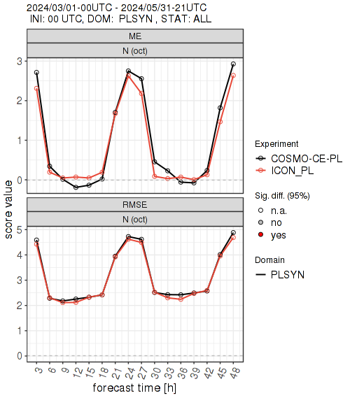
Total Cloud, JJA 2023 - MAM 2024
2024 ICON-LAM vs COSMO common verif.
Both ICON-PL and COSMO-CE-PL models have a diurnal cycle to their bias for all seasons. This bias is largest in Autumn and Winter at daytime when there is a large positive bias. The bias is smallest during the nighttime.
ICON-PL has more cloud than COSMO-CE-PL in Summer and less cloud in other seasons.
ICON-PL has a positive bias for all seasons for the whole forecast range. COSMO-CE-PL has also a positive bias for all seasons except for a small negative bias during daytime in Summer, Autumn and Spring.
Notes:
10

Slide 11
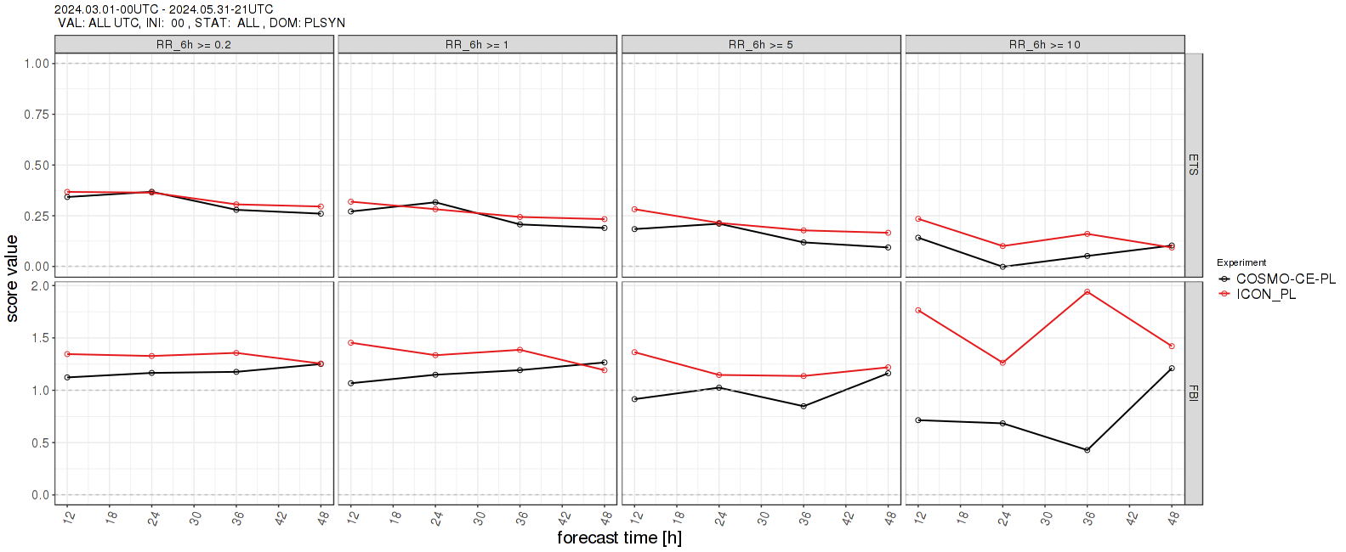
6-hourly precipitation accumulation, ETS, FBI, MAM 2024 COSMO-CE-PL vs ICON PL
2024 ICON-LAM vs COSMO common verif.
Frequency Bias Index (FBI)
Equitable Threat Score (ETS)
ICON-PL has better ETS scores than COSMO-CE-PL at the 0.2mm, 5.0mm and 10.0 mm thresholds. However, it has worse scores at the 1.0mm threshold.
ICON-PL produces more rain (higher FBI) than COSMO-CE-PL at all forecast ranges. The FBI is closer to unity in COSMO-CE-PL than ICON-PL at these thresholds. For the 10.0mm thresholds, the FBI is quite noisy.
Notes:
11

Slide 12
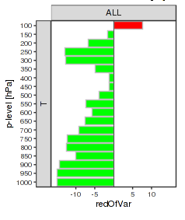
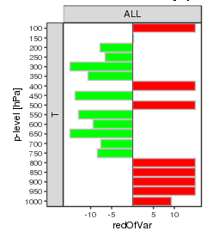
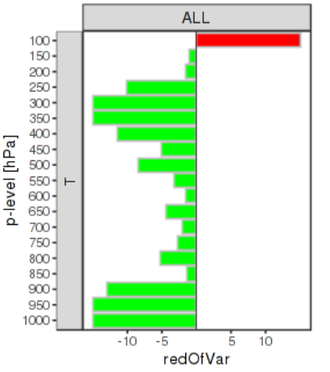
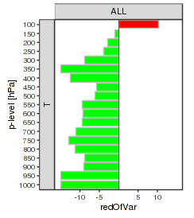
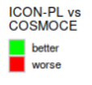
Upper air temperature (K), JJA 2023 - MAM 2024 Reduction of RMSE [%]
2024 ICON-LAM vs COSMO common verif.
Summer 2023
Autumn 2023
Winter 2024
Spring 2024
ICON-PL has a reduced RMSE compared to COSMO-CE-PL for temperature throughout the depth of the atmosphere and for all seasons. The reduction is greatest between 200-600hPa and 900-1000hPa for all seasons (except from Autumn).
There is an increase in RMSE at the very top of the atmosphere (100-150hPa) in every season. Also between 400-550 hPa and from 800 hPa in Autumn and around 200 hPa, 600 hPa and 850 hPa in Winter.
Notes:
12

Slide 13
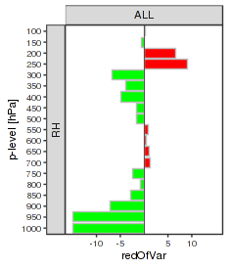
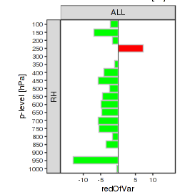
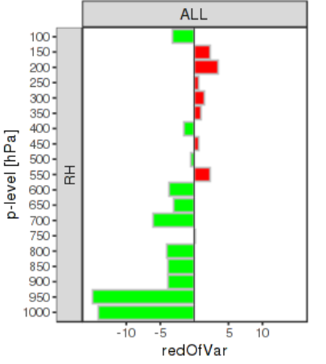
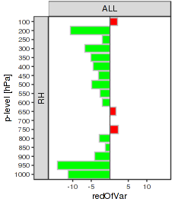
RH relative humidity, JJA 2023 - MAM 2024 Reduction of RMSE [%]
2024 ICON-LAM vs COSMO common verif.
Summer 2023
Autumn 2023
Winter 2024
Spring 2024
ICON-PL generally has a reduced RMSE compared to COSMO-CE-PL for relative humidity throughout the depth of the atmosphere and for all seasons. The reduction is greatest at 950-1000hPa for all seasons (except from Winter).
For each season, the RMSE increase is at different depths of the atmosphere.
Notes:
13

Slide 14
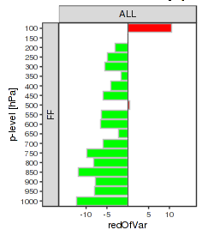
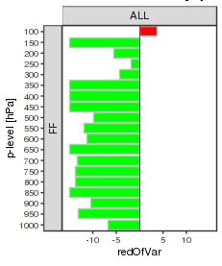
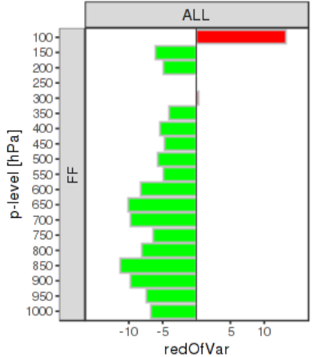
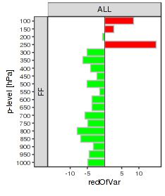
Wind speed (m/s), JJA 2023 - MAM 2024 Reduction of RMSE [%]
2024 ICON-LAM vs COSMO common verif.
Summer 2023
Autumn 2023
Winter 2024
Spring 2024
ICON-PL generally has a reduced RMSE compared to COSMO-CE-PL for wind speed throughout the depth of the atmosphere and for all seasons. The reduction is greatest between 150-950hPa in Autumn and Winter.
There is an increase in RMSE at the top of the atmosphere (100-200hPa) and around 250hPa in Spring.
Notes:
14

Slide 15
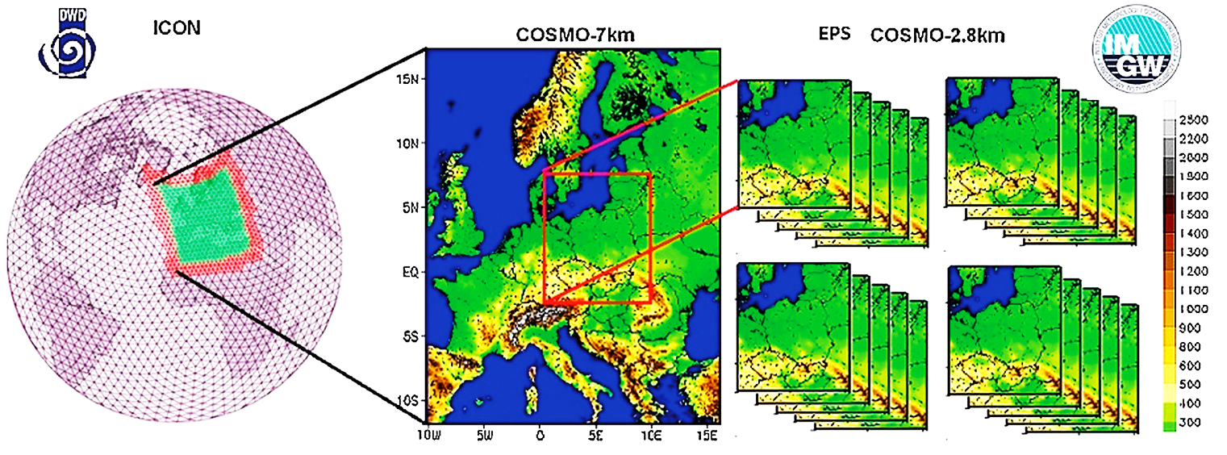
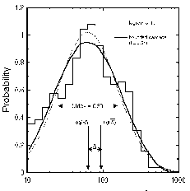
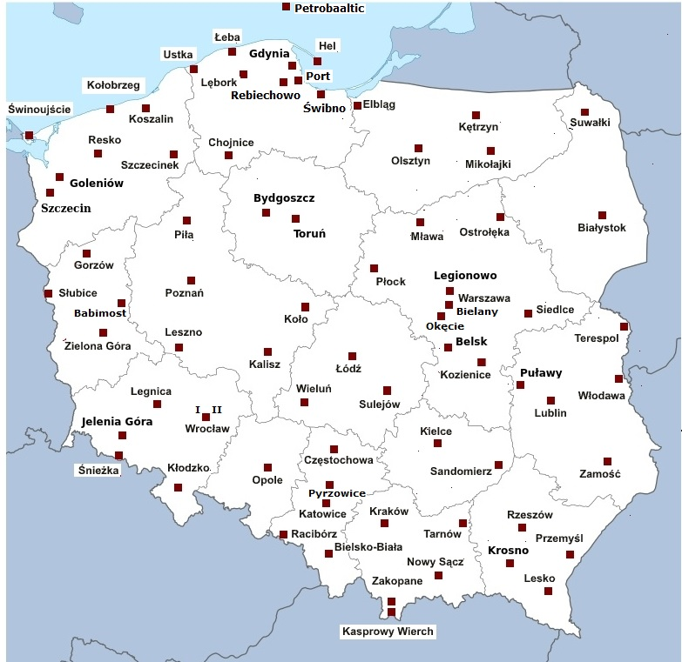
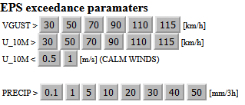
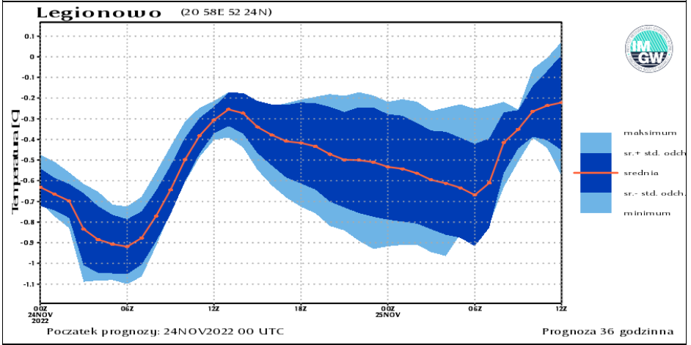
COSMO-TLE – Ensemble system
ICON -> COSMO 7km
TIME LAGGED EPS / COSMO 2k8 (20 members)
products
verification
statistical postprocessing
Soil physics
PERTURBATIONS:
C-Soil, surf temperature
ICON, GFS,
KENDA (EPS)

Slide 16
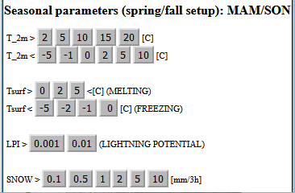
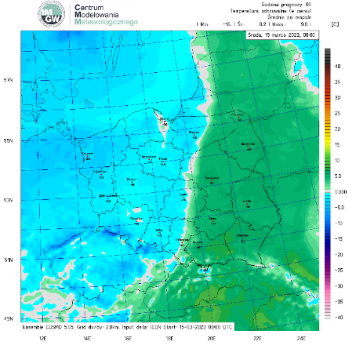
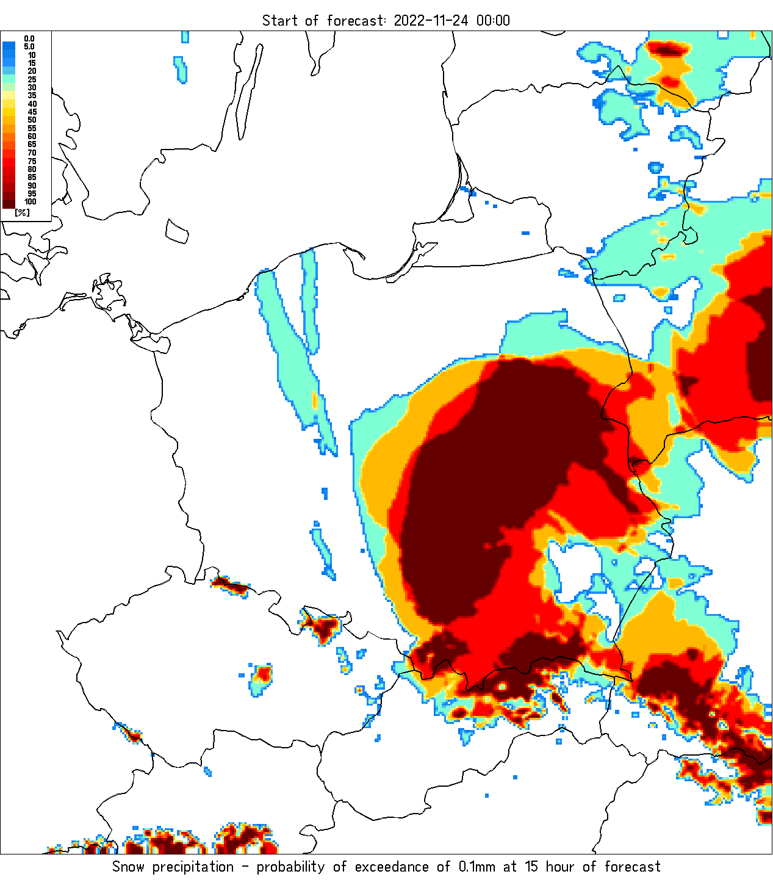
COSMO-TLE – Ensemble system
Extensions/changes in 2024/2025
Seasonal sets for exceedance paramaters
User oriented products
Posssibility of adding new perturbations in MICROPHYSICS: droplets collision kernel
Switch from COSMO –> ICON-LAM on the cluster
Exceedance precip > 0.1 mm/h
Feels like / apparent temperature

Slide 17
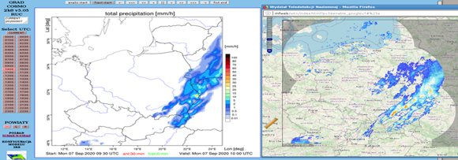
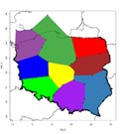
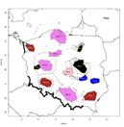
COSMO – Rapid Update Cyce (RUC)
COSMO 2.8km / 3h forecast/ update every 30 min
Aviation control FIR zones
Applications:
aciation,
nowcasting,
flash flood
Forecast of turbulence, icing, visibility, convective parameters

Slide 18
COSMO – Rapid Update Cyce (RUC)
1h analysis
3h forecast
update frequency 30 min (48/day)
OPERA (LHN)​ 2km
Telemetry (380 stations)
AMDAR
Plans in 2024/2025:
Move from opera (15 min frequency) → RainGRS (5/10 min, gauge/radar/sat)
Switch to 2-moment microphysical scheme (graupel and hail)
Coupling with nowcasting SCENE system (seamless 8 hour forecasts)

Slide 19
COSMO – Rapid Update Cyce (RUC)
RainGRS composites
RainGRS+OPERA,PWS,CML
METEOSAT SATELLITES
multi-source GRS precipitation fields
data quality control,
weighted processing of precipitation inputs
POLRAD+ NETWORK
NETWORK OF TELEMETRIC RAIN GAUGE STATIONS (491)
POLRAD + OPERA
Doppler /dual-polarized radar data: Poland (8) + Lithuania (2), Ukraine (1), Slovakia (4), Czech Republic (2), Germany (4)

Slide 20
COSMO projects
C2I4LC (Establishing COSMO to ICON migration for Licensees' Countries) -> ICON Training Course 2023, D. Wójcik, W. Interewicz, G. Duniec, A. Mazur
PP PROPHECY (PRObabilistic Prediction at High-resolution with EnhanCed perturbation strategY) - A. Mazur, G. Duniec, J. Linkowska, W. Interewicz
PP CITTA (City Induced Temperature change Through A’dvanced modelling) – A. Jaczewski, A. Wyszogrdzki, W. Interewicz
PP EPOCS (Evaluation of Personal Weather Station and Opportunistic Sensor Data CrowdSourcing). J. Linkowska, et al.
PT EGALITE (Early warninG and AnaLysIs SysTEm for release and dispersion of contaminants) A. Mazur
New PP/PTs
PP APOCS (Application of Personal Weather Station and Opportunistic Sensor Data CrowdSourcing). M. Zosicz, et al. (waiting for approval later in 2024)

Slide 21
PP EGALITE
PP PURPOSE:
a need for improvement/developing early warning systems (EWAS) for the response to release of toxic and/or harmful substances into the atmosphere (e.g. radioactive contaminants, vulcanic pollutants, etc.)
gathering/exchange the experience among COSMO partners on the coupled NWP / pollutant dispersion modeling that respond to the threats
Increase the ability to quickly provide information about the occurrence of an event and its possible consequences
IMGW-PIB: Ring of Threats (RIOT)
operational system
Risk from power plant accidents
Vulcano eruption Cumbre Vieja (09-12.2021)
Subtask 1. General survey (DONE)
Subtask 2. Tests and intercomparisons
Subtask 3. General post-processing and verification
Contributing scientists: Christoph Siewert (DWD), Pirmin Kaufmann (MCH), Andrzej Mazur (IMWM)

