Slide 1
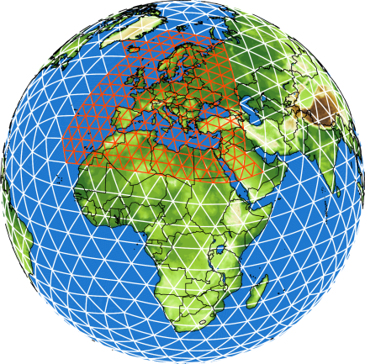
ICON-NWP: Recent activities and advances
Günther Zängl, on behalf the ICON development team @ DWD
COSMO-GM 2024, Offenbach, September 3, 2024

Slide 2
Overview
Operationalization of SINFONY-RUC
High-resolution activities: GLORI, TEAMx forecasts, ICON-D05
Major improvements in our operational system
Notes:
2

Slide 3
Operationalization of SINFONY-RUC
SINFONY: Seamless INtegrated FOrecastiNg sYstem; project led by Uli Blahak
SINFONY-RUC: Rapid-Update-Cycle variant of ICON-D2
Same model domain as ICON-D2, but full two-moment cloud microphysics including hail, and pure shallow convection scheme instead of deep convection with grayzone tuning
Hourly analyses and forecasts with 14 h lead time, much shorter data cutoff than standard ICON-D2 (~ 15 min), forecasts are completed 35-40 min after analysis time
Assimilation cycle branches off from ICON-D2 each day at 03 UTC, followed by 4 hours of spinup, in order to avoid disadvantages due to short cutoff time
Focus on nowcasting of (heavy) precipitation and seamless blending between nowcasting products and NWP output
Two-moment microphysics provides much better radar reflectivities than one-moment scheme, which is particular important for combined nowcasting products
RUC became operational on July 10, 2024, after ~ 6 years of intensive development work
Notes:
3

Slide 4
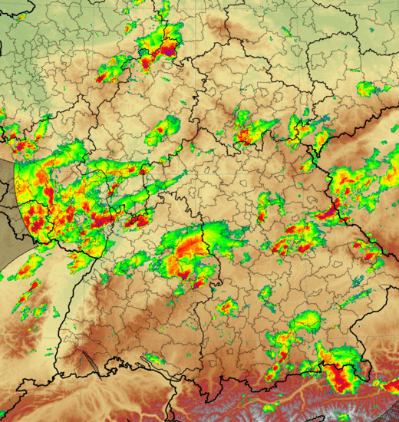
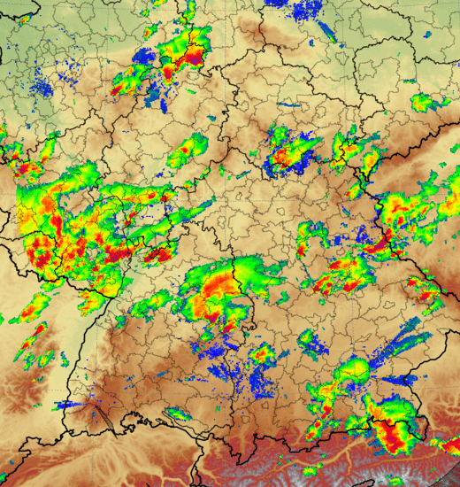
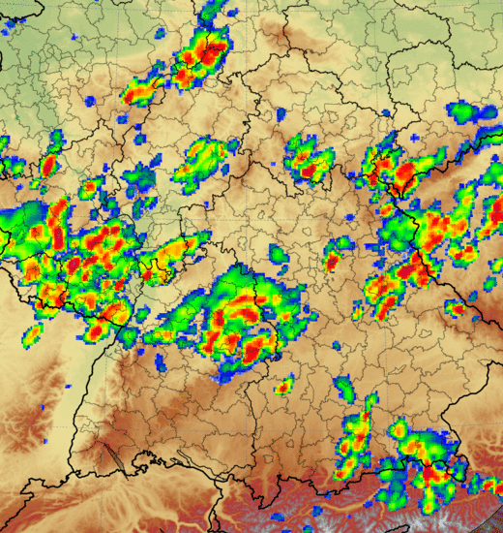
What does „seamless“ mean in the context of nowcasting? One example for SINFONY products
Nowcasting STEPS-DWD
Combination INTENSE
NWV ICON-RUC-EPS
Nowcasting-ENS (5‘ updates)
INTENSE (comb. ENS)
Nerini et al. 2019
Only 1 member shown
- combined products
„Best of both worlds“
NWV-ENS (hourly updated forecasts)
Uli Blahak
t₀
Fcst lead time

Slide 5
Verification of reflectivity STEPS-Nowcasting and SINFONY-RUC vs. Radar in 07/2023
Period: 01.07. – 31.07.2023
Forecasts: 12, 13, 14, … ,18 UTC (deterministic)
Parameter: Radar reflectivity (dBZ)
Score: fraction skill score (FSS)
STEPS-DWD Nowcasting (det)
ICON-D2-RUC det, 2 km, LHN + 3D-rad
„Good“
35 km
25 dBZ
FSS
„Bad“
Lead time [h]
Uli Blahak

Slide 6
Verification of reflectivity STEPS-Nowcasting and SINFONY-RUC vs. Radar in 07/2023
Period: 01.07. – 31.07.2023
Forecasts: 12, 13, 14, … ,18 UTC (deterministic)
Parameter: Radar reflectivity (dBZ)
Score: fraction skill score (FSS)
STEPS-DWD Nowcasting (det)
ICON-D2-RUC det, 2 km, LHN + 3D-rad
„Good“
35 km
25 dBZ
FSS
Overlay: Same comparison 5 years ago
Period: 26.05. – 25.06.2016 !!!
Previous version of STEPS (det)
COSMO det, 2.8 km, 1-mom, LHN
COSMO det, 2.8 km, 2-mom, 3D-rad
5 years of progress in NWP
Caution: different periods!
„Bad“
Lead time [h]
Uli Blahak

Slide 7
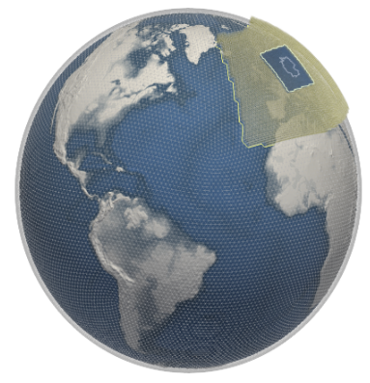
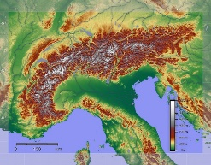
The GLORI Digital Twin
global storm-resolving (~3km)
Tri-lateral Cooperation Germany, Italy, Switzerland
global-to-regional short-range high resolution Digital Twin
configurable
on-demand
based on the prediction capability of the ICON earth system model and the Data Assimilation Coding Environment DACE
regional km-scale (down to 500 m)

Slide 8
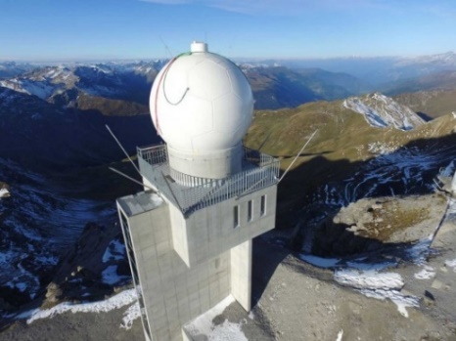
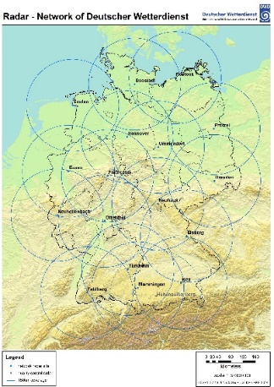
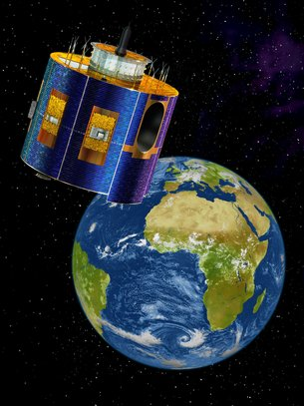
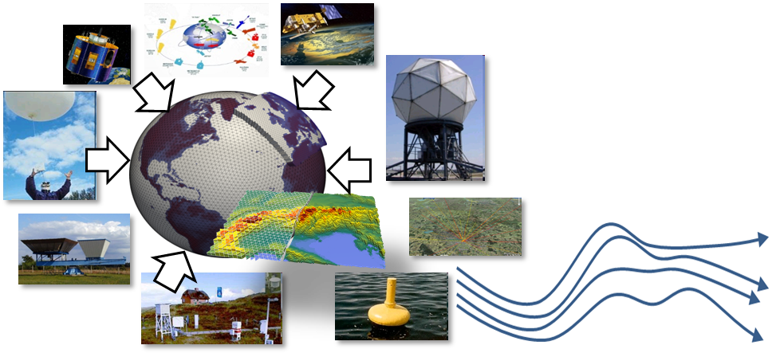
High-resolution Data Assimilation
enhanced DA (high-resolution, high-impact weather):
OPERA surface precipitation rates for LHN
radial winds and 3D radar reflectivities data from D, CH, I and near countries
near-surface station data, also crowd-sourced
soil-moisture and wind from satellite
satellite data for moisture
wind lidars
microwave radiometers
Raman lidar
wind profiler
frequent uptake
Chiara Marsigli

Slide 9
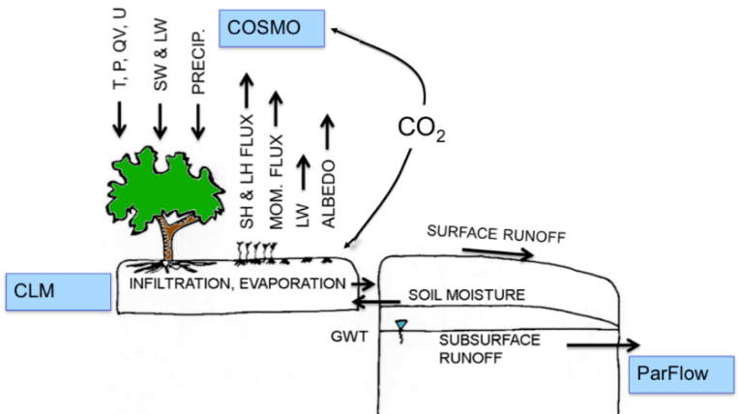
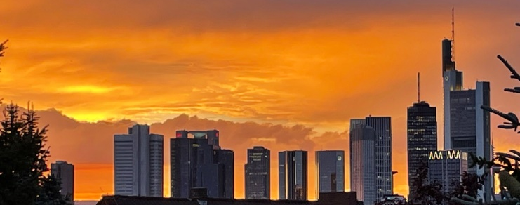
Model improvement for high-resolution
physical parameterization development:
turbulence and convection parametrization;
treatment of orographic gravity waves;
representation of orographic shading effects on radiative fluxes
perturbation methods for improving the description of the precipitation uncertainty in the ensemble formulation
physics-based parameterization of surface and subsurface flow including groundwater and coupling to the land surface (ParFlow)
better representation of the surface energy and water balances in the model, including the urban parameterization (TERRA_URB)

Slide 10
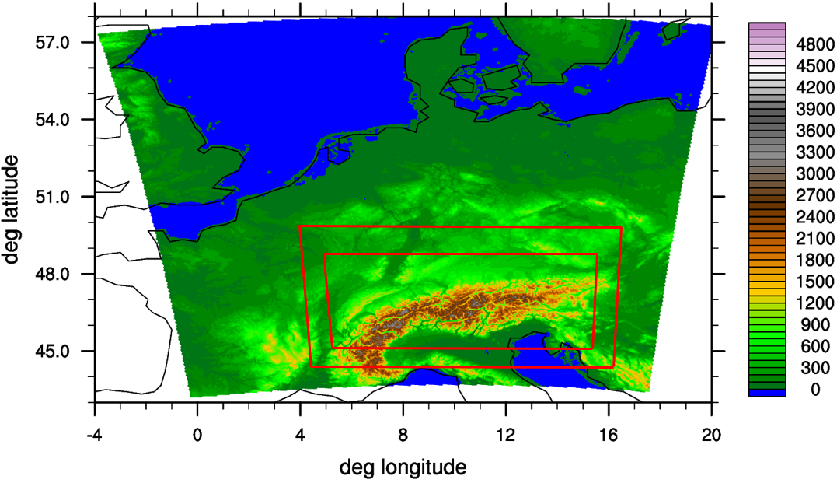
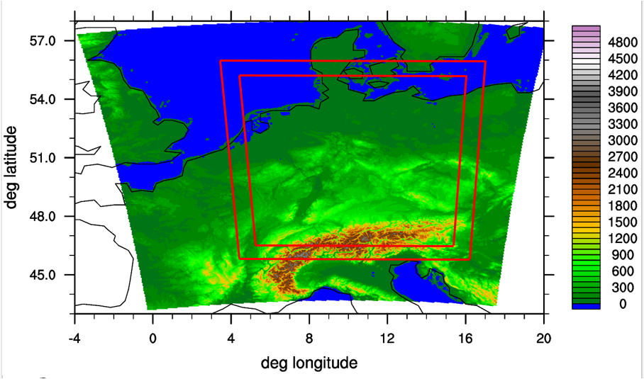
ICON @ 500 m for the Alps / Germany
First suite of experiments motivated by the plan to prepare dedicated high-resolution forecasts for the TEAMx observational campaign starting next week
Envisaged configuration: start from operational D2 analysis and spawn two nested domains (1 km, 500 m) after the end of the latent-heat-nudging phase
A few months later, the idea came up to investigate an analogous configuration for Germany
approximate domain configurations
Notes:
10

Slide 11
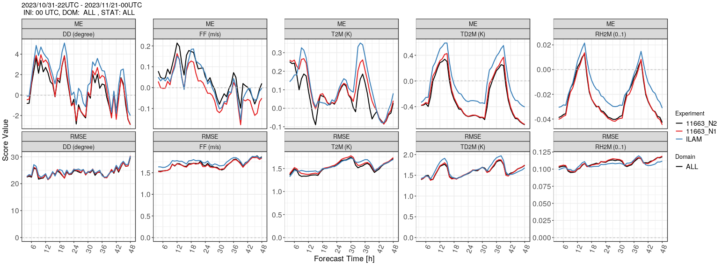
ICON-LAM with 500 m
Refining the mesh size from 2 km to 500 m tends to improve the model skill in various aspects
Improved 10-m winds in mountainous regions under stable conditions, for T2M this depends on the time period, and results for TD2M (dew point) and RH2M are contradicting
500 m
1 km
2 km
Nov 2023, Alpine domain
Notes:
11

Slide 12
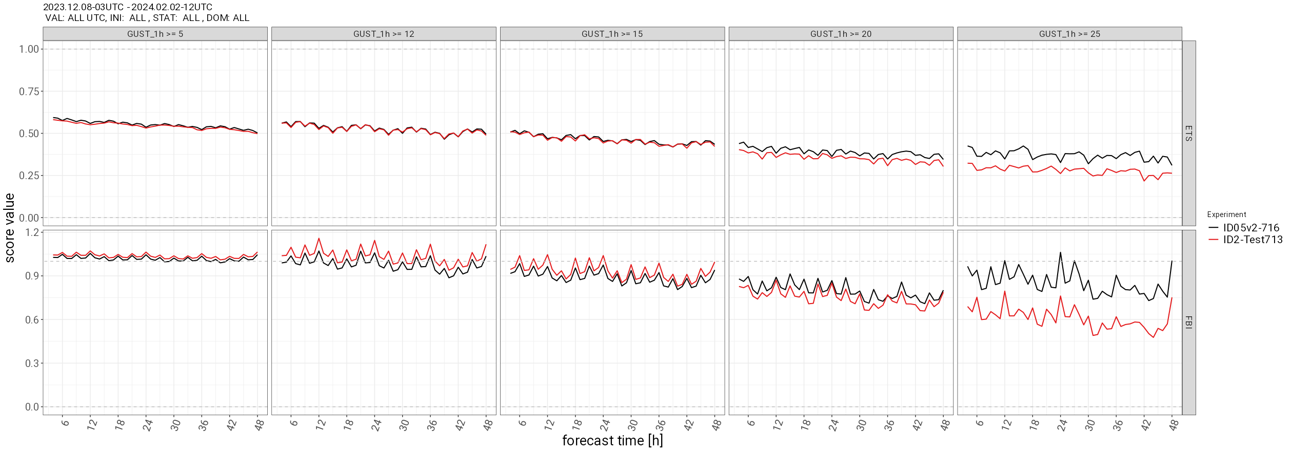
ICON-LAM with 500 m
Refining the mesh size from 2 km to 500 m tends to improve the model skill in various aspects
Better representation of wind maxima / gust at mountain crests
5 m/s 12 m/s 15 m/s 20 m/s 25 m/s
ETS
FBI
Dec 2023 + Jan 2024, German domain, categorical gust verification
Notes:
12

Slide 13
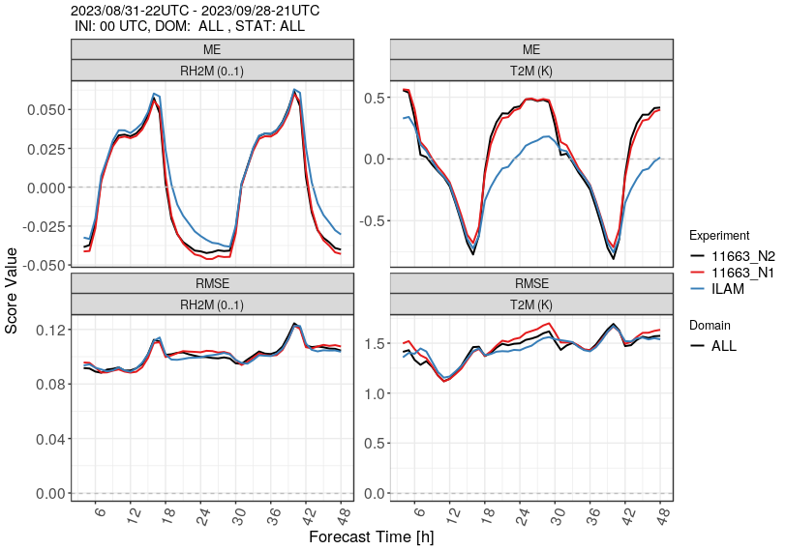
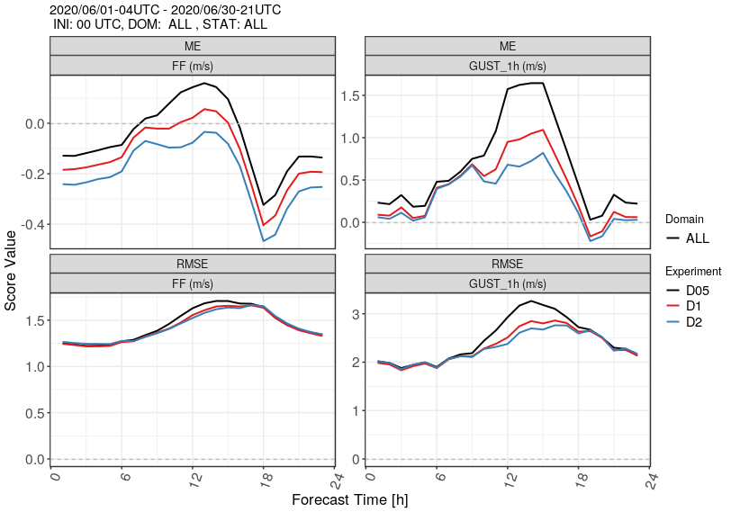
ICON-LAM with 500 m
However, there were also several issues that required further model development
Increased nocturnal warm bias in valleys during the summer months
Large overestimation of diagnosed wind gusts in summertime conditions with a deep daytime PBL due to double-counting issues with ‘permitted large eddies’
500 m
1 km
2 km
Sep 2023, Alpine domain
Jun 2020, German domain
Notes:
13

Slide 14
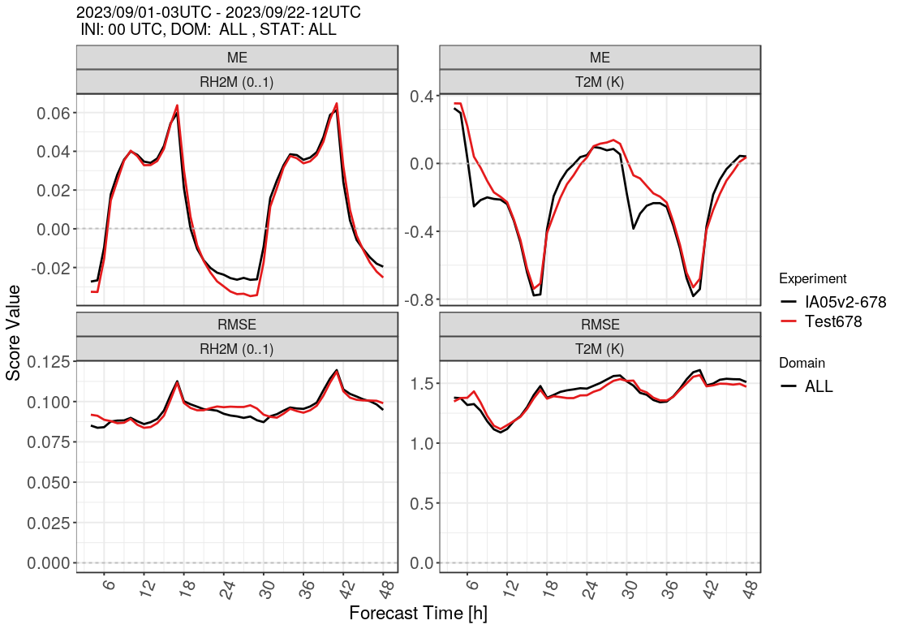
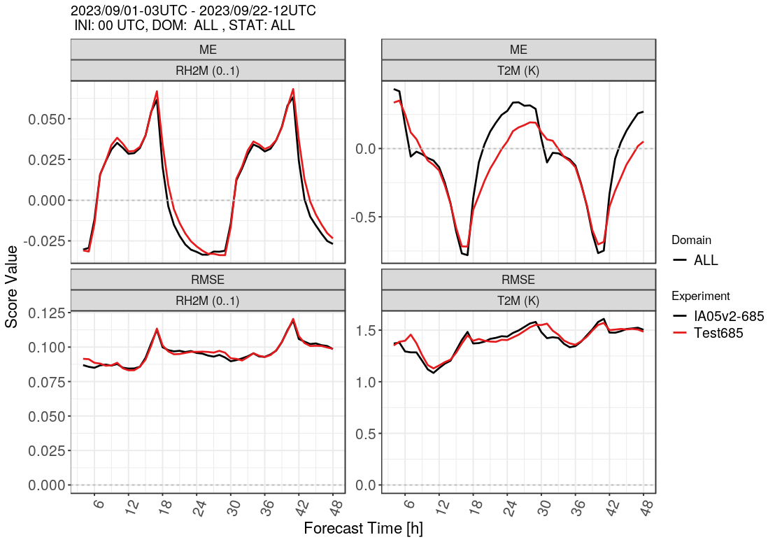
ICON-LAM with 500 m
Subsequent findings related to the nocturnal temperature bias difference
Interpolating the model orography from 2 km to 500 m removes the bias difference (left)
Reducing parameterized turbulent mixing over sloping terrain reduces the bias difference (right)
500 m
2 km
Sep 2023, Alpine domain, interpolated orography
Sep 2023, Alpine domain, turbulence tuning
Notes:
14

Slide 15
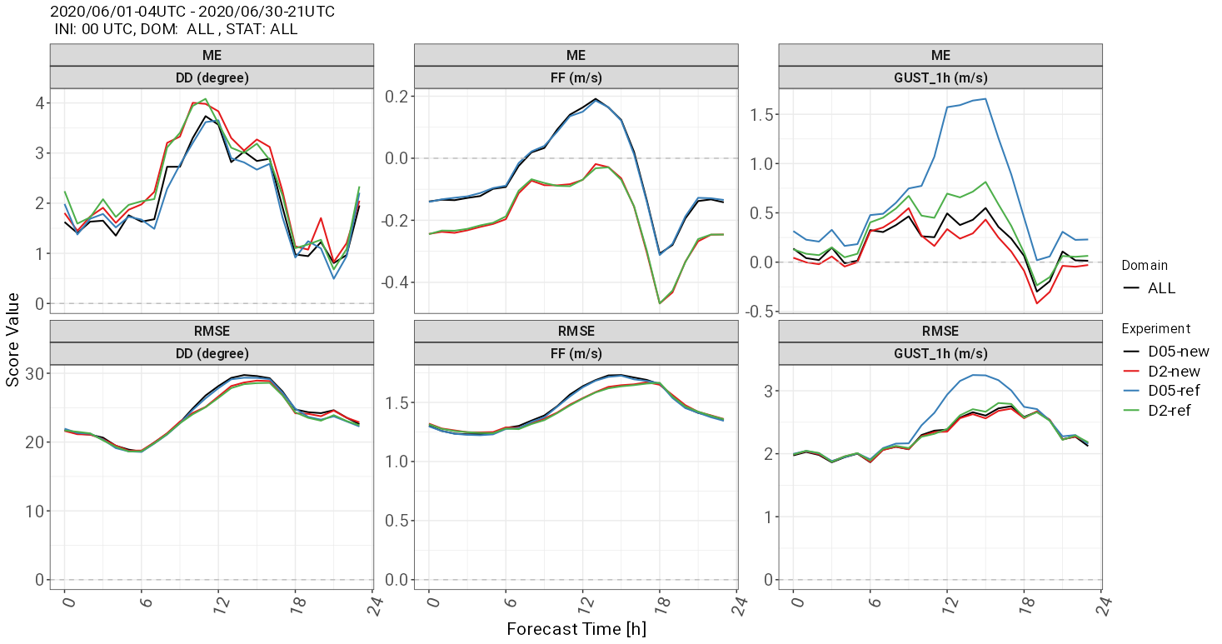
ICON-LAM with 500 m
Adapted gust parameterization
Based upon 10-min averaged 10-m winds rather than instantaneous values in order to reduce impact of ‚permitted turbulence‘
Limitation of gust excess speed to resolved PBL wind maximum (times tuning factor)
Hindcast for June 2020
10-m winds used for verification are still instantaneous values
Notes:
15

Slide 16
ICON-LAM with 500 m
Summary of tuning changes / model improvements developed and implemented so far
Slightly increased orography filtering
Reduced parameterized turbulent mixing over sloping terrain, combined with reduced transfer resistance for surface fluxes
Reduced SSO source term for TKE
Turn off sub-grid-scale condensation heating at 500 m
Revision of resolution-dependence of tuning parameters in convection scheme (shallow convection is still active at 500 m)
Modified gust parameterization based upon 10-min averaged 10-m winds with additional PBL limitation
Under investigation
Reduced snow albedo over steep slopes
Notes:
16

Slide 17
Adaptive surface friction in ICON-D2
Builds upon time-filtered assimilation increments of wind speed at the lowest model level (10 m AGL)
Provided that 10-m winds are assimilated, these can be used as a proxy for the model bias at this level
Along with the revision of the 10-m wind assimilation, the assumed observation error was reduced significantly because this further improved the results (Hendrik Reich, Klaus Stephan, Christoph Schraff)
Additional minor improvements could be achieved by retuning the SSO scheme
Operational in ICON-D2 since February 2024 (global since November 2022)
See Zängl (2023) https://doi.org/10.1002/qj.4535 for further information
Notes:
17

Slide 18
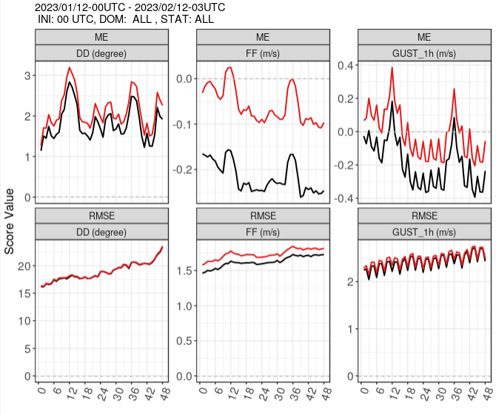
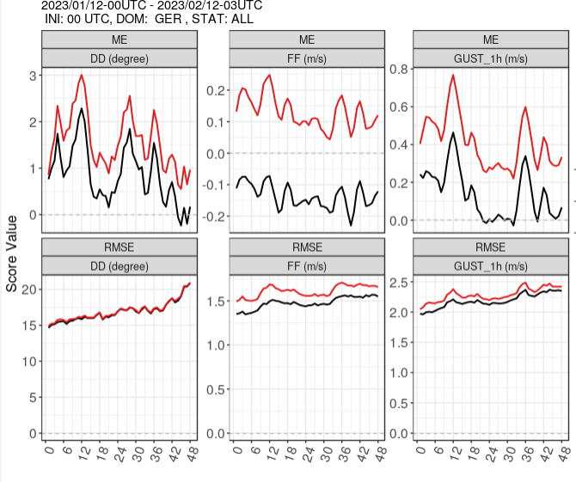
Synop scores for winter test period
(bias/RMSE)
Full domain
German stations only
wind direction
wind speed
wind gusts

Slide 19
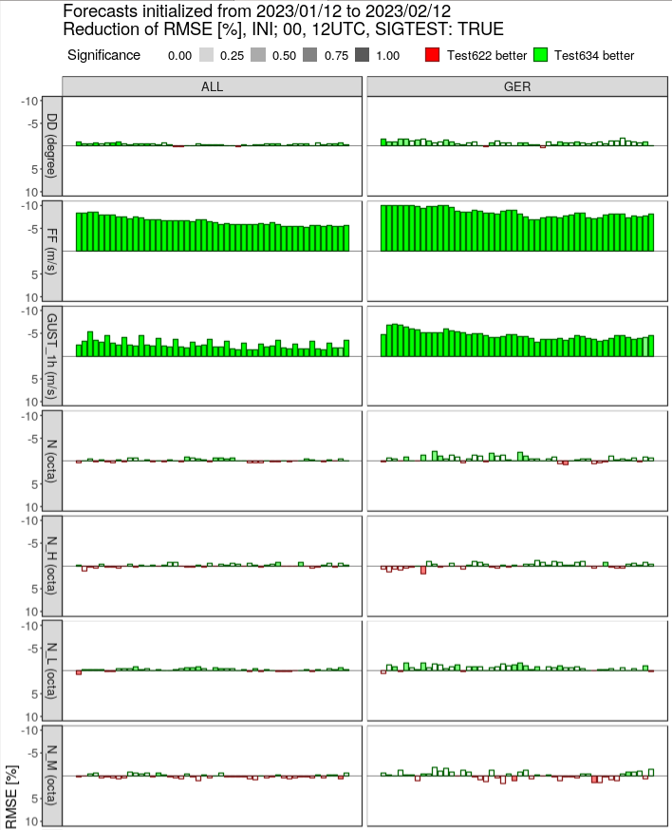
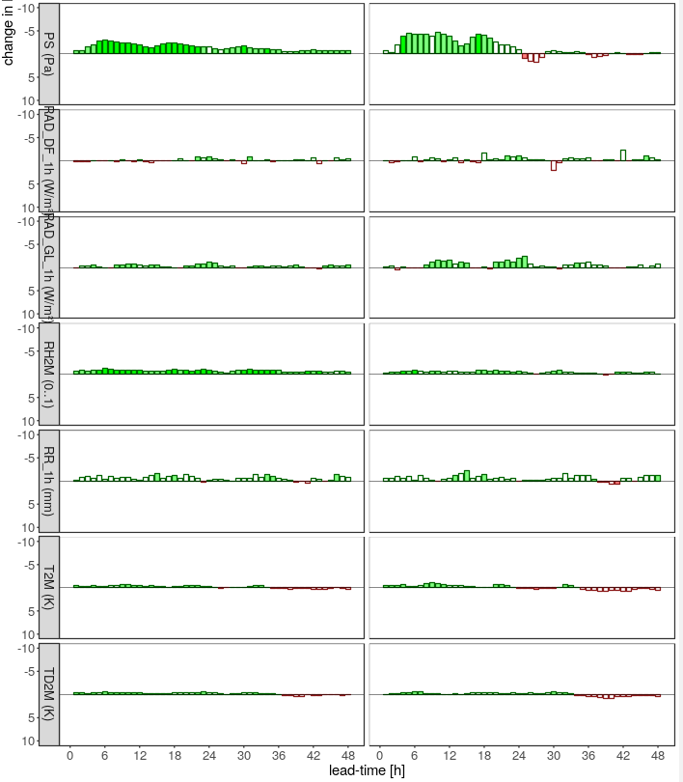
Corresponding SYNOP score card
pressure
wind dir
wind speed
radiation
gusts
RH2M
precip
T2M

Slide 20
Summary of further model improvements
Modifications in convection and cloud-cover schemes to reduce cloudiness and radiation biases in stable PBLs (Maike Ahlgrimm)
Improved sea-ice scheme, accounting for bottom heat flux (Dmitrii Mironov)
Revision of SSO tuning (along with minor formulation changes in the scheme) in order to reduce wind speed errors over the Tibetan plateau in winter
Enhanced EPS perturbations for deep convection scheme in global system, going along with a reduction of the SST perturbations
Consideration of moisture dependence of atmospheric heat capacities (Bjorn Stevens)
Update of greenhouse gas concentrations (2012 → 2023)
Activation of EPS perturbations (including LHN tuning parameters) in ICON-D2 assimilation cycle (Klaus Stephan, Hendrik Reich)
Notes:
20

