Slide 1
WG 4 status, activities and plans
Andrzej Mazur
Institute of Meteorology and Water Management
National Research Institute

Slide 2
Contents
Running and/or (lately) finished PP/PTs
ICON-COMFORT (leader: Dimitra; presented many times, just to remind)
MILEPOST – final report (!)
EGALITE – currently running priority task – Christoph, Pirmin and me (details to follow)
Suggestions for future PP/PTs and other possible activities,
Specific meteorological data for General Aviation (”small aviation”) – a reminder
Lightning (flashrates) forecasts
Applications for renewable energy sources
Methodology for determining MUMC for the needs of locating NPP
Overall status and summary

Slide 3
Running/finished PP/PTs
PP ICON-COMFORT – ICON-COMpetence on FORecasTing
Participants (HNMS, MCH, CNMA, NMA, IMS, ARPA-P, IMGW)
Goals and motivation:
The subjective evaluation of ICON-LAM forecasts by forecasting departments and the translation of this feedback to the COSMO-ICON community.
Evaluation of COSMO licensees-NMHSs' satisfaction of the COSMO forecasts before the migration to ICON-LAM.
Results : The forecasters feedback on ICON-LAM performance in respect to COSMO forecasts and detection of ICON deficiencies for different weather conditions by means of:
Regular surveys ( distributed twice a year)
Representative test cases.
In case COSMO is not available anymore, the comparison can be done with the respect to the operational used model of each service.
Task 1. Forecasters Survey Completion and analysis
Sub-Task 1.1 Survey Creation and Distribution (SON 2022/MAM 2023)
Sub-Task 1.2 Survey analysis (DJF 2022/23, JJA 2023)
Task 2 : Evaluation of ICON-LAM forecast skill
Sub-Task 2.1 Forecasters feedback assessment report.
Sub- Task 2.2 Systematic errors (from objective verification) vs. forecasters feedback report.

Slide 4
Running/finished PP/PTs
PP ICON-COMFORT – ICON-COMpetence on FORecasTing
List of participants providing survey answers |  |  |  | List of participants providing test cases
 | SON-DJF | MAM-JJA | C2I (*) |  | SON-DJF | MAM-JJA | C2I (*)
ARPA-P | X | X | X | ARPA-P | X
IMS |  | X | X | IMS
CNMCA |  | X | X | CNMCA |  | X | X
NMA | X | X | X | NMA | X | X
IMGW | X | X |  | IMGW | X | X
MCH | X | X |  | MCH | X
HNMS | X | X | X | HNMS | X | X
(*) Older surveys from C2I PP

Slide 5
Running/finished PP/PTs
PP ICON-COMFORT – ICON-COMpetence on FORecasTing
Main points on model use and products.
There were delays in receiving ICON-LAM data for visualization. This is a reason ICON-LAM is not the main forecast model for some services.
Visualization is not satisfactory for most services. Better map resolution, multi-model meteograms, color scale improvement or zooming tools are needed.
Many products (direct or post-processing) are needed for some services. Especially convective indices, high weather impact products and visibility/fog maps. Higher temporal resolution of outputs is also desirable.
Verification is not always useful as the forecasters look more visually the outputs. Some verification products are not comprehensive to the forecasters. Some additional products such verification of severe weather may be useful.
ICON-LAM is not the main model for issuing aeronautical and sea forecasts, but it is only used for comparison.
(*) Older surveys from C2I PP

Slide 6
Running/finished PP/PTs
PP ICON-COMFORT – ICON-COMpetence on FORecasTing
Wind Speed
ICON-LAM better predictions than COSMO.
Overestimation of wind/wind gust and convective and orographic situations in warm seasons
Temp
ICON-LAM better predictions than COSMO.
Nighttime overestimation is reported.
Clouds
Fog
Better cloud predictions of ICON-LAM than COSMO especially for low-level clouds.
False alarms and fog risk overestimation of ICON-LAM are reported, but less than COSMO, especially in winter.
Precip
More contradictory opinions about precipitation performance.
ICON-IT Poor prediction of severe summertime deep convection hail events with misses and better performance of IFS in comparison to local models.
ICON-IT Nighttime convection inhibition resulting in poor deep convection overnight
Comparable or even better predictions for COSMO for frontal precipitation in winter season.
The precipitation area is better forecasted than the amounts which can be wrong.
Better predictions of ICON than COSMO in summer convective and orographic conditions , although events and rainfall amounts overestimation is often reported.
The 700hpa humidity map does not affect ICON-IT predictions as much as COSMO-IT
(*) Older surveys from C2I PP

Slide 7
Running/finished PP/PTs
PP ICON-COMFORT – ICON-COMpetence on FORecasTing
You can find the report and test cases @COSMO website:
https://www.cosmo-model.org/view/repository/wg4/PP-COMFORT

Slide 8
Running/finished PP/PTs
PP MILEPOST – MachIne LEarning-based POST-processing – Final Report.
The main goal – supply the COSMO community with new/advanced/refined post-processing methods based on ML, to allow the forecast to be as close as possible to the actual state of the atmosphere.
The outcome – the investigation the relationship between numerical predictions in terms of Direct Model Output (DMO) and results of ML-based Postprocessing results, including verification with observations. All methods were ultimately to be delivered in the form of software packages to be used for advanced post-processing.
Due to the circumstances of force majeure,
project was stopped (and terminated) much earlier than expected;
the form of the report is significantly different from the standard ones. Only the results obtained by the project contractors until the forced termination of the project are listed in the report. The Russian partners could not participate in the report’s preparation;
similarly, to standardize the form of the entire report, the other participants of the project (IMWM and MCH) also presented the results of the work performed until the premature termination of PP MILEPOST.

Slide 9
Running/finished PP/PTs
PT EGALITE
Early warninG and AnaLysIs sysTEm
for release and dispersion of contaminants.

Slide 10
Running/finished PP/PTs
PT EGALITE - Early warninG and AnaLysIs sysTEm for release and dispersion of contaminants.
Introduction
A need for improvement/developing early warning systems (EWAS) being able to respond to release of toxic and/or harmful substances into the atmosphere.
”Early Warning” – the ability to quickly provide information about the occurrence of an event and its possible consequences.
Released contamination/pollution – dangerous due to its nature (i.e., radioactive, toxic…) and/or emission intensity (i.e., the amount released).
Operational EWAS use meteorological data (an output from operational meteorological forecast models).
PT EGALITE aims at gathering/exchange the experience available among COSMO partners on the connection: numerical weather forecasts – pollutant dispersion modeling in favor of new- and/or of existing EWAS that respond to the mentioned threats.

Slide 11
Running/finished PP/PTs
PT EGALITE - Early warninG and AnaLysIs sysTEm for release and dispersion of contaminants.
Subtask 1. General survey
Detailed review and survey of the systems running and plans for further developments at collaborating parties.
Description and comparison of scientific background, methods used and setup(s).
Deliverables:
Reports on review/survey; info on the comparison results, suggestions for further research.

Slide 12
Running/finished PP/PTs
PT EGALITE - Early warninG and AnaLysIs sysTEm for release and dispersion of contaminants.
Subtask 2. Tests and intercomparisons
Preparing and conducting exercises regarding threats of potential releases from identified sources in domains specific to each participant and/or in a jointly established common area.
The results of such exercises will of course contribute to the final report.
Deliverables:
Intermediate reports, final report, comparison results, guidelines/ suggestions for further research directions, publication in JCR journal.

Slide 13
Running/finished PP/PTs
PT EGALITE - Early warninG and AnaLysIs sysTEm for release and dispersion of contaminants.
Subtask 3. General post-processing and verification
Complementary to sub-tasks 1 and 2 – verification of test results and exercises.
Results – a detailed description of the exercises, preparation of the final report.
Deliverables:
Description of exercises conducted, verification results for various domains/setups and over the common area, contributions to preparation of the final report.
Contributing scientists:
Christoph Siewert (DWD), Pirmin Kaufmann (MCH), Andrzej Mazur (IMWM)

Slide 14
Running/finished PP/PTs
PT EGALITE - Early warninG and AnaLysIs sysTEm for release and dispersion of contaminants.
Current status:
Subtask 1 – survey finished satisfactorily, results to be incorporated in the final report
Subtask 2 – first test (”dry run”) finished
The "dry run" for release of radioactive material from NPP of Isar, Germany (it is no longer operational but, still, it is in the "common area" of our domains for dispersion calculations).
All participants did the calculations for both high- and medium resolution dispersion models.
Results were transferred to - again - common area, to compare results not only qualitatively, but also quantitatively.
This should be the first of several dry runs.

Slide 15
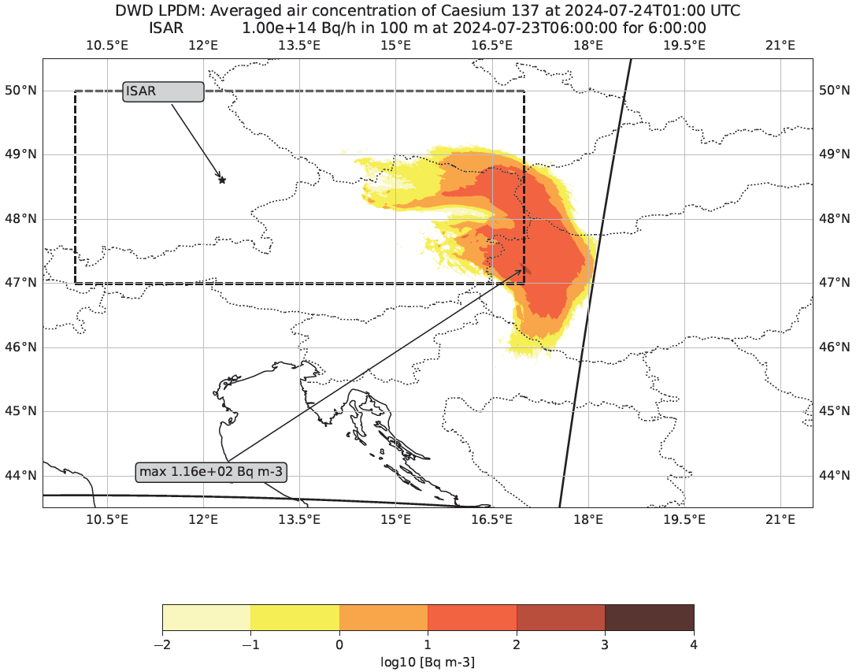
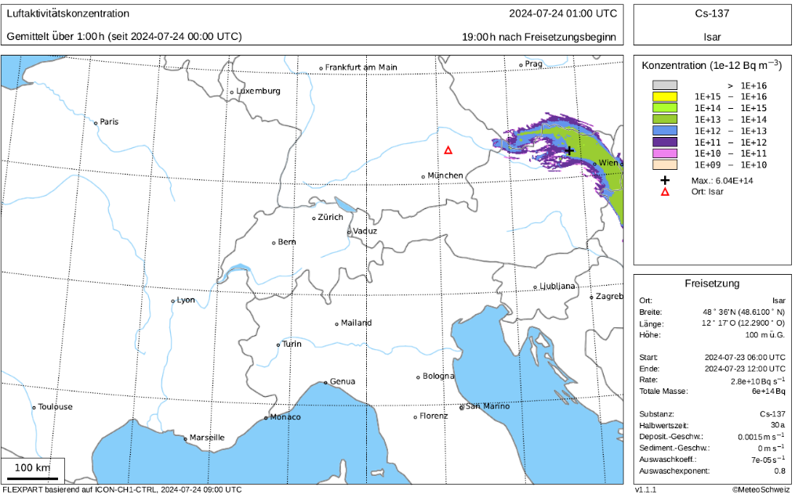
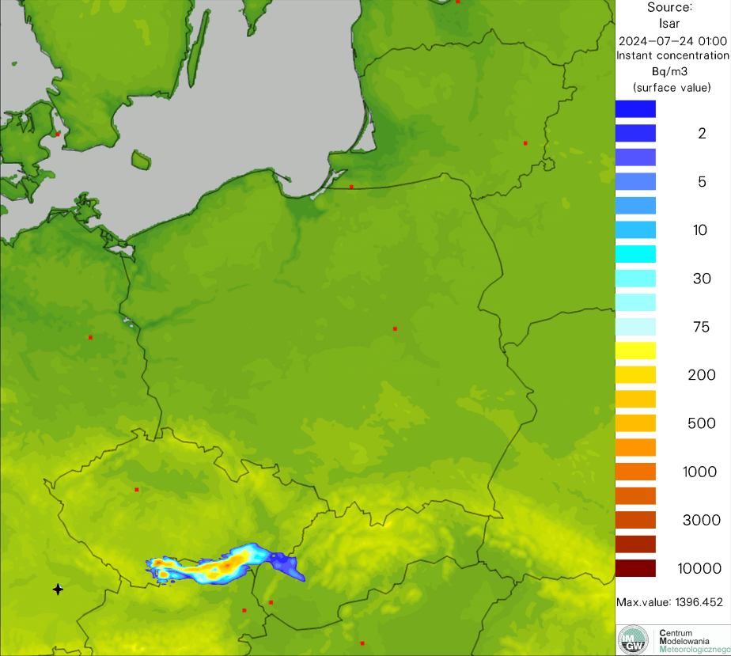
Running/finished PP/PTs
PT EGALITE - Early warninG and AnaLysIs sysTEm for release and dispersion of contaminants.
The setup of "dry run" for release of radioactive material from NPP of Isar, Germany – location in domains
First dry run

Slide 16
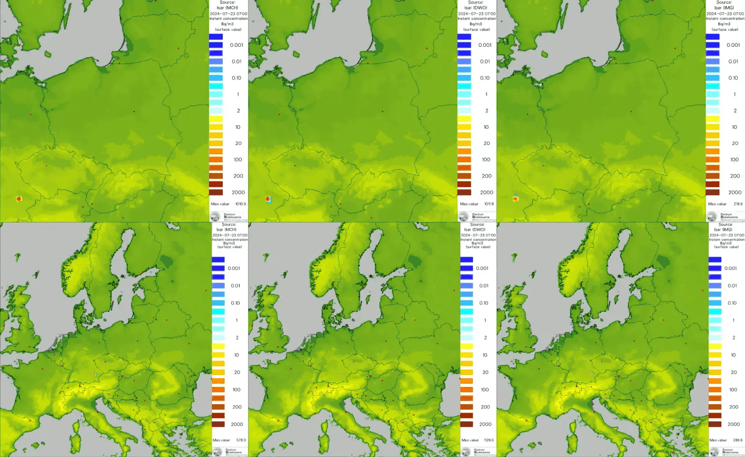
Comparison of MCH/DWD/IMWM results of dry run – release from ISAR NPP (high/low resolution simulation)
Running/finished PP/PTs

Slide 17
Running/finished PP/PTs
PT EGALITE - Early warninG and AnaLysIs sysTEm for release and dispersion of contaminants.
Probability of impact (POI)
Visualization of which points the contamination cloud will pass over, according to the simulations of individual models. Left – high resolution models only; right – medium resolution models only; middle panel – both types of models
First dry run

Slide 18
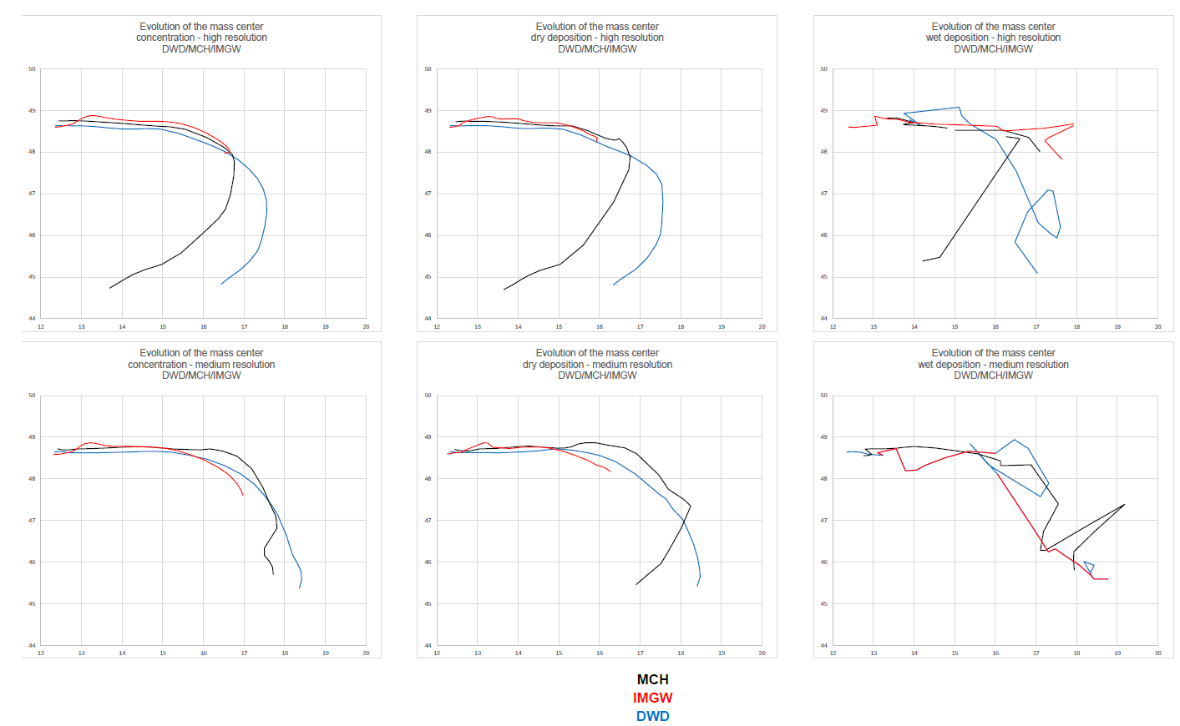
Running/finished PP/PTs
PT EGALITE - Early warninG and AnaLysIs sysTEm for release and dispersion of contaminants.
Time evolution of center of mass of fields (conc., dry dep., wet dep.) for high and medium resolution calculations
x_{cm}, y_{cm}: coordinates od center of mass
M – total mass in the system
m_{i}x_{i},– moments of individual masses (x)
m_{i}y_{i} – moments of individual masses (y)
First dry run

Slide 19
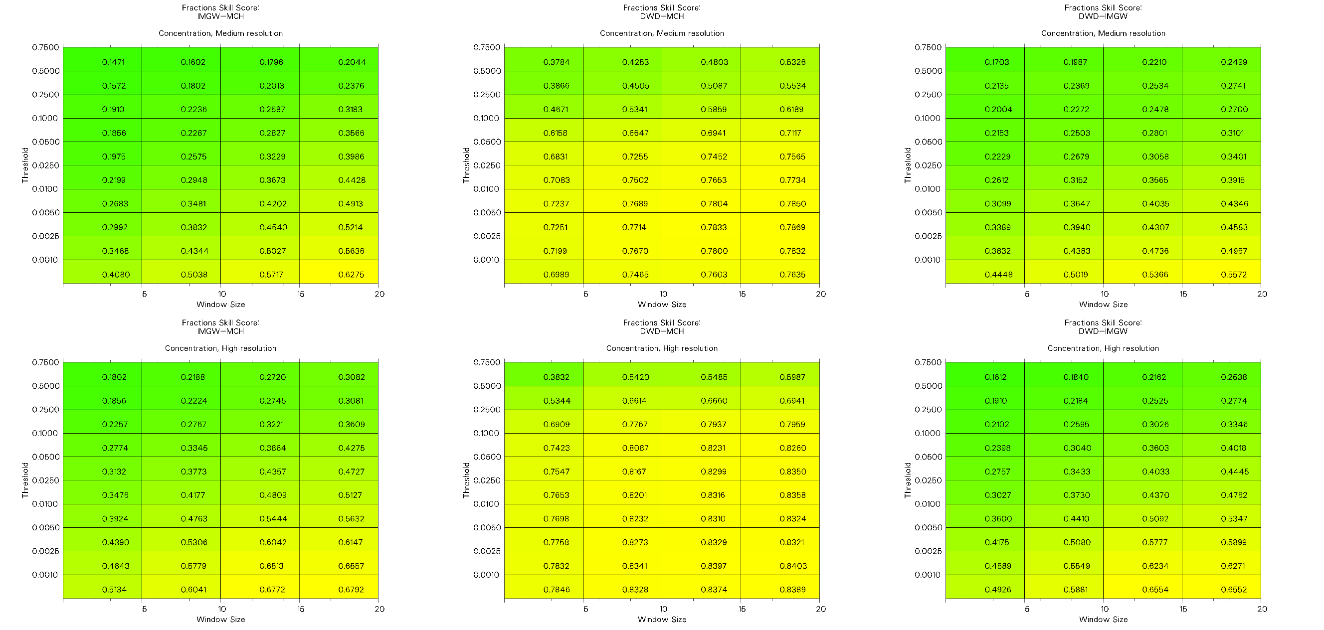
PT EGALITE - Early warninG and AnaLysIs sysTEm for release and dispersion of contaminants.
Relative FSS – concentration
First dry run

Slide 20
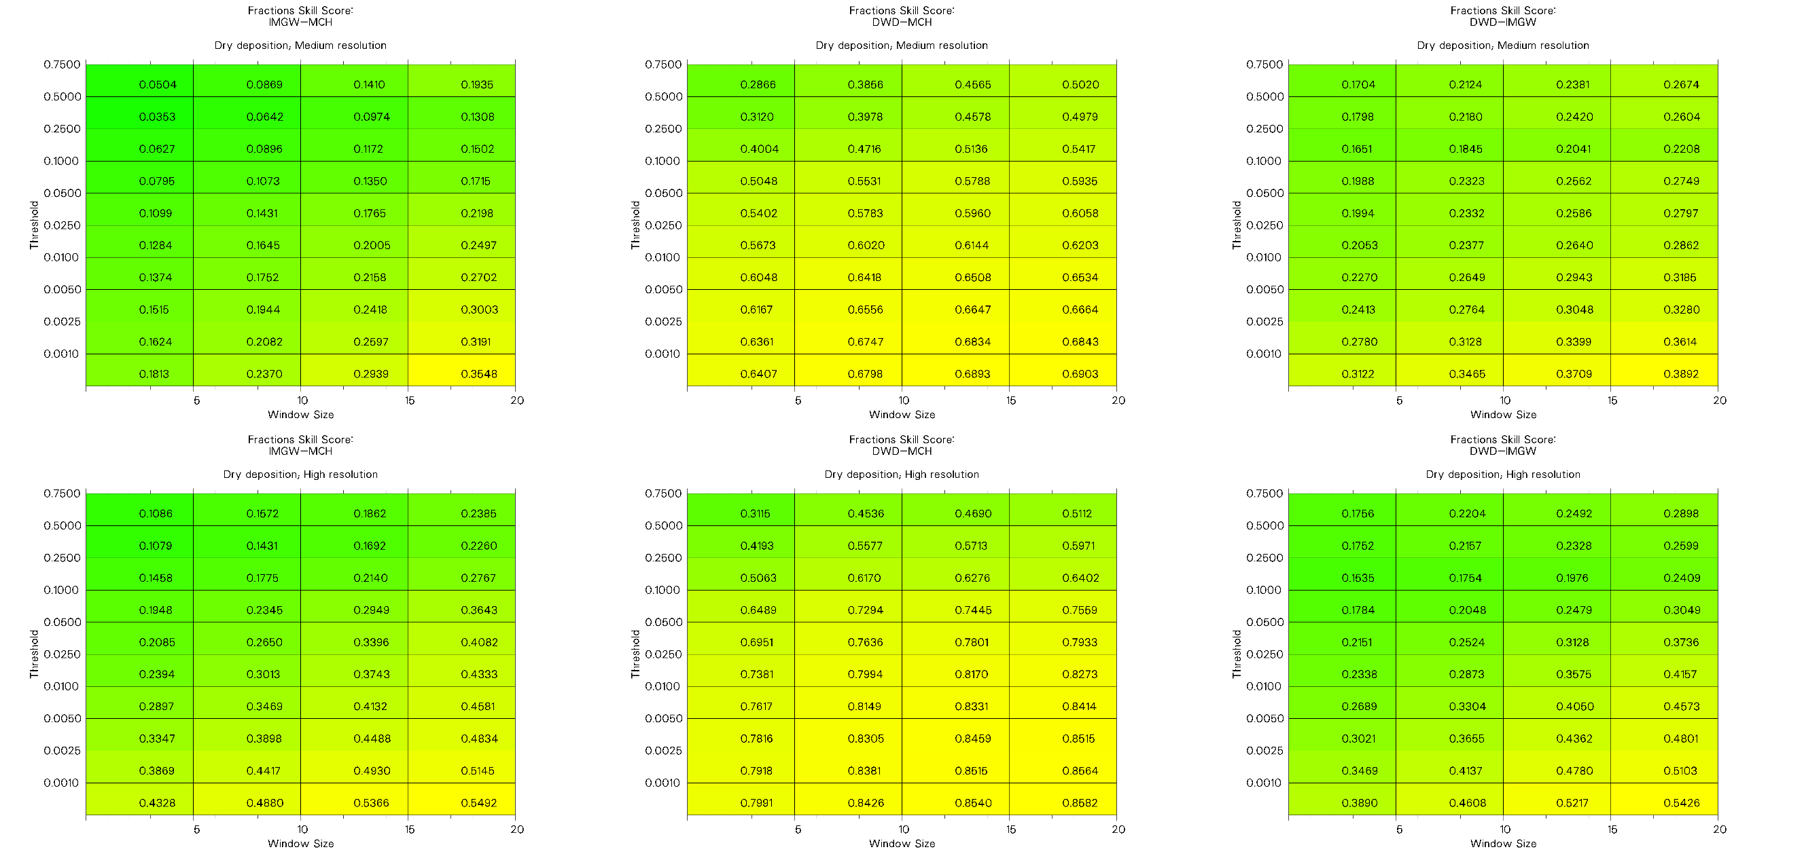
PT EGALITE - Early warninG and AnaLysIs sysTEm for release and dispersion of contaminants.
Relative FSS – dry deposition
First dry run

Slide 21
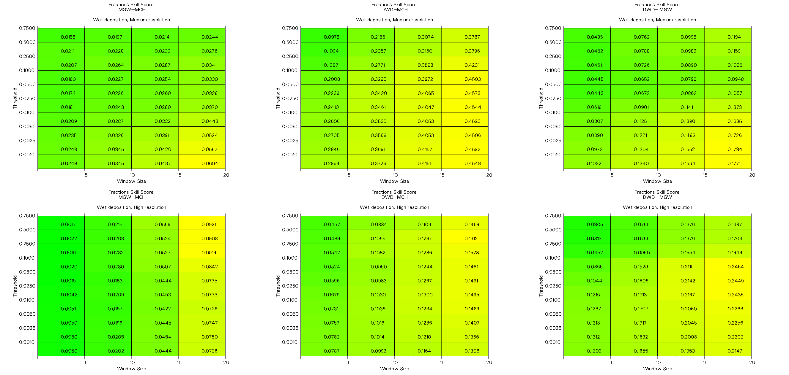
PT EGALITE - Early warninG and AnaLysIs sysTEm for release and dispersion of contaminants.
Relative FSS – wet deposition
First dry run

Slide 22
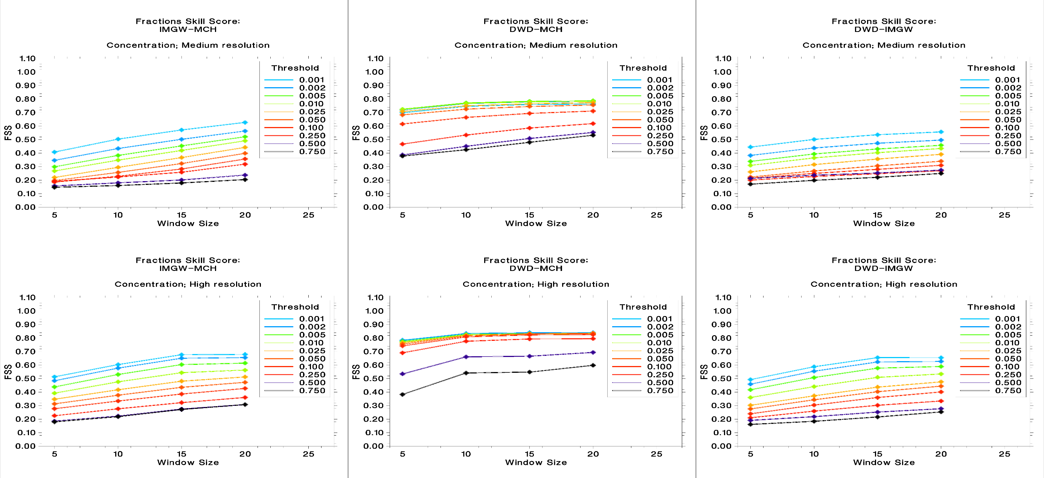
PT EGALITE - Early warninG and AnaLysIs sysTEm for release and dispersion of contaminants.
Relative FSS – concentration
First dry run

Slide 23
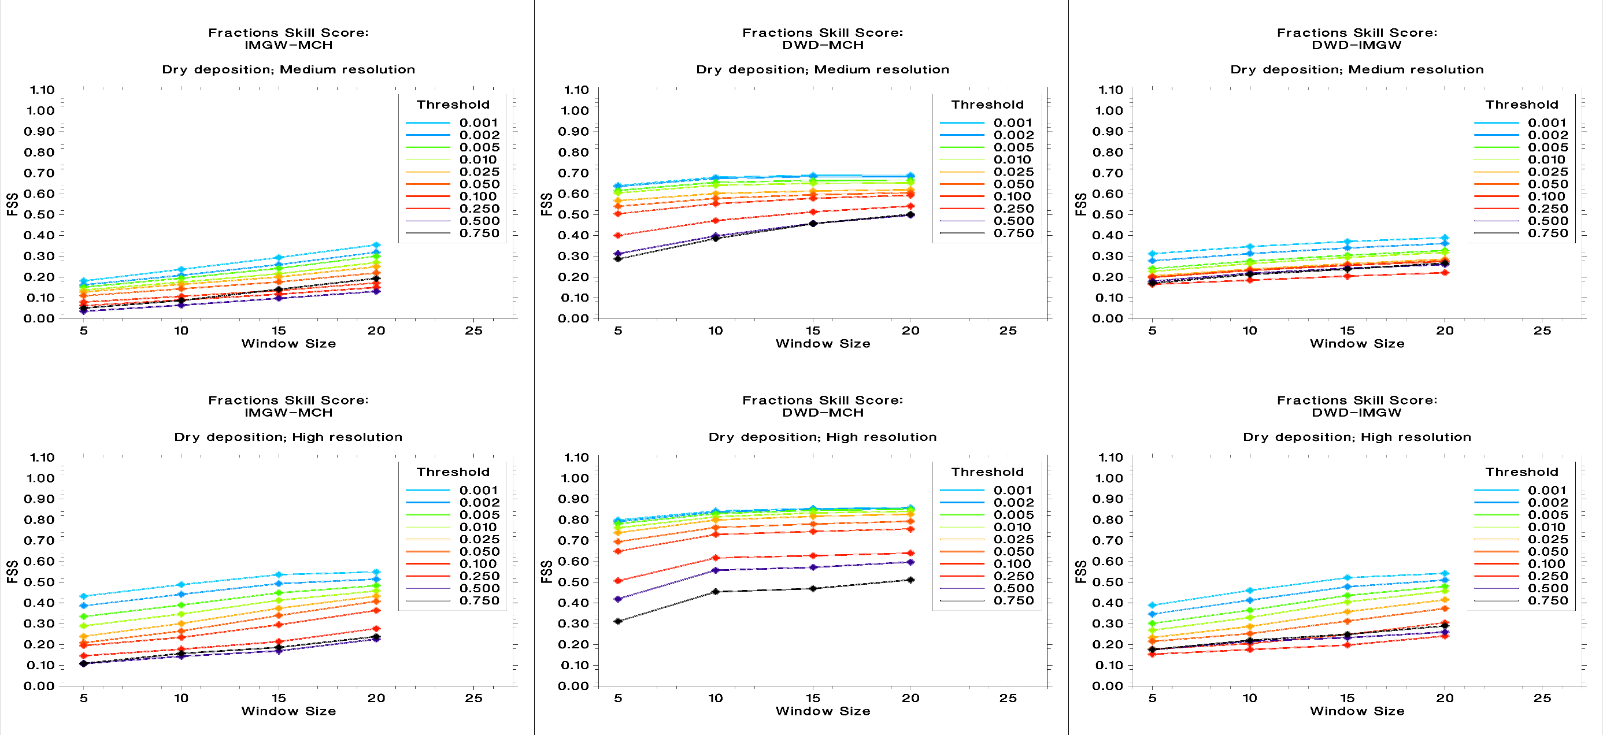
PT EGALITE - Early warninG and AnaLysIs sysTEm for release and dispersion of contaminants.
Relative FSS – dry deposition
First dry run

Slide 24
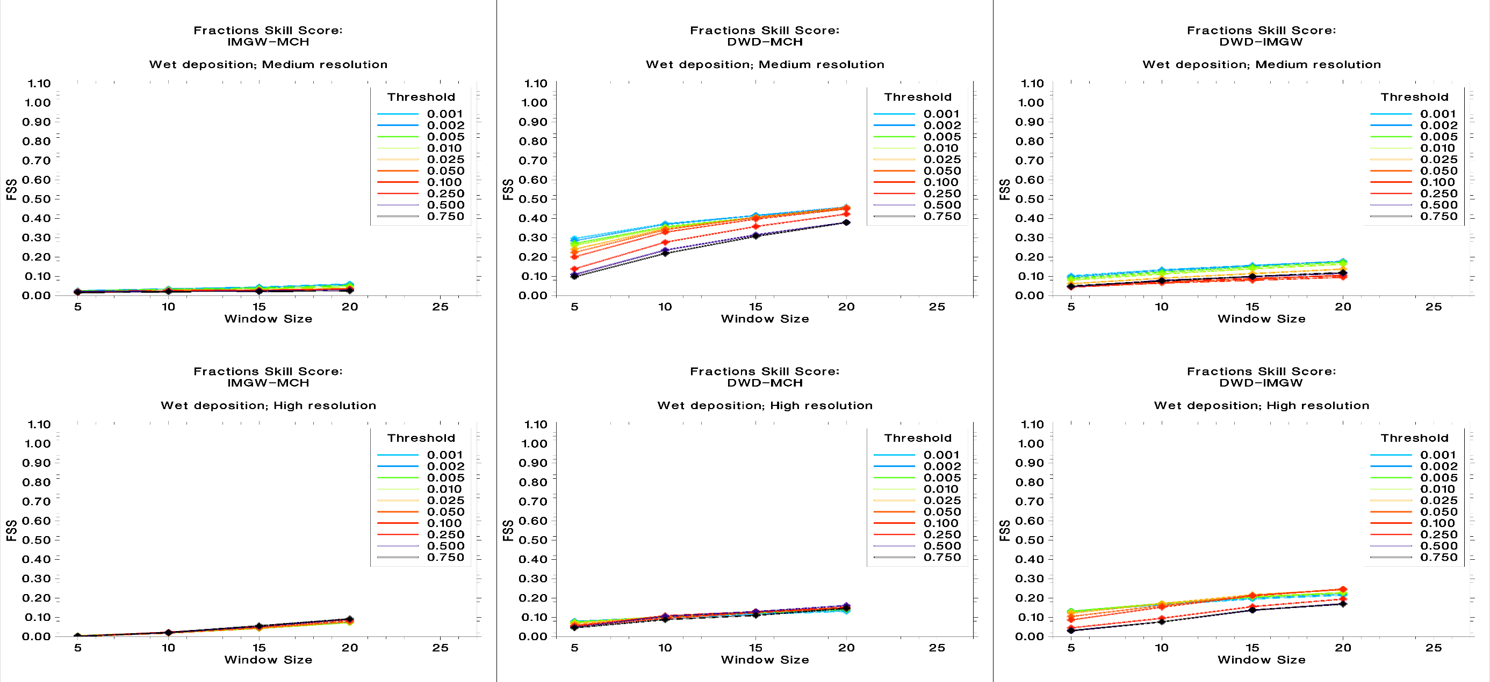
PT EGALITE - Early warninG and AnaLysIs sysTEm for release and dispersion of contaminants.
Relative FSS – wet deposition
First dry run

Slide 25
Suggestions for future PP/PTs and other possible activities

Slide 26
Suggestions for future PP/PTs and other possible activities
Specific meteorological data for General Aviation (”Small Aviation”) – a reminder
Q/A
What is a General Aviation (in Polish – ”Small Aviation”)?
All air traffic except liners, charters and large cargo planes/shipments.
What kind of air traffic?
Small tourist planes, light/small aircrafts, ultralights, gliders, paragliders, choppers, ...
What meteorological data would be needed?
QNH, wind field, wind gusts, windshear, microbursts and other dangerous air movement (funnels, ups and downs; WINDEX, WMSI – Wet Microburst Severity Index), information about precipitation, cloud cover (especially low level), info about convection, visibility range, cloud electricity and lightnings (-> LPI, flashrate), CATs, Lowest Freezing Level…
Spatio-temporal scale and resolution, time horizon of forecast?
Below 3 km/1 hour, 24+ hours…
Basic works has been started at IMGW, still, it’s a wide issue – both for research and applications.

Slide 27
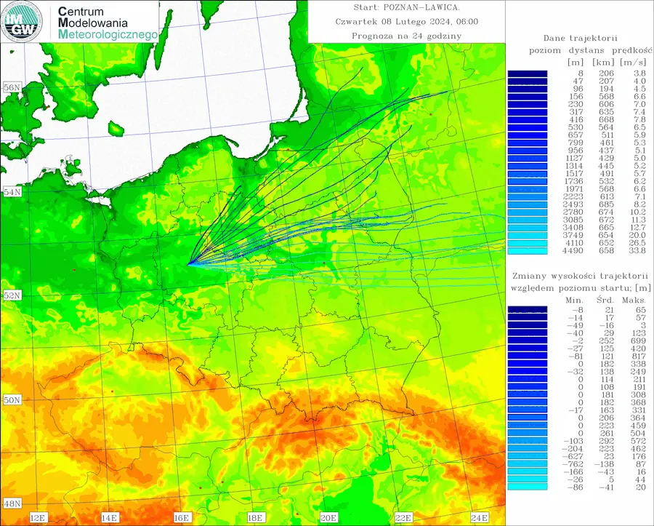
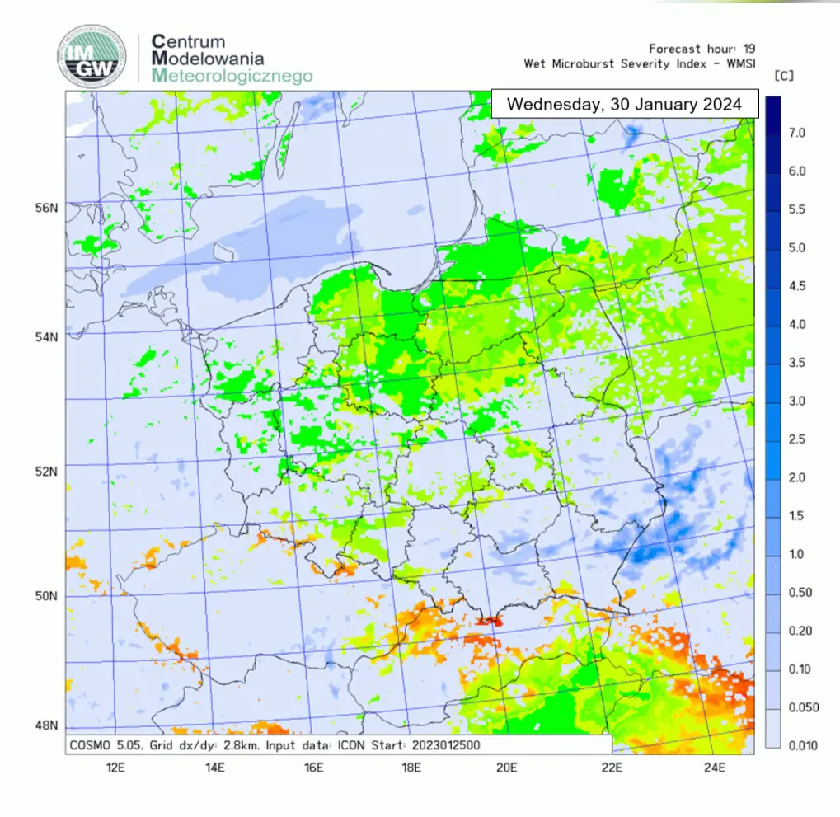
Suggestions for future PP/PTs and other possible activities,
Specific meteorological data for General Aviation (”Small Aviation”) – a reminder

Slide 28
Suggestions for future PP/PTs and other possible activities,
Lightning (flashrates) forecasts
COSMO-DE – parameterization of electricity of the atmosphere (Dahl et al., 2009-2011) to get flashrates density
ECMWF model – flashrate density diagnosed from the ECMWF convection scheme (Lopez 2016): CAPE, profiles of the frozen precipitation convective flux and of cloud condensate within the convective updraught, the convective cloud base height z_{base}
Simplified: assumed relationship between CAPE, cloud-top and cloud-bottom temperatures (CTT/CBT, respectively) and frequency of lightnings (Wong et al., Geosci. Model Dev., 6, 429–443, 2013):
$$FR={\left(0.0289⋅\sqrt{CAPE}\right)}^{4.54}$$
$$CTT>−15°C→FR=FR⋅\left[\max\left(\frac{−CTT}{15},0.01\right)\right];CBT<−5°C→FR=FR⋅\left[\max\left(\frac{CBT+15}{10},0.01\right)\right]$$
Over water surfaces – condensation accounted for: $\text{FR}=3.196⋅10^{−10}{\left(\sqrt{\text{CAPE}}\right)}^{4,54}$
LPI – Lightning Potential Index – DMO (e.g. at IMWM), linear or quadratic correlation with flashrate density assumed

Slide 29
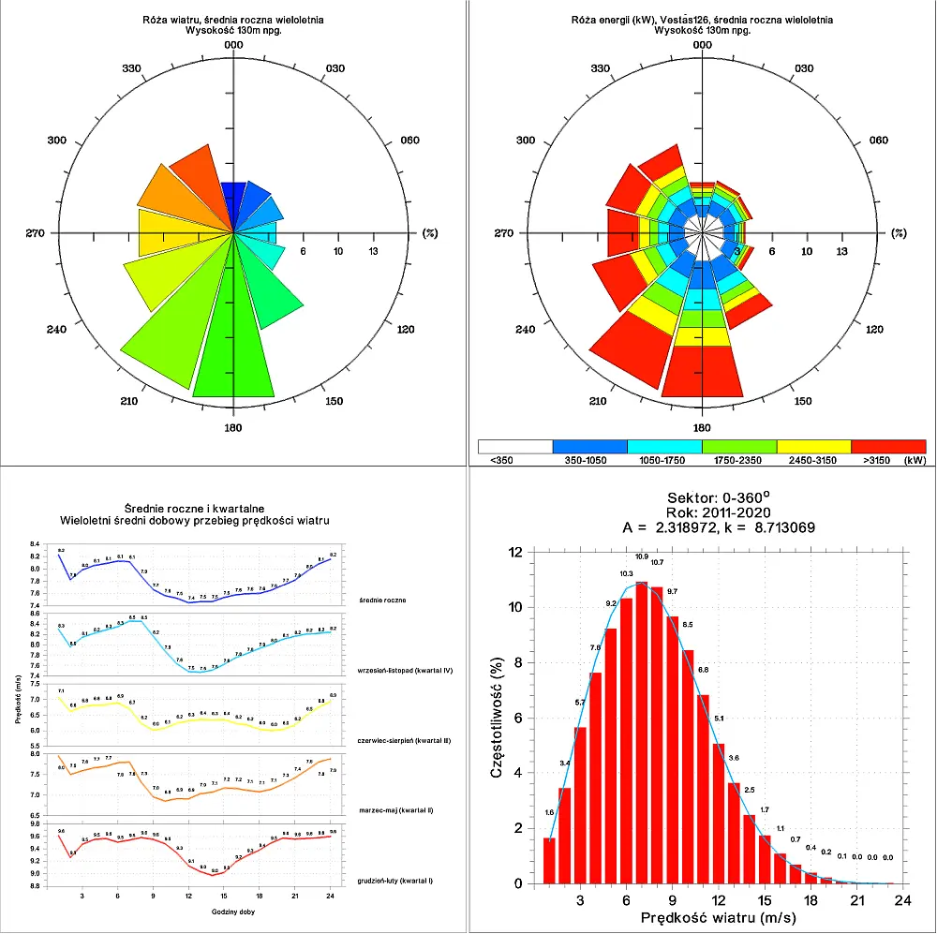
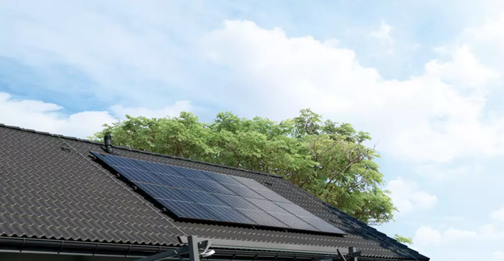
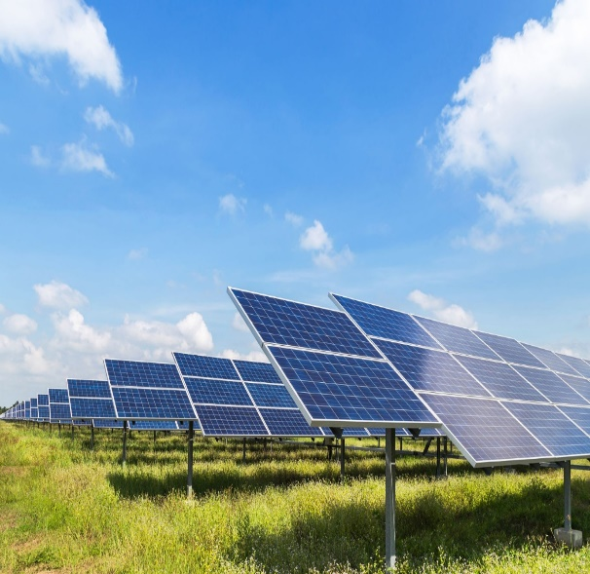
Suggestions for future PP/PTs and other possible activities,
Applications for renewable energy sources
Wind energy applications – statistical estimates of windspeed, energy and power.
Photovoltaic applications – statistical estimates of solar radiation, energy and power.
Parameterization – for a given location – of maximal energy availability in an ideal case and power generation for specific device.
Both for house instalations and for commercial energy producers

Slide 30
Suggestions for future PP/PTs and other possible activities,
Methodology for determining the Most Unfavorable Meteorological Conditions (MUMC) for the needs of locating NPP.
MUMC can be defined as meteorological conditions that cause long-range, fast transport of particle released from NPP or as conditions that provide the maximum surface deposition after release from NPP over given area.
The combination of these two approaches allows to determine how a hypothetical incident in a future NPP might affect the environment. The most unfavorable – for society, state organization, economy, etc. – are those that facilitate the spread of contamination
A long-term analysis is carried out – find meteorological conditions that could cause the fastest arrival of radioactive material to the (predefined) receptor.
The most unfavorable conditions – in the first approximation – are those for which (1) ETA (Estimated Time of Arrival) is minimum and (2) POI (Probability Of Impact) – maximum .
Of course, there can be a lot of sets of such conditions. If so, the second stage is decisive, which consists not only of a specific ETA, but also of other meteorological conditions related to the dispersion of contamination – the amount of precipitation (causing wet deposition), convective conditions (determining vertical diffusion) or local conditions (e.g. terrain roughness > the amount of dry deposition).

Slide 31
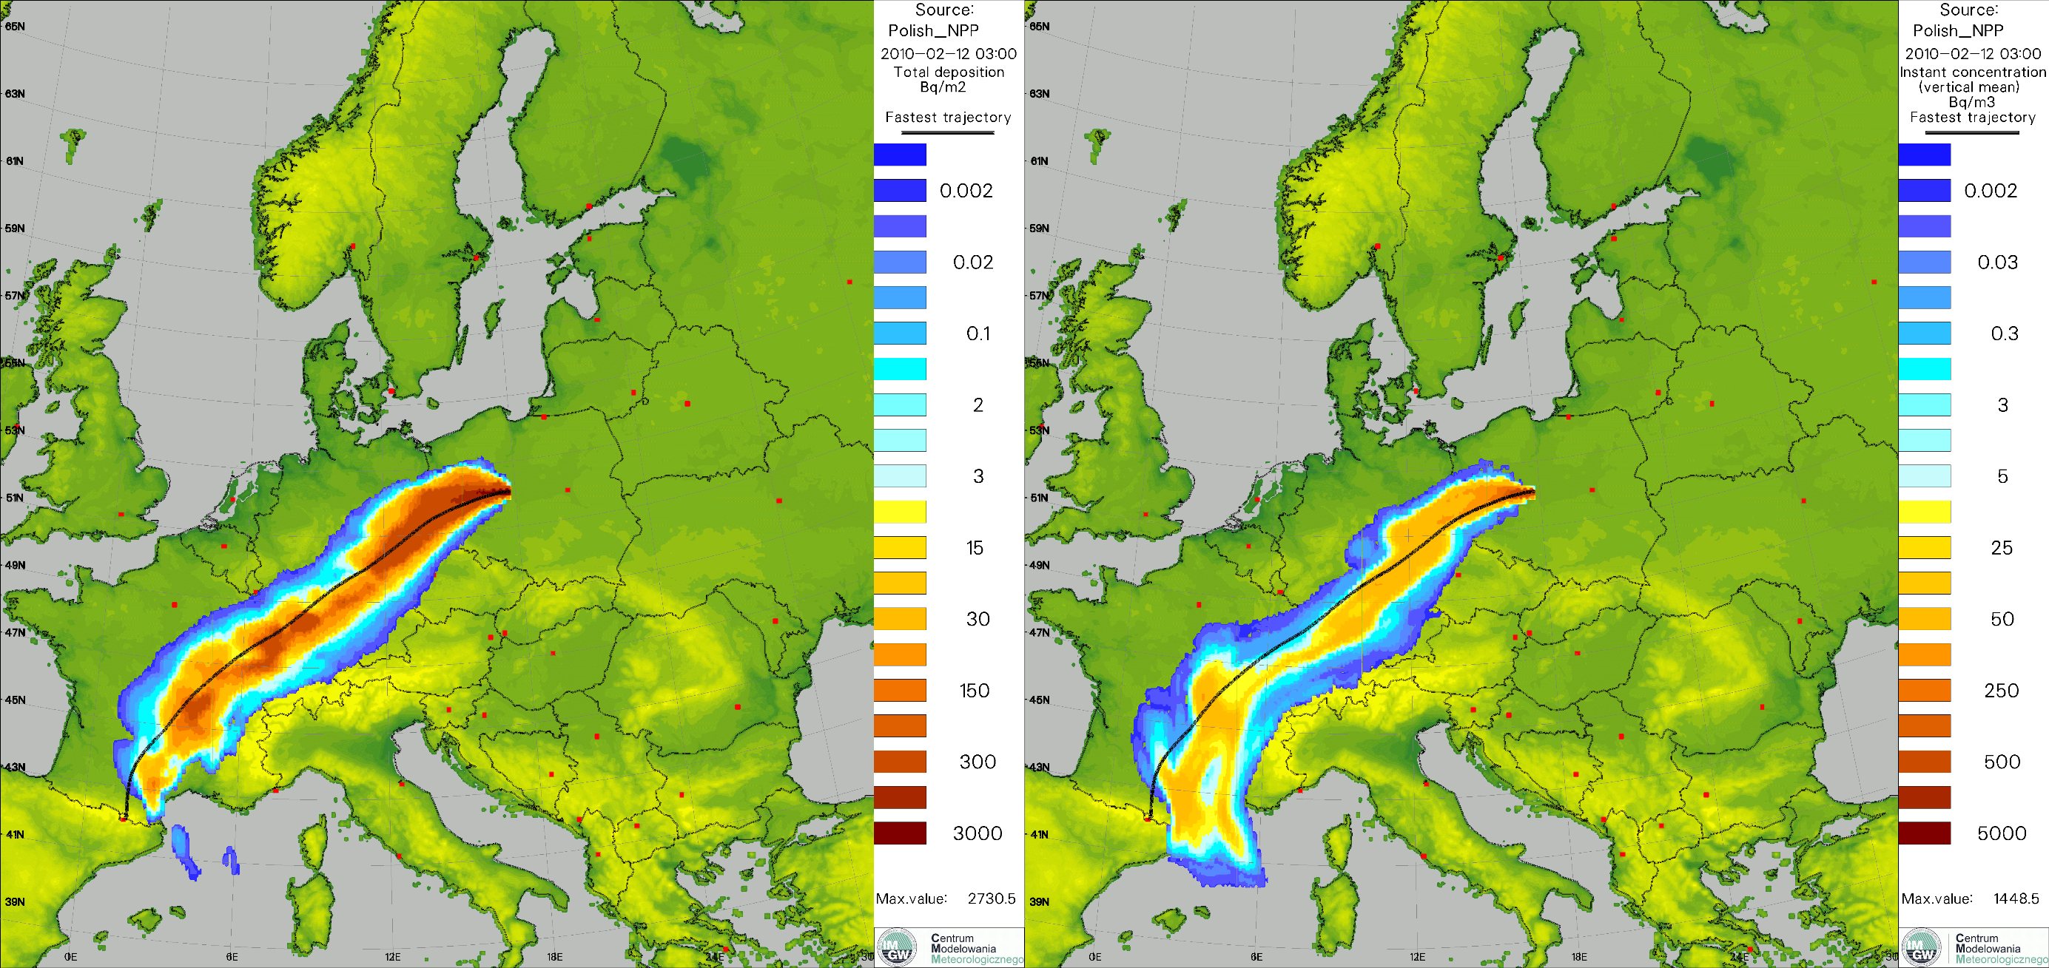
Methodology for determining the Most Unfavorable Meteorological Conditions (MUMC) for the needs of locating NPP.

Slide 32
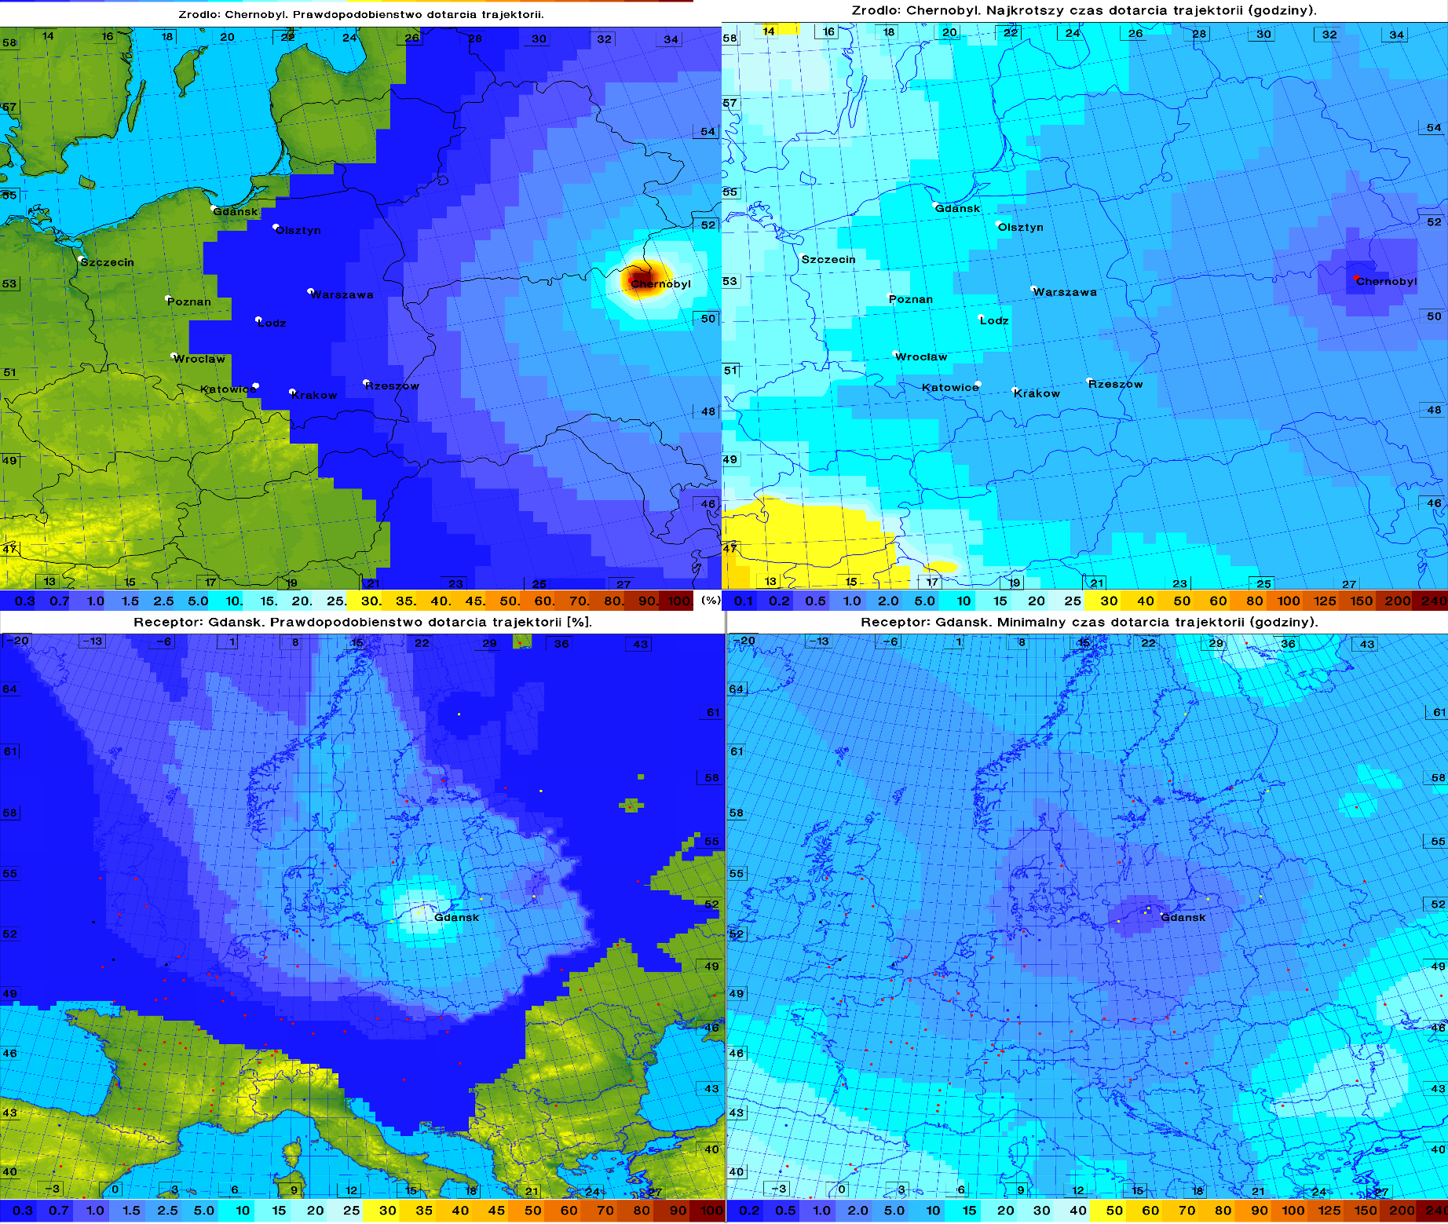
Methodology for determining MUMC for the needs of locating NPP.
Source: Chernobyl, POI
Source: Chernobyl, fastest ETA
Receptor: Gdańsk, POI
Receptor: Gdańsk, fastest ETA

Slide 33
Overall status and summary
People of WG4
Dimitra Boucouvala (HNMS, also works as operational forecaster),
Evgeny Brainin (IMS, Israel, forecaster),
Alessio Canessa (CNMCA),
Christoph Siewert (DWD),
Amalia Iriza (NMA),
Josué Gehring (MCH),
Pirmin Kaufmann (MCH),
Andrzej Mazur (IMGW),
Several people in co-operation with WG4, not being official members:
Valeria Garbero (ARPA-PT, ICON feedback),
Daniele Nerini (MCH),
Maria Stefania Tesini (ARPAE-SIMC),
Susanne Theis (DWD)
Caveat: lack of human resources!

Slide 34
Remember:
no matter how kind you are
German kids are kinder!
Thank you for your attention
Andrzej Mazur
Institute of Meteorology and Water Management
National Research Institute

