Slide 1
C-SRNWP 2024 – 2028
Chiara Marsigli (DWD, Germany)

Slide 2
Organisation
EUMETNET – WEATHER FORECASTING COOPERATION (E-WFC)
Legend:
Manager
Scientist
SRNWP-EPS module
C-SRNWP module
software scientist
DWD- Coordinating Member
Vacant
E-NWC module
Chiara Marsigli
GeoSphere Austria
Coordinating Member
AEMET – co-coordinator
PP module
Franziska Schmid
Alfons Callado Pallares
vacant
RMIB
Coordinating Member
Aitor Atencia
Itaf-Met – co-coordinator
Stephane Vannitsem
Francesca Marcucci
Jonathan Demaeyer
vacant

Slide 3
Summary of 2024 – 2028 - aims
Foster exchanges and cooperation between limited area modeling consortia in Europe
Efficient exchange of information on scientific, technical and operational aspects of NWP
Focus on the new challenges for the development of next generation forecasting systems:
high resolution and the development of Digital Twins, with a strong link with applications and the end-users;
AI/ML based method, where is needed to promote a beneficial interaction with the traditional NWP approaches;
representation of uncertainties in the forecasts with probabilistic and ensemble methods (with SRNWP-EPS).
Ccooperative effort to address these common challenges, and exploit the synergies with the other Modules.

Slide 4
Summary of 2024 – 2028 - requirements
Req no. | Requirement description | Priority | Your Proposal (including methodology statement)
C-SRNWP_1 | Ensure efficient exchange of information between Participating Members and European LAM consortia in relation to scientific, technical and operational aspects of NWP. | M | Communication and exchange; Expert Teams support; enforce the collaboration between the Module Participants on the new challenges EWGLAM Workshop reporting about conferences/projects/tables which are outside of the traditional scope of the established Consortia cooperation follow the DestinE project and keep in contact with the Task Team of STAC&PFAC
 |  | RU | In case of emerging scientific or technical blocking points or new scientific results), initiate the organization of dedicated workshops within the scientific field in focus.
C-SRNWP_2 | Ensure the maintenance of resources (e.g. existing software) and development of new resources under the EUMETNET 'umbrella' to support the NWP community, e.g. in data assimilation (DA) and parametrization. | M | Compile and update a catalogue of resources also focusing on transversal topics of Digital Twins and AI/ML. Coordinate the maintenance and development of the existing resources (Global Lake Database and the SRNWP Surface Data Pool) - activities important for all LAM consortia
 |  | RU

Slide 5
C-SRNWP Expert Teams
Advisory Expert Team:
Consortia Leaders and thematic Expert Teams chairpersons
Thematic Expert Teams:
Data assimilation and use of observations
Diagnostics, validation and verification
Dynamics and lateral boundary coupling
Link with applications
Physical parameterisation (upper air)
Predictability and EPS
Surface and soil processes (model and data assimilation)
System aspects
This year @EWGLAM: discussion on reviewing the role of the Expert Teams

Slide 6
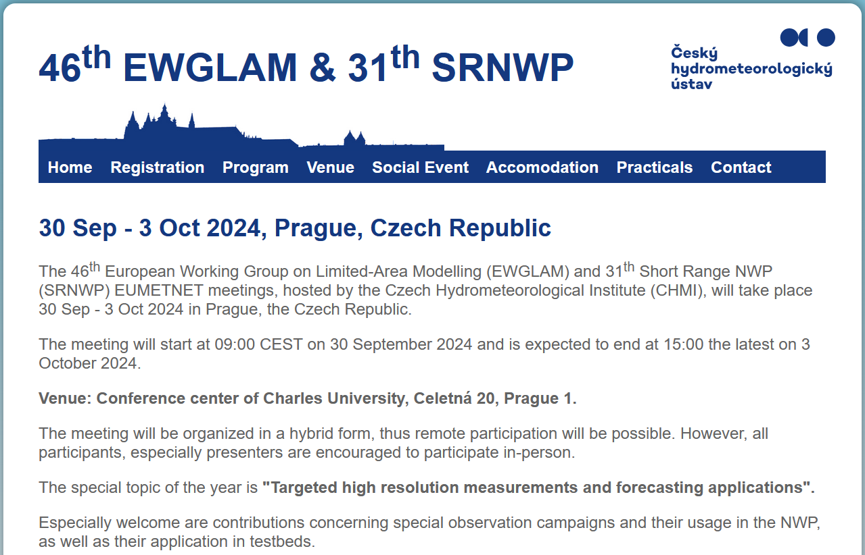
C-SRNWP annual meeting – EWGLAM/SRNWP

Slide 7
E-WFC Conference: https://enwfc-2024.met.no/
Nowcasting
Seamless predictions
Ensemble forecasting
Post-processing

Slide 8
Short Term Scientific Missions
The Short Term Scientific Missions aim at facilitating cooperative work between scientists of different Met Services and different modelling Consortia, in the framework of the E-WFC project.
We would like to support young scientists who would like to have a short stay in different Met Service to carry out some work in collaboration, for the mutual benefit and of the entire community.
Scientific / technical content of the mission: it should be dedicated to a specific and well defined piece of work, related to the topics of the E-WFC Programme: nowcasting, seamless forecasting, post processing, short range NWP, SRNWP ensemble prediction systems

Slide 9
New website: srnwp.eu
Many thanks Theodore!!!

Slide 10
Thank you!

