Slide 1
WG1 / KENDAscope
Christoph Schraff
KENDAscope: KENDA from Surface to Cloud Observations Progressive Extension
(Sept. 2020 – Aug. 2025)
Task 1: algorithmic developments (operational KENDA; (C)EnVar)
Task 2: observations (from surface to clouds)
  2.1 Radar (Z + Vr)
  2.2 ground-based GNSS ZTD + STD
  2.3 all-sky IR WV + VIS radiances
  2.4 MTG IRS
  2.5 screen-level obs (T2M, RH2M; 10-m wind)
  2.6 PBL profiling obs (wind lidar, MW radiometer, Raman lidar, drones, towers)
Task 3: soil / surface
MeteoSwiss, ARPAE, CNMCA

Slide 2
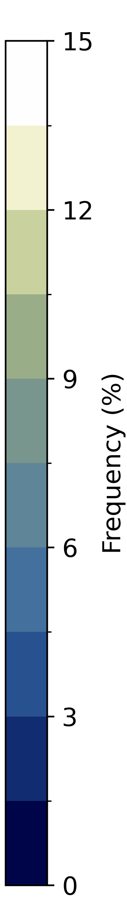
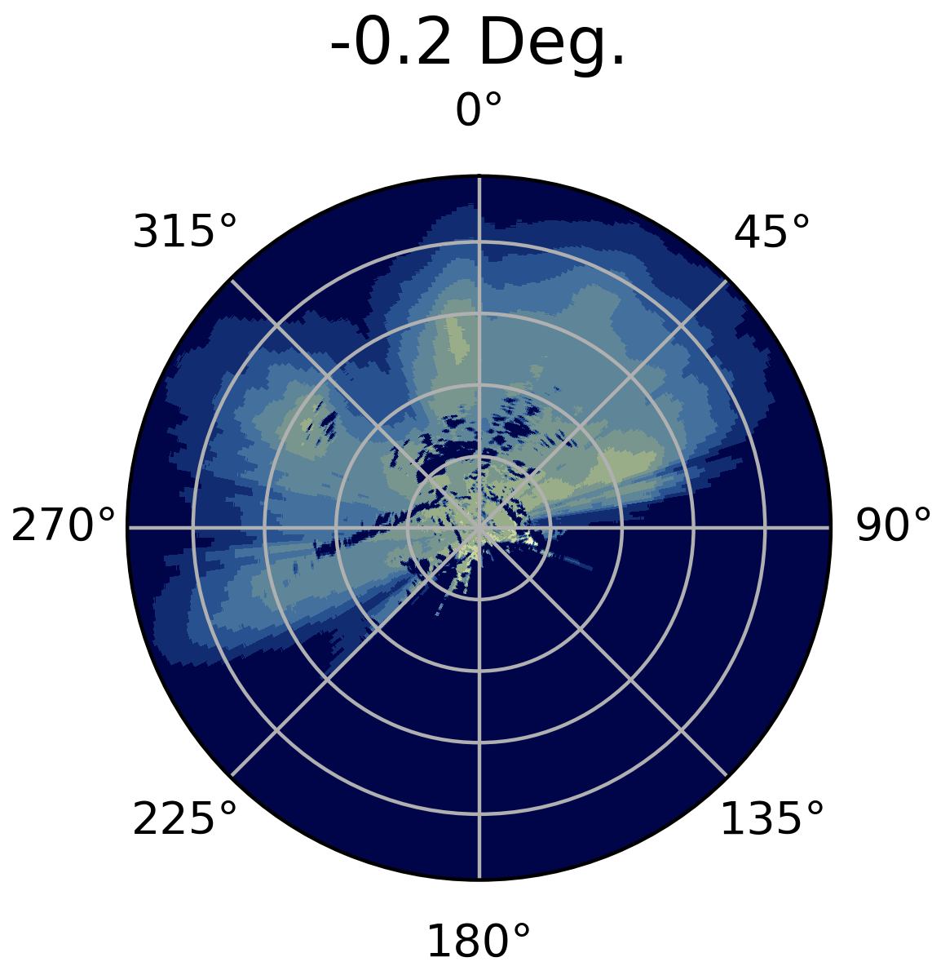
Activities Overview (ongoing)
Daniel Leuenberger, Claire Merker, Krishnamoorthy Chandramouli, Alina Yapparova, Bas Crezee
Finalized KENDA-CH1 setup using ICON, operational since 2024-05-28 (Daniel)
Assimilation of Raman Lidar humidity and temperature profiles (Bas, Claire)
  impact in KENDA-1 (COSMO) positive on analysis + FG, neutral – slightly positive on forecasts
  paper submitted
  obs operator implementation in MEC/DACE being finalized, DA with ICON soon
Assimilation of Swiss radar volume observations (Alina, Claire)
→ shading by real and simulated topography, use frequency / visibility maps
→ settings (e.g. EMVORADO) to get similar obs & simulated Z frequencies
Adaptive Parameter Tuning (Daniel)
Diagnosis of KENDA-CH1 system (Krishna)
  discovered several bugs / inconsistencies (e.g. rel. to redundancy check, …, and …)
  frequency map Albis radar (1st half 2024)

Slide 3
Cross validation diagnostics (Stiller, 2021)
in some cases, fit of analysis to radiosondes degraded due to T2M assimilation:
station-wise diagnostics of T2m assimilation w.r.t. Milan TEMP during OND 2023
orography height
only stations below 950 hPa considered here
negative impact from most stations
negative impact mostly at night,
particularly from very cold T2M obs:
systematic cold bias in O-B
(hints of limited representativity
where certain stations (in valleys / near orography)
tend to have lower T2M than other stations)
negative impact
positive
impact
00 UTC
12 UTC

Slide 4
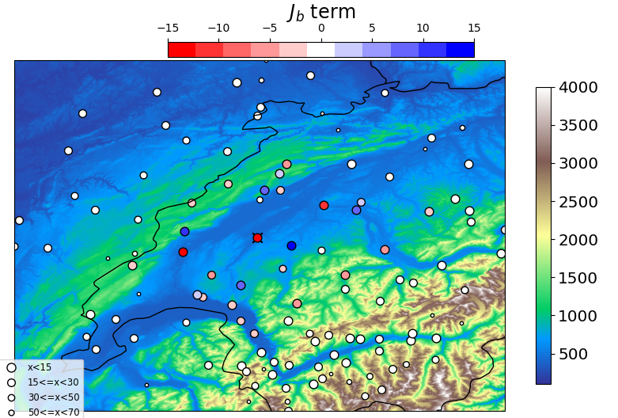

Cross validation diagnostics (Stiller, 2021)
degradation due to T2M assimilation:
station-wise diagnostics of T2m assimilation w.r.t. PAY TEMP during JJA 2023
negative impact
positive impact
Orography height
negative impact
positive impact
Orography height
00UTC
12UTC
effect of nighttime low-level inversion: large negative impact during the night
illustrates the difference in impact of high-altitude stations (positive at night, negative at daytime)
→ potential of optimization of localization scales for these obs

Slide 5
Cross validation diagnostics (Stiller, 2021)
mismatch between observation minus model
and ensemble estimated covariances (near-surface temperature, OND 2023)
→ testing reduced horizontal localization scale for SYNOP

Slide 6
model space diagnostics: ensemble vertical temperature correlation at g.p. near Payerne, (June 2023)
model top
12UTC
00UTC
surface
more detailed study underway to understand effect of the vertical localization scale on low-level inversion cases
− remind: overall, T2M + RH2M very beneficial for forecast of fog / low stratus;
station selection also an issue

Slide 7
CNMCA
Valerio Cardinali, Antonio Vocino, …
DE
2024: − DA of radar reflectivity now operational in ICON
    DA of radar radial winds is under testing
    DA of surface obs from other Italian networks in ICON being tested:
      MeteoNetwork (crowd sourced synoptic stations): 667 stations
      MeteoMont (Army Alpine stations): 46 stations
      Autostrade: 207 stations
      DPC (Civil Protection): 5375 stations
Plans for 2025: − DA of radar radial winds in ICON
      DA of GPS observations (ZTD and STD) in ICON
      complete the ICON transition with the implementation of ICON-MED (~ 2.5 or 5 km resolution) and ICON-IT EPS (20 ensemble members)
IT

Slide 8
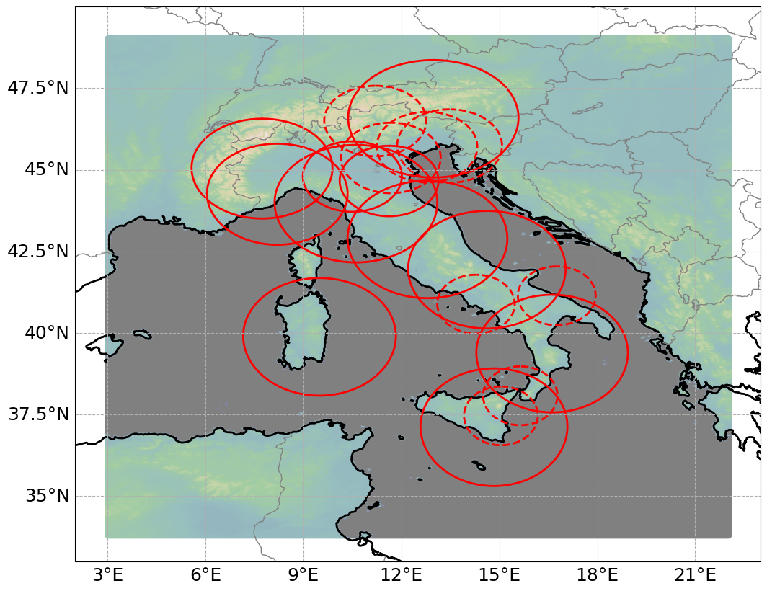
DA for ICON-I2 at Arpae and ItaliaMeteo
Thomas Gastaldo, Virginia Poli, Chiara Marsigli, Enrico Minguzzi,
Marcello Grenzi, Alfonso Ferrone, Davide Cesari, Pier Paolo Alberoni
ICON-2I model fully operational
since 18/06/2024
KENDA implementation:
40 + 1 members, 1-hrly cycle, IAU, RTPS
Control vector: pf, t, q, u, v, qcl, qci, qr, qs, qg
Assimilated observations:
AIREP, TEMP, SYNOP (wind and surface pressure),
3-D reflectivity + radial wind (radars: solid lines)
LHN: radar estimated precipitation rates
from composite of all radars (solid + dashed lines)
Work in 2024:
Transition to ICON
3-D radar DA, LHN
MW WV channels from polar satellites (→ all-sky)

Slide 9
Future plans
From 2025: ItaliaMeteo responsible for maintenance and development of ICON-2I,
Arpae will collaborate on this
T2M, RH2M from SYNOP stations (Q4/24 – Q2/25)
T2M, RH2M, 10-m wind, PS from other Italian networks (Civil Protection, Regions) (Q3/25 – Q4/26)
LHN: increase impact (by improved QC + parameter tuning) (Q4/24 – Q4/25)
MODE-S (Q3/25 – Q4/25)
microwave (MW) water-vapor channels from polar satellites, clear-sky (Q3/24 – Q4/25)
+ all-sky (Q1/26 – Q4/26)
MTG-FCI (Q1/26 – Q4/26)

Slide 10
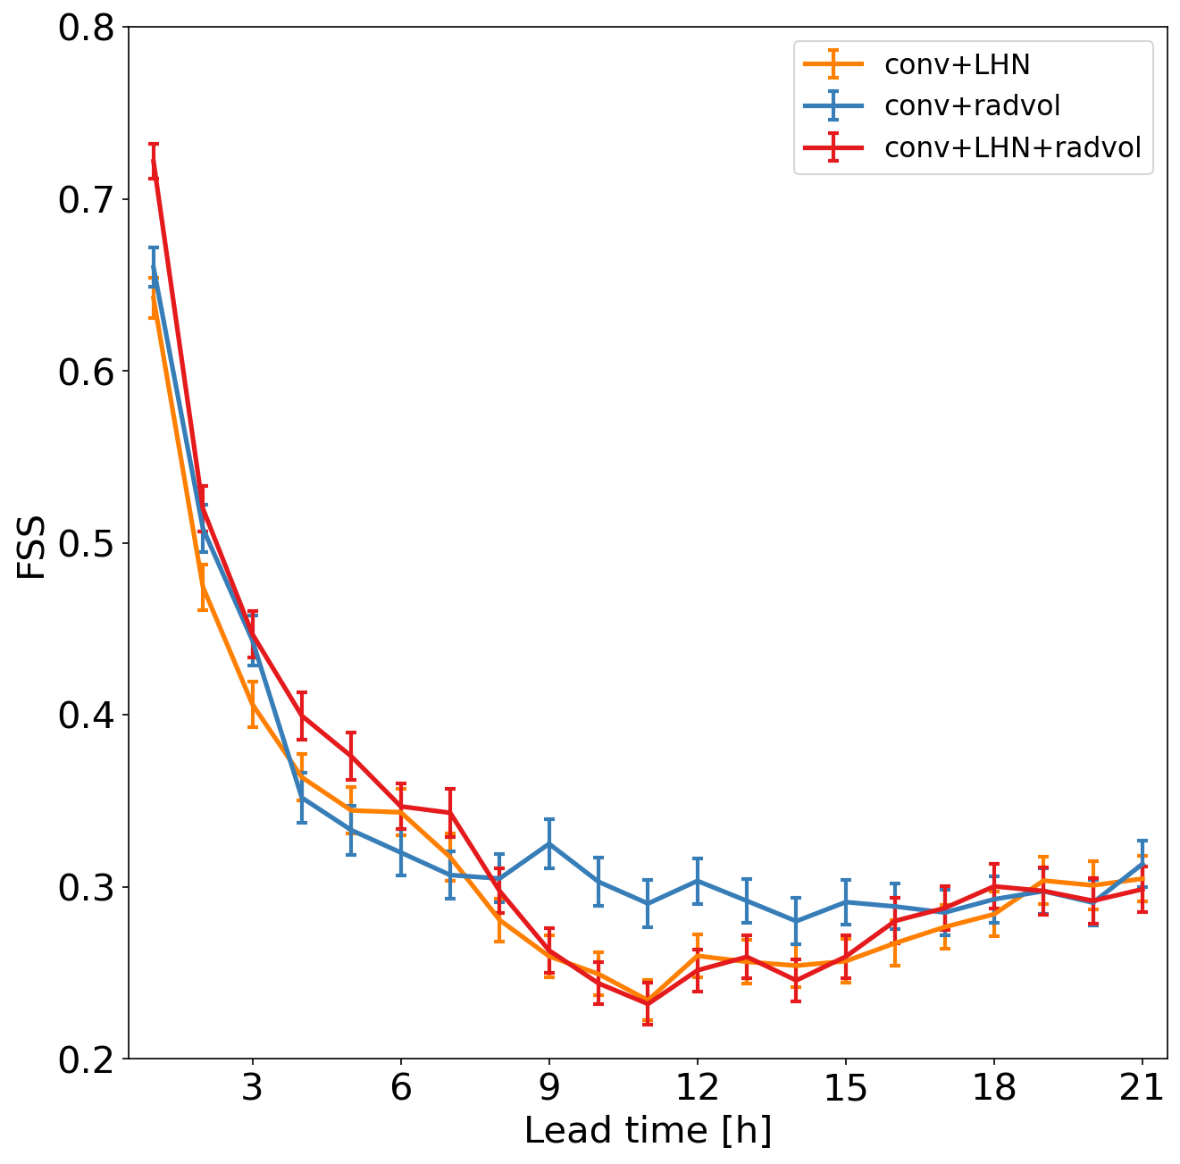
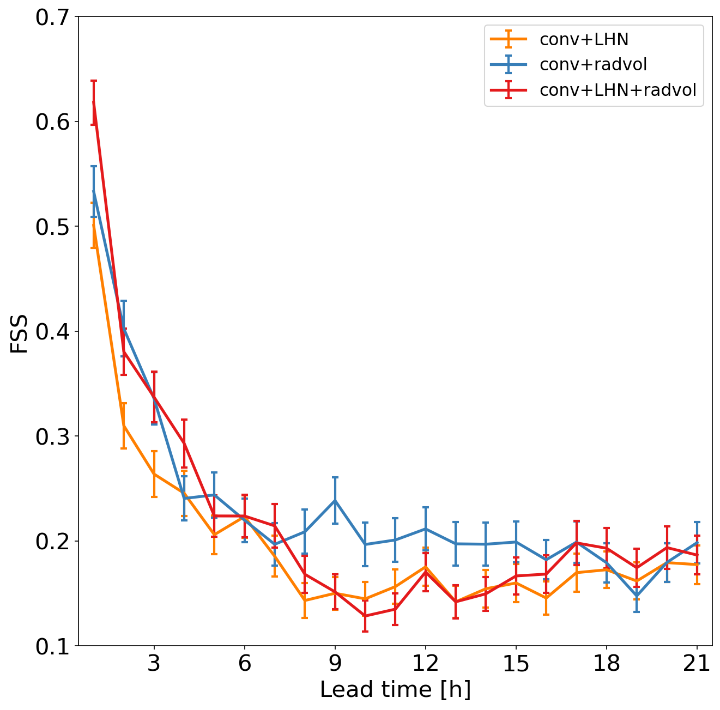
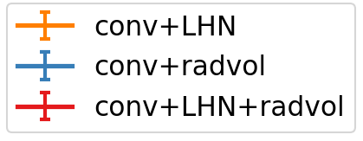
Assimilation of radar volumes
precipitation FSS: Aug. 2022 (1 – 22 Aug., forecasts every 3 h)
thr = 1.0 mm
thr = 5.0 mm

Slide 11
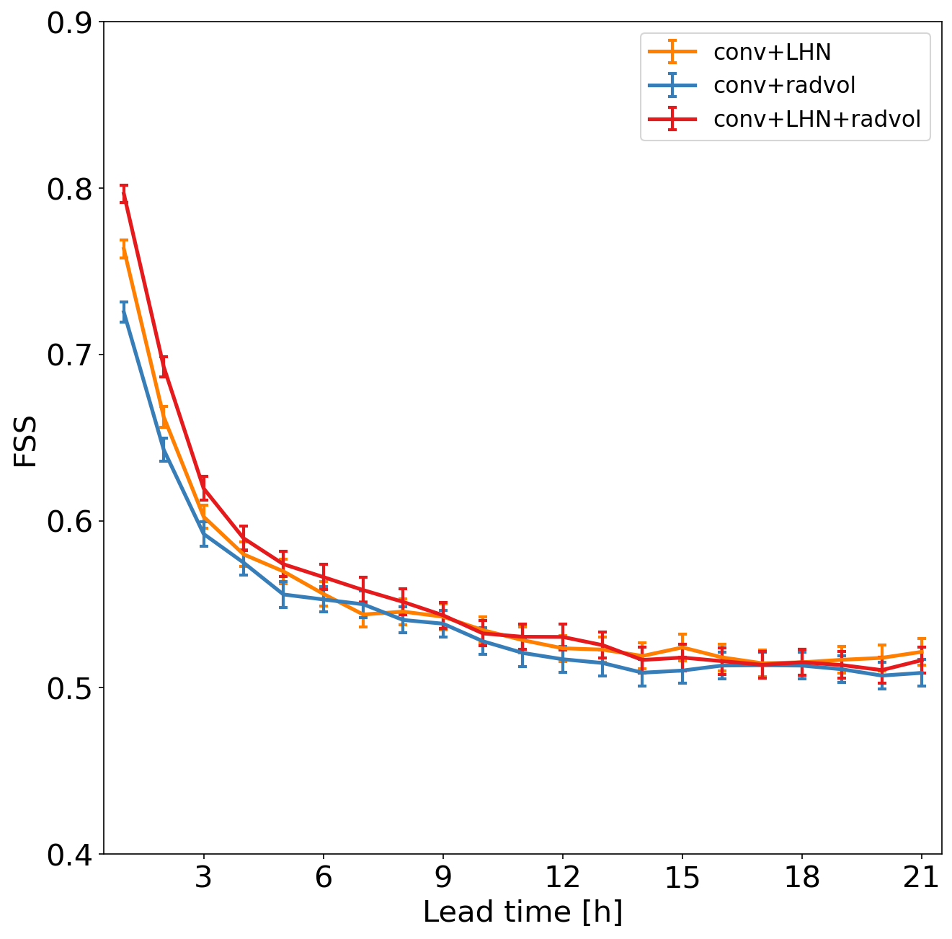
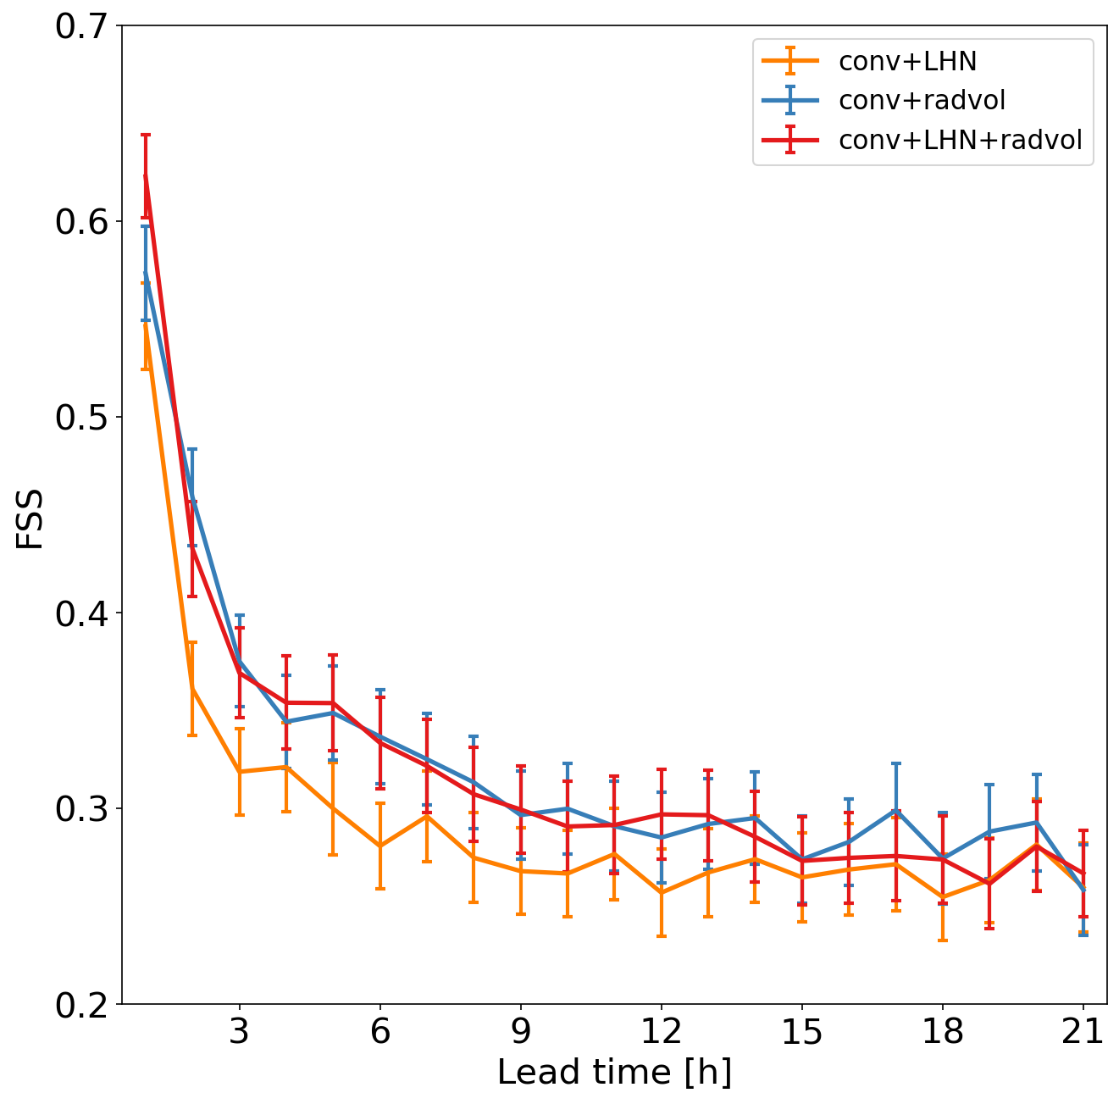
Assimilation of radar volumes
precipitation FSS: May 2023 (29 April – 18 May, forecasts every 3 h)
thr = 1.0 mm
thr = 5.0 mm

Slide 12
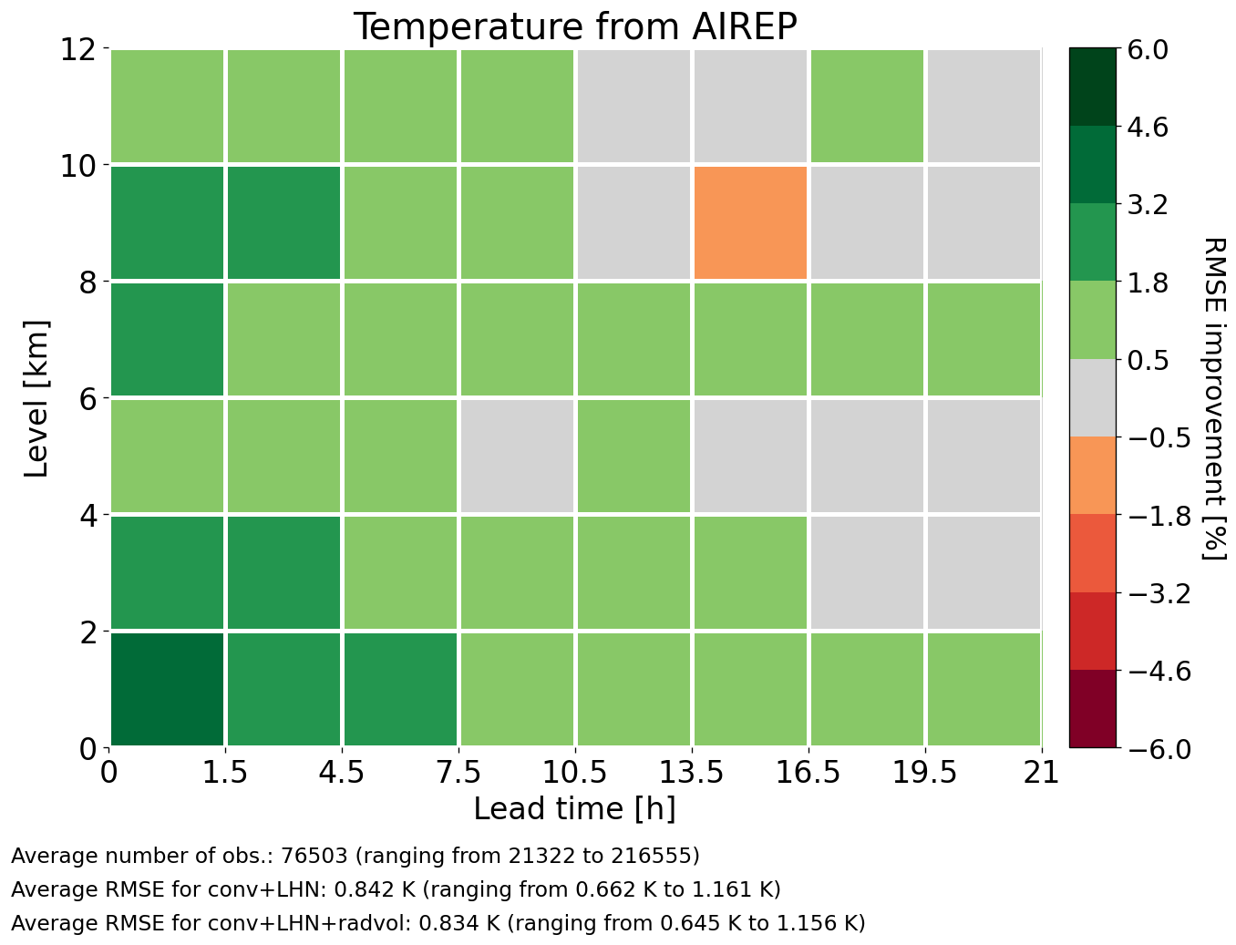
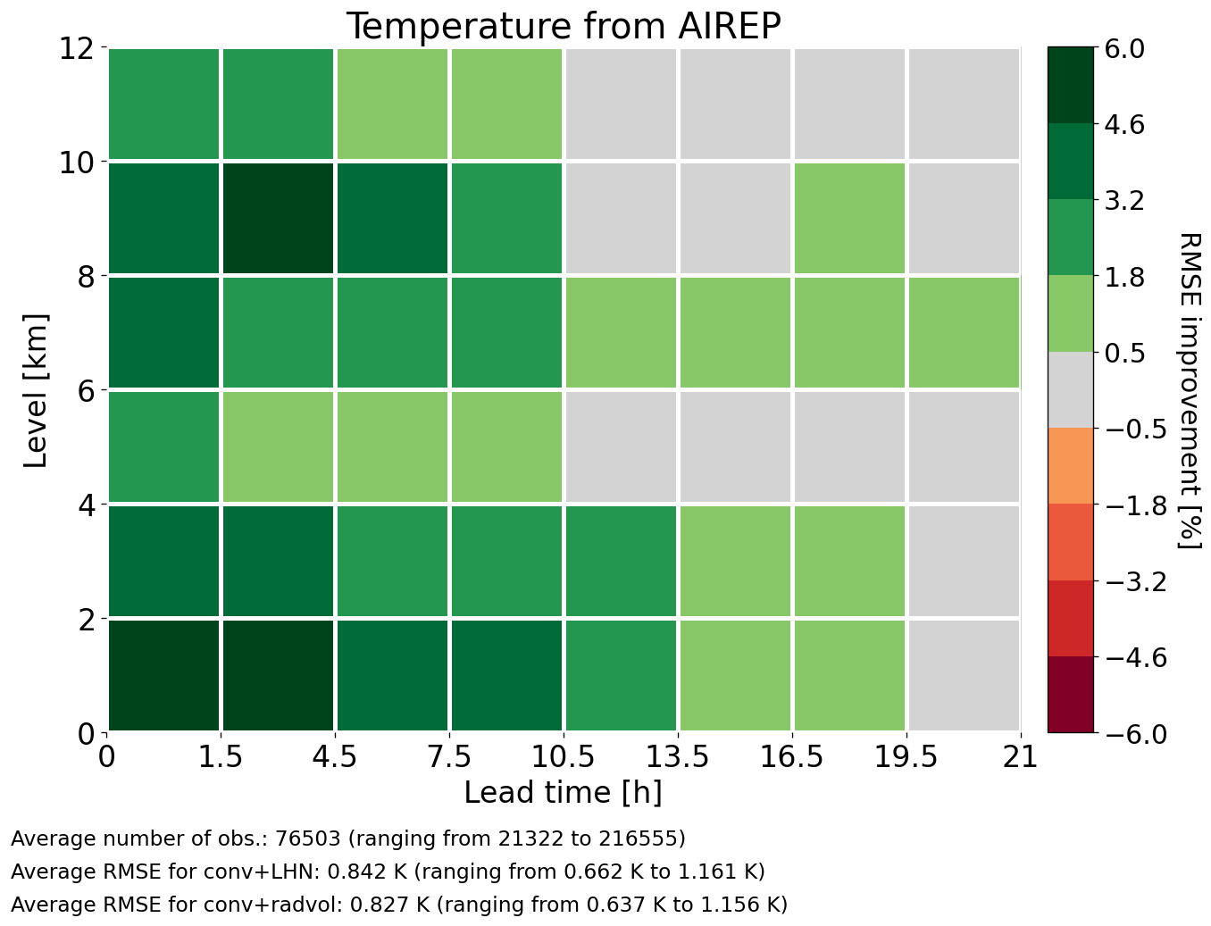
Assimilation of radar volumes
upper-air temperature
RMSE(conv+LHN) – RMSE(conv+LHN+radvol)
RMSE(conv+LHN) – RMSE(conv+radvol)
Positive values (green): conv+LHN+radvol
better than conv+LHN
Positive values (green): conv+radvol
better than conv+LHN

Slide 13
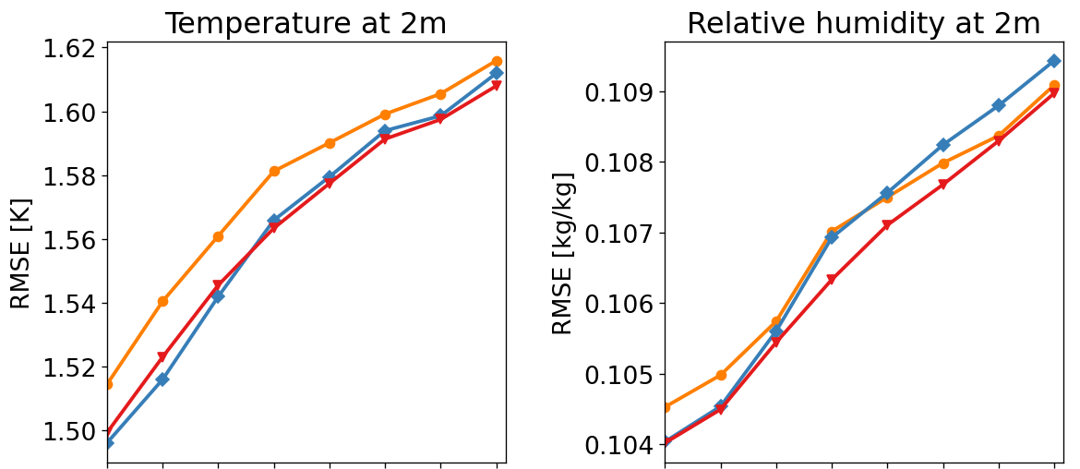
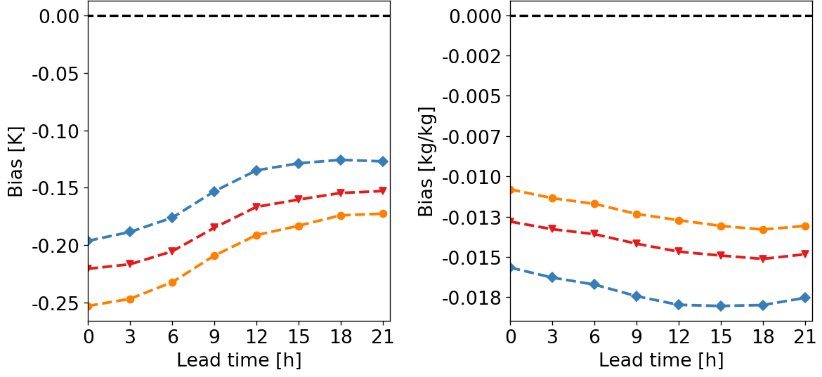
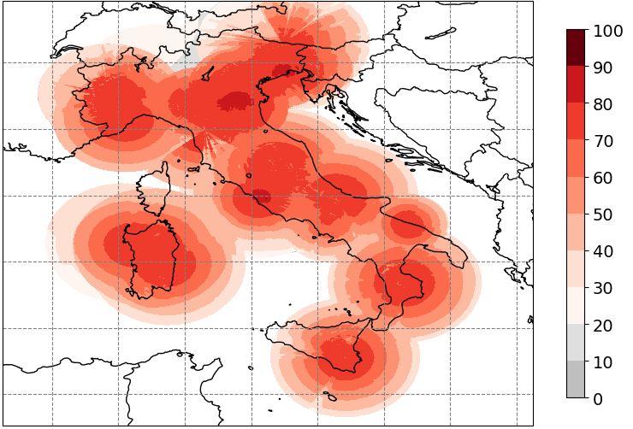
Assimilation of radar volumes
assimilation of 3-D radar Z + Vr improves
precip, upper-air, T2M, RH2M, 10-m wind …
impact of LHN (if in addition to 3-D radar data)
  positive on precip in DA cycle → soil moisture
  mixed on forecasts
(note: qr, qs, qg in LETKF update as in Sinfony RUC)
ongoing work on LHN: parameter tuning, QC,
SRI quality index by Civil Protection …
Surface rainfall intensity quality index

Slide 14
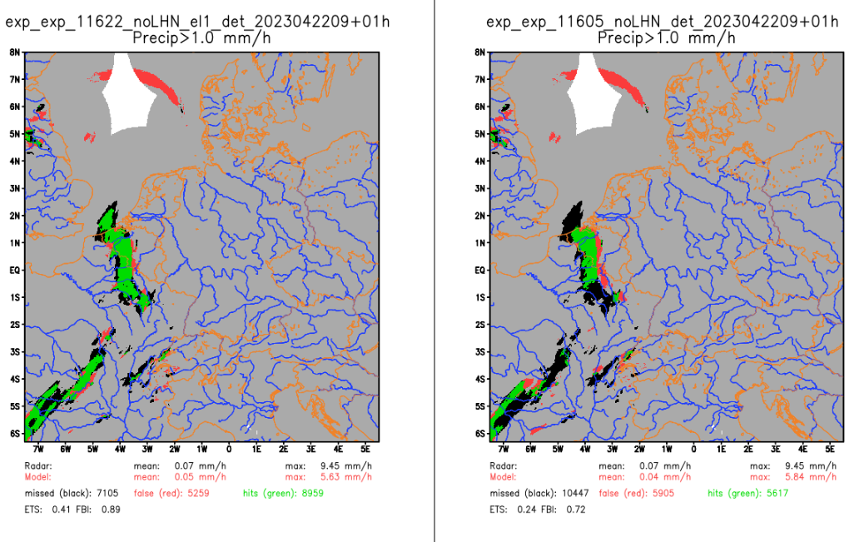
Task 2: Observations (surface to clouds)
Task 2.1: 3-D radar reflectivity + radial velocity
Sinfony-RUC: − adjustment to 2-moment microphysics, tuning EMVORADO (Alberto de Lozar, … )
  − use of Nowcasting radar data in 1st hour via LHN not yet beneficial (further tuning required) (Klaus Stephan)
ICON-D2: − observation errors for radar reflectivity (Klaus Stephan) :
10 dBZ replaced by values used in Sinfony-RUC: 7 dBZ near surface to 4 dBZ above 500 hPa
→ neutral impact, operational since 9 July 2024
ICON-D2 + RUC: work on use of foreign radars (Klaus Stephan) :
  very heterogeneous data / scan strategies
  → evaluate country-wise
  start with (17) French (C-band) radars (Z + Vr):
  → positive impact on precip (particularly w/o LHN)
with French radars
without French radars
  → very slight positive impact in TEMP + SYNOP verif
  (irrespective of LHN)
  (RUC: April / May 2023; ID2: June 2023)
Example 22.04.2023 10 UTC (vv +1h)
ICON-RUC Setup without LHN

Slide 15
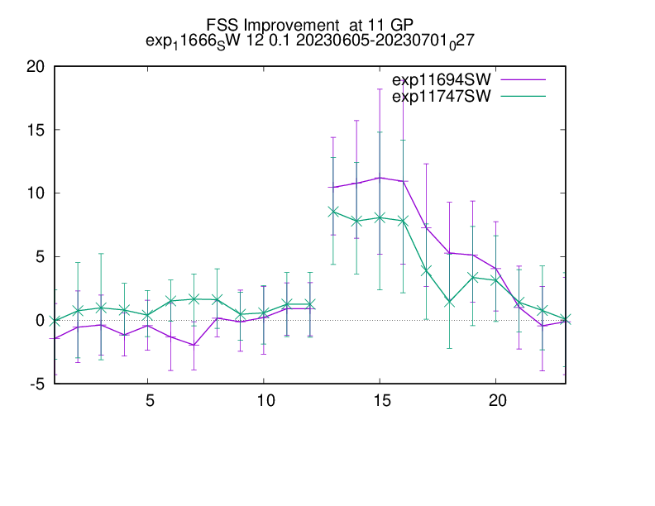
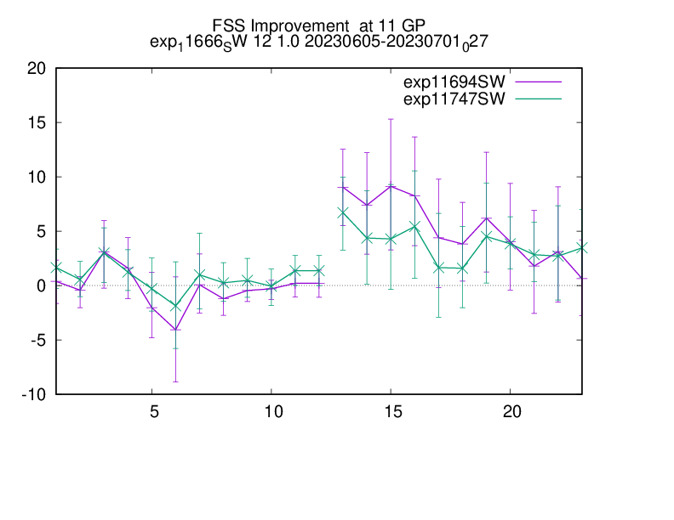
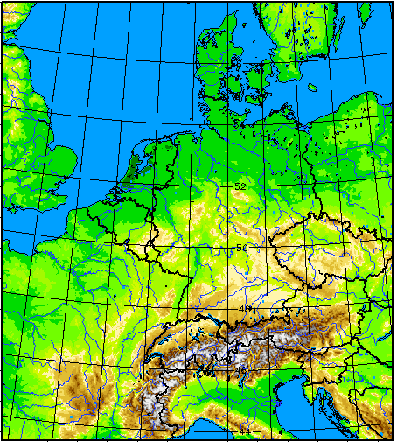
Task 2: Observations (surface to clouds)
Task 2.1: 3-D radar reflectivity + radial velocity
  17 stations within model domain: costs too large (reading of fdbk files, to be checked)
  → use only 9 stations actively: → 20 % less data, but 50 % cost reduction
  (cost: ~1 min per 3-hr cycle, at (non-parallel) pre-reading of fdbk files in LETKF → optimizable?)
ICON-D2 with LHN: rel. change of FSS 23 km, 12 UTC, 5 June – 1 July 2023
0.1 mm/h
1.0 mm/h
+17 stations
+ 9 stations
+17 stations
+ 9 stations
verification
area
  in ICON-D2 operational since 22 May 2024
  in Sinfony-RUC suite

Slide 16
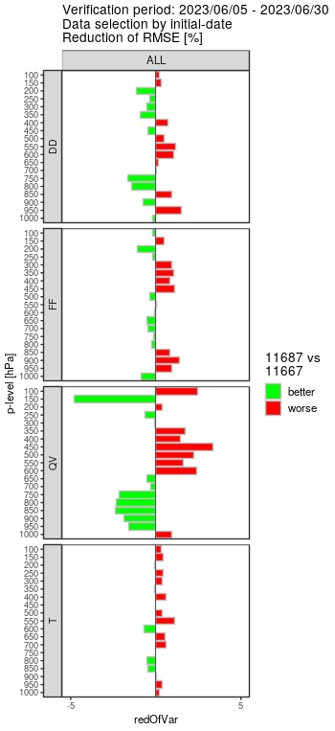
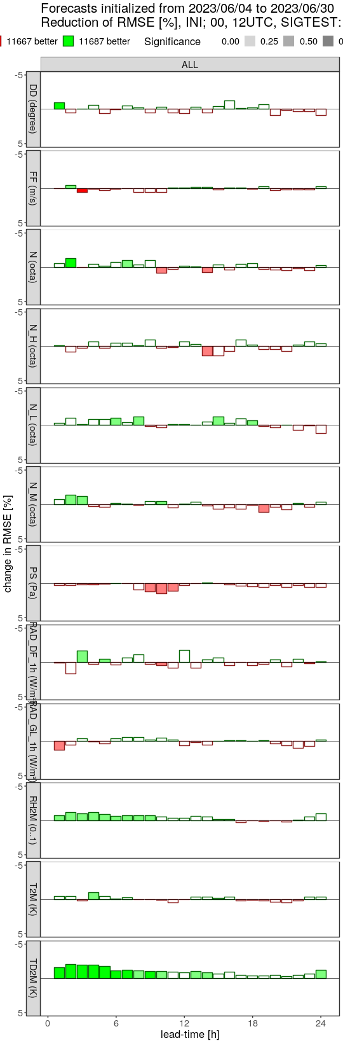
Task 2: Observations (surface to clouds)
Task 2.2: ground-based GNSS ZTD (+ STD)
impact of ZTD in 4-week (NUMEX) experiment in summer 2023 (4 – 30 June)
(incl. use of high-res. Mode-S in ref!)
(Michael Bender)
Synop: improved 2-m humidity, slightly improved low cloud
improved boundary layer humidity but degradation above
further tuning experiments needed
(vertical localization,
height assignment)
for ZTD,
even more for STD

Slide 17
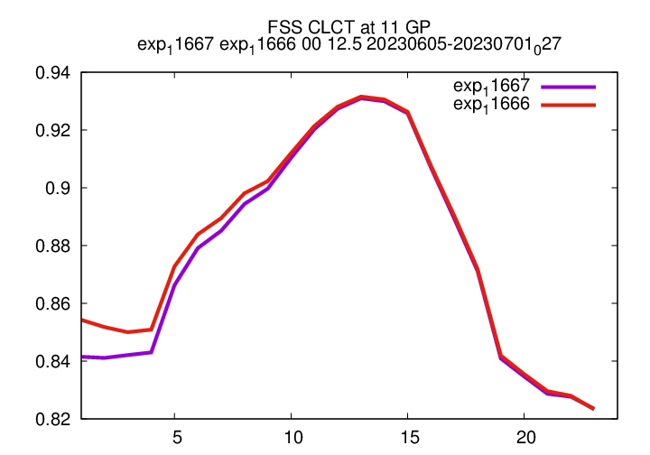
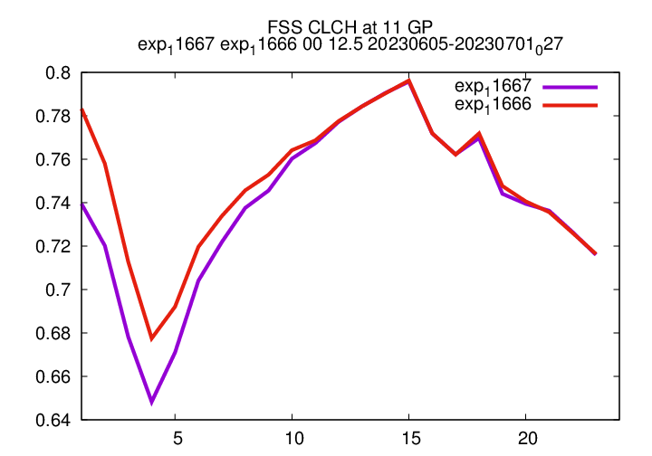
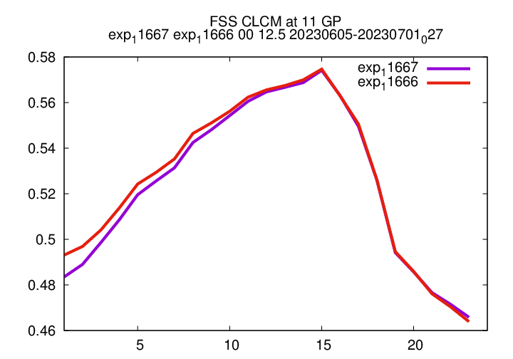
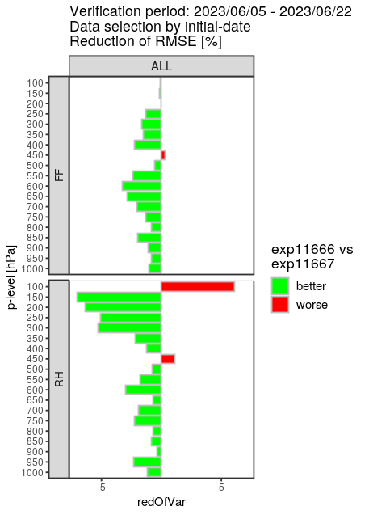
Task 2: Observations (surface to clouds)
Task 2.3: all-sky (cloudy) SEVIRI IR WV radiances
FSS against NWCSAF satellite products (0-UTC runs, 5 – 30/06/23
summer (5 – 22 June 2023)
wind
speed
change [%]
of RMSE,
1 – 12 h
total
cloud
high
cloud
mid-level
cloud
RH
SEVIRI WV operational in ICON-D2 & in SINFONY RUC since Nov 2023
first time internationally: use of operational all-sky IR data assimilation
paper in preparation
next steps:
  preparation of FCI @ MTG: delayed (no data available until few weeks ago), started recently
  (first implement and test setup analogous to SEVIRI)
  further visible + near IR channels of FCI

Slide 18
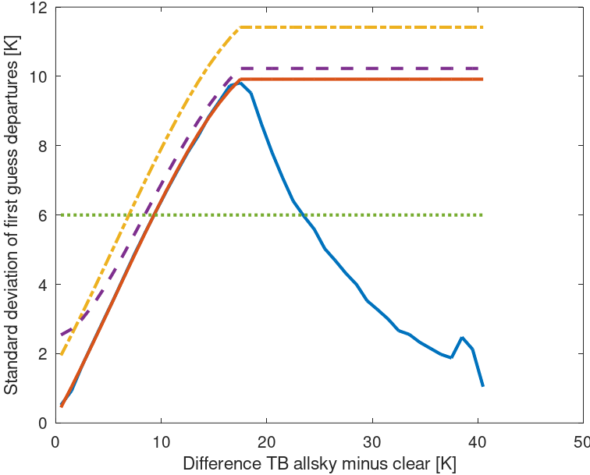
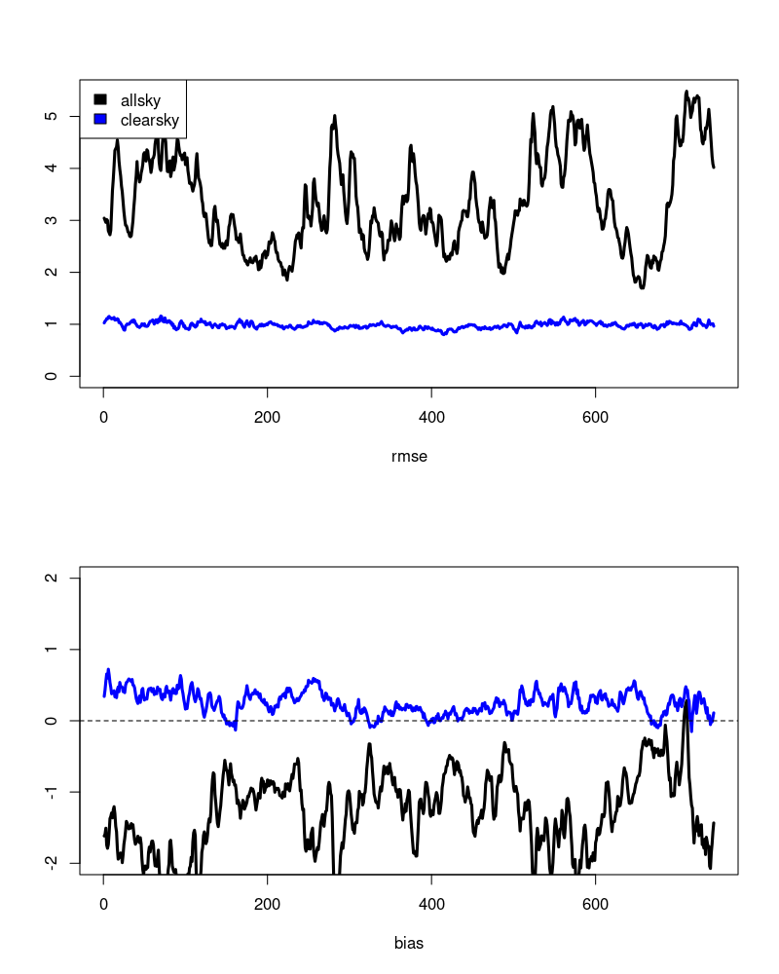
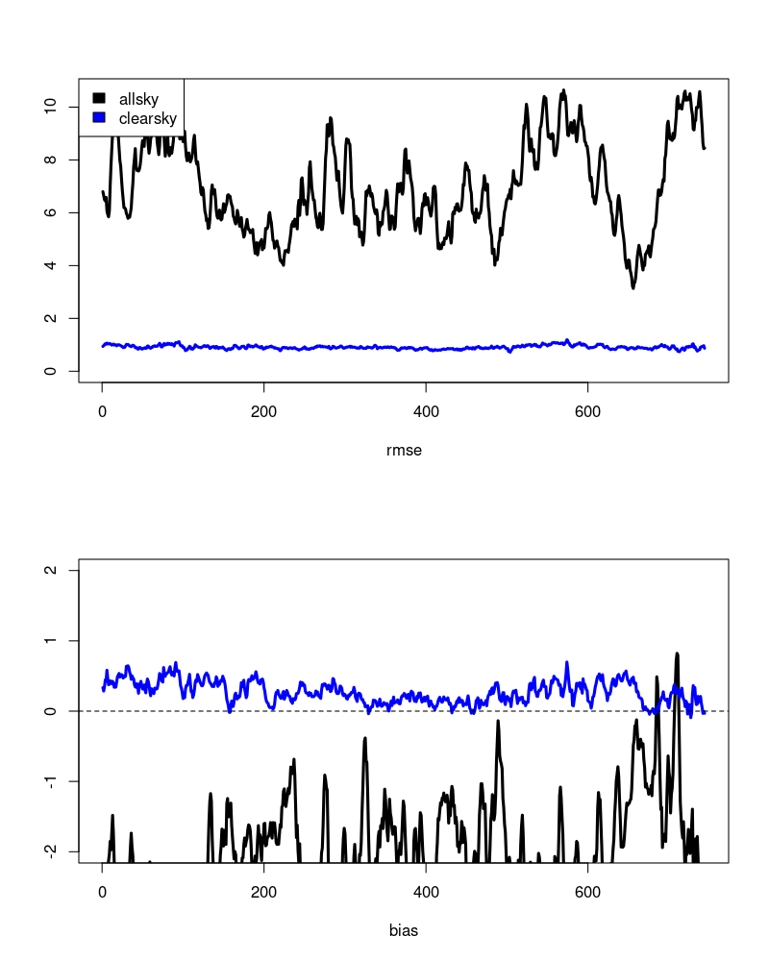
Task 2: Observations (surface to clouds)
Task 2.3: all-sky (cloudy) SEVIRI IR WV radiances
so far − no bias correction for SEVIRI …
− obs error of 2 K assigned to clear-sky obs = 2 K >> stdev(O – FG)
→ low weight given to clear-sky data (→ water vapour) (while cloud info is used well)
ch 6
inflated error model
const obs error
clear-sky biases in a experiment with passive SEVIRI data (4 weeks August 2022)
6.2µm – Channel 5
7.3µm – Channel 6
stdev Obs – FG
stdev Obs – FG
cloud impact −→
clear-sky (cloud impact < 1K)
all-sky
→ average clear-sky bias: + 0.25 K
→ average clear-sky bias: + 0.27K
assimilation experiment with constant bias correction of – 0.25 / – 0.27 K for channels 5 / 6 (applied all-sky)
→ impact on forecast verif vs. radiosondes: positive on humidity bias, neutral (slightly negative) on RMSE (RH, T, wind)

Slide 19
Task 2: Observations (surface to clouds)
Task 2.4: MTG IRS (hyperspectral IR sounder)
‘clear-sky’ assimilation of IRS (Mahdiyeh Mousavi, Christina Köpken-Watts)
→ temperature + humidity profile information (clear-sky, above clouds)
launch planned in 2025, data in ~ 2026
→ IRS data for testing: simulated ‚obs’ (with RadSim) into fdbk file
real-data IASI, SEVIRI as proxy for IRS
technical test in KENDA successful
simulated IRS obs – channel 59
(20200802, 1UTC)
ICON-LAM: significant land contribution → use of IRS observations over land
→ use surface-sensitive channels for analysis in middle + lower troposphere
  improvement of land surface emissivity → employing IR emissivity atlas (instead of constant values)
  skin temperature (model FG not good enough) → skin temperature retrieval from channels strongly sensitive
  to the surface (by inversion of the radiative transfer eqn.)
also important: slant radiative transfer, 4D-EnVar (for indirect wind info), horiz. obs error correlations

Slide 20
Task 2: Observations (surface to clouds)
Task 2.4: MTG IRS (hyperspectral IR sounder)
Cloud detection & adaptive bias correction :
used in global EnVar for IASI, but major adaptation for …
– ICON-LAM (low model top → extension of FG with global fields for cloud detection) and
– KENDA (cloud detection + bias correction in ICON ensemble members)
Future work (a.o.):
revisit channel selection
implementation of non-diagonal observation error covariance matrix in LETKF
tests on thinning, height assignment, localization, …
code optimization needed for IRS assimilation with many channels

Slide 21
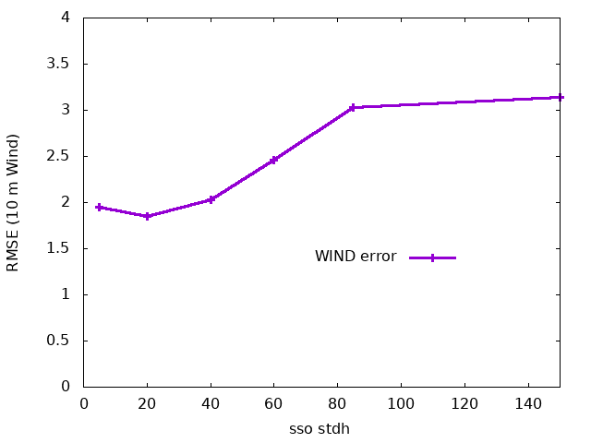
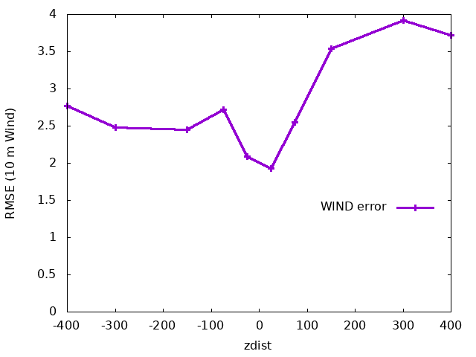
Task 2: Observations (surface to clouds)
Task 2.5: Screen-level obs: 10-m wind
revised criteria for station selection for 10-m wind assimilation
(Hendrik Reich, Christoph Schraff, Klaus Stephan, Günther Zängl et al.)
until Jan. 2024: use only stations ≤ 100 m altitude
now: SSO standard deviation ≤ 70 m (as in global ICON setup) (rejects ~13 %)
& distance station height vs model orography ≤ 100 m (< 1% additionally)
0.3% of all
accepted
stations
4%
9%
5%
82%
thereof > 99.9 %
are valley stations
with SSO_STD > 70 m
(weak winds → small rmse;
rest has large rmse)
rmse O – B
rmse O – B
reject
reject
reject
01/04 – 15/06/2023

Slide 22
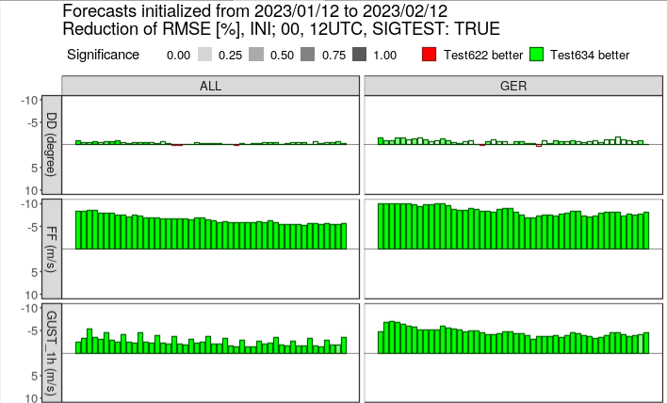
Task 2: Observations (surface to clouds)
Task 2.5: Screen-level obs: 10-m wind
revised criteria for station selection for 10-m wind assimilation
reduced obs errors : 3.6 m/s → 2.0 m/s (~ rmse O – B)
→ neutral impact for upper-air wind, slightly positive for 10-m wind in first hour(s)
allows for introduction of adaptive surface friction (as in global ICON, Günther Zängl),
(using wind analysis increments at lowest model level (~10m a.g.) as predictor field):
  adaptive adjustment of vegetation roughness length
  adaptive SSO blocking tendency at lowest model level
→ major improvement of 10-m wind speeds + gusts
(winter + summer)
operational since Jan. 2024

Slide 23
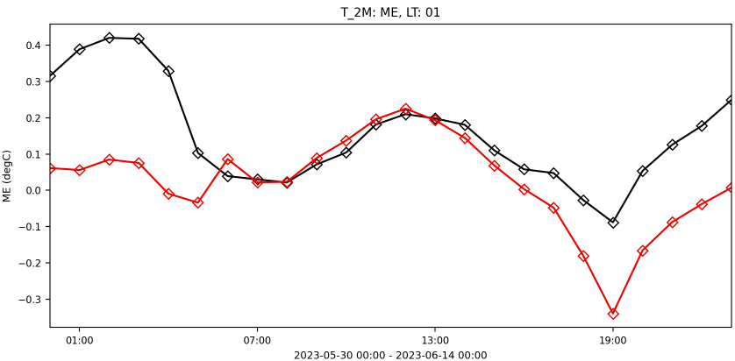
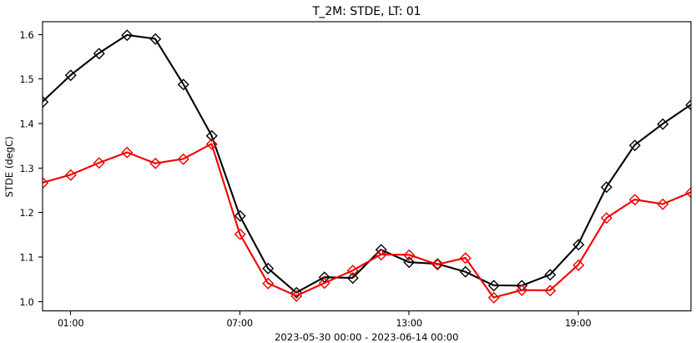

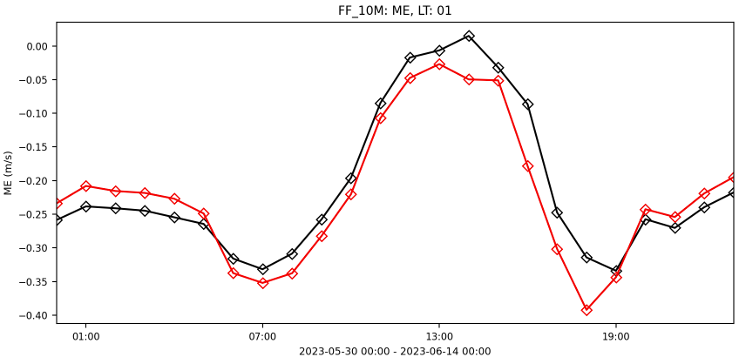
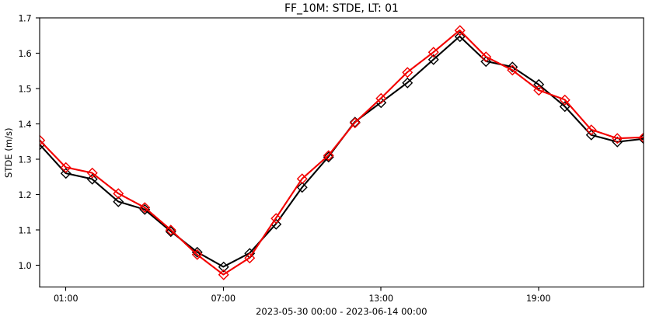

Adaptive Parameter Tuning
KENDA-CH1 first guess verification against Swiss SYNOP stations (30.5.-14.6.2023)
With APT
Without APT
T2m
BIAS
STDDev
FF10m
→ will have a closer look in first e-suite results with a MSc student

Slide 24
Task 2: Observations (surface to clouds)
Task 2.6: PBL profiler obs: ICOS towers
ICOS: Integrated Carbon Observation System
Helgoland 110 m
ecosystem, ocean, atmosphere
(greenhouse gases)
9 towers in Germany
(within ICON-D2: Cabauw NL,
Ispra IT, 1 CZ, 3 FR
(no access to data yet))
heterogeneous architectures,
max. heights 98 – 341 m
(min. heights 10 – 60 m)
T, RH on 2 – 6 levels,
wind on 1 – 5 levels

Slide 25
Task 2: Observations (surface to clouds)
Task 2.6: PBL profiler obs: ICOS towers
observation operator
aircraft, TEMP,
wind profiler
model equivalent: HASL
T, RH, wind vertically interpolated
model equivalent computed at ‘correct’
(i.e. same as observation)
  height above sea level “HASL”
  height of sensor above ground “HOSAG”
tower
monitoring: both observation operators applied
to each tower observation
T2M, RH2M, 10-m wind obs
ICON tower network Germany:
  2 mountain stations: OXK dh = +137m
  HPB dh = + 91 m
  2 ‘hill’ stations: HEL dh = + 43 m
  GAT dh = + 32 m
  5 ‘flatland’ stations: -3 ≤ dh ≤ + 13 m
  no valley station
real
orography
model equivalent: HOSAG
T2M, RH2M, 10-m wind
(T2M: height correction)
model orography (grid point)

Slide 26
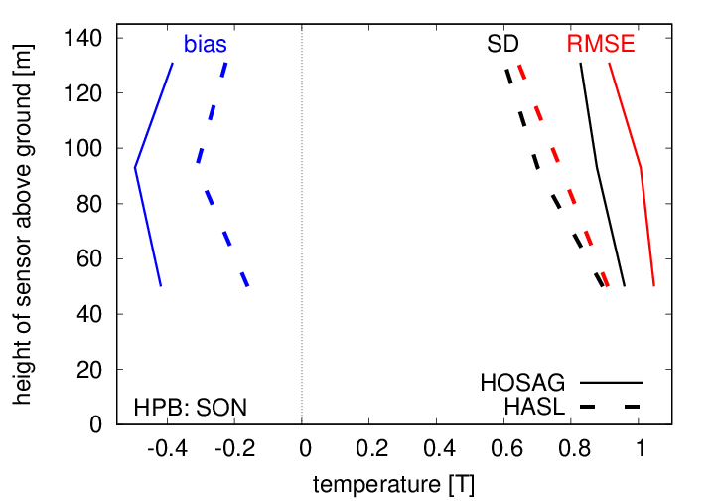
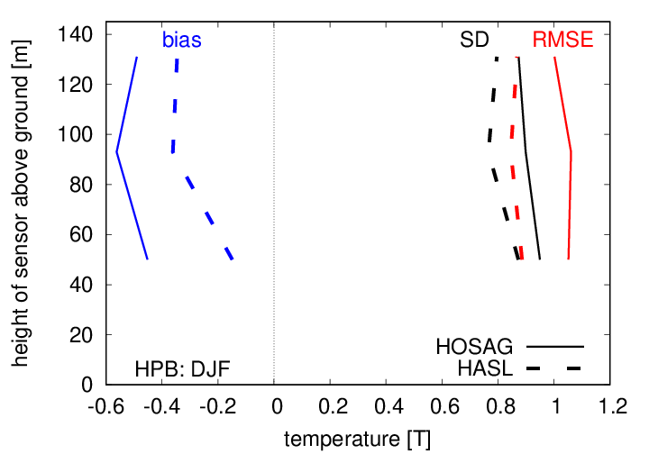
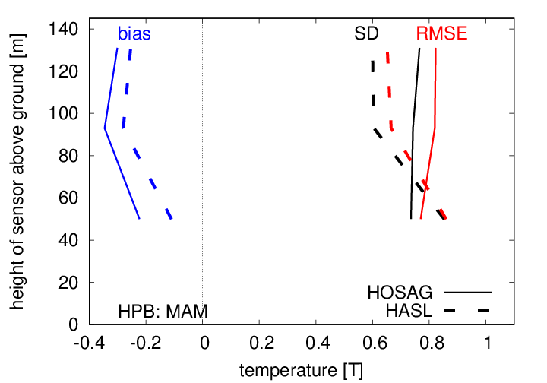
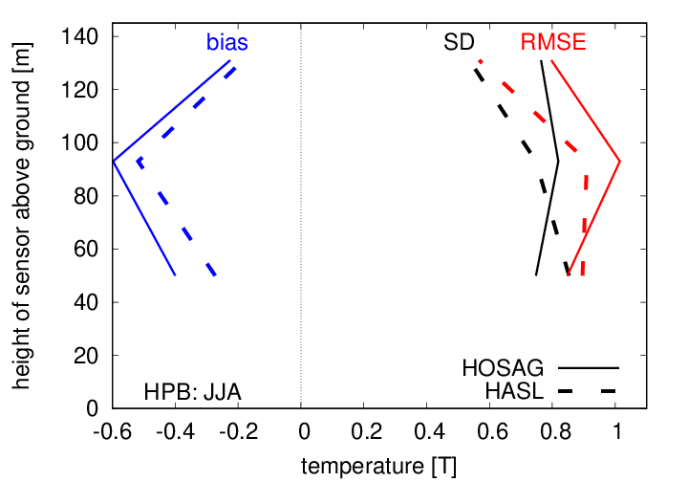
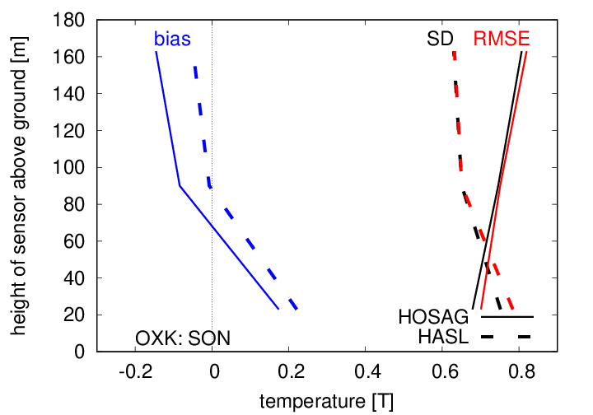
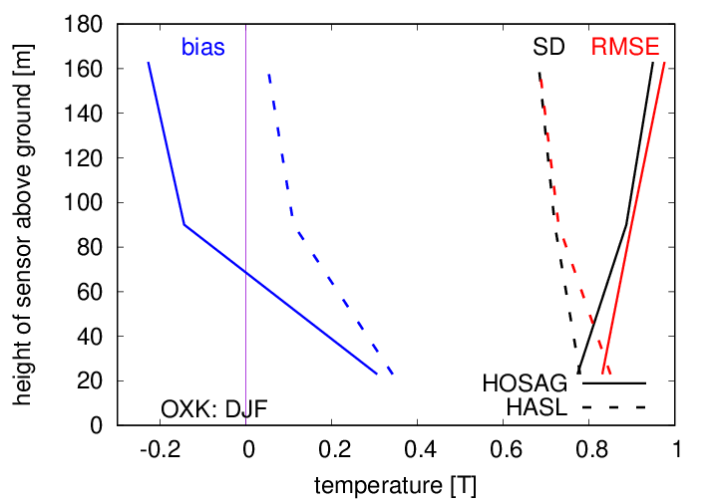
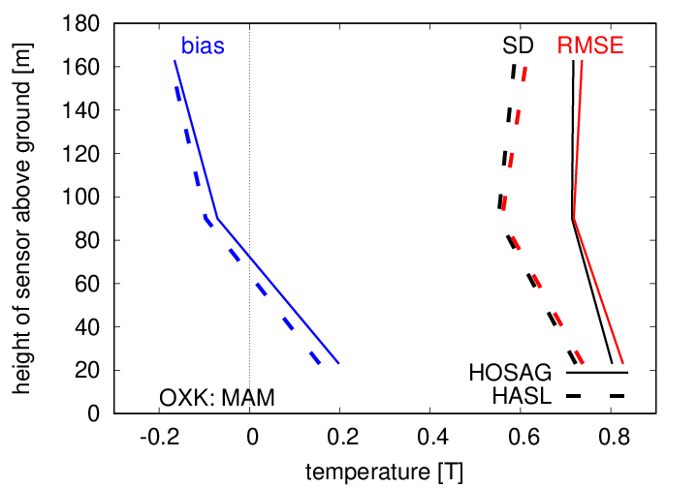
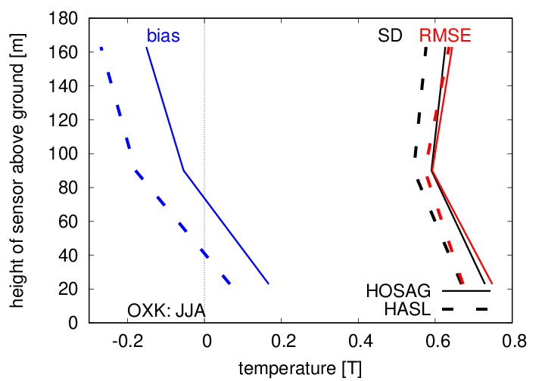
Task 2: Observations (surface to clouds)
Task 2.6: PBL profiler obs: ICOS towers
observation operator: monitoring
temperature
autumn (SON 23)
winter (DJF 24)
spring (MAM 24)
summer (JJA 24)
HPB
OXK

Slide 27
Task 2: Observations (surface to clouds)
Task 2.6: PBL profiler obs: ICOS towers
Observation operator: − T, RH: HASL always (equal or) better
  − wind: tower / level dependent (4 (+2) HASL, 1 HOSAG better)
blacklisting: − T: 97 % good (34/35) , -0.3 K ≤ obs bias ≤ 0.5K, RMSE 0.45 – 0.8 K mostly
  − RH: 83 % good (29/35) , obs bias ≤ 4%, RMSE 4 – 9 %
  − wind: 18 % good ( 5/28) , obs bias < 0.8 m/s RMSE 1.2 – 2.2 m/s
  rejected winds: negative wind speed bias > 1 m/s (or large bias U, V)
assimilation experiments (o.a.): 16 days winter (25.02. – 11.03.24), limited advection, some low stratus
20 days summer (15.05. – 03.06.24), little advection, w. convection
  reference: ICON-D2 operational setup as in summer 2024
  tower (9 ICOS + 2 nuclear plants (1 T, 2 wind obs))
  tower + RASS (3 / 2 stations, T-profiles up to ~ 2 – 2.5 km,
  blacklisted below 925 / 900 hPa, (T stdev 0.7 – 0.9 K)
  constant bias correction -0.5 or -0.6 K to reduce biases 0.6 – 1.1 K)

Slide 28
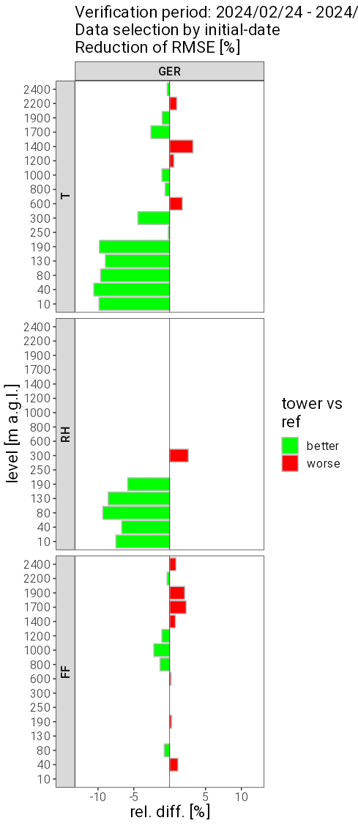
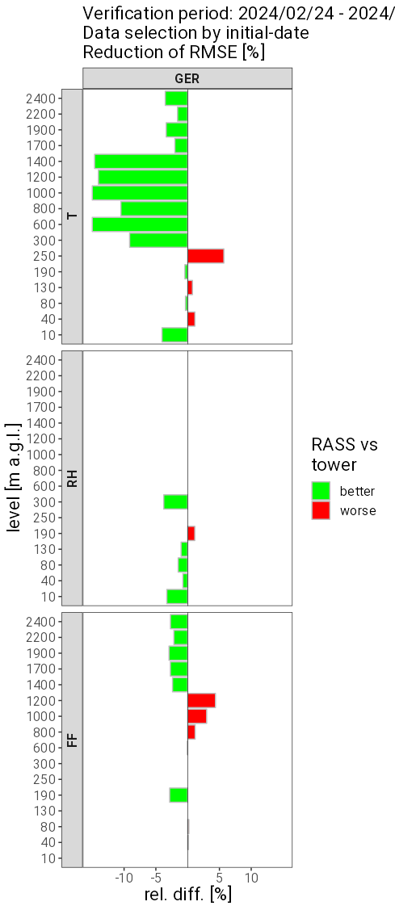
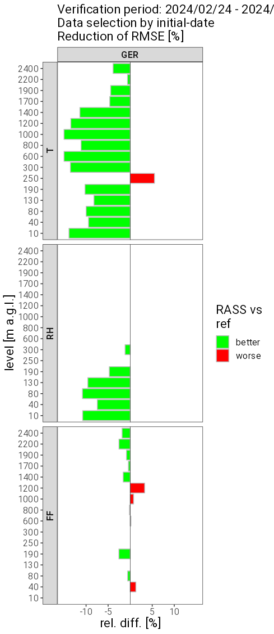
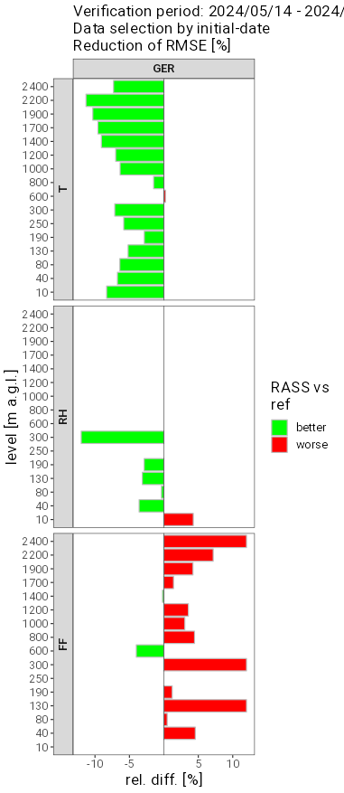
Task 2: Observations (surface to clouds)
Task 2.6: PBL profiler obs: ICOS towers / RASS
‘PILOT’ verification
(i.e. against tower,
RASS, wind profiler)
winter (24.02. – 11.03.24)
summer (15.05 – 03.06.24)
tower vs. ref
RASS+tower vs. tower
RASS+tower vs. ref
RASS+tower vs. ref
T
RMSE
+ 1h forecasts
RH
wind
speed

Slide 29
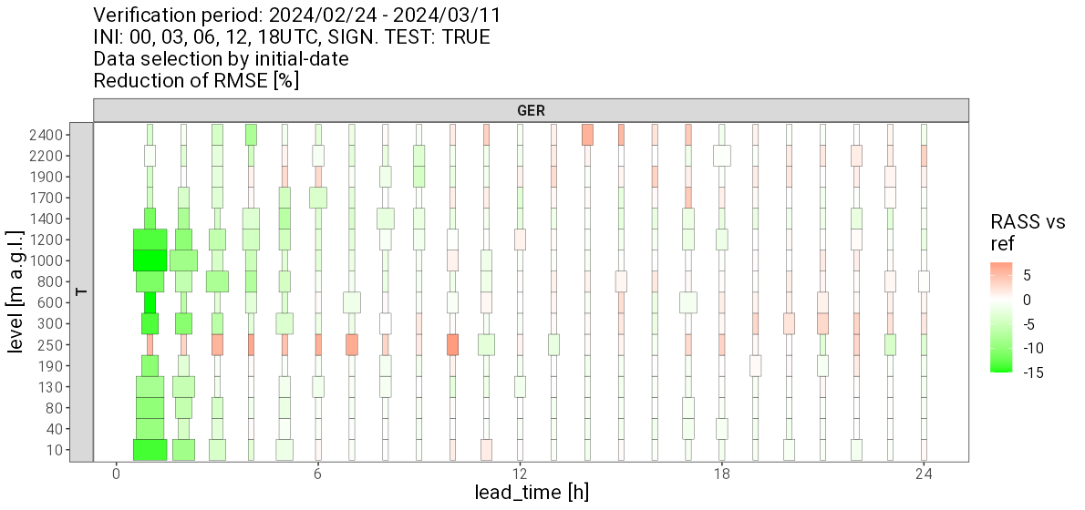
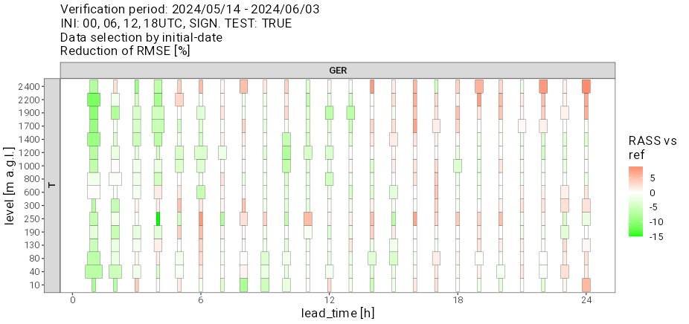
Task 2: Observations (surface to clouds)
Task 2.6: PBL profiler obs: ICOS towers / RASS
winter
(24.02. – 11.03.24)
summer
(15.05. – 03.06.24)
T
Summary of results:
large positive impact vs. tower T + RH & RASS T in first hour, decreasing rapidly within 6 hrs,
possible negative impact on wind in summer to be investigated
difficult to see impact vs. other obs (some indication of benefit vs. TEMP), evaluation to be continued

