Slide 1
Operational NWP at MeteoSwiss
Oliver Fuhrer
COSMO General Meeting 2024, 3.9.2024

Slide 2
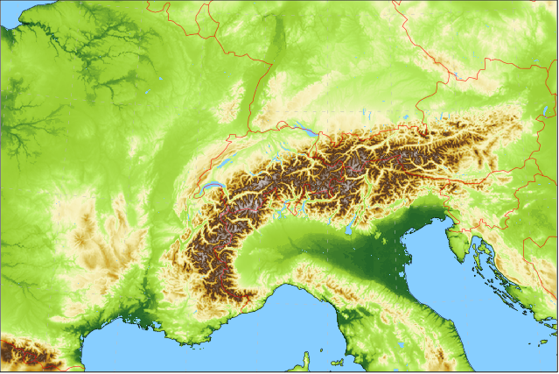
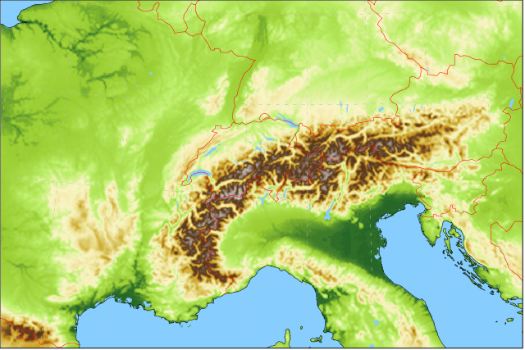
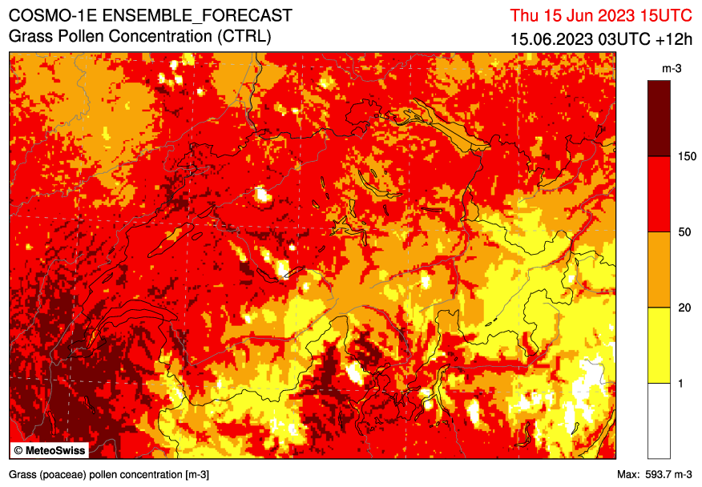
Forecasting System based on
operational since 28 May 2024
Ensemble Data Assimilation: KENDA-CH1 with LETKF
40+1 members at 1.0 km grid size with ICON-CH1 setup (SPPT) hourly cycling
Lateral boundary conditions: IFS ENS 9 (18) km 4x per day
ICON-CH1-EPS: 33 hour forecasts, 8x per day 1.0 km grid size (R19B08), 80L 11 ensemble members
ICON-CH2-EPS: 5 day forecasts, 4x per day 2.1 km grid size (R19B07), 80L 21 ensemble members

Slide 3
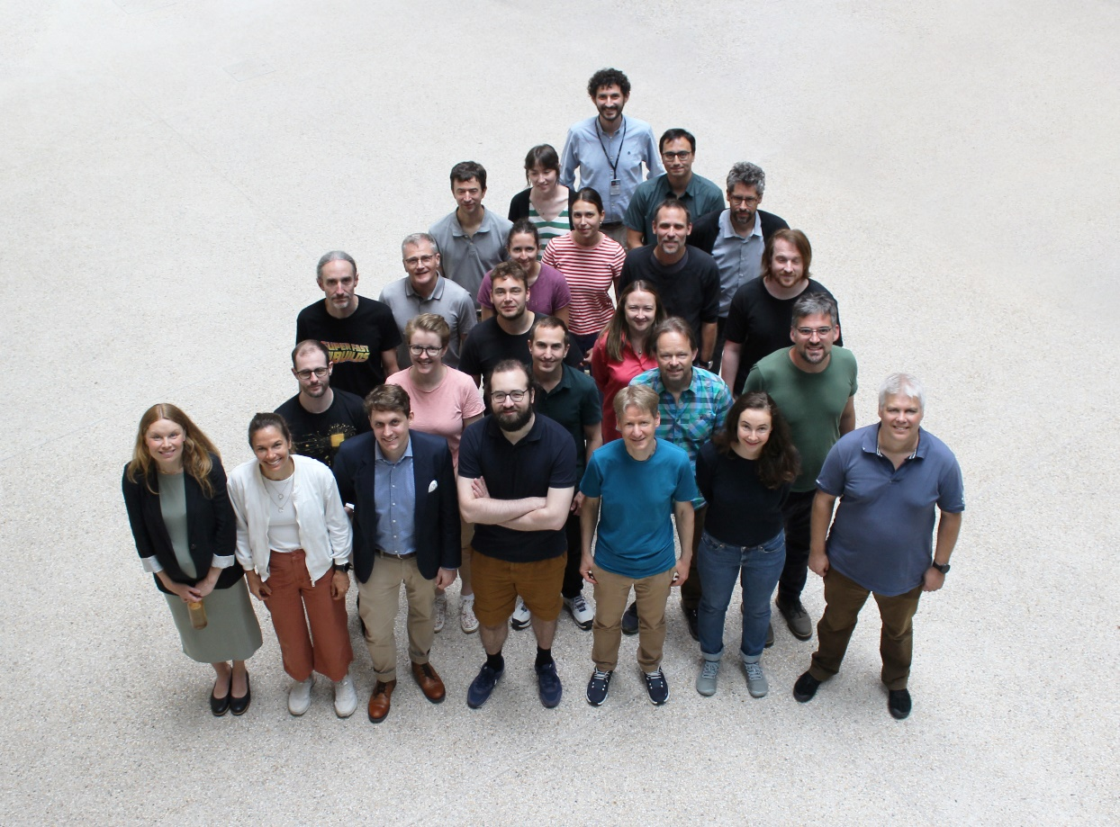
A lot of work…

Slide 4
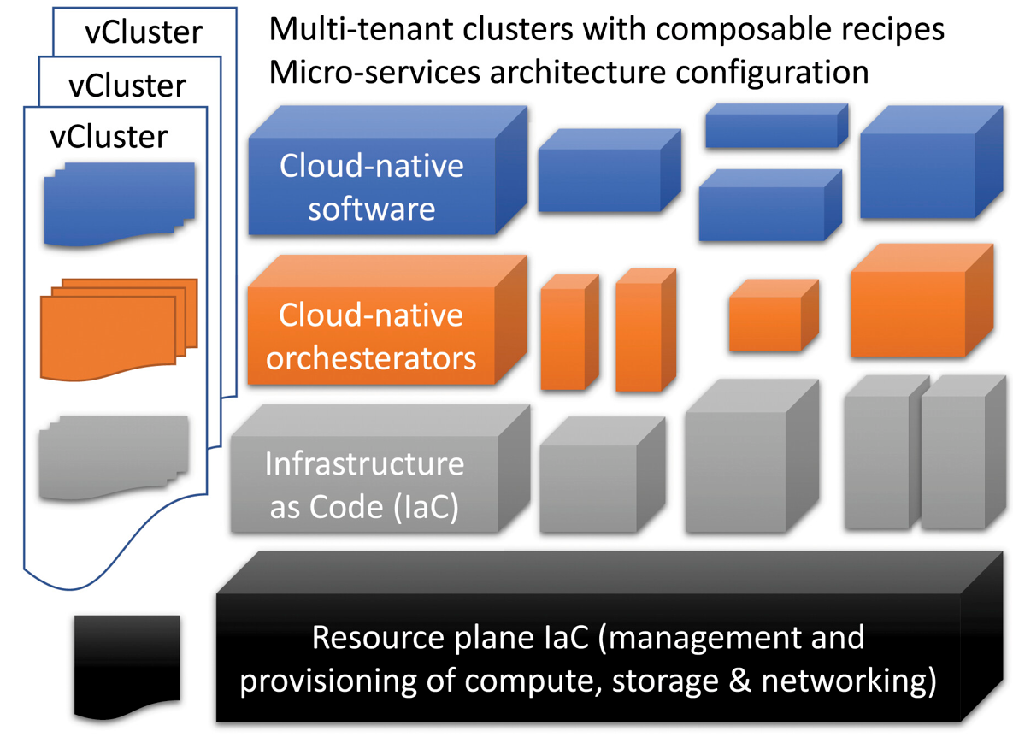
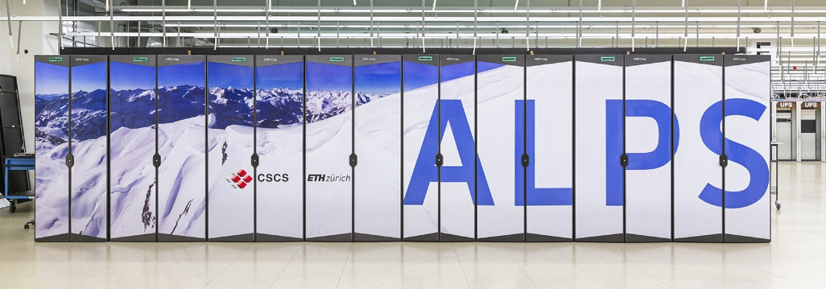
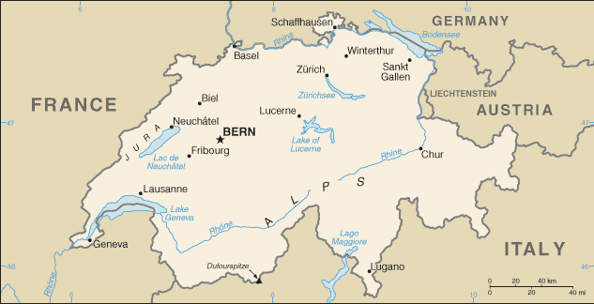
HPC Systeme ICON-22
Use of HPC Services on ALPS Platform @ CSCS
Versatile clusters (IaC)
Elasticity
2 locations: Lugano and Lausanne
Annual service costs
Production: vCluster tasna
168 A100 GPUs
28 CPUs
Failover and R&D: vCluster balfrin
120 – 216 A100 GPUs (elastic)
36 CPUs

Slide 5
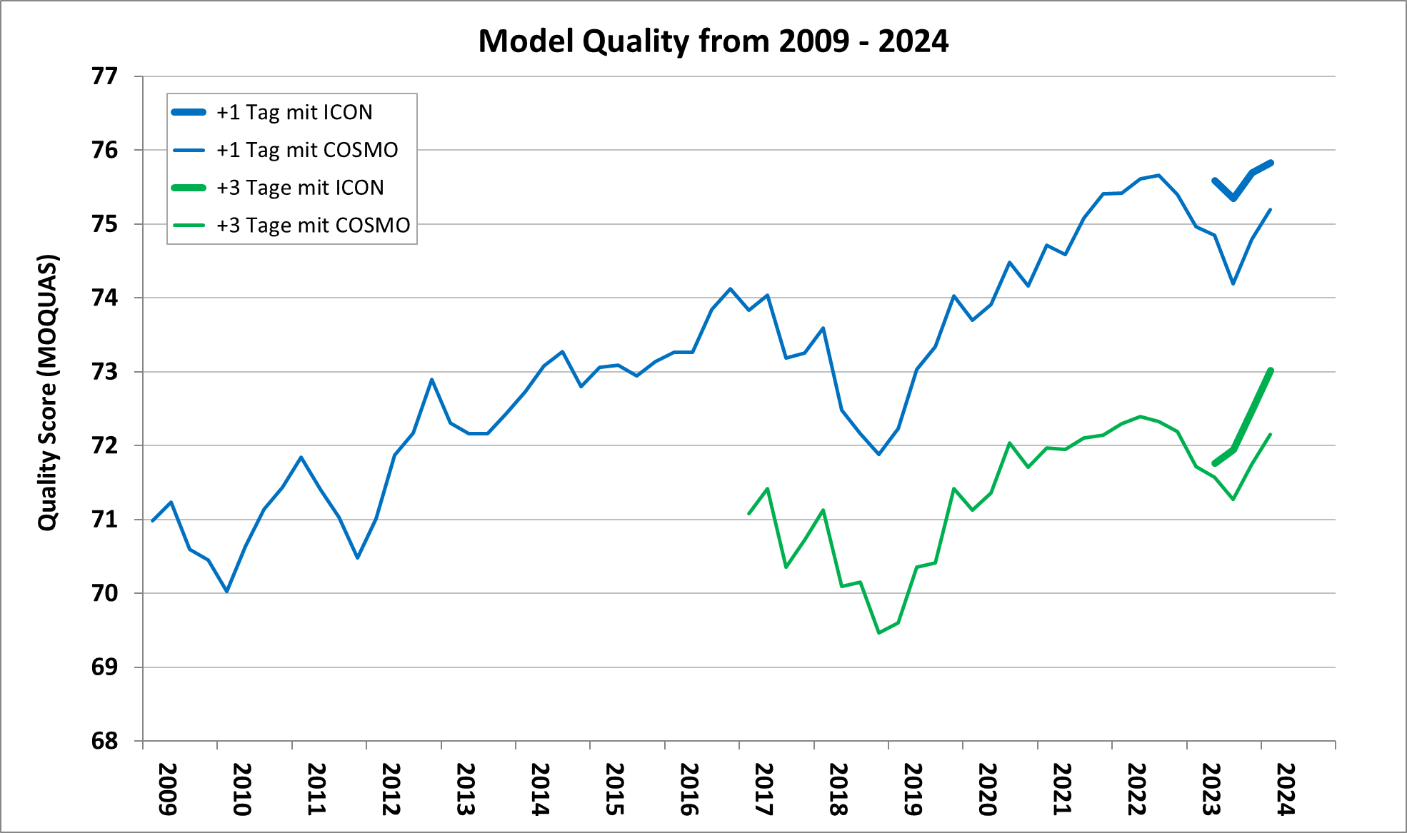
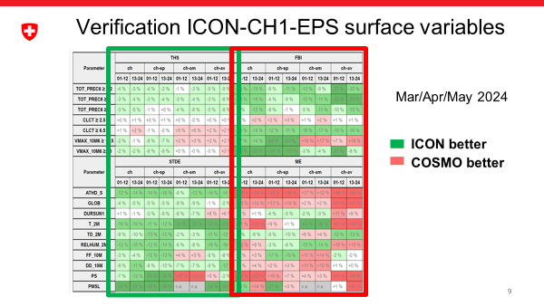
Headline Score & Verification
Structure (spatial and temporal) better in ICON than COSMO
Probabilities better in ICON than COSMO
ICON has larger biases for some parameters
Notes:
Temperature at valley stations
Global radiation at valley stations
Wind speed in complex topography

Slide 6
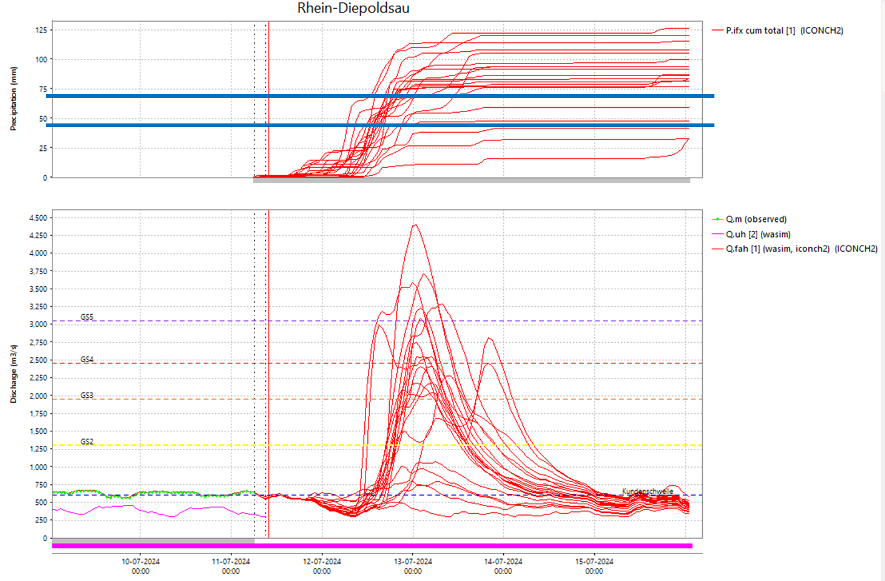
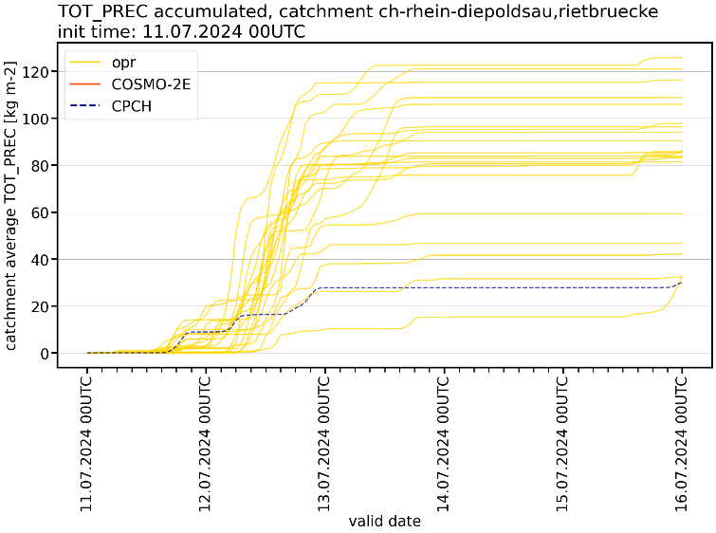
Our current headache problem
Hydrologists: “excessive spread and frequent overestimation in the runoff forecasts”
→ multiple events in early summer (May – Jul); large convective contributions
Figures: BAFU / Lukas Jansing

