Slide 1
Latest development in the PROPHECY project
Andrzej Mazur
Institute of Meteorology and Water Management
National Research Institute

Slide 2
Contents
Introduction
Results
Conclusions

Slide 3
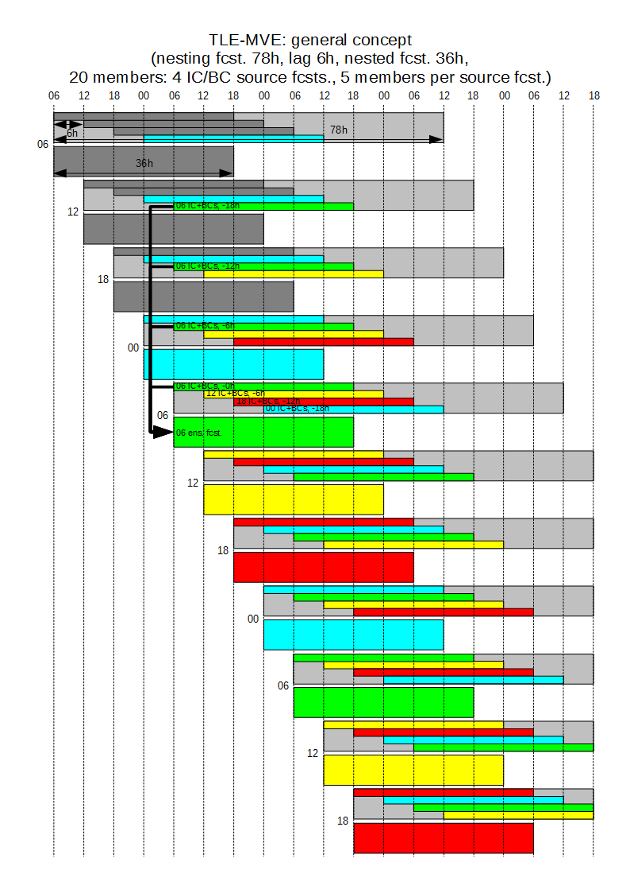
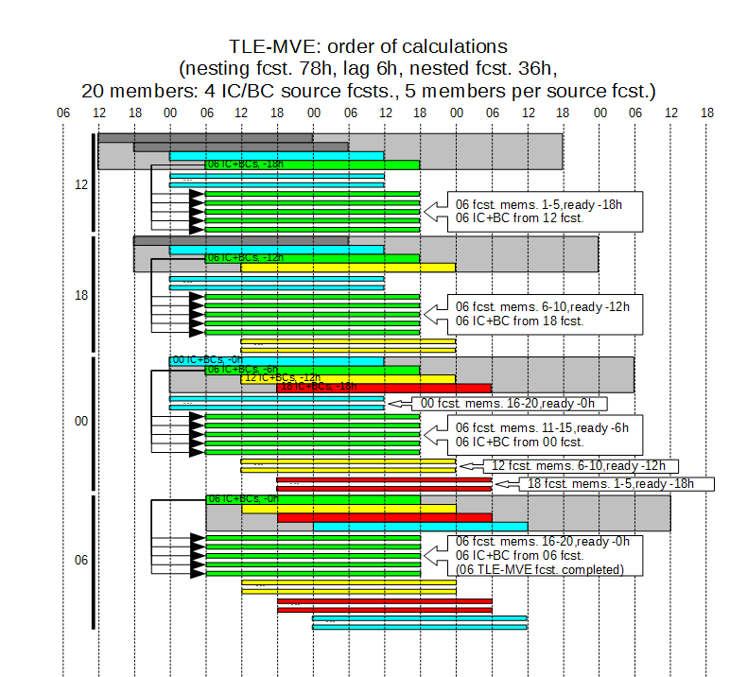
Introduction
Details of the deterministic models configuration.
Model Res. Grid size XxYxH Forecast length
ICON 13 2949120 triangles 120
COSMO 7 415x460x40 84
COSMO 2.8 380x405x50 36 (det. 48)
TLE – Time-Lagged Ensemble; MVE – Model-Varied Ensemble

Slide 4
Introduction
Subtask 1.1 – Development of the parameter perturbation.
Subtask 2.2 – Assessment of the influence of various methods of perturbation of initial field of soil temperature (with focus on the depth of perturbation).
Subtask 3.5 – Modification of lagged-approach scheme (”weights with memory”); median-based EPS mean
Dataset used for verification – measurements in Polish SYNOP stations, hourly data (ongoing).

Slide 5
Subtasks
Subtask 1.1 (I have showed it so many times before…)
Parameters tested (perturbed):
- c_soil – evaporation area index (basic, operational one)
- laf_pert – perturbation in soil surface temperature; initial values, with the amplitude of perturbation depending on the type of soil (sand, clay, peat, etc.)
- eff_coeff – perturbation of the collection efficiency coefficient
- combinations of the above
General perturbation scheme had the following form
perturbed_value=basic_value * [1+(random_number -0.5 ) * amplitude]
where “random_number” (from a computing dependent pseudorandom number generator) varies from 0 to 1.
Loose soil (sand): amplitude =1 (the perturbation ranged from 0.5 to 1.5 of the undisturbed value).
The more compact the structure, such as peat or clay, the smaller the amplitude becomes (eg. for clay = 0.6; for peat = 0.5).

Slide 6
Subtasks
Subtask 1.1
Despite of extending appraisal period to 10+ years no significant improvement has been achieved comparing to the operational setup.
Again, soil properties (parameters) did not meet expectations.
Hence – DO NOT introduce it to operational work.

Slide 7
Subtasks
Subtask 2.2
Question: How deep into the ground the temperature perturbation should be introduced for significant/positive impact.
Answers…
CGM2023: ”Similarly, increasing the depth to 2.5 meters did not introduce a significant improvement (compared to the previous assumptions – 1m down), only a slight improvement in skill (on average, about 1-2%) for MAM 2021 – SON 2023”.
ICCARUS 2024: ”Increase in depth to 2-2.5 meters resulted in significant improvement in skill – over the last three months (DJF 2023/2024), about 10-15%”.
Now: ”Increase in depth to 2-2.5 meters resulted in various improvement in skill – very significant in cold period(s) – DJF, SON, not that significant at all – during warm periods (MAM, JJA)”

Slide 8
Subtasks
Subtask 3.5 – last, but absolutely not least.
Current operational setup – every member is used with equal importance (and equal probability with input weight), and every group has the same number of members. This data is subsequently passed to ANN-based post-processing.
The "weight with memory" approach – an interesting alternative to equal weights. Slight improvement with linear time-dependency of particular member(s)’ weights. As before, various types of weights versus time dependencies were tested. Finally, it was found that better results were obtained – interesting – for logarithmic decay, i.e. the relationship: "the older weights, the less significant", but logarithmic, not linear.
Another modification to the scheme – lagging already at the ICs/BCs stage – the boundary and initial conditions would come from the lagging of the deterministic 7km model. this would give the possibility – among other benefits – to extend the forecast length of 2.8 km EPS.

Slide 9
Conclusions
Subtask 1.1
No significant achievement in terms of skill improvement noticed. On the contrary, unfortunately, perturbation of soil properties/parameters did not meet expectations...
Decision – strong suggestion NOT to implement this into operational work.
Subtask 2.2
Comparison with ERA-5 reanalysis and verification against measurements at Polish synoptic stations has been performed. Recent studies have confirmed that the increase in skill with increasing depth of initial soil temperature disturbance is much more visible in cold periods… Apparently, it must have something to do with frozen/thawed/ or tight/loose ground.
Subtask 3.5
Still running the "weight with memory" approach and the results are nice (meaning, skill improvement for an operational setup). The other issue – ICs/BCs lagging looks promising, but also requires further evaluation. One can think of it as a poor men's EPS – which, with minor changes in operational configuration and low usage of computing resources, can bring great benefits – EPS (lagged) at 7km resolution with TLE/MVE at 2.8km resolution over a longer time horizon.

Slide 10
Suggestion for a new PP?

Slide 12
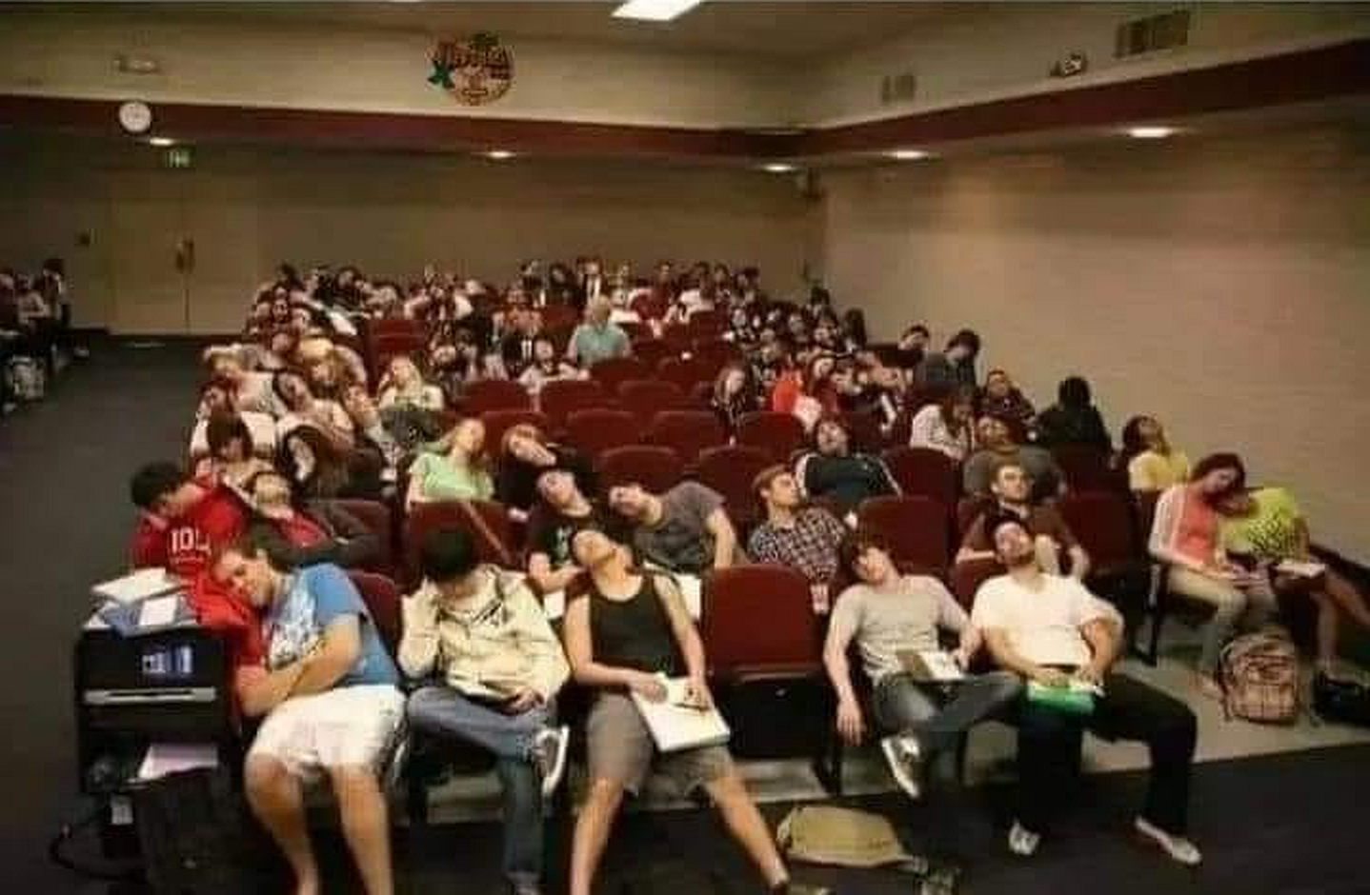
Thank you for hearing me yawn-t!

