Slide 1
The new operational ICON ensembles of MeteoSwiss
Marco Arpagaus for the MeteoSwiss team

Slide 2
Outline
KENDA-CH1, ICON-CH1-EPS, ICON-CH2-EPS
verification highlights; comparison with COSMO (and ICON-D2)
excessive precipitation amounts and spread

Slide 3
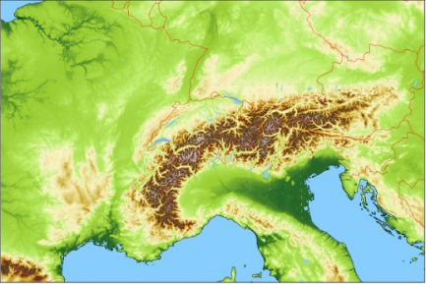
NWP forecasts in use at MeteoSwiss
Lateral boundary conditions
4x per day
ICON-CH1-EPS: 33 hour forecasts, 8x per day 1.0 km grid size (convection permitting) 11 ensemble members
ICON-CH2-EPS: 5 day forecasts, 4x per day 2.1 km grid size (convection permitting) 21 ensemble members
ECMWF IFS ENS 15 days, 2x per day 9 km / 0.1° 51 ensemble members
33h / 45h
120h
360h

Slide 4
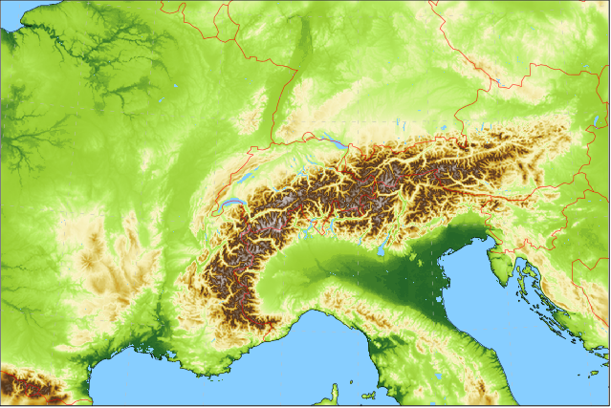
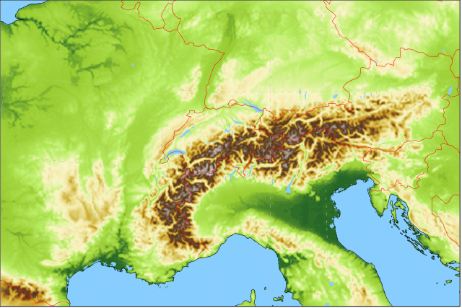
Forecasting System based on
Lateral boundary conditions: IFS ENS 9 (18) km 4x per day
Ensemble Data Assimilation: LETKF
40+1 members at 1.0 km grid size with ICON-CH1 setup (SPPT) hourly cycling
operational since 28 May 2024
ICON-CH1-EPS: 33 hour forecasts, 8x per day 1.0 km grid size (R19B08), 80L 11 ensemble members
ICON-CH2-EPS: 5 day forecasts, 4x per day 2.1 km grid size (R19B07), 80L 21 ensemble members

Slide 5
Verification

Slide 6
Verification summary ICON vs COSMO
Structure (spatial and temporal) better in ICON than COSMO (all parameters)
Probabilities better in ICON than COSMO (all parameters)
ICON has larger bias for (details on following slides)
Temperature at valley stations
Global radiation at valley stations
Wind speed in complex topography
→ Overall ICON-CH1/2-EPS is clearly better than COSMO-1/2E

Slide 7
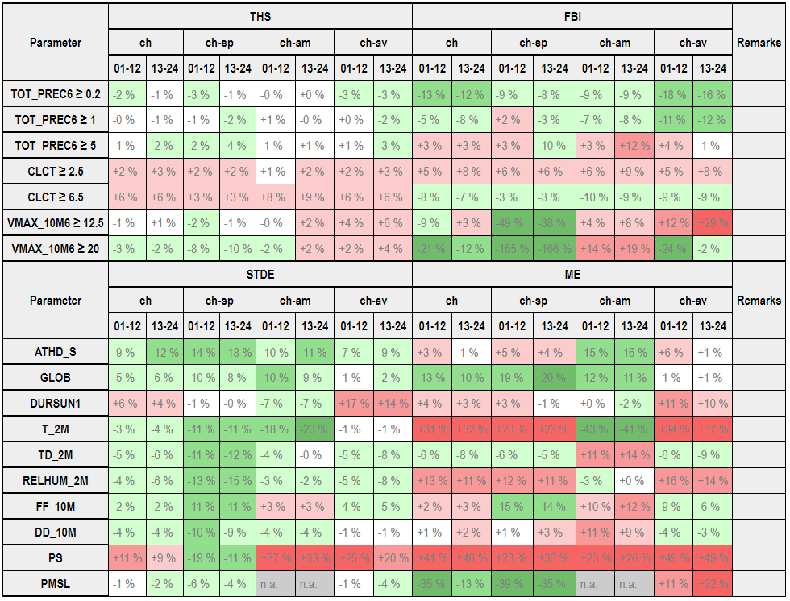
Verification ICON-CH1-EPS surface variables
Sep/Oct/Nov 2023
ICON better
COSMO better

Slide 8
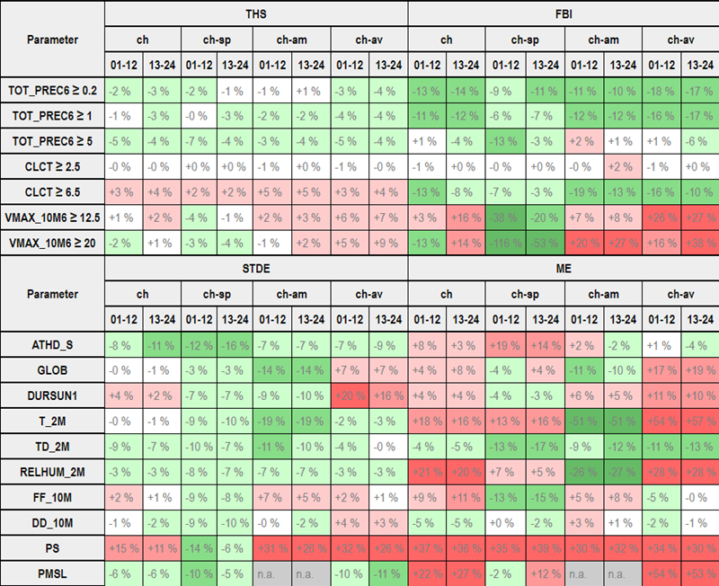
Verification ICON-CH1-EPS surface variables
Dec/Jan/Feb 2023/24
ICON better
COSMO better

Slide 9
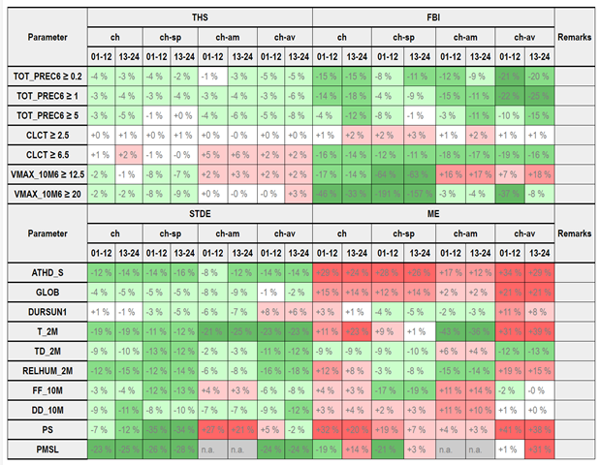
Verification ICON-CH1-EPS surface variables
Mar/Apr/May 2024
ICON better
COSMO better

Slide 10
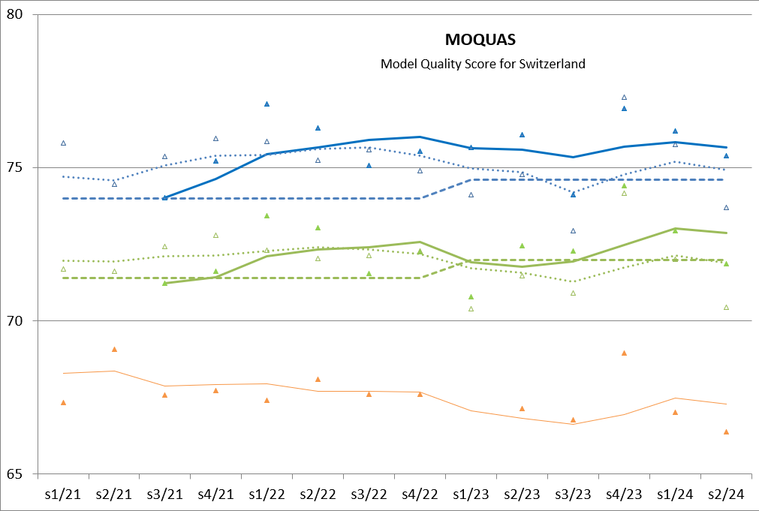
Development MOQUAS ICON vs COSMO
ICON
COSMO
ICON better than COSMO since 2022 (except for s3/22)
ICON: model evolving; median since summer 2023
+1 day
+3 days
30% precipitation (ETS)
30% cloudiness (ETS)
30% temperature (MAE)
10% wind speed (MAE)
+3 days IFS
Figure: Pirmin Kaufmann

Slide 11
ICON: Most severe deficiencies
Temperature at 2m (T2m): warm bias (mean error (ME)) all seasons; most pronounced in Alpine valleys
Global radiation (GLOB): overestimation (mean error (ME)) winter and spring, most pronounced in Alpine valleys
Relative humidity at 2m (RH2m): behaviour is often reflecting problems in T (i.e., in winter and spring); unclear behaviour in summer
Wind speed at 10m (FF10m): underestimation (mean error (ME)) for Alpine mountains and valleys
Note (for MeteoSwiss …): The biases for T2m and FF10m can be removed by post-processing. – No post-processing yet for GLOB, though!

Slide 12
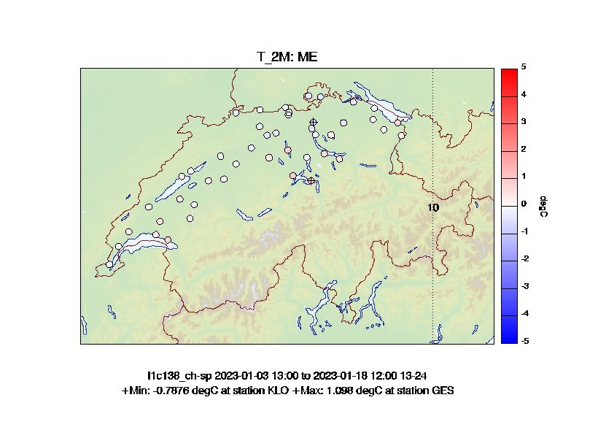
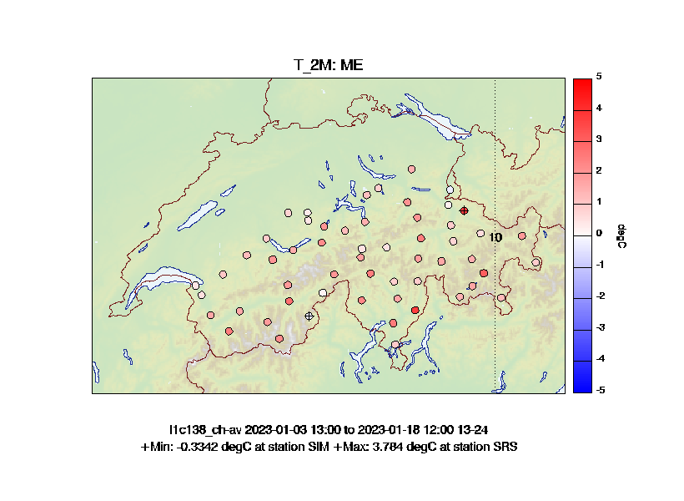
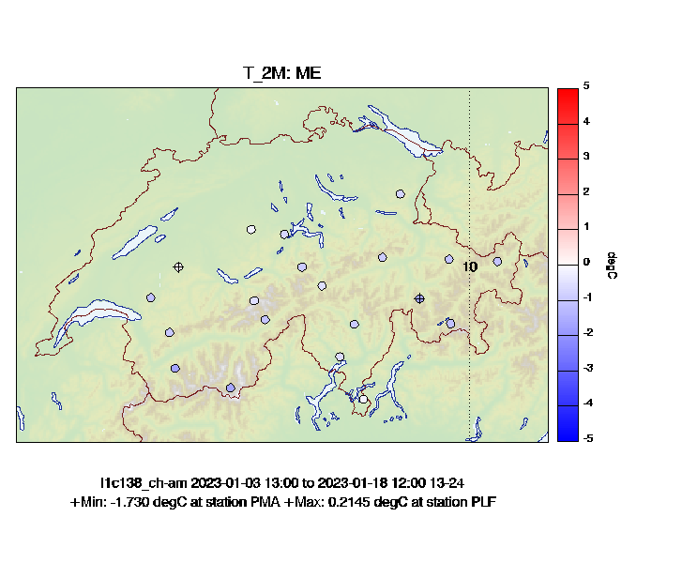
Verification domains (T2m, rainy winter)
AM: Alpine «Mountains»
SP: Swiss Plateau
AV: Alpine «Valleys»
Figures: Pirmin Kaufmann

Slide 13
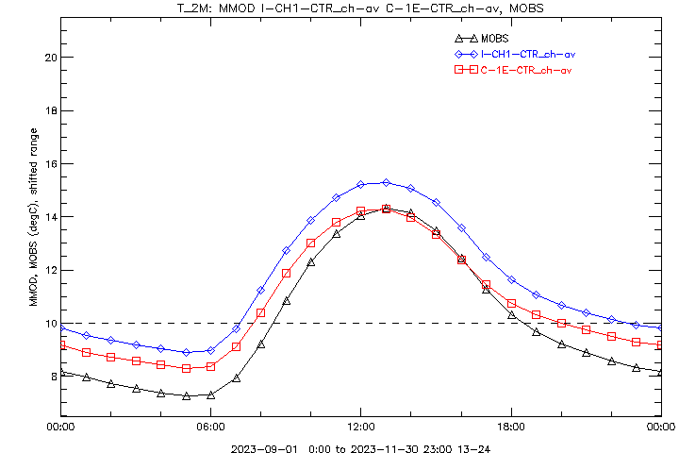
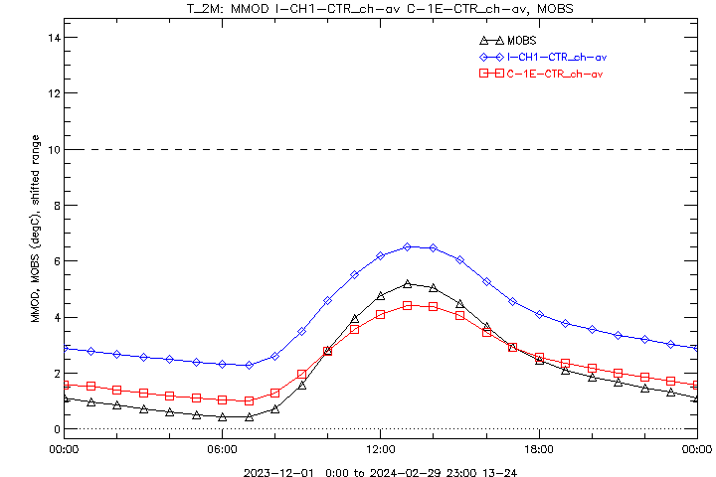
T2m in valleys
∆─∆ Observations
□─□ COSMO-1E Ctrl
◊─◊ ICON-CH1 Ctrl
Sep/Oct/Nov 2023
Dec/Jan/Feb 2023/24

Slide 14
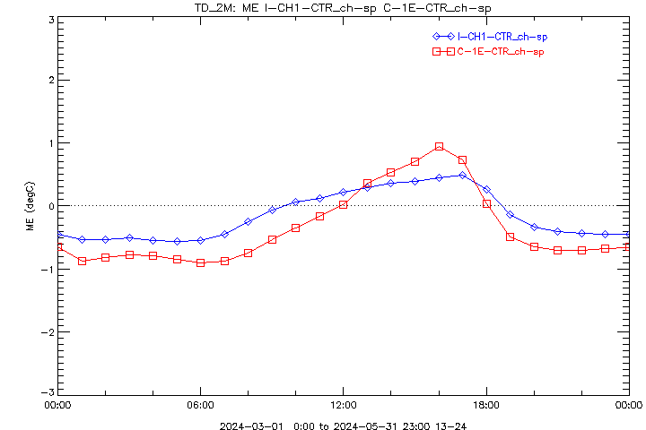
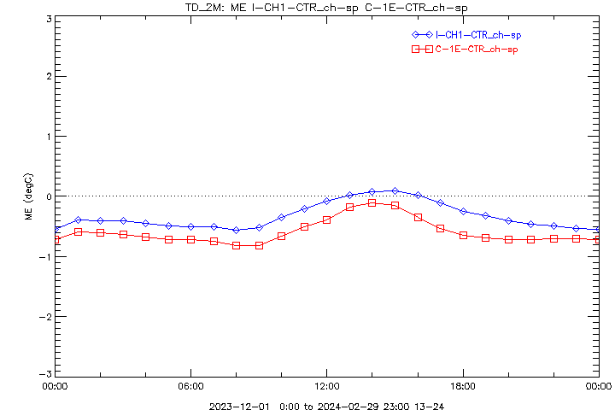
Dewpoint over Swiss Plateau
ICON: small dry bias at night, wet bias at daytime, all seasons
COSMO: large afternoon wet bias, except in winter
∆─∆ Observations
□─□ COSMO-1E Ctrl
◊─◊ ICON-CH1 Ctrl
Diurnal Cycle
(Summer, Autumn,) Spring
Winter

Slide 15
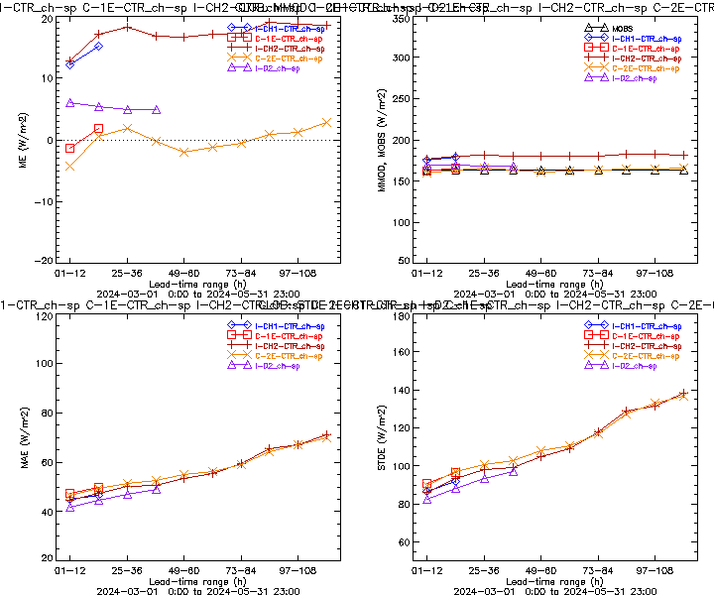
Global radiation over Swiss Plateau
Mar/Apr/May 2024

Slide 16
ICON-CH2 vs ICON-D2, Dichotomous
ch-sp Swiss Plateau
ch-am Alpine Mountain Tops
ch-av Alpine Valley Floors
Threat score about neutral
Frequency bias mostly better
Mar/Apr/May 2024

Slide 17
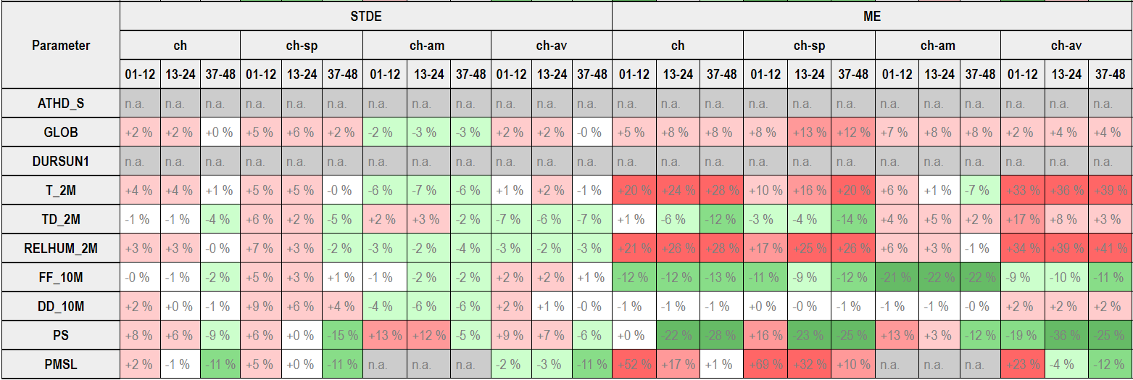
ICON-CH2 vs ICON-D2, Continuous
ch-sp Swiss Plateau
ch-am Alpine Mountain Tops
ch-av Alpine Valley Floors
In general ICON-CH2 similar to ICON-D2
Bias for (GLOB,) T2m, RH, PMSL worse (→ APT!)
Mar/Apr/May 2024

Slide 18
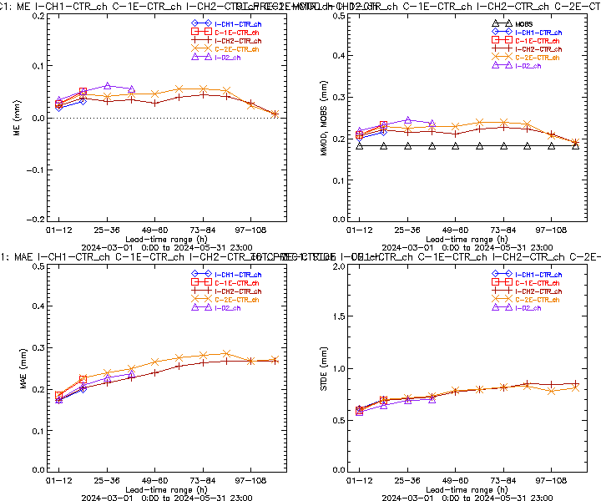
Precipitation over Switzerland
Mar/Apr/May 2024

Slide 19
Precipitation

Slide 20
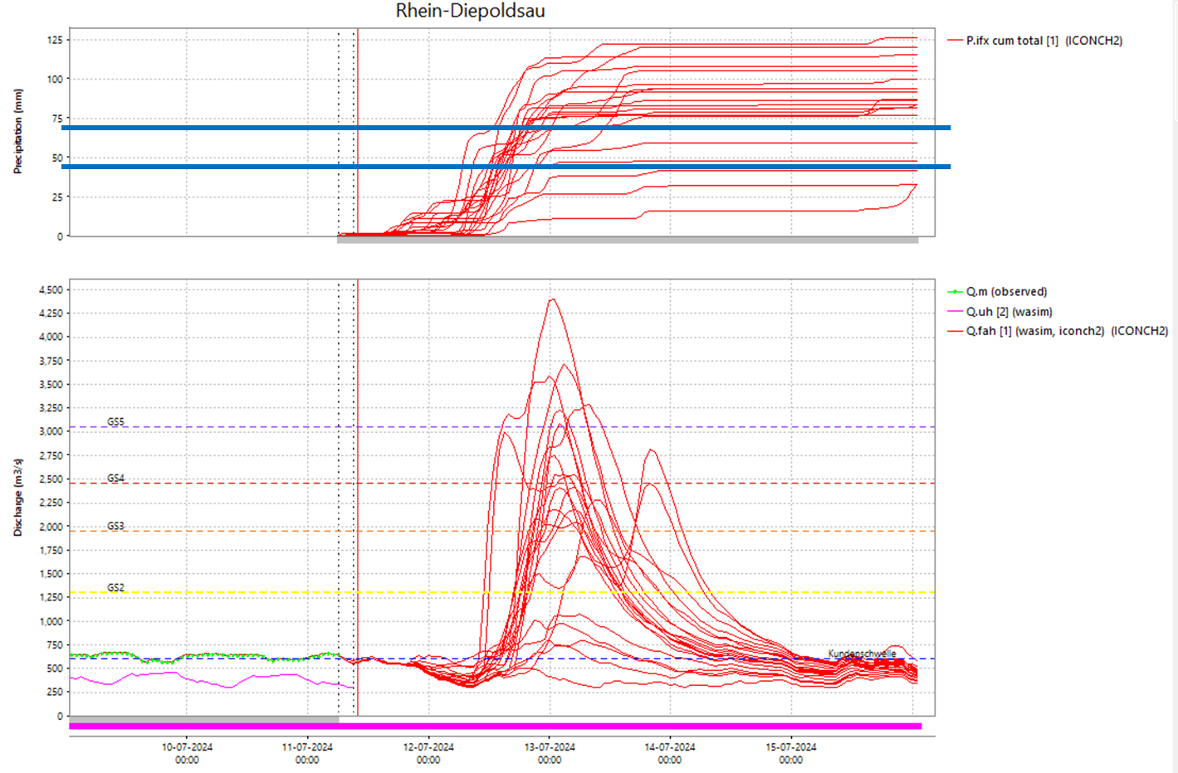
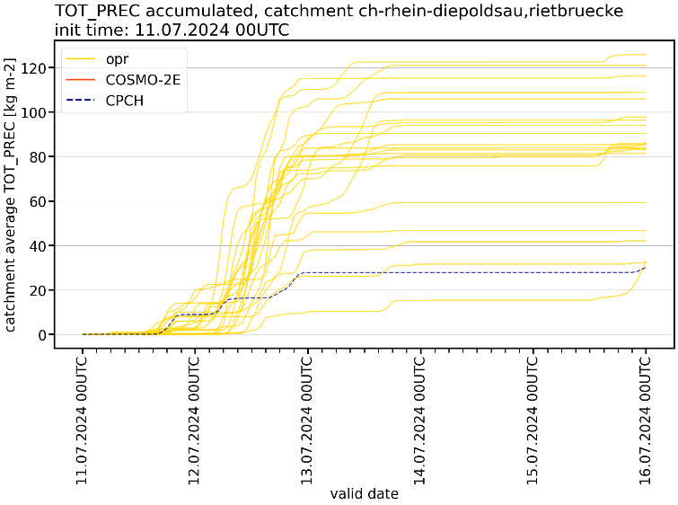
Our current headache problem
Hydrologists: “excessive spread and frequent overestimation in the runoff forecasts”
→ multiple events in early summer (May – Jul); large convective contributions
Figures: BAFU / Lukas Jansing

Slide 21
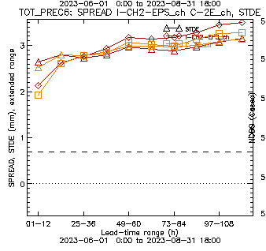
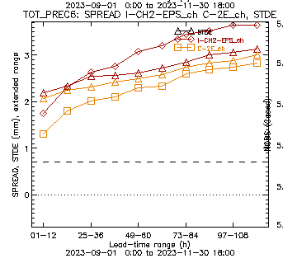
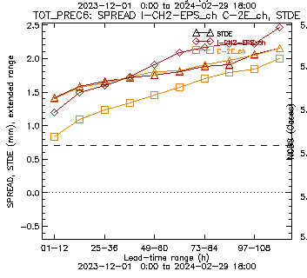
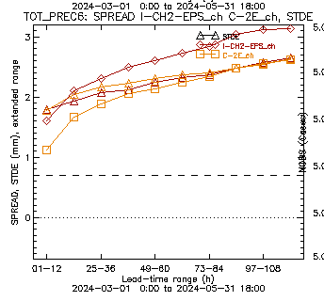
Precipitation: spread vs skill
Ensemble spread exceeds skill (STDE) in all past seasons for ICON-CH2-EPS
for the large lead times
Triangles: skill
JJA 2023
SON 2023
DJF 2024
MAM 2024
No SPPT!
COSMO-2E
ICON-CH2-EPS
Figures: Pirmin Kaufmann

Slide 22
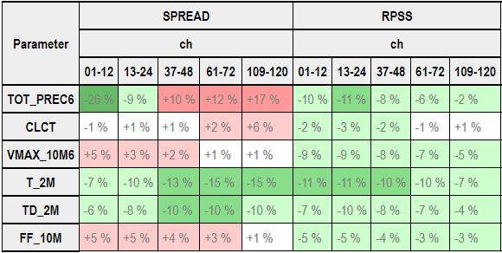
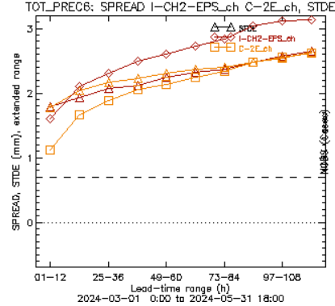
Ensemble Verification 2 km
Spread/skill relation
Better for 2 m temperature and dewpoint
Cloud coverage, gusts: similar
Precipitation spread better for short lead time but too large after +12h
Spread of wind speed smaller
RPSS better for all parameters!
SPREAD/SKILL

Slide 23
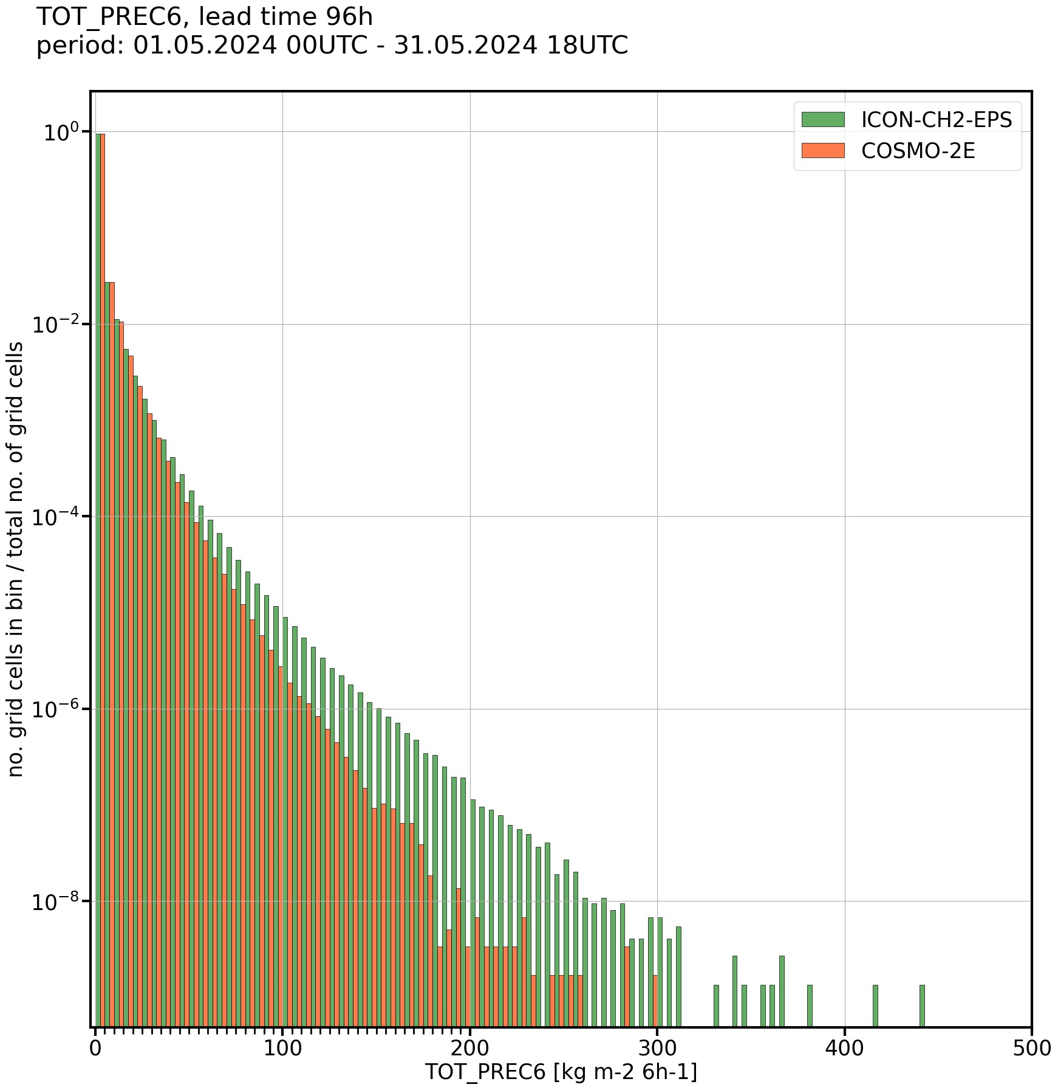
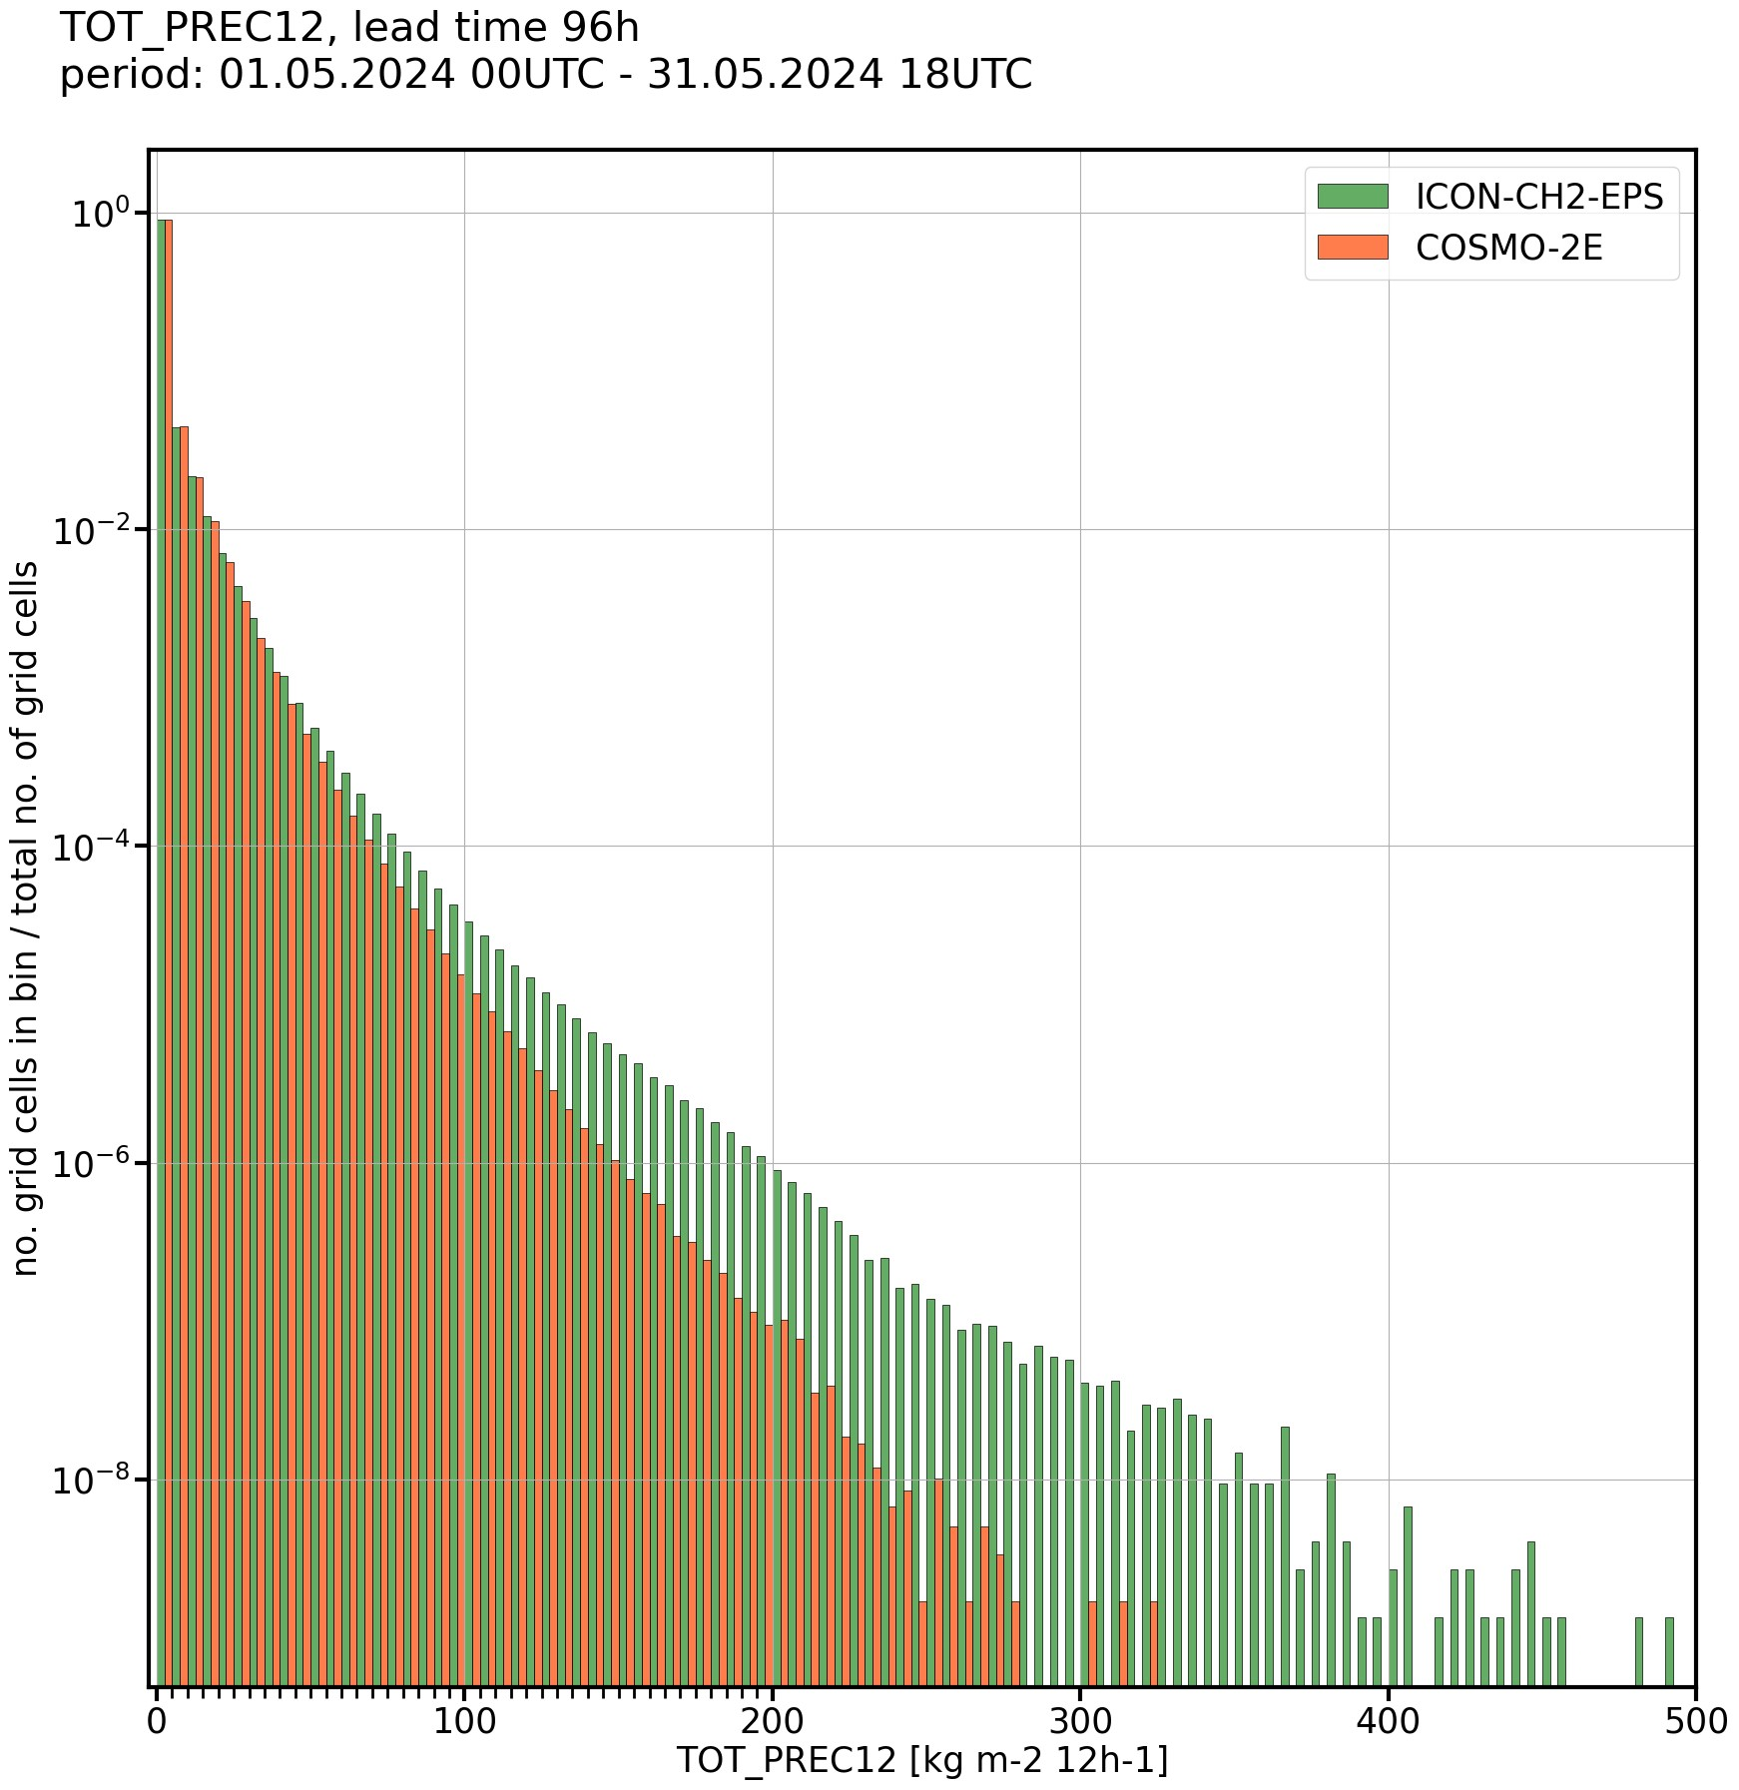
Precipitation – comparison of ICON to COSMO
Comparison of precipitation from ICON and COSMO for +4d lead time in May 2024
→ ICON-CH2-EPS produces higher precipitation amounts than COSMO-2E (conclusion valid for different aggregations and lead times)
6h-precip
12h-precip
Normalized histograms of precipitation aggregated over all members and init times:
Figures: Lukas Jansing

Slide 24
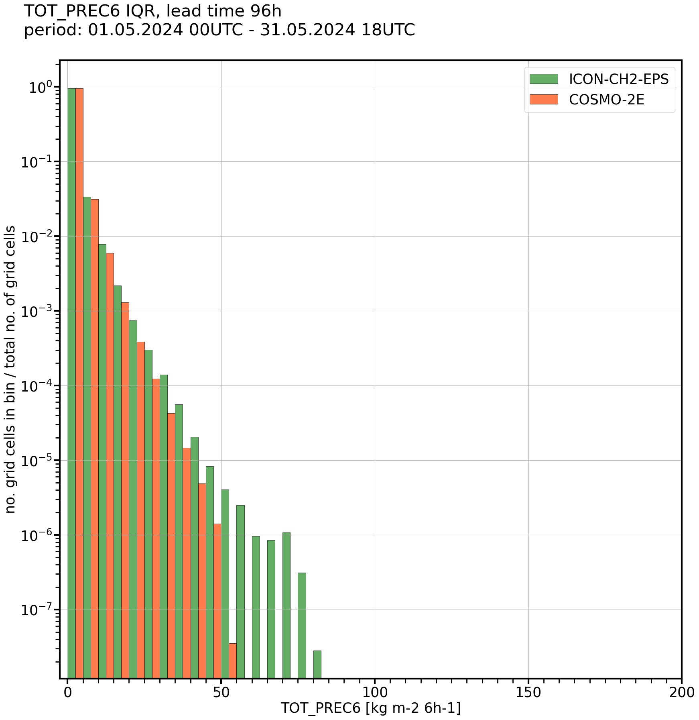
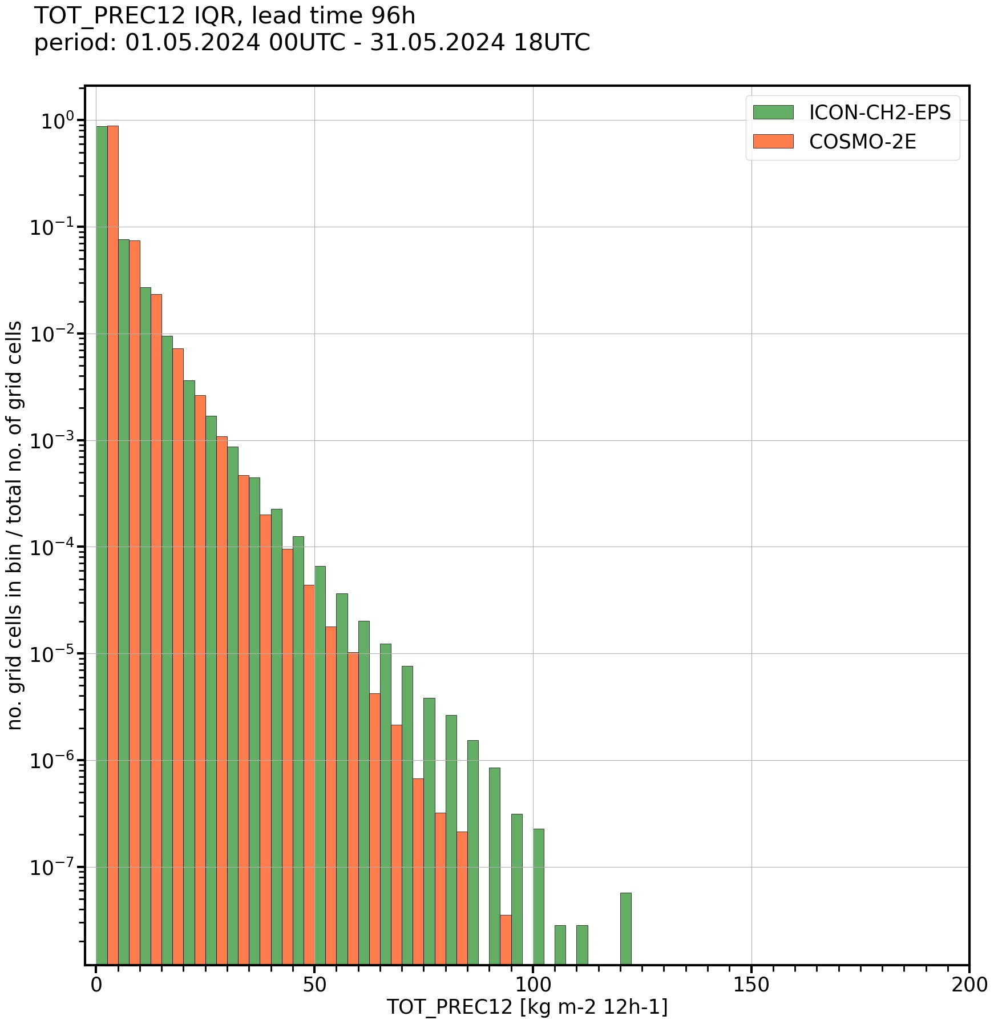
Precipitation – comparison of ICON to COSMO
Comparison of precipitation from ICON and COSMO for +4d lead time in May 2024
ICON-CH2-EPS produces a larger ensemble spread than COSMO-2E
(conclusion valid for different aggregations and lead times)
6h-precip IQR
12h-precip IQR
Normalized histograms of precipitation IQR (= Q3 – Q1) aggregated over all members and init times:
Figures: Lukas Jansing

Slide 25
Precipitation – potential explanations
The search for an explanation (and a fix) …
Technical error? → Can be excluded (see first plot)
SPPT causing too much spread and too high precipitation values? → test
Too high instability in the vertical profile, too vigorous convection?
Precipitation efficiency in microphysics too high?
Issue with LBCs? → unlikely
Too weak topography smoothing? → no evidence so far
Slide: Lukas Jansing

Slide 26
Precipitation – ICON experiments, 01-13 Jul 2024
E-suites to test out sensitivity of ICON to different namelist settings:
270: lgrayzone_deepconv = .true., lshallowconv_only = .false.
Goal: Reduce CAPE in the vertical profile and dampen convection
271: rlam_heat = 1 (rat_sea = 8)
Goal: Reduce the scaling factor of the laminar boundary layer for heat to dampen near-surface temperatures and convection
272: lsppt = .false.
Goal: Switch of SPPT to reduce spread and precipitation amounts
273: range_rn = 0.3
Goal: Reduce random numbers in SPPT to dampen spread
274: lsppt = .false, lgrayzone_deepconv = .true., lshallowconv_only = .false.
Goal: Test combined effect of no SPPT and lgrayzone_deepconv
Reduce convection
Reduce model perturba-tions
Reduce both
Slide: Lukas Jansing

Slide 27
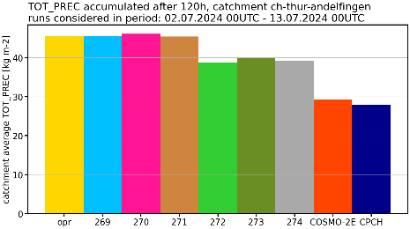
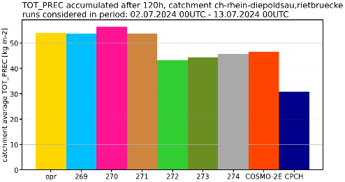
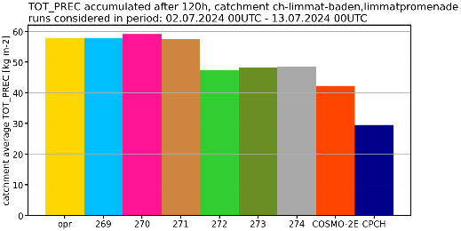
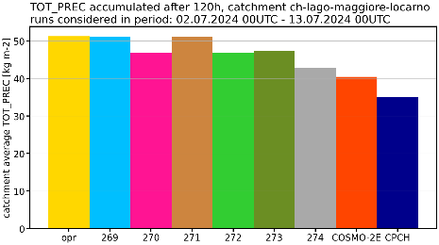
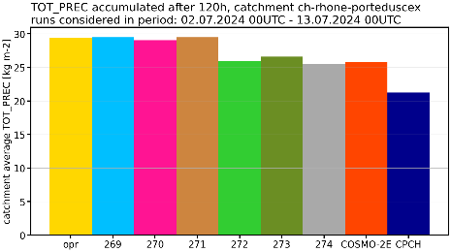
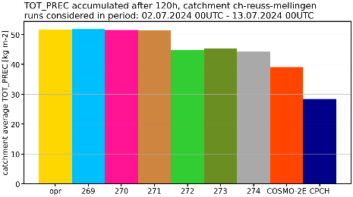
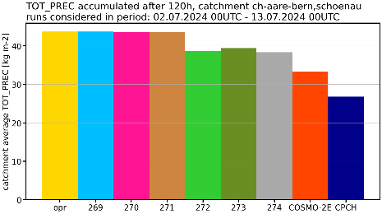
Precipitation – ICON experiments, 01-13 Jul 2024
Accumulated +5d precip, all members and forecasts – average for large-scale river catchments
→ Only changing model perturbations reduces precipitation
Thur
Rhein
Limmat
Lago Maggiore / Ticino
Rhone
Reuss
Aare
Slide: André Walser

Slide 28
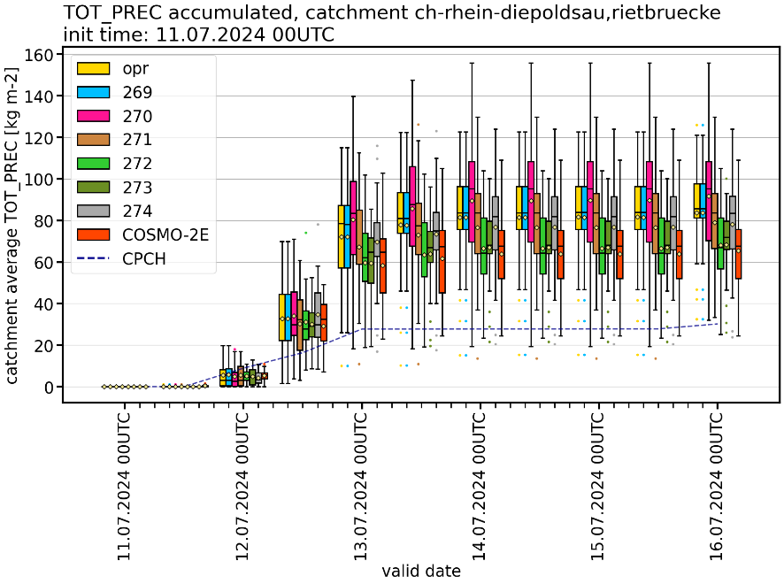
Precipitation – Rhine catchment case
forecast of 11.07.2024 00 UTC
ICON-CH2-EPS with reduced and skipped model perturbations shows a smaller precipitation spread, similar to COSMO-2E
Reduced precipitation in the median, but still more than COSMO-2E and CombiPrecip (CPCH)
Slide: André Walser

Slide 29
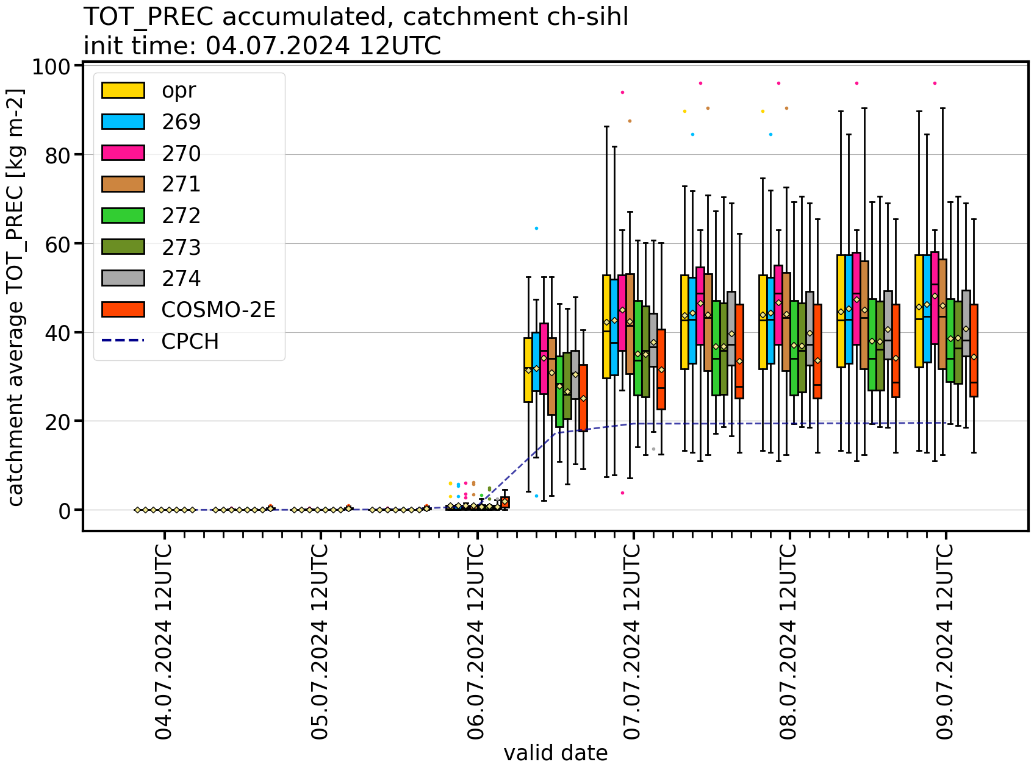
Precipitation – Sihl catchment case
forecast of 04.07.2024 12 UTC
ICON-CH2-EPS with reduced and skipped model perturbations shows a smaller precipitation spread, similar to COSMO-2E
Reduced precipitation in the median, but still more than COSMO-2E and CombiPrecip (CPCH)
Slide: André Walser

Slide 30
Precipitation – Summary
Not a technical issue (interpolation, aggregation, workflow,..)
ICON-CH2-EPS produces higher precipitation amounts and larger spread than COSMO-2E
Reduction of the model perturbations reduces the precipitation of the ICON-CH2-EPS members on average and the precipitation spread, and hence mitigates the precipitation issue
However, the ICON-CH2-EPS uncertainty forecasts for temperature, humidity and wind speed get worse (not shown)
Still unclear why model perturbations in ICON trigger more excessive precipitation than in COSMO → investigations ongoing
Slide: André Walser

Slide 31
ICON-22 – Summary
We are operational …
… and happy with ICON!
Note
all customers have in the meatime been migrated
COSMO will be switched off this Wednesday

