Slide 1
Infrastructure
Seamless INtegrated FOrecastiNg sYstem
26th COSMO General Meeting, WG6, Offenbach am Main
2nd of September 2024
Christian A. Welzbacher on behalf of
Project-Team & Friends: Ulrich Blahak, Roland Potthast, Kathleen Helmert, Alberto De Lozar, Axel Seifert, Elisabeth Bauernschubert, Thomas Hanisch, Matthias Zacharuk, Manuel Werner, Robert Feger, Rafael Posada Navia Osorio, Lilo Bach, Michael Hoff, Martin Rempel, Lisa Neef, Kathrin Feige, Markus Schultze, Sven Ulbrich, Kobra Khosravian, Jana Mendrok, Mareike Burba, Jana Mendrok, Klaus Vobig, Leonhard Scheck, Christian Berndt, Gregor Pante, Vera Maurer, Maike Ahlgrimm, Annett Strauß, Beke Kremmling, Ulrich Friedrich, Arne Spitzer, Lukas Josipovic, Thomas Deppisch, Matthias Gottschalk, Tobias Bergmann, Cornelius Hald, Isabel Urbich, Malte Schmid, Jan Bondy, Matthias Brechtel, Michael Denhard, Marcus Paulat, Felix Fundel, Vanessa Fundel, Andreas Höfer, Markus Zeindl, Christoph Schraff, Tanja Winterrath, Ewelina Walawender, Katharina Lengfeld, Kathrin Wapler, Linda Schlemmer, Julia Bachmann, Julia Keller

Slide 2
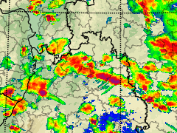
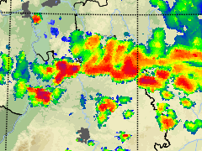
Starting point: forecast time range 0-12 h currently covered by two forecasting methods
Nowcasting
(0-2 h, update every 5 min)
Based on observations, efficient, deterministic, quickly available
Observations
DWD radar network
9.Juli 2021, Southern Germany
Numerical Weather Prediction
(0-48 h, update every 3 h)
Expensive numerical model, only available after 1-1,5 h
15:00 UTC
Started 15:00 UTC
Started 12:00 UTC

Slide 3
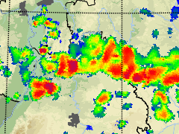
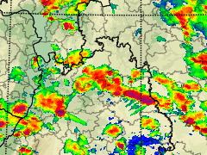
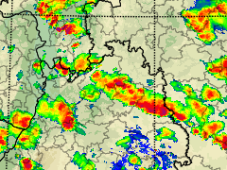
Starting point: forecast time range 0-12 h currently covered by two forecasting methods
Nowcasting
(0-2 h, update every 5 min)
Based on observations, efficient, deterministic, quickly available
Observations
DWD radar network
9.Juli 2021, Southern Germany
Numerical Weather Prediction
(0-48 h, update every 3 h)
Expensive numerical model, only available after 1-1,5 h
15:00 UTC
15:30 UTC
Started 15:00 UTC
Started 12:00 UTC

Slide 4
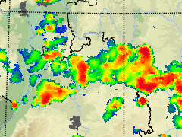
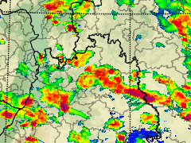
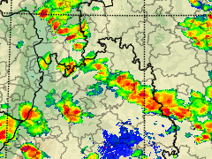
Starting point: forecast time range 0-12 h currently covered by two forecasting methods
Nowcasting
(0-2 h, update every 5 min)
Based on observations, efficient, deterministic, quickly available
Observations
DWD radar network
9.Juli 2021, Southern Germany
Numerical Weather Prediction
(0-48 h, update every 3 h)
Expensive numerical model, only available after 1-1,5 h
15:00 UTC
15:30 UTC
16:00 UTC
Started 15:00 UTC
Started 12:00 UTC

Slide 5
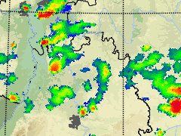
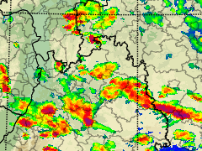
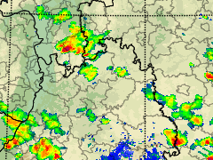
Starting point: forecast time range 0-12 h currently covered by two forecasting methods
Nowcasting
(0-2 h, update every 5 min)
Based on observations, efficient, deterministic, quickly available
Observations
DWD radar network
9.Juli 2021, Southern Germany
Numerical Weather Prediction
(0-48 h, update every 3 h)
Expensive numerical model, only available after 1-1,5 h
15:00 UTC
15:30 UTC
16:00 UTC
17:00 UTC
Started 15:00 UTC
Started 12:00 UTC

Slide 6
Starting point: forecast time range 0-12 h currently covered by two forecasting methods
Nowcasting
(0-2 h, update every 5 min)
Based on observations, efficient, deterministic, quickly available
Observations
DWD radar network
9.Juli 2021, Southern Germany
Numerical Weather Prediction
(0-48 h, update every 3 h)
Expensive numerical model, only available after 1-1,5 h
15:00 UTC
15:30 UTC
16:00 UTC
17:00 UTC
Both methods …
… have their specific problems
… were separately developed by different teams
... and there were no common products!
Started 15:00 UTC
Started 12:00 UTC

Slide 7
Starting point: forecast time range 0-12 h currently covered by two forecasting methods
Nowcasting
(0-2 h, update every 5 min)
Based on observations, efficient, deterministic, quickly available
Observations
DWD radar network
9.Juli 2021, Southern Germany
Numerical Weather Prediction
(0-48 h, update every 3 h)
Expensive numerical model, only available after 1-1,5 h
15:00 UTC
15:30 UTC
16:00 UTC
17:00 UTC
SINFONY improves both methods separately, interlocks them and produces combined forecasting products – seamless for and based on discussions with the users
Started 15:00 UTC
Started 12:00 UTC

Slide 8
Differences between ICON-RUC and ICON-D2
ICON-D2-RUC
ICON-D2
Hourly new forecasts with Leadtime 14h
Data available in database ~45 min after init
Short Observation-Cutoff-Time, hence less conventional observations are assimilated
Assimilation cycle branches every day at 03UTC from ICON-D2 (Reset)
LBC always from ICON-EU-forecasts, partly based on longer leadtimes
Complex and more expansive 2-Moment cloud-microphysics parametrization and reflectivity diagnostics (Mie), also in data assimilation
Radar reflectivity forecasts in five minute intervals for all German radar stations
High frequent output of convection-relevant quantites
New forecast every 3h with Leadtime 48h
Data available in database ~1:30 h after init
Long(er) Observation-Cutoff-Time, hence more conventional observations are assimilated
Continuous assimilation cycle (“base cycle”) with long Observation-Cutoff-Time
LBC from more recent ICON-EU runs, partly from global DA-cycle
Simpler 1-Moment cloud-microphysics-parametrization and reflectivity diagnostics (Rayleigh)
Same model area and model grid

Slide 9
Operationelles System: Parallelsuite RUC
ICON-D2
BASE-ANA
FG & ANA
03 UTC
BASE-ANA
FG & ANA
03 UTC
BASE-ANA
FG & ANA
03 UTC
BASE-ANA
FG & ANA
03 UTC
BASE-ANA
FG & ANA
04 UTC
BASE-ANA
FG & ANA
04 UTC
BASE-ANA
FG & ANA
05 UTC
BASE-ANA
FG & ANA
05 UTC
BASE-ANA
FG & ANA
06 UTC
BASE-ANA
FG & ANA
06 UTC
BASE-ANA
FG & ANA
07 UTC
BASE-ANA
FG & ANA
07 UTC
BASE-ANA
FG & ANA
08 UTC
BASE-ANA
FG & ANA
08 UTC
BASE-ANA
FG & ANA
09 UTC
BASE-ANA
FG & ANA
09 UTC
BASE-ANA
FG & ANA
03 UTC
BASE-ANA
FG & ANA
04 UTC
BASE-ANA
FG & ANA
03 UTC
BASE-ANA
FG & ANA
04 UTC
BASE-ANA
FG & ANA
05 UTC
BASE-ANA
FG & ANA
05 UTC
BASE-ANA
FG & ANA
06 UTC
BASE-ANA
FG & ANA
06 UTC
BASE-ANA
FG & ANA
07 UTC
BASE-ANA
FG & ANA
07 UTC
BASE-ANA
FG & ANA
08 UTC
BASE-ANA
FG & ANA
08 UTC
BASE-ANA
FG & ANA
09 UTC
BASE-ANA
FG & ANA
09 UTC
BASE-ANA
FG & ANA
09 UTC
BASE-ANA
FG & ANA
09 UTC
[...]
[...]
[...]
2:50h
2:50h
2:50h
3:00h
4:30h
4:40h
3:40h
3:50h
2:50h
3:00h
4:30h
4:40h
3:40h
3:50h
2:50h
3:00h
2:50h
4:30h
3:00h
4:30h
3:40h
3:40h
2:50h
2:50h
4:30h
4:30h
3:40h
3:40h
2:50h
2:50h
2:50h
2:50h
Hauptl. FG &
ANA 04
Hauptl. FG &
ANA 04 UTC
Hauptl. FG &
ANA 05
Hauptl. FG &
ANA 05 UTC
Hauptl. FG &
ANA 06
Hauptl. FG &
ANA 06 UTC
NWV-
FCST 06 + 48h
NWV-
FCST 06 UTC + 48h
Hauptl. FG &
ANA 07
Hauptl. FG &
ANA 07 UTC
Hauptl. FG &
ANA 08
Hauptl. FG &
ANA 08 UTC
Hauptl. FG &
ANA 09
Hauptl. FG &
ANA 09 UTC
NWV-
FCST 09 + 48h
Hauptl. FG &
ANA 04
NWV-
FCST 09 UTC + 48h
Hauptl. FG &
ANA 04
Hauptl. FG &
ANA 05
Hauptl. FG &
ANA 05
Hauptl. FG &
ANA 06
Hauptl. FG &
ANA 06
NWV-
FCST 06 + 48h
NWV-
FCST 06 + 48h
Hauptl. FG &
ANA 07
Hauptl. FG &
ANA 07
Hauptl. FG &
ANA 08
Hauptl. FG &
ANA 08
Hauptl. FG &
ANA 09
Hauptl. FG &
ANA 09
NWV-
FCST 09 + 48h
NWV-
FCST 09 + 48h
End of
„RUC-day“
2:15h
2:15h
1:25h
1:25h
0:25h
0:30h
2:15h
2:15h
1:25h
1:25h
0:25h
2:15h
0:30h
2:15h
1:25h
1:25h
0:25h
0:25h
2:15h
2:15h
1:25h
1:25h
0:25h
0:25h
SINFONY-RUC Cycle assimilation hourly
14h-forecasts hourly
RUC-
FG & ANA
17
RUC-
FG & ANA
05 UTC
RUC-
FG & ANA
17
RUC-
FG & ANA
07
RUC-
FG & ANA
17
RUC-
FG & ANA
07
RUC-
FG & ANA
07
RUC-
FG & ANA
06
RUC-
FG & ANA
07 UTC
RUC-
FG & ANA
06 UTC
RUC-
FG & ANA
06
RUC-
FG & ANA
05
RUC-
FG & ANA
06
RUC-
FG & ANA
05
RUC-
FG & ANA
05
RUC-
FG & ANA
04
RUC-
FG & ANA
05 UTC
RUC-
FG & ANA
04
RUC-
FG & ANA
04
RUC-
FG & ANA
04 UTC
RUC-
FG & ANA
04
RUC-
FG & ANA
04
RUC-
FG & ANA
04
[...]
RUC-
FG & ANA
04 UTC
[...]
[...]
[...]
2:15h
1:00h
2:15h
1:05h
1:00h
2:15h
1:05h
1:00h
2:15h
1:00h
1:00h
2:15h
1:00h
1:00h
2:15h
1:05h
2:15h
1:00h
2:15h
2:15h
1:00h
1:50h
2:15h
1:55h
2:15h
1:50h
2:15h
2:15h
1:50h
2:40h
2:15h
2:45h
2:15h
2:40h
2:15h
2:15h
2:45h
2:40h
2:15h
2:40h
2:15h
2:40h
2:15h
2:40h
RUC-
FG & ANA
06 UTC
RUC-
FG & ANA
18
RUC-
FG & ANA
18
RUC-
FG & ANA
18
RUC-
FCST
18 + 9h
RUC-
FCST
18 + 9h
RUC-
FCST
18 + 9h
RUC-
FG & ANA
08 UTC
RUC-
FCST
06 UTC + 14h
RUC-
FG & ANA
07
RUC-
FG & ANA
08
RUC-
FG & ANA
07
RUC-
FCST
08 + 9h
RUC-
FCST
08 UTC + 14h
RUC-
FCST
07 + 9h
RUC-
FG & ANA
07
RUC-
FCST
07 + 9h
RUC-
FG & ANA
07
RUC-
FG & ANA
07
RUC-
FG & ANA
07
RUC-
FCST
07 + 9h
RUC-
FCST
07 UTC + 14h
RUC-
FCST
07 + 9h
RUC-
FCST
07 + 9h
Observation-Cutoff-Time
0:15h
0:15h
0:15h
0:15h
0:15h
0:15h
0:15h
0:15h
0:15h
0:15h
0:15h
0:15h

Slide 10
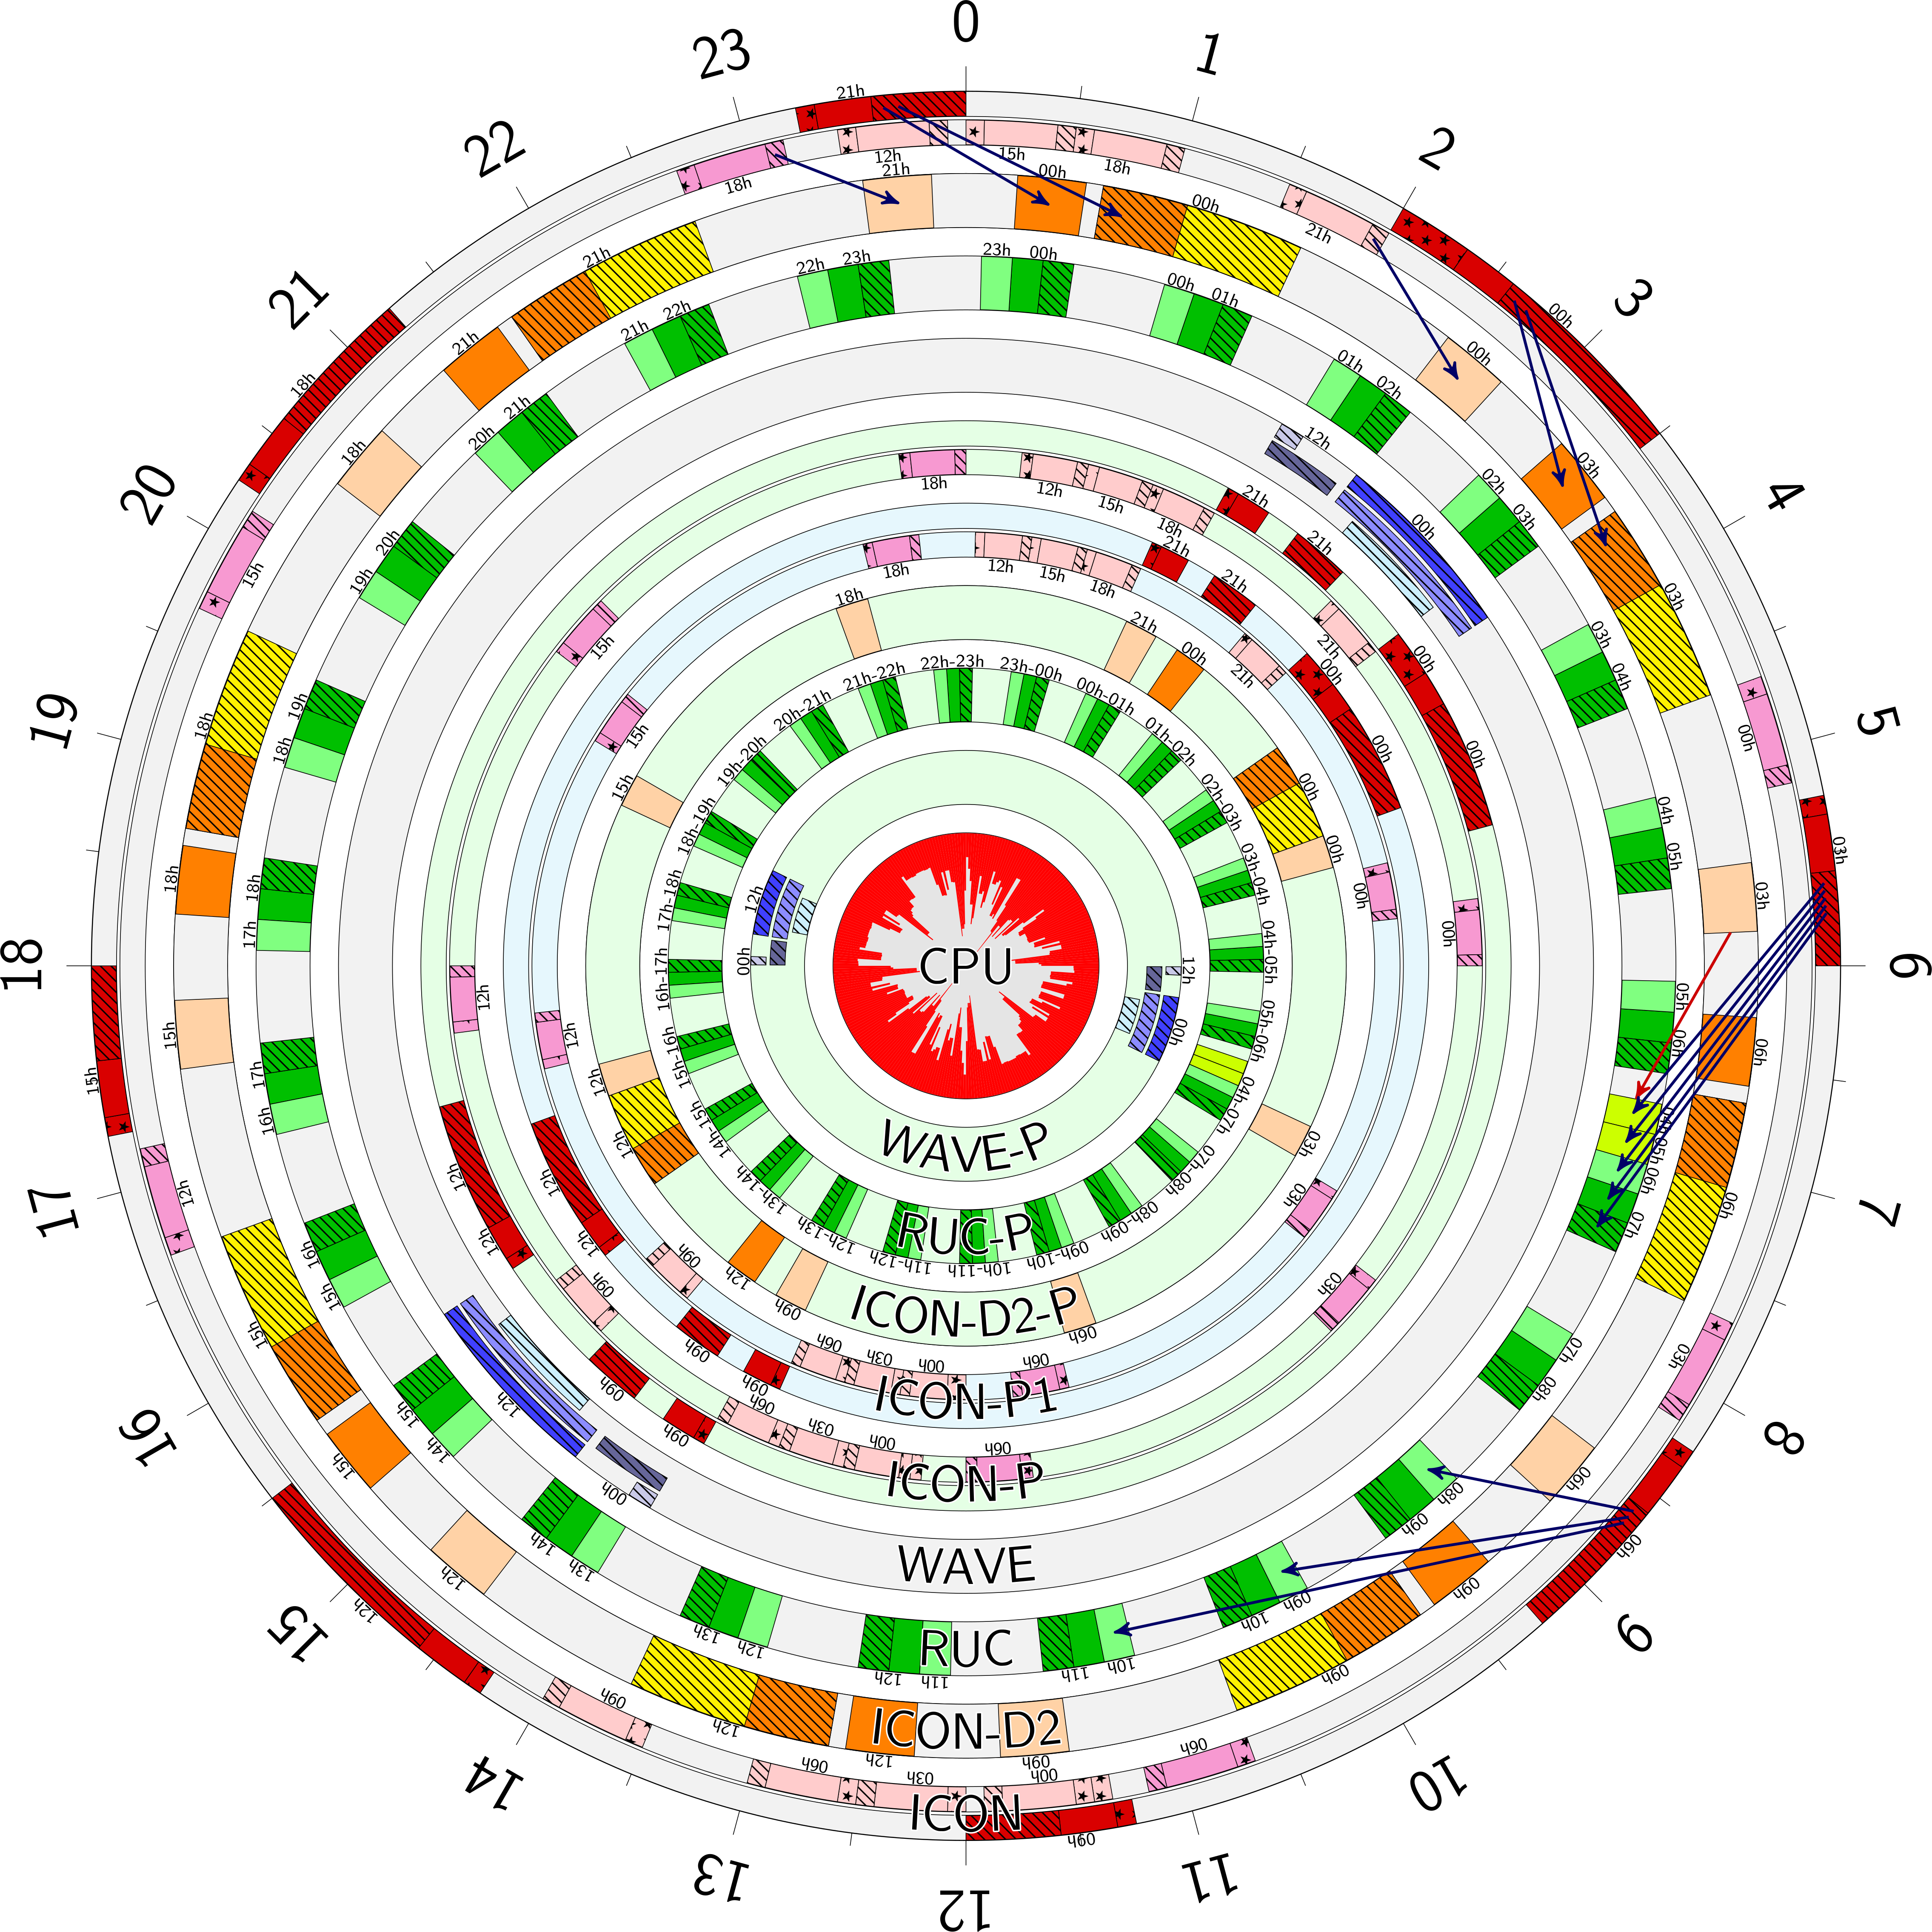
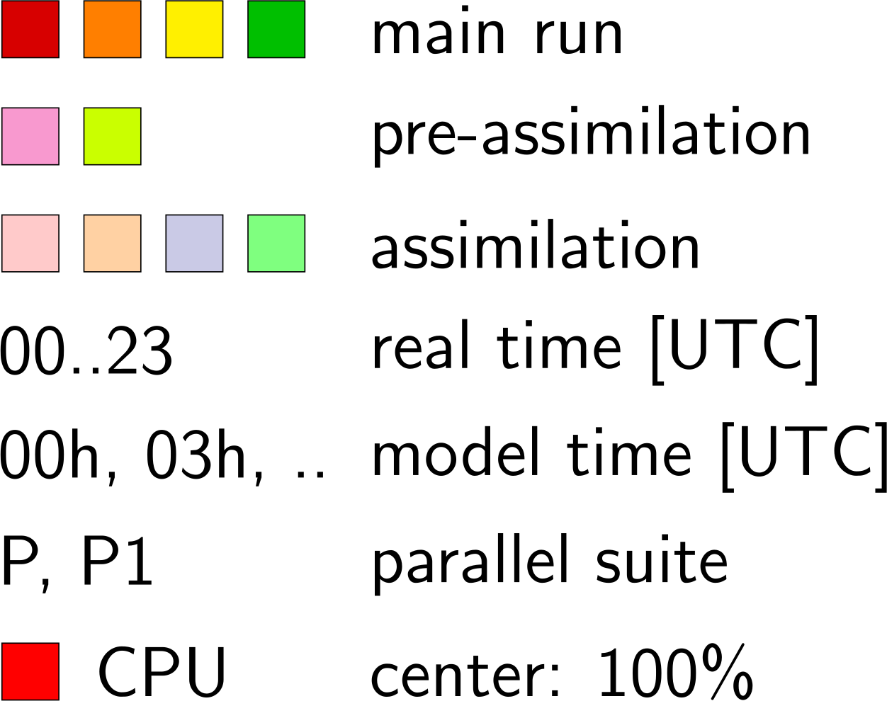
“Modell-Uhr”
Notes:
- short look to the operational timetable
- here we have a look onto the outer part
Schedule of GME, C-EU, C-DE, WAVE and RLM
- dark colors = forecast runs
- brighter colors assimilation
- the innerpart contains the schedule of our operational parallel suite
→ later

Slide 11
Branching from the ICON-D2 Routine
LBC from ICON-EU-Forecasts

Slide 12
Similarity between ICON-D2 and ICON-D2-RUC : Why is it desirable
(Large) Differences in the setup between ICON-D2 and ICON-D2-RUC lead to:
Problem with the seamless-Strategy
Potentially loss of „trust“ due to „inconsistent“ NWP at the forecasters side
Development and tests have to be performed separately
It’s a self-accelerating system: the more the two setups differ, the more likely it is that we find different effects of developments leading to more tuning for best results of each system separately

Slide 13
Best setup for ICON-D2 and ICON-D2-RUC each
Consistency in settings between ICON-D2 and ICON-D2-RUC
No blocking of development/upgrades
due to testing

Slide 14
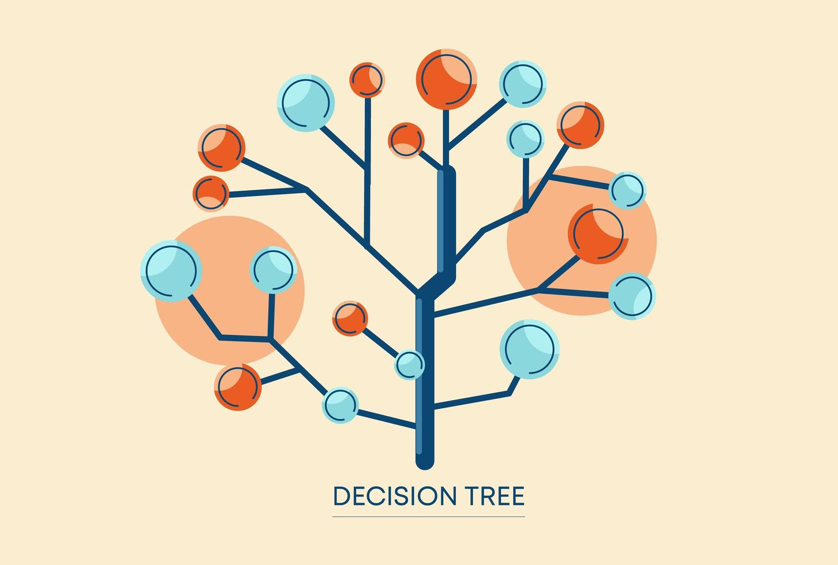
Differences in judgement of new developments:
For ICON-D2-RUC are important:
Precipitation and reflectivity verification
Object verification
Timeliness

Slide 15
Technical challenge: Apply Nowcasting algorithm to NWP-data
In order to generate Nowcasting objects based on NWP data, the corresponding program (Konrad3D) has to be applied to NWP data
The program is a demanding C++-based component, not running on the OS of HPC
Two attempts to solve the problem:
Bring the data to the algorithm: NFS-export to have the data available at Level-2 where the algorithm runs ➔ not performant, not stable, “communication” difficult
Bring the algorithm to the data: Use containerisation on HPC ➔ promising approach

Slide 16
RUC Objects
SKY ….
…
KONRAD3D ….
KONRAD3D ….
…
Clean up ….
cronjob.sh
Expected Runtime [min]
RUC-EMVORAD
Data transfer
KONRAD3D
Combination
35
5
120
10
170
Pre.
Container
45,4 GB
Post.
127 min
Slide by Matthias Zacharuk

Slide 17
Benchmark
20240629:17
MEM [GB] load / job: 0,35 / 42,9 0,39 / 25,97 0,48 / 25,97 0,37 / 15,28
VMEM [GB] load / job: 1,5 / 45,4 1,55 / 28,5 1,61 / 28,56 1,54 / 17,89
cpunum / Thread: 4 / 1 4 / 1 4 / 1 2 / 1
Vertikalchecks
Parallelisierung
Feature
K3D-20240617
K3D-20240715
K3D-20240719
K3D-20240725
126,87 min
40,97 min
81,82 min
72,28 min
Slide by Matthias Zacharuk

