Slide 1
SCA Report for ICON-NWP
Ulrich Schättler
ICON Gatekeeper (in charge for COSMO)

Slide 2
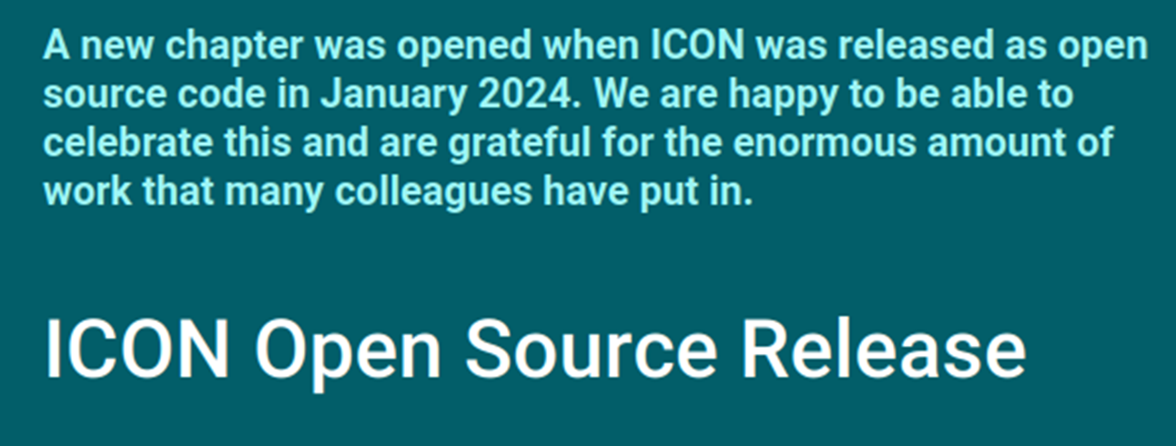
ICON now is Open Source

Slide 3
Where to find ICON and Related Informations
https://icon-model.org New webpage with basic information on ICON and the download link:
Going to „ICON-Model ⇒ Release Download“, which is a publicly availabe gitlab page
https://gitlab.dkrz.de/icon/icon-model
From here you can download a tar-ball (go to „Code“ ⇒ „Download source code“)
You can also download directly with git or https:
git clone git@gitlab.dkrz.de:icon/icon-model.git
https://gitlab.dkrz.de/icon/icon-model.git
https://docs.icon-model.org/
Still under construction, should be publicly available „any day now“

Slide 4
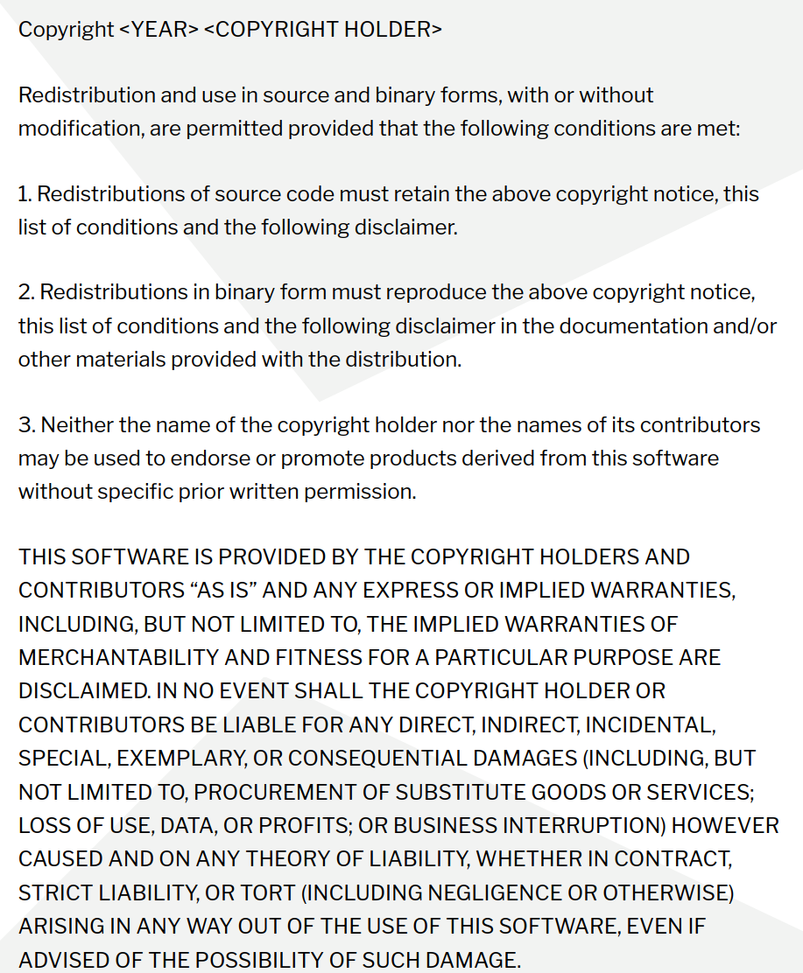
The W-Questions
What is Open Source?
Open Source software can be used, investigated, modified, and enhanced by everybody.
It can be downloaded for free.
Why Open Source?
Enables the greatest possible scientific dissemination.
Project funding from the EU (for example) requires that software developed by the project is Open Source.
Reduces amount of administrative work to issue special licenses to partners.
Which Open Source?
ICON is now licensed under BSD-3C permissive license.

Slide 5
HowTo Open Source?
Preliminary work:
A working group AGIL (Arbeitsgruppe ICON Lizenz) elaborated 10 recommendations for an Open Source License (for about a year).
Florian Prill and Daniel Reinert inspected ICON to identify parts of code which have not been written by ICON developers. E.g. Tiedtke-Bechtold Convection (ECMWF), RRTM in all flavors (AER), etc.
Work on the ICON repository: From October on colleagues from all ICON partners took care of necessary modifications in the repository. This work was organized by Florian Prill and Uli Schättler.
Every file in the source code directories was modified to replace the old license header by a new one.
For external code it was ensured that proper permissive open source licences are available.
Exception: the new stochastic convection scheme (under development) still uses ACM code, which needs a commercial license, if used in commercial applications; a replacement is under testing).
Also files in other parts of the repository need a proper license: run-scripts, pictures, pdf-files, data,…

Slide 6
Consequences
For Users:
Only if you use the stochastic convection scheme for commercial applications, i.e. if you sell your products. Then you need a commercial ACM license (about 500 US$ per year).
For Developers:
If you contribute code to ICON, you have to agree that it is published under the BSD-3C license.
For colleagues working for ICON partners this is guaranteed by the ICON partner.
Also the COSMO STC agreed that code contributed by COSMO colleagues will be published under BSD-3C.
You cannot add code which has no permissive open source license.

Slide 7
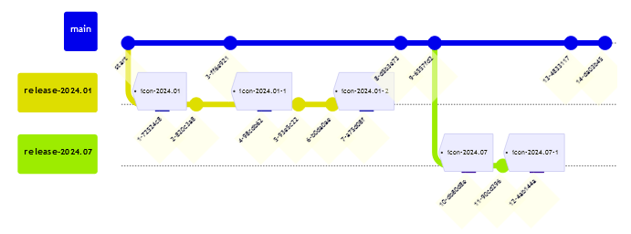
Release Names
Old: icon-2.6.7 also with patch level icon-x.y.z.n, e.g. icon-2.6.5.1
New: icon-2024.01 also with patch level icon-yyyy.mm-n, e.g. icon-2024.01-1
On icon/icon.git: Note: There is no icon-x.y.z-rc any more!
© Florian Prill
Branch Tag

Slide 8
Naming Conventions for Institutional Releases (Operational Tags)
Institutional releases will (still) be build from icon/icon-nwp.git!
See: https://gitlab.dkrz.de/icon/icon-nwp/-/tags
Needed to implement necessary changes (e.g. hotfixes) quickly to operations.
The name of the last common tag is used as the prefix, e.g. icon-2024.01 (without any patch-level).
The institute tags are named
icon-2024.01-dwd-x.y
icon-2024.01-mch-x.y
Procedure for institutional releases:
Create a branch op-release-2024.01-dwd-x (a separate branch for every x)
If appropriate, create a tag: icon-2024.01-dwd-x.y
Branch names are different from tag names to avoid confusion.

Slide 9
Use Cases
These are publicly available test cases:
Whoever downloads and installs ICON should be able to test it with special (recommended) configurations.
Recommended means: we only support these configurations!
For NWP we provide a global (R02B06, 40 km) and a local (R19B07, ICON-D2) case.
Available from (once the docs-pages are available)
https://docs.icon-model.org/how_to_run/recommended_config/recommended_config.html
These pages lead you to the DKRZ Swiftbrowser, from where you can download the tar-balls:
https://swiftbrowser.dkrz.de/public/dkrz_4d992e1b-f237-4258-a2bc-138ca6a1cf59/icon-model-use-cases/

Slide 10
Latest ICON Releases

Slide 11
release-2024.01 (formerly known as Release Candidate 2.6.7)
Work on this release candidate started on 09.02.2023!
It was released on 15.01.2024 as the first ICON Open Source version, now named release-2024.01.
Informations on the contents of this (and all other) releases can be found in
The file RELEASE_NOTES.md of the open source releases.
The Protocol of Release Commits: https://gitlab.dkrz.de/icon/wiki/-/wikis/Protocol-of-Release-Commits (and subpages).
Advantage: this protocol contains links to the corresponding merge requests with more informations.
Disadvantage: Only accessible with a DKRZ and gitlab account.
On the following slides some highlights from the development topics since last September are listed.

Slide 12
Since September 2023 (implemented to 2.6.7-rc on 19.10.2023)
Modified z_pbl output for NWP (icon-nwp!683)
CAMS climatological aerosol as an option for ecRad radiation (icon-nwp!783)
Modification to relative humidity based visibility diagnostic. (icon-nwp!1088)
sfc_seaice: heat transfer from the sea-ice slab is modified (icon-nwp!1112)
Bug fixes
SPPT: fix issue leading to the observed t2m and td2m biases (cold and dry) (icon-nwp!996)
Bug fix for soil water check in initicon (icon-nwp!1069)
Fix soil layer depths in IFS interpolation (icon-nwp!1125)

Slide 13
Since September 2023 (implemented to 2.6.7-rc on 01.12.23)
ECRAD: updated version by ECMWF (icon-nwp!1150 (merged), icon-nwp!1174)
Anthropogenic aerosol for 2D-aerosol scheme (icon-nwp!714)
First set of tuning changes / new tuning options for ICON-D05 (icon-nwp!1171)
adapt HZEROCL diagnostic for MCH (icon-nwp!1173)
Bugfix in vertical interpolation in cams climatology (icon-nwp!1149)
For Open Source Release
remove the turbulence scheme EDMF from ICON (icon-nwp!1143)
rewrite gamma functions to avoid license issues (icon-nwp!1156), icon-nwp!1198)
changes to ICON and submodule EMVORADO for compilation without dace_icon (icon-nwp!1179)
remove RTTOV coefficients from /data directory due to license isssues (icon-nwp!1196)
Move two radar interface modules from ICON source code to submodule EMVORADO (icon-nwp!1147)

Slide 14
Since September 2023 (implemented to 2.6.7-rc on 23.01.24)
DyCore
Revised implementation of moist thermodynamic correction term (lmoist_thdyn) (icon-nwp!1216)
Misc
First release of the ICON Community Interface (ICON ComIn) (icon-nwp!1038)
GPU port of lseaice=.true. with sstice_mode=6 and Upper boundary nudging (icon-nwp!824), icon-nwp!1253)
Speed up effective radius calculation for two-moment microphysics scheme (icon-nwp!1211)

Slide 15
release-2024.07
Improvements to adaptive parameter tuning (icon-nwp!1271, icon-nwp!1283, icon-nwp!1315)
EcRad update (icon-nwp!1220)
DeMott ice nucleation parametrization (icon-nwp!1199)
2-moment-microphysics: new hail/graupel shedding and limitation of graupel production (icon-nwp!1330)
Update ecrad submodule with fixes from ecrad master (icon-nwp!1249)
Tuning parameters for TERRA-URB and wind gusts (icon-nwp!1400, icon-nwp!1444)
CAMS forecasted aerosol as an option for ecRad radiation (icon-nwp!1180)

Slide 16
ICON NWP Releases

Slide 17
DWD and MCH Special Releases
„Parallel Universe“ for operational weather forecasting
Build from icon/icon-nwp.git
icon-2024.01-dwd-3.2
icon-2024.01-mch-2.1
More information on DWD versions:
https://gitlab.dkrz.de/icon/wiki/-/wikis/ICON-NWP-operational-release-tags

Slide 18
DWD ICON Tools
Version 2.6.0 available since 15 May 2024.
Many fixes and consolidations
Support for lat-lon grids in python bindings
Bug fix for spherical area
icondelaunay: close grid file as soon as it is no longer needed
Use at your own risk!
DWD does not support the ICON Tools officially
Colleagues in Romania are willing to take a look, if something goes wrong.

Slide 19
License and Support Issues

Slide 20
Status of ICON Licensees
Running ICON: UAE, Oman (preoperational), Brazil (Navy)
Contracts also signed by: Kirgistan, Lesotho, Nigeria,Turkmenistan, Yemen, Zimbabwe
Contracts already sent to: Botswana, Brazil (INMET), Tanzania.
Possible paying countries (still in negotiation): Bahrain, Colombia, Panama

Slide 21
COSMO Money 2024 and Beyond (Using World Bank Data)
Country | 2024 |  | 2025
 | GDPpc¹ | Fee | GDPpc² | Fee
Botswana | Still COSMO | 20,000 | 7,249.8 | 10,300
Brazil (INMET) | Still COSMO | 20,000 | 10,043.6 | 15,900
Brazil (Navy) | 8,917.7 | 13,700 | 10,043.6³ | 15,900
Oman | 16,439.3 | 20,000 | 23,295.3 | 20,000
Turkmenistan | 8,792.5 | 13,400 | 8,792.5 | 13,400
UAE | 36,284.6 | 20,000 | 52,976.8 | 20,000
 |  | 107,100 |  | 95,500
GDPpc taken from https://data.worldbank.org/indicator/NY.GDP.PCAP.CD (August 2023)
GDPpc taken from https://data.worldbank.org/indicator/NY.GDP.PCAP.CD (26.08.2024)
If we really want to raise the fee, we have to send a written notice until end of September!

Slide 22
Support Activities
Organized an online workshop for Central Asia to give information on ICON-LAM and the migration from COSMO to ICON-LAM. Held on 01.12.24
Turkmenistan is back in business with the COSMO-Model. 3 colleagues participated to the NWP Training.
Kirgistan signed the ICON license (already before 01.12.24); 2 colleagues participated to the NWP Training
NWP Model Training in June 2024 (see next slides)
The Request Tracker is online and we already got one ticket from UAE:
ICON consistently overestimates forecasted rainfall amounts.

Slide 23
NWP Model Training

Slide 24
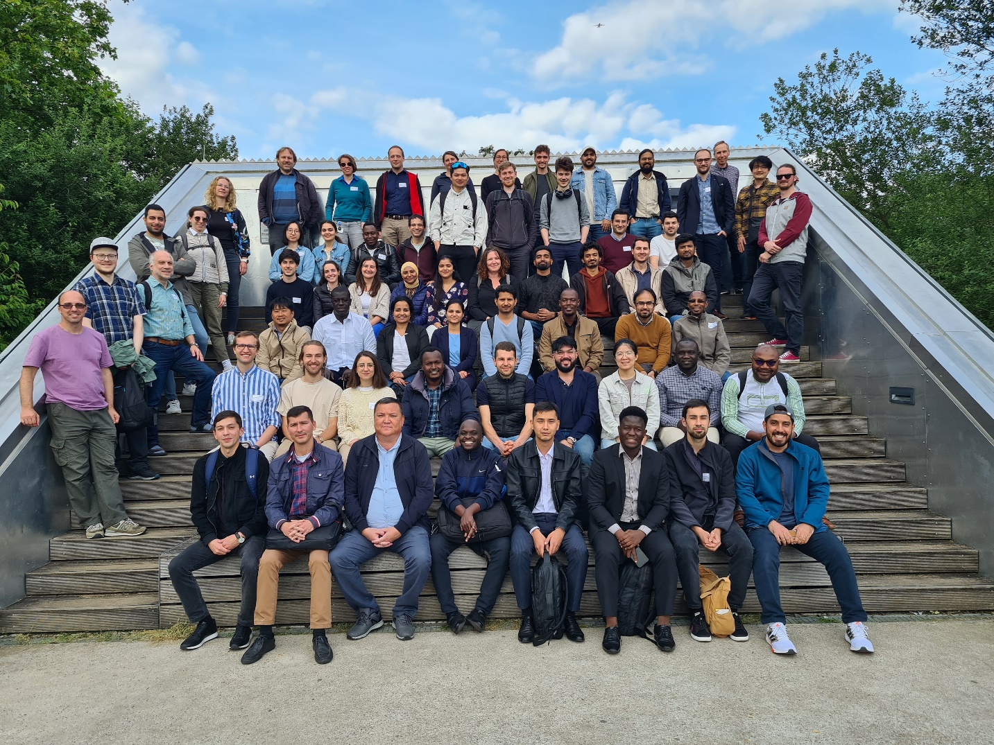
Basic Informations
Took place from 10.-14. June at DWD Headquarters (conference area) in 3 different groups.
85 registered participants, 5 excused before the Training started. But only 60 participants present!
MetServices: 19 participants (+ 2 from DWD accepted at short notice): but 31 registrations!
Theoretical lessons (morning) and practical exercises (afternoon).
Practical exercises for MetServices again on ECMWF‘s HPC in Bologna.

Slide 25
Time Table for MetServices
Slighly modified timetable:
Added presentation on verification.
Added presentation and exercise for scheduler ecFlow. But time was too short.
Challenges:
How to fit all material in one week?
More participants have no (good) knowledge in Linux and shell scripts.

Slide 26
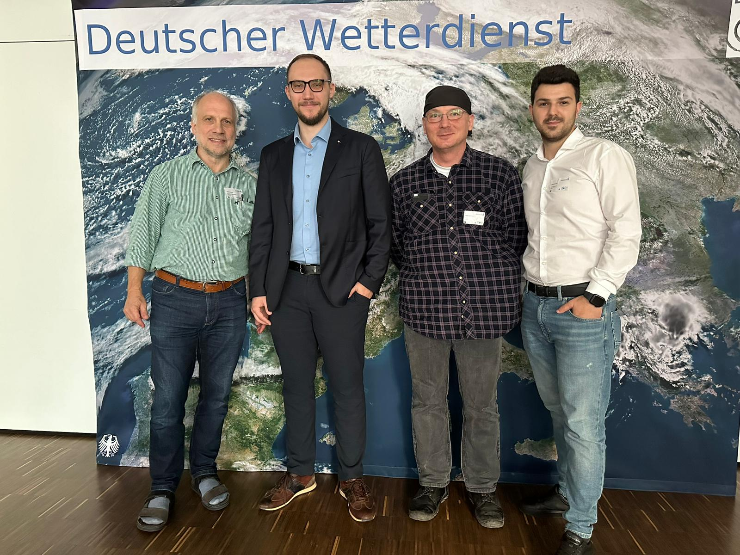
The Tutor Team
Preparation of the exercises again was a joint COSMO development!
4 Videoconferences between January and May.
Colleagues involved:
DWD: Daniel Rieger, Uli Schättler (General Info, Installation)
IMGW: Witold Interewicz (Preprocessing, Grid Generator Web Interface)
NMA: Stefan Dinicila, Stefan Gabrian (ICON-LAM; Visualization, Verification)
DWD: Sascha Brand (ecFlow)

Slide 27
NWP Model Training: Summary
Joint COSMO development of the exercises: GREAT SUCCESS!
Material available for everybody, who wants to do a Training.
Scheduler and Verification included now:
At least in a „basic state“. Have to be elaborated.
Perhaps need some more time for the Training?
Sascha is working on an ecFlow based operational setup.
Next Step: Encourage partners to install and test ICON.
I think we have to push them!
We have to see, how much support is necessary.

Slide 28
ICON on ATOS (ECMWF)
No news this year!

Slide 29
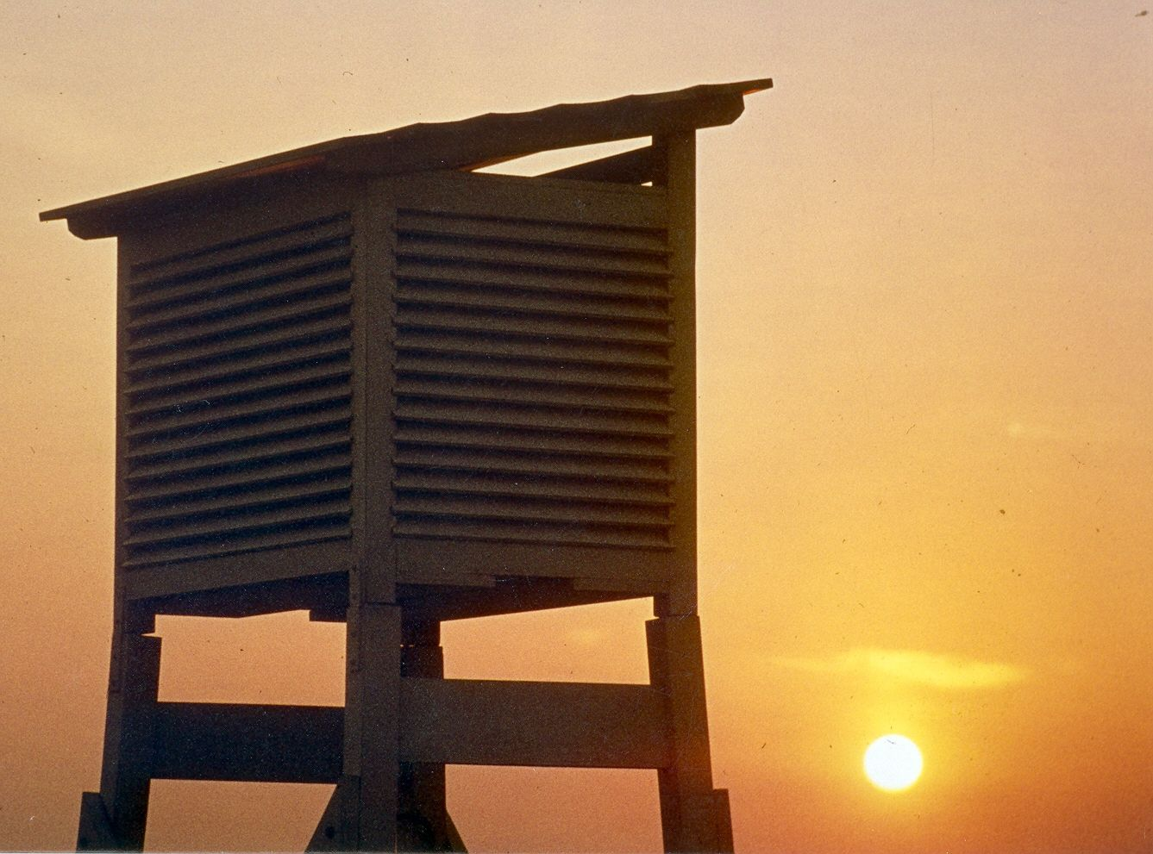
It is difficult
to predict
especially
the future.
And we have
only just begun…

