Slide 1
AI Approaches at DWD
Marek Jacob, Florian Prill & the DWD AICON team
Deutscher Wetterdienst | COSMO GM | 02 Sep 2024

Slide 2
Introduction

Slide 3
Fundamental perspective ^{[1]}
~ 2023: NWP based on machine learning (ML) has reached semi-operational status,
see, eg., ECMWF’s global ML model AIFS.
ML outperforms traditional systems for some skill scores
Clear distinction between what needs to run in near real-time, how ML training data is generated and how the classical NWP systems are managed:
computing cost of the actual operational forecasts reduced significantly,
runs on a few GPUs in seconds-minutes
compute power required for ML training dataset generation and ML training
classical NWP models provide the physical-process based insight
Push from private companies discovering the profits to be made in weather and climate services, including NVIDIA, Google Deep Mind, Huawei and Microsoft.
[1] reading recommendation: What if? Numerical weather prediction at the crossroads. P. Bauer, July 2024, https://arxiv.org/pdf/2407.03787

Slide 4
ML Glossary
Neural network: algorithms designed to recognize patterns, modeled loosely after the human brain
Deep Learning: machine learning methods based on neural networks
PyTorch: easy-to-use and efficient AI software environment
Foundation model: pre-trained models that require minimal fine-tuning
Inference: process of running data points into an ML model to calculate an output
Rollout: repeated application of model, taken into account in training
End-to-end NWP: from observations to forecasts
Obs-to-obs: predict future observations from observations
Zarr file format: lightweight data format for efficient storage and retrieval of large N-dim. arrays

Slide 5
DWD Projects

Slide 6
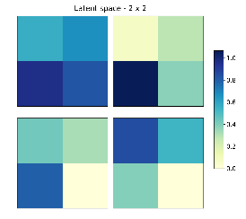
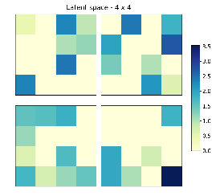
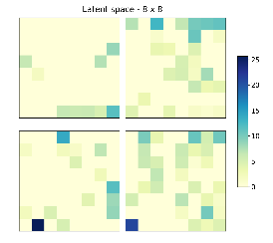
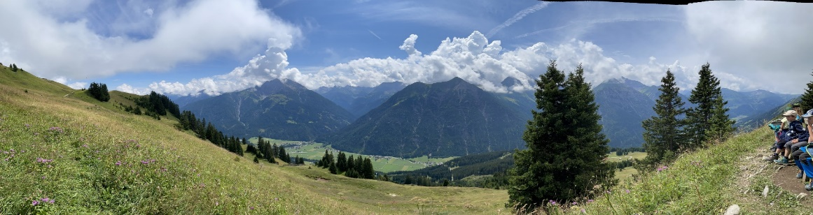
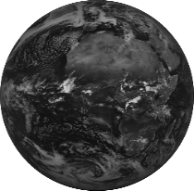
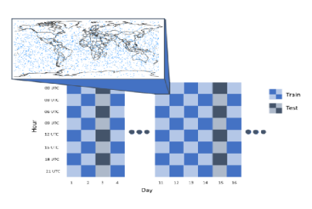
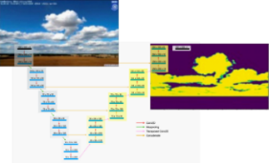
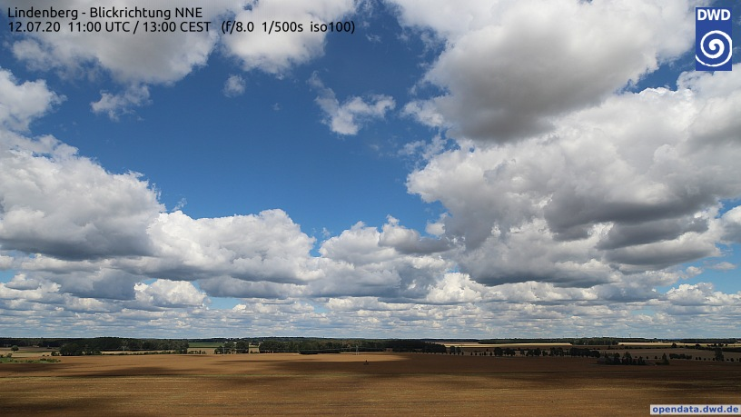
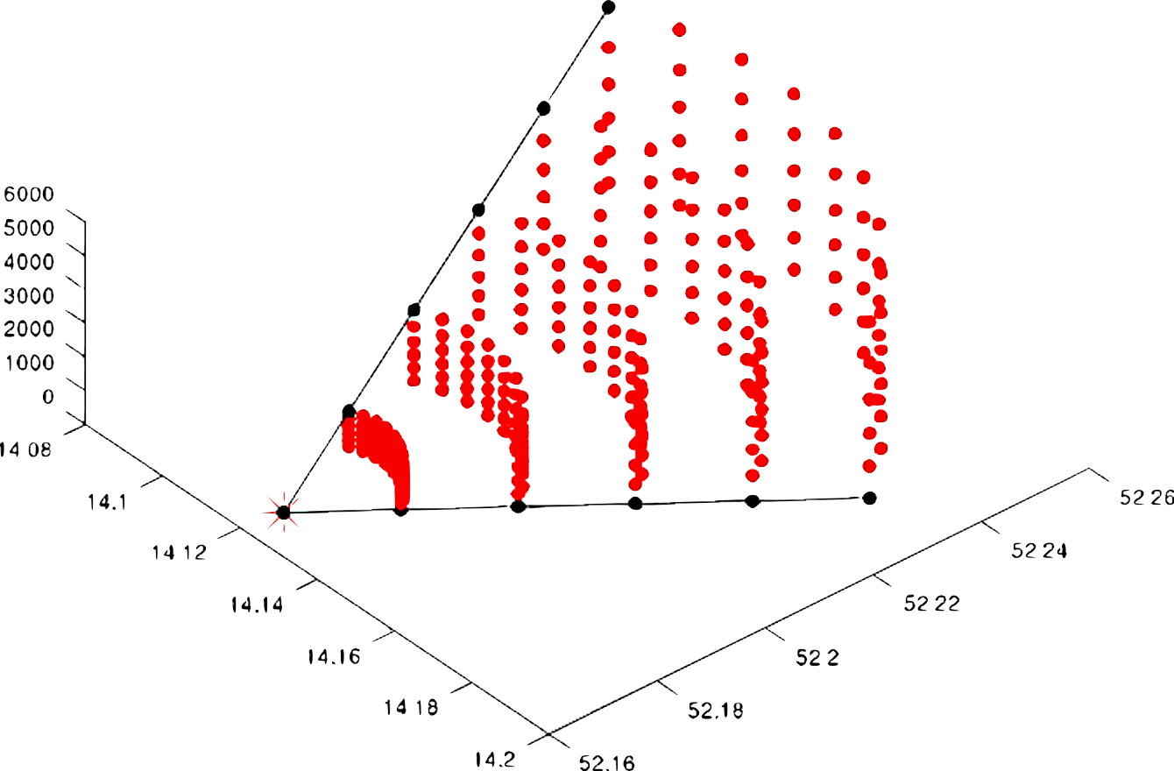
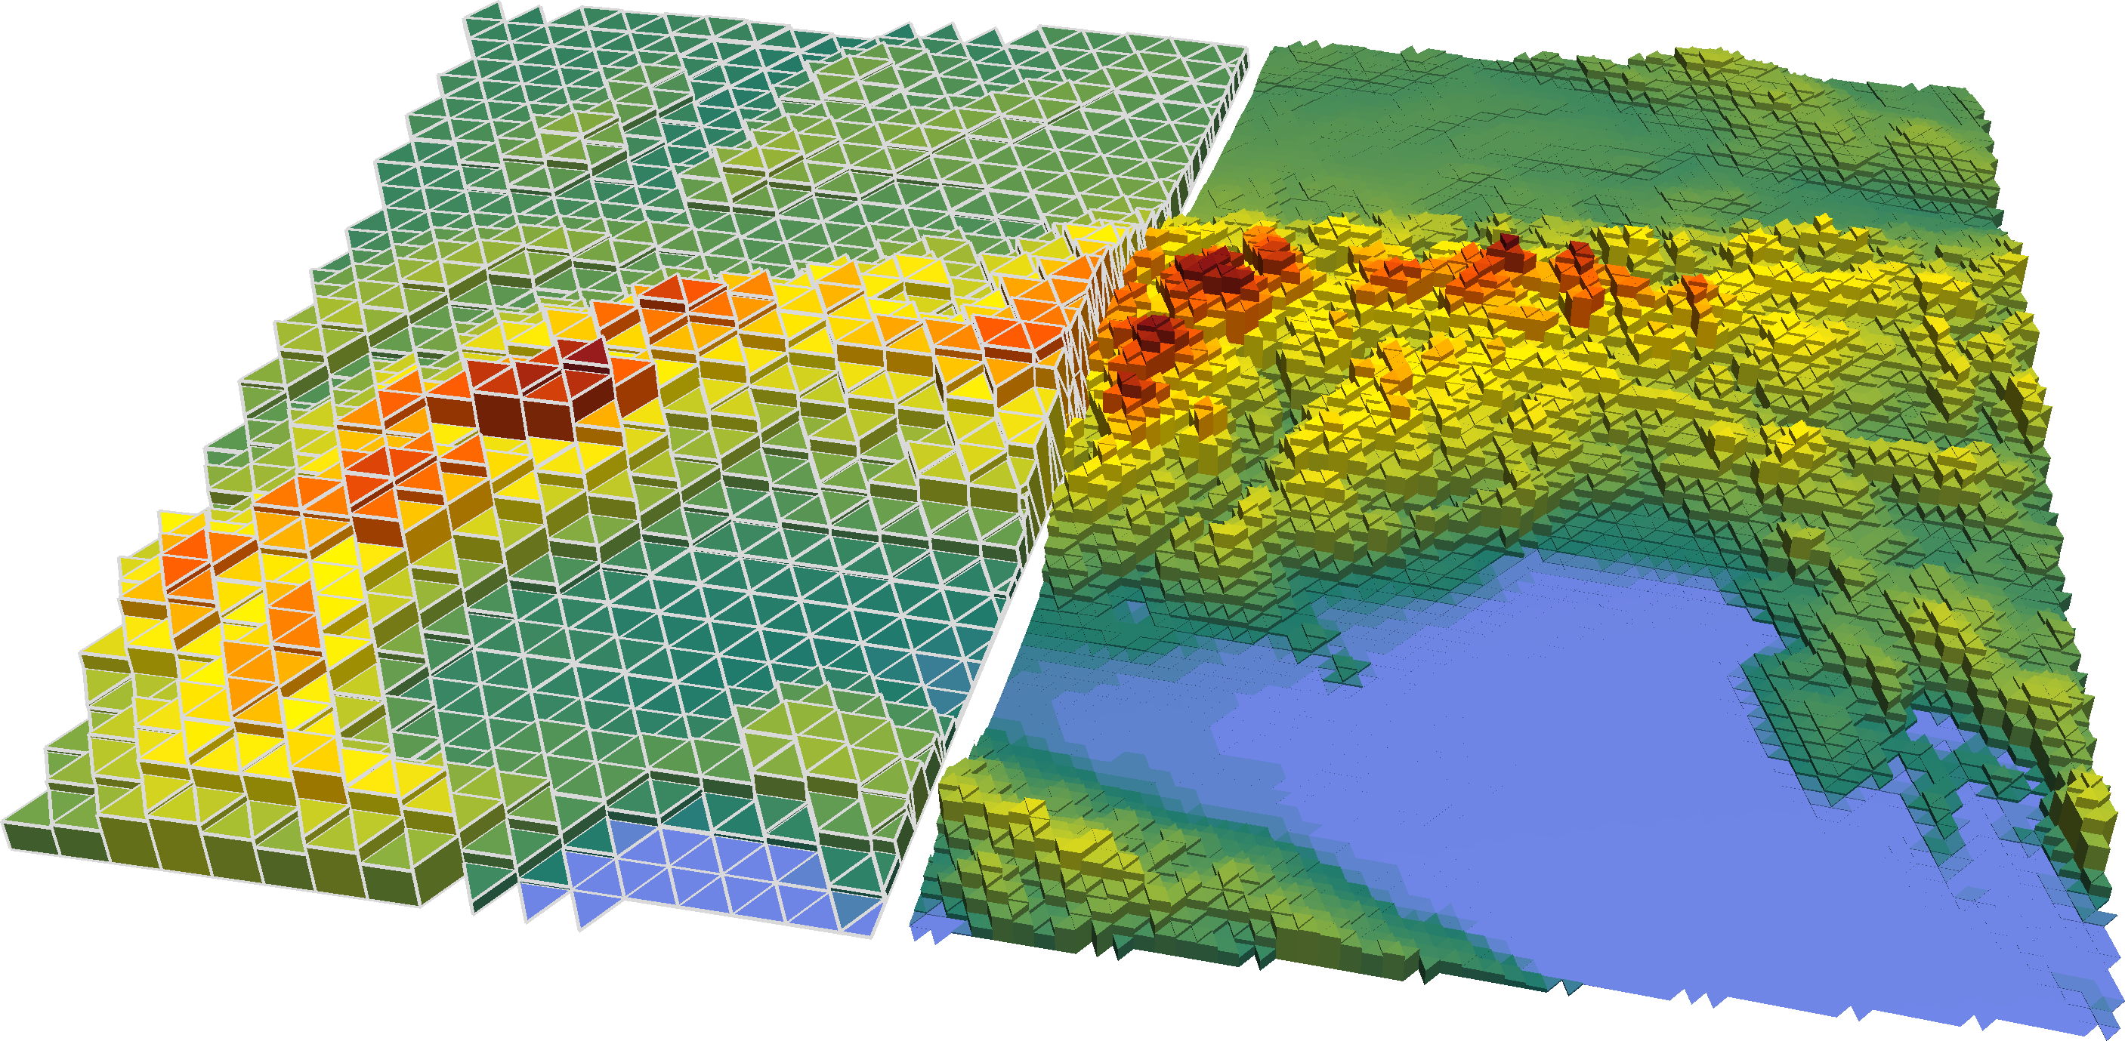
AI all along the value chain
OBSERVATIONS | NN to detect Volcanic Ash in satellite data | RTTOV MFASIS: NN for faster radiative transfer calculations
AI to automate weather stations | NOWCASTING | iCamCloudOps: NN for Cluod Cams | AI Dataassimilation with model emulators
AI/ML for Quality Control | Deep Learning for Nowcasting of Thunder Storms | MODELING OF OBSERVATIONS | AI for Bias Correction |  | AI for Conditioned Parametrisations
AI for Satellite Retrieval | AI Training Data for volcanic ash and ice clouds | AI to correct inhomogeneities of radiance in models | DATEA ASSIMILATION | AICON for data driven forcasting | "Research2Operations" AI for Lightning probability | CONFILIENCE AI for weather and financial economics
AI for Data Merging | Neural Networks to detect ice clouds in satellite image | AI estimates Observations Bias | AI-Singular-Vectors in Data Assimilation | NUMERICAL MODELING | Blending & Calibration of SINFONY data to NWC and NWV | Met4Airports
 | AI Combination of Nowcasting and NWP-Ensembles |  | AI technology for Oobject Detection in the Verification | AI for Physics Parametrisations | POST-PROCESSING | ITMS: AI to estimate biogenic CO2-Emissions
 |  |  |  | AI-Model-Data-Assimilation-Coupling f. Parametrisations | Data Readiness for AI applications | IMACT MODELS | AI Texts
 |  |  |  |  | DEEP RAIN for precipitation estimation | AI Grids | CONSULTING | genAI for administrative Processes
 |  |  |  |  |  | AI Time Series | genAI for Consulting | SUPPORTING APPLICATIONS
 |  |  |  |  |  |  |  | AI Impact
AI Applications
are being developed and used in all areas of DWD.
(R. Potthast DWD)

Slide 7
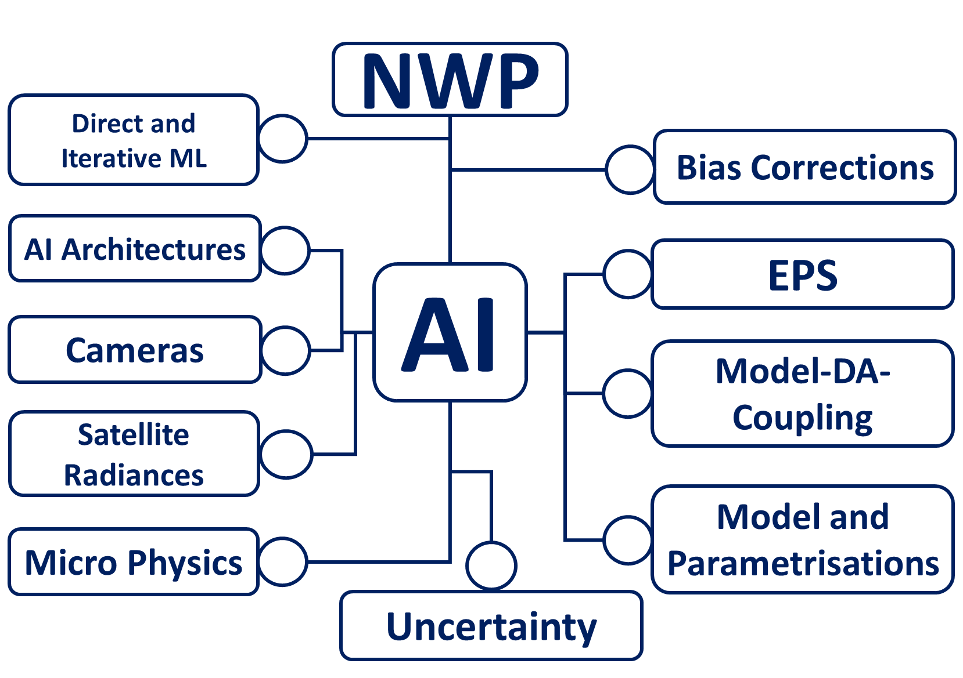
General DWD strategy for AI in NWP
Develop an NWP model emulator for global and regional forecasts
  Faster and more efficient forecast
  Larger ensembles
  Completely new products
  AI/ML competence building
Continue development of classical NWP model for
  Verification
  Reliability
  Understanding of physics of the atmosphere
  User tailored and established products
Develop machine learned data assimilation for global and regional, e.g. AI-Var
(R. Potthast DWD)

Slide 8
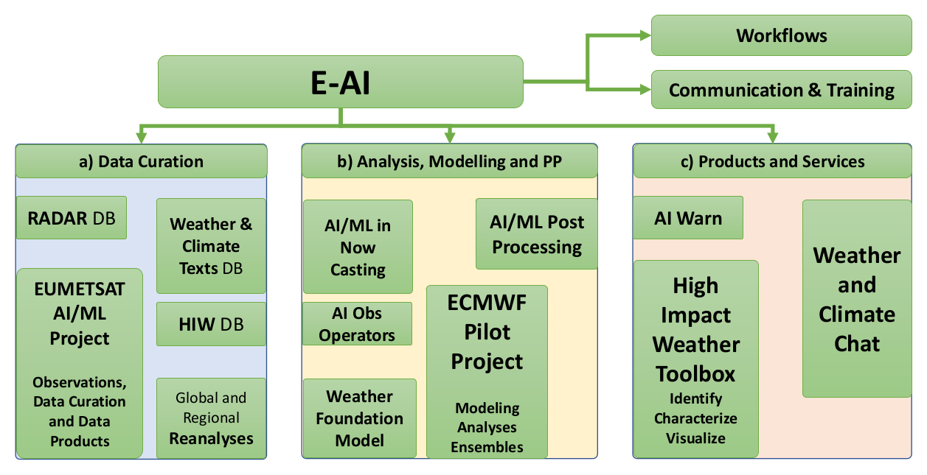
EUMETNET Programme: E-AI
Artificial Intelligence and Machine Learning in Weather, Climate and Environmental Applications
Programme Coordinator:
  Roland Potthast
Started 2024
Open Participation
  UK MetOffice
  MeteoSwiss
  Dutch KNMI
  MetNorway
  DWD
  MeteoFrance
  EUMETSAT
  ...
250 interested individuals

Slide 9
E-AI Workgroups Proposed
WG 1 Data Readiness and Curation (Preparation, Management, Standards, IPR, Labeling)
WG 2 LLM Implementation and LLM Services
WG 3 AI Operationalization, Maintenance and QC, MLOps
WG 4 AI Sensing and Noval Observations (e.g. Phenomena and Identificationm, Webcams and Co.)
WG 5 AI based Infomation Condensation and Communication, AI based HIW Warnings, Personalization
WG 6 Nowcasting, Obs2Forecast, and Data Fusion, Downscaling, PostProcessing (together with NWC Programme and PP Programme of EUMETNET,)
WG 7 User Optimized Products and Impacts (e.g.Cross Border Aviation Products - cross border module EUMETNET), Personalization…
WG 8 Ethics (e.g. Trustworthiness of ML-results)
WG 9 AI Frameworks (E-AI-Toolkit, AnemoI, etc.)

Slide 10
Graph Neural Networks

Slide 11
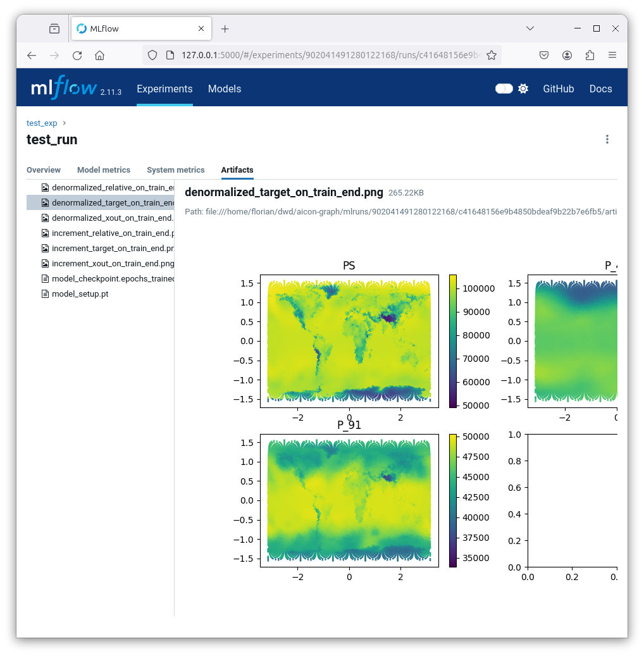

AICON-Graph prototype
ML model based on graph neural network
newly established team at DWD: ~5 people
exploration, hyperparameter tuning
basic idea of GNNs: see next slide
software engineering: PyTorch Lightning, MLflow, Gitlab CI/CD
started work on LAM mode integrated in the global model
This activity was discontinued in June 2024 and transferred to the development of the Anemoi framework.
Mlflow screenshot

Slide 12
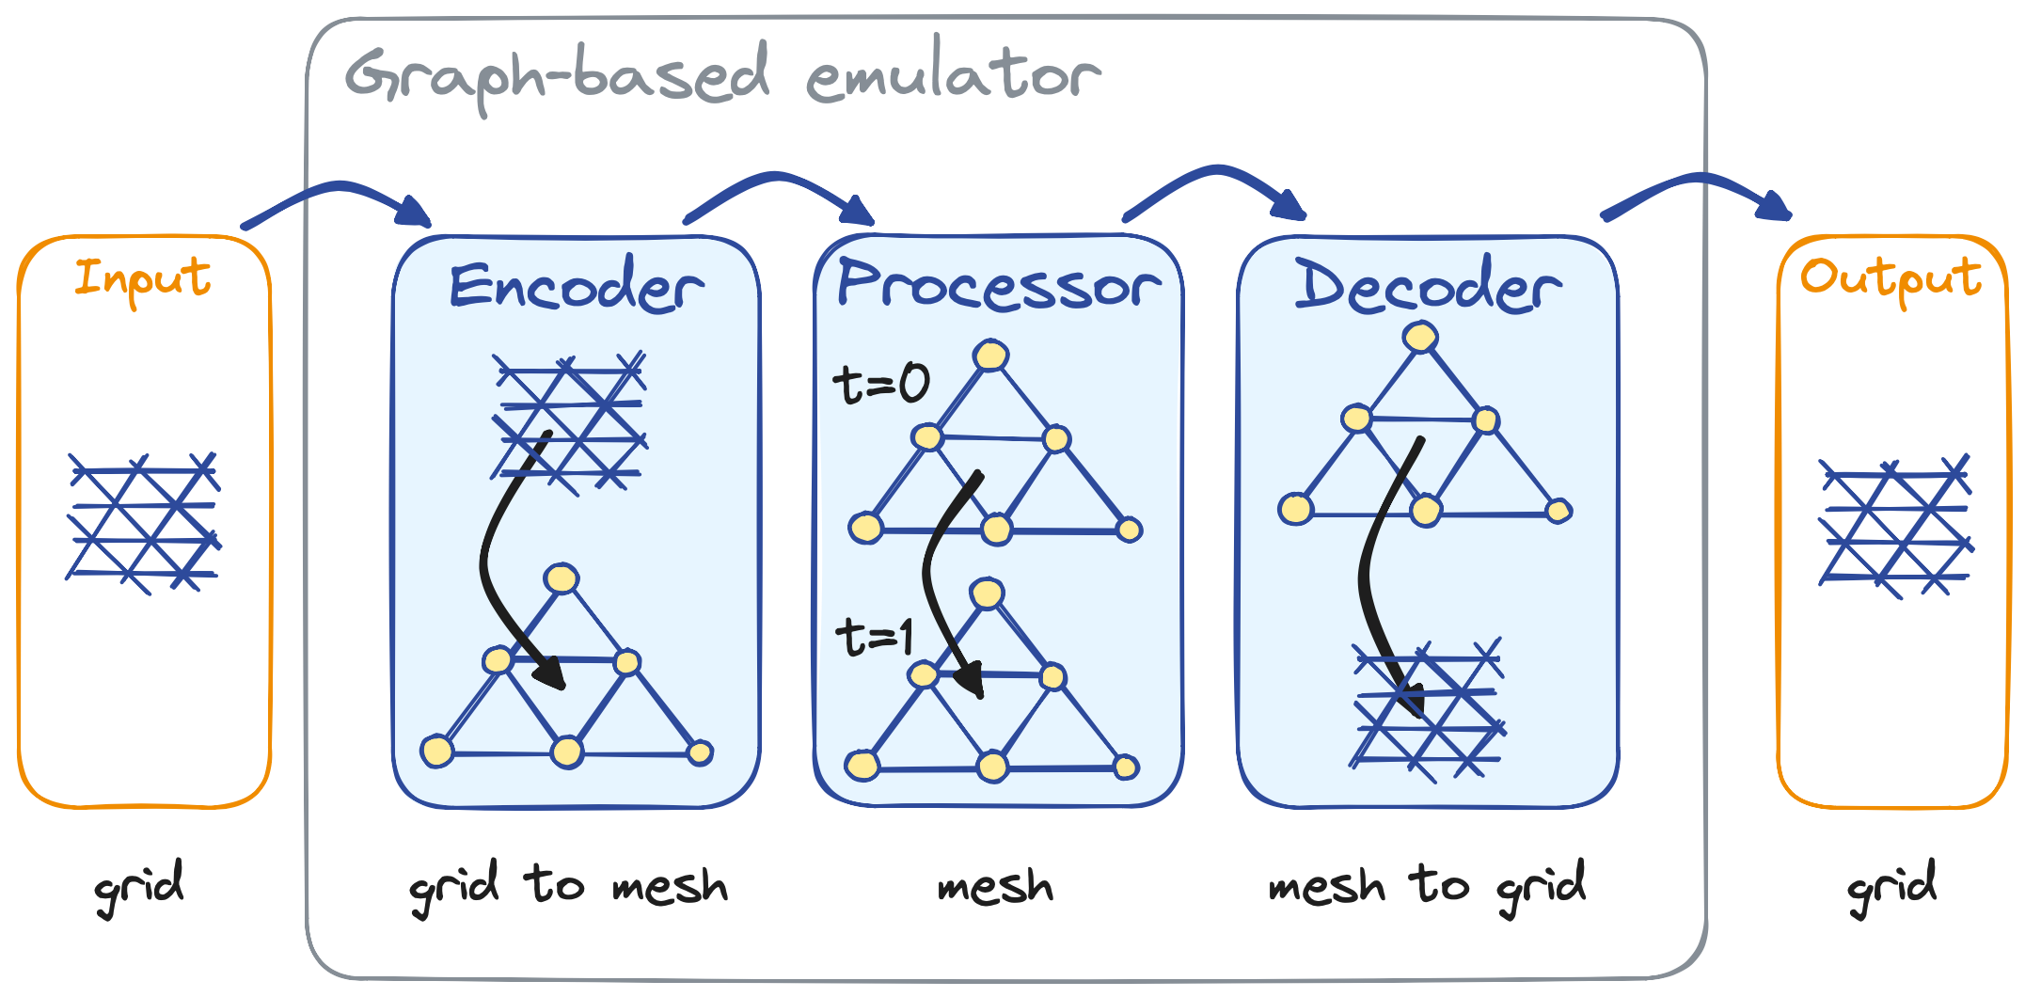
Basic idea of "GraphCast-like" GNNs
Development following the implementations of Google (GraphCast) and ECMWF (AIFS).
In traditional convolutional neural networks,
the input data is arranged in a grid-like structure,
such as an image
Graph Neural Networks (GNNs) can operate
on graph-structured (unstructured) data
Multi-mesh: GNNs process the entire graph
at once, preserving local and global relationships
Message passing mechanism allows each node
in the graph to receive messages from its neighbors,
which are then combined (or "passed") to compute
the output representation for that node.
AICON-Graph structure (J. Keller, DWD)

Slide 13
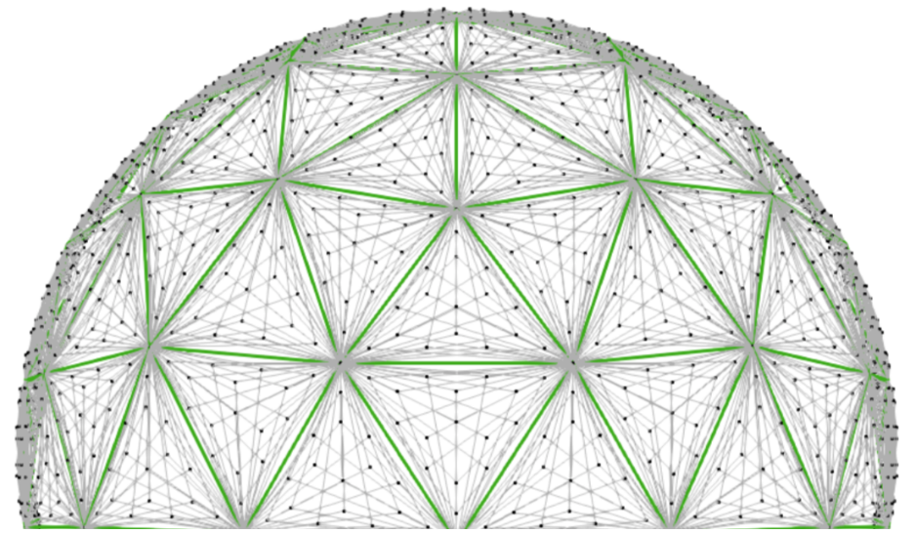
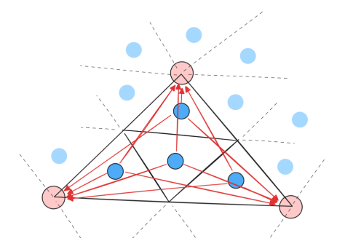
AICON Graph – Prototype
Trained on ICON-DREAM (icosahedral grid)
Processor graph („multi-mesh“) is based on the
same ICON topology (R03B07 and coarsenings)
Example illustration:
Cell data locations for an R03B04 dataset
are „mapped“ onto multi-mesh vertices
of an R03B00 grid (F. Prill)

Slide 14
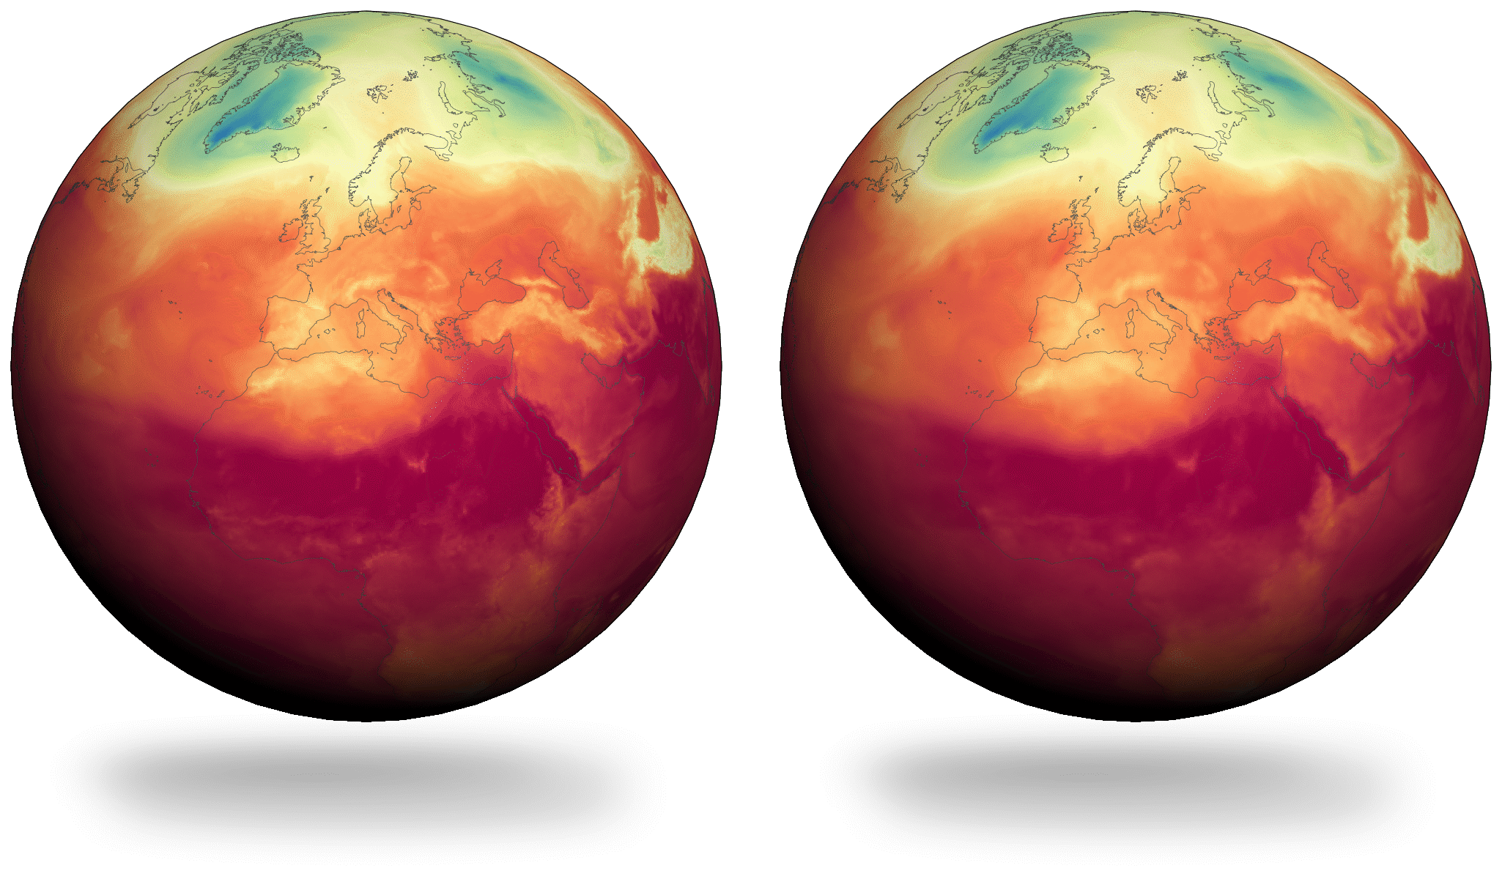
AICON Graph – Inference example
Inference on R03B05 grid (~50km)
3-hour forecasts up to 24 hours
Surface pressure
T, QV, U, V on 13 model levels
Reanalysis and AICON-Graph Inference
Temperature on model level 101 (~700 hPa)

Slide 15
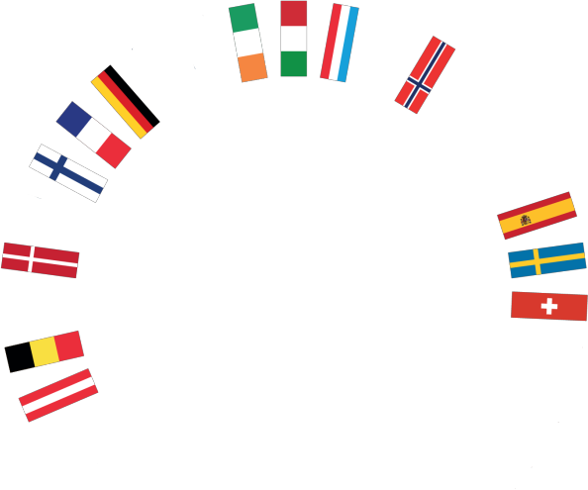

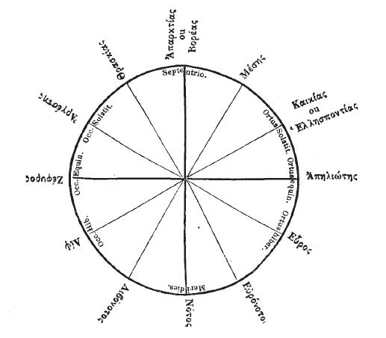
Anemoi - a framework for data-driven weather forecasting
Anemoi were the gods of winds in ancient Greece.

Slide 16
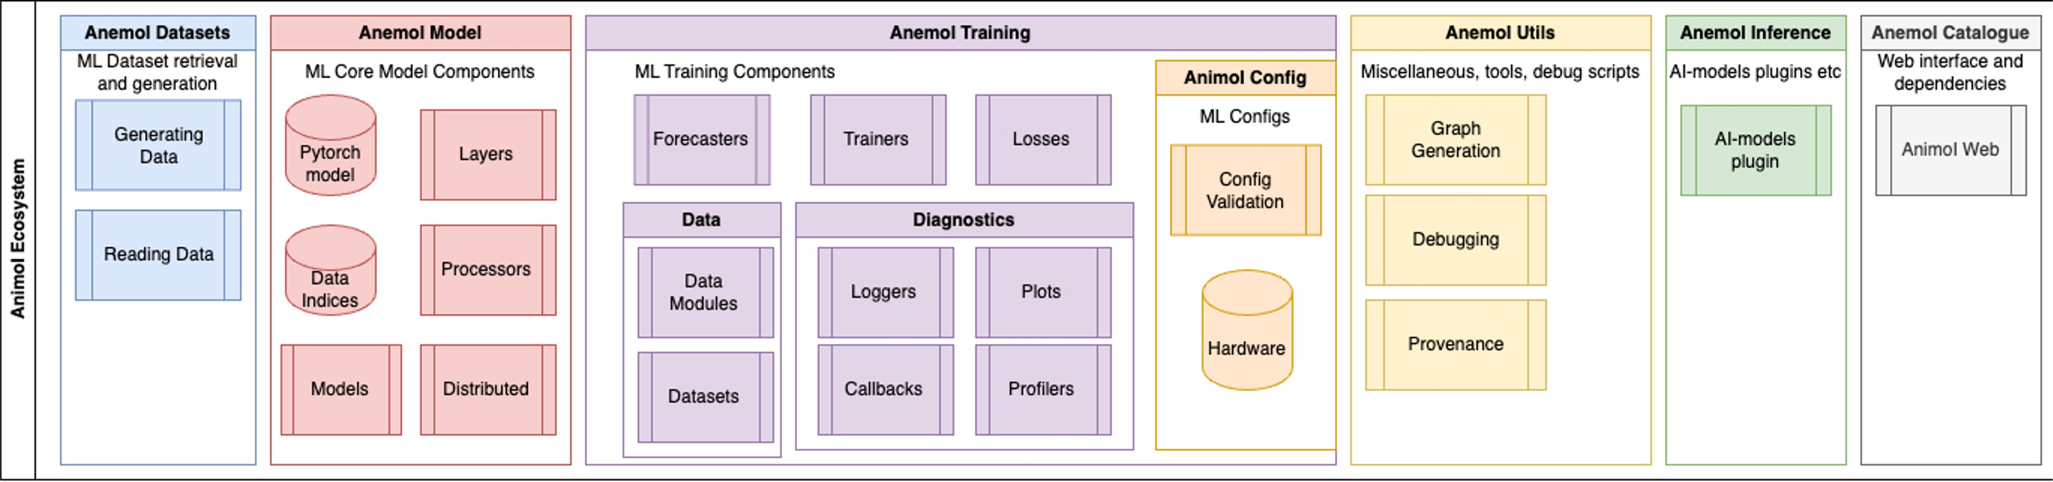
Anemoi building blocks
Anemoi components (ECMWF)
Initially developed by ECMWF, now collaboration with ECMWF and European Met Services
Structured in 7 Python modules
Designed as a modular system, whereby different network architectures are "configured"
Code available at https://github.com/ecmwf

Slide 17
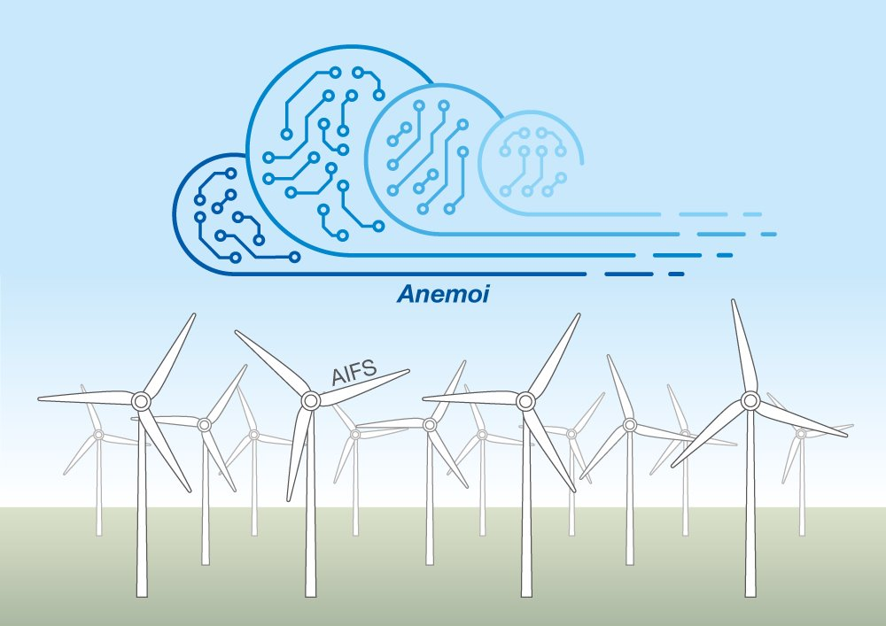
Anemoi configurations
ECMWF Artificial Intelligence
Forecasting System (AIFS)
  Initial motivation for Anemoi code base
  Trained on global ERA5
  Predicts:
  single level: z, cp, msl, 10u, 10v, 2t, 2d
  at 13 p-levels: z, t, u, v, w, q
  Lower RMSE of z_500 than IFS
AICON
  DWD's data-driven weather forecast
  Trained on ICON data and grid
  Targets global and regional
Anemoi is the driving force for models such as AIFS (ECMWF)

Slide 18
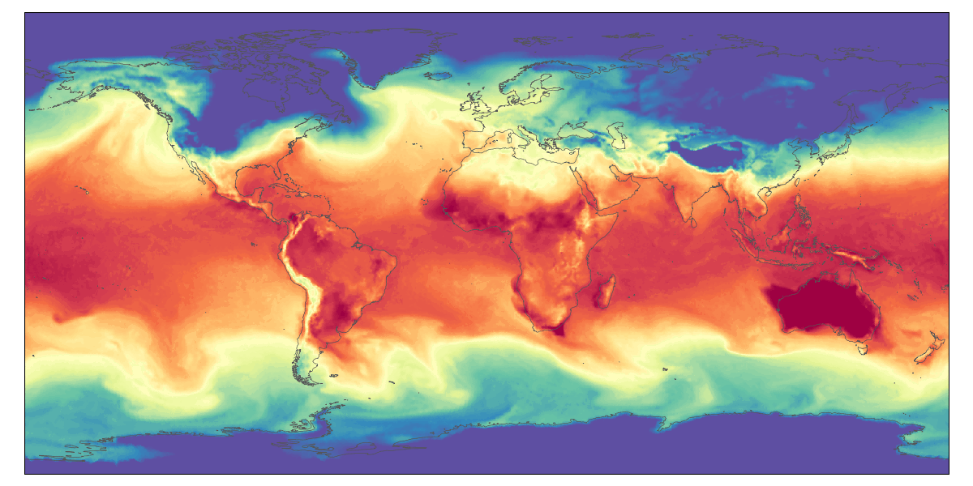
AICON – inference example
DWD's data-driven weather forecast
  Data resolution: R03B05 (~50km)
  Training 2018 to 2020 (ICON-DREAM)
  6 hour forecasts for 10 days ahead
  Rollout under investigation
Training on different data than ERA 5
  Trained on unstructured grid
  Trained on 13 vertical layers
  ICON DREAM Reanalysis
Work in progress: T on model level 112 (~850hPa)
(T. Göcke, J. Keller)

Slide 19
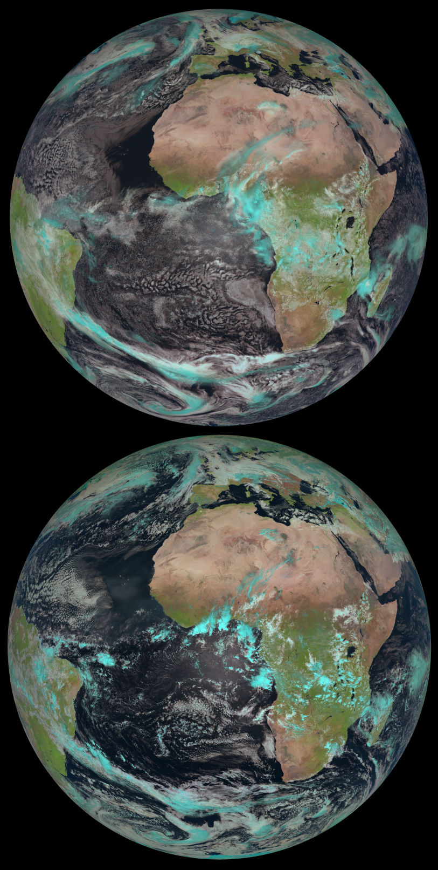
ICON-DREAM Reanalysis
Dual resolution Reanalysis for Emulators, Applications and Monitoring
Based on the operational ICON model, 3D-Var and LETKF
Conventional observations (including wind profilers),
AMVs (atmospheric motion vectors), GNNS-radio occultation,
scatterometer wind (including altimeters)
Available 2010 – 2023, probably extended to current
Global resolution: 13 km det, 40 km EPS (20 members)
  Plus Nest over EU (6.5 / 20 km)
  3hr-ly analysis, 1hr-ly reforecasts at 120 levels,
  111 variables per time step, 445 TB per year (GRIB2 compressed)
Is being evaluated internally
Will be shared among COSMO partners
ICON-DREAM and the Earth from Space
(Courtesy of L. Scheck and EUMETSAT)

Slide 20
Outlook

Slide 21

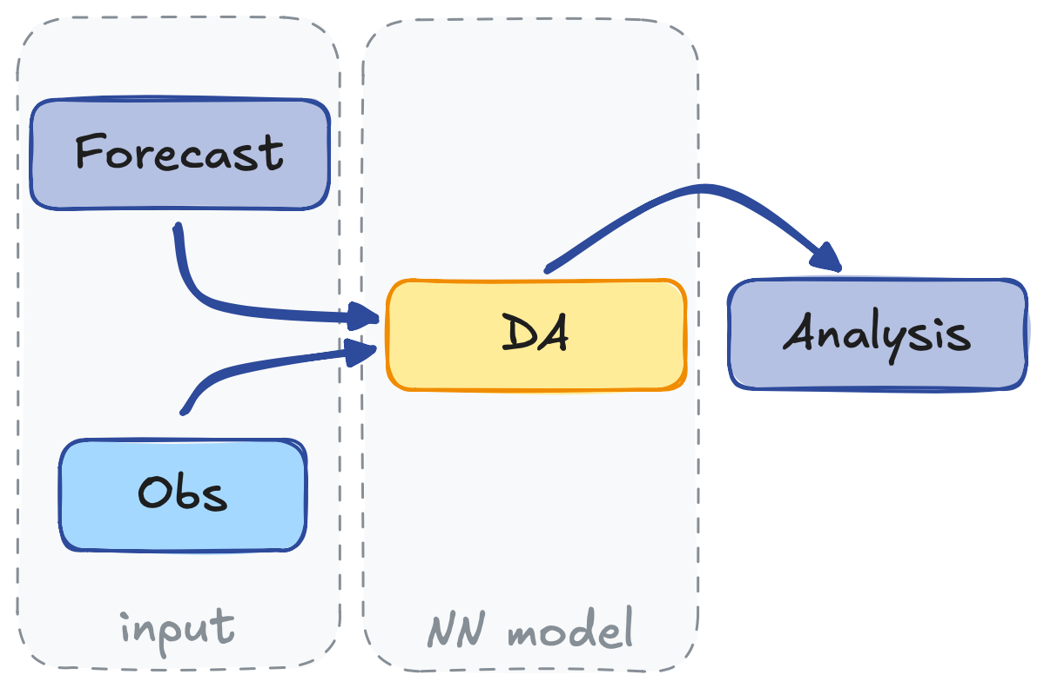
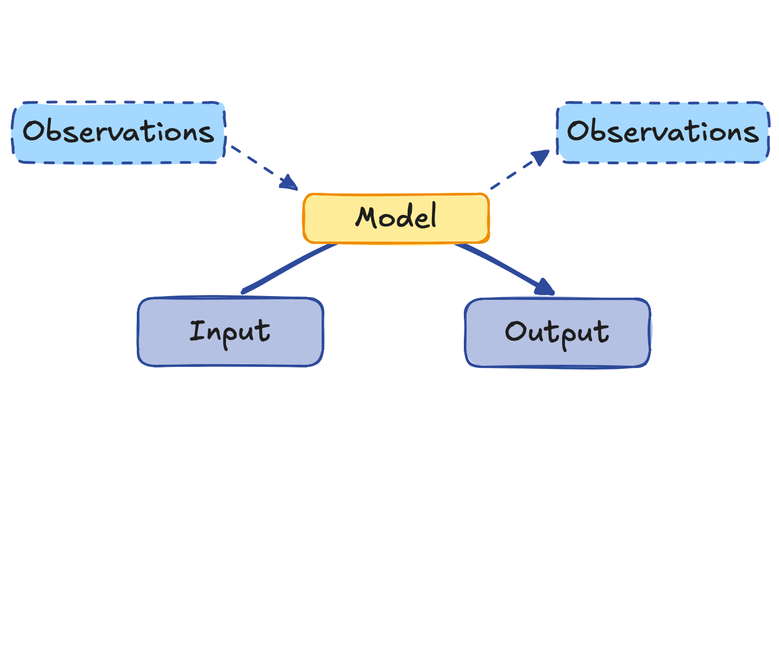
AI-based DA – Learning the DA step
Presented in Data Assimilation WG
DA functional is the loss function
We developed an AI-based data assimilation scheme
  Results in Keller and Potthast
  (2024, https://arxiv.org/abs/2406.00390)
AIDA structure (J. Keller, DWD)

Slide 22


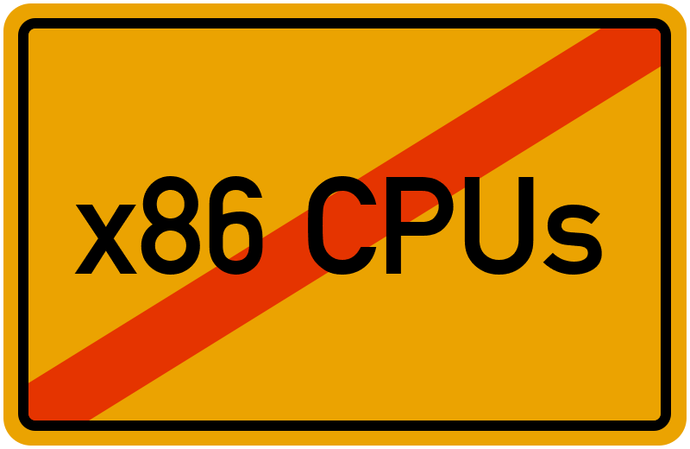

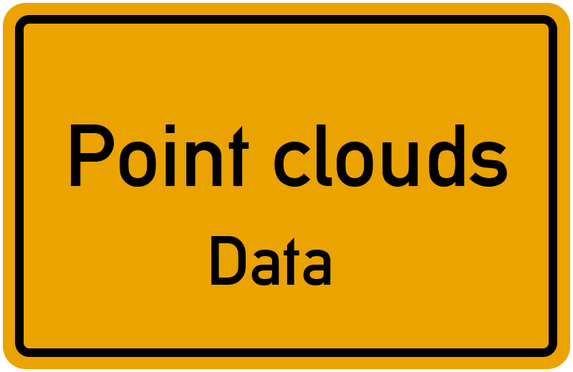

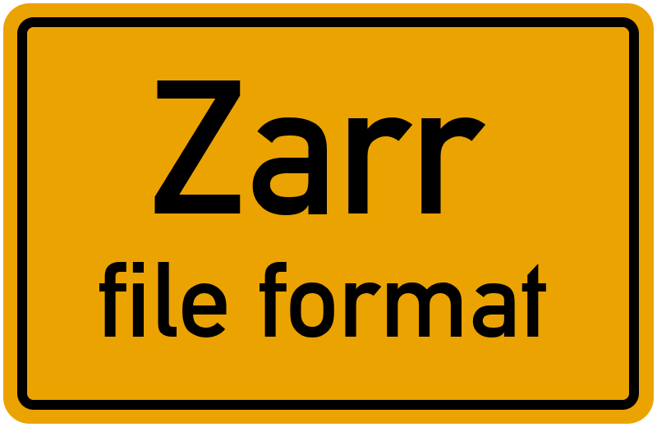

Paradigm shift in software design
ML represents a paradigm shift in modelling and software engineering.
data-driven: weights checkpoints represent the model
asymmetry between training und inference (forecast)
no explicit modelling of vertical levels or orography

Slide 23
Wrap-Up
DWD conducts R&D on machine learning in various areas
Machine learning impacts all parts of the NWP process chain
ML software development differs from classical models
The research area is rapidly evolving
AICON: DWD’s data driven weather forecast
  Using AnemoI Framework
  Trained on ICON data and grid
  Targets global to regional scales
AnemoI framework: Collaboration with ECMWF and European Met Services is expected to unlock synergies and advances in the field

Slide 24
AICON project team: Tobias Göcke, Marek Jacob, Florian Prill, Hendrik Reich, Maria Reinhard, Arianna Valmassoi, Sabrina Wahl, Jan D. Keller, Roland Potthast
Marek Jacob, Florian Prill
Met. Analyse und Modellierung
Deutscher Wetterdienst

Slide 25

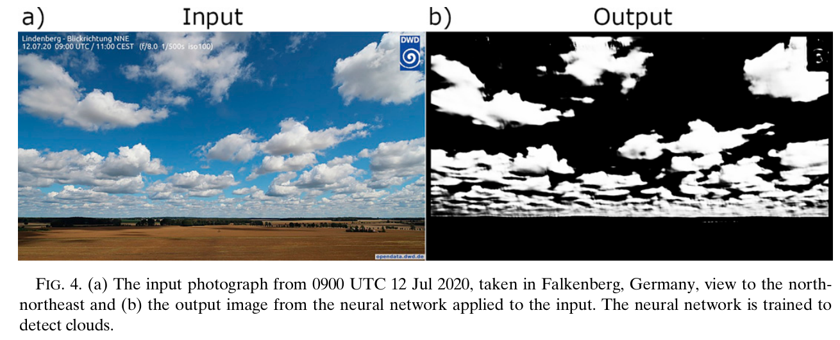
Other ML Activities
In recent years, DWD has been active with ML for NWP on many levels:
data assimilation, model and parameterizations, post-processing.
Examples:
neural network for cloud identification and classification
ML for microphysics parametrizations
satellite reflectance emulation, cloud cover emulation
…
(M. Reinhardt et al., DWD)
Reinhardt, M., S. Y. Schoger, F. Kurzrock, and R. Potthast, 2023: Convective-Scale Assimilation of Cloud Cover from Photographs Using a Machine Learning Forward Operator. Artif. Intell. Earth Syst., 2, e220025, https://doi.org/10.1175/AIES-D-22-0025.1.
Baur, F., Scheck, L., Stumpf, C., Köpken-Watts, C., and Potthast, R.: A neural network-based method for generating synthetic 1.6 μm near-infrared satellite images, EGUsphere [preprint], https://doi.org/10.5194/egusphere-2023-353, 2023.
Seifert, A., & Rasp, S. (2020). Potential and limitations of machine learning for modeling warm-rain cloud microphysical processes. Journal of Advances in Modeling Earth Systems, 12, e2020MS002301. https://doi.org/10.1029/2020MS002301.

Slide 26
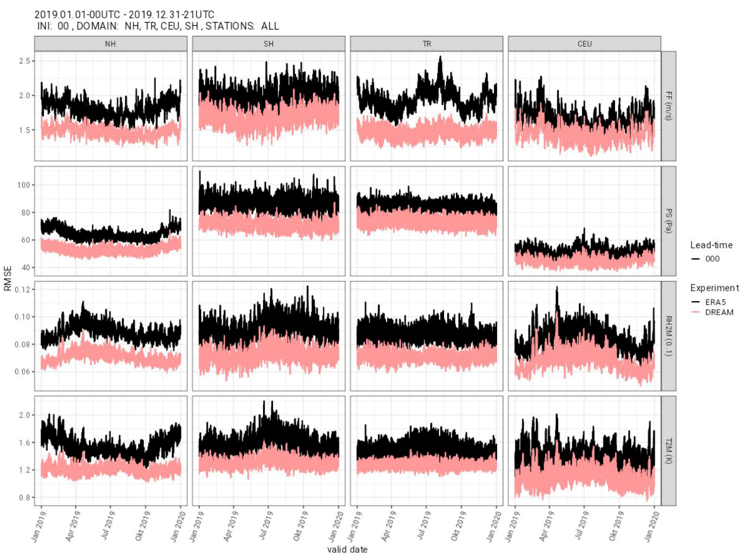
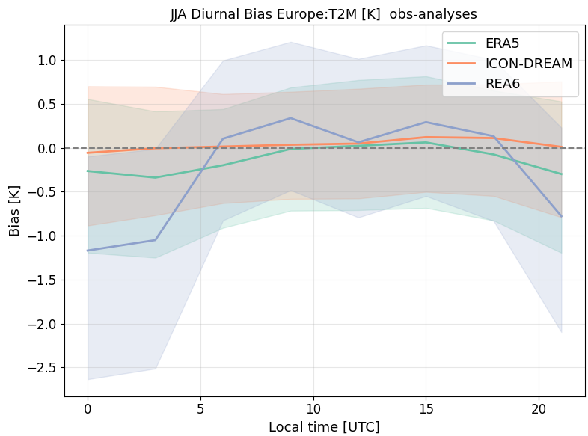
ICON-DREAM Preliminary evaluation
(A. Valmassoi)
(F. Fundel)

