Slide 1
Update ICON on GPU and status of the gt4py dycore
C. Müller¹, D. Hupp¹, X. Lapillonne¹, V. Cherkas¹, R. Dietlicher¹, F. Gessler¹,, M. Röthlin¹, N. Burgdorfer¹, M. Stellio¹, G. Vollenweider¹, C. Osuna¹, A. Walser¹, A. Gopal³, M. Jacob⁴, A. Jocksch³, J. Jucker², R. Meli³, W. Sawyer³, U. Schättler⁴, D. Alexeev⁵, A. Leuthard¹,
S. Kellerhals³, N. Farabullini³, M. Luz³, C. Ong³, D. Strasmann³ , P. Kumar³
¹MeteoSwiss, ²C2SM, ³CSCS, ⁴DWD, ⁵Nvidia
07.03.2024, ICCARUS 2024 – Model Development

Slide 2
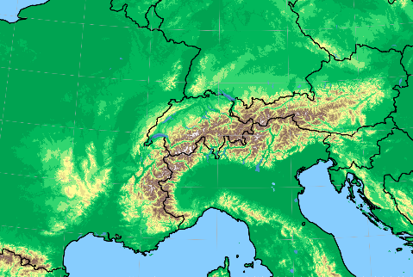
GLORI-A Configuration
ICON-CH1-EPS
Resolution: 500m
Initial Conditions:
KENDA-i1
Lateral Boundary Conditions :
IFS 9km / ICON 3.5 km
Online Nest:
Interpolation and relaxation during forward integration
ICON-Alp-05

Slide 3
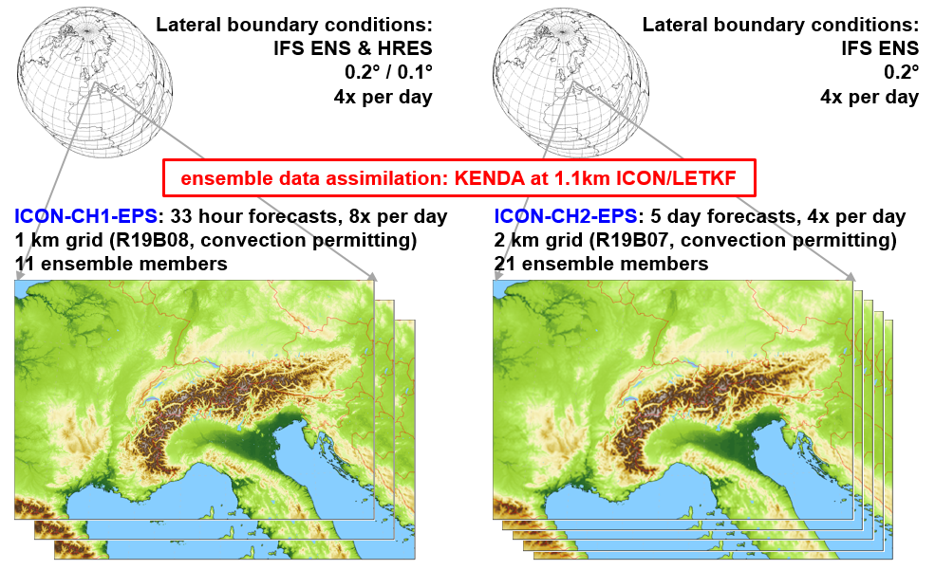
MeteoSwiss operational configuration
Operational since May 28th 2024 at CSCS
Not using all optimization yet (no cuda-graph)
Full schedule on Tasna (ALPS)
ICON-CH1-EPS : 3 nodes/member
ICON-CH2-EPS : 1 node/member
KENDA-CH1 : 1 node/member

Slide 4
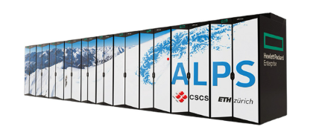
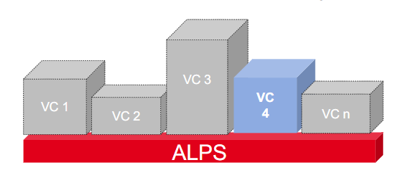
Alps infrastructure at CSCS
New MeteoSwiss system HPC Computing Services on Alps Platform
2 Virtual Clusters (VC):
Production: 42 GPU / 15 CPU Nodes
R&D: 30-50 GPU / ~15 CPU Nodes (elastic)
GPU nodes:
4 x NVIDIA A100
1 x AMD Epyc 64-cores CPU
CPU nodes:
2 x AMD Epyc 64-cores CPUs
Part of the large system (alps):
R&D partition can be extended
new challenges : maintenance, testing, ML, …

Slide 5
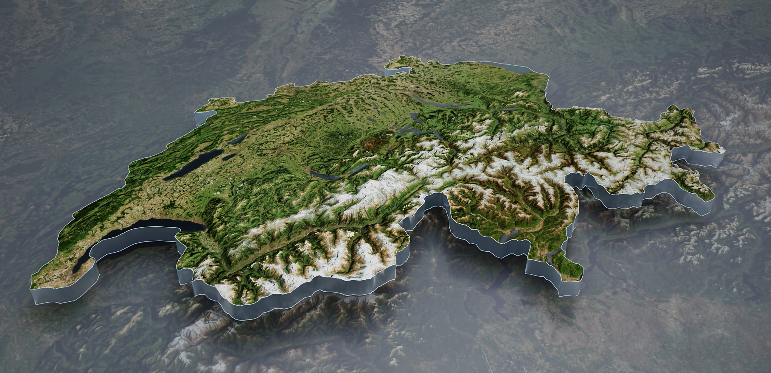
Multi-site system
The ALPS system at CSCS has been deployed on two physical sites since Q1 2024
Operation at MeteoSwiss:
High-availability zone in the two sites
Main operation : Lausanne
Failover system : Lugano
Currently not fully geo-redundant (e.g. authentification in Lugano), but could be in the future
MeteoSchweiz
ALPS Lugano
ALPS
Lausanne
Failover
Production

Slide 6
OpenACC porting strategy
timeloop
Init. of physics
Parametrizations
Dynamics
Infrastructure
GPU
Initialization
Data assimilation
CPU
Regular testing on the Buildbot infrastructure
Having implementation and style guide
Support for double and mixed precision
Notes:
Data assimilation is OK on CPU, because only done 3 times per hour, each time costs about 1 timestep
Data which is assimilated is sparse

Slide 7
Status of the OpenACC port to GPU
 | ported | merged
nh_solve
nh_hdiff
transport
2 way nesting
convection
microphysics (graupel)
radiation
radheat
surface (terra)
cover
turbulence
sea-ice
SSO
non-or. wave drag
2 mom. microphysics
 | ported | merged
NWP diagnostic
hailcast
DA: LHN
DA: conv. operation
DA: IAU (incr. analisys update)
SPPT
ICON-ART
pollen
EMVORADO
ICON-HAM
snow (nix)
RTTOV (synthetic sat. imag.)
 | completed
 | in progress
 | on CPU + data copy and interface ported
 | not started
For more details checkout on Thursday 7th March 10:00 “Status and Performance of ICON on GPU for NWP” by M. Jacob

Slide 8
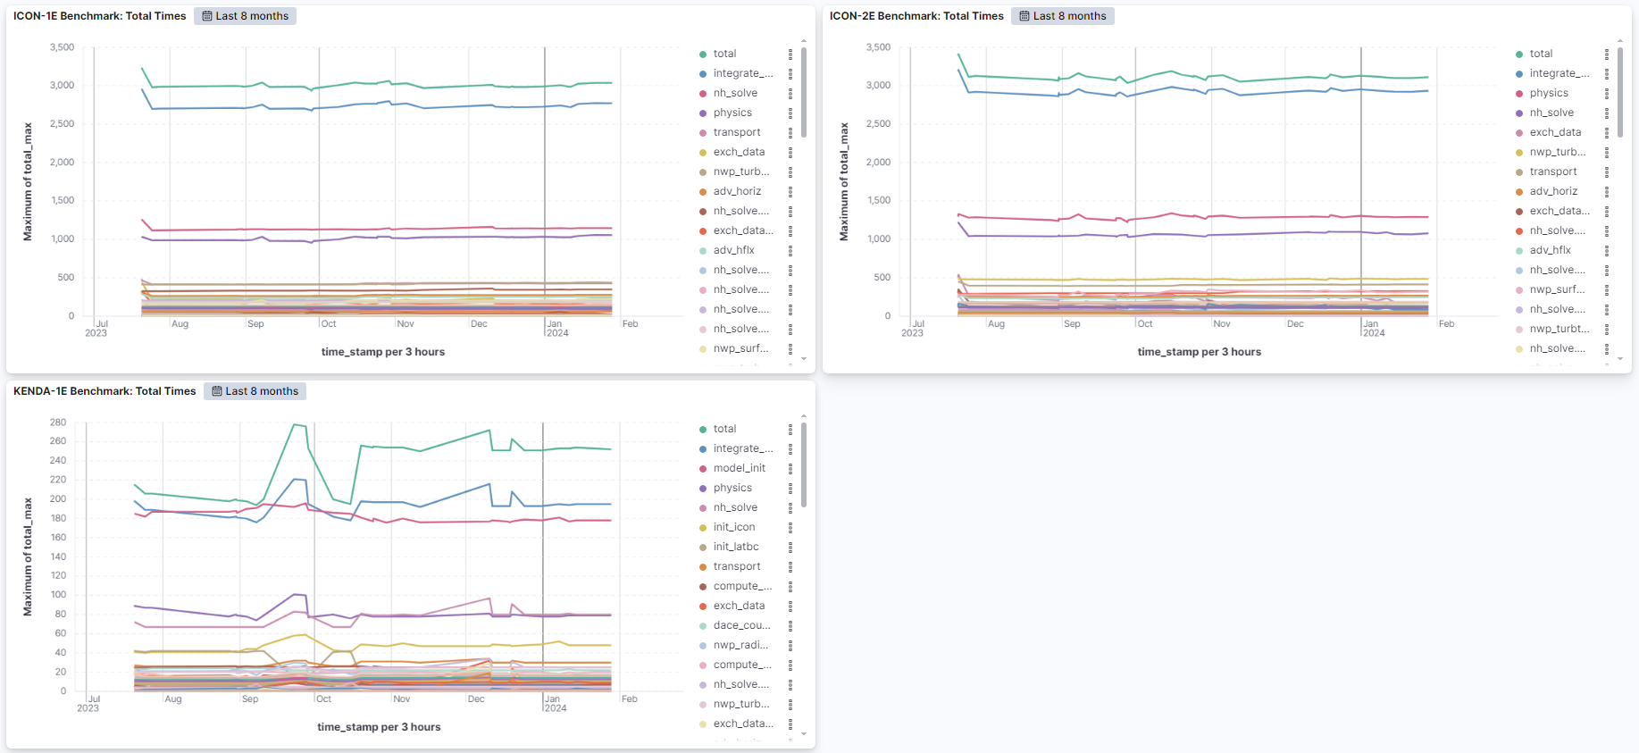
Performance: Monitoring and Control
Weekly running benchmarks on current ICON-NWP master
Monitoring with Kibana and Elastic
Performance CI-test in Buildbot
Thanks to Capucine Lechartre and Tobias Wicky-Pfund

Slide 9
Summary of GPU Status
Most components for global and regional NWP ported
COSMO PP IMPACT project was formally completed in Dec. 2023
Further components will be ported depending on the case by different institutions
Increase stability of GPU-port
Bitwise reproducibility is resolved (A. Leuthard)
Performance monitoring established
Running operationally ICON-CH1-EPS, ICON-CH2-EPS, KENDA-CH1 ensembles on GPU since 28th May

Slide 10
ICON-CH1, 33h on 8 GPUs/2 nodes
22.4% reduction

Slide 11
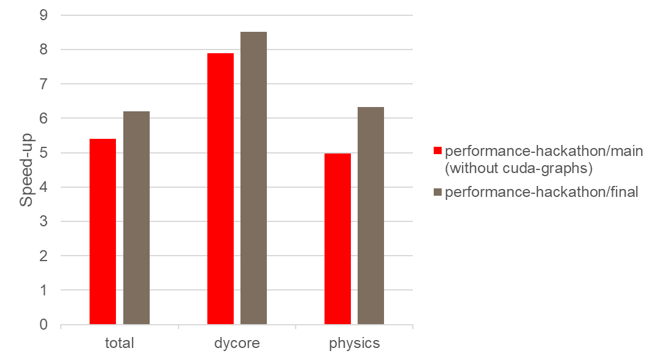
8CPUs vs 8GPUs comparison
⚠ CPU without OpenMP
⚠ CPU without optimizations

Slide 12
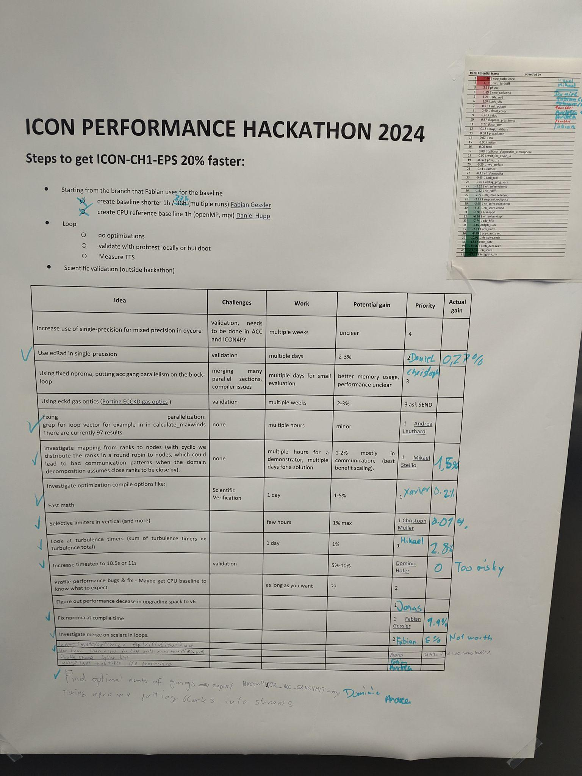
The worst offenders
Potential Gain (s)
7.36 nwp_turbulence
4.19 nwp_turbdiff
2.31 physics
1.89 nwp_radiation
1.21 adv_vert
1.07 adv_vflx
0.71 wrt_output
0.40 cloud_cover
0.40 satad
0.37 diagnose_pres_temp
Actual Gain (s)
3.29 nwp_turbulence
2.66 nwp_turbdiff
5.86 physics
1.38 nwp_radiation
1.26 adv_vert
1.27 adv_vflx
0.06 wrt_output
0.36 cloud_cover
0.48 satad
0.21 diagnose_pres_temp

Slide 13
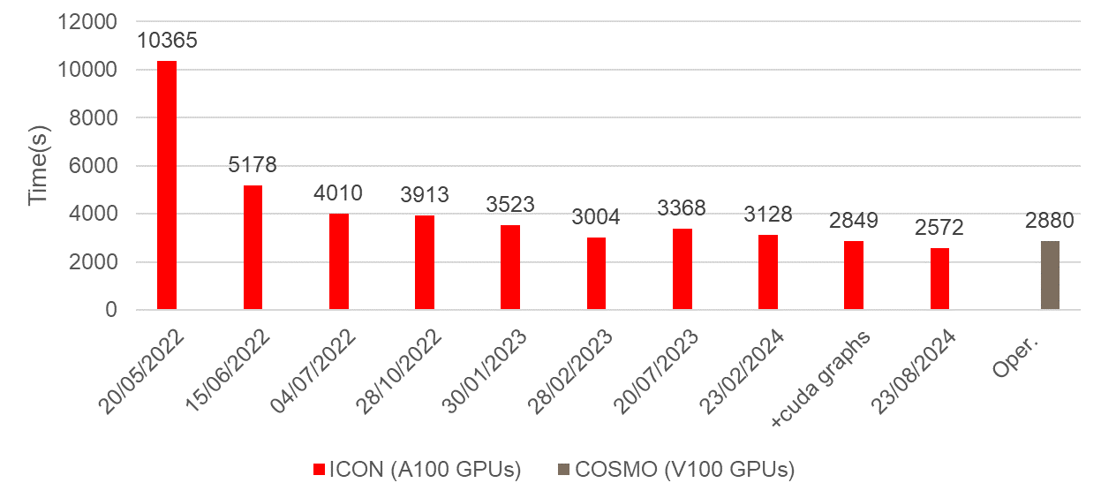
Where we ended up
performance hackathon

Slide 14
List of performance improvements
6.8% Changing compiler options: -O2 -Mstack_arrays (Sergey)
~5% CUDA graphs in terra and turbtrans (Dmitry)
~9% without -O2 -Mstack_arrays
2.8% Optimizations in turbulence
1.5% Improved rank-node association
1.4% Hardcoded nproma
1.2% Optimizations in ecRad (-55.7% radiation timer)
1.0% Vertical Advection
…

Slide 15
ecRad improvement: using TILE
!$ACC PARALLEL DEFAULT(NONE) ASYNC(1)
!$ACC LOOP COLLAPSE(3)
DO JLEV = 1, KLEV
!cdir unroll=4
DO JI = 1, JPGPT
DO JLON = KIDIA, KFDIA
POD(JI,JLEV,JLON) = ZTAU(JLON,JI,JLEV)
ENDDO
ENDDO
ENDDO
!$ACC END PARALLEL
!$ACC PARALLEL DEFAULT(NONE) ASYNC(1)
!$ACC LOOP GANG VECTOR TILE(2, 64, 1)
DO JLEV = 1, KLEV
!cdir unroll=4
DO JI = 1, JPGPT
DO JLON = KIDIA, KFDIA
POD(JI,JLEV,JLON) = ZTAU(JLON,JI,JLEV)
ENDDO
ENDDO
ENDDO
!$ACC END PARALLEL
kernel with 2nd longest duration
19ms → 2.5ms
for multiple kernels: -1.2% (-55.7% radiation)

Slide 16
GPU optimizations
!$ACC PARALLEL DEFAULT(NONE) ASYNC(1)
!$ACC LOOP GANG VECTOR COLLAPSE(2)
DO jk = 1, nlev
DO jc= i_startidx, i_endidx
z_rth_pr(jc,jk,1,1) = 0._vp
z_rth_pr(jc,jk,1,2) = 0._vp
ENDDO
ENDDO
!$ACC END PARALLEL
Parallelism in ICON
Inner 80 x 100‘000
Halo 80 x 1‘000

Slide 17
GPU optimizations
!$ACC PARALLEL DEFAULT(NONE) ASYNC(1)
!$ACC LOOP GANG VECTOR COLLAPSE(2)
DO jk = 1, nlev
DO jc= i_startidx, i_endidx
z_rth_pr(jc,jk,1,1) = 0._vp
z_rth_pr(jc,jk,1,2) = 0._vp
ENDDO
ENDDO
!$ACC END PARALLEL
Parallelism in ICON
Inner 80 x 100‘000
Halo 80 x 1‘000
Parts of ICON that do not have horizontal + vertical parallelism?
Example: Surface model
Parallel work = num_cells on ground level
Divided into ground types
Cannot parallelize over soil types without restructuring

Slide 18
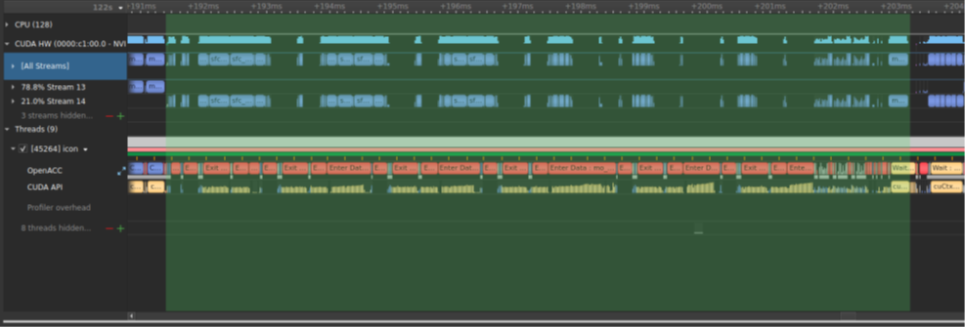
GPU optimizations
Try using CUDA streams!

Slide 19
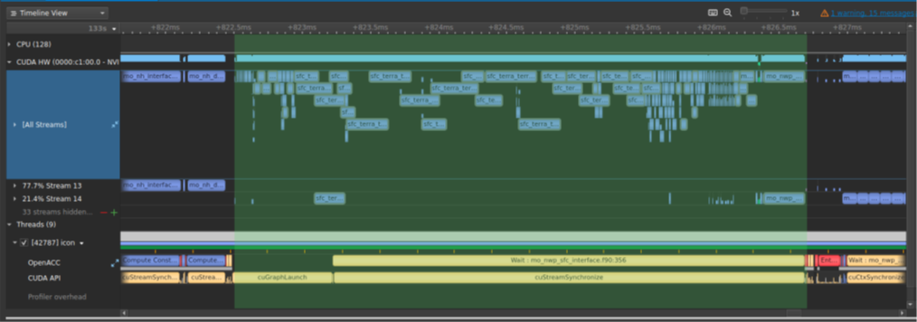
GPU optimizations - CUDA streams
Parts of ICON that do not have horizontal + vertical parallelism?
Terra:
Parallel work = num_cells on ground level
Divided into soil types

Slide 20
GPU optimizations - CUDA streams
Parts of ICON that do not have horizontal + vertical parallelism?
Terra:
Parallel work = num_cells on ground level
Divided into soil types
Model | Original, ms | CUDA graphs, ms | Speedup
Surface | 11.8 | 4.2 | 2.8x
Turbtrans | 10.4 | 2.0 | 5.1x

Slide 21
ICON4Py Update – Overview
Granules ported (same interface as ICON-C)
Dycore
Diffusion
In progress
Microphysics
Tracer advection
Performance improvements delayed
Currently on par with OpenACC
Define new IR called GTIR to be able to do optimization passes
Interface to ICON now on granule level

Slide 22
GT4Py Toolchain
GridTools4Python: embedded in Python, uses GridTools in its toolchain.
Toolchain
Callable
Parsing
Lowering
Code generation
Compilation
Backend
GTFN CPU
C++
Python
Frontend
@program
PAST
ITIR
GTFN GPU
CUDA C++
@field_operator
FOAST
Python
Python
@scan_operator
Optimizations
DaCe
C++
Embedded execution

Slide 23
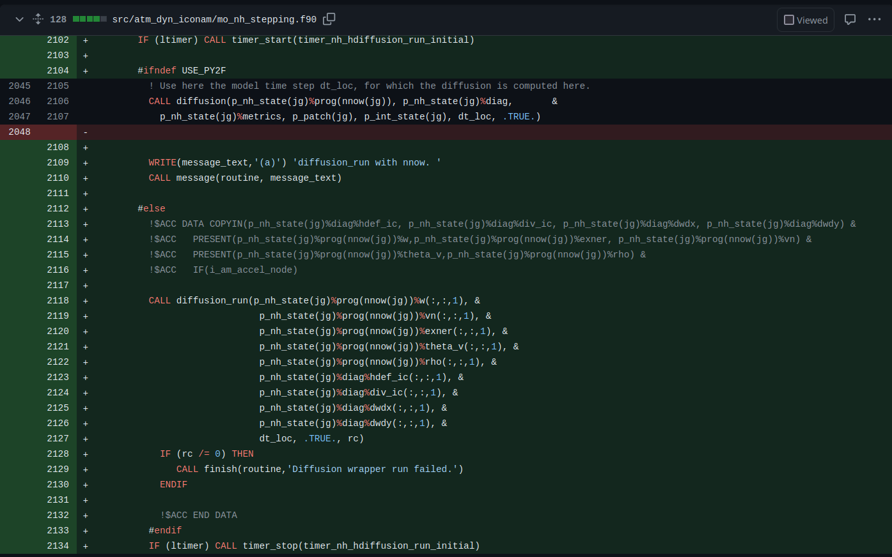

Slide 24
Py2F (CFFI - Fortran Interface Generator)
Fortran runtime
Subroutine
diffusion
Interface diffusion(a,b)
C Dynamic Library
Python Interpreter diffusion(a,b)
Embedding Python in Fortran Workflow
Generate a wrapper function for the target Python function.
Convert Fortran pointers to numpy/cupy arrays.
Create GT4Py fields from arrays.
Execute the Python function.
Use Python-CFFI to produce a C file containing the wrapper code, Python interpreter initialization, and more.
Compile the C code into a shared library for Fortran usage.
Generate Fortran interfaces/bindings for the CFFI-generated C code.
Call the CFFI C interface directly from Fortran.

Slide 25
Py2F (CFFI - Fortran Interface Generator)
Only not previously verified component are the halo exchanges (ghex)
Pass MPI communicator from Fortran to Python
To merge upstream into icon-nwp only one additional function call per granule

Slide 26
ICON4Py Update – Overview
Granules ported (same interface as ICON-C)
Dycore (granule verification pending)
Diffusion (granule verifying)
In progress
Microphysics
Tracer advection
Performance improvements delayed
Currently on par with OpenACC
Define new IR called GTIR to be able to do optimization passes
Interface to ICON now on granule level

Slide 27
ICON4Py Update – Overview
Granules ported (same interface as ICON-C)
Dycore (granule verification pending)
Diffusion (granule verifying)
In progress
Microphysics
Tracer advection
Performance improvements delayed
Currently on par with OpenACC
Define new IR called GTIR to be able to do optimization passes
Interface to ICON now on granule level
Want to merge as soon as performance improvement significant

Slide 28
DSL Motivation
Model software development starts at numerical discretization of continuous quantities:

Slide 29
Motivation
DO jk = slev, elev
DO je = i_startidx, i_endidx
grad_norm_psi_e(je,jk) =
(psi_c(iidx(je,2),jk)-psi_c(iidx(je,1),jk))/lhat(je)
ENDDO
END DO
(very) straight forward implementation
"actual science" + mesh

Slide 30
Motivation
DO jb = i_startblk, i_endblk
CALL get_indices_e(ptr_patch, jb, i_startblk, i_endblk, &
i_startidx, i_endidx, rl_start, rl_end)
DO jk = slev, elev
DO je = i_startidx, i_endidx
grad_norm_psi_e(je,jk,jb) = &
( psi_c(iidx(je,jb,2),jk,iblk(je,jb,2)) -
psi_c(iidx(je,jb,1),jk,iblk(je,jb,1)) )
/ ptr_patch%edges%lhat(je,jb)
ENDDO
END DO
END DO
CPU cache performs badly, add blocks

Slide 31
Motivation
#ifdef _OMP
!$OMP PARALLEL
!$OMP DO PRIVATE(jb, i_startidx, i_endidx, je, jk)
#endif
DO jb = i_startblk, i_endblk
CALL get_indices_e(ptr_patch, jb, i_startblk, i_endblk, &
i_startidx, i_endidx, rl_start, rl_end)
DO jk = slev, elev
DO je = i_startidx, i_endidx
grad_norm_psi_e(je,jk,jb) = &
( psi_c(iidx(je,jb,2),jk,iblk(je,jb,2)) -
psi_c(iidx(je,jb,1),jk,iblk(je,jb,1)) )
/ ptr_patch%edges%lhat(je,jb)
ENDDO
END DO
END DO
#ifdef _OMP
!$OMP END DO NOWAIT
!$OMP END PARALLEL
#endif
code doesn't perform on multi-core CPU, add directives to exploit shared memory machines

Slide 32
Motivation
#ifdef _OMP
!$OMP ....
#else
!$ACC ....
#endif
DO jb = i_startblk, i_endblk
CALL get_indices_e(ptr_patch, ...)
#ifdef __LOOP_EXCHANGE
DO je = i_startidx, i_endidx
DO jk = slev, elev
#else
DO jk = slev, elev
DO je = i_startidx, i_endidx
#endif
grad_norm_psi_e(je,jk,jb) = &
( psi_c(iidx(je,jb,2),jk,iblk(je,jb,2)) -
psi_c(iidx(je,jb,1),jk,iblk(je,jb,1)) )
/ ptr_patch%edges%lhat(je,jb)
ENDDO
END DO
END DO
#ifdef _OMP
!$OMP ...
#else
!$ACC ...
#endif
code needs to target another architecture...
... with different optimal memory layout

Slide 33
Motivation
#ifdef _OMP
!$OMP ....
#else
!$ACC ....
#endif
DO jb = i_startblk, i_endblk
CALL get_indices_e(ptr_patch, ...)
#ifdef __LOOP_EXCHANGE
DO je = i_startidx, i_endidx
DO jk = slev, elev
#else
DO jk = slev, elev
DO je = i_startidx, i_endidx
#endif
grad_norm_psi_e(je,jk,jb) = &
( psi_c(iidx(je,jb,2),jk,iblk(je,jb,2)) -
psi_c(iidx(je,jb,1),jk,iblk(je,jb,1)) )
/ ptr_patch%edges%lhat(je,jb)
ENDDO
END DO
END DO
#ifdef _OMP
!$OMP ...
#else
!$ACC ...
#endif

Slide 34
Motivation
#ifdef _OMP
!$OMP ....
#else
!$ACC ....
#endif
DO jb = i_startblk, i_endblk
CALL get_indices_e(ptr_patch, ...)
#ifdef __LOOP_EXCHANGE
DO je = i_startidx, i_endidx
DO jk = slev, elev
#else
DO jk = slev, elev
DO je = i_startidx, i_endidx
#endif
grad_norm_psi_e(je,jk,jb) = &
( psi_c(iidx(je,jb,2),jk,iblk(je,jb,2)) -
psi_c(iidx(je,jb,1),jk,iblk(je,jb,1)) )
/ ptr_patch%edges%lhat(je,jb)
ENDDO
END DO
END DO
#ifdef _OMP
!$OMP ...
#else
!$ACC ...
#endif
Scientist and performance engineers work on the same code!

Slide 35
Motivation
#ifdef _OMP
!$OMP ....
#else
!$ACC ....
#endif
DO jb = i_startblk, i_endblk
CALL get_indices_e(ptr_patch, ...)
#ifdef __LOOP_EXCHANGE
DO je = i_startidx, i_endidx
DO jk = slev, elev
#else
DO jk = slev, elev
DO je = i_startidx, i_endidx
#endif
grad_norm_psi_e(je,jk,jb) = &
( psi_c(iidx(je,jb,2),jk,iblk(je,jb,2)) -
psi_c(iidx(je,jb,1),jk,iblk(je,jb,1)) )
/ ptr_patch%edges%lhat(je,jb)
ENDDO
END DO
END DO
#ifdef _OMP
!$OMP ...
#else
!$ACC ...
#endif
What if
Further model development
Higher order approximation of gradient?
Optimize for all architectures again!
A third (fourth...) architecture?
20+ Person years (PY) to port ICON to nvidia GPUs with OpenACC
4 PYs to port ICON to LUMI using OpenACC

Slide 36
GT4Py – A DSL
@field_operator
def _grad_norm(psi: Field[[CellDim, KDim], float], lhat: Field[[EdgeDim], float],
) -> Field[[EdgeDim, KDim], float]:
return (psi(E2C(1)) - psi(E2C(0)))/lhat
@program
def grad_norm(psi: Field[[CellDim, KDim], float],
lhat: Field[[EdgeDim], float],
grad_norm_psi_n: Field[[CellDim, KDim], float,
):
_grad_norm(psi, lhat, out=grad_norm_psi_n)
grad_norm(psi, lhat, grad_norm_psi_n, offset_provider = {“E2C”: e2c_offset_provider})

Slide 37
GT4Py – A DSL
@field_operator
def _grad_norm(psi: Field[[CellDim, KDim], float], lhat: Field[[EdgeDim], float],
) -> Field[[EdgeDim, KDim], float]:
return (psi(E2C(1)) - psi(E2C(0)))/lhat
@program
def grad_norm(psi: Field[[CellDim, KDim], float],
lhat: Field[[EdgeDim], float],
grad_norm_psi_n: Field[[CellDim, KDim], float,
):
_grad_norm(psi, lhat, out=grad_norm_psi_n)
grad_norm(psi, lhat, grad_norm_psi_n, offset_provider = {“E2C”: e2c_offset_provider})

Slide 38
GT4Py – A DSL
@field_operator
def _grad_norm(psi: Field[[CellDim, KDim], float], lhat: Field[[EdgeDim], float],
) -> Field[[EdgeDim, KDim], float]:
return (psi(E2C(1)) - psi(E2C(0)))/lhat
@program
def grad_norm(psi: Field[[CellDim, KDim], float],
lhat: Field[[EdgeDim], float],
grad_norm_psi_n: Field[[CellDim, KDim], float,
):
_grad_norm(psi, lhat, out=grad_norm_psi_n)
grad_norm(psi, lhat, grad_norm_psi_n, offset_provider = {“E2C”: e2c_offset_provider})

Slide 39
GT4Py – A DSL
@field_operator
def _grad_norm(psi: Field[[CellDim, KDim], float], lhat: Field[[EdgeDim], float],
) -> Field[[EdgeDim, KDim], float]:
return (psi(E2C(1)) - psi(E2C(0)))/lhat
@program
def grad_norm(psi: Field[[CellDim, KDim], float],
lhat: Field[[EdgeDim], float],
grad_norm_psi_n: Field[[CellDim, KDim], float,
):
_grad_norm(psi, lhat, out=grad_norm_psi_n)
grad_norm(psi, lhat, grad_norm_psi_n, offset_provider = {“E2C”: e2c_offset_provider})

Slide 40
GT4Py – A DSL
@field_operator
def _grad_norm(psi: Field[[CellDim, KDim], float], lhat: Field[[EdgeDim], float],
) -> Field[[EdgeDim, KDim], float]:
return (psi(E2C(1)) - psi(E2C(0)))/lhat
@program
def grad_norm(psi: Field[[CellDim, KDim], float],
lhat: Field[[EdgeDim], float],
grad_norm_psi_n: Field[[CellDim, KDim], float,
):
_grad_norm(psi, lhat, out=grad_norm_psi_n)
grad_norm(psi, lhat, grad_norm_psi_n, offset_provider = {“E2C”: e2c_offset_provider})

Slide 41
GT4Py – A DSL
@field_operator
def _grad_norm(psi: Field[[CellDim, KDim], float], lhat: Field[[EdgeDim], float],
) -> Field[[EdgeDim, KDim], float]:
return (psi(E2C(1)) - psi(E2C(0)))/lhat
@program
def grad_norm(psi: Field[[CellDim, KDim], float],
lhat: Field[[EdgeDim], float],
grad_norm_psi_n: Field[[CellDim, KDim], float,
):
_grad_norm(psi, lhat, out=grad_norm_psi_n)
grad_norm(psi, lhat, grad_norm_psi_n, offset_provider = {“E2C”: e2c_offset_provider})

Slide 42
GT4Py Toolchain
Idea of GT4Py / DSLs in general
CUDA
double _var_25[5] DACE_ALIGN(64); double _var_35[5] DACE_ALIGN(64);
double _var_38[5] DACE_ALIGN(64);
double _var_41[1] DACE_ALIGN(64); {
for (auto _i_Edge_36 = 0; _i_Edge_36 < _num_Edges; _i_Edge_36 += 1) {
{
long long _i_Edge = ____stencil_arg0_i_Edge;
const double* _inp = &__stencil_arg0[0];
double* _out = _var_35;
…
GT4Py
(psi(E2C(1)) - psi(E2C(0)))/lhat

Slide 43
GT4Py Toolchain
Idea of GT4Py / DSLs in general
CUDA
double _var_25[5] DACE_ALIGN(64); double _var_35[5] DACE_ALIGN(64);
double _var_38[5] DACE_ALIGN(64);
double _var_41[1] DACE_ALIGN(64); {
for (auto _i_Edge_36 = 0; _i_Edge_36 < _num_Edges; _i_Edge_36 += 1) {
{
long long _i_Edge = ____stencil_arg0_i_Edge;
const double* _inp = &__stencil_arg0[0];
double* _out = _var_35;
…
GT4Py
(psi(E2C(1)) - psi(E2C(0)))/lhat
Exactly the same approach as tensorflow or pytorch for DL

Slide 44
GT4Py Toolchain
GridTools4Python: embedded in Python, uses GridTools in its toolchain.
Toolchain
Callable
Parsing
Lowering
Code generation
Compilation
Backend
GTFN CPU
C++
Python
Frontend
@program
PAST
ITIR
GTFN GPU
CUDA C++
@field_operator
FOAST
Python
Python
@scan_operator
Optimizations
DaCe
C++
Embedded execution

Slide 45
GT4Py Toolchain
A higher order gradient scheme?
Toolchain
Callable
Parsing
Lowering
Code generation
Compilation
Backend
GTFN CPU
C++
Python
Frontend
@program
PAST
ITIR
GTFN GPU
CUDA C++
@field_operator
FOAST
Python
Python
@scan_operator
Optimizations
DaCe
C++
Embedded execution

Slide 46
GT4Py Toolchain
Supporting a new architecture
Toolchain
Callable
Parsing
Lowering
Code generation
Compilation
Backend
GTFN CPU
C++
Python
Frontend
@program
PAST
ITIR
GTFN GPU
CUDA C++
@field_operator
FOAST
Python
Python
@scan_operator
Optimizations
DaCe
C++
Embedded execution

Slide 47
GT4Py Toolchain
The cost: The initial investment in the toolchain is high
The benefit: Economy of scale - toolchain can be reused for other models
Toolchain
Callable
Parsing
Lowering
Code generation
Compilation
Backend
GTFN CPU
C++
Python
Frontend
@program
PAST
ITIR
GTFN GPU
CUDA C++
@field_operator
FOAST
Python
Python
@scan_operator
Optimizations
DaCe
C++
Embedded execution

Slide 48
Porting
Decommission of Fortran model
Fortran
Python
Years of high investment

Slide 49
Porting: Vulcan/AI2 approach
FV3
Fortran
Dycore

Slide 50
Porting: Vulcan/AI2 approach
FV3
Fortran
Dycore
FV3
Python
Dycore
Translate

Slide 51
Porting: Vulcan/AI2 approach
FV3
Fortran
Dycore
FV3
Python
Dycore
Translate
Serialize
Serialize
Compare

Slide 52
Porting: Vulcan/AI2 approach
Keywords: offline/serialization, top down, whole component/model
Advantages:
Whole model/component in Python to begin with
No direct interaction with Fortran
Disadvantages:
Verification of thousands of lines of code at once
Not performant if DSL under development
Needs serialization library

Slide 53
Porting: MCH/EXCLAIM
ICON
Fortran
Dycore
Translate
ICON
Python
Dycore
Stencil01
Stencil01
Stencil02
Stencil02
Stencil03
Stencil03
Stencil68
Stencil68
Notes:
This is where all of Meteoswiss animation budget went. Only this slide.

Slide 54
Porting: MCH/EXCLAIM
ICON
Fortran
Dycore
Integrate
ICON
Python
Dycore
Stencil01
Stencil01
Stencil02
Stencil02
Stencil03
Stencil03
Stencil68
Stencil68
Notes:
This is where all of Meteoswiss animation budget went. Only this slide.

Slide 55
Porting: MCH/EXCLAIM
ICON
Fortran
Dycore
Integrate
ICON
Python
Dycore
Stencil01
Stencil01
Stencil02
Stencil02
Stencil03
Stencil03
Integration code
Stencil68
Stencil68
Notes:
This is where all of Meteoswiss animation budget went. Only this slide.

Slide 56
Porting: MCH/EXCLAIM
ICON
Fortran
Dycore
Integrate
ICON
Python
Dycore
Stencil01
Stencil01
Stencil02
Stencil02
Stencil03
Stencil03
Integration code
Stencil68
Stencil68
Notes:
This is where all of Meteoswiss animation budget went. Only this slide.

Slide 57
Porting: MCH/EXCLAIM - Integration
mo_solve_nonhydro.f90
stencil_01.py
…
stencil_68.py
stencil_01.hpp
stencil_01.cpp stencil_01.h
stencil_01.f90
Porting: Convert Fortran stencils to GT4Py stencils written in Python.
Code generation: Utilize GT4Py to produce efficient C++ code.
Bindings generation: Create Fortran bindings to enable calling the generated C++ code.
Preprocess: Modify the ICON codebase to automatically invoke the C++ code.
mo_solve_nonhydro.pp-liskov.f90

Slide 58
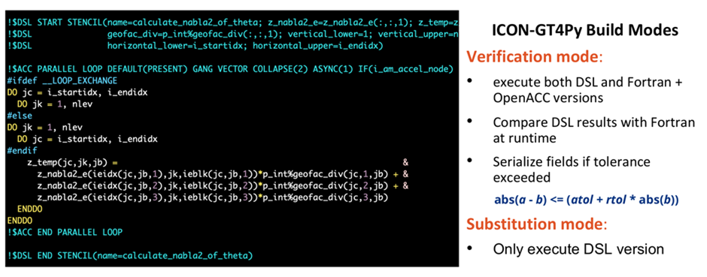
Porting: MCH/EXCLAIM – Liskov

Slide 59
Porting: MCH/EXCLAIM – Liskov

Slide 60
Porting: MCH/EXCLAIM approach
Keywords: online, bottom up, fine-grained translation
Advantages:
Very fine-grained verification
No serialization needed
Disadvantages:
Glue code to Fortran must be written and maintained
Until Fortran model decommissioned
Temporarily tying yourself to the Fortran model

Slide 61
Hierarchies of testing
Software
Engineers
Level 0 – unit tests
Unit test gt4py
Unittest stencils – compare backends
Faster turnaround time
CI integration possible
Level 1 – on-line stencil-wise comparison (Fortran+ACC using Liskov)
Computational
Scientists
Level 2 – Probtest (perturbation growth test 15 - 20 timesteps)
Level 3 – Validation/ Analysis of longer-term climate simulations
Domain
Scientists

Slide 62
MCH – production requirements
Substantial performance improvement
Releases of gt4py + icon4py + icon-exclaim
Documentation
Dycore tested
Dycore easily debuggable
Dycore maintainable (keep up with icon-nwp upstream)
Easy to build
Support (contract) for gt4py
Toolchain debuggable
Toolchain tested

Slide 63
MCH – production experience
MCH has COSMO + gridtools dycore in production since 2016
Never had a surprising crash where specific weather caused instability
Response time is hours
CUDA upgrade caused performance problem (1/100 binaries was 100x slower)
Dycore changes upstream from COSMO
Response time months

Slide 64
Summary
(psi(E2C(1)) - psi(E2C(0)))/lhat
Motivation to use a DSL
Porting approaches
Production considerations
Support (contract) for gt4py
Toolchain debuggable
Toolchain tested
christoph.mueller@meteoswiss.ch

