Slide 1
Fuzzy verification on Common Areas
Naima Vela
September the 2nd 2024 - 26th COSMO General Meeting - Offenbach

Slide 2
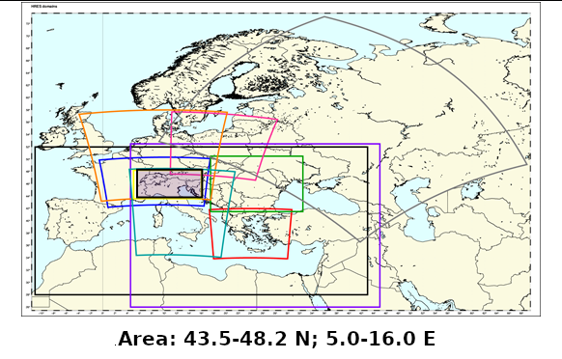
WHAT IS COMMON AREA 2
MODELS: ICON D2, COSMO 1E, ICON 1E, ICON GR, COSMO 2I, COSMO IT, ICON IT, ICON 2I, ICON IL
September the 2nd 2024 - 26th COSMO General Meeting - Offenbach

Slide 3
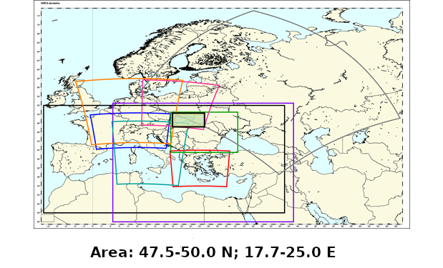
WHAT IS COMMON AREA 3
MODELS: ICON GR, ICON PL, COSMO CE PL, ICON IL
September the 2nd 2024 - 26th COSMO General Meeting - Offenbach

Slide 4
DESCRIPTION OF THE VERIFICATION
Models:
Common Area 2:
ICON D2, COSMO 1E, ICON 1E, ICON GR, COSMO 2I, COSMO IT, ICON IT, ICON IL, ICON 2I (MAM)
Common Area 3:
ICON GR, ICON PL, COSMO CE PL, ICON IL
Observation: OPERA database by EUMETNET
Resolution (forecast and observation): 0.025°, lat-lon
Period: JJA 2023, SON 2023, DJF 2024, MAM 2024
Scores: FSS, FBI, ETS, FAR, POD
Methods: 1 timestep/3 timesteps
D0/D1
Cumulation: 3h
September the 2nd 2024 - 26th COSMO General Meeting - Offenbach

Slide 5
Plot explanation
O: Period
O: Score
O: Day and timesteps
O: Thresholds
O: Models
O: Spatial scales
5
September the 2nd 2024 - 26th COSMO General Meeting - Offenbach

Slide 6
Methodology
For each score I will show you some features that occur in all of the seasons or in some of them.
In case of peculiar behaviours I will then show you features that only occur in one season, but for all the verification modalities (1t/3t/D0/D1).
The most common behaviours will be shown first.
Common areas 2 and 3 will be shown separately.
Only representative plots will be shown (all the plots can be visualized on the Cosmo web page).
6
September the 2nd 2024 - 26th COSMO General Meeting - Offenbach

Slide 7
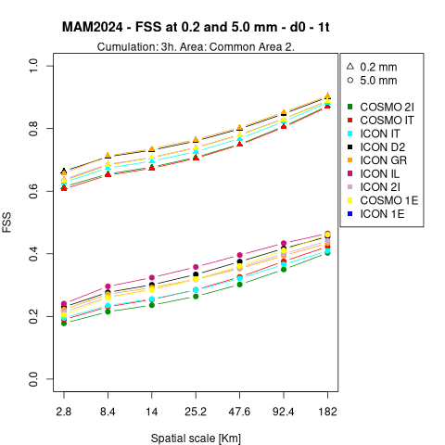
FSS – Common area 2
SON, DJF, MAM
COSMO 2I, COSMO IT and ICON IT are always among the worst performances for both thresholds
JJA, SON, MAM
COSMO 1E, where present (D0), is always better than the other COSMO models
SON, DJF, MAM
ICON GR is always the best for the 0.2 mm/3h threshold
JJA
ICON D2 is always the best at 0.2 mm/3h ( followed by ICON GR)
ICON GR is always the worst at 5 mm/3h threshold (a lot worse than the others)
ICON IL is always the best for the 5 mm/3h threshold
MAM
For D0, 5 mm threshold, ICON IL is the best model
ICON 2I worsten less than the other models moving from D0 to D1; for D1 is the best model for the 5 mm/3h threshold for large boxes
7
September the 2nd 2024 - 26th COSMO General Meeting - Offenbach

Slide 8
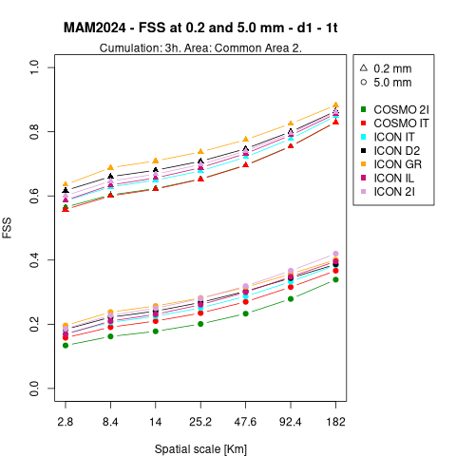
FSS – Common area 2
SON, DJF, MAM
COSMO 2I, COSMO IT and ICON IT are always among the worst performances for both thresholds
JJA, SON, MAM
COSMO 1E, where present (D0), is always better than the other COSMO models
SON, DJF, MAM
ICON GR is always the best for the 0.2 mm/3h threshold
JJA
ICON D2 is always the best at 0.2 mm/3h ( followed by ICON GR)
ICON GR is always the worst at 5 mm/3h threshold (a lot worse than the others)
ICON IL is always the best for the 5 mm/3h threshold
MAM
For D0, 5 mm threshold, ICON IL is the best model
ICON 2I worsten less than the other models moving from D0 to D1; for D1 is the best model for the 5 mm/3h threshold for large boxes
7
September the 2nd 2024 - 26th COSMO General Meeting - Offenbach

Slide 9
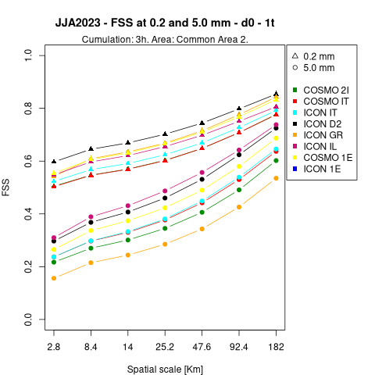
FSS – Common area 2
SON, DJF, MAM
COSMO 2I, COSMO IT and ICON IT are always among the worst performances for both thresholds
JJA, SON, MAM
COSMO 1E, where present (D0), is always better than the other COSMO models
SON, DJF, MAM
ICON GR is always the best for the 0.2 mm/3h threshold
JJA
ICON D2 is always the best at 0.2 mm/3h ( followed by ICON GR)
ICON GR is always the worst at 5 mm/3h threshold (a lot worse than the others)
ICON IL is always the best for the 5 mm/3h threshold
MAM
For D0, 5 mm threshold, ICON IL is the best model
ICON 2I worsten less than the other models moving from D0 to D1; for D1 is the best model for the 5 mm/3h threshold for large boxes
7
September the 2nd 2024 - 26th COSMO General Meeting - Offenbach

Slide 10
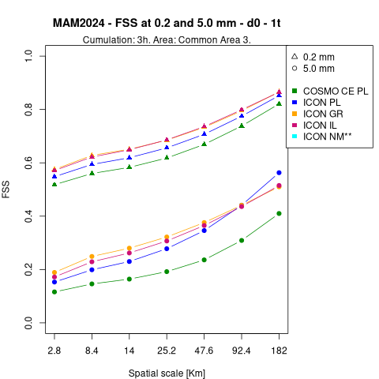
FSS – Common area 3
SON, MAM
COSMO CE PL is always the worst
JJA, SON
ICON GR is the best for the 0.2 mm/3h threshold
JJA
ICON GR is the worst for the 5 mm/3h threshold
ICON IL best model for the 5 mm/3h threshold for D0, ICON PL is the best for D1
DJF
For D0 both 0.2 mm/3h and 5 mm/3h thresholds are very close to eachother for D1 this happend only for 0.2 mm/3h
ICON GR is the best model for D0, while ICON IL is the best for D1.
MAM
ICON IL and ICON GR are almost overlapping with very good results
8
September the 2nd 2024 - 26th COSMO General Meeting - Offenbach

Slide 11
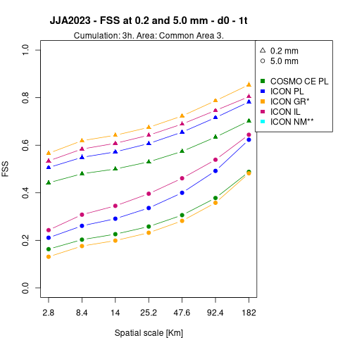
FSS – Common area 3
SON, MAM
COSMO CE PL is always the worst
JJA, SON
ICON GR is the best for the 0.2 mm/3h threshold
JJA
ICON GR is the worst for the 5 mm/3h threshold
ICON IL best model for the 5 mm/3h threshold for D0, ICON PL is the best for D1
DJF
For D0 both 0.2 mm/3h and 5 mm/3h thresholds are very close to eachother for D1 this happend only for 0.2 mm/3h
ICON GR is the best model for D0, while ICON IL is the best for D1.
MAM
ICON IL and ICON GR are almost overlapping with very good results
8
September the 2nd 2024 - 26th COSMO General Meeting - Offenbach

Slide 12
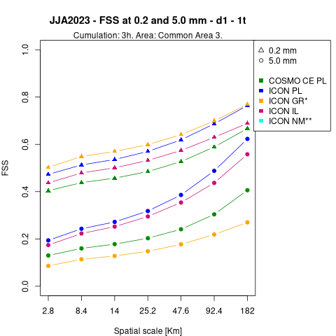
FSS – Common area 3
SON, MAM
COSMO CE PL is always the worst
JJA, SON
ICON GR is the best for the 0.2 mm/3h threshold
JJA
ICON GR is the worst for the 5 mm/3h threshold
ICON IL best model for the 5 mm/3h threshold for D0, ICON PL is the best for D1
DJF
For D0 both 0.2 mm/3h and 5 mm/3h thresholds are very close to eachother for D1 this happend only for 0.2 mm/3h
ICON GR is the best model for D0, while ICON IL is the best for D1.
MAM
ICON IL and ICON GR are almost overlapping with very good results
8
September the 2nd 2024 - 26th COSMO General Meeting - Offenbach

Slide 13
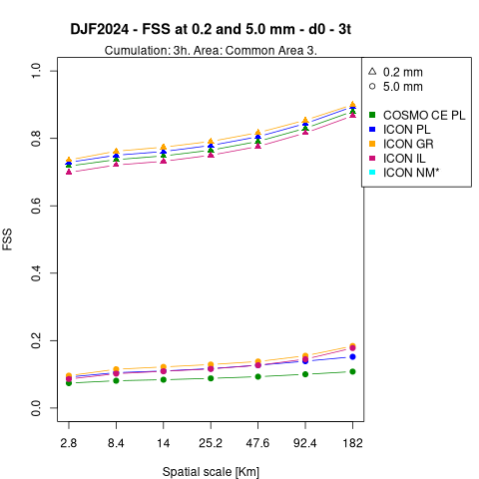
FSS – Common area 3
SON, MAM
COSMO CE PL is always the worst
JJA, SON
ICON GR is the best for the 0.2 mm/3h threshold
JJA
ICON GR is the worst for the 5 mm/3h threshold
ICON IL best model for the 5 mm/3h threshold for D0, ICON PL is the best for D1
DJF
For D0 both 0.2 mm/3h and 5 mm/3h thresholds are very close to eachother for D1 this happend only for 0.2 mm/3h
ICON GR is the best model for D0, while ICON IL is the best for D1.
MAM
ICON IL and ICON GR are almost overlapping with very good results
8
September the 2nd 2024 - 26th COSMO General Meeting - Offenbach

Slide 14
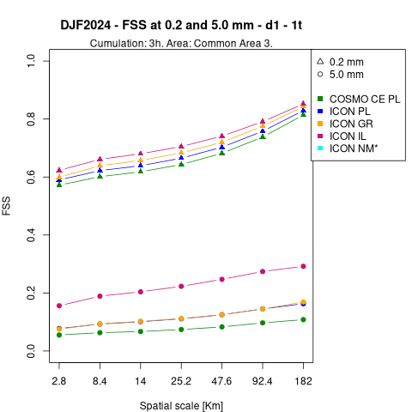
FSS – Common area 3
SON, MAM
COSMO CE PL is always the worst
JJA, SON
ICON GR is the best for the 0.2 mm/3h threshold
JJA
ICON GR is the worst for the 5 mm/3h threshold
ICON IL best model for the 5 mm/3h threshold for D0, ICON PL is the best for D1
DJF
For D0 both 0.2 mm/3h and 5 mm/3h thresholds are very close to eachother for D1 this happend only for 0.2 mm/3h
ICON GR is the best model for D0, while ICON IL is the best for D1.
MAM
ICON IL and ICON GR are almost overlapping with very good results
8
September the 2nd 2024 - 26th COSMO General Meeting - Offenbach

Slide 15
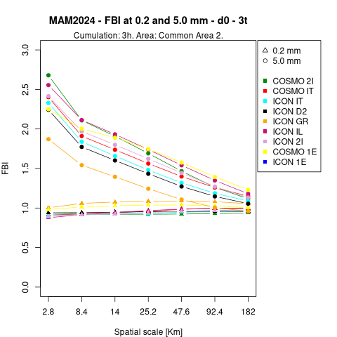
FBI – Common area 2
SON, DJF, MAM
Great overestimation at small scales for the 5 mm/3h threshold
SON, MAM
ICON GR has lower overestimation for the 5 mm/3h threshold
DJF, MAM
ICON GR is the closest to the real value for the 0.2 mm/3h threshold
SON, DJF
ICON IT and COSMO IT have less overestimation for the 5 mm/3h threshold
JJA
No overestimation
Values for the two thresholds very close to eachother and among them
All the models underestimate for the 0.2 mm/3h threshold and have minimum BIAS for the 5 mm/3h one, but ICON GR does the opposite.
9
September the 2nd 2024 - 26th COSMO General Meeting - Offenbach

Slide 16
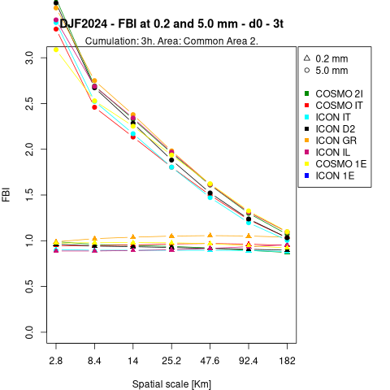
FBI – Common area 2
SON, DJF, MAM
Great overestimation at small scales for the 5 mm/3h threshold
SON, MAM
ICON GR has lower overestimation for the 5 mm/3h threshold
DJF, MAM
ICON GR is the closest to the real value for the 0.2 mm/3h threshold
SON, DJF
ICON IT and COSMO IT have less overestimation for the 5 mm/3h threshold
JJA
No overestimation
Values for the two thresholds very close to eachother and among them
All the models underestimate for the 0.2 mm/3h threshold and have minimum BIAS for the 5 mm/3h one, but ICON GR does the opposite.
9
September the 2nd 2024 - 26th COSMO General Meeting - Offenbach

Slide 17
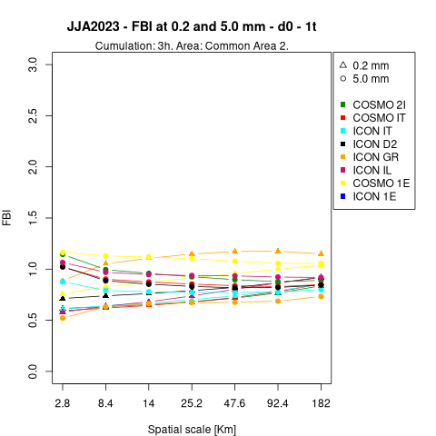
FBI – Common area 2
SON, DJF, MAM
Great overestimation at small scales for the 5 mm/3h threshold
SON, MAM
ICON GR has lower overestimation for the 5 mm/3h threshold
DJF, MAM
ICON GR is the closest to the real value for the 0.2 mm/3h threshold
SON, DJF
ICON IT and COSMO IT have less overestimation for the 5 mm/3h threshold
JJA
No overestimation
Values for the two thresholds very close to eachother and among them
All the models underestimate for the 0.2 mm/3h threshold and have minimum BIAS for the 5 mm/3h one, but ICON GR does the opposite.
9
September the 2nd 2024 - 26th COSMO General Meeting - Offenbach

Slide 18
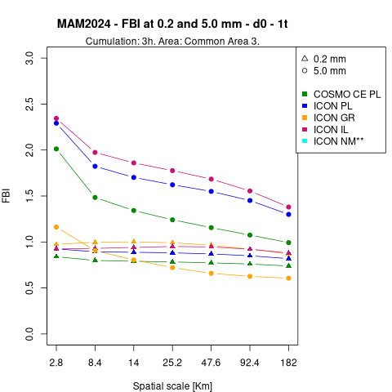
FBI – Common area 3
SON, DJF, MAM
Overestimation for small boxes for the 5 mm/3h threshold
JJA
There is no overestimation for small boxes for the 5 mm/3h threshold
All the models underestimate for the 0.2 mm/3h threshold and have minimum BIAS for the 5 mm/3h one, but ICON GR does the opposite.
D0: ICON IL and ICON PL have almost no bias starting from medium boxes for the 5 mm/3h threashold
DJF
The models have a small overestimation also for the 0.2 mm/3h threshold (ICON GR overestimates more)
MAM
ICON GR has less BIAS than ICON IL and ICON PL where they overestimate, but it tends to underestimate (5 mm/3h)
COSMO CE PL has smaller bias for the 5 mm/3h threshold but has greater underestimation if compared to the others for the 0.2 mm/3h threshold
10
September the 2nd 2024 - 26th COSMO General Meeting - Offenbach

Slide 19
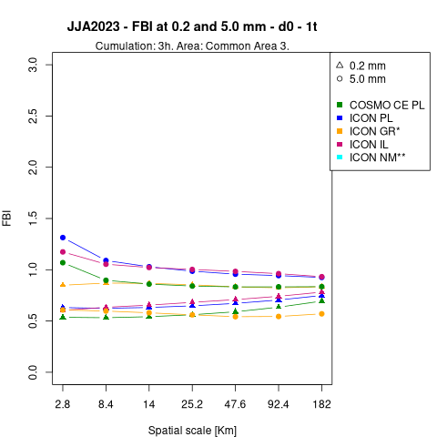
FBI – Common area 3
SON, DJF, MAM
Overestimation for small boxes for the 5 mm/3h threshold
JJA
There is no overestimation for small boxes for the 5 mm/3h threshold
All the models underestimate for the 0.2 mm/3h threshold and have minimum BIAS for the 5 mm/3h one, but ICON GR does the opposite.
D0: ICON IL and ICON PL have almost no bias starting from medium boxes for the 5 mm/3h threashold
DJF
The models have a small overestimation also for the 0.2 mm/3h threshold (ICON GR overestimates more)
MAM
ICON GR has less BIAS than ICON IL and ICON PL where they overestimate, but it tends to underestimate (5 mm/3h)
COSMO CE PL has smaller bias for the 5 mm/3h threshold but has greater underestimation if compared to the others for the 0.2 mm/3h threshold
10
September the 2nd 2024 - 26th COSMO General Meeting - Offenbach

Slide 20
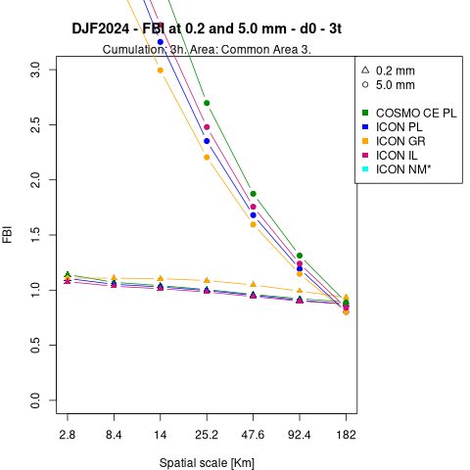
FBI – Common area 3
SON, DJF, MAM
Overestimation for small boxes for the 5 mm/3h threshold
JJA
There is no overestimation for small boxes for the 5 mm/3h threshold
All the models underestimate for the 0.2 mm/3h threshold and have minimum BIAS for the 5 mm/3h one, but ICON GR does the opposite.
D0: ICON IL and ICON PL have almost no bias starting from medium boxes for the 5 mm/3h threashold
DJF
The models have a small overestimation also for the 0.2 mm/3h threshold (ICON GR overestimates more)
MAM
ICON GR has less BIAS than ICON IL and ICON PL where they overestimate, but it tends to underestimate (5 mm/3h)
COSMO CE PL has smaller bias for the 5 mm/3h threshold but has greater underestimation if compared to the others for the 0.2 mm/3h threshold
10
September the 2nd 2024 - 26th COSMO General Meeting - Offenbach

Slide 21
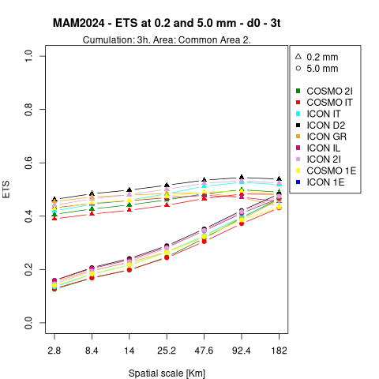
ETS – Common area 2
ALL SEASONS
At the bigger scales the results for the 5 mm/3h threshold reach those for the 0.2/3h mm threshold
JJA, SON, DJF
Very mixed results, with ICON D2 better for the 0.2 mm/3h threshold
SON, DJF
Very close values among the models at 5 mm/3h
JJA
ICON IL best model for the 5 mm/3h threshold
ICON GR among the best for the 0.2 mm/3h threshold (small boxes) and worst for the 5 mm/3h threshold
SON
COSMO IT the worst and COSMO 2I in the middle for the 0.2 mm/3h threshold
DJF
ICON D2 and ICON GR among the best for the 5 mm/3h threshold
ICON IL among the worst (especially at 0.2 mm/3h)
MAM
ICON D2 and ICON 2I best models
COSMO IT and COSMO 2I worst models
11
September the 2nd 2024 - 26th COSMO General Meeting - Offenbach

Slide 22
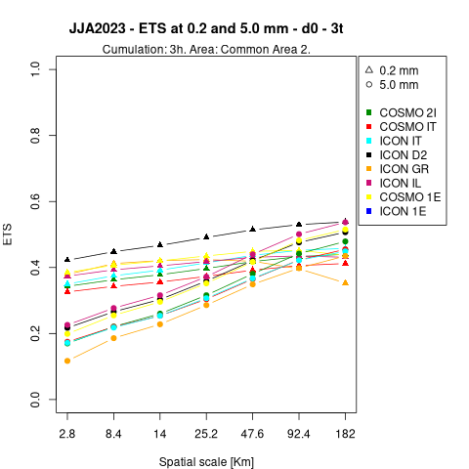
ETS – Common area 2
ALL SEASONS
At the bigger scales the results for the 5 mm/3h threshold reach those for the 0.2/3h mm threshold
JJA, SON, DJF
Very mixed results, with ICON D2 better for the 0.2 mm/3h threshold
SON, DJF
Very close values among the models at 5 mm/3h
JJA
ICON IL best model for the 5 mm/3h threshold
ICON GR among the best for the 0.2 mm/3h threshold (small boxes) and worst for the 5 mm/3h threshold
SON
COSMO IT the worst and COSMO 2I in the middle for the 0.2 mm/3h threshold
DJF
ICON D2 and ICON GR among the best for the 5 mm/3h threshold
ICON IL among the worst (especially at 0.2 mm/3h)
MAM
ICON D2 and ICON 2I best models
COSMO IT and COSMO 2I worst models
11
September the 2nd 2024 - 26th COSMO General Meeting - Offenbach

Slide 23
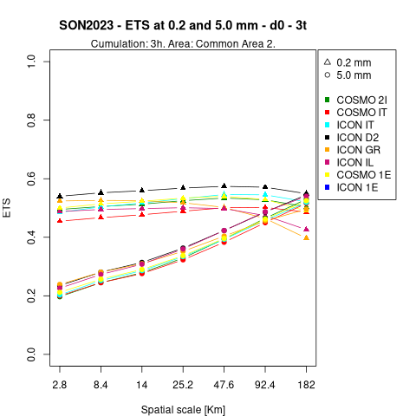
ETS – Common area 2
ALL SEASONS
At the bigger scales the results for the 5 mm/3h threshold reach those for the 0.2/3h mm threshold
JJA, SON, DJF
Very mixed results, with ICON D2 better for the 0.2 mm/3h threshold
SON, DJF
Very close values among the models at 5 mm/3h
JJA
ICON IL best model for the 5 mm/3h threshold
ICON GR among the best for the 0.2 mm/3h threshold (small boxes) and worst for the 5 mm/3h threshold
SON
COSMO IT the worst and COSMO 2I in the middle for the 0.2 mm/3h threshold
DJF
ICON D2 and ICON GR among the best for the 5 mm/3h threshold
ICON IL among the worst (especially at 0.2 mm/3h)
MAM
ICON D2 and ICON 2I best models
COSMO IT and COSMO 2I worst models
11
September the 2nd 2024 - 26th COSMO General Meeting - Offenbach

Slide 24
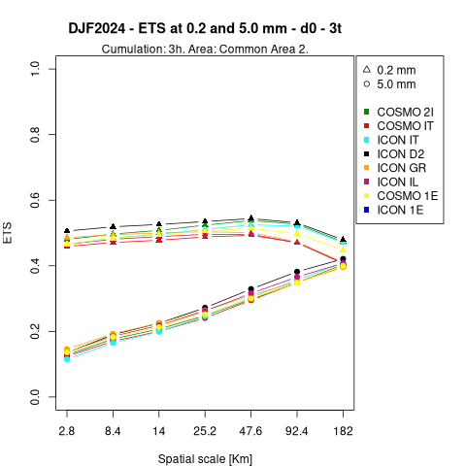
ETS – Common area 2
ALL SEASONS
At the bigger scales the results for the 5 mm/3h threshold reach those for the 0.2/3h mm threshold
JJA, SON, DJF
Very mixed results, with ICON D2 better for the 0.2 mm/3h threshold
SON, DJF
Very close values among the models at 5 mm/3h
JJA
ICON IL best model for the 5 mm/3h threshold
ICON GR among the best for the 0.2 mm/3h threshold (small boxes) and worst for the 5 mm/3h threshold
SON
COSMO IT the worst and COSMO 2I in the middle for the 0.2 mm/3h threshold
DJF
ICON D2 and ICON GR among the best for the 5 mm/3h threshold
ICON IL among the worst (especially at 0.2 mm/3h)
MAM
ICON D2 and ICON 2I best models
COSMO IT and COSMO 2I worst models
11
September the 2nd 2024 - 26th COSMO General Meeting - Offenbach

Slide 25
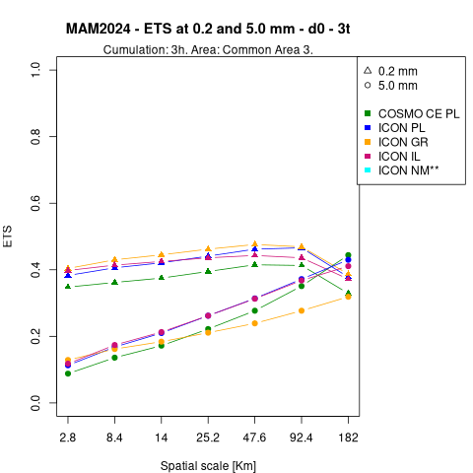
ETS – Common area 3
ALL SEASONS
At the bigger scales the results for the 5 mm/3h threshold reach those for the 0.2/3h mm threshold
JJA, SON, DJF
ICON IL best for the 5 mm/3h threshold
JJA, SON, MAM
COSMO CE PL almost always the worst
JJA, MAM
ICON GR best for the 0.2 mm/3h threshold
JJA, SON
ICON PL among the best at 0.2 mm/3h, especially for D1
MAM, SON
Small difference between D0, D1, 1t, 3t
JJA
ICON PL always among the best
DJF
All the models very close to eachother
MAM
ICON PL among the best or best for the 5 mm/3h threshold
12
September the 2nd 2024 - 26th COSMO General Meeting - Offenbach

Slide 26
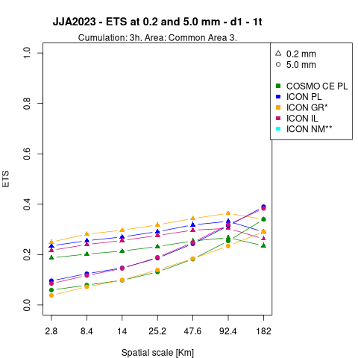
ETS – Common area 3
ALL SEASONS
At the bigger scales the results for the 5 mm/3h threshold reach those for the 0.2/3h mm threshold
JJA, SON, DJF
ICON IL best for the 5 mm/3h threshold
JJA, SON, MAM
COSMO CE PL almost always the worst
JJA, MAM
ICON GR best for the 0.2 mm/3h threshold
JJA, SON
ICON PL among the best at 0.2 mm/3h, especially for D1
MAM, SON
Small difference between D0, D1, 1t, 3t
JJA
ICON PL always among the best
DJF
All the models very close to eachother
MAM
ICON PL among the best or best for the 5 mm/3h threshold
12
September the 2nd 2024 - 26th COSMO General Meeting - Offenbach

Slide 27
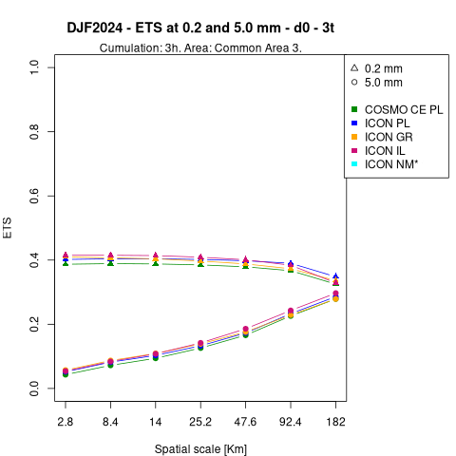
ETS – Common area 3
ALL SEASONS
At the bigger scales the results for the 5 mm/3h threshold reach those for the 0.2/3h mm threshold
JJA, SON, DJF
ICON IL best for the 5 mm/3h threshold
JJA, SON, MAM
COSMO CE PL almost always the worst
JJA, MAM
ICON GR best for the 0.2 mm/3h threshold
JJA, SON
ICON PL among the best at 0.2 mm/3h, especially for D1
MAM, SON
Small difference between D0, D1, 1t, 3t
JJA
ICON PL always among the best
DJF
All the models very close to eachother
MAM
ICON PL among the best or best for the 5 mm/3h threshold
12
September the 2nd 2024 - 26th COSMO General Meeting - Offenbach

Slide 28
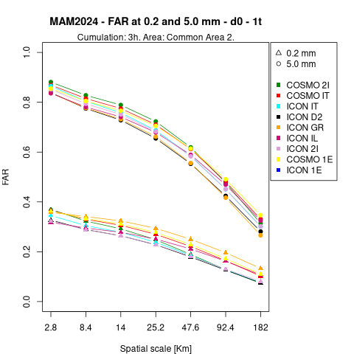
FAR – Common area 2
ALL SEASONS
ICON GR overestimates for the 0.2 mm/3h threshold
JJA, DJF
COSMO 1E overestimates by a lot
SON, DJF
ICON IT always the best
Very close values for the 5 mm/3h threshold
JJA, MAM
ICON D2 and ICON GR best for the 5 mm/3h threshold
JJA
Good performance for ICON IT at 0.2 mm/3h
DJF
ICON D2 always among the best
MAM
ICON 2I best for the 0.2 mm/3h threshold (especially for D1)
13
September the 2nd 2024 - 26th COSMO General Meeting - Offenbach

Slide 29
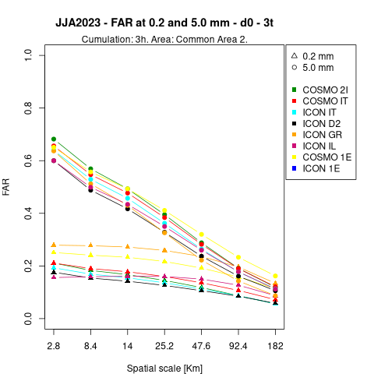
FAR – Common area 2
ALL SEASONS
ICON GR overestimates for the 0.2 mm/3h threshold
JJA, DJF
COSMO 1E overestimates by a lot
SON, DJF
ICON IT always the best
Very close values for the 5 mm/3h threshold
JJA, MAM
ICON D2 and ICON GR best for the 5 mm/3h threshold
JJA
Good performance for ICON IT at 0.2 mm/3h
DJF
ICON D2 always among the best
MAM
ICON 2I best for the 0.2 mm/3h threshold (especially for D1)
13
September the 2nd 2024 - 26th COSMO General Meeting - Offenbach

Slide 30
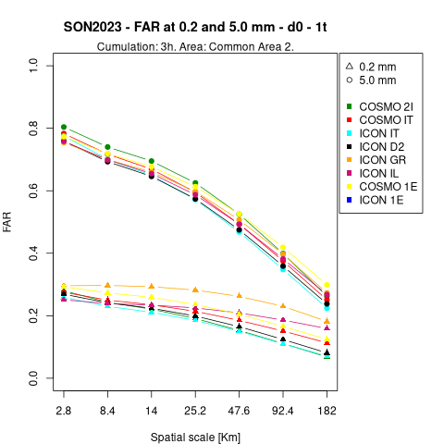
FAR – Common area 2
ALL SEASONS
ICON GR overestimates for the 0.2 mm/3h threshold
JJA, DJF
COSMO 1E overestimates by a lot
SON, DJF
ICON IT always the best
Very close values for the 5 mm/3h threshold
JJA, MAM
ICON D2 and ICON GR best for the 5 mm/3h threshold
JJA
Good performance for ICON IT at 0.2 mm/3h
DJF
ICON D2 always among the best
MAM
ICON 2I best for the 0.2 mm/3h threshold (especially for D1)
13
September the 2nd 2024 - 26th COSMO General Meeting - Offenbach

Slide 31
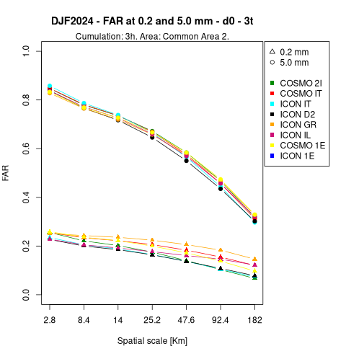
FAR – Common area 2
ALL SEASONS
ICON GR overestimates for the 0.2 mm/3h threshold
JJA, DJF
COSMO 1E overestimates by a lot
SON, DJF
ICON IT always the best
Very close values for the 5 mm/3h threshold
JJA, MAM
ICON D2 and ICON GR best for the 5 mm/3h threshold
JJA
Good performance for ICON IT at 0.2 mm/3h
DJF
ICON D2 always among the best
MAM
ICON 2I best for the 0.2 mm/3h threshold (especially for D1)
13
September the 2nd 2024 - 26th COSMO General Meeting - Offenbach

Slide 32
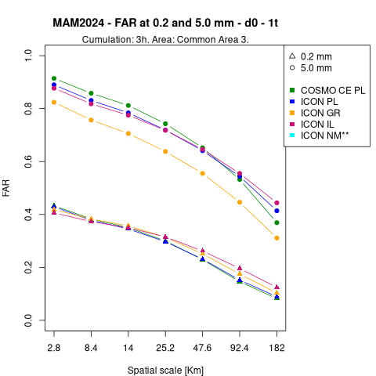
FAR – Common area 3
ALL SEASONS
All the models are close to eachother at 0.2 mm/3h
JJA, MAM
ICON GR best for the 5 mm/3h threshold
ICON IL among the worst at 5 mm/3h for large boxes.
SON, DJF
All the models are close to eachother at 5 mm/3h
Variety among the best models
JJA
ICON GR among the worst for the 0.2 mm/3h threshold
DJF
COSMO CE PL always the worst for the 5 mm/3h threshold
14
September the 2nd 2024 - 26th COSMO General Meeting - Offenbach

Slide 33
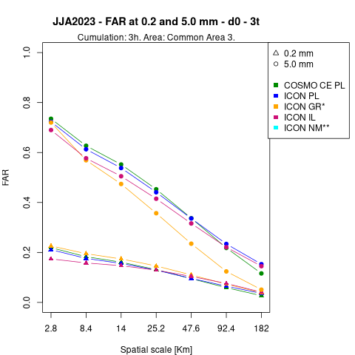
FAR – Common area 3
ALL SEASONS
All the models are close to eachother at 0.2 mm/3h
JJA, MAM
ICON GR best for the 5 mm/3h threshold
ICON IL among the worst at 5 mm/3h for large boxes.
SON, DJF
All the models are close to eachother at 5 mm/3h
Variety among the best models
JJA
ICON GR among the worst for the 0.2 mm/3h threshold
DJF
COSMO CE PL always the worst for the 5 mm/3h threshold
14
September the 2nd 2024 - 26th COSMO General Meeting - Offenbach

Slide 34
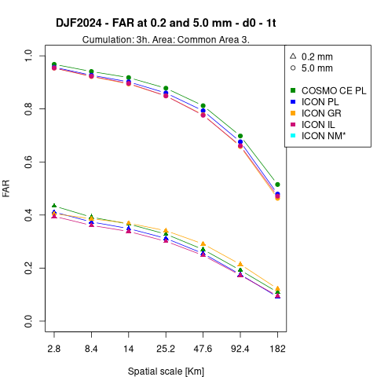
FAR – Common area 3
ALL SEASONS
All the models are close to eachother at 0.2 mm/3h
JJA, MAM
ICON GR best for the 5 mm/3h threshold
ICON IL among the worst at 5 mm/3h for large boxes.
SON, DJF
All the models are close to eachother at 5 mm/3h
Variety among the best models
JJA
ICON GR among the worst for the 0.2 mm/3h threshold
DJF
COSMO CE PL always the worst for the 5 mm/3h threshold
14
September the 2nd 2024 - 26th COSMO General Meeting - Offenbach

Slide 35
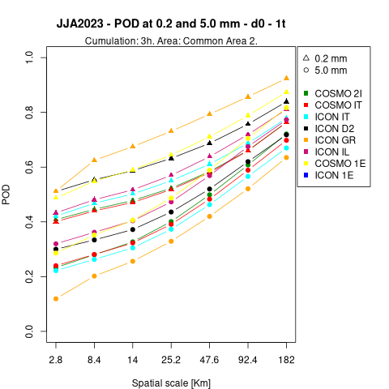
POD – Common area 2
JJA, SON, DJF
ICON IT, COSMO IT and COSMO 2I always among the worst
JJA, SON, MAM
Values very close between the two thresholds for very large boxes
JJA, MAM
ICON GR best for the 0.2 mm/3h thresholds, but worst at 5 mm
ICON IL always among the best for the 5 mm/3h threshold
SON, DJF
ICON GR always the best
ICON IL often among the worst for the 0.2 mm/3h threshold
JJA
COSMO 1E always among the best
15
September the 2nd 2024 - 26th COSMO General Meeting - Offenbach

Slide 36
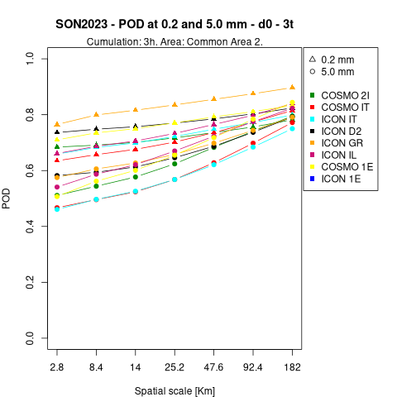
POD – Common area 2
JJA, SON, DJF
ICON IT, COSMO IT and COSMO 2I always among the worst
JJA, SON, MAM
Values very close between the two thresholds for very large boxes
JJA, MAM
ICON GR best for the 0.2 mm/3h thresholds, but worst at 5 mm
ICON IL always among the best for the 5 mm/3h threshold
SON, DJF
ICON GR always the best
ICON IL often among the worst for the 0.2 mm/3h threshold
JJA
COSMO 1E always among the best
15
September the 2nd 2024 - 26th COSMO General Meeting - Offenbach

Slide 37
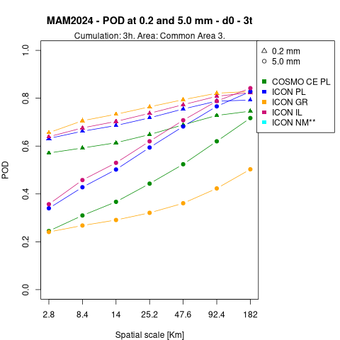
POD – Common area 3
ALL SEASONS
ICON GR best for the 0.2 mm/3h threshold
JJA, SON, MAM
Reasults always very mixed
JJA, DJF, MAM
ICON GR almost always the worst at 5 mm/3h
JJA, MAM
5 mm/3h: ICON IL and ICON PL very close to eachother and COSMO CE PL and ICON GR much lower
At bigger scales results for the 0.2 and 5 mm/3h thresholds, results are very close to eachother
SON
COSMO CE PL almost always the worst
ICON GR worsens by increasing the dimension of the boxes at 5 mm/3h
ICON IL is the best for the 5 mm/3h threshold
MAM
0.2 mm/3h: all the models are very similar with the exception of COSMO CE PL, which is lower
16
September the 2nd 2024 - 26th COSMO General Meeting - Offenbach

Slide 38
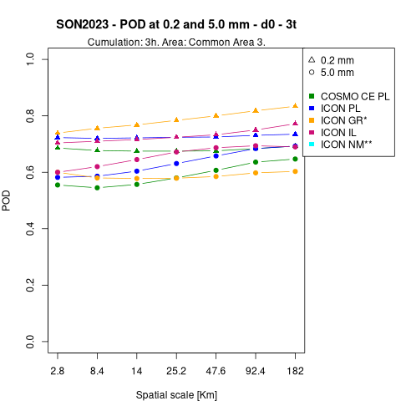
POD – Common area 3
ALL SEASONS
ICON GR best for the 0.2 mm/3h threshold
JJA, SON, MAM
Reasults always very mixed
JJA, DJF, MAM
ICON GR almost always the worst at 5 mm/3h
JJA, MAM
5 mm/3h: ICON IL and ICON PL very close to eachother and COSMO CE PL and ICON GR much lower
At bigger scales results for the 0.2 and 5 mm/3h thresholds, results are very close to eachother
SON
COSMO CE PL almost always the worst
ICON GR worsens by increasing the dimension of the boxes at 5 mm/3h
ICON IL is the best for the 5 mm/3h threshold
MAM
0.2 mm/3h: all the models are very similar with the exception of COSMO CE PL, which is lower
16
September the 2nd 2024 - 26th COSMO General Meeting - Offenbach

Slide 39
Conclusions
ALL SEASON RESULTS
ETS: At the bigger scales the results for the 5 mm/3h threshold reach those for the 0.2/3h mm threshold (both areas)
FAR: ICON GR overestimates for the 0.2 mm/3h threshold (both areas)
POD: ICON GR best for the 0.2 mm/3h threshold (Common Area 3)
In winter all the model results tend to be close to eachother
When verifying the same season, models that appear in both configurations behave differently according to the verified area
When verifying the same common area, models behave very differently according to the season
17
September the 2nd 2024 - 26th COSMO General Meeting - Offenbach

Slide 40
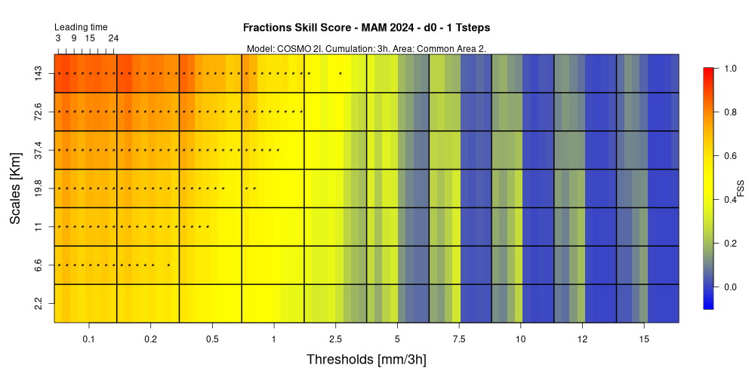
Lead time verification
How do you propose to make a comparison among the models by using the newly available data from the lead time?
17
September the 2nd 2024 - 26th COSMO General Meeting - Offenbach

Slide 41
THANK YOU FOR YOUR ATTENTION!
Please send all your comments and questions to:
naima.vela@arpa.piemonte.it
18
September the 2nd 2024 - 26th COSMO General Meeting - Offenbach

