Slide 1
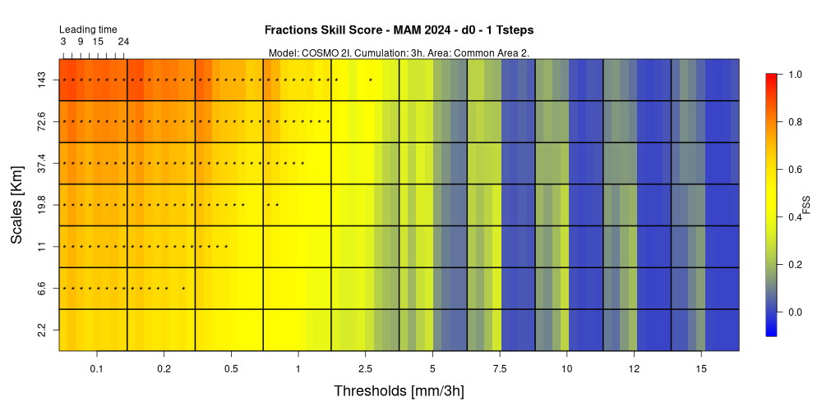
VAST 3.0 – QUICK OVERVIEW
Naima Vela¹
¹ Arpa Piemonte, Torino, Italy
September the 2nd 2024 - 26th COSMO General Meeting - Offenbach

Slide 2
WHAT IS VAST 3.0
VAST 3.0 is a software package composed by Bash, Fortran 90 and R scripts
Main Components: 3 bash scripts, 3 Fortran 90 scripts (and 1 README pdf)
Purpose: Fuzzy verification of precipitation
INPUT: GRIB files (forecast and observation)
OUTPUT: heatmap plots
September the 2nd 2024 - 26th COSMO General Meeting - Offenbach

Slide 3
REQUIRED SOFTWARE
The grib files are elaborated using CDO functions (https://code.mpimet.mpg.de/projects/cdo/wiki/Cdo#Documentation)
The ECMWF package “grib_api” or “ecCodes” is needed by the user to elaborate the grib files (https://www.ecmwf.int/en/elibrary/80529-grib-api , https://confluence.ecmwf.int/display/ECC )
Part of the fuzzy elaboration is run through Fortran 90 scripts compiled using the gfortran compiler (https://gcc.gnu.org/onlinedocs/gfortran/)
The plots are created by VAST using R (https://www.r-project.org/) A version 3.0 or higher is required.
September the 2nd 2024 - 26th COSMO General Meeting - Offenbach

Slide 4
INPUT FILES
VAST 3.0 works with GRIB files
The GRIB files must contain only the precipitation variable
One file per day
Hourly messages
Area covered by the GRIB must be wider than the one chosen for verification
FORECAST
Run 00
Cumulated precipitation since the beginning of the run
Naming: mmm00_YYYYMMDD.grb (mmm=3 letter code for model name)
OBSERVATION
Hourly precipitation in each message
Naming: YYYYMMDD.grb
September the 2nd 2024 - 26th COSMO General Meeting - Offenbach

Slide 5
STRUCTURE
VAST 3.0 is composed by 3 main sections, each one driven by a Bash script
VAST_3_0_main.sh Reads the input GRIB files and produces partial
results used by the other two scripts (TXT)
make_fss_period_VAST_3_0.sh Reads the partial files produced by the main script
and produces FSS plots for the required period
contingency_statistics_VAST_3_0.sh Reads the partial files produced by the main script
and produces plots of the chosen categorical score
A Fortran script is associated to each Bash section to perform the elaboration.
The configuration files needed by the Fortran scripts are produced and replaced by the Bash scripts according to the user’s requests.
All Bash scripts require the user to input a list of option to produce the verification. All options are mandatory (no dafault).
September the 2nd 2024 - 26th COSMO General Meeting - Offenbach

Slide 6
VAST_3_0_MAIN.SH / 1
OPTIONS:
-s [YYYYMMDD] starting date
-e [YYYYMMDD] ending date
-m [aaa] code of the model to be verified
-t [1t/3t] 2D verification/ 3D verification
-d [d0/d1] first 24h verification/second 24h verification
-l [LT/24] Lead time (only compatible with 1t) /24h with 3 hourly cumulation
-D [a] single character to identify the verification
-a [a2/a3/new] verification area.
a2-> Common area 2, 2.8 Km
a3-> Common area 3, 2.8 Km
new-> different area (insert required parameters in the script)
-r [Y/N] remove or keep partial files (heavy on disk, not needed at the end of the verification) MODELS: COSMO 2I (-m c22), ICON IT (ico), ICON 2I (i22), COSMO 1E (c1e),
COSMO CE PL (ccp), ICON PL (ipl), ICON D2 (id2), ICON IL (il4), ICON GR (igr)
September the 2nd 2024 - 26th COSMO General Meeting - Offenbach

Slide 7
VAST_3_0_MAIN.SH / 2
OUTPUT:
The script produces TXT files with partial results to be used to create FSS and/or categorical scores aggregation
For Fraction Skill Score calculation:
fss_YYYYMMDD_mmmtt_dd_3hd_ts.txt (mmm=model, tt=1t/3t, dd=d0/d1, d=suffix, ts=03/06/09/…) sample: fss_20240304_c221t_d0_3h2_18.txt
For categorical score calculation:
contingency_YYYYMMDD_mmmtt_dd_3hd_ts.txt sample: contingency_20240304_c221t_d0_3h2_18.txt
2D or 3D verification:
1t -> 8 files/day (LT or 24 option available)
3t -> 1 file/day (only 24 option available)
September the 2nd 2024 - 26th COSMO General Meeting - Offenbach

Slide 8
MAKE_FSS_PERIOD_VAST_3_0.SH / 1
OPTIONS:
-s [YYYYMMDD] starting date
-e [YYYYMMDD] ending date
-m [aaa] code of the model to be verified
-t [1t/3t] 2D verification/ 3D verification
-d [d0/d1] first 24h verification/second 24h verification
-D [a] single character to identify the verification
-a [a2/a3/new] verification area.
a2-> Common area 2
a3-> Common area 3
new-> different area (the procedure will ask to insert the long name)
-g [num] side of the smallest box (Km) (same of the one used in the main script)
-l [LT/24] Lead time (only compatible with 1t) /24h with 3 hourly cumulation
MODELS: COSMO 2I (-m c22), ICON IT (ico), ICON 2I (i22), COSMO 1E (c1e),
COSMO CE PL (ccp), ICON PL (ipl), ICON D2 (id2), ICON IL (il4), ICON GR (igr)
September the 2nd 2024 - 26th COSMO General Meeting - Offenbach

Slide 9
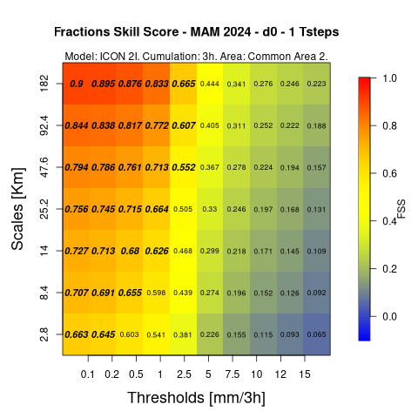
MAKE_FSS_PERIOD_VAST_3_0.SH / 3
OUTPUT:
The script produces the Fractions Skill Score heatmap plots according to the user’s selection
-l 24
September the 2nd 2024 - 26th COSMO General Meeting - Offenbach

Slide 10
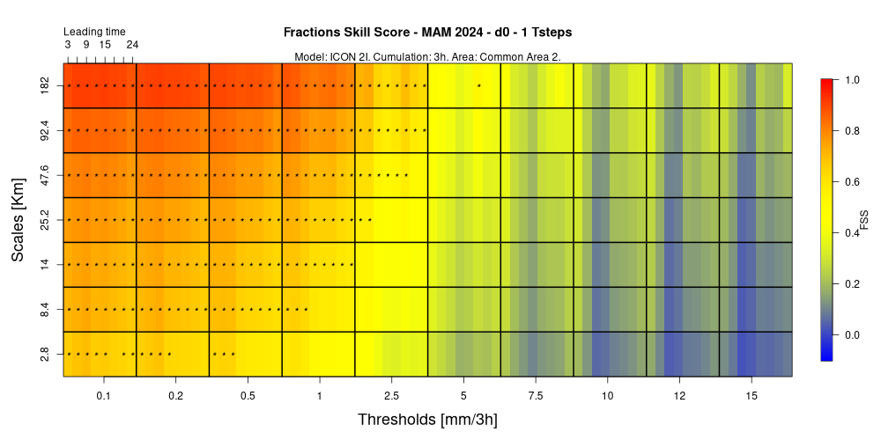
MAKE_FSS_PERIOD_VAST_3_0.SH / 3
OUTPUT:
The script produces the Fractions Skill Score heatmap plots according to the user’s selection
-l LT
September the 2nd 2024 - 26th COSMO General Meeting - Offenbach

Slide 11
MAKE_FSS_PERIOD_VAST_3_0.SH / 3
OUTPUT:
The script produces the Fractions Skill Score heatmap plots according to the user’s selection
-l LT
September the 2nd 2024 - 26th COSMO General Meeting - Offenbach

Slide 12
CONTINGENCY_STATISTICS_VAST_3_0.SH / 1
OPTIONS:
-s [YYYYMMDD] starting date
-e [YYYYMMDD] ending date
-m [aaa] code of the model to be verified
-t [1t/3t] 2D verification/ 3D verification
-d [d0/d1] first 24h verification/second 24h verification
-D [a] single character to identify the verification
-a [a2/a3/new] verification area.
a2-> Common area 2
a3-> Common area 3
new-> different area (the procedure will ask to insert the long name)
-g [num] side of the smallest box (Km) (same of the one used in the main script)
-l [LT/24] Lead time (only compatible with 1t) /24h with 3 hourly cumulation
-i [FBI/ETS/FAR/POD] Categorical score to be plotted
MODELS: COSMO 2I (-m c22), ICON IT (ico), ICON 2I (i22), COSMO 1E (c1e),
COSMO CE PL (ccp), ICON PL (ipl), ICON D2 (id2), ICON IL (il4), ICON GR (igr)
September the 2nd 2024 - 26th COSMO General Meeting - Offenbach

Slide 13
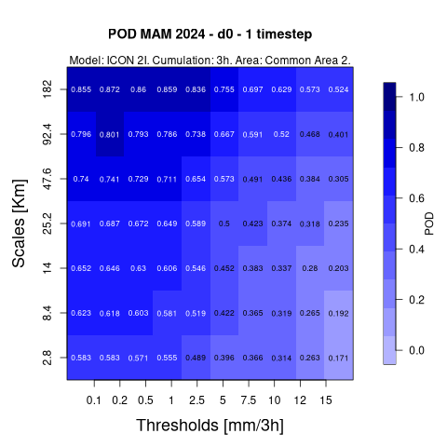
CONTINGENCY_STATISTICS_VAST_3_0.SH / 2
OUTPUT:
The script produces the heatmap plots for the chosen score according to the user’s selection
-l 24
September the 2nd 2024 - 26th COSMO General Meeting - Offenbach

Slide 14
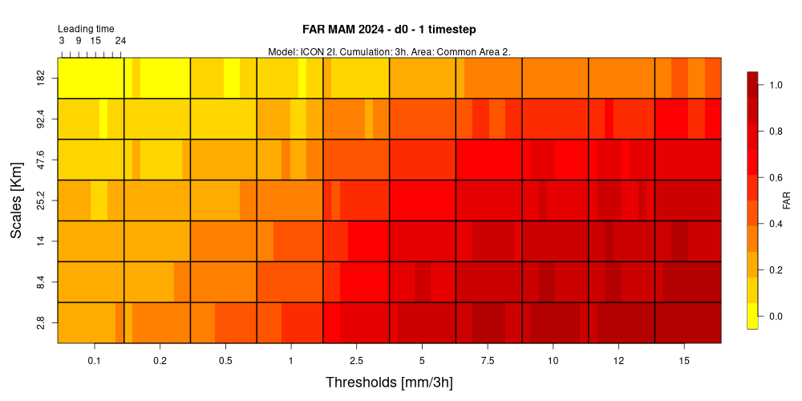
CONTINGENCY_STATISTICS_VAST_3_0.SH / 3
OUTPUT:
The script produces the heatmap plots for the chosen score according to the user’s selection
-l LT
September the 2nd 2024 - 26th COSMO General Meeting - Offenbach

Slide 15
THANK YOU FOR YOUR ATTENTION!
Please send all your comments and questions to:
naima.vela@arpa.piemonte.it
September the 2nd 2024 - 26th COSMO General Meeting - Offenbach

