Slide 1
Update CP GM 2024
Ioan-Stefan GABRIAN
26th COSMO General Meeting

Slide 2
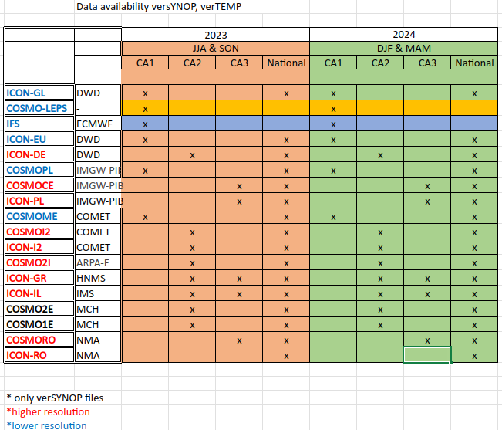
CP Activity: Score Production w/ MEC+FFV2
Notes:
1

Slide 3
CP Activity: Score Production w/ MEC+FFV2
Notes:
2

Slide 4
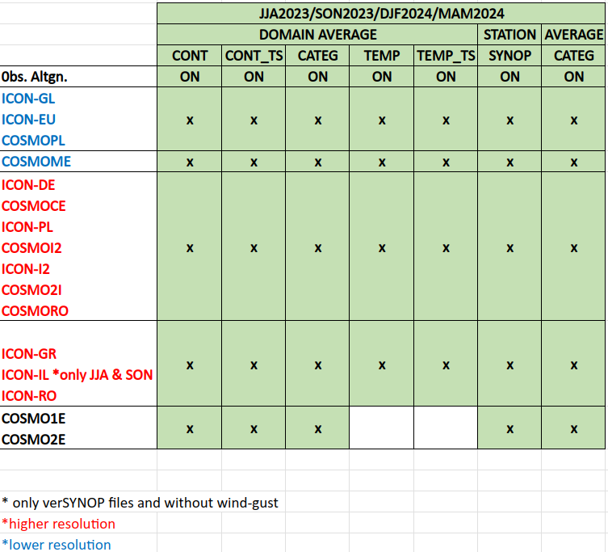
CP Activity: Score Production w/ MEC+FFV2
Notes:
2

Slide 5
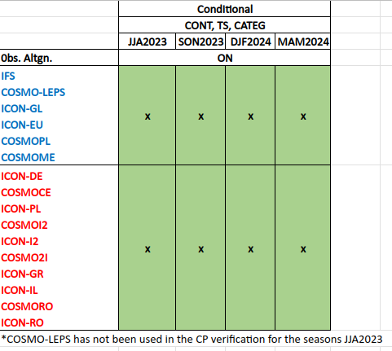
CP Activity: Score Production w/ MEC+FFV2
Notes:
3

Slide 6
Issues (Tackled and On-going)
MEC for IFS – solved . After a colaboration with Anlauf Harald and NMA colleagues in utilizing the DACE system on ECMWF ATOS HPC the MEC has received a bug fix and now a specific branch of MEC can produce the FF from IFS. Documented process to use MEC on IFS can be found in the Guidelines for MEC produced in the PP CARMENS.
Scores from SON23, DJF24, and MAM24 on-going. Solved issues with DWD model missing FF and with the FTP server (to many FF in the folders of the DWD models).
The conditional verification for the period JJA2022-MAM2023 was performed with FFV2 software
The new ICON-PL dataset for MAM24 is not usable.
Curentlly, NMA exterior VM does not have access to the DURA HPC to upload the Scorefiles.
Issue partially solved with Theodore sugestion to use command line function wget.
Namelist must be carefully adapted to include all the members, and for the members that uploaded all the FF to have all the verifications available. (Multiple runs for most domains)
Since JJA23 the Common Area Evaluation will include the IFS scores. FF produced by Stefan Gabrian. (Solved Issue with TEMP verification)
Since SON23 The Common Area Evaluation includes the control run of COSMO-LEPS. FF produced by Flora Gofa.
Notes:
4

Slide 8
Systematic issues with the Feedback Files
MCH's COSMO1E and COSMO2E do not produce the parameters that are verified in the in the Common Plot activities (wind gust) and do not produce the feedback files with the TEMP observation
HNMS's ICON-GR had poor availability since the previous GM but for MAM2024 there are no missing files.
The NMA team have to email all COSMO members, apart for DWD, for every new season of data. A deadline of 1 month would help the team to fix any issue that may occur.
File names - An issue that NMA team has to work through every season is the different names formats the COSMO members are producing.
Models/ Members | Issues
DWD,IMS,HNMS... | Standard-Example: verTEMP.YYYMMDDHH verSYNOP.YYYMMD
Arpae | Archive with many subsequent directories ~/COSMO-2I_MAM_2024/OUTPUT/YYYMMDDHH/cosmo_2I/run
COMET | Files come in separate archives for months and type of verification (TEMP and SYNOP) Files end in the standard name with the sufix _(model)_cp
IMGW | Separate TEMP and SYNOP archives
MCH | Format of the FF name is: verSYNOP_YYYMMDDHHMMSS.nc verTEMP_YYYMMDDHHMMSS.nc
Notes:
6

Slide 9
Excel file documenting the missing FF
From the discussions with Cristoph Gebhart for the SMC in June the necessity of a documentation with a detailed rapport of the available FF from each COSMO Member. The average is ~16.6% missing.
A document with all the missing FF accounted can be found at the link: Situation_FF-CP_GM2024
*Lacking TEMP obs over Romania
Notes:
7

