Slide 1

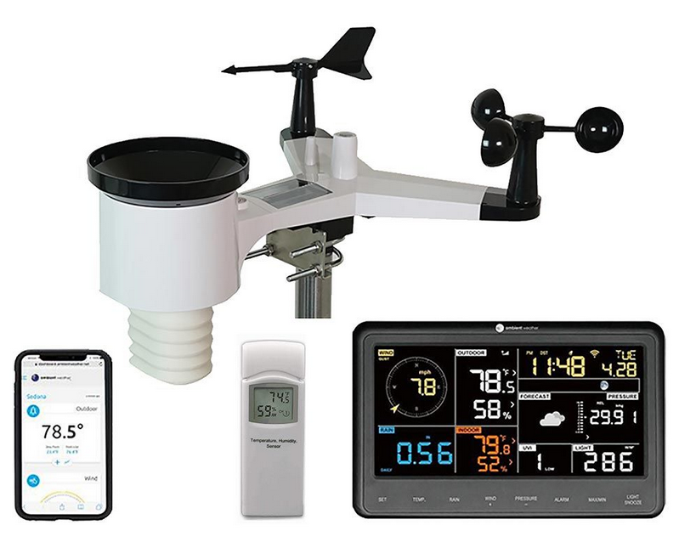




IMGW-PIB: Joanna Linkowska, Jan Szturc, Anna Jurczyk, Katarzyna Ośródka, Marcin Grzelczyk
CIMA: Massimo Milelli, Elena Oberto, Umberto Pellegrini, Francesco Uboldi
CNMCA: Francesco Sudati
September 2024
Priority Task: EPOCS (Evaluate Personal Weather Station and Opportunistic Sensor Data CrowdSourcing)
Final summary

Slide 2
COSMO PT EPOCS Tasks
1. PWS databases survey and exploitation
2. QC algorithms for precipitation
3. Analysis of PWS based gridded rainfall products
4. Suggestions for the follow up activities
(all tasks completetd)

Slide 3
COSMO PT EPOCS Tasks
1. PWS databases survey and exploitation
1.1 Comprehensive survey of available data platforms at the European and Global level.
Participants: Marcin Grzelczyk, Francesco Sudati, Massimo Milelli (March 2023 - June 2023)
1.2 Testing the process of collection of a real-time PWS data (from IMGW-PIB employees that are using their own stations) by starting new internal database server.
Participant: Marcin Grzelczyk (March 2023 – October 2023)
1.3 Testing integrity and correctness of stored data,
assess usefulness of external databases/projects (CENAGIS).
Participant: Marcin Grzelczyk (November 2023 – February 2024)
1.4 Analysis of the mobile PWS sensors: testing QC proprieties of a new mobile weather sensors from Meteotracker.
Participants: Francesco Sudati, Massimo Milelli (March 2023 - February 2024)

Slide 4
COSMO PT EPOCS Tasks
2. QC algorithms for precipitation
2.1 Development and testing automatic QC methods based on the RainGaugeQC algorithms developed at IMGW-PIB.
Participants: Katarzyna Ośródka, Jan Szturc, Anna Jurczyk (March 2023 - February 2024)
2.2 Testing and application of the open-source software package TITAN for a quality control of ground data.
Participants: Elena Oberto, Umberto Pellegrini (March 2023 - February 2024)
Purpose: potential of further use of PWS for data assimilation in NWP/Nowcasting models or verification of model forecast.

Slide 5
COSMO PT EPOCS Tasks
3. Analysis of PWS based gridded rainfall products
3.1 Processing different rainfall data sources (private rain gauges, commercial microwave links, sewer/water service stations, etc.)
Participants: Katarzyna Ośródka, Anna Jurczyk, Jan Szturc (March 2023 - February 2024)
Combine PWS with other standard data (telemetry, radar, satellite) into new enhanced rainfall estimates (RainGRS+)
3.2 Reliability analysis of a gridded RainGRS+ high-resolution estimates of precipitation.
Participant: Joanna Linkowska (September 2023 - February 2024)
Sample data of RAINGRS+ and RAINGRS (without PWS) fields will be verified against chosen independent precipitation data.

Slide 6
COSMO PT EPOCS Tasks
4. Suggestions for the follow up activities
Coordinated by: Joanna Linkowska
  Planning a collaboration for a longer Priority Project (PP)
  Assessment for application of project results in supporting other COSMO R&D activities:
    forecast verification,
    data assimilation of NWP/Nowcasting models,
    postprocessing (machine learning), etc.

Slide 7

1.1 Comprehensive survey of available data platforms
at the European and Global level (Marcin Grzelczyk)
Web service | PWS network in PL | Law | API | Frequency | Start
https://www.wunderground.com | >1000 | Non-commercial, individal usage | Yes, professional | 1-60min | 1995 (1993)
https://app.weathercloud.net | 773 | <30 dni: manualne sprawdzenie PWS >30dni: dane prywatne | No | 60min | 2015
https://www.awekas.at | 90 | Can not be used | No | 60min | 2004
https://www.pwsweather.com https://www.aerisweather.com | 61 | Only commercial usage | Yes, professional | 1-30min | 2014
​There are several web services collecting PWS data​ covering Europe and Worldwide​
All parameters in a selected areas were checked​
Checked API as interface of downloading and collecting data​
Paid plan available for commercial purposes depends on frequency of downloading the data and a purpose of its usage
Web service | PWS network in PL | Law | API | Frequency | Start
https://openweathermap.org/ | b.d. | Non commercial up to 1 GET/min | Yes, professional | 1-60min | 2014
https://www.meteomatics.com | b.d. | Non commercial up to 0,3 GET/min | Tak, profesjonalne | 1-60min | 2012 (1979)
https://www.weatherapi.com/ | b.d. | Non commercial up to 0,4 GET/min | Tak, profesjonalne | 10-15min | 2019
https://www.google.com
https://medium.com/@imdipto/best-free-alternatives-to-the-wunderground-weather-api-21acb22450e6

Slide 8
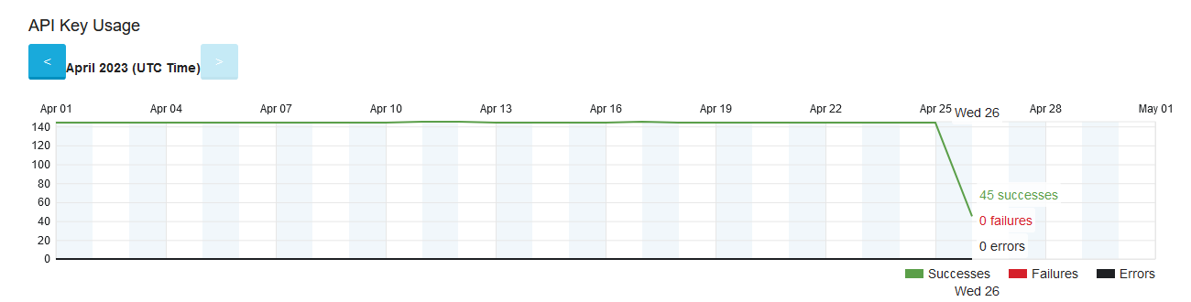
1.2 Testing the process of collection of a real-time PWS data (IMGW-PIB employees stations) by starting new internal database server (Marcin Grzelczyk)
10 PWS stations operated by IMGW PIB employees have been established.​
A virtual server named "pwsimgw" has been set up within IMGW-PIB.​
Data collection and storage processes are functioning without errors or issues.​
The server has been tested using PWS data from an external service (Wunderground), with 100% of the information successfully downloaded.​
The main data formats (JSON and XML) have been checked and tested.
An example of data access via API:
https://api.weather.com/v2/pws/observations/all/1daystationId=IMAZOWIE62&format=json&units=e&apiKey= [CLIENT_SECRET]
Station ID:
Access to API with no errors:

Slide 9
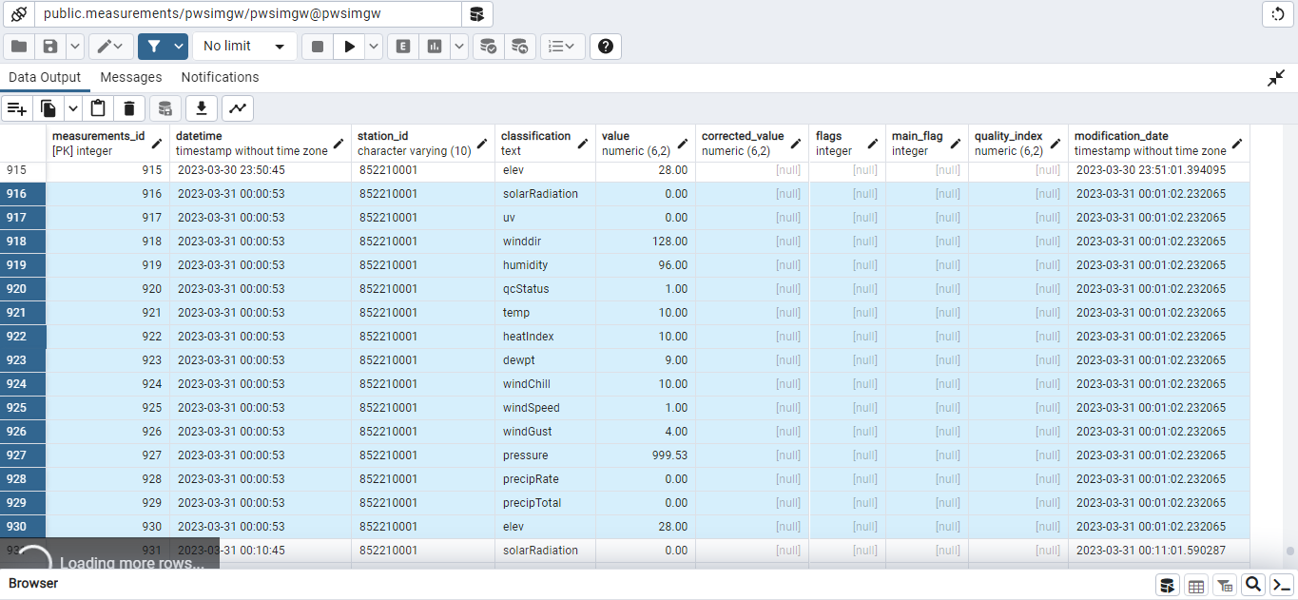
1.3 Testing integrity and correctness of stored data, assess usefulness of external databases/projects (CENAGIS) (Marcin Grzelczyk)
data are storaged in non SQL database (pwsimgw),
Data Base frequency is 10min with all available parameters also possibility of cooperation with Cenagis (Centre for Scientific Geospatial Analyses and Satellite Computations) to provide an infrastructure for the backup PWS database

Slide 10

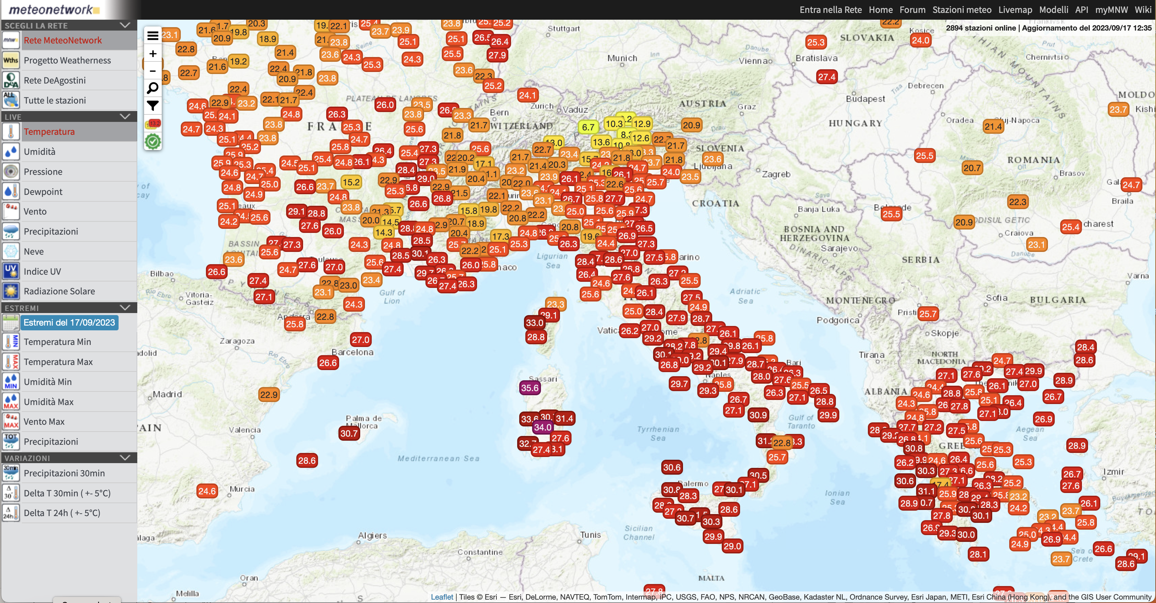
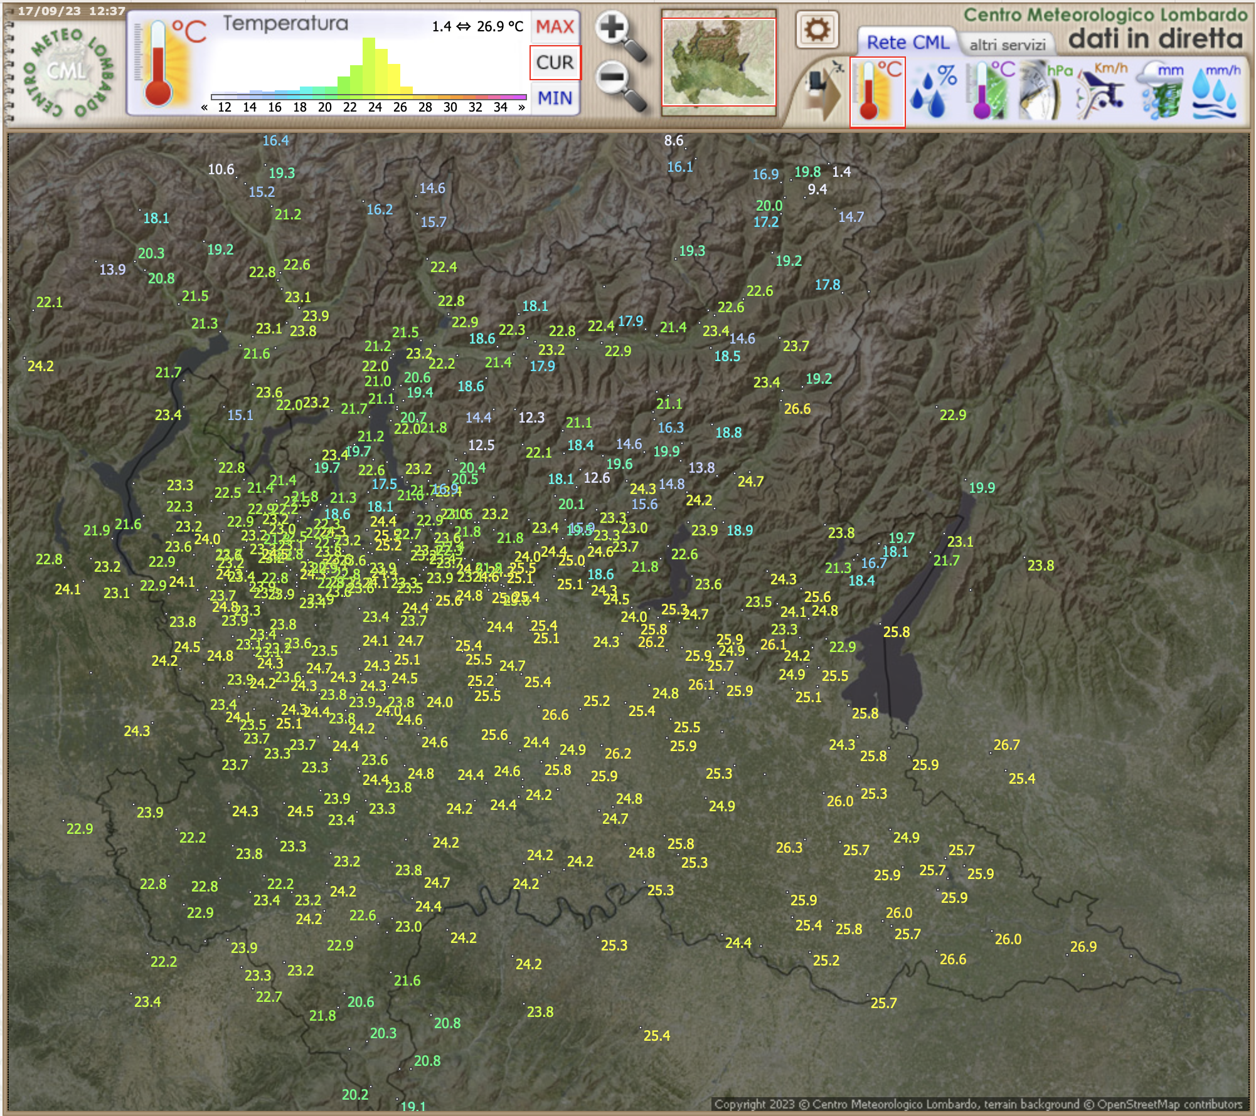
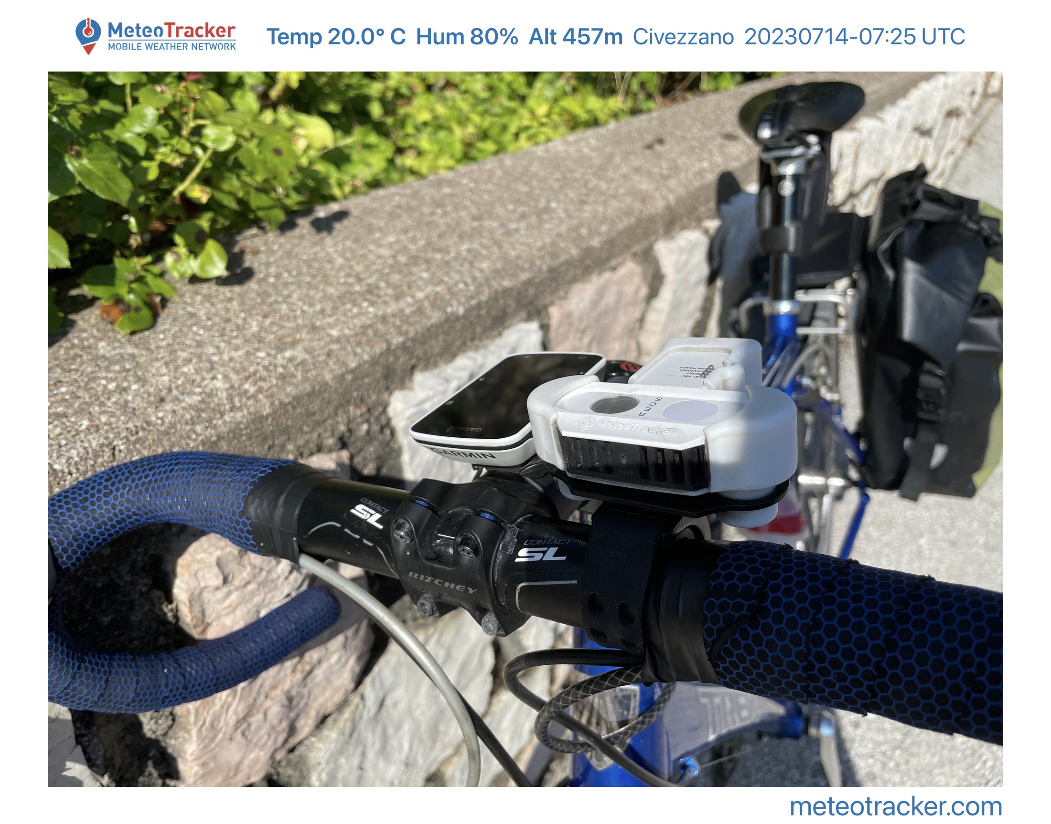
1.4 Analysis of the mobile PWS sensors: testing QC proprieties of a new mobile weather sensors from Meteotracker (Francesco Saudati)
Objective and work plan
Carry out an initial qualitative quality control on the data of the two measurements networks: MeteoNetwork and Centro Meteorologico Lombardo.
Establish an agreement with associations of meteorology enthusiasts.
Testing “Meteotracker” instrument with specific campaigns.
Build the IT infrastructure necessary for the continuous reception of the data.
Create data acquisition scripts to get amateur measurements to be implemented in the process flows of SAPP system and convert data in BUFR format.
Create “Feedback File” that compare observation and ICON local area model.
Analysis of preliminary results useful for operational purposes.
Future developments: use PWS for post processing.
Italian/European network of WS
MeteoNetwork association (2002)
https://www.meteonetwork.it
Lombardia Region & closeness PWS
Centro Meteorologico Lombardo Association (2000)
http://www.centrometeolombardo.com
https://app.meteotracker.com/
https://meteotracker.com

Slide 11
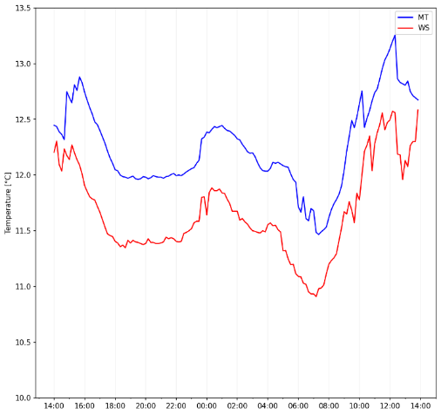
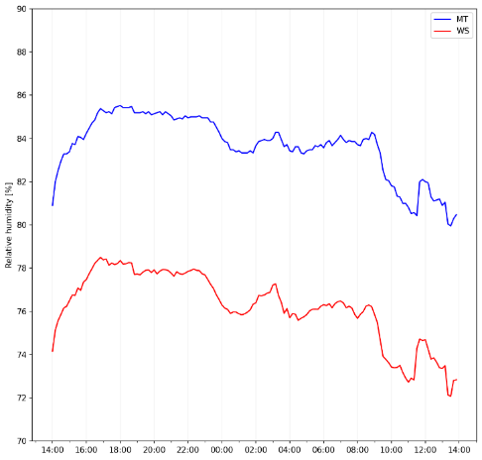
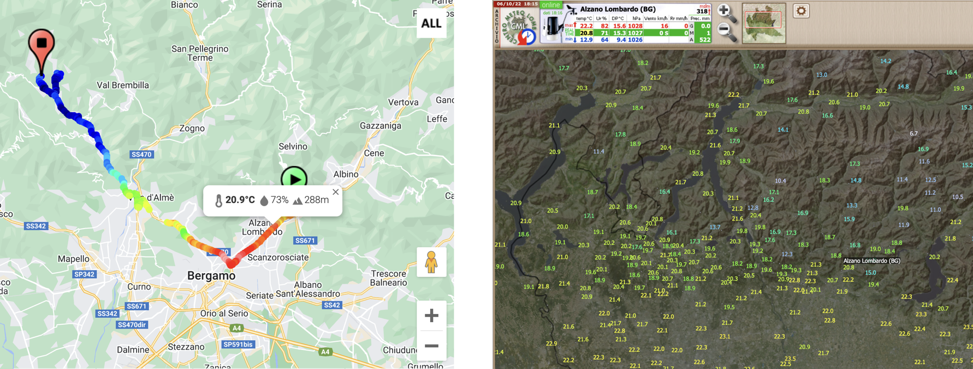
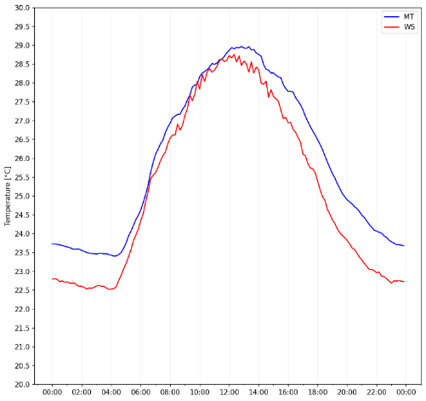
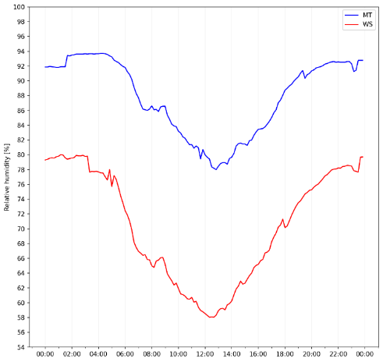
1.4 Analysis of the mobile PWS sensors: testing QC proprieties of a new mobile weather sensors from Meteotracker (Francesco Saudati)
Testing of Meteo Tracker mobile WS => QUALITY
temp
rh
Up to 10000 point recorded (275 km)
Winter period
Temperature accuracy of MT is comparable to WS (~0.5°C difference in winter and in summer)
Relative Humidity accuracy is poorer, MT tends to overestimate RH (~10% difference in winter and ~20% difference in summer);
Coherent winter and summer behaviour (overestimation of MT);
Altitude marked by the GPS is sometimes completely wrong;
Poor measures in case of rain or thick fog;
Wrong measure in case of wet snow.
Summer period
Nice application for qualitative purposes (citizen science), to be improved for more “scientific” purposes

Slide 12
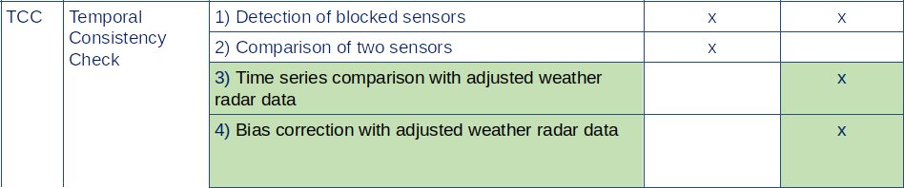
2.1 Development and testing automatic QC methods based on the RainGaugeQC algorithms developed at IMGW-PIB (K. Ośródka, J. Szturc, A. Jurczyk)
The RainGaugeQC system has been developed for the quality control of data from unprofessional networks, including private PWS, and is now being operationally implemented.
It features new QC algorithms that compare data with adjusted weather radar outputs, utilizing time series comparison and bias correction, and includes a preliminary analysis of using precipitation data from commercial microwave links (CMLs).
Netatmo data was used to test QC algorithms, but it is not operationally available to IMGW-PIB.
The reduction in the quality index (QI) of data from a given rain gauge depends on the correlation coefficient calculated for the time series (of the last 5 or 10 days) of rain gauge and radar data at that pixel.

Slide 13
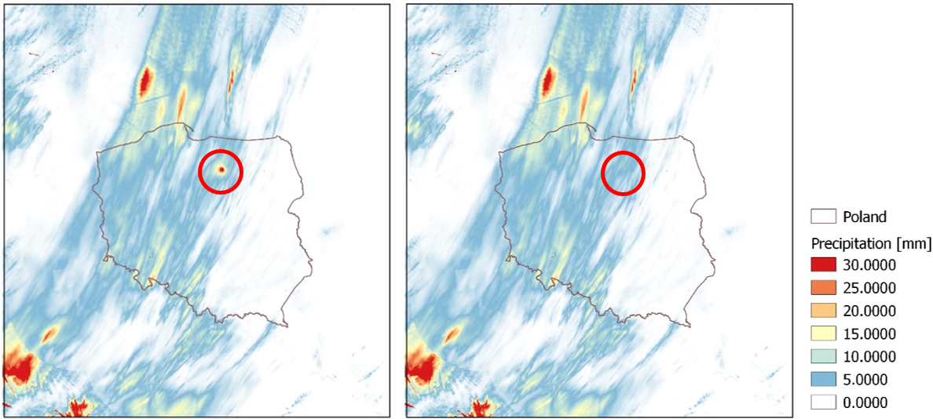
2.1 Development and testing automatic QC methods based on the RainGaugeQC algorithms developed at IMGW-PIB (K. Ośródka, J. Szturc, A. Jurczyk)
Data from the State Forests' unprofessional network is currently utilized as a component of the RBS+ system.
An agreement is in preparation with the agricultural eDWIN network (approximately 600 gauges), and work on organizing the IMGW's PWS network is also ongoing.
Example of the RainGaugeQC software performance:
Impact of reduction of the false high precipitation values observed by one of the non-professional rain gauges on RainGRS+ estimate.
Daily accumulations (in mm) applying standard (left) and improved (right) version of RainGaugeQC.
RainGRS+ domain, data from 2023-09-22.

Slide 14

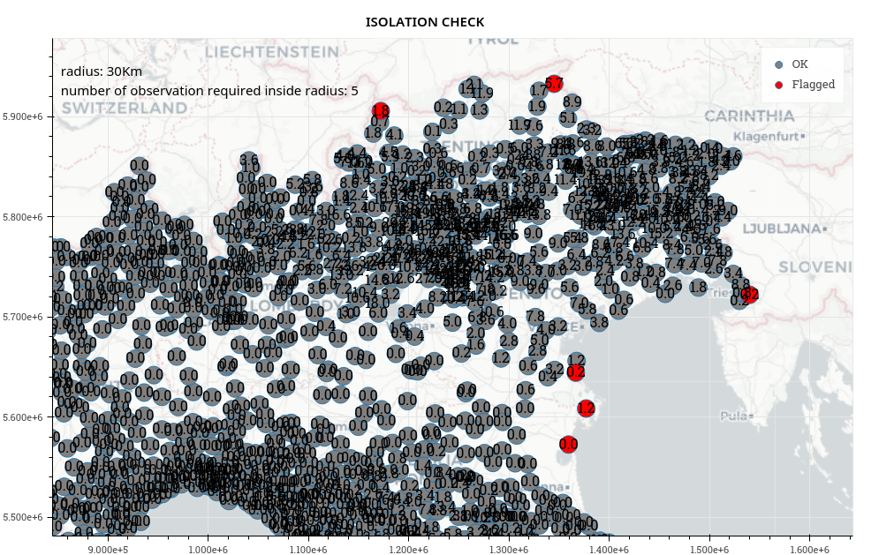
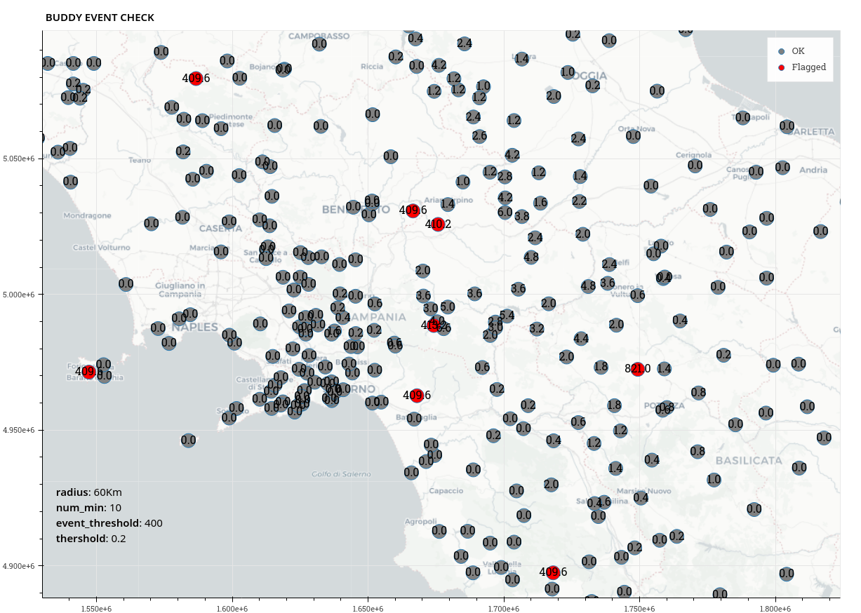
2.2 Testing and application of the open-source software package TITAN for a quality control of ground data (U. Pellegrini, E. Oberto, M. Milelli, F. Uboldi)
Objective and work plan
Testing and application of the open-source software package TITAN (www.github.com/metno/titan) for a quality control of ground data, which could be further used for data assimilation purposes or verification of model forecast
A first step: apply TITAN QC to the "official" network of stations of the Italian National Civil Department
Then to apply the results to "non-official" networks
The tests focus on precipitation
Isolation check: It requires a num_min buddies within a specified radius
Buddy event check: The observations are converted into yes/no values of exceeding a specified threshold (event_threshold).
The threshold argument in this test is minimum fraction of other observations in the neighbourhood that must agree with the observation being inspected.
TITANLIB main tests
Titanlib sequential tests on daily data/seasonal data: buddy check and buddy event check with several different configurations (depending on seasonal/weather configuration)
Titanlib range check (<0mm; >600mm) on hourly data
Completeness of daily values (rejected daily values if number of hours < 24)
Titanlib range check on daily data (>1000mm)
Titanlib isolation check (pre-operational fine tuning)

Slide 15
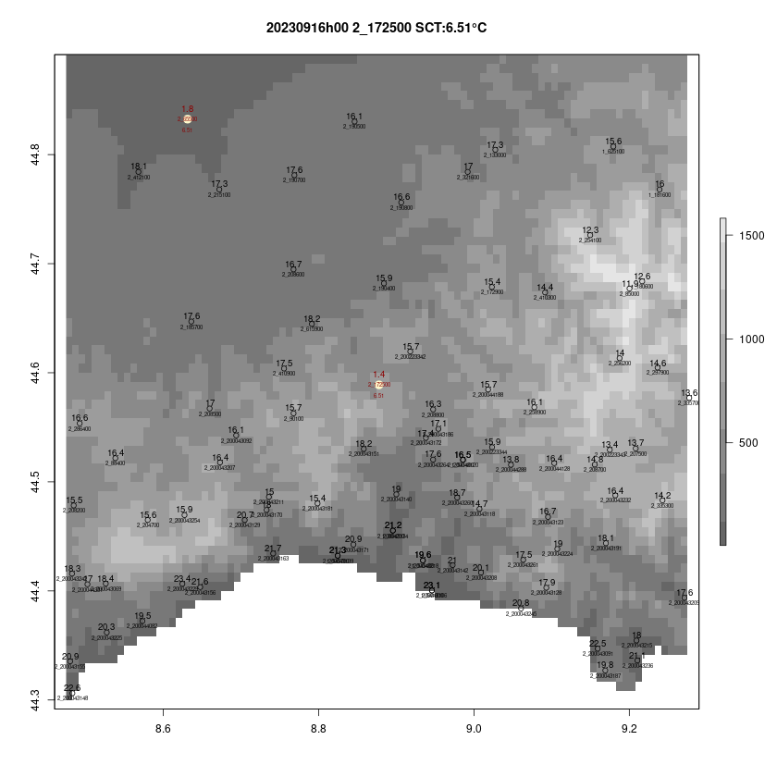
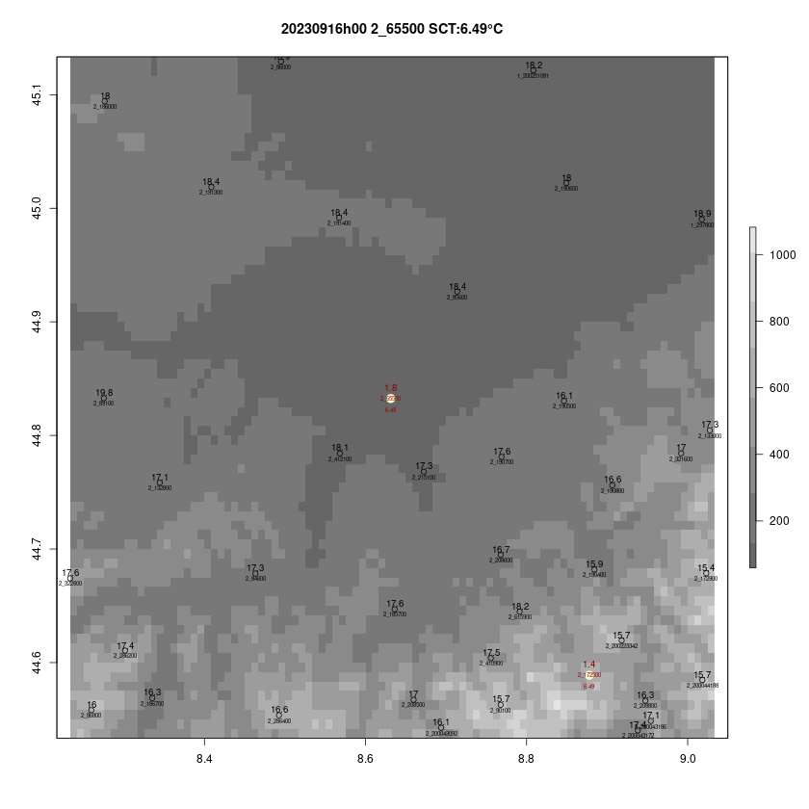
2.2 Testing and application of the open-source software package TITAN for a quality control of ground data (U. Pellegrini, E. Oberto, M. Milelli, F. Uboldi)
SUMMARY & CONCLUSION FOR THE PRECIPITATION
The tool offers both power and flexibility, allowing for a range of choices in thresholds and radius of influence.
These values depend on the network's characteristics and need to be empirically determined, with seasonal adjustments also required.
Special care is necessary for convective cases to avoid discarding accurate data during thunderstorm events.
Additionally, the tool can be applied to other variables, such as temperature.
SCT on T2m: some application for example
Future application of Titanlib & Potential follow up of the project
QC Rh%2m → to be started, studied and implemented
Titan applied to "not conventional" and free network as "meteonetwork"

Slide 16
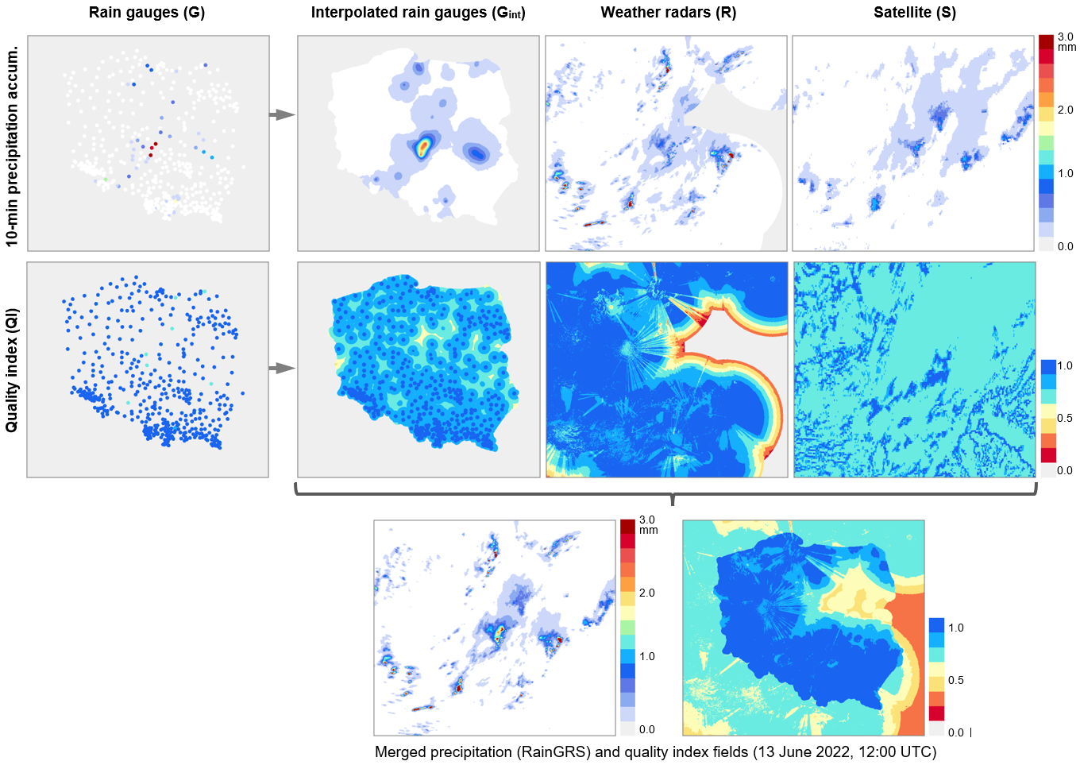
3.1 Processing different rainfall data sources (private rain gauges, commercial microwave links, sewer/water service stations, etc.) (K. Ośródka, A. Jurczyk, J. Szturc)
The RainGRS+ system was developed to generate real-time estimates of multi-source precipitation fields.
The input data are:
  IMGW rain gauge network,
  Unprofessional networks of rain gauges (Polish Forest State data)
  IMGW POLRAD radar network completed with radars from neighbouring countries (GE, CZ, SK, LT, DK),
  EUMETNET OPERA radar precipitation,
  Meteosat (NWC-SAF) based precipitation estimates (algorithm: Jurczyk et al., 2020,
  Remote Sensing).
Algorithm: a conditional merging (Sinclair and Pegram, 2005) modified by taking into account the quality information of the individual input data.

Slide 17
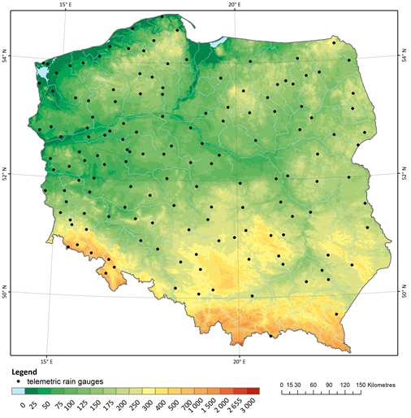
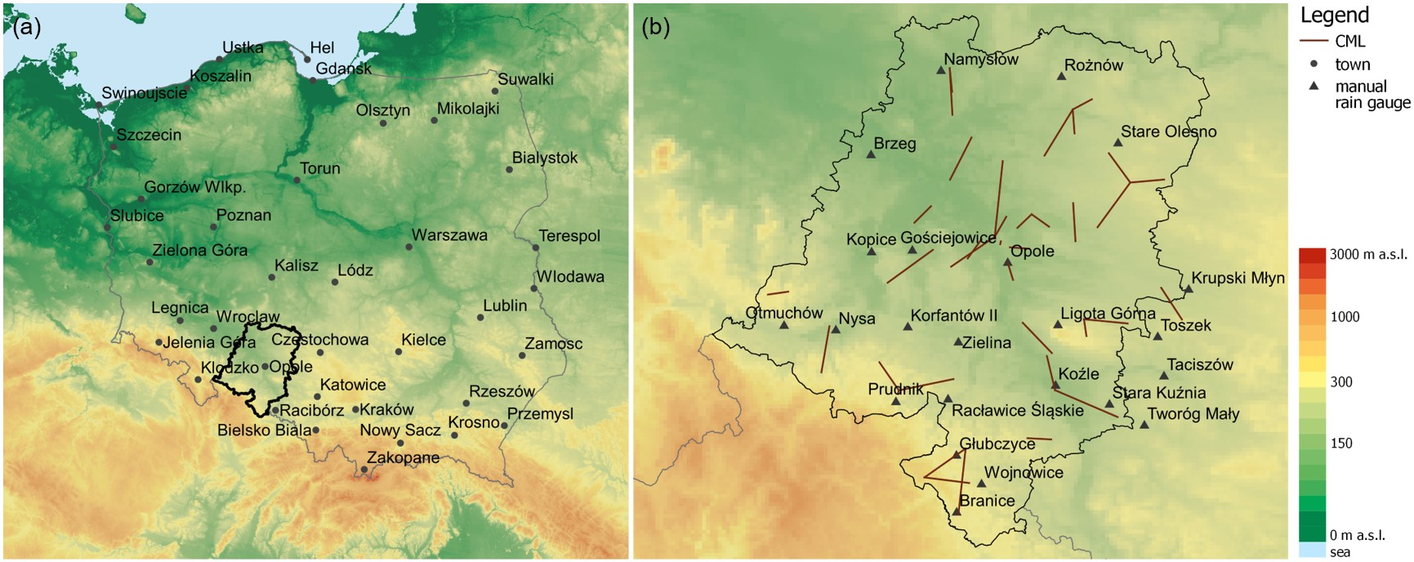
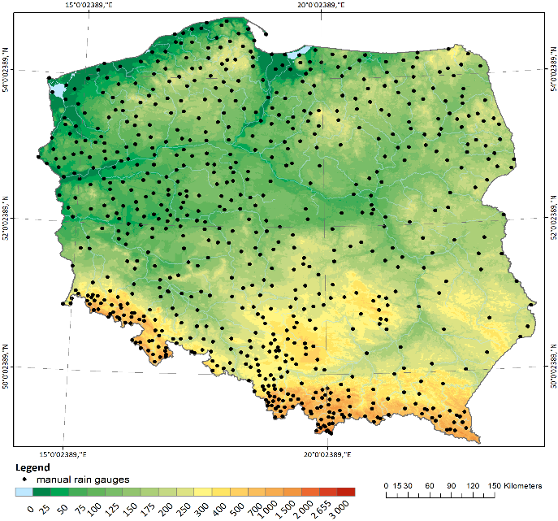
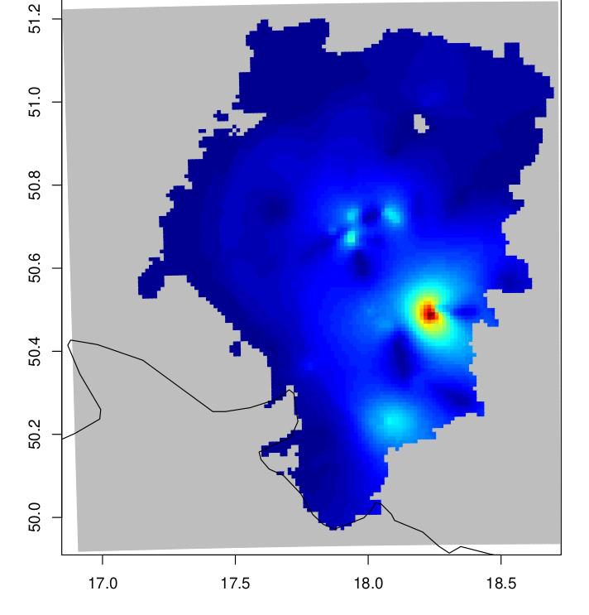
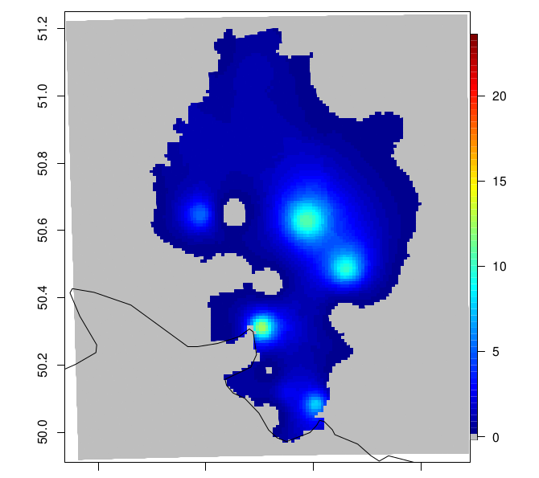
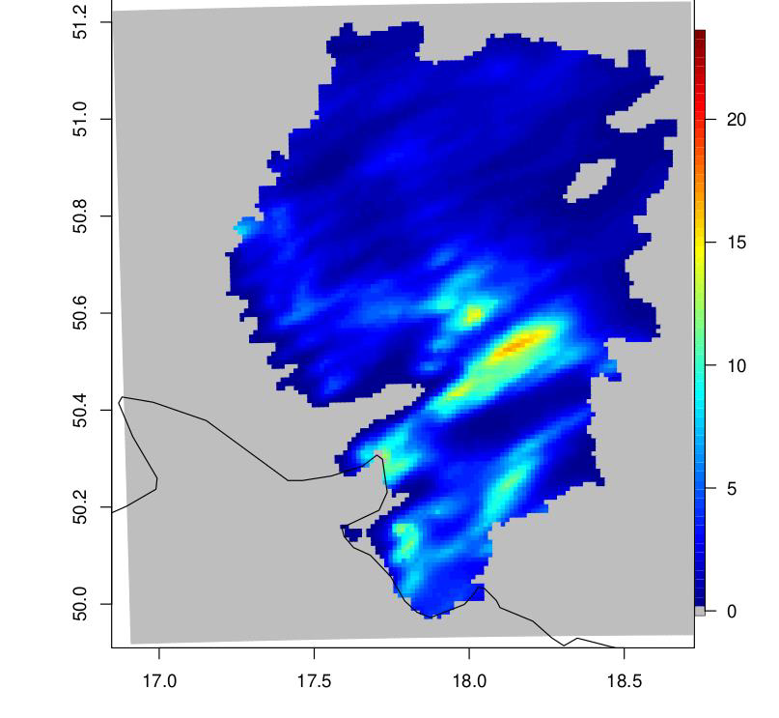
3.2 Reliability analysis of a gridded RainGRS+ high-resolution estimates of precipitation - case study 20230919 - 24h precipitation (Joanna Linkowska)
24h accum. precipitation: RainGRS, RainGRS+ data (including State Forest Data)
24h accum. CML-based precipitation
Spatial and categorical verification over the whole Poland and selected areas
Reference data: Hellman rain gauges
Polish State Forest data
CML location, Opole Voivodeship
Signal attenuation within CML sublinks determine different precipitation values.
Rain Gauges Hellmans
CML
Hellmans Rain Gauges
Rain GRS

Slide 18
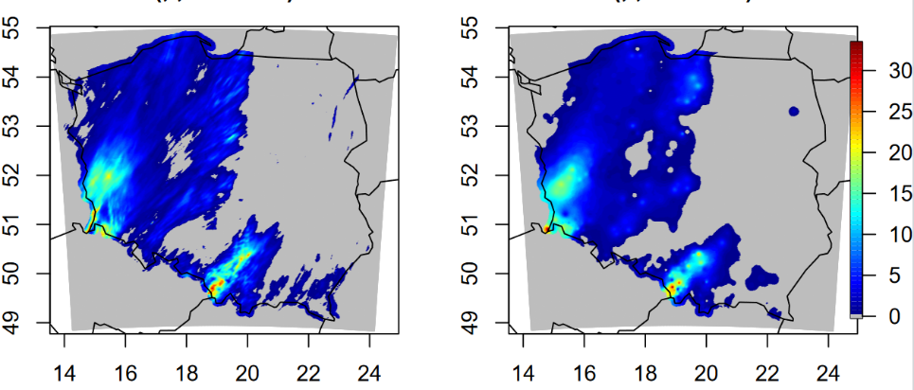
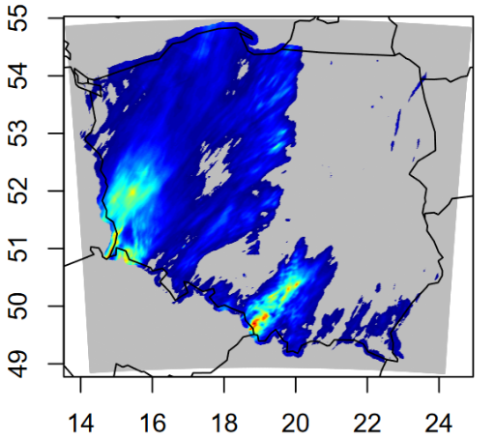
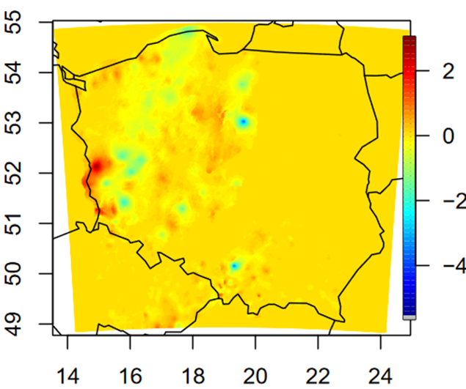
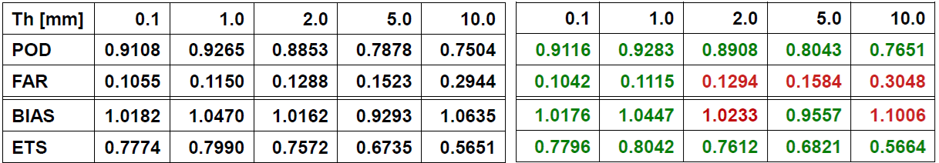
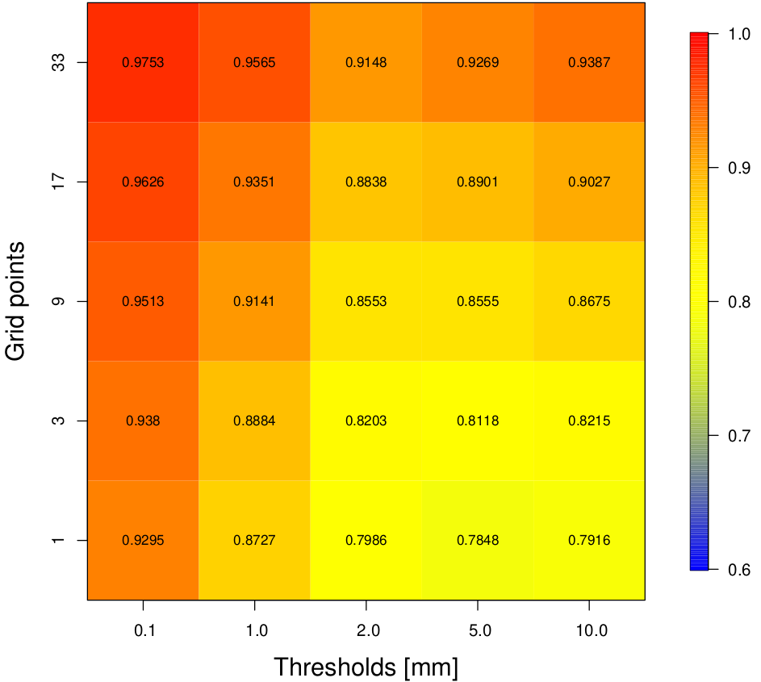
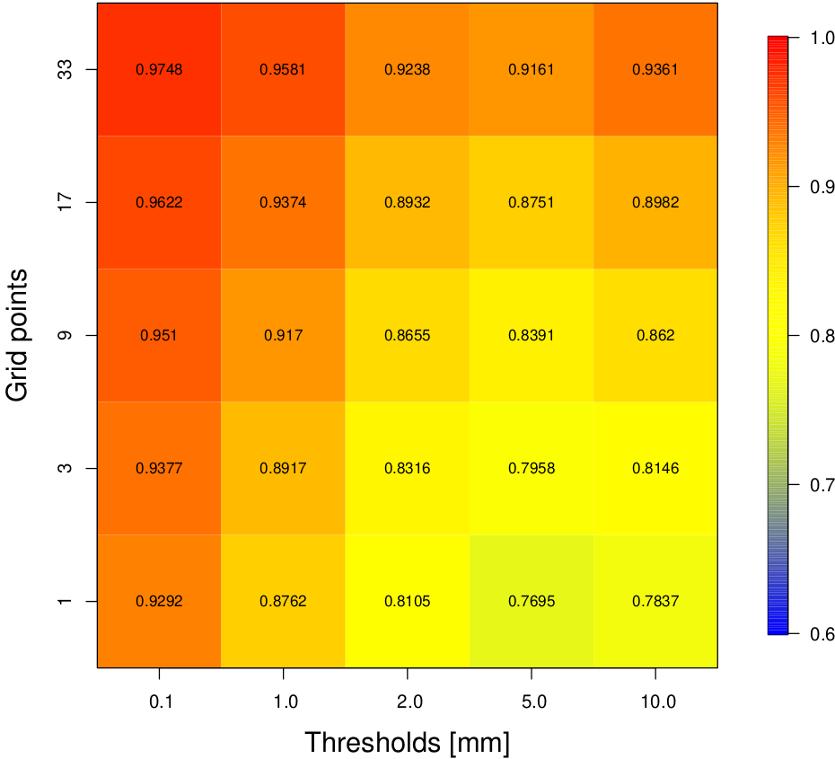
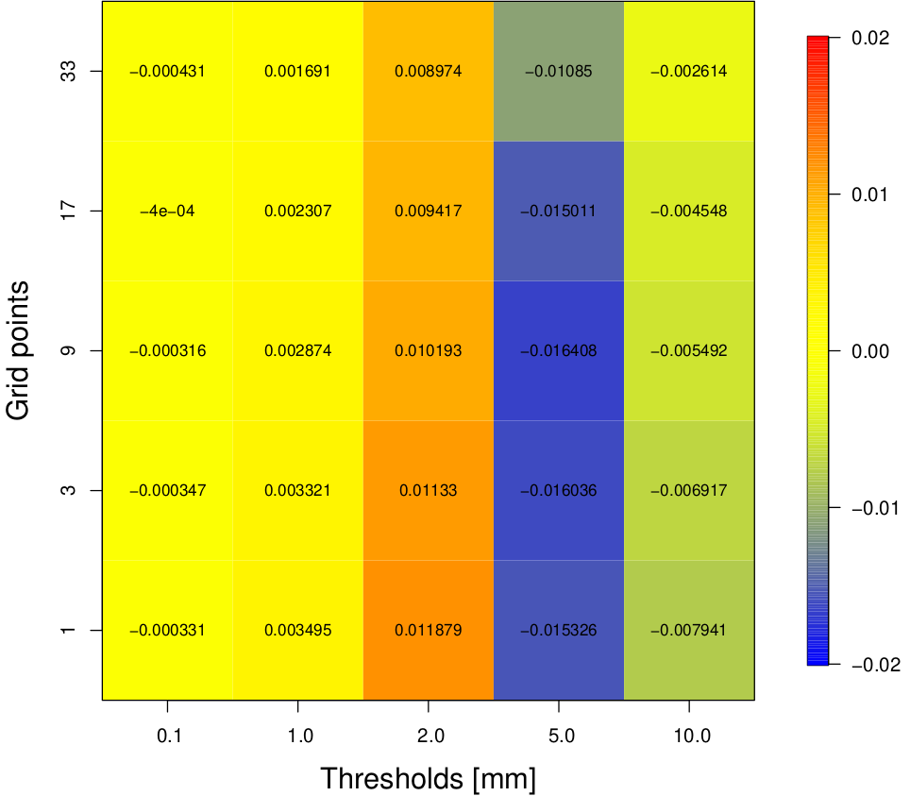
3.2 Reliability analysis of a gridded RainGRS+ high-resolution estimates of precipitation - case study 20230919-20231001- 24h precipitation (Joanna Linkowska)
Rain GRS
Rain GRS +
Difference Rain GRS+ vs Rain GRS
Rain Gauges Hellmans
Rain GRS v s Hellmann Rain Gauges
Rain GRS + v s Hellmann Rain Gauges
Slightly better POD and ETS for RainGRS + for all the thresholds,
FAR slightly better only for small precipitation.
BIAS better for all the thresholds except 2.0mm and 10.0mm.
For all thresholds & spatial scales FSS > 0.7
Very high values of FSS for smaller thresholds and smaller & larger spatial scales
Difference of FSS for Rain GRS & Rain GRS + are neglectable
Rain GRS +
Difference Rain GRS+ vs Rain GRS
Rain GRS

Slide 19
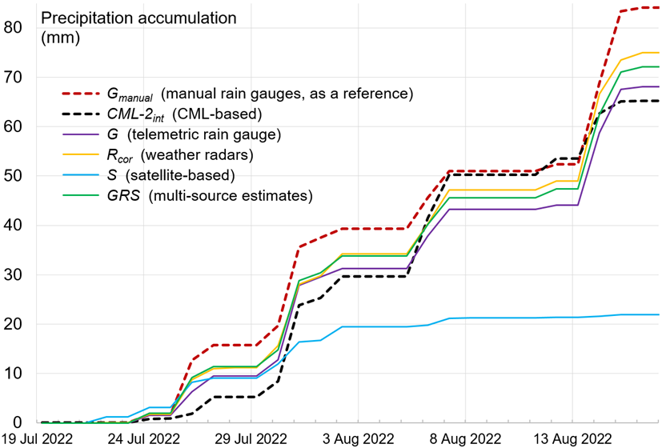
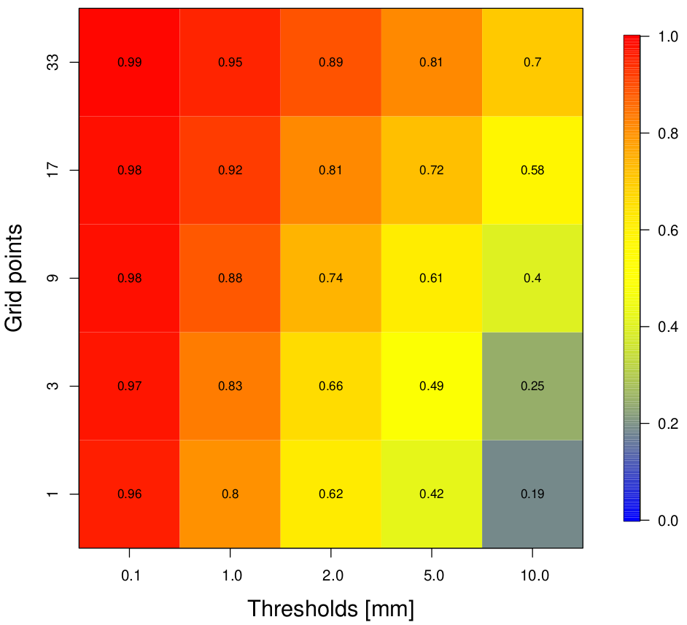
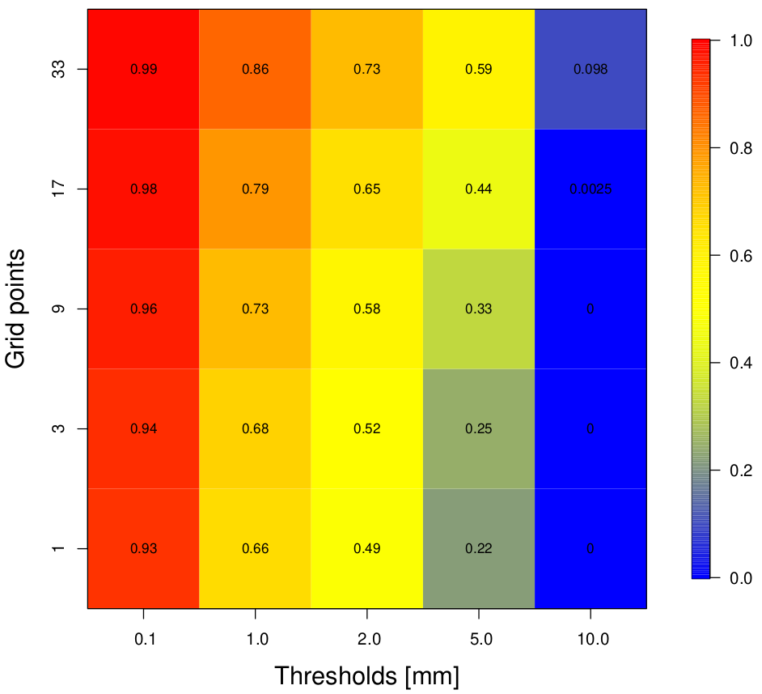
3.2 Reliability analysis of a gridded RainGRS+ high-resolution estimates of precipitation - CML based precipitation case study (Joanna Linkowska)
24h precipitation (mm) Opole station
FFS: CML vs RainGRS
CML vs Hellman Rain Gauges
Higher FSS values for CML compared to Rain GRS than against Rain Gauges.
Very high or high FSS for smaller thresholds and small and larger spatial scales.
Better scores for RainGRS than Rain Gages for higher thresholds and larger spatial scales
Correct detection of the precipitation using CML-based estimates (CML-2) with respect to the manual rain gauge, but not quite satisfactory estimation of the precipitation amount.
The spatial precipitation distribution captured relatively well
Further research is needed.

Slide 20
4. Suggestions for the follow up activities
4. Suggestions for the follow up activities
PT APOCS
Project duration: 2 years, October 2024 – September 2026
Objectives of the task:
Building a useful database with PWS data for research purposes.
Application and testing of the developed RainGaugeQC and Titan - Quality Control (QC) software packages.
Evaluation of the quality of various physical parameters, including precipitation, temperature, and humidity.
Application of products developed from PWS data for model assimilation and numerical forecast verification.
Aligning the project plan with WG5 Guidelines (2021) concerning short-term goals (exploitation of spatial verification methods) and long-term activities (utilization of non-conventional observational datasets).

Slide 21
4. Suggestions for the follow up activities​
4. Suggestions for the follow up activities
Planned work
PWS application for verification of an urban parametrisation
Web service for PWS (data from pwsimgw server)
Assimilation of PWS data from pwsimgw server
Modification of the RainGaugeQC / SCC algorithm: for higher spatial variability of convective precipitation.
Incorporation of precipitation data based on commercial microwave links (CMLs) into RainGRS+ (the network contains more than 1,000 links within the territory of Poland, and is particularly dense in large urban areas, for which radar precipitation observations are subject to high uncertainty due to ground clutters and interferences with RLAN signals.
Task 1
Task 2

Slide 22
4. Suggestions for the follow up activities​
4. Suggestions for the follow up activities
Planned work
PWS data for high resolution simulation of e.g. mountain areas, lowlands, valleys.
Further analysis of Rain GRS + with Board of the State Forests data component: selected period, selected areas
To integrate the enhanced RainGRS+ dataset, including PWS data, into the RUC models to improve the accuracy of very short-range precipitation forecasts.
To enhance the RainGRS+ system by integrating additional data sources, including OPERA radar composites and PWS data.
To assess and improve urban area representation in NWP models using PWS and other observational data, particularly in high-resolution urban simulations.
Task 3
Task 4

Slide 23


CIMA (Centro Internazionale in Monitoraggio Ambientale) Research Foundation
CNMCA (Centro Nazionale di Meteorologia e Climatologia Aeronautica) - Italian Air Force Weather Service
IMGW-PIB (Instytut Meteorologii i Gospodarki Wodnej – Państwowy Instytut Badawczy) – Polish Weather Services
Thank you

