Slide 1
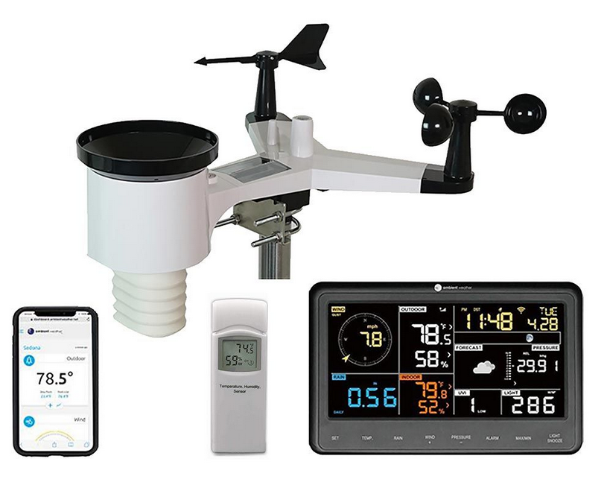
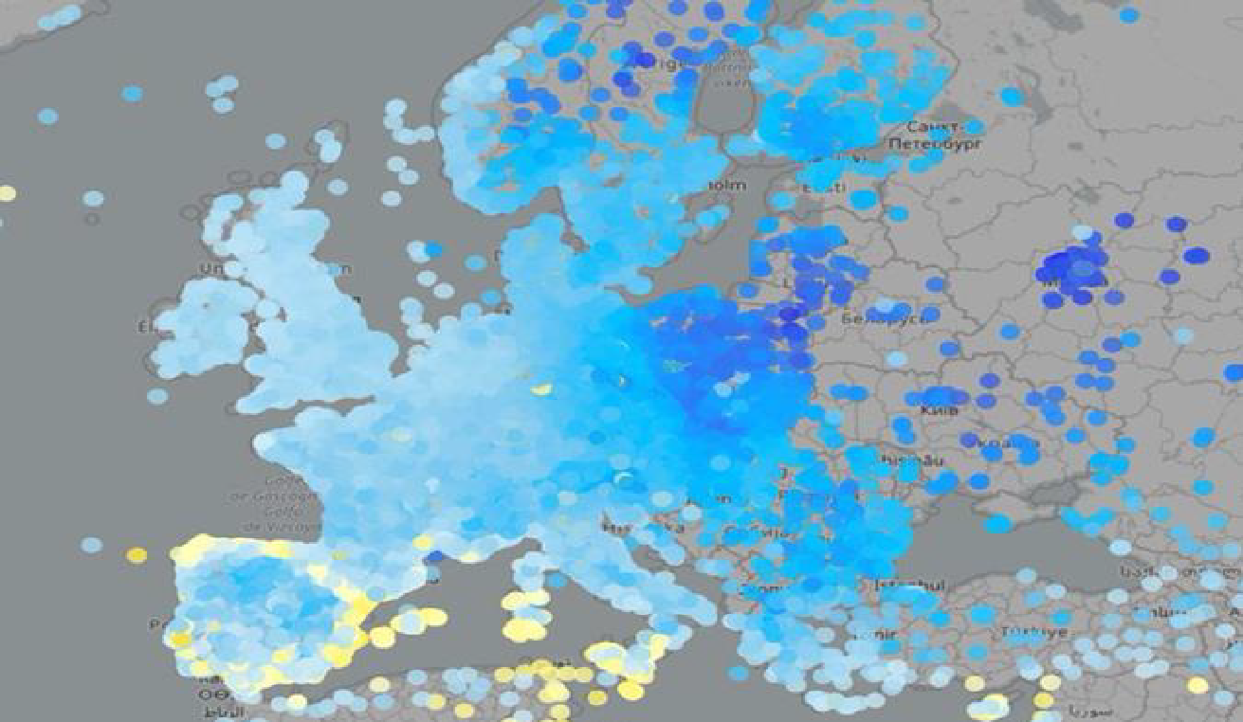
IMGW-PIB: Jan Szturc, Anna Jurczyk, Katarzyna Ośródka, Magdalena Pasierb, Marcin Grzelczyk, Radosław Drożdżoł, Martyna Zosicz, Bartłomiej Sobczyk, Adam Jaczewski, Joanna Linkowska (?) HNMS: Flora Gofa, Dimitra Boucouvala CIMA: Massimo Milelli, Elena Oberto, Francesco Uboldi ARPA Piemonte: Valeria Garbero
Politecnico di Torino: Tanguy Houget CNMCA: Francesco Sudati
Priority Project: EAPOCS (Evaluate Application of Personal Weather Station and Opportunistic Sensor Data CrowdSourcing)
SMC: 26 June 2024

Slide 2
COSMO PP APOCS Tasks
PP APOCS Purpose: extension of the work done in PT EPOCS
Participants: IMGW-PIB, HNMS, CIMA, CNMCA,
ARPA-Piemonte, Politecnico di Torino
PP Leader: Martyna Zosicz (IMGW-PIB)
FTEs: TBD
Duration: 2 years minimum
Start: September/October 2024
STATUS and PLANS:
PP tasks ready, initial discussion at SMC 2024/06
SMC comments and recommendations sent by email 2024 07/08
STC conditional approval expected at CGM2024
SMC approval expected at CGM 2024
….. with STC final approval afterwards by email

Slide 3
COSMO PP APOCS Tasks
Task 1 Development of COSMO PWS database
Subtask 1.1 Survey on available PWS from COSMO employees
Subtask 1.2 Building up passer for decoding data formats
Subtask 1.3 Adaptation or building up transfer protocols
Subtask 1.4 Development database functionalities
Task 2 Further testing of different QC to new databases and parameters
SubTask 2.1: Adaptation of the RainGaugeQC system to CML-based precipitation data
SubTask 2.2: Titan lib applied to “not conventional” raingauge datasets.
SubTask 2.3: Quality control procedure for T2m and Rh2m%
SubTask 2.4: Comparison between the “Meteonetwork” network and that of the CML (Centro Meteorologico Lombardo), Incorporate CML PWS and test Meteotracker data

Slide 4
COSMO PP APOCS Tasks
Task 3 Adaptation of PWS to verification over Greece
SubTask 3.1: Titan lib applied to meteorological data in the Greek domain
SubTask 3.2: Climatology based Interpolation methodology of precipitation data from various sources
Task 4. Application of PWS products to model data assimilation and verification
SubTask 4.1: Improving RainGRS+ precipitation estimates by combining different types of data in more efficient and seamless manner.
SubTask 4.2: Spatial verification techniques based on gridded precipitation obs enhanced with crowdsource data
SubTask 4.3: Application of PWS to NWP model verification in urban areas.
SubTask 4.4: Application of gridded RainGRS+ precipitation estimates for assimilation in NWP models (COSMO-RUC)
Sub Task 4.5: Application of Meteonetwork PWS at CNMCA: testing stability and consistency before using

Slide 5
COSMO PP APOCS Tasks
Task 1 Development of COSMO PWS database
The first tests with employee devices and the test database were successful
The project assumes to created PWS database which include a larger number of stations for internal tests
Possibility of adding external participants from COSMO partners and other collaborating institutions.
Include data QC software and web based GUI with visualization

Slide 6
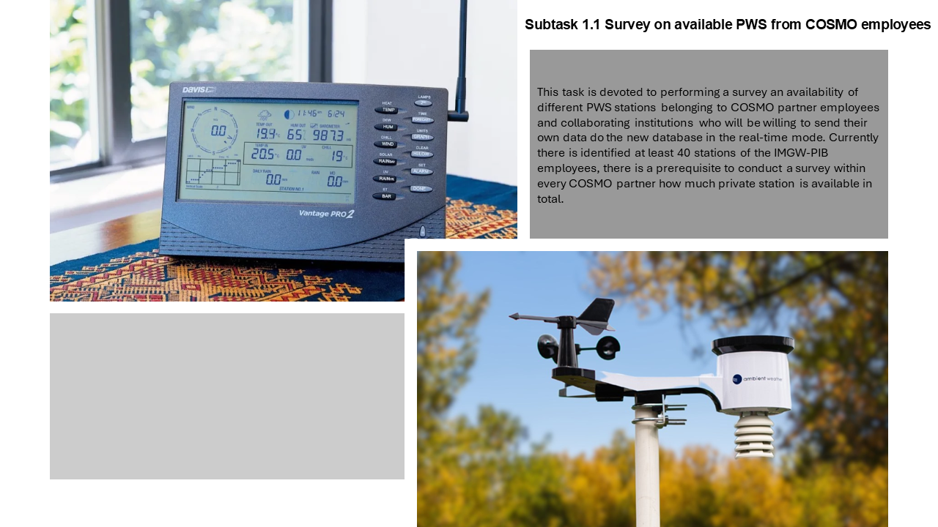
COSMO PP APOCS Tasks

Slide 7
COSMO PP APOCS Tasks

Slide 8
COSMO PP APOCS Tasks

Slide 9
COSMO PP APOCS Tasks

Slide 10
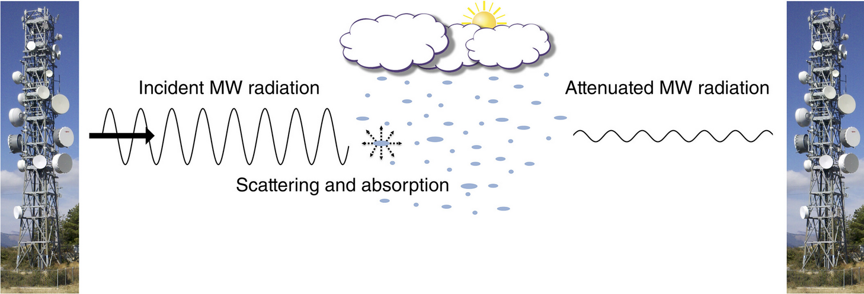
COSMO PP APOCS Tasks
SubTask 2.1: Adaptation of the RainGaugeQC system to CML-based precipitation data
The RainGaugeQC system is designed for quality control (QC) of telemetric rain gauge data in real-time, using radar precipitation as auxiliary information. In the frame of APOCS project, RainGaugeQC will be adapted to rainfall estimates from signal attenuation in commercial microwave links (CMLs).
Chwala C, Kunstmann H. Commercial microwave link networks for rainfall observation: Assessment of the current status and future challenges. WIREs Water. 2019; 6:e1337.

Slide 11
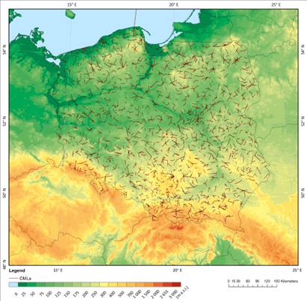
COSMO PP APOCS Tasks
SubTask 2.1: Adaptation of the RainGaugeQC system to CML-based precipitation data
CML-based precipitation is characterised by a spatial distribution and error structure very different from point rain gauge or spatial radar data.
The CML-derived data are distributed along links with lengths up to several tens of km.
The uncertainty in the precipitation estimation depends on the length of the link, the signal frequency, interference from moisture in the atmosphere, among others.
Many of these factors are impossible to quantify. It is therefore necessary to develop a QC methodology that takes these specifics into account.
Participants: Katarzyna Ośródka, Magdalena Pasierb, Anna Jurczyk, Jan Szturc (IMGW-PIB)

Slide 12
COSMO PP APOCS Tasks
SubTask 2.2: Titan lib applied to “not conventional” raingauge datasets
It is useful and interesting to apply the QC (Titan software) also to "non-official" free networks, for instance “Meteonetwork”
Participating scientists: Francesco Uboldi, Elena Oberto, Massimo Milelli (CIMA)
SubTask 2.3: Quality control procedure for T2m and Rh2m%
Primary scope: apply Spatial Consistency Test (SCT, new R code developed) to the official temperature dataset and to study and investigate the results.
Furthermore both Titalib and SCT R code can also be applied to relative humidity (RH) official dataset for the quality control.
A new QC procedure will then be developed in Python specifically for NetAtmo data and compared to the Titanlib package
Participating scientists: Francesco Uboldi, Elena Oberto, Massimo Milelli (CIMA), Valeria Garbero (Arpa Piemonte), Tanguy Houget (Politecnico di Torino)

Slide 13
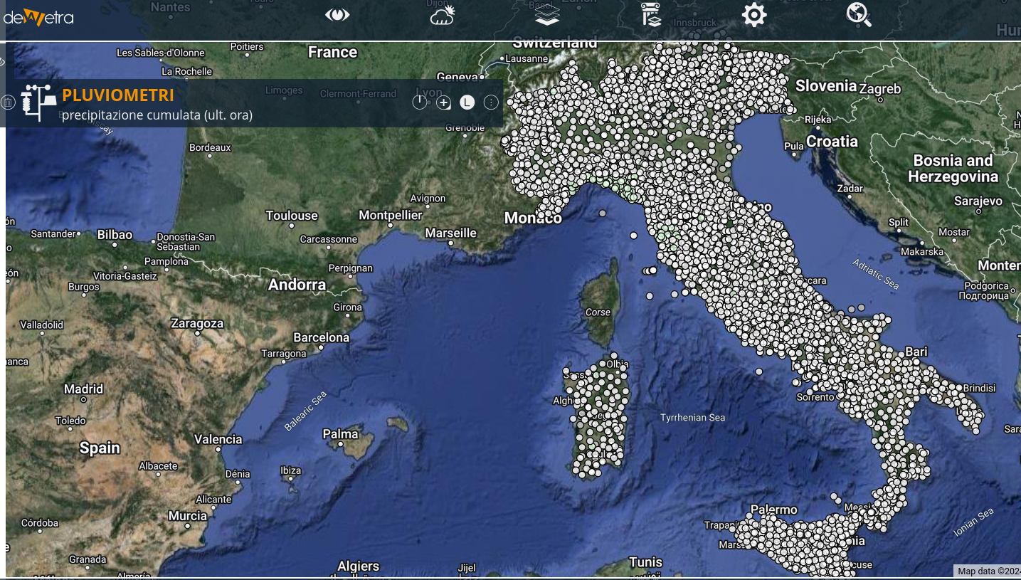
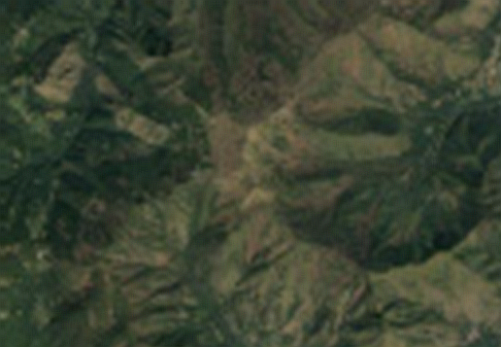
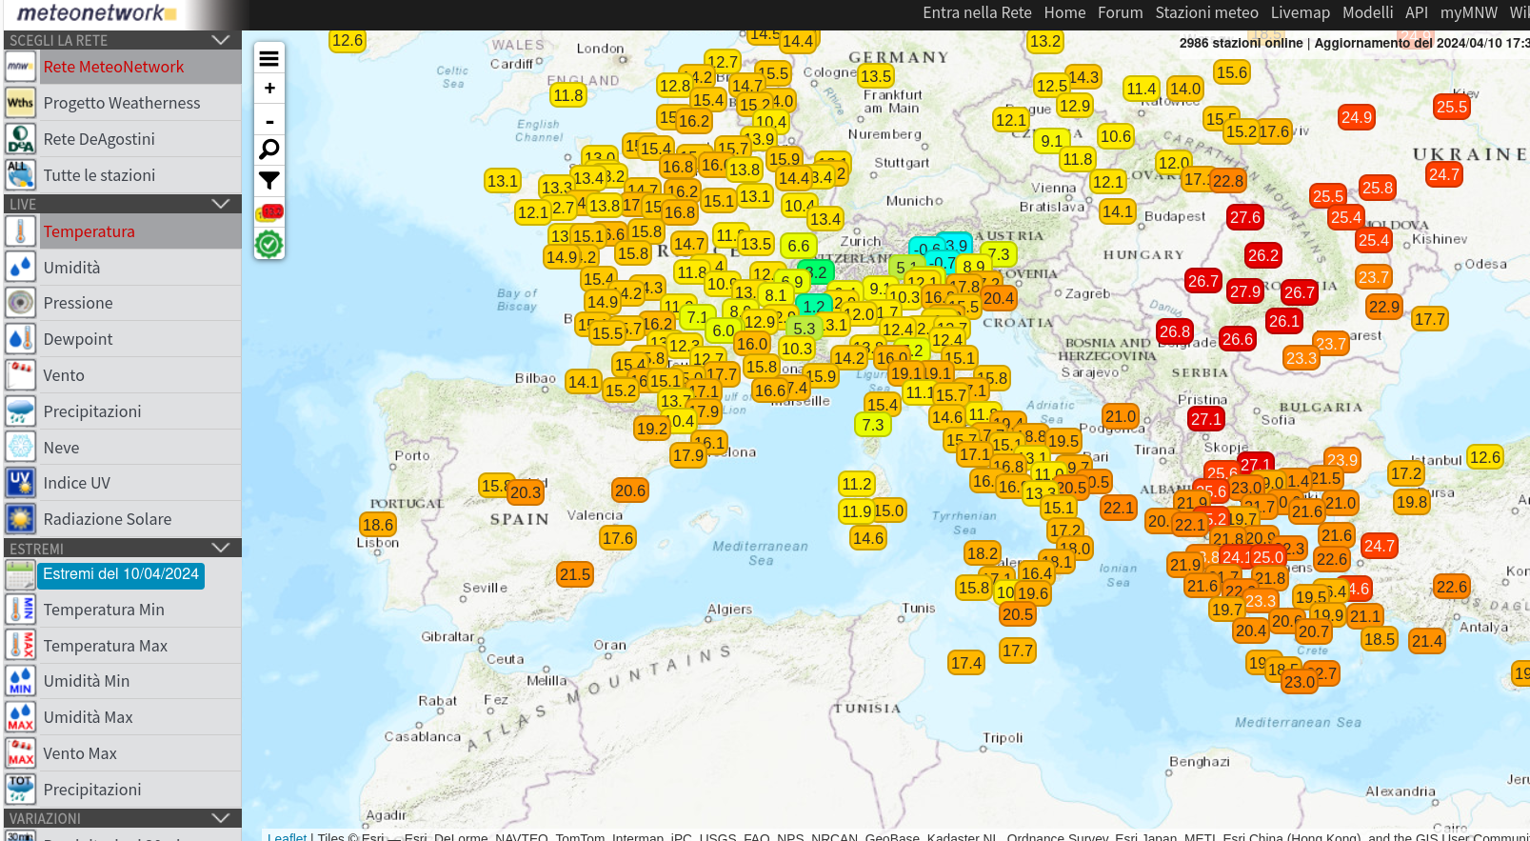
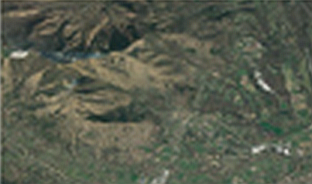
COSMO PP APOCS Tasks
High resolution network from “conventional” dataset (Civil Protection Department)
NetAtmo network
Meteonetwork
Turin and surroundings

Slide 14
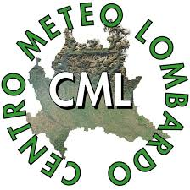
COSMO PP APOCS Tasks
SubTask 2.4, a: Comparison between the “Meteonetwork” network and that of the CML (Centro Meteorologico Lombardo).
Participating scientist: Francesco Sudati (CNMCA)
The regional network (CML) is more reliable and has much greater coverage: more than 400 PWS over a part of the north of Italy, rather than about 1400 PWS over entire Italy.

Slide 15
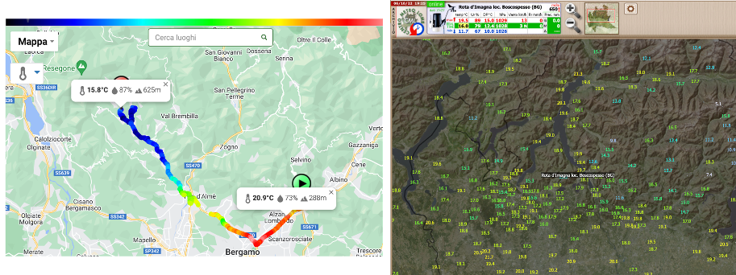
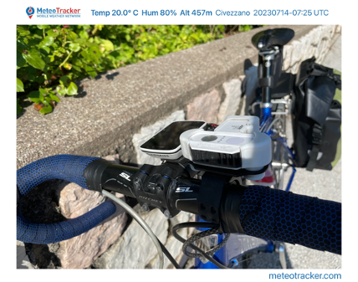
COSMO PP APOCS Tasks
SubTask 2.4, b: Incorporate CML PWS and test Meteotracker data
Participating scientist: Francesco Sudati (CNMCA)

Slide 16
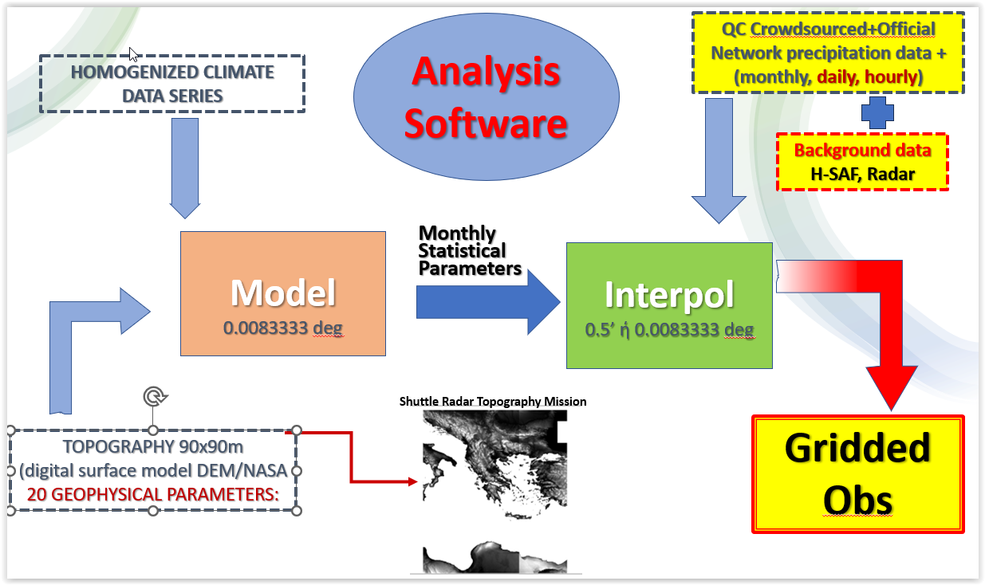
COSMO PP APOCS Tasks
TASK 3: Adaptation of private/citizen datasets for verification purposes over Greece

Slide 17
COSMO PP APOCS Tasks
TASK 3: Adaptation of private/citizen datasets for verification purposes over Greece
SubTask 3.1: Titan lib applied to meteorological data in the Greek domain
Installation testing and application of TITAN software for a quality control of Temp and Preci over the Greek domain.
Gather meteorological datasets from private networks and crowdsourced data, focusing on areas with inadequate coverage of the HNMS network is. The terms of operational/research use of such data will be identified.
Application of TITAN software package for a quality control of ground measurements from the "official" network of stations of HNMS, and "non-official" network
Set up an optimized methodology for production of a reliable - quality controlled - homogenenized dataset of point measurements
Participants: Dimitra Boucouvala, HNMS. 0.2FTEs, Sep 2024 - Feb 2025

Slide 18
COSMO PP APOCS Tasks
TASK 3: Adaptation of private/citizen datasets for verification purposes over Greece
SubTask 3.2: Climatology based Interpolation methodology of precipitation data from various sources
A verification procedure must be based on equally realistic and detailed observations as high-res forecasts Precipitation observations from “official” and “unofficial” networks together with remote sensing data can only increase the accuracy of the “true” location of rainfall events.
Methodology to create precipitation gridded datasets for areas with complex terrain as Greece, which is based on an interpolation method that uses long climate data series to determine the geographical characteristics that this parameter is best correlated with, as well as remote sensing estimates as background information to cover the areas where observations are insufficient.
Application on datasets resulted from SubTask 3.1, with the addition of H-SAF precipitation estimates mainly to over sea areas that ground observations are not available.
Participants: Flora Gofa, HNMS, 0.5FTEs, Mar 2024 - Feb 2025

Slide 19
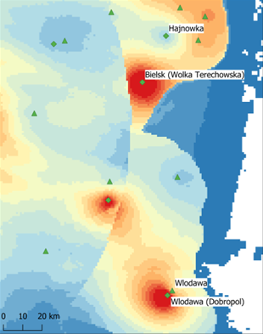
COSMO PP APOCS Tasks
SubTask 4.1: Improving RainGRS+ precipitation estimates by combining different types of data in more efficient and seamless manner
The RainGRS+ system, developed as part of the EPOCS project, requires improvements related to the specifics of the additional data included in the extended “+” version of the system, in particular the OPERA radar composite maps.
These data, in addition to their lower spatial resolution (~2km), have a different quality, which depends on the institutions providing the data and applied QC algorithms.
This requires the development of a technique to combine radar data of different origins for a seamless merging of POLRAD+ and OPERA data.

Slide 20
COSMO PP APOCS Tasks
SubTask 4.1: Improving RainGRS+ precipitation estimates by combining different types of data in more efficient and seamless manner
In the frame of further work, a case study of implementation of the methodology for incorporating PWS and CML-based precipitation data into RainGRS+ system will be performed
Verification of the results will be carried out using precipitation from Hellmann's manual rain gauges (daily totals) as a reference.
In addition, the RainGRS+ system will be adapted to the new domains of the NWP model versions COSMO2.8 and ICON2.5.
Participants: Anna Jurczyk, Jan Szturc, Katarzyna Ośródka,
Magdalena Pasierb (IMGW-PIB)

Slide 21
COSMO PP APOCS Tasks
SubTask 4.2: Spatial verification techniques based on gridded precipitation obs enhanced with crowdsource data
Spatial verification methodologies are subsequently applied to certain convective events that accentuate the relative skill of high resolution forecasts in revealing characteristics in the precipitation patterns such as structure and intensity that can be applied with equally detailed gridded observation fields.
Participants: Flora Gofa, Dimitra Boucouvala, HNMS, ??FTEs, Mar 2025 - Feb 2026

Slide 22
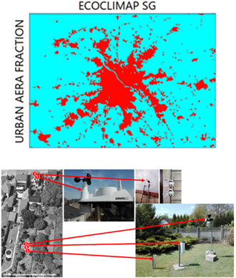
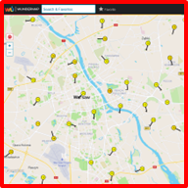
COSMO PP APOCS Tasks
SubTask 4.3: Application of PWS to NWP model verification in urban areas
Implementation of TERRA_URB in COSMO and ICON-LAM models has been made within PP-CITTA.
Local Climate Zones (LCZs) have been incorporated into TERRA_URB model based on ECOCLIMAP-SG land use data.
Better representation of urban heterogeneity in high-resolution NWP require also much denser observational network for model verification.
COSMO and ICON-LAM simulations will be evaluated based on measurements (temperature, humidity and wind) from PWS or other professional observational networks operated by independent agencies.
Participating scientists: Adam Jaczewski (IMGW-PIB)

Slide 23
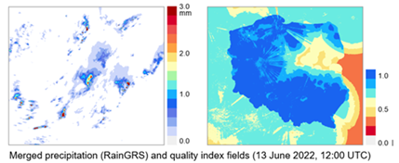
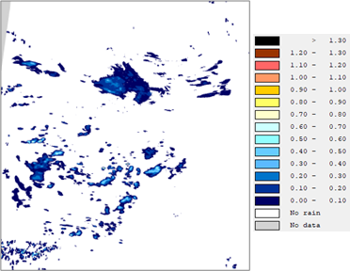
COSMO PP APOCS Tasks
Subtask 4.4: Application of gridded RainGRS+ precipitation estimates for assimilation in NWP models (COSMO-RUC)
Very short-range precipitation forecasts with
COSMO-RUC @IMGW-PIB at 2.8km and LHN data assimilation (DA)
Currently DA utilizes radar OPERA SRI precipitation composites at 2km resolution and 15 min frequency.
RainGRS+ composite developed in PT EPOCS includes PWS data at 1km resolution grid and 5 minute time intervals.
The performance of new COSMO-RUC setup and the quality of the NWP forecast with RainGRS+ composite will be performed
RainGRS+ (COSMO 2.8) domain
Participating scientists: Martyna Zosicz, Andrzej Wyszogrodzki (IMGW-PIB)

Slide 24
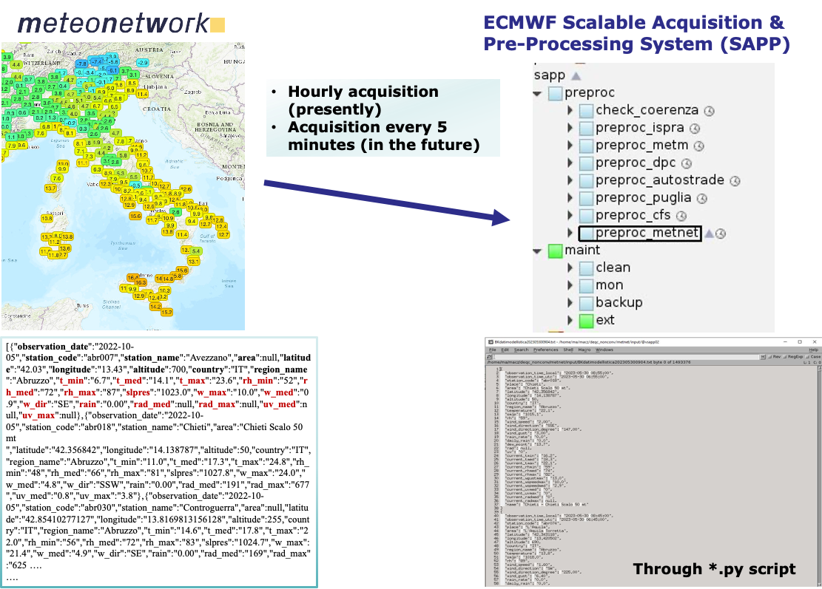
COSMO PP APOCS Tasks
Subtask 4.5: Application of Meteonetwork PWS at CNMCA: testing stability and consistency before using
Participating scientist: Francesco Sudati (CNMCA)

