Slide 1
National domain verification at NMA
Ioan Stefan Gabrian
Stefan Dinicila
Mihaela Bogdan
Catalin S Rucareanu

Slide 2
Introduction
The verification was performed using the verification suite MEC/FFV2
NMA database of synoptic observations, including all 168 stations, is used
Feedback Files are produced automatically from both MARS and NMA observations
NMA integrates:
ICON version 2.6.6, 2.8 km with ecRad
COSMO version 6.0, 7 and 2.8 km

Slide 3
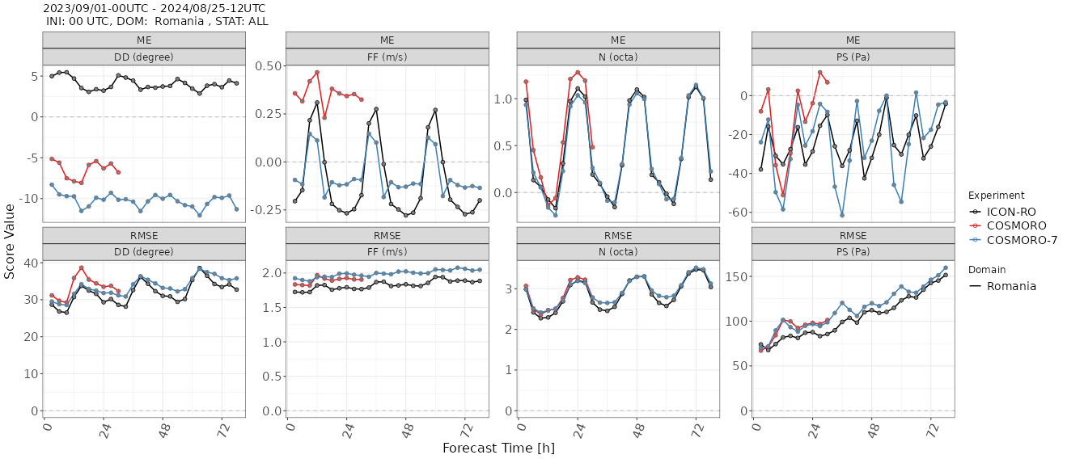
Continuous parameter annual verification(1)
Notes:
Wind direction is

Slide 4
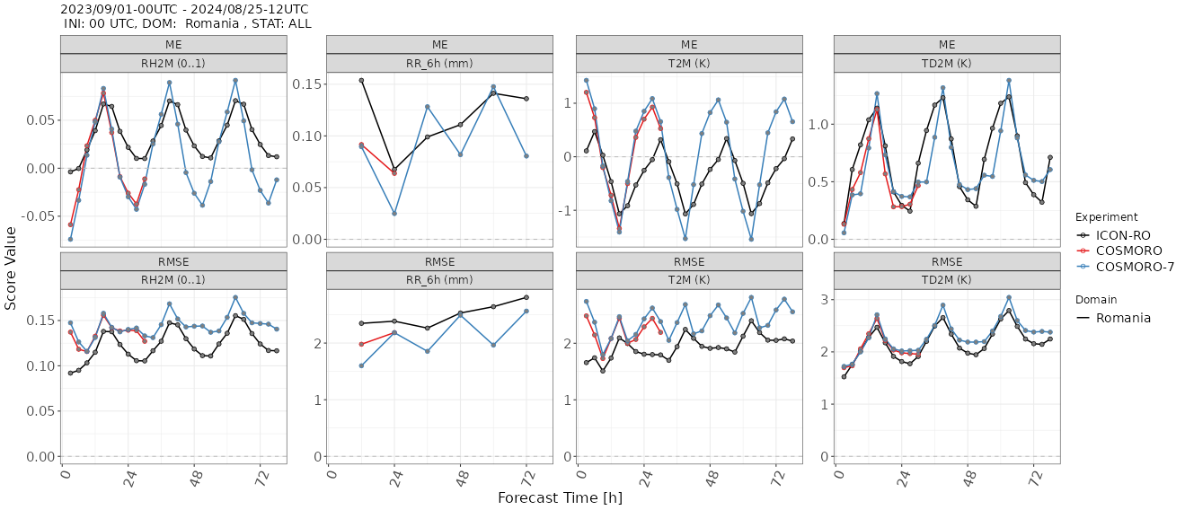
Continuous parameters annual verification(2)

Slide 5
Continuous parameters annual verification - Time Series

Slide 6
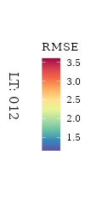
Continuous parameters annual verification by station

Slide 7
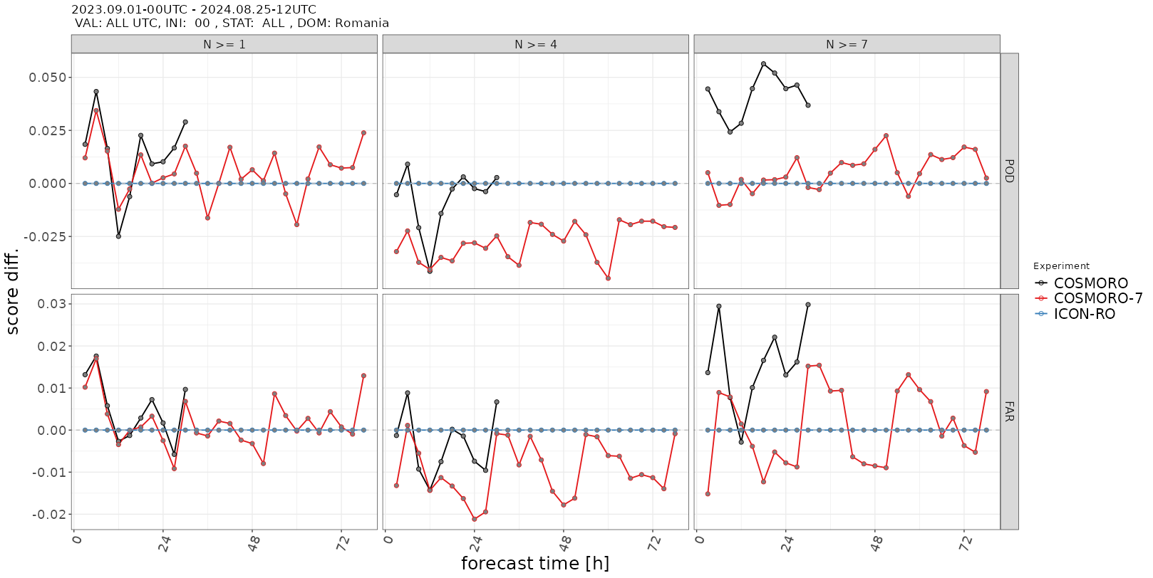
Categorical parameters annual verification

Slide 8
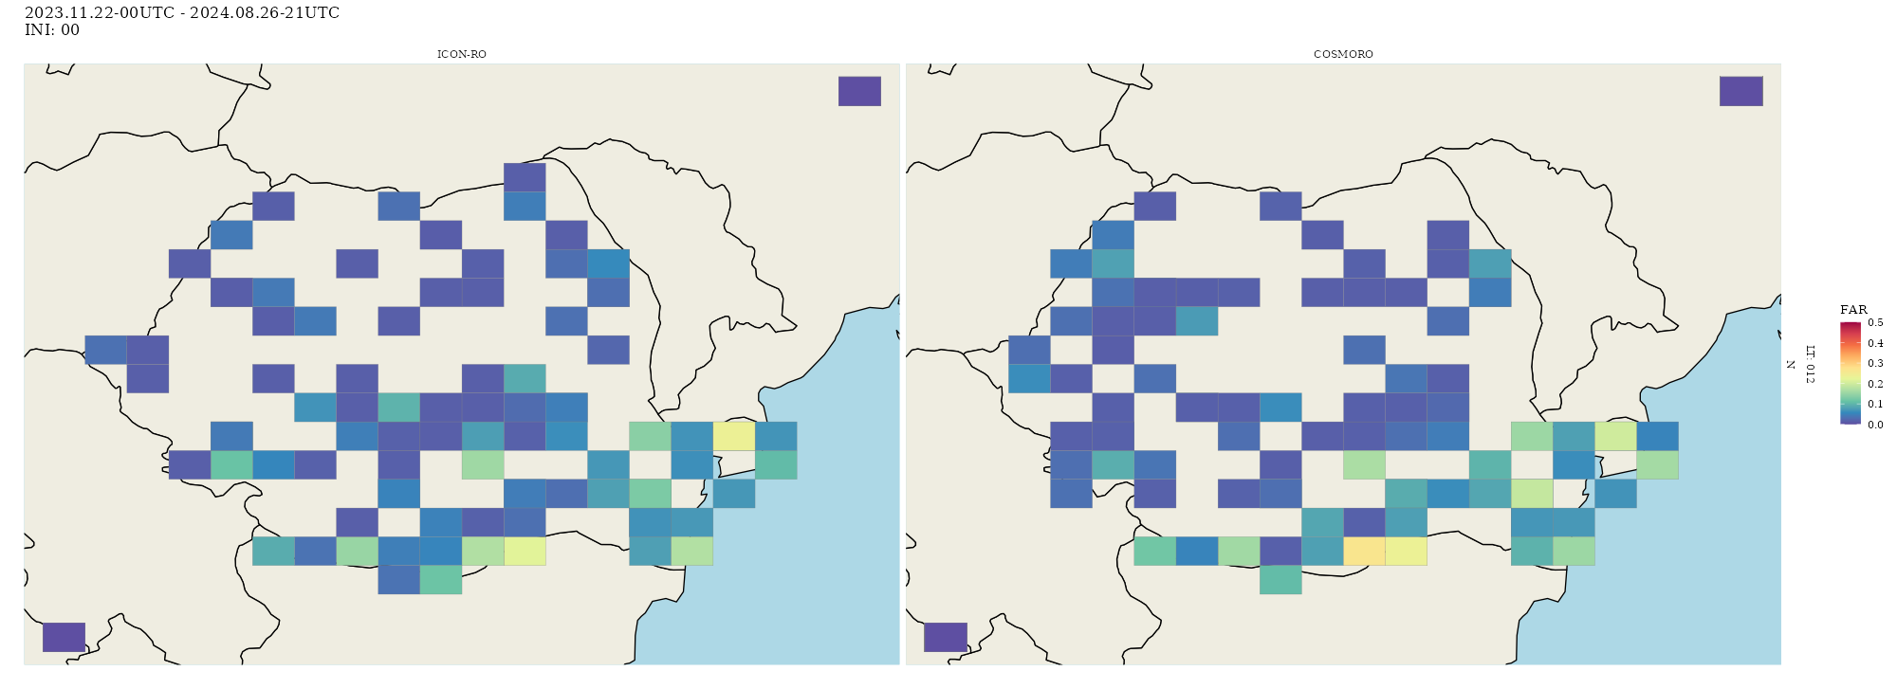
Categorical parameters annual verification by station

Slide 9
NMA Model Verification
Inside the Numerical Modeling Department exists a verification section which computes the Verification Scores for all the models integrated operationally in the National Meteorological Administration.
The verification software used was developed in house utilizing the our Observation Database.

Slide 10
Temperature at 2m Mean Error and RMSE for January 2024

Slide 11
Temperature at 2m Mean Error and RMSE for July 2024

Slide 12
Wind Speed 10m Mean Error and RMSE for January 2024

Slide 13
Wind Speed 10m Mean Error and RMSE for July 2024

Slide 14
12h accum. prec. Gilbert's SKILL SCORE for January 2024

Slide 15
12h accum. prec. Gilbert's SKILL SCORE for July 2024

Slide 16
Thank you for your attention!

