Slide 1
Greek domain verification 2023-2024
ICON-GR2.5
IFS-ECMWF
Dimitra Boucouvala

Slide 2
2m TEMPERATURE
ICON-GR2.5
IFS-ECMWF
RMSE
ME
RMSE
ME
ICON-GR overestimates 2mT for all seasons during late afternoon hours and night .
RMSE similar for both models

Slide 3
WIND SPEED
ICON-GR2.5
IFS-ECMWF
RMSE
ME
RMSE
ME
RMSE better for ICON-GR in all seasons. IFS underestimates in warm hours,
when a slight overestimation is shown for ICON-GR, with a weaker bias variability.

Slide 4
SURFACE PRESSURE
ICON-GR2.5
IFS-ECMWF
RMSE
ME
RMSE
ME
RMSE better for ICON-GR in all seasons with error increasing with lead time. Similar bias
variability for both models with overestimation in warm hours .

Slide 5
DEW POINT TEMPERATURE
ICON-GR2.5
IFS-ECMWF
RMSE
ME
RMSE
ME
ICON-GR overestimates Td2m especially in SON and DJF and afternoon hours .
RMSE similar for both models with better score for ICON-GR especially in summer.

Slide 6
TOTAL CLOUD COVER
ICON-GR2.5
IFS-ECMWF
RMSE
ME
RMSE
ME
ICON-GR overestimates TCC for all seasons mainly at night . IFS tendency of underestimation especially in warm seasons. RMSE similar for both models but ICON-GR slightly worse in JJA.

Slide 7
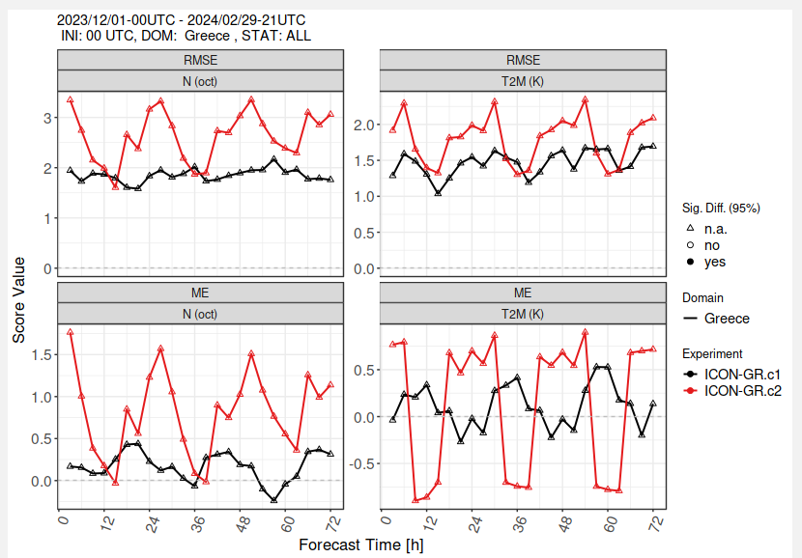
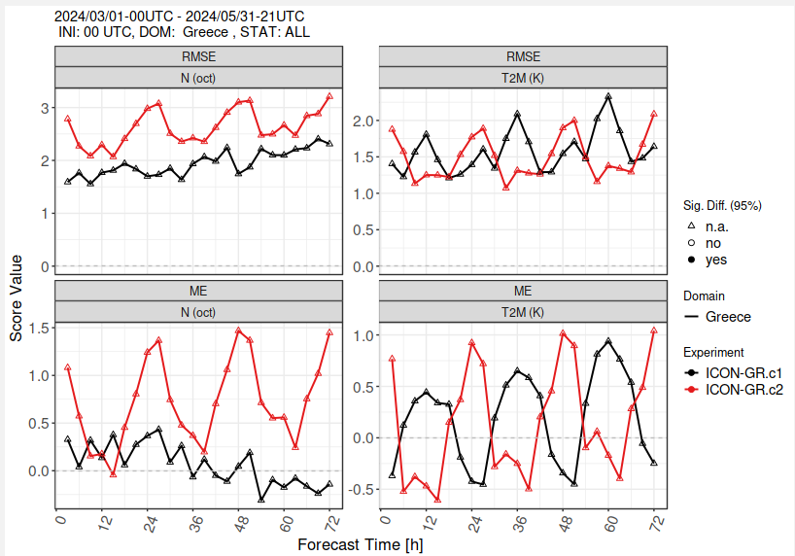
ICON-GR CONDITIONAL VERIFICATION BASED ON TCC COVERAGE
C1 obs >= 6 (HIGH) , C2 obs= <2 (LOW)
RMSE
TCC
T2m
TCC
T2m
Errors are higher for the condition C2-LOW coverage for both T2m and TCC
2mT variability is opposite for the two conditions with the C2-LOW
overestimating especially at night

Slide 8
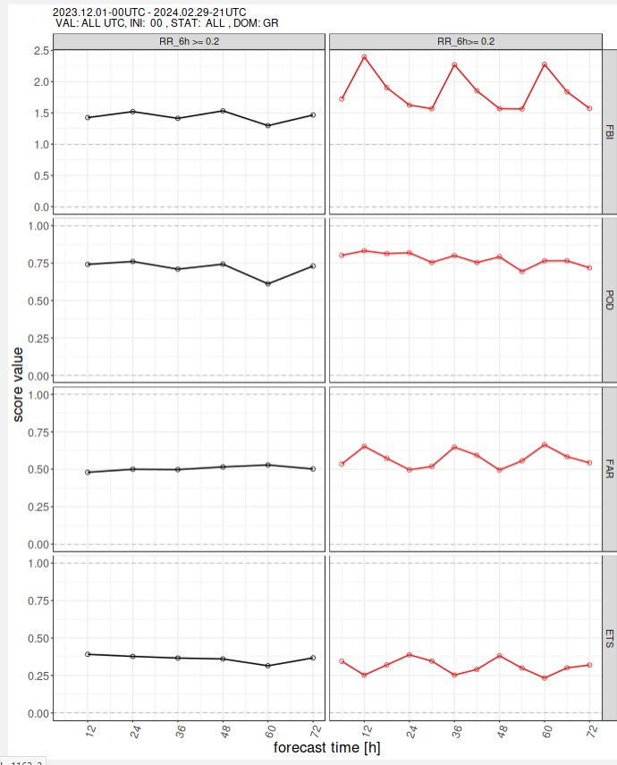
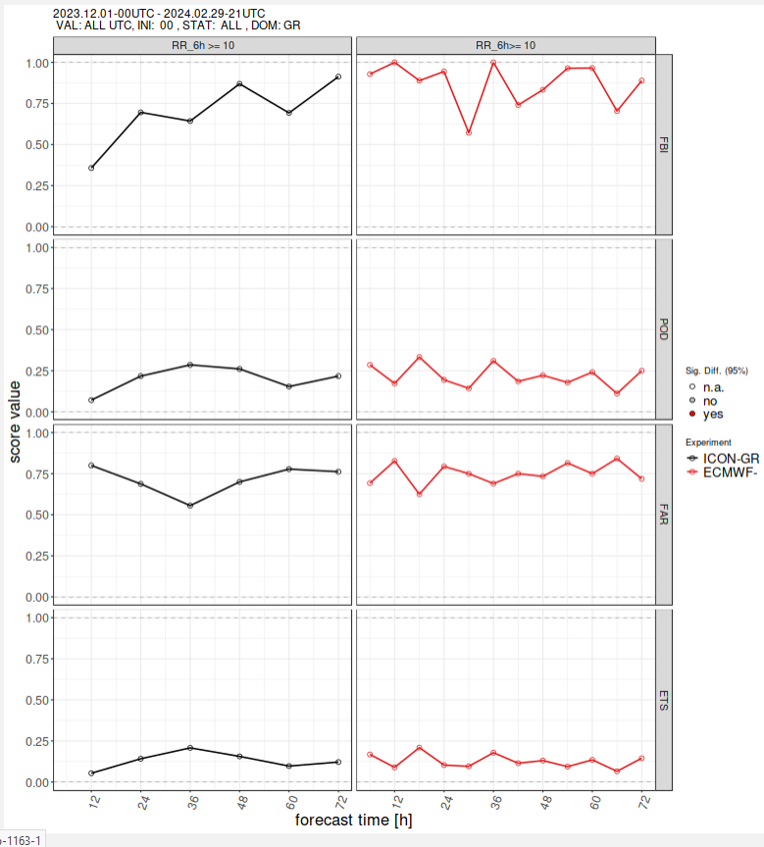
6H PRECIPITATION
ICON-GR2.5
IFS-ECMWF
0.2 mm
10 mm
FBI
POD
FAR
ETS
Overestimation of low threshold events especially for IFS with diurnal variation . Events underestimation for high thresholds. POD and FAR slightly higher for IFS for low thresholds, ETS higher for ICON-GR. Scores comparable for high thresholds.

Slide 9
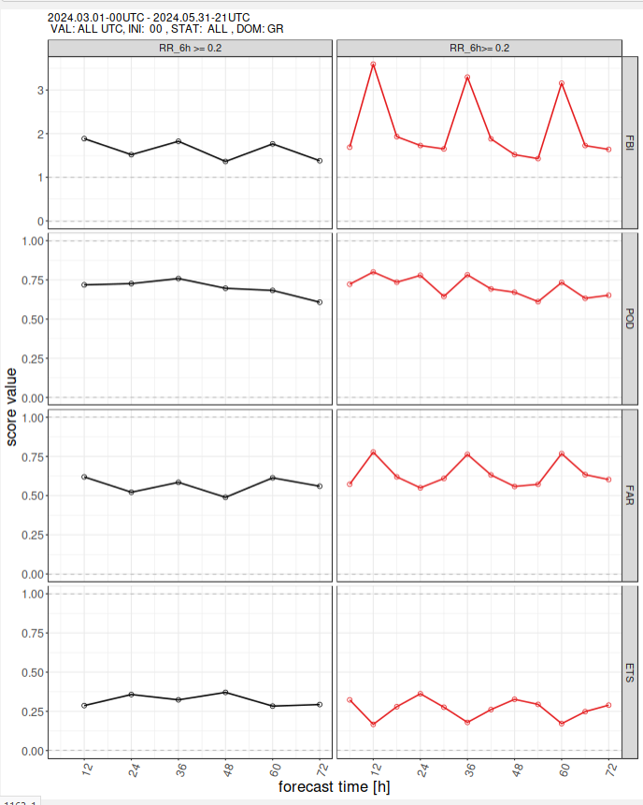
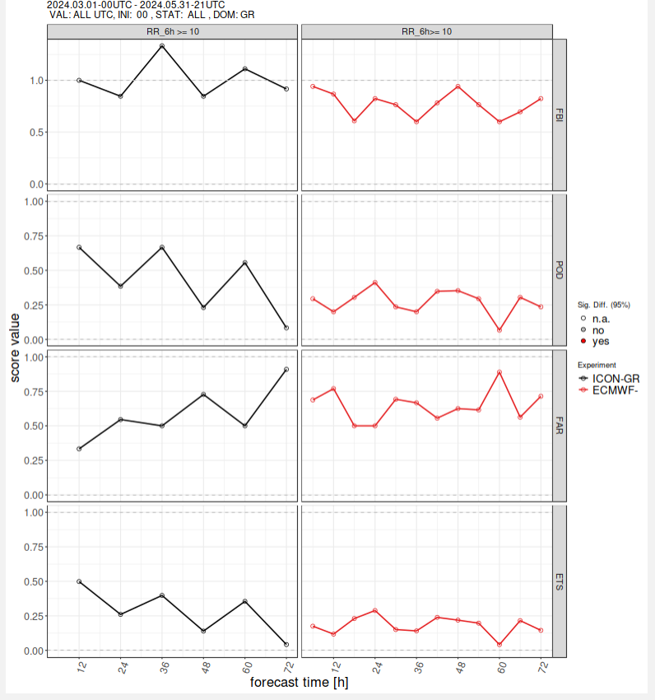
6H PRECIPITATION
ICON-GR2.5
IFS-ECMWF
0.2 mm
10 mm
FBI
POD
FAR
ETS
Similar results for MAM, but POD and ETS are now better for ICON-GR for higher thresholds.

Slide 10
CONCLUSIONS
RMSE:
ICON-GR is mainly lower or similar for all parameters. Only for TCC and JJA season IFS score is better . There is an increase of RMSE for MSLP with lead time for both models.
BIAS:
2mT : ICON-GR bias is positive and higher than IFS during late afternoon hours and night .
Wind Speed : ICON-GR weaker bias variability than IFS with slight overestimation in warm hours.
MSLP : bias variability is similar for both models with overestimation in warm hours .
Td2m: ICON-GR overestimates especially during SON and DJF in afternoon hours .
TCC: ICON-GR overestimates mainly at night , while IFS shows tendency of underestimation especially in warm seasons.
BOTH SCORES are worse for TCC and T2m when the condition of LOW CLOUD cover is applied.
PRECIPITATION SCORES : Low precipitation events are overestimated and high are underestimated . ICON-GR POD/FAR are lower than IFS but ETS score is higher.

