Slide 1
FFV2 Update
Felix Fundel
Deutscher Wetterdienst
Referat FE 12
Frankfurter Straße 135
63067 Offenbach am Main
E-Mail: Felix.Fundel@dwd.de
Tel.: +49 (0) 69 / 80 62 -2422
COSMO-GM 2024 – Felix Fundel

Slide 2
Outline
FFV2
Shiny Apps
MEC

Slide 3
FFV2
Avoid scp of results if Shiny-Apps and verification run on same server.
Allow upper and lower threshold in ensemble verification
e.g. categorical and probabilistic scores for gusts between 10 and 20 m/s
Same Tmin/Tmax observation filter consistent with TD2M and T2M
z_station – z_modsurf <=150m
sso_stdh <= 200
Updating bitcheck function (bitcheck2)
bitcheck allows to filter bit encoded variables (e.g. ‚flags‘ that hold reasons for obs. rejection)
Any combination of bits can be set for an observation
Old bitcheck function only checked if a bit is set.
New function can check if a bit and only this bit is set or not set.
Additional filtering options
‚mdlsfc‘ (model surface characteristics)
‚level_sig‘ (type of TEMP level)
‘veri_model‘ (model name)
Extension for ocean observations (ARGOS, OSTIA, SMOS)

Slide 4
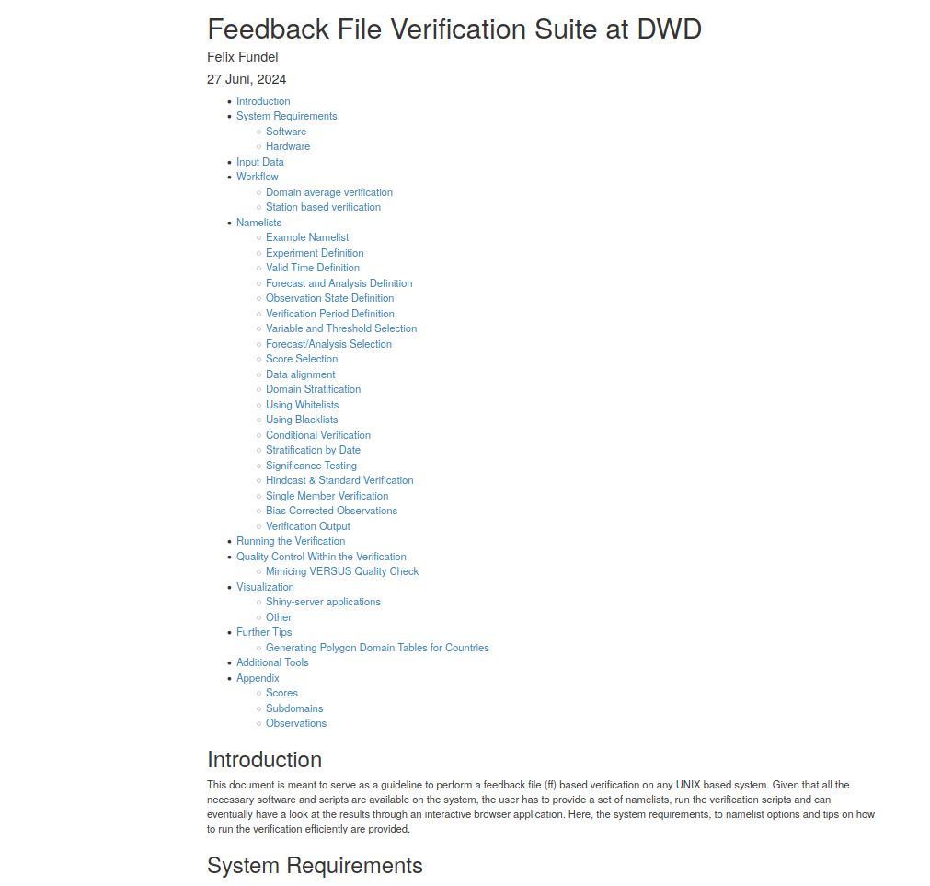
FFV2
Revised Documentation
http://www.cosmo-model.org/shiny/users/fdbk/RfdbkVeriDoku.html
Some updates relevant for EPS verification

Slide 5
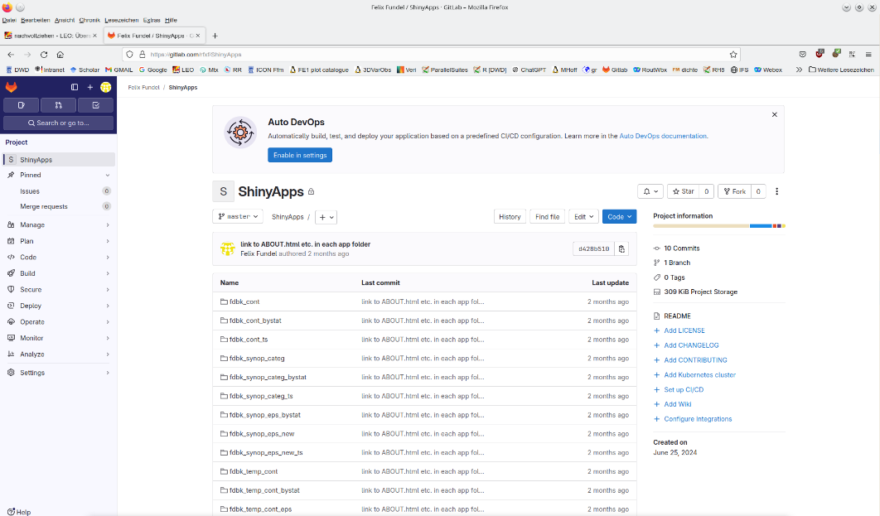
Shiny Apps
Apps require a config file FFVSHINYAPPCONFIG
Sets some site specific variables needed in all apps
E.g. sever name, path to score files, app directory
Allows to port apps more easily to new environments
Namelist in extra tab
The verification namelist is shown in the app
Helps to follow verification setup and debugging
New gitlab repository
https://gitlab.com/rfxf/ShinyApps
Including a short setup instruction (similar to CARMENS guidelines)

Slide 6
MEC
AI model verification needed
DWD started developing an own AI model (AICON) and reanalysis (DREAM) for training
Verification with in house tool needed
Available AI models (Pangu, GraphCast, AIFS.. run by ECMWF) have reduced output
T, Z, U, V, RH on 13 pressure levels
T2M, U10M, V10M, TD2M, PMSL, (TOT_PREC)
0.25° ERA5 grid
MEC adaptations
Needed to cope with fewer levels (linear vertical interpolation to avoid overshooting)
Needed to works with PMSL and PS
But still uses lowest model level for FF10M, renders verification on pressure levels useless
MEC developments by Harald Anlauf
Now we have first observation based verification results using MEC/FFV2

Slide 7
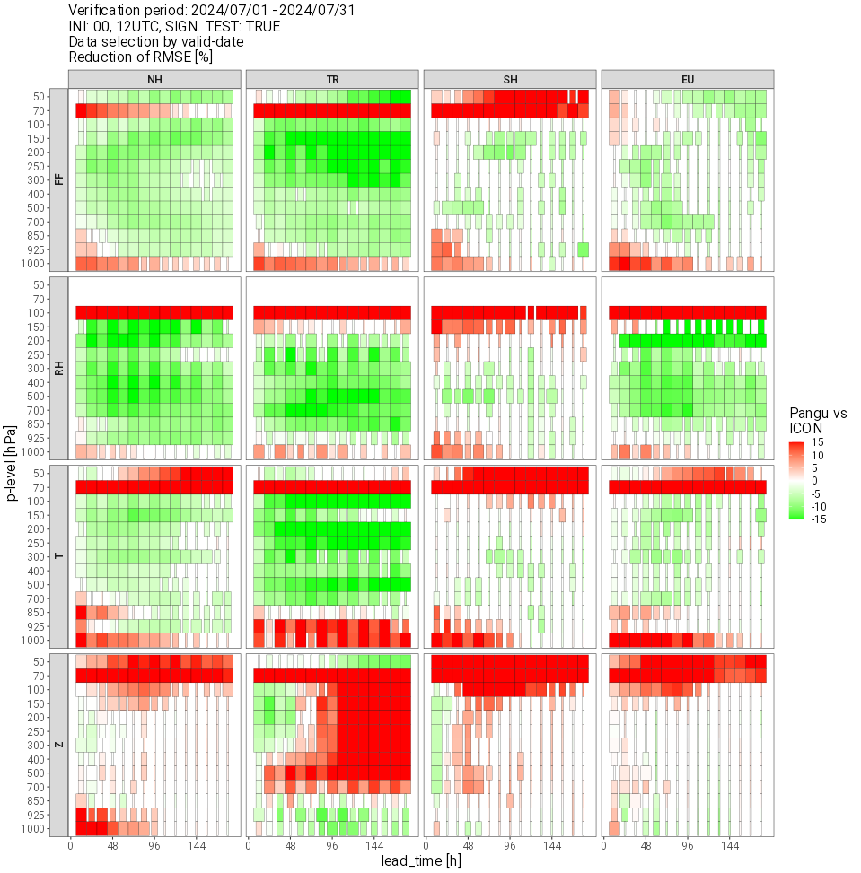
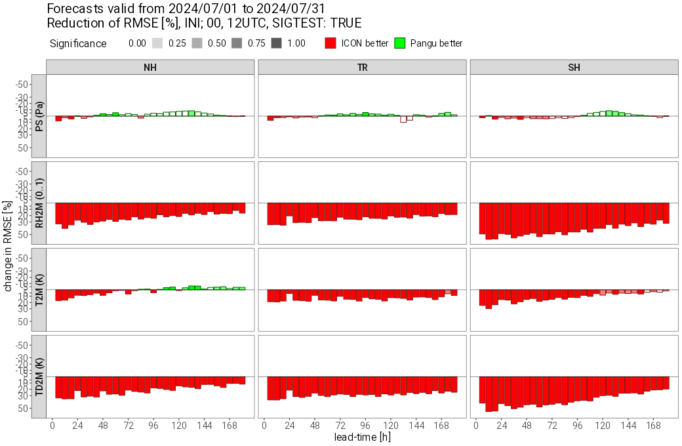
MEC
Pangu (ICON initialized) vs. ICON
TEMP 2024/07
SYNOP 2024/07
Good performance upper air
Not on ICON level at or near surface and in very high levels
Some issues with humidity sensitive variables at surface

Slide 8
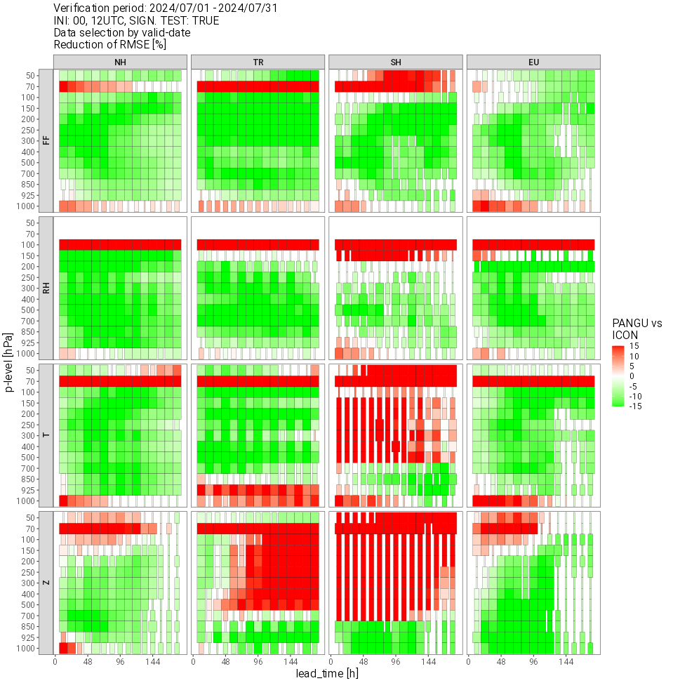
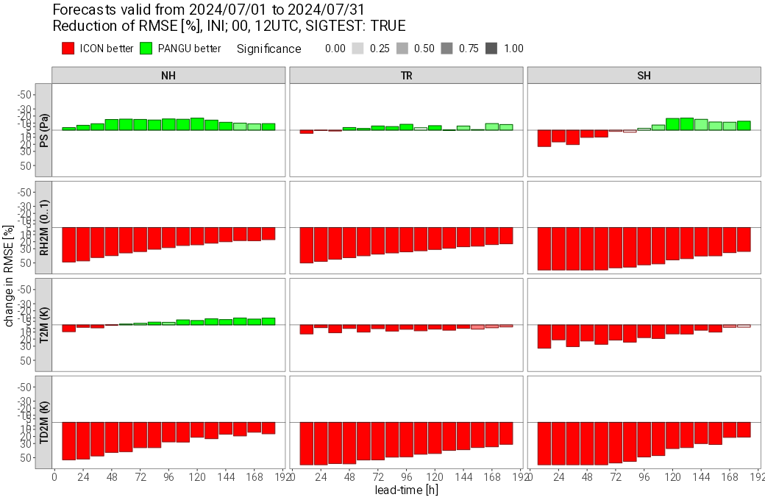
MEC
Pangu (EC initialized) vs. ICON
TEMP 2024/07
SYNOP 2024/07
Similar pattern
Upper air prifts using EC initial conditions
Surface verification was a bit better using ICON initial conditions

Slide 9
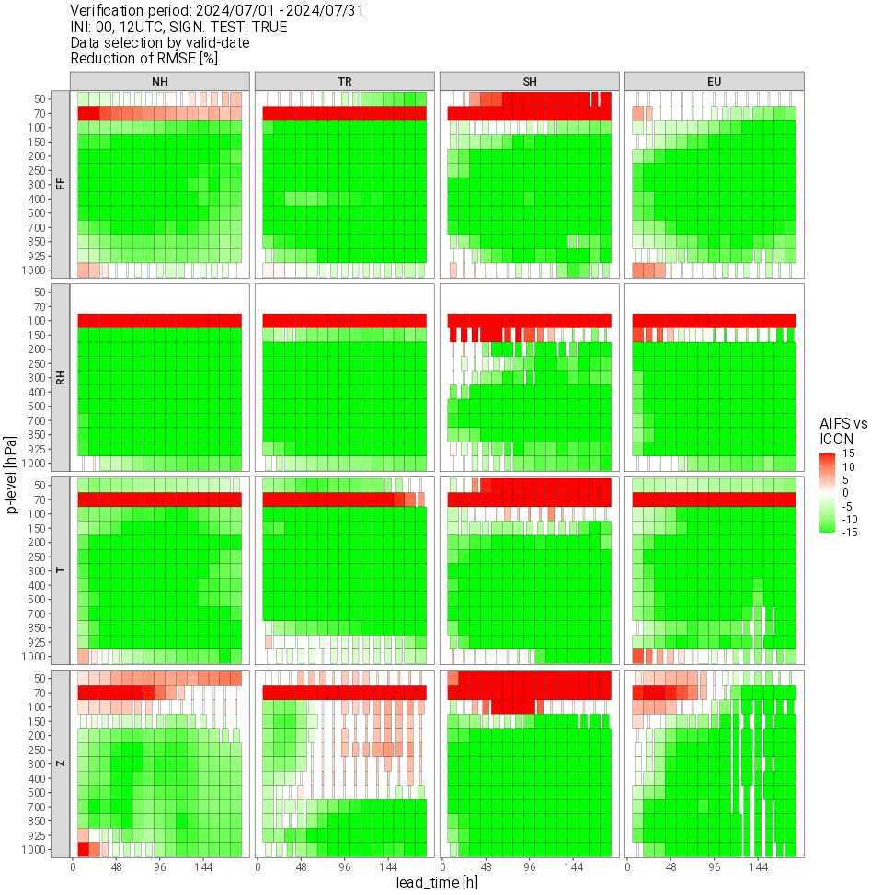
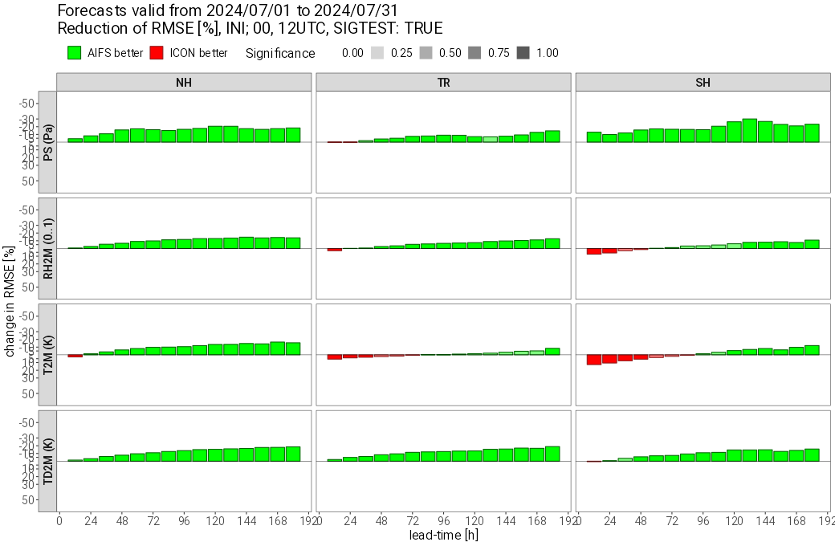
MEC
AIFS vs. ICON
AIFS much improved compared to PANGU
Even surface scores are

Slide 10
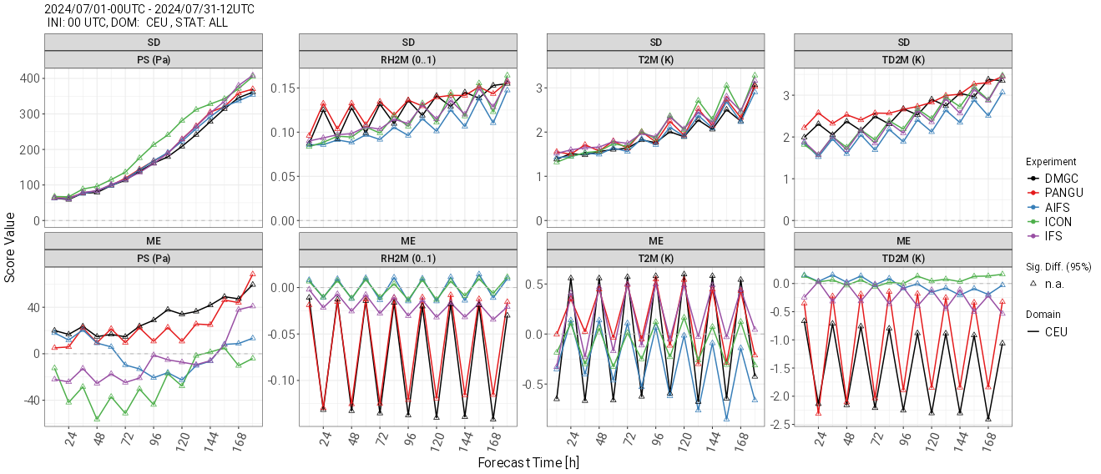
MEC
StDev and Bias for GraphCast, Pangu, AIFS, ICON and IFS against SYNOP 2024/07, Europe, 00UTC runs
Pangu and Graphcast show huge daily humidity cycles, too dry, especially at night
Good performance in verification does not guarantee consistency in forecast

Slide 11
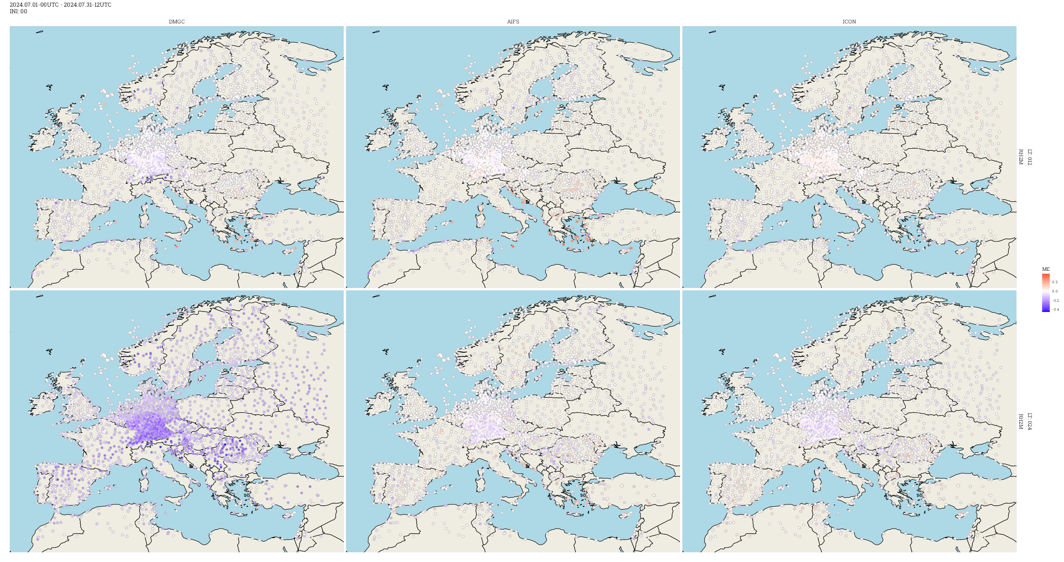
MEC
RH2M Bias
GraphCast
AIFS
ICON
12UTC
00UTC

Slide 12
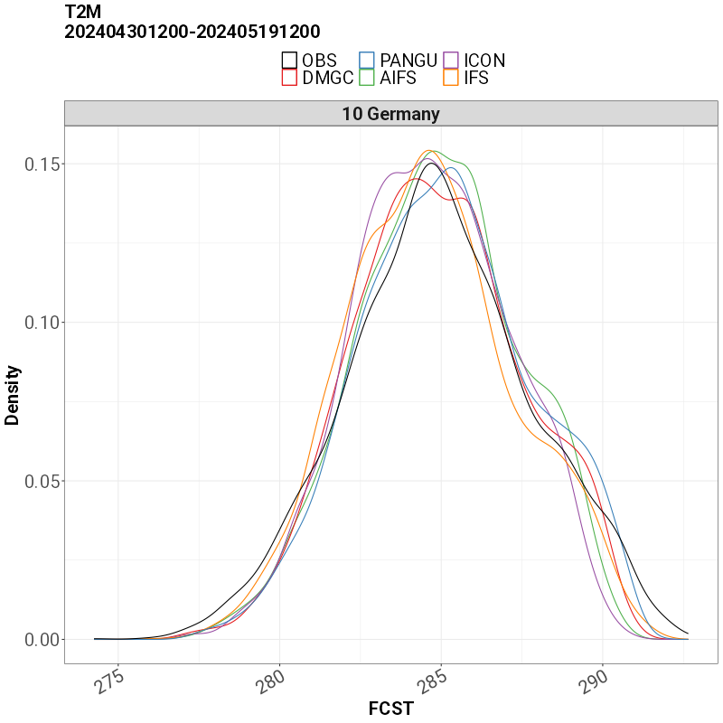
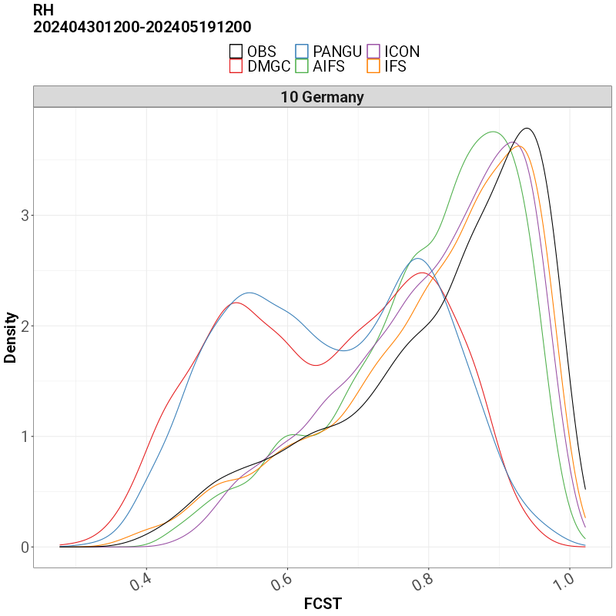
MEC
T2M of all models is consitent with observations
RH2M of PANGU and GraphCast is not consisitent with observations
Obviously also the T2M/RH2M relation of Pangu and GraphCast is flawed

Slide 13
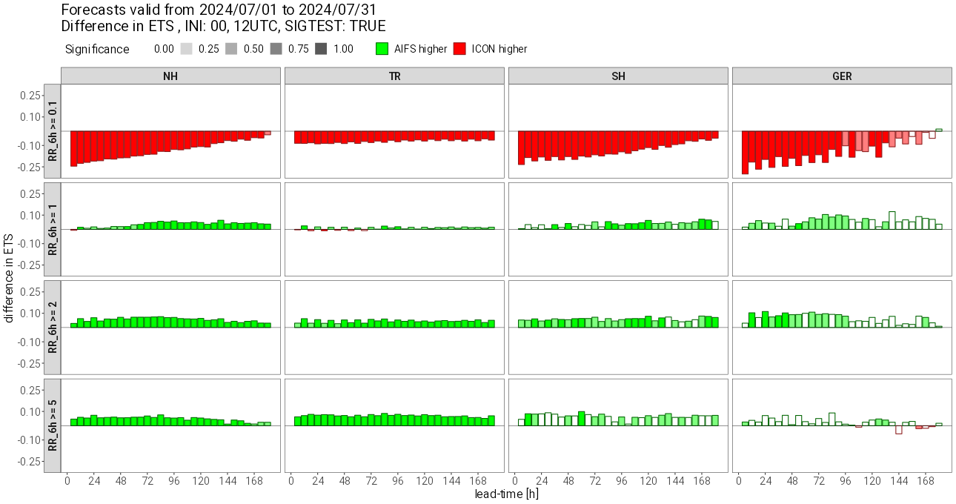
MEC
6h total precipitation ETS scorecard, AIFS vs. ICON
AIFS overestimating small precipiation rates (coarse resolution)
Outperforming ICON at higher precipitation rates
Double penalty effects may explain for some of the differences

Slide 14
Conclusion
No major/breaking, only incremental developments with FFV2
Setup of Shiny application should be more convenient now
MEC adaptations to cope with AI models, first results show strength of models
Still some MEC work coming up with AICON
MEC needs to work on model levels without HHL
For FF10M verification MEC needs to use surface wind not lowest model level

