Slide 1
Cloud and Precipitation Verification of ICON-CH Models
WG5 Meeting, COSMO GM 2024

Slide 2
Total Cloud Cover

Slide 3
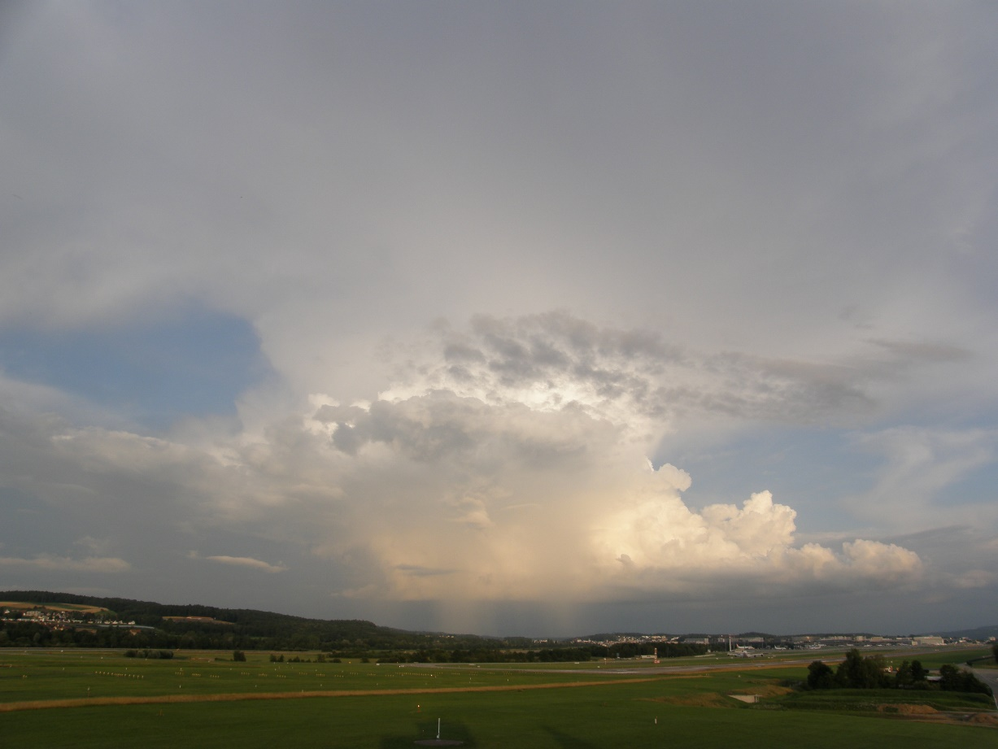
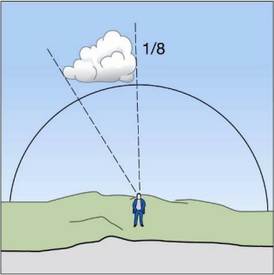
Original SYNOP Eye Observations
Field of view
r = ~30 km
Pirmin.Kaufmann@MeteoSwiss.ch

Slide 4
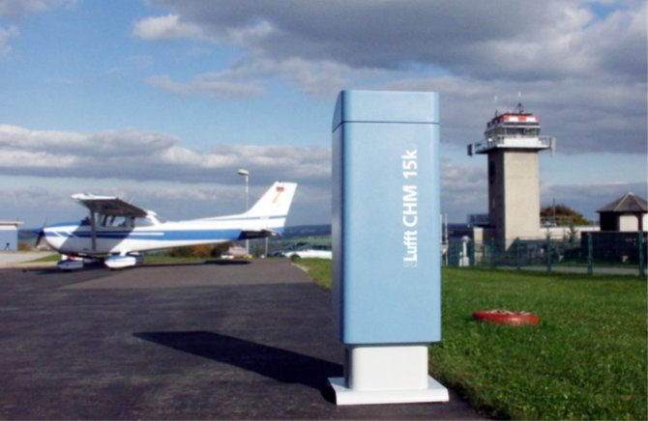
Modern Measurement: Ceilometer
Cloud cover derived from LIDAR backscatter
→ Much narrower viewing angle
Pirmin.Kaufmann@MeteoSwiss.ch

Slide 5
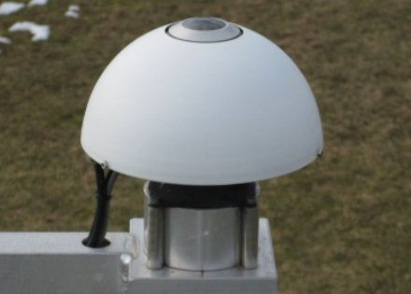
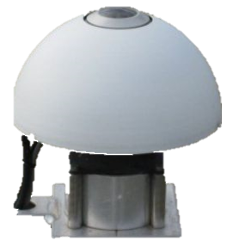
Modern Measurement: Pyrgeometer
Cloud cover derived from incoming longwave radiation
Narrower viewing angle for main contribution to measurement
Pirmin.Kaufmann@MeteoSwiss.ch

Slide 6
Averaging Area for Modeled CLCT
Model | Radius approp. for SYNOP Obs. | Radius approp. for LWR Derived
ICON-CH1 (1 km grid) | 26 gp ~ 27 km | 4 gp ~ 4 km
ICON-CH2 (2 km grid) | 13 gp ~ 27 km | 2 gp ~ 4 km
Fieldextra namelist: hoper="nbhavg,square,<radius>"
Pirmin.Kaufmann@MeteoSwiss.ch

Slide 7
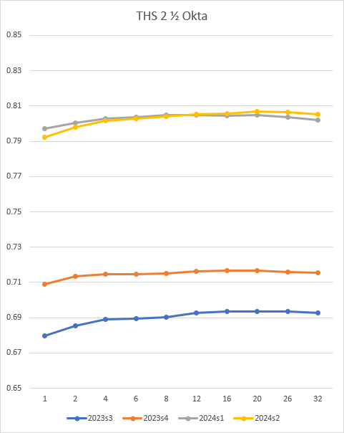
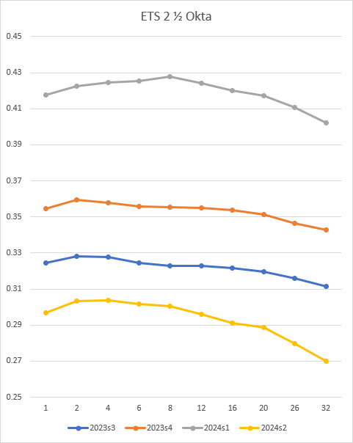
ICON-CH1-Ctrl, Threshold 2 ½ Okta
Averaging area with radius 1 to 32 grid points
Pirmin.Kaufmann@MeteoSwiss.ch

Slide 8
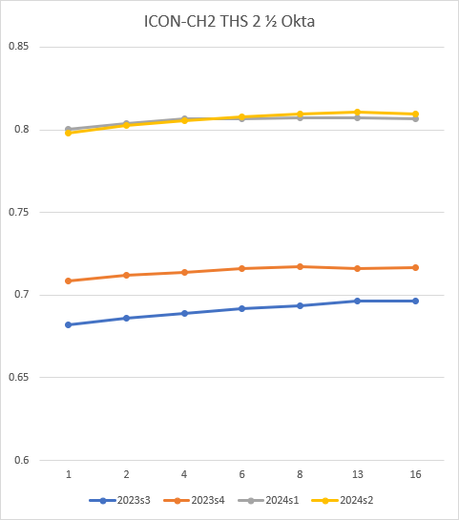
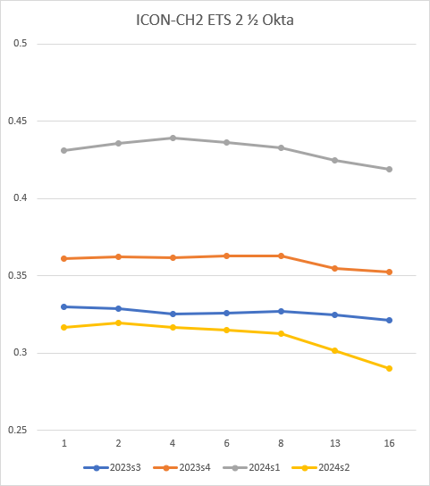
ICON-CH2-Ctrl, Threshold 2 ½ Okta
Averaging area with radius 1 to 16 grid points
Pirmin.Kaufmann@MeteoSwiss.ch

Slide 9
Conclusions for Threshold 2 ½ Okta
Threat Score (THS, also named Critical Success Index) depends on base frequency (Schaefer 1990): Larger averaging area → higher frequencies of events → higher THS
Equitable Threat Score (ETS, also named Gilbert Skill Score) compensates frequency effect
Better for smaller averaging area (as opposed to THS)
Optimal radius 2 – 8 km

Slide 10
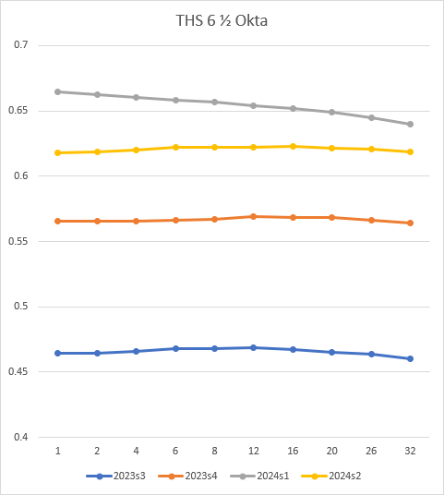
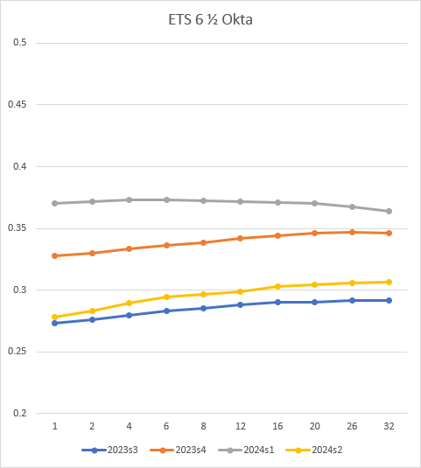
ICON-CH1-Ctrl, Threshold 6 ½ Okta
Averaging area with radius 1 to 32 grid points
Pirmin.Kaufmann@MeteoSwiss.ch

Slide 11
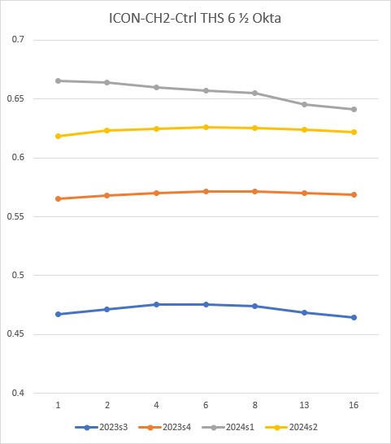
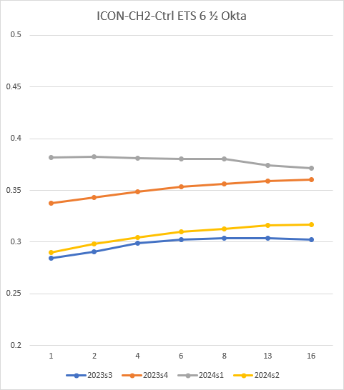
ICON-CH2-Ctrl, Threshold 6 ½ Okta
Averaging area with radius 1 to 16 grid points
Pirmin.Kaufmann@MeteoSwiss.ch

Slide 12
Conclusions for Threshold 6 ½ Okta
General underestimation of frequency of event
THS depends on base frequency (Schaefer 1990)
Winter has highest base frequency of all seasons. Smaller averaging area → higher frequencies of events → higher THS
Spring, Summer, Autumn: THS is independent of averaging area
ETS compensates frequency effect
Winter: independent of averaging area
Spring, Summer, Autumn: larger averaging areas have better ETS despite a larger underestimation of the frequency of occurrence → contradiction to frequency bias (does the ETS overcompensate the frequency effect? Maybe because sample frequency instead of climatology is used in our ETS?)
In winter similar as for 2 ½ okta threshold, but in spring, summer, and autumn opposite behavior → optimal radius depends on season

Slide 13
Overall Conclusions
Smaller averaging radius
improves ETS for 2 ½ okta and THS for 6 ½ okta
reduces THS for 2 ½ okta and ETS for 6 ½ okta
improves frequency bias for both thresholds (less underestimation)
better corresponds to what instruments see in automated measurements
➔ For verification with cloud cover measured by instruments, use smaller averaging radius (~4 km) for the model data than for verification with eye observations (~30 km)

Slide 14
Precipitation

Slide 15
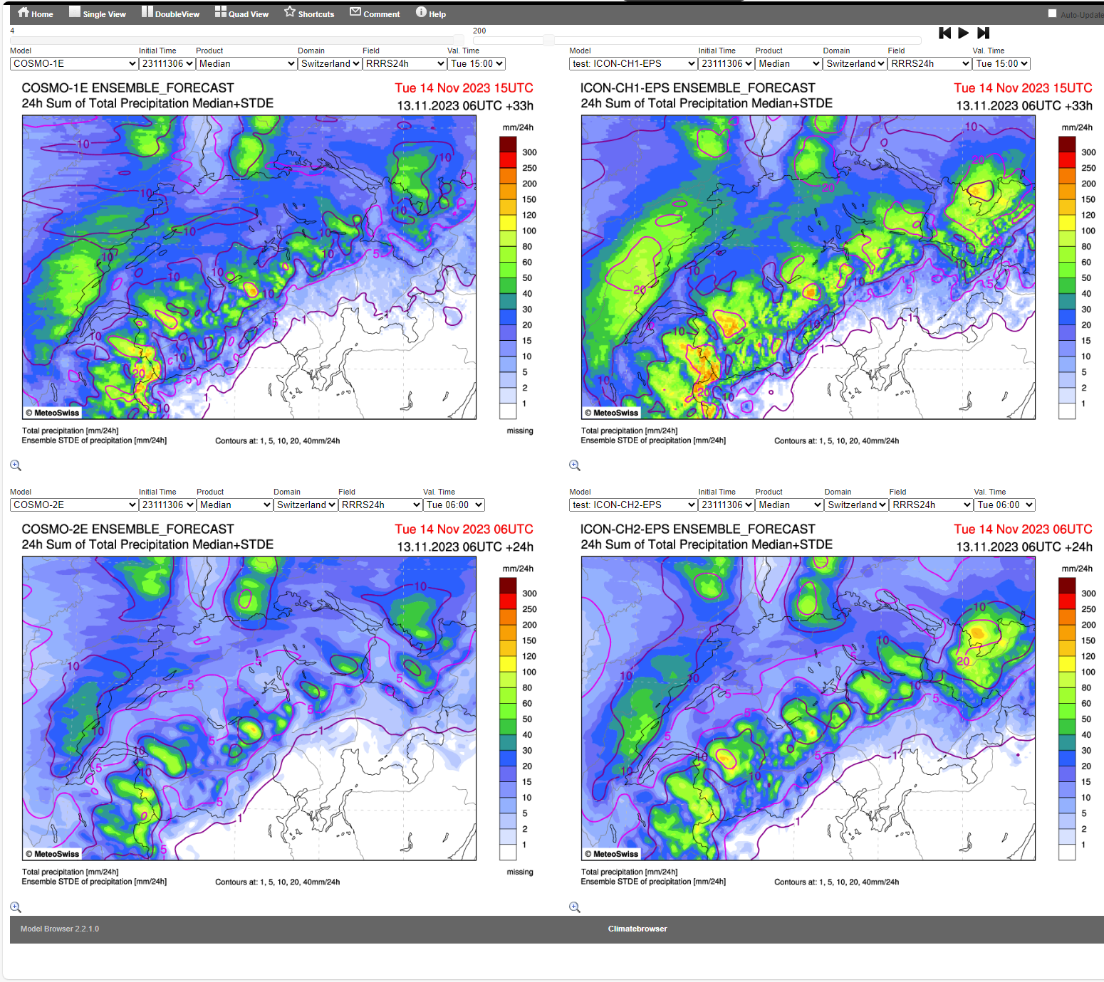
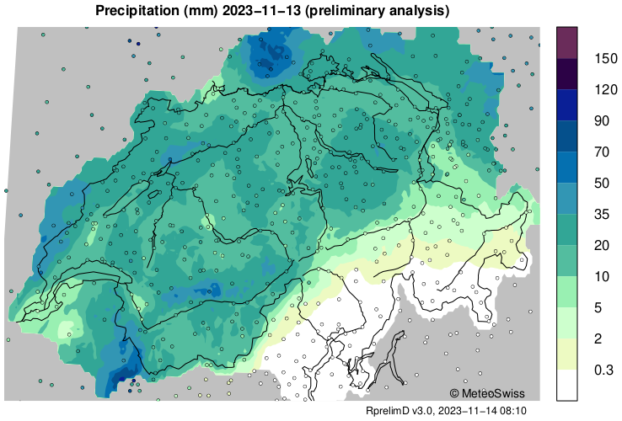
ICON exaggerates precipitation peaks more than COSMO
Radar+Gauges
COSMO
ICON
Note: different color scale ↑

Slide 16
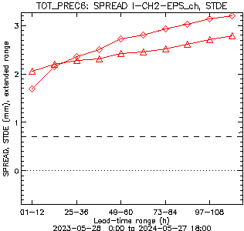
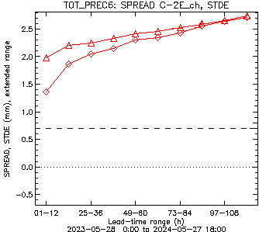
2023 – 2024 (1 y) Spread vs Std
∆─∆ STDE
◊─◊ Spread
COSMO-2E
ICON-CH2-EPS
Pirmin.Kaufmann@MeteoSwiss.ch

Slide 17
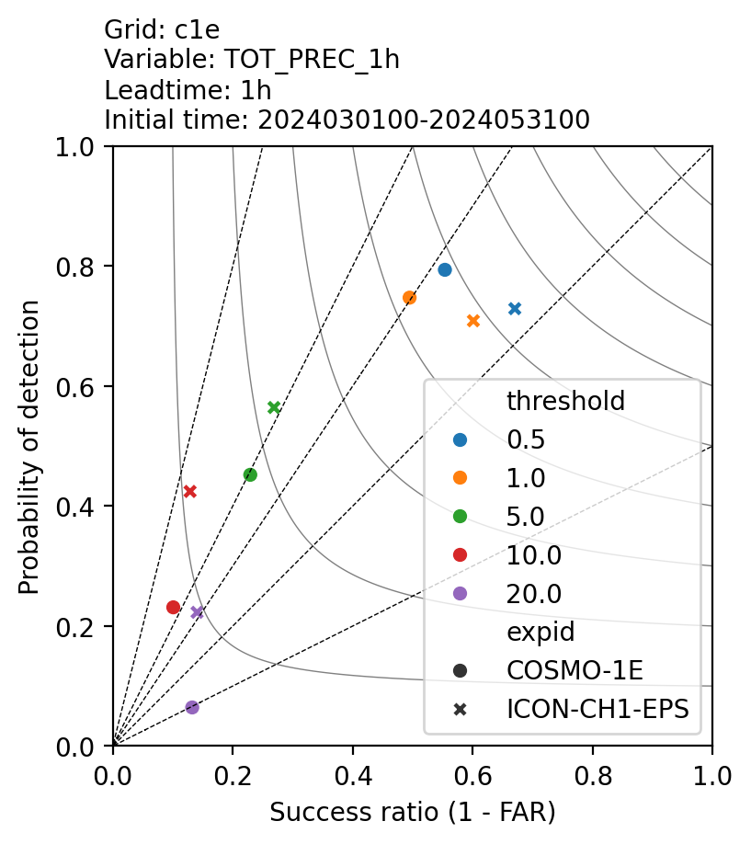
Performance diagram – Leadtime 1 h
MAM 2024 spatial verification
ICON-CH1-EPS better Threat-Score than COSMO-1E for all thresholds
Frequency bias strongly depends on threshold
ICON-CH1-EPS vs COSMO-1E:
Improvement in frequency bias for low thresholds (0.5, 1 mm/h)
Larger frequency bias (factor 2-3) for higher thresholds (5, 10 mm/h)
Bas.Crezee@MeteoSwiss.ch

Slide 18
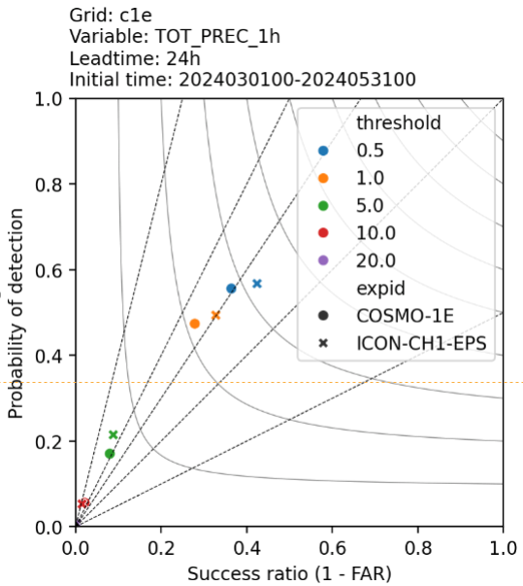
Performance diagram – Leadtime 24 h
MAM 2024 spatial verification
ICON-CH1-EPS better Threat Score than COSMO-1E for all thresholds
Frequency overestimated for all thresholds
ICON-CH1-EPS vs COSMO-1E :
Slight improvement in frequency bias for low thresholds (0.5, 1 mm/h)
Slightly larger bias for 5 mm/h only.
Much less difference than for lead time +1 h
Bas.Crezee@MeteoSwiss.ch

Slide 19
Summary Precipitation
Higher precipitation peaks in ICON than in COSMO (more details and possible causes see talk of Marco Arpagaus in WG 7)
Spread/Skill > 1 in ICON, ~1 in COSMO for lead times > 1 d
Frequency bias only slightly stronger in ICON than in COSMO
Nevertheless better threat score (critical success index) for ICON, for all thresholds and lead times

Slide 21
Slides in reserve

Slide 22
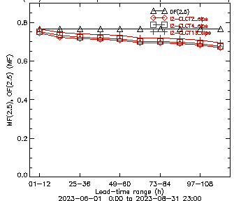
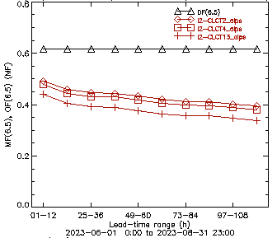
Observed and Modelled Frequency

Slide 23
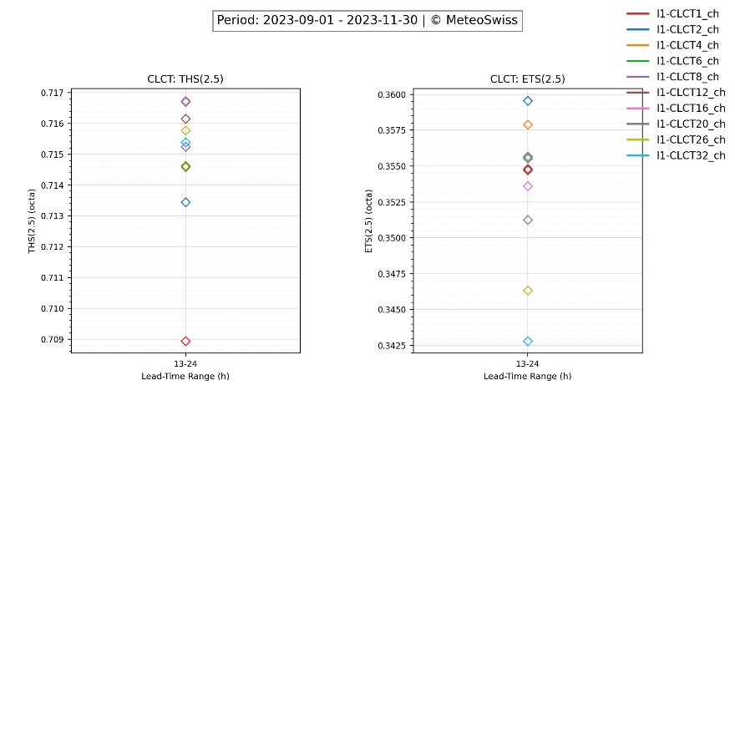
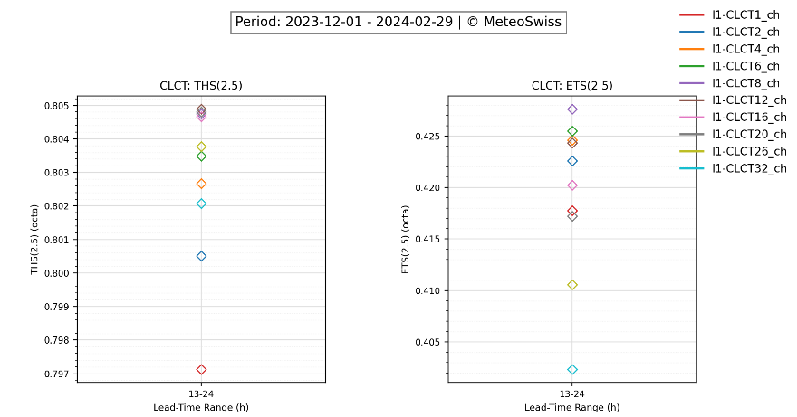
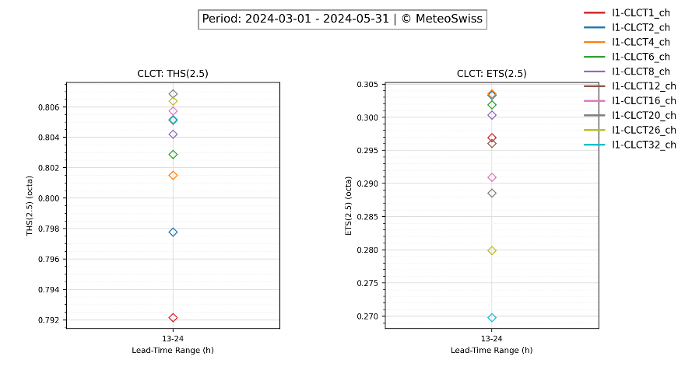
ICON-CH1-Ctrl, Threshold 2.5 okta
Pirmin.Kaufmann@MeteoSwiss.ch

Slide 24
ICON-CH1-Ctrl, Threshold 2.5 okta
Season | Sequence best..worst THS | Sequence best..worst ETS
Summer 2023 | (20, 16, 26), 32, 8, (6, 4), 2, 1 | 2, 4, (6, 1), 8, 12, 16, 20, 26, 32
Autumn 2023 | (16, 20), 12, 26, 32, 8, (6, 4), 2, 1 | 2, 4, (6, 8), (12, 1), 16, 20, 26, 32
Winter 23/24 | (12, 20, 8, 16), 26, 6, 4, 32, 2, 1 | 8, 6, (4, 12), 2, 16, 1, 20, 26, 32
Spring 2024 | 20, 26, 16, (32, 12), 8, 6, 4, 2, 1 | (4, 2), 6, 8, 1, 12, 16, 20, 26, 32
Threat Score
Smaller averaging area → lower frequencies of events > 2.5 → lower THS
Larger averaging area → higher frequencies of events > 2.5 → higher THS
Equitable Threat Score ETS compensates this effect and is always better for smaller averaging area
Pirmin.Kaufmann@MeteoSwiss.ch

Slide 25
ICON-CH1-Ctrl, Threshold 6.5 okta
Season | Sequence best..worst THS | Sequence best..worst ETS
Summer 2023 | 12, (8, 6), 16, 4, 20, 2, 1, 26, 32 | (26, 32), 20, 16, 12, 8, 6, 4, 2, 1
Autumn 2023 | (12, 20, 16), 8, (26, 6), 4, 2, 1, 32 | (26, 20, 32), 16, 12, 8, 6, 4, 2, 1
Winter 23/24 | 1, 2, 4, 6, 8, 12, 16, 20, 26, 32 | (4, 6), 8, 2, 12, 16, 20, 1, 26, 32
Spring 2024 | (16, 6, 8), 12, 20, 26, 4, 2, 32, 1 | (32, 26), 20, 16, 12, 8, 6, 4, 2, 1
Threat Score
Smaller averaging area → higher frequencies of events > 6.5 → higher THS
Larger averaging area → lower frequencies of events > 6.5 → lower THS
Equitable Threat Score ETS: tends to overcompensate, opposite effect
Pirmin.Kaufmann@MeteoSwiss.ch

Slide 26
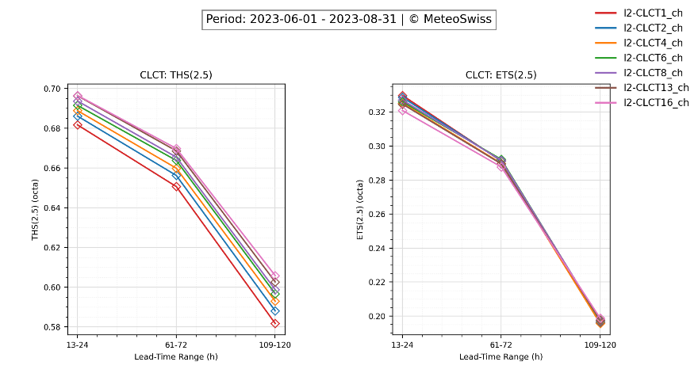
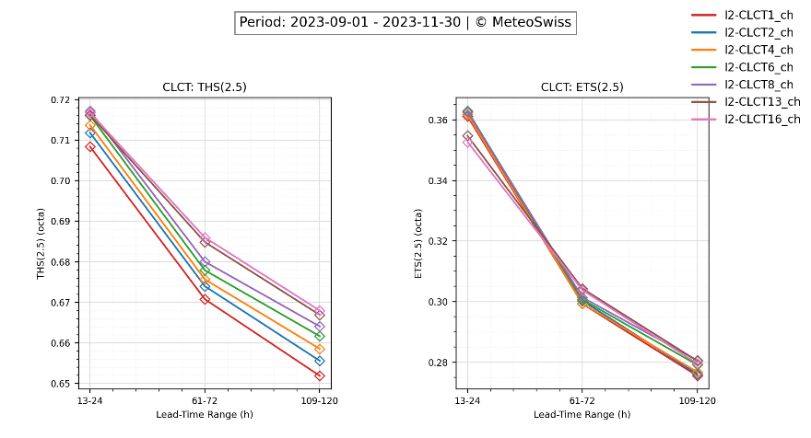
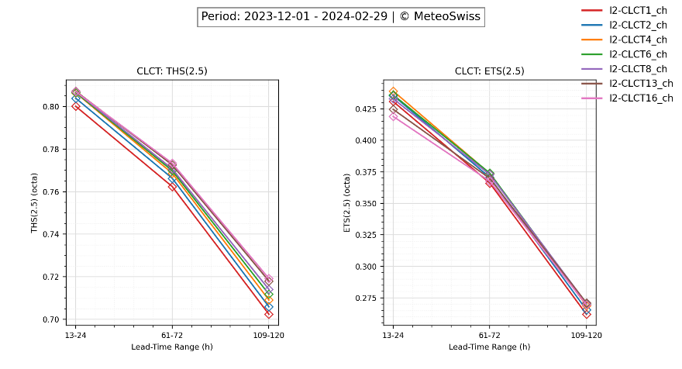
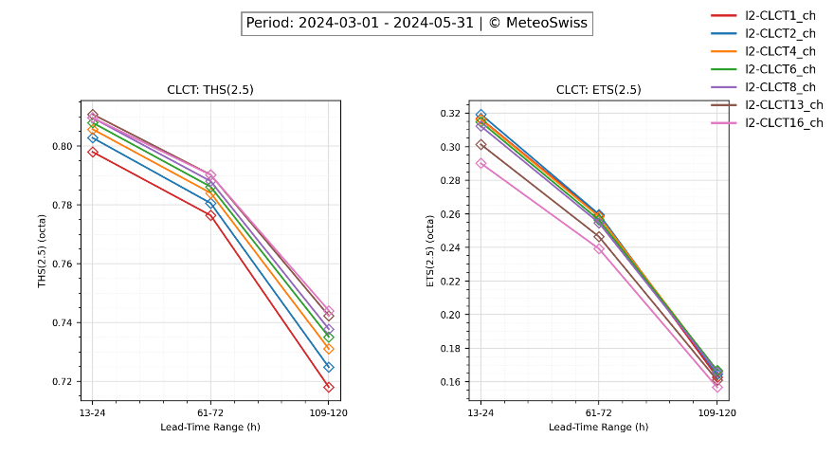
ICON-CH2-Ctrl, Threshold 2.5 okta
Pirmin.Kaufmann@MeteoSwiss.ch

Slide 27
ICON-CH2-Ctrl, Threshold 2.5 okta
Season | Sequence best..worst THS | Sequence best..worst ETS
Summer 2023 | 16, 13, 8, 6, 4, 2, 1 | +1d: (1, 2), (8, 6, 4, 13), 16 +3d: (6, 8, 2, 1), (4, 13), 16 +5d: (16, 8, 13, 6, 4, 2, 1)
Autumn 2023 | 16, 13, 8, 6, 4, 2, 1 | +1d: (6, 8, 2), (4, 1), 13, 16 +3d: (13, 16), (8, 6, 2, 4, 1) +5d: (13, 8), (16, 6), 4, 2, 1)
Winter 23/24 | 16, 13, 8, 6, 4, 2, 1 | +1d: 4, 6, 2, 8, 1, 13, 16 +3d: (6, 4, 8), 13, 2, 16, 1 +5d: (8, 13, 6, 16, 4), 2, 1
Spring 2024 | 16, 13, 8, 6, 4, 2, 1 | +1d: 2, (1, 4), 6, 8, 13, 16 +3d: (2, 4, 1, 6, 8), 13, 16 +5d: (6, 4, 8), 2, 1, 13, 16
Pirmin.Kaufmann@MeteoSwiss.ch

Slide 28
ICON-CH2-Ctrl, Threshold 6.5 okta
Season | Sequence best..worst THS | Sequence best..worst ETS
Summer 2023 | +1d: (6, 4, 8), 2, 13, 1, 16 +3d: (4, 6, 2, 8, 1), 13, 16 +5d: (2, 1, 4, 6, 8), 13, 16 | +1d: (8, 13, 6, 16), 4, 2, 1 +3d: (8, 13, 16), 6, 4, 2, 1 +5d: (2, 4, 6, 8, 13, 1, 16)
Autumn 2023 | +1d: (8, 6, 4, 13, 8, 16, 2), 1 +3d: (6, 4, 8, 13, 2, 16, 1) +5d: (4, 2, 1, 6, 8), 13, 16 | +1d: (16, 13), 8, 6, 4, 2, 1 +3d: (16, 13, 8, 6), 4, 2, 1 +5d: (16, 13, 8, 6, 4, 2, 1)
Winter 23/24 | +1d: 1, 2, 4, 6, 8, 13, 16 +3d: (2, 1), 4, 6, 8, 13, 16 +5d: 1, 2, 4, 6, 8, 13, 16 | +1d: (2, 1, 4, 6, 8), 13, 16 +3d: (8, 6, 13, 4, 2, 16, 1) +5d: (1, 2, 4, 6, 8, 13, 16)
Spring 2024 | +1d: (6, 8, 4), (13, 2), 16, 1 +3d: (6, 8, 4), (13, 16), 2, 1 +5d: (2, 1, 4), 6, 8, 13, 16 | 16, 13, 8, 6, 4, 2, 1
Pirmin.Kaufmann@MeteoSwiss.ch

Slide 29
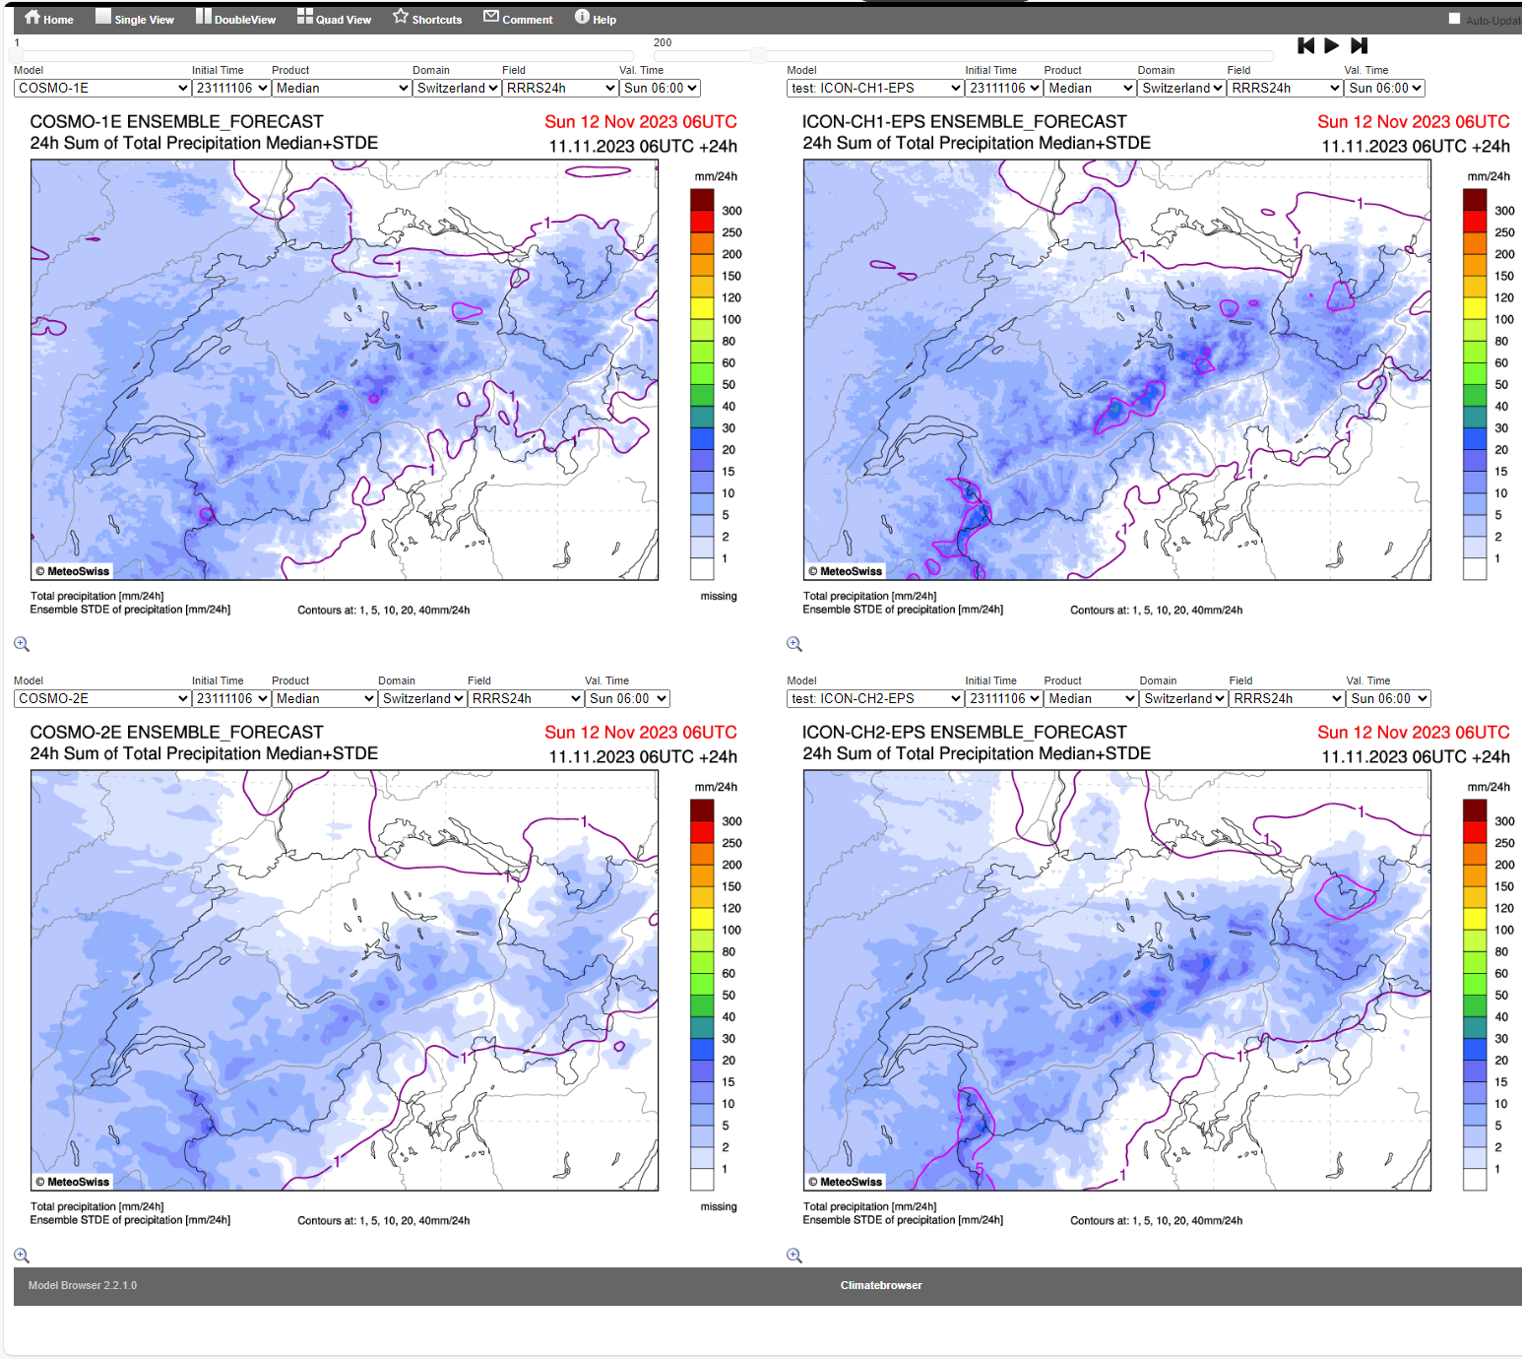
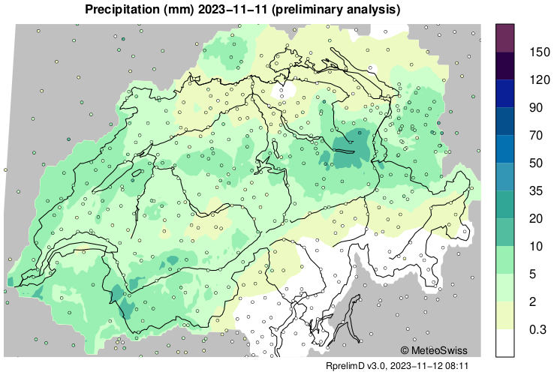
ICON exaggerates precipitation peaks more than COSMO
COSMO
ICON

Slide 30
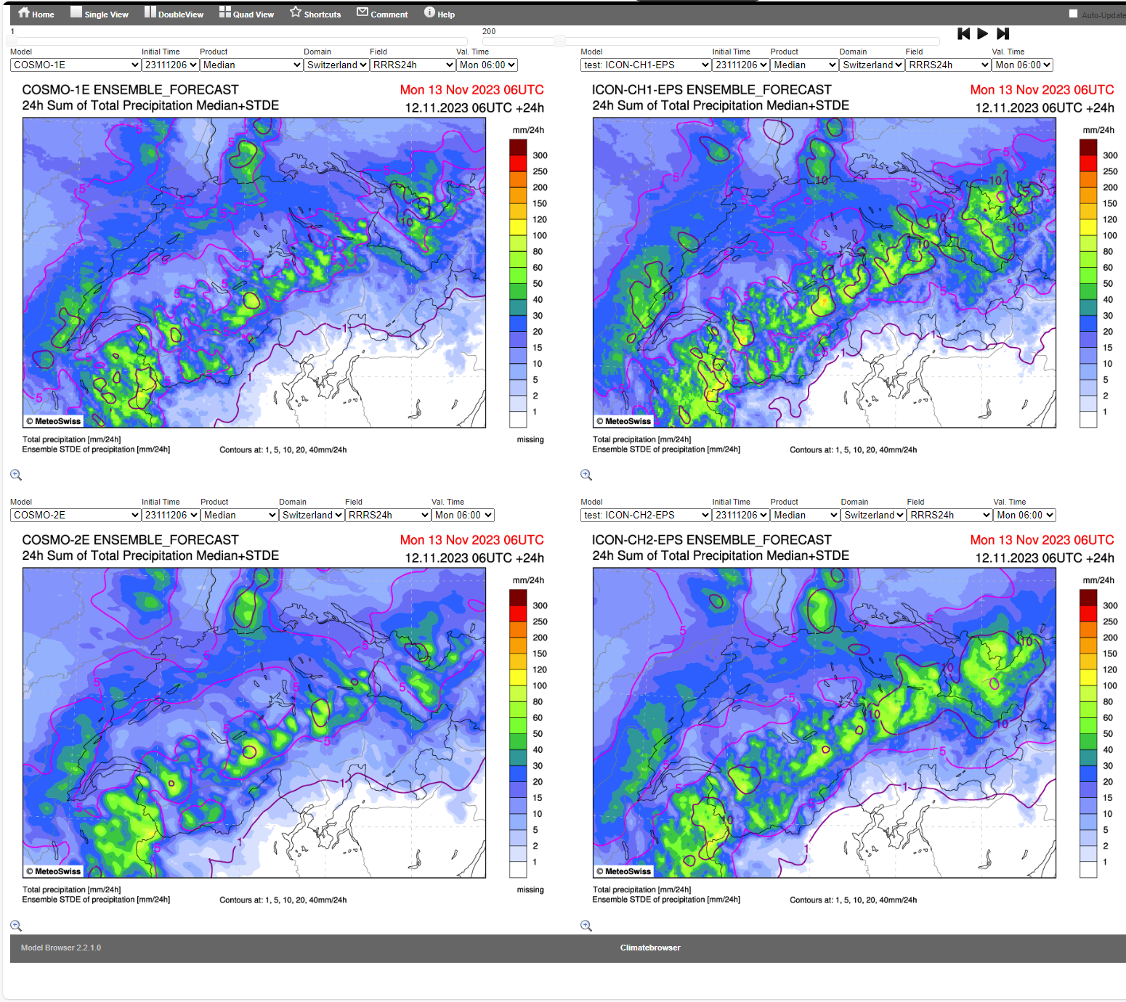
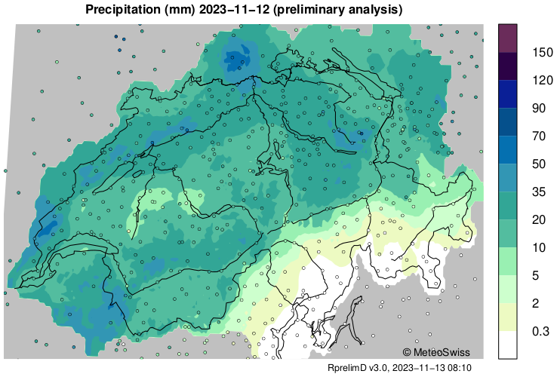
ICON exaggerates precipitation peaks more than COSMO
COSMO
ICON

Slide 31
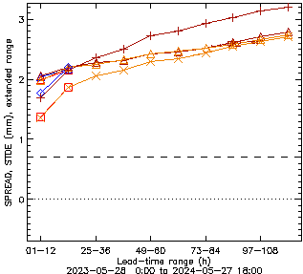
∆─∆ Std
◊─◊ Spread ICON-CH1
□─□ Spread COSMO-1E
+─+ Spread ICON-CH1
X─X Spread COSMO-1E
Pirmin.Kaufmann@MeteoSwiss.ch

