Slide 1

ICON-COMFORT final results Dimitra Boucouvala WG4 GM 2024 Parallel Session

Slide 2
Main goals of ICON-COMFORT
The subjective evaluation of ICON-LAM forecasts by forecasting departments and the translation of this feedback to the COSMO-ICON community.
Results : The forecasters feedback on ICON-LAM performance in respect to COSMO forecasts and detection of ICON deficiencies for different weather conditions by means of:
Regular surveys ( distributed twice a year)
Representative test cases.
In case COSMO was not available any more, the comparison was done with the most used model of each service.
Participants (HNMS, MCH,CNMA,NMA,IMS,ARPA-P,IMGW)

Slide 3
Task 1 : Forecasters Survey Completion and analysis
Sub- Task 1.1 Survey Creation and Distribution (SON 22/MAM23)
The survey was created and sent to representative person of each service, who distributed it to the forecasters. (DONE)
Sub -Task 1.2 Survey collection and analysis (DJF 23/JJA23)
At the end of two consecutive seasons the representative of each service collected survey answers and representative cases. (DONE).
Task 2 : Evaluation of ICON-LAM forecast skill
Sub-Task 2.1 Forecasters feedback assessment report. (DONE).
Sub- Task 2.2 Systematic errors (from objective verification) vs Forecasters feedback report (DONE).
The internal report is in the COSMO website, together with test cases of the participants. The external report is being prepared.

Slide 4
List of participants providing survey answers
 | SON-DJF | MAM-JJA | C2I (*)
ARPA-P | x | x | x
IMS |  | x | x
CNMCA |  | x | x
NMA | x | x | x
IMGW | x | x
MCH | x | x
HNMS | x | x | x
List of participants providing test cases
 | SON-DJF | MAM-JJA | C2I (*)
ARPA-P | x
IMS
CNMCA |  | x | x
NMA | x | x
IMGW | x | x
MCH | x
HNMS | x | x
(*) Older surveys from C2I PP

Slide 5
Main points on model use and products.
There are delays in receiving ICON-LAM data for visualization. This is a reason ICON-LAM is not the main forecast model for some services.
Visualization is not satisfactory for most services. Better map resolution, multi-model meteograms, color scale improvement or zooming tools are needed.
Many products ( direct or post-processing) are needed for some services. Especially convective indices, high weather impact products and visibility/fog maps. Higher temporal resolution of outputs is also desirable.
Verification is not always useful as the forecasters look more visually the outputs. Some verification products are not comprehensive to the forecasters. Some additional products such verification of severe weather may be useful.
ICON-LAM is not the main model for issuing aeronautical and sea forecasts, but it is only used for comparison.

Slide 6
Some interesting facts on model performance
Wind Speed
ICON-LAM better predictions than COSMO.
Overestimation of wind/wind gust and convective and orographic situations in warm seasons
Temp
ICON-LAM better predictions than COSMO.
Night time overestimation is reported.
Clouds
Fog
Better cloud predictions of ICON-LAM than COSMO especially for low-level clouds.
False alarms and fog risk overestimation of ICON-LAM are reported, but less than COSMO, especially in winter.
Preci
More contradictory opinions about precipitation performance.
ICON-IT Poor prediction of severe summertime deep convection hail events with misses and better performance of IFS in comparison to local models.
ICON-IT Night time convection inhibition resulting in poor deep convection overnight
Comparable or even better predictions for COSMO for frontal precipitation in winter season.
The precipitation area is better forecasted than the amounts which can be wrong.
Better predictions of ICON than COSMO in summer convective and orographic conditions , although events and rainfall amounts overestimation is often reported.
The 700hpa humidity map does not affect ICON-IT predictions as much as COSMO-IT

Slide 7
Comparison of subjective/objective verification
The last part of the report compares subjective verification statements to the objective verification
(from reports and verification cosmo site) and are mostly compatible. For example:
The overestimation of convective events reported by the forecasters in summer is compatible with ICON-PL FBI > 1 for high thresholds.
ICON overestimation of convective wind gusts in warm hours (NMA) as shown on the ICON-RO wind speed bias maxima

Slide 8
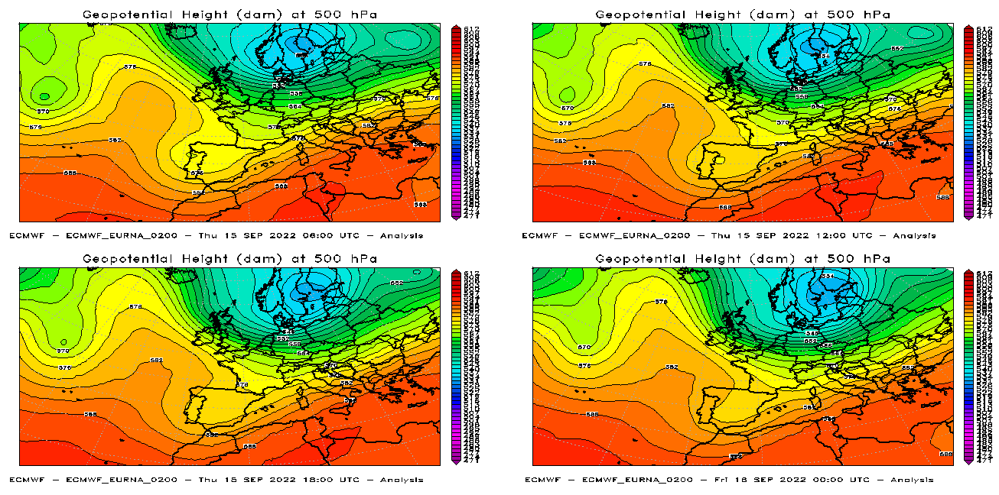
TEST CASES
ARPA-P 15/9/22 Marche region in Italy intense and persistent rainfall.
The central Italian regions were affected by westerly flows and this situation channelled colder air of Arctic origin present at higher latitudes, which entered the central-northern Tyrrhenian regions, and, at the same time, warmer and more humid air from North Africa towards the central-southern Tyrrhenian regions.

Slide 9
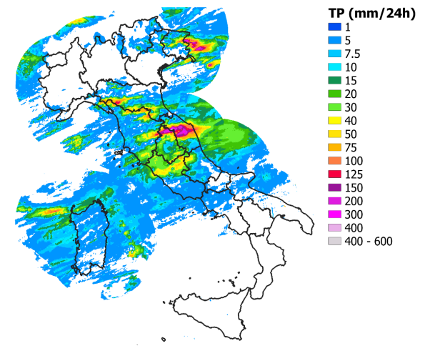
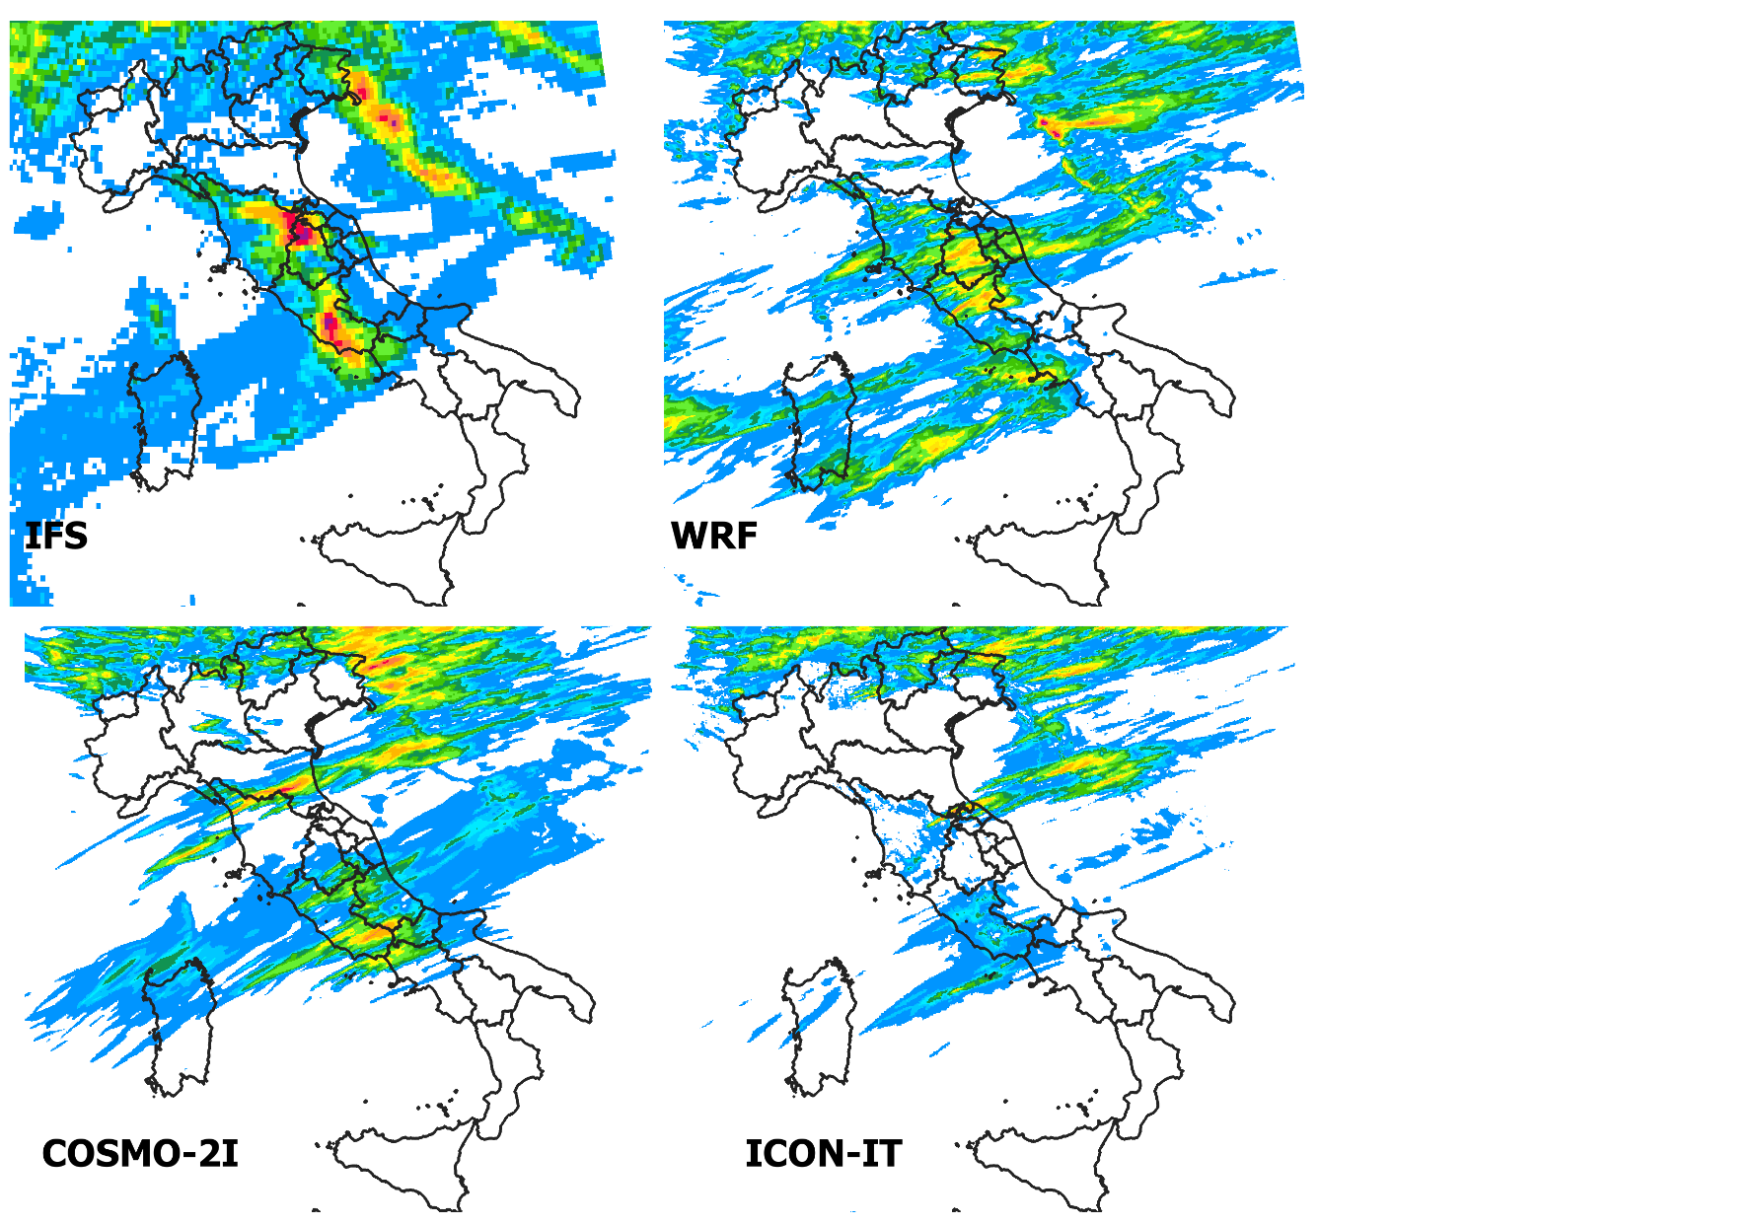

15/9/22 OBS vs IFS, COSMO-IT, ICON-IT
OBS
ICON-IT underestimated the high precipitation
amounts. (Forecasts of Run of 14/09 00 UTC).

Slide 10
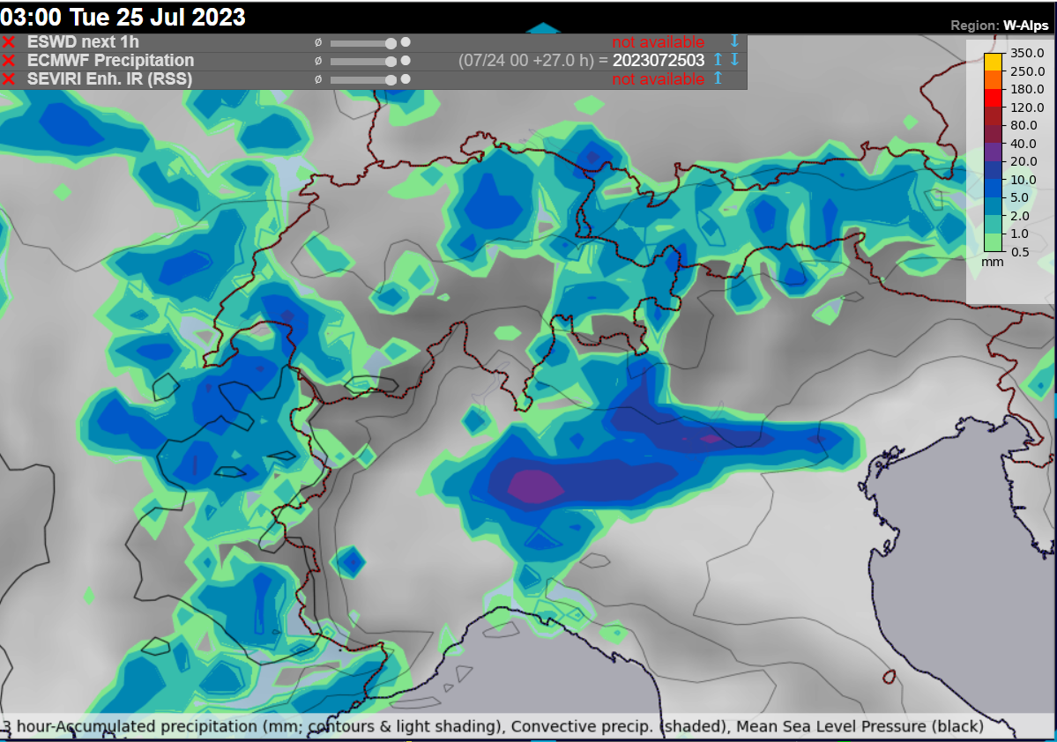
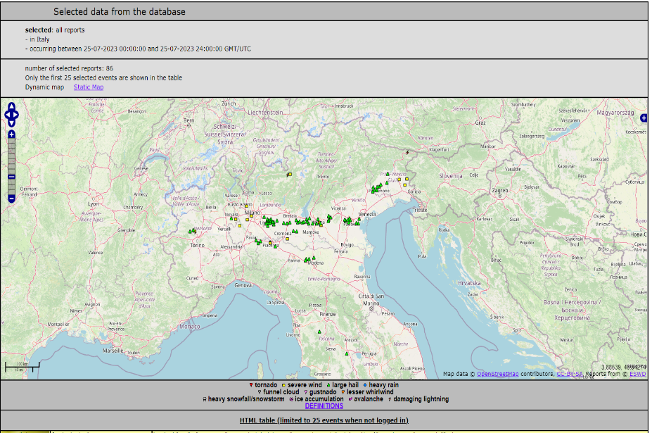

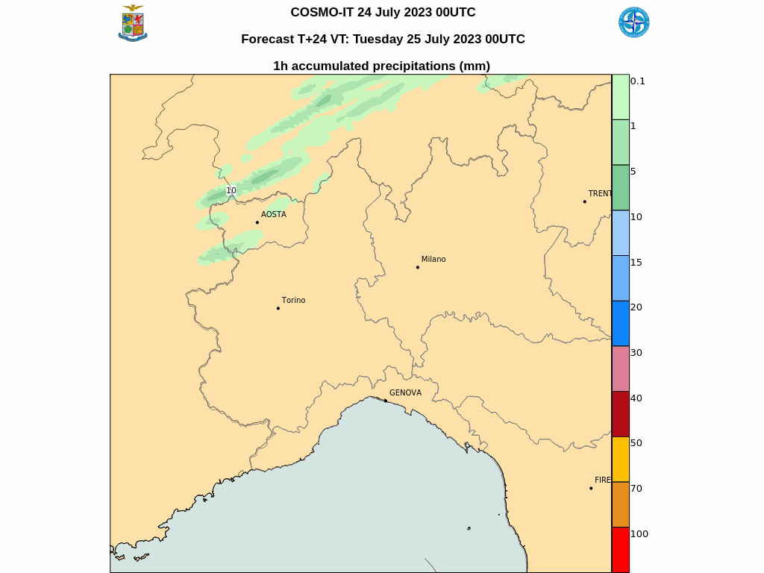
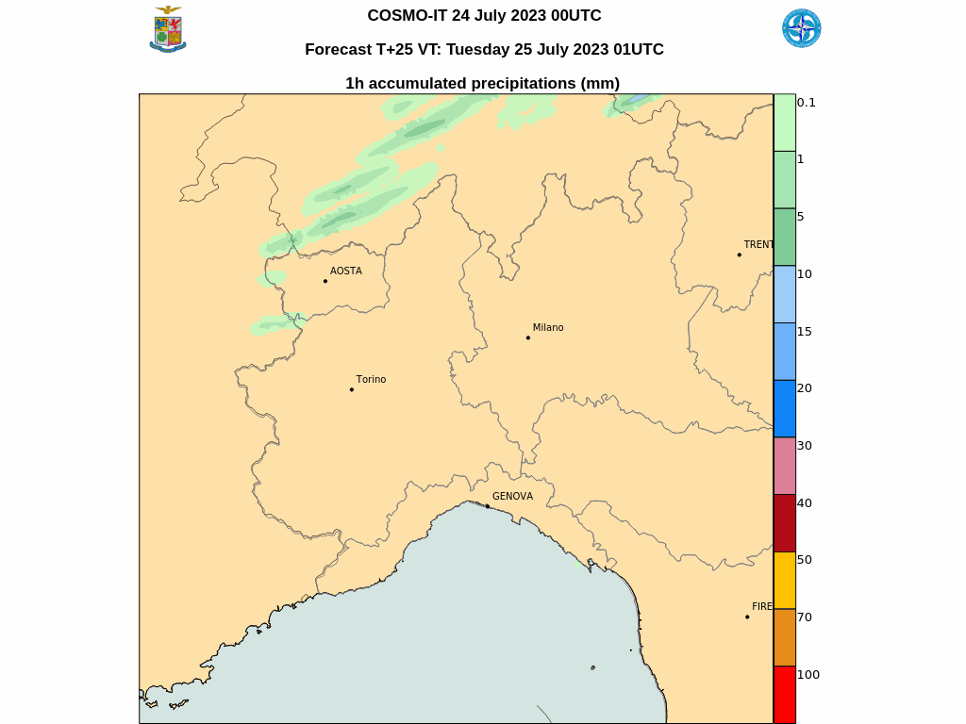
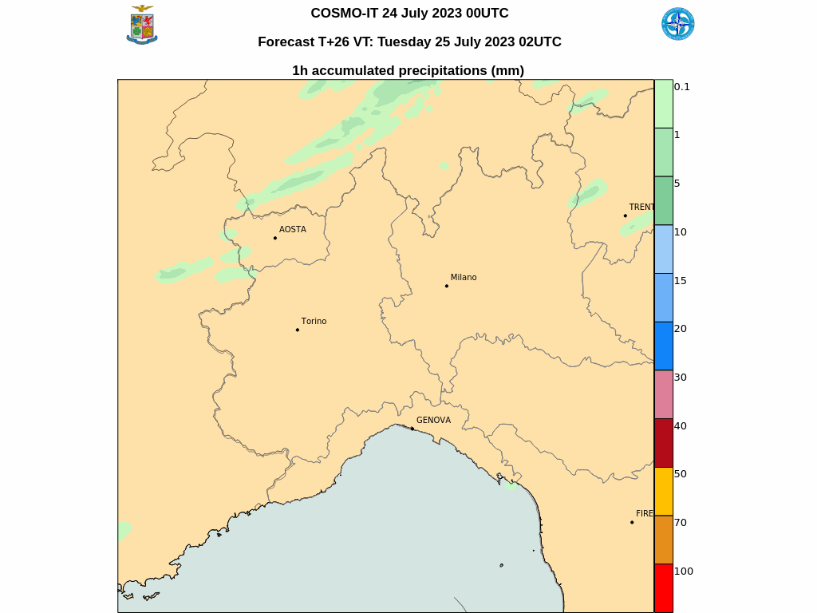
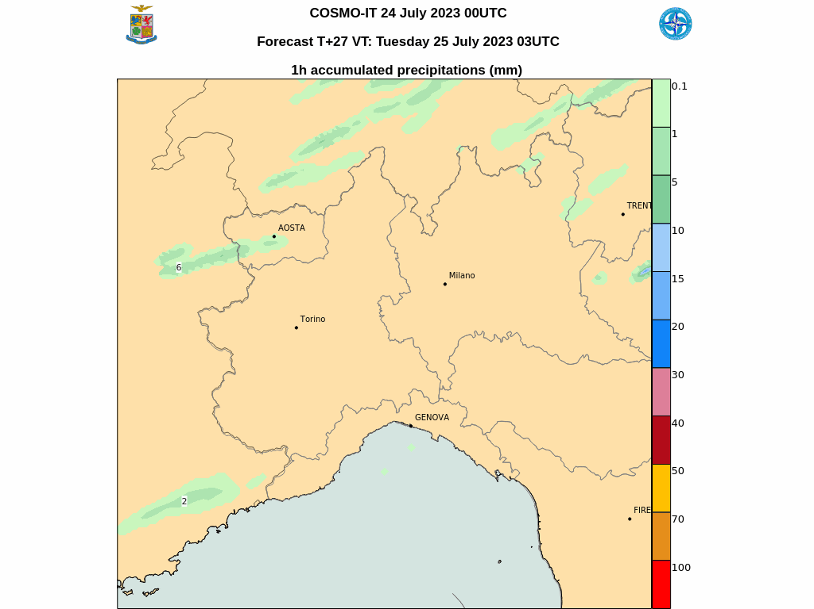


ECMWF vs COSMO-IT
CNMCA : 25 july 2023 0140 UTC Milan
Quasi Linear Convective Storm - QLCS
Distructive convective wind gust and giant hail.
Both local models failed

Slide 11
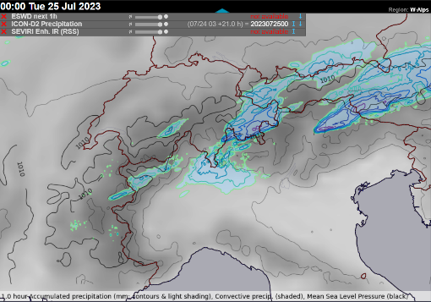
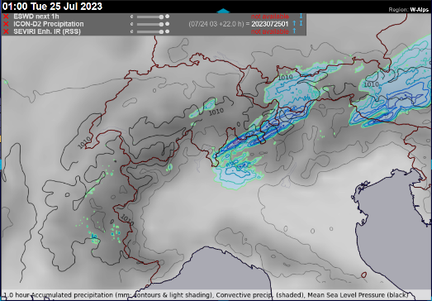
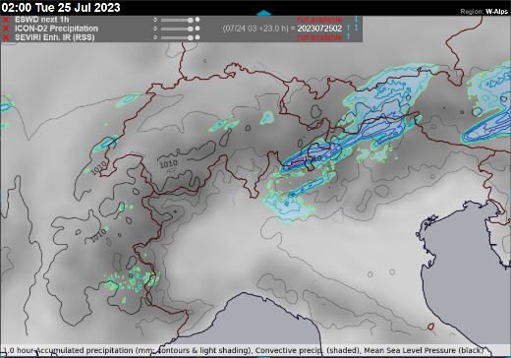
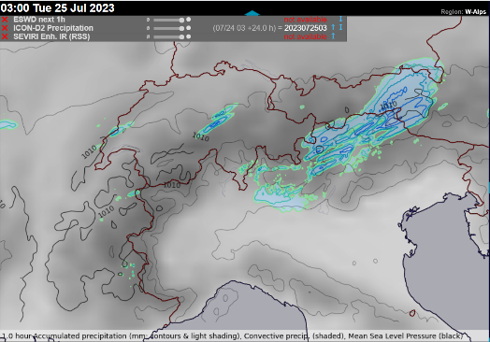

ECMWF vs ICON-D2
25 july 2023 0140 UTC Milan
Quasi Linear Convective Storm - QLCS
Distructive convective wind gust and giant hail

Slide 12
You can find the report and test cases on the cosmo website:
https://www.cosmo-model.org/view/repository/wg4/PP-COMFORT
Thank you !

