Slide 1
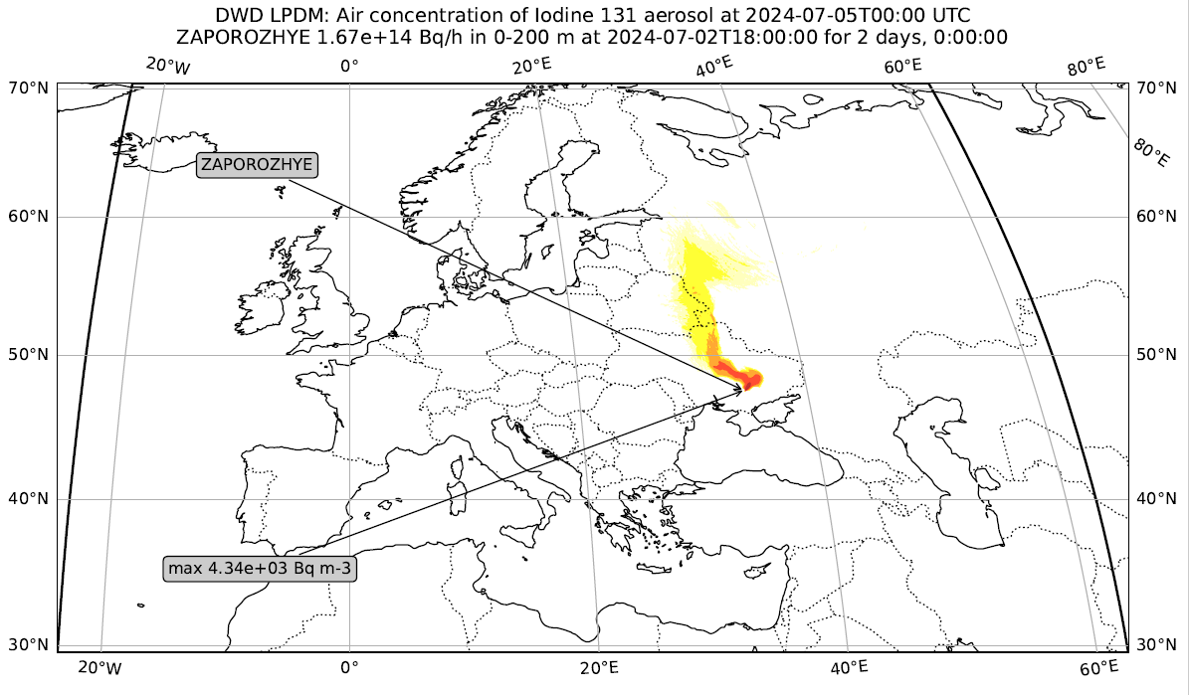
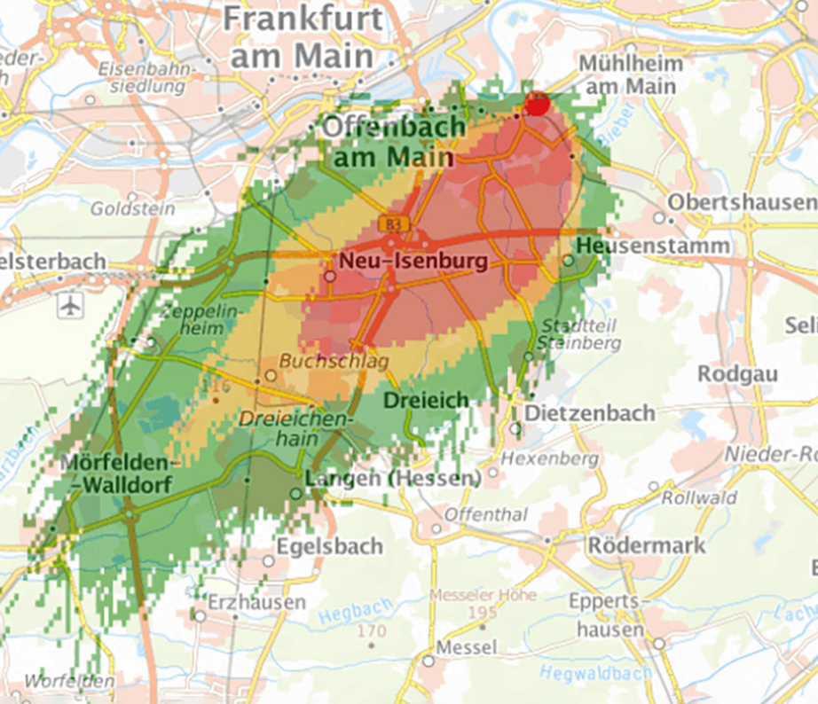
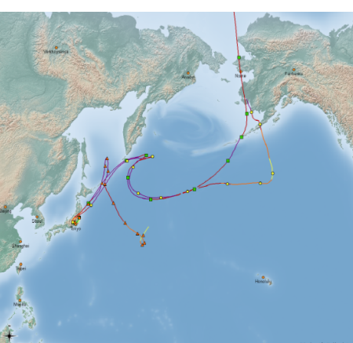
DWD’s emergency dispersion forecast system
Christoph.Siewert@DWD.de
Deutscher Wetterdienst, Frankfurter Str. 135, 63067 Offenbach am Main

Slide 2
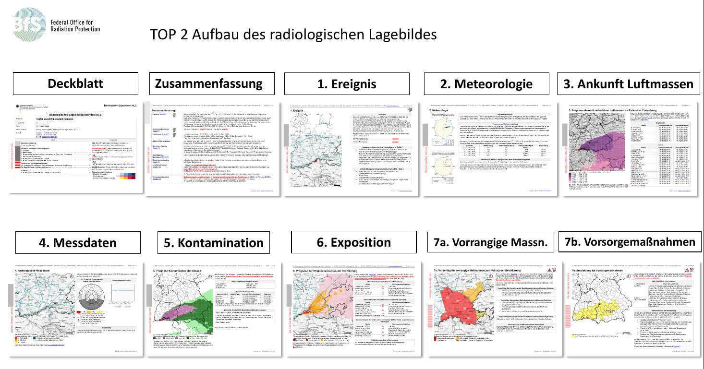
Legal aspects
DWD Law §4 duties (1).7:
Monitoring the atmosphere for radioactive substances and predicting their transport
Interpretation and recommend actions:
Federal Office for Radiation Protection (BfS)
Taking actions:
Federal States supported by Federal Office of Civil Protection and Disaster Assistance
Notes:
10 duties
DWD Bq
BfS equivalent dosis in Sievert
DWD service provider for BfS

Slide 3
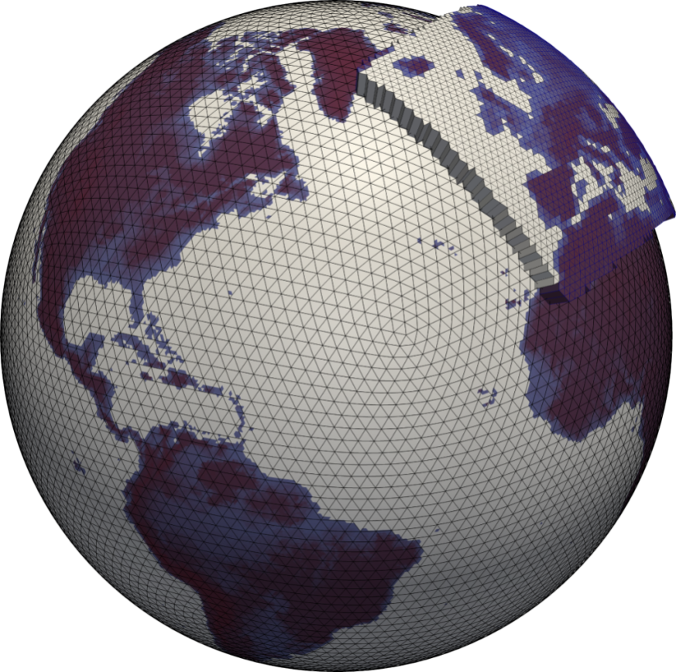
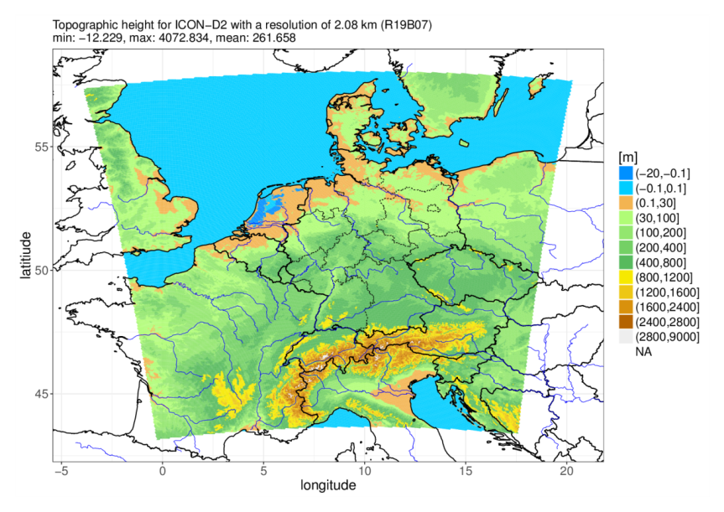
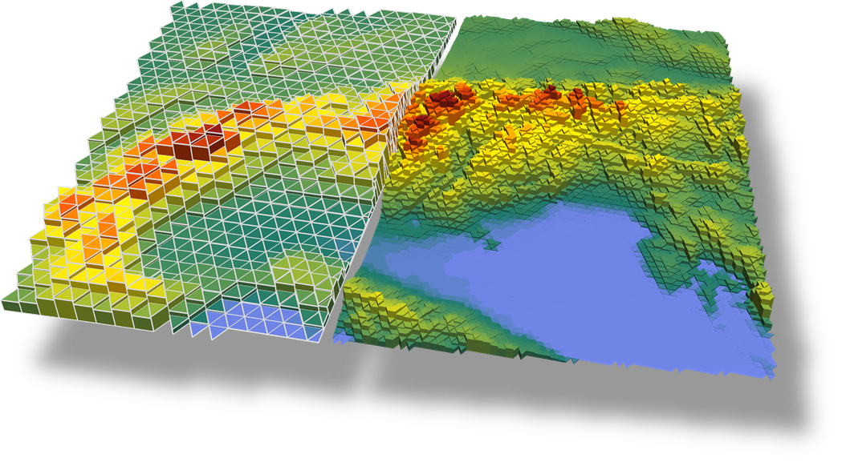
Postprocessing to ICON NWP
Global: Grid 13 km
EU-Nest: Grid 6.5 km
D2: Grid 2.2 km
for low latency:
hourly met. data stored on disk
Notes:
Store Forecasts on disk for low latency

Slide 4
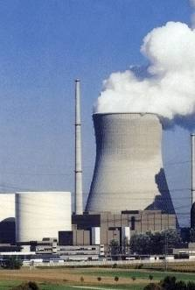
Trajectory Model
z
wind
v
x_{n}, y_{n}, z_{n}, t_{n}
x₃, y₃, z₃, t₃
x₄, y₄, z₄, t₄
Advection
with interpolated grid scale winds
x₂, y₂, z₂, t₂
x₁, y₁, z₁, t₁
x₀, y₀, z₀, t₀
y
x
Notes:
Interpolation of grid scale winds in time and space

Slide 5
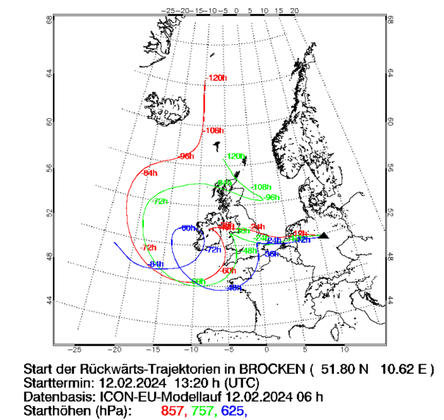
Operational Trajectories
Level 0 Backup:
Backward trajectories from radioactivity measurements stations
Forward trajectories from all known nuclear power plants
Notes:
Level 0 Backup: Backward trajectories from German radioacitivity meseaurement stations

Slide 6
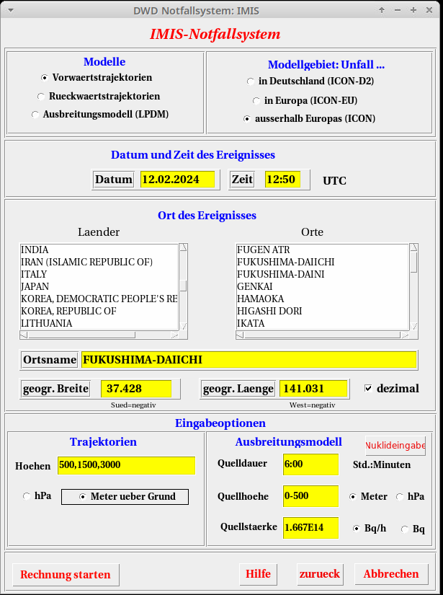
Emergency GUI
On demand GUI:
Global/EU/D2
Forward/Backward
Timing
Source location
Further specifications
Notes:
GUI for forecaster on duty to start on demand dispersion

Slide 7
Emergency Trajectories
Fukushima, 14.03.2011 17 UTC, 163h Trajectories based on GME
Notes:
Fukushima forward trajectory

Slide 8


Lagrangian Particle Dispersion Model
Advection + Diffusion
with interpolated grid scale winds + TKE-based modelled turbulent velocities
emission source
volume for counting
representative particles
wind
z
y
z₀
x
Physics: radioactive decay, dry and wet deposition (sedimentation, convection)

Slide 9
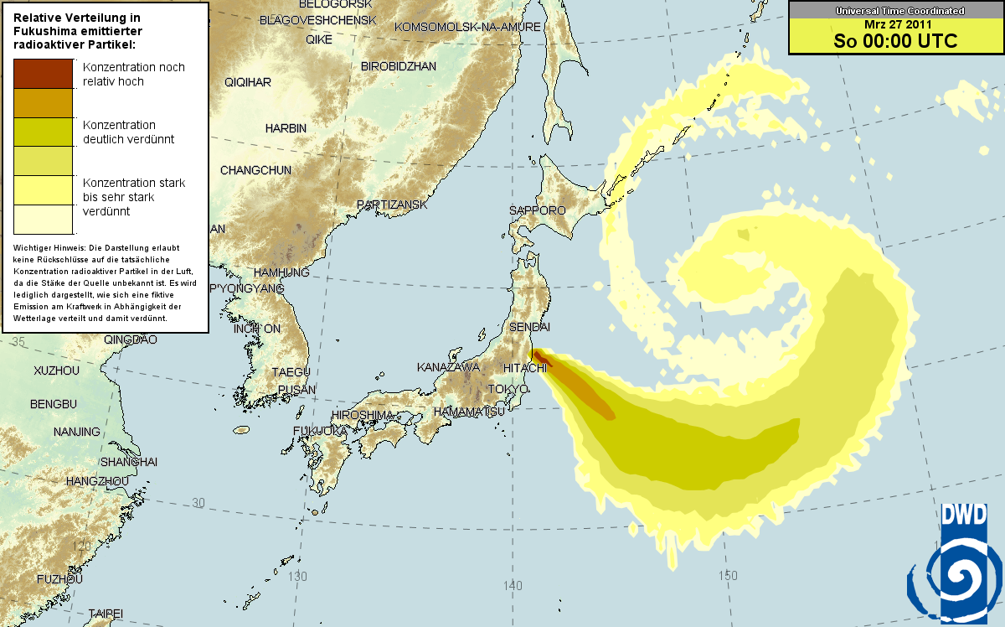
DWD LPDM
Offline Lagrangian Particle Dispersion Model (LPDM)
Fukushima
48 h-GME-
LPDM-Forecast
25.03.2011 00 UTC
Scenario:
Continuous emissions 0-500 m

Slide 10
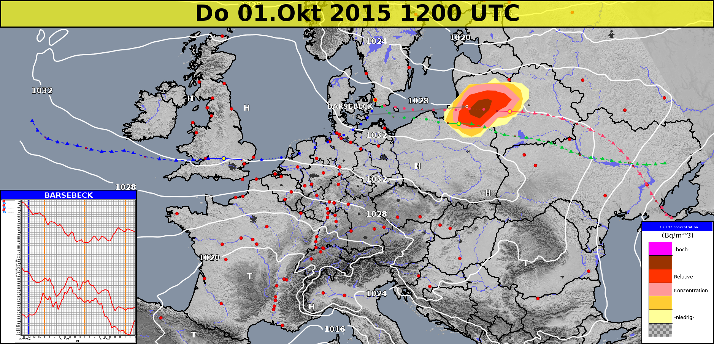
NinJo Visualization
NWP + Trajectory + Concentration
Notes:
Store Forecasts on disk for low latency

Slide 11
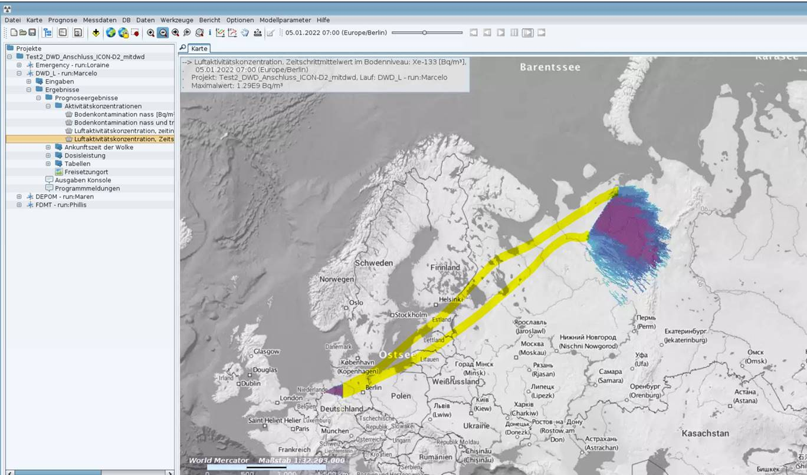
Seamless Near- and Far-Field
BfS Near-Field DWD Far-Field

Slide 12
Radiological Situation Report
Cover Summary 1. Event 2. Meteorology 3. Arrival time
4. Measurements 5. Contamination 6. Exposure 7a. Priority measures 7b. Preventive
Notes:
In total 1h to dismay radiological situtation report -> 10 max 15 min for dispersion simulation

Slide 13

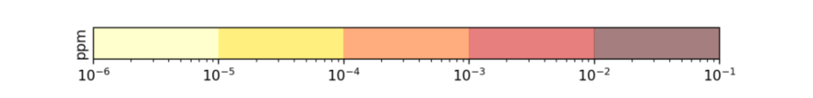
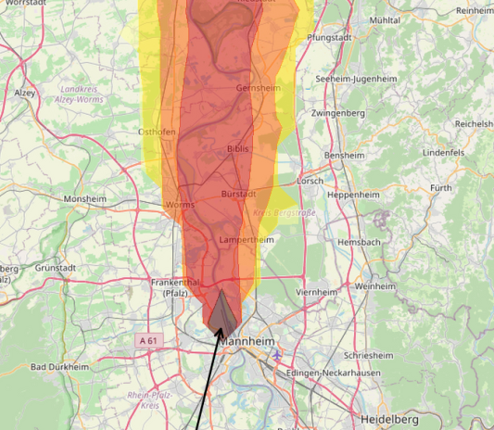
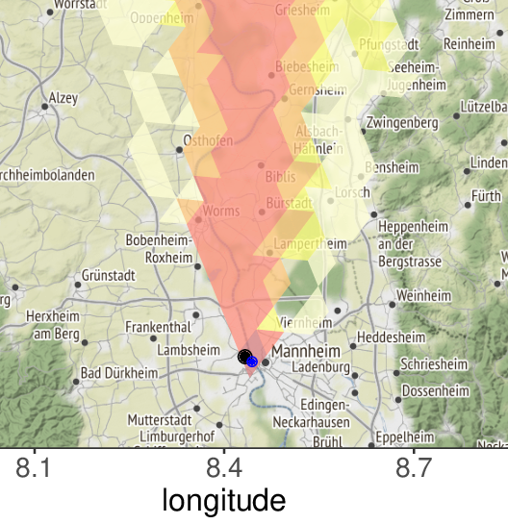
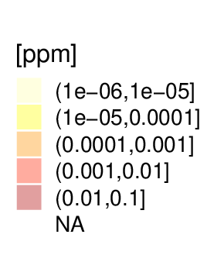
DWD Lagrange - Euler Comparison
Fictional Fire at BASF, “simple” meteorological situation
Offline-coupled DWD-LPDM Online-coupled ICON
71 s (8 NEC vector cores) 316 s (128 NEC vector cores)
→ very similar plume dispersion

Slide 14

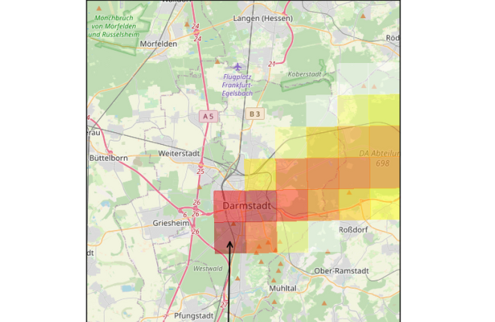
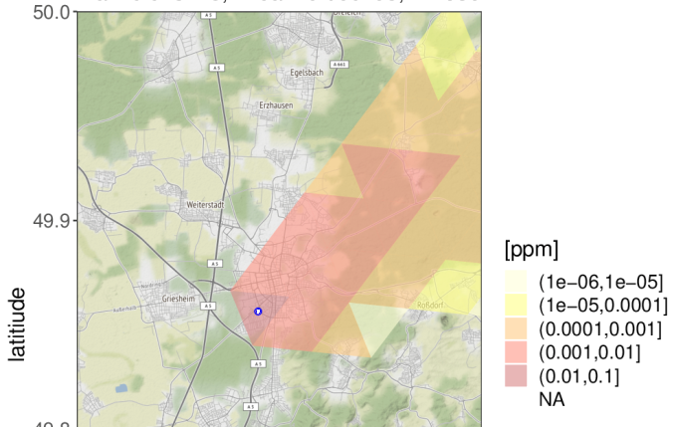
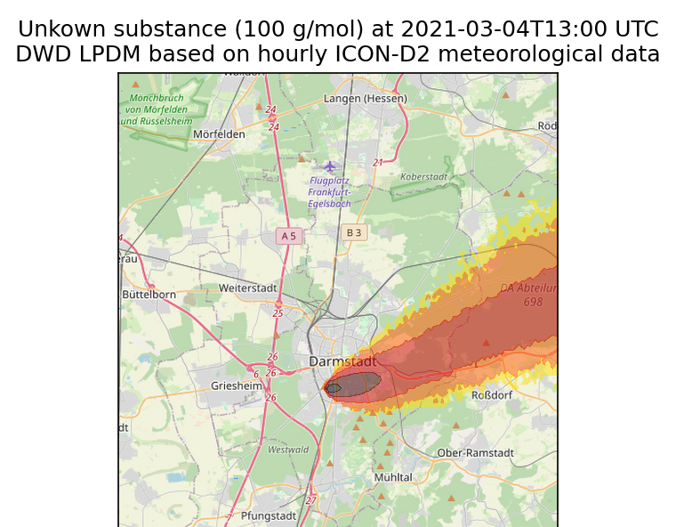
Subgrid concentration
DWD-LPDM (120 s on 1 VE)
ICON (316 s on 16 VE)
DWD-LPDM counting @ 200 m
Counting at ~200 m possible:
exact source location
interpolation onto particles
TKE-based subgrid-winds
→ used for firefighter support

Slide 15
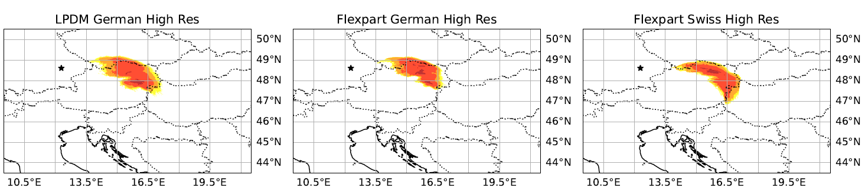
Conclusion
Very stable operational dispersion forecast system to
Contribute to national radiological situation report
Support fire fighters
(CTBTO backtracking)
However, Trajectory and LPDM codes are very old and difficult to maintain
Add a Lagrangian Framework in the official ICON code?
  Are we willing to implement it? And support it for the ICON community?
Or use model from other COSMO member?
  Cosmo PT EGALITE: Evaluate Cosmo-Flexpart from Empa/MeteoSwiss
  (vectorization, global dispersion, GRIB output … ?)

Slide 16

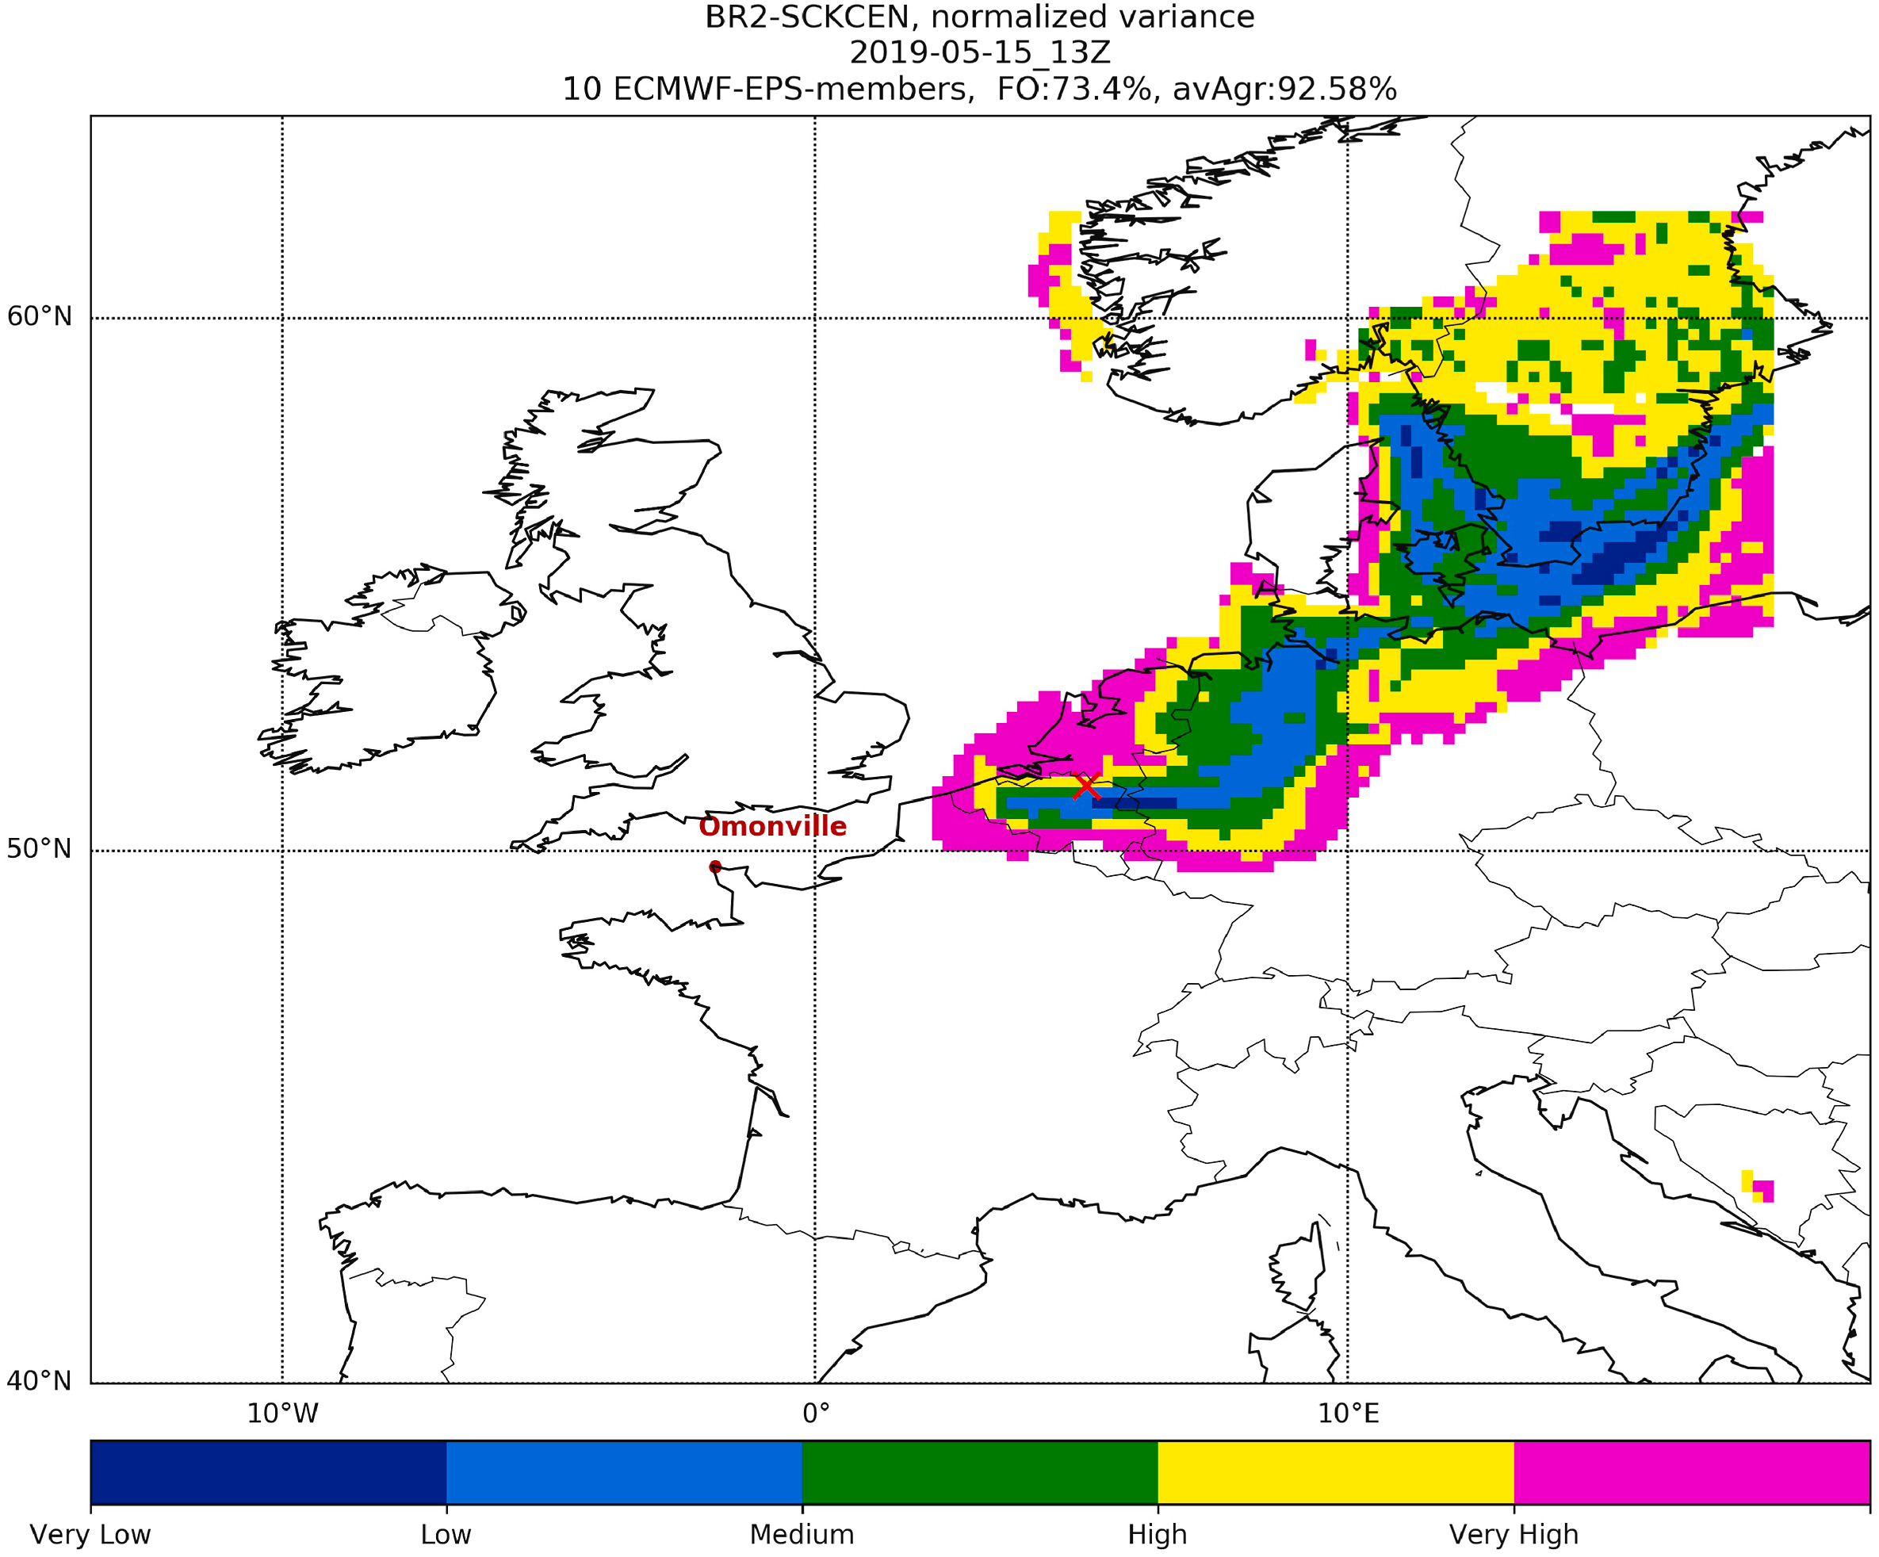
Backtracking

Slide 17
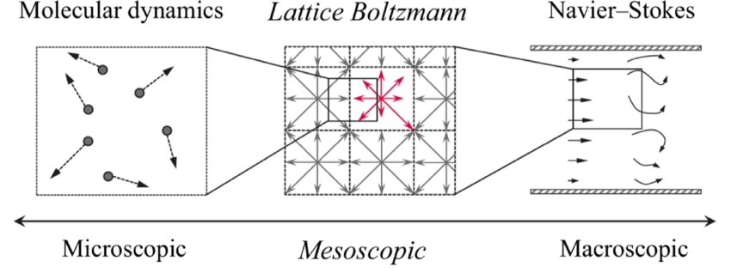
Lagrangian vs. Eulerian Dispersion
Lagrangian: Coarse-grain at end Eulerian: Coarse-grain first
+ subgrid information - continuum hypothesis
+ no numerical diffusion - numerical diffusion
+ cost independent of No_properties - cost scales with No_properties
o costs scale with plume size o constant computational effort
- risk of sub-sampling + straight-forward error estimate
unstructured time varying data + time-constant structure
→ short range dispersion → large-scale dispersion
source
volume for counting
wind
particles
z
y
z₀
x
Notes:
Advection efficiency for Lagrangian objects with large number of properties (bin microphysics > 600 fields)
Sehr gut statt toll

