Slide 1
Priority Task EGALITE – information, test results
Andrzej Mazur
Institute of Meteorology and Water Management
National Research Institute

Slide 2
PT EGALITE - Early warninG and AnaLysIs sysTEm for release and dispersion of contaminants
Contents
Priority Task EGALITE – information, test results
Introduction
Participants, models, domains …
Survey
First dry run
Overall status and summary

Slide 3
PT EGALITE - Early warninG and AnaLysIs sysTEm for release and dispersion of contaminants
Introduction
A need for improvement/developing early warning systems (EWAS) being able to respond to release of toxic and/or harmful substances into the atmosphere.
”Early Warning” – the ability to quickly provide information about the occurrence of an event and its possible consequences.
Released contamination/pollution – dangerous due to its nature (i.e., radioactive, toxic…) and/or emission intensity (i.e., the amount released).
Operational EWAS use meteorological data (an output from operational meteorological forecast models).
PT EGALITE aims at gathering/exchange the experience available among COSMO partners on the connection: numerical weather forecasts – pollutant dispersion modeling in favor of new- and/or of existing EWAS that respond to the mentioned threats.

Slide 4
PT EGALITE - Early warninG and AnaLysIs sysTEm for release and dispersion of contaminants
Participants, models, domains…
Three main parties involved in the PT – DWD (Christoph Siewert), MeteoSwiss (Pirmin Kaufmann) and IMWM (Andrzej Mazur).
Three dispersion models used for tests, dry runs and comparisons.
Every participants applied both high- and medium resolution domain to calculations

Slide 5
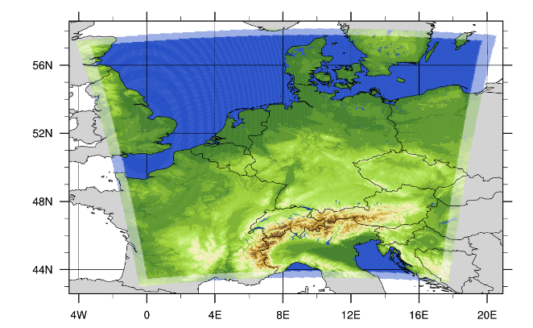
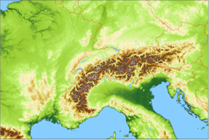
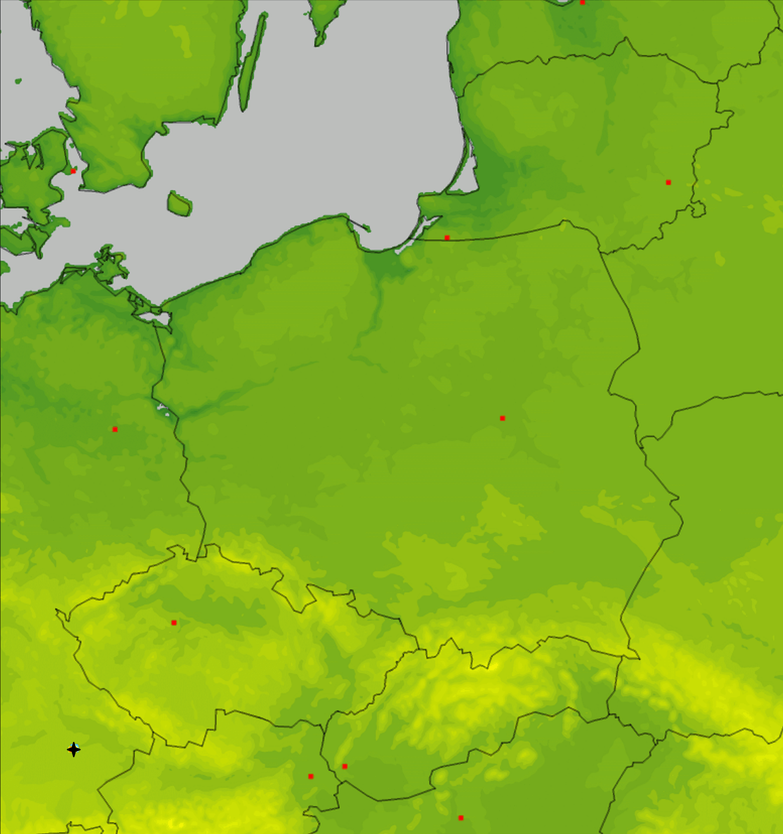
PT EGALITE - Early warninG and AnaLysIs sysTEm for release and dispersion of contaminants
Participants, models, domains…
IMGW – high resolution
(rotated lat-lon, 2.8 km)
DWD – high resolution
(regular lat-lon, 0.02°)
MCH – high resolution
(rotated lat-lon, 1.0 km)

Slide 6
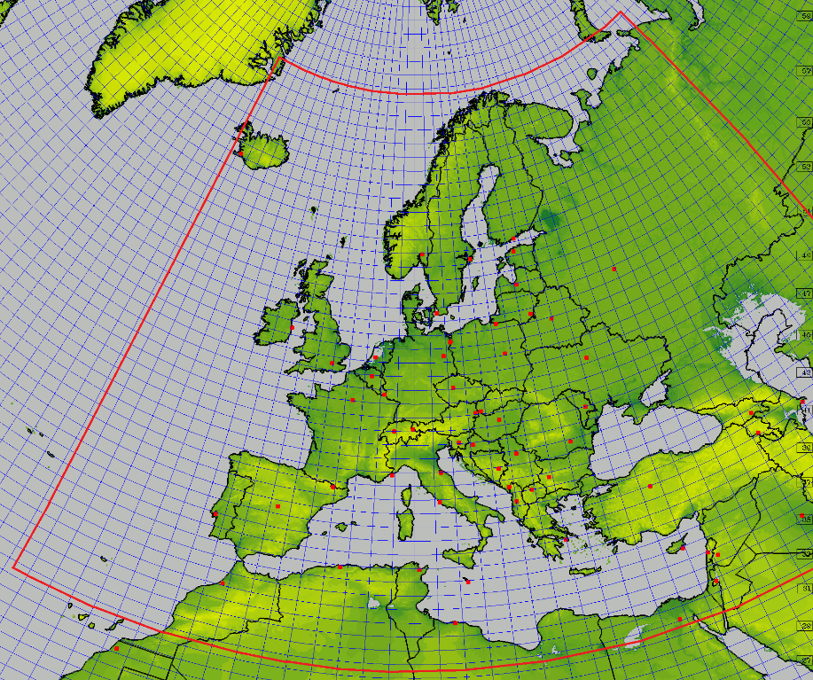
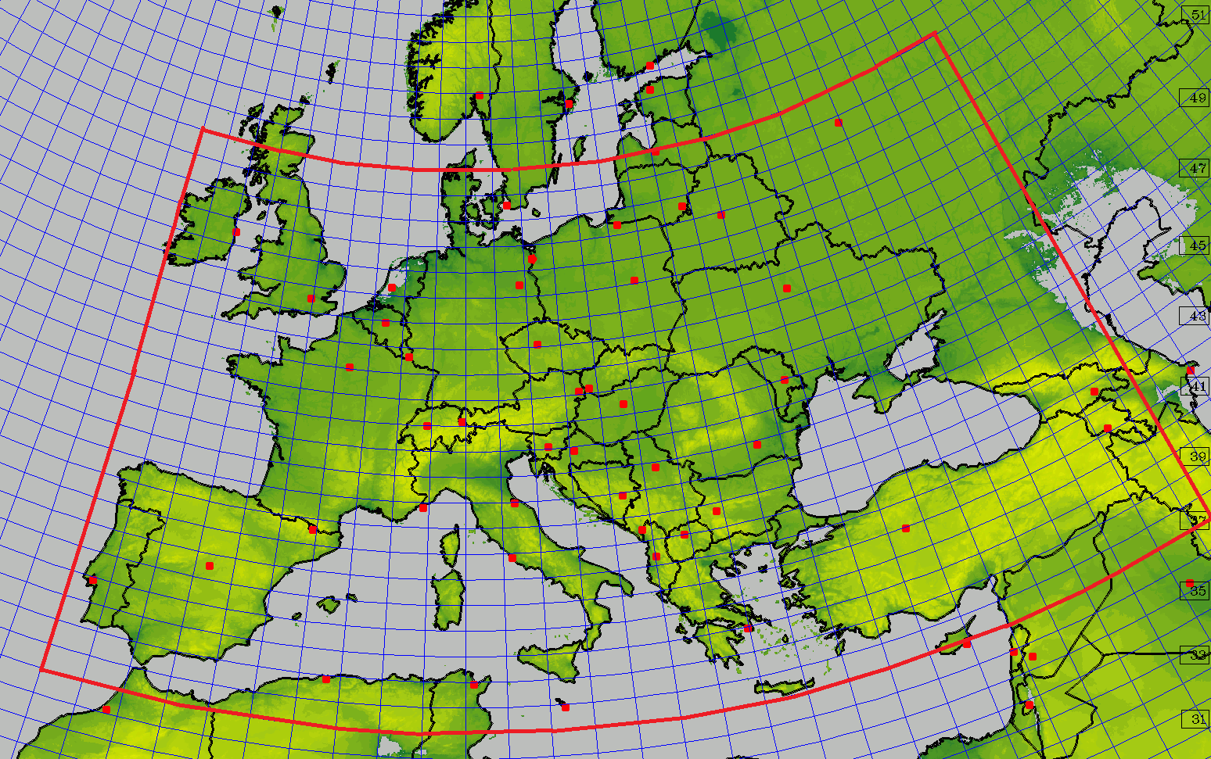
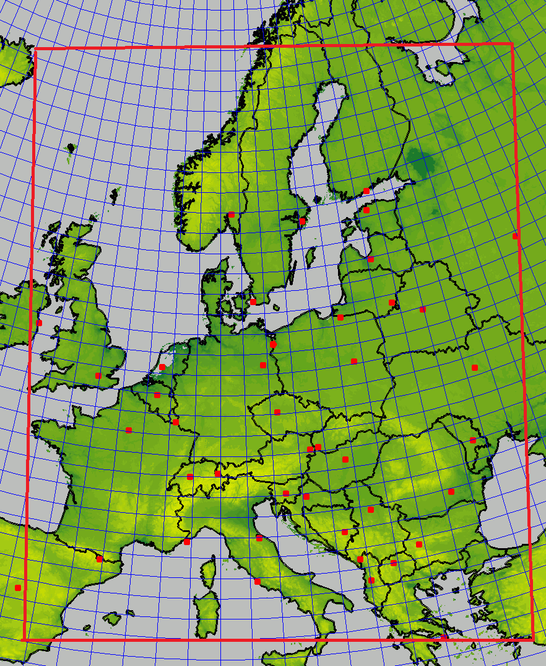
PT EGALITE - Early warninG and AnaLysIs sysTEm for release and dispersion of contaminants
Participants, models, domains…
IMGW – medium resolution
(rotated lat-lon, 7 km)
MCH – medium resolution
(regular lat-lon, 0.1°)
DWD – medium resolution
(regular lat-lon, 0.0625°)

Slide 7
PT EGALITE - Early warninG and AnaLysIs sysTEm for release and dispersion of contaminants
Survey
Subtask 1. General survey (Current status: DONE)
Detailed review and survey of the systems running and plans for further developments at collaborating parties, description and comparison of scientific background, methods used and setup(s).
Deliverables:
Reports on review/survey; info on the comparison results, suggestions for further research.
Subtask 2. Tests and intercomparisons
Preparing and conducting exercises regarding threats of potential releases from identified sources in domains specific to each participant and/or in a jointly established common area.
The results of such exercises will of course contribute to the final report.
Deliverables:
Intermediate reports, final report, comparison results, guidelines/ suggestions for further research directions, publication in JCR journal.

Slide 8
PT EGALITE - Early warninG and AnaLysIs sysTEm for release and dispersion of contaminants
First dry run
Subtask 2 – first test (”dry run”) finished
The "dry run" for release of radioactive material from NPP of Isar, Germany (it is no longer operational but, still, it is in the "common area" of our domains for dispersion calculations).
All participants did the calculations for both high- and medium resolution dispersion models.
Results were transferred to - again - common area, to compare results not only qualitatively, but also quantitatively.
This should be the first of several dry runs.

Slide 9
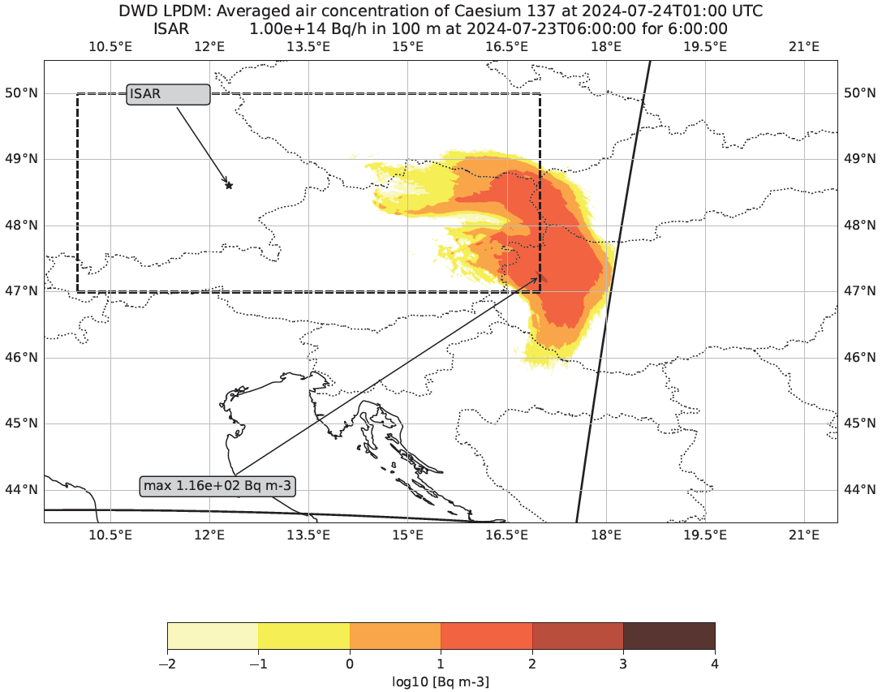
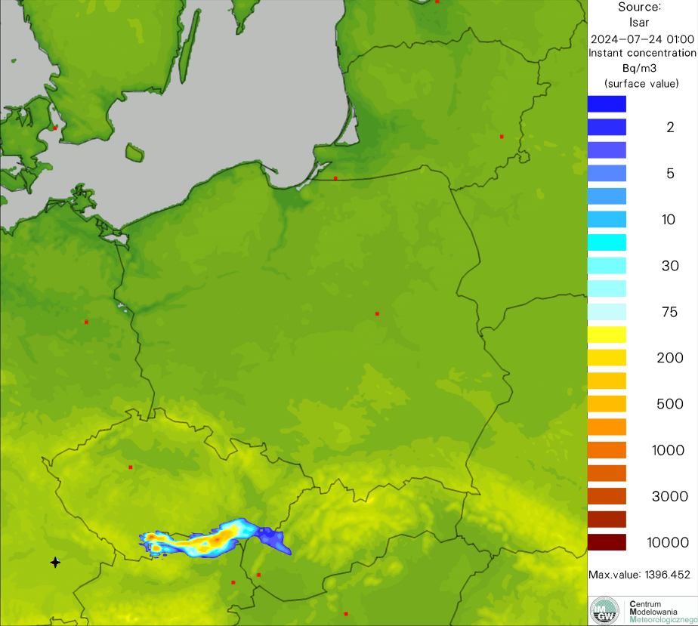
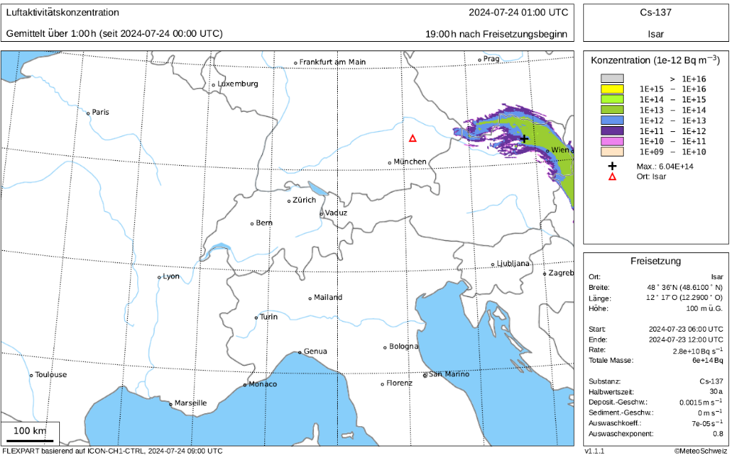
PT EGALITE - Early warninG and AnaLysIs sysTEm for release and dispersion of contaminants
First dry run
The setup of "dry run" for release of radioactive material from NPP of Isar, Germany – location in domains

Slide 10
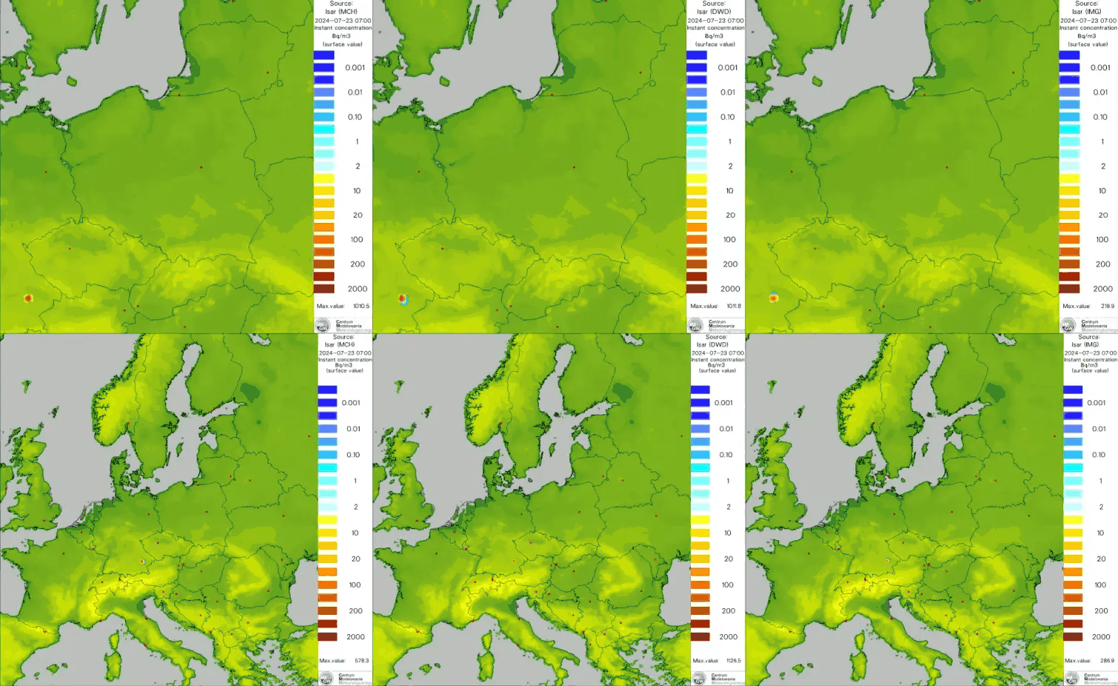
Comparison of MCH/DWD/IMWM results of dry run – release from ISAR NPP (high/low resolution simulation)
Running/finished PP/PTs

Slide 11
PT EGALITE - Early warninG and AnaLysIs sysTEm for release and dispersion of contaminants
First dry run
Probability of impact (POI)
Visualization of which points the contamination cloud will pass over, according to the simulations of individual models
Left – high resolution models only; right – medium resolution models only; middle panel – both types of models

Slide 12
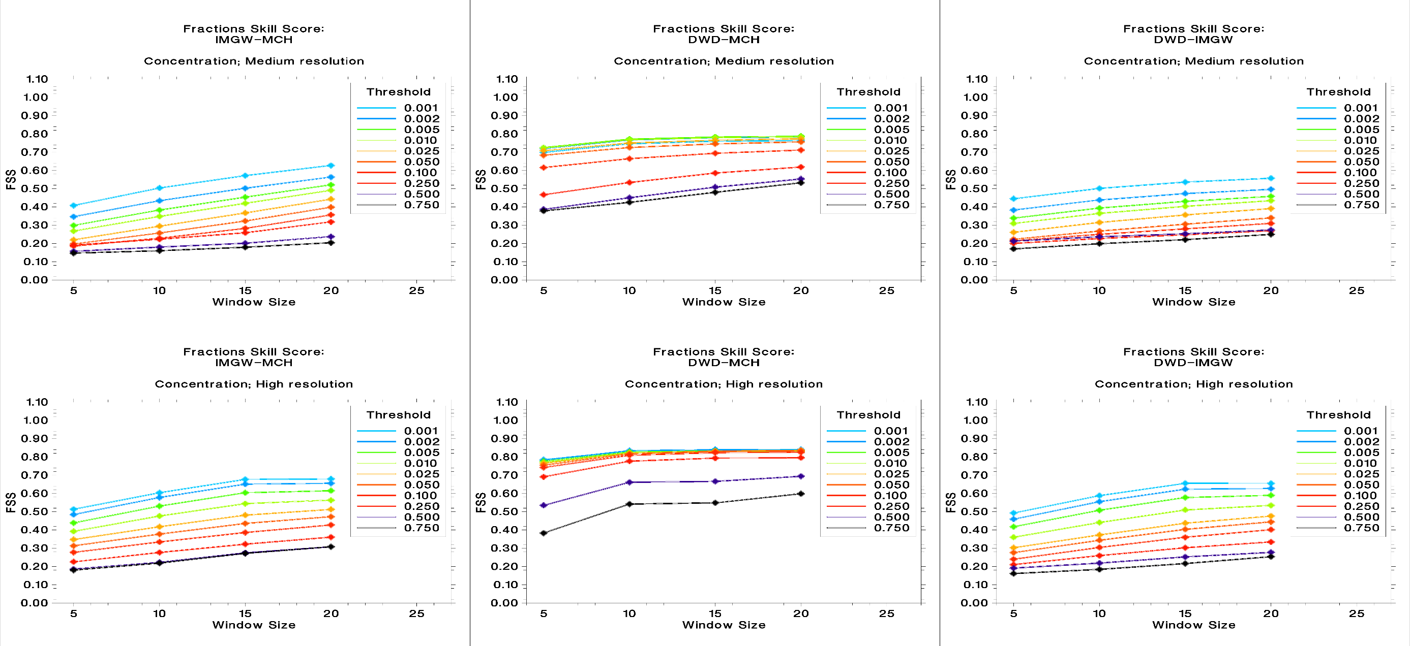
PT EGALITE - Early warninG and AnaLysIs sysTEm for release and dispersion of contaminants
First dry run
Comparison of MCH/DWD/IMWM results of dry run – release from ISAR NPP (high/low resolution simulation)
Relative FSS – concentration

Slide 13
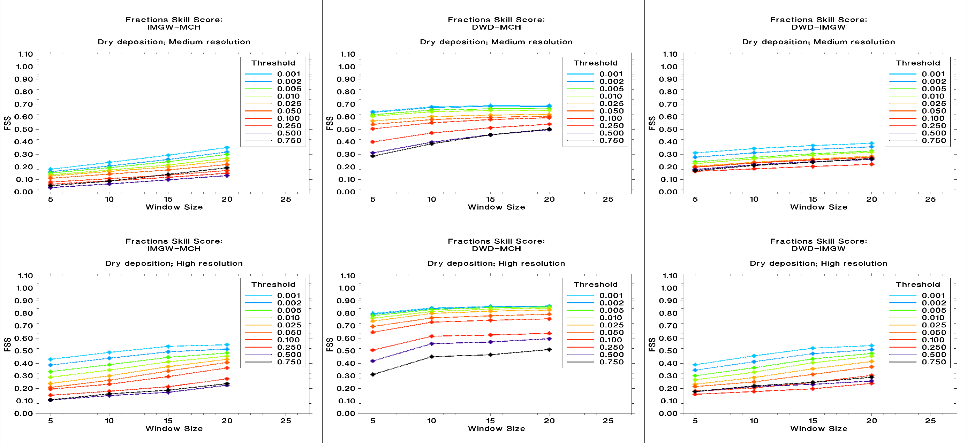
PT EGALITE - Early warninG and AnaLysIs sysTEm for release and dispersion of contaminants
First dry run
Comparison of MCH/DWD/IMWM results of dry run – release from ISAR NPP (high/low resolution simulation)
Relative FSS – dry deposition

Slide 14
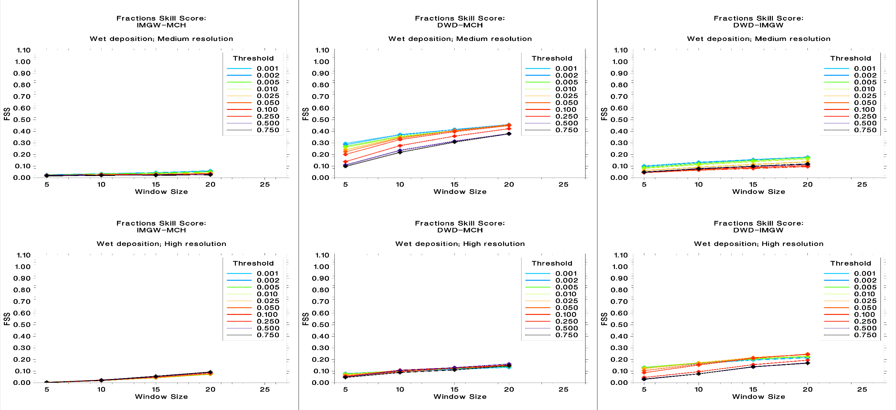
PT EGALITE - Early warninG and AnaLysIs sysTEm for release and dispersion of contaminants
First dry run
Comparison of MCH/DWD/IMWM results of dry run – release from ISAR NPP (high/low resolution simulation)
Relative FSS – wet deposition

Slide 15
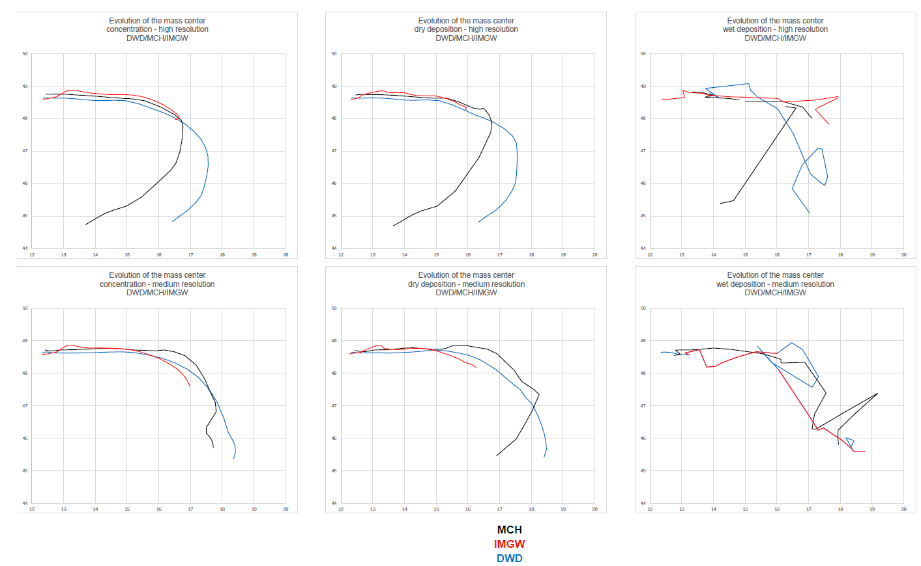
PT EGALITE - Early warninG and AnaLysIs sysTEm for release and dispersion of contaminants
First dry run
x_{cm}, y_{cm}: coordinates od center of mass
M – total mass in the system
m_{i}x_{i},– moments of individual masses (x)
m_{i}y_{i} – moments of individual masses (y)
Evolution of center of mass of fields (conc., dry dep., wet dep.) for high and medium resolution calculations

Slide 16
PT EGALITE - Early warninG and AnaLysIs sysTEm for release and dispersion of contaminants
Overall status and summary
The first test showed that the results of dispersion calculations are very strongly dependent on meteorological data (their quality and accuracy).
This is very clearly visible, especially when taking into account the results of wet deposition calculations and/or time evolution of center of mass...
Therefore: further tests are planned, especially using common (i.e. identical and uniform) meteorological data.
People of EGALITE (thnx!!!):
Christoph Siewert (DWD),
Pirmin Kaufmann (MCH),
and me
Andrzej Mazur (IMGW)

Slide 17
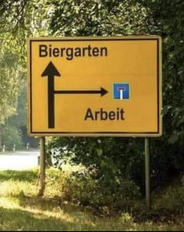
That’s all from me,
Thank you for hearing me out!!!

