Slide 1


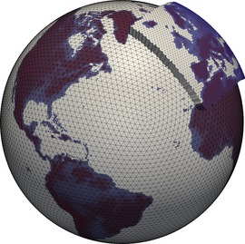
Development of a New FLEXPART Version for Use with ICON Output
S. Henne, K. Ivanova, P. Kaufmann, D. Brunner
2024-09-03

Slide 2
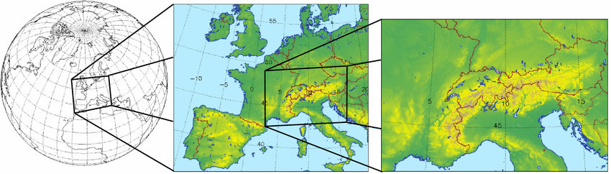
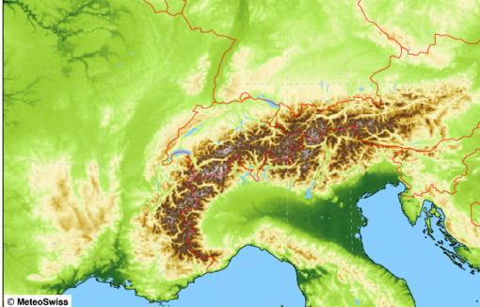
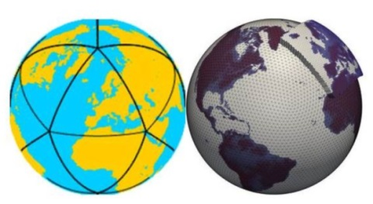
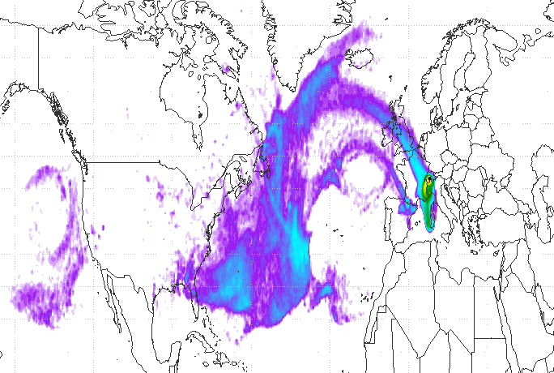
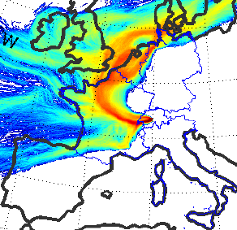
Atmospheric Transport Models @ MeteoSwiss and Empa
Global
Regional
Global+Regional
COSMO-7
COSMO-1
(since 2016)
Numerical
weather
prediction
models
COSMO-2
ECMWF - IFS
COSMO
ICON
Atmospheric
transport
models
FLEXPART-COSMO
FLEXPART-ICON
FLEXPART-ECMWF
COSMO-GHG / -ART
ICON-ART

Slide 3
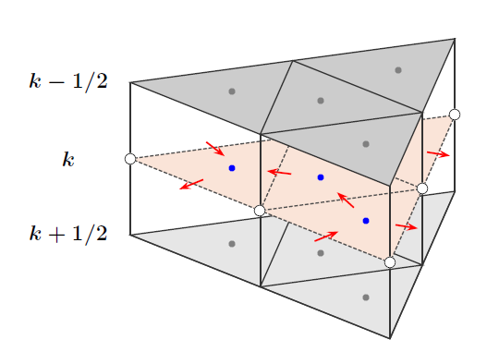
COSMO vs. ICON Grid
COSMO grid
Rotated rectangular Arakawa C-grid
Edge normal wind defined at interfaces
Scalars in cell centers
Trivial localisation and (bi-linear) interpolation
ICON output with FLEXPART
Indirect
(ICON -> COSMO -> FLEXPART)
  Use available interpolation tools to rectangular grid
  Small code modifications in FLEXPART
  Implemented and tested versus ICON-ART
Direct (ICON -> FLEXPART)
  Single interpolation to particle position in FLEXPART
  Requires portable implementation of interpolation methods
  Generalisation of grids in FLEXPART
ICON grid
Icosahedral-triangular
C grid
Edge normal wind defined at interfaces
Scalars in triangle centers
Localisation requires search
Best interpolation?
Wan et al. (2013)

Slide 4
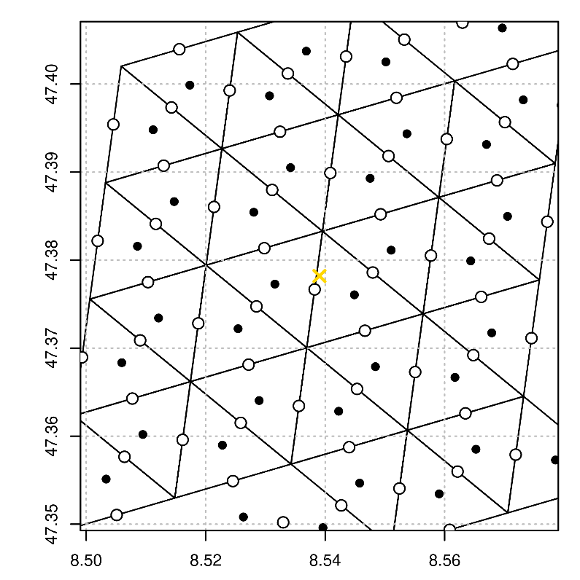
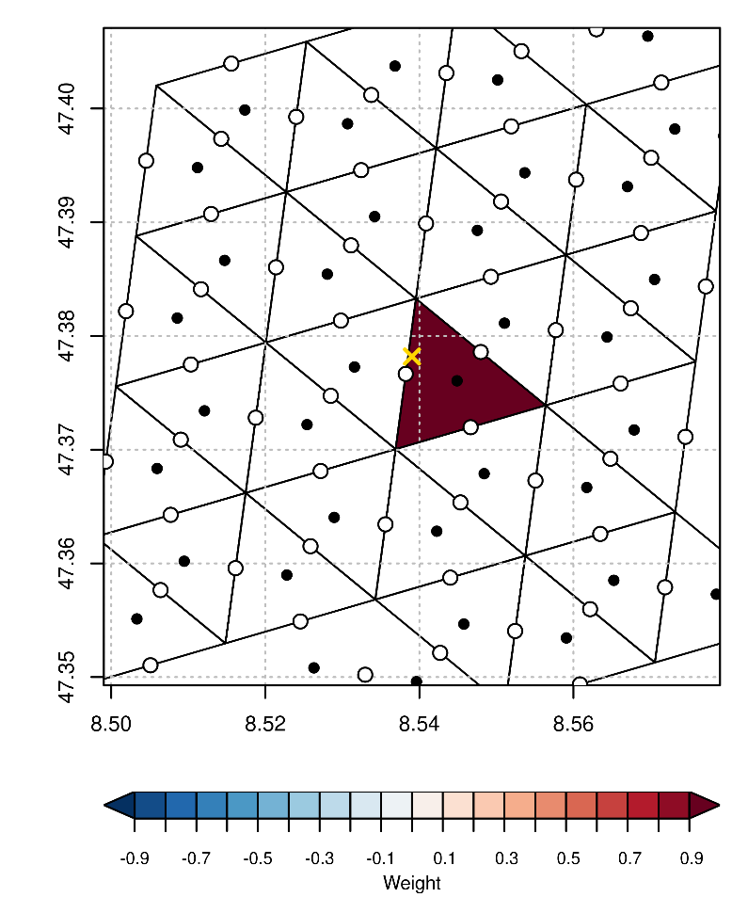
Interpolation Examples
cell centers
edge centers
target
Trivial:
next neighbor
(i.e., local cell )
#stencil = 1
weight = 1

Slide 5
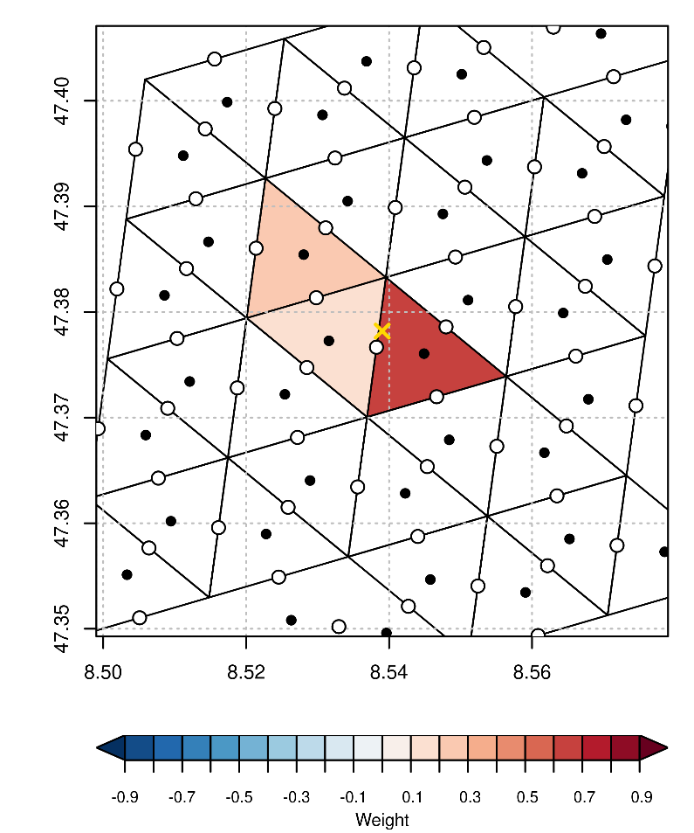
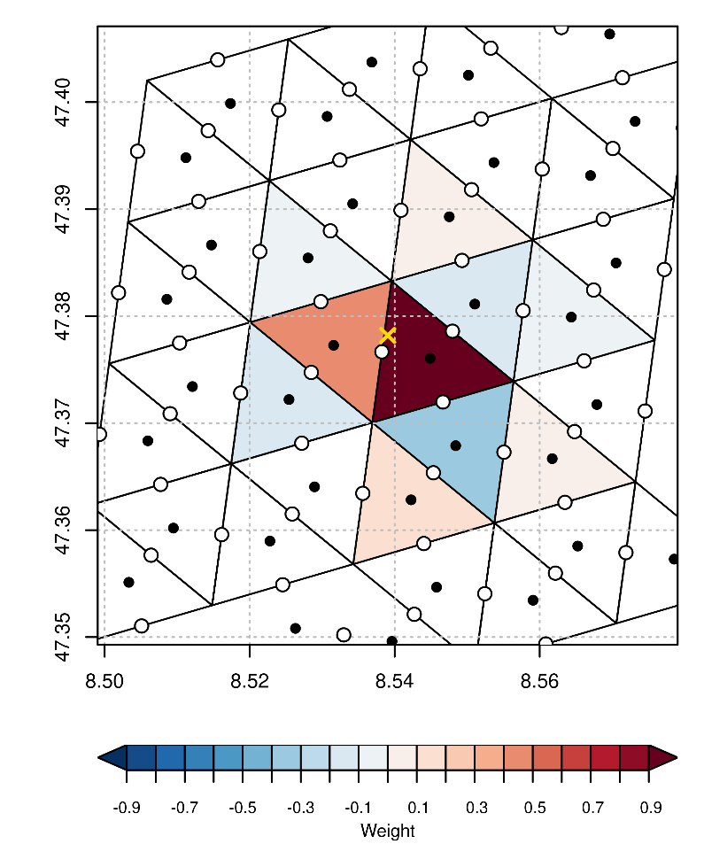
Interpolation Examples
Radial basis functions
Scale parameter
#stencil = 10
-1 < weight < 1
Barycentric
Requires triungulation
#stencil = 3
0 < weight < 1

Slide 6
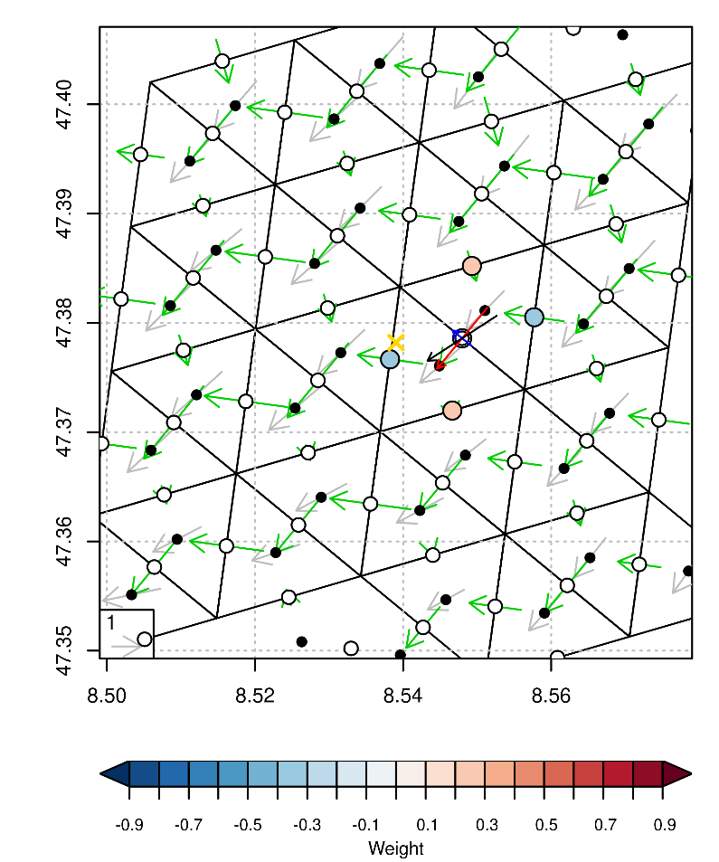
Four Point RBF Stencil for VT Reconstruction
Gray: U,V @ cell centers
Green: VN @ edge centers
Blue: VT @ destination edge, reconstructed from VN at 4 point stencil (coloured points)
Red: VN @ destination edge, reconstructed from VN at 4 point stencil (coloured points)
In the plot: Scaling for U,V vectors slightly differs from others!
(See Zängl et al., 2014)

Slide 7
Wind Input & Interpolation Options
U, V (@ cell centers) required for interpolation to particle position
VN, VT (@ edge centers) required for contravariant wind correction
VN, U, V in ICON output
  Calculate VT field every time new file is read
  Interpolate from U, V to particle (scalar)
VN in ICON output
  Calculate VT, U, V field every time new file is read
  Interpolate from U, V to particle (scalar)
VN in ICON output
  Calculate VT field every time new file is read
  Interpolate from VN to particle (vector)
U, V in ICON output
  Calculate VN, VT every time new file is read
  Interpolate to particle from U, V (scalar)
For flexibility implement all 4?

Slide 8

WP2: Status of FLEXPART-ICON Development
S. Henne
2024-08-30

Slide 9
Status August 2024
Validation simulation of FLEXPART-ICON implementation
  Simulation of GHG concentrations at BRM tower
    2023: June, November
    Comparison with FLEXPART-COSMO-1
    Comparison with observations: CH₄
  Plume comparison vs. ICON-ART (ongoing)
Further optimisation required
Further implementations
  Tree method for finding containing triangle

Slide 10
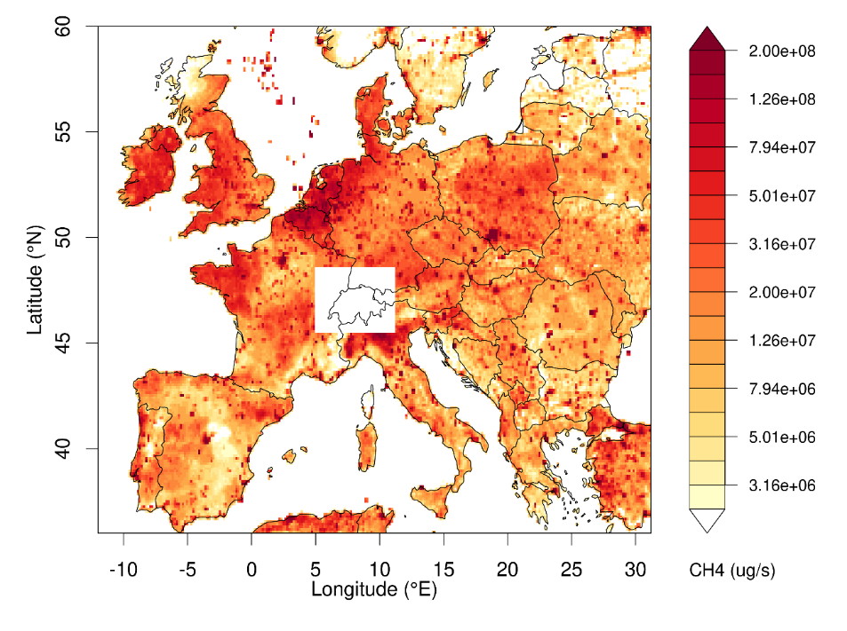
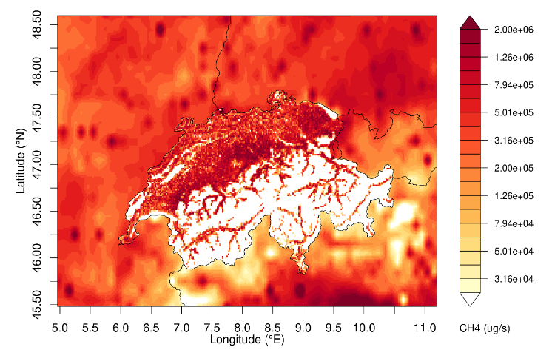
Operational setup for greenhouse gas simulations
Common FLEXPART setup
3-hourly release at observation sites
4 days backward in FLEXPART-COSMO/ICON
Offline coupling to FLEXPART-IFS (handover of particle positions)
Continue simulation up to 10 days backwards
Store residence times/source sensitivities
From source sensitivities to concentrations
Emissions: Swiss high-resolution inventory, TNO inventory for Europe
Background conditions: Jungfraujoch
CH₄ emission inventories for two different FLEXPART output domains.

Slide 11
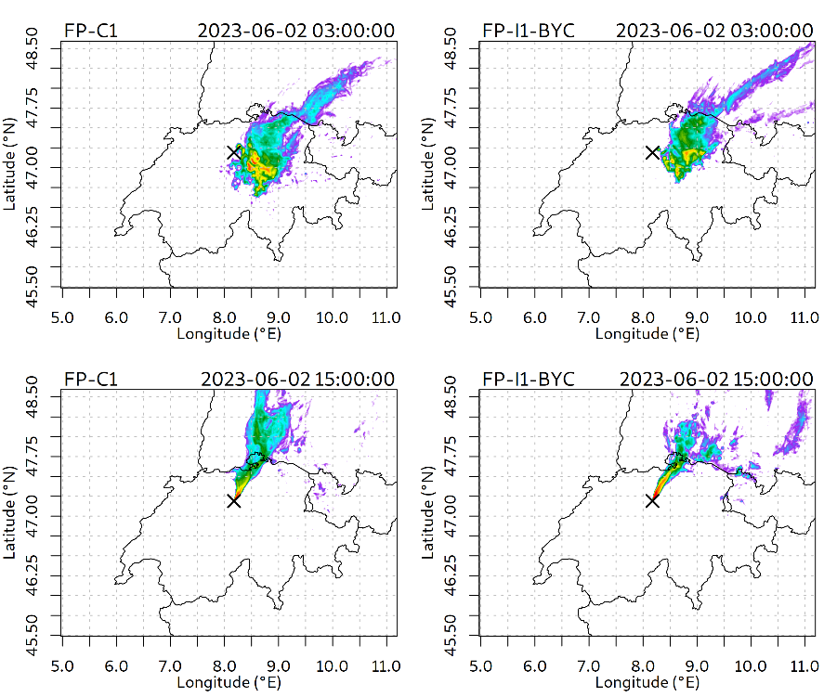
CH₄ Concentration Simulations at Beromünster Tall Tower
Footprint Examples
COSMO
ICON
Two different input meteorologies both on native grid:
COSMO: operational MeteoSwiss analysis at 1 km x 1 km
ICON: pre-operational MeteoSwiss analysis at 0.9 km scale
FLEXPART-COSMO and FLEXPART-ICON footprints similar to the extent expected from different input meteorologies
Footprints more similar during afternoon with well defined wind
Simulated concentration footprints for Beromünster tall tower for two times on 2023-06-02: (left) FLEXPART-COSMO, (right) FLEXPART-ICON

Slide 12
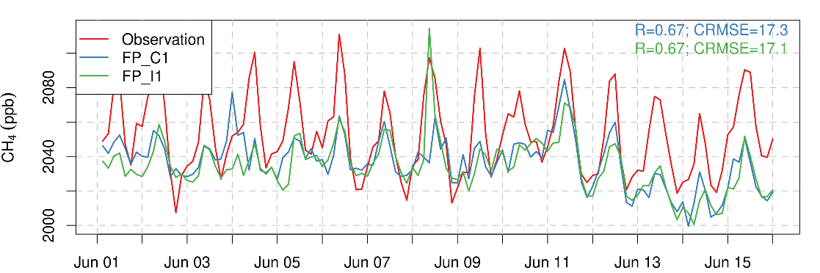
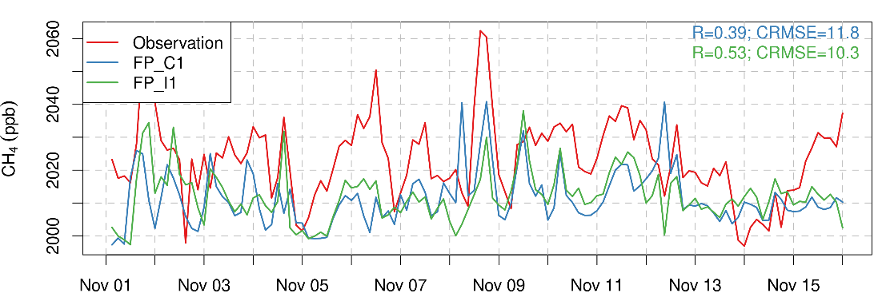
CH₄ Concentration Simulations at Beromünster Tall Tower
Simulated time series exhibit same features between FLEXPART-COSMO and FLEXPART-ICON
Very similar comparison statistics to observations
Observed morning peak (summer) not well covered by either model version
Simulated afternoon values agree closer between models and with observations
FP-ICON close to replacing FP-COSMO in ongoing GHG analysis/inverse modelling
Observed and simulated time series of CH₄ at Beromünster tall tower for two 15 day periods in 2023: (blue) FLEXPART-COSMO, (green) FLEXPART-ICON

Slide 13

Acknowledgements
Financial support by Federal Office for the Environment (FOEN) & Federal Office of Meteorology and Climatology (MeteoSwiss)

