Slide 1
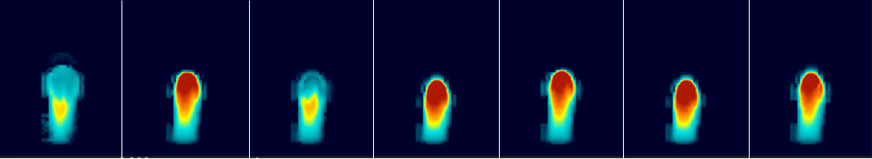
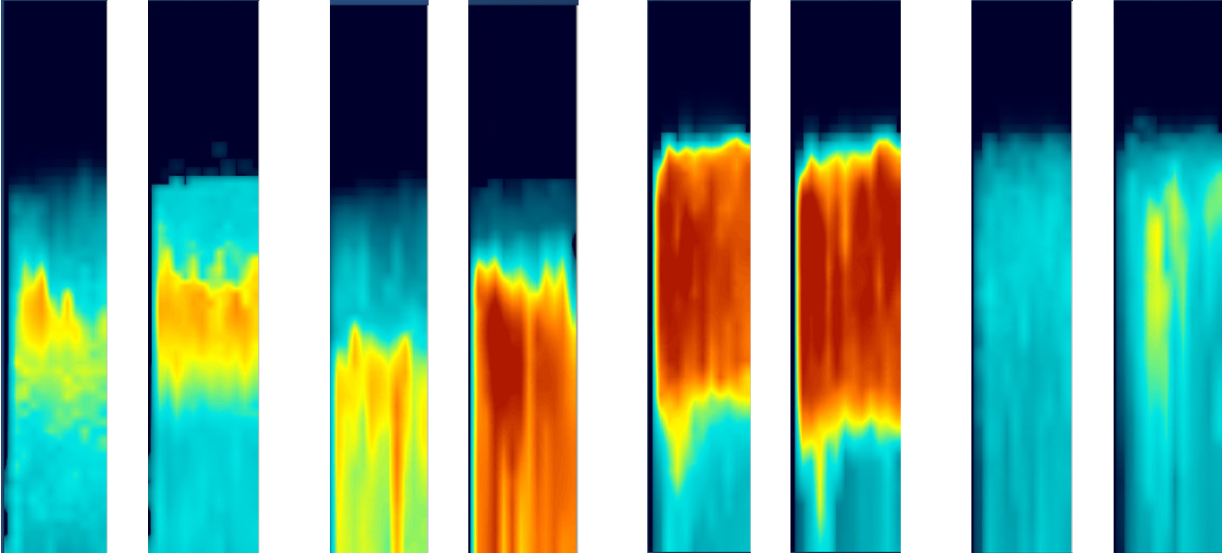
Mixed-phase Spectral-Bin Microphysics (SBM) in ICON:
first real-case results
Pavel Khain¹, Harel Muskatel¹, Yoav Levi¹, Koby Shpund², and Alexander Khain²
Thanks to: Daniel Reinert³, Uli Schättler³, Axel Seifert³, Daniel Rieger⁴
      Israeli Meteorological Service
      The Hebrew University of Jerusalem
      Deutscher Wetterdienst
COSMO GM, September 2024

Slide 2
Outlook
  SBM Implementation in ICON
  Tests of Cumulonimbus development (Weisman-Klemp 1982)
  Real case example (very much improved)

Slide 3

Two methods of representing cloud microphysics
Bulk-microphysics Parameterization Spectral (Bin) Microphysics (SBM)
Description of size distributions | Gamma distributions with several given parameters | Examples of real size distributions (droplets)
Basic equations | For moments: K=0 number concentration; k=1 mixing ratios; k=2-radar reflectivity. 2M → 2 parameters are free and 2 are preset | For size distribution functions f(m)
PSDs along flight track
core
edge
Diameter, µm

Slide 4
Two methods of representing cloud microphysics
Bulk-microphysics Parameterization Spectral Bin Microphysics (SBM)
Description of size distributions | Gamma distributions with several given parameters | Examples of real size distributions (droplets)
Basic equations | For moments: K=0 number concentration; k=1 mixing ratios; k=2-radar reflectivity. 2M → 2 parameters are free and 2 are preset | For size distribution functions f(m)
PSDs along flight track
core
edge
Diameter, µm

Slide 5
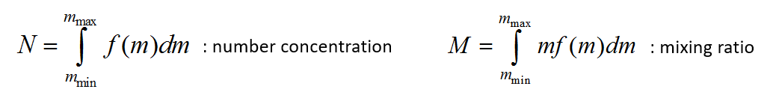
SBM implementation in ICON
f(m₀)
f(m_{i})
f(m_{i+1})
(= 2 in ICON)
Processes which change f in the ICON code:
advection
sedimentation
nucleation (Kohler)
condensation/evaporation (eqn for diff. growth and supersaturation, i.e. NO saturation adjustment)
freezing (both immersion and contact) and melting
coalescence/break up (stochastic eqn for collisions)
nucleation of ice
Still to do:
mixed phase particles, CCN regeneration
4 distributions are advected:
f_{drop+rain}(m): 33 bins for drops (cloud and rain water)
f_{ice+snow}(m): 33 bins for ice crystals (cloud ice and snow)
f_{grau/hail}(m): 33 bins for graupel or hail
f_{ccn}(m): 33 bins for CCN concentration
Dec 2022:
Khain P, Shpund J, Levi Y, Khain A:
“Warm-phase spectral-bin microphysics in ICON:
Reasons of sensitivity to aerosols”, Atmos. Res. 2022, 279, 106388.
July 2023:
warm-phase version was implemented in ICON master! 4 new files: mo_sbm_driver.f90, mo_sbm_main.f90, mo_sbm_util.f90, mo_sbm_storage.f90
Ongoing:
mixed-phase version implementation in ICON (using SBM in the WRF model)

Slide 6
More comments
The version we implement is so called “Fast SBM”, which contains only two size distributions of ice: low density (snow PSD) and large density (graupel PSD).
For snow PSD: small bins are considered as ice crystals, and large bins are aggregates.
Fast SBM is based on full SBM, that uses additionally size distributions of three types of ice crystals (dendrites, plates and columns) and hail with high density of pure ice (0.9 g/cm3). There are also size distributions for mixed-phase particles (e.g. water mass fraction in melting ice).

Slide 7
SBM implementation in ICON
subr. integrate_nh
(mo_nh_stepping.f90)
call perform_dyn_substepping
call diffusion (numerical)
call step_advection
call nwp_nh_interface
subr. nwp_nh_interface (mo_nh_interface_nwp.f90)
call satad_v_3D (saturation adjustment, LH release, qc)
call nwp_surface (land/sea)
call nwp_turbdiff (turbulent diffusion – atmo. column)
store T,qv using mo_sbm_storage.f90 (after advection and turbulence)
call nwp_microphysics
call nwp_turbtrans (atmo-surf interface)
call nwp_convection (slow)
call cover_koe (cloud cover - slow)
call set_reff (calc reff for radiation - slow)
call nwp_radiation (slow)
call nwp_gwdrag (gravity waves drag - slow)
call nwp_upatmo_interface (upper-atmo physics - slow)
store T,qv using mo_sbm_storage.f90 (end of a time step)
T,qv=?
High SupSat (S) after advection
(using mo_sbm_storage.f90)
move here?
(using mo_sbm_storage.f90)

Slide 8
SBM implementation in ICON
subr. nwp_microphysics
(mo_nwp_gscp_interface.f90)
subr. graupel
(gscp_graupel.f90)
subr. two_moment_mcrph
(mo_2mom_mcrph_driver.f90)
subr. sbm
(mo_sbm_driver.f90)
PSD_{drops}, PSD_{ccn}
T,qv(b.ad), T,qv(a.ad)
subr. clouds_twomoment
(mo_2mom_mcrph_main.f90)
call ccn_activation_hdcp2
call ccn_activation_sk_4d
call autoconversionKB
call accretionKB
call rain_selfcollectionSB
call autoconversionKK
call accretionKK
call rain_selfcollectionSB
call autoconversionSB
call accretionSB
call rain_selfcollectionSB
call rain_evaporation
subr. sedimentation_explicit
(mo_2mom_mcrph_main.f90)
subr. warm_sbm
(mo_sbm_main.f90)
call nucleation
call diffusional growth
call collisions, break up
call sedimentation
subr. diffusional growth
call calc coefs for the diffusional growth eqn
call calc coefs for the supersaturation eqn
call calc integral S(t)*dt
call recalc drops size
call get new PSD - remapping
subr. collisions, break up
call collision efficiency X swept volume
call stochastic collision eqn
call collisional breakup
1 moment
…
warm phase
mixed phase is more complicated
mixed phase switched off
…
subr. satad_v_3D
(mo_satad.f90)
subr. satad_v_3D
(mo_satad.f90)
subr. satad_v_3D
(mo_satad.f90)
PSD_{drops}, PSD_{ccn}
T,qv,qc,qr,qnc,qnr

Slide 9
Outlook
  SBM Implementation in ICON
  Tests of Cumulonimbus development (Weisman-Klemp 1982)
  Real case example

Slide 10
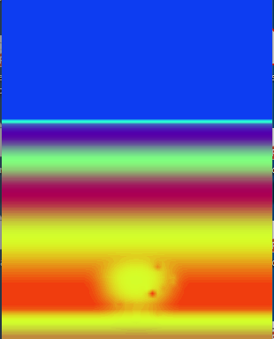
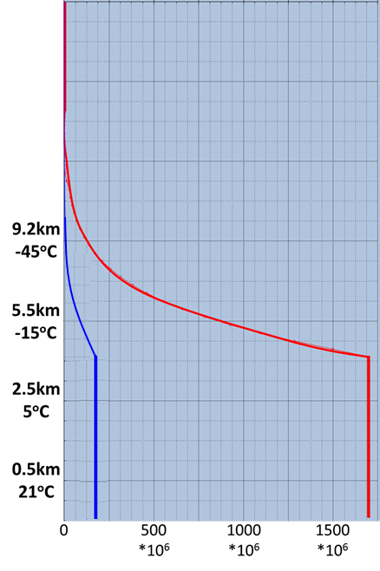
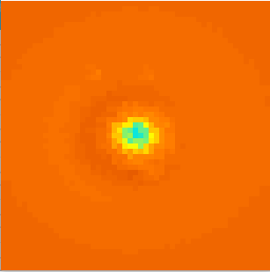
ICON run setup:
dt=1sec
dx=1.2km
Tests of Cumulonimbus development (Weisman-Klemp 1982)
View from above
Cross section
Effect of aerosols
CAPE (J/kg) after several minutes
CCN (z)
Height
Height
50km
polluted
dT=2K
Resolution: 1.2 km
Z=2100m
“clean”
50km
Z=700m
qv=14g/kg
50km
CAPE (J/kg)
NC_{a} (1/kg)
Initial Relative Humidity (%)

Slide 11

10 g/kg
1M mixed
cloud_num=200cm-3
SBM mixed
clean const
SBM mixed
clean
SBM mixed
polluted const
SBM mixed
polluted
SBM warm
polluted
All the versions start similarly
9 g/kg
qc
8 g/kg
7 g/kg
qi
6 g/kg
5 g/kg
qs
4 g/kg
3 g/kg
qg
2 g/kg
1 g/kg
qr
0 g/kg
50km
50km
50km
50km
time=10min

Slide 12
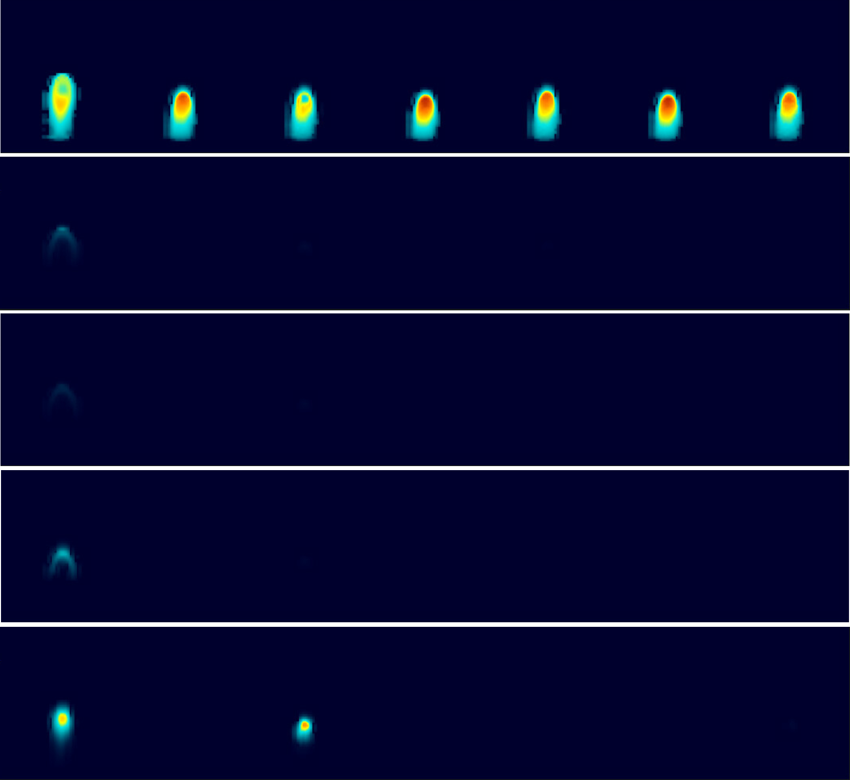
10 g/kg
1M mixed
cloud_num=200cm-3
SBM mixed
clean const
SBM mixed
clean
SBM mixed
polluted const
SBM mixed
polluted
SBM warm
polluted
1M develops faster probably because of saturation adjustment
SBM mixed clean ccn(t): small amount of ccn which decrease with time, rain forms quickly via drops collisions without ice processes
9 g/kg
qc
8 g/kg
7 g/kg
qi
6 g/kg
5 g/kg
qs
4 g/kg
3 g/kg
qg
2 g/kg
1 g/kg
qr
0 g/kg
time=20min

Slide 13
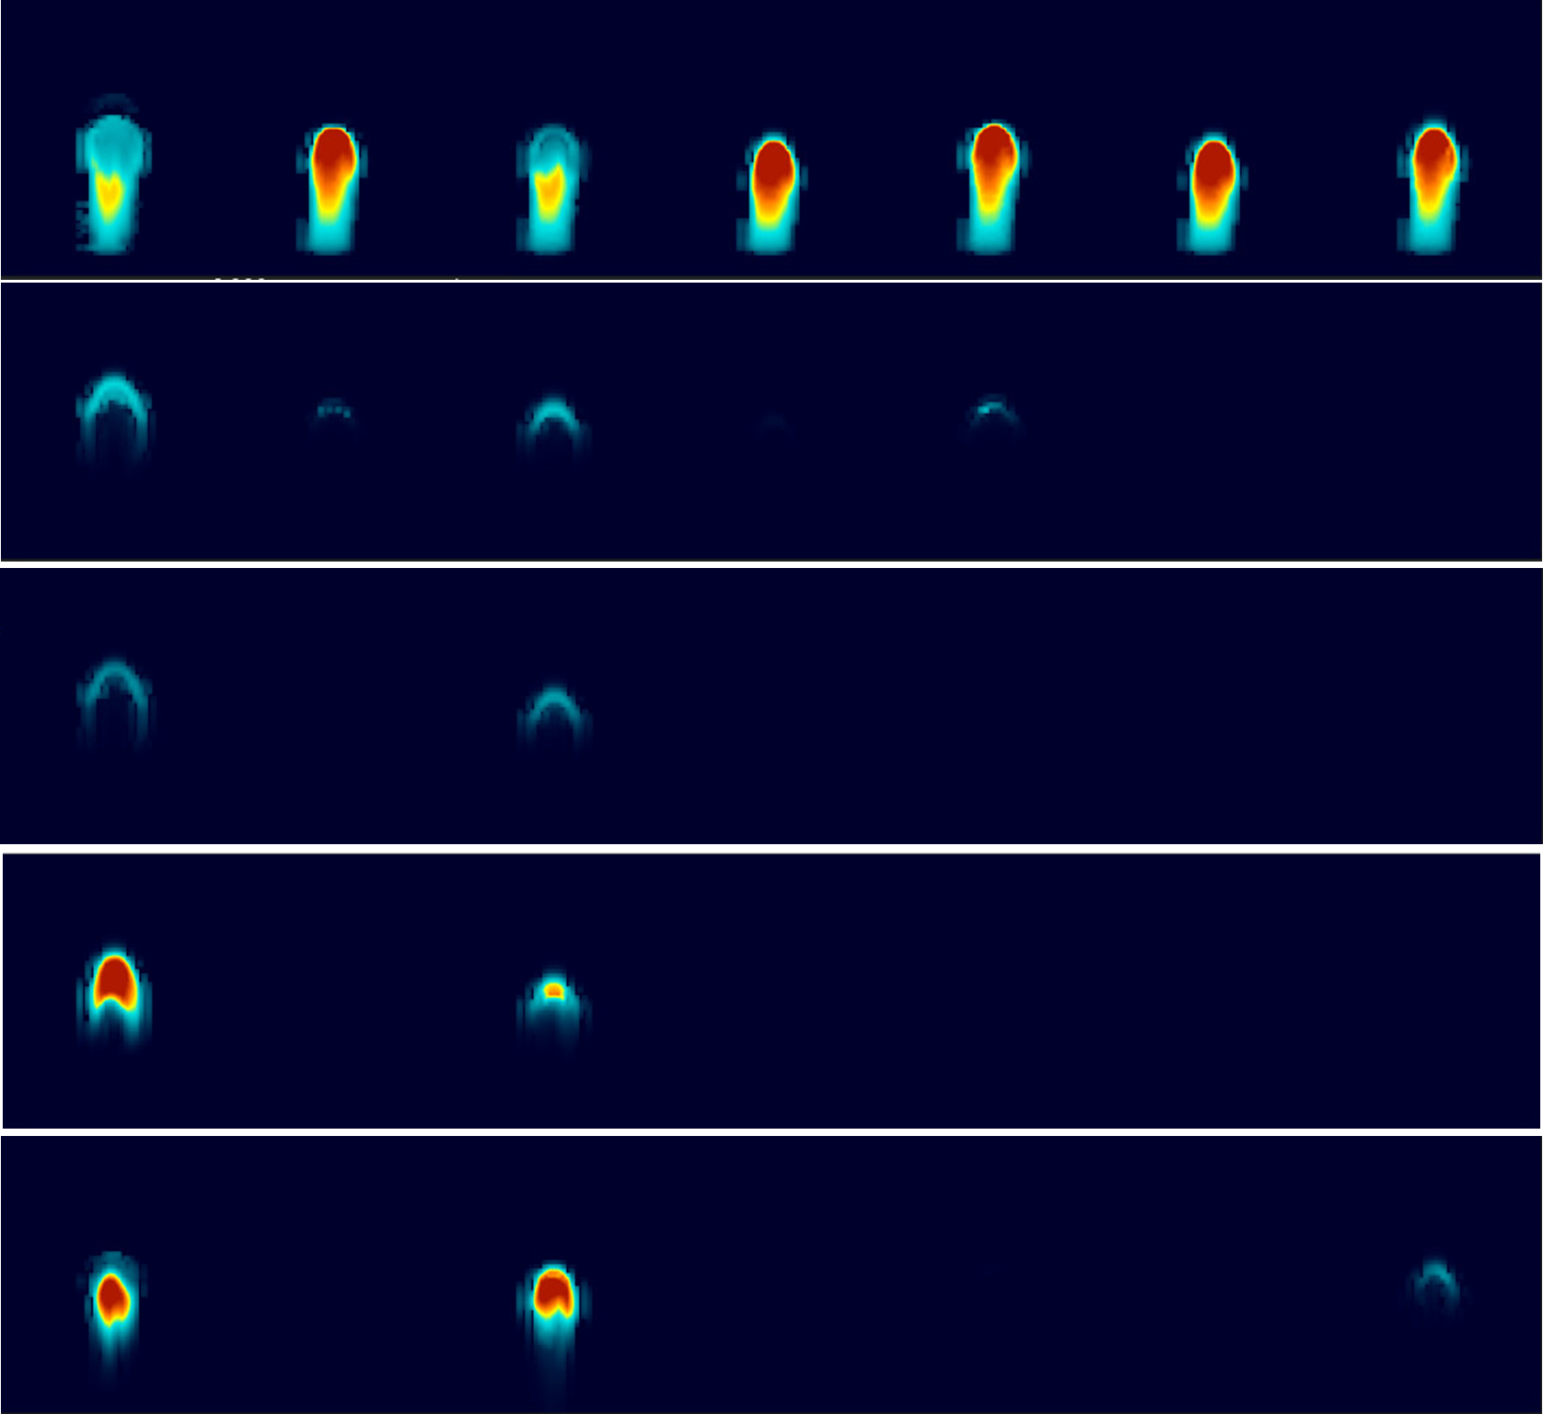
10 g/kg
1M mixed
cloud_num=200cm-3
SBM mixed
clean const
SBM mixed
clean
SBM mixed
polluted const
SBM mixed
polluted
SBM warm
polluted
SBM mixed clean ccn(t): drops reach freezing level → qi,qs,qg
9 g/kg
qc
8 g/kg
7 g/kg
qi
6 g/kg
5 g/kg
qs
4 g/kg
3 g/kg
qg
2 g/kg
1 g/kg
qr
0 g/kg
time=25min

Slide 14
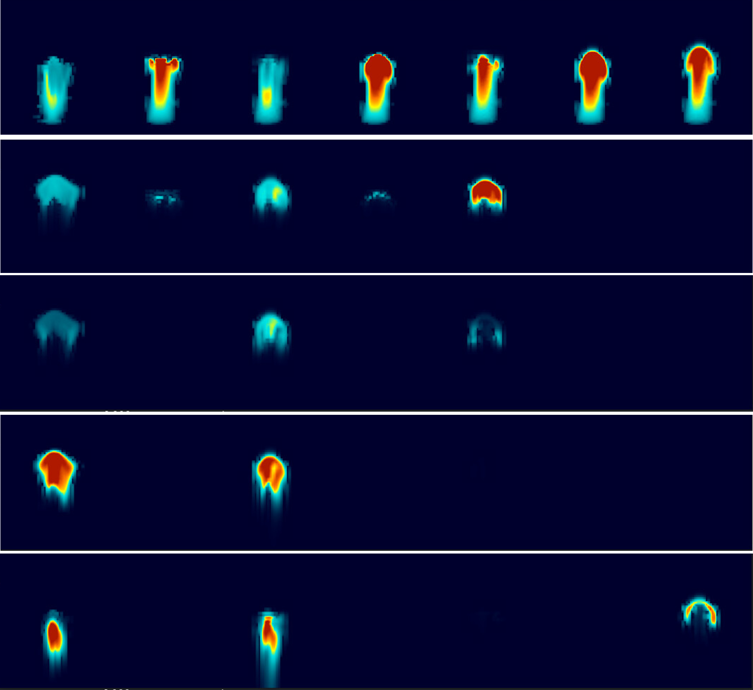
10 g/kg
1M mixed
cloud_num=200cm-3
SBM mixed
clean const
SBM mixed
clean
SBM mixed
polluted const
SBM mixed
polluted
SBM warm
polluted
SBM mixed clean ccn(t): rain reaches surface
SBM mixed polluted ccn(t): homogeneous freezing of small drops → qi, but do not collide
SBM warm polluted: super-cooled drops collide forming rain at cloud edge (in the core the updraft is too strong)
9 g/kg
qc
8 g/kg
7 g/kg
qi
6 g/kg
5 g/kg
qs
4 g/kg
3 g/kg
qg
2 g/kg
1 g/kg
qr
0 g/kg
time=30min

Slide 15
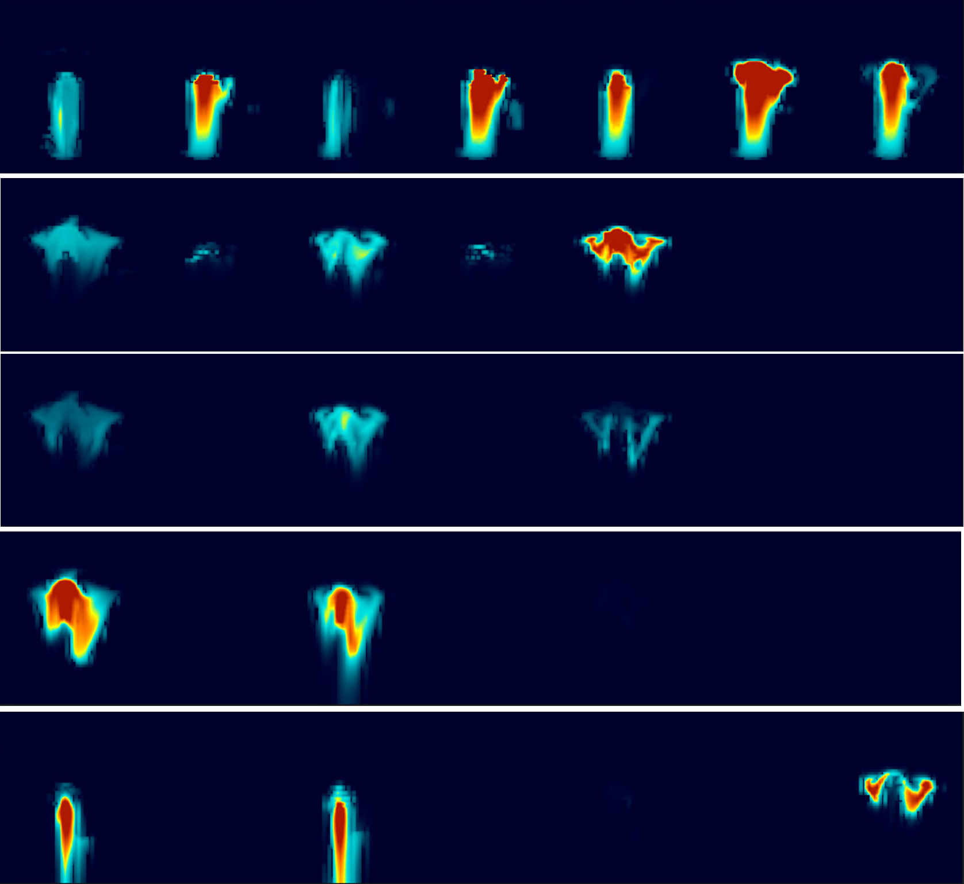
10 g/kg
1M mixed
cloud_num=200cm-3
SBM mixed
clean const
SBM mixed
clean
SBM mixed
polluted const
SBM mixed
polluted
SBM warm
polluted
SBM mixed clean ccn(t): graupel melts to rain that reaches surface
High sensitivity to CCN concentration
1M scheme corresponds to small CCN concentration in hydrometeors evolution, but has very strong updraft which should not produce precipitation (next slide)
9 g/kg
qc
8 g/kg
7 g/kg
qi
6 g/kg
5 g/kg
qs
4 g/kg
3 g/kg
qg
2 g/kg
1 g/kg
qr
0 g/kg
time=40min

Slide 16
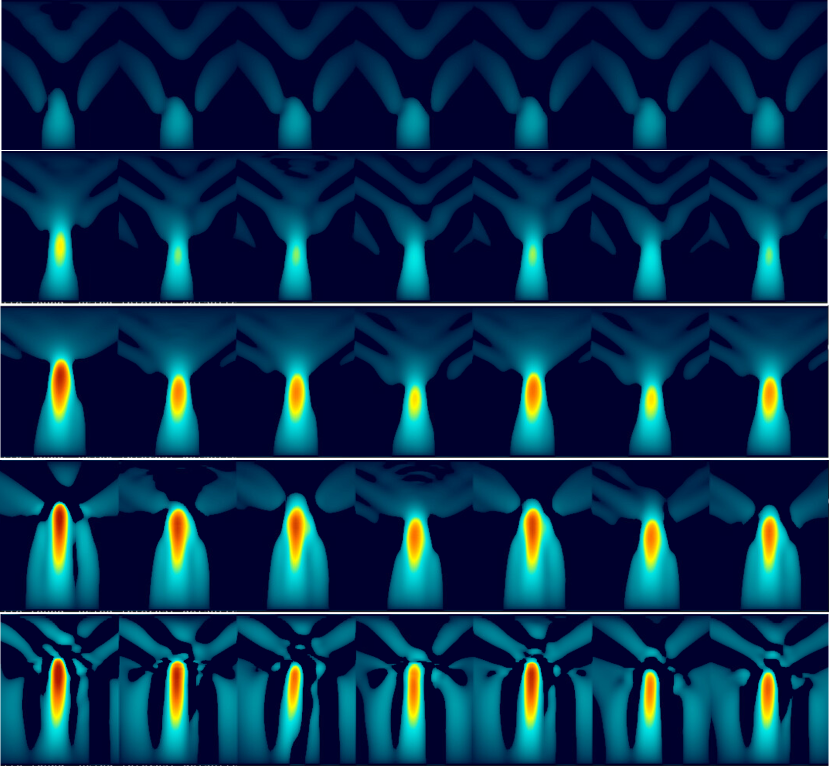
50 m/s
1M mixed
cloud_num=200cm-3
SBM mixed
clean const
SBM mixed
clean
SBM mixed
polluted const
SBM mixed
polluted
SBM warm
polluted
1M develops faster probably because of saturation adjustment
Polluted version have stronger updraft because of larger latent heat release and smaller water loading (at the cloud core)
W(10min)
45 m/s
40 m/s
35 m/s
W(20min)
30 m/s
25 m/s
W(25min)
20 m/s
15 m/s
W(30min)
10 m/s
5 m/s
W(40min)
0 m/s

Slide 17
Outlook
  SBM Implementation in ICON
  Tests of Cumulonimbus development (Weisman-Klemp 1982)
  Real case example

Slide 18
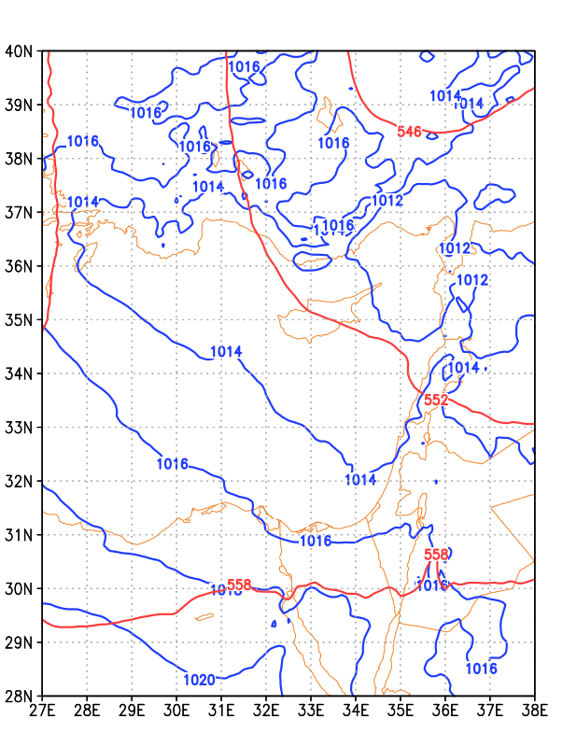
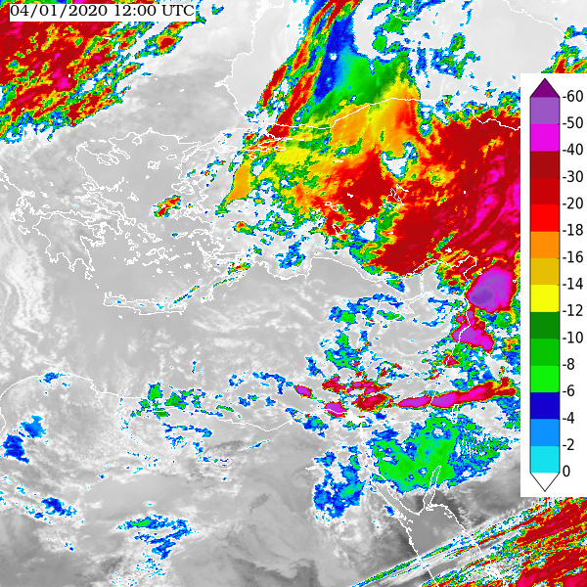
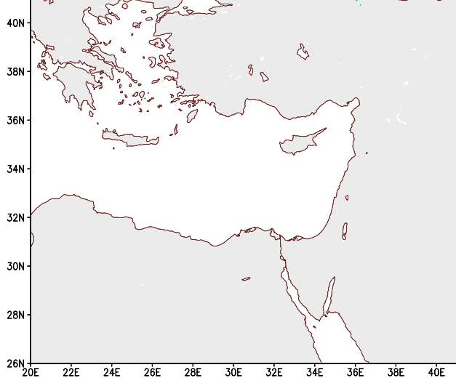
Real case: 4/1/2020
4 Jan 12Z: upper air trough, weak low at surface
4 Jan 12Z: Indian ocean MSG IR image
1 km resolution
simulation over the Eastern Mediterranean
2020010400 + …
Cloud top temperature (ºC)

Slide 19
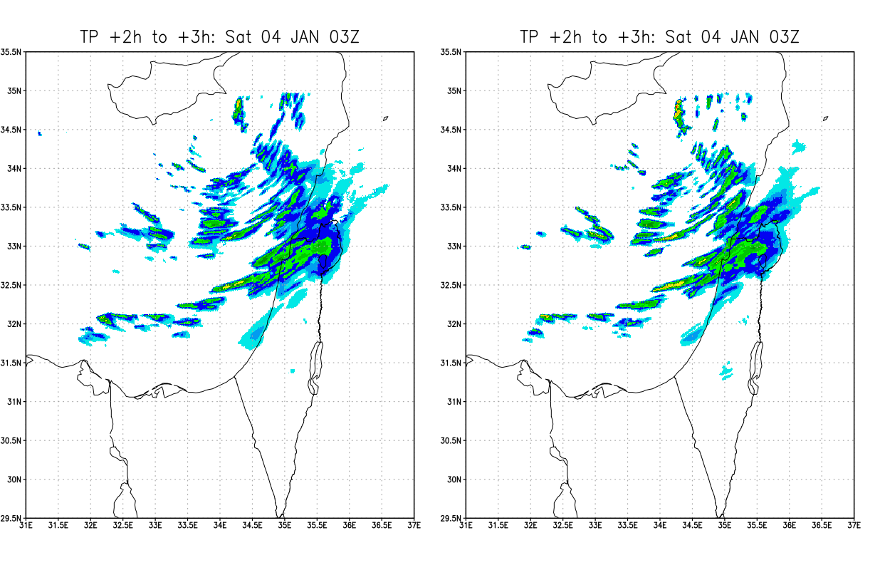

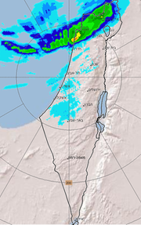
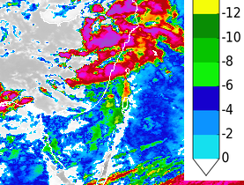
20240104: 03UTC
ICON 1km SBM
ICON 1km 1-moment
Cloud top T(C)
mm/1h

Slide 20
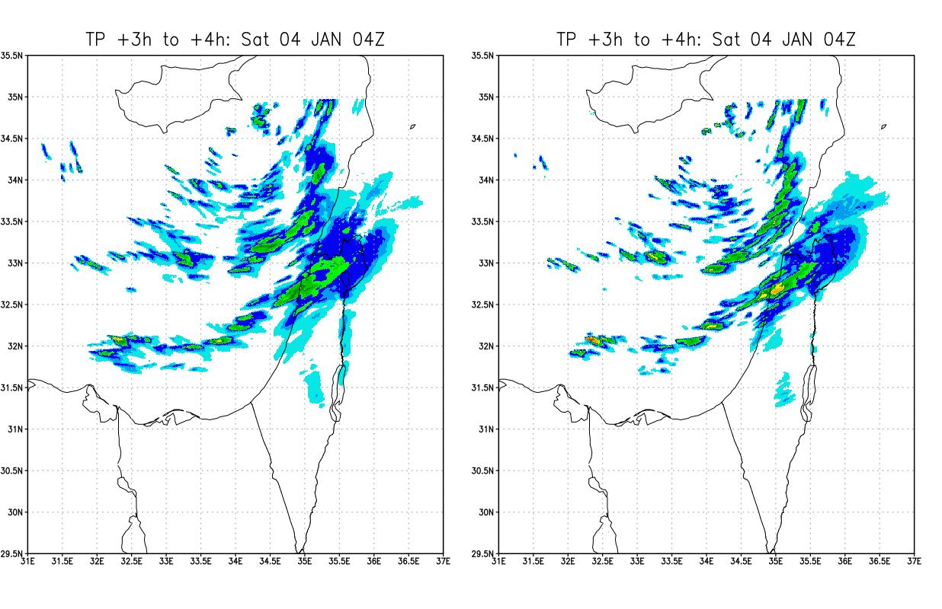
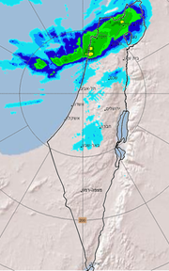
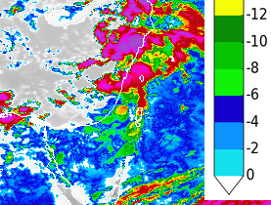
20240104: 04UTC
ICON 1km SBM
ICON 1km 1-moment
Cloud top T(C)
mm/1h

Slide 21
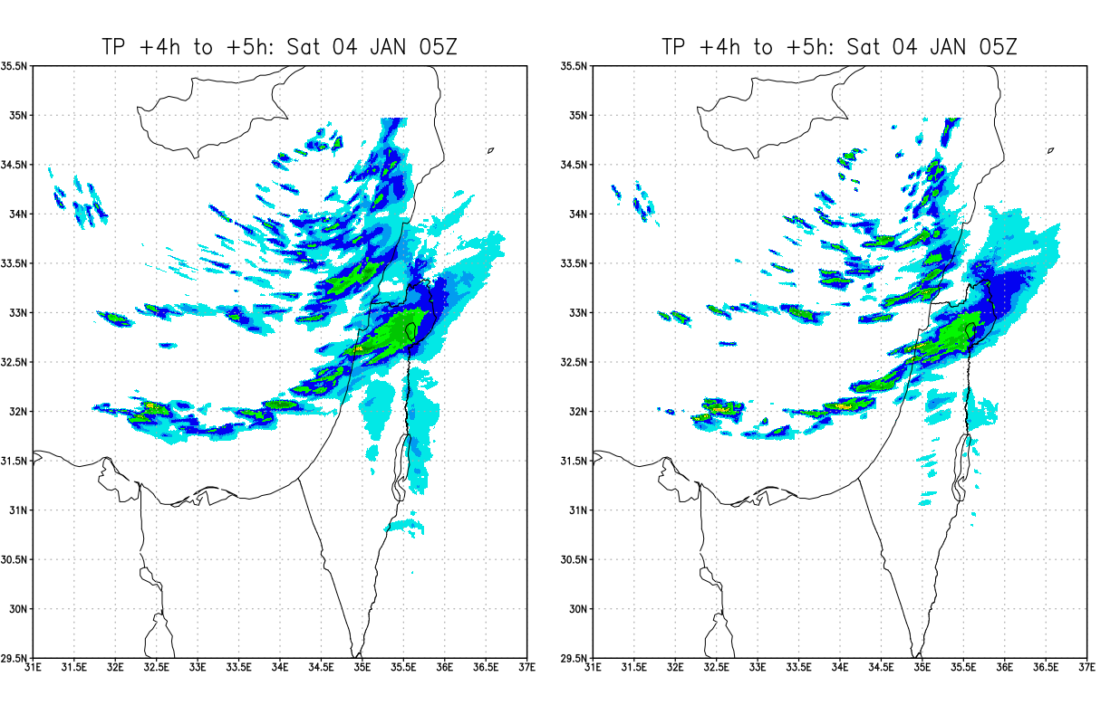
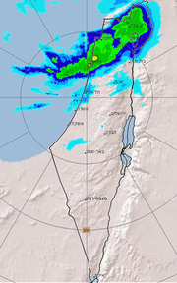
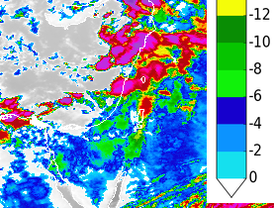
20240104: 05UTC
ICON 1km SBM
ICON 1km 1-moment
Cloud top T(C)
mm/1h

Slide 22
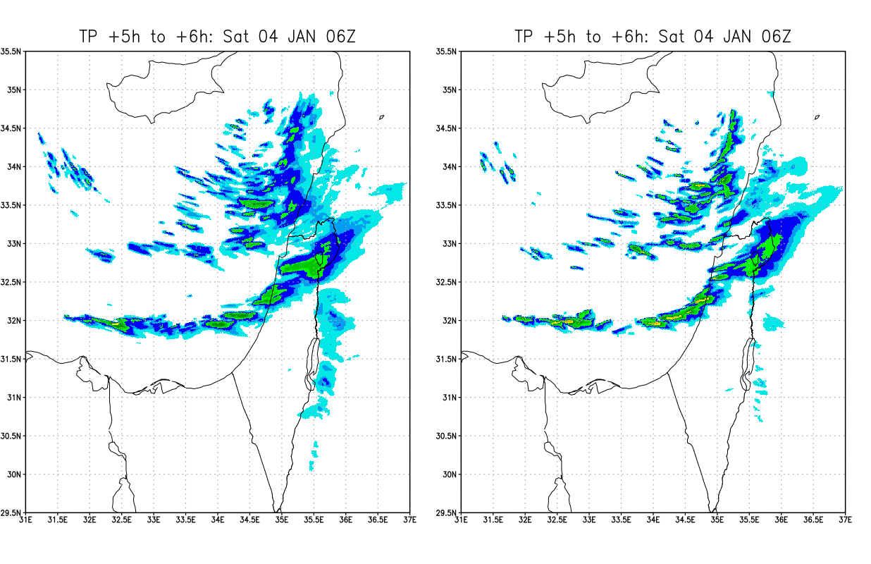
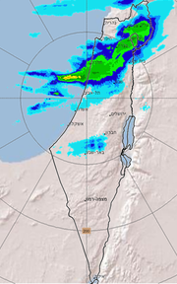
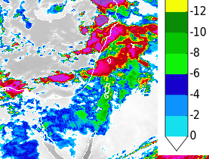
20240104: 06UTC
ICON 1km SBM
ICON 1km 1-moment
Cloud top T(C)
mm/1h

Slide 23
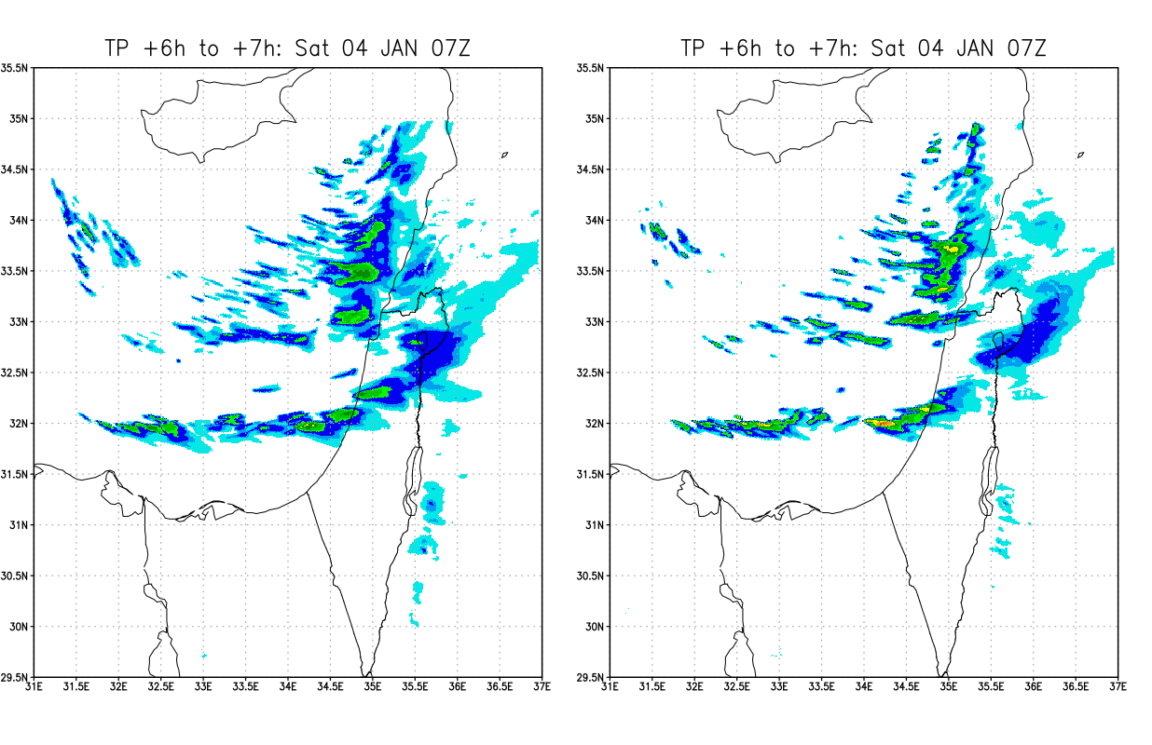
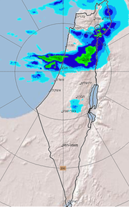
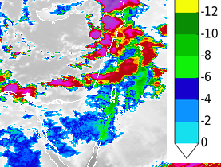
20240104: 07UTC
ICON 1km SBM
ICON 1km 1-moment
Cloud top T(C)
mm/1h

Slide 24
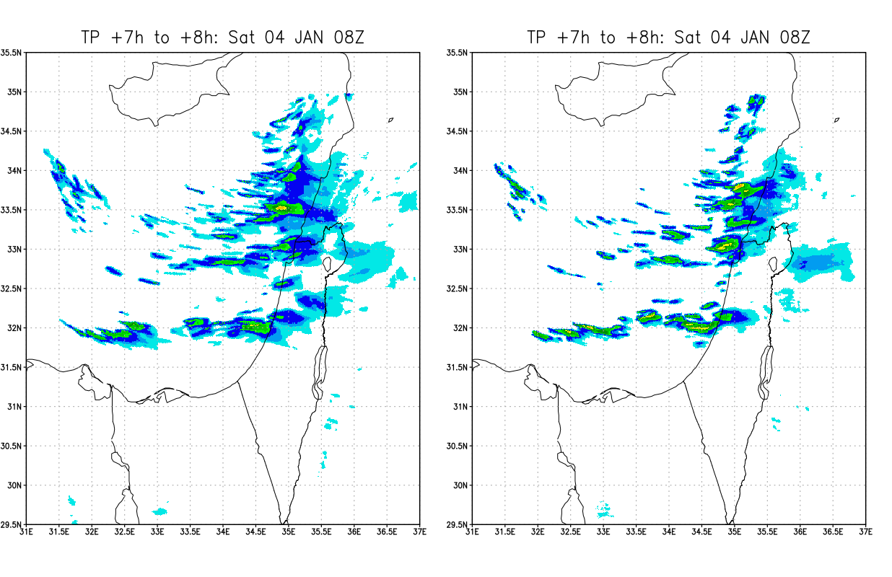
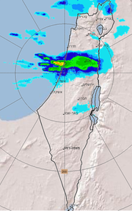
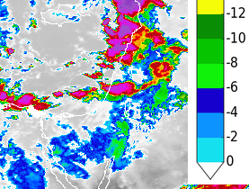
20240104: 08UTC
ICON 1km SBM
ICON 1km 1-moment
Cloud top T(C)
mm/1h

Slide 25
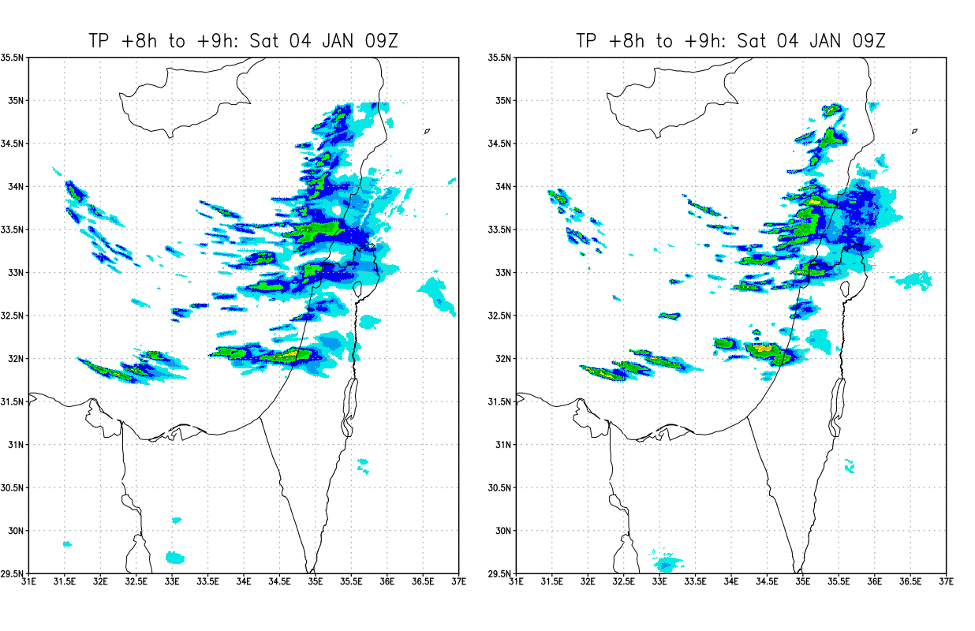
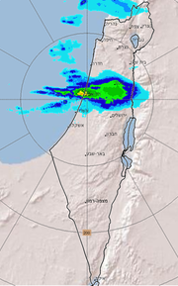
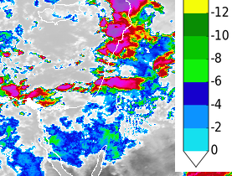
20240104: 09UTC
ICON 1km SBM
ICON 1km 1-moment
Cloud top T(C)
mm/1h

Slide 26
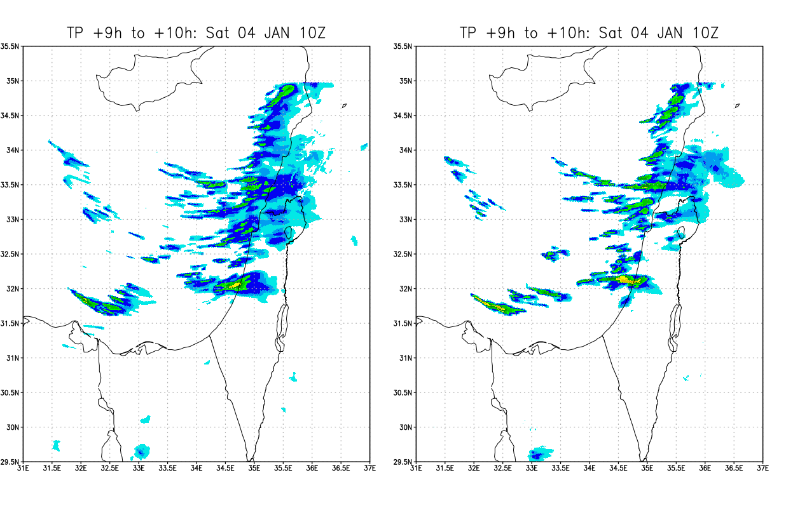
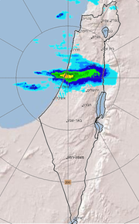
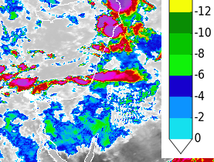
20240104: 10UTC
ICON 1km SBM
ICON 1km 1-moment
In reality: 68 mm/h
Cloud top T(C)
mm/1h

Slide 27
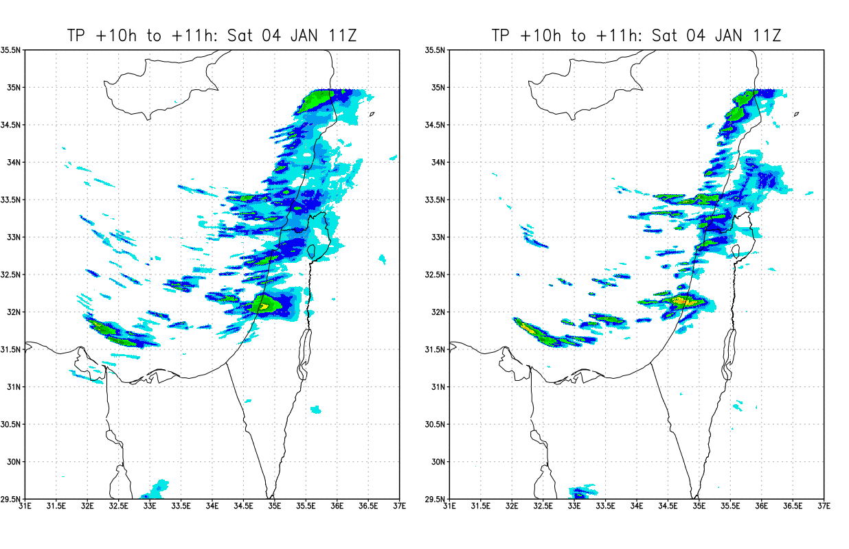
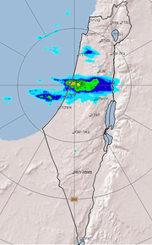
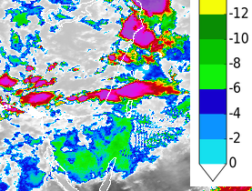
20240104: 11UTC
ICON 1km SBM
ICON 1km 1-moment
Cloud top T(C)
mm/1h

Slide 28
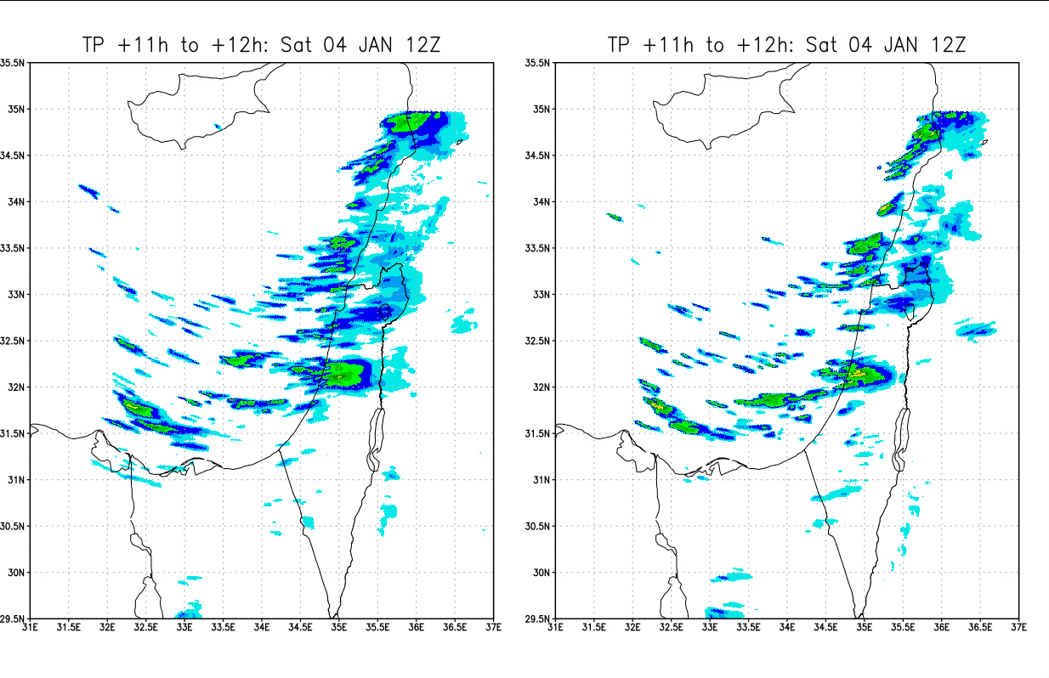
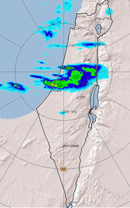
20240104: 12UTC
ICON 1km SBM
ICON 1km 1-moment
Cloud top T(C)
mm/1h

Slide 29
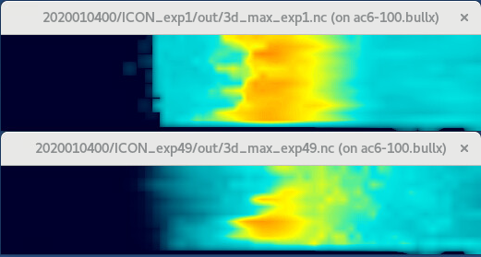
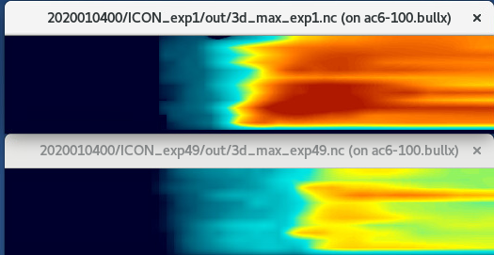
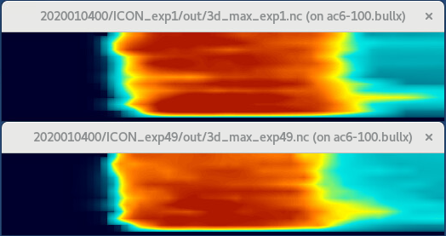
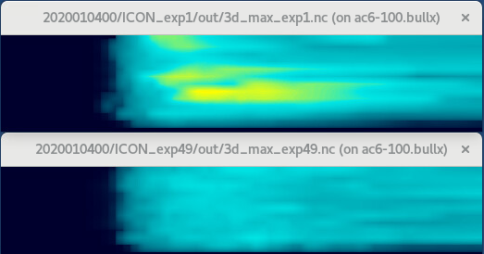
Maximum profile over the domain
kg/kg
ICON 1km
SBM
ICON 1km
1-moment
ICON 1km
SBM
ICON 1km
1-moment
ICON 1km
SBM
ICON 1km
1-moment
ICON 1km
SBM
ICON 1km
1-moment
20km
8km
5km
0ºC
1km
time 0-12h
time 0-12h
time 0-12h
time 0-12h
time 0-12h
time 0-12h
time 0-12h
time 0-12h
Cloud water content
Rain water content
Graupel water content
Snow water content

Slide 30
Summary
Implementation of mixed-phase SBM in ICON is ongoing. To be added: mixed phase particles, CCN regeneration
Good preliminary results for real case!
Additional issues for real case simulations:
  For real cases: nudge towards predefined CCN profile?
  Currently mixed phase code runs ~26 times slower than 1M. Can we skip advection of tracers with zero mass? Ongoing: switch off advection of a tracer at some model level and time step, in case it has zero (<epsilon) value at some geographic rectangle processed by a specific HPC processor.
  How to read QX at LBC? SBM needs the distributions, not the total water contents. Ongoing: “Evaporate” QX of the driving model at boundaries (move them to QV), and let SBM to condensate it

