Slide 1
The Global-to-Regional ICON Digital Twin (GLORI)
Problems/Challenges at High Resolution Runs
Does high resolution help over complex terrain?
Daniela Littmann¹, Alberto De Lozar¹, Günther Zängl¹, Chiara Marsigli^{1,2}, and Linda Schlemmer¹
¹ Deutscher Wetterdienst (DWD), Offenbach am Main, Germany
² Arpae Emilia-Romagna, Bologna, Italy
2 September 2024
Notes:
Investigating the performance of the parametrisation for the grey zone area and check if they need to be adapted or even switched

Slide 2
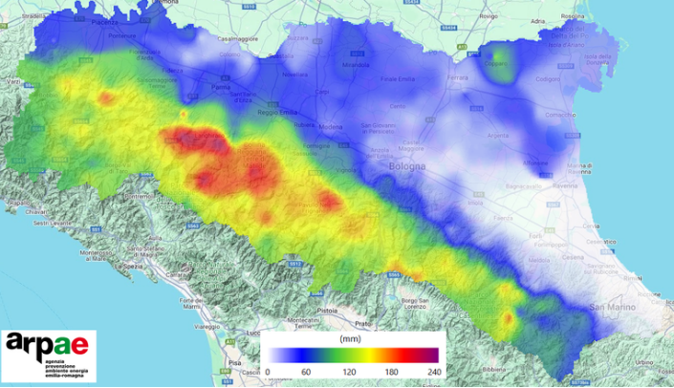
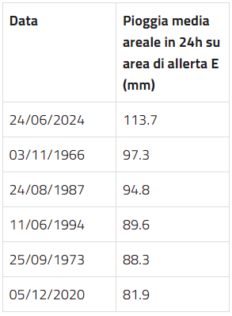
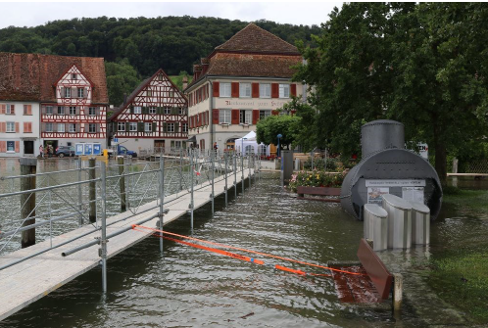

Storms over Central Europe in June 2024
Figure: Hail (left) and flooding (right) in southern Germany.
Credit: ©Gewitterjäger, https://x.com/Gewitterjaeger/status/1799099655051178272.
Figure: Accumulated precipitation from 23 June, 2 a.m., to 25 June, 2 p.m. in the Emilia-Romagna region.
Table: Averaged measured value of precipitation in mm during 24 hours.
Credit: © Arpae, https://www.arpae.it/, last access: 19.7.24.
Figure: Flooding (9-11 June) at Bodensee (Untersee) in Berlingen.
Credit: © D. Gerstgrasser, MeteoSchweiz 2024: Klimabulletin Juni 2024. Zürich.

Slide 3
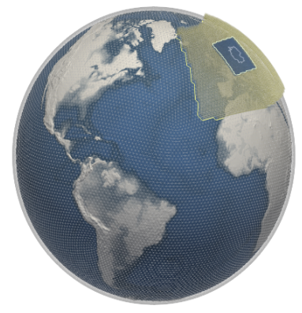
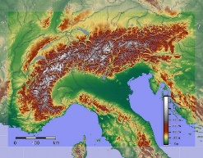
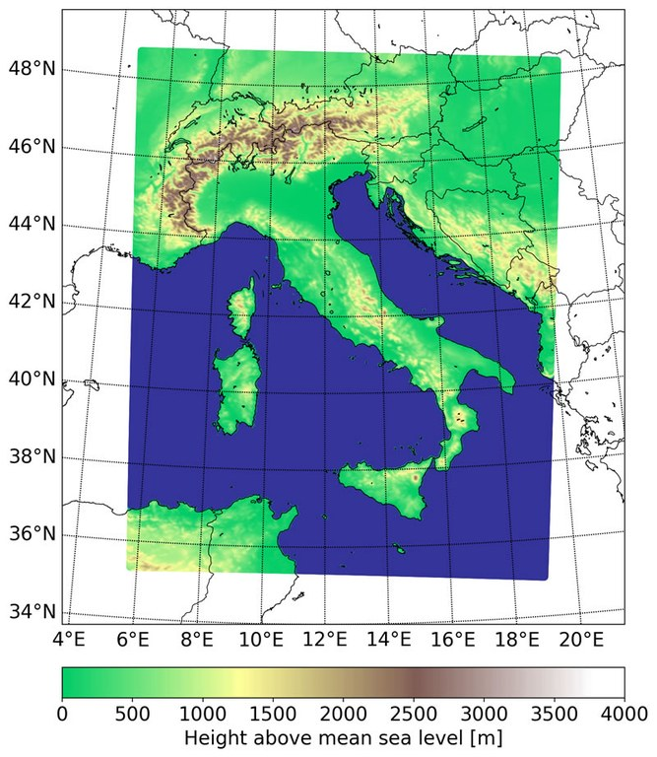
The GLORI Digital Twin
Tri-lateral Cooperation
Germany, Italy, Switzerland
Global storm-resolving simulations (~ 3km) and regional high-resolved mesoscale simulations (500m)
Extreme event prediction:
→ (Urban) Flooding
→ Pollen
→ Mineral Dust
→ (Urban) Heat Island

Slide 4

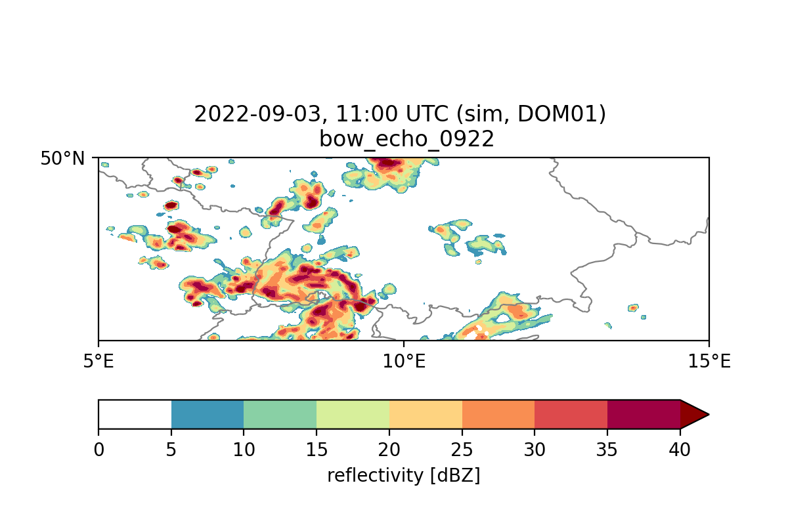
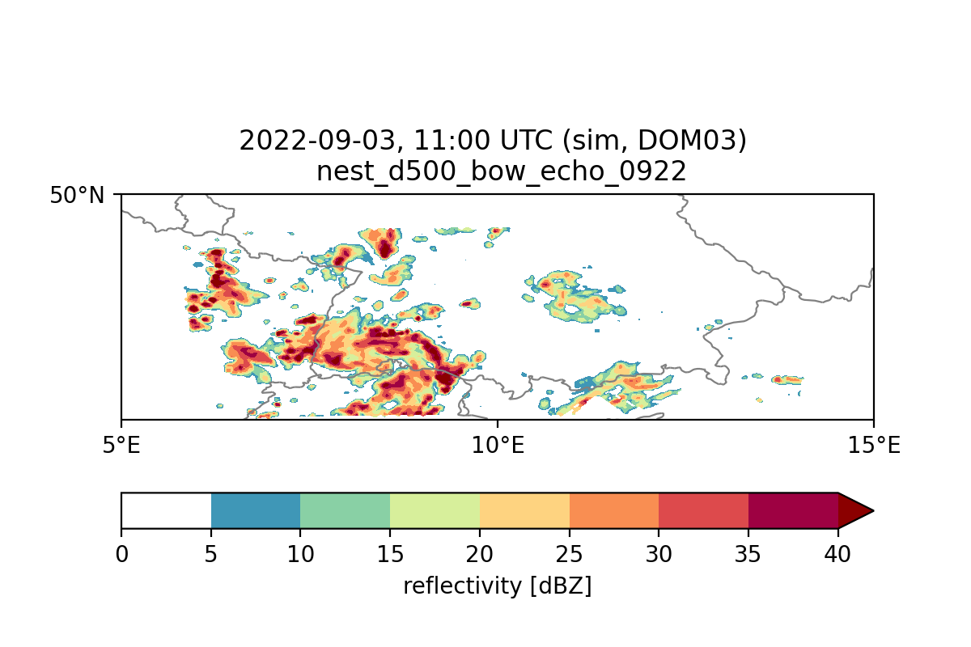
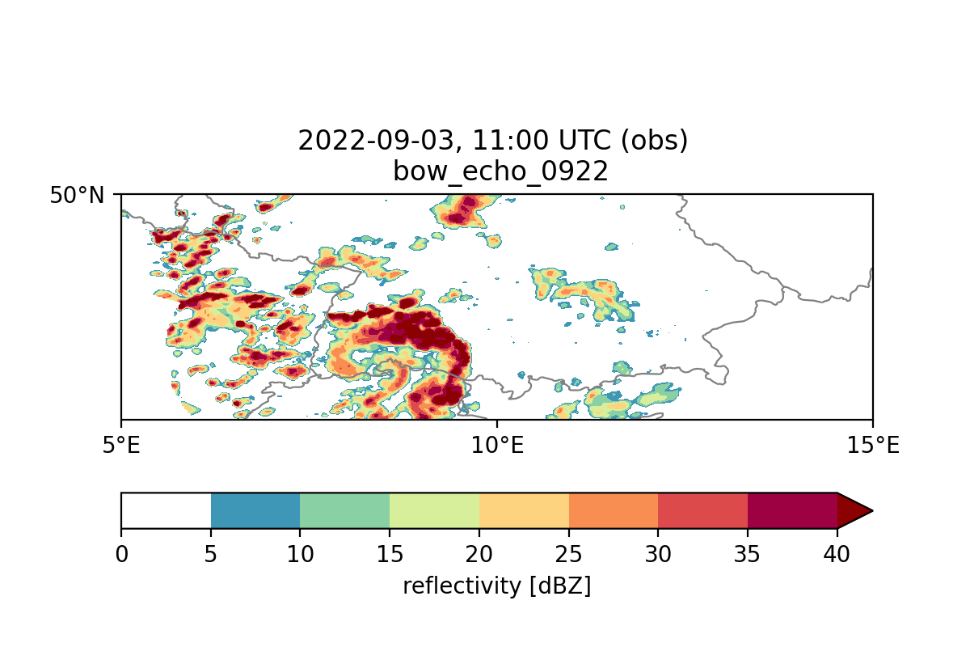
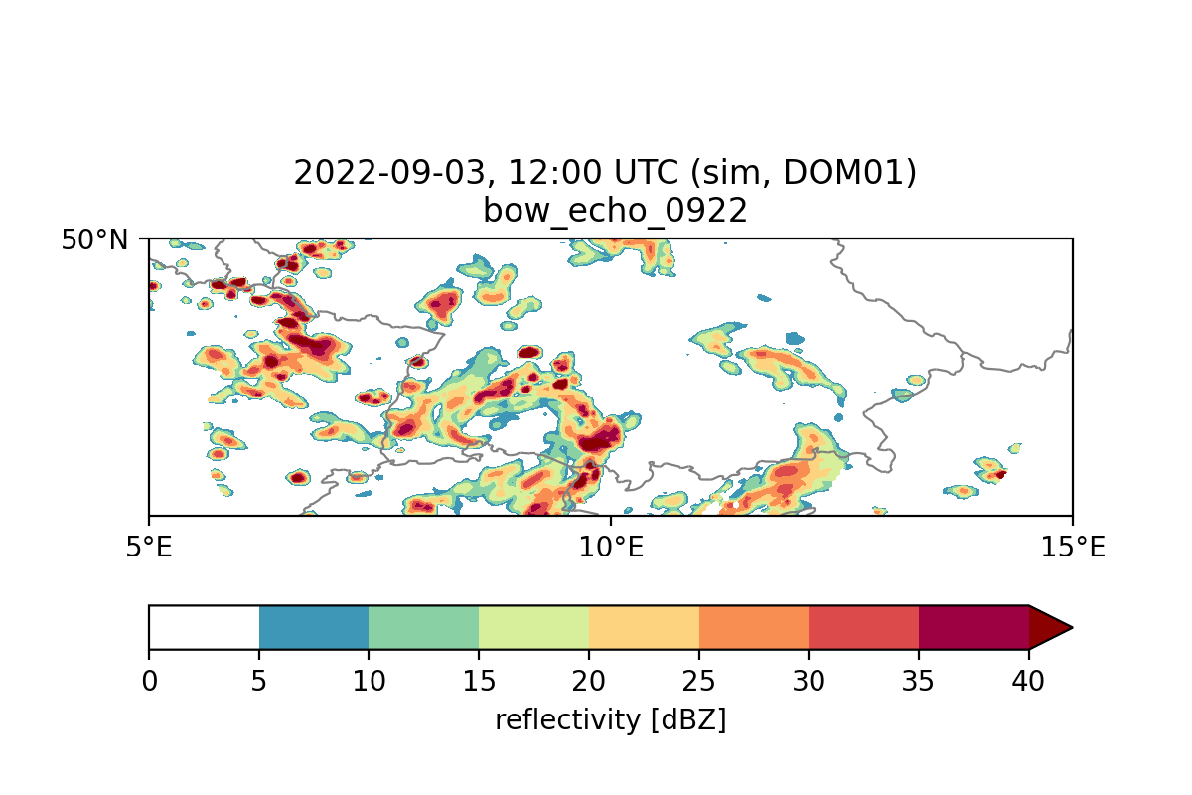
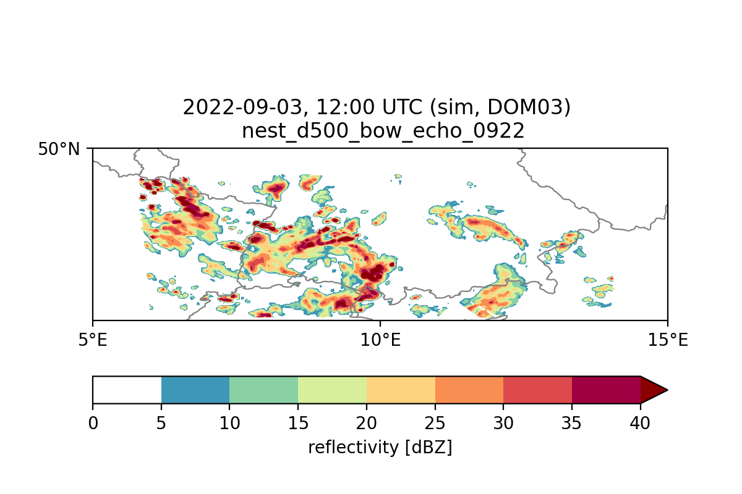
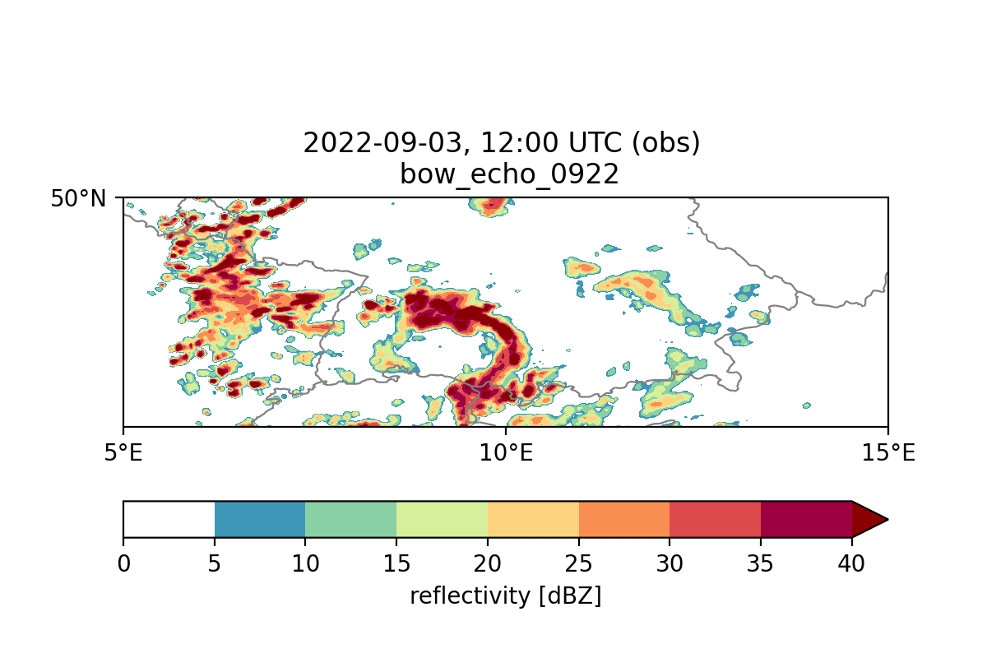
What have we learned from ?
In SINFONY we focus on the prediction of severe convective storms over Germany.
Significant improvements are obtained by assimilating radar data and by using the two-moment microphysical scheme.
A few case-studies with higher resolution did not show large improvements.
Operarional 2km forecast
500 m forecast
Observation
+2h
+3h

Slide 5
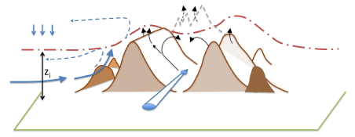
Focus on flow over complex terrain
The flow and boundary layer over complex terrain are probably under resolved for current NWP resolutions (2km). This improves for higher resolutions.
Resolved thermal circulations can produce quite different surface fluxes

Slide 6
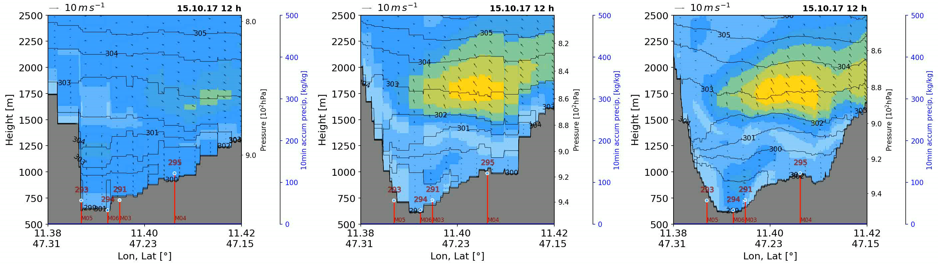
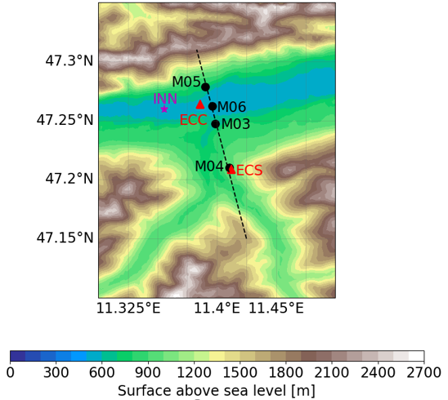
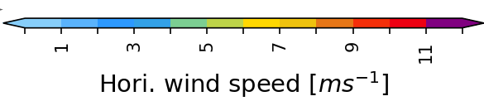
Case study: the cold air pool 2017
∆x = 2 km
∆x = 1 km
∆x = 500 m
Location: Inn Valley
Figures: Vertical cross sections in the Inn Valley (dashed line in right figure) for horizontal grid scales of 2 km, 1 km, and 500 m (left to right). Contours represent the averaged horizontal wind speed,, contour lines show the potential temperature for a cold air pool case during the night of 15.-16. October 2017. A strong jet (observed) is resolved by higher resolutions.

Slide 7
Hypothesis
The wind over complex terrain is better resolved at higher resolutions .This can improve the weather prediction.
Experiment:
Compare forecasts over the Alps at 2km (operational) and 1 km resolution.

Slide 8
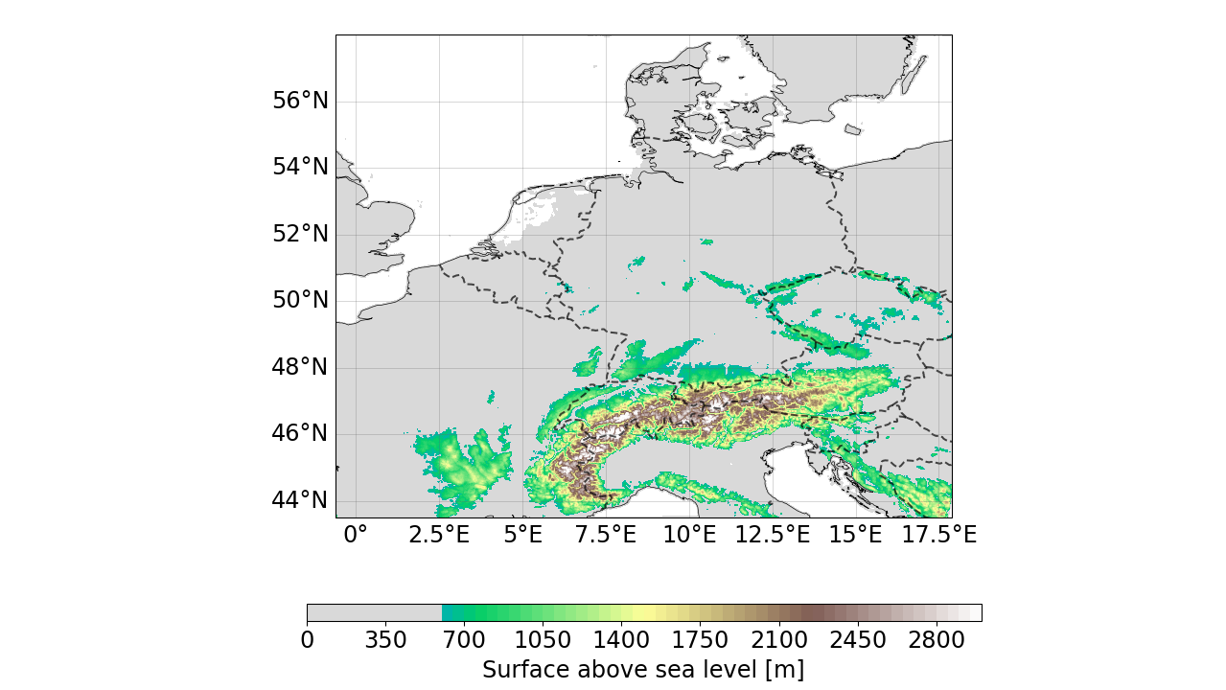

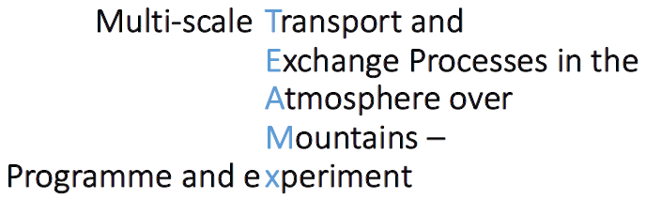
Model Domain over complex terrain
∆x
2 km
1 km
500 m

Slide 9
Experiments
Experiments | Reforecast from DWD analysis
Configuraion | SINFONY (two-moments microphysics) Retuning of gusts and minimal turbulent diffusion (see Günther’s talk)
Forecast lead time | 36 h
Runs | Every day at 0h and 12h. In this talk only 0h is shown, but the 12h shows similar results.
Duration | 1 month in summer (60 forecasts) with heavy convection

Slide 10
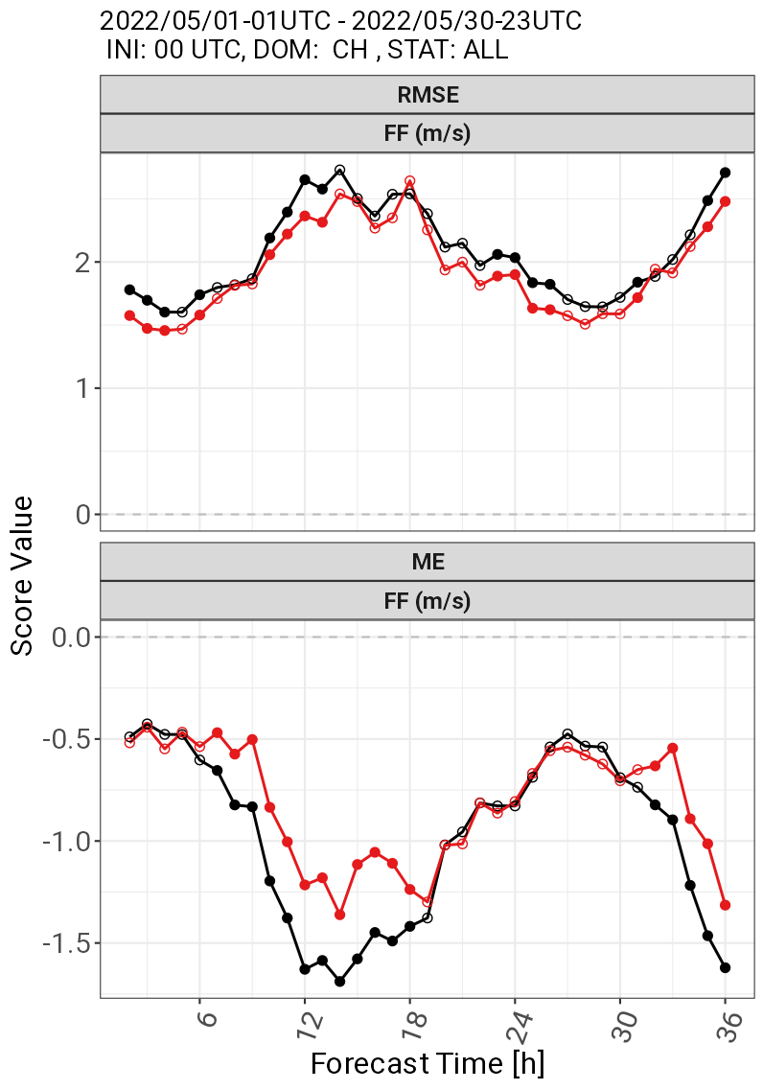
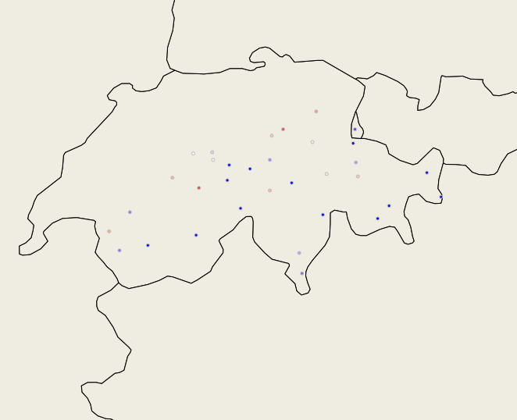
Verification over valley stations
Δx = 2km
Δx = 1km
Station | FF | T
Valley | 25 | 34
Clear improvement for wind speed, but not much differences for other parameters.
The Valley stations in Switzerland used for verification.

Slide 11
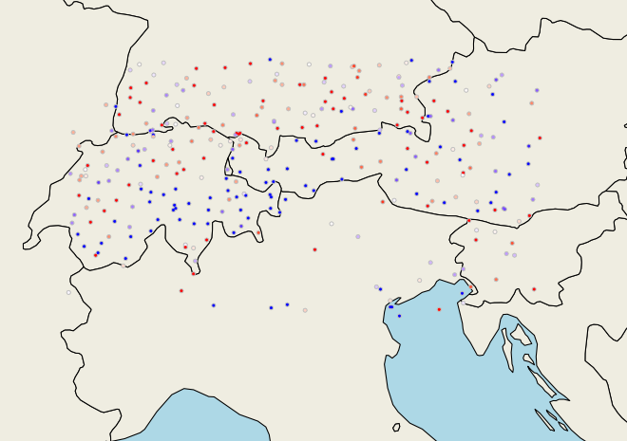

All Observations
Only meteorological stations from the innermost
TEAMx domain (ICON-A05) used for comparison.
Notes:
Map of TEAMx @1km, met-stations, ME of temperature
Table: Experiments, reference
No convection: operational @MeteoSwiss. Motivation: part of the processes are getting resolved and some parametrisations need to be switched off

Slide 12
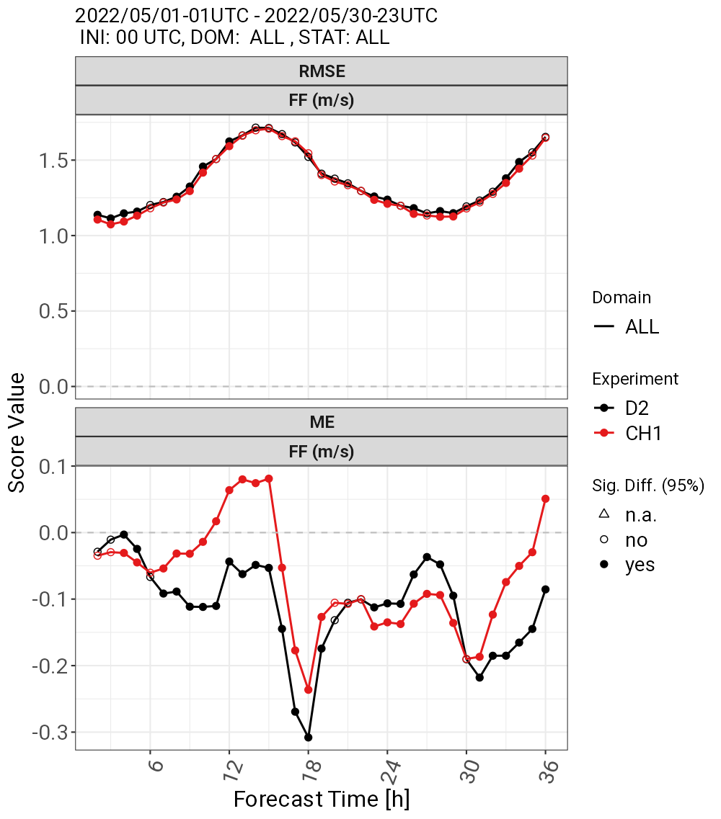
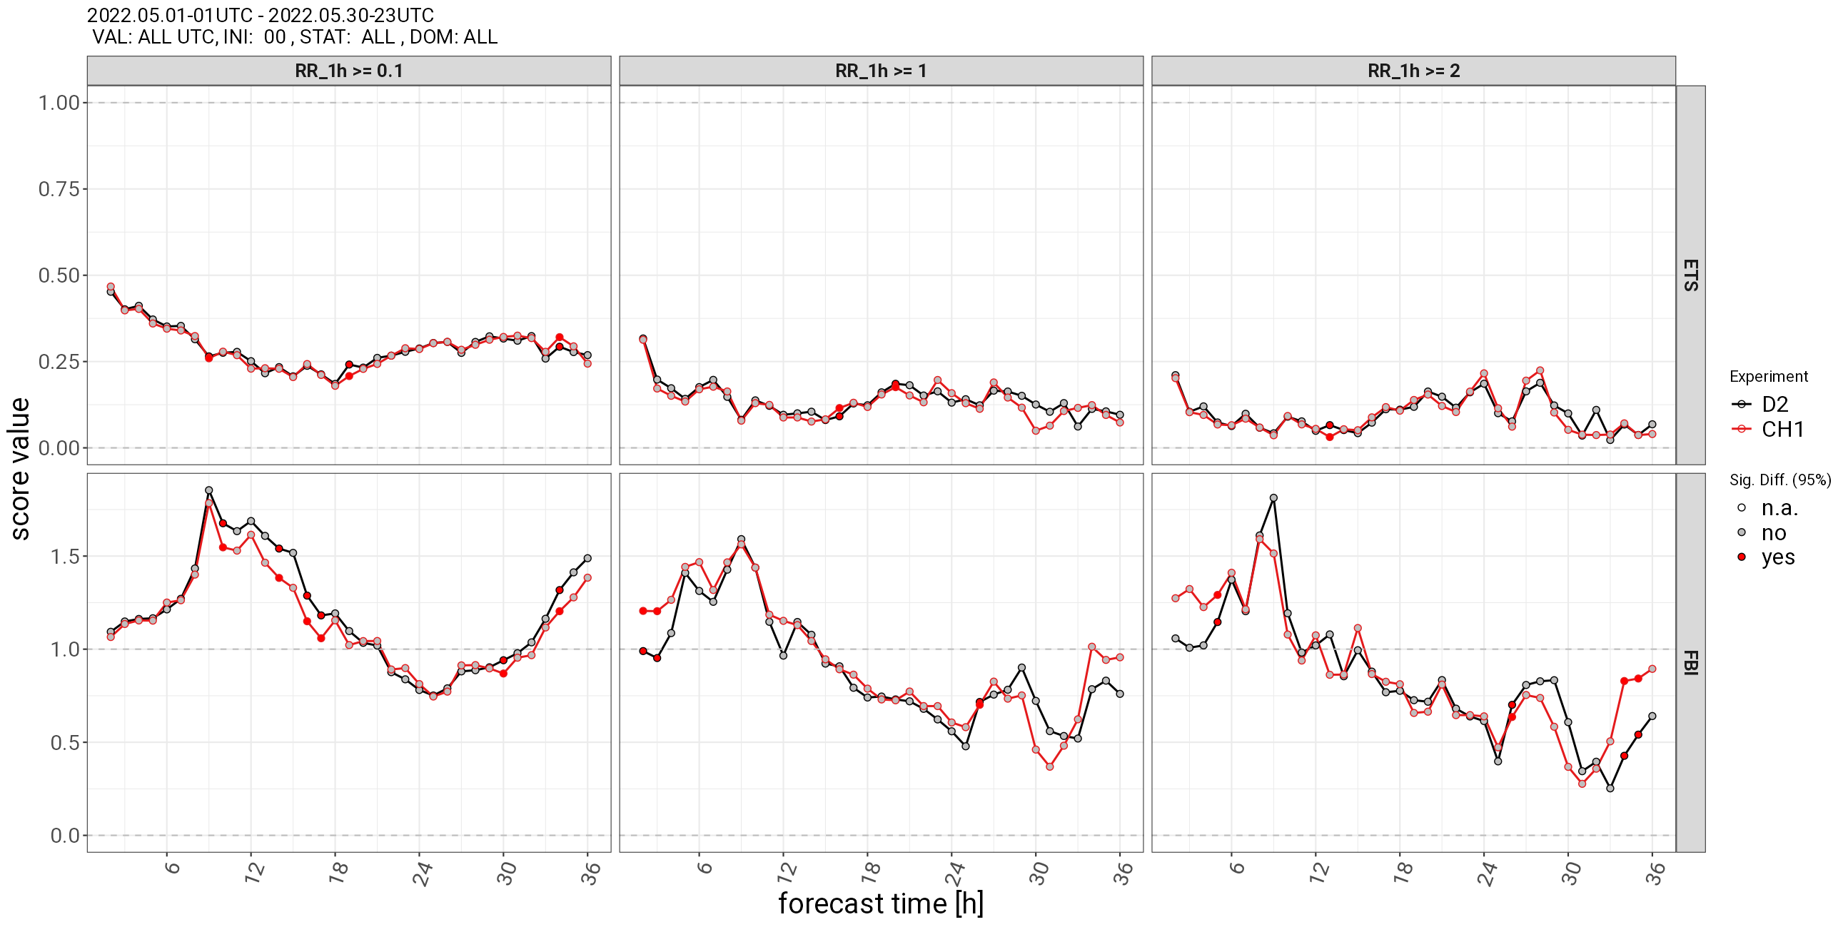
Verification with all stations
Δx = 2km
Δx = 1km
When looking at all stations the the improvement for wind almost disappears.
Winds gets faster for 1km during day-time.
No clear benefit for other meteorological parameters: rain scores look similar.

Slide 13
Hypothesis 2
The wind over complex terrain is better resolved at higher resolutions (Yes!). This can improve the weather prediction (Not really…).
1-km simulations are in the gray zone; improvements can be expected for higher resolutions
Experiment:
Compare 1km and nested 500m domain (similar domain as before but different period).

Slide 14
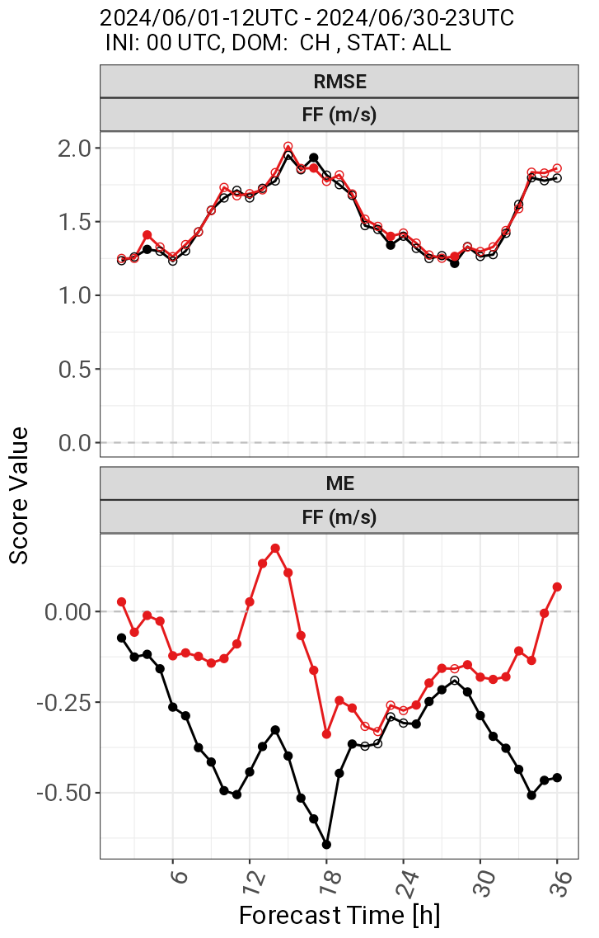
Complex terrain: Valley Stations
Δx = 1km
Δx = 500 m
Station | FF | T
Valley | 25 | 34
Figure: The Valley stations in Switzerland used for verification.
Clear improvement for wind speed bias, but not much differences for other parameters.

Slide 15
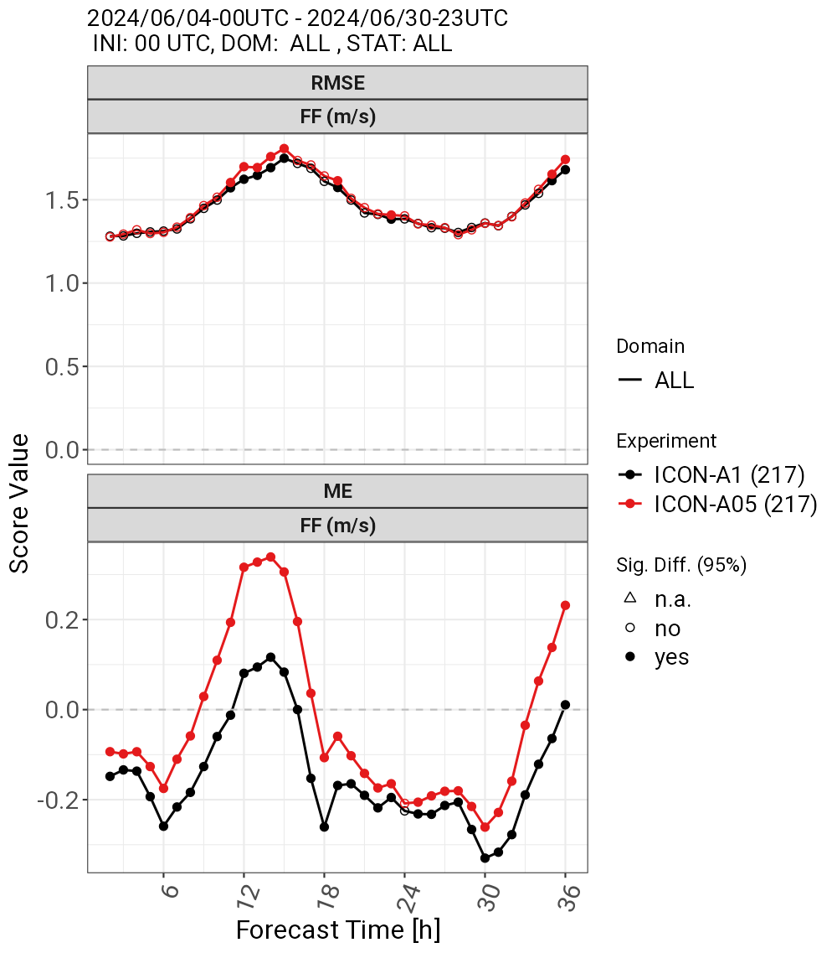
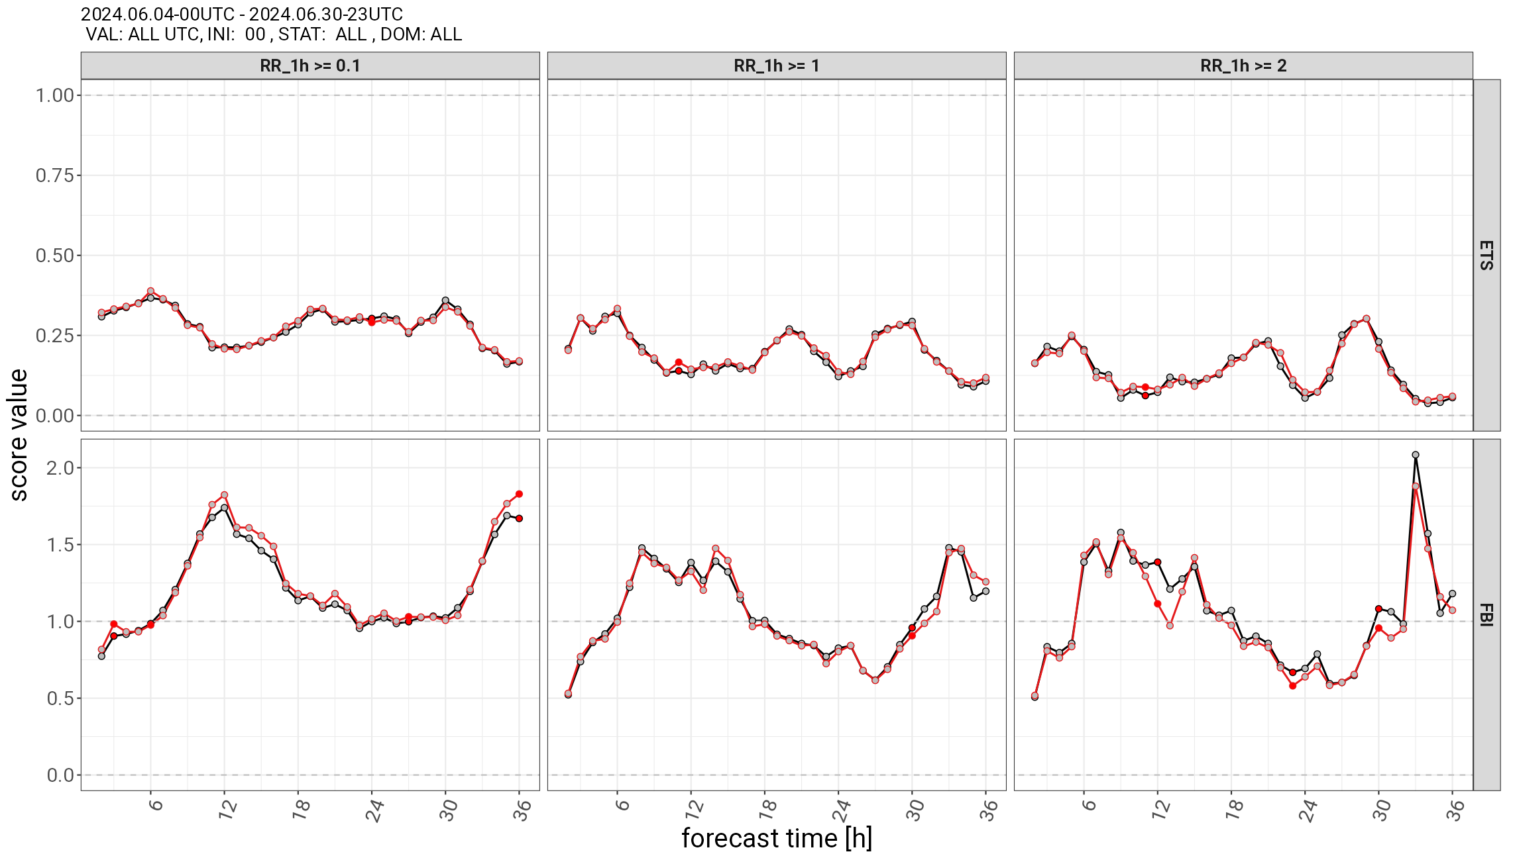
Verification with all stations
Δx = 1km
Δx = 500 m
When looking at all stations the the improvement for wind almost disappears.
Winds gets faster for 1km during day-time, probably too fast.
No clear benefit for other meteorological parameters: rain scores look identical.

Slide 16
Hypothesis 3
The wind over complex terrain is better resolved at higher resolutions (Yes!). This can improve the weather prediction (Not really…).
1-km simulations are in the gray zone; improvements can be expected for higher resolutions (Not really for 500m…).
500m simulations resolve processes that are already parametrized. We should adapt /switch off some parameterizations.
Experiments:
Experiment with reduced asymptotic length scale l = 80m instead of –=300m. (Remember that σ ~ l*u_{TKE}).
Experiment with no shallow convection.

Slide 17
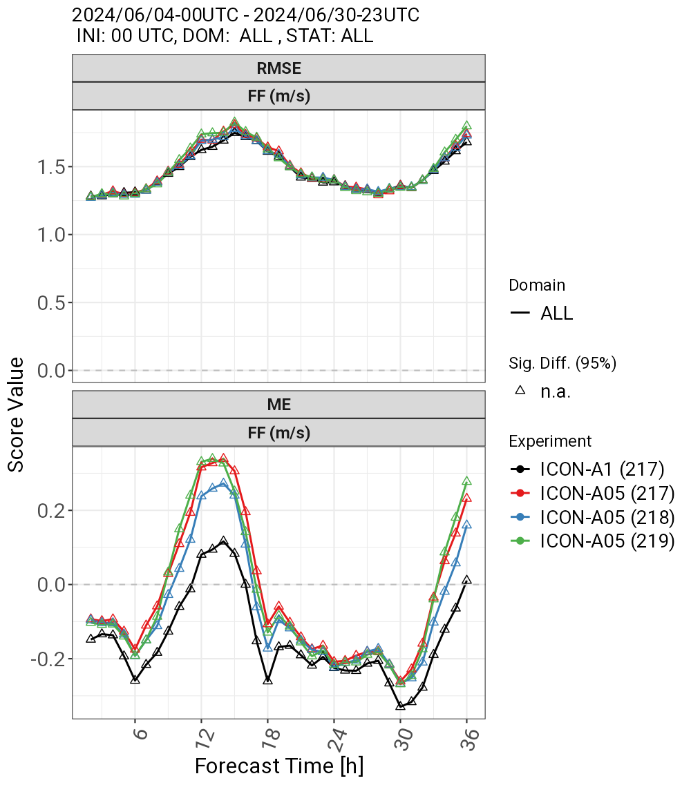
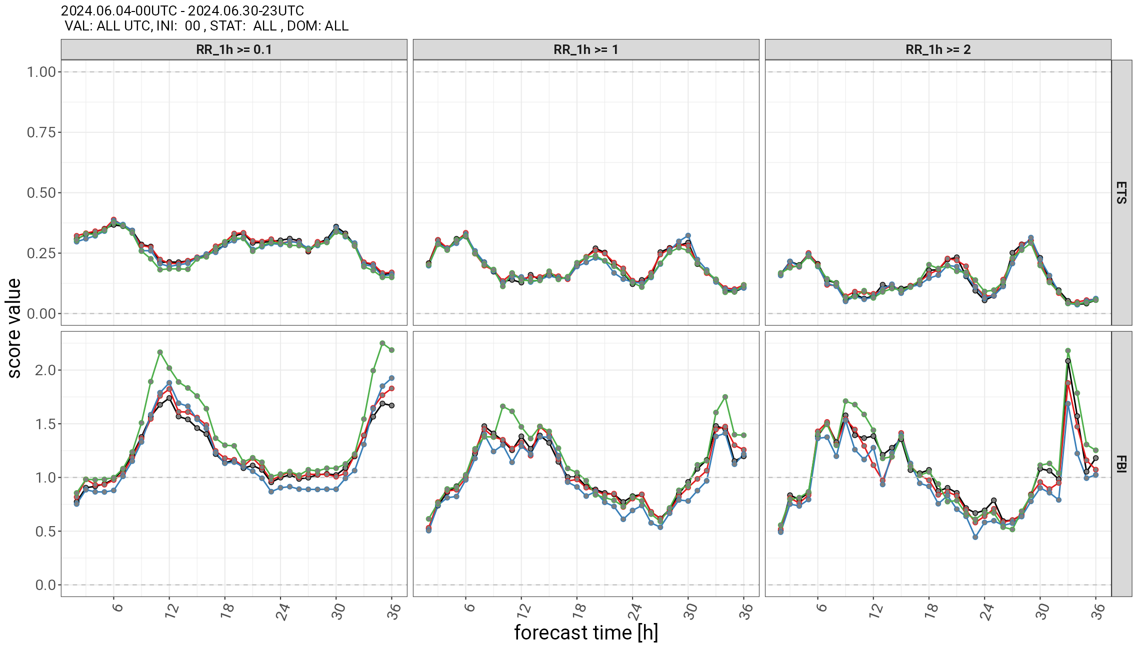
Verification with all stations
Δx = 1km
Δx = 500 m
No conv
l_{TKE}=80m
Small changes in velocity, moderate changes in rain.
Shallow-convection-off is of comparable quality. We could switch it off.
After such a drastic reduction in turbulence. Is turbulence still important?

Slide 18
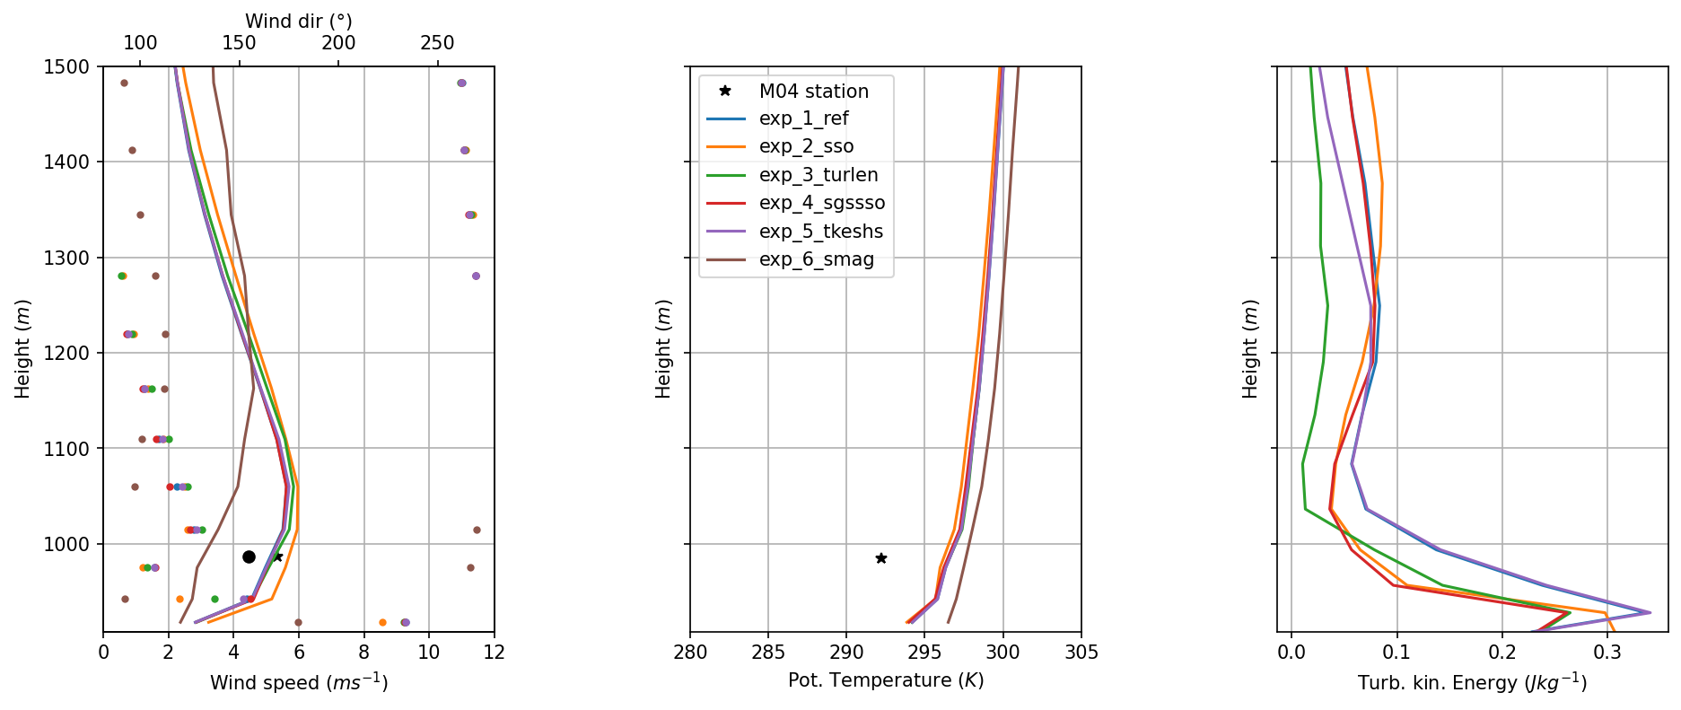
16.10.2017 – 0 h
Turbulence in Case Study at 500m
Reference
NO SSO
l_{TKE}=30m
SSO in TKE
Hor. shear in TKE
Smagorinsky
Profiles do not change much by changing TKE (for example from hor. Shear to l =30m).
SSO seems more important. First experiments with Smagorinsky.

Slide 19
Conclusions
Increasing resolution from 2km to 1km and 500m improves the wind forecast in valleys. Case studies clearly show how new features are being resolved.
However, this improvements do not translate to a better weather forecast: all scores considering rain are almost unchanged.
The shallow convection parametrization seems unimportant at 500m. We could switch it off or retune it.
Our simulation suggests that small changes in turbulence (like new sources in the TKE equation) do not have a great effect. Running turbulence at a minimum produced moderate changes.

Slide 20
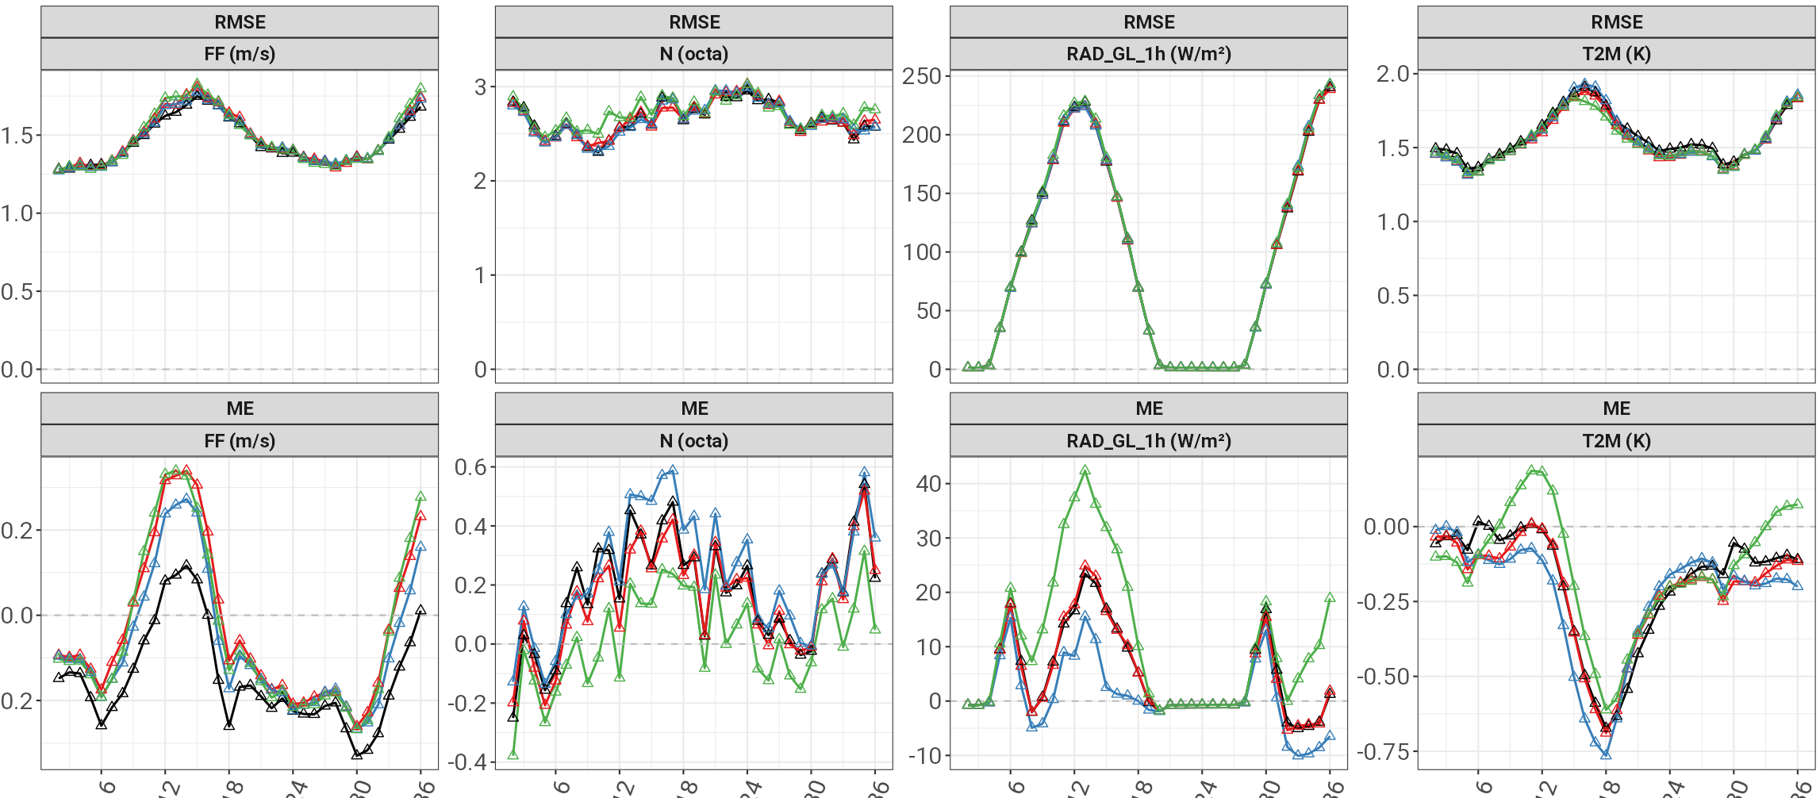
3. General Verification
RMSE (Top) and Mean Error (ME) (below)
Initial hour: 12 h
Wind speed ms⁻¹
Cloud cover %
Radiation (Wm⁻² )
2m-Temperature K
Score Value
Wind speed ms⁻¹
Cloud cover %
Radiation (Wm⁻² )
2m-Temperature K
ICON-A1
ICON-A05
ICON-noconv
ICON-turlen
Forecast Time
Notes:
RMSE (top line), ME (low line) HALBZEIT
Score values over whole forecast period for specific var‘s that were more affected by changes
DD, FF, N, T2M
Black, red, blue

Slide 21
3. Local Verification over Switzerland
Figure: Meteorological stations in Switzerland used for the comparison to the model results. The colors show the mean error (ME) of the model for the temperature at 2m height above ground.
Notes:
Performance may differ locally, to encounter..
Valley: FF, T
Plateau: FF, T
Slope nur vier Stationen, keine Aussagbarkeit.

Slide 22
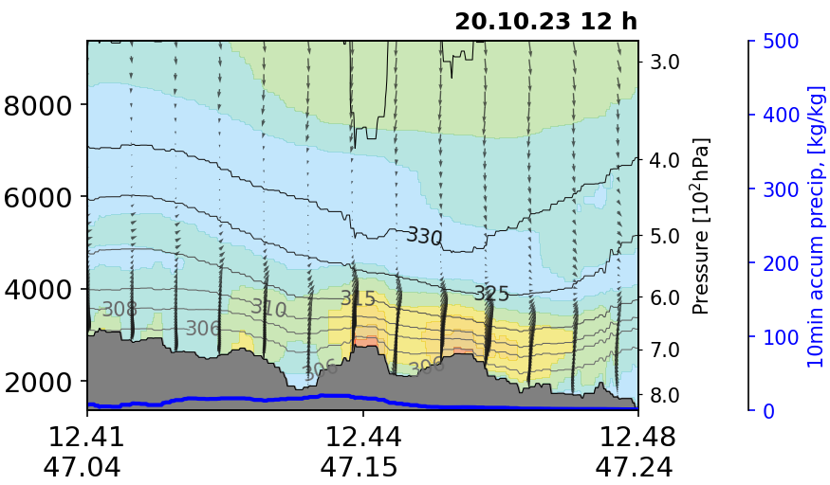
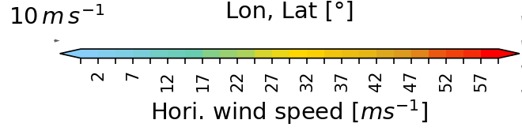
3. Adapted gust parameterisation (AGP)
New gust diagnostic option for large eddy permitting model applications
AGP uses 10 min averaged 10 m wind speeds as input
Scale dependent boundary layer constraint to avoid unrealistic wind speed maxima at the top of mountains
Notes:
- During the investigation, unrealistic high wind speed maxima close to the surface were observed (>150 m/s)

Slide 23
4. Summary & Outlook

Slide 24
Vertical profiles (500m)
exp_1_ref exp_2_sso exp_3_turlen exp_4_sgssso exp_5_tkeshs exp_6_smag
&nwp_phy_nml
inwp_sso = 1,1,1,1 1,0,0,0 1,1,1,1 1,1,1,1 1,1,1,1 1,1,1,1
inwp_turb = 1,1,1,1 1,1,1,1 1,1,1,1 1,1,1,1 1,1,1,1 1,1,5,5
&turbdiff_nml
ltkesso = T T T F T T
ltkeshs = T T T T F T
tur_len = 300. 300. 30. 300. 300. 300.
&twomom_mcrph_nml
lturb_enhc = T T T T T F

Slide 25
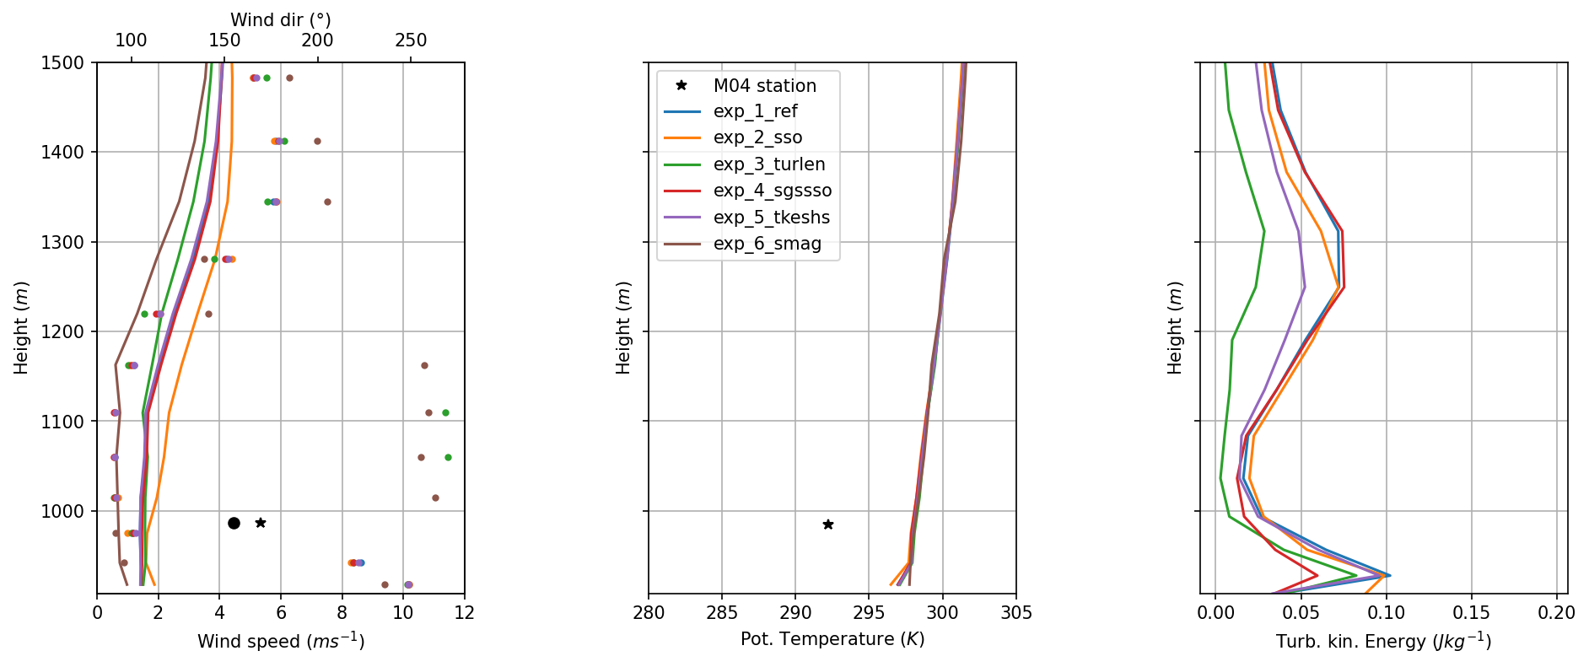
15.10.2017 – 18 h

Slide 26
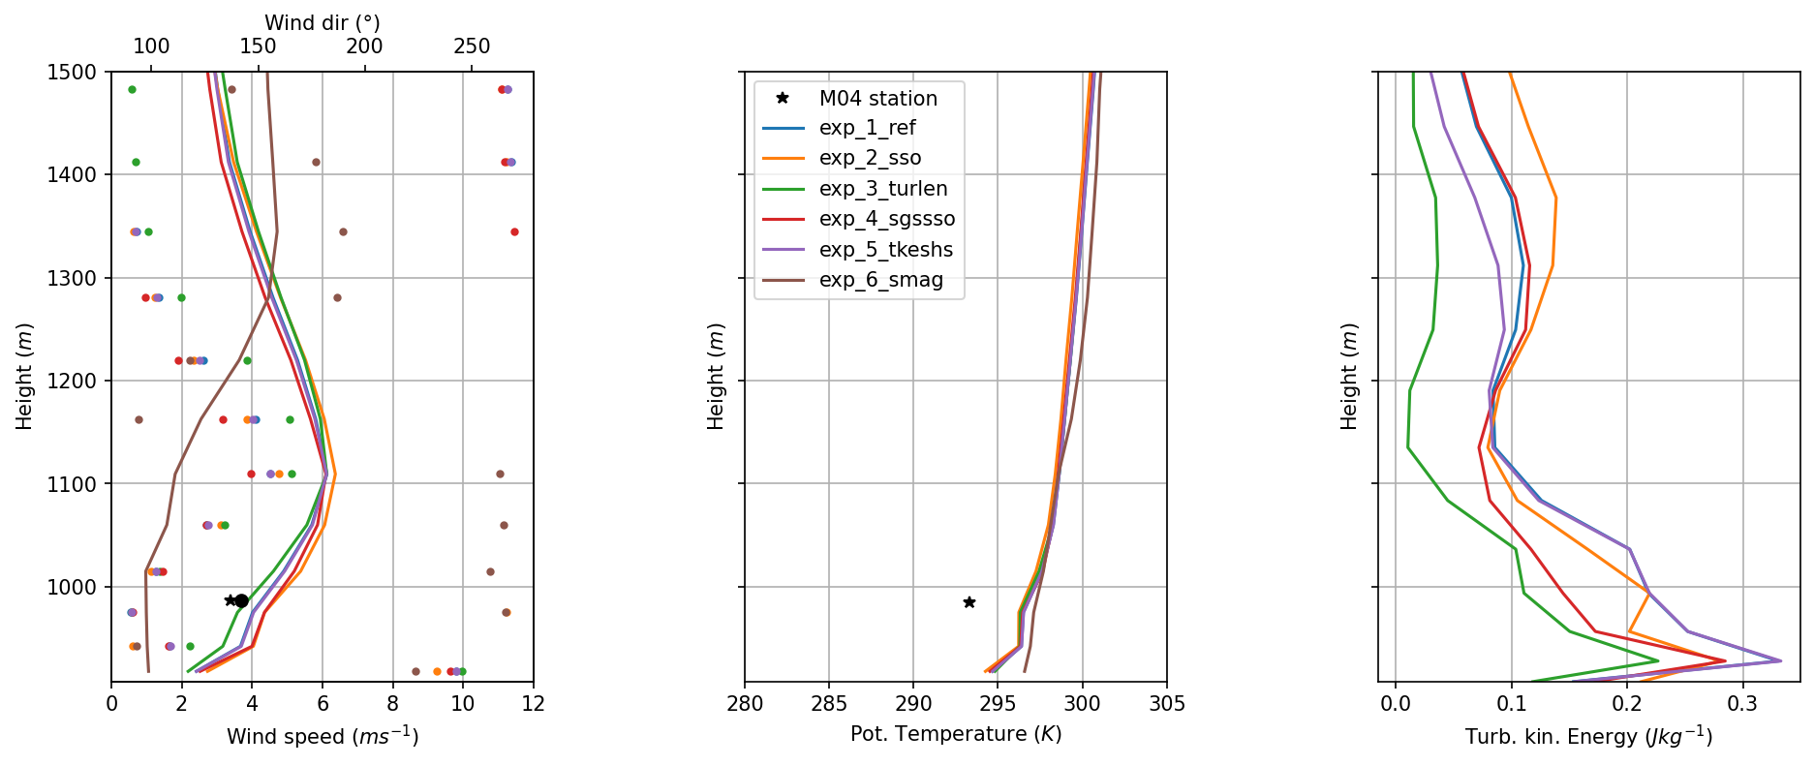
15.10.2017 – 21 h

Slide 27
16.10.2017 – 0 h

Slide 28
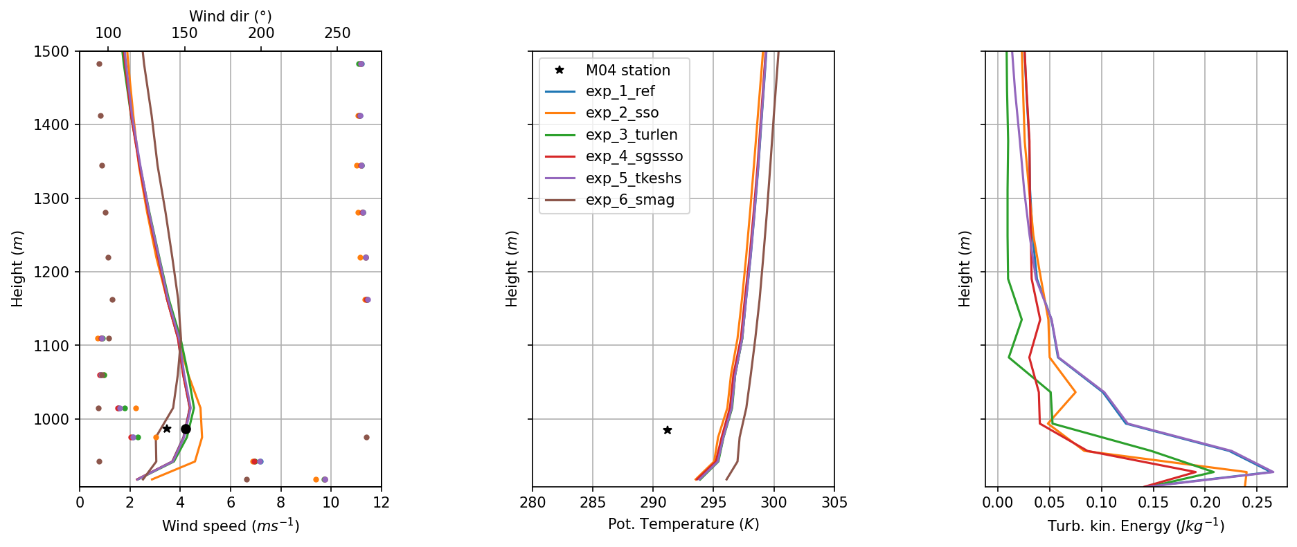
16.10.2017 – 3 h

Slide 29
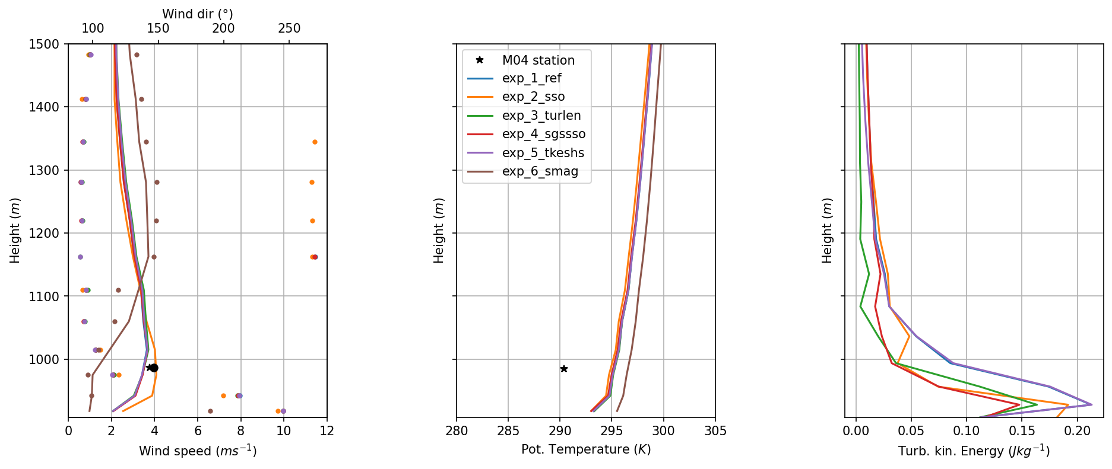
16.10.2017 – 6 h

Slide 30
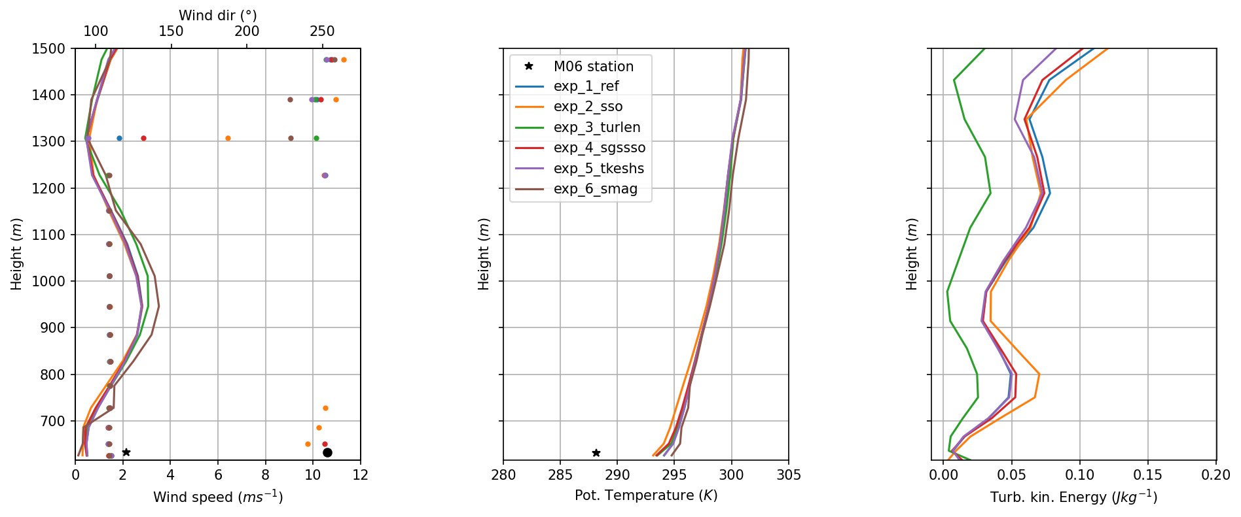
15.10.2017 – 18 h

Slide 31
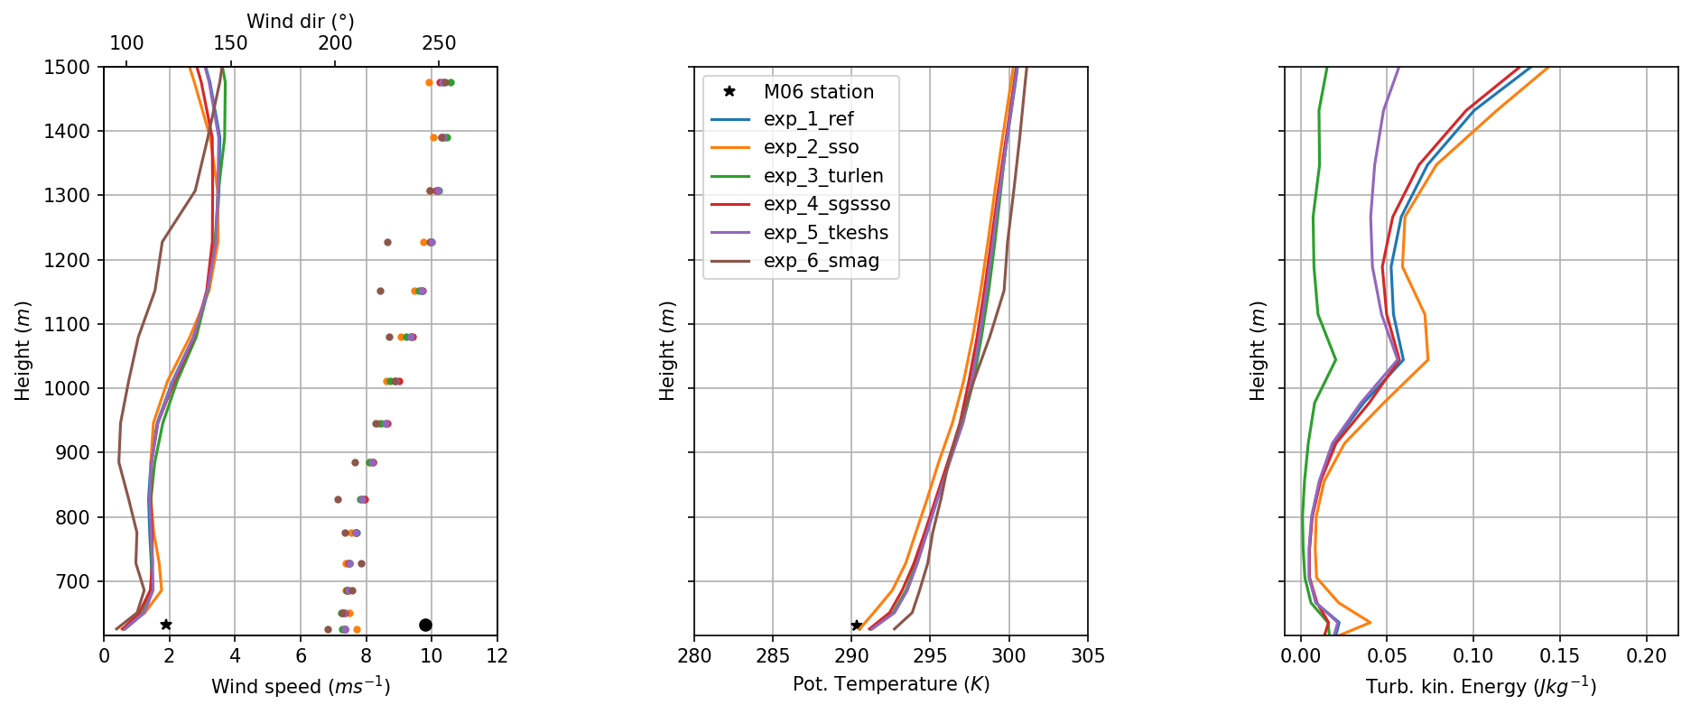
15.10.2017 – 21 h

Slide 32
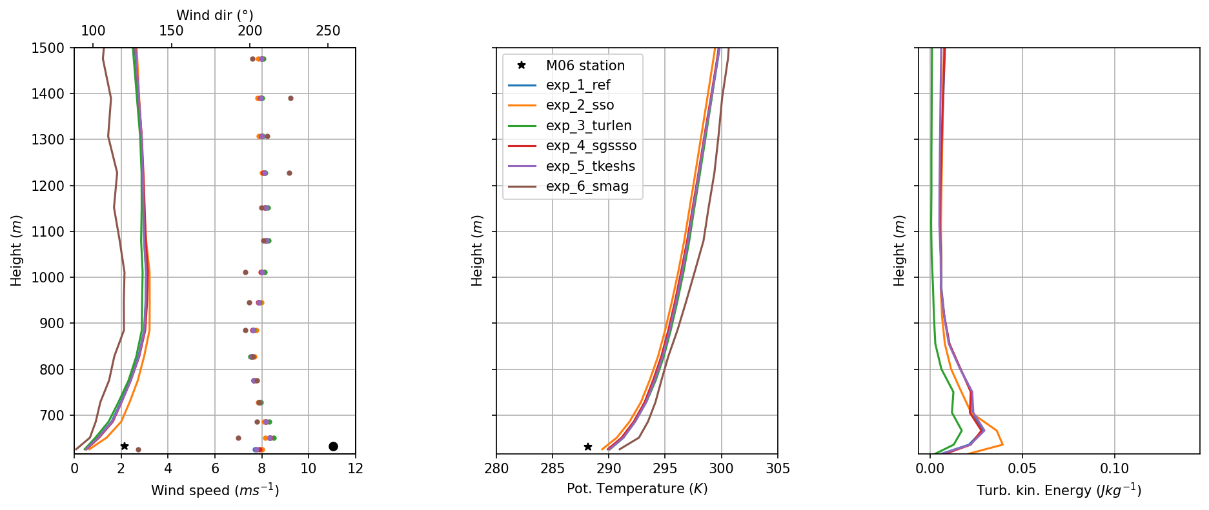
16.10.2017 – 0 h

Slide 33
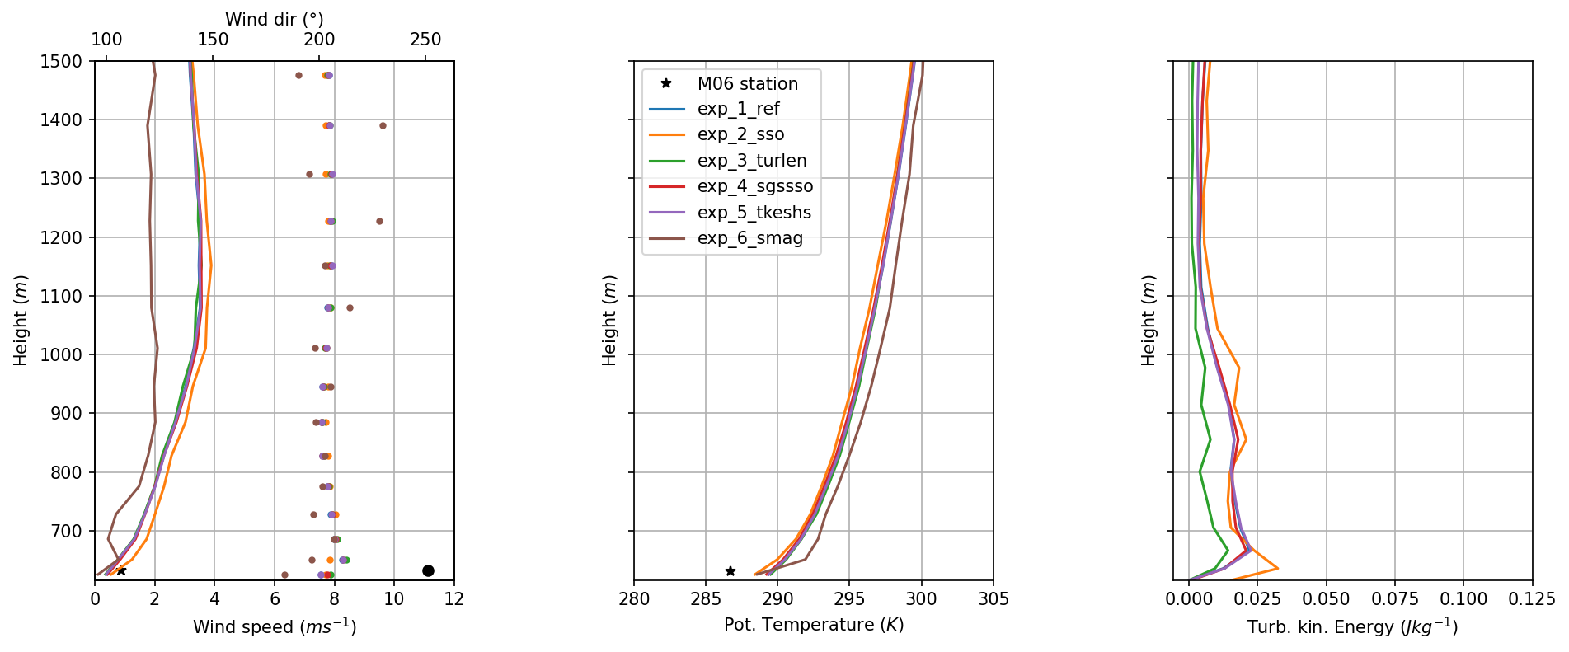
16.10.2017 – 3 h

Slide 34
4. Summary & Outlook
After adapting the gust parametrisation, the model performance slightly improved with increasing horizontal grid scale from 2 km and 1 km, mainly in valleys.
Shallow-convection seems to get resolved starting with very high horizontal grid scales of 500 m.
Parameterized turbulence does not have a big influence on the results. Using the minimum possible TKE length has a minor effect.
Next:
  Investigation of the thermal surface fluxes.
  Investigation of (scale depending) clouds and precipitation.
Notes:
Slope-related*: itune_slopecor, tkesso=3, hgtdiff_max_smooth_topo=750,400,200

Slide 35

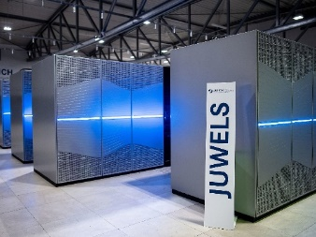









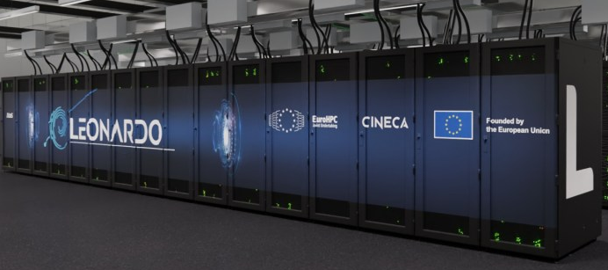


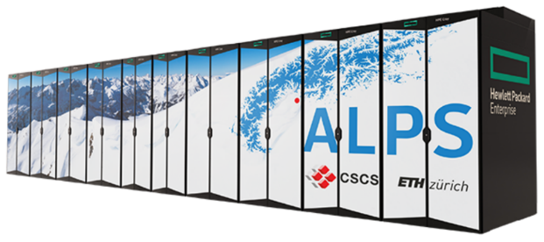

GLORI Partners and HPC system
IDEA-S4S

Slide 36
References
Gohm et al. 2021 - Gohm, A., Umek, L., Haid, M., Ward, H. C., & Rotach, M. W. (2021). PIANO (Penetration and Interruption of Alpine Foehn)
MOMAA weather station data set (Version v1) MOMAA_lev1_Final. Zenodo. https://doi.org/10.5281/zenodo.4745957
Radiosonde data set (Version v1) LOWI. Zenodo. https://doi.org/10.5281/zenodo.4763137
flux station data set (Version v1) EC_Centre, EC_South. Zenodo. https://doi.org/10.5281/zenodo.5795431
Prill et al. 2020 - …
Rotach et al. 2015 - …

Slide 37
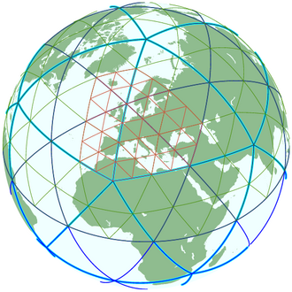
2. ICOsahedral Non-hydrostatic Model
Fully compressible non-hydrostatic core
Unified model system (climate & numerical weather prediction)
From low resolution (~80 km) to high-resolution (~75 m)
Triangular grid → No pole problem
Prill et al. (2020)

Slide 38
2. Model Setup of ICON-LAM*
Physics Configuration
Orography | Orographic gravity wave drag
Mircrophysics | Double-moment
Turbulence | Turbdiff (TKE closure)
Sfc Transfer | Turbtran (TKE extension)
Convection | Shallow convection
Model top | 22 km
Vertical level | 65 full (66 half)
Hor. grid scale | 2 km, 1 km, 500 m, 250m
LATBC (at start) | Forecast (ICON-EU)
Forecast restart | 12 h
Duration | 36 h
1-way-Nesting
Model version icon-2024.07
Land Surface | TERRA
Lott an Miller (1997)
Seifert and Beheng (2006)
Mellor and Yamada (1982), and Raschendorfer (2001)
Tiedke (1989), and Bechthold et al. (2008)
Schrodin and Heise (2001), Schulz et al. (2016), and Mironov et al. (2012)
* Limited Area Mode (LAM)
Notes:
RUC: SINFONY heavy convective cases

Slide 39
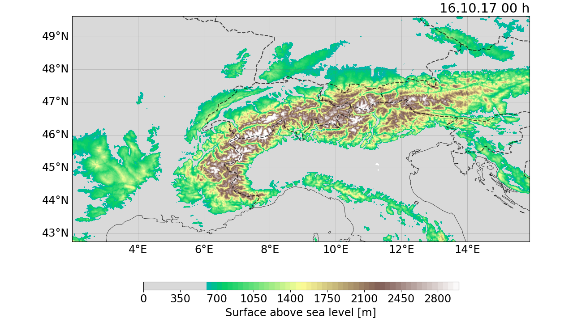
3. TEAMx Model Domain
∆x
2 km
1 km
Nochmal mit 2km parent
500 m
Notes:
Use what is already available
x1, TEAMx

Slide 40
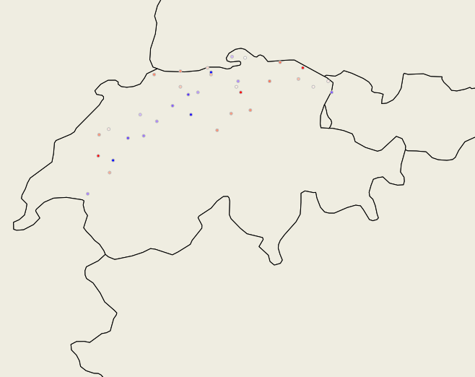
3. Plateau Stations
Station | FF | T
Valley | 25 | 34
Plateau | 37 | 36
Figure: The Plateau stations in Switzerland used for the comparison to the model results. The colors show the mean error (ME) of the model for the temperature at 2m height above ground.

Slide 41
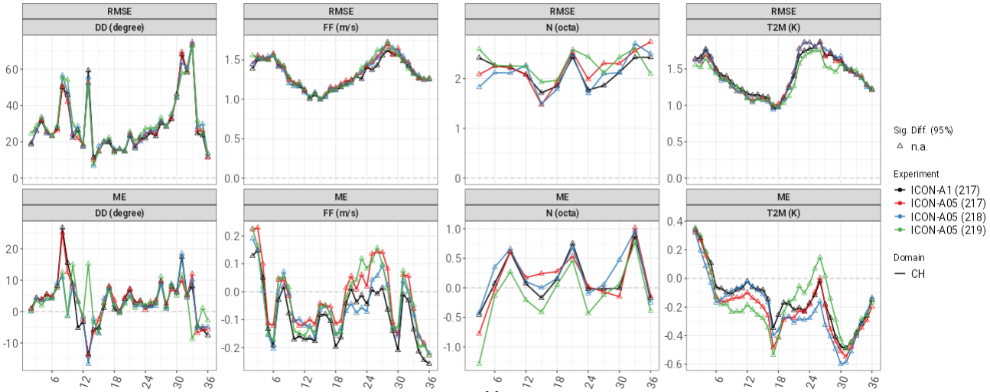
3. Plateau Stations
Root Mean Square Error (RMSE) and Mean Error (ME) for June 2024
Wind dir °
Wind speed ms⁻¹
Cloud cover %
2m-Temperature K
Score Value
Statt RMSE → ME von 2km und 1 km nutzen
Wind dir °
Wind speed ms⁻¹
Cloud cover %
2m-Temperature K
Initial hour: 12 h
Time
Notes:
More mixed results for FF
Too many clouds from 212, too few from 209‘s
Smaller T2M bias from 212

Slide 42
4. TEAMx Case Study

Slide 43
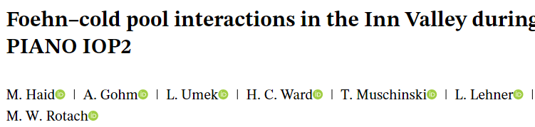
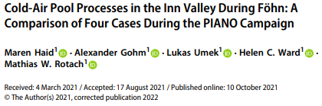
4. Motivation: Near-Surface Bias
PHY-EPS (5.-7.2.24) Conclusion: Increasing the horizontal resolution > 2 km does not necessarily improve the model performance
Meteo France (AROME): Warm Bias during very stable stratification of the atmosphere
PIANO Study: Comprehensive measurements during a Cold Air Pool Occurrence in fall/ Winter 2017

Slide 44

4. Model Domain
∆x
2 km
1 km
500 m
250 m
Station site

Slide 45
4. PIANO Observation
Penetration and Interruption of AlpiNe FOehn (2017)
Inn Valley and Wipp Valley
Fall & early winter
Study erosion and cold air pools
MOMAA weather station data M0*
Radiosonde data INN
Flux station data EC*
Gohm et al. 2021

Slide 46
4. Experiments
Experiment-ID | Remark
exp_1_ref | Reference
exp_2_sso | No SSO scheme for ∆x = 250 m
exp_3_turlen | Asymp. turb. Length scale t₀ = 30 m (instead of 300 m)
exp_4_sgssso | No SGS SSO source term in TKE
exp_5_tkeshs | No hori. shear source term in TKE
exp_6_smag | Smagorinsky turbulence (instead of TKE)

Slide 47
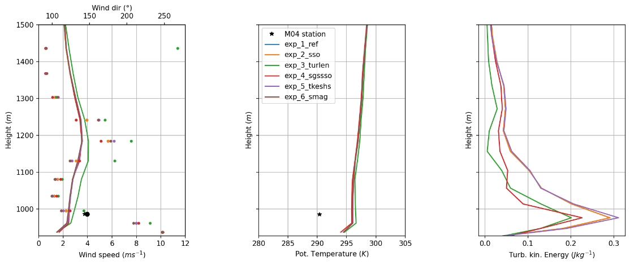

4. Valley Results
1 km
15.10.2017 – 18 h
250 m

Slide 48


4. Valley Results
1 km
16.10.2017 – 2 h
250 m

Slide 49


3. General Verification
Mean Error (ME) for May 2022 (top) and for June 2024 (below)
Initial hour: 12 h
Wind speed ms⁻¹
Cloud cover %
Radiation (Wm⁻² )
2m-Temperature K
ICON-A1
ICON-D2
Score Value
Wind speed ms⁻¹
Cloud cover %
Radiation (Wm⁻² )
2m-Temperature K
ICON-A1
ICON-A05
ICON-noconv
ICON-turlen
Time
Notes:
RMSE (top line), ME (low line) HALBZEIT
Score values over whole forecast period for specific var‘s that were more affected by changes
DD, FF, N, T2M
Black, red, blue

Slide 50
4. Slope Results
Profiles, but each our res on top
M04 worse that m06 (valley)

