Slide 1
Problems/Challenges at high Resolution Runs
(CMCC contribution to the GLORI project)
A. Campanale, M. Raffa, G. Ceci, P. Mercogliano, P. Schiano
26th COSMO General Meeting, 02-06 September 2024, Offenbach Germany

Slide 2
Outlook of the presentation
Goal:
main motivation of the CMCC contribution to GLORI project
Setup of the simulations:
1km configurations starting from ICON-D2 as reference
Evaluation:
precipitation and temperature against stations data
Conclusion and future perspective

Slide 3
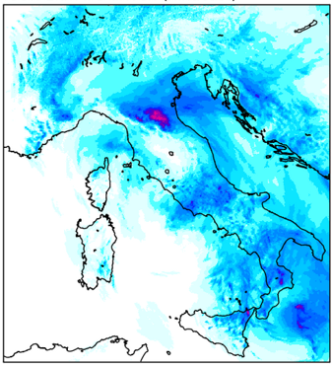
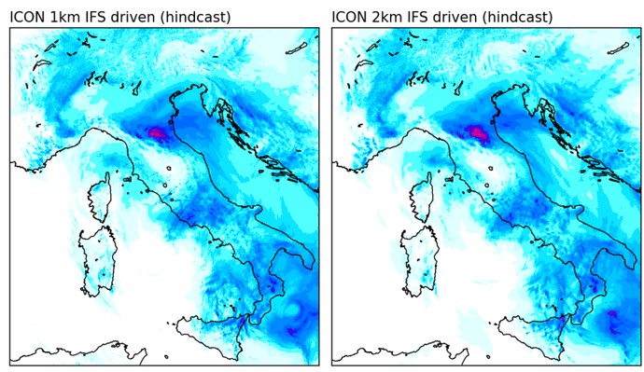
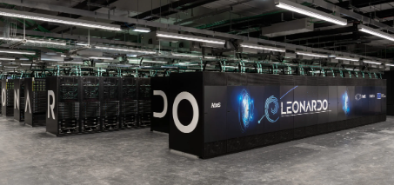
GLORI WG1: Implementation and configuration
GLORI-Med configuration
ICON-LAM on Mediterranean domain configuration
Goal
Dataflow
So far…
Development of a configuration of the ICON model at high resolution (1km) over the Mediterranean region.
IFS to ICON-LAM («Scenario 3»)
Data are download on CMCC machine, preprocessed and uploaded on Leonardo
Tests (hindcast simulations) of ICON-LAM (2km / 1km) on GLORI-Med domain on first Emilia-Romagna flood event of May 2023 on Leonardo.
Coupled configuration of ICON-LAM + ICON-O-LAM (a first version is ready Alija.Bevrnja@dwd.de)

Slide 4
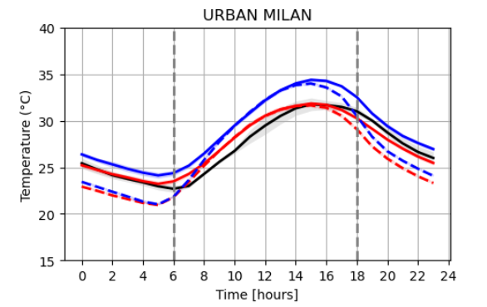
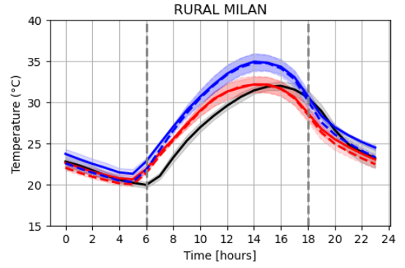
WG1: Implementation and configuration
GLORI-Med configuration
starting from ICON-D2…
Precipitation seasonal BIAS vs EOBS (2022).
ICON (bottom) vs COSMO (blue)
Temperature diurnal cycle of August 2017 of MILAN.
ICON (red) vs COSMO (blue)
ICON-D2 have been demonstrated to be very reliable config. over GLORI-Med domain in different applications !

Slide 5
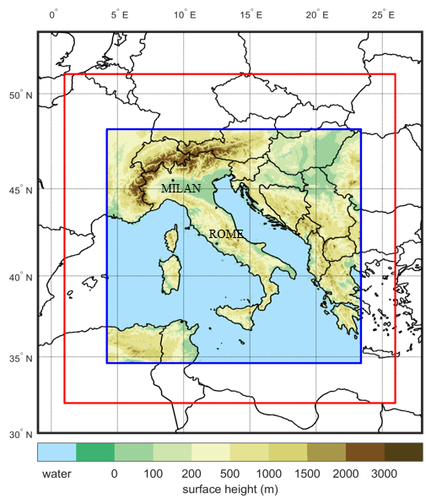
WG1: Implementation and configuration
Simulations setup
GLORI-Med configuration
Model: ICON GPU version (ICON standalone)
Resolution: - 2.5km (0.0225°) over GLORI-Med domain R02B10
- 1km (0.0009°) over GLORI-Med domain R05B10
Period: 01 May 2023 00:00 to 05 May 2023 00:00
Forcing data: ECMWF 8.5km (0.075°) IFS analyses at 6hr,
both IC and BCs analyses (hindcast smulations)
No nesting from 2.5km to 1km, direct downscale from IFS for all simulations
Time step: - 20 s for 2.5km simulation
- 10 s for 1km simulation
N° vertical levels: 65 (top model level elevation = 22km)
Configuration | Reference | Main namelist change respect to ICON-D2
GM1 1km | ICON-D2 | None (basically ICON-D2 but at 1km)
GM2 1km | ICON-D2 | lshallowconv_only=true, lgrayzone_deepconv = false,
GM3 1km | ICON-D2 | inwp_conv=0
ICON domain in blue, IFS domain in red

Slide 6
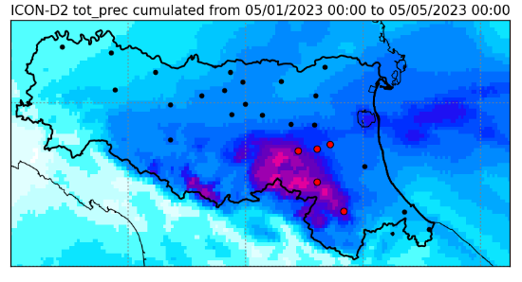
WG1: Implementation and configuration
GLORI-Med configuration
Evaluation
26 AGRMET weather stations https://simc.arpae.it/dext3r/ from the dexter ARPAE portal distribuited over Emilia-Romagna region for tot_prec (hourly cumulated) and t_2m.
Focus on stations of:
- Sasso_Morelli
- San. Agata sul Santerno
- Castel San Pietro Arpa
- Cusercoli
- Brisighella
closer to the Tuscan-Emilian Appenines and
near the cluster of precipitation (in red).
Unfortunately less data (from the same weather
network) were registered for humidity and wind.

Slide 7
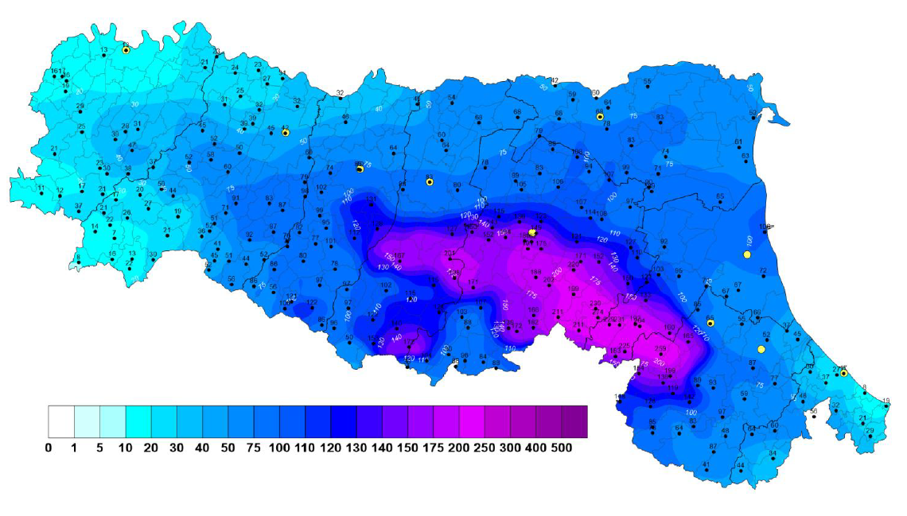
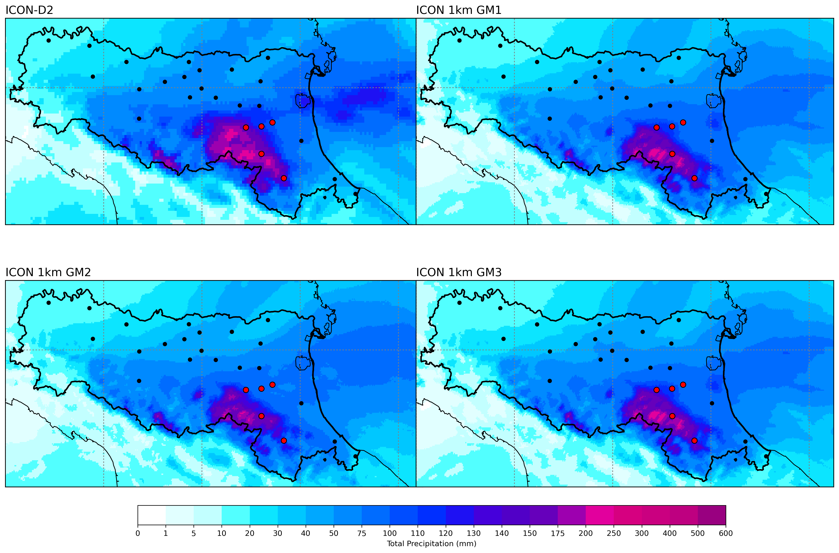
WG1: Implementation and configuration
GLORI-Med configuration
Precipitation evaluation
Emilia Romagna first flood event: cumulated precipitation from 01/05/2023 (00:00) to 04/05/2023 (00:00)
Observed $(∗)$
$(∗)$From dataset ERG5, report of ARPAE:
«Rapporto degli eventi
meteorologici di piena e di frana dell’1-4 maggio 2023»
https://allertameteo.regione.emilia-romagna.it/documents/20181/437770/Evento+01-04+maggio+2023.pdf/50890b74-2457-2e83-ba89-64fa4e0bc688?t=1688133544377

Slide 8
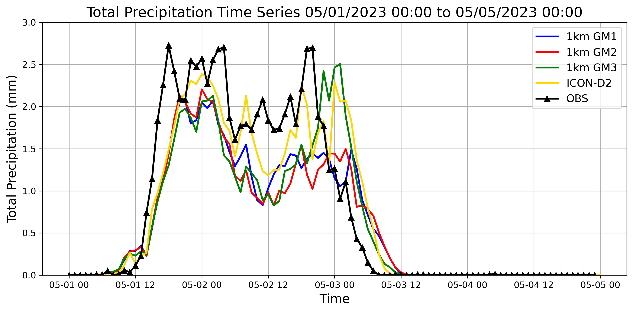
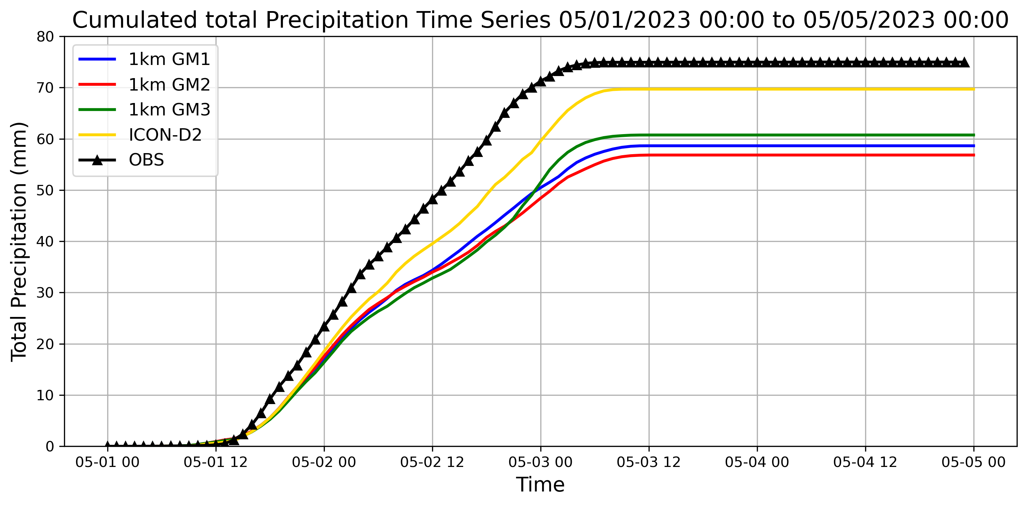
WG1: Implementation and configuration
GLORI-Med configuration
Precipitation evaluation: comparison vs all stations
ICON 2km shows better performances during the entire event period (also confirmed by the cumulated curve).
Among all the 1km configs, the GM3 (inwp_conv=0 and lshallowconv_only=true) seems the most «promising»

Slide 9
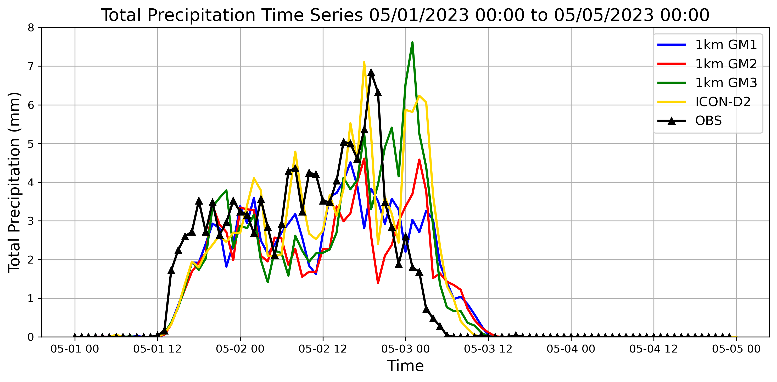
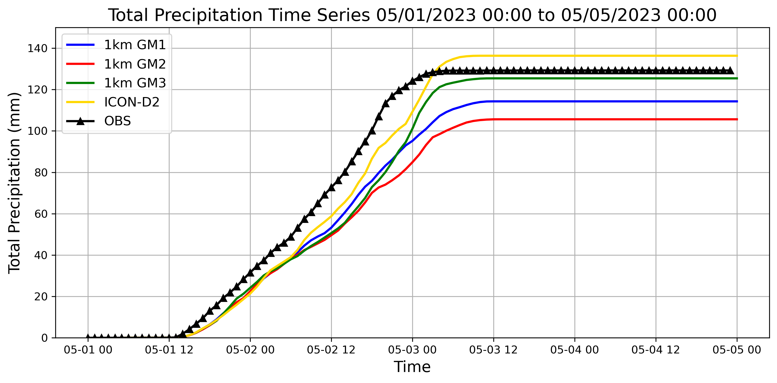
WG1: Implementation and configuration
GLORI-Med configuration
Precipitation evaluation: comparison vs «red» stations
Also for the stations closer to the high intensity cluster of the event ICON 2km shows better performances.
Among all the 1km configs, GM3 remains the better especially in capturing the magnitudo of the peak. Confrimed in the final part of the cumulated curve.

Slide 10
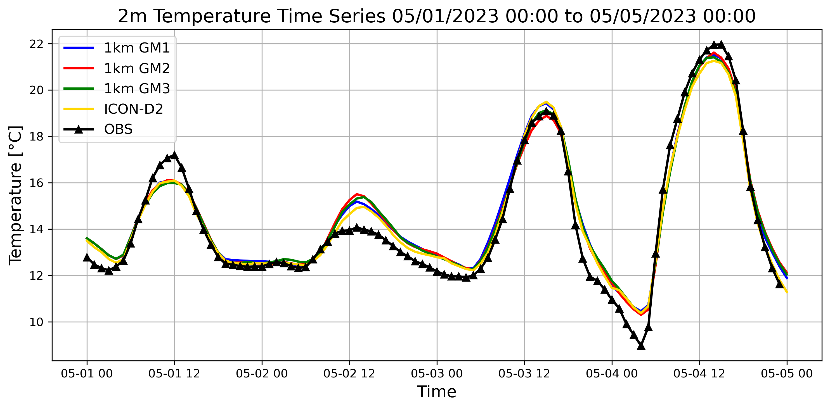
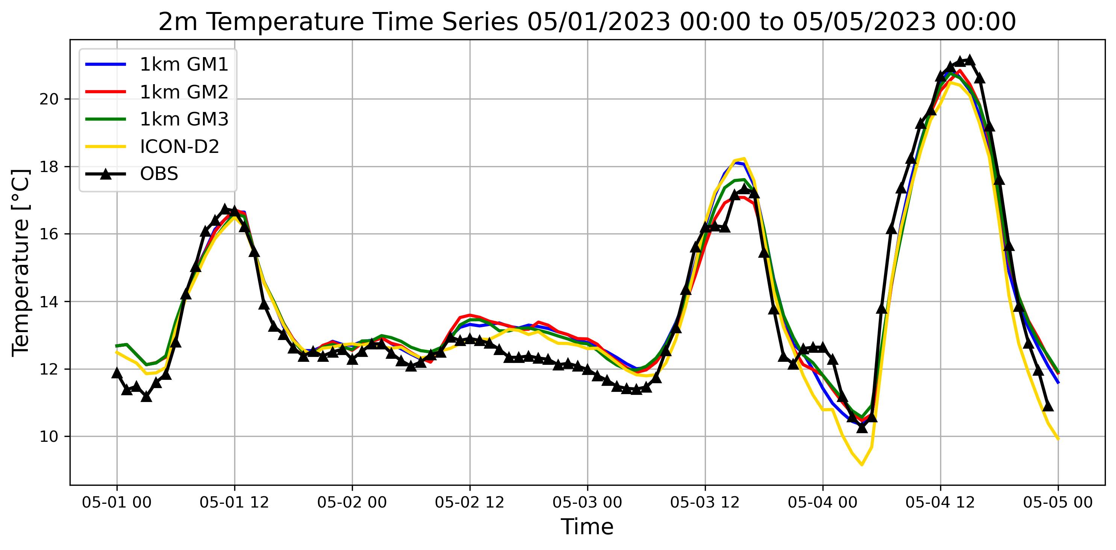
WG1: Implementation and configuration
GLORI-Med configuration
2m Temperature evaluation
(lapse rate correction 6.5 °C/Km)
Comparison vs all stations
Comparison vs «red» stations
During the peak of the precipitation event (05/01 to 05/03), ICON 2km is closer to the observations.
Among all the 1km configs., GM3 remains the better especially in capturing the temperature diurnal cycle amplitude after event.

Slide 11
Conclusions
Several ICON configurations at 1km have been tested over GLORI-Med domain in hindcast mode (IFS analyses) for the first flood event of Emilia Romagna region (01-04 May 2023), and compared against ICON-D2, served as benchmark, and observations.
ICON-D2 provide general better performances both for precipitation and temperature and there are no big improvements from 1km configs. Among all the 1km configs, ICON GM3 (inwp_conv=0) seems the most promising.
Outlook
Test 2-moment scheme on 1km configs., other suggestion to improve the 1km config.? Smagorinsky?
Working on ocean coupling (YAC+ICON-O-LAM) and test the effect of the ocean component,
Test different simulations conditions: DWD IC and BCs, nesting from 2km to 1km, forecasts BCs instead of analyses (semi-operational condition), finally operational on the optimal config. with DA. Testing also other events (e.g. Emilia Romagna flood event of 16/17 May 2023).

Slide 12
Thank you for your attention!
angelo.campanale@cmcc.it
26th COSMO General Meeting, 02-06 September 2024, Offenbach Germany

