Slide 1
Updates from CMCC on the last TERRA_URB implementation in ICON
${A. Campanale}^{(∗)}$, ${M. Adinolfi}^{(∗)}$, ${M. Raffa}^{(∗)}$, ${\text{J}\text{.− }{P. Schulz}^{(∗∗)(∗)} and P. Mercogliano}^{(∗)}$
(*) CMCC Foundation, REgional Models and geo-Hydrological Impacts Division (REMHI) division
(**) DWD, Deutscher Wetterdienst
26th COSMO General Meeting, 02-06 September 2024, Offenbach Germany

Slide 2
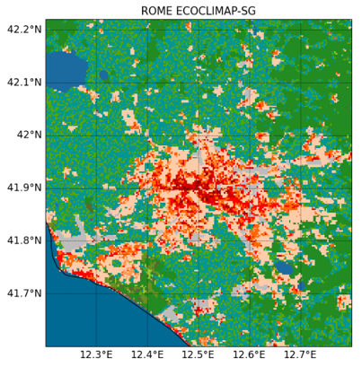
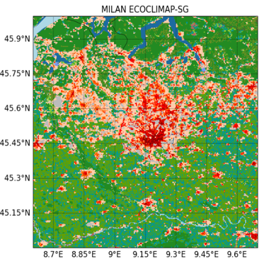
Outlook of the presentation
Setup of the simulations:
test of the new TERRA_URB implementations in ICON:
case study of ROME and MILAN
Evaluation:
temperature against stations data,
effects of the new ISA distribution on nocturnal temperature
Conclusions and future perspectives

Slide 3
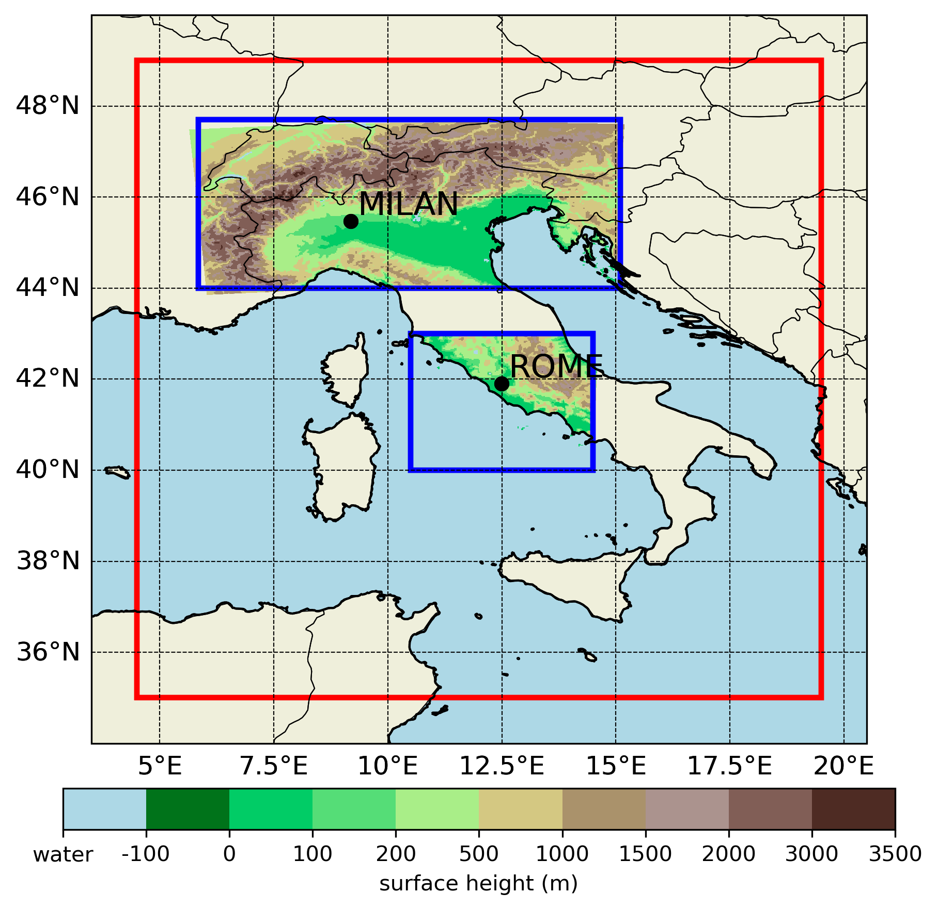
WG1: Porting of TERRA_URB to ICON
New ISA and AHF implementation: simulations
- Model version: ICON-nwp https://gitlab.dkrz.de/icon/icon- nwp (downloaded 26 July 2024)
- Resolution: 2.5km (0.022°) over Rome and Milan
- Period: 01 July 2017 (00 UTC) to 31 August 2017 (24 UTC) July 2017 as spinup, August 2017 as evaluation period (very hot August in Italy, +2.53°C anomaly in respect to period 1971/2000)
- Forcing data: 8.5km ECMWF IFS analyses at 6hr
Simulations:
TU_new smoothed ISA (urb_isa) and itype_ahf = 2, AHF based on climatological T_2M
TU_old ISA based on URBAN class of GLC2009 and lurbahf = .TRUE., constant value of AHF (max 15 W/m^2). Simulations performed with the old ICON version.
ctrl TERRA_URB off
Computational domains of ICON in blue, IFS forcings domain in red

Slide 4
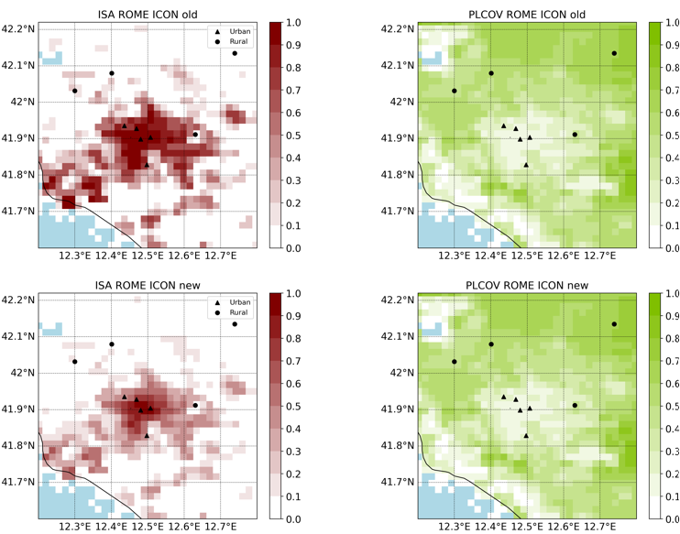
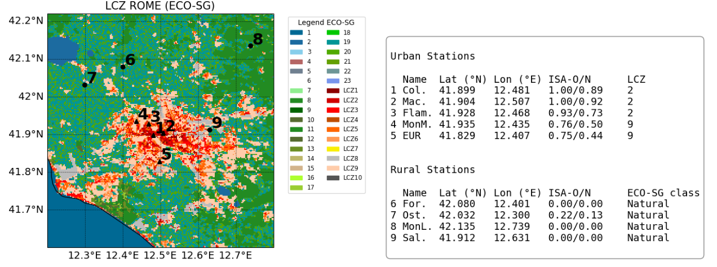
WG1: Porting of TERRA_URB to ICON
New ISA and AHF implementation: ROME results
Reduction of ISA for urban stations of about 0.1 in the city center and about 0.3 in the periurban
Same vegetations levels for both simulations (e.g. PLCOV). This is true also for other physiographic parameters that can affect TU performances (e.g. skin conductivity, stomatal resistance, roughness length…).

Slide 5
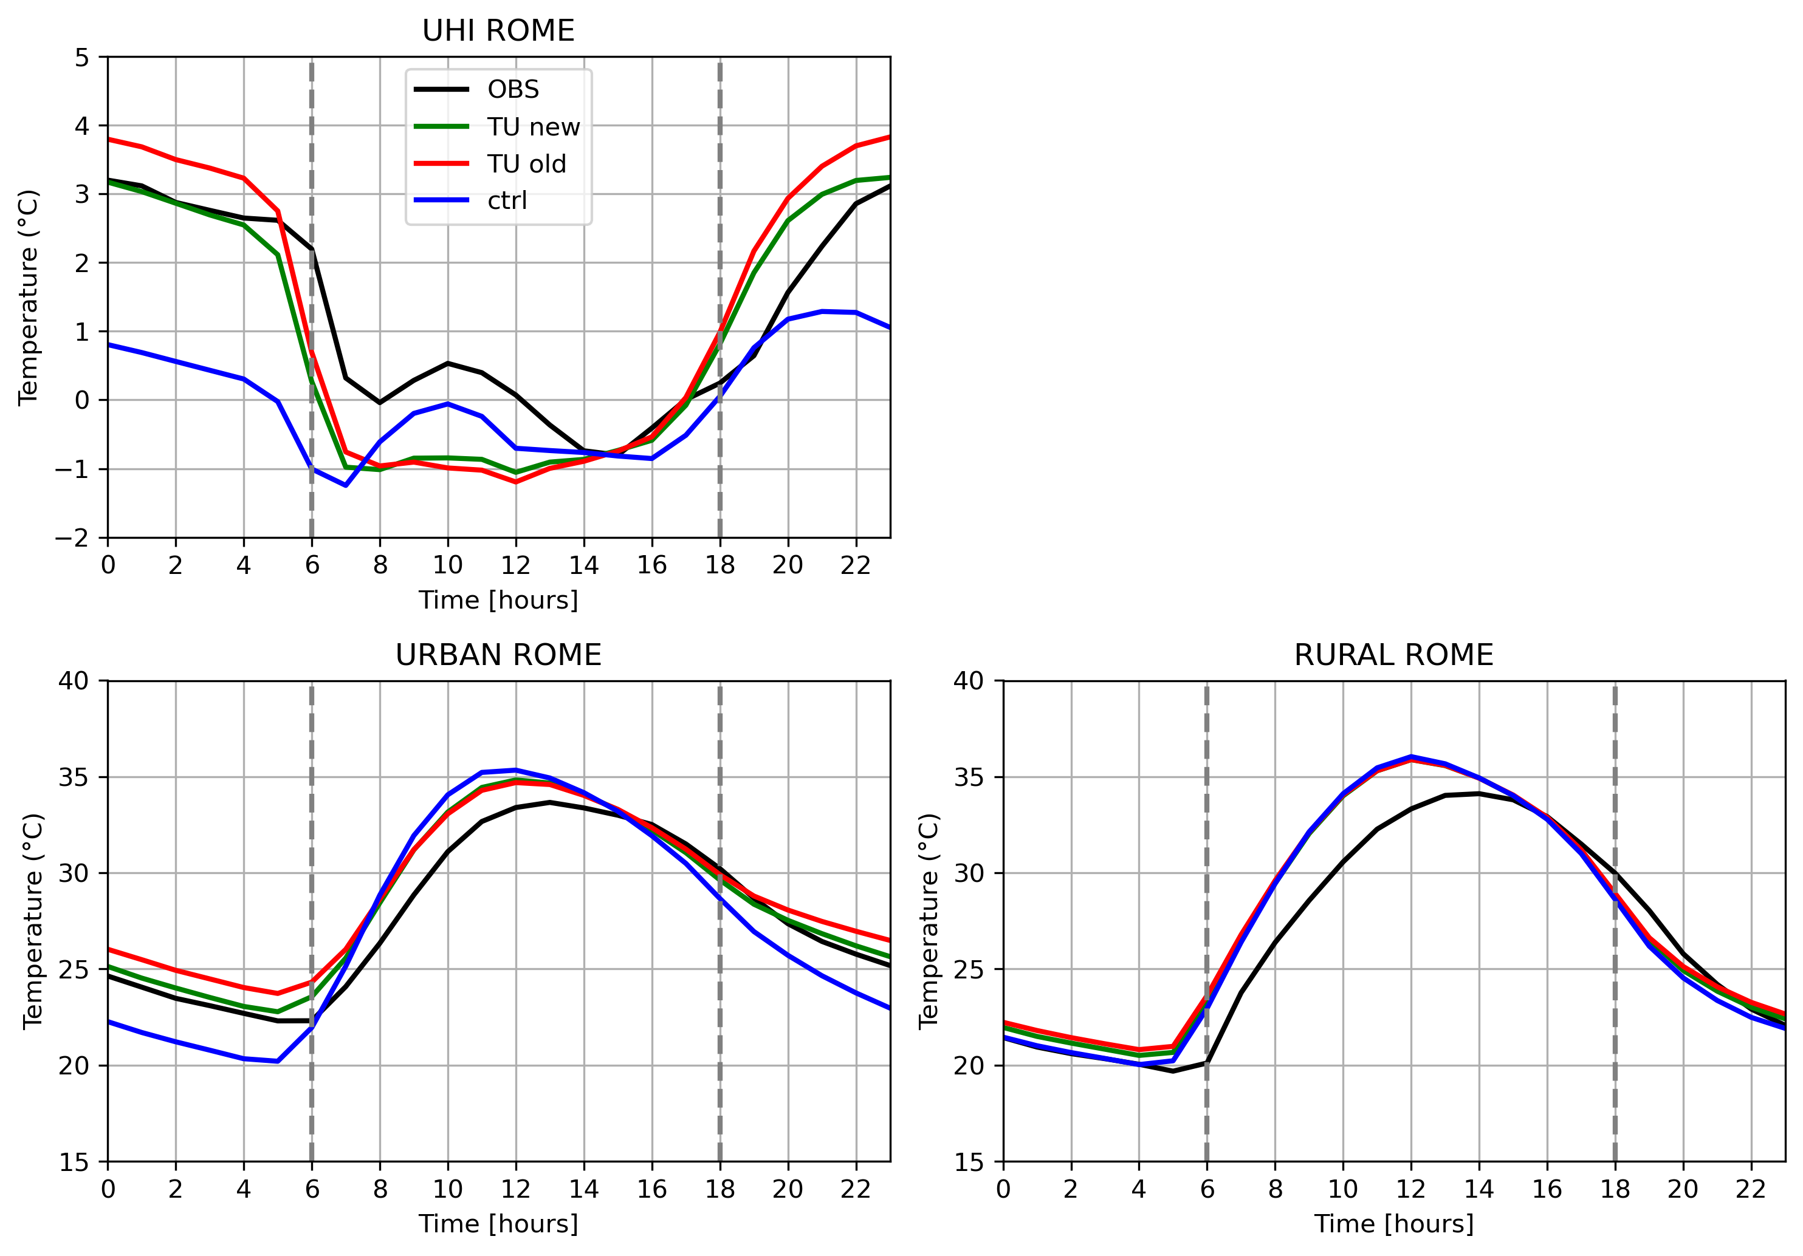
WG1: Porting of TERRA_URB to ICON
New ISA and AHF implementation: ROME results
Reduction of nighttime temperature with TU_new
and better representation of UHI and urban
diurnal cycle,
TU_old tends to overestimate nocturnal UHI and urban temperature,
Reduced effect during daytime and for rural signal, as expected.

Slide 6
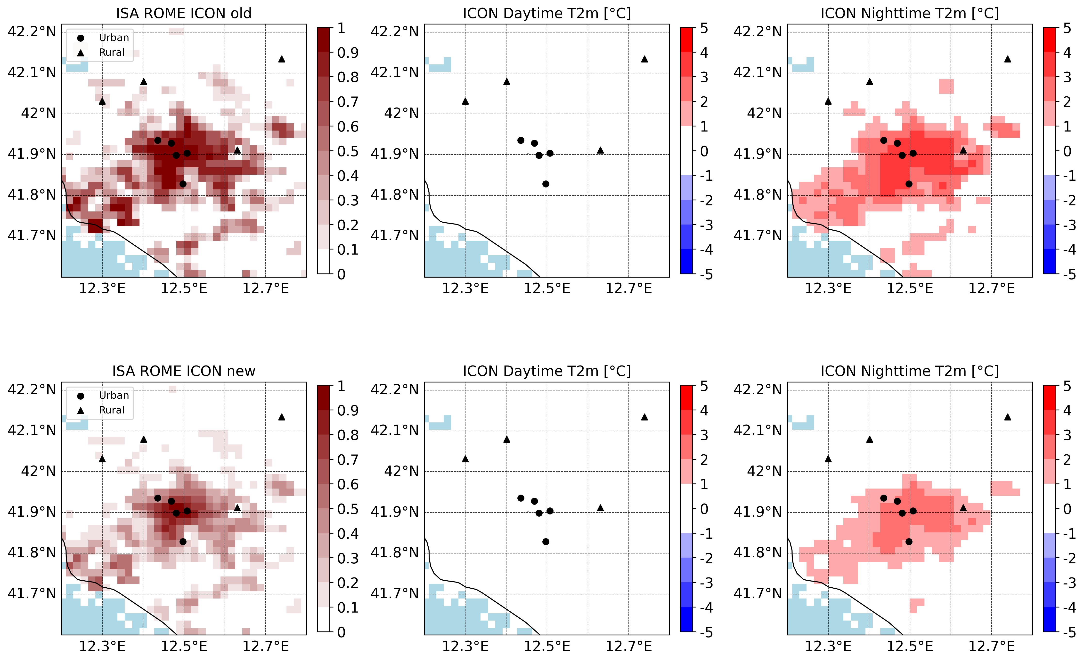
WG1: Porting of TERRA_URB to ICON
New ISA and AHF implementation: ROME results

Slide 7
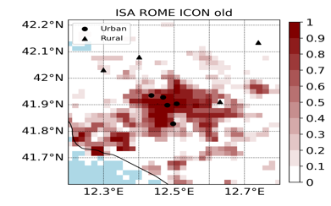
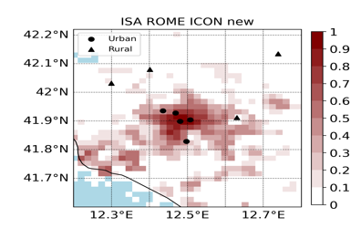
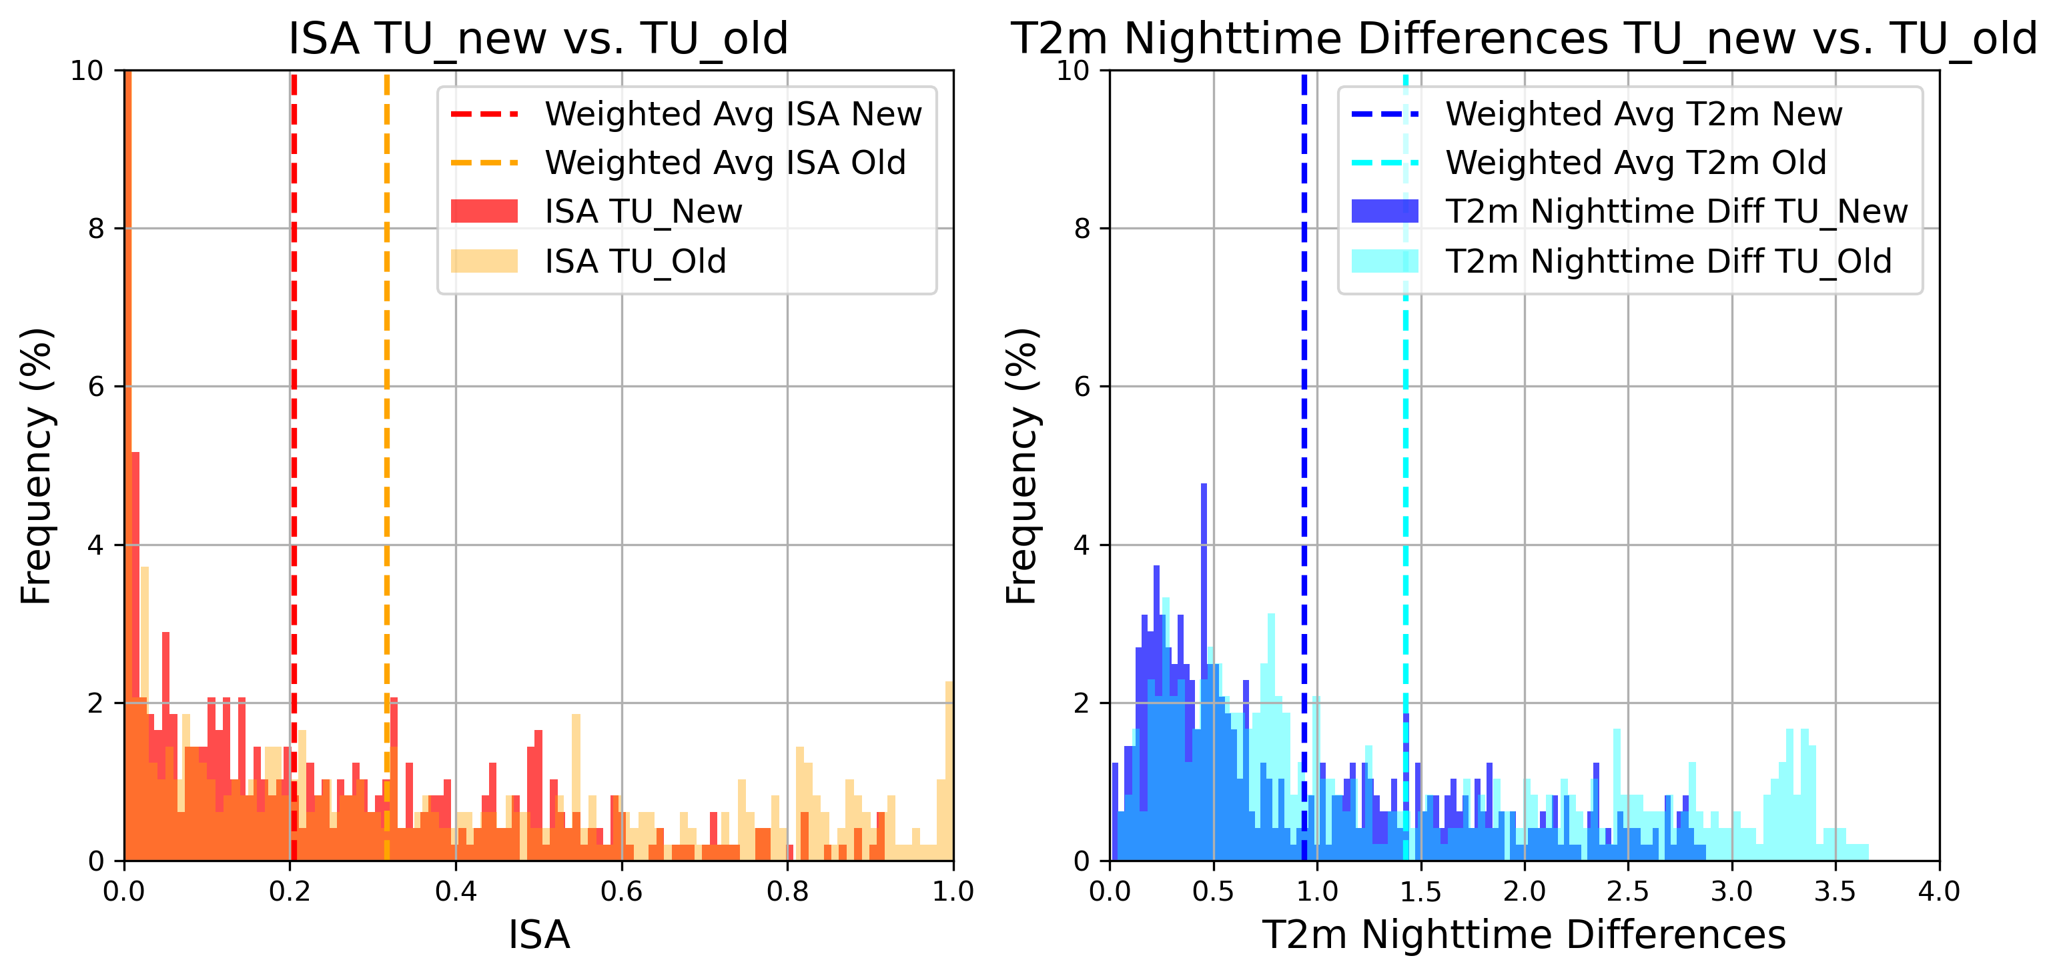
WG1: Porting of TERRA_URB to ICON
New ISA and AHF implementation: ROME results
With TU_new, weighted avg. and max values of ISA are reduced of about 0.1
With TU_new, weighted avg. of nightt. T2m diff. is reduced of about 0.5 °C and max values of nightt. T2m diff. is reduced of about 0.8 °C
Note that these temp. reductions could also be due to AHF effects
Avg. ISA TU_new = 0.2041
Avg. ISA TU_old = 0.3159
Max ISA TU_new = 0.9170
Max ISA TU_old = 1
Avg. T2m nightt. diff. TU_new = 0.9393 °C
Avg. T2m nightt. diff. TU_old = 1.4274 °C
Max T2m nightt. diff. TU_new = 2.8763 °C
Max T2m nightt. diff. TU_old = 3.6560 °C

Slide 8
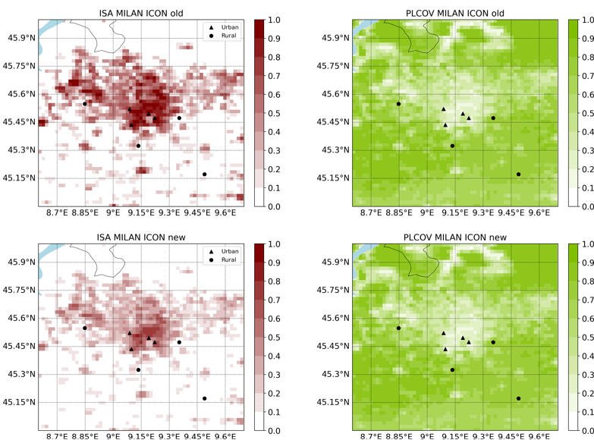
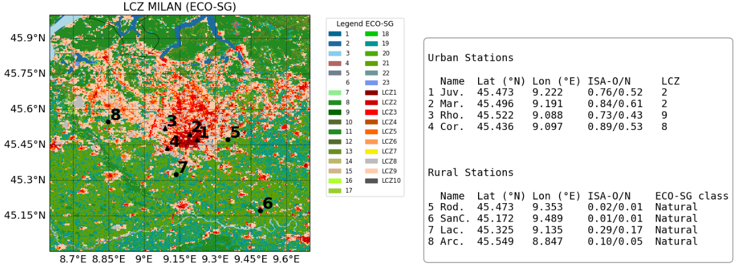
WG1: Porting of TERRA_URB in ICON
New ISA and AHF implementation: MILAN results
Reduction of ISA for urban stations of about 0.2 in the city center and about 0.3 in the periurban
Same vegetations levels for both simulations (e.g. PLCOV). This is true also for other physiographic parameters that can affect TU performances (e.g. skin conductivity, stomatal resistance, roughness length…).

Slide 9
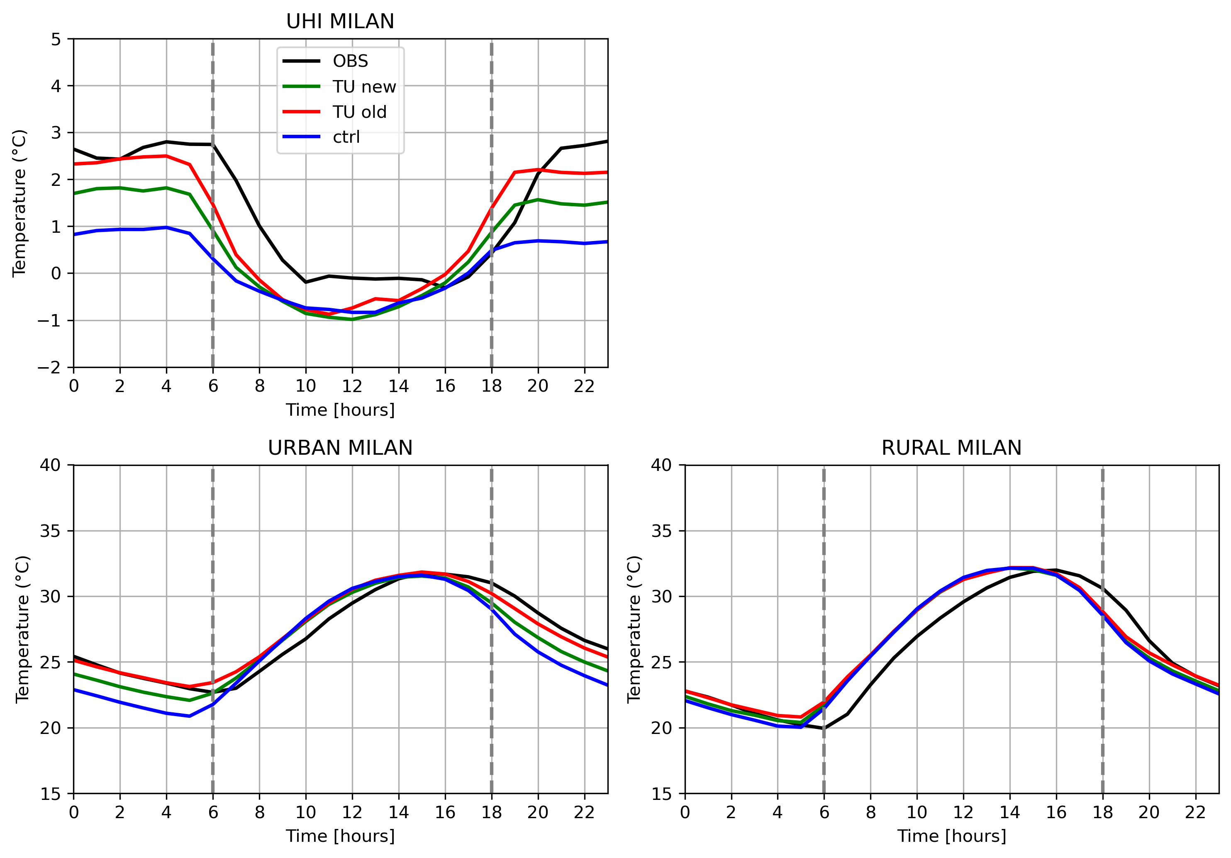
WG1: Porting of TERRA_URB to ICON
New ISA and AHF implementation: MILAN results
Reduction of nighttime temperature with TU_new
and worst representation of UHI and urban
diurnal cycle,
TU_new tends to underestimate nocturnal UHI and urban temperature,
Reduced effect during daytime and for rural signal, as expected.

Slide 10
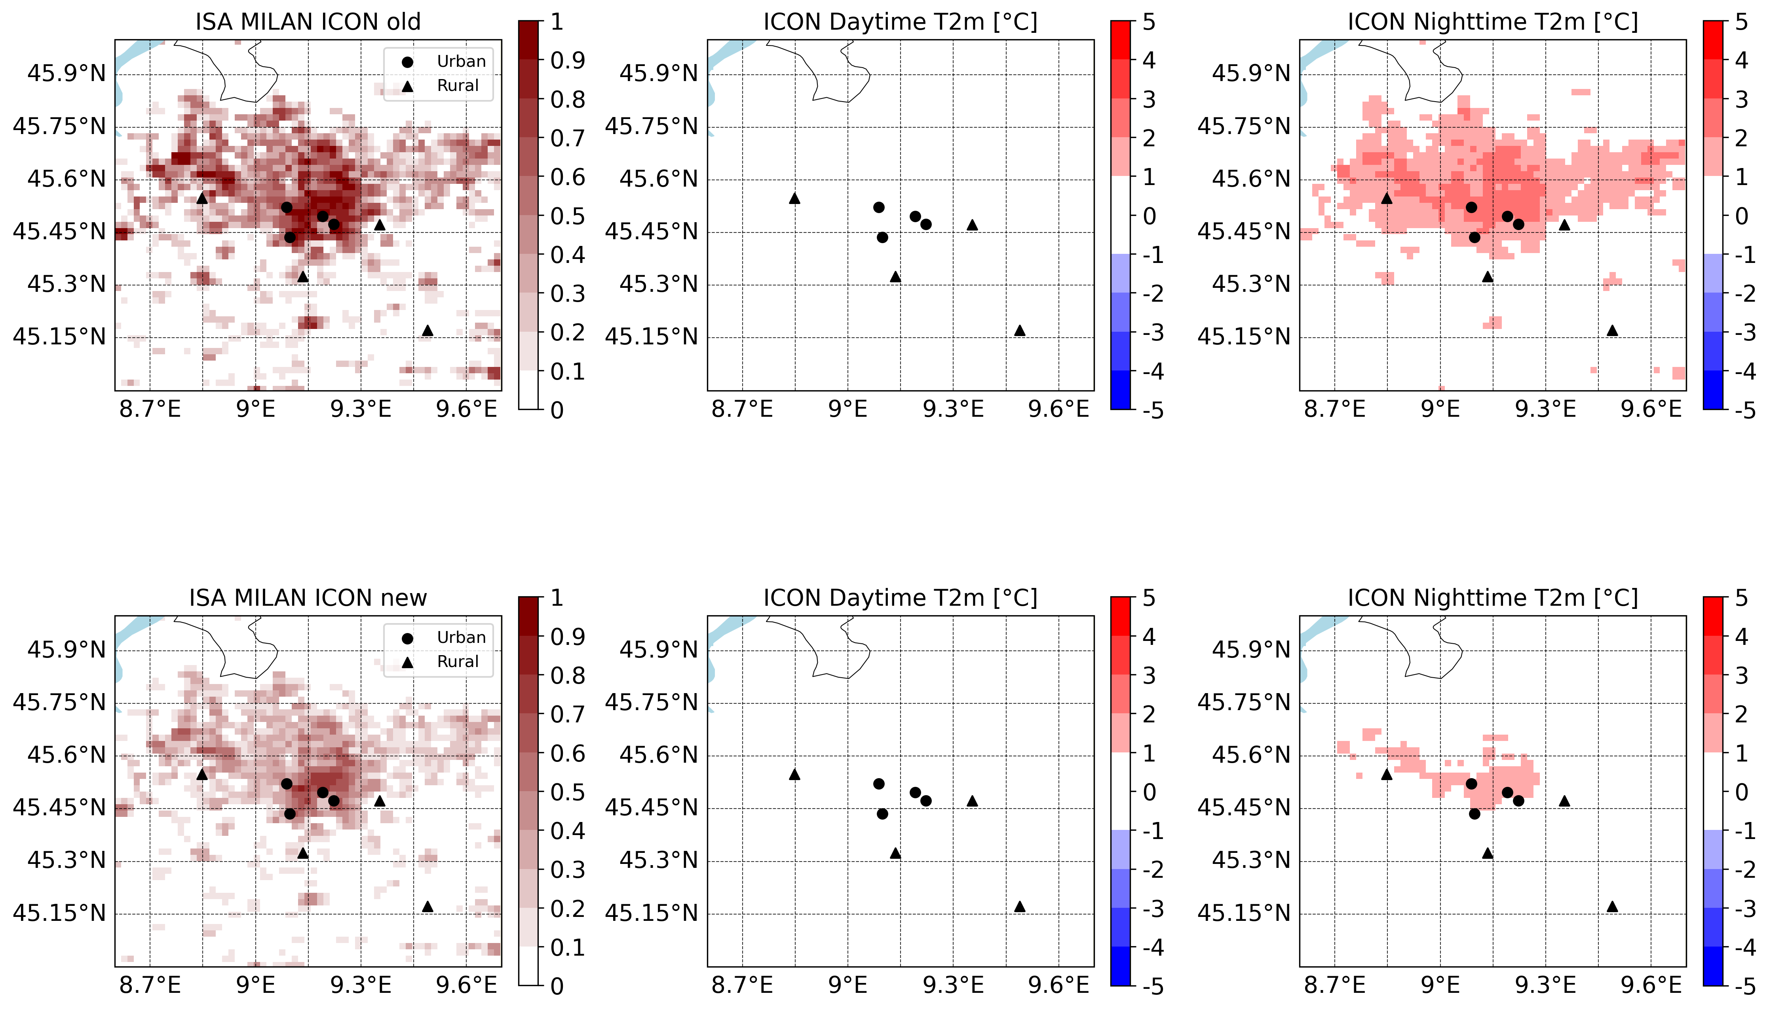
WG1: Porting of TERRA_URB in ICON
New ISA and AHF implementation: MILAN results

Slide 11
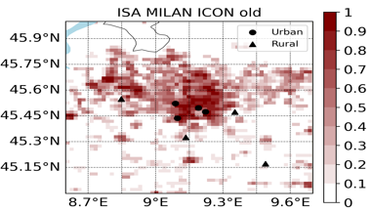
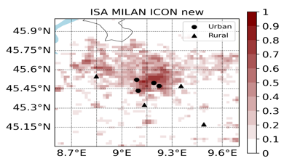
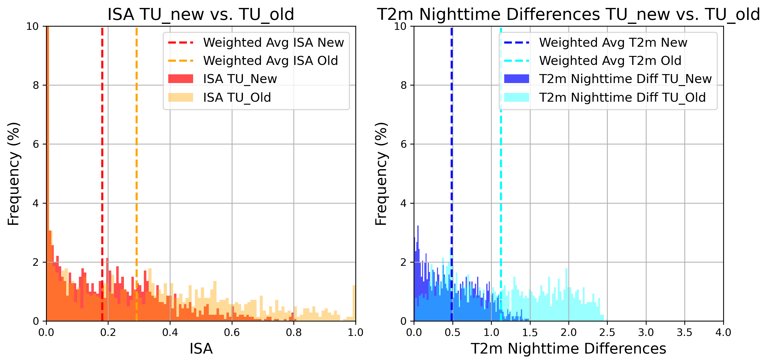
WG1: Porting of TERRA_URB to ICON
New ISA and AHF implementation: MILAN results
With TU_new, weighted avg. is reduced of about 0.1 and max values of ISA is reduced of about 0.2
With TU_new, weighted avg. of nightt. T2m diff. is reduced of about 0.6 °C and max values of nightt. T2m diff. is reduced of about 1 °C
Note that these temp. reductions could also be due to AHF effects
Avg. ISA TU_new = 0.1804
Avg. ISA TU_old = 0.2914
Max ISA TU_new = 0.8088
Max ISA TU_old = 1
Avg. T2m nightt. diff. TU_new = 0.4873 °C
Avg. T2m nightt. diff. TU_old = 1.1256 °C
Max T2m nightt. diff. TU_new = 1.4868 °C
Max T2m nightt. diff. TU_old = 2.5064 °C

Slide 12
WG1: Porting of TERRA_URB to ICON
Conclusions
The last TU implementation, regarding ISA and AHF, has been tested with 2-month period simulations (1 month as spinup and 1 month as evaluation) over ROME and MILAN,
The analysis confirm a reduction in urban effects at nighttime. In Rome, the new implementation yields better results, as the previous implementation overestimated nighttime temperatures. Conversely, in Milan, where the previous results were already good, the new implementation leads to a worsening in the results,
The results are now city-dependent, with improvements seen in Rome but a worsening in Milan. Anyway, further improvements are possible, as the new implementation allows for tuning of ISA (‘itune_urbisa’) and AHF (‘itune_urbahf’):
- itune_urbisa: lower and upper bounds
- itune_urbahf: constant value, cooling and heating gradients, and upper value

Slide 13
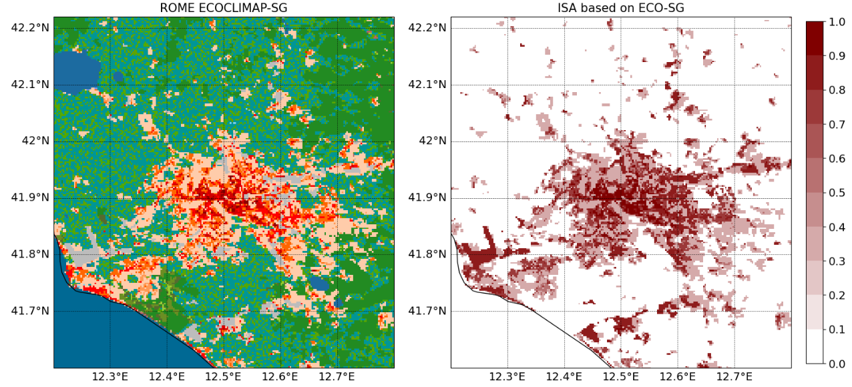
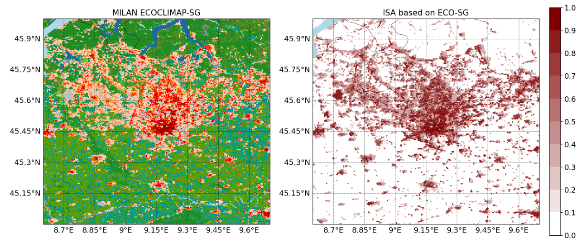
WG1: Porting of TERRA_URB to ICON
Further developments
Try to tune itype_isa, in order to mimic the ISA based on ECOCLIMAP-SG.
E.g. ISA calculated with LCZs provided by ECO-SG for ROME. The lookup table are derived from Steward and Oke (2012)
Longer simulations over specific cities (e.g. climate runs), in order also to see AHF effect during winter period.
Start testing high resolution domains than 2km, in order to better capture subgrid elements in cities (e.g. park in urban environment)

Slide 14
Thank you for your attention!
angelo.campanale@cmcc.it
26th COSMO General Meeting, 02-06 September 2024, Offenbach Germany

