Slide 1
PP CITTA’
Update on high-resolution experiments with ICON-LAM
Valeria Garbero, Arpa Piemonte
GM2024 Offenbach, 03/09/2024

Slide 2
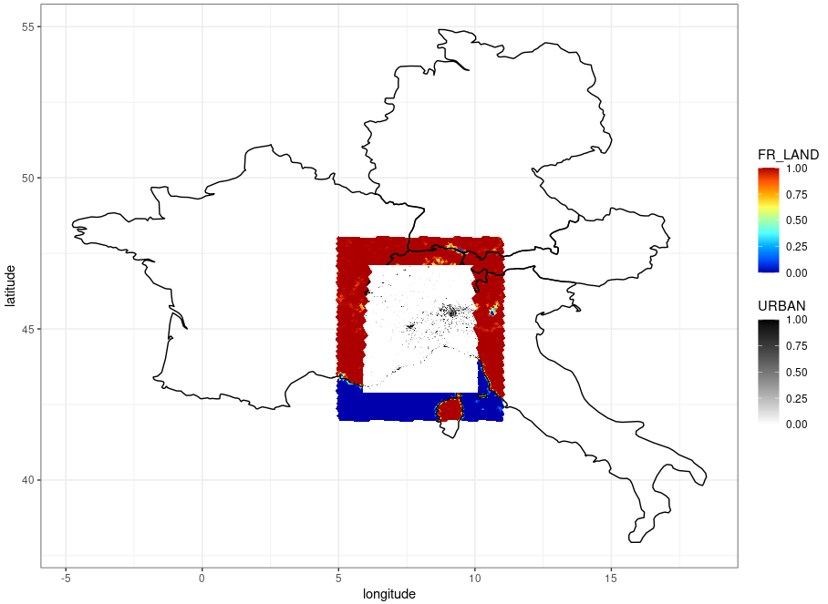
ICON set-up
3 different Land Use Classification:
GLOBCOVER 300 m resolution (2019),
23 Land Use Classes, URBAN: LU=19
2. ESA WorldCover 10 m resolution (2021),
10 Land Use Classes, URBAN: LU=50*
…
3. ECOCLIMAP-SG 300 m resolution (2020),
23 natural Land Use Classes, 10 urban classes (LCZ)
ICBC from ICON-EU analysis
at 7 km resolution (R03B08)
ntiles=1 to use landuse variables directly by extpar files [as suggested by J. Canton]
but error in mo_ext_data_inquire::inquire_extpar_file:
Number of land-use classes in external file 33 does not match ICON-internal value num_lcc 23
How can we solve this problem?
ICON-LAM domain
@ 1.3 km resolution
*Roni Drori (IMS) converted 10 ESA LU classes into 23 GlobCov classes

Slide 3
ICON+TERRA_URB experiments
1 week simulation in hindcast mode during a heat waves on Turin: 9-16 June 2022
Version | LU | Lterra_urb | urb | Name
icon-2.2.6 branch terra_urb_ahf | GLOBCOVER | FALSE | - | CTRL
icon-2.2.6 branch terra_urb_ahf | GLOBCOVER | TRUE | lurbahf=TRUE | URB
icon-2.2.6 branch terra_urb_ahf | ESA | TRUE | lurbahf=TRUE | URBesa
icon-2024.07 | GLOBCOVER | FALSE | - | REF
icon-2024.07 | GLOBCOVER | TRUE | Itype_ahf=1 | AHF1
icon-2024.07 | GLOBCOVER | TRUE | Itype_ahf=1 | AHF1esa
icon-2024.07 | ESA | TRUE | Itype_ahf=2 | AHF2
DWD namelist +
lurbalb =TRUE
itype_eisa=3
New implementations:
ISA horizontally averaged
AHF constant (itype_ahf=1) or annual cycle (itype_ahf=2)

Slide 4
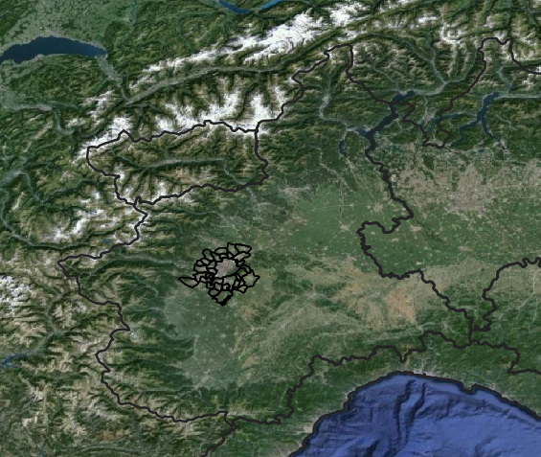
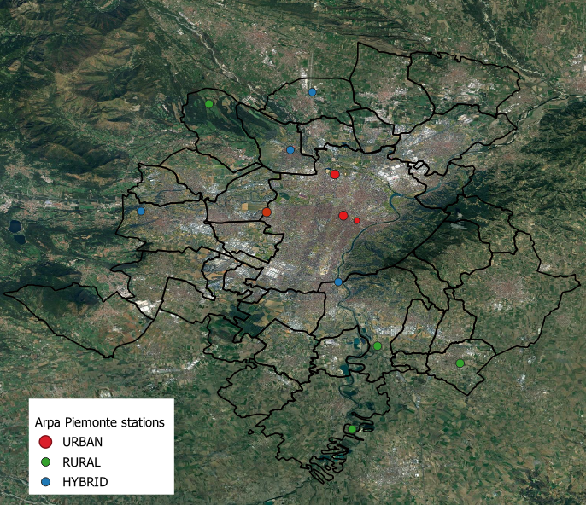
Verification on Turin and surrounding stations
Piemonte domain

Slide 5
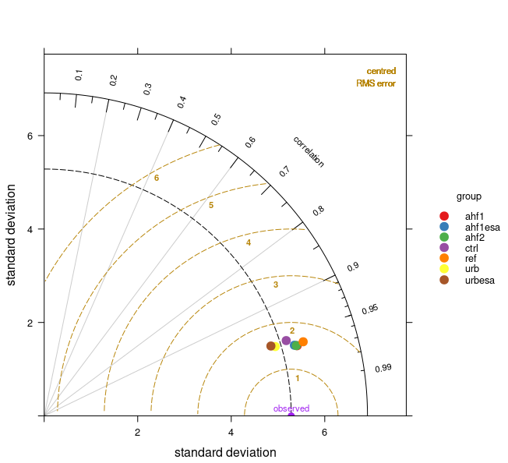
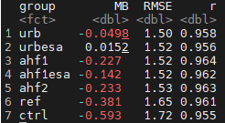
2M TEMPERATURE
FOCUS ON TURIN AGGLOMERATION
Latest ICON version worsens the MB but sligthly improves the correlation coefficient
TERRA_URB switched on improves all the scores

Slide 6
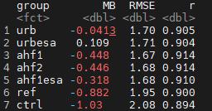
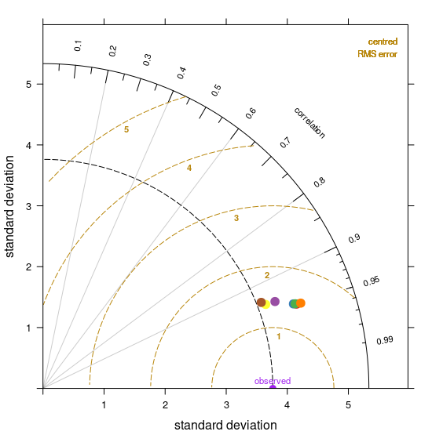
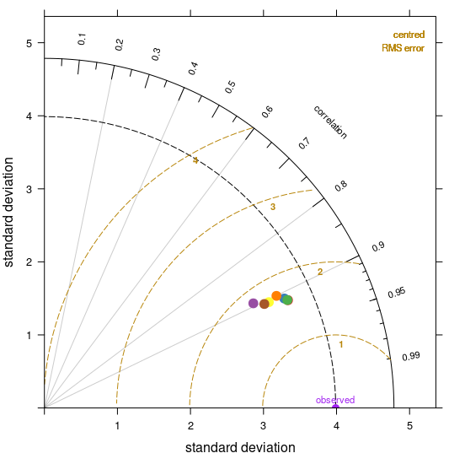
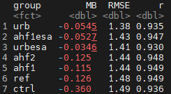
2M TEMPERATURE
FOCUS ON TURIN AGGLOMERATION
Urban parameterization improves all the scores
Latest ICON version worsens MB, especially during the night when the minimum temperatures are underestimated, and RMSE during the day, but improves the correlation coefficient and slightly reduces RMSE during the night

Slide 7
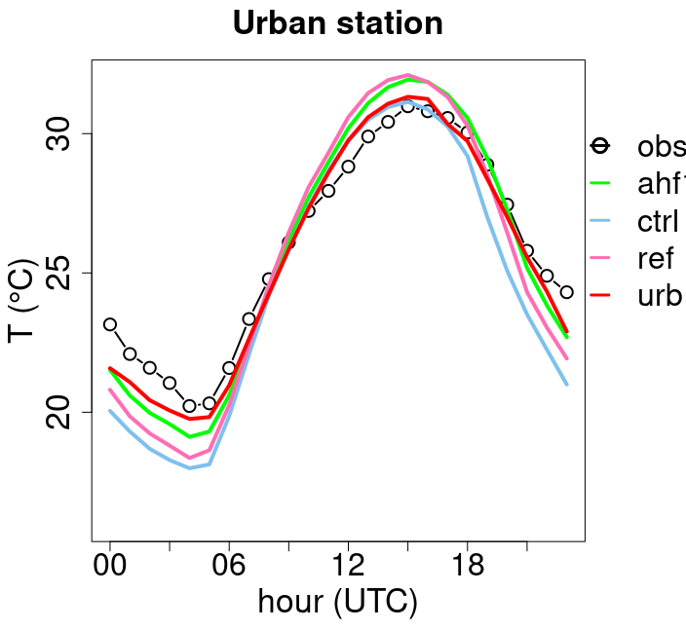
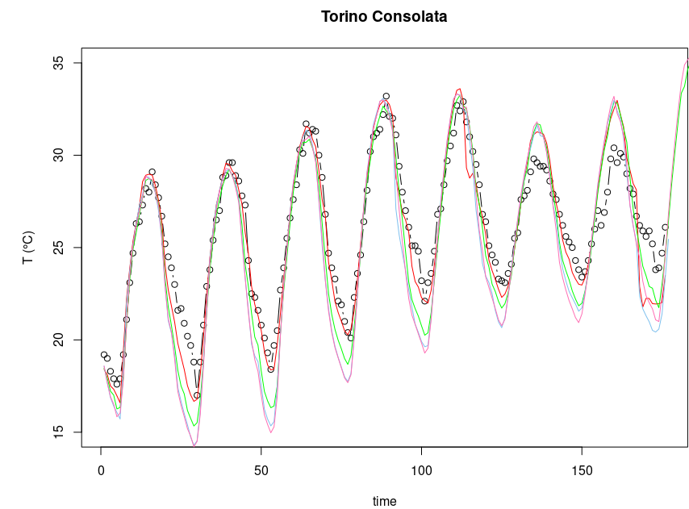
Urban parameterization improves forecast of nighttime t2m
Latest ICON version worsens the performance overestimating during day and underestimating during night

Slide 8
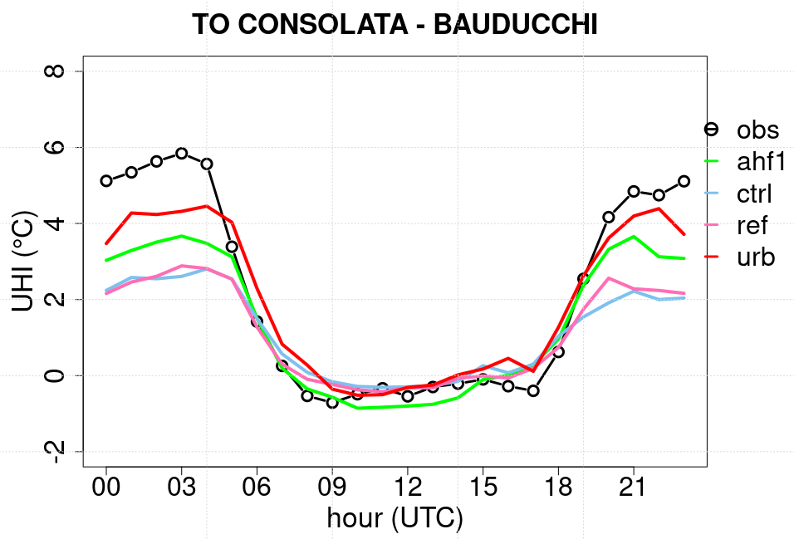
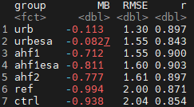
UHI
Urban parameterization improves the UHI prediction, even if the new implementations worsen the performance

Slide 9
CONCLUSIONS
and FURTHER WORKS
Urban parameterization improves the reconstruction of the UHI phenomenon, whereas the new implementations (ISA, AHF) worsen the performance
New experiments to become independent from the ICON version and to exclude the new Gunther’s modifications:
lterra_urb = .TRUE.
itype_ahf = 1
tune_urbahf = 15., 0., 0., 15.
tune_urbisa = 1.0, 1.0
N.B. Assuming constant values for urban parameters means that we disregard the city's heterogeneity, represented by the LCZ classes of Oke & Stewart.
2D urban parameters ! ntiles=1?
(AHF, ISA, geometrical and thermal parameters)

