Slide 1



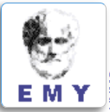
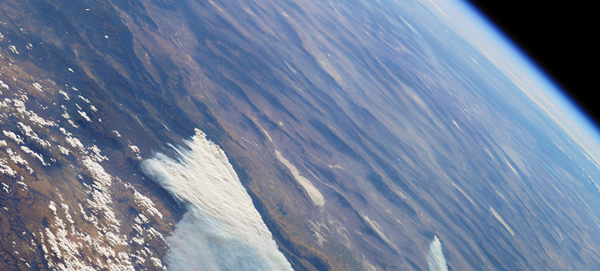
Clouds and Aerosols Improvements in ICON Radiation Scheme - CAIIR Priority Project
בס"ד
Harel Muskatel (IMS)
26th COSMO General Meeting, September 3, 2024

Slide 2
Clouds and Aerosols Improvements in ICON Radiation Scheme - CAIIR Priority Project
Project duration: March 2020 - September 2024
Participants:
Harel Muskatel (IMS)
Pavel Khain (IMS)
Alon Shtivelman (IMS)
Yoav Levi (IMS)
Daniel Rieger (DWD)
Uli Blahak (DWD)
Euripides Augoustoglou (HNMS)
Alexey Poliukhov (RHM)
Julia Khlestova (RHM)
Gdaly Rivin (RHM)
Natalia Chubarova (RHM)
Marina Shatunova (RHM)
Contributions from:
Martin Kohler (DWD)
Alberto De Lozar (DWD)
Uli Shaettler (DWD)

Slide 3
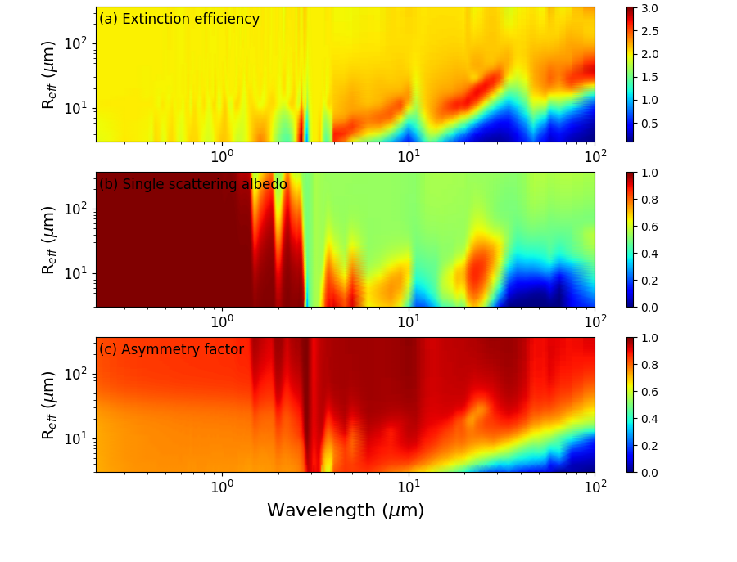
New Ice Optics – including large particles
Extended size:
60 µm → 300 µm
Ice particles surfaces:
Rough/Smooth
High resolution:
Reff / Wavelength

Slide 4
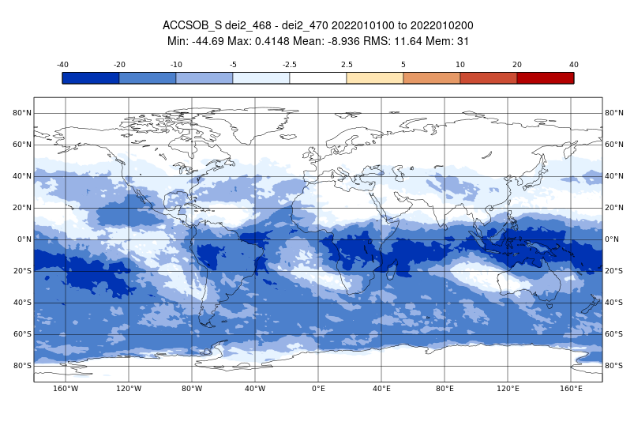
Large hydrometeors effect on radiation
Surface SW irradiance January

Slide 5
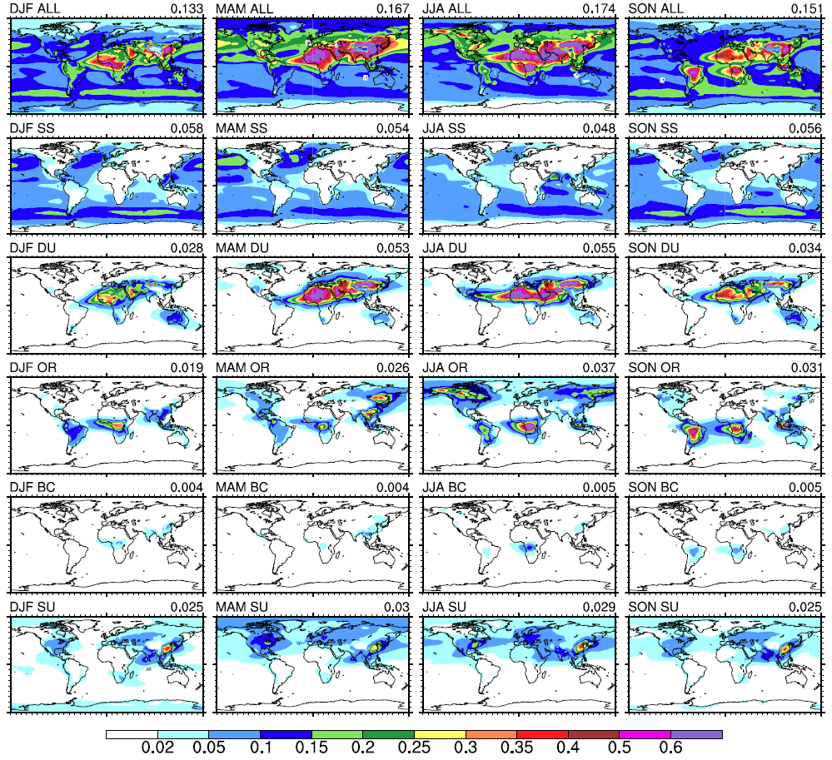
CAMS climatology - Seasonal AOD at 550nm
Bozzo et al.
2017

Slide 6
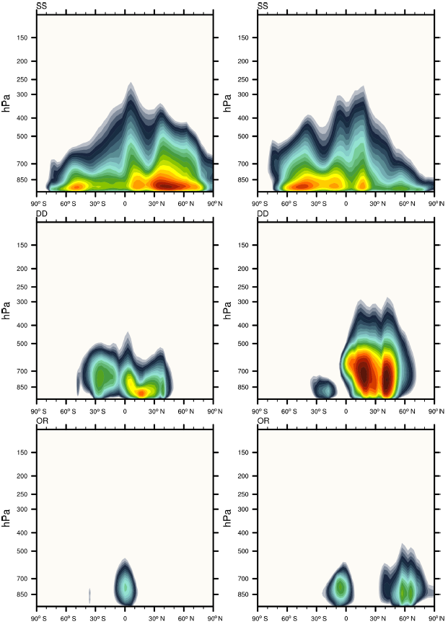
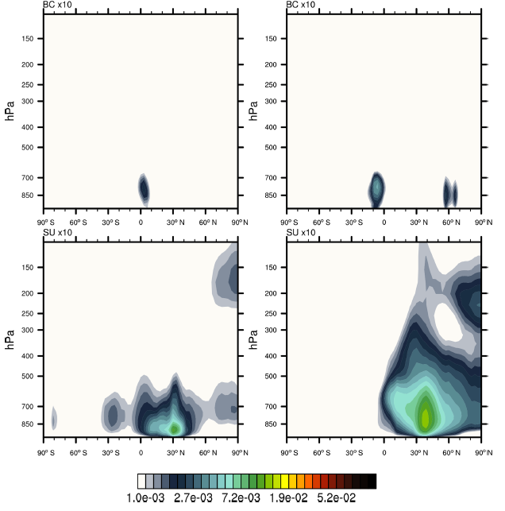
Zonal-mean layer-integrated mass profiles
Jan
Jul
SS
Jan
Jul
BC
DU
SU
OM
gr/m²
Bozzo et al. 2020

Slide 7
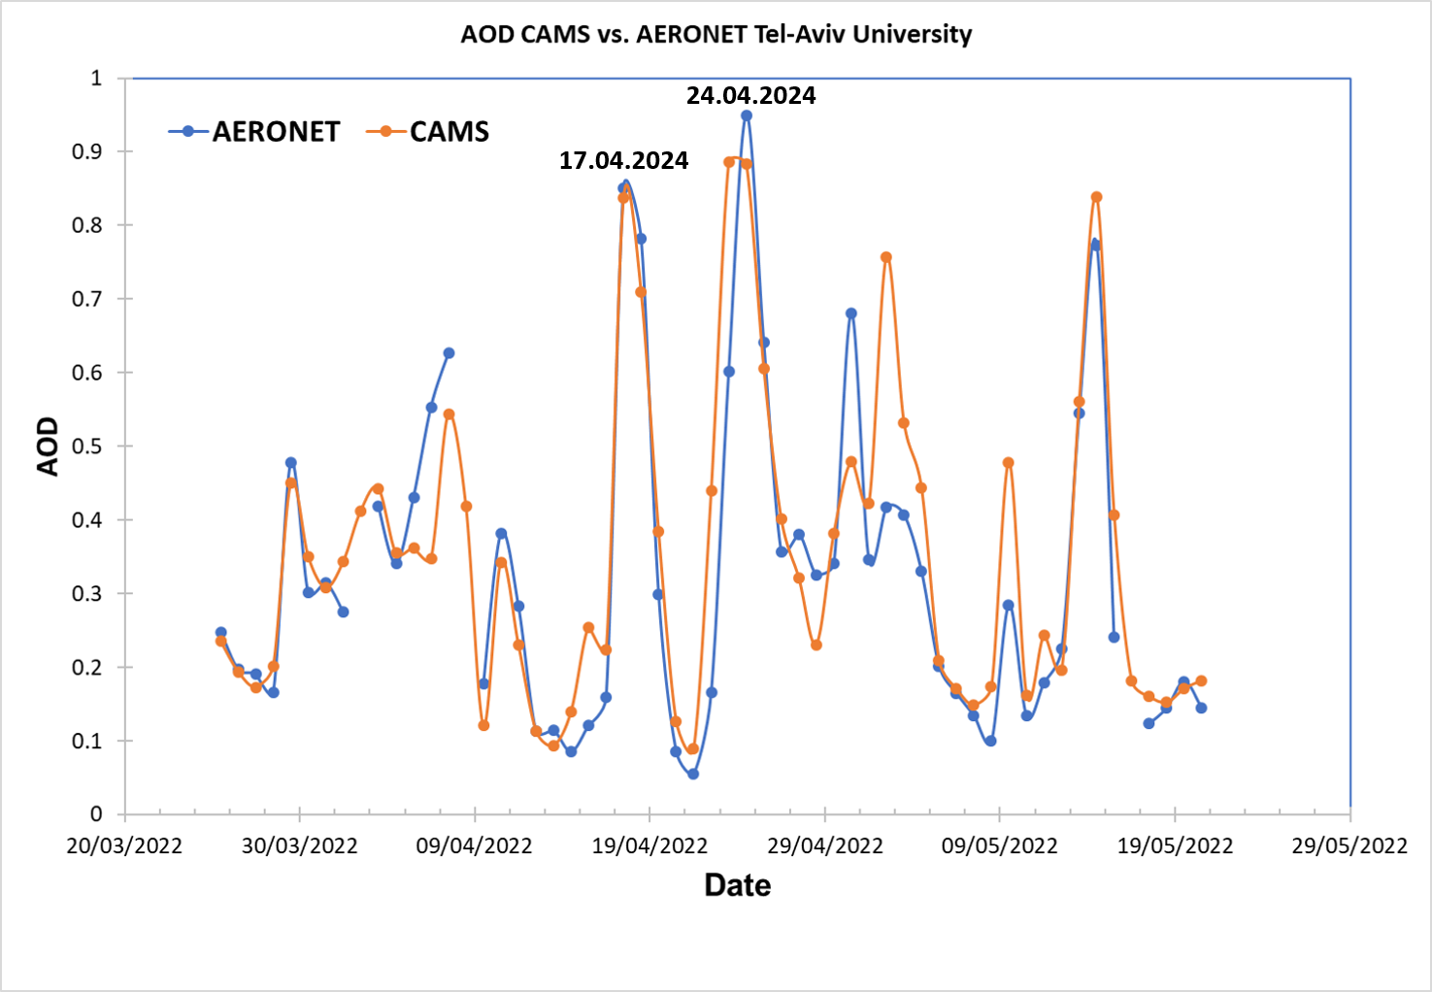
CAMS forecasted aerosols

Slide 8
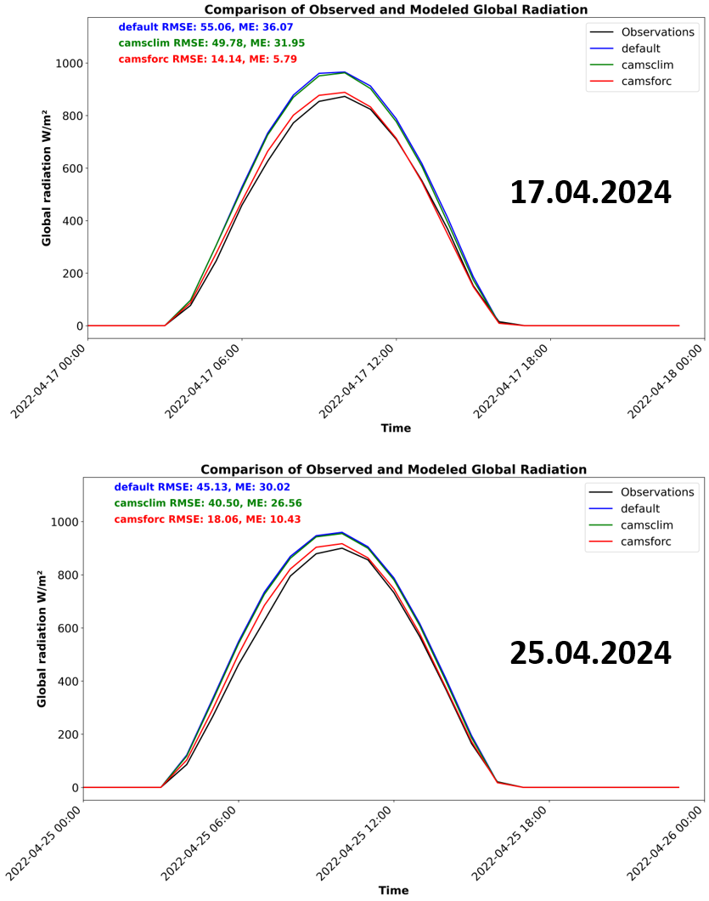
CAMS forecasted aerosols
17.04.2022
25.04.2022

Slide 9
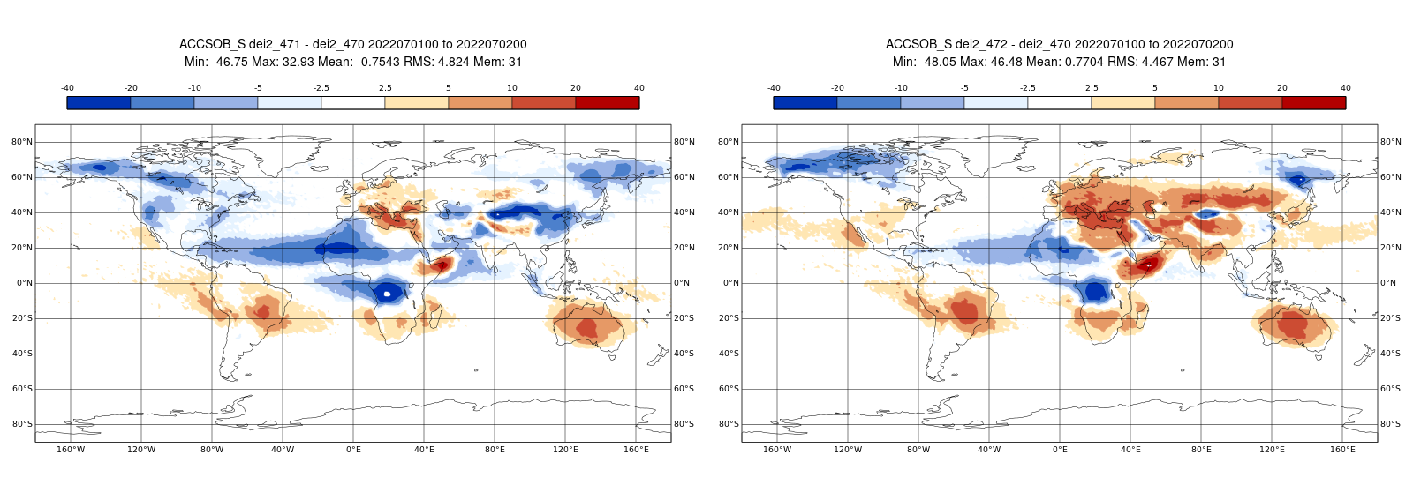
CAMS climatology and forecasted aerosols
Surface SW irradiance July
CAMSclim - default
CAMSforc - default

Slide 10
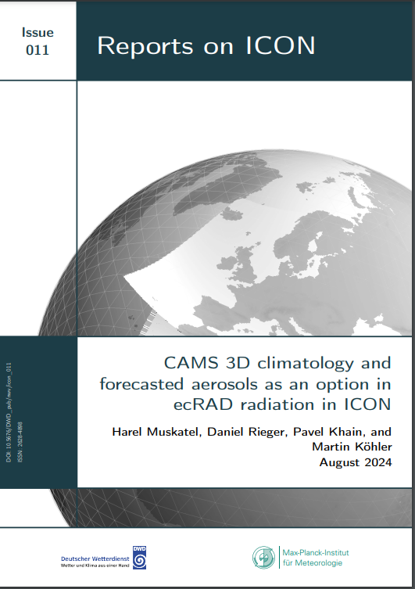
CAMS climatology and forecasted aerosols

Slide 11
2D AOD advection scheme (D. Rieger)

Slide 12
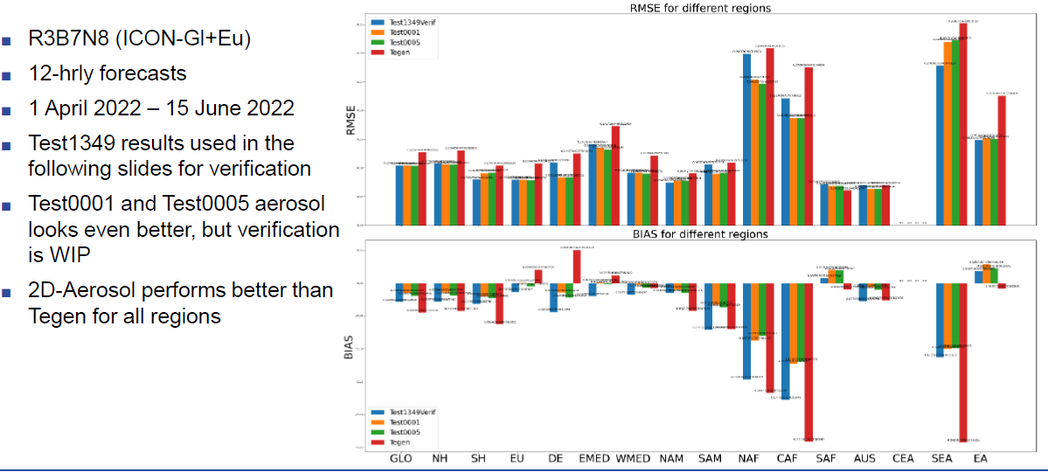
2D AOD – verifications against AERONET stations

Slide 13
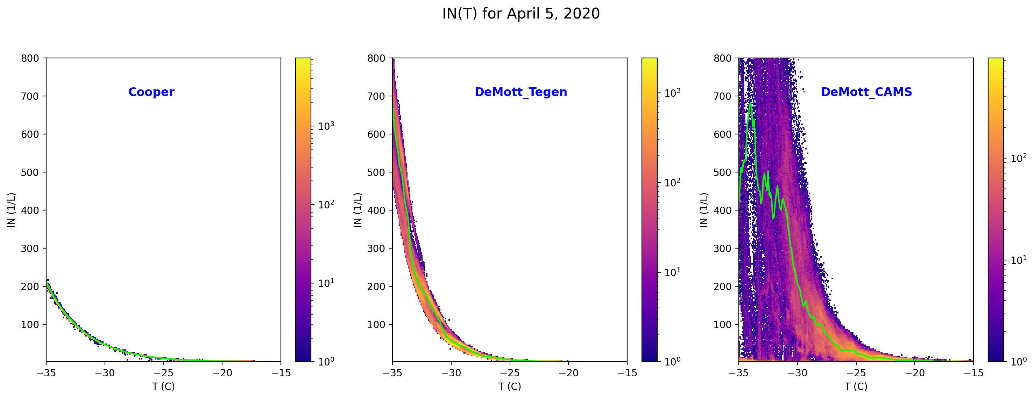
ICON Ice nucleation with DeMott (2015) scheme
$INP(T,ndust)=1000∙{n_{dust}}^{1.25}\exp^{0.46\left(T_{0}−T\right)−11.6}$
$$INP(T)=5∙\exp^{0.304(T_{0}−T)}$$
Tegen
CAMS forecast
CAMS climatology

Slide 14
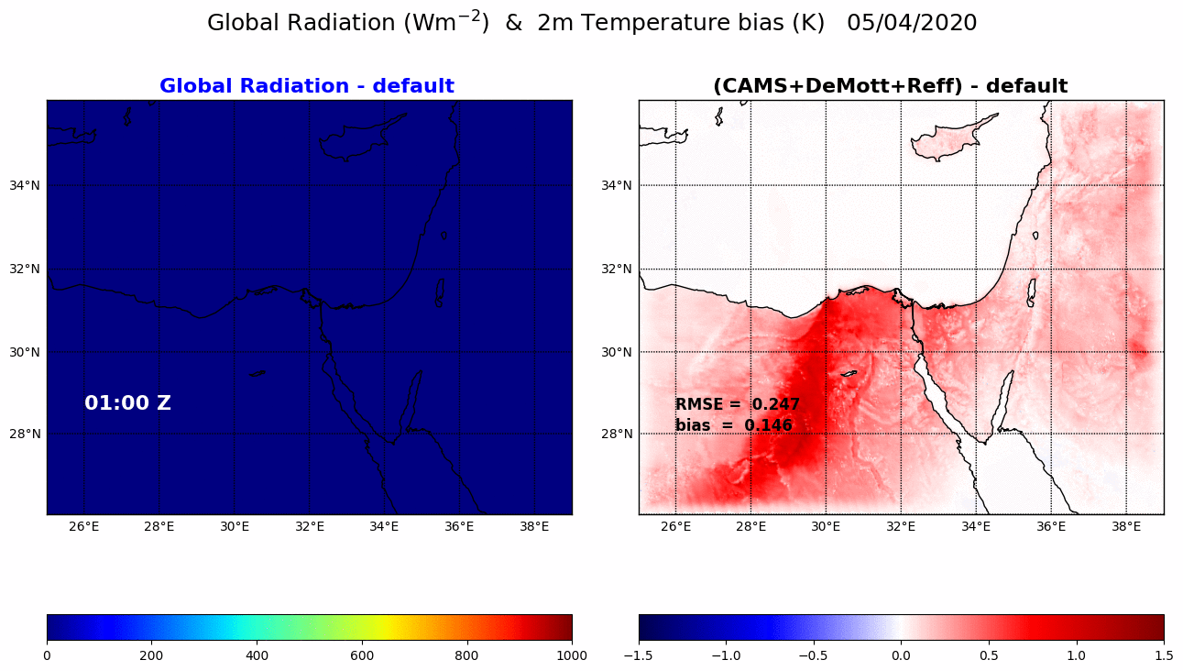
ICON Ice nucleation with DeMott (2015) scheme
direct + indirect effect

Slide 15
CAIIR Tasks: done, removed, moved to ACLIIM
Analysis and revision of ice optical properties based on Fu (1996, 1998) in ecRAD
Introduction of new liquid clouds optics based on Hu & Stamnes (1993) in ecRAD
New ice nucleation parametrization (DeMott 2015) / Implementation of Segal & Khain (2006) droplets activation scheme for the effective radius calculation in ICON radiation
Implementation of CAMS forecasted aerosols 3D fields as input for ICON radiation
Implementation of CAMS climatology aerosols as input for ICON radiation scheme
Improvements/testing of the 2D aerosols advection scheme in ICON
Implementation of Kinne aerosols climatology fields as input for ICON radiation scheme
Testing the radiation code using different aerosol inputs against experimental datasets for clear/cloudy sky conditions
Analysis/Revision of shallow convection scheme/SGS cloudiness in ICON radiation
Systematic tuning (CALMO methodology) of the different ICON-RRTM versions for finding the best operative setup
Warm phase SBM / Mixed phase SBM

Slide 16
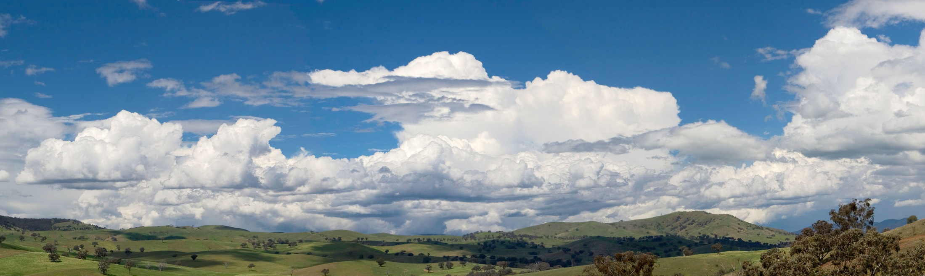
Aerosol-CLoud Interactions in ICON Model:
ACLIIM Priority Project
בס"ד

Slide 17
Aerosol-CLoud Interactions in ICON Model:
ACLIIM Priority Project
September 2024 - August 2027
Total planed FTEs : 4.8
Participants:
Harel Muskatel (IMS)
Pavel Khain (IMS)
Euripides Augoustoglou (HNMS)
Daniel Rieger (DWD)
Alberto de Lozar (DWD)

Slide 18
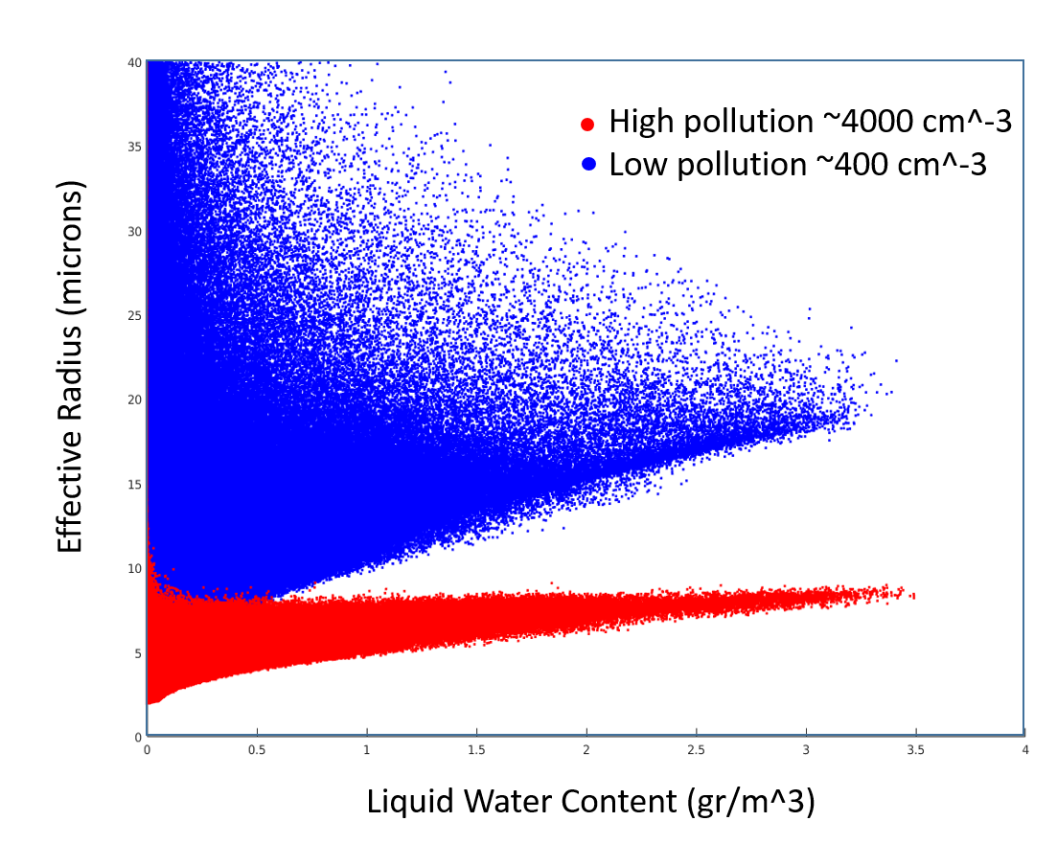
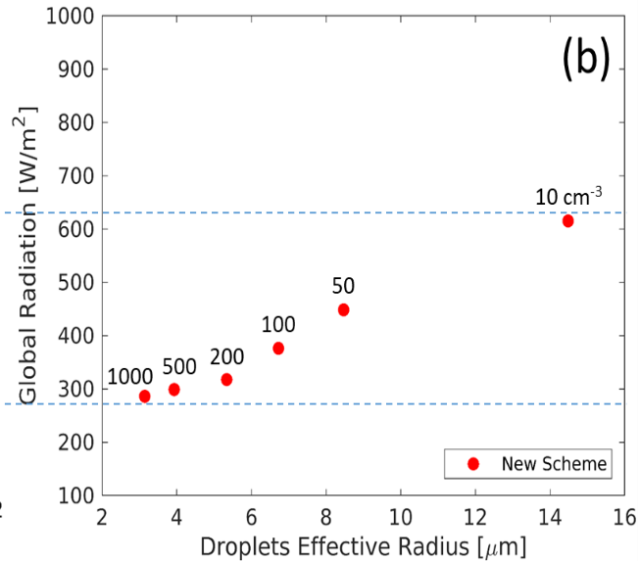
CDNC importance for radiation
SBM simulations
COSMO simulations

Slide 19
CDNC importance for microphysics
Pristine tropical clouds with low CCN concentration can rain out too quickly to mature to long lived clouds
Polluted clouds with very high CCN concentrations may evaporate before rain can occur
Rosenfeld et al., Science, 321 , 2008

Slide 20
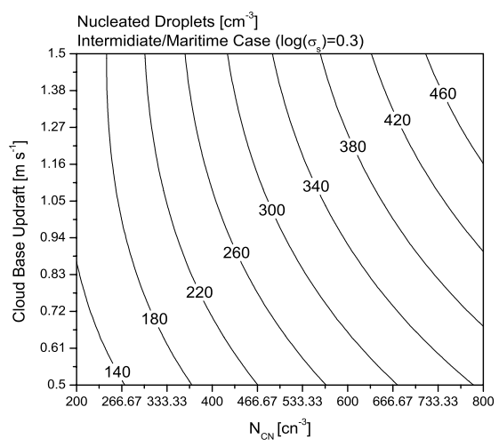
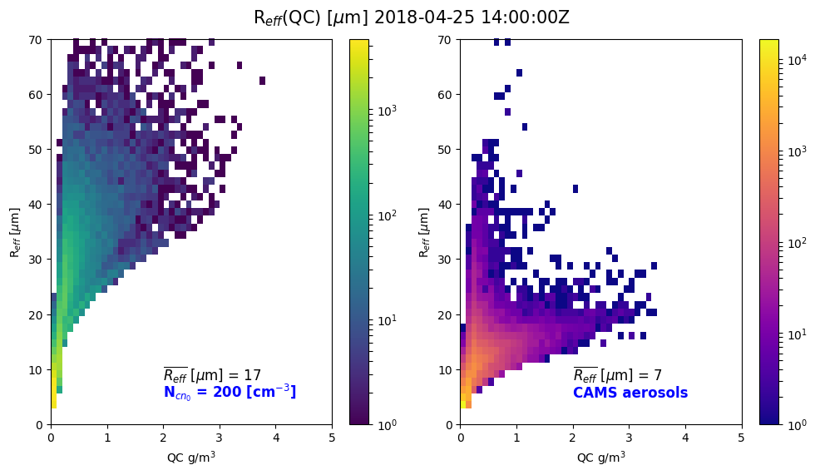

Segal & Khain cloud droplets activation scheme
  Calculation of CDNC from N_{CN} is estimated from Segal & Khain (2006)
  4D look-up table:
$$CDNC=f(n_{cn}, log(σ),r_{mod}{,w}_{CB})$$
Segal & Khain (2006)

Slide 21
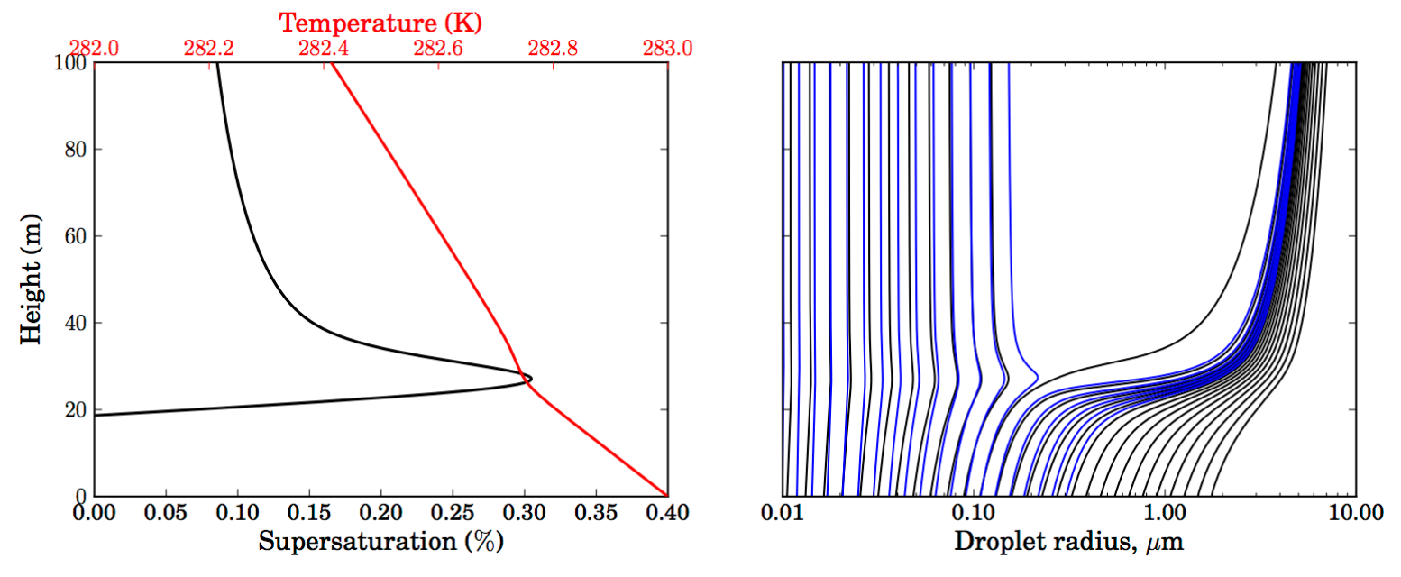

pyrcel: cloud parcel model
    Setup pyrcel
    Run pyrcel with different combinations of initial conditions:
    Train a ML model
    Plug-in of the trained ML model in ICON (Comin)
$$CDNC=f(n_{cn}, p,S,t{,w}_{CB})$$
Daniel Rothenberg and Chien Wang, 2016. J. Atmos. Sci., 73, 1255–1272.

Slide 22
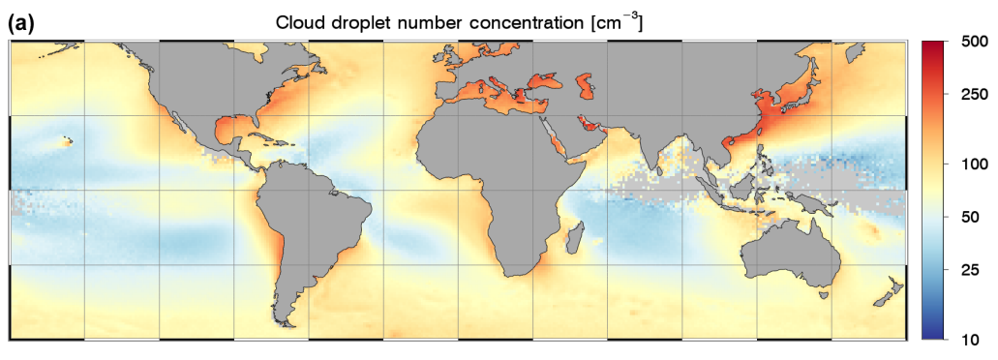
Comparisons to other datasets
1. MODIS climatology (already in ICON)
2. MODIS daily values 2000-2020 (Gryspeerdt et al., 2022)
Bennartz, R; Rausch, J (2017). ATMOSPHERIC CHEMISTRY AND PHYSICS, 17(16), 9815-9836.

Slide 23
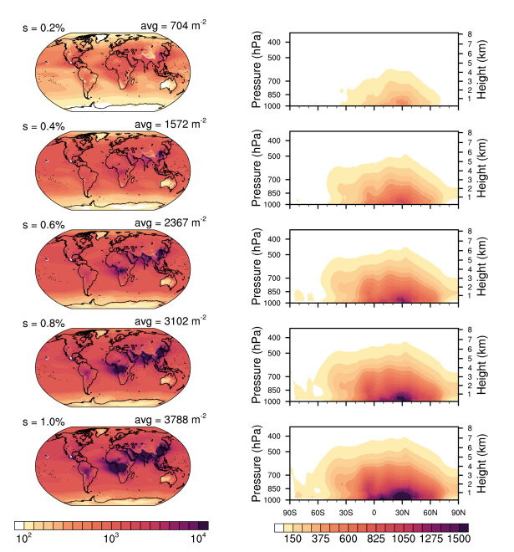
Comparisons to other datasets
3. CAMS reanalysis daily values 2003-2021 (Block et al., 2024)

Slide 24
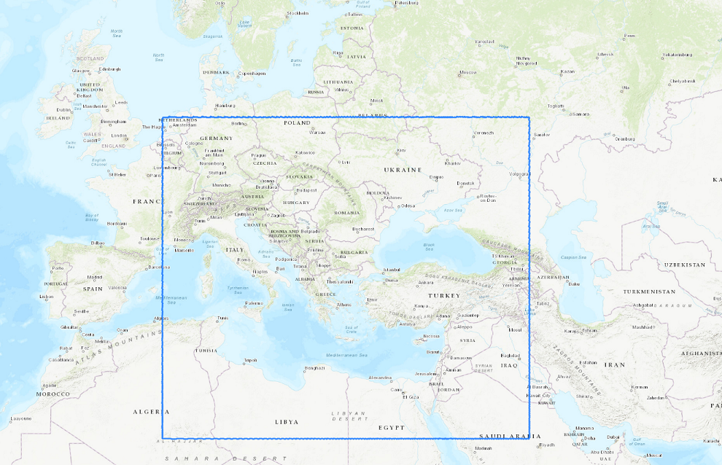
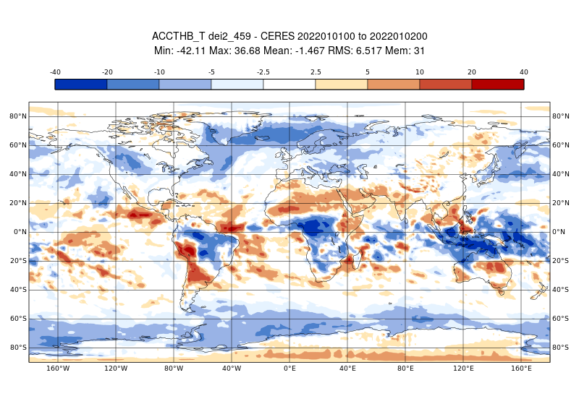
Verifications

Slide 25

Spectral Bin Microphysics in ICON
Warm-Phase Spectral-Bin Microphysics (SBM) scheme was implemented in ICON in master as part of CAIIR
66 bins: droplets + CCN tracers
Runs ~7 times slower than 1M.
SBM and 2M schemes compared: SBM shows reasonable behavior, strong sensitivity to CCN.
Example: Cumulonimbus development (Weisman-Klemp 1982)
ACLIIM: mixed-phase SBM implementation and calibration
16
12
QC+QR (g/kg)
8
4
0
50km
Khain, P., J. Shpund, Y. Levi and A.P. Khain, 2022. Atmos. Res., 279, 106388.
Acknowledgments: Axel Seifert, Daniel Reinert, Daniel Rieger

Slide 26
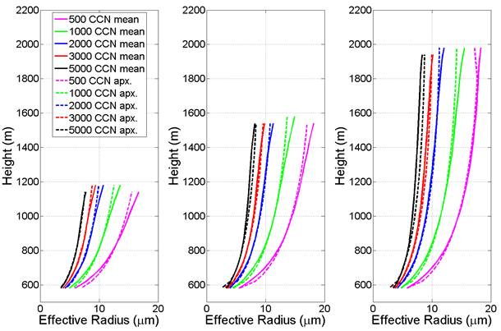
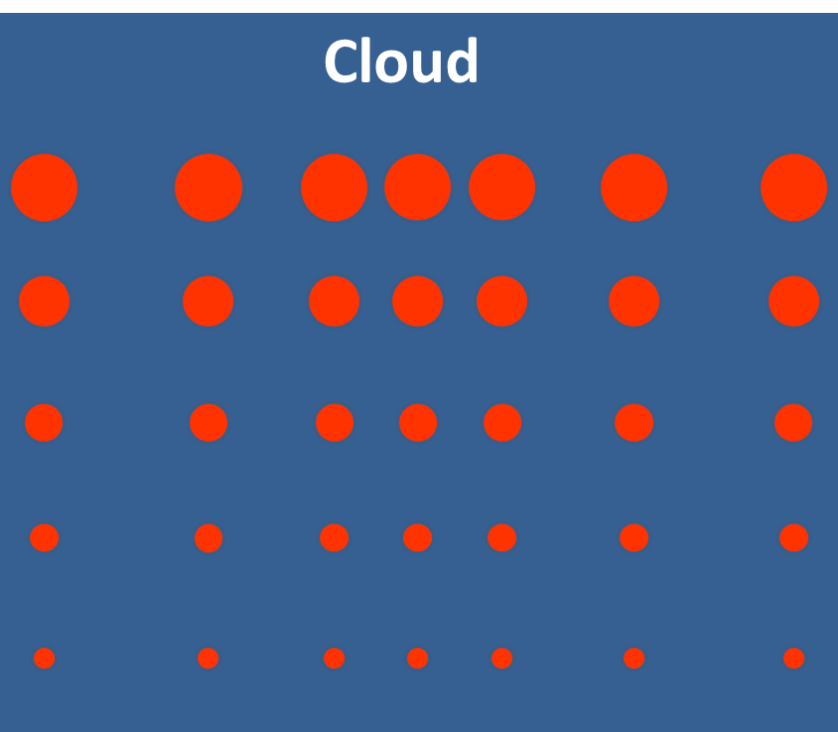
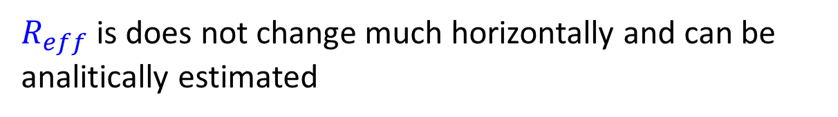
Implementation of KH2019 parametrization of droplets effective radius in shallow convection clouds
$R_{eff}$ is does not change much horizontally and can be analitically estimated
$$\overline{R_{eff}}=fct({CCN}_{cloud base},H_{above c. base},T)$$
Khain, P., R. Heiblum, U. Blahak, Y. Levi, H. Muskatel, E. Vadislavsky, O. Altaratz, I. Koren, G. Dagan, J. Shpund, and A. Khain, 2019. J. Atmos. Sci., 76, 533–560

Slide 27
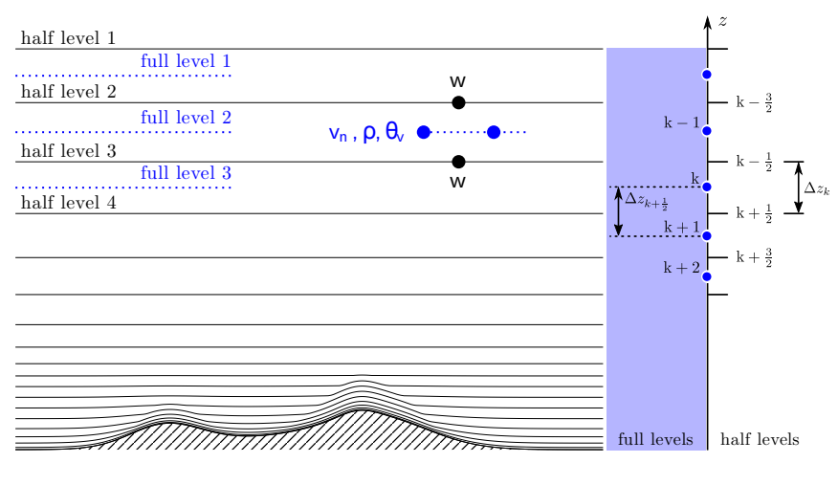
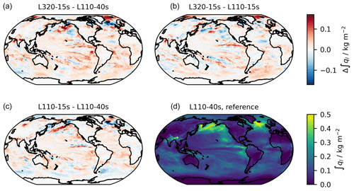
Vertical resolution impact on cloud formation, cloud cover and precipitation
Schmidt, H., et al. Geosci. Model Dev., 17, 1563–1584, https://doi.org/10.5194/gmd-17-1563-2024, 2024.

Slide 28
ACLIIM Tasks
Implementation of the 4D SK2006 droplets activation scheme coupled with CAMS aerosols
Development of a new cloud droplets activation parametrization for CAMS aerosols using pyrcel model
Comparisons of CDNC results with previous observational data sets and climatologies
Validation of ICON scores using different cloud nucleation schemes against observational measurements
Implementation of KH2019 parametrization of droplets effective radius in shallow convection clouds
Inclusion of mixed-phase in the Spectral Bin Microphysics scheme in ICON
Investigation of the vertical resolution impact on cloud formation and radiation effects
Thank you for your attention!

