Slide 1
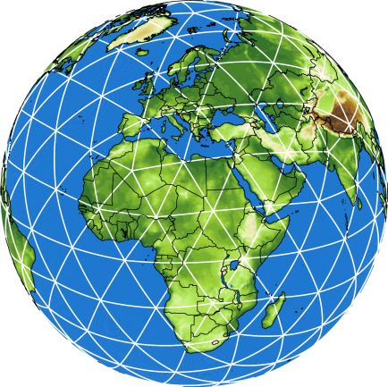
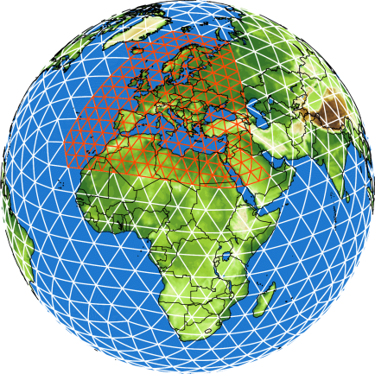
Towards higher resolution in global and regional configurations
Günther Zängl
COSMO-WG-Phy, Offenbach, Sep 2, 2024

Slide 2
Challenges at high resolutions
First global convection-permitting experiments (conducted in 2021) indicated – among other things – substantial quality problems over the Tibetan Plateau
This motivated more detailed investigations using multi-step nesting down to 1.6 km over the Tibet-Himalaya region
For the Alpine region, there are multiple motivations to consider higher resolution (~ 500 m)
TEAMx – for which DWD plans to provide dedicated forecasts
GLORI-Alps – our Digital Twin project complementing DestinE
ICON-D05 – DWD’s plan for higher-resolution operational forecasts for Germany
Notes:
2

Slide 3
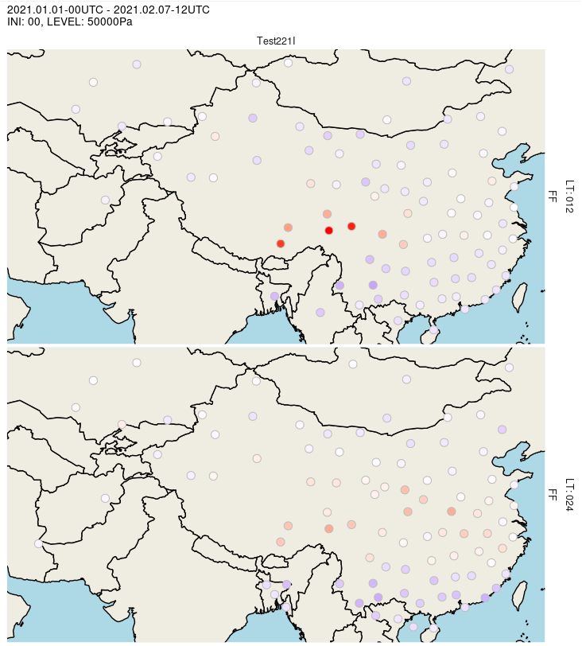
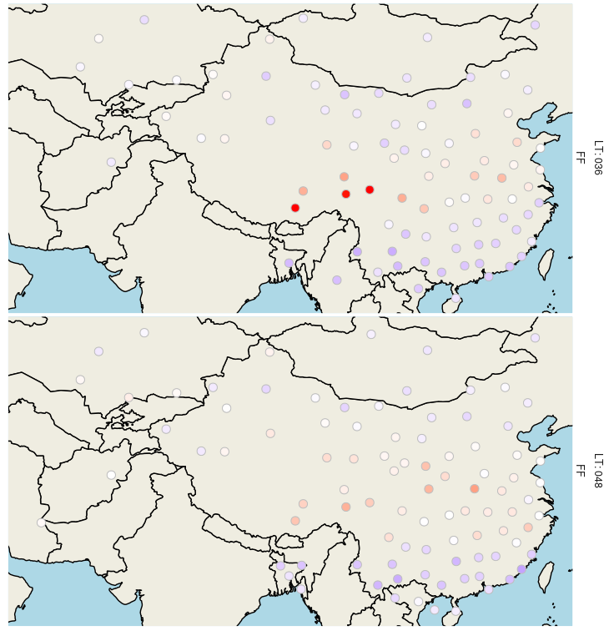
Bias FF 500 hPa vs. radiosondes, January 2021, 00-UTC forecasts starting from interpolated IFS analyses LT 12h-48h
operational configuration (13 km)
Scale 7.5 m/s (!)

Slide 4
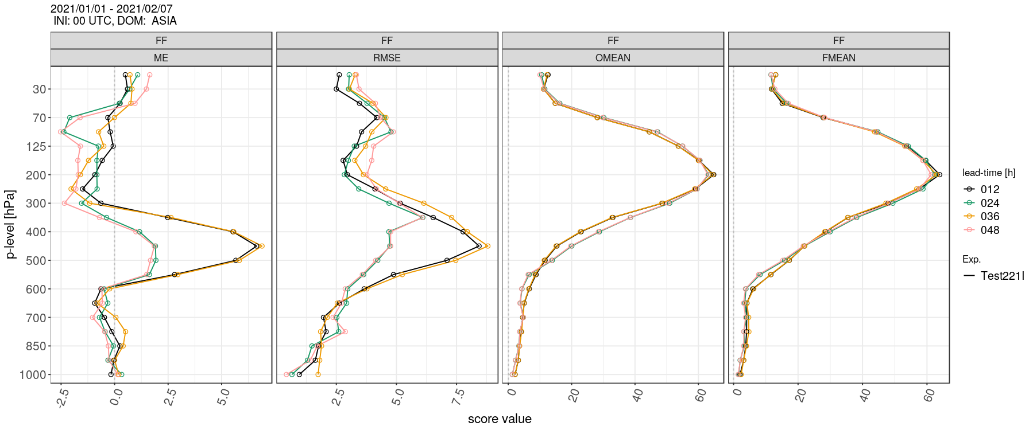
Wind speed profiles; 29-35N, 85-105E; January 2021, 00-UTC forecasts
verification against radiosondes
bias RMSE obs mean fc mean
Positive wind speed bias in middle troposphere could be reduced by SSO retuning
Reason for diurnal cycle still unclear

Slide 5
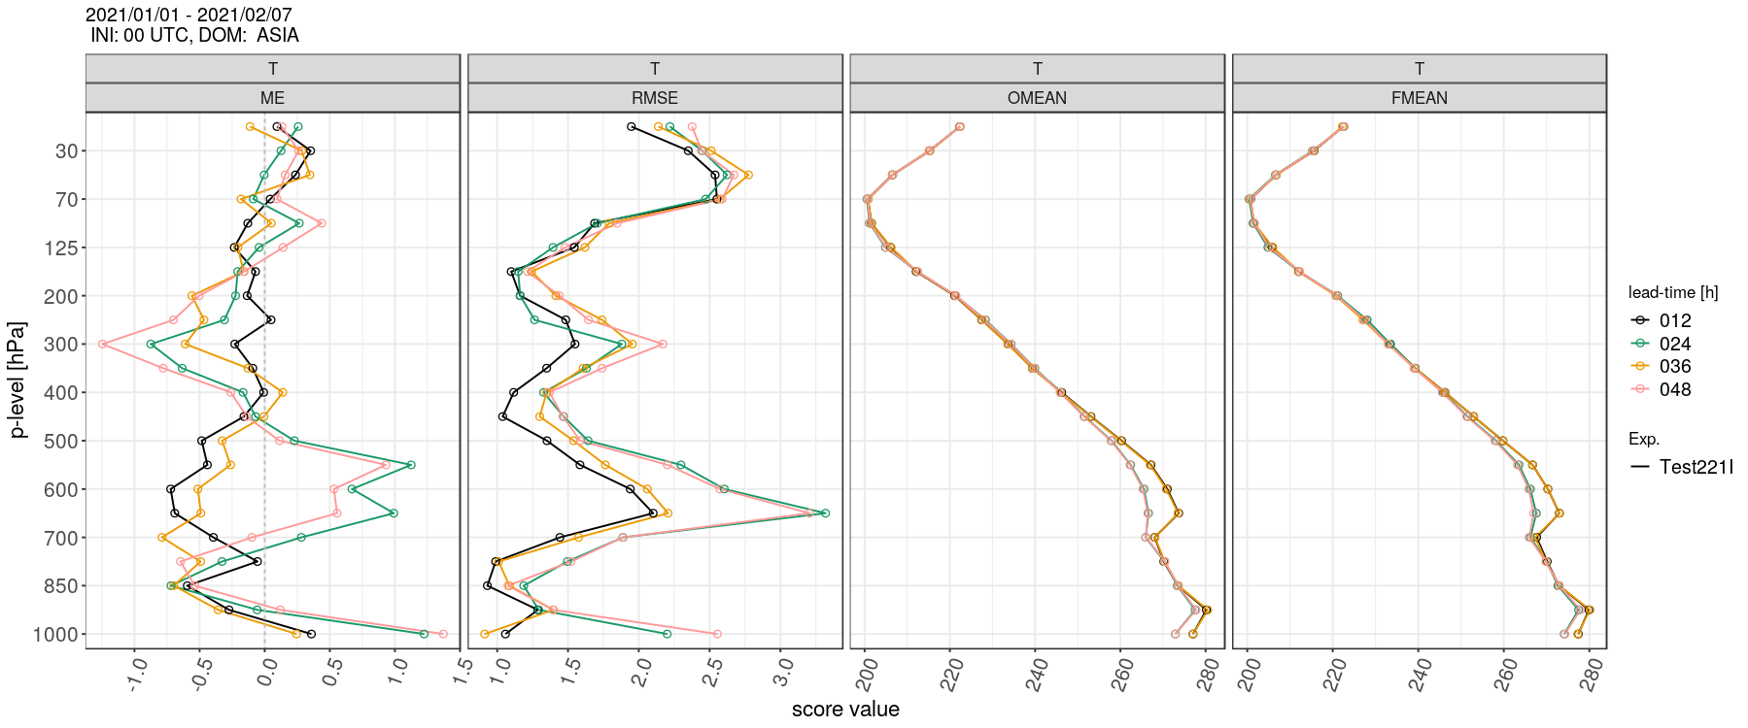
Temperature profiles; 29-35N, 85-105E;
January 2021, 00-UTC forecasts
verification against radiosondes
Note: the diurnal cycle bias of FF and T is in phase opposition!

Slide 6
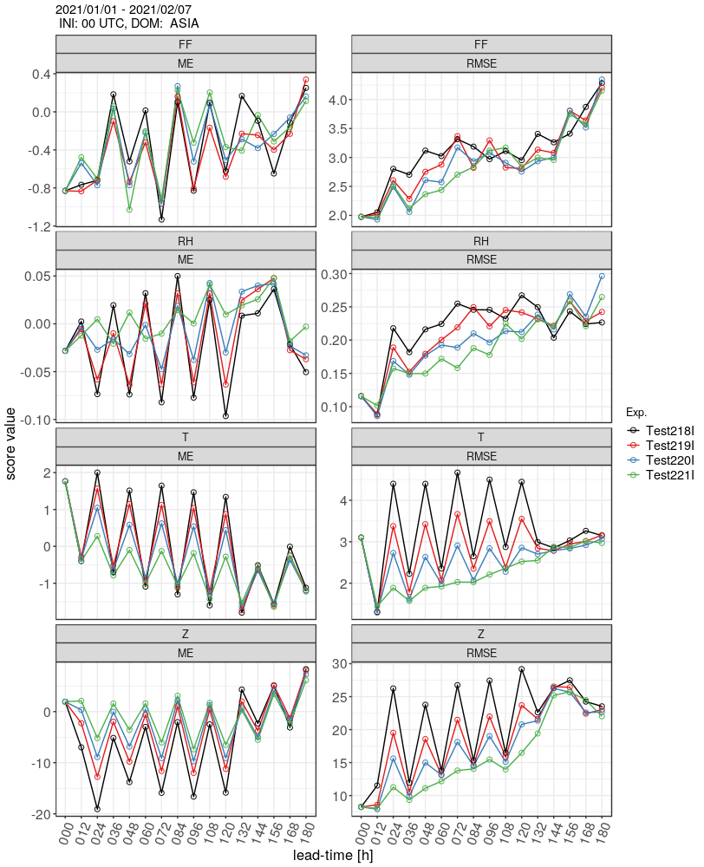
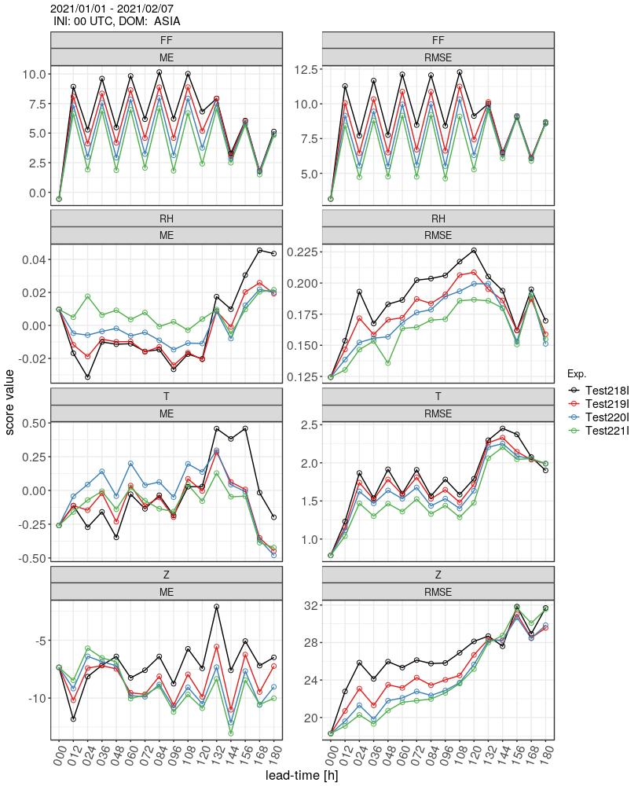
Radiosonde verification – higher resolution expts.
700 hPa
450 hPa
1.6 km
3.25 km
6.5 km
13 km
Note: the verification is computed from the 13-km domain in all cases; it EXCLUDES double-penalty effects that might arise from resolving more gravity waves!
The nests are turned off after 120 h

Slide 7
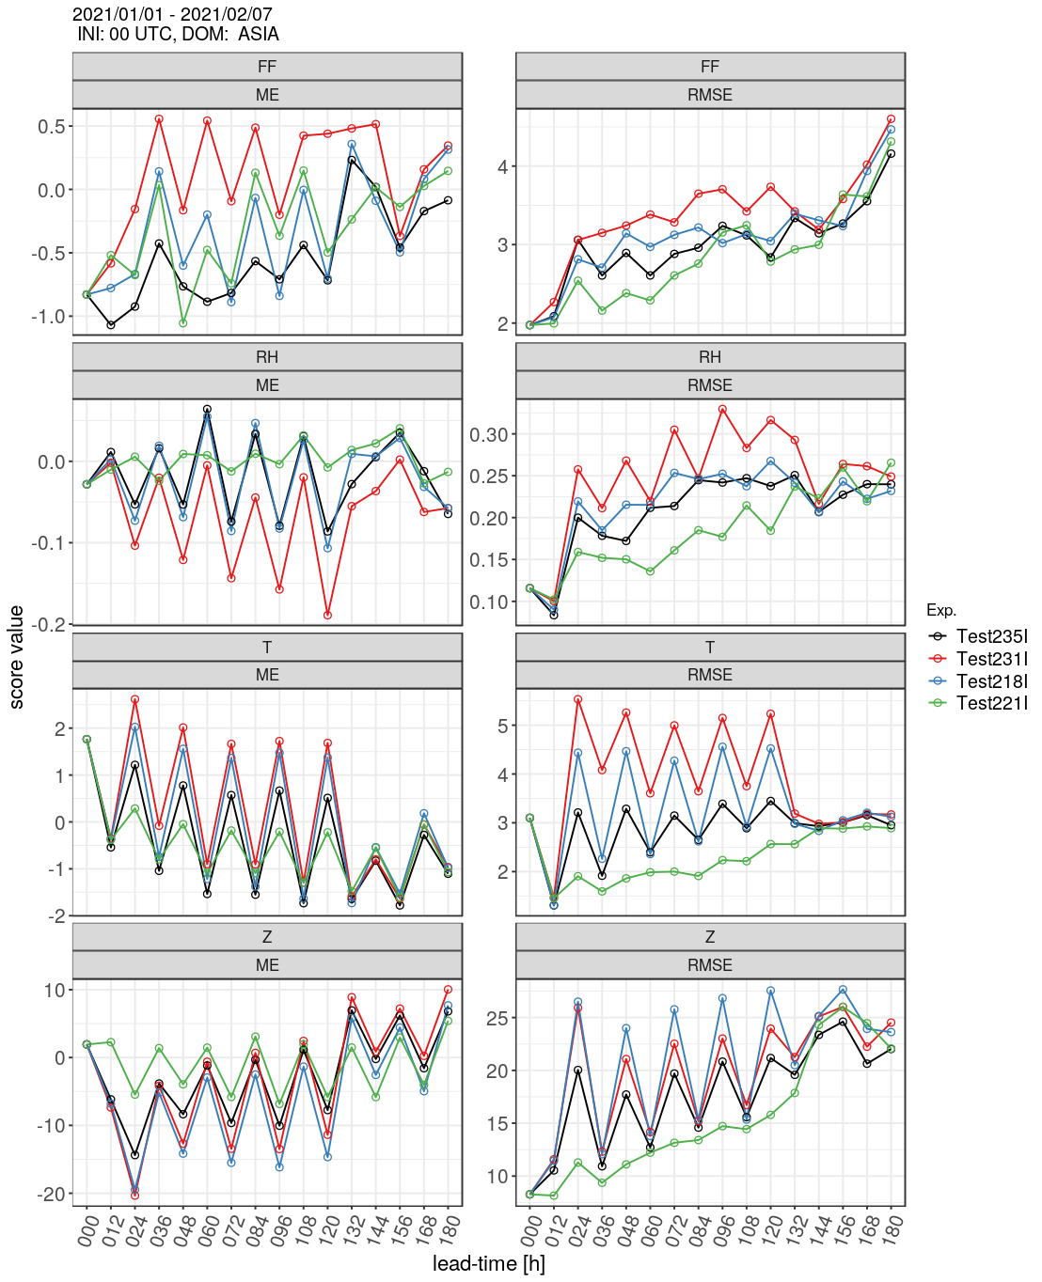
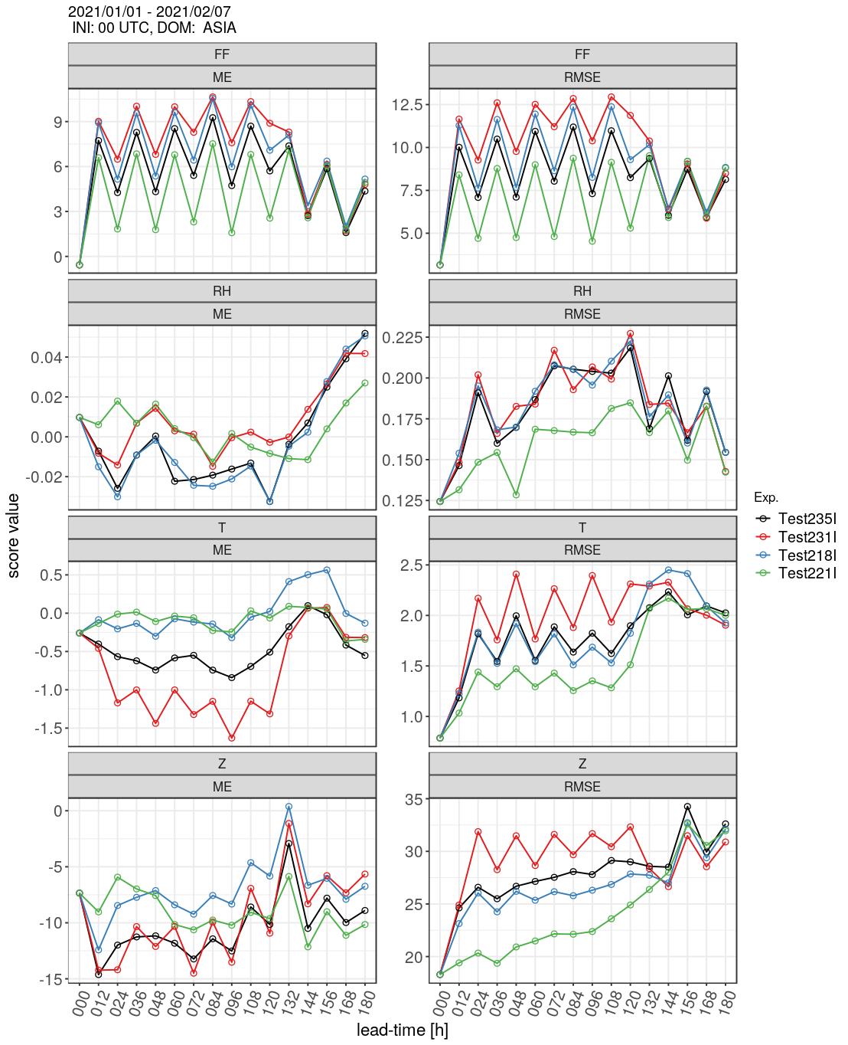
Sensitivity tests
700 hPa
450 hPa
1.6 km, increased SSO tuning
1.6 km, GWD part of SSO scheme turned off
1.6 km, result from previous slide
13 km
Remark: turning off low-level blocking in addition increases the errors by another 10-30%
Further investigation postponed in favor of 500 m LAM config’s

Slide 8
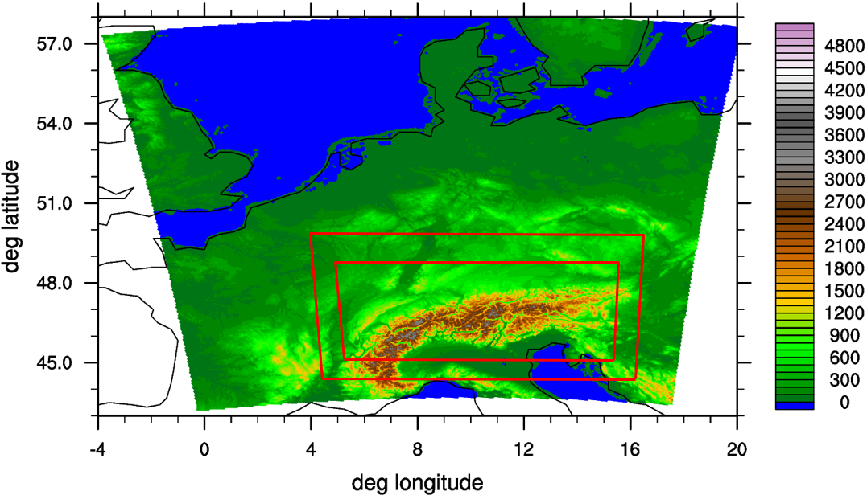
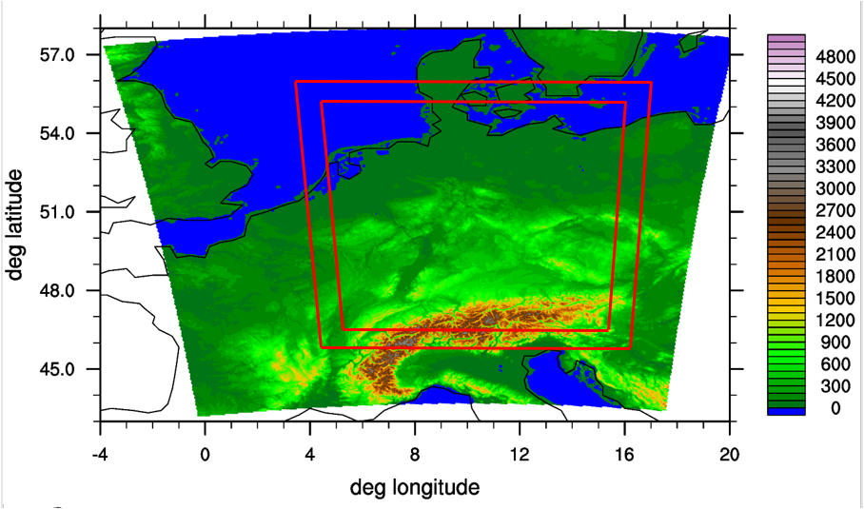
ICON @ 500 m for the Alps / Germany
First suite of experiments motivated by the plan to prepare dedicated high-resolution forecasts for the TEAMx observational campaign starting in late summer this year
Envisaged configuration: start from operational D2 analysis and spawn two nested domains (1 km, 500 m) after the end of the latent-heat-nudging phase
A few months later, the idea came up to investigate an analogous configuration for Germany
approximate domain configurations
Notes:
8

Slide 9
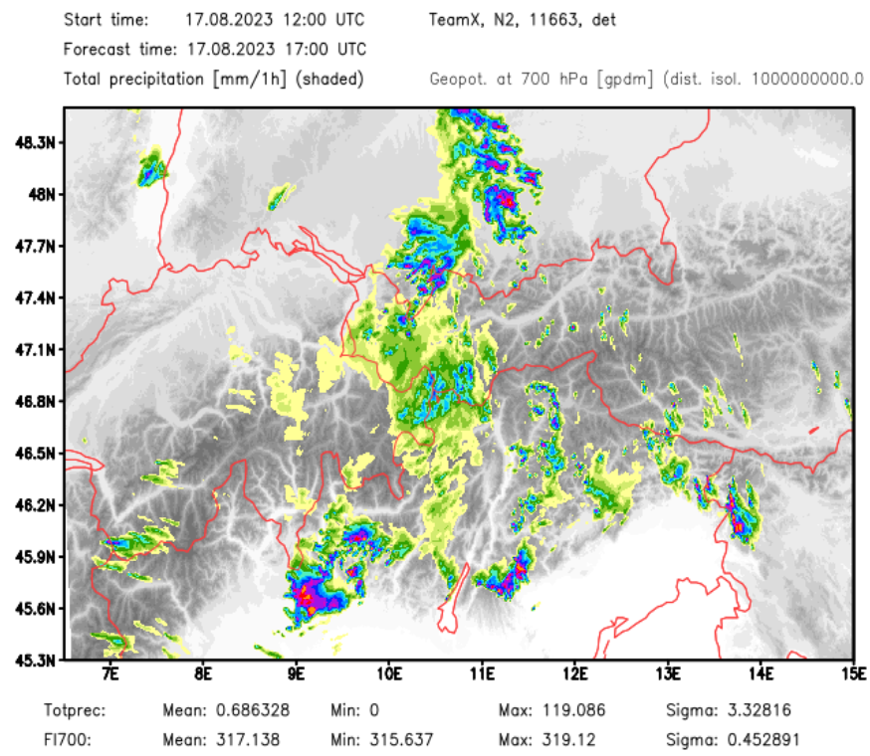
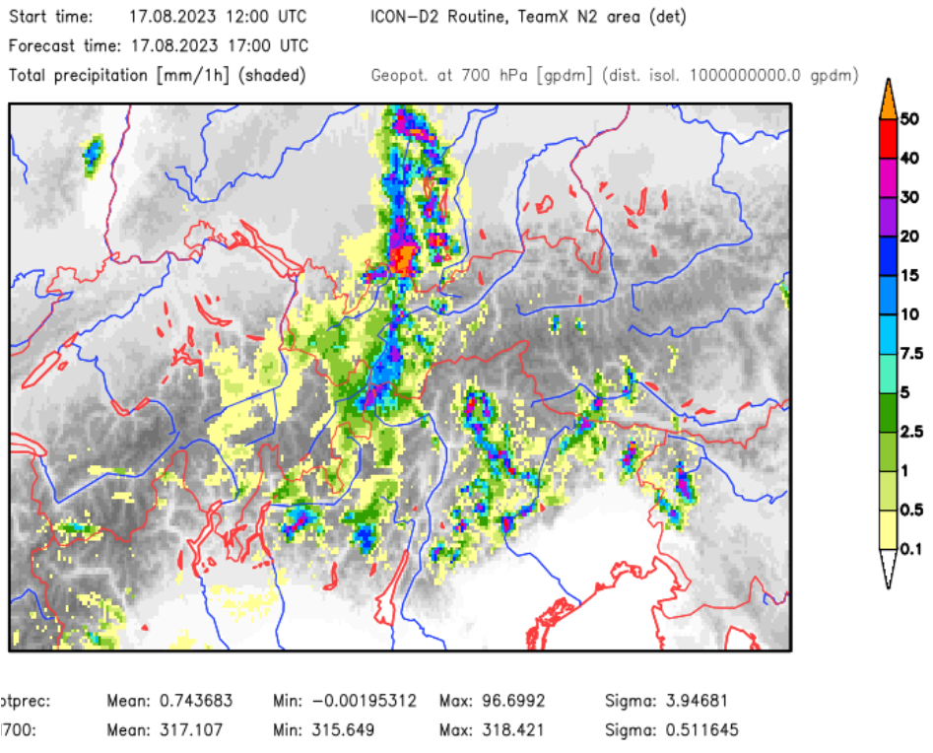
ICON-LAM with 500 m
Refining the mesh size from 2 km to 500 m tends to improve the model skill in various aspects
Reduced overestimation of high precipitation intensities (> 10 mm/h)
However, local intensity peaks get even higher
ICON-A05
ICON-D2 (subd.)
Notes:
9

Slide 10
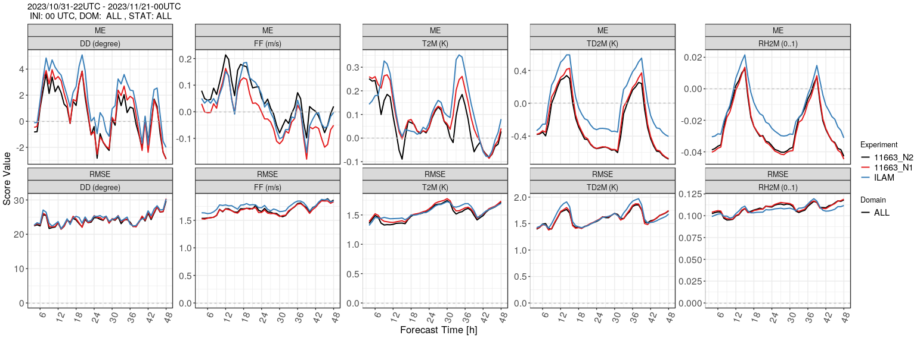
ICON-LAM with 500 m
Refining the mesh size from 2 km to 500 m tends to improve the model skill in various aspects
Improved 10-m winds in mountainous regions under stable conditions, for T2M this depends on the time period, and results for TD2M (dew point) and RH2M are contradicting
500 m
1 km
2 km
Nov 2023, Alpine domain
Notes:
10

Slide 11
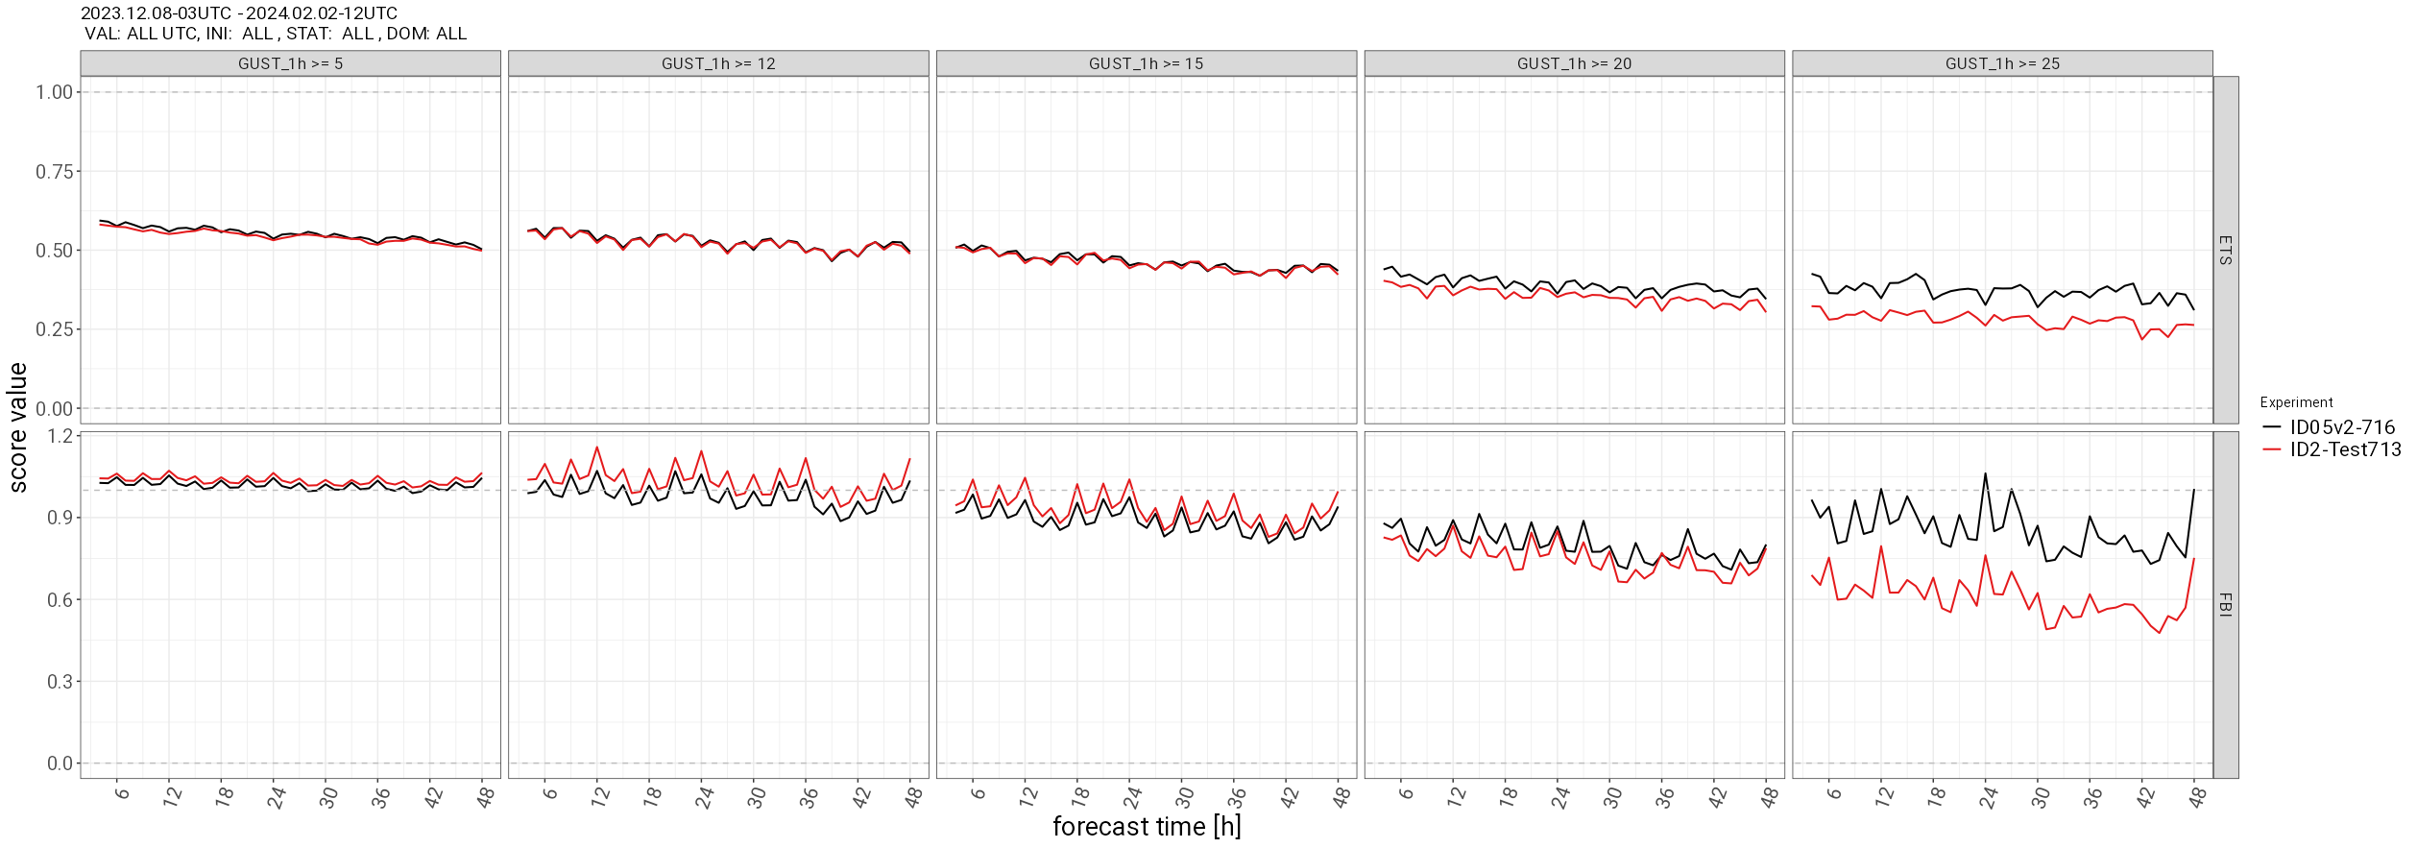
ICON-LAM with 500 m
Refining the mesh size from 2 km to 500 m tends to improve the model skill in various aspects
Better representation of wind maxima / gust at mountain crests
5 m/s 12 m/s 15 m/s 20 m/s 25 m/s
Dec 2023 + Jan 2024, German domain, categorical gust verification
Notes:
11

Slide 12
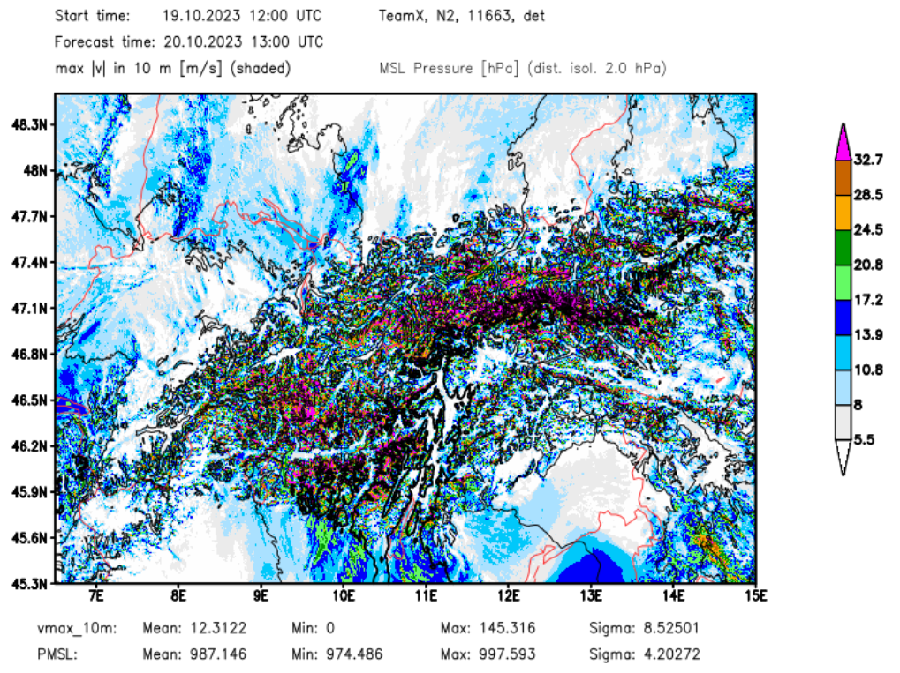
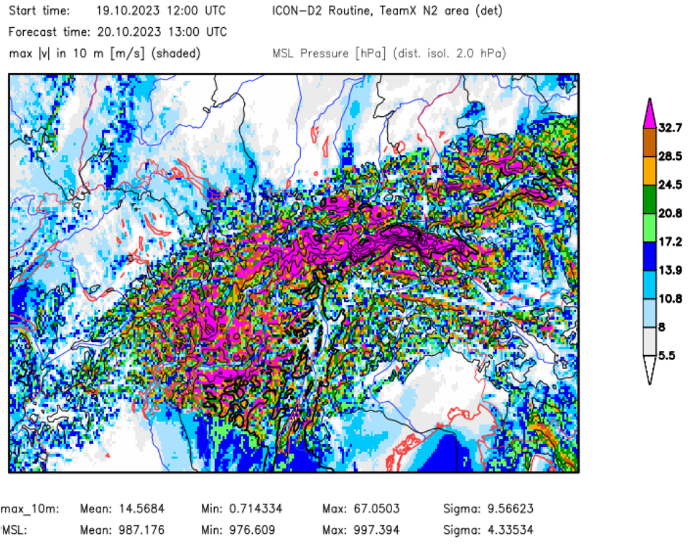
ICON-LAM with 500 m
However, there are also several issues that required further model development
Although the restriction of strong wind gusts to mountain peaks / crests is much better at 500 m than at 2 km, local extrema are way too high (145 m/s in the south foehn case displayed below)
This was fixed by a modified gust parameterization a few weeks ago
ICON-A05
ICON-D2 (subd.)
Notes:
12

Slide 13
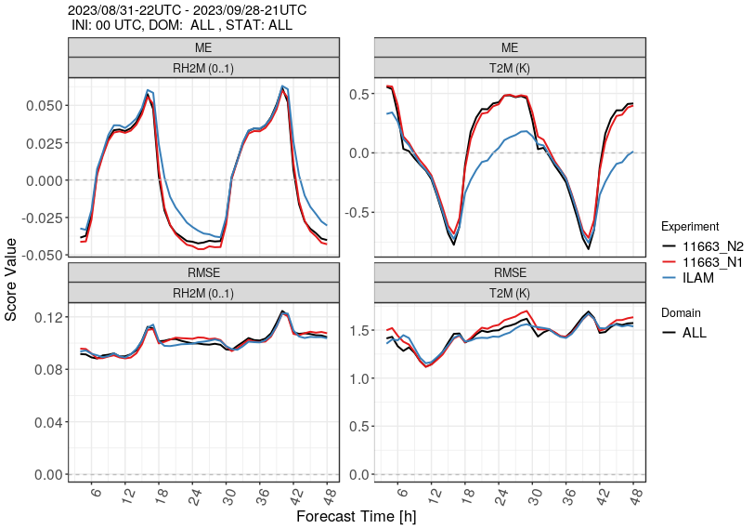
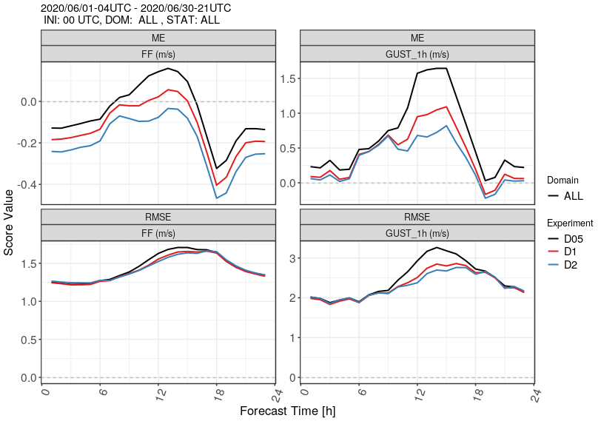
ICON-LAM with 500 m
However, there are also several issues that required further model development
Increased nocturnal warm bias in valleys during the summer months
Large overestimation of diagnosed wind gusts in summertime conditions with a deep daytime PBL due to double-counting issues with ‘permitted large eddies’
500 m
1 km
2 km
Sep 2023, Alpine domain
Jun 2020, German domain
Notes:
13

Slide 14
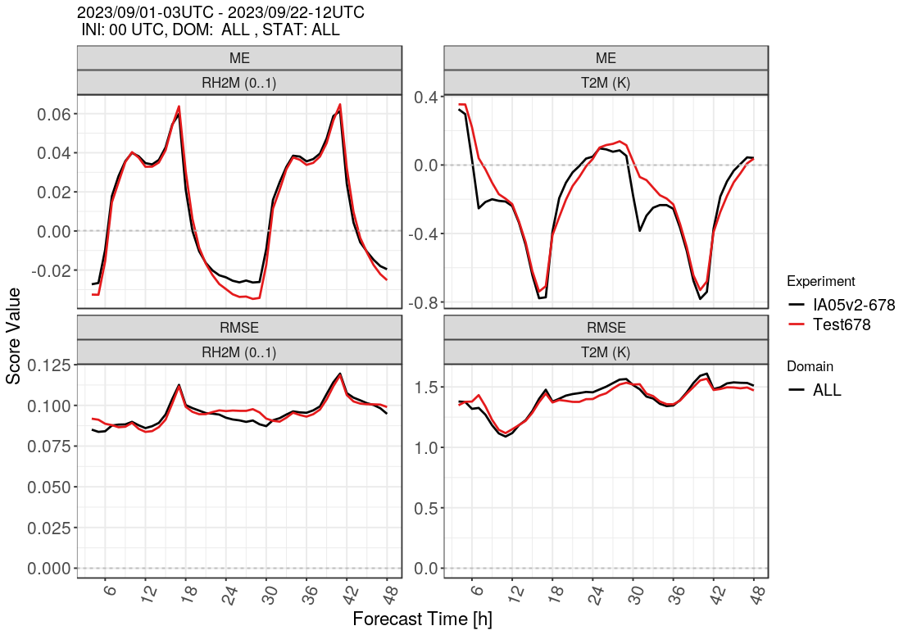
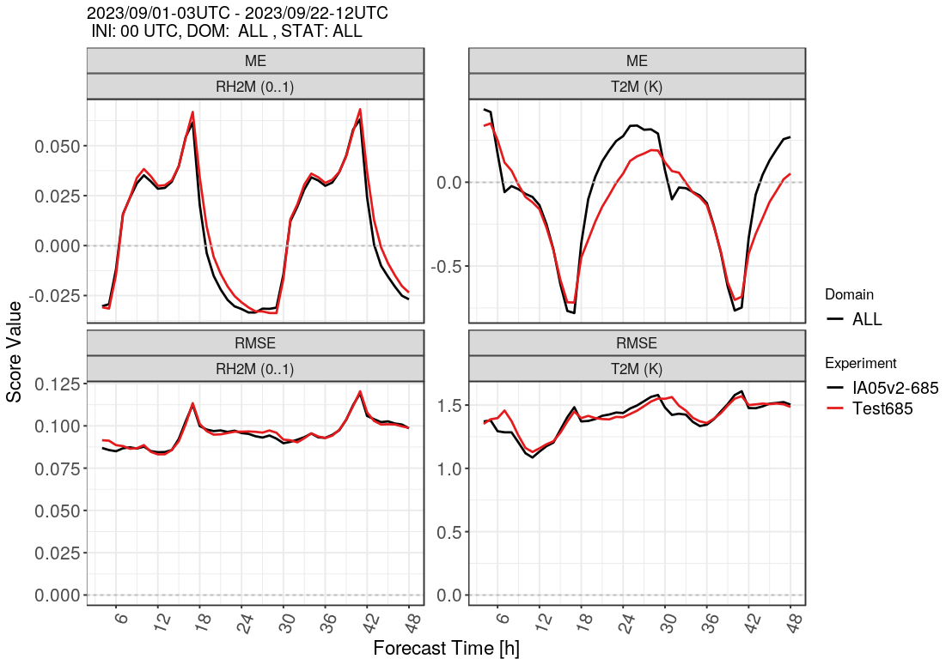
ICON-LAM with 500 m
Further findings related to the nocturnal temperature bias difference
Interpolating the model orography from 2 km to 500 m removes the bias difference (left)
Reducing parameterized turbulent mixing over sloping terrain reduces the bias difference (right)
500 m
2 km
Sep 2023, Alpine domain, interpolated orography
Sep 2023, Alpine domain, turbulence tuning
Notes:
14

Slide 15
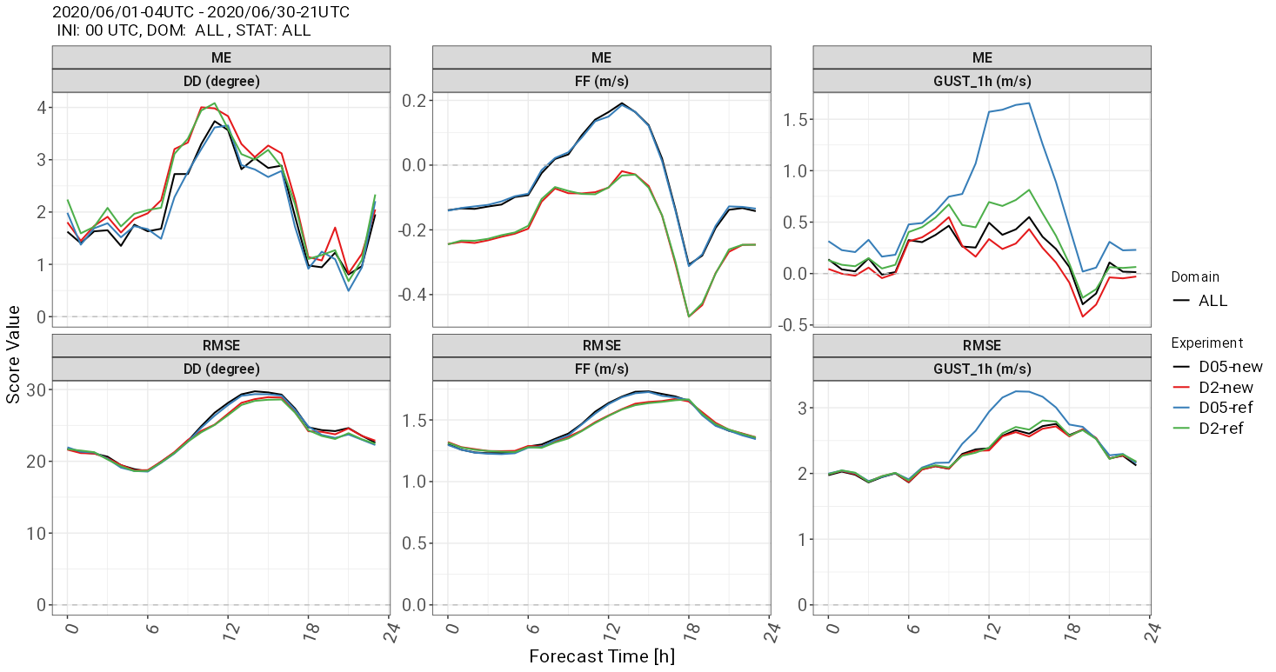
ICON-LAM with 500 m
Adapted gust parameterization
Based upon 10-min averaged 10-m winds rather than instantaneous values in order to reduce impact of ‚permitted turbulence‘
Limitation of gust excess speed to resolved PBL wind maximum (times tuning factor)
Hindcast for June 2020
10-m winds used for verification are still instantaneous values
Notes:
15

Slide 16
ICON-LAM with 500 m
Summary of tuning changes / model improvements developed and implemented so far
Slightly increased orography filtering
Reduced parameterized turbulent mixing over sloping terrain, combined with reduced transfer resistance for surface fluxes
Reduced SSO source term for TKE
Turn off sub-grid-scale condensation heating at 500 m
Revision of resolution-dependence of tuning parameters in convection scheme (shallow convection is still active at 500 m)
Modified gust parameterization based upon 10-min averaged 10-m winds with additional PBL limitation (recently introduced in operational ICON-D2 incl. RUC)
Under investigation
Reduced snow albedo over steep slopes
Notes:
16

