Slide 1


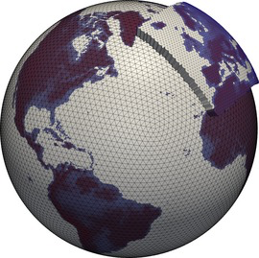
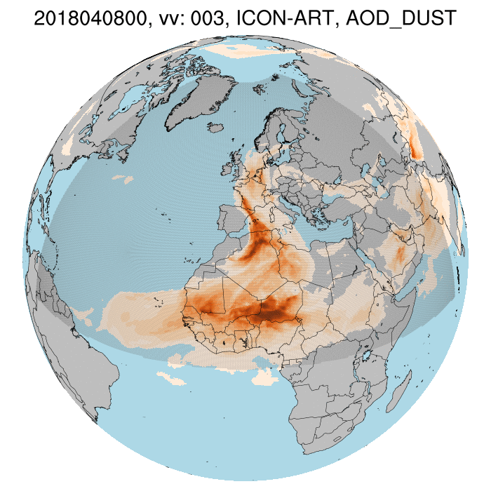
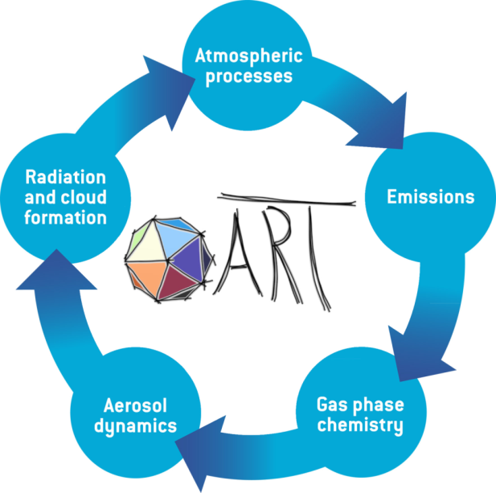
GM Meeting Sept 2024
Ali Hoshyaripour and the ARTists

Slide 2

: latest release 2024.07
Optics of all natural aerosols
Optics of internally mixed aerosols
Coupling with radiation (full and reduced grid)
Warm and cold activation
Dusty-cirrus parameterization
Point source
All natural aerosols
Biomass-burning plumes
Volcanic plumes (FPLUME)
Online emission module
MEGAN
  Lifetime based
  Linearized schemes (LINOZ, N₂O-NOy)
  Simplified OH chemistry
  MECCA/KPP
Modal treatment
AERODYN
ISORROPIA
Water uptake by SS
(--enable-art-gpl)

Slide 3
Aerosol optical properties in ICON-ART
Look-up tables:
  Dust
  Sea salt → updated in PermaStrom
  BB aerosols → updated in PermaStrom
  Sulfate
  (coated) Ash/Dust
MieAI: online calculation of aerosol optics (Kumar et al 2024)
  Developed mainly for internally mixed aerosols
  Usable/adoptable for externally mixed aerosols

Slide 4
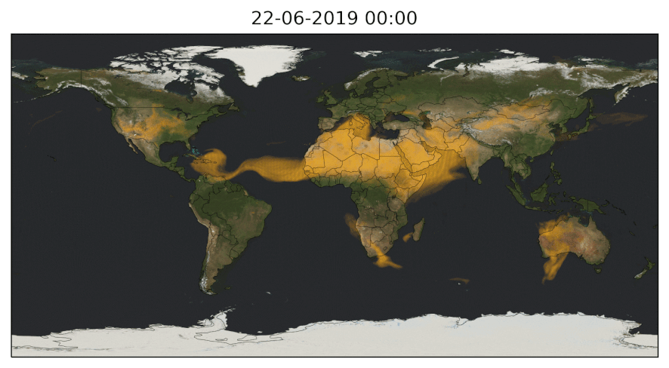



Multi-aerosol simulations
R2B06
Mineral Dust
Sea Salt
Biomass Burning Aerosols
Anika Rohde

Slide 5
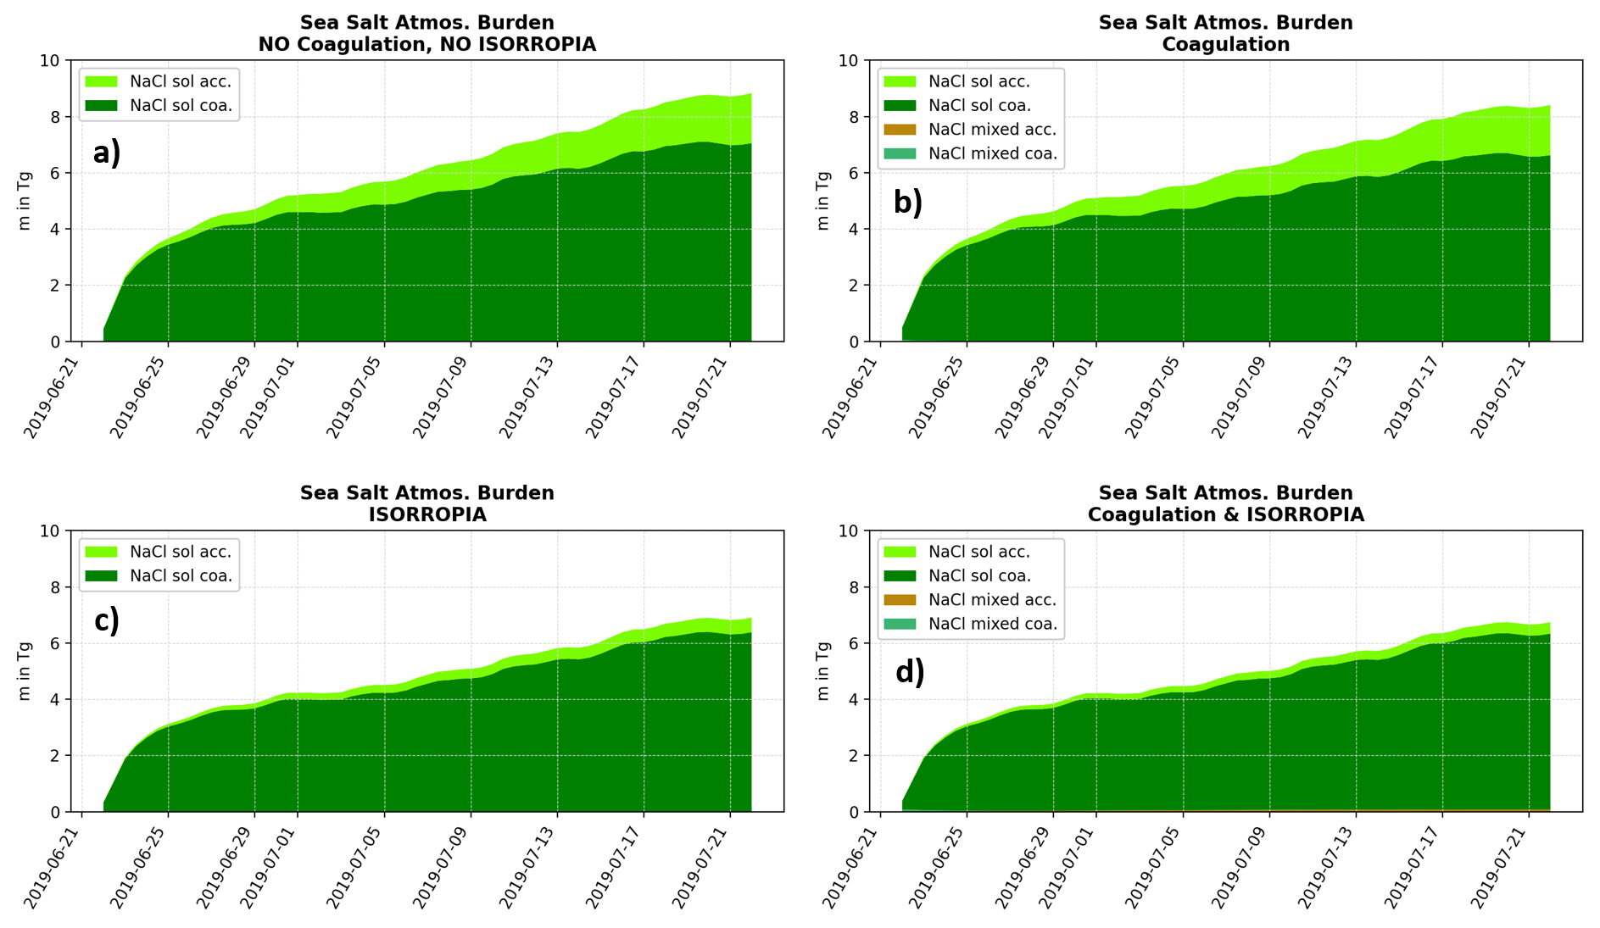
Aerosol dynamics affect sea salt burden
Anika Rohde

Slide 6
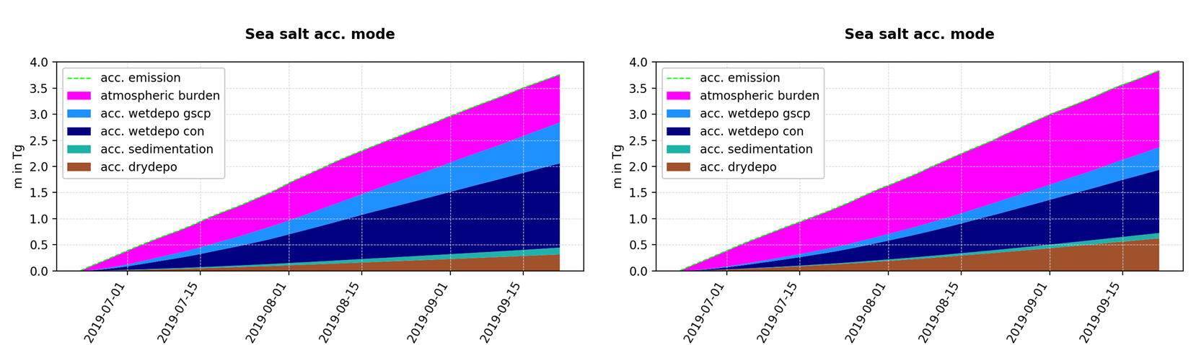
Parameterization of water uptake by sea salt
ISORROPIA does not run on the HPC-System of DWD.
Water uptake by sea salt particles is parameterized based on the Zdanovskii-Stokes-Robinson (ZSR) relation (as documenetd by Lundgren 2010)
Particle growth enhances washout and lowers the burden
Water uptake on
Water uptake off
Heike Vogel

Slide 7
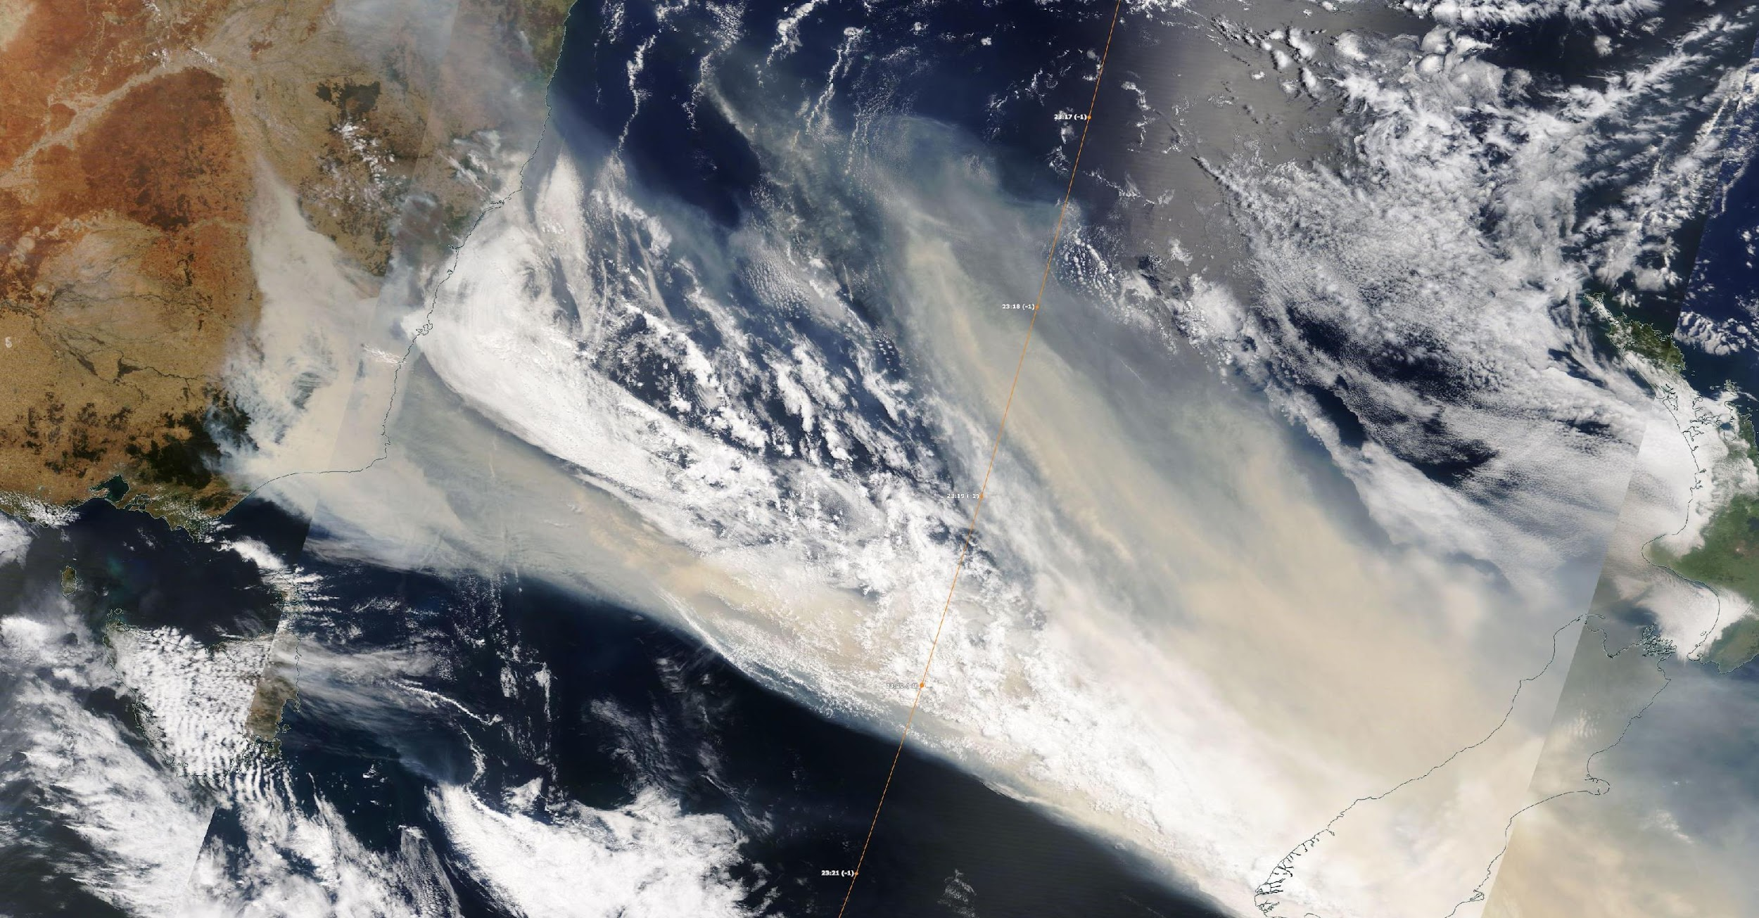
Wildfires on Australia’s New Year 2020 (ANY)
Objective:
To explore the effects of sensible and latent heat release + ARI on the heights Smoke plumes
Experiment:
30.12.19 to 02.01.2020
LAM with 6 km grid spacing
Emission based on GFAS
  OC + BC
  FRP
  Emission factor *3.4
  Injection using plume rise model
with ecrad & aerosol aging
NASA Worldview: Modis 31.12.19 ~23:15 UTC
Lisa Muth et al. 2024 (in prep)

Slide 8
Sensible heat release by the fire is the key
Which process has the largest effect on injection heights?
We study the following ones:
  H₂O emission
  Sensible heat release
  Aerosol radiation interactions
Lisa Muth et al. 2024 (in prep)

Slide 9
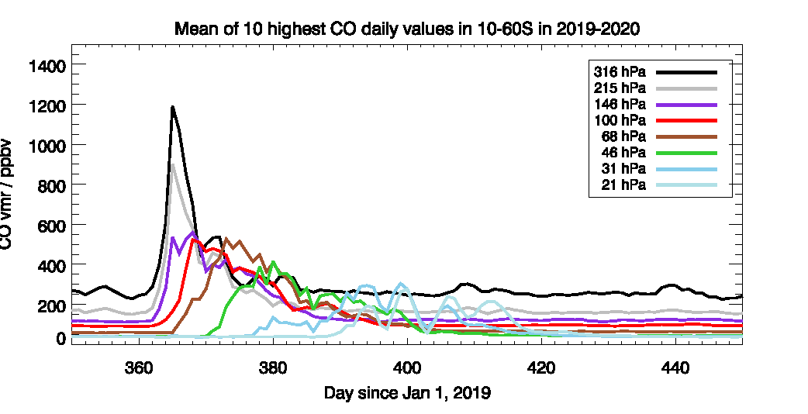
Lofting rate of ANY Plume in observations
From Alexandra Laeng, KIT
Ohneiser et al. 2022
Lofting from 12 km to 17,5 km within 7 days
Lofting from 13 km to 18 km within 7 days
Lofting_rate = 0.785 km d⁻¹
Lofting_rate = 0.715 km d⁻¹
Tabea Unser

Slide 10
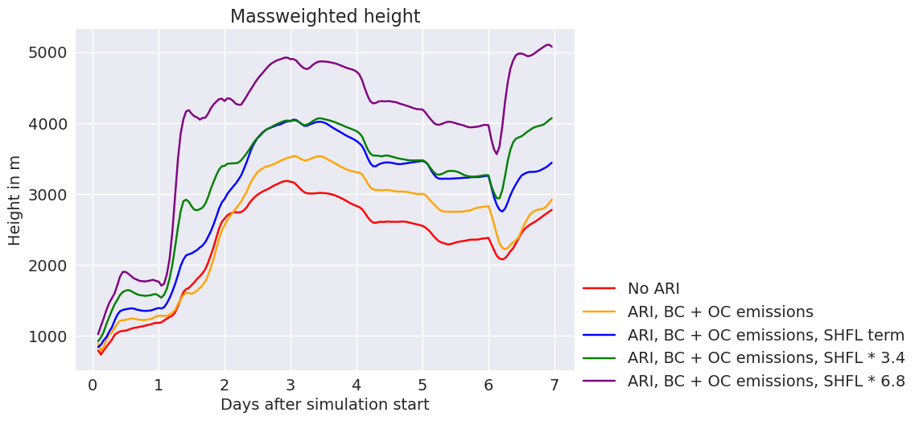
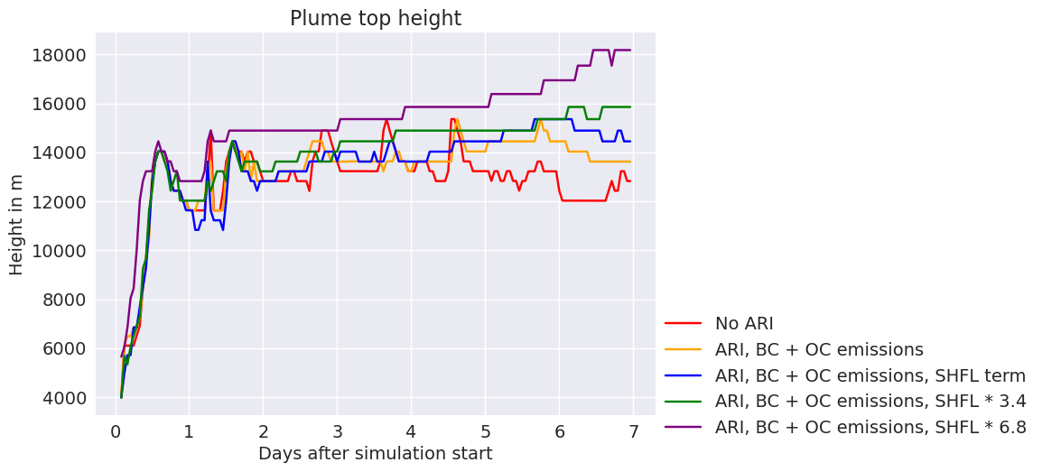
Lofting rate from ICON-ART
Lofting from 13 km to 18 km within 7 days
Lofting_rate = 0.5 - 0.8 km d⁻¹
Tabea Unser

Slide 11
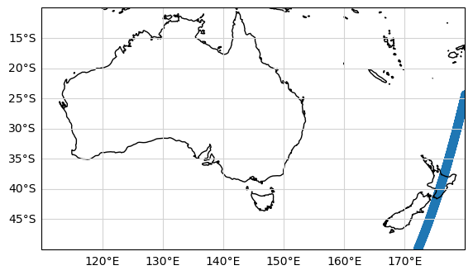
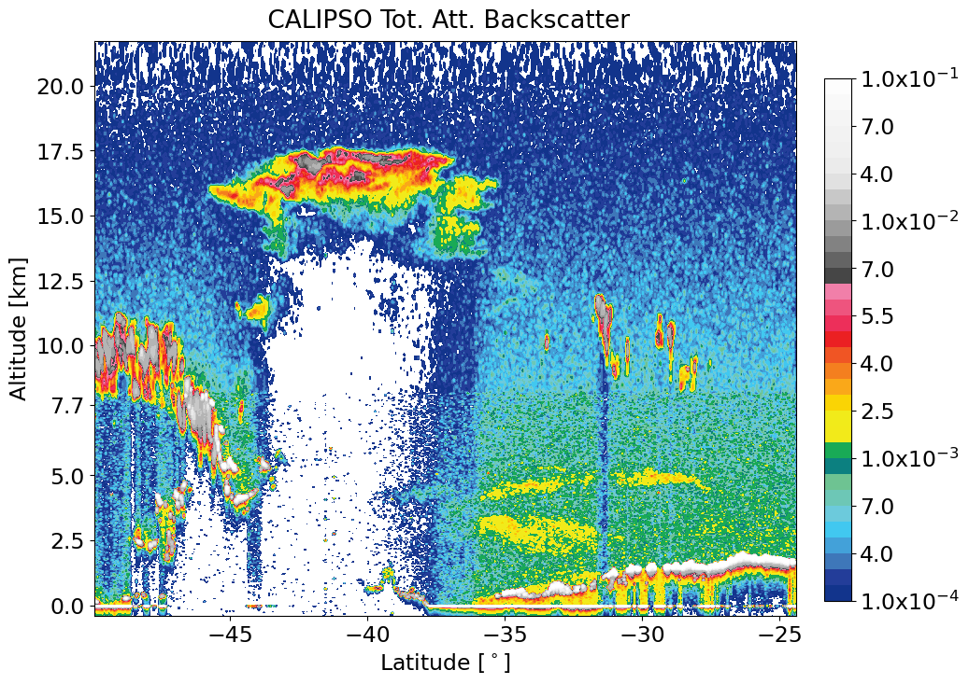
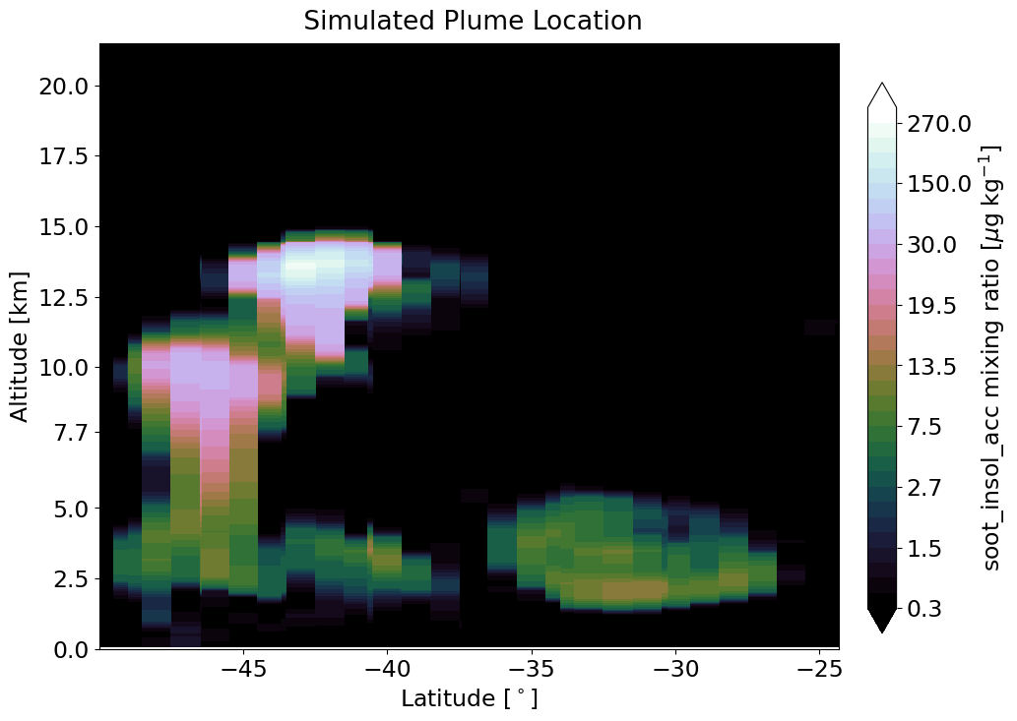
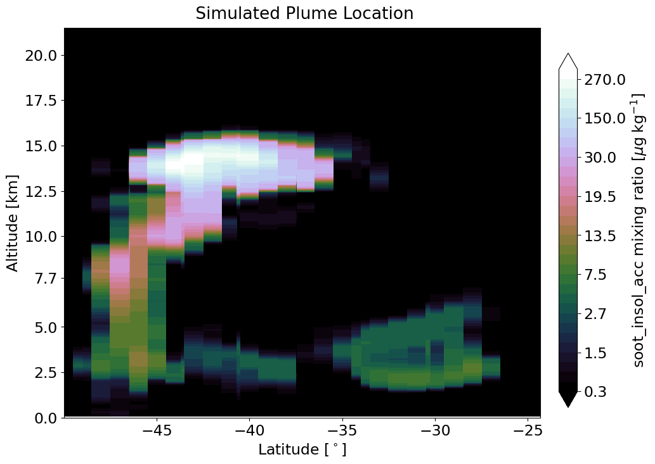
Comparison with CALIOP
CALIOP profile on 01/01/2020 13:04 UTC
SHFL*3.4
SHFL*6.8
Tabea Unser

Slide 12
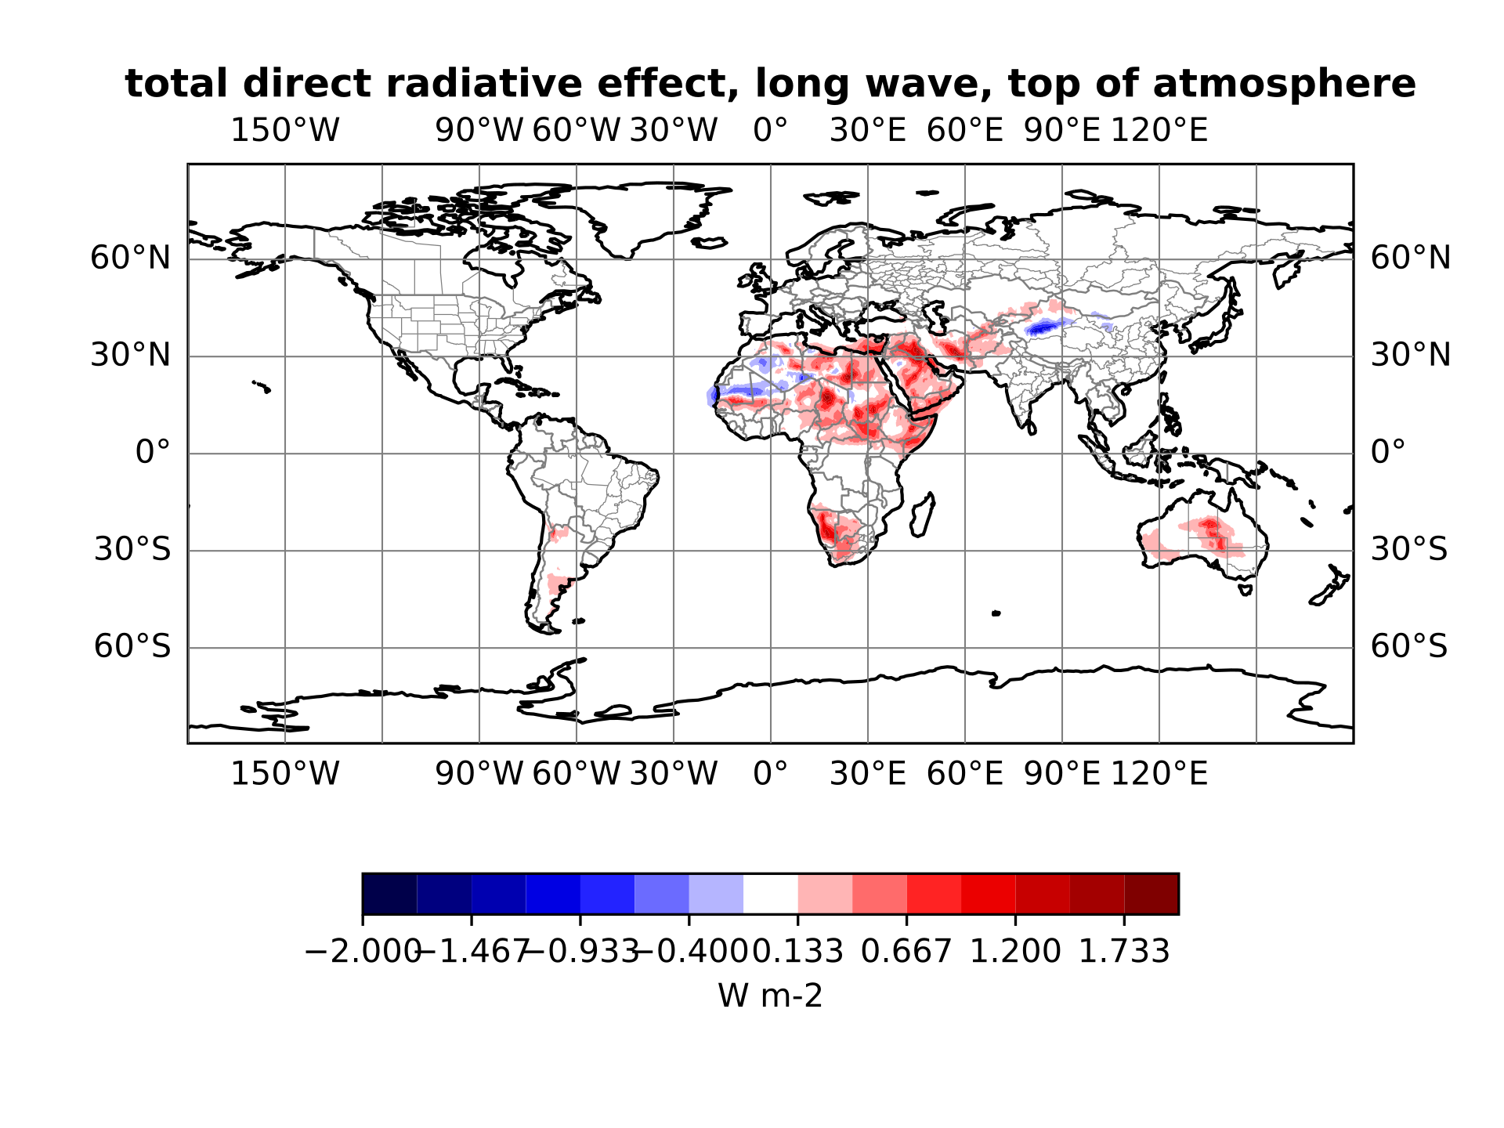
Radiation multiple call scheme
Calculate direct radiative effect of aerosols (total/per mode) at surface/TOA by calling radiation scheme twice/multiple times (with/without aerosols)
Daily average (example: 03 Jan 2018)
Dust only
A. Baer, M. Klose

Slide 13
Redesign: CCN-Activation with ART
Goal: Avoid code duplication of 2-moment microphysics code
mo_nwp_gscp_interface.f90
mo_2mom_mcrph_main.f90
Call ART activation routine prior to microphysics scheme
  Updates qnc and qc tracer
Prevent ICON‘s nucleation calls
  Triggered by ccn_type=9
……
#ifdef __ICON_ART
ELSE IF (icpl_aero_gscp == 4 .AND. inwp_gscp == 6) THEN
CALL art_activation_interface(nproma, nlev, jg, jb, …. )
#endif
……
ELSE
#ifdef __ICON_ART
IF(nuc_c_typ /= 9) & ! case 9 = activation done (ART)
#endif
CALL ccn_activation_sk_4d(…)
ENDIF
Replace microphysics scheme CALL for ART (inwp_gscp=6)
  No art_clouds_interface_2mom (duplicated code)
……
#ifdef __ICON_ART
CASE (6)
CALL two_moment_mcrph ( …. )
#endif
Current state:
Successful compiling
Local testing commenced
S. Bierbauer, S. Werchner, H. Vogel

Slide 14
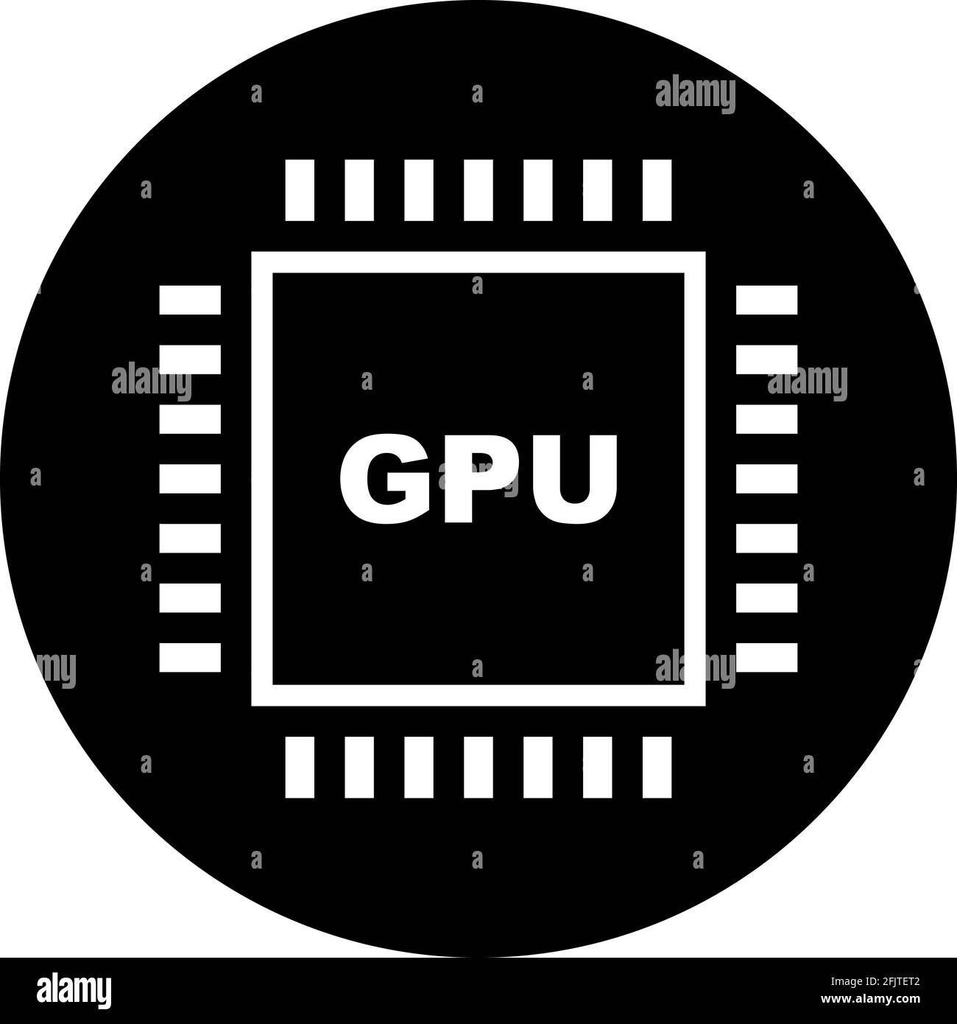

: mission and vision
Seamless AC model scalable for weather, seasonal, global climate and ESM applications
Code optimized and GPU-ready
Comprehensive and flexible coupling
Enhanced performance with ML
Notes:
Enhanced Performance with ML: Accelerating model components using machine learning techniques.
Optimized and Ready: Ensuring code optimization for heterogeneous HPC systems.
Comprehensive and Flexible Integration: Enabling flexible coupling and interactions among processes and linking with other Earth System Model (ESM) components.
Target is „Scalable Applications: Supporting scalability for Numerical Weather Prediction (NWP), sub-seasonal, seasonal, climate, and ESM applications.“

