Slide 1
TERRA
Fixes to water balance (Roland Wirth, Martin Köhler)
Coupled runs Atmosphere – TERRA – HD – OCEAN conserve mass well (new buildbot test for water conservation (1e-11)), 2.5 cm/10 years
Inclusion of HiHydroSoil v2.0 (Jürgen Helmert) (https://www.futurewater.eu/projects/hihydrosoil/)
Modifications to TERRA
Processing of data in Extpar

Slide 2
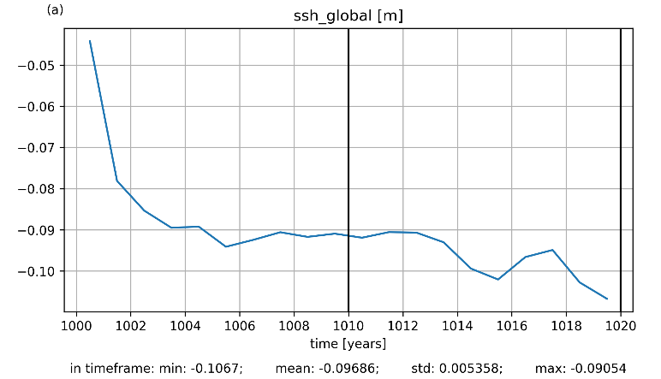
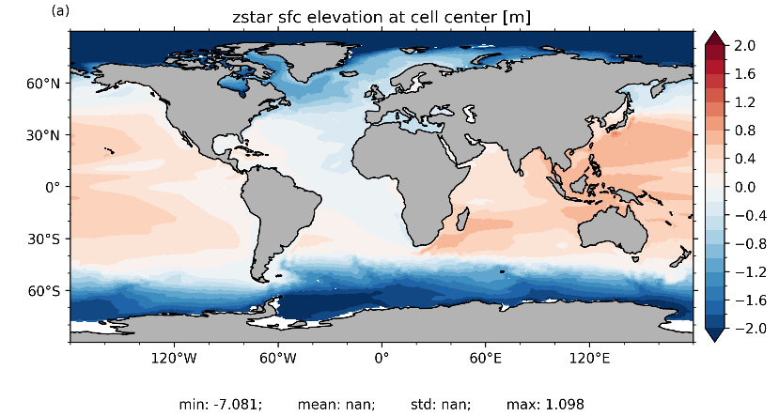
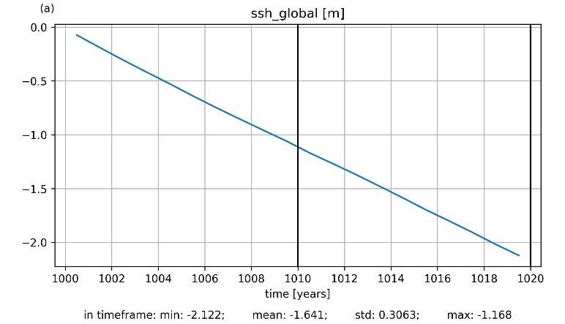
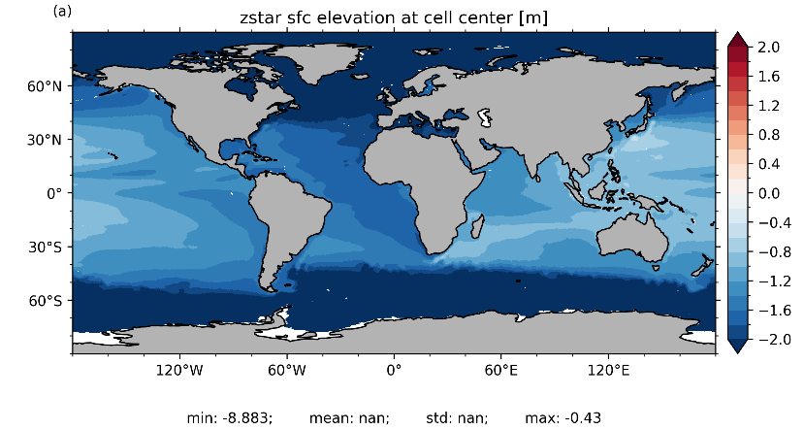
impact on sea surface height 0-20y
- 2.5cm/10y
with
HD-model
- 1.1m/10y
without
HD-model
Martin Köhler
Small remaining water conservation inconsistency in TERRA

Slide 3
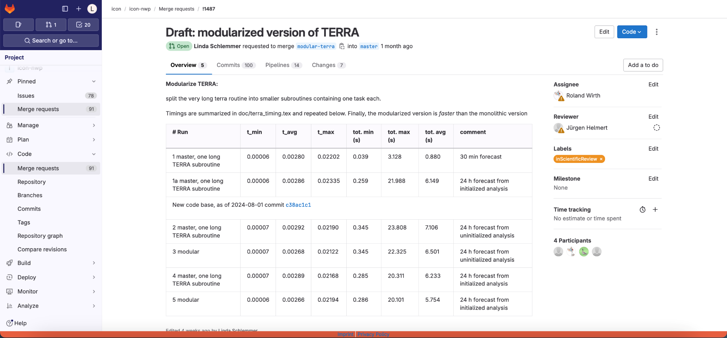
Modularization of TERRA
Merge request in progress (some buildbot tests still failing)
https://gitlab.dkrz.de/icon/icon-nwp/-/merge_requests/1487
Code restructuring, „identical“ results
Which further TERRA developments that are in progress must be migrated?

Slide 4
ICON-LAND (ICON-XPP configuration)
Coupling of HD model via YAC completed (Trang v. Pham, Roland WIrth)
Tuning
Work on using tmx (turbulent diffusion – land coupling infrastructure) in progress (Moritz Waldmann, WarmWorld)

Slide 5
Further ongoing Work
New Surface analysis
Snow – tests are running
SST – work in progress
T_{2m} – work in progress
CERISE (ICON-LAND)
New snow analysis applied
Time-dependent ESA-CCI land cover used

