Slide 1
TKESV Turbulence Scheme
Working Progress
Ekaterina Machulskaya and Dmitrii Mironov
German Weather Service, Offenbach am Main, Germany
(ekaterina.machulskaya@dwd.de, dmitrii.mironov@dwd.de)
COSMO General Meeting
2-5 September 2024

Slide 2
Key features of TKESV
prognostic scalar variances → counter-gradient vertical heat and moisture transport (non-local nature of convective motions)
non-Gaussian statistical cloud scheme (currently of Bechtold-Cujipers) → intensive turbulence due to latent heat release within clouds of small area coverage (skewed nature of convective motions)
non-local turbulence length scale → consistent interaction of turbulence with the atmospheric stability
regularization of stability functions (required to avoid their singularity) → emulation of the neglected transport terms in the diagnostic equations for fluxes
different constant values (as compared to the operational scheme turbdiff)

Slide 3
Global ICON runs
Global runs for July 2023, control (turbdiff) vs. exp (TKESV)
Forecasts issued at 0 UTC for 30 hours
No own data assimilation cycle (initial conditions are taken from the routine)

Slide 4
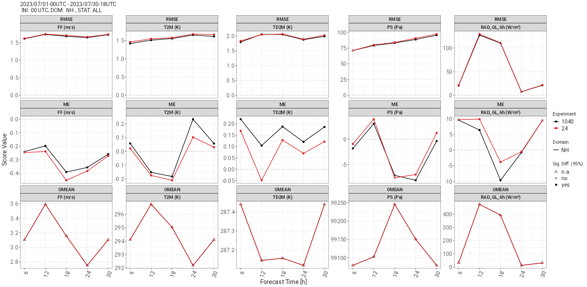
Global ICON runs: SYNOP verification
NH
control
exp
RMSE
Bias
Obs
Wind 10m T 2m Td 2m PS RAD

Slide 5
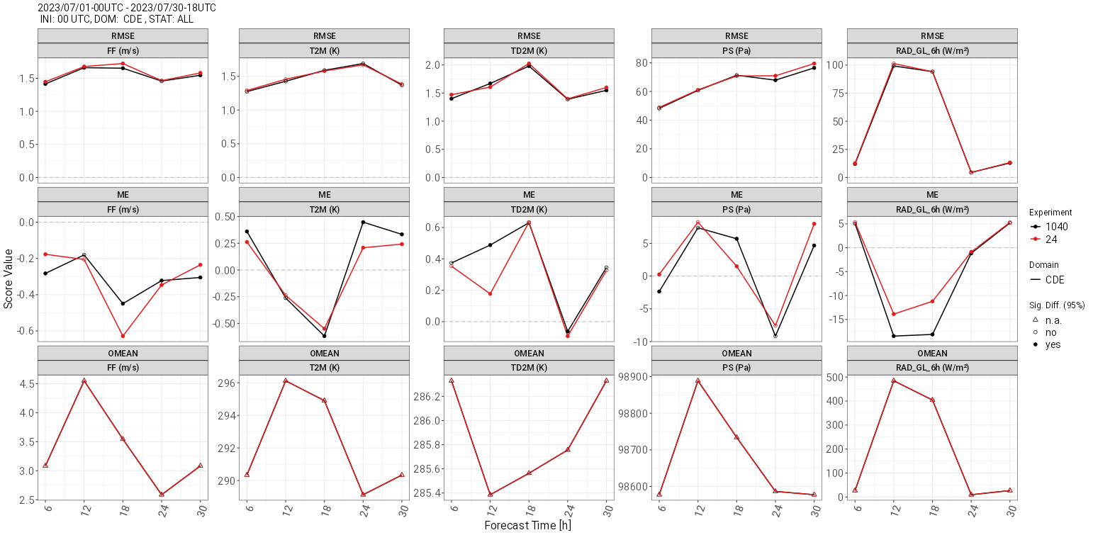
Global ICON runs: SYNOP verification
DE
RMSE
Bias
Obs
Wind 10m T 2m Td 2m PS RAD

Slide 6
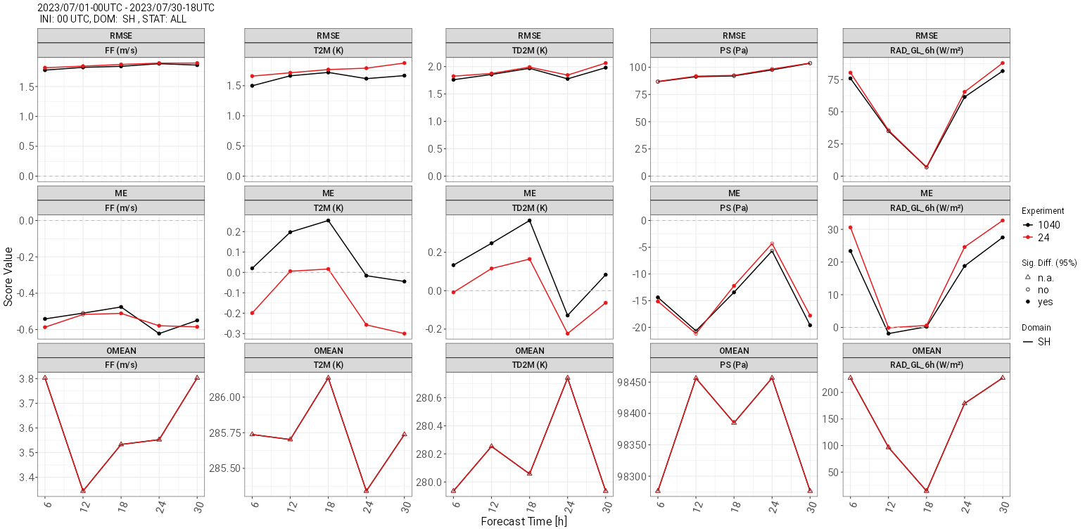
Global ICON runs: SYNOP verification
SH
RMSE
Bias
Obs
Wind 10m T 2m Td 2m PS RAD

Slide 7
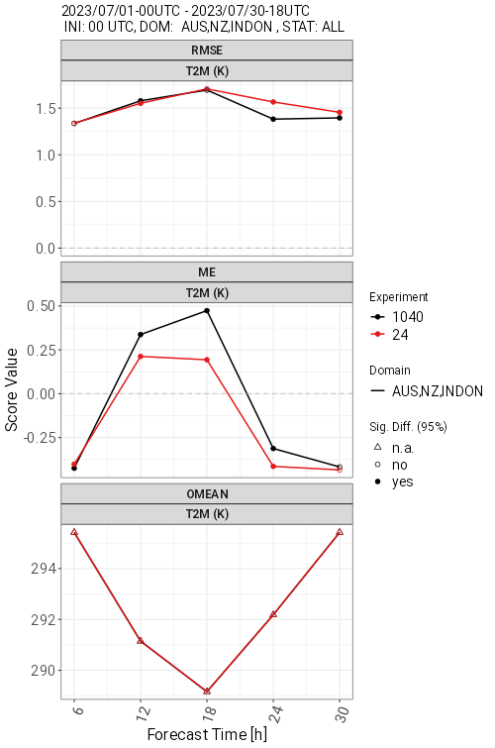
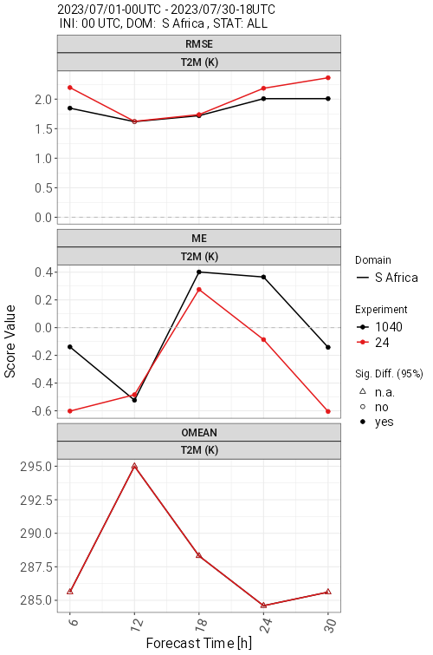
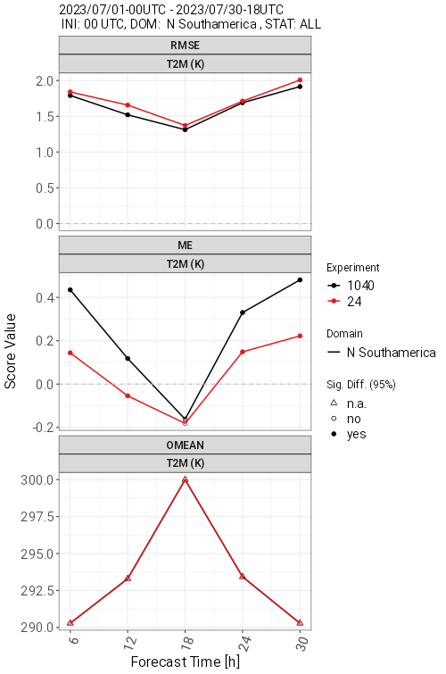
Global ICON runs: SYNOP verification
Australia
South Africa
Northern Southamerica

Slide 8
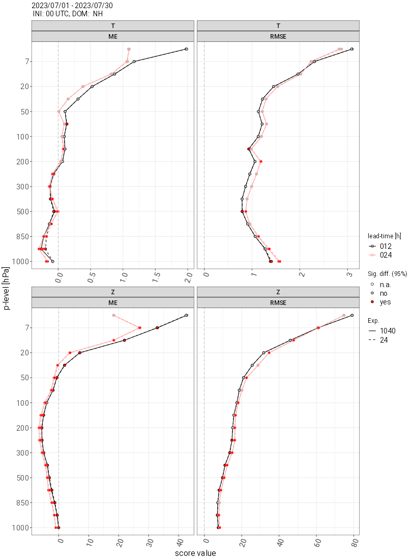
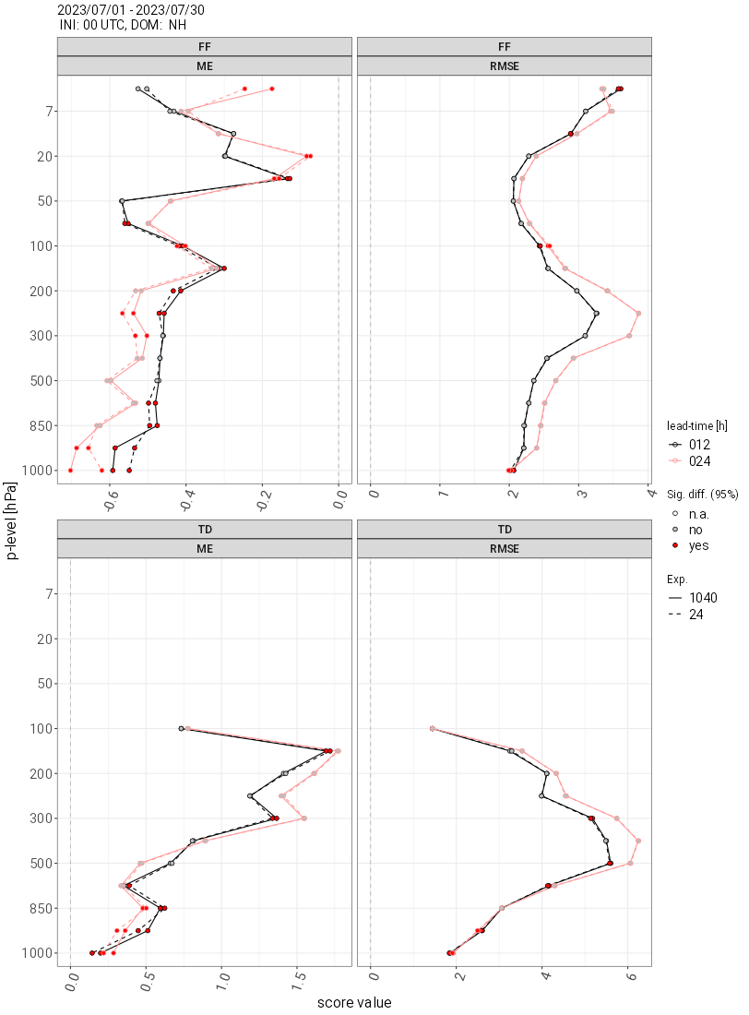
Global ICON runs: upper air verification
NH
12h
24h
control
exp

Slide 9
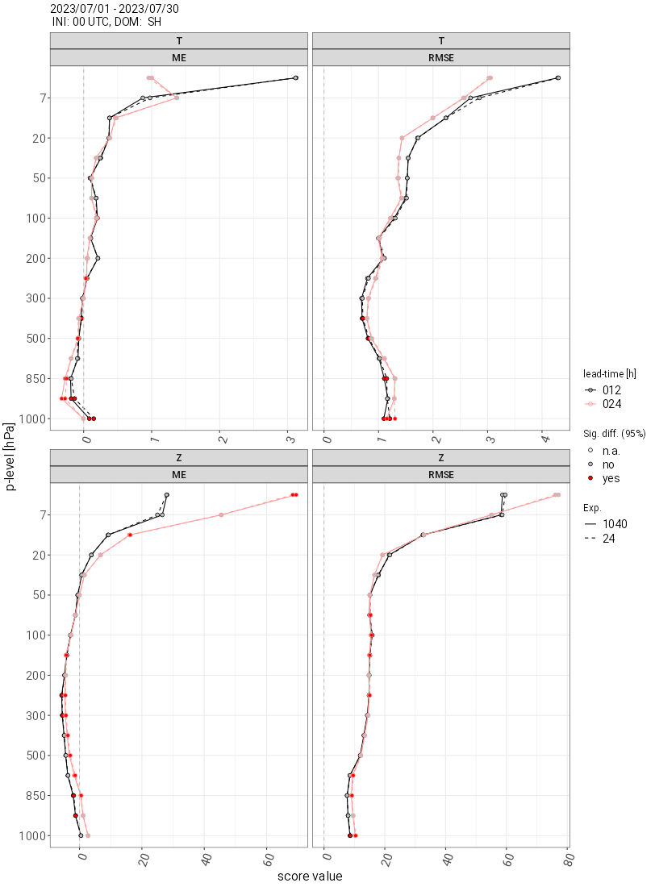
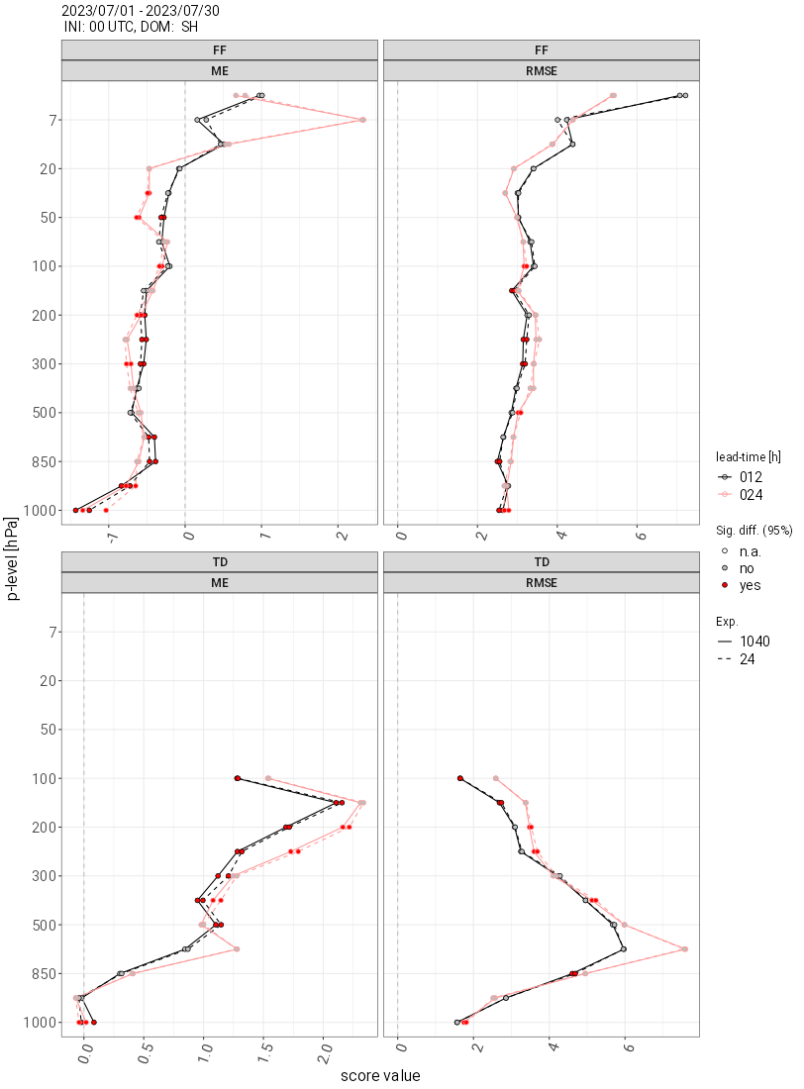
Global ICON runs: upper air verification
SH

Slide 10
Conclusions
The TKESV scheme runs stably within the global ICON with the operational settings
Day 2m temperatures decrease due to enhanced mixing (← counter-gradient transport, non-gaussian latent heat release in clouds), but increase due to reduced cloudiness; night 2m temperatures decrease due to a less diffusive stable PBL (← nonloc length scale)
Problems: lower day 10m winds (but good for tropics), too cold in the morning in the winter hemisphere, low winds in the free troposphere

Slide 11
Thanks for your
kind attention!

Slide 12
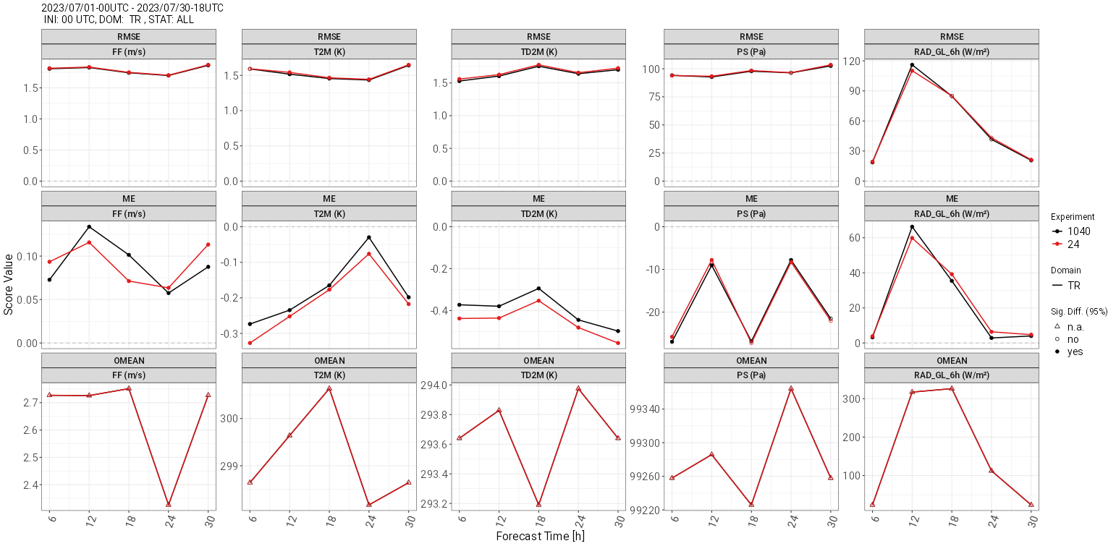
Global ICON runs: SYNOP verification
Tropics
RMSE
Bias
Obs
Wind 10m T 2m Td 2m PS RAD

Slide 13
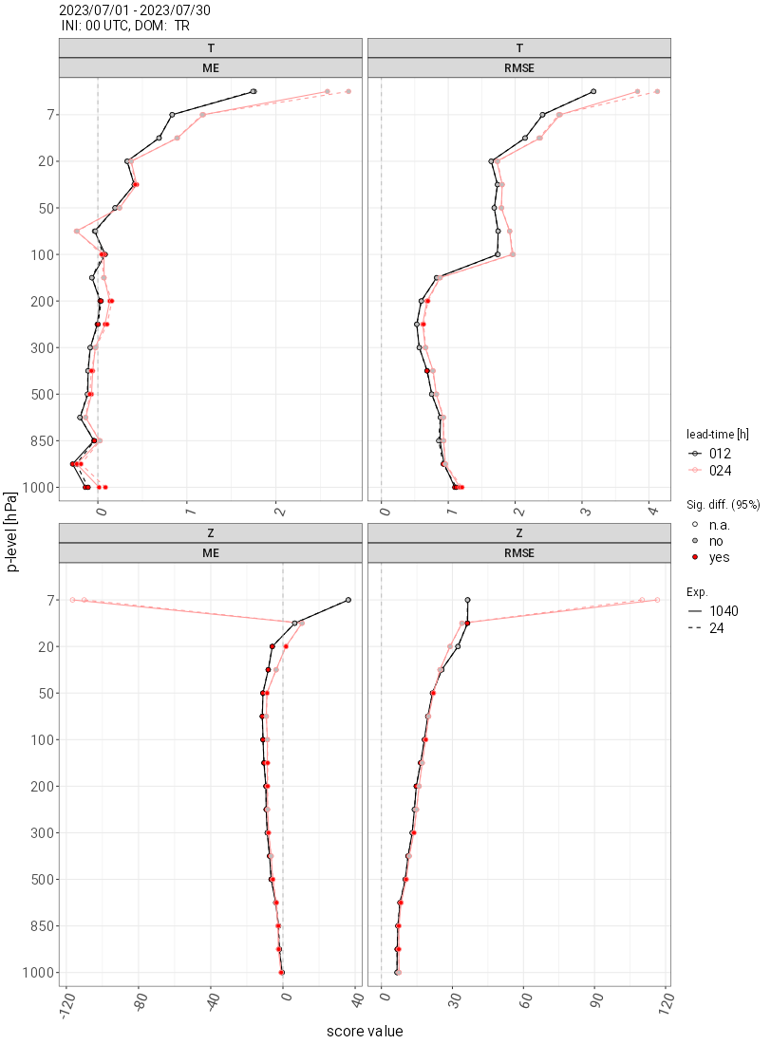
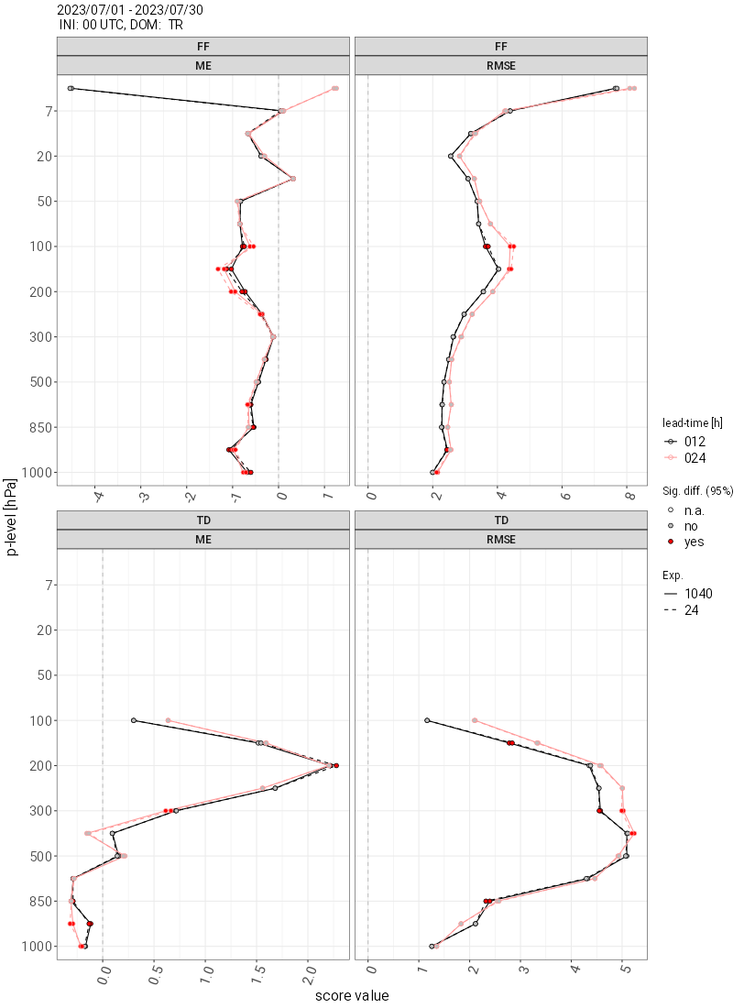
Global ICON runs: current status

Slide 14
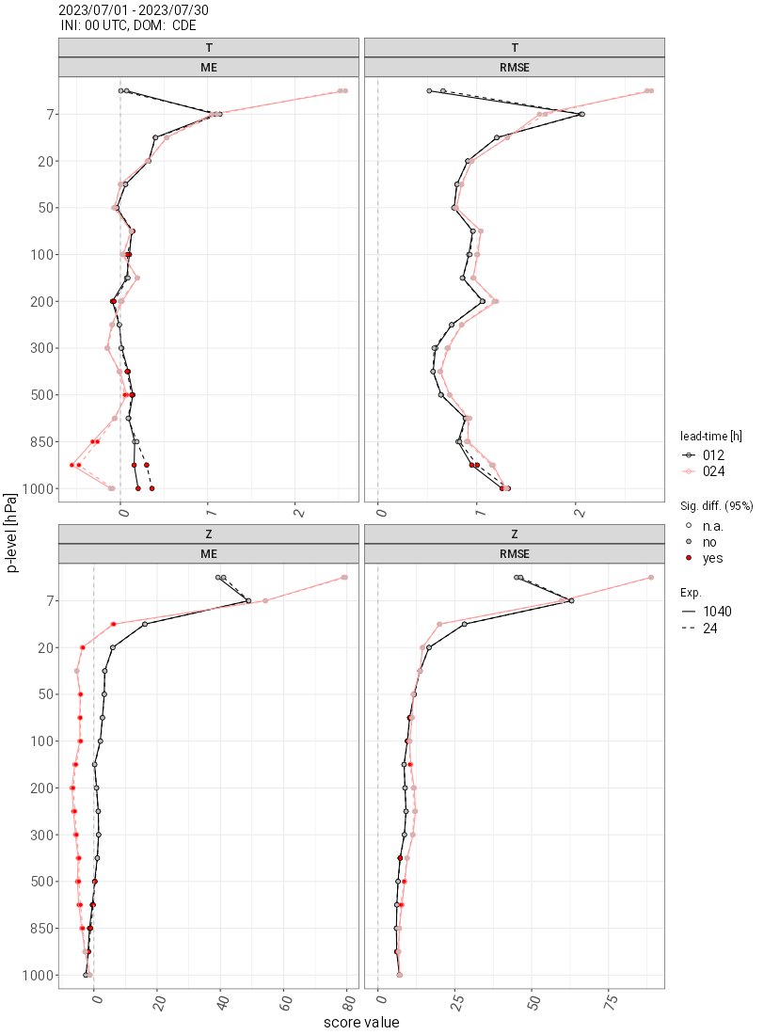
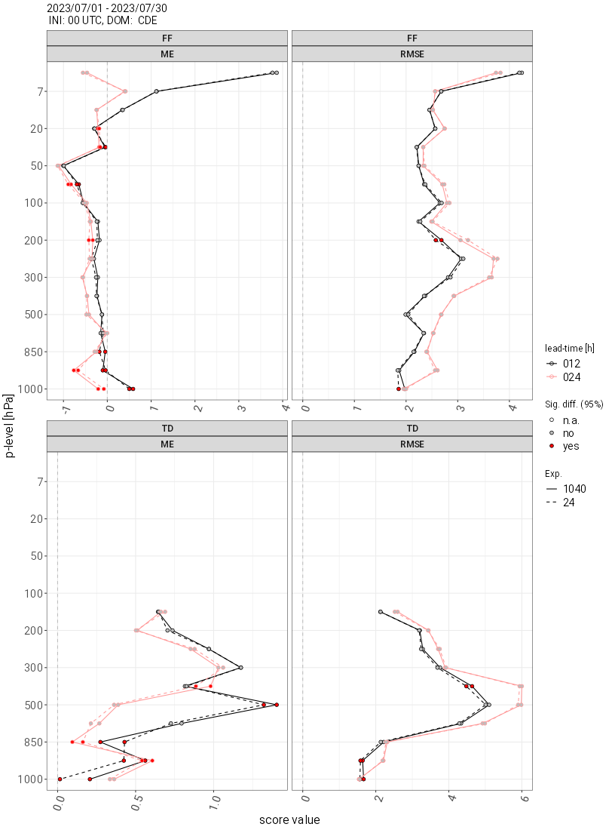
Global ICON runs: current status

Slide 15
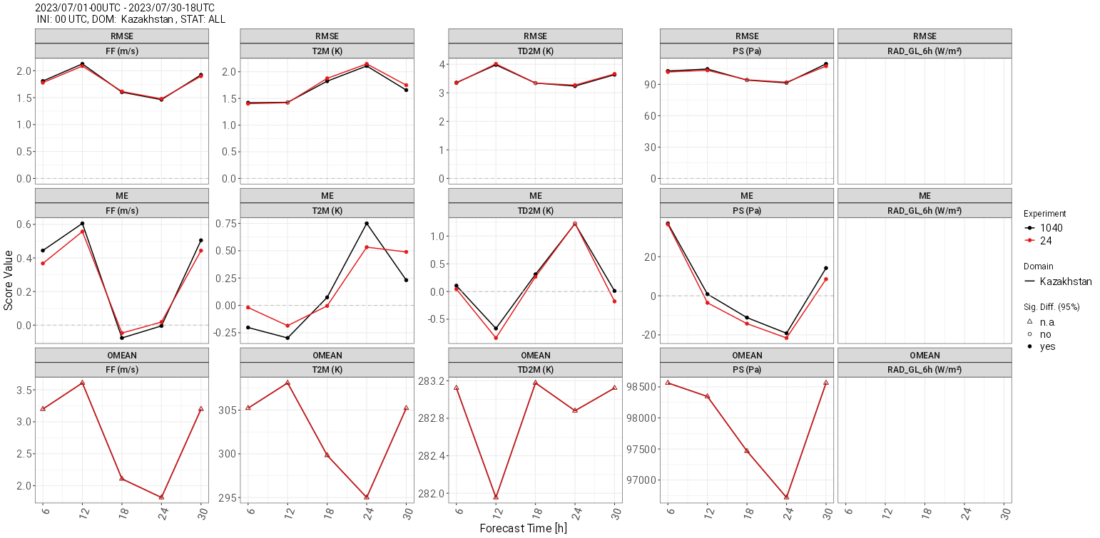
Global ICON runs: current status

Slide 16
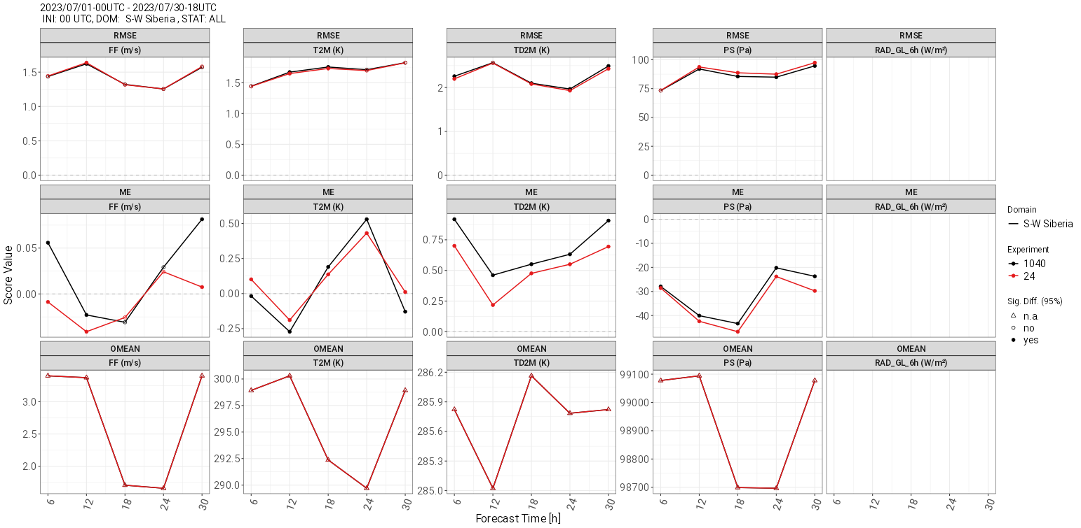
Global ICON runs: current status

Slide 17
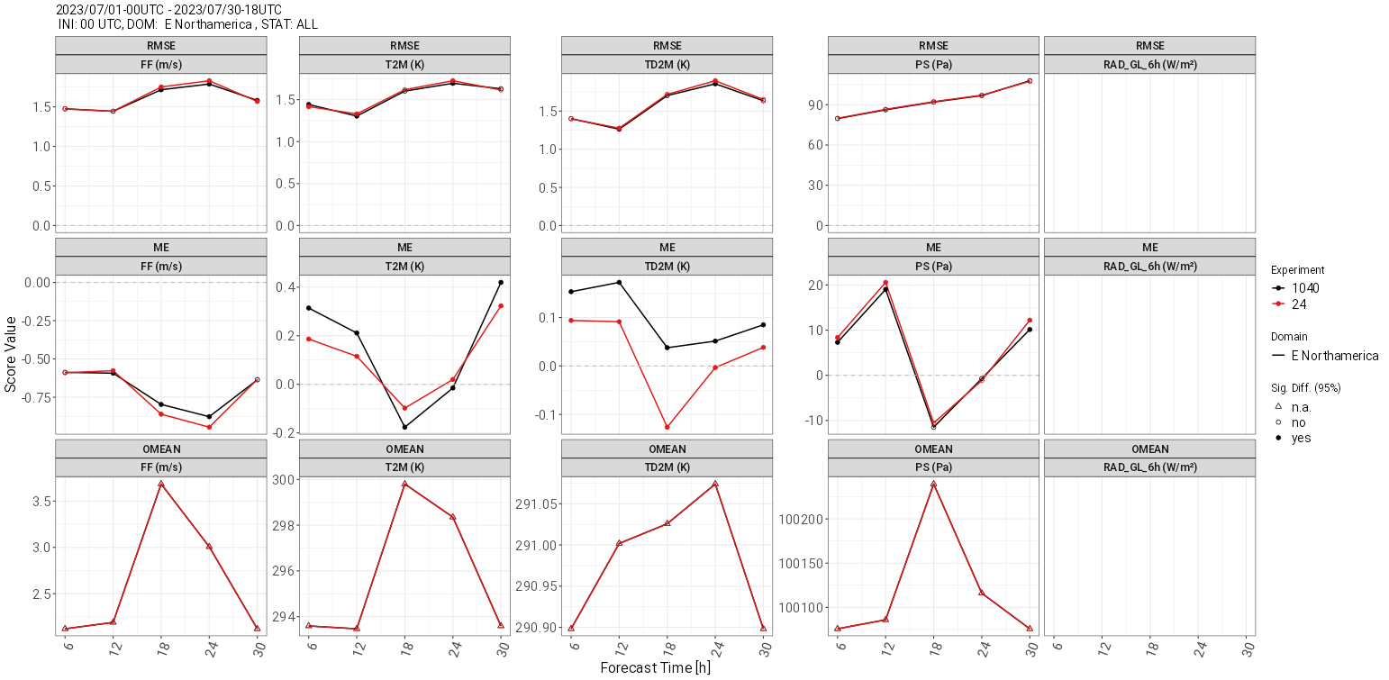
Global ICON runs: current status

