Slide 1
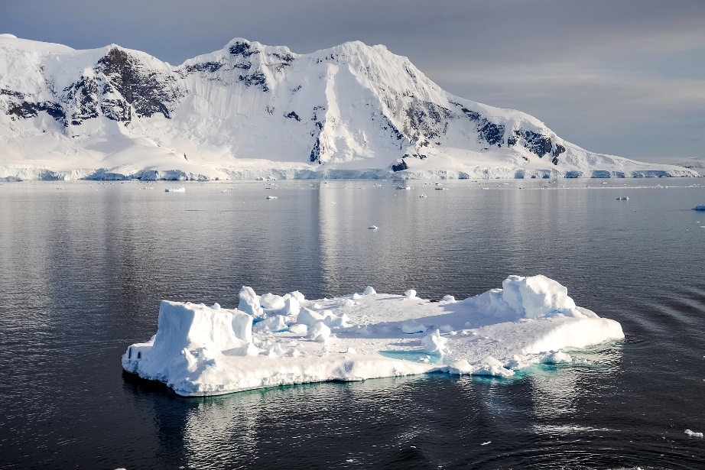
Snow on Sea Ice Roland Wirth, Dmitrii Mironov & Daniel Krüger

Slide 2
Overview
Motivation
Treatment in ICON
Adaption
Testcases
Summary

Slide 3
Physics of Snow on Sea Ice
Snow has insulating effect
Slower build-up of sea ice in autumn
slower melting in spring/summer
Albedo is higher than for sea ice alone
Complex behaviour (different kinds of snow, age, puddles, etc.)

Slide 4
Treatment in ICON
Treatment of Sea ice split between Code parts:
Thermodynamics done in ICON-Atm
Rheology done in ICON-O
„one-layer“ model for calculation of sea ice thermodynamics
(Mironov et al., Parameterisation of sea and lake ice in numerical weather prediction models of the German Weather Service. Tellus A, 64(1), 2012. doi:10.3402/tellusa.v64i0.17330)
Snow is calculated, effect on albedo considered implicitly
But no treatment of heat transport

Slide 5
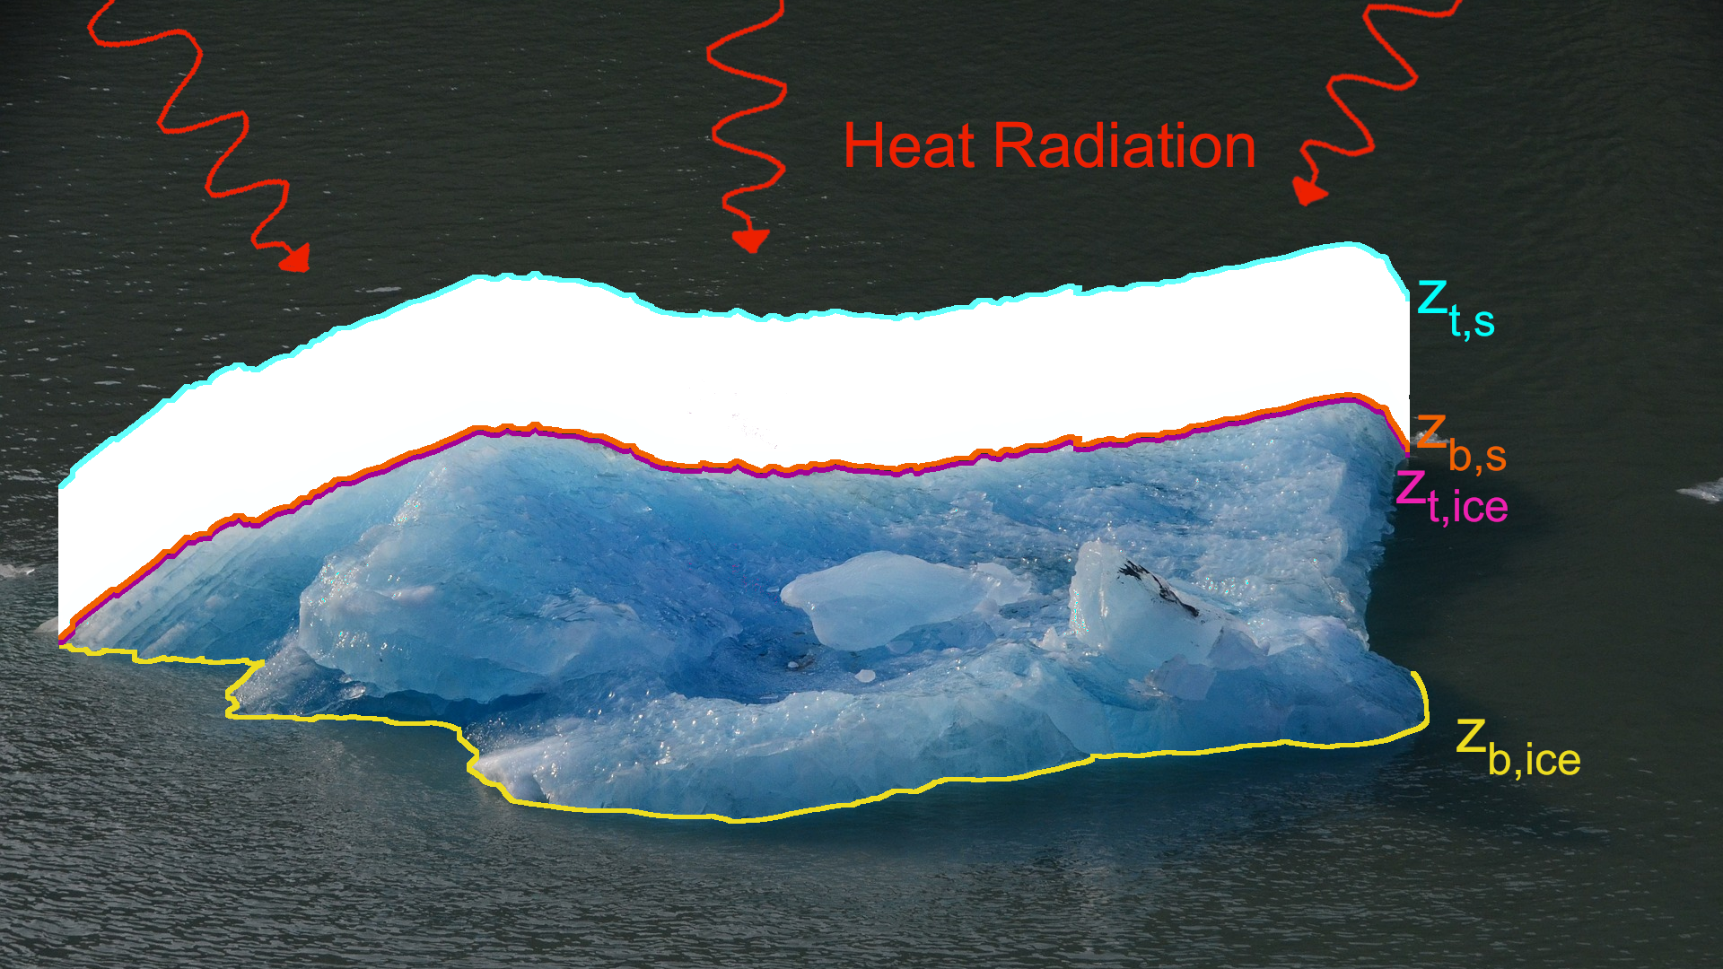

Slide 6
Adaptions
Assume no snow melting at snow-ice-boundary
${\text{ρ}}_{s}$and $k_{s}$ are time-dependent
Introduce profiling function for sea ice / snow:
$\text{Φ}\left(ζ\right)=\left({\text{Φ}}_{∗}−1\right)\frac{h}{h_{max}}ζ^{3}−\left({\text{Φ}}_{∗}−2\right)\frac{h}{h_{max}}ζ^{2}+\left(1−\frac{h}{h_{max}}\right)ζ$, $ζ=\frac{z −z_{b}}{z_{t} −z_{b}}$
fullfilling $\text{Φ}\left(0\right)=0, \text{Φ}\left(1\right)=1, \text{Φ}′\left(0\right)\text{= 1− }\frac{h}{h_{max}}$
Use MOSAiC data to determine ${\text{Φ}}_{∗,i/s}$ and $h_{i/s,max}$

Slide 7
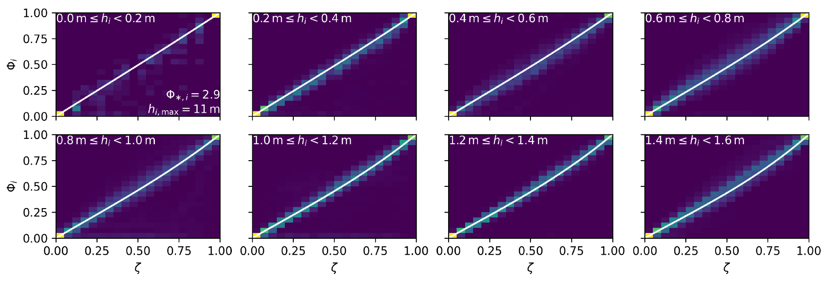
Profiling functions for ice

Slide 8
Profiling functions for snow

Slide 9
Testcases
Use coupled run with ICON-XPP setup
Run for ~1 year
Start from state from ESM-W experiment
1 Month additional spin-up
Vary ${albsi}_{max}$
NOAA: ${albsi}_{max}\text{= 0.9}$, IFS: ${albsi}_{max}\text{= 0.}\text{85}$

Slide 10
Weakly-Coupled Experiment Setup
Atmosphere:
3DVAR every 3h (hybrid EnVAR+LETKF is technically possible)
Assimilation of conventional data, SYNOP, and satellite data
No IAU
80km resolution (R02B05) + 90 levels
Ocean:
3DVAR at 00UTC applied to ARGO temperature and salinity
3DVAR (with FGAT) at 00UTC applied to OSTIA SST and SMOS SSS
No IAU
40km resolution (R02B06) + 72 vertical levels

Slide 11
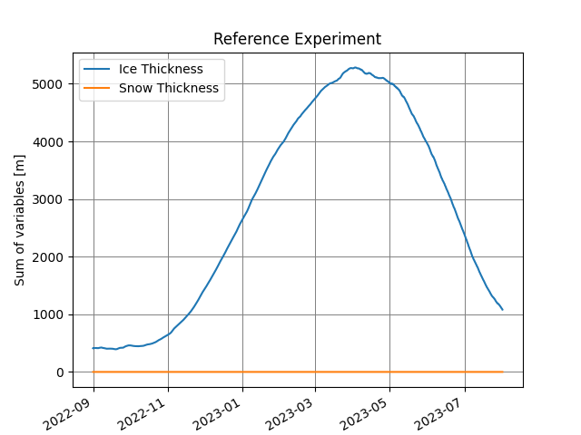
$${albsi}_{max}\text{= 0.}\text{7, }\text{Northern} \text{Hemisphere}$$

Slide 12
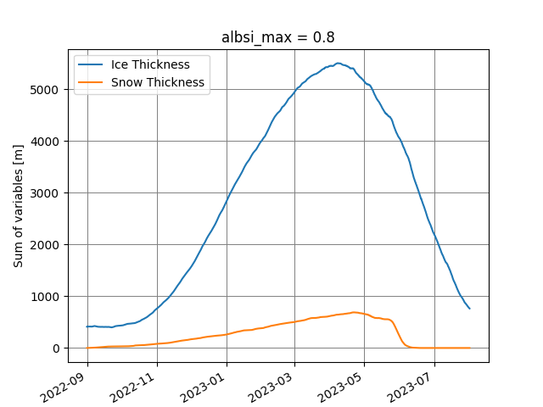
$${albsi}_{max}\text{= 0.}\text{8, }\text{Northern} \text{Hemisphere}$$

Slide 13
$${albsi}_{max}\text{= 0.}\text{85, }\text{Northern} \text{Hemisphere}$$

Slide 14
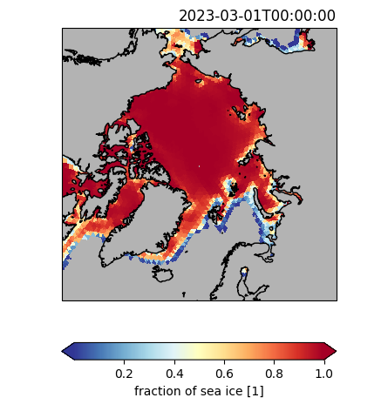
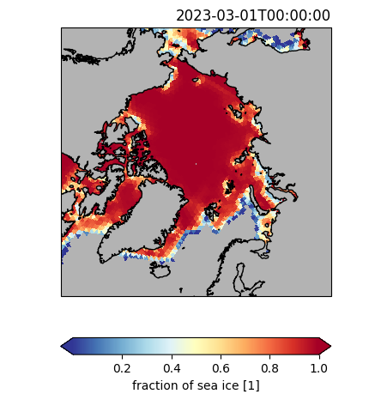
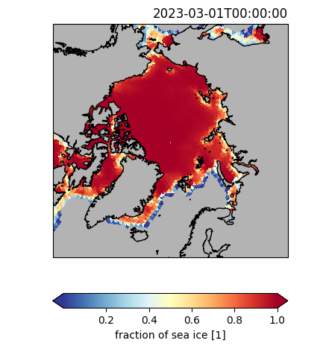
fr_seaice at Northpole
reference
$${albsi}_{max}\text{= 0.}\text{7}$$
${albsi}_{max}\text{= 0.}$8
$${albsi}_{max}\text{= 0.}\text{85}$$

Slide 15
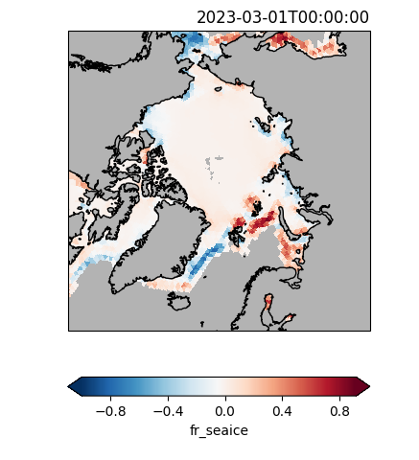
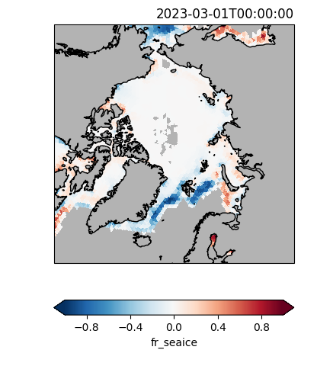
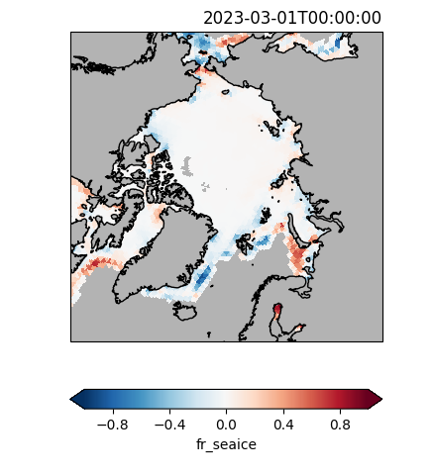
Difference of fr_seaice (ref – testcase) at Northpole
reference
$${albsi}_{max}\text{= 0.}\text{7}$$
${albsi}_{max}\text{= 0.}$8
$${albsi}_{max}\text{= 0.}\text{85}$$

Slide 16
Summary
Implementation of heat transfer through snow on sea ice
Profiling function following MOSAiC data
Delay in build-up of sea ice visible
But sea ice still melts too fast => more tuning necessary?
Maximum sea ice albedo
vary profiling functions (MODIS?)
test initialization (Start from routine data? More testcases?)
Wait for new sea ice rheology
(C. Mehlmann et al., Discretization of Sea Ice Dynamics in the Tangent Plane to the Sphere by a CD-Grid- Type Finite Element, JAMES Vol 14/12, Dec. 2022)

Slide 17
Thank you for your attention!
Questions?

Slide 18
Atm-only run, 11/1979 – 07/1980
Ice thickness and Snow thickness in the Arctic, parametrization turned on

Slide 19
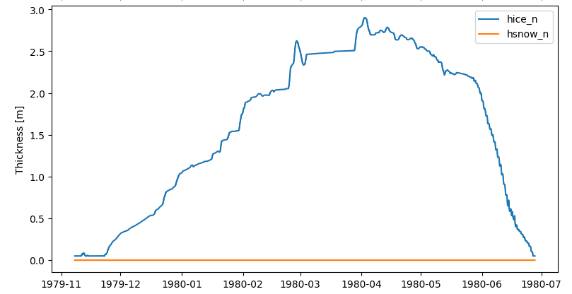
Atm-only run, 11/1979 – 07/1980
Ice thickness and Snow thickness in the Arctic, parametrization turned off

