Slide 1
Strongly Stable Boundary-Layer Flows over Thermally Heterogeneous Surfaces:
Effect of Heterogeneity Orientation
Dmitrii V. Mironov⁽¹⁾ and Peter P. Sullivan⁽²⁾
(1) Deutscher Wetterdienst, Offenbach am Main, Germany
(2) National Center for Atmospheric Research, Boulder, CO, USA
(dmitrii.mironov@dwd.de, pps@ucar.edu)

Slide 2
Outline
Motivation, previous studies
Flow governing parameters, simulation set-up, DNS data set
Results: mean fields, variances and fluxes, skewness, flow visualization
Implications for SBL parameterization
Conclusions and outlook

Slide 3
Motivation
Poor understanding of the role of horizontal heterogeneity in maintaining turbulence in SBLs
Most SBL models (parameterization schemes), incl. surface layer schemes, either ignore many important features (e.g., gravity waves, meanders of cold air, radiation flux divergence, and horizontal thermal heterogeneity of the underlying surface), or use ad hoc ideas
Mironov and Sullivan (2016, 2023) analysed the structure and transport properties of weakly stable (using LES) and strongly stable (using DNS) boundary-layer flows over surfaces with streamwise thermally heterogeneity
Extend the analysis of MS23 to look at the effect of the orientation of the surface heterogeneity patterns relative to the mean velocity

Slide 4
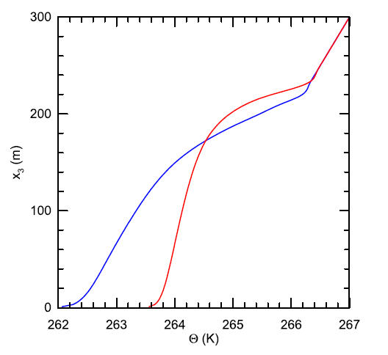
LES of Weakly Stable PBLs (Mironov and Sullivan 2016, J. Atmos. Sci., 73, 449-464.)
The SBL over a heterogeneous surface (HET) has larger TKE and is better vertically mixed as compared to its homogeneous counterpart (HOM).
The temperature variance plays a key role in enhanced mixing: increased <θ ′²> near the surface → reduced magnitude of the downward buoyancy flux → increased TKE → more vigorous mixing.
Because of surface heterogeneity, the turbulent transport term (divergence of the third-order moment) in the <θ ′²> budget is a net gain.
The SBL in both HOM and HET is turbulent (weakly stable regime!).
Mean temperature from simulations HOM (blue) and HET (red).
But what about strongly stable SBL?

Slide 5
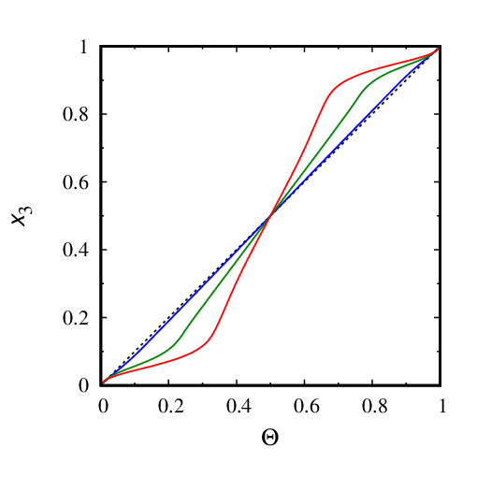
DNS of Strongly Stable PBLs (Mironov and Sullivan 2023, Boundary-Layer Meteorol., 187, 371-393.)
Idealized plane Couette flow configuration
Stratification is strong enough to quench turbulence over homogeneous surface (HOM)
Turbulence survives over heterogeneous surfaces (HET)
Both molecular and turbulent fluxes of momentum are down-gradient
Turbulent heat flux is up the gradient of mean temperature (cf. counter-gradient heat transport in convective flows)
Analysis of the flow structure and of the vertical-velocity and temperature skewness suggests a physically sound explanation of the observed features
All HET runs are with the streamwise heterogeneity, i.e., surface temperature wave crests are normal to the mean flow
Mean temperature from simulations HOM (dotted) and HET (solid).
But what about orientation of heterogeneity patterns?

Slide 6
Couette Flow Configuration
The fluid depth is H.
The lower boundary is at rest.
The upper boundary moves with a constant velocity U_{u}.
Stable buoyancy stratification is maintained by a (constant) temperature difference Δθ=θ_{u}−θ_{l} between the upper and lower boundaries.
The temperature at the horizontal upper and lower surfaces is either homogeneous or varies sinusoidally in the streamwise (HETx cases) or spanwise (HETy cases) direction.
The horizontal-mean temperature is the same in the homogeneous and heterogeneous cases.

Slide 7
Governing Equations
The length H, velocity U_{u}, time H/U_{u}, and temperature Δθ scales are used to make the problem dimensionless.
Governing equations (in dimensionless form):
$$\begin{matrix}\left(\frac{∂}{∂t}+u_{k}\frac{∂}{∂x_{k}}\right)u_{i}=−\frac{∂p}{∂x_{i}}+δ_{i3}\text{Ri}θ+\frac{1}{\text{Re}}\frac{∂^{2}u_{i}}{∂x_{k}^{2}}, \\ \frac{∂u_{i}}{∂x_{i}}=0, \\ \left(\frac{∂}{∂t}+u_{k}\frac{∂}{∂x_{k}}\right)θ=\frac{1}{\text{PrRe}}\frac{∂^{2}θ}{∂x_{k}^{2}}.\end{matrix}$$
Dimensionless parameters:
$$\begin{matrix}\text{Pr}=\frac{ν}{χ}, & \text{Re}=\frac{U_{u}H}{ν}, & \text{Ri}=\end{matrix}\frac{Hg_{3}α_{T}Δθ}{U_{u}^{2}}$$

Slide 8
Boundary Conditions
Periodic boundary conditions in the streamwise x₁ and the spanwise x₂ horizontal directions. At the horizontal boundaries,
$$\begin{matrix}u_{1}=0, & u_{2}=u_{3}=0, & at & x_{3}=0, \\ u_{1}=1, & u_{2}=u_{3}=0, & at & x_{3}=1,\end{matrix}$$
and (in HETx and HETy runs, respectively),
$$\begin{matrix}θ=δθ\sin\left[2πnx_{1}/L_{1}\right] & \text{at} & x_{3}=0, \\ θ=1+δθ\sin\left[2πn\left(x_{1}−U_{u}t\right)/L_{1}\right] & \text{at} & x_{3}=1,\end{matrix}$$
$$\begin{matrix}θ=δθ\sin\left[2πnx_{2}/L_{2}\right] & \text{at} & x_{3}=0, \\ θ=1+δθ\sin\left[2πnx_{2}/L_{2}\right] & \text{at} & x_{3}=1,\end{matrix}$$
where L₁ and L₂ are the domain sizes in the x₁ and x₂ direction, respectively, δθ is the (dimensionless) amplitude of the temperature variations at the upper and lower surfaces, and n is the number of cold and warm stripes (the number of surface temperature waves).

Slide 9
Governing Parameters of Simulated Cases
In all cases, Pr=1, Re=10⁴, Ri=0.25, n=4, the domain size is (8,8,1), and the number of grid points is (512,512, 256).
Case | δθ | T_{t} | T_{s} | Re_{τ} | Ri_{τ}×10³ | u*×10² | Q*×10⁵ | 1/L
HOM | 0 | 1115 | 15 | 104.63 | 2.28 | 1.05 | −10.93 | 9.54
HET025x | 0.25 | 1166 | 166 | 100.50 | 2.48 | 1.01 | −9.80 | 9.65
HET050x | 0.50 | 1392 | 392 | 107.77 | 2.15 | 1.08 | −7.45 | 5.95
HET025y | 0.25 | 1908 | 908 | 114.85 | 1.90 | 1.15 | −9.49 | 6.26
HET050y | 0.50 | 864 | 466 | 207.95 | 0.58 | 2.08 | −20.45 | 2.27
Here, T_{t} is the total length of the simulation (in dimensionless time units), T_{s} is the length of the sampling period (at the end of the run), u* is the surface friction velocity, Re_{τ}=u*Re and Ri_{τ}=u*⁻²Ri are the Reynolds and Richardson numbers based on u*, Q* is the surface temperature flux, and L is the Obukhov length.

Slide 10
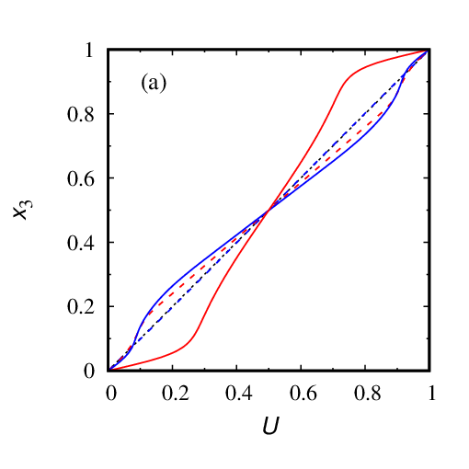
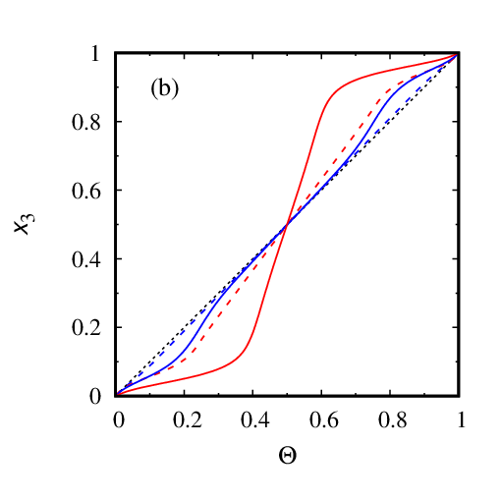
Mean Fields
Streamwise component of mean velocity (a), and mean temperature (b) from simulations HET025x (blue dashed), HET050x (red dashed), HET025y (blue solid), and HET050y (red solid). Thin black dotted line shows the laminar solution (HOM).

Slide 11
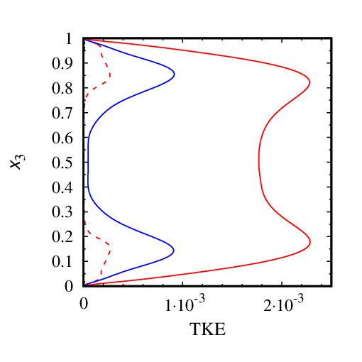
TKE
Turbulence kinetic energy from simulations HET025x (blue dashed), HET050x (red dashed), HET025y (blue solid), and HET050y (red solid).

Slide 12
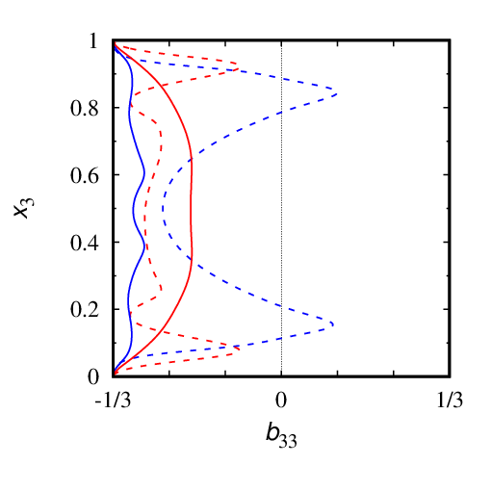
Turbulence Anisotropy
Departure-from-isotropy tensor
$$b_{ij}=\frac{\left\langle \overline{u_{i}^{′}u_{j}^{′}}\right\rangle }{\left\langle \overline{u_{k}^{′2}}\right\rangle }−\frac{1}{3}δ_{ij}$$
b₃₃<0 indicates anisotropy, where the vertical-velocity fluctuations are suppressed.
The b₃₃ component of the departure-from-isotropy tensor from simulations HET025x (blue dashed), HET050x (red dashed), HET025y (blue solid), and HET050y (red solid).

Slide 13
Conservation of Momentum and Heat in Steady State
If the flow is stationary, the sum of vertical turbulent and molecular fluxes of streamwise momentum is depth-constant, the same holds for the vertical heat flux:
$$\begin{matrix}\left\langle \overline{u_{1}^{′}u_{3}^{′}}\right\rangle +\frac{1}{\text{Re}}\frac{∂\left\langle {\bar{u}}_{1}\right\rangle }{∂x_{3}}=const, \\ \left\langle \overline{u_{3}^{′}θ^{′}}\right\rangle +\frac{1}{\text{PrRe}}\frac{∂\left\langle \bar{θ}\right\rangle }{∂x_{3}}=const.\end{matrix}$$

Slide 14
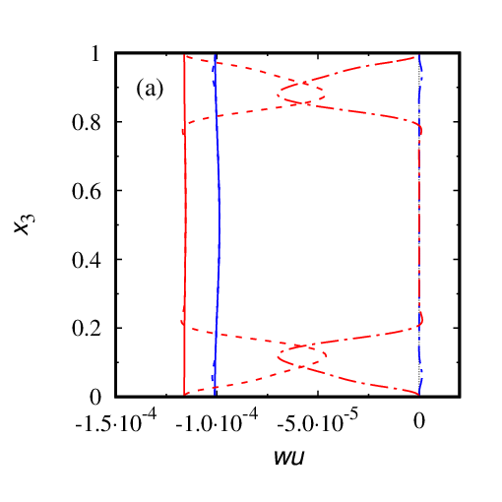
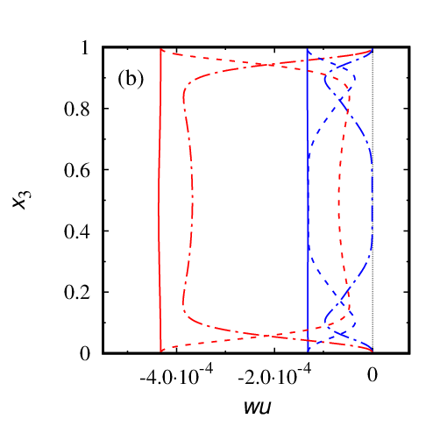
Vertical Momentum Flux
Streamwise momentum-flux component from simulations (a) HET025x (blue) and HET050x (red), and (b) HET025y (blue) and HET050y (red). Solid curves show total (turbulent plus molecular)flux, and dot-dashed and dashed curves show contributions due to turbulence and due to molecular diffusion, respectively.

Slide 15
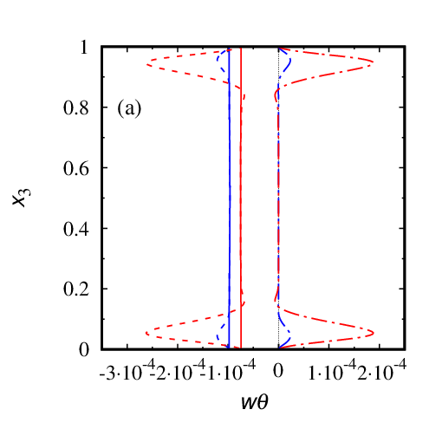
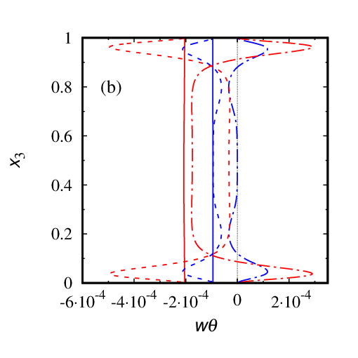
Vertical Temperature Flux
Vertical component of the temperature flux from simulations (a) HET025x (blue) and HET050x (red), and (b) HET025y (blue) and HET050y (red). Solid curves show total (turbulent plus molecular)flux, and dot-dashed and dashed curves show contributions due to turbulence and due to molecular diffusion, respectively. Counter-gradient turbulent heat transfer.

Slide 16
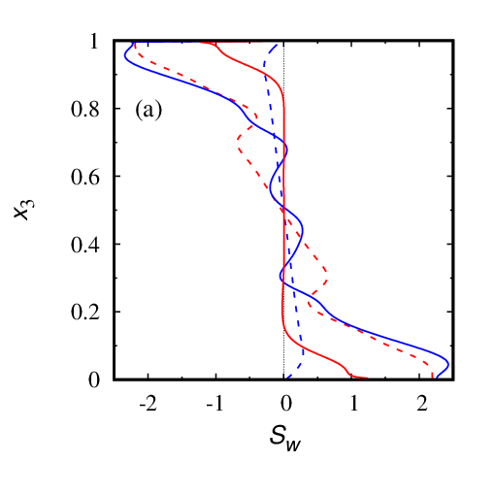
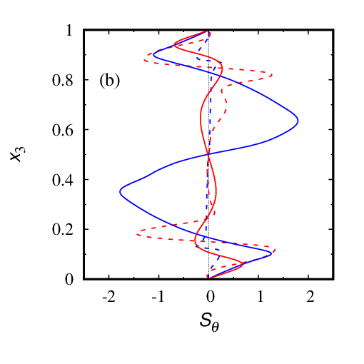
Vertical-Velocity and Temperature Skewness
Vertical-velocity skewness (a) and temperature skewness (b) from simulations HET025x (blue dashed), HET050x (red dashed), HET025y (blue solid), and HET050y (red solid).

Slide 17
Flow Visualization: w’ and θ‘ (HET050x)
Horizontal cross sections of the fluctuations of (left) vertical velocity and (right) potential temperature about their horizontal mean values for simulation HET050x. The cross section is taken at x₃=0.076 (x₃⁺=8.19) above the lower surface near the end of the sampling period; 1/4 of numerical domain is shown. Red (blue) colors correspond to positive (negative) values of u₃ʹ (×10²) and θʹ as shown in the color scale bars. For reference the spatial variation of the imposed surface temperature θ_{sfc} is shown in the bottom panel of each figure.

Slide 18
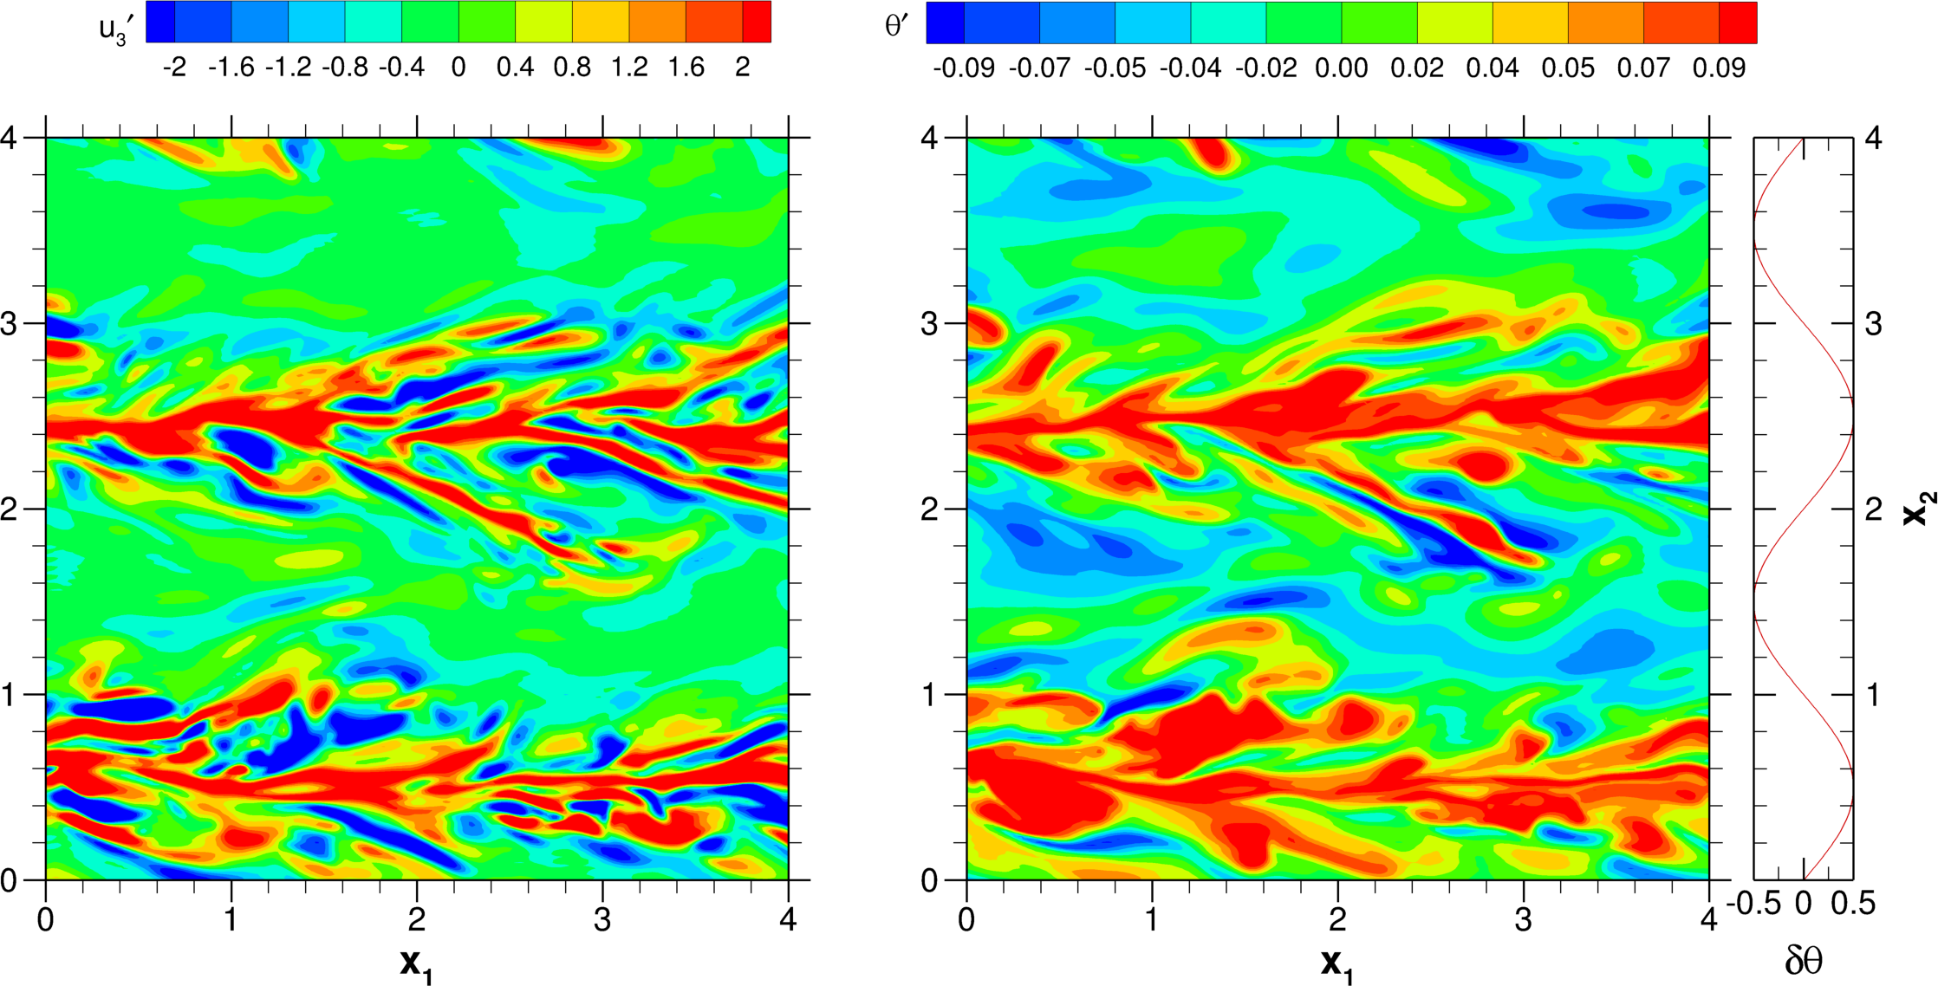
Flow Visualization: w’ and θ‘ (HET050y)
Horizontal cross sections of the fluctuations of (left) vertical velocity and (right) potential temperature about their horizontal mean values for simulation HET050y. The cross section is taken at x₃= 0.076 (x₃⁺=15.80) above the lower surface near the end of the sampling period; 1/4 of numerical domain is shown. Red (blue) colors correspond to positive (negative) values of u₃ʹ (×10²) and θʹ as shown in the color scale bars. The spatial variation of the imposed surface temperature θ_{sfc} is shown to the right of θ‘ figure.

Slide 19
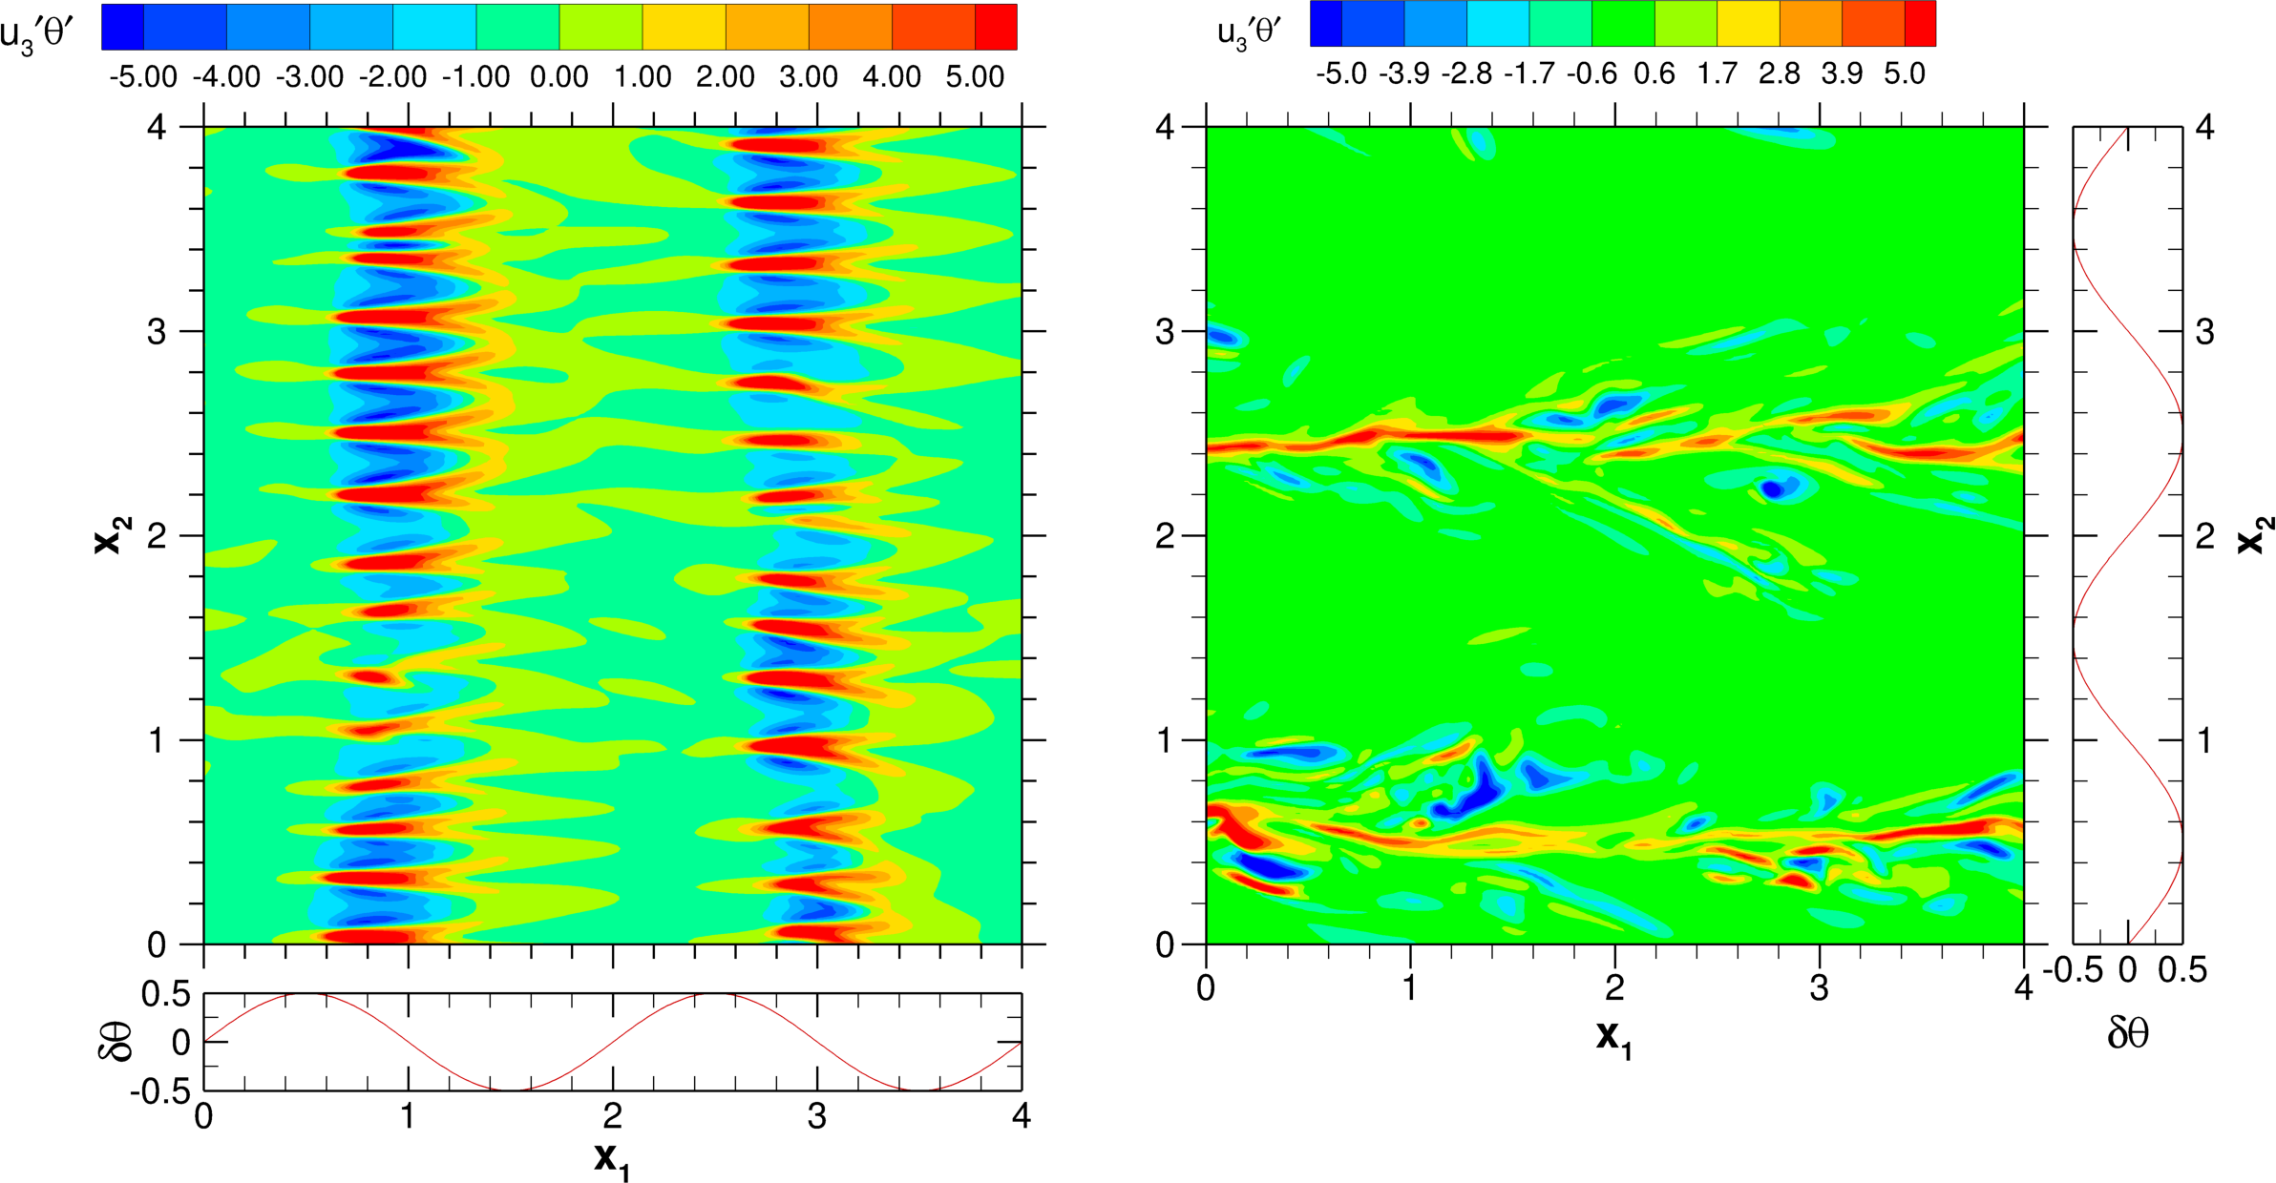
Flow Vis: w’θ‘ (HET050x and HET050y)
Horizontal cross section of the vertical temperature flux for simulations HET050x (left) and HET050y (right). Red (blue) colors correspond to positive (negative) values of the temperature flux (×10³) as shown in the color scale bars. The spatial variation of the imposed surface temperature θ_{sfc} is shown for each figure.

Slide 20
Qualitative Explanation
Both HETx and HETy: surface thermal heterogeneity → local convective instabilities
Both HETx and HETy: convectively generated turbulence is advected in the streamwise direction
HETy: advection over the lines of surface temperature maxima → further support of convective motions and TKE generation
HETx: advection over cold regions with stable stratification → TKE is spent to work against gravity

Slide 21
Implications for SBL Parameterization
Strongly stable flows over heterogeneous surfaces feature local convective instability and counter-gradient heat transport (cf. convective PBLs)
Flow with spanwise surface heterogeneity is more turbulent and more efficient in terms of vertical transport of heat and momentum as compared to its counterpart with streamwise heterogeneity; analysis of turbulent statistics and flow vis helps explain why
Issues to ponder
Orientation of heterogeneity patterns matters (cf. SSO effects)
Pragmatic tile approach would not help
Find the key points (what should be modified in the second-order closures to account for the effect of orientation of the surface heterogeneity patterns)

Slide 22
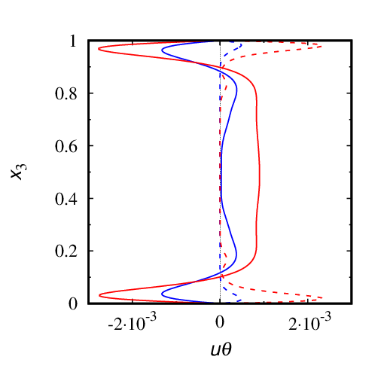
Streamwise Temperature Flux
Streamwise component of the temperature flux from simulations HET025x (blue dashed), HET050x (red dashed), HET025y (blue solid), and HET050y (red solid).

Slide 23
Effect of Streamwise Temperature Flux
Enhances/reduces vertical momentum flux in HETy/HETx
$$\left(\frac{∂}{∂t}+\left\langle u_{3}\right\rangle \frac{∂}{∂x_{3}}\right)\left\langle u_{1}^{′}u_{3}^{′}\right\rangle =−\left(\left\langle u_{1}^{′}u_{3}^{′}\right\rangle \frac{∂\left\langle u_{3}\right\rangle }{∂x_{3}}+\left\langle u_{3}^{′2}\right\rangle \frac{∂\left\langle u_{1}\right\rangle }{∂x_{3}}\right)+g_{3}α_{T}\left\langle u_{1}^{′}θ^{′}\right\rangle$$ $−\frac{∂}{∂x_{3}}\left(\left\langle u_{1}^{′}u_{3}^{′2}\right\rangle +\left\langle u_{1}^{′}p^{′}\right\rangle \right)−ε_{13}$+ $\left\langle p^{′}\left(\frac{∂u_{1}^{′}}{∂x_{3}}+\frac{∂u_{3}^{′}}{∂x_{1}}\right)\right\rangle$
$$\left(\frac{∂}{∂t}+\left\langle u_{3}\right\rangle \frac{∂}{∂x_{3}}\right)\left\langle u_{3}^{′}θ^{′}\right\rangle =−\left\langle u_{3}^{′2}\right\rangle \frac{∂\left\langle θ\right\rangle }{∂x_{3}}−\left\langle u_{3}^{′}θ^{′}\right\rangle \frac{∂\left\langle u_{3}\right\rangle }{∂x_{3}}+g_{3}α_{T}\left\langle θ^{′2}\right\rangle$$ $−\frac{∂}{∂x_{3}}\left\langle u_{3}^{′2}θ^{′}\right\rangle −ε_{θ3}−$ $\left\langle θ^{′}\frac{∂p^{′}}{∂x_{3}}\right\rangle$
Effect is hidden in the pressure-scrambling term
Notes:
The TKE-Scalar Variance closure model carries four prognostic equations, for turbulent kinetic energy, for the variances of liquid-water potential temperature and total moisture and for their cross-correlation, in comparison with the TKE scheme currently used in the COSMO model which carries one prognostic equation for TKE. The equation for temperature variance looks like this, the equations for moisture variance and for cross-correlation are similar. As compared to the TKE scheme, two additional terms are present (not neglected), time rate-of-change and vertical transport. All other second moments are modelled diagnostically, by means of algebraic formulations.

Slide 24
Conclusions and Outlook
Stably-stratified flows over heterogeneous surface feature local convective instabilities and up-gradient eddy heat transport
Flow with spanwise surface heterogeneity is more turbulent and more efficient in terms of vertical transport of heat and momentum as compared to its counterpart with streamwise heterogeneity; analysis of turbulent statistics and flow vis helps explain why
DNS of channel and Ekman flows over heterogeneous surfaces
DNS/LES of “less idealized” configurations, e.g., checkerboard and randomly distributed warm and cold patches
Analysis of second-moment budgets and of pressure-scrambling effects
Look at real-world data
Develop usable parameterizations (based on sound physics)

Slide 25
Thank you for your
kind attention!

Slide 26
…

Slide 27
References
Mironov, D. V., and P. P. Sullivan, 2010: Effect of horizontal surface temperature heterogeneity on turbulent mixing in the stably stratified atmospheric boundary layer. Proc. 19th Amer. Meteorol. Soc. Symp. on Boundary Layers and Turbulence, Keystone, CO, USA, paper 6.3, 10 pp.
Mironov, D. V., and P. P. Sullivan, 2012: Mixing in the SBL over temperature-heterogeneous surfaces: LES findings and some parameterisation ideas. Proc. ECMWF Workshop on Diurnal Cycles and the Stable Boundary Layer, European Centre for Medium-Range Weather Forecasts, Reading, UK, 149-151.
Mironov, D. V., and P. P. Sullivan, 2016: Second-moment budgets and mixing intensity in the stably stratified atmospheric boundary layer over thermally heterogeneous surfaces. J. Atmos. Sci., 73, 449-464. doi: 10.1175/JAS-D-15-0075.1
Mironov, D., and P. Sullivan, 2018: Turbulence Structure and mixing in strongly stable boundary-layer flows over thermally heterogeneous surfaces. Proc. 23rd Amer. Meteorol. Soc. Symp. on Boundary Layers and Turbulence, Oklahoma City, OK, USA, paper 1B.3, 12 pp.
Mironov, D. V., and P. P. Sullivan, 2023: Effect of surface thermal heterogeneity on the structure and mixing intensity in strongly stable boundary-layer flows: a DNS study. 10th International Symposium on Turbulence, Heat and Mass Transfer, Rome, Italy. 4 pp.
Mironov, D. V., and P. P. Sullivan, 2023: Turbulence structure and mixing in strongly stable boundary-layer flows over thermally heterogeneous surfaces. Boundary-Layer Meteorol., 187, 371-393. doi: 10.1007/s10546-022-00766-x
Sullivan, P. P., J. C. Weil, E. G. Patton, H. J. J. Jonker, and D. V. Mironov, 2016: Temperature fronts and vortical structures in turbulent stably stratified atmospheric boundary layers. Proc. VIIIth International Symposium on Stratified Flows, San Diego, CA, USA, 8 pp.
Sullivan, P. P., J. C. Weil, E. G. Patton, H. J. J. Jonker, and D. V. Mironov, 2016: Impacts of surface cooling on turbulence and temperature fronts in the stable atmospheric boundary layer. 22nd Amer. Meteorol. Soc. Symp. on Boundary Layers and Turbulence, Salt Lake City, UT, USA.
Sullivan, P. P., J. C. Weil, E. G. Patton, H. J. J. Jonker, and D. V. Mironov, 2016: Turbulent winds and temperature fronts in large-eddy simulations of the stable atmospheric boundary layer. J. Atmos. Sci., 73, 1815-1840. doi: 10.1175/JAS-D-15-0339.1
Mironov, D. V., and P. P. Sullivan, 2024: Turbulence structure and mixing in strongly stable Couette flows over thermally heterogeneous surfaces: effect of heterogeneity orientation. Submited to Flow Turbul. Combust.

Slide 28
Spin-Up of Simulations
The homogeneous simulation starts with a fully developed, stationary, neutral Couette flow. The stable buoyancy stratification is established by gradually (linearly in time) increasing the Richardson number over 100 dimensionless time units from Ri=0 to Ri=0.25. The simulations are then continued until turbulence dies out and the laminar Couette flow regime is achieved. We give turbulence all the chances to survive, but Ri=0.25 is sufficient to fully quench turbulence in the homogeneous case.
The heterogeneous simulations start with Ri=0, δθ=0, and the linear velocity and temperature profiles. The Richardson number is increased from Ri=0 to Ri=0.25 over 10 time units, while the temperature difference δθ is increased (linearly in time) from zero to its final value (see Table) over 100 time units. In order to assist initial turbulence spin-up, velocity and temperature fluctuations taken from the neutral turbulent Couette flow are added in the lower 1/4 and the upper 1/4 of the computational domain (we give turbulence only a very little help). The simulations are then continued over many time units required to achieve a quasi-stationary flow regime over heterogeneous surfaces, and then continued further in the quasi-stationary regime over the sampling period.

Slide 29
…

