Slide 1
Status in 2d-Var surface analysis
Assimilation of Snow depth observations from high elevation stations of SNOTEL network, in IFS and ICON model
Martin Lange, Gernot Geppert, Thomas Hüther

Slide 2
Recent developments 2dVar surface analysis
The present surface analysis packages for sea surface temperature, snow and 2m temperature, based on Cressman and Optimal Interpolation schemes will be replaced by 2d-Var algorithm as part of DWD‘s DACE coding environment.
T2m- and snow analysis are ready for testing with recent focus on finalisation the snow analysis as this is also required as part of the seasonal prediction work package in the CERISE project.
Observation processing, and analysis parameter are harmonized with old analysis e.g. qc, radius of influence for observations to use established configuration for comparison and as reference for further developments.
Evaluation of first short testperiod shows acceptable results, some issues still to be investigated.
Next steps: Target is Parallel Experiment this winter

Slide 3
Assimilation of high elevation observations from Snotel network
COSMO WG3b meeting, 2.09.2024

Slide 4
Assimilation of high elevation observations from Snotel network
Snow depth observations from Snotel network in western US and less dense in Alaska became available in GTS end of march last year.
Due to sparse observation cover in this region very interesting for assimilation into ICON model.
First tests using Snotel in ICON in parallel Routine were not successful due to much more snow in the region than found in the snow analysis of all other NWP models compared.
Similar problematic at ECMWF. Therefore detailed testing is required before using the data. Cooperation on assimilation SNOTEL data in ICON and IFS.
Results shown here are for both models.

Slide 5
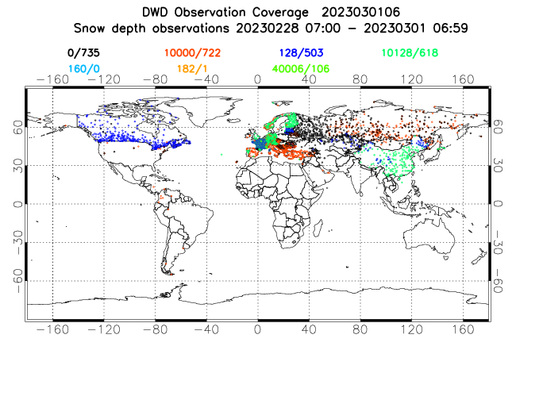
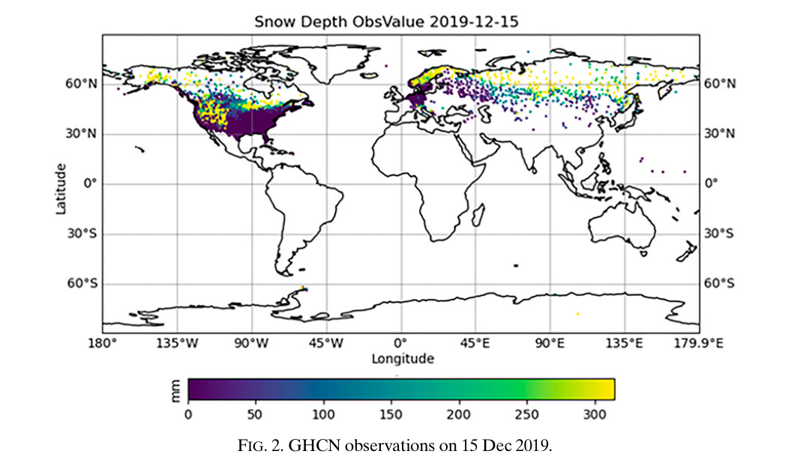
Around 1000 new observations in western US from Snotel network reported in GTS
Real time obs in GTS
Snow depth obs in GHCN
(global historical climatology network)
From Gichamo and Draper, 2022

Slide 6
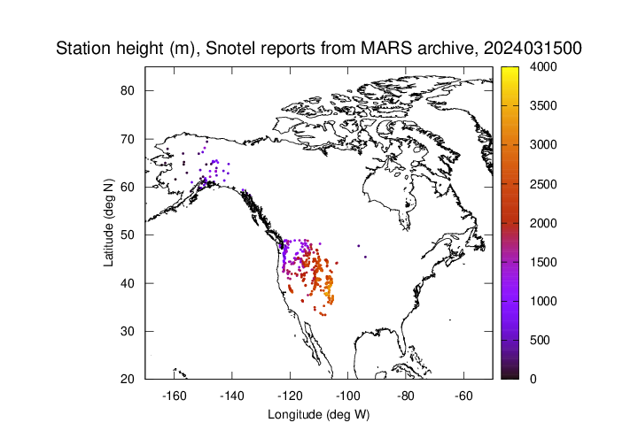
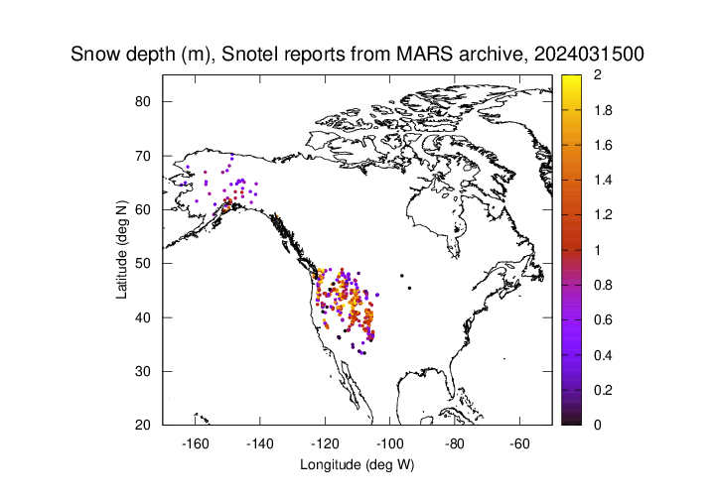
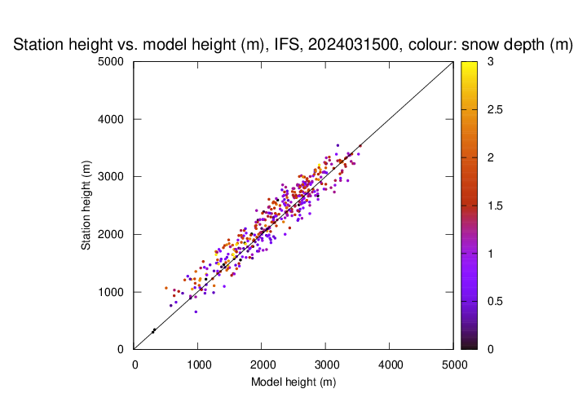
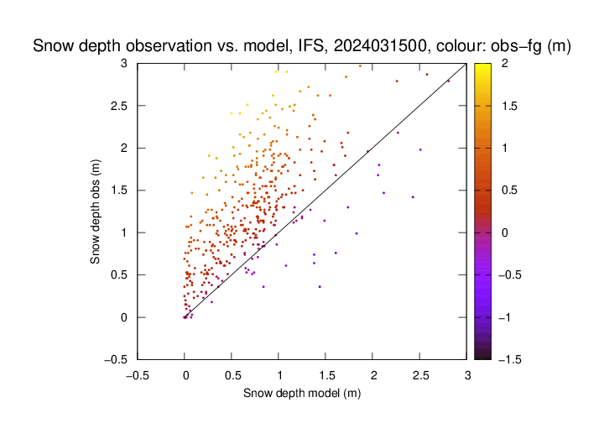
Around 1000 new observations in western US from Snotel network reported in GTS
a)
b)
c)
d)
Western US / Canada only

Slide 7
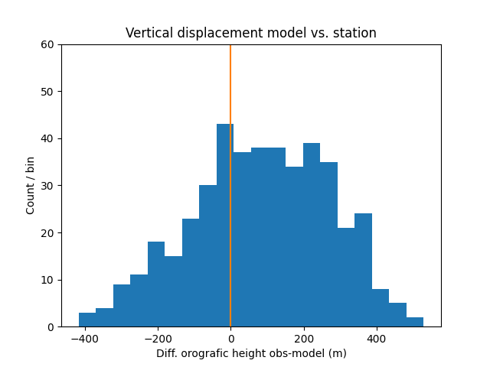
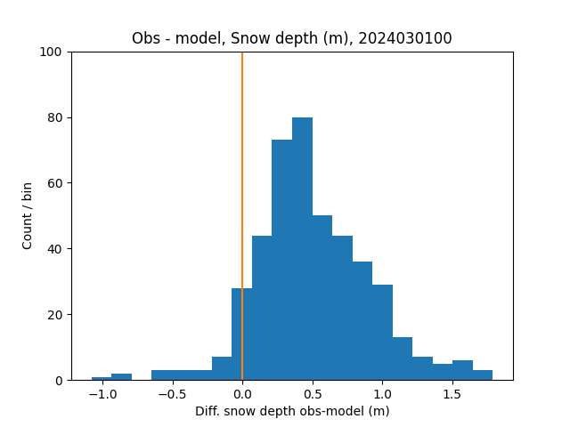
Much more snow in observations, even if model orografie is above station ground
a)
b)

Slide 8
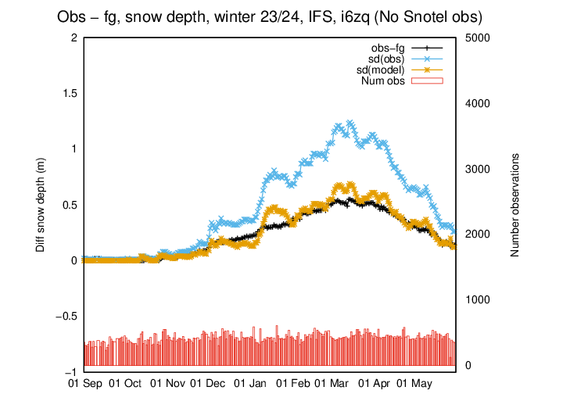
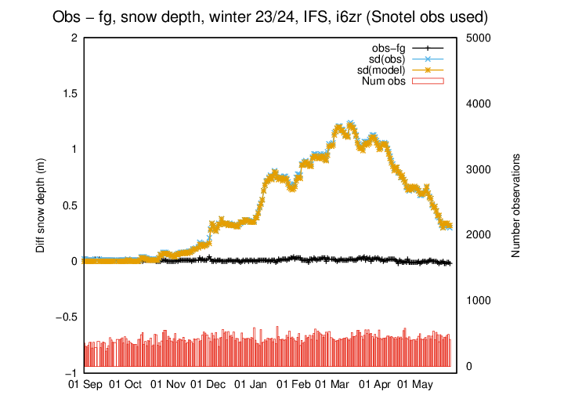
Strong impact of Snotel observations assimilated in IFS
Obs-fg, snow depth, winter 23/24, IFS, i6zq, (no snotel)
Obs-fg, snow depth, winter 23/24, IFS, i6zr, (Snotel obs used)
a)
b)

Slide 9
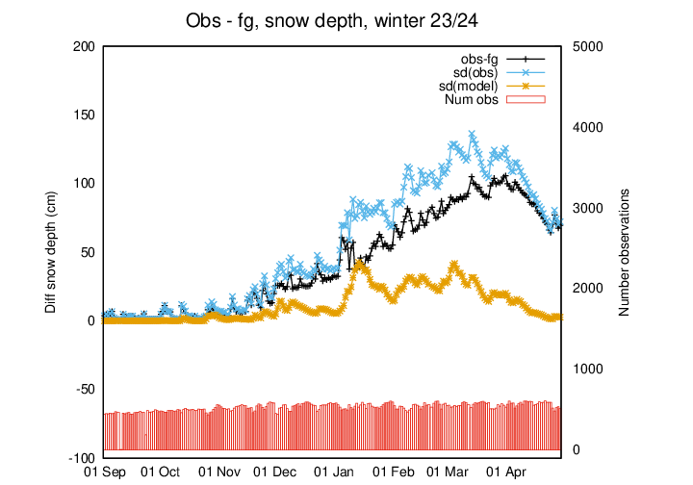
Strong impact of Snotel observations assimilated in IFS
IFS snow analysis
ICON snow analysis
Obs-fg, snow depth, winter 23/24, IFS, i6zq, (no snotel)
Obs-fg, snow depth, winter 23/24, ICON
a)
b)

Slide 10
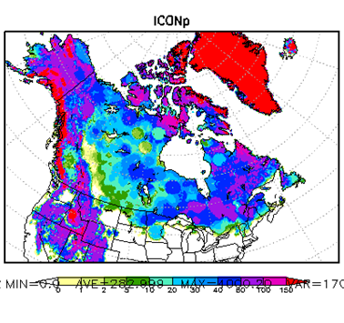
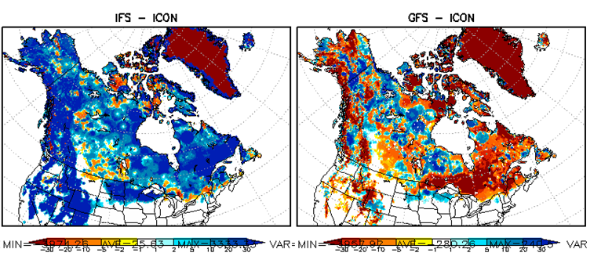
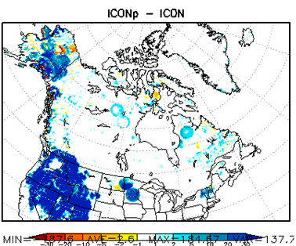
Very strong impact on analysis in ICON-Parallel Routine
(more snow than IFS which shows highest values)
ICON
IFS
GFS
CMC
ICONP
IFS-ICON
GFS-ICON
ICONP-ICON

Slide 11
Use of Snotel data at ECMWF and DWD
Conclusions
Snotel snow depth observations from high elevation snow sites are much larger, than model values in ICON and IFS analysis
Assimilation of the data put the models (IFS and ICON) towards the observations leading to vanishing obs-fg departures when starting assimilation at begin of winter season.
Given limited representativity of the data total snow mass in the area gets strongly overestimated.
Large uncertainties in all snow models. Error in snow mass is factor 2 and more. If NWP centres aim at providing valuable analysis for downstream applications as hydrologic or hydropower or avalanche forecast to interdisciplinary services this is not satisfying.

Slide 12
Use of Snotel data at ECMWF and DWD
Discussion
How to improve the situation ?
Using more existing snow depth observations from the existing networks. Preparing single observations from US networks is slow process, for Snotel it needed around 10 years from first attempts in the Global cryosphere watch initiative.
Are there any other interdisciplinary services interested in using NWP data for initialising their models or as additional information source?
Are there further observations which might be used, e.g. SWE observations from hydrological services?

Slide 13
References
Tseganeh Z. Gichamo and Clara S. Draper 2022: A Optimal Interpolati-Based Snow Data Assimilation for NOAAs Unified Forecast System (UFS). Weather and forecasting, 37, 2209-2221.

Slide 14
FIN

Slide 15
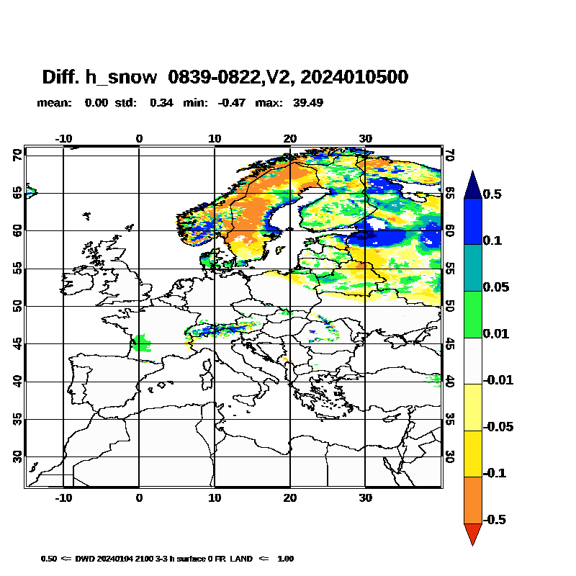
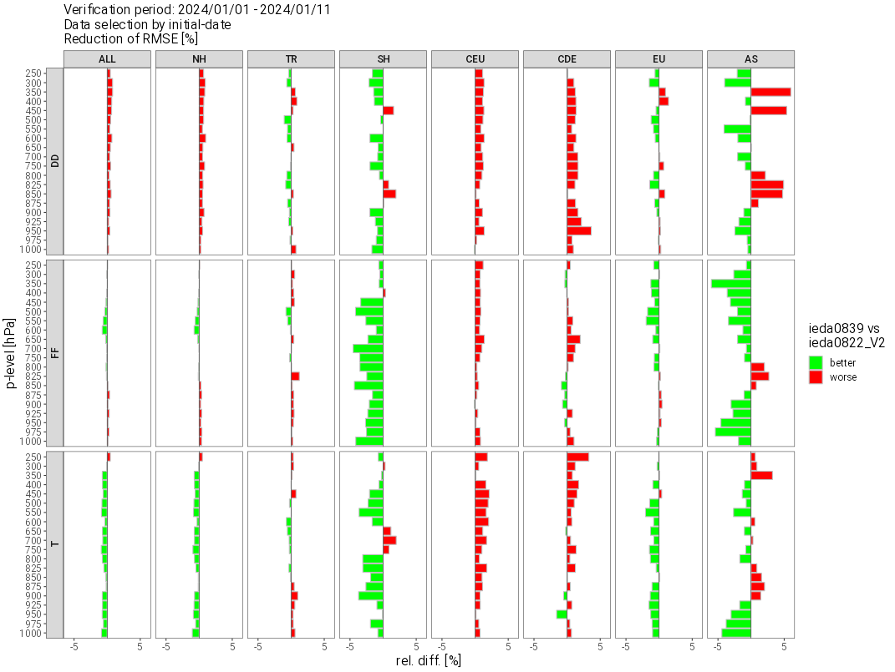
COSMO WG3b meeting, 2.09.2024

Slide 16
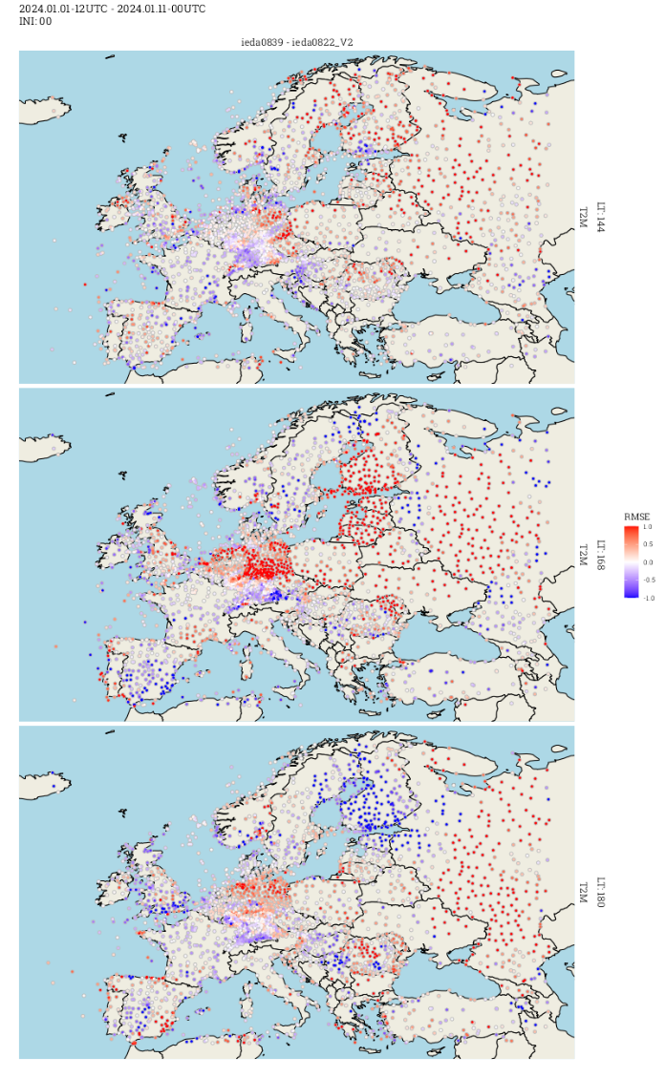
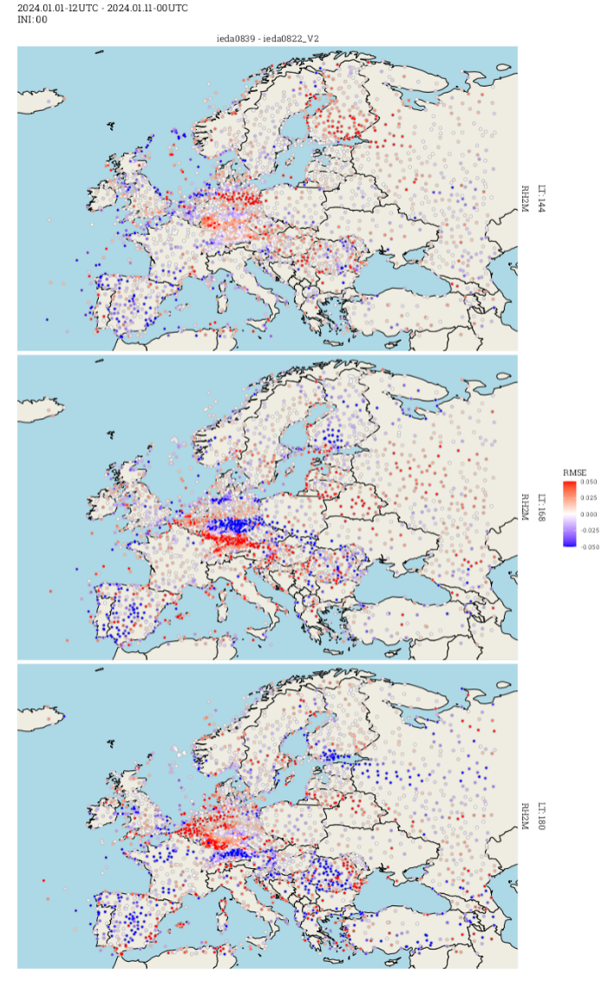
Strong day to day and 0:00.-12:00 variation in verification of 10 day exp.
Diff Rmse T2m, 2dVar – old scheme
Diff Rmse Rh2m, 2dVar – old scheme
ini=00
vv=144
vv=168
vv=180

Slide 17
Motivation
Experiments: IFS: September 2023 – May 2024
ICON: January 2024 – May 2024 (to be evaluated)
Period starting from September 2023 in progress.
Work in progress,
results shown mainly for IFS, results apply also for ICON

Slide 18
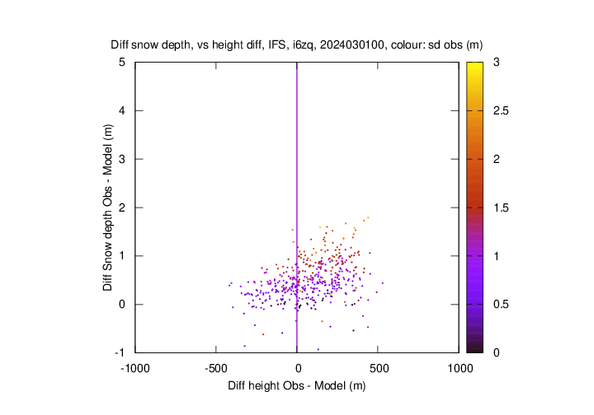
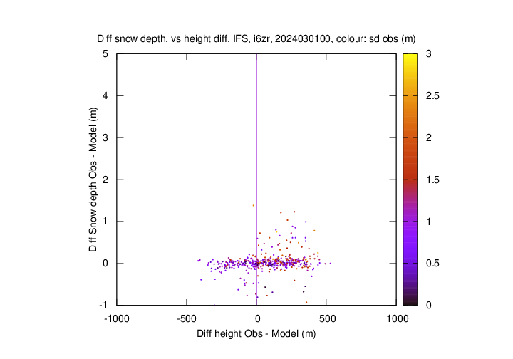
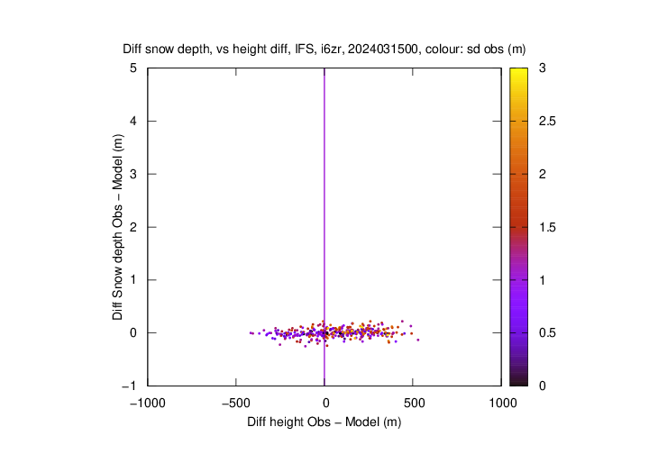
Assimilation of Snotel data pulls the model strong towards the observations
a)
b)
c)
Active obs only

Slide 19
Large variety in obs–model snow depth differences at different Snotel site locations
95% obs
Median obs
95% model
Median model
5% obs
5% model
Num obs
Obs and model snow depth at three selected stations
Median, 5%, and 95% percentile for obs and model.

Slide 20
Use of Snotel data at ECMWF and DWD
Conclusions
Snotel snow depth observations from high elevation snow sites are much larger, than model values in ICON and IFS analysis
Assimilation of the data put the models (IFS and ICON) towards the observations leading to vanishing obs-fg departures when starting assimilation at begin of winter season.
ECMWF is underway to use the observations operationally based on neutral scores, even though observations (probably) introduce some positive bias.
DWD analysis shows much less snow, therefore impact is stronger. One option to alleviate this effect is, to use Snotel, but not to fully push the model towards the observations.
Tests are planned rescaling Snotel obs to reduce obs-fg differences.

