Slide 1

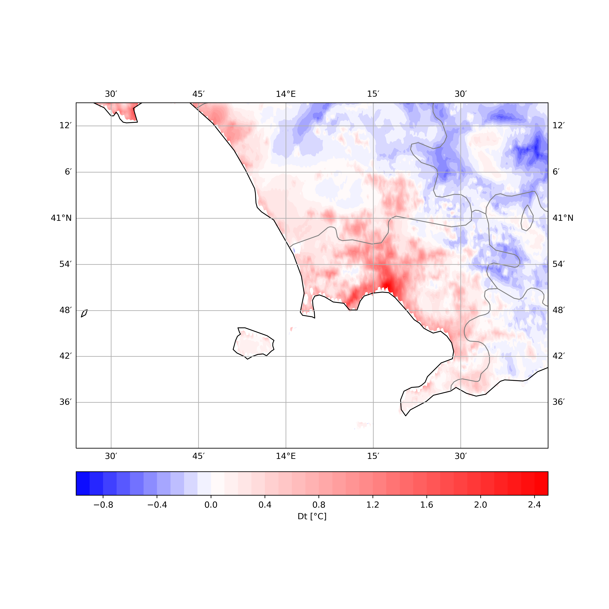
effects of varying AHF ON UHI in Naples metropolitan area aT hectometric scale with TERRA_URB scheme
D. Cinquegrana, M. Montesarchio, A. Zollo, E. Bucchignani
METE Lab , CIRA – Italian Aerospace Research Center, Capua CE Italy
PT CITTA’ @ 26th COSMO General Meeting 2024
2-6 Sept 2024 – Deutscher Wetterdienst, Offenbach am Main, Germany | Hybrid

Slide 2
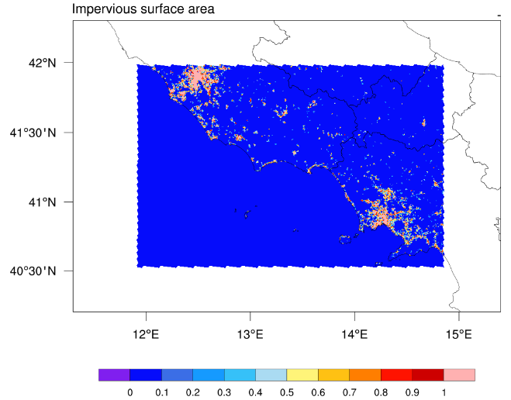
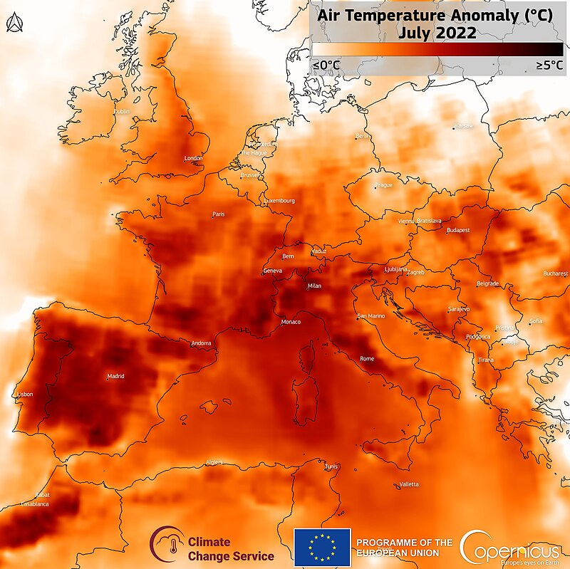
Domain and Period
Domain:
Lazio-Campania Southern Italy regions
Horizontal resolution = ~ 0,6 Km (R02B12)
ncells = 109860; vertical levels: 65
First level: 20m; Top height: 22.000 m
Simulated Period:
Heat waves hit Europe from June to August 2022
July 2022: severe heat waves over Italy
ICON forecast run from 18/7 to 24/7 2022
By Contains modified Copernicus Sentinel data 2022, Attribution, https://commons.wikimedia.org/w/index.php?curid=132519157

Slide 3
ICON Numerical Settings
ICON LAM/LEM :
BC’s and IC’s:
  Forecast time: 30h
  IC: DWD Analysis @ 18:00
  BCs reads @ ECMWF-IFS forecast every 3h
Timestep size= 6 s
REF lterra_urb Parameters
  Albedo and Antropogenic Heat Flux contribution active
  itype_kbmo = 2
  itype_eisa =3
  AHF = const. = 15 w/m2
  urbisa bounds = (1.0, 1.0)
Comparisons Terra-on vs Terra-off
  REF vs
    latest TERRA version (icon.2024.1)
      AHF(T2m_clm):
      Urbisa bounds = (0.6, 1.0)
    IFS-Soil Climatology (IC IFS vs IC DWD)
    Turbulence Models (LES)
Parameterization schemes
Shallow convection parameterization active
Deep and mid-level convection switched off
Single moment cloud microphysics
Diagnostic Kohler cloud cover
Land use & Orography
Land use: GLOBCOVER 2009
Orography: ASTER

Slide 4
New AHF: details on studied domain
Annual T2m_clm: min, max and mean spatial avg
AHF landscape vs T2m_clm: new vs const. ver
At given time (July) and domain of simulation, AHF ‘potentially’ lower than previous TERRA version (from 6 to 12 vs 15 w/m2 )

Slide 5
OBSERVATIONAL DATA
Ground Stations
Station selected in a box defined as [12.00, 14.75, 40.5, 41.5 ]
Model evaluation: comparison with ground observations downloaded from MISTRAL portal
  Urban Stations: fr_paved > 0.80
  Rural Stations: fr_paved < 0.25
Meteo Italian Supercomputing Portal
Stations per variables
Stations | T2m | RH2m | WS10m | WD10m
Rural | 40 | 16 | 6 | 8
Urban | 4 | 3 | 2 | 2
Stations with fr_paved

Slide 6
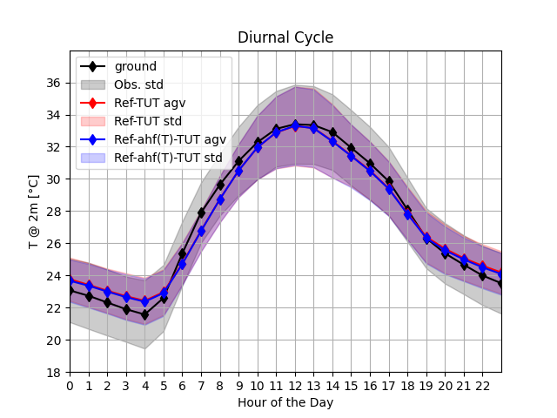
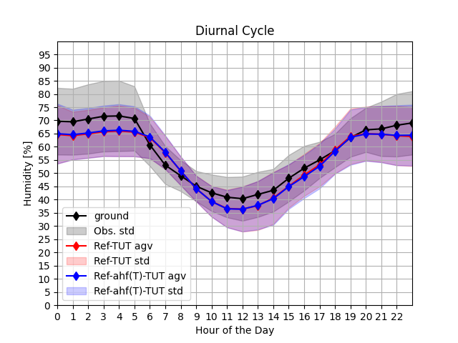
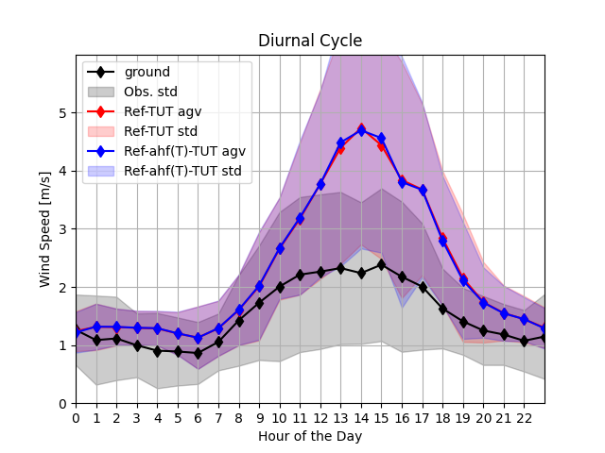
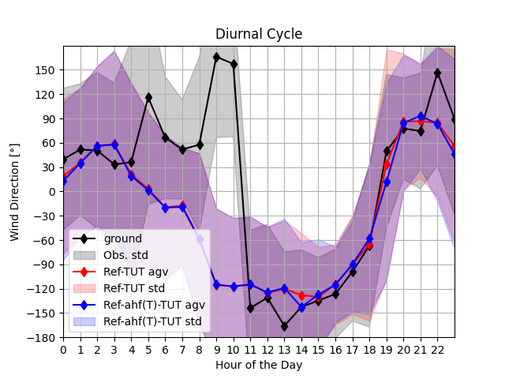
Const. Vs AHF(T2m): Rural Stat.
Stations | T2m | RH2m | WS10m | WD10m
Rural | 40 | 16 | 6 | 8

Slide 7
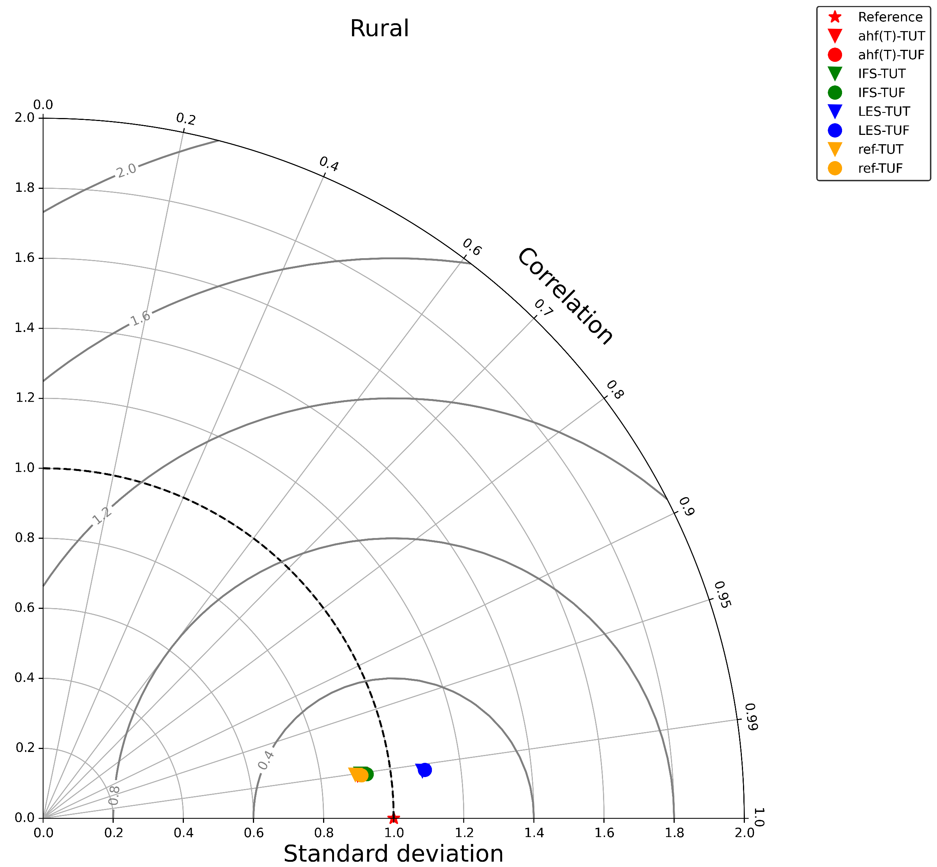
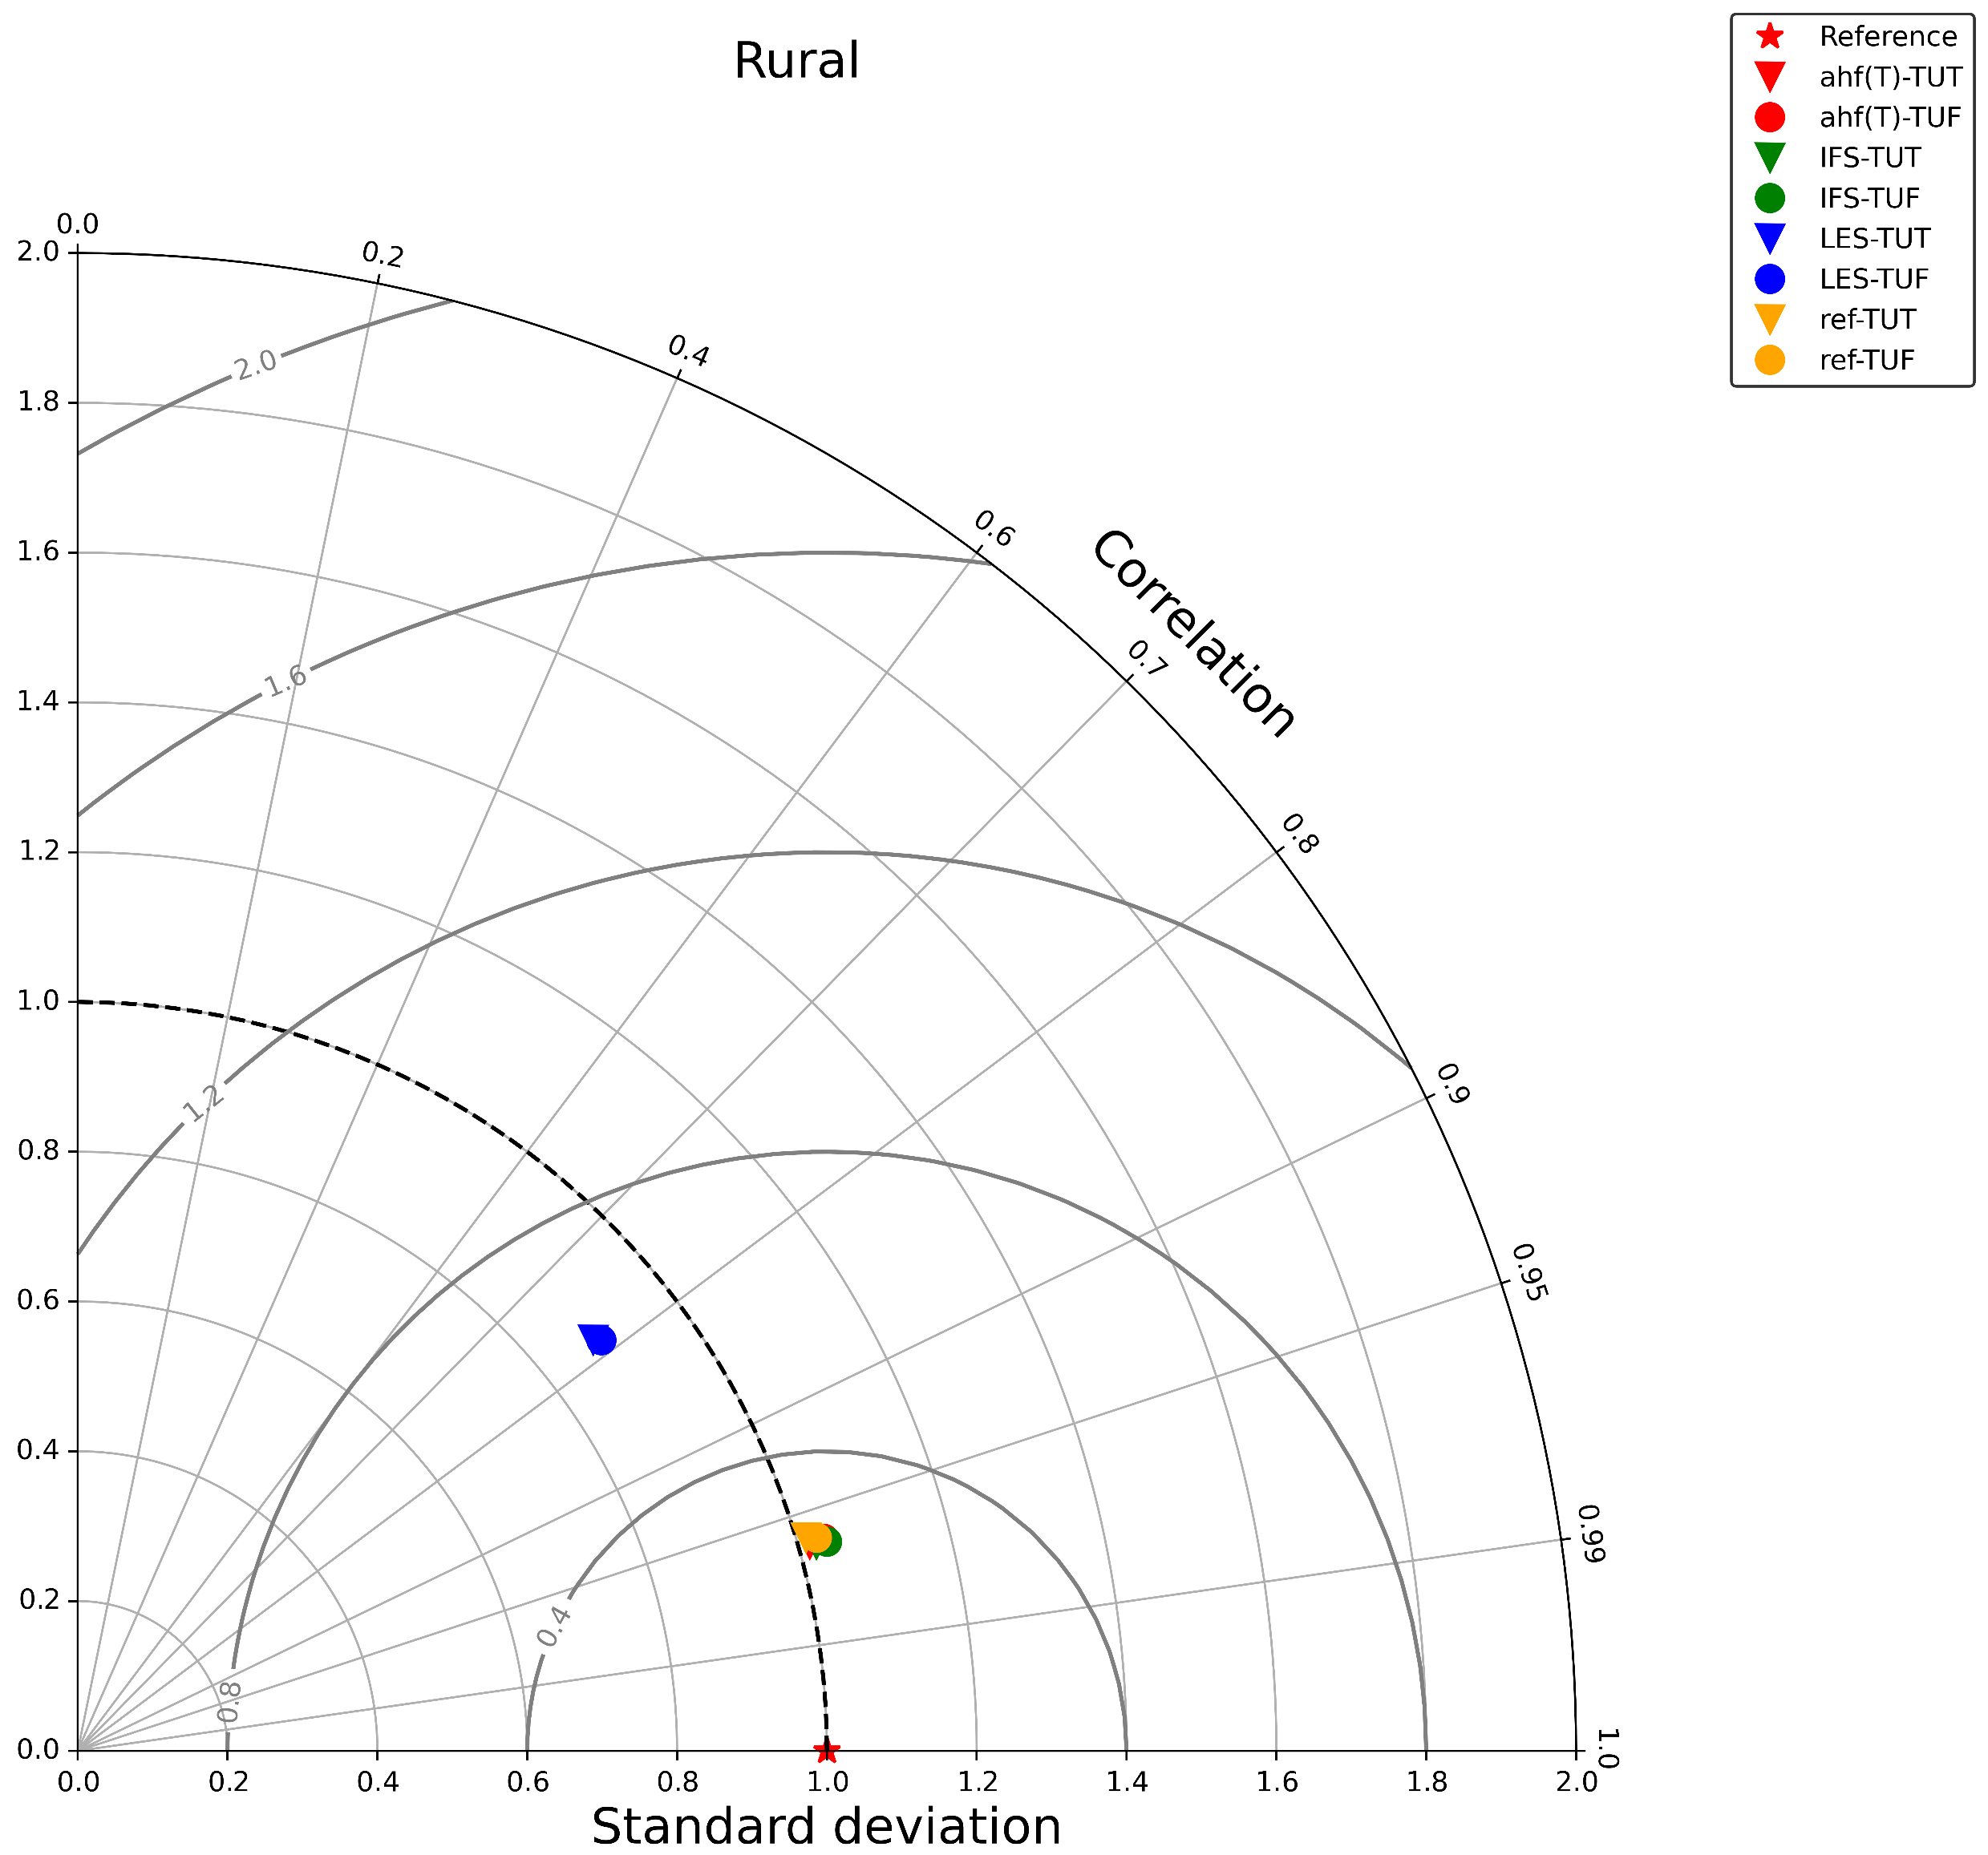
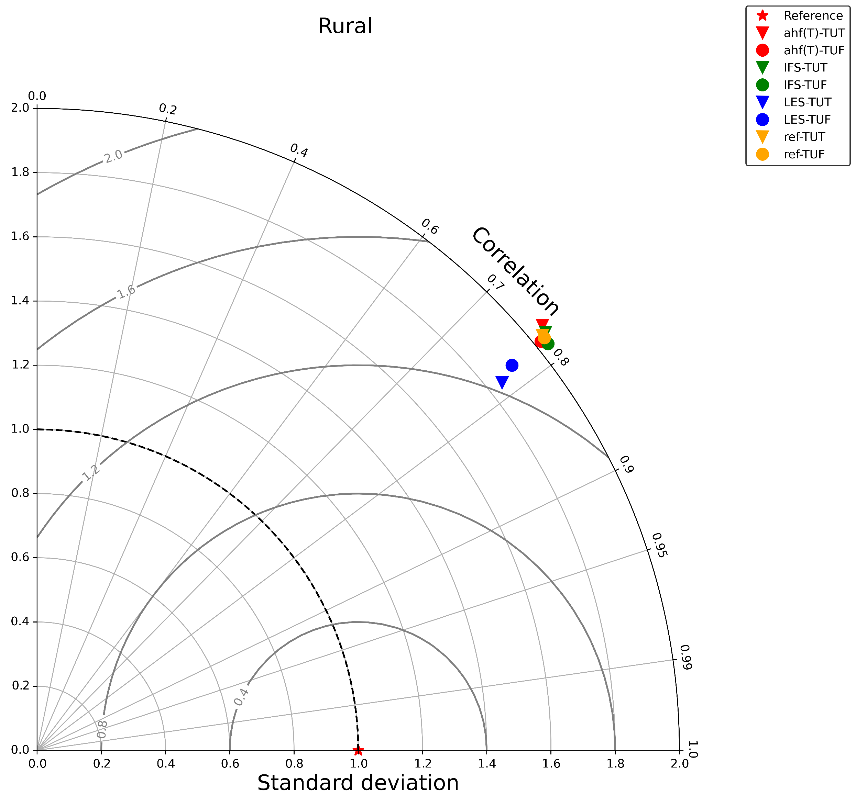
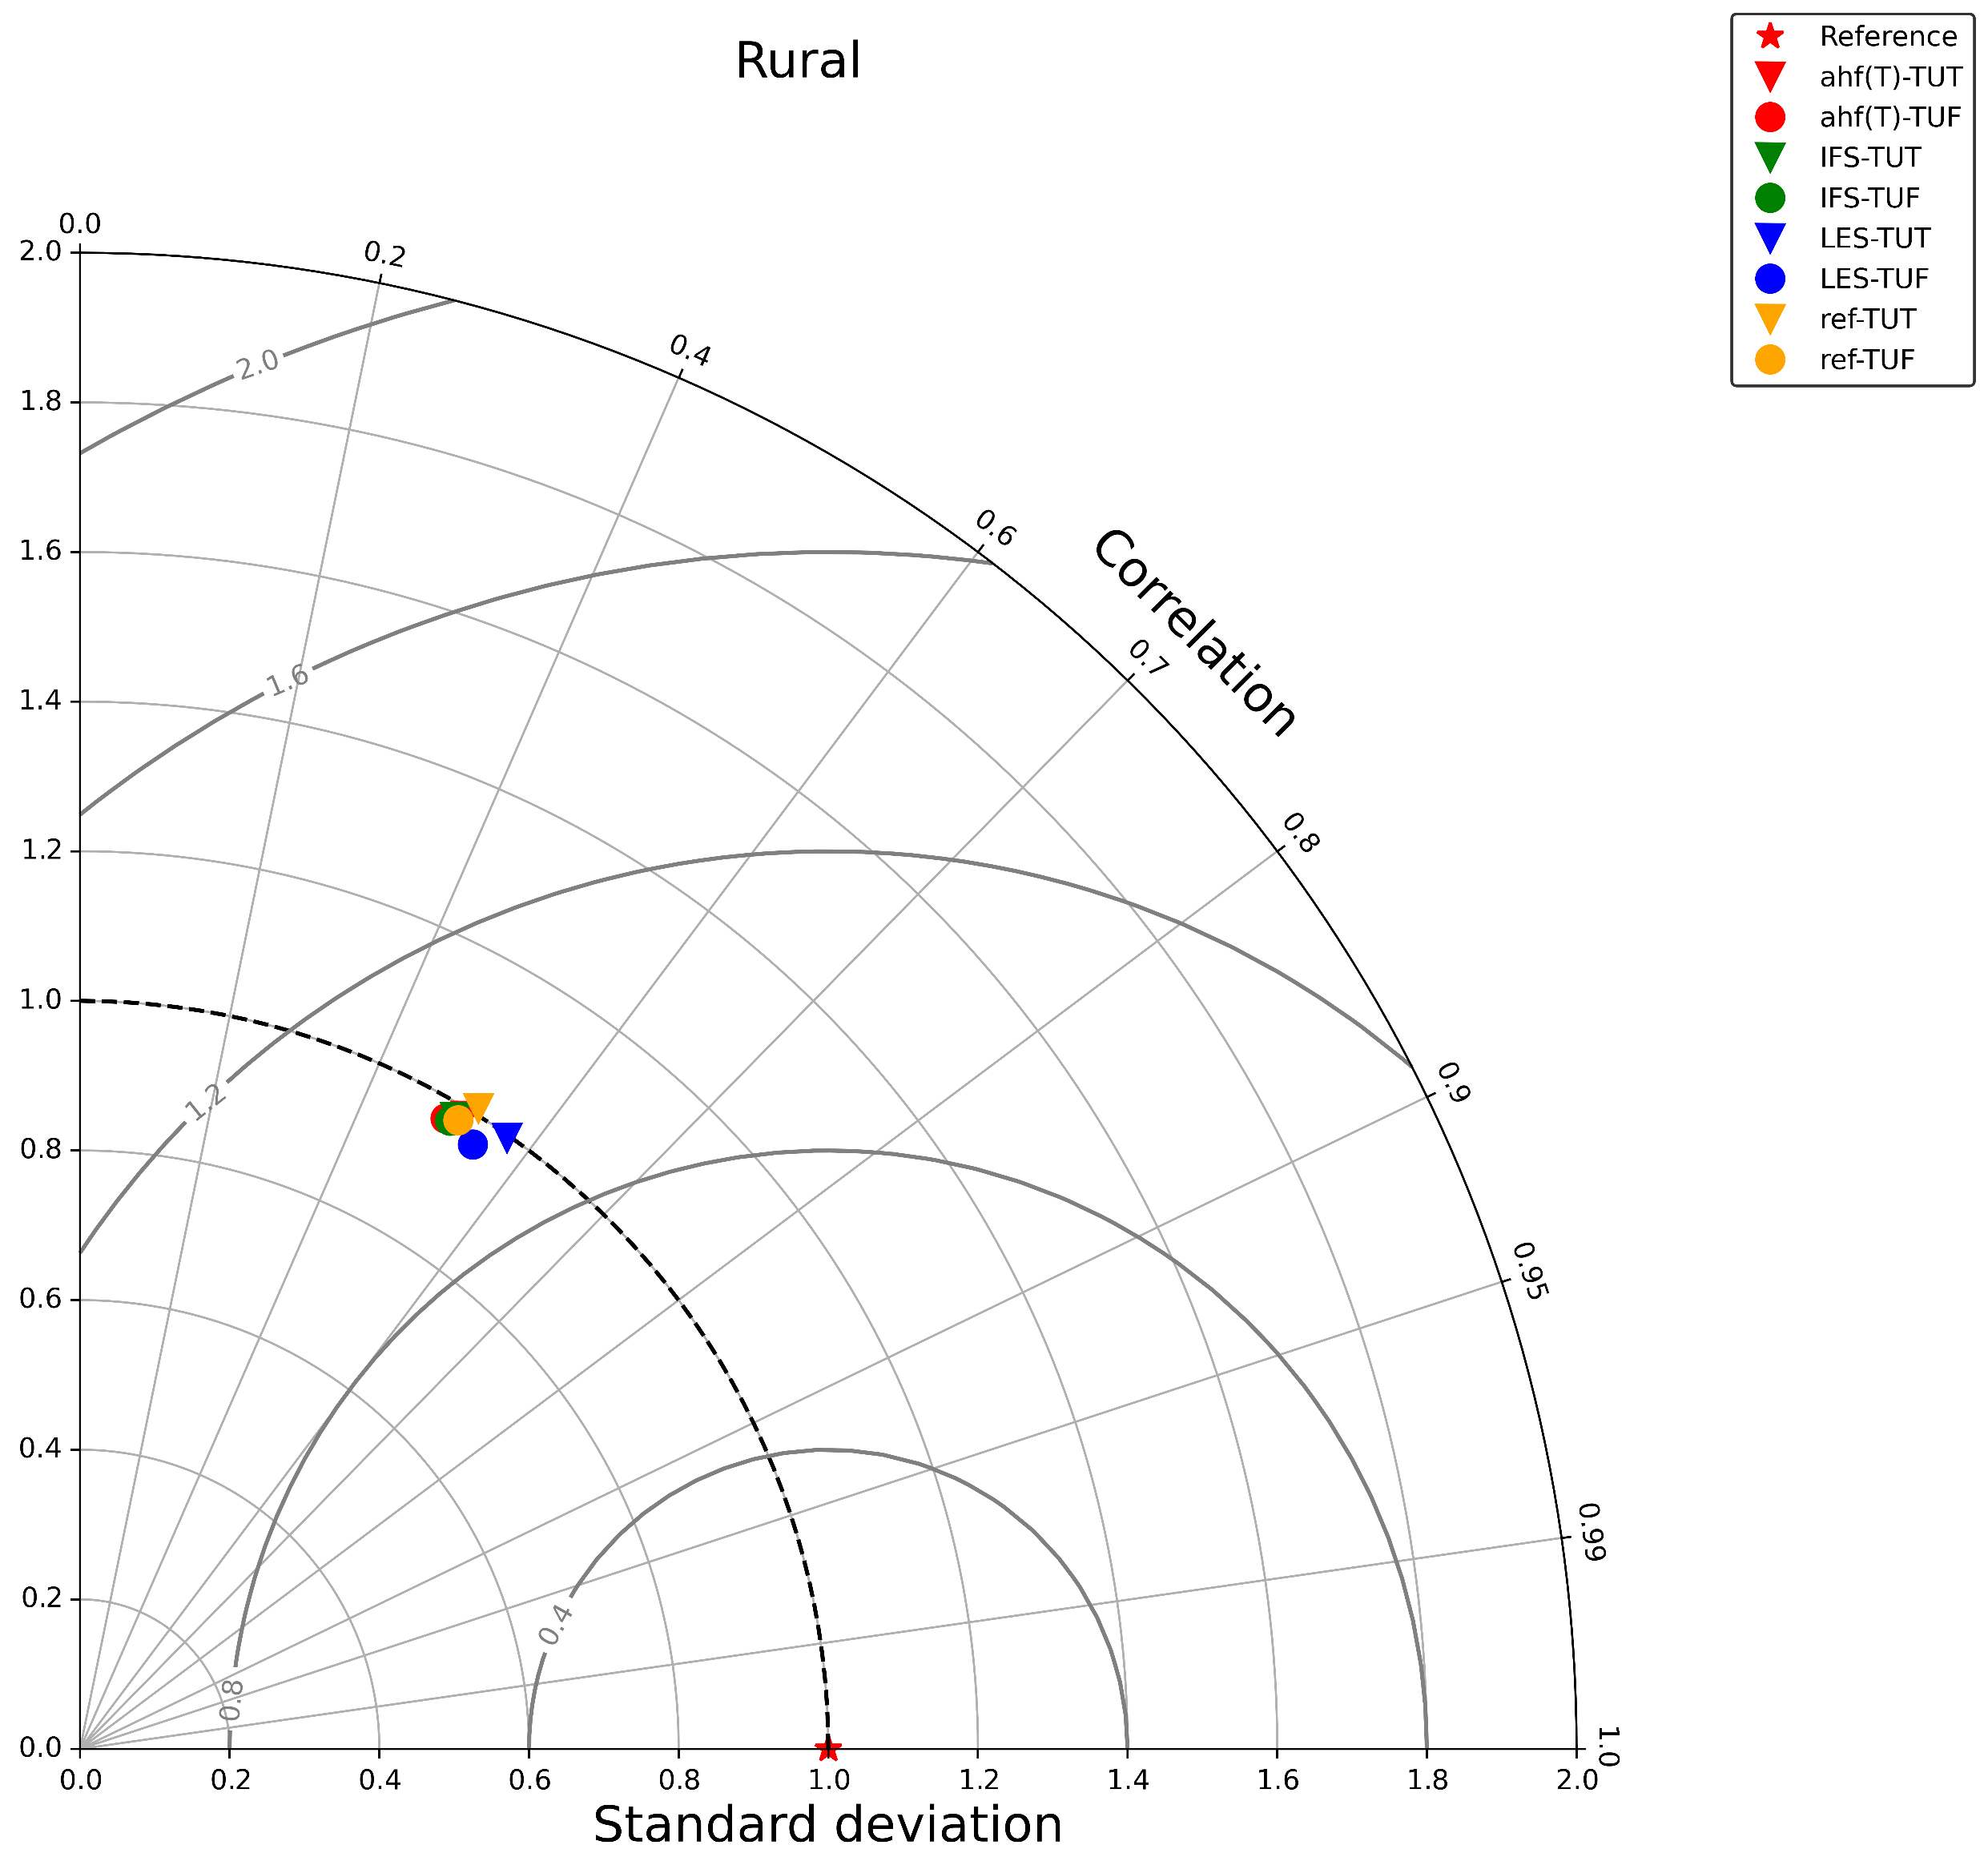
Taylor Rurals

Slide 8
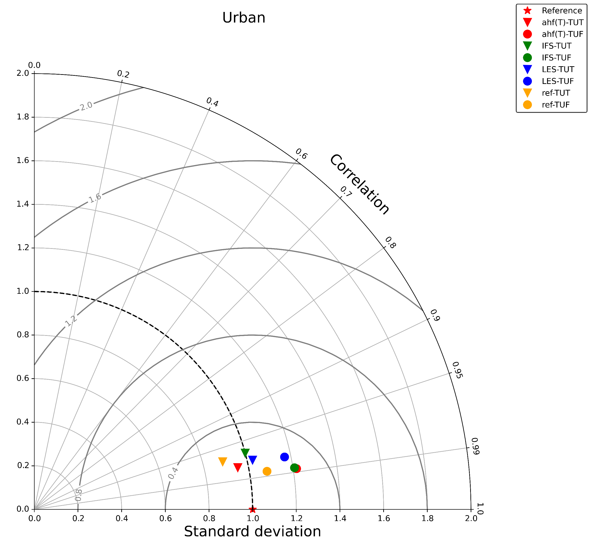
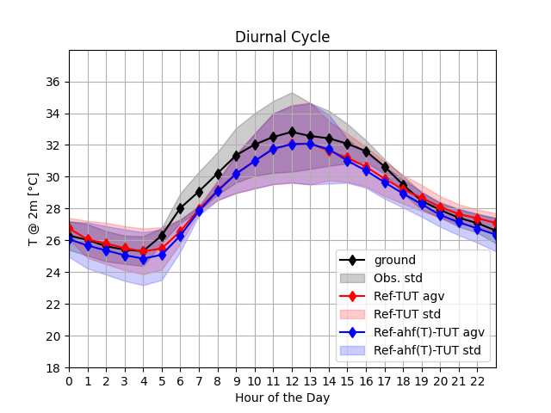
Const. Vs AHF(T2m): T2M URBAN
Stations | T2m
Urban | 4
Notes:
TU-ON: best configuration for AHF(T2m_clm) on urban areas for t2m

Slide 9
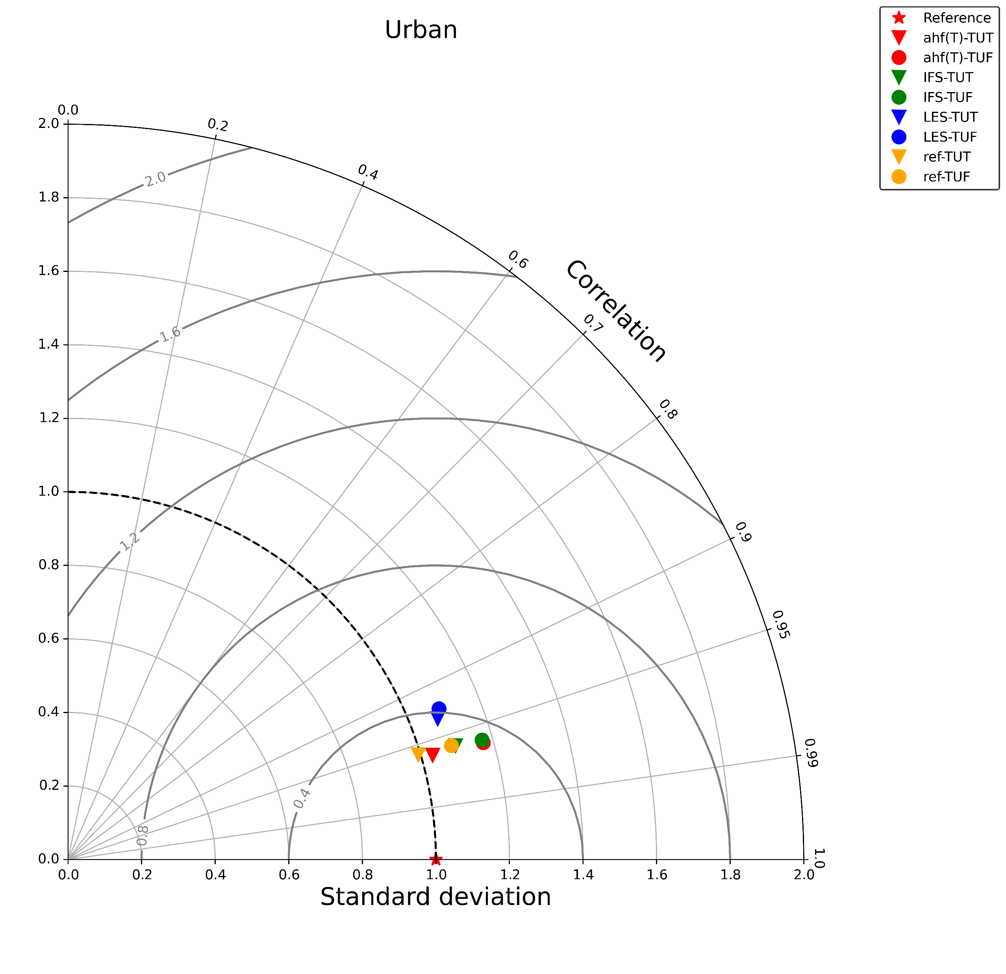
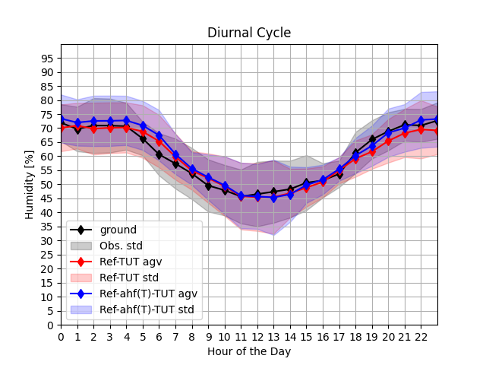
Const. Vs AHF(T2m): RH2M Urban
Stations | RH2m
Urban | 3
Notes:
TU-ON: GENERAL best configuration for ref model, best correlation for AHF(T2m_clm) on urban areas, RH2m

Slide 10
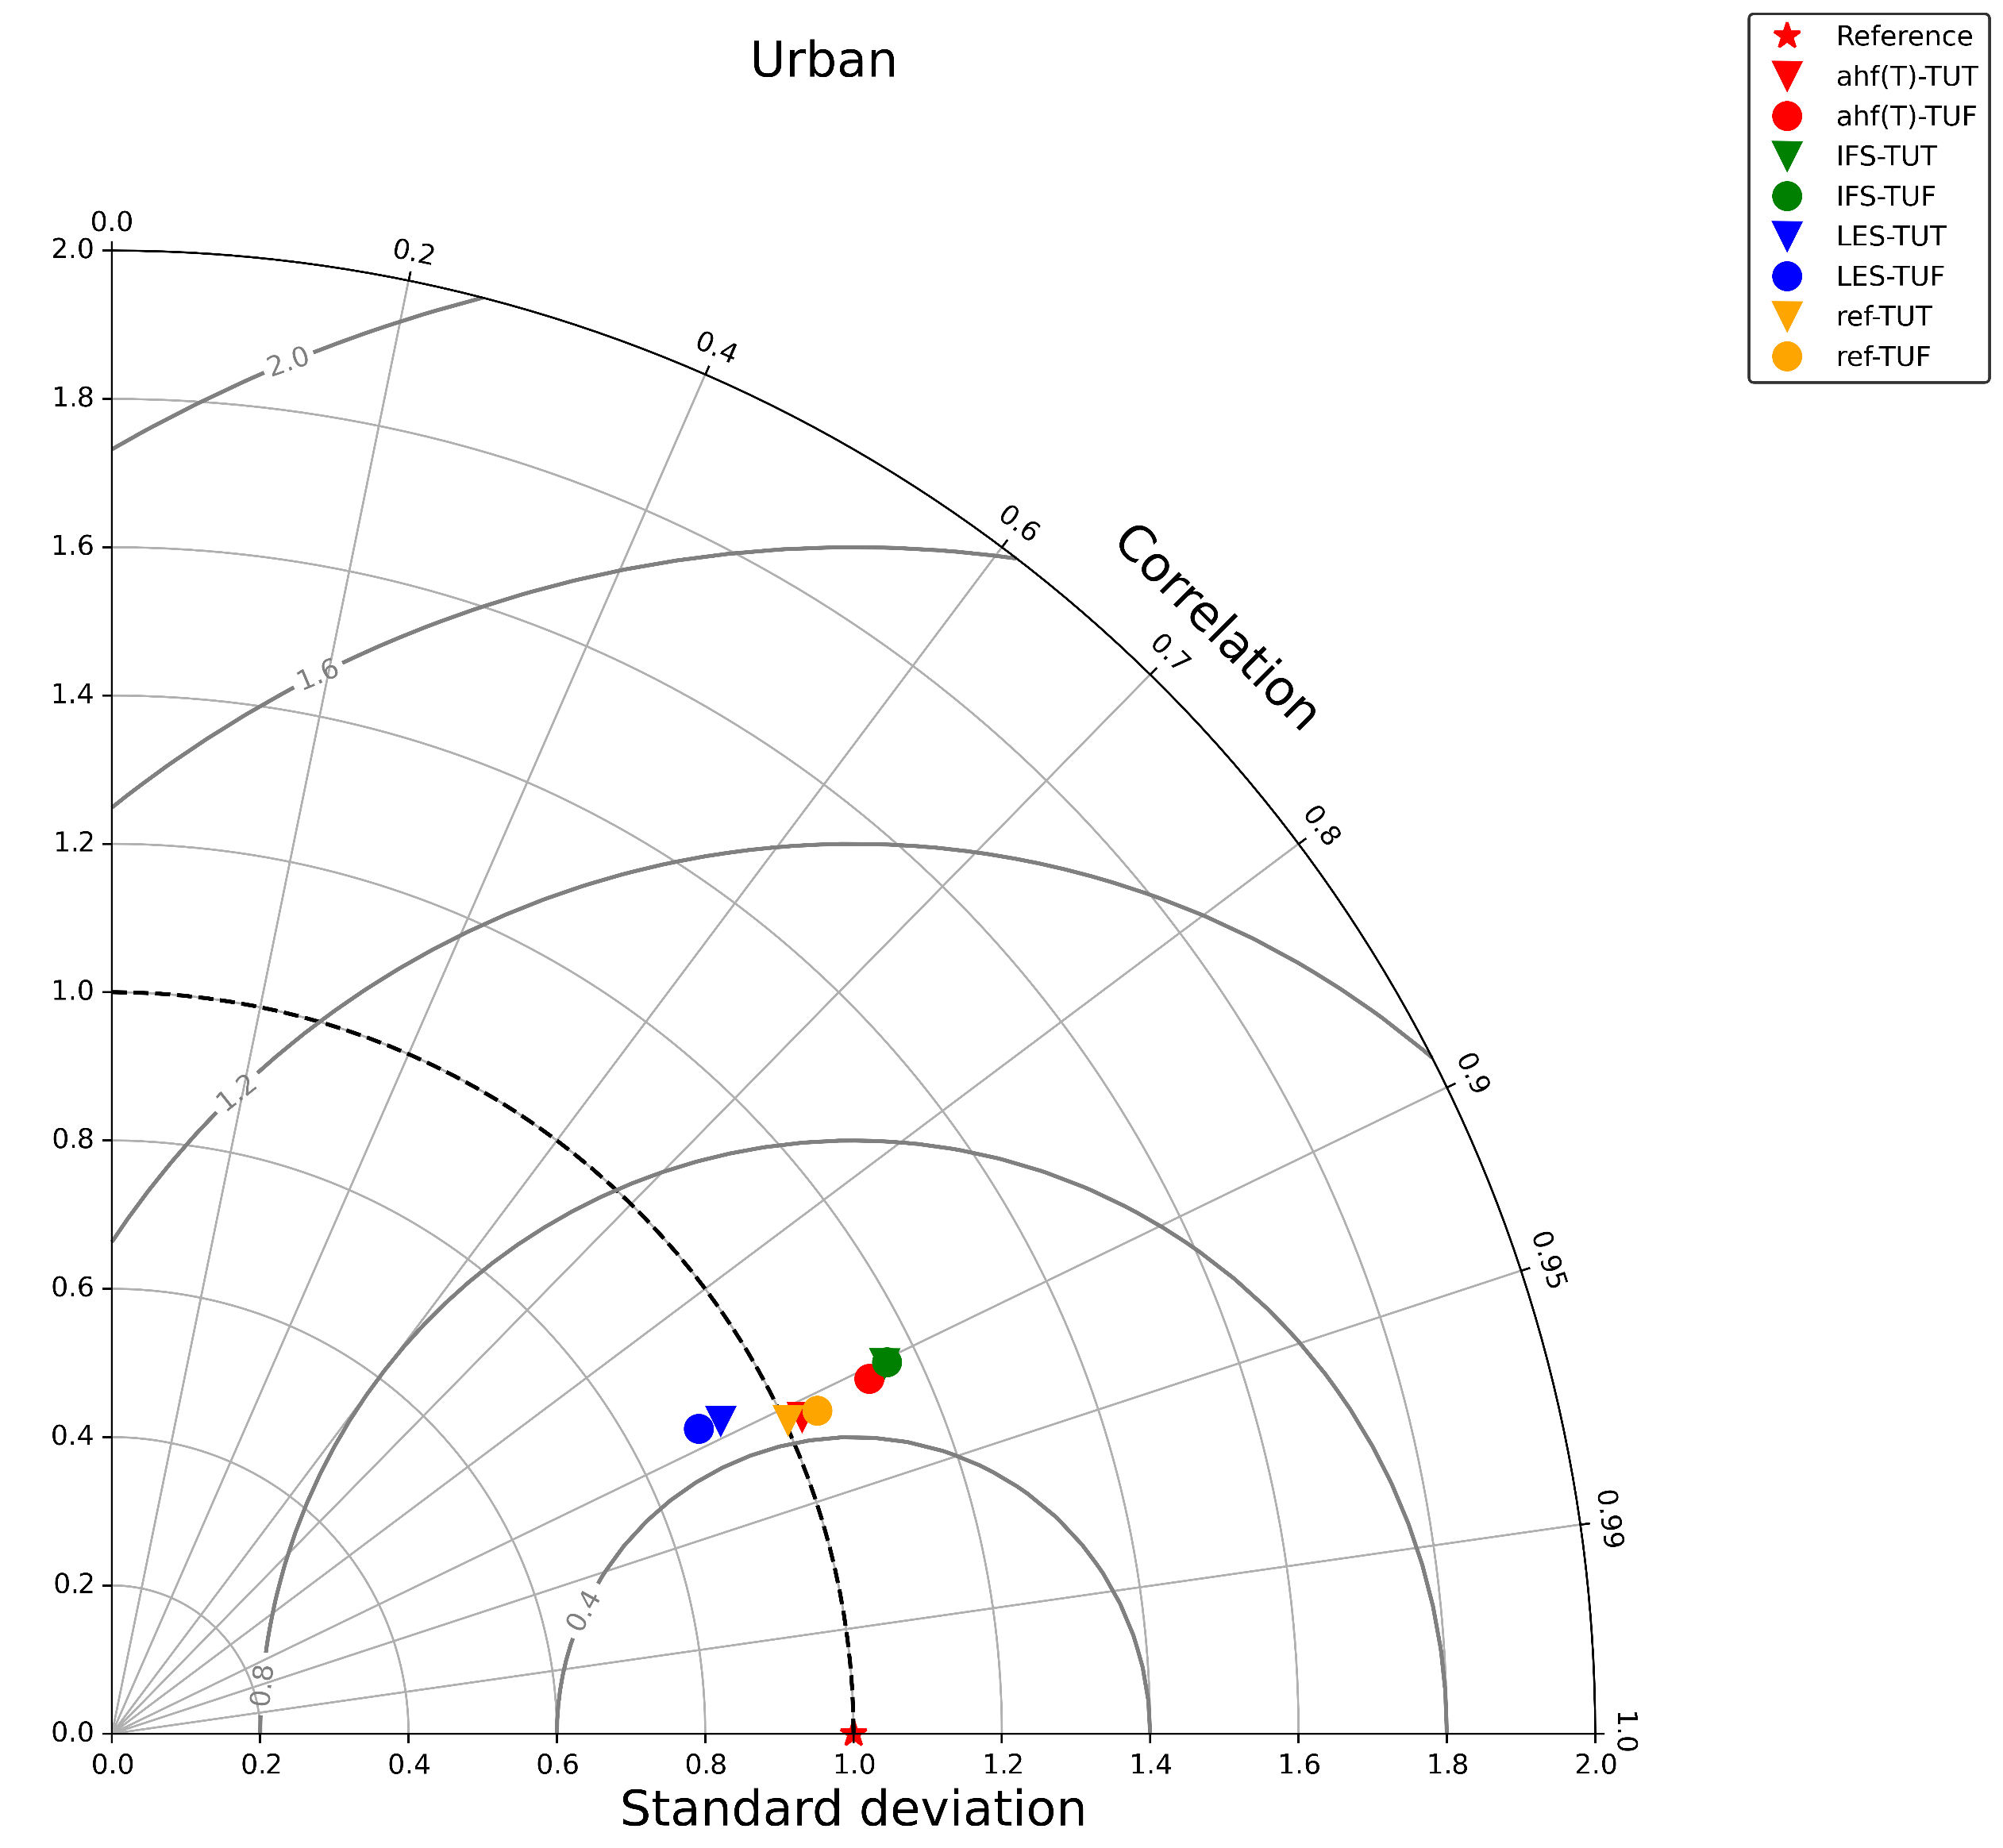
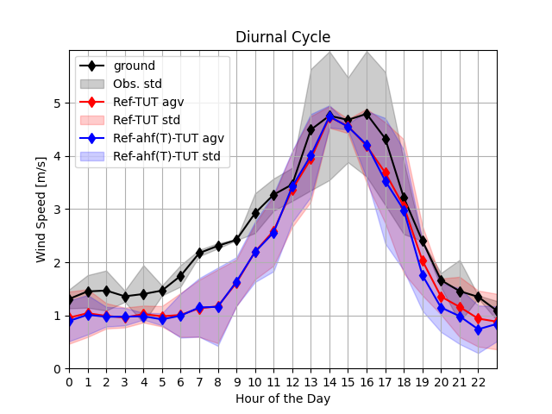
Const. Vs AHF(T2m): WS10M
Stations | WS10m
Urban | 2

Slide 11
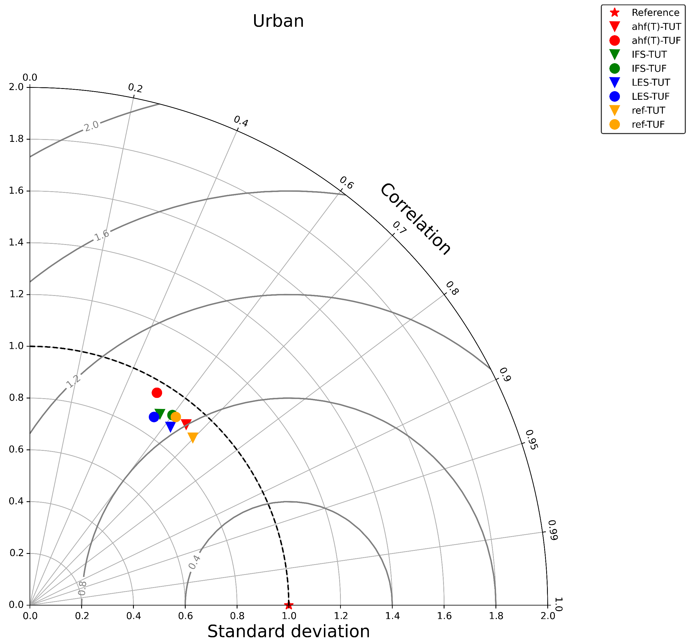
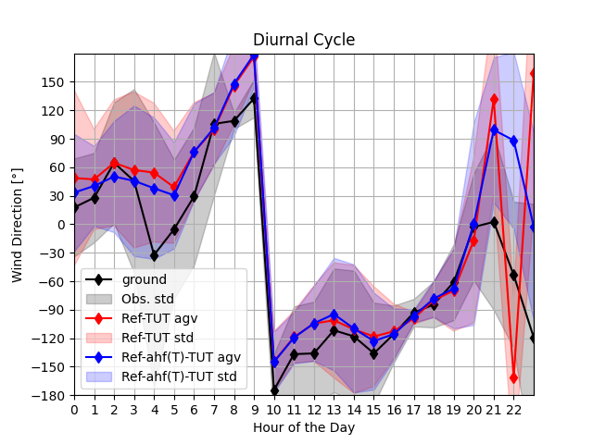
Const. Vs AHF(T2m): WD10M
Stations | WD10m
Urban | 2

Slide 12
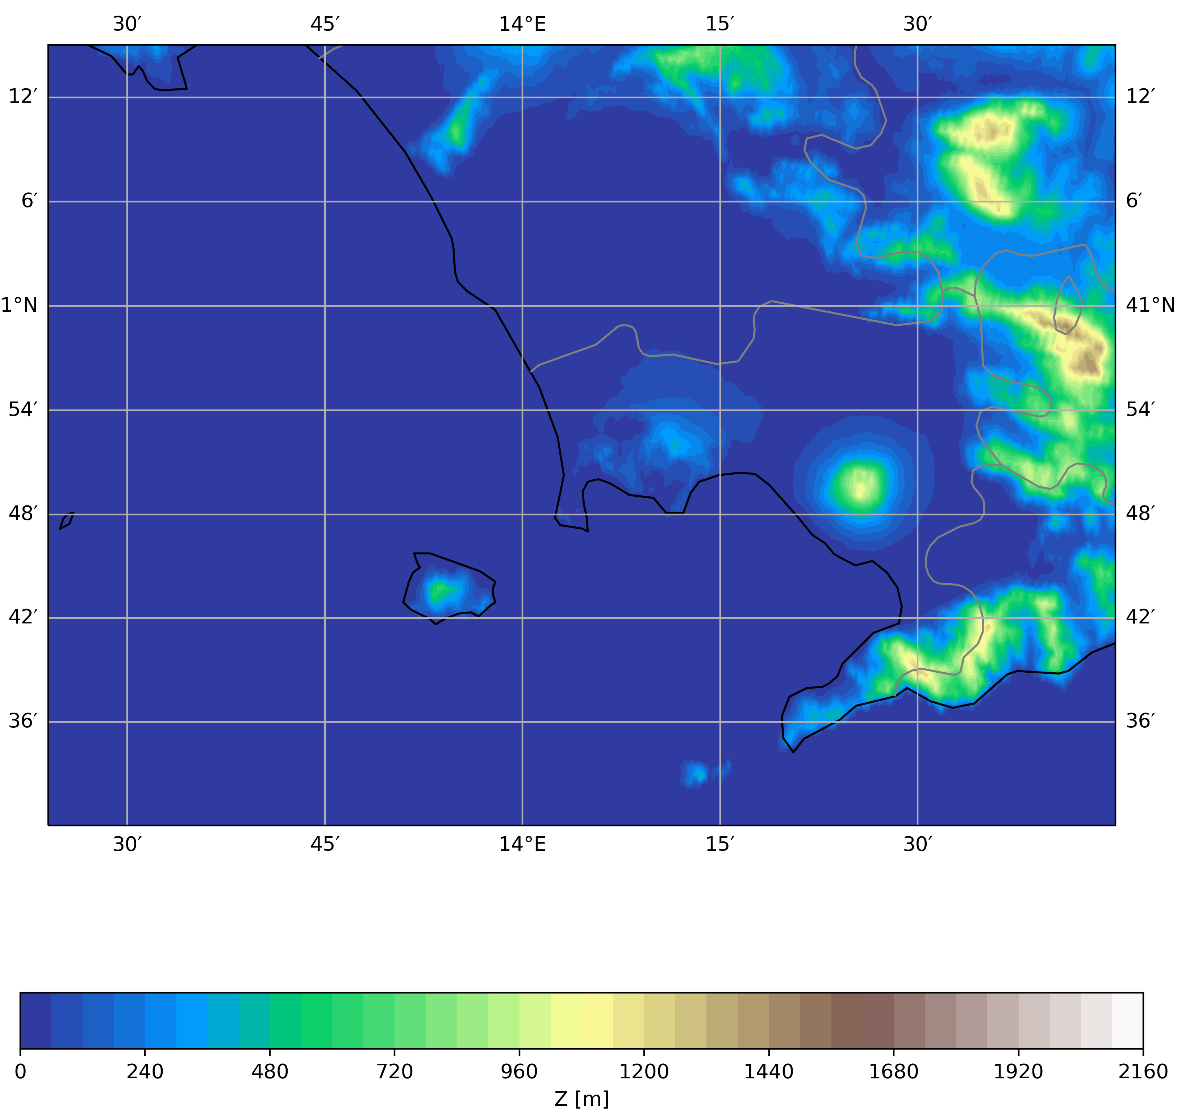
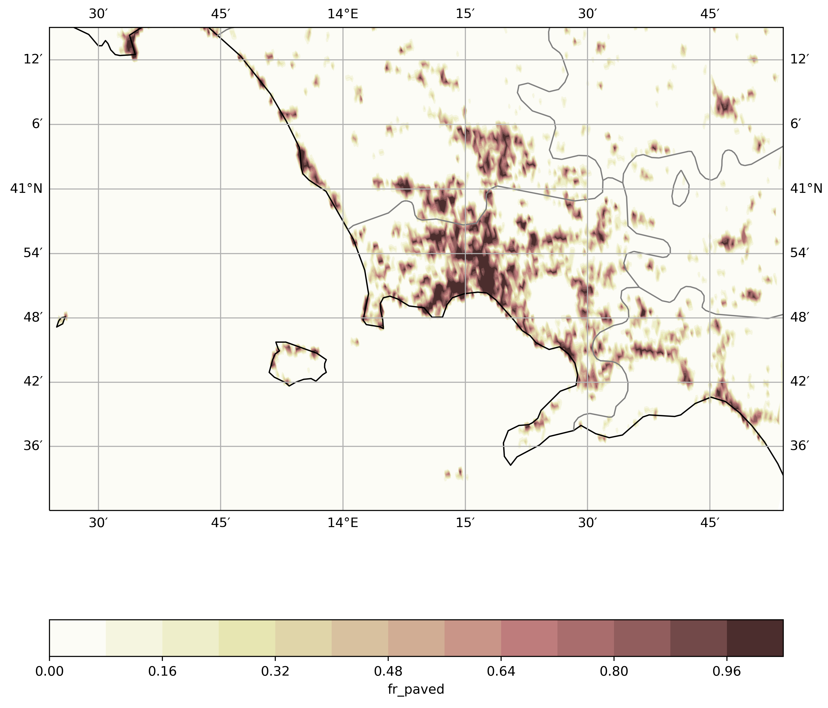
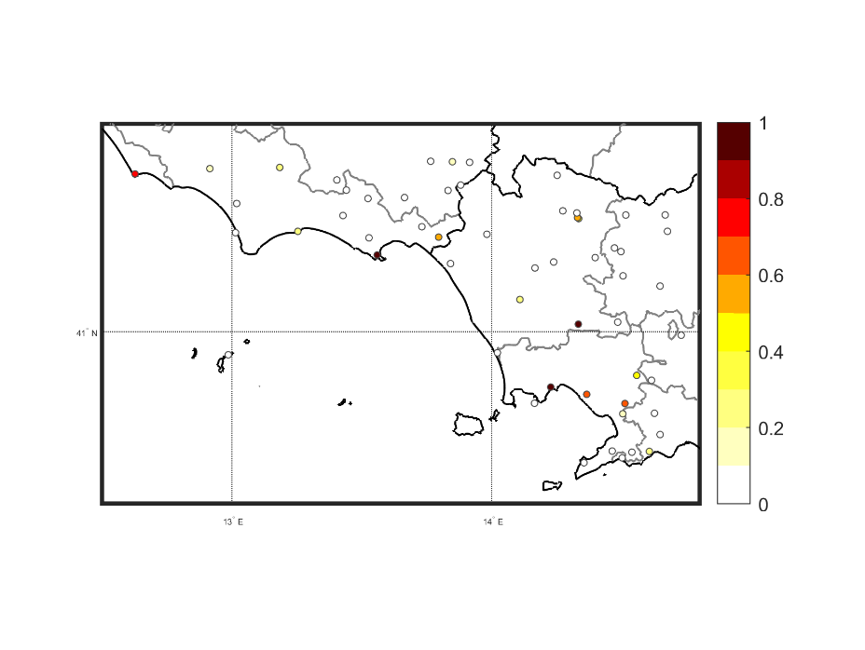
Urban Heat Island - Uhi
Test Case Area:
Few stations available on Napoli city
Neapolitan Metropolitan Area
  4.434.136 people lives on 2300 kmq (SVIMEZ)
  Area includes also parts of Caserta and Salerno province.
Piana Campana: vaste planar area on which urban conurbation of Caserta and Napoli cities is growing
  Here, 6 (3 for UDI) stations considered, included in a box of ~38 km
Orography
Fr_paved
Stations with ICON fr_paved
~38 km
ICON fr_paved on stations

Slide 13
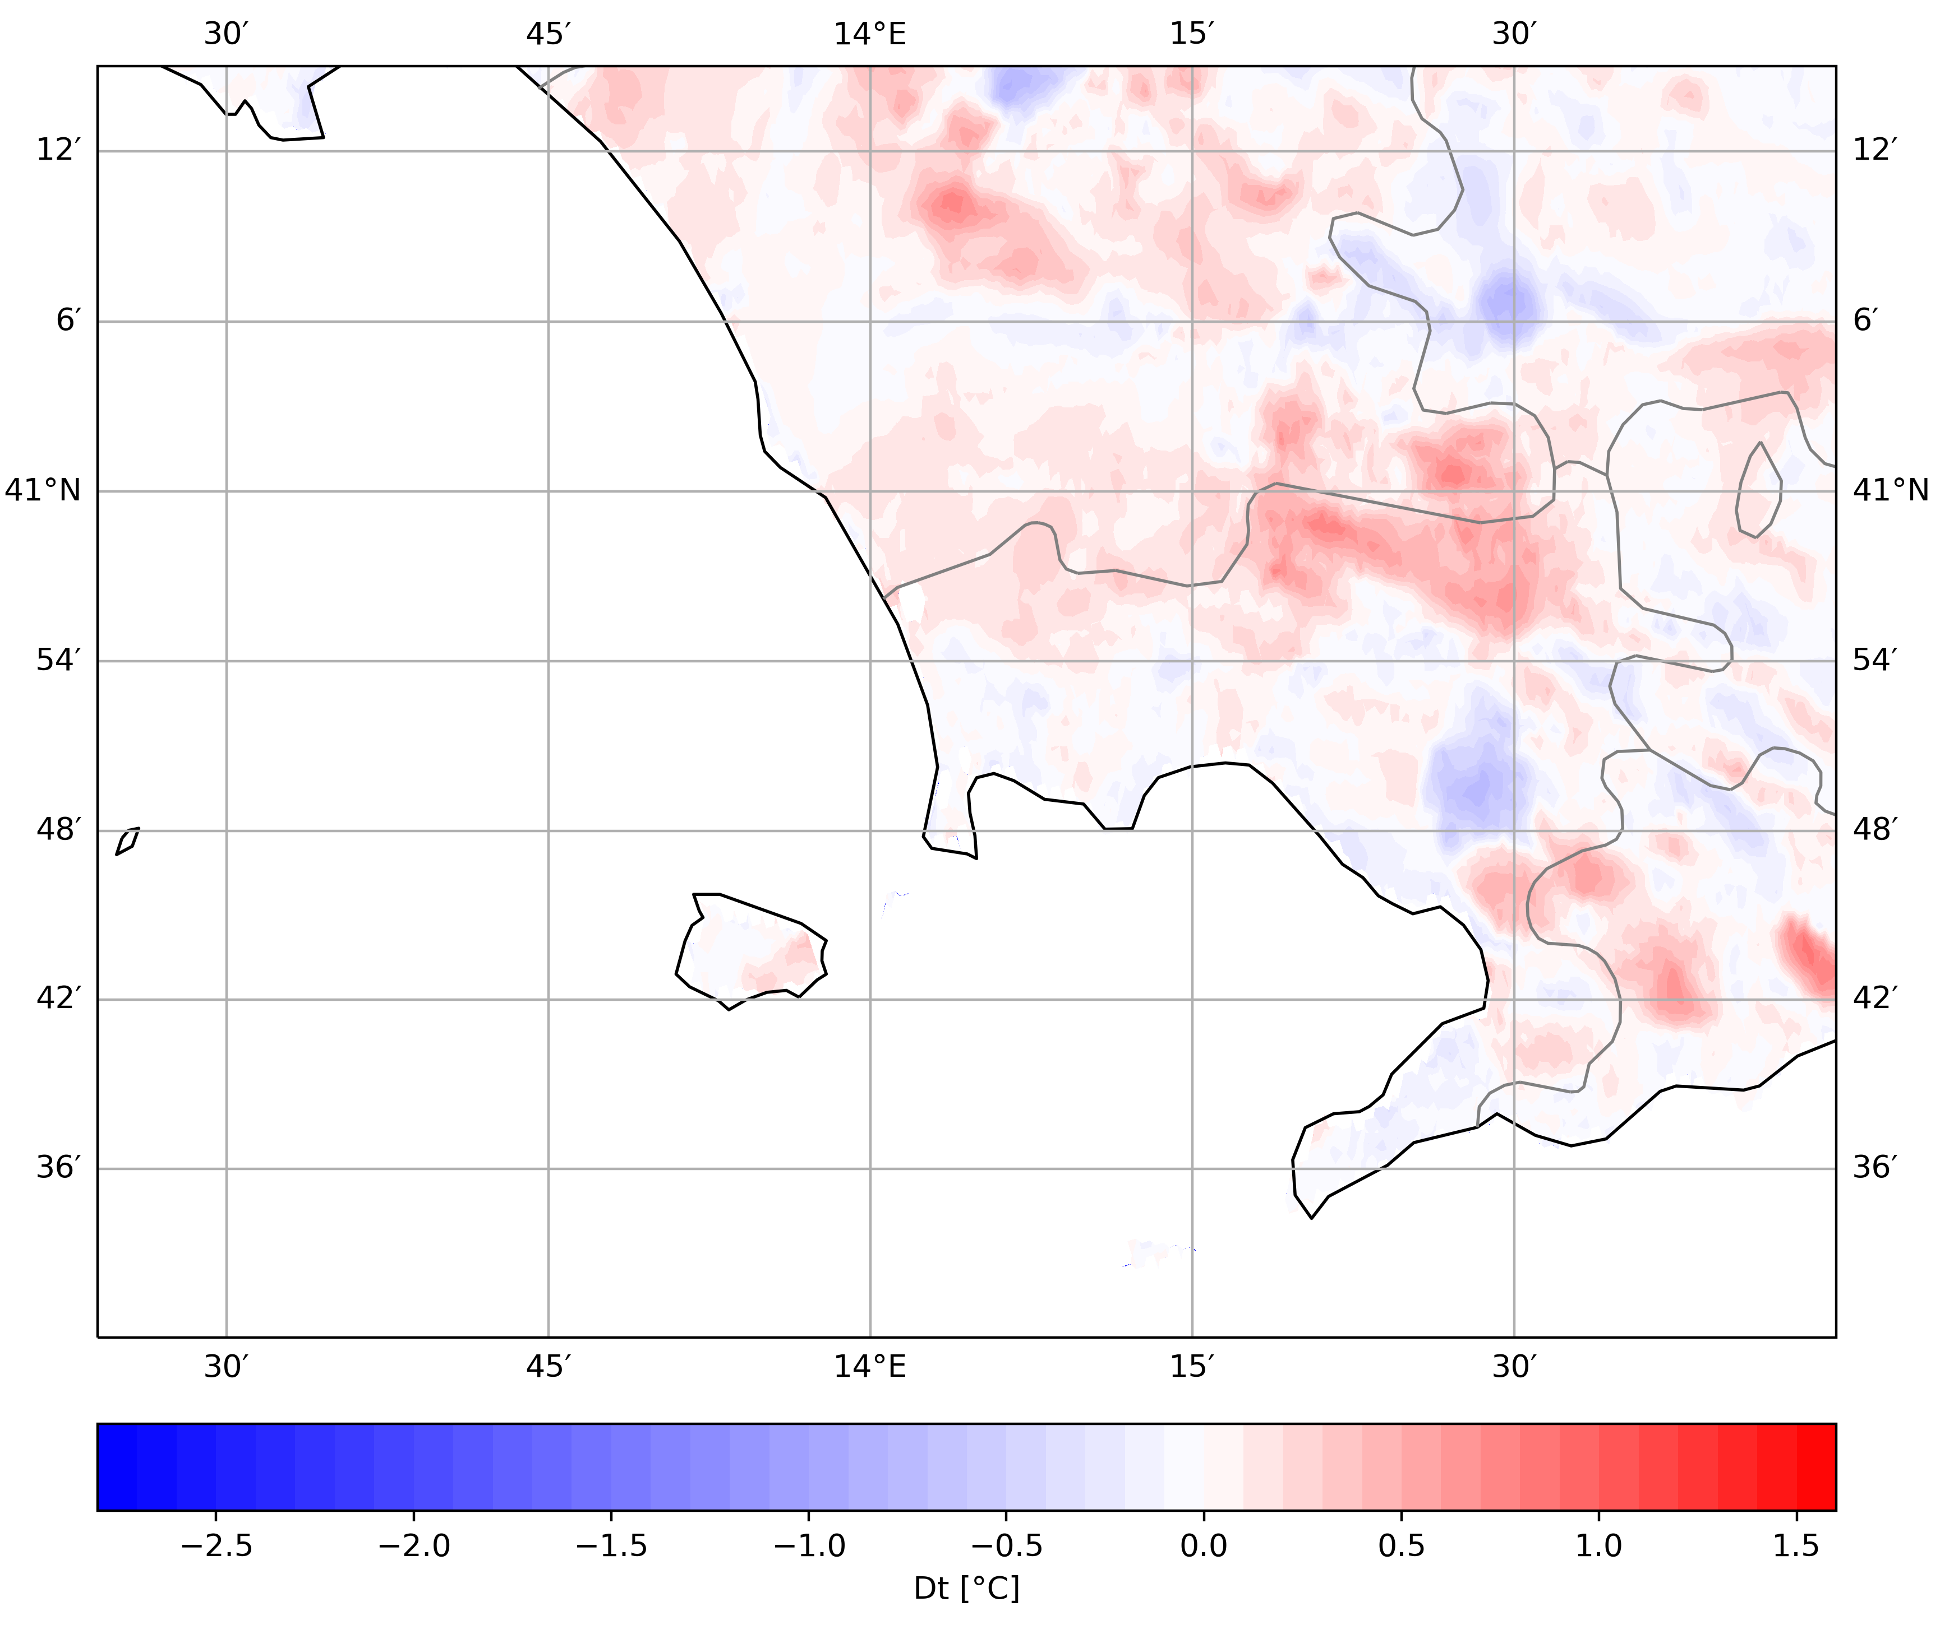
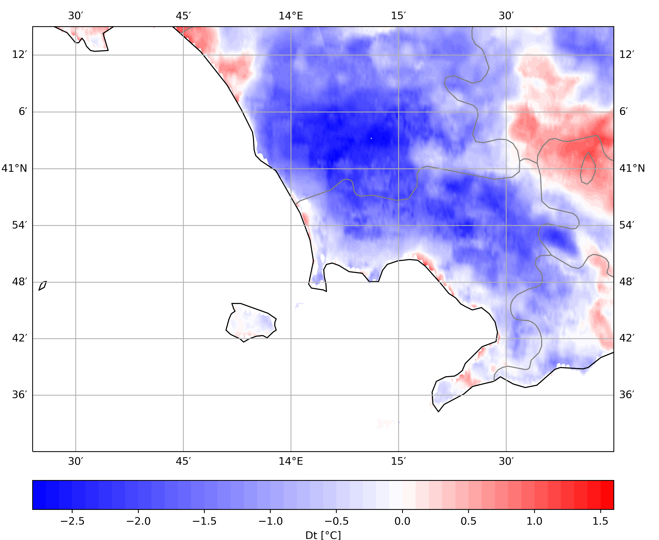
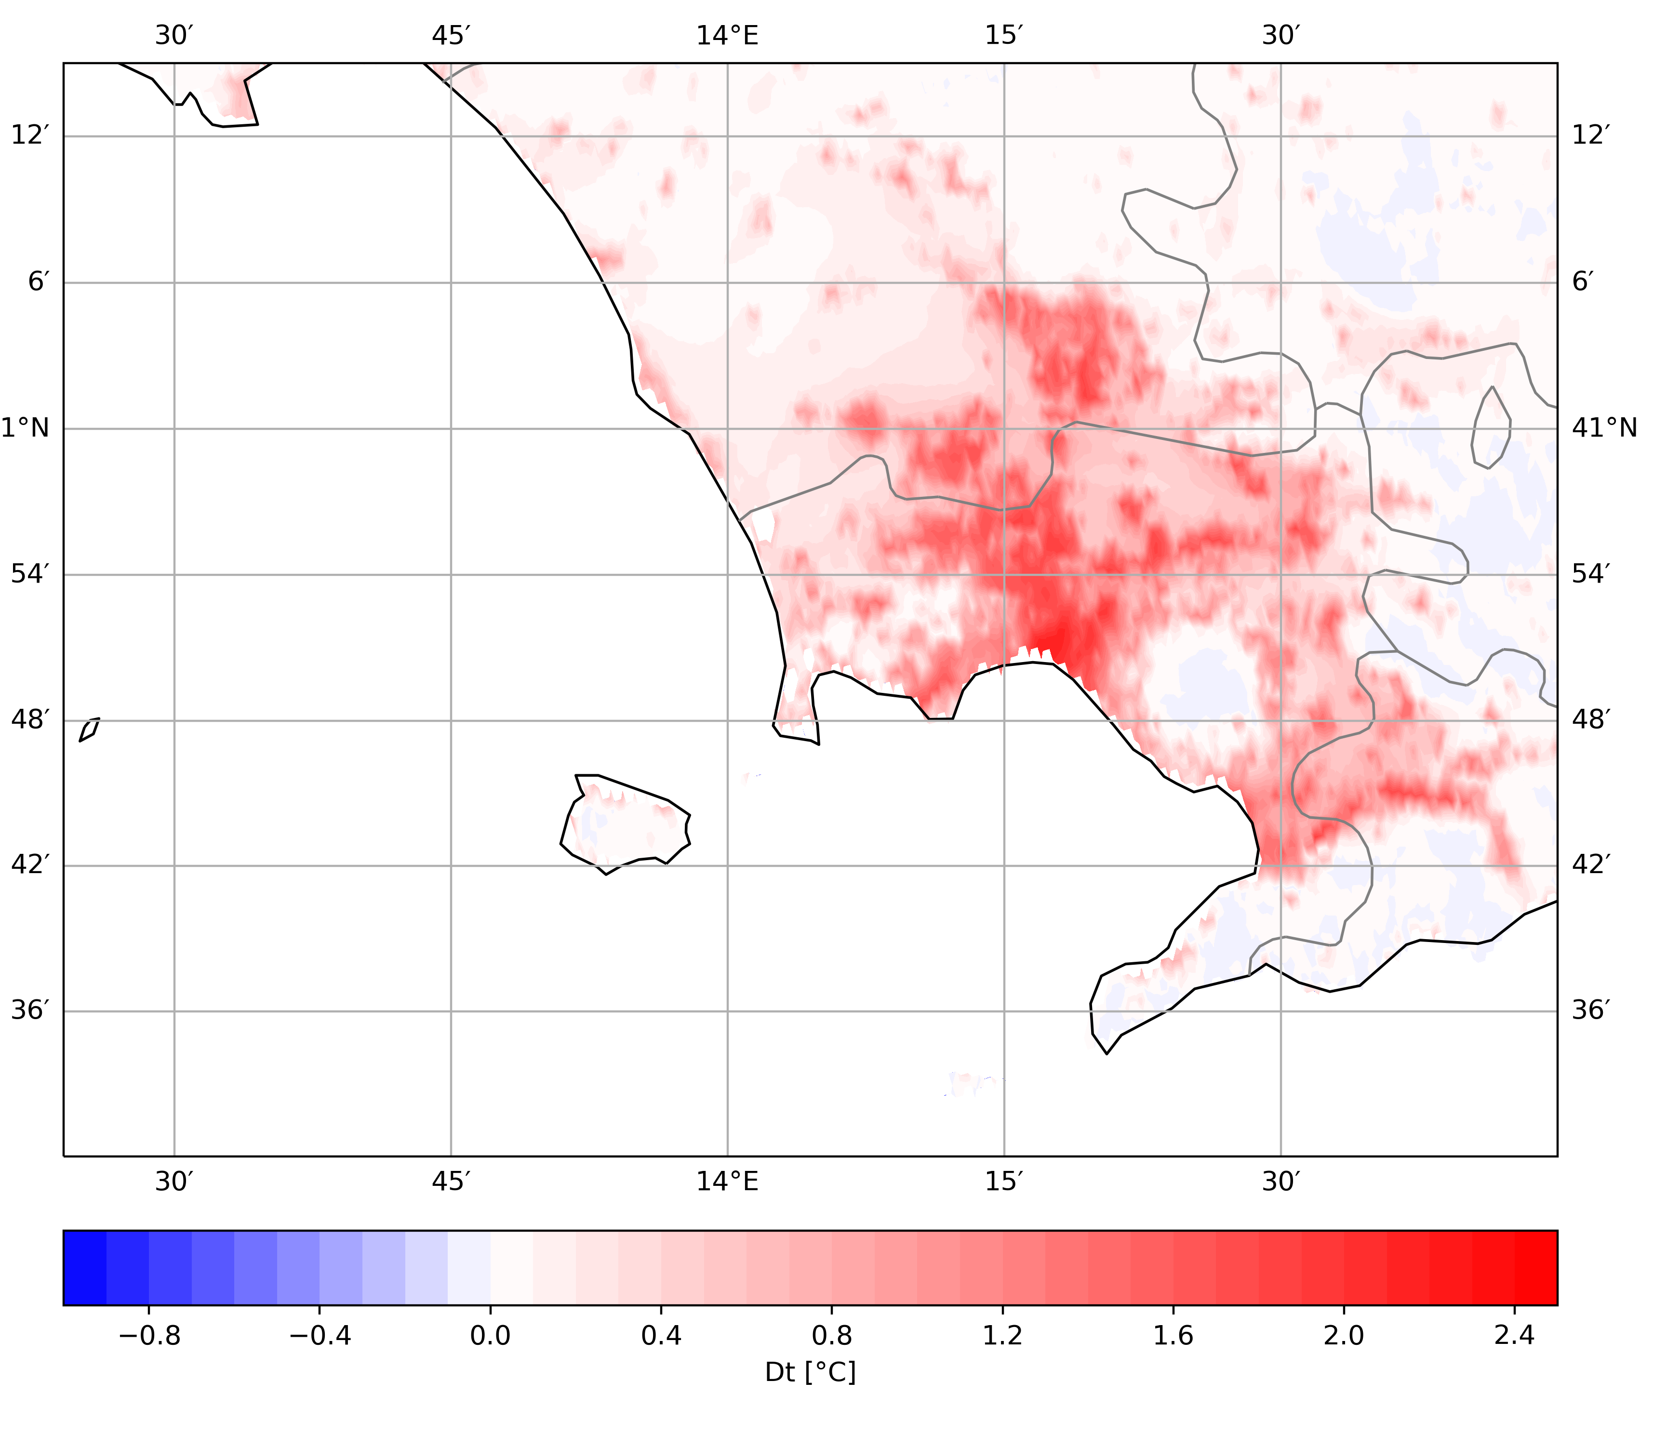
T @2m - UHI : TU on – TU off
REF
AHF(T2m_clm)
DayTime (06h – 18h)
NightTime (18h – 06h)

Slide 14
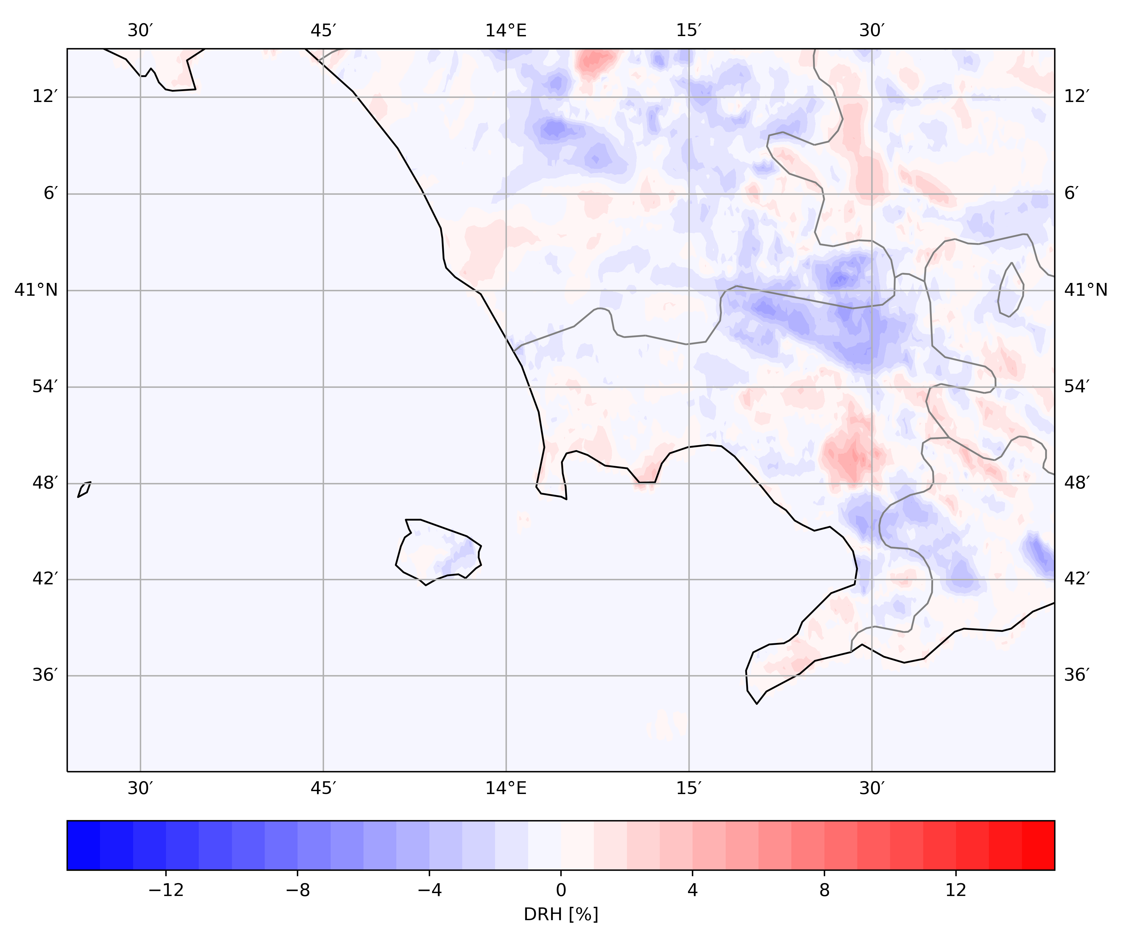
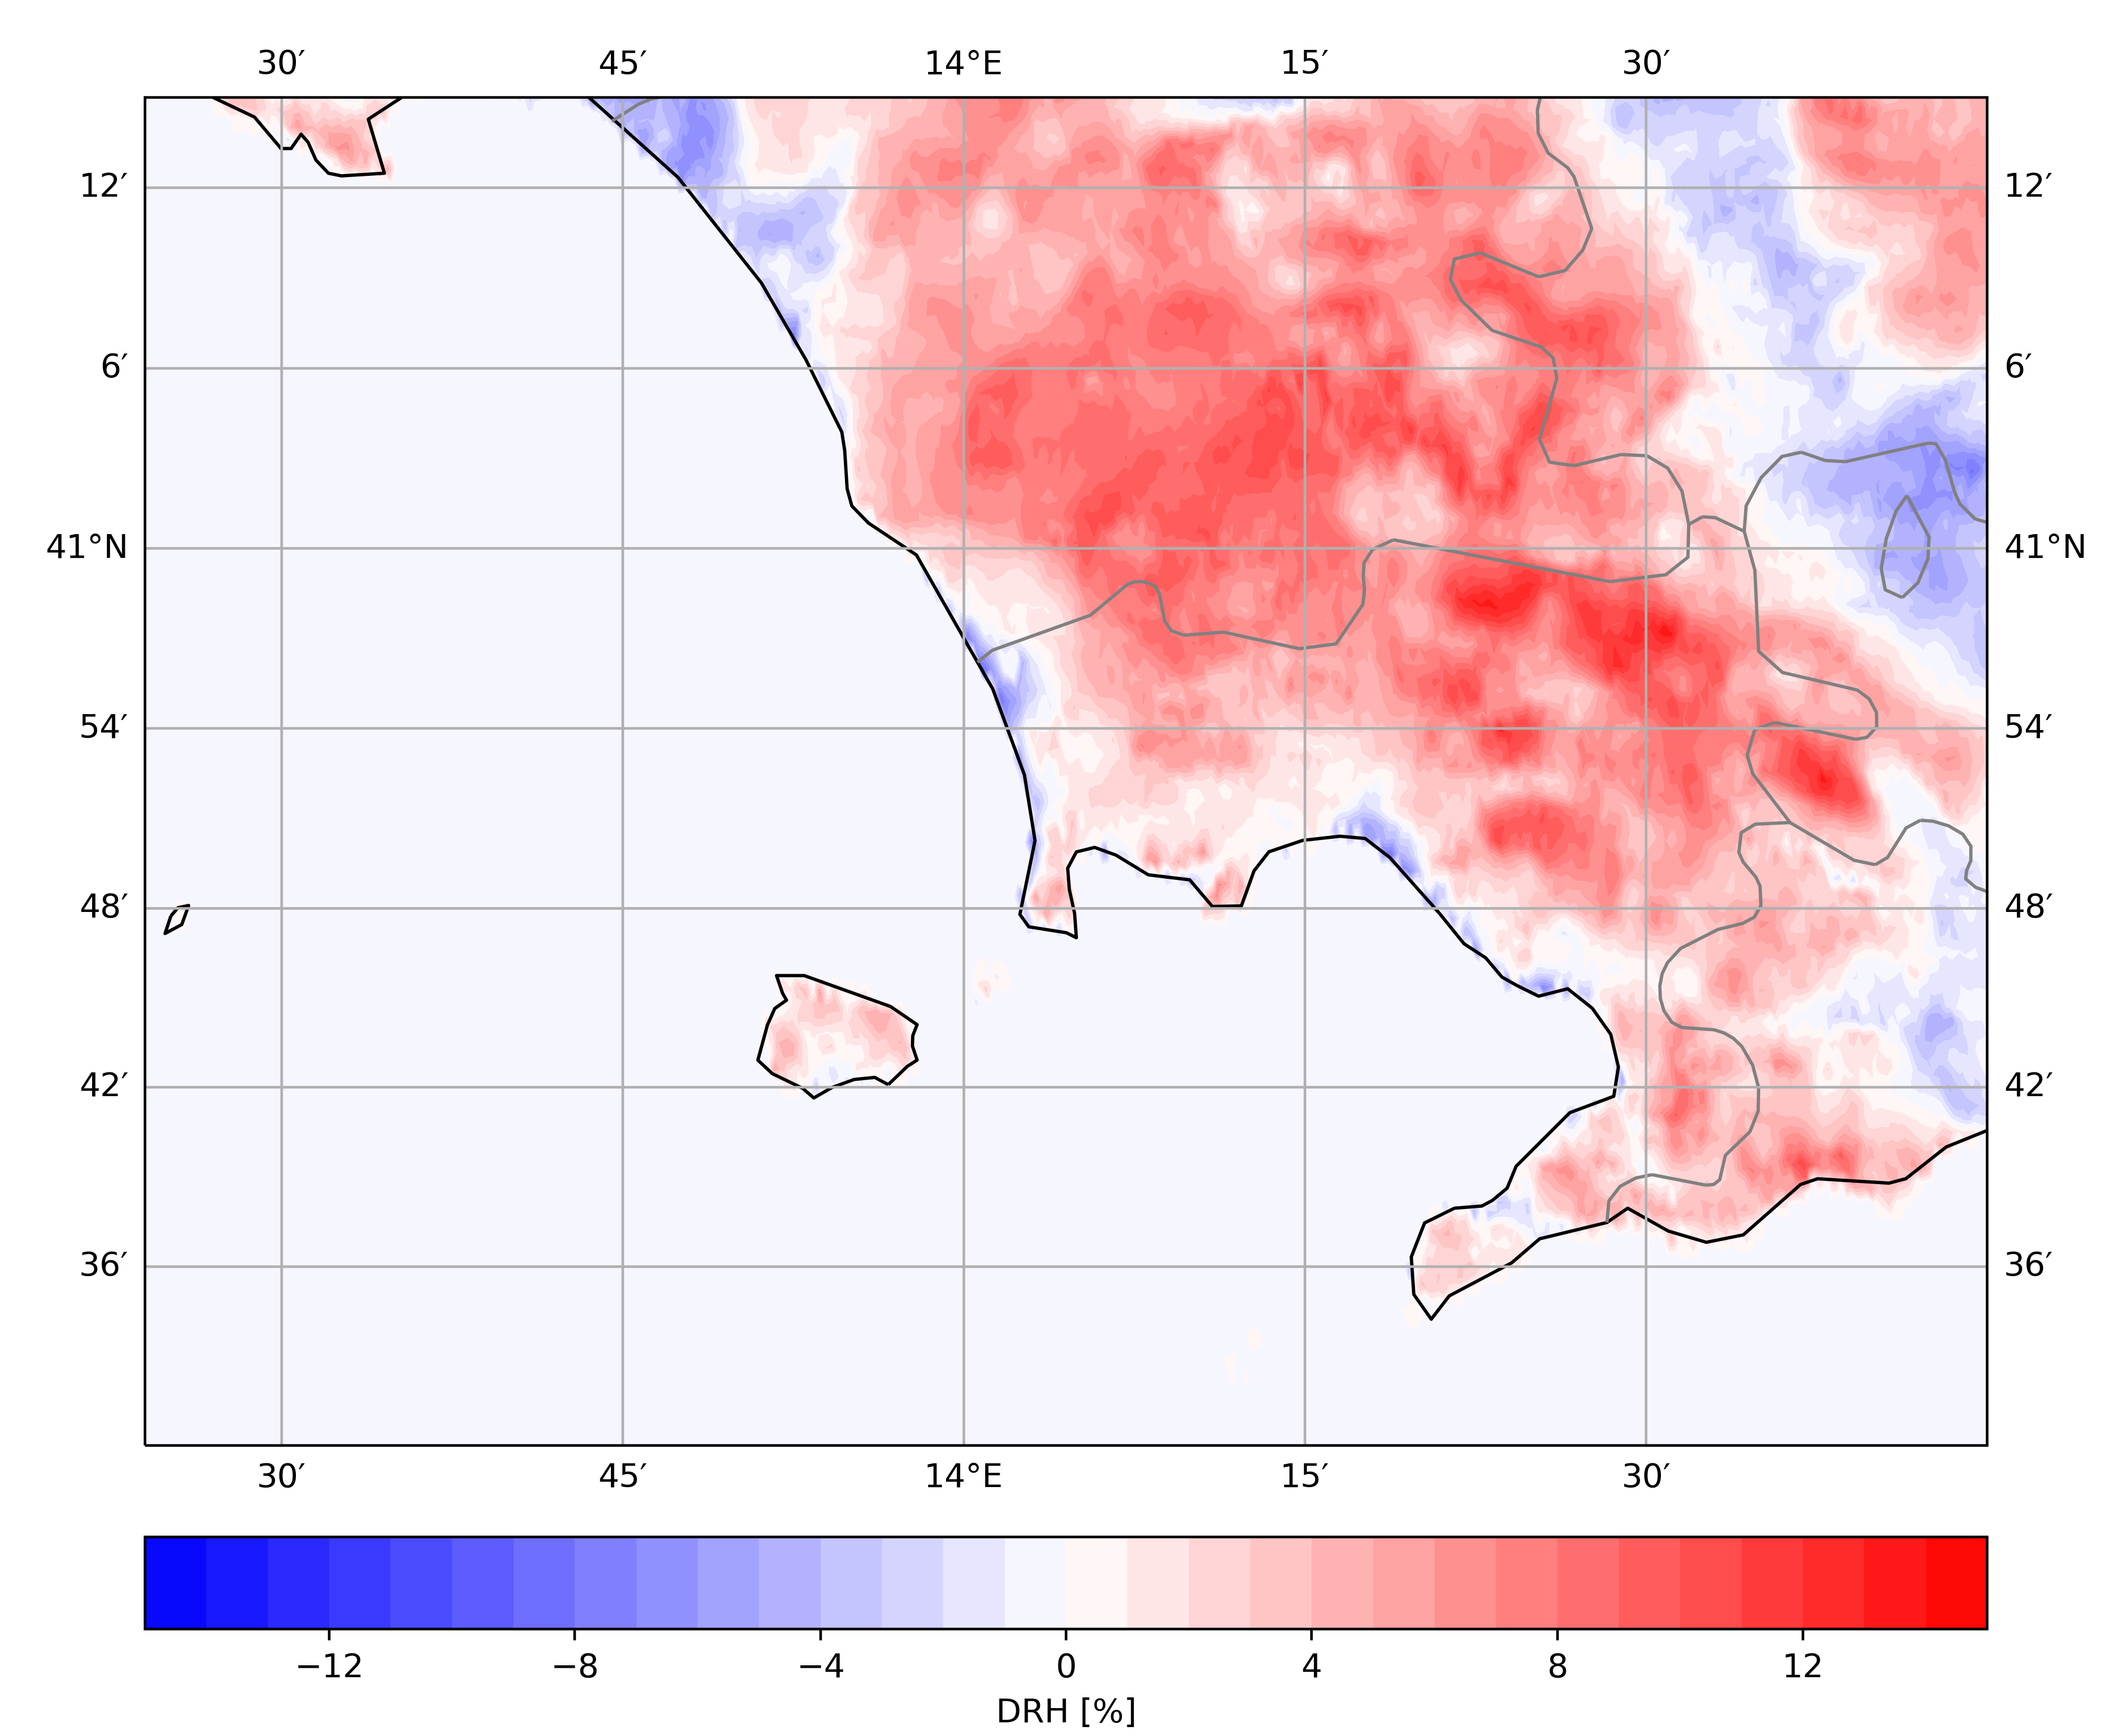
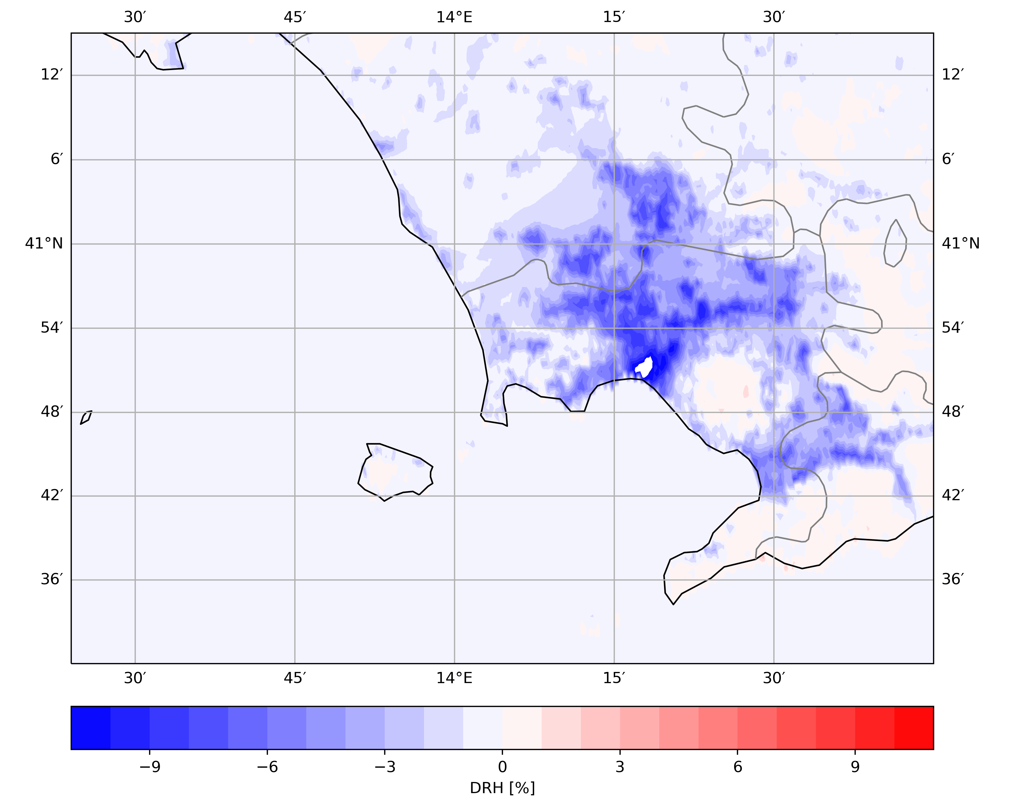
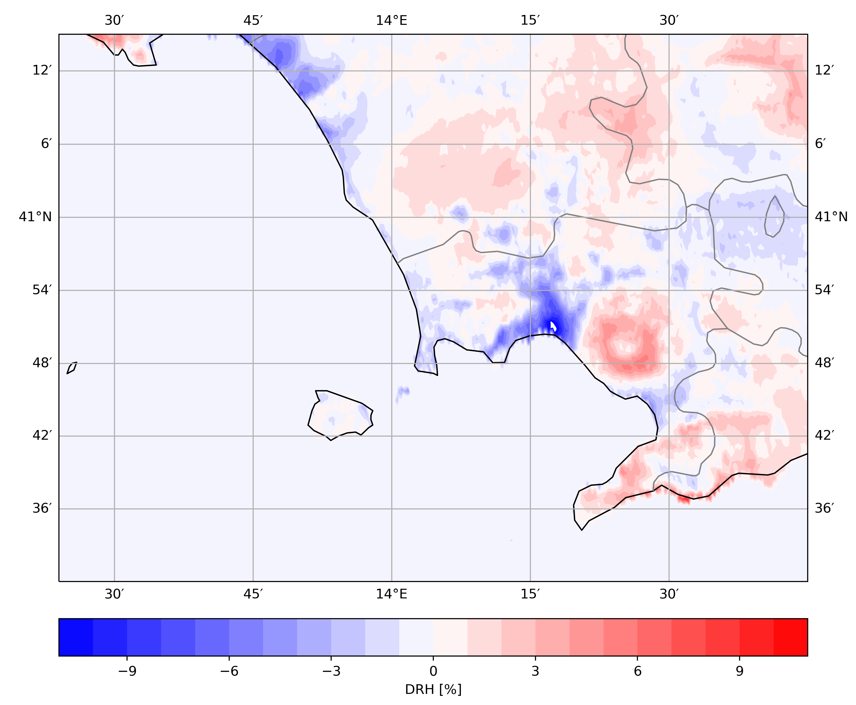
RH @2m - UDI : TU on – TU off
REF
AHF(T2m_clm)
DayTime (06h – 18h)
NightTime (18h – 06h)

Slide 15
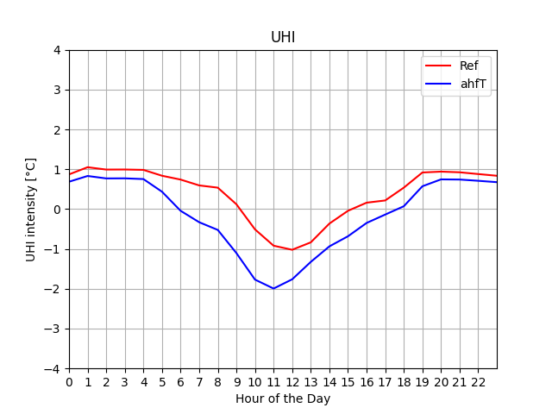
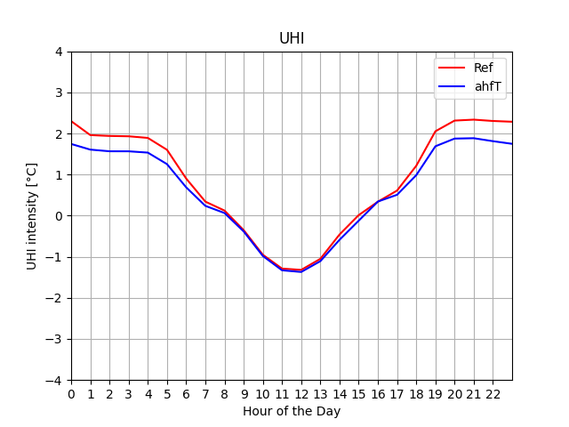
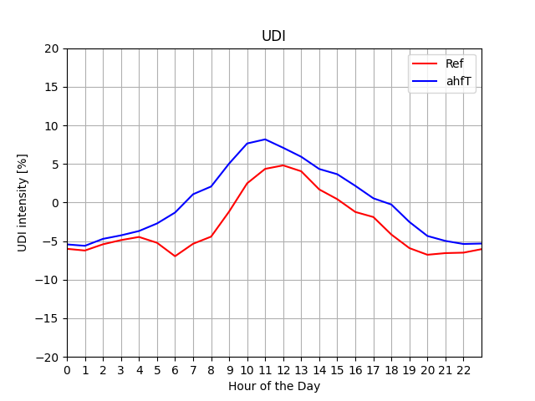
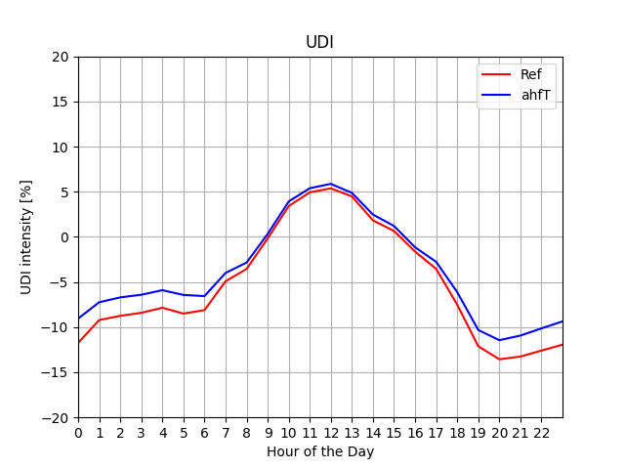
ICON UHI
Model’s (Turb – Trur) cells comparisons
TerraUrb Off
TerraUrb - On

Slide 16
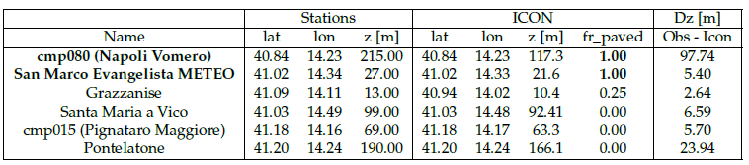
Stations Distribution and classification
Stations in Neaples Metropolitan Area:
Stations classification
Urban -> Fr_paved > 0.8
Rural -> Fr_paved > 0.25
UHI: T @ 2m
2 Urban: cmp080 (Vomero - Napoli); S. Marco Evangelista Meteo.
4 rural: cmp015 (Pignataro Maggiore); Grazzanise; Pontelatone; Santa Maria a Vico.
UDI: RH @ 2m
Solid Lines = Urban
Dotted Lines = Rural
2 Urban: cmp080 (Vomero - Napoli); S. Marco Evangelista Meteo.
1 rural: cmp015 (Pignataro Maggiore).

Slide 17
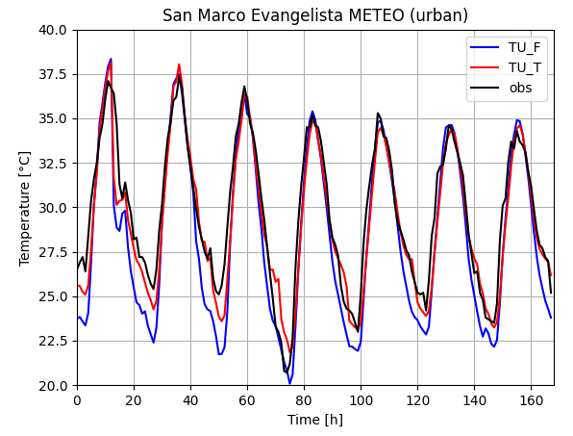
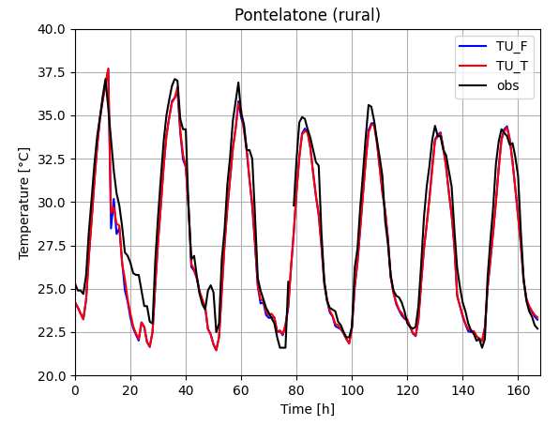
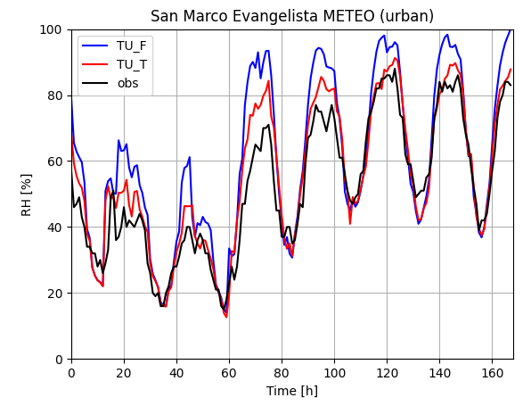
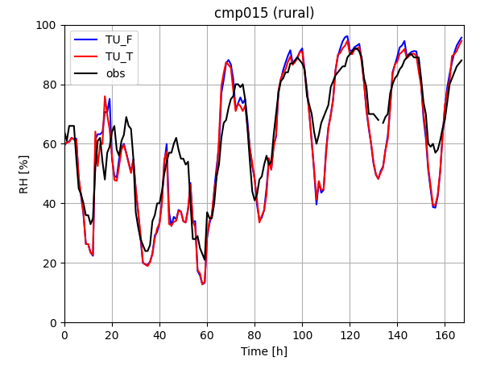
Ovserved vs ICON: T2m and rh2m cycles
Urban
Rural
T2m
rh2m

Slide 18
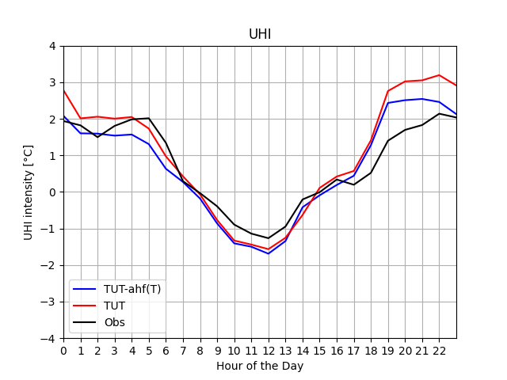
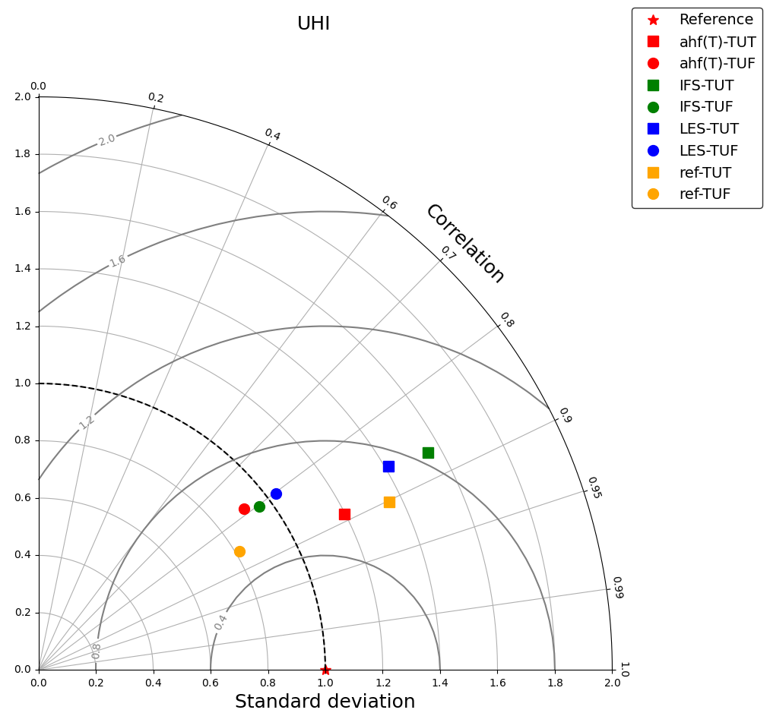
UHI: Const. Vs AHF(T2m):
Switch from TUF (o) to TUT (square) deteriorates in terms of devst, while correlation is enhanced
Ahf(T)-TUT vs REF-TUT shows an enhancement in terms of standard deviation and CRMSE, comparable in terms of correlation

Slide 19
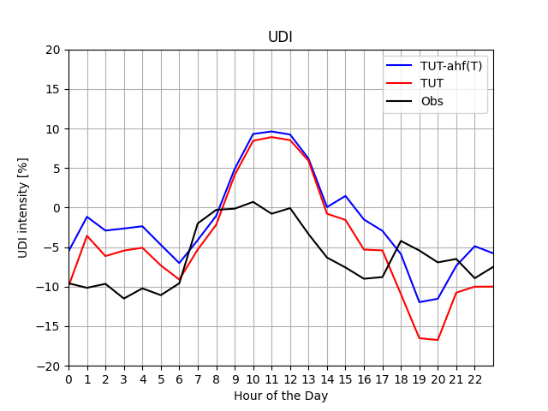
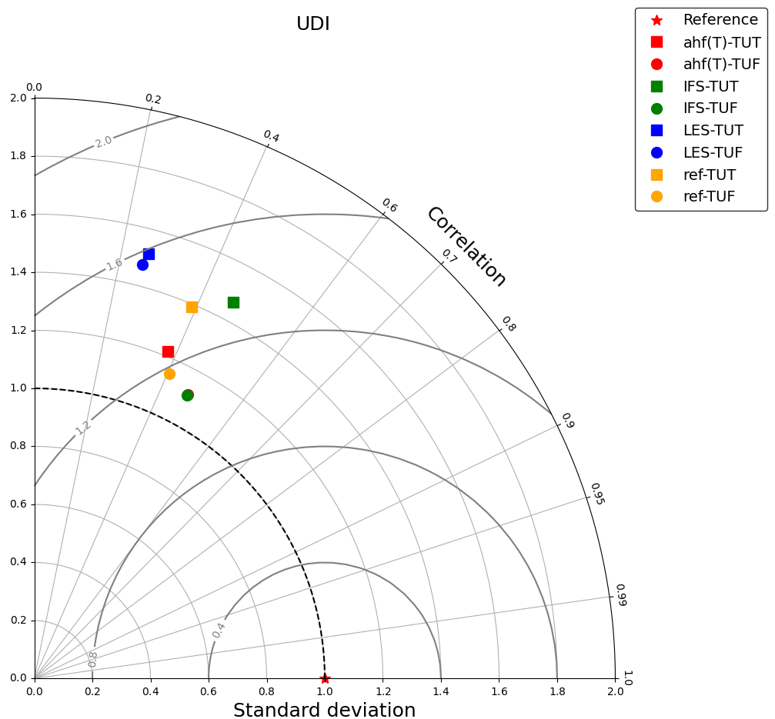
Const. Vs AHF(T2m): UDI
Ratio of st.dev|crmse increase when TU in ON
AHF performs better of Const. (REF), when TU is ON
Notes:
Switching on TU give rise to an increase of Standard Deviation. looking

Slide 20
Heat Fluxes
Check of Surface Fluxes
  CTH
  Sensible
  Latent

Slide 21
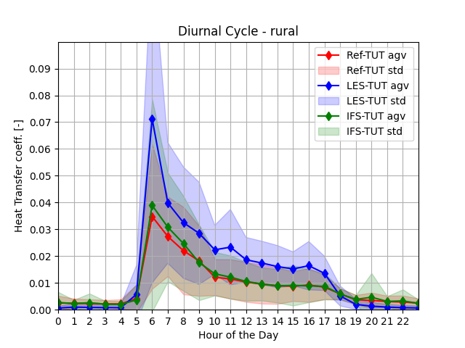
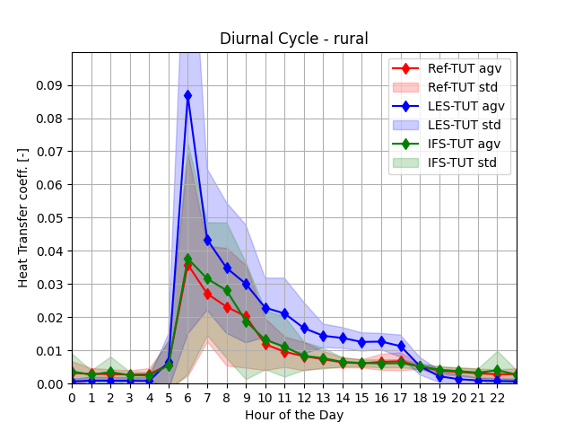
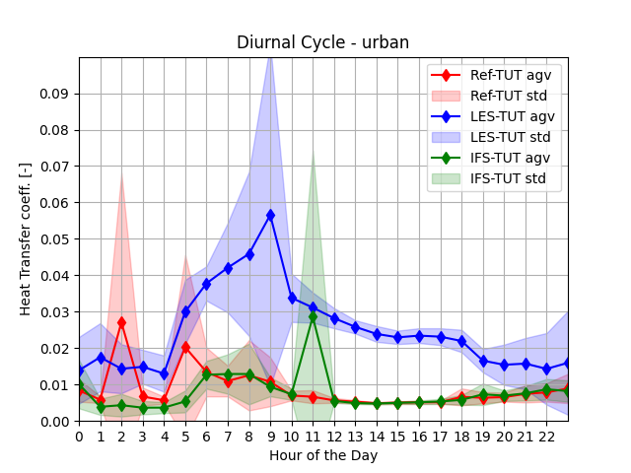
CTH
< 2000 mt
< 200 mt

Slide 22
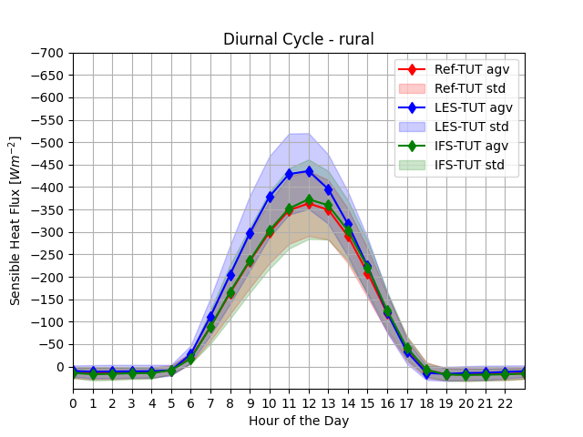
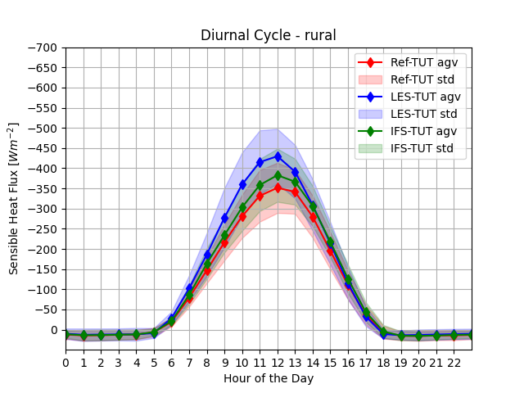
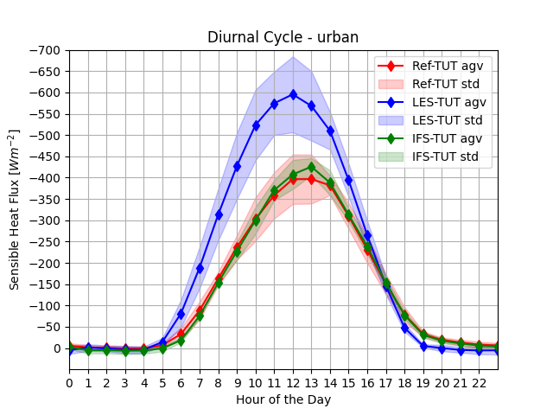
Sensible Heat Fluxes
Q > 0 when entering towad ground/soil/surface, i.e., atmosphere is warming soil.
Q < 0 when flowing from surface to atmosphere.
< 2000 mt
< 200 mt

Slide 23
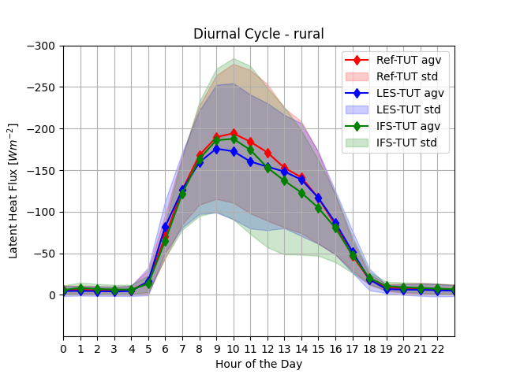
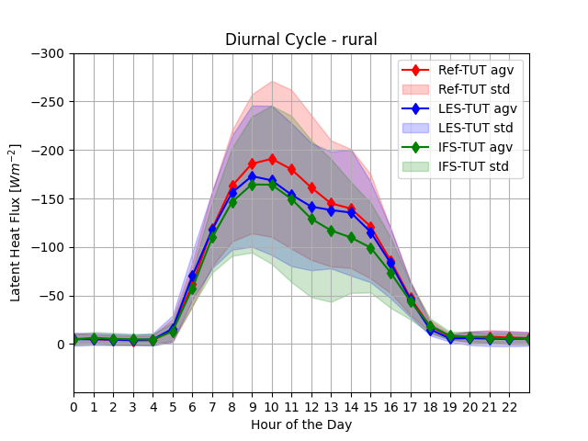

Latent Heat Fluxes
< 2000 mt
< 200 mt

Slide 24
Comments
Evaluation of updated Terra_URB scheme on ICON –LAM
  7-day simulation, considering a week with a severe heat wave in July 2022
Comparing const. vs AHF(T2m_clm):
  Diurnal Cycles
    Week diurnal T2m cycles enhanced in urban areas
    Rh2m, ws10m and wd10m not affected or sliglty worst
  UHI and UDI:
    Beneficial effect std.dev and crmse
    Beneficial effect
Generally TU is observed an increases std.dev and crmse

Slide 25
Thank you for your attention!

