Slide 1
Assimilating 3D radar reflectivity observations in complex topography
Alina Yapparova, Claire Merker, Daniel Leuenberger, Marco Boscacci, Urs Germann, David Leutwyler
MeteoSwiss, Switzerland

Slide 2
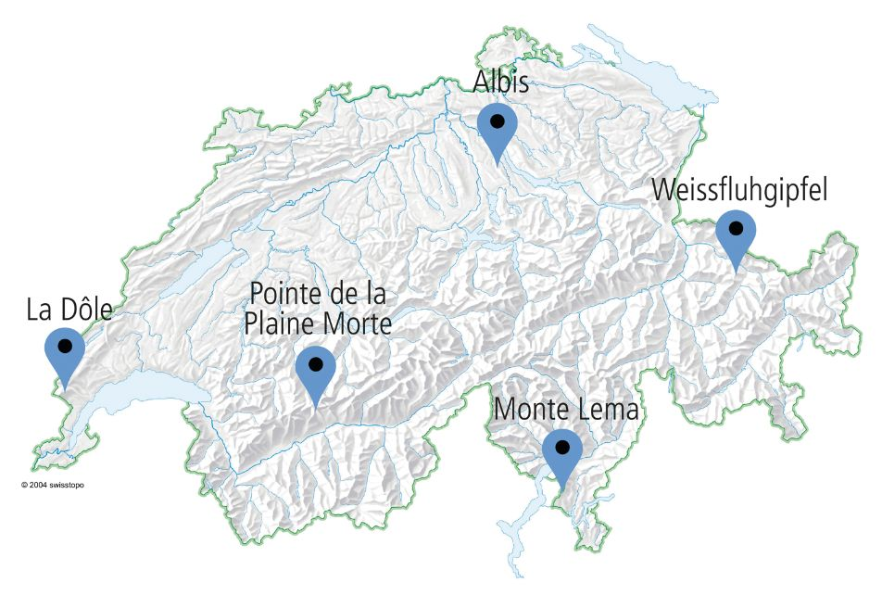
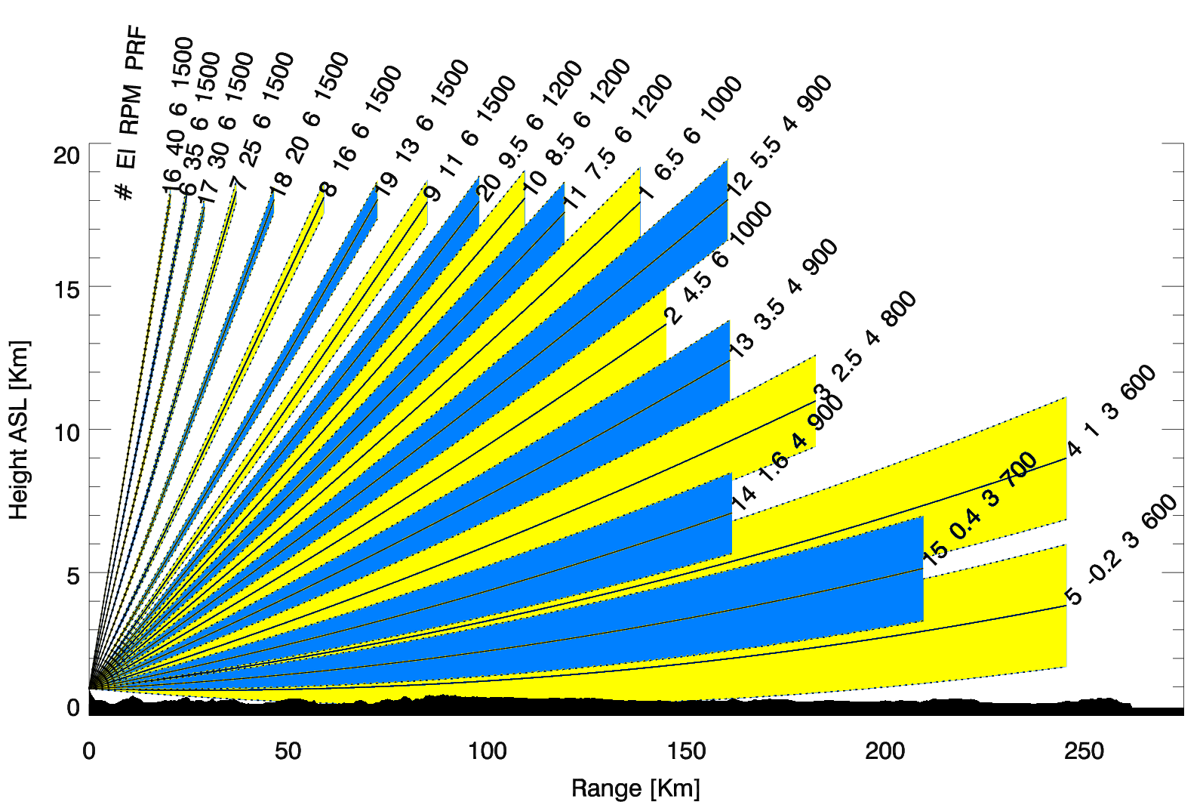
Swiss radar network
Radar | Operational since | Altitude* (m asl)
Albis | June 2012(1959) | 938
Dôle | October 2011 (1959) | 1682
Lema | May-June 2011(1993) | 1626
Plaine Morte | June 2014 | 2937
Weissfluh | January 2016 | 2850
(2004, swisstopo)
5 C-band radars with wavelength 5.45 GHz (5.5 cm)
20 elevation scans, two half-scans every 5 mins
Range up to 18 km height and to 162 km distance from the radar (2 scans up to 246 km)
this is preliminary work aiming at preparing the assimilation of the 3d radar reflecivity in our DA system
(MeteoSwiss)

Slide 3
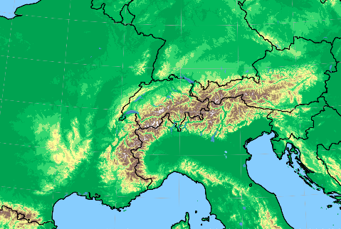
Setup for 3D radar reflectivity assimilation
ICON model: regional Swiss domain, initial conditions from DA system with LHN, IFS boundary conditions, 1 moment microphysics scheme, 1h deterministic forecasts every 1h
EMVORADO (Blahak et al., 2016): radar forward operator, computes synthetic radar volume reflectivity based on ICON at the end of the 1h forecasts
EMVORADO forward operator settings:
Mie scattering (using lookup table)
Actual radar antenna elevation and not model topography elevation
Tested combinations of lonline={True,False} (ray tracing computation) and lsmooth={True,False}(‘pencil beam’ vs. ‘pulse volume’ using 2D Gauss-Legendre quadrature with 3 horizontal and 9 vertical points).
Notes:
Computation of unattenuated Zh and polarization parameters on the model grid based on the simulated hydrometeor fields (depending
on the chosen microphysics scheme) as described in Blahak (2016) and Zeng et al. (2016). Mie-scattering option assuming spherical particles for all hydrometeors. Mie scattering describes the scattering of an electromagnetic plane wave by a homogeneous sphere
Option for \online" beam propagation. If .TRUE., enables actual ray tracing / beam bending computations based on the actual simulated air refractive index field. The sub-switch lsode provides the choice of two dierent
ray tracing methods. If .FALSE., the much simpler and more efficient climatological \4/3-earth" model is used.
Master switch to take into account that radar returns are a beam function weighted volume average (“pulse volume"). If .FALSE. the simulated radar returns are represented by their value at the center point of the
pulse volume only (“pencil beam" approximation). If .TRUE. a 2D Gauss-Legendre quadrature using a variable number of integration nodes with respect to an azimuth-elevation-sector perpendicular to the beam direction
around the center point of the pulse volume is performed, within which about 90% of the transmitted energy is conned.

Slide 4
Challenges: radars in complex terrain
(Image courtesy: C.Steger, 2024)
Monte Lema radar, 1626 m
ICON grid @ 1km
Notes:
MeteoSwiss operates a network of five C-band radars situated in the intricate topography of the Swiss Alps.
The 3D measurements of reflectivity and radial winds encounter challenges, including high amounts of clutter and beam blocking by mountains.
Assimilating Swiss radar data into our high-resolution operational data assimilation system based on an ensemble Kalman Filter, the EMVORADO forward operator and the ICON model with a grid spacing of 1km.
Show results from case studies of convective and stratiform precipitation comparing reflectivity observations and model equivalents.

Slide 5
Radar data quality control
Calculate freq. map from many obs
freq_lim
obs
Cross-apply no_data mask
Apply frequency mask
sim

Slide 6
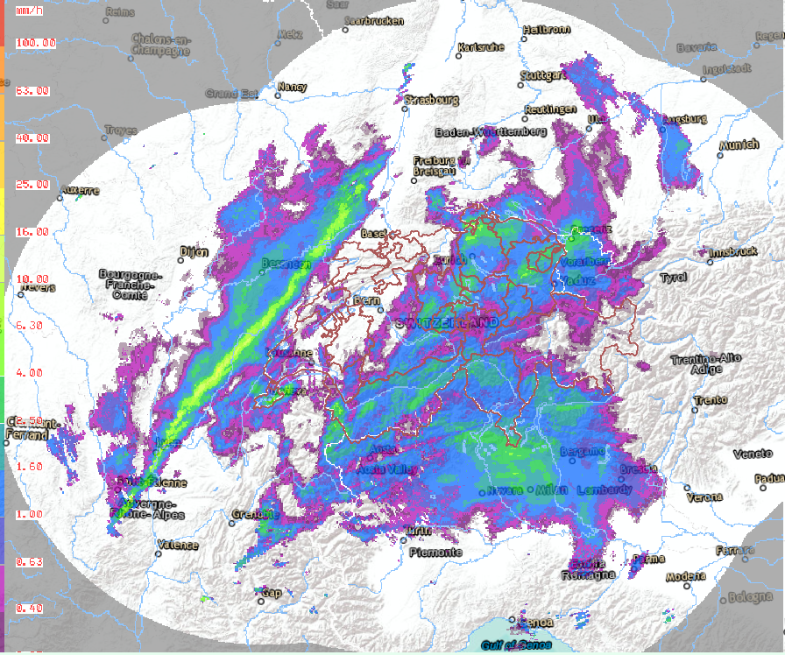
Case study
22.02.24 18:55 UTC
stratiform precipitation
one day (22.02.2024)
hourly data

Slide 7
Influence of lsmooth: Albis
obs
sim, ‘pencil beam’
sim, ‘pulse volume’
-0.2°
0.4°
Notes:
Master switch to take into account that radar returns are a beam function weighted volume average (“pulse volume"). If .FALSE. the simulated radar returns are represented by their value at the center point of the pulse volume only (\pencil beam" approximation). If .TRUE. a 2D Gauss-Legendre quadrature using a variable number of integration nodes with respect to an azimuth-elevation-sector perpendicular to the beam direction around the center point of the pulse volume is performed, within which about 90% of the transmitted energy is conned. Up to now, range weighting is not taken into account. The effective Gaussian beam weighting function of an azimutally scanning radar with axisymmetric beam pattern (Blahak, 2008) is applied for weihting. The additional computational costs and main memory requirements of this option scale with the product of the chosen numbers of integration nodes in both angular directions. Because hydrometeors vary predominantly in the vertical, elevational smoothing is considered more important than azimutal smoothing. Notable eects are expected mainly for radial wind. Another aspect is the simulation of (partial) beam blocking caused by the (model) orography, but always in light of the fact that the model orography is smoother than the true orography.

Slide 8
Why using the frequency map: Albis
obs, no frequency mask
frequency (obs first half 2024)
sim, no frequency map
-0.2°
0.4°
Notes:
Master switch to take into account that radar returns are a beam function weighted volume average (“pulse volume"). If .FALSE. the simulated radar returns are represented by their value at the center point of the pulse volume only (\pencil beam" approximation). If .TRUE. a 2D Gauss-Legendre quadrature using a variable number of integration nodes with respect to an azimuth-elevation-sector perpendicular to the beam direction around the center point of the pulse volume is performed, within which about 90% of the transmitted energy is conned. Up to now, range weighting is not taken into account. The effective Gaussian beam weighting function of an azimutally scanning radar with axisymmetric beam pattern (Blahak, 2008) is applied for weihting. The additional computational costs and main memory requirements of this option scale with the product of the chosen numbers of integration nodes in both angular directions. Because hydrometeors vary predominantly in the vertical, elevational smoothing is considered more important than azimutal smoothing. Notable eects are expected mainly for radial wind. Another aspect is the simulation of (partial) beam blocking caused by the (model) orography, but always in light of the fact that the model orography is smoother than the true orography.

Slide 9
Influence of freq_lim: Weissfluh
frequency (obs first half 2024)
sim, freq_lim = 0
sim, freq_lim = 3
-0.2°
0.4°
Notes:
Master switch to take into account that radar returns are a beam function weighted volume average (“pulse volume"). If .FALSE. the simulated radar returns are represented by their value at the center point of the pulse volume only (\pencil beam" approximation). If .TRUE. a 2D Gauss-Legendre quadrature using a variable number of integration nodes with respect to an azimuth-elevation-sector perpendicular to the beam direction around the center point of the pulse volume is performed, within which about 90% of the transmitted energy is conned. Up to now, range weighting is not taken into account. The effective Gaussian beam weighting function of an azimutally scanning radar with axisymmetric beam pattern (Blahak, 2008) is applied for weihting. The additional computational costs and main memory requirements of this option scale with the product of the chosen numbers of integration nodes in both angular directions. Because hydrometeors vary predominantly in the vertical, elevational smoothing is considered more important than azimutal smoothing. Notable eects are expected mainly for radial wind. Another aspect is the simulation of (partial) beam blocking caused by the (model) orography, but always in light of the fact that the model orography is smoother than the true orography.

Slide 10
PPI plots: La Dôle no_data=true, freq_lim=3
obs
sim

Slide 11
PPI plots: Plaine Morte no_data=true, freq_lim=3
obs
sim

Slide 12
Histograms (accum. over 1 day) 22.02.2024
MLA
MLW
MLD
MLP
MLL
Reflectivity (no rain set to 10 dBZ)
O-B Counts for different fq_lim values

Slide 13
Conclusions
In general, there is a good match between the observations and simulated EMVORADO data in complex terrain!
In the analysed sample, EMVORADO seems to produces less rain and more light rain.
To compare observations and simulations, we need to apply quality control carefully. Also, lsmooth=true helps to increase the amount of valid data, but also brings the complexity of partially blocked data.
Increasing freq_lim value improves the observation-minus-background match, but at cost of an increasing loss of information.

Slide 14
Outlook, next steps
Increase sample size by running longer experiments, check if the signals we see are stable or due to small sample
Tune attenuation in EMVORADO if needed
Look at the superobed data that is used by the LETKF (full resolution was very helpful to detect issues with the data)
Decide on the elevation scan thinning strategy
Conduct first data assimilation experiments with KENDA system.

Slide 15
Thank you!

