Slide 1
Overview of KENDA Activities at MeteoSwiss
Daniel Leuenberger, Claire Merker, Krishnamoorthy Chandramouli, Alina Yapparova, Bas Crezee
MeteoSwiss, Zürich, Switzerland

Slide 2
Activities Overview
Finalized KENDA-CH1 setup using ICON, operational since 2024-05-28 (Daniel)
Assimilation of Raman Lidar humidity and temperature profiles
Paper submission (Bas)
Implementation of obs operator in MEC/DACE (Bas and Claire)
Diagnosis of KENDA-CH1 system (Krishna)
Discovered several inconsistencies and bugs and pointed to possible improvements
Assimilation of Swiss radar volume observations (Alina and Claire)
Adaptive Parameter Tuning (Daniel)

Slide 3
Assimilation of Raman Lidar profiles
Positive impact in KENDA-1 (COSMO) on analysis and first guess, neutral to slightly positive impact in forecasts.
Paper submitted to QJRMS
Implemented Raman Lidar support in DACE obs operator (mo_temp.f90)
Implemented BUFR template for Raman Lidar (humidity and temperature profiles, including uncertainties)

Slide 4
KENDA-CH1 Diagnostics
KENDA-CH1 (ICON) superior to old KENDA-1 (COSMO), but larger T2m and 10m wind biases
Suspition: T2m/RH2m supports TEMP assimilation during day, but counteracts it during night
Use of cross validation and other diagnostics to shed light on the SYNOP assimilation
Discovered a number of inconsitencies/bugs
Points towards using smaller localization lengths for T2m/RH2m

Slide 5
Discovery of inconsistencies/bugs
Non-optimal assimilation of SYNOP stations if surface pressure is not measured -> bug fix by Christoph Schraff
Large spread in 30min surface pressure assimilation every 6h, leading to false negative inflation -> pointed to a problem with use of LBC
Inconsistency in redundancy check for SYNOP observations and TEMP surface reports

Slide 6
Cross validation diagnostics (Stiller, 2021)
Station-wise diagnostics of T2m assimilation w.r.t. PAY TEMP during JJA 2023
negative impact
positive impact
Orography height
negative impact
positive impact
Orography height
00UTC
12UTC
Effect of nighttime low-level inversion: Large negative impact during the night
Illustrates the difference in impact of high-altitude stations (Positive impact during night, negative impact during day)

Slide 7
Assimilation of Swiss Radar Volume Obs
ICON-EMVORADO simulations with Swiss Radar observations
Focus on complex topography
Focus on shading/blocking effects by real and model topography
Use of visibility maps from long-term observation accumulations in quality control

Slide 8
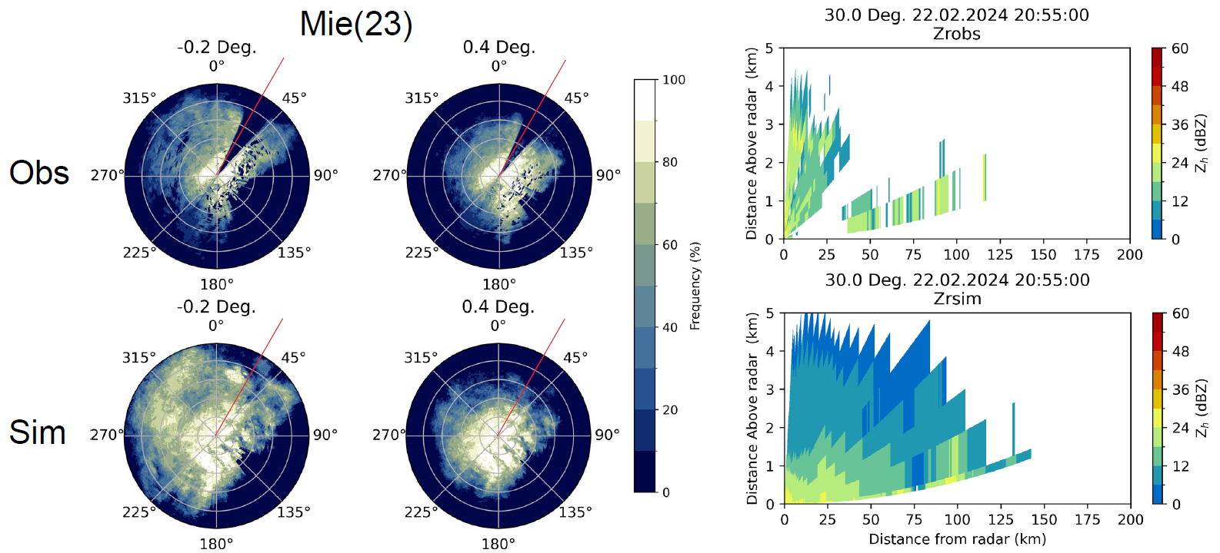
Shading by real and simulated topography
24h accumulated frequency
Snapshot at 22.2.2024 20:55UTC
Observation
no current echo,
or never observed due to mountain blocking?
Simulation

Slide 9
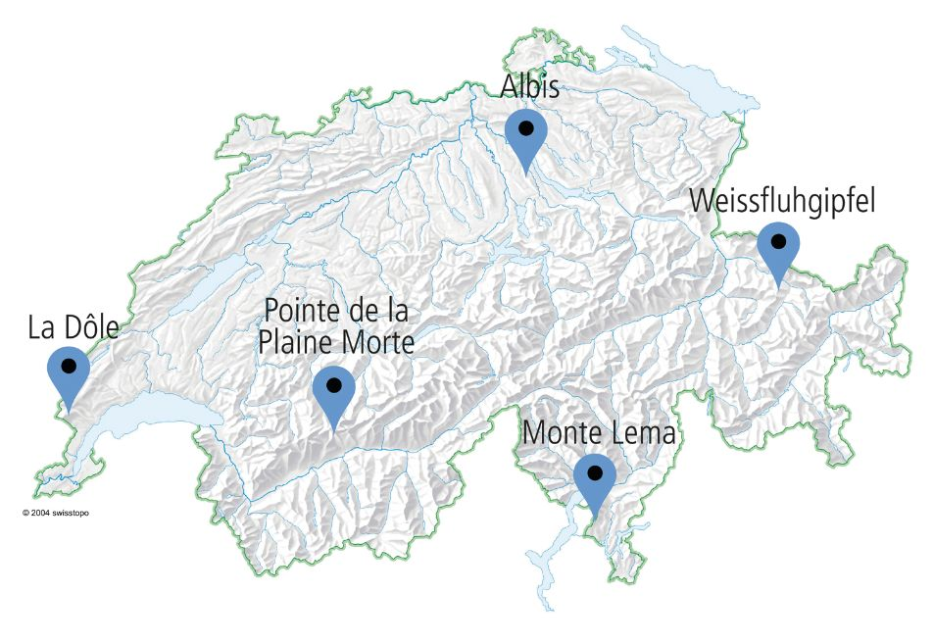
Reflectivity Distributions
Observation
Simulation
MLA
MLW
MLD
MLP
MLL
Observed and simulated reflectivity frequencies aggregated over 24h on 22.2.2024 for all 5 Swiss radar stations
no_rain threshold set to 10dBZ, as in the observations

Slide 10
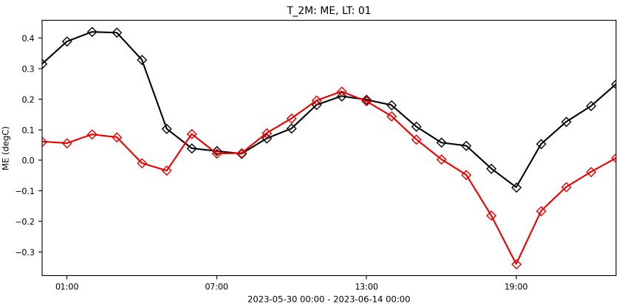
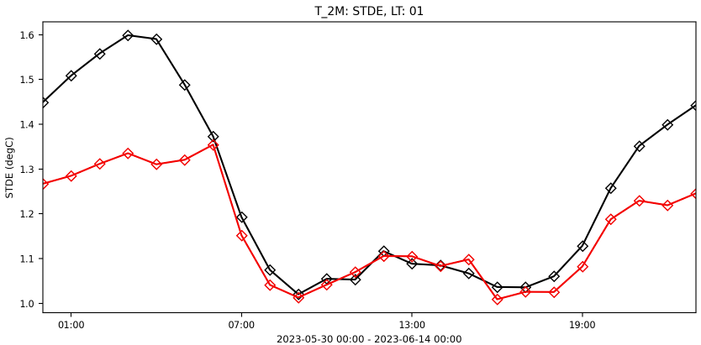
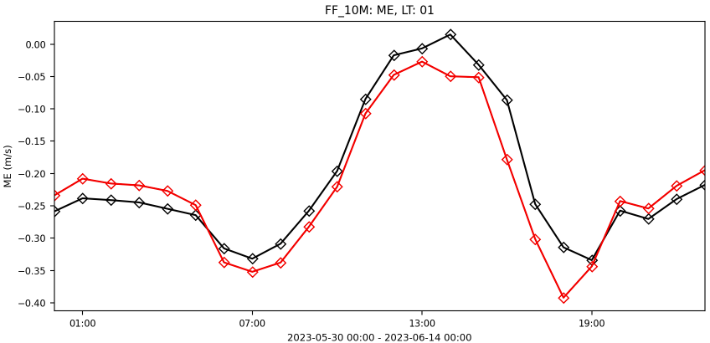
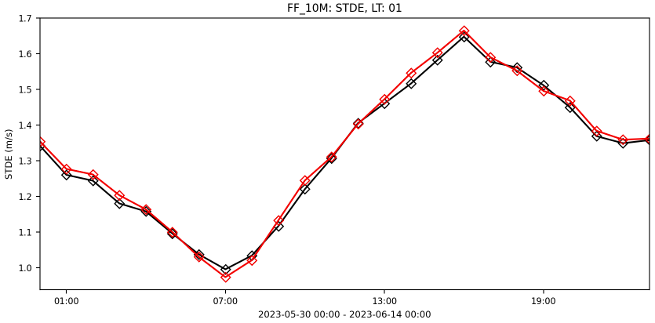
Adaptive Parameter Tuning
KENDA-CH1 first guess verification against Swiss SYNOP stations (30.5.-14.6.2023)
With APT
Without APT
T2m
BIAS
STDDev
FF10m
Experiments done by Lukas Jansing

Slide 11
Summary
KENDA-CH1 using ICON operational since 28.5.2024
Assimilation of Raman Lidar using DACE obs operator with ICON under way
KENDA-CH1 diagnostics helpful to find inconsitencies/bugs and to suggest improvements
Preparation for assimilation of Swiss Volume Radar data is under way and looks promising
First trial with adaptive parameter tuning shows excellent results for T2m and RH2m, but not (yet) for FF10m

Slide 12
Outlook
Finish implementation of Raman lidar obs operator in DACE, e-suites with KENDA-CH1
KENDA-CH1 diagnosis and testing
Reduced horizontal and vertical localisation of T2m and RH2m assimilation
Several setting improvements and bug fixes in LETKF
Radar Volume Assimilation
O-B statistics
Sensitivities to use of visibility maps, lsmooth
Assimilation studies
Adaptive parameter tuning
Have a close look into first e-suite results with a MSc Student
Implementation of MWR observation operator in DACE

