Slide 1
WG7 activities and PROPHECY PP
Chiara Marsigli
Deutscher Wetterdienst
Arpae-SIMC

Slide 2
Outline
Developments in the COSMO (Consortium) ensembles
Model perturbation:
  SPPT
  Care in verification!
Research on process-based perturbation:
  PSP2: Physically based stochastic perturbations for subgrid turbulence
  A proposal from IMGW
Soil temperature perturbation
Sensitivity to parameter variation

Slide 3

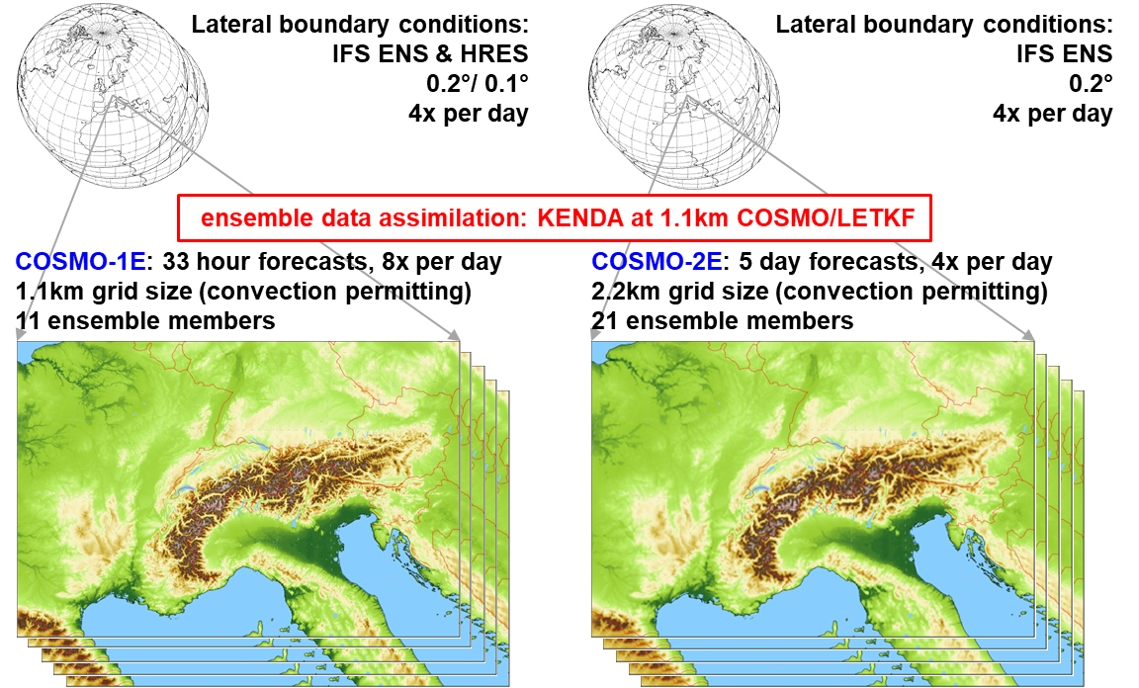
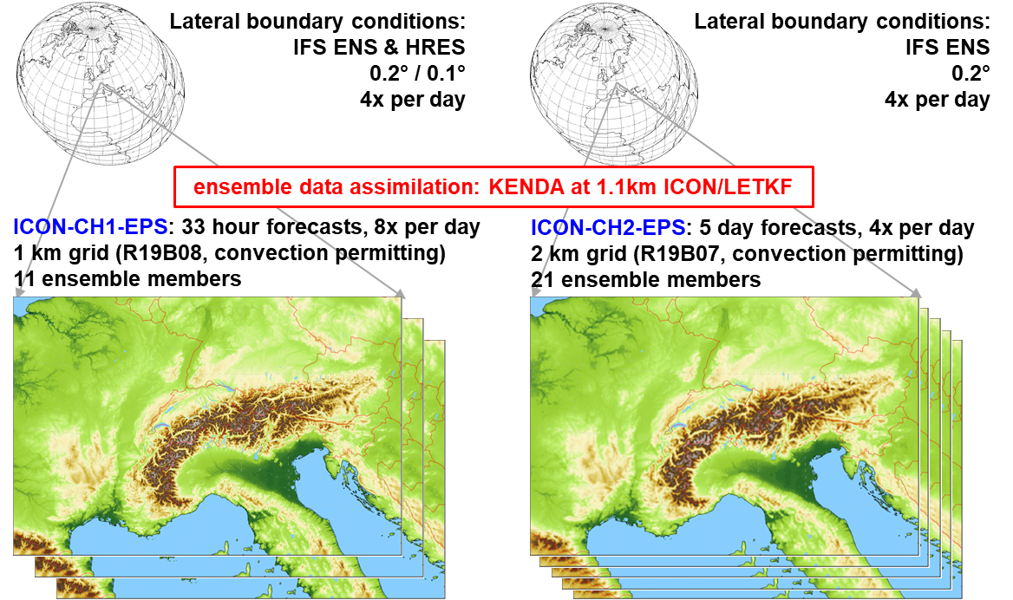
ICON-22 project: COSMO to ICON
ICON-CHx-EPS test forecasts run twice a day coupled with KENDA-CH1 in real-time (since 15.5)
«1:1-replacement with ICON»

Slide 4
Model setup
setup for ICON-CHx-EPS and KENDA-CH1 basically copied from ICON-D2
main differences:
  lgrayzone_deepconv = .false.
  no adaptive tuning (yet)
  HWSD soil type (higher resolution)
  model perturbations: SPPT instead of PP, however…

Slide 5
SPPT namelist switches in ICON (sppt_nml)
switch | default | ICON-CHx-EPS exp. | description | remarks
lsppt | .false. | .true.
hinc_rn | 21600 | 21600 | time increment (s) for drawing a new field of random numbers
dlat_rn | 0.1 | 5.0 | random number coarse grid point distance in meridional direction (deg)
dlon_rn | 0.1 | 5.0 | random number coarse grid point distance in zonal direction (deg)
range_rn | 0.8 | 0.6 / 0.8 | max magnitude of random numbers
stdv_rn | 1 | 1 | standard deviation of the gaussian distribution of random numbers | is still ignored

Slide 6
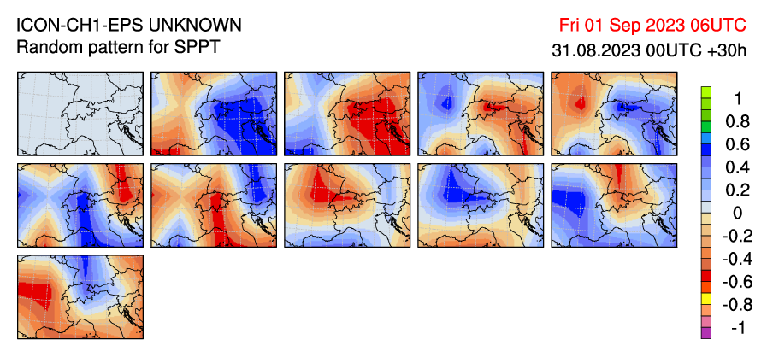
Opposed random patterns
new approach uses for every second member the opposed pattern from the previous one
to better sample the PDF with small ensembles
(idea and implementation by Daniel Hupp)

Slide 7
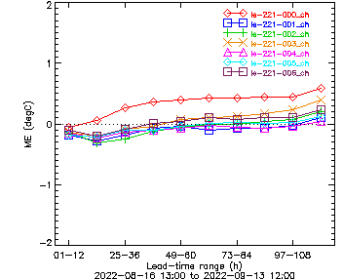
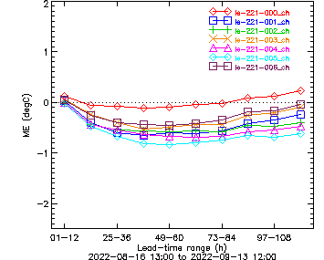
control and mem 1-6 with SPPT
SPPT makes member colder and drier:
t2m
td2m
Bug in tracer perturbations

Slide 8
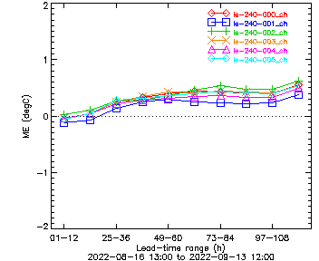
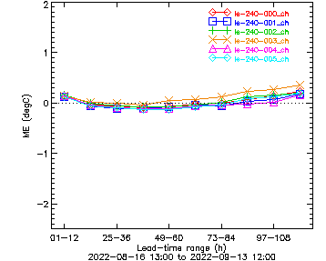
control and mem 1-6 with SPPT
Fix removed the changes in the biases surprisingly!!
t2m
td2m

Slide 9
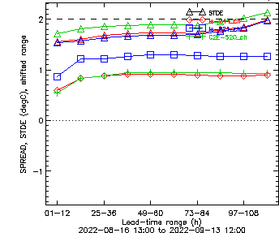
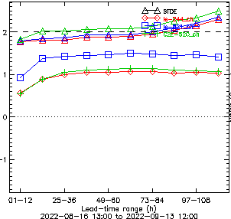
Impact of fix on ensemble spread
spread decrease (!) with fix but is very similar to COSMO-2E
STDE of ens mean error only slightly changed with fix
STDE
spread
ICON-CH2-EPS
ICON-CH2-EPS SPPT fix
COSMO-2E
ICON-CH2-EPS
ICON-CH2-EPS SPPT fix
COSMO-2E
t2m
td2m

Slide 10

SPPT mystery in ICON…
SPPT bug fix for the amplitude of the perturbations for the water tracers, i.e. applying significant water tracer perturbations at all
  eliminates the cold and dry bias of members with SPPT
  reduces the ensemble spread significantly
high non-linear interactions between temperature and missing corresponding water tracer perturbations, e.g. from microphysics, satad…?

Slide 11
SPPT / PP tests with ICON-CH1-EPS
4 weeks period: 2023-07-01 to 2023-07-28
00 and 12 UTC forecasts
up to +48h
IC perturbations: KENDA-CH1 (real-time suite)
LBCs perturbations: IFS-ENS
exp 135: SPPT, range_rn=0.6
exp 136: Parameter Perturbations (PP) as ICON-D2-EPS
exp 137: no model perturbations
surface verification for CH, verification with radio-sounding for entire domain

Slide 12
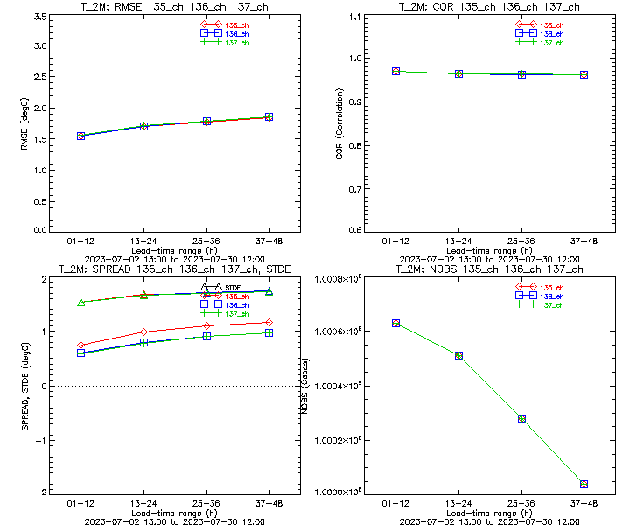
Spread and RMSE for t2m
SPPT
Parameter Perturbations
no model perturbations
Spread increased with SPPT,
but hardly with PP:
RMSE for ensemble mean ~identical:

Slide 13
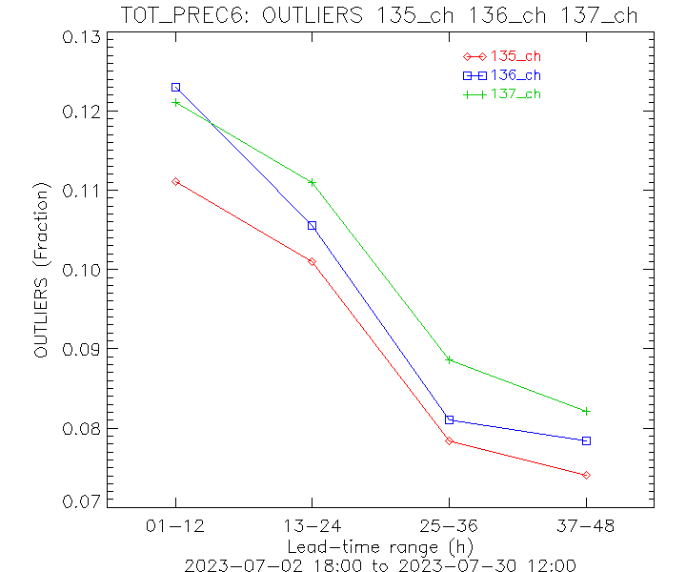
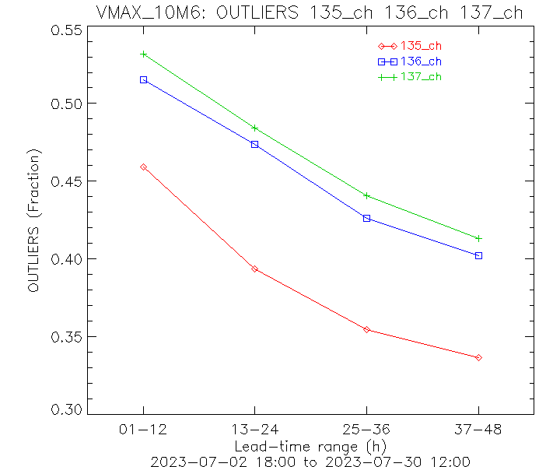
Outliers 6h precip & gusts
SPPT
Parameter Perturbations
no model perturbations
Reduction of outliers with model pert., particularly with SPPT for gusts:
~20%
6h precip
6h vmax@10m

Slide 14
Summary and conclusions SPPT
SPPT fix and ‘opposed random pattern’ made it into the icon-nwp master last week → many thanks to Daniel Reinert for the constant support and to Pavel for the review!
SPPT improves the ensemble scores in ICON-CH1-EPS quite consistently (but rather less than expected)
improvements in verification scores larger with SPPT than with PP
SPPT in ICON is ready to be used
→ introduced in real-time ICON-CHx-EPS and KENDA-CH1 suites end of August

Slide 15
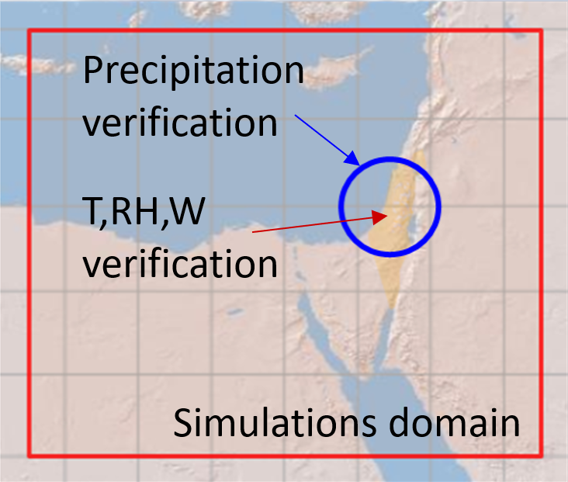
ICON ensemble (including SPPT) at IMS
ICON 20-members (2.5km resolution) driven by randomly selected ECMWF ensemble (EC-ENS) members over the Eastern Mediterranean using different perturbation methods.
EC_ENS_51 - full ECMWF ensemble (EC-ENS)
COSMO_SPPT_20 - Stochastic Perturbation
of Physics Tendencies (SPPT)
New:
ICON_20 - unperturbed
ICON_PP_20 - Parameter Perturbation (PP)
ICON_SPPT_20 - Stochastic Perturbation
of Physics Tendencies (SPPT)
ICON_SPPT4_20 – as previous but after
precipitation calibration
P. Khain, S. Bellaire, A. Shtivelman

Slide 16
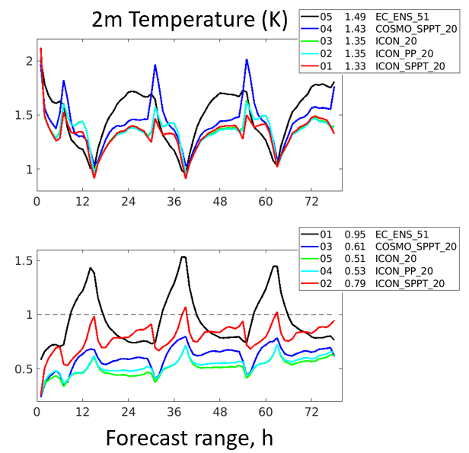
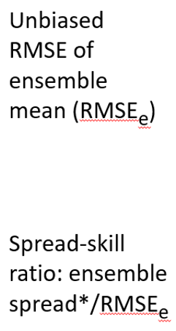
Spread Skill verification
reminder

Slide 17
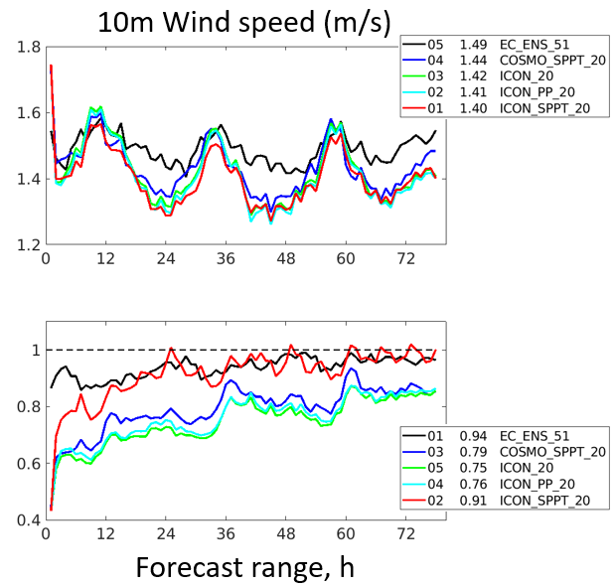
Spread Skill verification
reminder

Slide 18
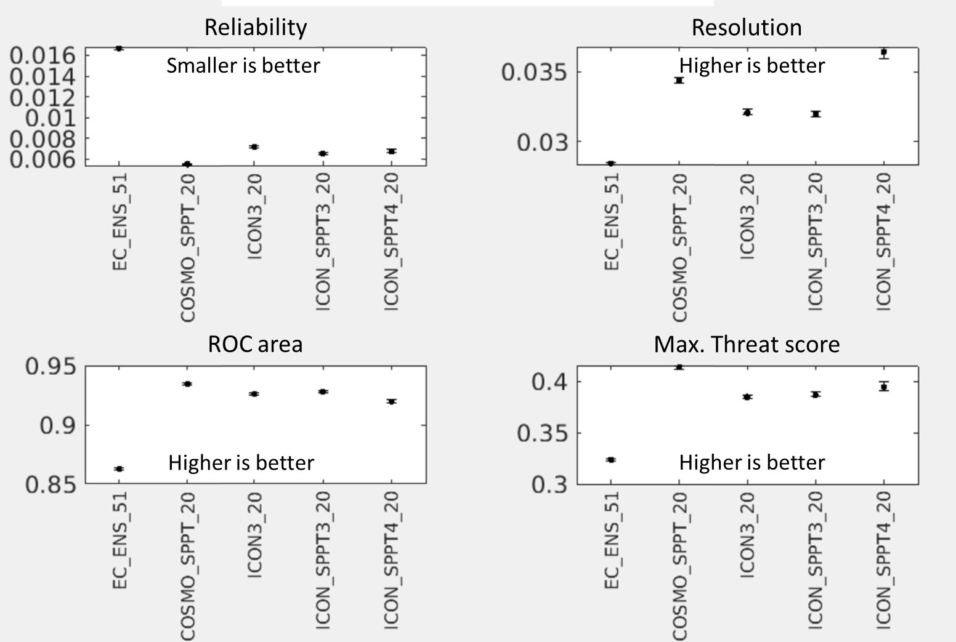
Precipitation verification

Slide 20
Perturbation of the soil temperature

Slide 21
Verification of mean and median of precipitation

Slide 25
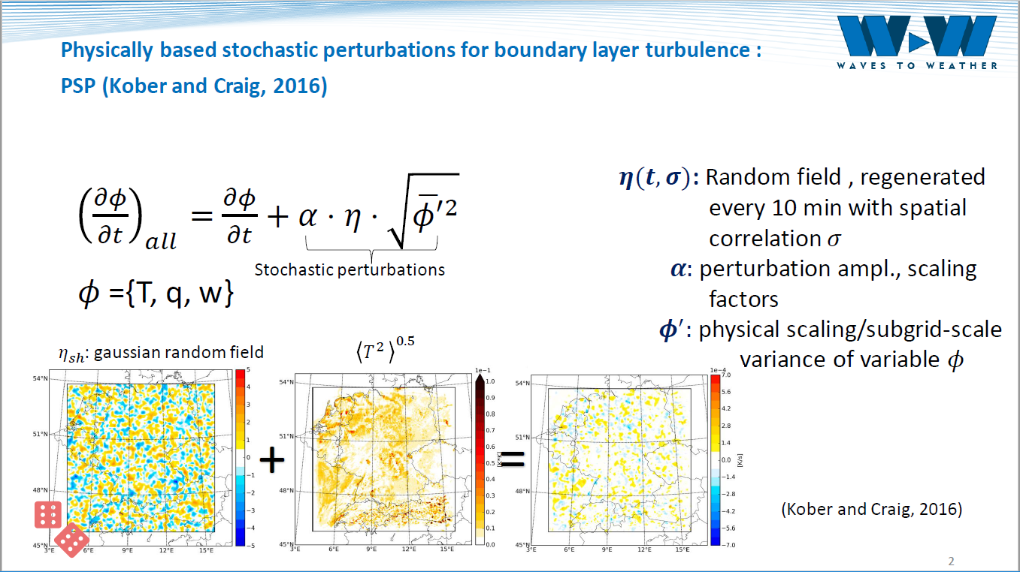
Physically based model perturbation: PSP2

Slide 26
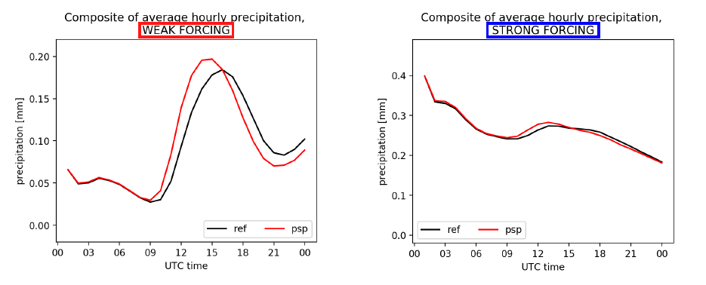
PSP2: impact on convection initiation
M. Puh, C. Keil (LMU)
C. Gebhardt, C. Marsigli (DWD)

Slide 27



SENSITIVITY TESTS BLUEPRINT
24 parameters are considerd.
3 values/parameter including default.
The evaluation period consisted of the year 2020 (366 days).
≈
~17000 runs based on ICON-IMS.
Horizontal grid size: R3B08 (~6.5km).
417x273 grid points (wider area of Greece and Italy), 65 levels.
Integration time-step: 60 secs.
Integration period: 132 hs. ( An equivalent period of two and a half centuries of model runs)
Boundary conditions : 3hr IFS Forecast.
Computational Cost ~ 10⁷-10⁸ b.u. on Cray X C40 of ECMWF (Gratis HNMS).
Euripides Avgoustoglou, Hellenic National Meteotological Service, 25^{5h} COSMO GM , Gdańsk, Poland, September 11-15, 2023
03

Slide 28
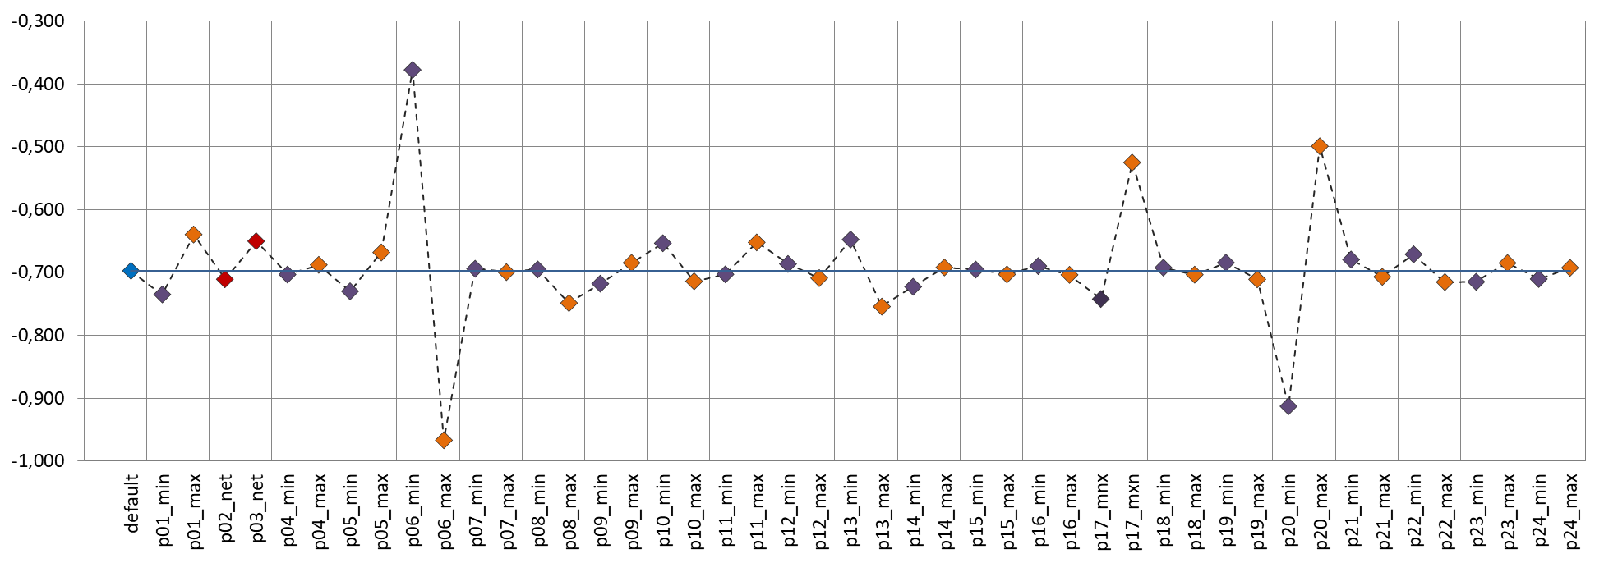
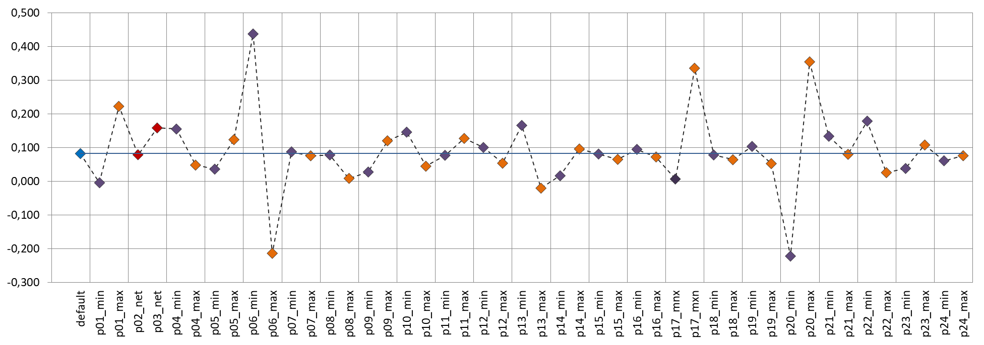
<Τ2m> | 2m Temperature [K], 196305 observations , 88 stations
p06
ST2m_DAY_1
p17
p20
p01
p13
|ΔS|=0,589
ST2m_DAY_5
|ΔS|=0,659
Euripides Avgoustoglou, Hellenic National Meteotological Service, 25^{5h} COSMO GM , Gdańsk, Poland, September 11-15, 2023
12

Slide 29
Conclusions and prospects:
The impact for the minimum and maximum values for most of the parameters turned out to be important for the considered meteorological fields, in reference to their default values regarding SYNOP observations over Greece.
The sensitivity was quite versatile justifying the choice to examine directly a very large number of parameters, probably one of the largest ever in a NWP model. However a set 7-9 parameters looks like displaying distinguished sensitivity regarding standard meteorological fields i.e. T, TD, PRECI, PMSL and U10M.
These sensitivities look practically independent of the lead time.
The advancement towards ICON-LEPS is a formidable operational but also research challenge for the years to come and is expected to have some impact model to ICON model overall.
Due to the inclusion of a large and complicated marine area in the desired integration domain (i.e. the whole Mediterranean) for the proposed ICON-LEPS, the project is expected to provide significant and lasting advancements in the area of marine meteorology along with additional challenges in NWP in general.
Euripides Avgoustoglou, Hellenic National Meteotological Service, 25^{5h} COSMO GM , Gdańsk, Poland, September 11-15, 2023
17

Slide 30
A Note on some References and Visibility :
In addition to the Presentations regarding the progress of this work in COSMO as well as in ICCARUS Meetings within PROPHECY Priority Project, a peer reviewed paper has been submitted in addition to the following publications:
  Avgoustoglou, E; Shtivelman, A.; Khain, P.; Marsigli, C.; Levi, Y; Cerenzia, I. On the Seasonal Sensitivity of ICON Model, COSMO Newsletter, 2023, 22, 10.5676/dwd pub/nwv/cosmo-nl 22 7. https://www.cosmo-model.org/content/model/documentation/newsLetters/newsLetter22/pg19_sensitivity.pdf
  Avgoustoglou, E; Shtivelman, A.; Khain, P.; Marsigli, C.; Levi, Y; Cerenzia, I. ICON (ICOsahedral Non-hydrostatic) Model Sensitivity over the Central Mediterranean, Environ. Sci. Proc. 2023, 26(1), 156; https://doi.org/10.3390/environsciproc2023026156
  Also, it is considered that Sensitivity of Numerical Weather Prediction Models in general is by itself a very important standalone scientific subject . A Special Issue of « Atmosphere » Peer Reviewed Journal is currently open for submissions:
Euripides Avgoustoglou, Hellenic National Meteotological Service, 25^{5h} COSMO GM , Gdańsk, Poland, September 11-15, 2023
18

Slide 31
Concluding remarks
Model perturbations for ICON:
  Parameter perturbation
  SPPT
  Plans at DWD for SPP (in GLORI)
Research on process-based perturbations

Slide 32
Thank you for your attention!

