Slide 1

WG3b and related activities
ICON-S, ICON-LAND → Linda
ConSAT → Matthias
Urban model (PP CITTA’) → Jan-Peter
Snow model (NIX)
EXTPAR
Fieldextra

Slide 2

Fieldextra
Pre- and post-processing of gridded fields
Designed for production
SCA is Jean-Marie Bettems / MeteoSwiss
https://github.com/COSMO-ORG/fieldextra
Notes:
More information…

Slide 3

Status
  Last version is v14.3.0 released on 31.08.2023
  Focus of last year development
    improved support of the ICON grid (interpolations, frames, grib subset, tiles…),
    improved support of NetCDF import and export (lossless transformation between GRIB 2 & NetCDF),
    consolidated set of tools built on top of fieldextra (grins, fx_transform…)
  fx_transform is a Python module built on top of fx which dynamically set complex fx namelist based on input content;
  it is used in production at MCH for the following tasks
    upscale ICON initial conditions from ICON-CH1-EPS to ICON-CH2-EPS,
    interpolate IFS HRES & ENS onto a common 3D ICON grid to prepare LBC
25 years since version 1.0
jean-marie.bettems@meteoswiss.ch, COSMO GM 2023, Gdansk 3

Slide 4
Outlook (1)
  Even more support for native ICON grid (e.g. cropping)
  Further consolidation of tools (e.g. fx_transform)
  Code quality control
    Consolidation of regression suites (e.g. performance monitoring)
    Consolidation of continuous integration on GitHub
  Documentation
    Consolidate code documentation (both internal and external)
    Documentation of tools
jean-marie.bettems@meteoswiss.ch, COSMO GM 2023, Gdansk 4

Slide 5
Outlook (2)
A new python framework to replace (some) fieldextra functionalities is in a prototyping phase
at MeteoSwiss
  native cloud support,
  automatic usage of hardware capabilities for improved performances,
  modern language and API could improve usability
  no timetable has been defined for a first release
  fx development and support will remain available for the years to come
jean-marie.bettems@meteoswiss.ch, COSMO GM 2023, Gdansk 5

Slide 6
Community Access
  Main releases and stable head of develop branch deployed at
  ECMWF : chcosmo@atos:/perm/chcosmo/projects/fieldextra/ (group cfxtra)
  Code, tools and documentation on GitHub
  https://github.com/COSMO-ORG/fieldextra
  Self-contained package, main releases only, on COSMO web site as tar file
  https://www.cosmo-model.org/content/support/software/default.htm
  (includes all libraries & short regression suite)
  Support
  fieldextra@cosmo-model.org
jean-marie.bettems@meteoswiss.ch, COSMO GM 2023, Gdansk 6

Slide 7
Extpar
Production of external parameters (backend)
SCA is Jonas Jucker / C2SM
https://github.com/C2SM-RCM/extpar/
Center for Climate Systems Modeling C2SM
05/09/2022
7
Notes:
7

Slide 8
Status Extpar v5.12 (August 2023)
Scientific updates
Drop ecoclimap landuse data
But add ecoclimap second generation landuse data (including fields for terra urb)
Define more classes associated with Corine landuse data
New module to process HWSD for ICON-ART
Technical updates
Documentation attached to each release on GitHub
Wrapper script for Extpar (used in new WebPep interface from HEREON)
More (see GitHub repo)…
Center for Climate Systems Modeling C2SM
01/09/2023
8
Notes:
8

Slide 9
Future activities
Scientific updates
New global data set carbon and sulfur emissions (already merged into rc_5_13)
Technical updates
More Python-CDO rewrite
Testsuite consolidation
Organizational
Regular dedicated meetings with stakeholders will be organized (NEW)
Evaluate infrastructures, workflow, web interface
Link with EUMETNET C-SRNWP (data set, data providers!)
Center for Climate Systems Modeling C2SM
05/09/2022
9
Notes:
9

Slide 10
More infos
More info on GitHub
https://github.com/C2SM-RCM/extpar/blob/master/ReleaseNotes.md
https://github.com/C2SM-RCM/extpar/wiki
https://github.com/C2SM-RCM/extpar/releases/download/v5.12/user_and_implementation_manual.pdf
Support
jonas.jucker@c2sm.ethz.ch
support@c2sm.ethz.ch
Center for Climate Systems Modeling C2SM
01/09/2023
10
Notes:
10

Slide 11
Snow model (NIX)
Sascha Bellaire / MeteoSwiss

Slide 12
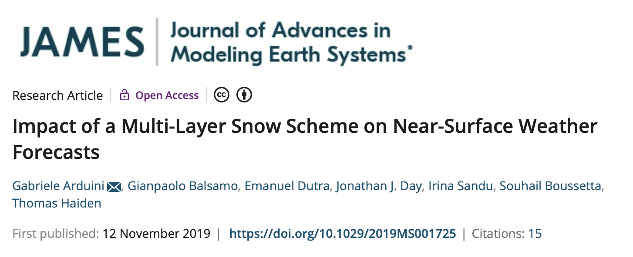
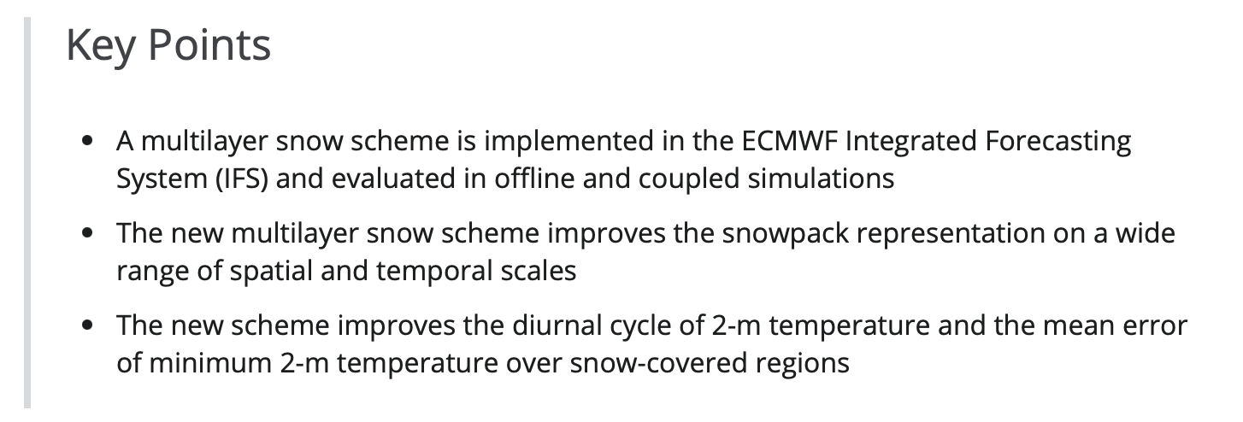
ECMWF implements multi-layer snow cover scheme into IFS

Slide 13
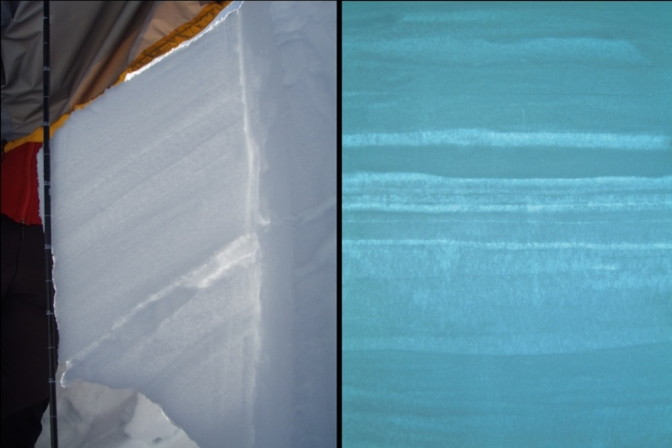
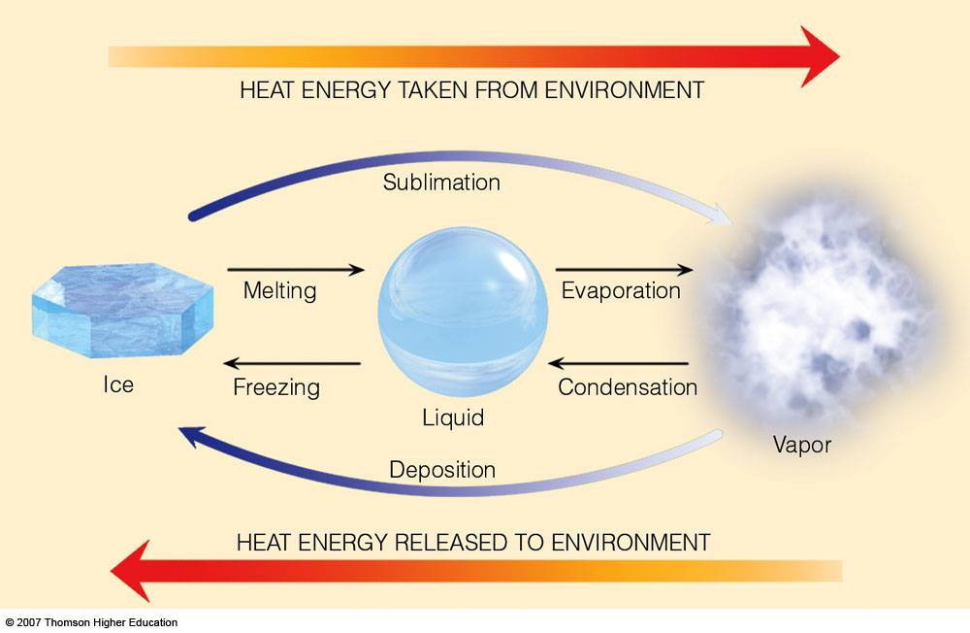
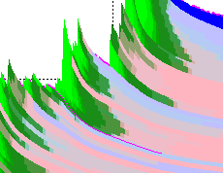
SNOWPACK – a sophisticated snow cover model developed at SLF
Phase changes
Layering
Water transport
Metamorphism
Settling

Slide 14

SNOWPOLINO – a limited ‘small’ version of SNOWPACK
1D heat equation
Phase Changes
Layering (n_{def.}= 10)
SNOWPOLINO → NIX
(NIX is latin for snow)
Water transport
Settling/Densification
No Metamorphism!
Snow Height
Photos’s: SLF
Time

Slide 15
Status
  Code implemented in ICON in a modular way, i.e., full flexibility for future developments
  (such ICON-S, ICON-Land)
  A 9 months high resolution test over Switzerland shows
  - tuning of density parameterization and settling needed
  - neutral surface verification scores where snow height is correctly represented
  Preliminary global test shows stable algorithm and correct results in snow free regions
  Merge request opened and on-going
  (agreement about code in 08.2023 session with ICON gatekeeper, only minor issues remaining)
jean-marie.bettems@meteoswiss.ch, COSMO GM 2023, Gdansk 15

Slide 16
Urban model (PP CITTA’)
Jan-Peter Schulz / DWD
… next speaker, please!

