Slide 1
WG4 status, activities and plans
Andrzej Mazur
Institute of Meteorology and Water Management
National Research Institute
11.09.2023
Institute of Meteorology and Water Management – National Research Institute; CGM’2023, Gdańsk
1

Slide 2
Contents
Running PP/PTs
ICON-COMFORT (in details presented yesterday by Dimitra)
C2I4LC (cooperation between WG4/5/6, in details presented yesterday by Bogdan at WG6 session, to be presented – again – on Thursday during plenary session)
Other possible activities, suggestions for future PP/PTs
DMO from COSMO/ICON as an input to the dispersion models
COSMO "Weather and Health" products – completely new research direction
Overall status of WG4 and summary
11.09.2023
Institute of Meteorology and Water Management – National Research Institute; CGM’2023, Gdańsk
2

Slide 3
Running PP/PTs
PP ICON-COMFORT – ICON-COMpetence on FORecasTing
Goals and motivation:
The subjective evaluation of ICON-LAM forecasts by forecasting departments and the translation of this feedback to the COSMO-ICON community.
Expected results : The forecasters feedback on ICON-LAM performance in respect to COSMO forecasts and detection of ICON deficiencies for different weather conditions by means of:
Regular surveys ( distributed twice a year)
Representative test cases.
In case COSMO is not available anymore, the comparison can be with the most used model of each service.
Participants – HNMS, MCH, CNMCA, NMA, IMS, ARPA-P, IMGW.
11.09.2023
Institute of Meteorology and Water Management – National Research Institute; CGM’2023, Gdańsk
3

Slide 4
Running PP/PTs
PP ICON-COMFORT – ICON-COMpetence on FORecasTing
Goals and motivation:
Constant monitoring may detect model deficiencies with the forecasters' feedback.
Forecasters may have some special needs in terms of model outputs that can be useful for special types of forecasts
Additional requirements of COSMO (and subsequently) ICON-LAM users with respect to data format and output meteorological variables will be reported by the forecasters and will be taken into account.
11.09.2023
Institute of Meteorology and Water Management – National Research Institute; CGM’2023, Gdańsk
4

Slide 5
Running PP/PTs
PP ICON-COMFORT – ICON-COMpetence on FORecasTing
Task 1. Forecasters Survey Completion and analysis
Sub-Task 1.1 Survey Creation and Distribution (SON 2022)
The survey was created and distributed to representative person of each service, who had to distribute it to the forecasters. (DONE)
Sub-Task 1.2 Survey analysis (DJF 2022/23)
At the end DJF season the representative of each service collected survey answers and representative cases for SON, DJF, sent to PP leader. (DONE).
Task 1.1 was repeated again in MAM 23 for the seasons MAM 23 and JJA23 (answers expected, some have been received)
The main problems discussed to the meetings is that forecasters do not track differences among models on a daily basis. They also consult different models and they do not concentrate on COSMO and ICON differences.
A daily survey or a calendar was suggested as solutions together with downloading figures ( of course this may require extra work).
11.09.2023
Institute of Meteorology and Water Management – National Research Institute; CGM’2023, Gdańsk
5

Slide 6
Running PP/PTs
PP ICON-COMFORT – ICON-COMpetence on FORecasTing
Table with the surveys received for ICON-COMFORT and the ones of C2I PP
 | CNMCA | IMGW | NMA | HNMS | ARPA-P | MCH | IMS
C2I |  | - |  |  |  | -
SON22 DJF23 | - |  |  |  |  |  | -
MAM23JJA23
Survey and test cases
Survey only
In preparation
11.09.2023
Institute of Meteorology and Water Management – National Research Institute; CGM’2023, Gdańsk
6

Slide 7
Running PP/PTs
PP ICON-COMFORT – ICON-COMpetence on FORecasTing
Survey includes 35 questions for the following topics:
ICON-LAM and COSMO model information (grid, driving model, data assimilation, nesting, EPS) and other forecast models used in each service. Timely availability of ICON-LAM forecasts.
Information on available and needed ICON-LAM direct and pre-processing products used for the daily routine forecasts and specific forecasts (TAF, sea forecasts). Visualization products, satisfaction and needs.
Availability of verification products , use of them and specific needs.
ICON model performance in respect to COSMO: This is the main and the most interesting part, including questions about forecast parameters and their ICON-LAM added or decreased value. Precipitation forecasts in different regions and weather patterns, differences among ICON runs, HIW forecast efficiency.
Not all questions were answered from all, however there is some interesting feedback.
11.09.2023
Institute of Meteorology and Water Management – National Research Institute; CGM’2023, Gdańsk
7

Slide 8
Running PP/PTs
PP ICON-COMFORT – ICON-COMpetence on FORecasTing
A quick summary of the most important survey topics
Model information and products
ICON Versions are different (2.6.5 mostly used). Nested with IFS (ICON Global only IMGW, NMA). Data assimilation is used for MCH, ARPA-P, CNMCA, IMS. ICON-EPS is only used in MCA. HNMS ceased COSMO-GR runs in October 22, so afterwards comparison is only with IFS.
There are delays in receiving ICON-LAM data for forecast visualization. (HNMS, MCA, IMGW, IMS).T his is a reason ICON-LAM is not the main forecast model for some services . Reasons are delays in receiving boundary conditions (CNMCA), technical problems on ATOS machines where it is running (HNMS).
Usual DMO ICON-LAM products are used for all services. MCH uses also sunshine duration and radar reflectivity. Post-processing products are used (convective indices) and some more specific are needed such as lightning probability, fog maps, radar reflectivity, hail products. HNMS uses a post-processing product - probability of thunderstorm.(calculated with a weight factor of cloud tops and convective precipitation).
Visualization is mainly with Visual Weather. Some problems have been reported especially lack of zooming, color scale differences from IFS (HNMS), need for all models in one hub (IMS), need for vertical cross sections., multimodel meteograms (ARPA-P). A person also who can collaborate with the forecasters and provide them with what they need (IMGW).
11.09.2023
Institute of Meteorology and Water Management – National Research Institute; CGM’2023, Gdańsk
8

Slide 9
Running PP/PTs
PP ICON-COMFORT – ICON-COMpetence on FORecasTing
Model performance (1)
The ICON-LAM performance is satisfactory for most services and gives a good to very good guidance.
ICON-LAM wind speed predictions are generally better than COSMO. (HNMS, MCH, IMGW). Wind overestimation is reported for convective situations (NMA) and wind gusts overestimation in mountains (IMGW).
Low level clouds in MCH are better forecasted due to a better prediction of T2m, Td2m. TCC is better predicted by ICON-PL (IMGW) with less overestimation than COSMO-PL. IMS reported fog false alarms for winter ’22.
MCH reported overestimation of sunshine duration in all weather regimes (to be solved)
Precipitation: Better performance of ICON-LAM is mainly reported in summer/fall season. Convective precipitation area is better forecasted but values and intensity can be overestimated (IMGW, NMA, HNMS). In winter and frontal precipitation models show similar behavior, with even better performance of COSMO (NMA). IMS reported decreased ICON-IMS performance for scattered showers with low synoptic forcing. Snow level is frequently underestimated. (ARPA-P).
11.09.2023
Institute of Meteorology and Water Management – National Research Institute; CGM’2023, Gdańsk
9

Slide 10
Running PP/PTs
PP ICON-COMFORT – ICON-COMpetence on FORecasTing
Model performance (2)
CNMCA reported erroneous ICON-IT and COSMO-IT convection inhibition at night with no model signal. Severe convection was poorly forecasted by all local models, while it was better predicted by IFS, ICON-EU during hail events of July 23. COSMO-IT is considered more successful than ICON-IT.
ARPA-P reported poor precipitation performance of ICON-IT model in intense rainfall produced by convergence of cool and warm air masses in Central Italy.
Regarding model deviations after some hours of simulation, IMS reported better COSMO precipitation forecast during the first 6 hours due to DA and slightly better for ICON-LAM for longer lead times. NMA also reported better ICON-LAM forecast than COSMO after the 24 first hours.
ICON-LAM is useful for predicting HIW ahead of time in combination with IFS, especially thunderstorms, wind gust, fog. However, False alarms are common for thunderstorms, (HNMS,NMA), torrential rain and wind gusts at night (NMA), fog (IMS). Misses for deep convection are reported for ICON-IT (CNMCA), where COSMO-IT is the main model for issuing warnings.
11.09.2023
Institute of Meteorology and Water Management – National Research Institute; CGM’2023, Gdańsk
10

Slide 11
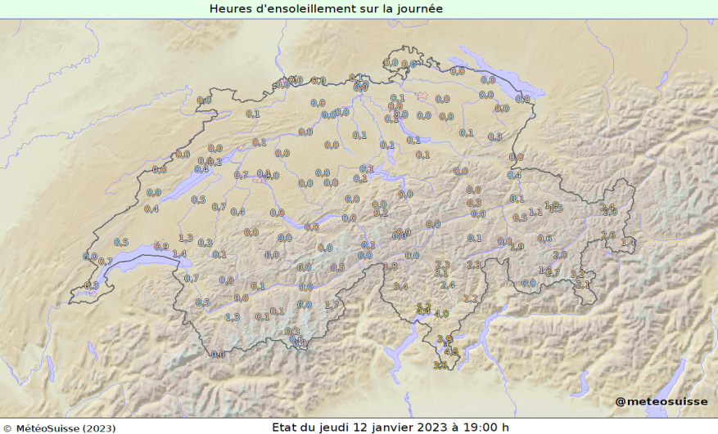
Running PP/PTs
PP ICON-COMFORT – ICON-COMpetence on FORecasTing
MCH -Sunshine duration (ICON-2E vs COSMO-2E)
12 January 2023 is a good example of overestimation of sunshine duration with ICON. The synoptic situation was dominated by a low-pressure system over the UK with a warm front passing over Switzerland. This lead to widespread clouds over the northern side of the Alps and more sun in the southern side. The differences between COSMO-2E (left) and ICON-2E (right) are shown.
11.09.2023
Institute of Meteorology and Water Management – National Research Institute; CGM’2023, Gdańsk
11

Slide 12
Running PP/PTs
PP C2I4LC – Establishing COSMO to ICON migration for Licensees’ Countries
WG4-related via Technical Feedback survey ( → PP COMFORT)
Kick-start meeting – November 2022 with the
Progress of the COSMO Technical User Survey
Web page design status
Issues on ICON Training Course 2023
I believe that Bogdan has already said / will say enough about it.
11.09.2023
Institute of Meteorology and Water Management – National Research Institute; CGM’2023, Gdańsk
12

Slide 13
Other possible activities, suggestions for future PP/PTs
DMO from COSMO/ICON as an input to the dispersion models
FLEXPART-COSMO
Derived by Empa^{*)} (Dominik Brunner, Stephan Henne) from FLEXPART v 8.0
OpenMP parallelization and reformatting in f90 free format by MeteoSwiss (Martin Schraner, Pirmin Kaufmann)
Maintained and regularly updated by Empa
Recent updates by Empa:
Modified turbulence scheme for high resolution COSMO ( < 3 km)
Control input files (COMMAND, etc.) in Fortran namelist format
Additional INPUT_PHY namelist with settings for PBL determination, turbulence scheme, landuse file, originating institution
FLEXPART for ICON is the next step of development by Empa
^{*)} Swiss Federal Laboratories for Materials Science and Technology
11.09.2023
Institute of Meteorology and Water Management – National Research Institute; CGM’2023, Gdańsk
13

Slide 14
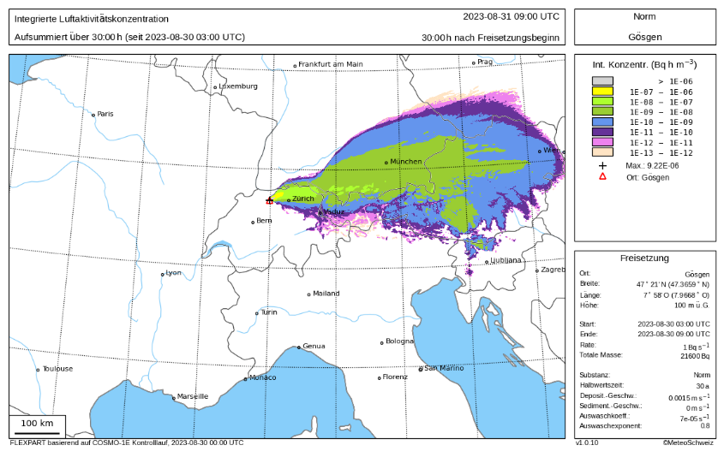
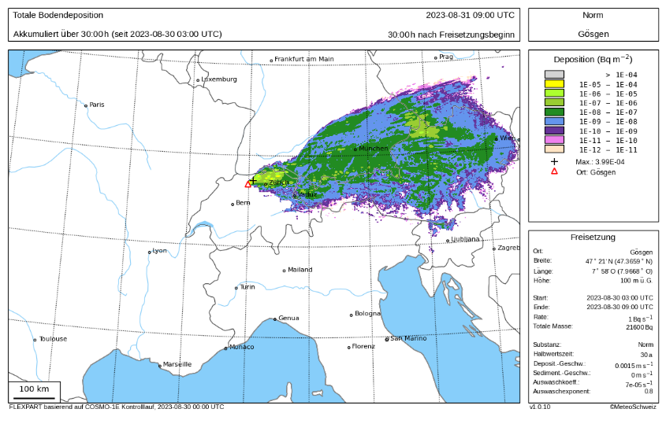
Other possible activities, suggestions for future PP/PTs
DMO from COSMO/ICON as an input to the dispersion models
FLEXPART for COSMO and ICON – Operational Use at MeteoSwiss
Regular deterministic runs every 3 hours for 6 locations, based on COSMO-1E Control
Integrated Conc. (30 h after release) Gösgen nuclear power plant Deposition (30 h after release)
11.09.2023
Institute of Meteorology and Water Management – National Research Institute; CGM’2023, Gdańsk
14

Slide 15
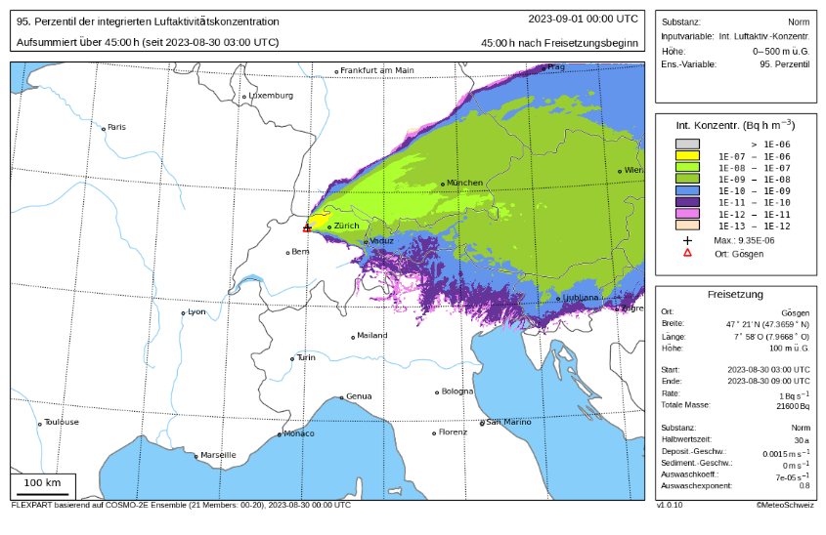
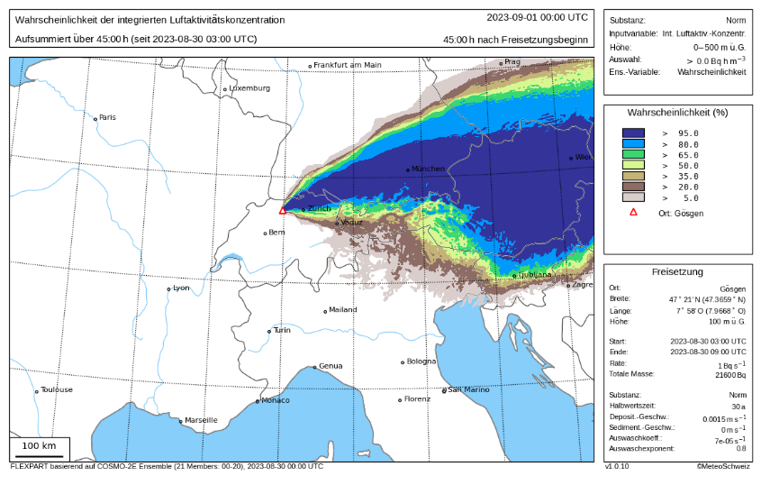
Other possible activities, suggestions for future PP/PTs
DMO from COSMO/ICON as an input to the dispersion models
FLEXPART for COSMO and ICON – Operational Use at MeteoSwiss
Regular ensemble runs every 6 hours for 6 locations, based on COSMO-2E Ensemble with 21 members
95% Quantile of integ. conc. (45 h after release) Gösgen nuclear power plant Probability (45 h after release)
11.09.2023
Institute of Meteorology and Water Management – National Research Institute; CGM’2023, Gdańsk
15

Slide 16
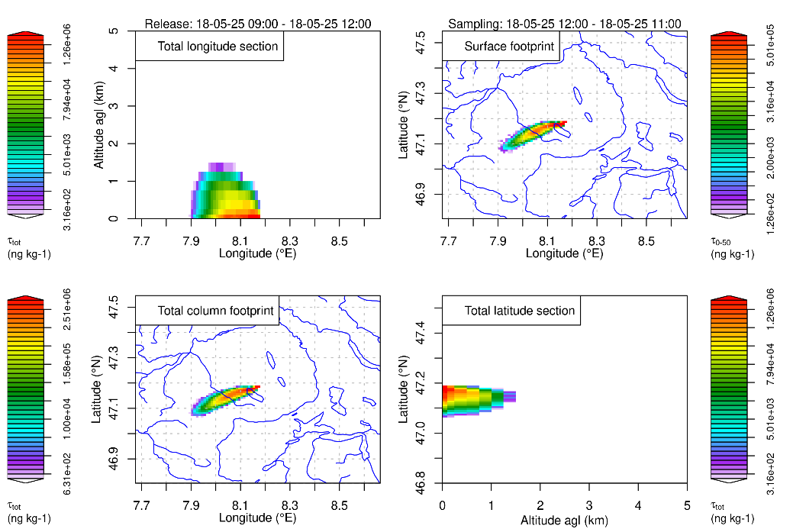
Other possible activities, suggestions for future PP/PTs
DMO from COSMO/ICON as an input to the dispersion models
FLEXPART for COSMO and ICON – Operational Use at MeteoSwiss
FLEXPART-ICON versus FLEXPART-COSMO (Starting from same ICON run)
Direct use of ICON output ICON->COSMO using BYC
Runtime: 220 s (debug, 8 threads);90 s (opt, 8 threads) Runtime: 109 s (debug, 8 threads); 35.7 s (opt, 8 threads)
11.09.2023
Institute of Meteorology and Water Management – National Research Institute; CGM’2023, Gdańsk
16

Slide 17
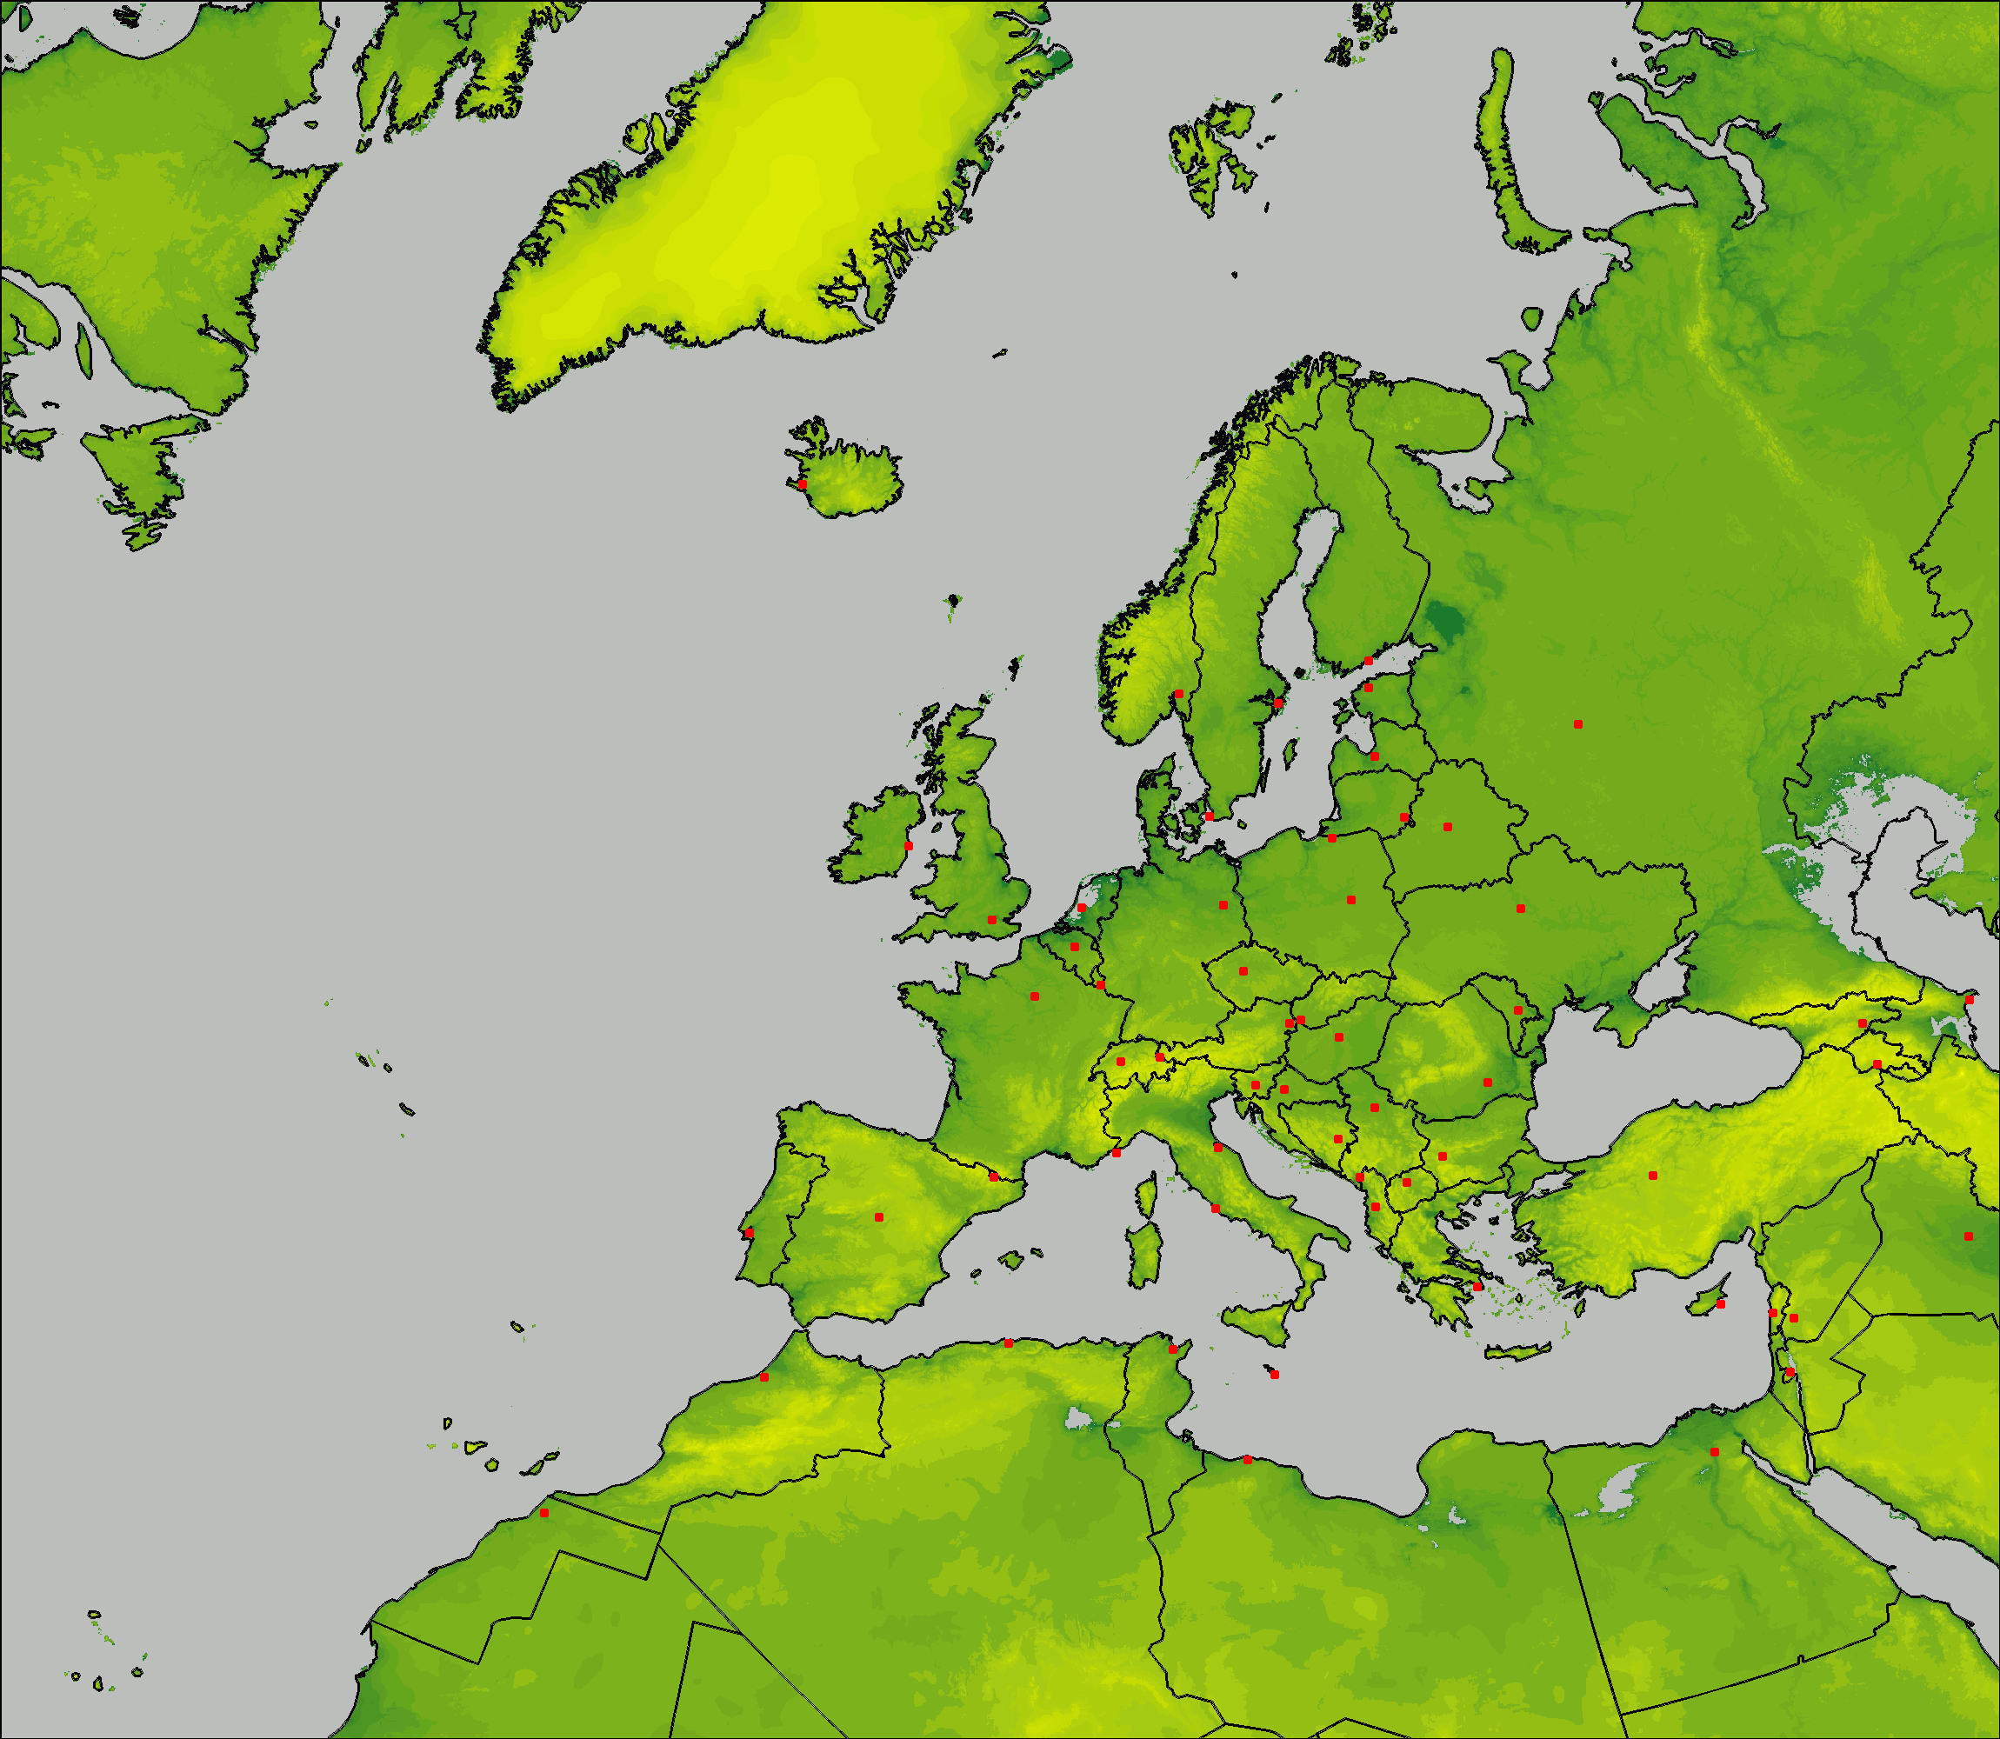
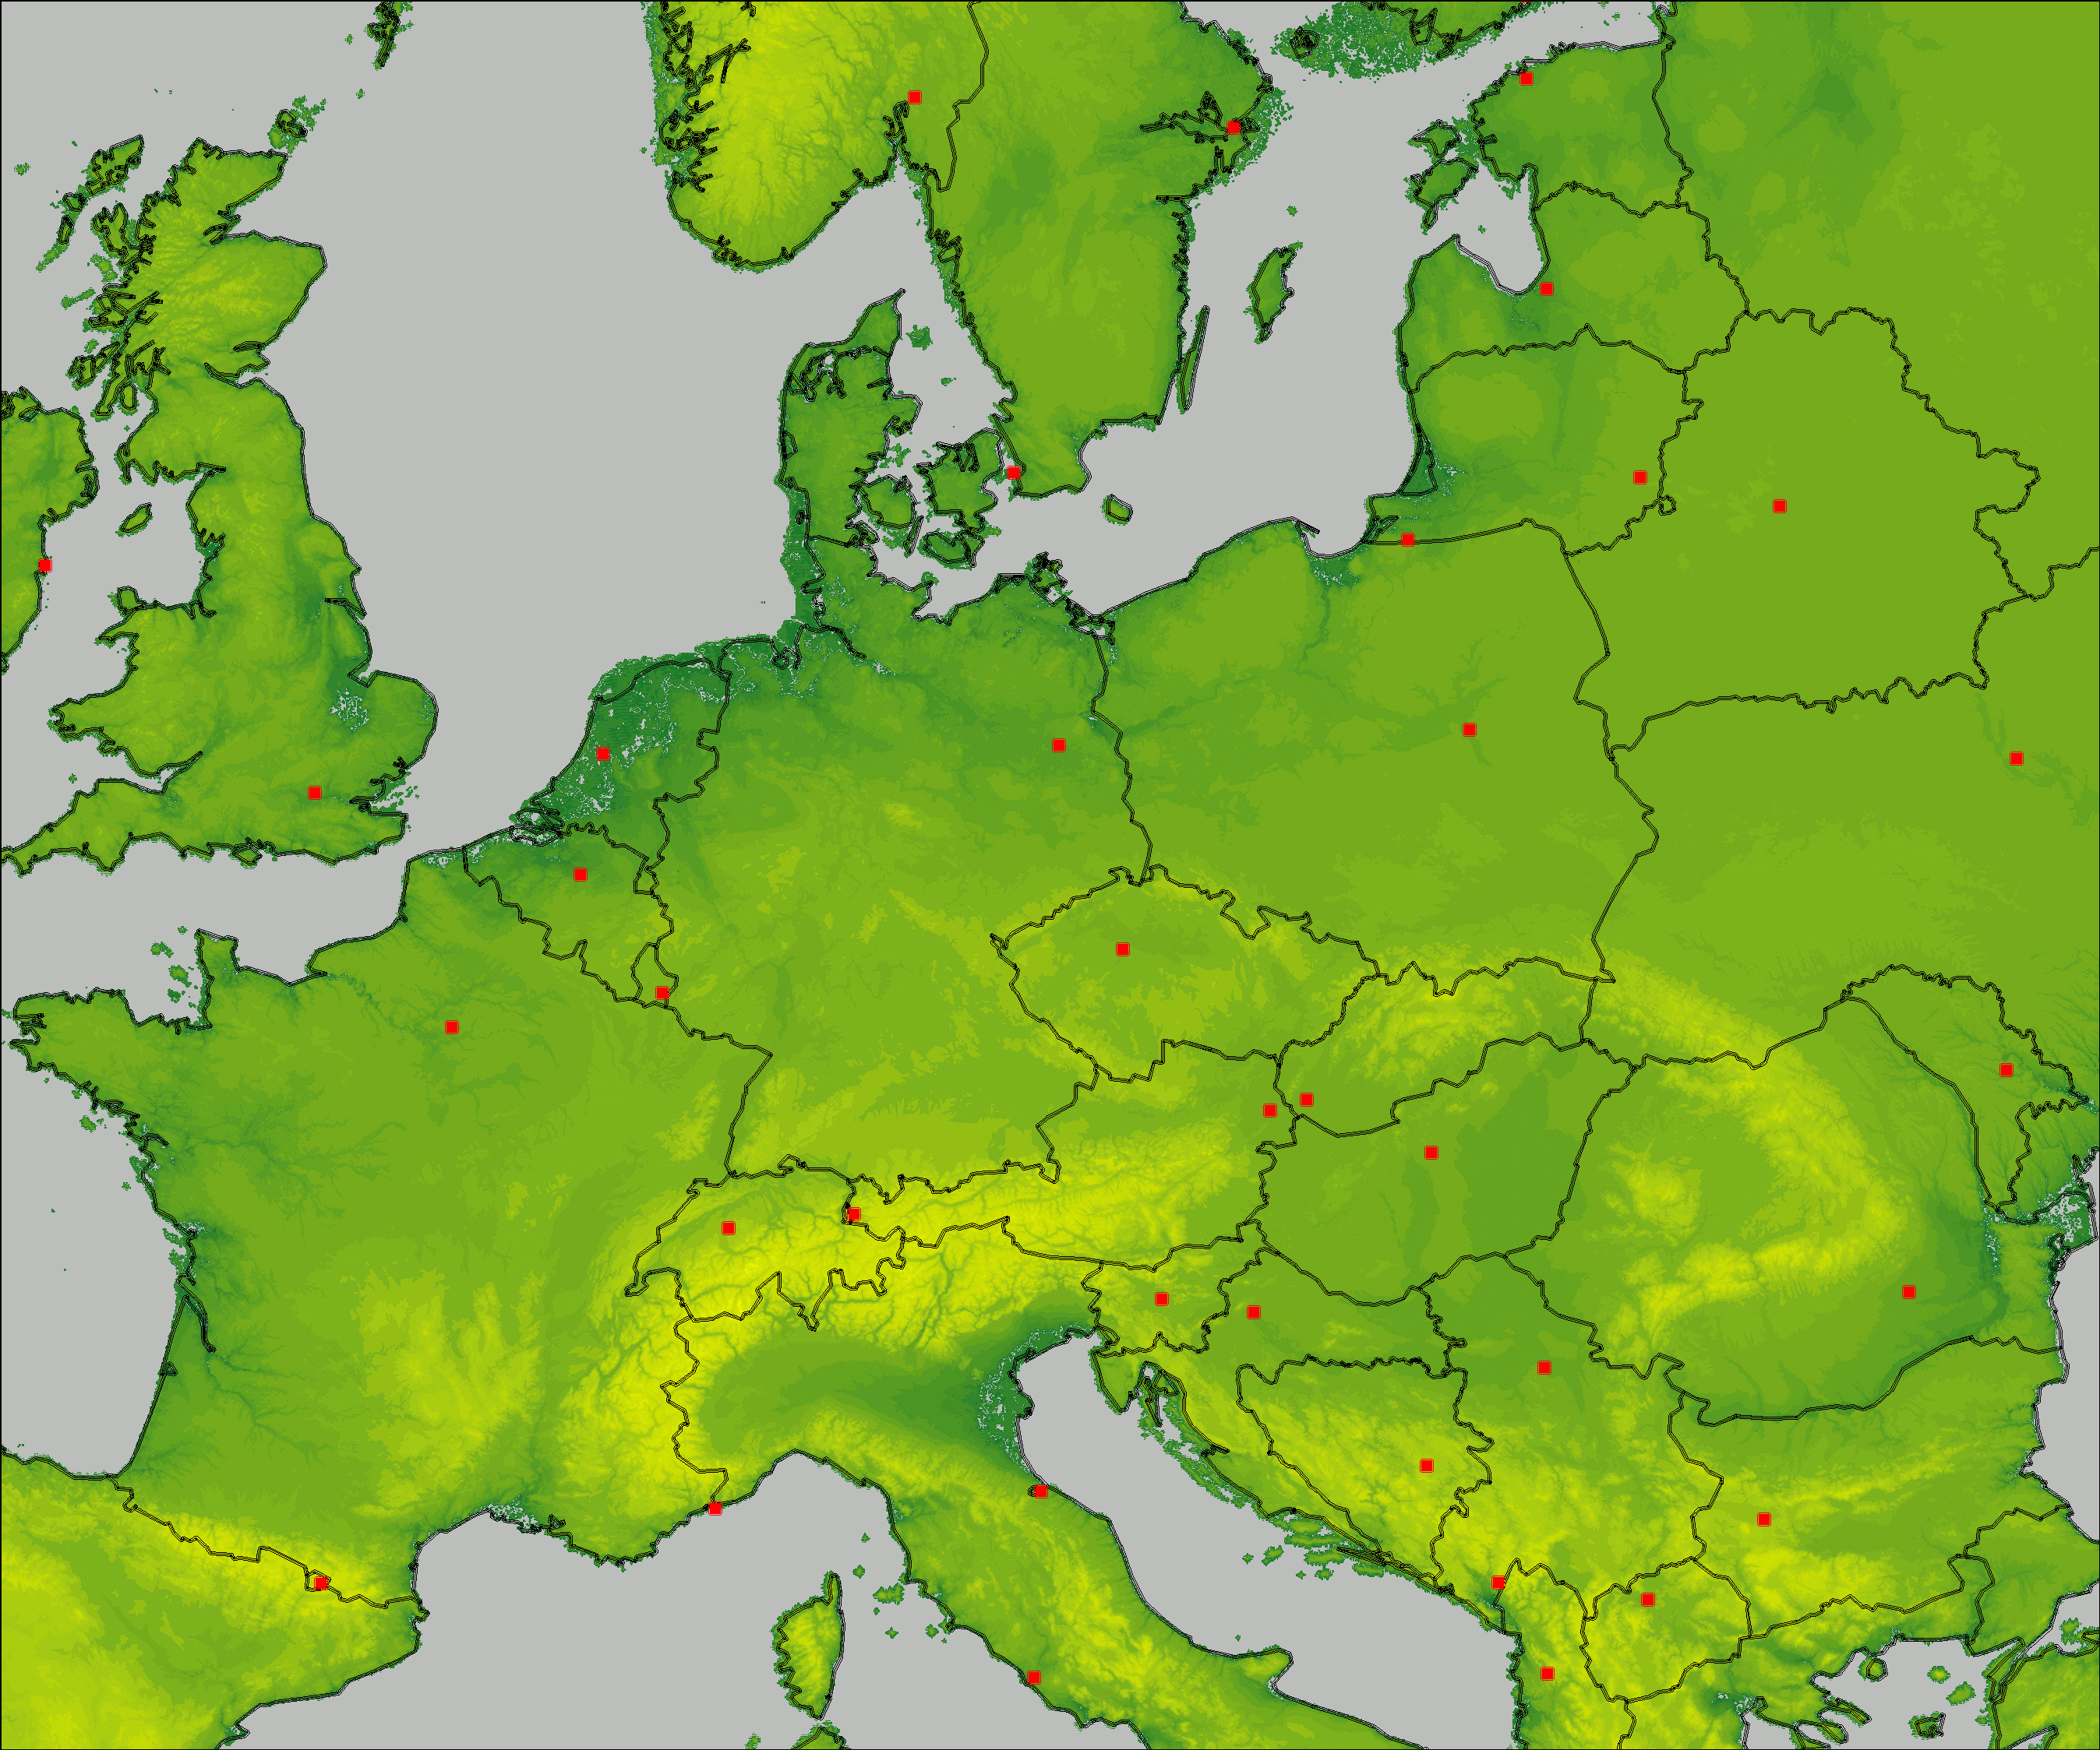
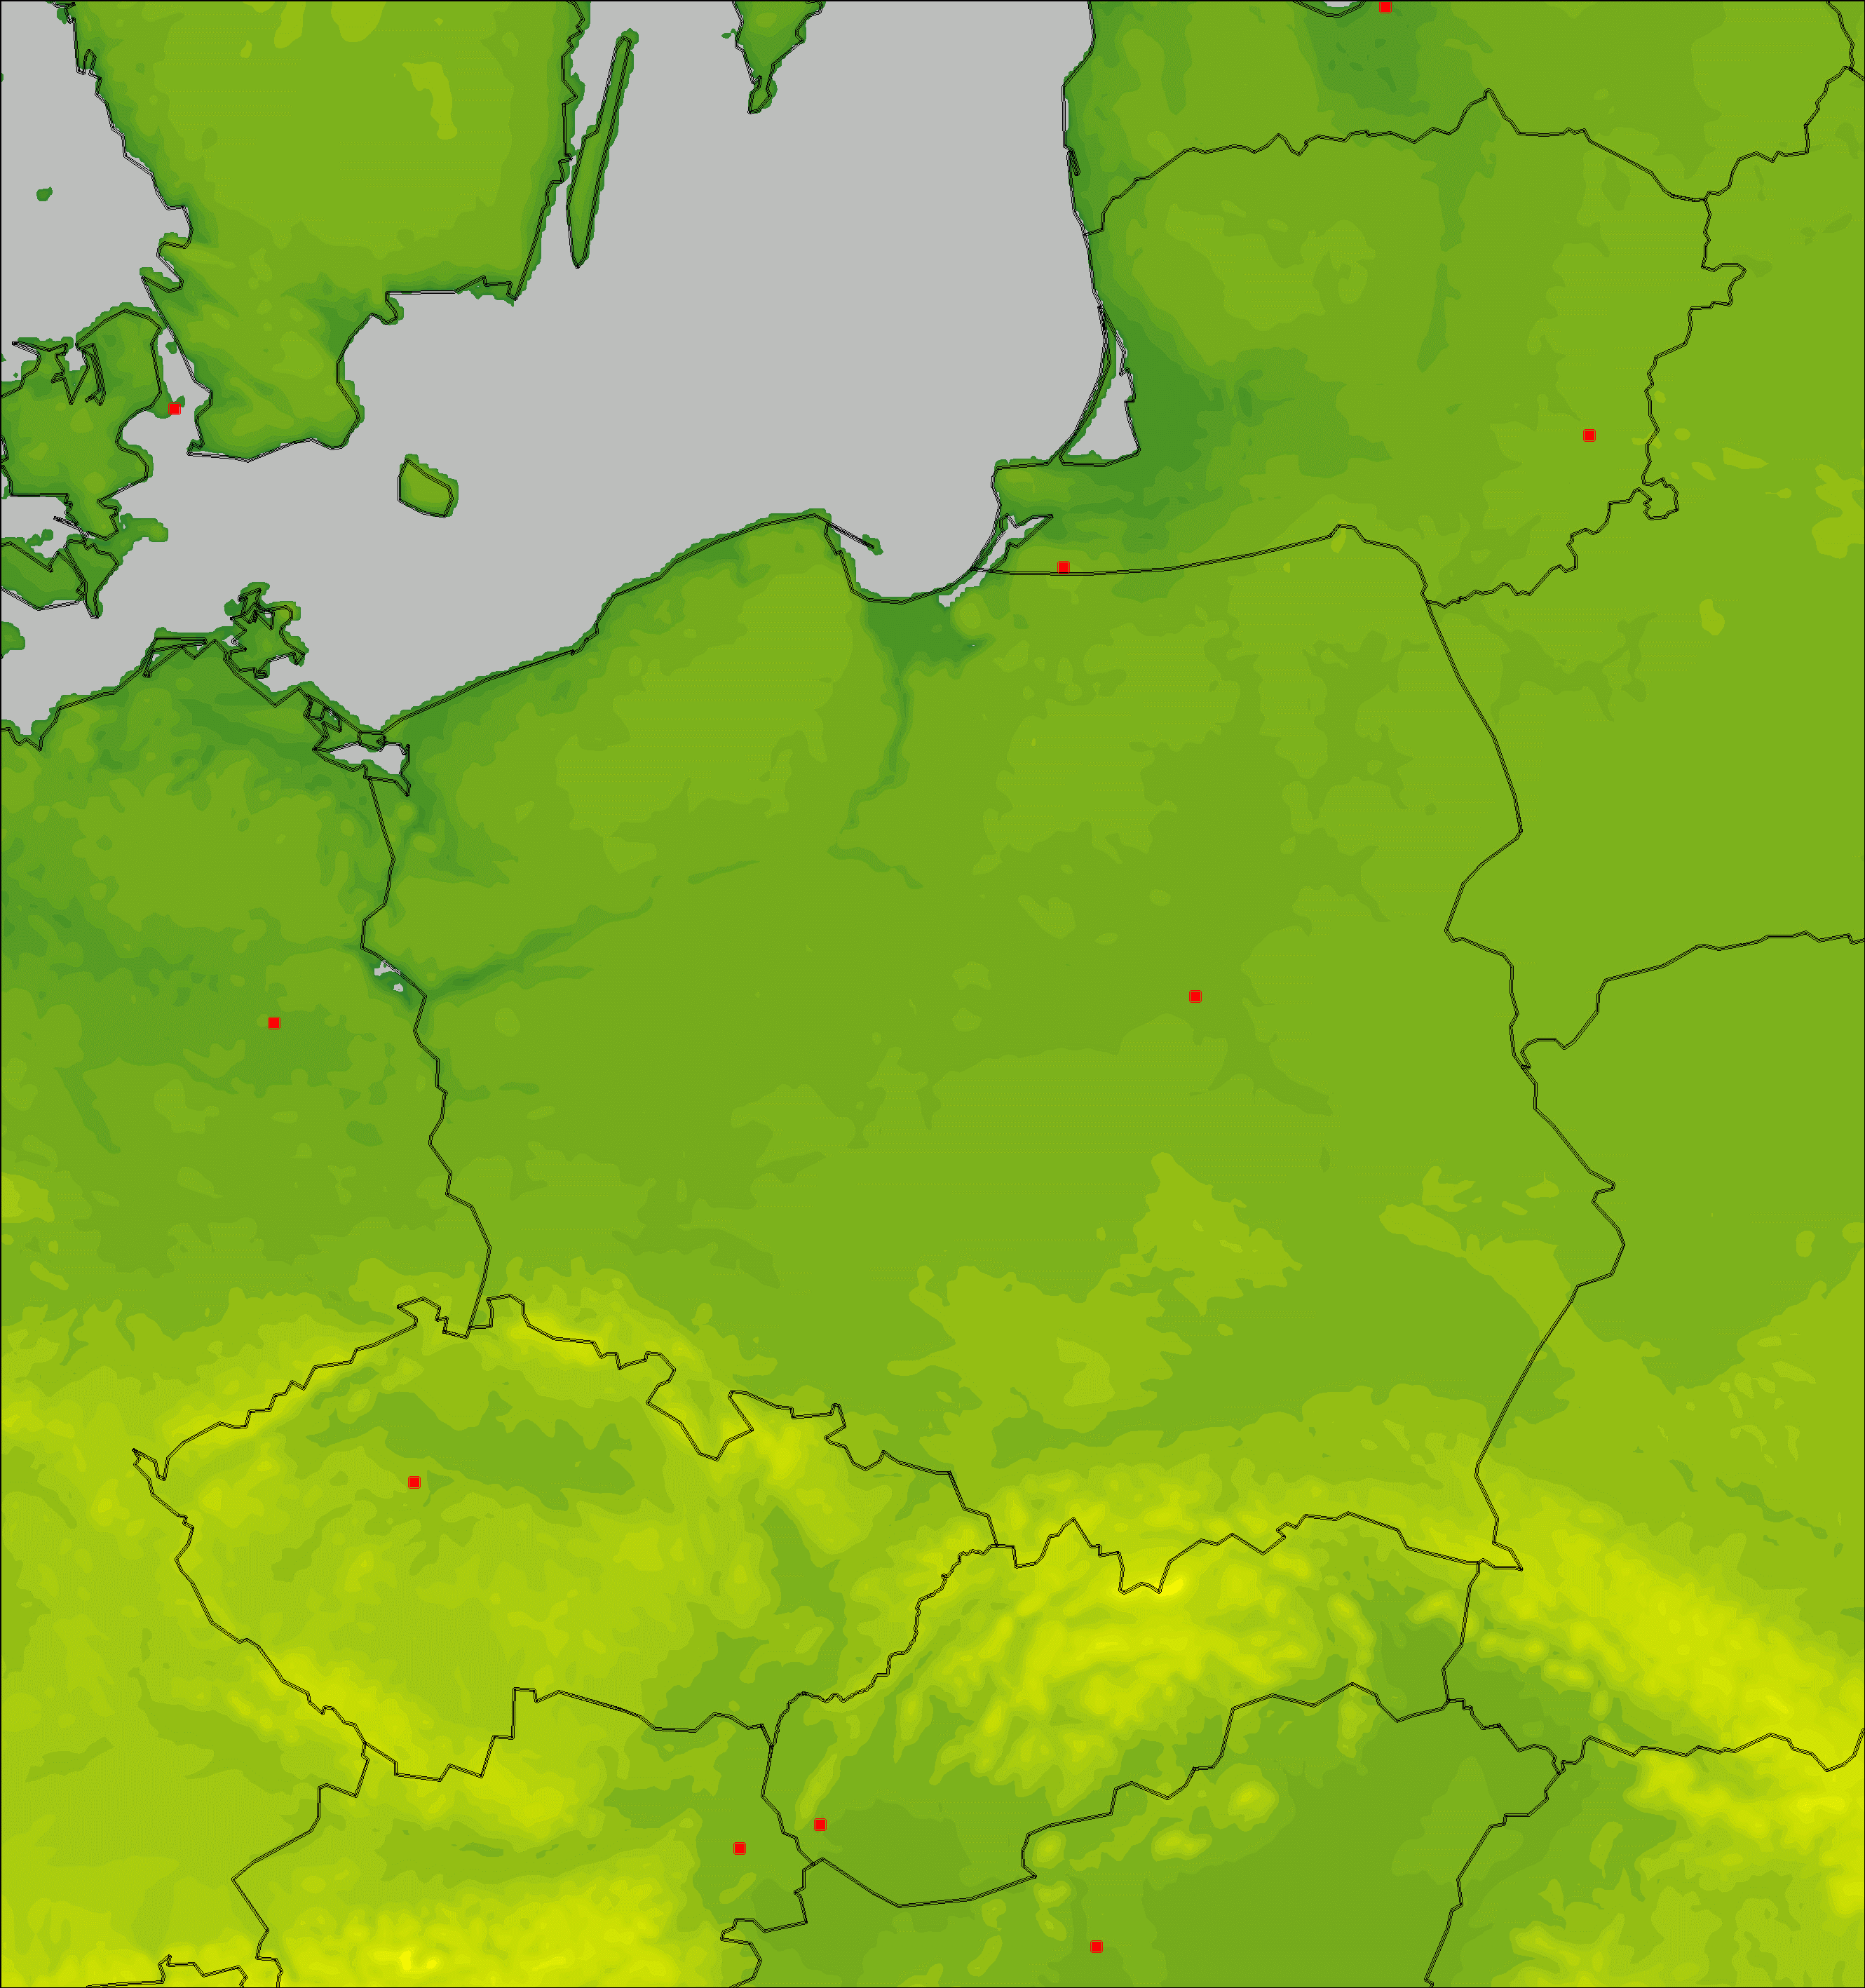
Other possible activities, suggestions for future PP/PTs
DMO from COSMO/ICON as an input to the dispersion models
This work may have an importance in the context of war in Ukraine, when Ukrainian NPPs are concerned. Other services (NMA, MCH, DWD) already running Early Warning Systems (EWAS) of similar type.
The system running at IMGW can generate warnings (graphs) based on dispersion forecasts prepared from DMOs of meteorological models in three resolutions – from 25 to 2.8 km, in the appropriate computational domains.
11.09.2023
Institute of Meteorology and Water Management – National Research Institute; CGM’2023, Gdańsk
17

Slide 18
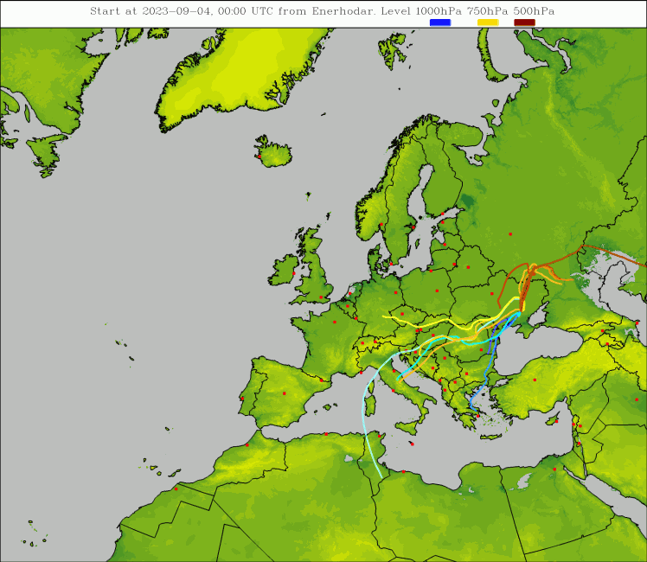
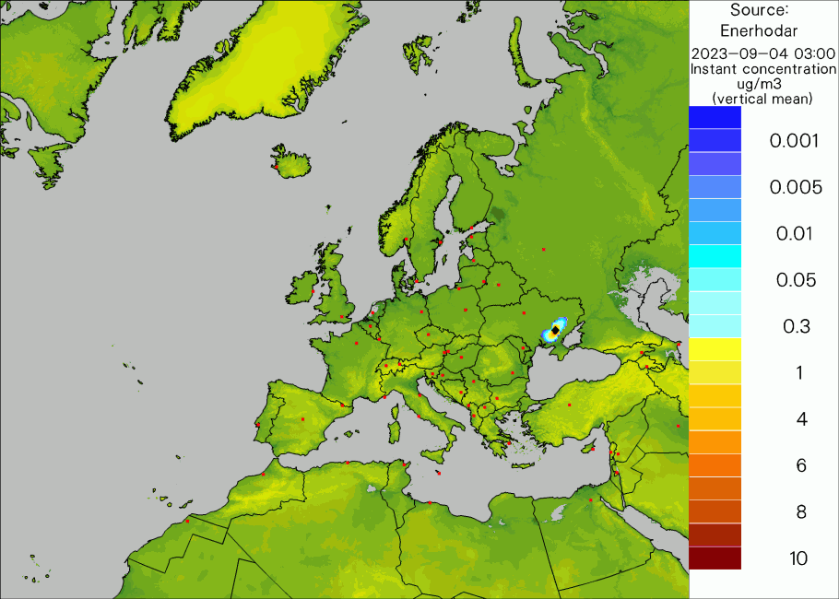
Other possible activities, suggestions for future PP/PTs
DMO from COSMO/ICON as an input to the dispersion models
Forecasts of dispersion for hypothetical accidents in selected NPPs. Special case – Enerhodar
11.09.2023
Institute of Meteorology and Water Management – National Research Institute; CGM’2023, Gdańsk
18

Slide 19
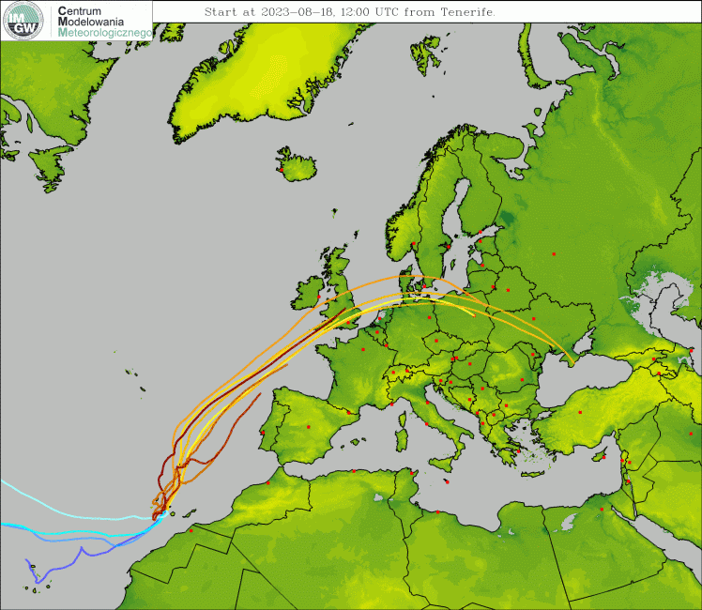
Other possible activities, suggestions for future PP/PTs
DMO from COSMO/ICON as an input to the dispersion models
The systems covers other potential and real sources of contamination, not only NPPs, but also volcanoes, forest fires etc.
Forest fires on the island of Rhodes in July and August. August 18th, forest fires broke out near Tenerife, Canary Island.
11.09.2023
Institute of Meteorology and Water Management – National Research Institute; CGM’2023, Gdańsk
19

Slide 20
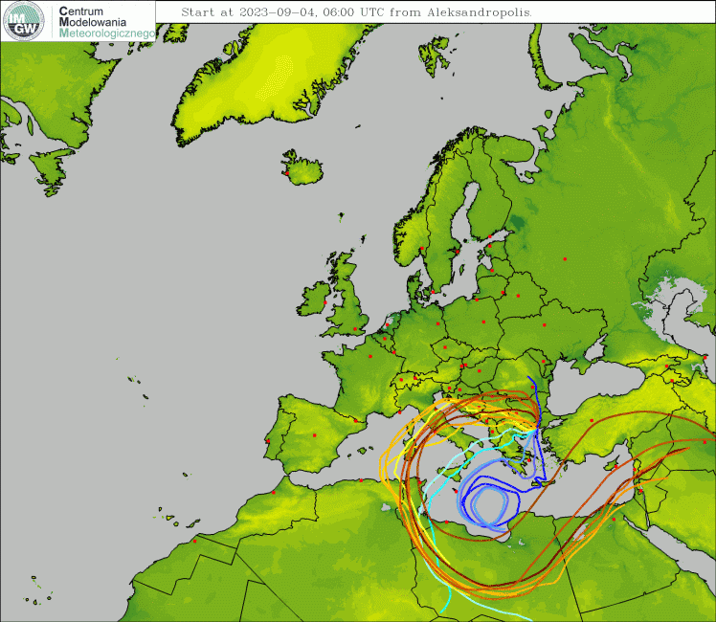
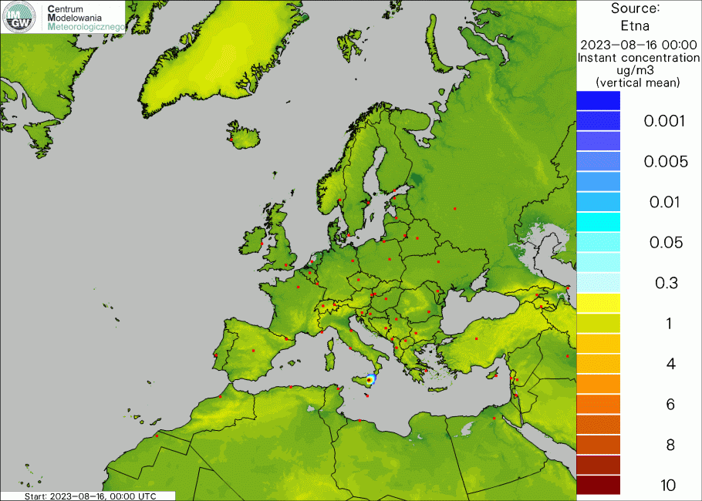
Other possible activities, suggestions for future PP/PTs
DMO from COSMO/ICON as an input to the dispersion models
August 14th, Mount Etna in Sicily erupted with the strongest intensity in three decades. August 20th, very violent forest fires broke out near the Greek city of Alexandroupolis. All these events affected the entire territory of Europe.
11.09.2023
Institute of Meteorology and Water Management – National Research Institute; CGM’2023, Gdańsk
20

Slide 21
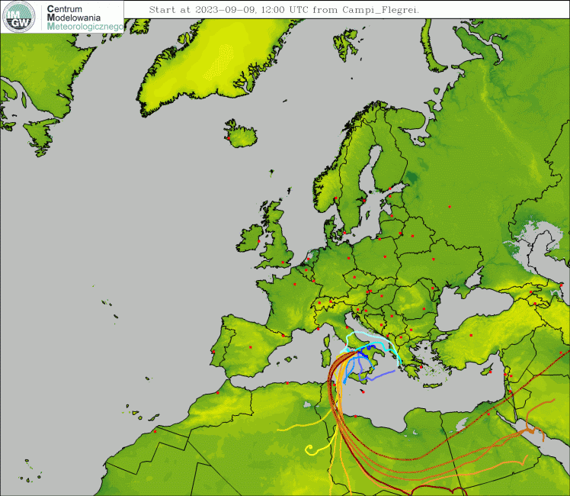
Other possible activities, suggestions for future PP/PTs
DMO from COSMO/ICON as an input to the dispersion models
Supercaldera in Campi Flegrei near Napoli is active again…
11.09.2023
Institute of Meteorology and Water Management – National Research Institute; CGM’2023, Gdańsk
21

Slide 22
Other possible activities, suggestions for future PP/PTs
DMO from COSMO/ICON as an input to the dispersion models
There is a need for efficient systems that would respond to a crisis situation - a threat resulting from the natural environment or human activity.
It is important to prepare tools that would allow to at least react to possible failures/releases…
…and warn the public/authorities who may be potentially exposed to the risk of contamination.
Such systems are intended to provide support – information on the further development of events, the forecasted state of the environment and the negative impact of various factors on human society within the range of such impact.
Similar systems are running in Switzerland, Romania and Germany. There is a need to exchange experiences between partners, related to possible improvements of existing systems, as well as the introduction of new ones.
Si vis pacem, para bellum!
11.09.2023
Institute of Meteorology and Water Management – National Research Institute; CGM’2023, Gdańsk
22

Slide 23
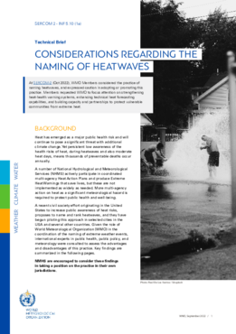
Other possible activities, suggestions for future PP/PTs
COSMO "Weather and Health" products
Searching for the motivation.
“Worldwide, more intense and extreme heat is unavoidable – it is imperative to prepare and adapt as cities, homes, workplaces are not built to withstand prolonged high temperatures – and vulnerable people are not sufficiently aware of the seriousness of the risk heat poses to their health and wellbeing”
Senior WMO extreme heat advisor dr John Nairn
https://library.wmo.int/index.php?lvl=notice_display&id=22190#.Y50EbezMJhA
Focusing on heatwave events alone may misinform the public and undermine awareness of the actual risks of heat to health.
Prolonged exposure to excessive heat above locally determined thresholds, such as hot nights, exertional heat-risk conditions, or prolonged elevated heat; these are responsible for the most heat related-illnesses and excess mortality.
11.09.2023
WMO&WHO joint efforts for better warnings systems
Institute of Meteorology and Water Management – National Research Institute; CGM’2023, Gdańsk
23

Slide 24
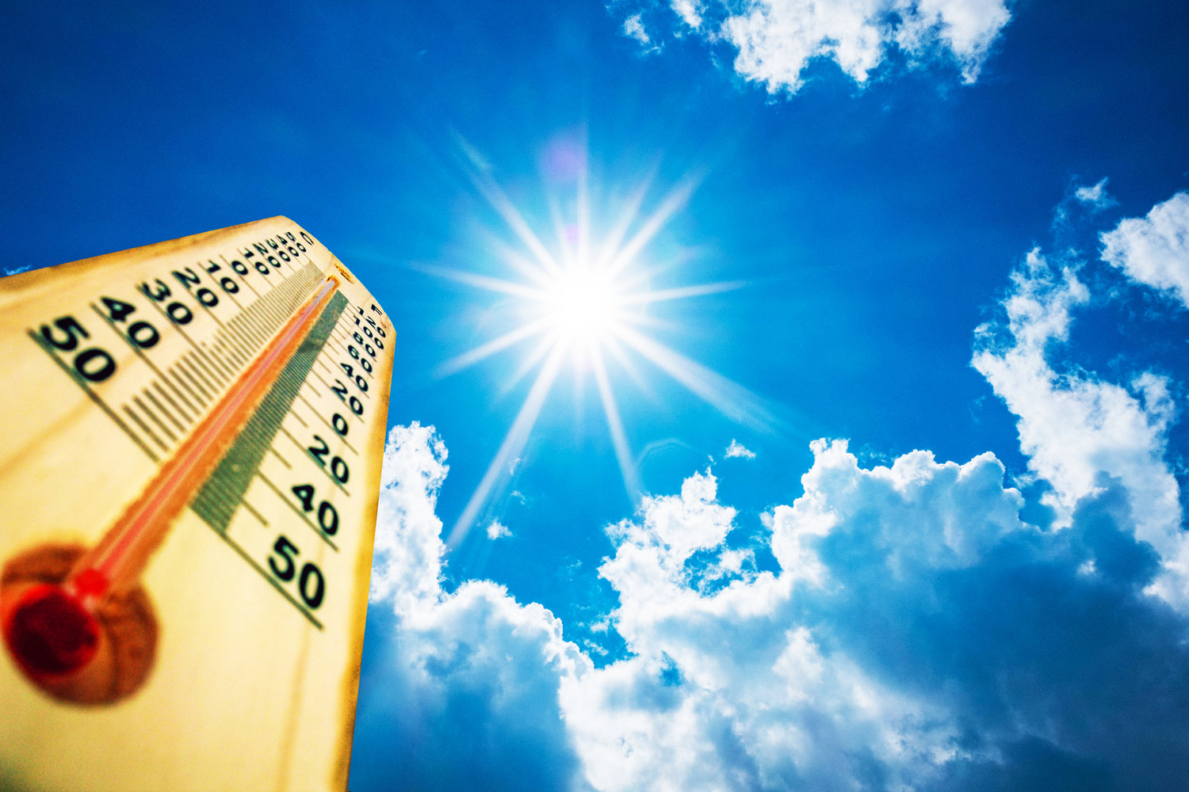
Other possible activities, suggestions for future PP/PTs
COSMO "Weather and Health" products
Simple one-element meteorological- vs. biometeorological indices forecast
The frequency of extreme events increases as climate change
Heat waves and cold speels forecasting is important - particularly in case human adaptability and over-sensitivity may become crucial
The key issue: temperature is not the only factor that affects a person's heat load.
11.09.2023
Institute of Meteorology and Water Management – National Research Institute; CGM’2023, Gdańsk
24

Slide 25
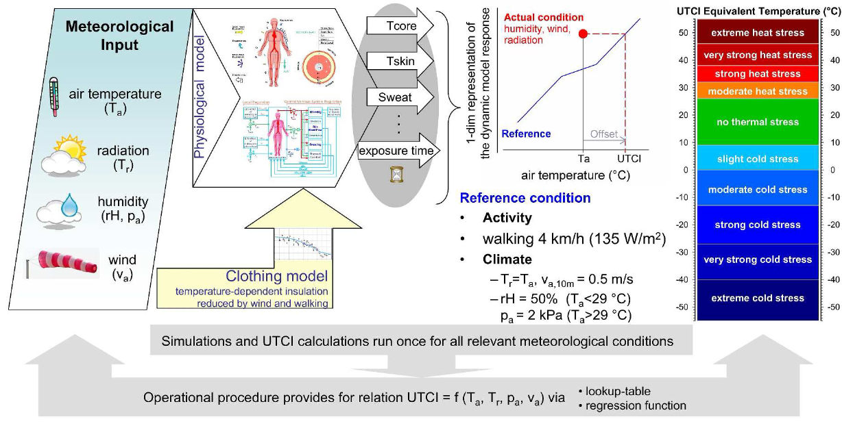
Other possible activities, suggestions for future PP/PTs
COSMO "Weather and Health" products
Not just heat and cold waves in mind.
Predicting everyday conditions that stress the body: NEW W&H PRODUCTS
Thermal load assessement
Universal Thermal Climate Index (UTCI, °C)
Thermal sensation assessement
Heat Index&Wind Chill Temperature (°C)
Normal effective temperature (°C)
Thermal workload assessement
Wet Bulb Globe Temperature (°C)
11.09.2023
Modelling human metabolism and thermoregulatory answers
Institute of Meteorology and Water Management – National Research Institute; CGM’2023, Gdańsk
25

Slide 26
Other possible activities, suggestions for future PP/PTs
COSMO "Weather and Health" products
Simple but relevant.
Predicting acute meteorological changes: DIURNAL & DAY-TO-DAY
Diurnal temperature range
Maximum/minimum temperature day-to-day changes
Barometric tendency
MORE?
Erythemal radiation = UV Index
Sunshine hours range
Sultriness sensation from water vapor pressure
Daily hot hours counting
11.09.2023
Institute of Meteorology and Water Management – National Research Institute; CGM’2023, Gdańsk
26

Slide 27
Overall status and summary
People of WG4
Dimitra Boucouvala (HNMS, also works as operational forecaster)
Alessio Canessa (CNMCA)
Josué Gehring (MCH)
Amalia Iriza (NMA)
Evgeny Brainin (IMS, Israel, forecaster)
Andrzej Mazur (IMGW)
Several people are active in WG4 not being official members:
Valeria Garbero (ARPA-PT, ICON feedback),
Daniele Nerini (MCH),
Maria Stefania Tesini (ARPAE-SIMC)
Susanne Theis (DWD)
Joanna Wieczorek (IMGW)
To-dos:
PP ICON-COMFORT
Collaboration with other WGs in the frames of other PP(s)
New PT/PP(s)?
Lack of human resources! Potential – hard to estimate.
11.09.2023
Institute of Meteorology and Water Management – National Research Institute; CGM’2023, Gdańsk
27

Slide 28
#StandWithUkraine
11.09.2023
Institute of Meteorology and Water Management – National Research Institute; CGM’2023, Gdańsk
28

