Slide 1
Status of the ‘model dynamics’ WG2 –
the BRIDGE project
COSMO General Meeting
Gdansk
11-15 September 2023
Michael Baldauf, Florian Prill (DWD)
M. Baldauf (DWD)
1

Slide 2
The BRIDGE project (Basic Research for ICON with DG Extension)
BRIDGE is an informal project at DWD, started ~ mid 2020
currently: F. Prill, M. Baldauf, D. Reinert
Goals:
develop a prototype for a Discontinuous Galerkin (DG) discretization of the 3D Euler equations (‚DG-HEVI on the sphere‘)
together with a minimal set of physical parameterizations
using ICON infrastructure (parallelisation via YAXT, I/O, ...)
more object-orientation and use of standard software (e.g. YAC coupler, ...)
→ BRIDGE is an intermediate step to a full–fledged ICON implementation.
Later on (starting ~2024), the BRIDGE code will serve as a code base for the final ICON-DG model.
M. Baldauf (DWD)
2

Slide 3
General properties of numerical methods for PDEs
Finite-difference discretization:
‚simple‘ approach
explicit time integration schemes are possible
difficult to apply on unstructured grids
Finite volume schemes:
use integral form of equations (Gauss theorem)
local conservation achievable
explicit time integration schemes are possible
easy application on unstructured grids, but difficult to find higher order schemes there
Finite element schemes:
use weak (integral) form of equations
applicable on unstructured grids
higher order methods doable
only implicit solvers are possible
(e.g. Hesthaven, Warburton (2008) Springer)
DG schemes
M. Baldauf (DWD)
3
M. Baldauf (DWD)

Slide 4
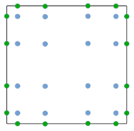
Discontinuous Galerkin (DG) methods in a nutshell
e.g.
Cockburn, Shu (1989) Math. Comput.
Cockburn et al. (1989) JCP
Hesthaven, Warburton (2008)
1.) weak formulation
2.) Finite-element ingredient
From Nair et al. (2011) in ‚Numerical techniques for global atm. models'
3.) Finite-volume ingredient: numerical flux
4.) Gaussian quadrature for the volume and surface integrals
→ ODE-system for q^{(k)}_{jl}(t)
5.) Use a time-integration scheme (Runge-Kutta, …)
M. Baldauf (DWD)
4

Slide 5
Improvements in the efficiency of the HEVI solver
M. Baldauf (DWD)
5

Slide 6
Efficiency of the HEVI (vertically implicit) solver
The HEVI approach applied to DG leads to (large) block-tridiagonal linear equation sytems (Baldauf (2021) JCP).
Problem: the complexity of a direct solver for a linear system of N equations for LU-decomposition is O(N³), for matrix vector mult. is O(N²) with
N = # of variables (5) * # of base functions in each cell (10*4) (for 4th order)
Efficiency improvement by Collocation (i.e. interpolation points = quadrature points)
This decouples the equations horizontally (also in the BCs!) →
N = # of variables (5) * # of vertical base functions in each cell (4)
HEVI solver ~ 10 times faster than before!
→ we are in the game again ☺
M. Baldauf (DWD)
6
M. Baldauf (DWD)

Slide 7
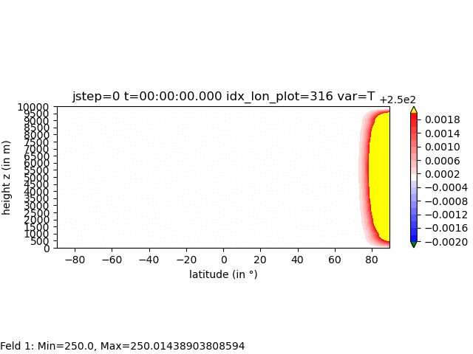
3D Euler equations:
quasi-linear expansion of gravity and sound waves in a spherical shell
Baldauf, Reinert, Zängl (2014) QJRMS derive a linearized analytic solution for
test scenario (A): f = 0
test scenario (B): f = 10 * f_{geo}(45°) → f / N ~ 0.05
DG 4th order scheme with explicit time integration (4th order Runge-Kutta)
‚small planet‘:
R = R_{earth} / 50
S E N
M. Baldauf (DWD)
7
M. Baldauf (DWD)

Slide 8
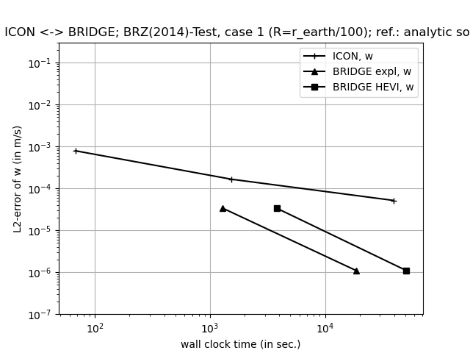
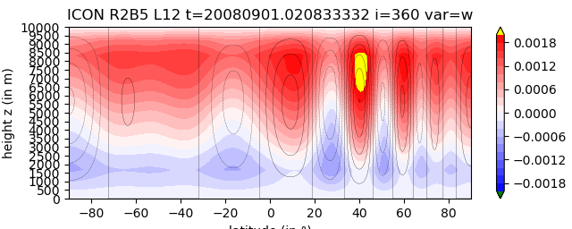
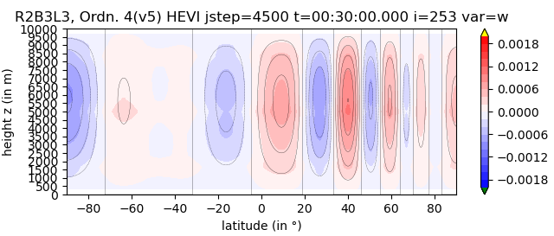
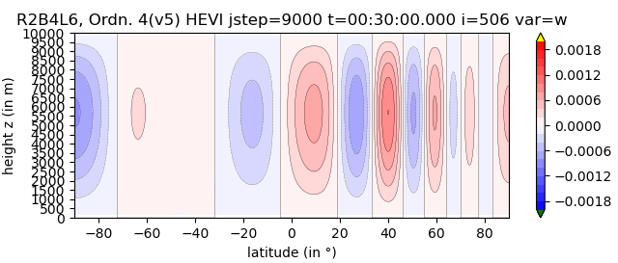
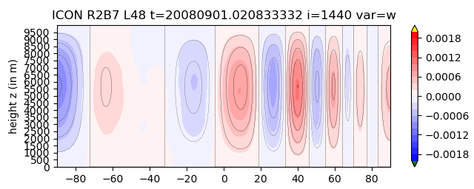
A very first (!), almost (!) fair comparison between ICON and BRIDGE
test case Baldauf, Reinert, Zängl (2014) QJRMS: expansion of sound- and gravity waves in a spherical shell (uses shallow atmosph. approx., U₀=0, f=0).
R= r_{earth} / 100 → almost isotropic grid cells → HEVI- (ICON) and purely expl. time integration (BRIDGE) are comparable!
all simul. on our RCL (ICON: 32, 64, 384 proc. (thanks to D. Reinert!), BRIDGE: 16 proc.)
R2B5L12
R2B3L3
R2B5L12
ICON
R2B6L24
ICON
R2B7L48
R2B3L3
BRIDGE
BRIDGE, HEVI
R2B4L6
R2B7L48
BRIDGE, expl
R2B4L6
M. Baldauf (DWD)
8
Notes:
Wave expansion test on the sphere (see next slide):
for an isotropic grid: HEVI still factor 4 more expensive than explicit solver
→ for grid anisotropy > 4:1 (in operational ICON we use more than 100:1) the HEVI solver by far outperforms the explicit solver

Slide 9
Choice of prognostic variables
M. Baldauf (DWD)
9

Slide 10
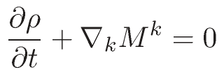
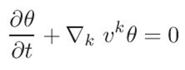
Euler equations (in covariant form)
Continuity eq.:
Momentum eq.:
Energy budget eq.:
Variant 1:
Variant 2:
p=p(θ)
E = E_{kin} + E_{pot} + E_{int}
p=p(E_{int})
M. Baldauf (DWD)
10
M. Baldauf (DWD)

Slide 11
Choice of prognostic variables, variant 1
density ρ
momentum M ^{i}=ρv ^{i}
density weighted potential temperature
Properties:
This equation set locally conserves mass, momentum and entropy for an ideal gas that does not change its mass mixing ratio (since for specific entropy holds s = c_{p} ln Θ) and for reversible processes
Local conservation of ρΘ still holds for diffusion (remark: entropy is not conserved since diffusion is irreversible)
No formal conservation of entropy in case of phase changes!
Θ is well defined for a dry atmosphere, but there are ambiguous definitions for a moist atmosphere (choice of c_{p}, R, ...?)
M. Baldauf (DWD)
11
M. Baldauf (DWD)

Slide 12
Choice of prognostic variables, variant 2
density ρ
momentum M ^{i}=ρv ^{i}
total energy E = E_{kin} + E_{pot} + E_{int} = ½ ρ v² + ρ gz + c_{v}ρT (dry case)
Properties:
This equation set locally conserves mass, momentum and total energy E! (note: any Runge-Kutta time integration scheme keeps this property)
This still holds in case of (turbulent) diffusion
E is unambiguously defined, also for a moist atmosphere (in contrast to Θ)
At least for a dry atmosphere, use of E avoids expensive powers (or exp/log) (p = R/c_{v} * E_{int})
The well-balancing problem is reduced (see below)
M. Baldauf (DWD)
12
M. Baldauf (DWD)

Slide 13
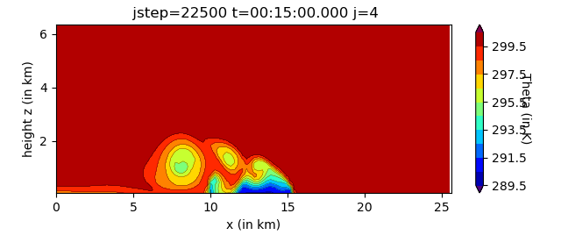
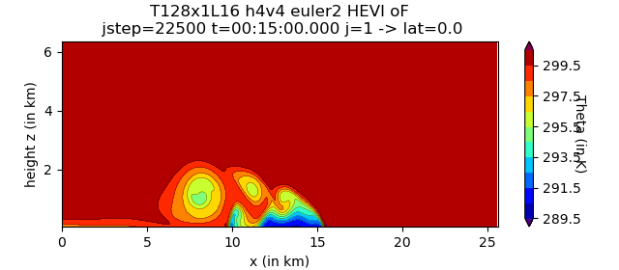
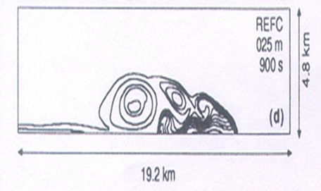
Falling cold bubble in a viscous medium
BRIDGE, 4th order, RK4, Δx=Δz=400m
with ρΘ
Reference solution
for θ from
Straka et al. (1993)
(Δx=Δz=25m)
with E
M. Baldauf (DWD)
13

Slide 14
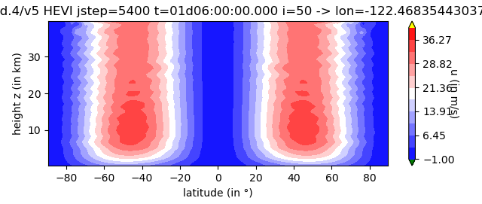
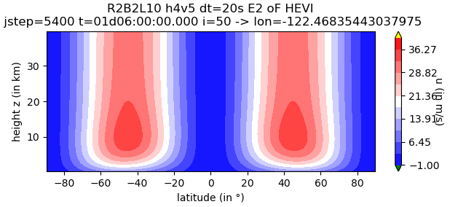
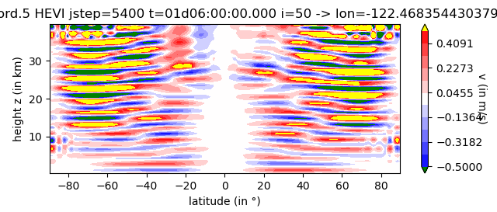
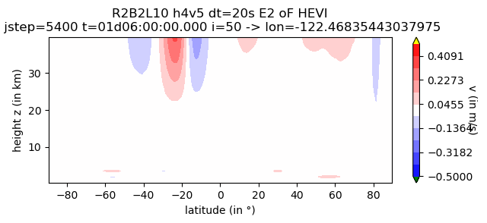
Baroclinic instability test on the sphere
Jablonowski, Williamson (2006) QJRMS
R2B2L10, 4th order, after t=30h
With ρθ, source term filtering
With E, no src term filtering
Becomes quickly unstable!
Observation: slowly increasing disturbances in the vertical.
Clear advantage by the use of E
M. Baldauf (DWD)
14
M. Baldauf (DWD)

Slide 15
Baroclinic instability test on the sphere
Jablonowski, Williamson (2006) QJRMS
With ρΘ, the simulation breaks after only ~30h, obviously due to heavy well-balancing problems
Using total energy E and without any further actions, the test runs about 7d and then breaks
Tests with any kind of physical diffusion (Smagorinsky or K=const.) either damps the unstable wave too much or doesn‘t prevent instability
Exponential filtering (e.g. Hesthaven, Warburton (2008)): in each time step reduce a bit the amplitude in dependence of the polynomial degree (but no change of degree 0! ← conservation) This is a relatively cheap proxy for hyperdiffusion; but acts separately on each grid cell
With the filter settings for exponential filtering found until now, the test runs until 15d
→ Obviously, further testing is necessary
Far future: use kinetic energy conserving DG schemes (Gassner et al. (2021), …)
M. Baldauf (DWD)
15
M. Baldauf (DWD)

Slide 16
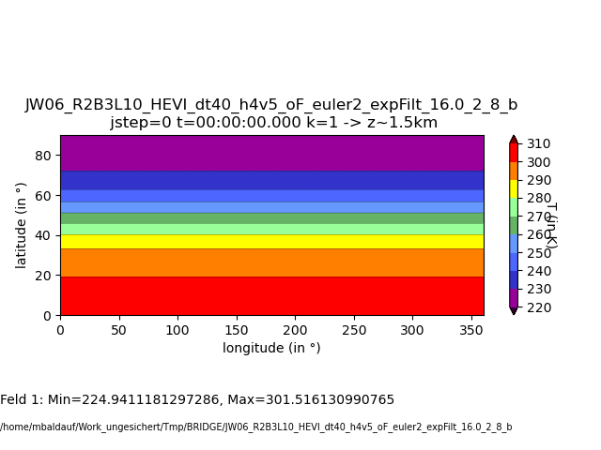
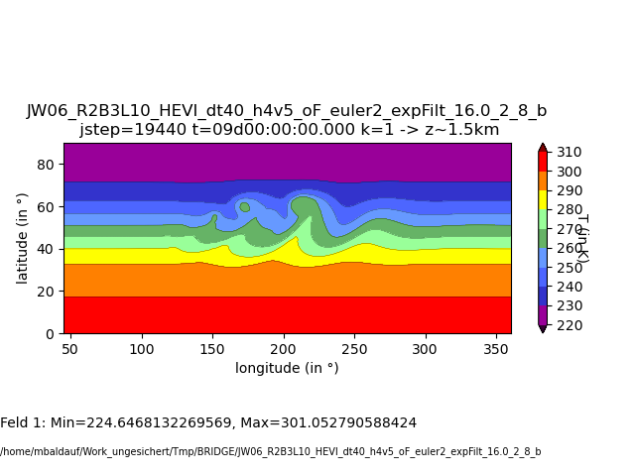
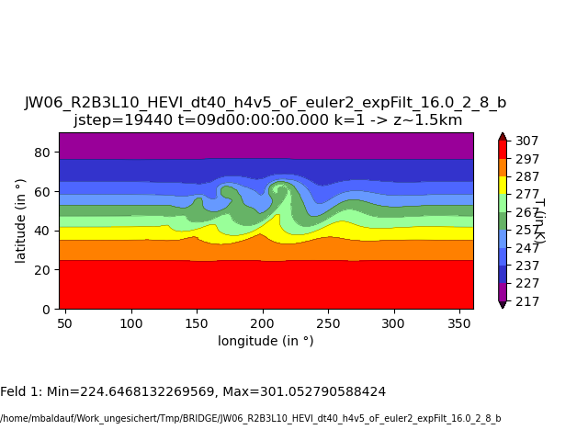
Baroclinic instability test on the sphere
Jablonowski, Williamson (2006) QJRMS
BRIDGE DG 4th order
R2B3 → Δx ~ 315 km, Δt=40s
T in z=1.5km
Δx ~ 60 km
Stabilization by an exponential filter
(formally of 8th order)
T in 850 hPa at t=9d (Fig. 7 from JW06)
M. Baldauf (DWD)
16
M. Baldauf (DWD)
Notes:
Anm. zu ‚850 hPa‘:
Z=1.5km bedeutet in lat=0° : 846hPa, in lat=45°: 830hPa, in lat=60°: 811 hPa, in lat=90° 783hPa 0=> consequently change a bit the color scale!

Slide 17
The DG scheme applied to the TKE equation
M. Baldauf (DWD)
17

Slide 18
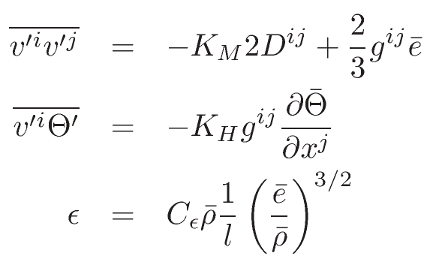
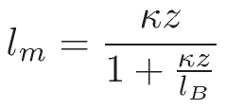
Example: Turbulence closure by a one-equation TKE model
Density of the turbulent kinetic energy (TKE density):
TKE equation:
Parameterizations:
Diffusion coefficients:
Mixing lengths (here only neutral case):
BCs from a simplified ‚transfer scheme‘ (wall law) for neutral stratification:
u* from
→ in z=0: u‘w‘=u*², v=0 and e = cρ u*²
Note: it is not the purpose of this implementation to have a ‚good‘ turbulence parameterization, but to have the main ingredients that must be considered for a DG treatment!
M. Baldauf (DWD)
18

Slide 19
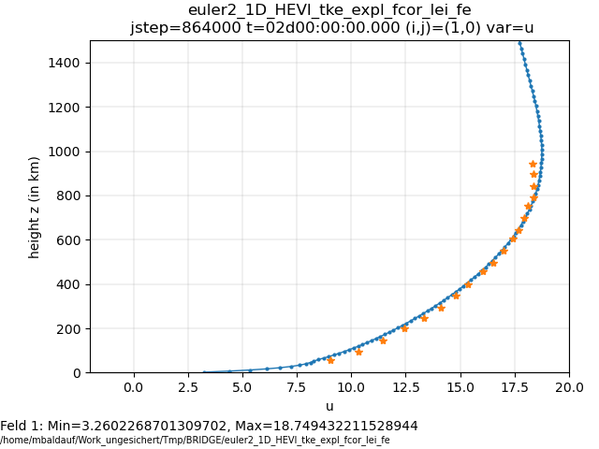
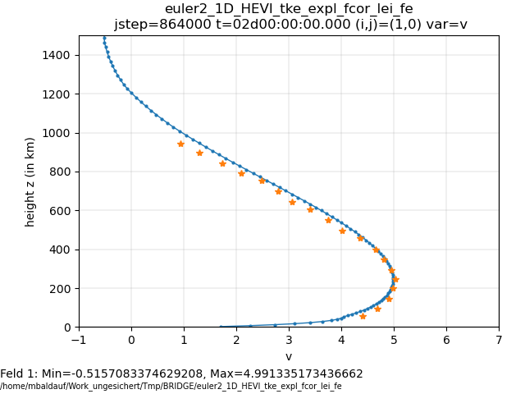
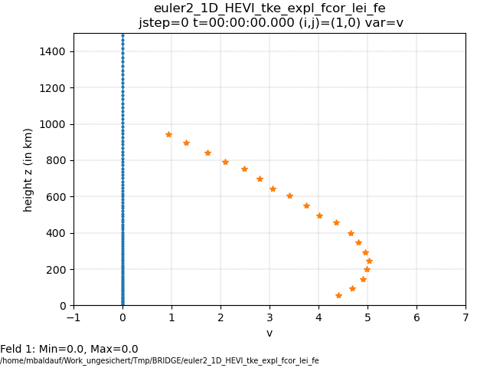
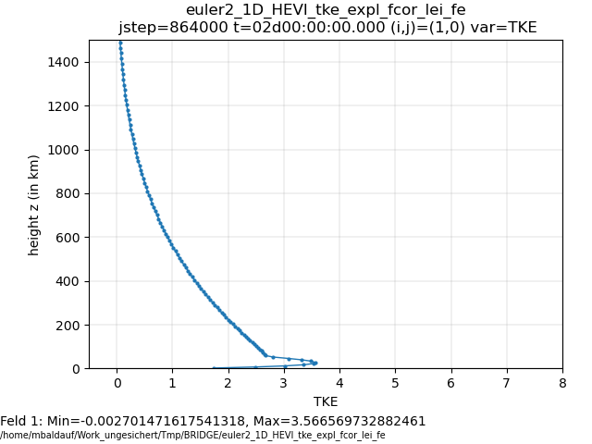
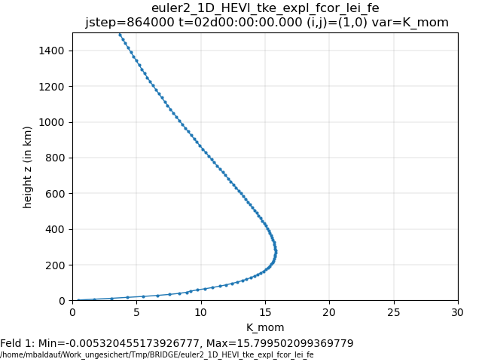
Euler equations + TKE-turbulence model
Simulation of the ‚Leipzig wind profile‘ (from 1931!) u_{g}=17.5 m/s, z₀=0.3m, l_{B}=40m
(u, v obs. data from Detering, Etling (1985))
u
v
v
TKE
K_{M}
Observed:
u* ~ 0.65 m/s
Simulated: u* ~ 0.667m/s
M. Baldauf (DWD)
19
M. Baldauf (DWD)

Slide 20
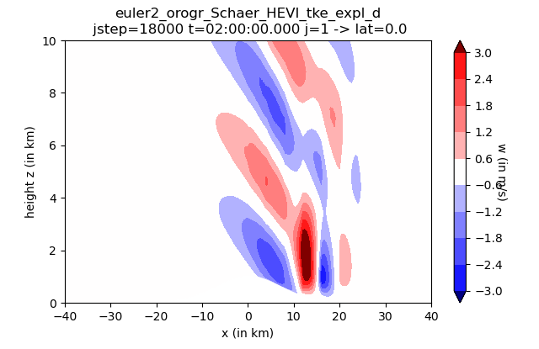
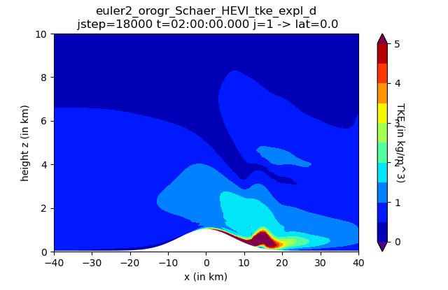
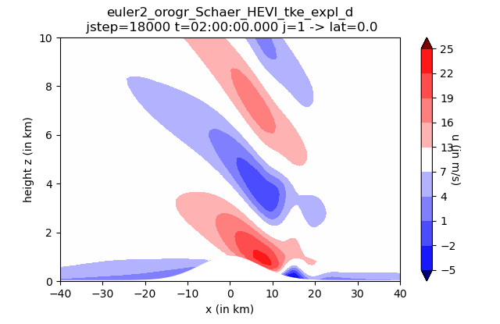
Euler equations + TKE turbulence model:
Flow over mountains
u₀=10m/s, N=const
Δx=4 km
z₀=0.3m
w
u
TKE
M. Baldauf (DWD)
20
M. Baldauf (DWD)

Slide 21
A few words about code design: equation classes
t_equation_base
<<abstract>>
init()
init_var()
flux_expl()
flux_expl_hface()
source_term_expl()
t_eq_adv2D
t_eq_euler
flux_impl_x3()
source_term_impl()
…
t_eq_euler2
flux_impl_x3()
source_term_impl()
…
t_eq_shw
t_eq_tracer_micro
t_eq_adv3D
Sub equation
classes
Master equation classes
t_eq_tke
M. Baldauf (DWD)
21

Slide 22
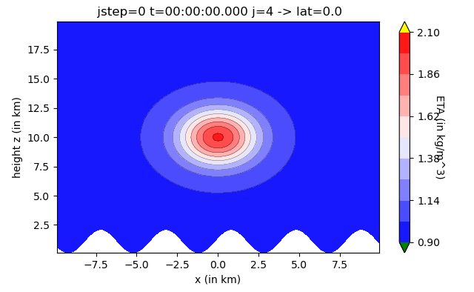
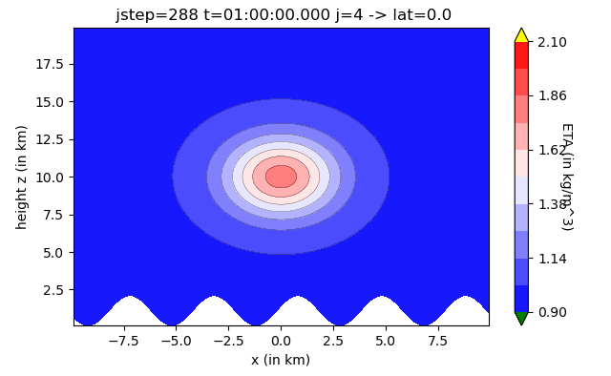
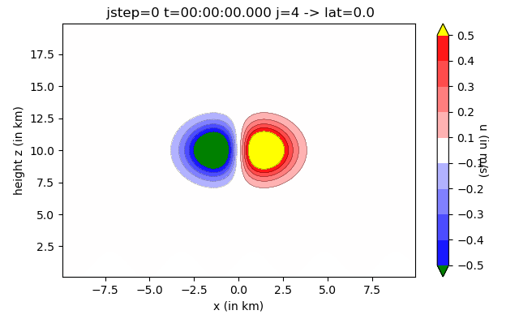
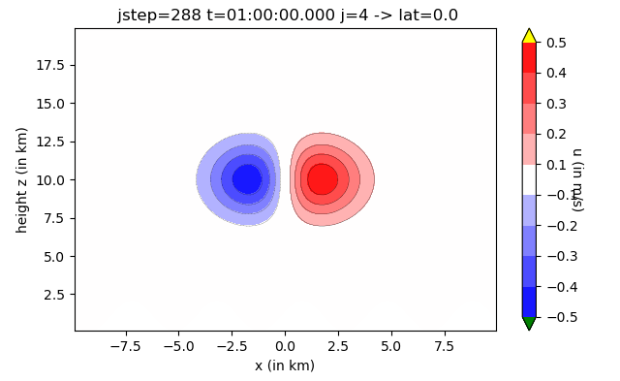
Diffusion treated by the HEVI scheme test case Baldauf, Brdar (2013), black lines: analytic solution
t=0
t=1 h
Scalar diffusion
ρΘ
Vector diffusion
u
… and inhomogeneous BCs work, too.
M. Baldauf (DWD)
22

Slide 23
Steps towards parameterizations
First Kick-off meeting with turbulence experts at DWD
(M. Raschendorfer, D. Mironov, E. Machulskaja, L. Schlemmer)
on 22 August 2023
Questions
Why does this DG stuff bothers in particular the turbulence developers?
What is the impact of the choice of new prognostic variables? (total energy vs. potential temperature)
M. Baldauf (DWD)
23

Slide 24
Building blocks for turbulence parameterizations
Keep in mind: we want to locally conserve prognostic variables,
therefore, instead of delivering only tendencies, the turbulence parameterization mainly should deliver
fluxes f ^{(s)} (for explicit time integration)
or a flux coefficient matrix of the form H^{ss‘} ≡ δf ^{(s)} /δq^{(s‘)} (for implicit time integration)
or a combination of both (explicit / implicit)
Therefore a turbulence parameterization should be separated into
the transport scheme i.e. the diffusion terms and additional transport equations ← they are replaced by the DG scheme
the ‚pure‘ turbulence parameterization, which preferably only uses local functional relationships between variables and spatial derivatives *)
By the way, a similar separation is requested by ‚ICON consolidated‘, ICON ComIn
*) This may be possible for turbulence param. but probably not for convection …
M. Baldauf (DWD)
24

Slide 25
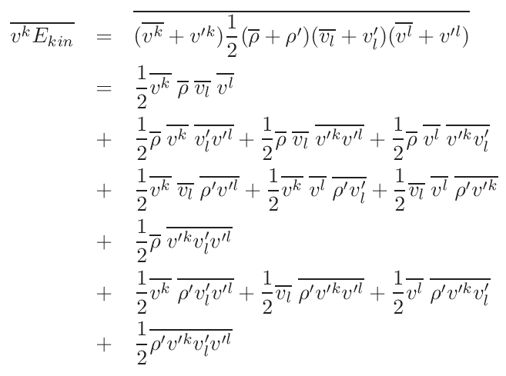
The choice of other/new prognostic variables (total energy!) requires the development of new closures for their related covariances (→ would be a lot of work)
Can we circumvent this by expressing the new covariances by the ‚old‘ ones?
Examples:
Currently not clear,
if we can close the higher order covariances in a satisfying manner!
M. Baldauf (DWD)
25
M. Baldauf (DWD)

Slide 26
Further issues
M. Baldauf (DWD)
26

Slide 27
Generalization of the quadratures (Florian Prill)
Currently, BRIDGE allows to use different base functions
in different cells and for different variables.
Motivation for this:
e.g. use lower order (i.e. cheaper) for moisture variables near model top.
However, the quadrature rule is always the same.
In future, quadrature rules can change for cells/variables, too.
This becomes in particular necessary with the requirement of collocation!
→ basic redesign of larger parts of the BRIDGE code needed!
M. Baldauf (DWD)
27

Slide 28
Contact with academia
group of Prof. Gassner, Univ. Köln and the DLR/Cologne
A first face-to-face meeting took place during
a mini-workshop 30.11./01.12.2022
Focal point of their work:
stabilization of DG schemes by designing entropy stable/entropy conserving / kinetic energy conserving schemes = next generation DG schemes! However, it is not yet clear how to combine this with our DG approach (on triangles, with flux transformations)
Grid generators to support in particular dynamic grid adaptation for DG solvers
M. Baldauf (DWD)
28

Slide 29
Milestones of the BRIDGE-project (status Sept. 2022)
0. first version of a FE/DG framework available, MPI parallelized Q2/2021 ✓
1. shallow water equations on the sphere, explicit time integration (RK) Q3/2021 ✓
2. 3D Euler equations on the sphere, explicit time integration (RK) Q1/2022 ✓
2.b with 3D diffusion (+ a simple turbulence scheme) Q2/2022 ✓/
2.c grid refinement works Q2/2022 ✓
3. Euler equations, HEVI time integration (IMEX-RK) Q3/2022 (✓)
3.b optimization of the vertically implicit solver (Schur compl.,...) Q4/2022 
3.c with 3D diffusion (+ a simple turbulence scheme), HEVI Q1/2023
4. cloud microphysics (Kessler) + tracer advection (positive definit)
+ explicit sedimentation scheme Q4/2022
4.b cloud microphysics (cloud ice, Graupel) + vertically implicit sedimentation scheme Q1/2023
5. limited area version available Q1/2023
5.b vectorized version available Q2/2023
6. coupling of a full fledged turbulence + BL scheme Q2/2023
M. Baldauf (DWD)
29

Slide 30
Milestones of the BRIDGE-project (status Sept. 2023)
0. first version of a FE/DG framework available, MPI parallelized Q2/2021 ✓
1. shallow water equations on the sphere, explicit time integration (RK) Q3/2021 ✓
2. 3D Euler equations on the sphere, explicit time integration (RK) Q1/2022 ✓
2.b with 3D diffusion (+ a simple turbulence scheme) BR1/BR2 Q2/2022 ✓/
2.c grid refinement works Q2/2022 ✓
3. Euler equations, HEVI time integration (IMEX-RK) Q3/2022 ✓
3.b optimization of the vertically implicit solver (Schur compl.,...) Q4/2022 ✓/... 3.c with 3D diffusion (+ a simple turbulence scheme), HEVI Q1/2023 ✓
4. cloud microphysics (Kessler) + tracer advection (positive definit)
+ explicit sedimentation scheme Q4/2022  !
4.b cloud microphysics (cloud ice, Graupel) + vertically implicit sedimentation scheme Q1/2023 4.c HEVI diffusion on physics time step; overall time integration Q4/2023
5. limited area version available Q1/2023
5.b vectorized version available Q2/2023
5.c GPU version Q1/2024
6. coupling of a full fledged turbulence + BL scheme Q2/2023 
M. Baldauf (DWD)
30

Slide 31
Summary(I): BRIDGE, current status (Sept. 2023)
DG-solver with explicit time integration (RK schemes) or implicit-explicit time integration (IMEX-RK schemes) for HEVI
Coordinate systems: on the sphere, ellipsoid or flat plane (3D or x-z) and terrain-following in case of orography
Nodal base
Tensor product representation on prism grid cells
MPI parallelisation, using YAXT library by
Grid refinement on non-conformal grid
Shallow-water or 3D Euler equations (compressible, non-hydrostatic, deep atmosph. or shallow atmosph. approx.)
Simplified turbulence parameterizations (Prandtl, TKE eq., Smagorinsky)
Diffusion via Bassi, Rebay 1 (expl. or HEVI) (BR2 under devel.)
Currently, bridge/src/ contains ~80000 lines of code
M. Baldauf (DWD)
31

Slide 32
Summary (II)
Large efficiency improvement in the HEVI solver by collocation → horizontal decoupling of FE amplitudes in one grid column! Further efficiency improvements by Schur complement technique?
Equation system using total energy E has clear advantages with regard to a well-balancing problem in comparison to the use of ρΘ
Source term filtering is no longer needed (since no problems to cure with the buoyancy term)
No other detrimental effects visible by using E
The baroclinic instability test case (JW06) is quite demanding and needs totel energy E formulation. High order exponential filtering stabilizes this case.
Successful treatment of a one-equation TKE turbulence model with the DG approach could be demonstrated.
First steps towards the use of real orography data are done.
M. Baldauf (DWD)
32

Slide 33
Summary (III)
The wish for local conservation requires a separation of the turbulence model into a transport part (DG treatment) and a ‚pure‘ parameterization part
Use of total energy as prognostic variable is quite probable → instead of developing a new turbulence scheme, can we just express the new covariances by known ones (+ only a few additional covariances)?
Extend all considerations for moisture and by moist transport equations!
Similar considerations are in principle necessary for convection param., gravity wave param., …
Many problems still must be solved in BRIDGE:
Collocation for use of different bases
Positive definite and mass consistent tracer transport; microphysics coupl.
Consistent higher (3rd) order time integration with multiple time steps
Overall efficiency
…
Nevertheless, we hope to start the marriage of BRIDGE with ICON in 2024 …
M. Baldauf (DWD)
33
Notes:
Turbulence is tightly coupled to the dynamical core …

Slide 35
Outline
Introduction to BRIDGE / the DG method
Improvements in the efficiency of the HEVI solver
Total energy as an alternative prognostic variable
The baroclinic instability test
The DG scheme applied to the TKE equation
First meeting with turbulence experts at DWD
First steps towards tracer advection
Further work
Milestones
Summary
M. Baldauf (DWD)
35

Slide 36
Discontinuous Galerkin (DG) methods in a nutshell (I)
e.g.
Cockburn, Shu (1989) Math. Comput.
Cockburn et al. (1989) JCP
Hesthaven, Warburton (2008)
1.) weak formulation
→
2.) Finite-element ingredient
Galerkin-idea: identify v ≡ p_{l}
Modal base: orthogonal functions e.g. Legendre-Polynomials
Nodal base: interpolation (Lagrange) polynomials
From Nair et al. (2011) in ‚Numerical techniques for global atm. models'
M. Baldauf (DWD)
36

Slide 37
Discontinuous Galerkin (DG) methods in a nutshell (II)
Weak formulation
3.) Finite-volume ingredient:
Replace physical flux by a numerical flux in the surface integral
→ couple two neighbouring cells
Often used: simple Lax-Friedrichs flux
4.) Gaussian quadrature for the volume and surface integrals
→ ODE-system for q^{(k)}_{jl}(t)
5.) Use a time-integration scheme (Runge-Kutta, …)
M. Baldauf (DWD)
37

Slide 38
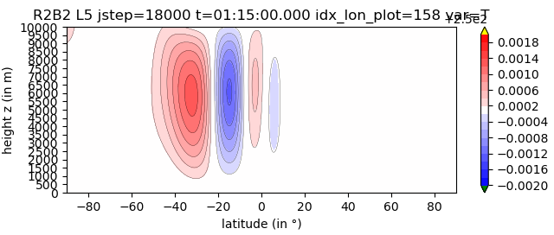
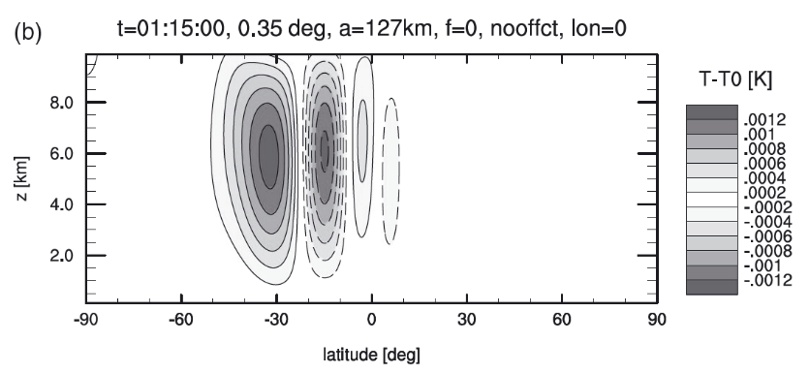
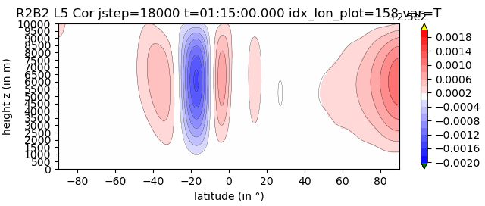
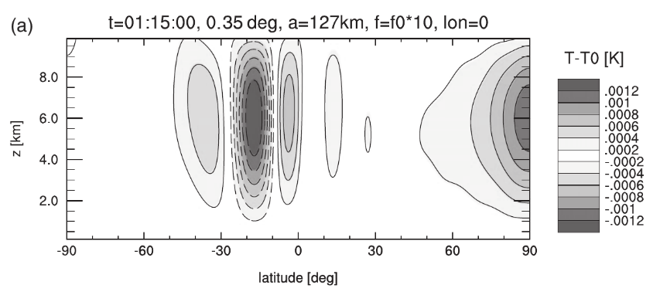
3D Euler equations:
quasi-linear expansion of gravity and sound waves in a spherical shell
Black lines: analytic solution (BRZ2014)
Color shading: BRIDGE / grey shading: ICON
BRIDGE, 4th order, R2B2 L5
ICON, R2B6 L40
(A):
f=0
(B):
f=10*f(45°)
(from Baldauf et al. (2014) QJRMS)

Slide 39
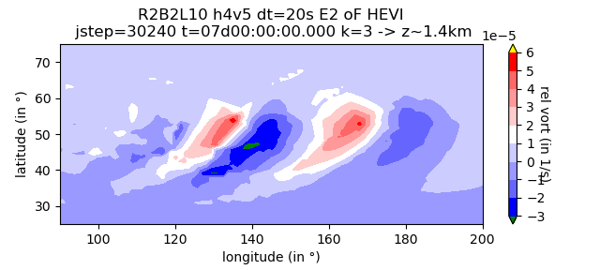
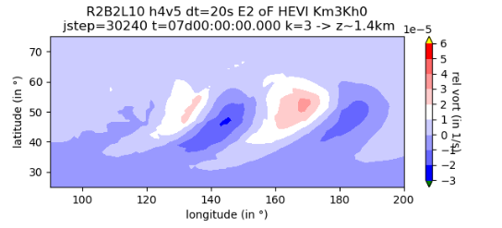
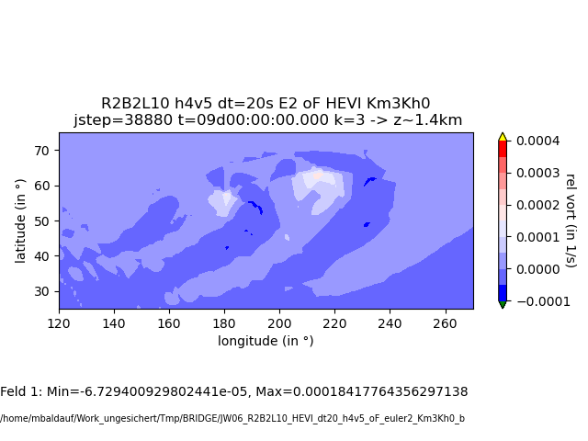
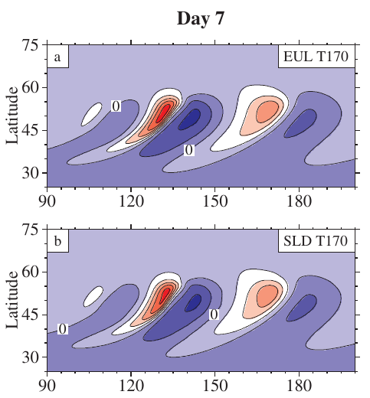
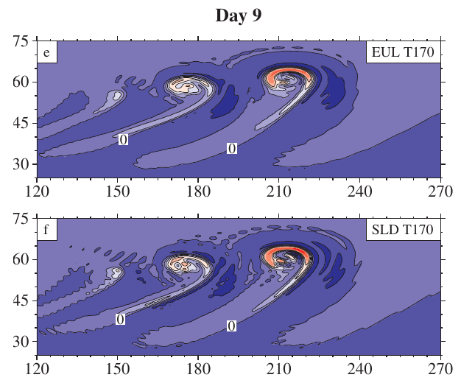
Baroclinic instability test
BRIDGE DG, HEVI, 4th order:
R2B2-grid, L10
dx ~ 630 km dt = 20s
unstable
with diffusion (K_{m}= 3 m²/s, K_{h}=0):
Reference simulations (Fig 7. from Jablonowski, Williamson (2006) QJRMS):
dx ~ 60 km

Slide 40
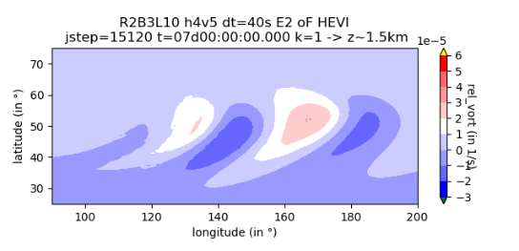
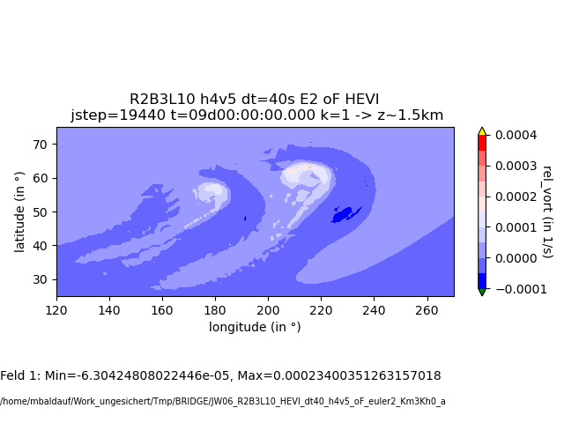
Baroclinic instability test
BRIDGE DG, HEVI, 4th order:
R2B2-grid, L10
dx ~ 630 km dt = 20s
with diffusion (K_{m}= 3 m²/s, K_{h}=0):
R2B3-grid, L10
dx ~ 315 km dt = 40s
Reference simulations (Fig 7. from Jablonowski, Williamson (2006) QJRMS):
dx ~ 60 km

Slide 41
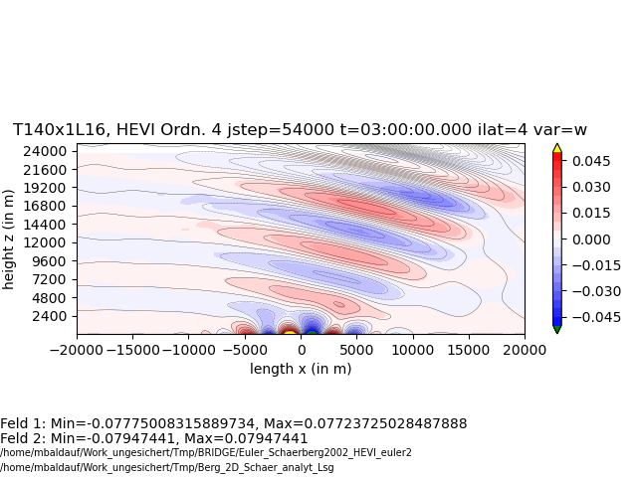
Flow over mountains; using total energy E

Slide 42
Why does this DG stuff bothers in particular the turbulence developers?
Choice of new prognostic variables: total energy vs. potential temperature
M. Baldauf (DWD)
42

Slide 43
Why does this DG stuff bothers in particular the turbulence developers?
Choice of new prognostic variables: total energy vs. potential temperature
M. Baldauf (DWD)
43

Slide 44
DG and Parameterisations
General principle: spatial transport (advection, sedimentation, diffusion, …) should be treated in the DG-scheme!
Otherwise we loose local conservation of the prognostic variables.
Note: local conservation is not just a convenient means to get global conservation. In contrast, it is an essential prerequisite to get a numerical scheme that produce physically reliable solutions (correct phase speeds, …)
Box-models (e.g. cloud physics, chemistry/aerosol-packages):
are evaluated and deliver tendencies in every quadrature point → at the first place no adaptations necessary!
Nevertheless, the ‚classical‘ physics/dynamics-coupling questions remain: overall time integration scheme? how to achieve positive definiteness?

Slide 45
Building blocks for turbulence parameterizations (I)
Keep in mind: we want to conserve prognostic variables,
therefore, instead of delivering only tendencies, the turbulence parameterization mainly should deliver
fluxes f ^{(s)} (for explicit time integration)
or a flux coefficient matrix of the form H^{ss‘} ≡ δf ^{(s)} /δq^{(s‘)} (for implicit time integration)
or a combination of both (explicit / implicit)
This holds both for the prognostic variables (velocity/momentum, temperature/energy) as for additional closure equations (TKE, variances, ..)
Note: don‘t bother with the time-integration itself; this takes place in a (hopefully)
stable IMEX-RK scheme.
Therefore a turbulence parameterization should be separated into
the transport scheme i.e. the diffusion terms and additional transport equations ← they are replaced by the DG scheme
the ‚pure‘ turbulence parameterization
M. Baldauf (DWD)
45

Slide 46
Building blocks for turbulence parameterizations (II)
To calculate these fluxes at a certain (quadrature) point r,
the turbulence model gets derivative variables at r from the dyn. core
(‚x-, y-, z-‘-derivatives of the prognostic variables ρ, M, ϑ=ρθ, q^{(s)}). Use the chain rule of differentiation to derive arbitrary other spatial derivatives
of a variable ϕ = f(ρ, M, ϑ, q^{(s)}).
In this ideal world, a turbulence modeler wouldn‘t need any grid information!
Problems to solve:
In ϕ = f(ρ, M, ϑ, q^{(s)}), the function f may contain non-differentiable Heaviside-functions (i.e. ‚if-conditions‘) (?). Replace these by ‚relaxation expressions‘?
How to treat non-local closures? (smoothing operations, spatial integrations, …)
M. Baldauf (DWD)
46

Slide 47
Support for the turbulence modelers by DG developers
Of course, turbulence modelers need a lot of support for their implementation into the DG-solver (i.e. into BRIDGE or ICON-DG), regarding
Preparation of the equations regarding correct metrics
Separation into explicit and vertically implicit parts (fluxes, eventual source terms)
Consider special treatment of higher order derivatives (e.g. diffusion terms) in a DG scheme (‚local DG‘, BR1, BR2, , ‚compact DG‘, …)
…
Currently implemented examples in BRIDGE:
Prandtl mixing length model ✓
Smagorinsky model ✓
prognostic TKE equation + transfer scheme (neutral stratification) ✓
M. Baldauf (DWD)
47

Slide 48
Horizontally explicit - vertically implicit (HEVI)-scheme with DG
Motivation: get rid of the strong time step restriction by vertical sound wave
expansion in flat grid cells (in particular near the ground)
explicit
implicit
explicit
implicit
The implicit part leads to several block-tridiagonal matrices
Collocation decouples equations in the horizontal base functions → more, but smaller block-tridiag. matrices → efficiency increase
direct solvers are useable (no need for iterative solvers)
Use of IMEX-Runge-Kutta (SDIRK) schemes: SSP3(3,3,2), SSP3(4,3,3) (Pareschi, Russo (2005) JSC)
Baldauf, M. (2021): A horizontally explicit, vertically implicit (HEVI) discontinuous Galerkin scheme for the 2-dim. Euler and Navier-Stokes equations using terrain-following coordinates, J. Comp. Phys. 446
M. Baldauf (DWD)
48

Slide 49
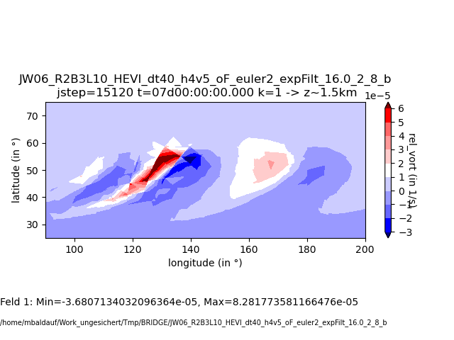
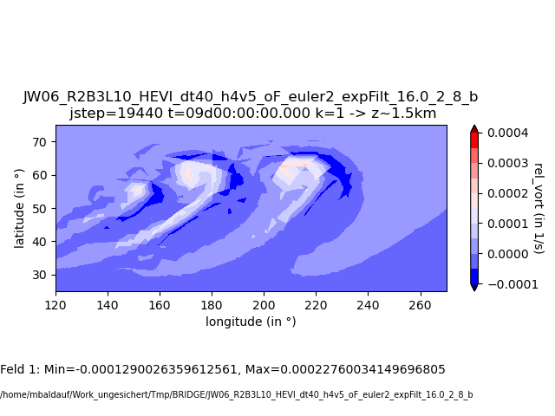
Baroclinic instability test
BRIDGE DG, HEVI, 4th order:
Relative vorticity in z=1.5km ~ 850hPa
R2B3-grid, L10
dx ~ 315 km dt = 40s
→ position and strength of the pattern is ok, the obvious noise in the first derivative must be treated by an adequate postprocessing, later on (e.g. Cockburn, Luskin, … (2003))
Reference simulations (Fig 8. from Jablonowski, Williamson (2006) QJRMS):
dx ~ 60 km

Slide 50
Steps towards real orography

Slide 51
Steps towards using real orography data
Our DG scheme needs in every (horizontal) quadrature point (i.e. in the cells and on hfaces):
Orography h_{oro}
First horizontal derivatives of h_{oro} for transformation matrices and the metric tensor g_{ij}
Second horizontal derivatives of h_{oro} for Christoffel symbols Γ ^{i}_{jk} (mainly needed in the diffusion operator)
Until now, we have used only analytically given orography and their derivatives and just calculated it in every point we needed.
We need a more general approach to deal with real orography data…

Slide 52
Steps towards using real orography data
Possible options to use real (discrete) orography data:
1. Directly read orography and its derivatives in every needed (horizontal) quadrature point
+ everything we need is known - this needs a complicated preprocessor program and unusual data structure
Directly read orography and its derivatives only in interpolation points of every (horizontal) cell
+ the most important properties (derivatives) are still consistently calculated … - … but must be interpolated to the quadrature points (errors?)
- still needs a preprocessor, but the data structure is simpler than in 1.
Only read orography data (Thanks to Oswald Knoth for this proposal!)
+ probably even needs no extra preprocessor
- Derivatives must be numerically calculated (consistency? errors?) - interpolation to quadrature points needed (errors?)
To test these 3 options, just use again analytically generated orography data …
Notes:
Ist das direkte Analogon zum bisherigen analytischen Zugang
2. Ist nicht exakt dasselbe wie 1. da zumindest für die numerischen Flüsse interpoliert wird,
Auf jeden Fall wird rechts- und linksseitige Orographie im allg. untersciedlich sein.
3. Innere Konsistenz vermutlich größtes problem (Hesse –Matrix der 2. Ableitungen ist nicht symmetrisch, ...)

Slide 53
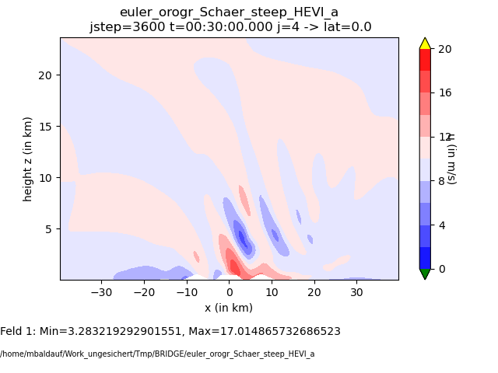
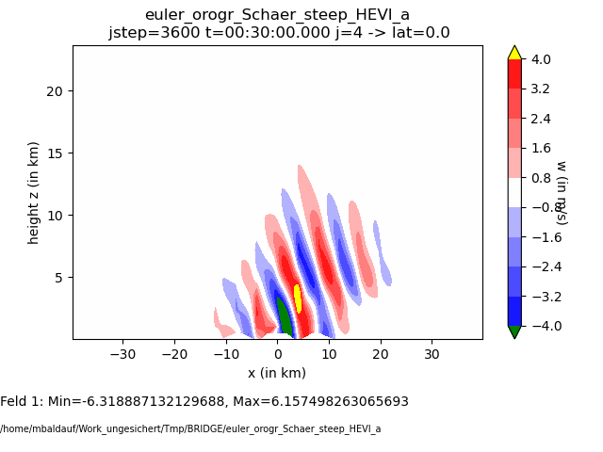
Steps towards using real orography data
Flow over steeper mountains, option 1 (‚everything analytic‘)

Slide 54
Steps towards using real orography data
Flow over steeper mountains, option 2 (‚derivs. analytic, interpolate‘)

Slide 55
Steps towards using real orography data
Flow over steeper mountains, option 3 (‚only h_{oro} analytic, derivs num.‘)

Slide 56
Steps towards using real orography data
Linear flow over mountains, option 1 (‚everything analytic‘)

Slide 57
Steps towards using real orography data
Linear flow over mountains, option 2 (‚derivs. analytic, interpolate‘)

Slide 58
Linear flow over mountains, option 3 (‚only h_{oro} analytic, derivs num.‘)

Slide 59
Steps towards using real orography data
Pure diffusion over orography, option 1 (‚everything analytic‘)
Δx=2 km, Δz~2 km, diffusion with K=const, HEVI
Notes:
Anm.: es wurde extra eine grobe Auflösung gewählt, damit insbes. die orographie möglichst grob behandelt wird.
Man will hier vor allem Unterschiede zwischen den 3 Optionen sehen.
Abgeknabberte rogr. Ist ein matplotlib Artefakt

Slide 60
Steps towards using real orography data
Pure diffusion over orography, , option 2 (‚derivs. analytic, interpolate‘)
Δx=2 km, Δz~2 km, diffusion with K=const, HEVI

Slide 61
Steps towards using real orography data
Pure diffusion over orography , option 3 (‚only h_{oro} analytic, derivs num.‘)
Δx=2 km, Δz~2 km, diffusion with K=const, HEVI

Slide 62
How to treat orography?
In general, orography is fractal!
DG scheme needs 1st and 2nd derivatives of orography :
use of a differentiable filter function g (Baldauf (2021) JCP)
consistent relation between h_{f} (x,y), ∂h_{f} /∂x^{i}, ∂²h_{f} /∂x^{i}∂x^{j}
metric terms can be calculated for Gal-Chen coordinate with arbitrary vertical stretching functions
SLEVE coordinate can be used as well (by using two different filter functions)
Klemp (2011) vertical coordinate smoothing would need additional considerations…
Practically, use a preprocessor (based on EXTPAR data). This would work for option 1 and 2, but not for 3.

Slide 63
Summary for orography treatment:
The 3 presented options to generate the needed metric variables
from a discretely given orography produce quite similar results
in a few idealized tests
At least for the moment we can start from option 3, which probably doesn‘t need an extra preprocessor (=a link between EXTPAR and BRIDGE)
The next step is to actually read the orography data from the EXTPAR files.
Later on, we have to investigate, if we need a more consistent approach to deal
with fractal orography…

Slide 64
DG and Parameterisations
General principle: spatial transport (advection, sedimentation, diffusion, …) should be treated in the DG-scheme!
Otherwise we loose local conservation of the prognostic variables.
Note: local conservation is not just a convenient means to get global conservation. In contrast, it is an essential prerequisite to get a numerical scheme that produce physically reliable solutions (correct phase speeds, …)
Box-models (e.g. cloud physics, chemistry/aerosol-packages):
are evaluated and deliver tendencies in every quadrature point → at the first place no adaptations necessary!
Nevertheless, the ‚classical‘ physics/dynamics-coupling questions remain: overall time integration scheme? how to achieve positive definiteness?

Slide 65
Building blocks for turbulence parameterizations (II)
To calculate these fluxes at a certain (quadrature) point r,
the turbulence model gets derivative variables at r from the dyn. core
(‚x-, y-, z-‘-derivatives of the prognostic variables ρ, M, ϑ=ρθ, q^{(s)}). Use the chain rule of differentiation to derive arbitrary other spatial derivatives
of a variable ϕ = f(ρ, M, ϑ, q^{(s)}).
In this ideal world, a turbulence modeler wouldn‘t need any grid information!
Problems to solve:
In ϕ = f(ρ, M, ϑ, q^{(s)}), the function f may contain non-differentiable Heaviside-functions (i.e. ‚if-conditions‘) (?). Replace these by ‚relaxation expressions‘?
How to treat non-local closures? (smoothing operations, spatial integrations, …)
M. Baldauf (DWD)
65

Slide 66
Horizontally explicit - vertically implicit (HEVI)-scheme with DG
Motivation: get rid of the strong time step restriction by vertical sound wave
expansion in flat grid cells (in particular near the ground)
explicit
implicit
explicit
implicit
The implicit part leads to several block-tridiagonal matrices
Collocation decouples equations in the horizontal base functions → more, but smaller block-tridiag. matrices → efficiency increase
direct solvers are useable (no need for iterative solvers)
Use of IMEX-Runge-Kutta (SDIRK) schemes: SSP3(3,3,2), SSP3(4,3,3) (Pareschi, Russo (2005) JSC)
Baldauf, M. (2021): A horizontally explicit, vertically implicit (HEVI) discontinuous Galerkin scheme for the 2-dim. Euler and Navier-Stokes equations using terrain-following coordinates, J. Comp. Phys. 446
M. Baldauf (DWD)
66

Slide 67
Why does this DG stuff bothers in particular the turbulence developers?
Choice of new prognostic variables: total energy vs. potential temperature
M. Baldauf (DWD)
67

Slide 68
First steps towards tracer advection
Introduction of a ‚variable group‘ concept and an own ‚tracer equation class‘
Example: flow over mountains with prescribed Gaussian cloud water distribution.
SSP3(4,3,3) IMEX-RK for Euler
Explizit RK4 for tracers
ndyn_substeps=5
However:
Not yet positive definite transport
No coupling with a microphysics scheme
No sedimentation
02.12.2022
M. Baldauf (DWD)
68

