Slide 1
25th COSMO General Meeting
11-15 September 2023
STC report
Panagiotis Skrimizeas
Chairman of COSMO Steering Committee (STC)

Slide 2
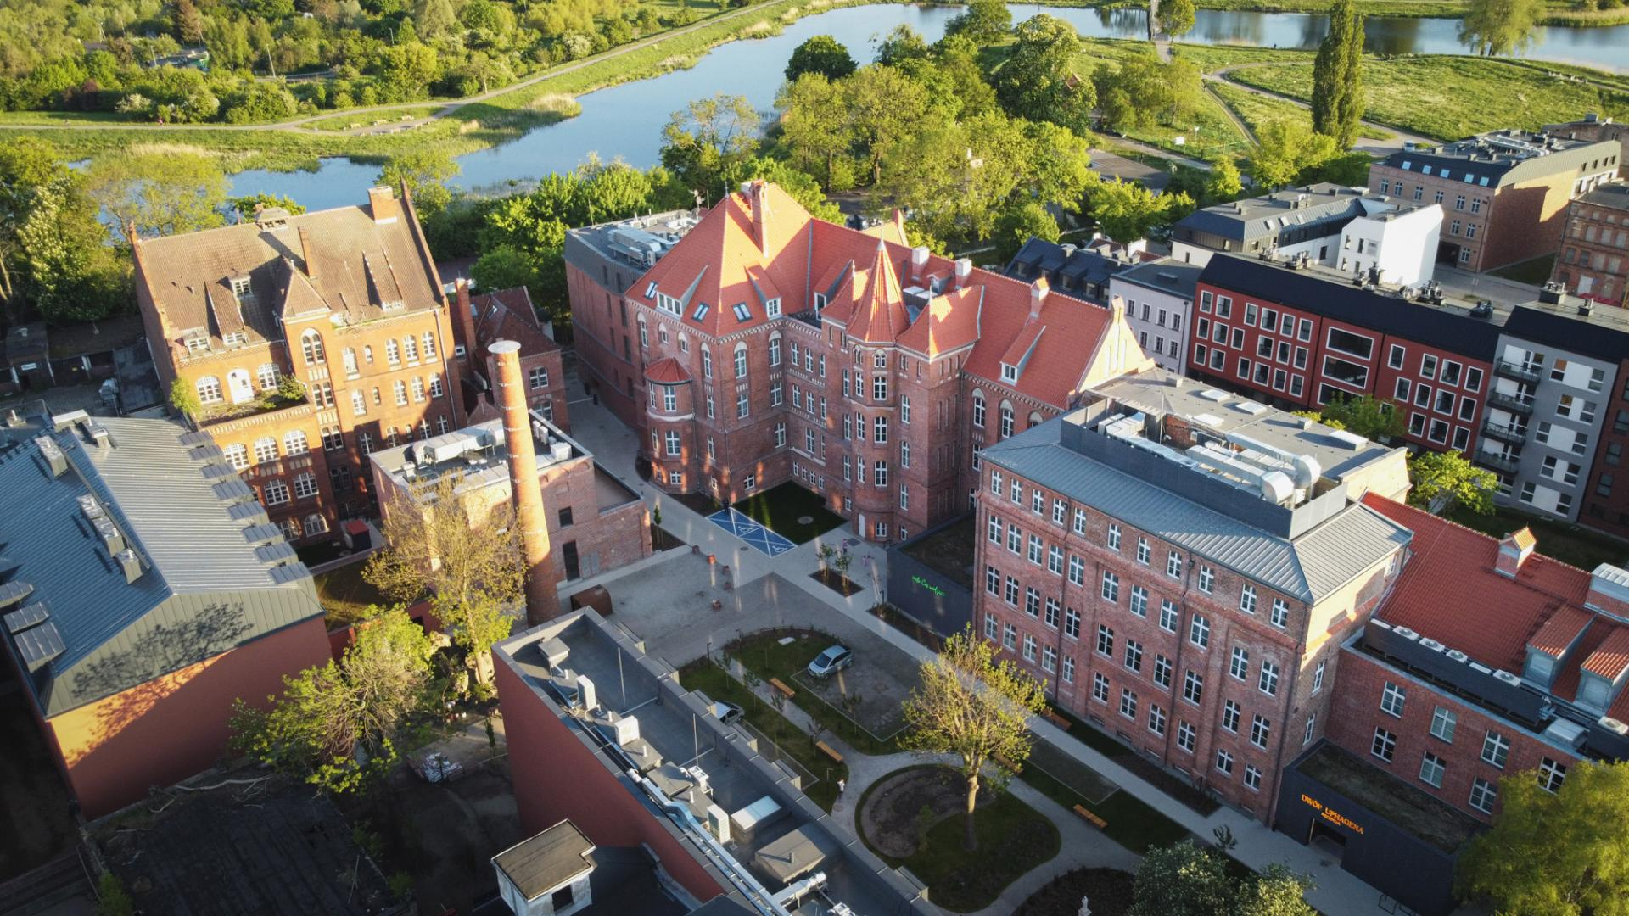
25th COSMO General Meeting
11-15 September 2023, Gdansk

Slide 3
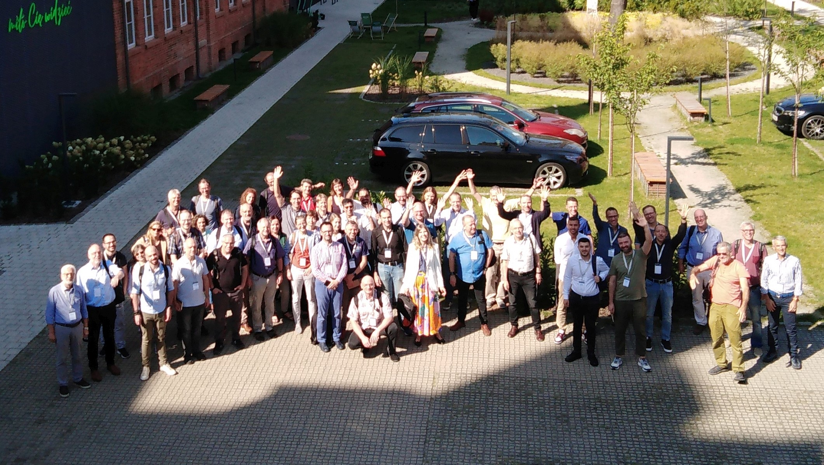
25th COSMO General Meeting
11-15 September 2023 - Gdansk Poland

Slide 4
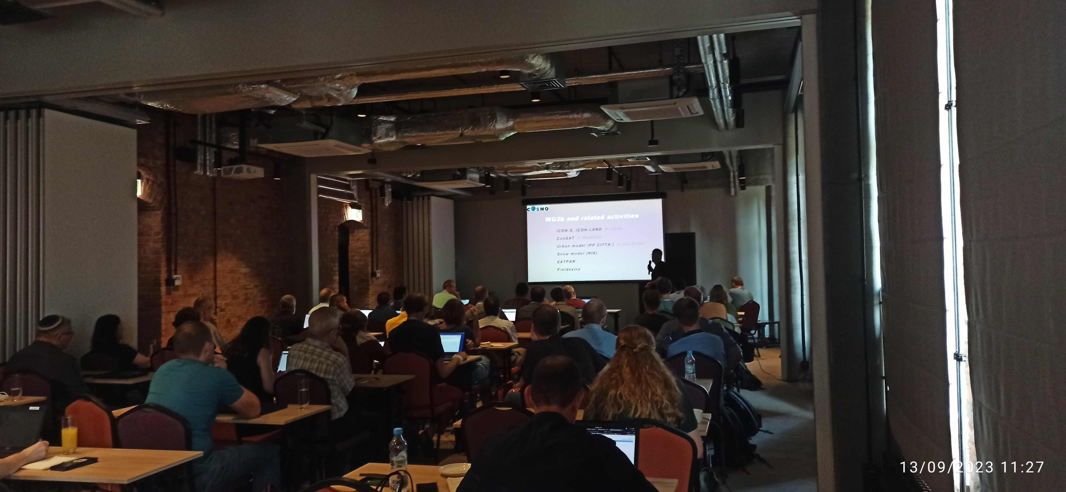
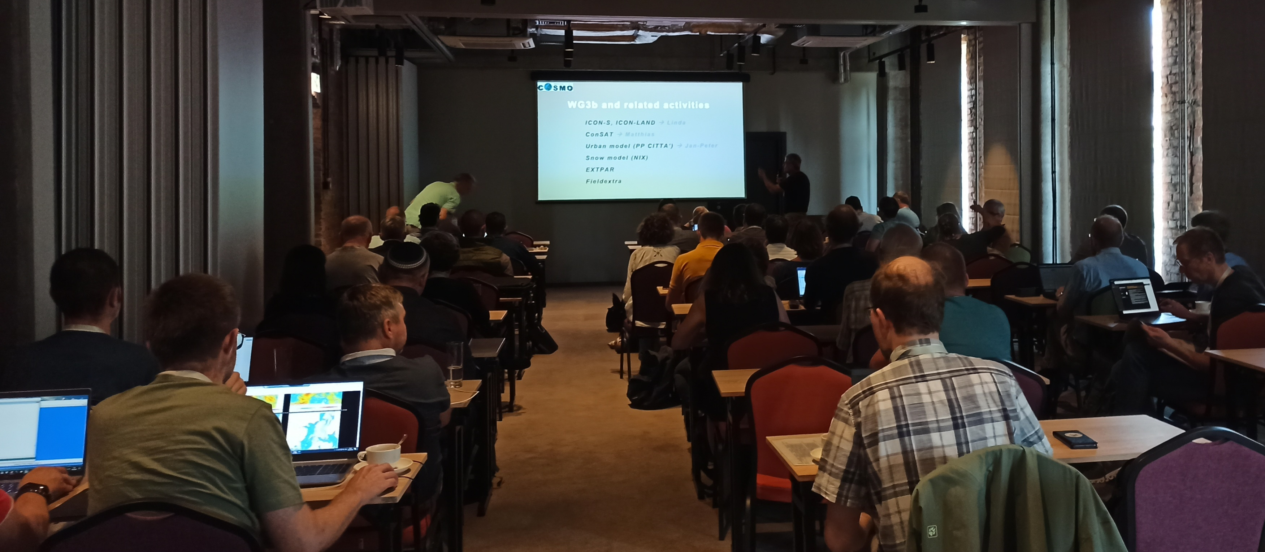

Slide 5
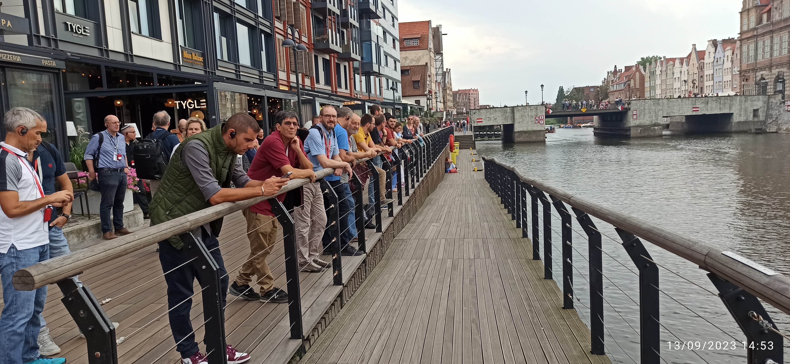

Slide 6
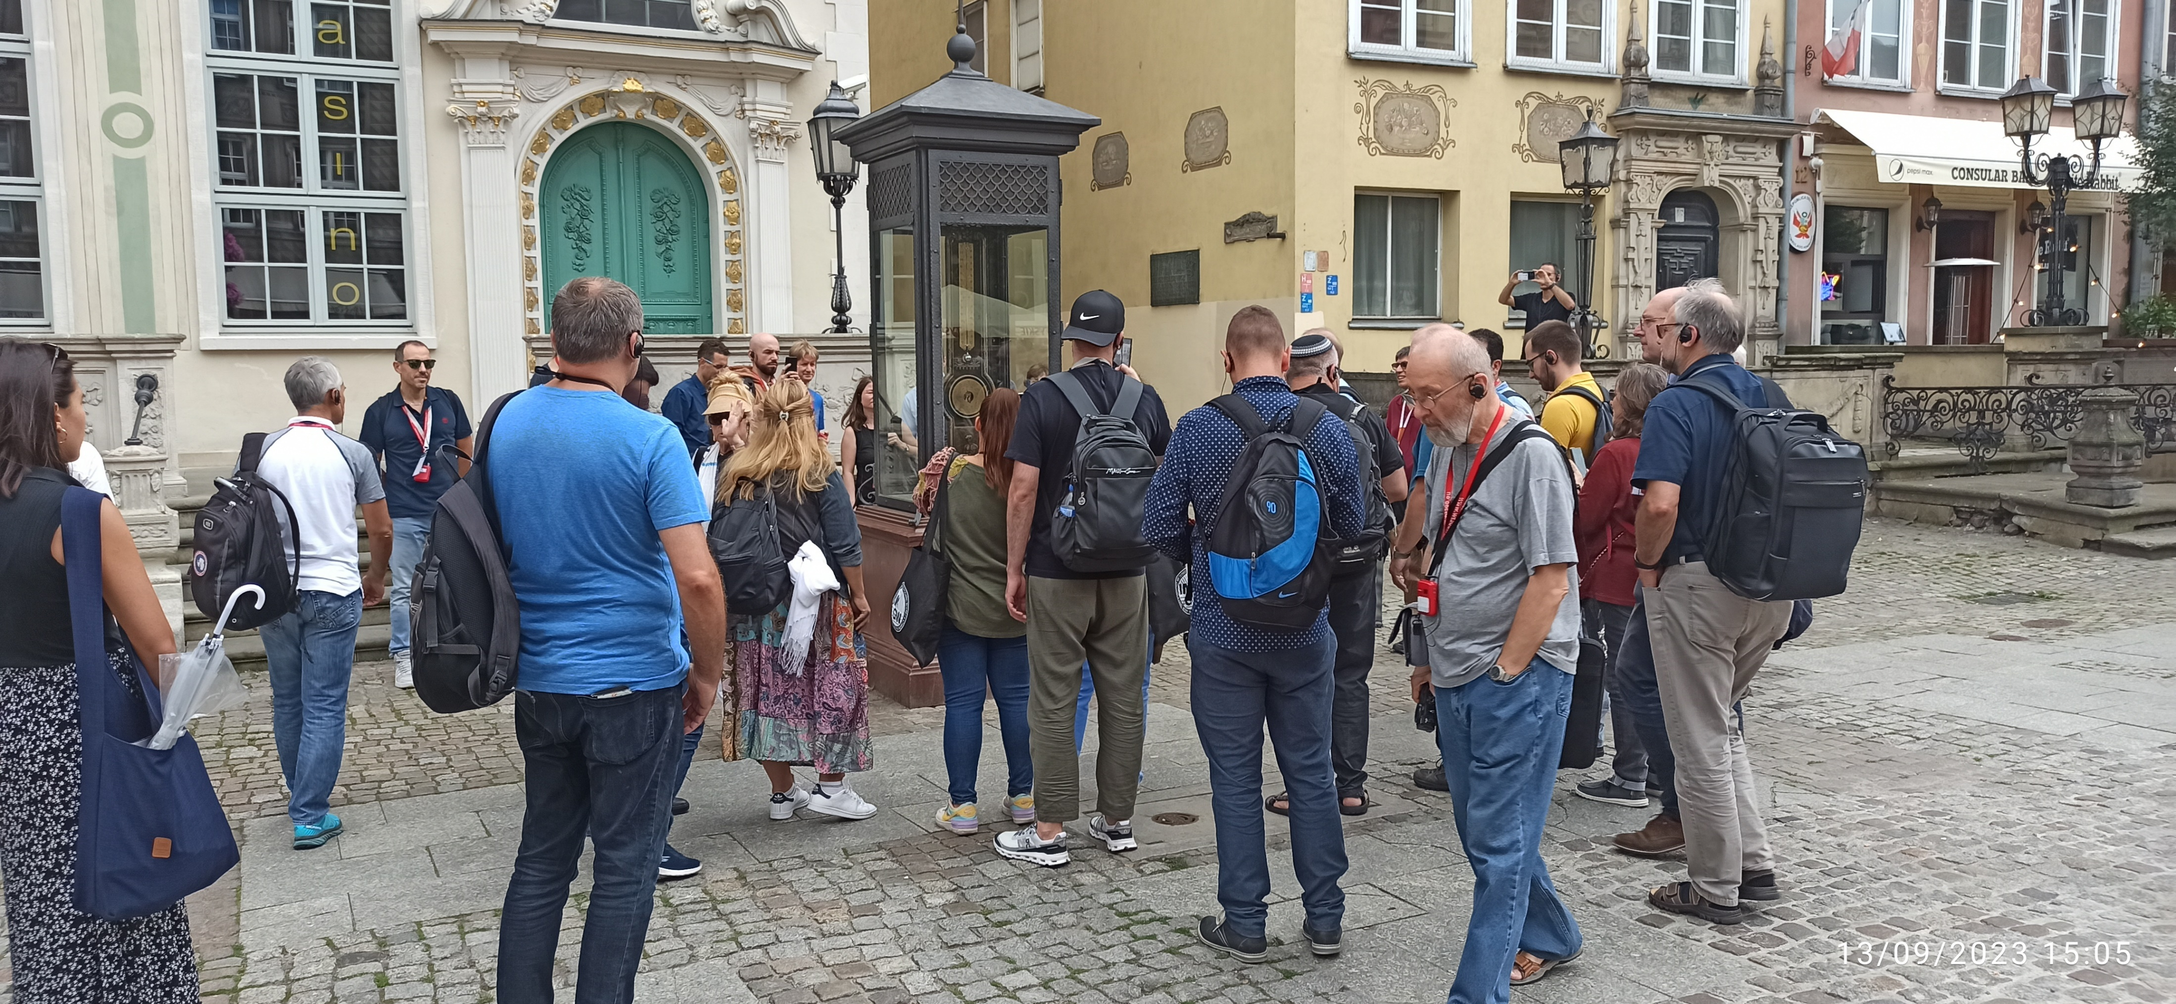

Slide 7
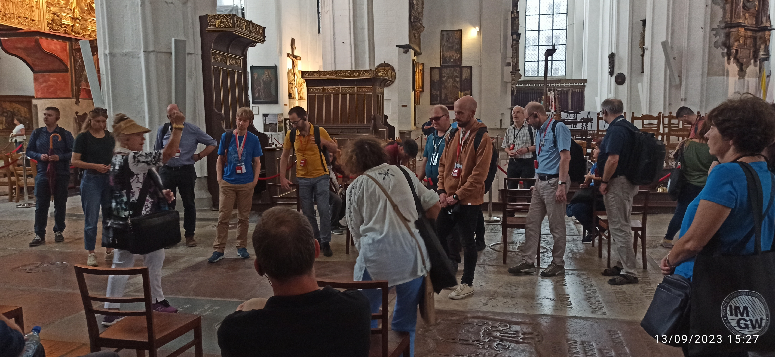

Slide 8
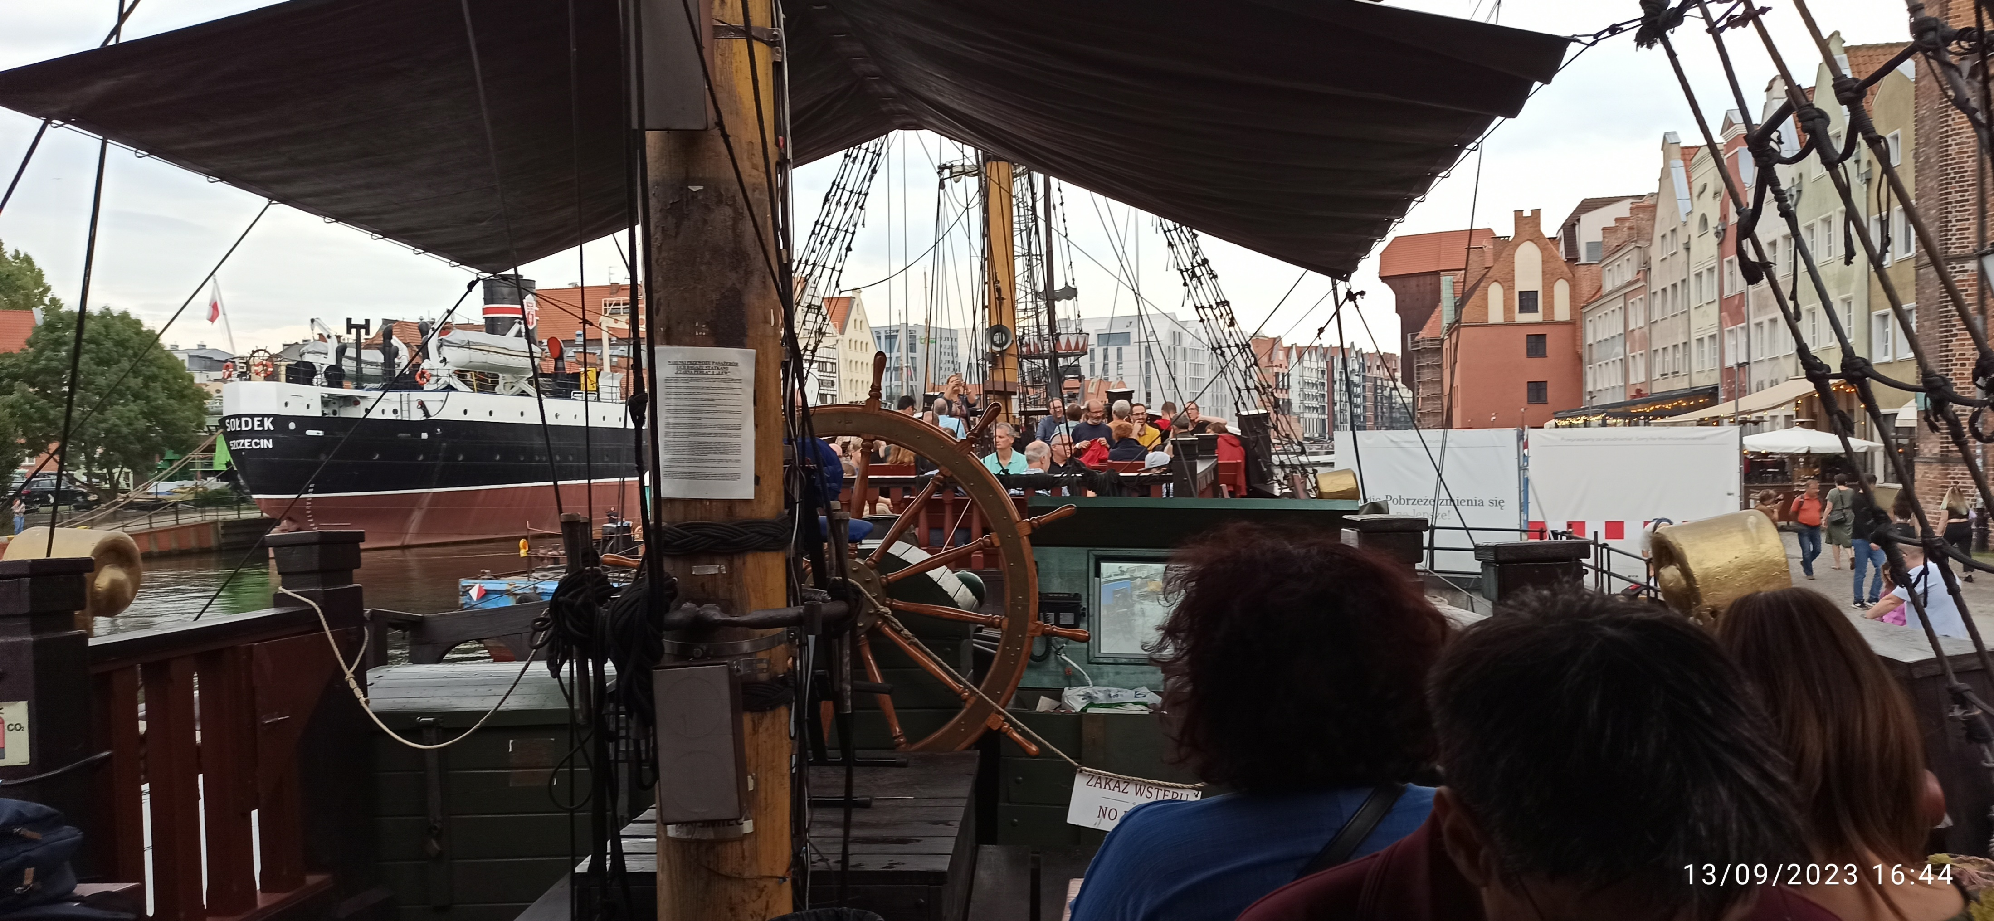

Slide 9
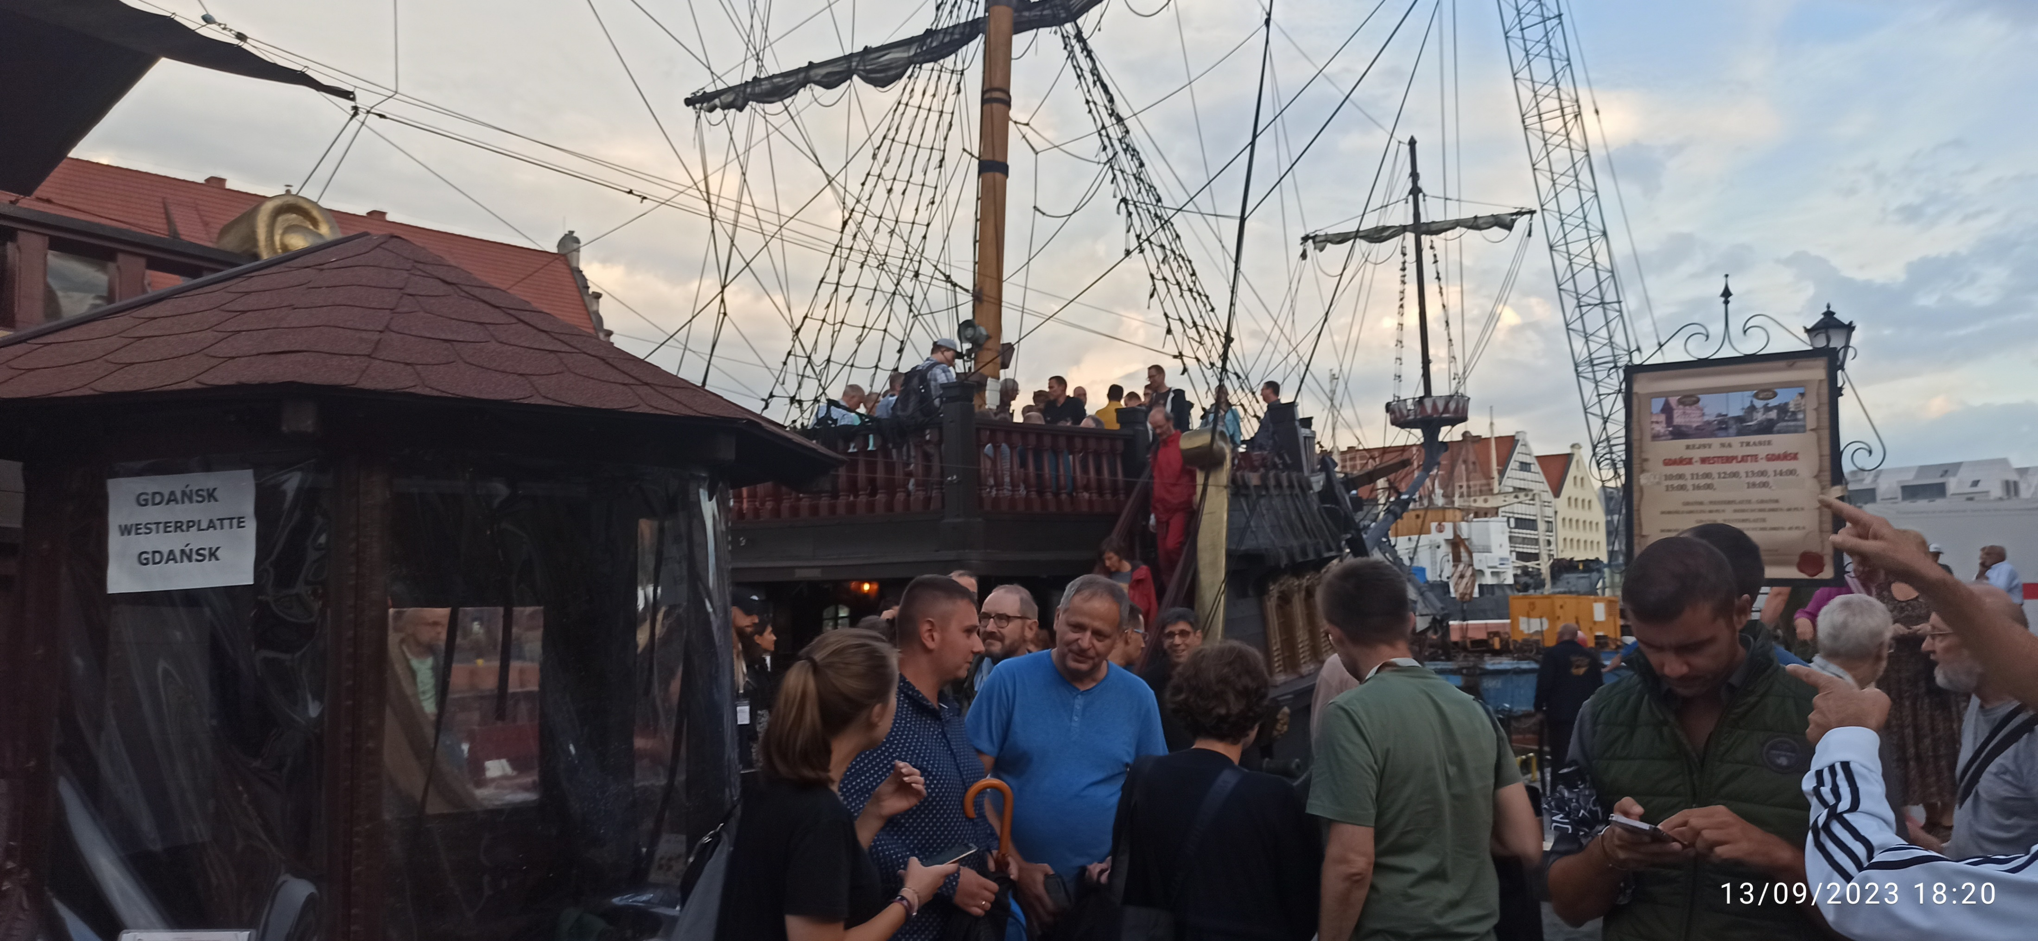

Slide 10
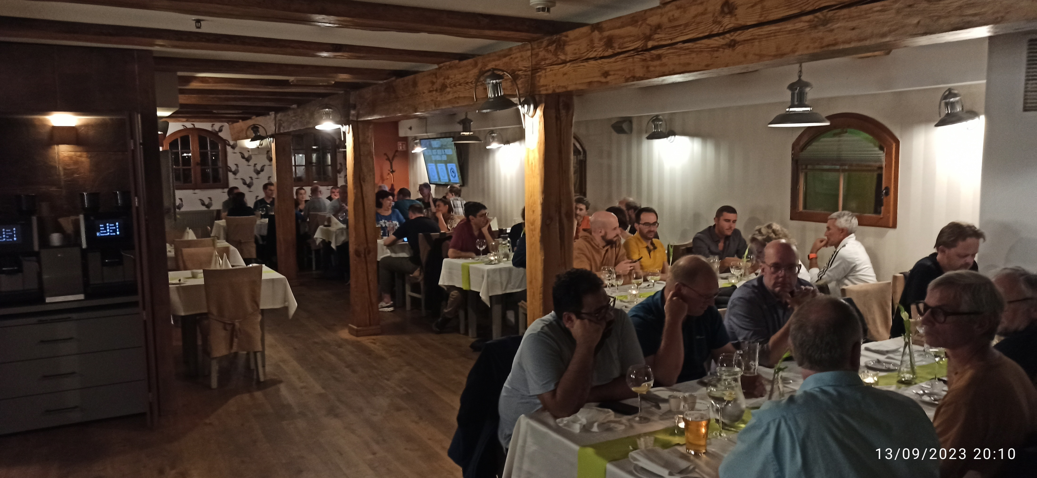

Slide 11
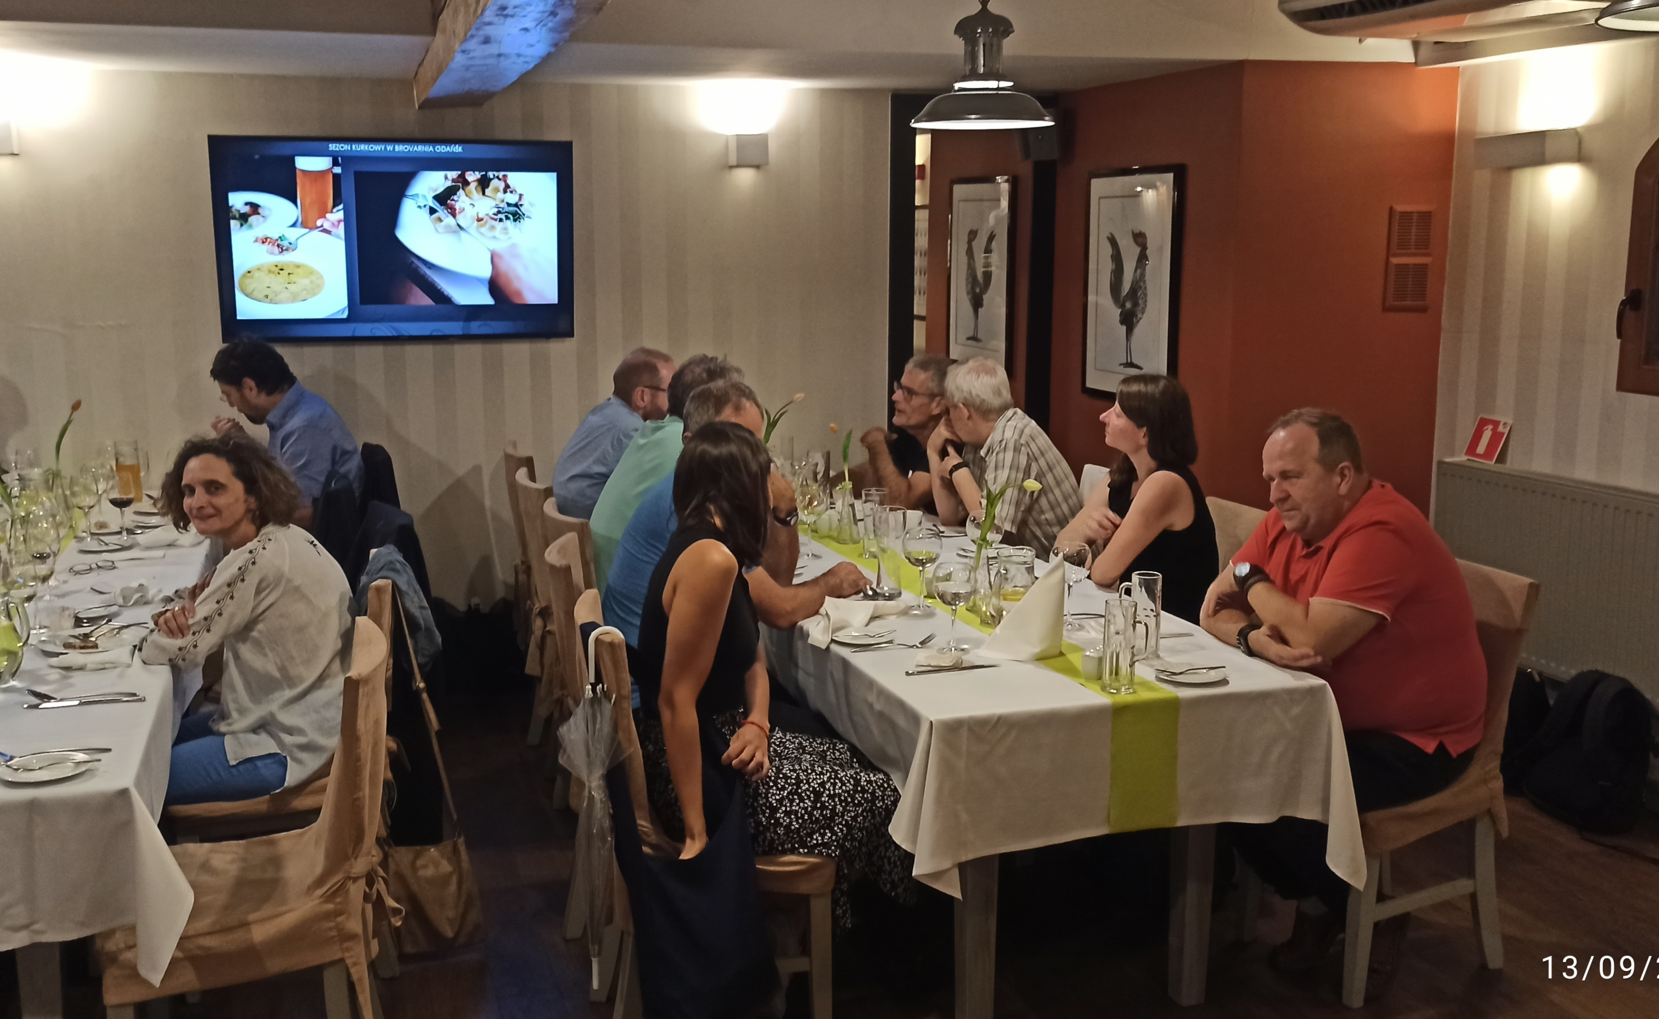

Slide 12
25 years of COSMO

Slide 13
Two main topics from the STC meeting
11-12 September 2023

Slide 15
STC has decided that AI/ML should be part of the consortium's research activities.

Slide 16
Strategy for COSMO on ICON
The STC re-emphasized its position to continue to build and strengthen the COSMO Consortium as the consortium of NHMS’ employing ICON for operational NWP.
Recognized that there are open questions in terms of scientific collaboration, organization, and governance that need to be addressed.

Slide 17
Strategy for COSMO on ICON
We need to focus our activities on the strategic priorities for developing ICON-LAM, such as:
Develop ultra high-resolution NWP
Explore new models of interactive forecasting and its application (digital twins, GLORI)
Enable COSMO scientists to use and integrate AI/ML techniques into their development work
Build joint activities of operational climate forecasting with climate communities

Slide 18
Strategy for COSMO on ICON
The STC recognizes the need for change of COSMO and to strengthen its relationship with ICON, since the landscape has changed significantly since the definition of COSMO’s governance and organizational structure.

Slide 19
25th COSMO General Meeting

